Slide 1
Large Scale Discriminative Metric Learning
Peter D. Kirchner¹, Matthias Boehm², Berthold Reinwald², Daby Sow¹, Michael Schmidt³, Deepak Turaga¹ and Alain Biem¹
³Columbia University Medical Center, New York, New York
²IBM Almaden Research Center, San Jose, California
¹IBM T.J. Watson Research Center, Yorktown Heights, New York
Parlearning Workshop at IPDPS 2014

Slide 2
Presentation Outline
Goal and Strategy
Timely and improved detection of complications in neurological Intensive Care Unit
Parallel machine learning: dimensionality reduction plus classification
Introduction to Localized Supervised Metric Learning and Trace Ratio Optimization
The need for additional exploration, in addition to trace ratio optimization, to optimize (or confirm optimality of) the predictive performance of the system
Available parallelism and reuse, to facilitate efficient exploration
LSML implementation on SystemML, a programmable, parallel ML system with automatic recompilation and execution plan optimizations.
Patient Similarity results from Neuro ICU data
Initial scaling results
Conclusions

Slide 3
Motivation: Improve detection of complications to permit earlier intervention and improve treatment outcomes in Neuro Intensive Care Unit.
Conceptual Depiction
Diagnosis at time t_{Dx}
(Case Label)
Likelihood
Of Detecting Complication
Expected
Effectiveness
Of Intervention
Complication
Time
The problem: Detecting the complication in time for the appropriate intervention to be effective

Slide 4
Motivation: Improve detection of complications to permit earlier intervention and improve treatment outcomes in Neuro Intensive Care Unit.
Conceptual Depiction
ML
Diagnosis at time t_{Dx}
Case Label
Likelihood
Of Detecting Complication
Expected
Effectiveness
Of Intervention
ML Prediction at time t
Complication
Time
Achieve via Parallel Machine Learning on High Dimension Patient Data:
(Supervised Dimensionality Reduction + Classification)

Slide 5
LSML optimizes a projection to locally maximize the within-class compactness and between-class ‘scatteredness’ for the labeled (supervised) training set. LSML has found use in problems such as Patient Similarity.
What is Localized Supervised Metric Learning?
Parameters: Reduced dimension
and neighborhood sizes, e.g.
d=1
k_{inner}=1 (matching labels)
k_{outer}=3 (non-matching labels)
Projection 2
Projection 1
i^{th} case
Labeled 2D data
LSML can be more discriminative than globally computed dimensional reduction (PCA, LDA) but its adjustable parameters are harder to tune.

Slide 6
Solution via Trace Ratio Optimization (Jia, et al., TNN 2009)
Core of LSML Projection Optimization
Trace Ratio = λ (higher is better).
Sp is penalty graph, Sl is similarity graph, encode scatteredness and compactness (both matrices are positive semi-definite)
W is transformation that maximizes λ
f(λ) is monotonic decreasing and convex. Find zero of f(λ)… λ will be at maximum.
Recognize this problem is suited to solution via Eigendecomposition:
Trace of matrix is sum of eigenvalues
Independent of transformation
Find λ such that the d algebraically largest eigenvalues sum to zero
Corresponding d eigenvectors form W
Gradients are the transformed similarity graph.
Find λ iteratively via Newton’s method … in our case, for a given reduced dimensionality d and neighborhood sizes k_{inner} = k_{outer}
Eigendecomposition followed by
gradient calculation with eigenvectors

Slide 7
Why parallel?
We should calculate projections over a large range of d and k
The optimization criterion (trace ratio) is not reliable for choosing among projections optimized for different parameterizations
We do not know (for certain) what regions of LSML parameterization to investigate
It can be efficient to calculate projections over a large range of d and k
Many calculations in LSML can be reused for many/all parameterizations
Euclidean distances between instances
S matrices for each neighborhood size
Other calculations in LSML can be run independently in parallel
Projection optimization
The performance of classifiers on the transformed data ultimately determines the predictive performance of the system.
Therefore…
Implement LSML on scalable Machine Learning system
Exploit available parallelism and reusable intermediates.
Explore performance of a selection classifiers and their parameterizations
In parallel
Exhaustively determine the optimum projection-classifier pair.
Once determined, the projection and matched classifier can be used to classify new/unlabeled instances.

Slide 8
Scalable, parallel training and evaluation
Patient
ECG
Waveforms
Feature Generation
Heart Rate Variability
Feature Extraction
(Streams)
Selection at 24H
& Labeling
Patient
Signs and
Annotations
Raw
ECG
HRV
timeseries
labeled feature vectors
testing data
(1 fold)
10 Fold
Data
Partitioning
training data
(9 data folds)
Repeat for
all folds
LSML
Training
SystemML/Hadoop
d_{min}, d_{max}
k_{min}, k_{max}
Compute for
all (d,k) and folds
Learned projections
Testing
Projection
Training
Projection
Apply for
all (d,k) and
folds
transformed testing feature vectors
transformed training feature vectors
Classification
Testing
learned models
Classification
Training
Perform for
all (d,k), folds,
and classifiers
Classifier+Projection
Performance
Comparison and Selection
Combine per-fold results to select best
(d,k) and classifier

Slide 9
LSML Implementation:
Z-normalization,
Data Stratification and Fold Generation
Classification, Evaluation and Selection
Feature
Vectors
(Training folds)
Distances and
Nearest Neighbor
indices
Similarity
and Penalty
Matrices for all
neighborhood
sizes k
Optimized
Transformation
Matrices for all
(dimension,k)
HDFS
Euclidean
Distance
Neighbor Ordering
S Matrix
Computations
LSML
Projection
Optimizations
Neighborhood Computation
LSML Application on SystemML
InfoSphere BigInsights (Hadoop)

Slide 10
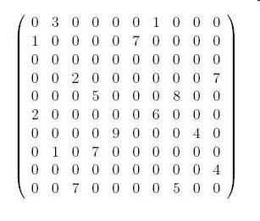
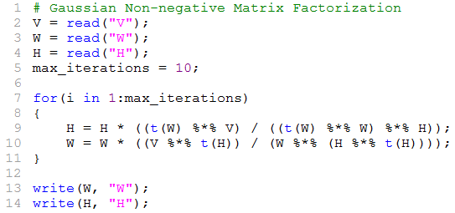
SystemML – Declarative high-level language with R-like syntax
Topic Detection in Social Media
Expressivity
Express a wide class of algorithms: Descriptive statistics, linear & logistic regression, decision trees, SVM, MCMC simulation, etc.
Productivity
Enable programmer productivity: algorithm developer does not have to worry about scalability, numeric stability and optimizations
Performance and Scalability
Optimizer to generate low-level executions plans
Cost-based operator selection based on
data characteristics (dimensions, sparsity)
cluster characteristics (memory, parallelism)
Generation of runtime execution plan
Big Data
Sparsity-driven data representation and operator implementations for data sets with Billions of non-zero values
tokens
K topics
tokens
W
H
1 1 0.10
1 2 0.30
1 3 0.22
1 4 1.24
: : :
: : :
K topics
1 1 0.10
1 2 0.30
: : :
documents
documents
SystemML

Slide 11
SystemML Architecture on Map-Reduce
Language
R- like syntax w/ constructs for meta learning and task parallelism
Rich set of statistical functions
User-defined & external function
Parsing
Statement blocks & statements
Program Analysis, type inference, dead code elimination
High-Level Operator (HOP) Component
Represent dataflow in DAGs of operations on matrices, scalars
Choosing from alternative execution plans based on time and cost estimates: operator ordering & selection; hybrid plans
Low-Level Operator (LOP) Component
Low-level physical execution plan (LOPDags) over key-value pairs
“Piggybacking” operations into minimal number Map-Reduce jobs
Runtime
Hybrid Runtime
CP: single machine operations & orchestrate MR jobs
MR: generic Map-Reduce jobs & operations
Numerically stable operators
Dense / sparse matrix representation
Multi-Level buffer pool (caching) to evict in-memory objects
Dynamic Recompilation for initial unknowns
R- like syntax

Slide 12
SystemML compiles hybrid runtime plans ranging from in-memory, single machine (CP) to large-scale, cluster (MR) compute
Example
Challenge
Guaranteed hard memory constraints (budget of JVM size) for arbitrary complex ML programs
Key Technical Innovations
CP & MR Runtime: Single machine & MR operations, integrated runtime
Caching: Reuse and eviction of in-memory objects
Cost Model: Accurate time and worst-case memory estimates
Optimizer: Cost-based runtime plan generation
Dynamic Recompiler: Re-optimization for initial unknowns
tokens
K topics
words
W
H
Gradually exploit MR parallelism
1 1 0.10
1 2 0.30
1 3 0.22
1 4 1.24
: : :
: : :
K topics
1 1 0.10
1 2 0.30
: : :
documents
documents
Runtime
V
CP
CP/MR
MR
High performance computing for small data sizes.
Data size
Scalable computing for large data sizes.
Hybrid Plans

Slide 13
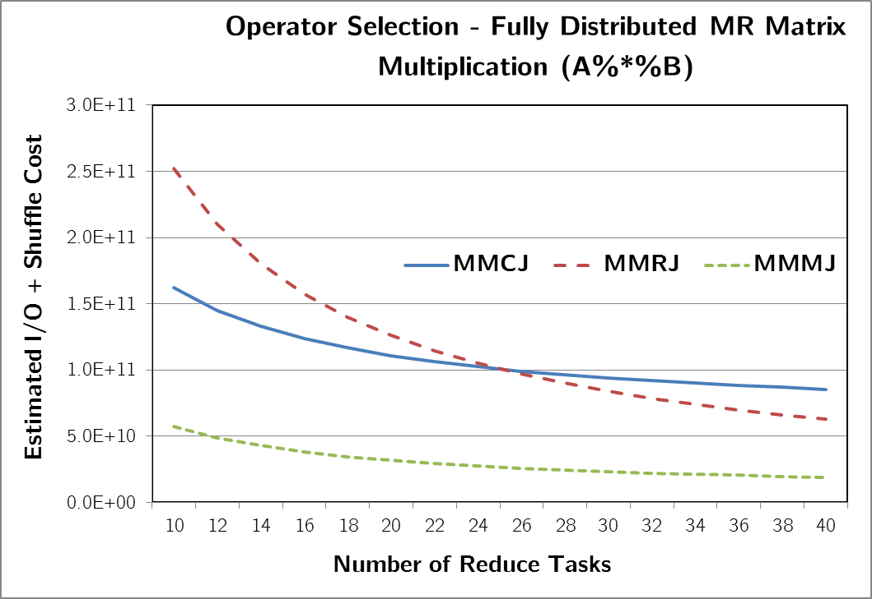
Optimization – Operator Selection
Goal is to exploit high degree of parallelism and to minimize shuffle costs
Decision is driven by
Data characteristics (matrix dimensions and shape, sparsity, etc.)
Cluster characteristics (degree of parallelism, memory, etc.)
Example: Matrix Multiplication
A: 10^7 x 50000
B: 50000 x 2000
ab(+*)
A
B
* Memory-constrained
In-memory Multiplication
Methods performing
Reduce-side Join
Methods performing
Map-side Join
InMem:
In-memory multiplication
Single machine execution
Chosen when both the inputs are small in size
Also includes specialized method for the case where one matrix is transpose of the other
MMCJ:
Cross join Method
2 MR jobs
Robust method to handle extremely large matrices
MMRJ:
Replicated join Method
1 MR job
Chosen when size of common dim is small relative to result dim
MMMJ:
Map-side join
1 MR job
Chosen when one matrix is large and the other is small enough to fit in memory of each map task
MMTSJ:
Transpose-self join
1 MR job
Specialized implementation for the case where one matrix is transpose of the other

Slide 14
SystemML code snippet showing pairwise distance computation for LSML in “imperative” style
Explicit, nested row-column triangular computation of (symmetric) squared-distance matrix
Better controls memory requirements
Currently gives LSML better scaling than “declarative” implementation
Currently, no compact representation for symmetric matrices
Results can be reused for all (d, k) combinations
Yes, semicolons are optional

Slide 15
SystemML Implementation Snippet of LSML
Code is executed until lambda converges, up to 20 iterations per (d,k)… about 500,000x for all (d,k) in the upcoming ICU example.
Enclosed in parfor() , independent instances of this can run on all cores in cluster
Programmer does not specify how the matrix multiplication for the gradient calculation is implemented.
Code snippet shows call to external procedure for eigendecomposition that wrappers jlapack function.
Code snippet also shows invocation of a user-defined function “getexpectation” also written in SystemML.

Slide 16
Patient Similarity in Neurological ICU
Columbia Medical Center NICU
295 patients (cases) with 107 features (measured values)
34 cases labeled DCI (Delayed Cerebral Ischemia)
113 cases develop one or more complications
Features from 24h prior to diagnosis
Predict if patient will develop complications, via dimensional reduction + classification
It is understood that accurate and earlier detection of complications will permit timely interventions that will improve patient outcomes.

Slide 17
LSML computation and Classifier performance
Dataset Generation (295 cases, 107 original dimensions, data Z-normalized)
Reduced dimension d = 2 to 45.
Neighborhood size k = 1 to 104
10 stratified folds
Of 45,760 parameter combinations, 38,088 projections converged
61 minutes (3673 seconds) on 5 node, 80 core cluster (SystemML/Hadoop)
Significant amortization of computation (e.g. neighborhood calculation) and exploitation of available parallelism
Projection and Analytic combined evaluation
5 Weka classifiers with 9 unique parameterizations
(small sampling of available analytics and their accessible parameterizations)
Training produces 342,792 models.
Models tested against matched testing fold
29,412 full sets of prediction results assembled across 10 folds, analytic performance calculated (Area Under Curve).
~3500 best results presented on heat map on next slide
Approximately 10 minutes for classification training and testing across 80 cores

Slide 18
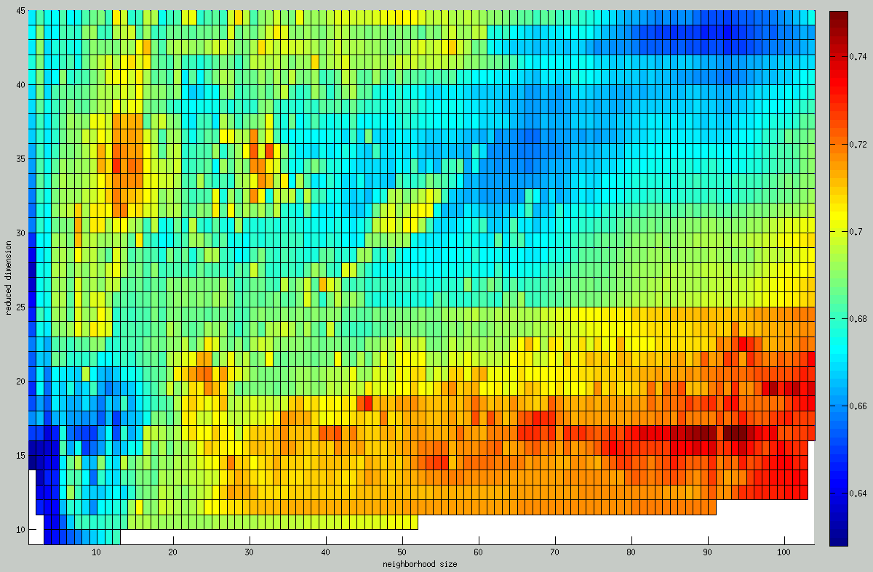
Classifier performance (AUC) versus reduced dimension and neighborhood size

Slide 19
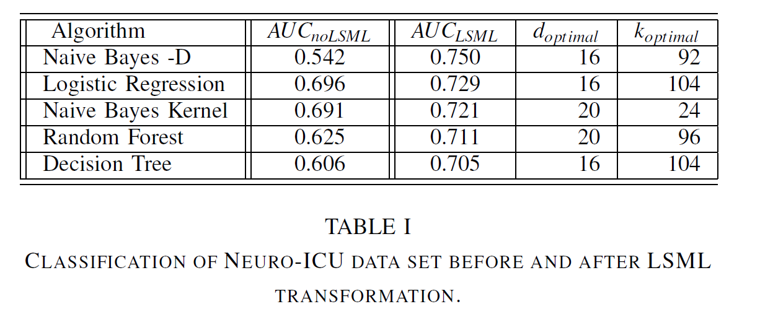
Improvement in classification performance with LSML optimized dimensionality reduction
Best performance with k=92 (local optimization improved over “global”)
Method is competitive with best hand-tuned classifiers.

Slide 20
Classifier performance (AUC) versus reduced dimension and neighborhood size

Slide 21
Scalability
Extend Neuro ICU data
Duplicate cases for more instances
Populate extra columns with random data to increase feature vector length.
Determine execution time scaling versus instances and feature vector length
k from 1 to 64
D from 2 to 32
Same 5 node, X5687 Xeon cluster with 16 core/node, 65GB/node

Slide 22
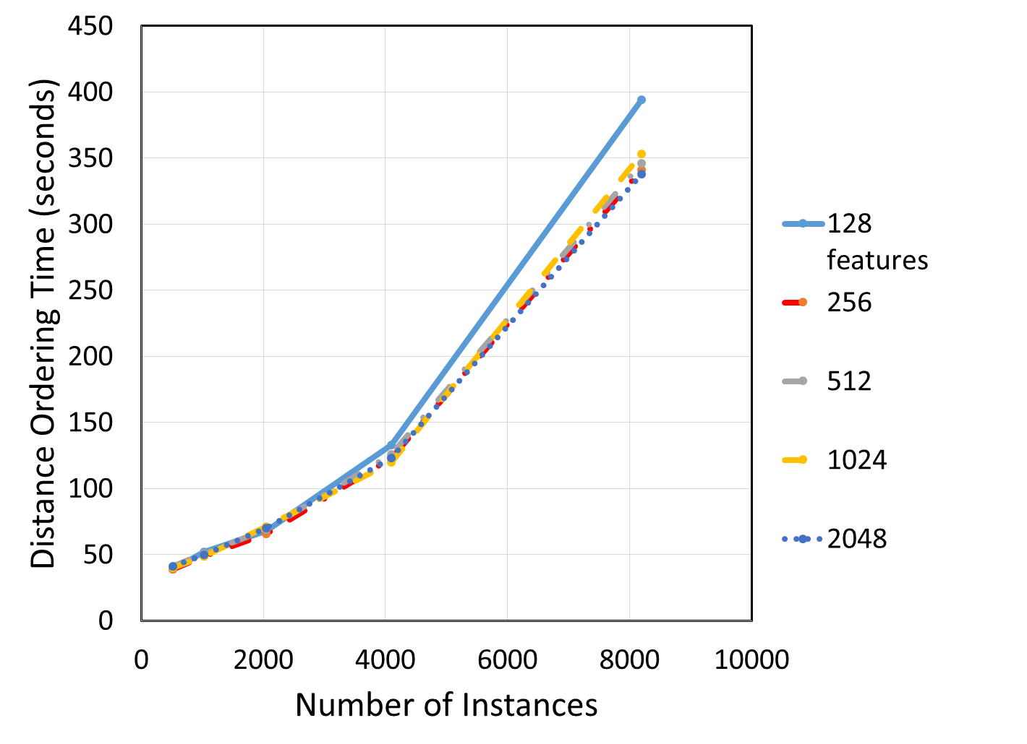
Scalability of Euclidean Distance + Ordering

Slide 23
Scalability of S Matrix calculation

Slide 24
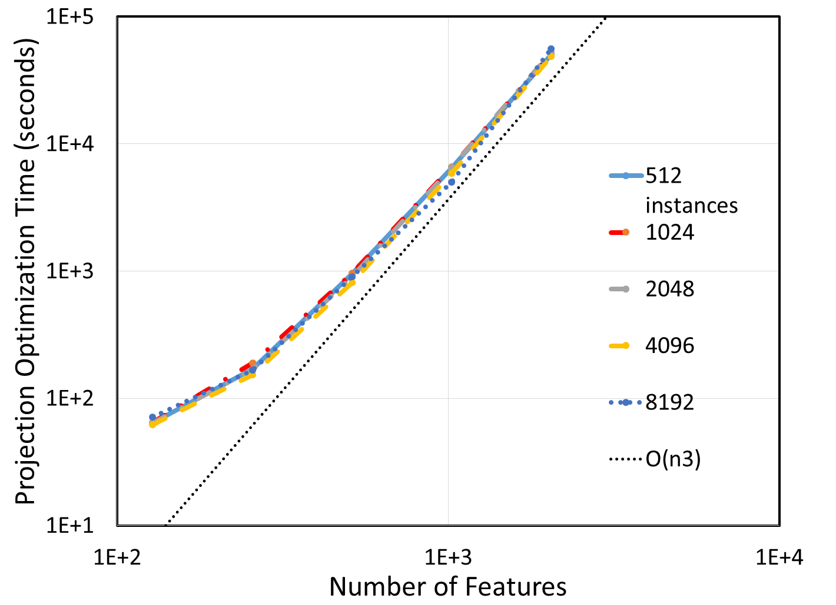
Scaling of projection optimization vs. feature vector length

Slide 25
SystemML Implementation Snippet of LSML
Code is executed until lambda converges, up to 20 iterations per (d,k)… about 500,000x for all (d,k) in the upcoming ICU example.
Enclosed in parfor() , independent instances of this can run on all cores in cluster
Programmer does not specify how the matrix multiplication for the gradient calculation is implemented.
Code snippet shows call to external procedure for eigendecomposition that wrappers jlapack function.
Code snippet also shows invocation of a user-defined function “getexpectation” also written in SystemML.

Slide 26
Conclusions
SystemML is an automatically scalable, easy-to-program system for machine learning well-suited to implementing custom algorithms such as LSML.
We have demonstrated a parallel implementation of Localized Supervised Metric Learning for dimensionality reduction and improving classifier performance.
For the example scenario, peak performance occurs at parameterizations < global values.
The LSML implementation is structured to calculate values over a range of reduced dimensionality d and neighborhood size k to optimize parallelism and reuse.
LSML parameterization affects downstream classifiers differently (classifier-dependent), creating a large parameter space to explore for overall optimization.
For now, exhaustive exploration is the most reliable means of achieving optimum pairing of classifier and projection.
Scaling of current implementation for larger problems is limited by O(n3) dependence of the gradient calculation on number of features (significant improvement is expected).

