Slide 1
Resource Elasticity for Large-Scale Machine Learning
Botong Huang², Matthias Boehm¹, Yuanyuan Tian¹, Berthold Reinwald¹, Shirish Tatikonda¹, Frederick R. Reiss¹
¹ IBM Research – Almaden ² Duke University
Acknowledgements: Alexandre V. Evfimievski, Prithviraj Sen, Umar Farooq Minhas, and reviewers

Slide 2
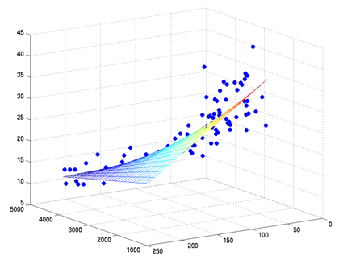
Motivation – Declarative Machine Learning
(1) Model Training (learning)
Example: Linear Regression
Given an input data set of regressors X and response y
Solve an ordinary least square problem y = X β
Declarative Machine Learning
Goal: Write ML algorithms independent of input data / cluster characteristics
Full flexibility ➔ ML DSL
Data independence ➔ Coarse-grained operations
Efficiency and scalability ➔ Hybrid runtime plans
Specified algorithm ➔ Opt for performance only
β
(2) Prediction (scoring)
n
Sex | Age | Salary
M | 32 | 60k
F | 29 | 145k
M | 51 | 150k
Insurance Cost
X
ŷ
y
β
m
≈
ΔX
ŷ
Notes:
Applications for large-scale machine learning are pervasive and range from customer classification, regression analysis, cluster, and recommendations. Let‘s use linear regression as an example.
R1: Full flexibility: Specify new / customize existing ML algorithms ➔ ML DSL
R2: Data independence: Hide physical data representation (sparse/dense, row/column-major, blocking configs, partitioning, caching, compression) ➔ Coarse-grained semantic operations
Simplifies compilation / optimization (preserves semantics)
Simplifies runtime (physical operator implementations)
R3: Efficiency and scalability: Very small to very large usecases ➔ Automatic optimization and hybrid runtime plans
Pure in-memory, single node computation provide high efficiency on “small“ use cases
Independence of underlying distributed runtime framework (e.g., MR vs Spark)
R4: Specified algorithm semantics: Understand, debug and control algorithm behavior ➔ Optimization for performance, not for performance and accuracy (consistent with language flexibility)

Slide 3
Background: Hybrid Runtime Plans in SystemML
Example: Linear Regression (in SystemML‘s R-like syntax)
Cluster Config:
client mem: 1 GB
map/red mem: 2 GB
Linreg DS (Direct Solve)
HOP DAG (after rewrites)
8KB
X = read($1);
y = read($2);
intercept = $3;
lambda = 0.001;
...
if( intercept == 1 ) {
ones = matrix(1,nrow(X),1);
X = append(X, ones);
}
I = matrix(1, ncol(X), 1);
A = t(X) %*% X + diag(I)*lambda;
b = t(X) %*% y;
beta = solve(A, b); ...
write(beta, $4);
CP
write
Scenario: X: 10⁶ x 10³, 10⁹ y: 10⁶ x 1, 10⁶
8MB
16MB
CP
b(solve)
CP
172KB
b(+)
16GB
CP
MR
8GB
r(diag)
ba(+*)
ba(+*)
MR
16GB
r(t)
8KB
MR
CP
8GB
8MB
dg(rand) (10³x1,10³)
X
(10⁶x10³,10⁹)
y (10⁶x1,10⁶)
LOP DAG
16KB
r’(CP)
reduce
ak+(MR)
ak+(MR)
Memory-Sensitive Compilation Steps:
Operator selection (cp/mr, phy. ops)
Hop-lop rewrites
Piggybacking bin constraints
map
mapmm(MR)
tsmm(MR)
r’(CP)
8MB
16MB
X
y
Notes:
NOTE: lops dag simplified (no group after mapmm) – for single output block, group not necessary (for tsmm we never have a group because single output block guaranteed by blocksize constraint)

Slide 4
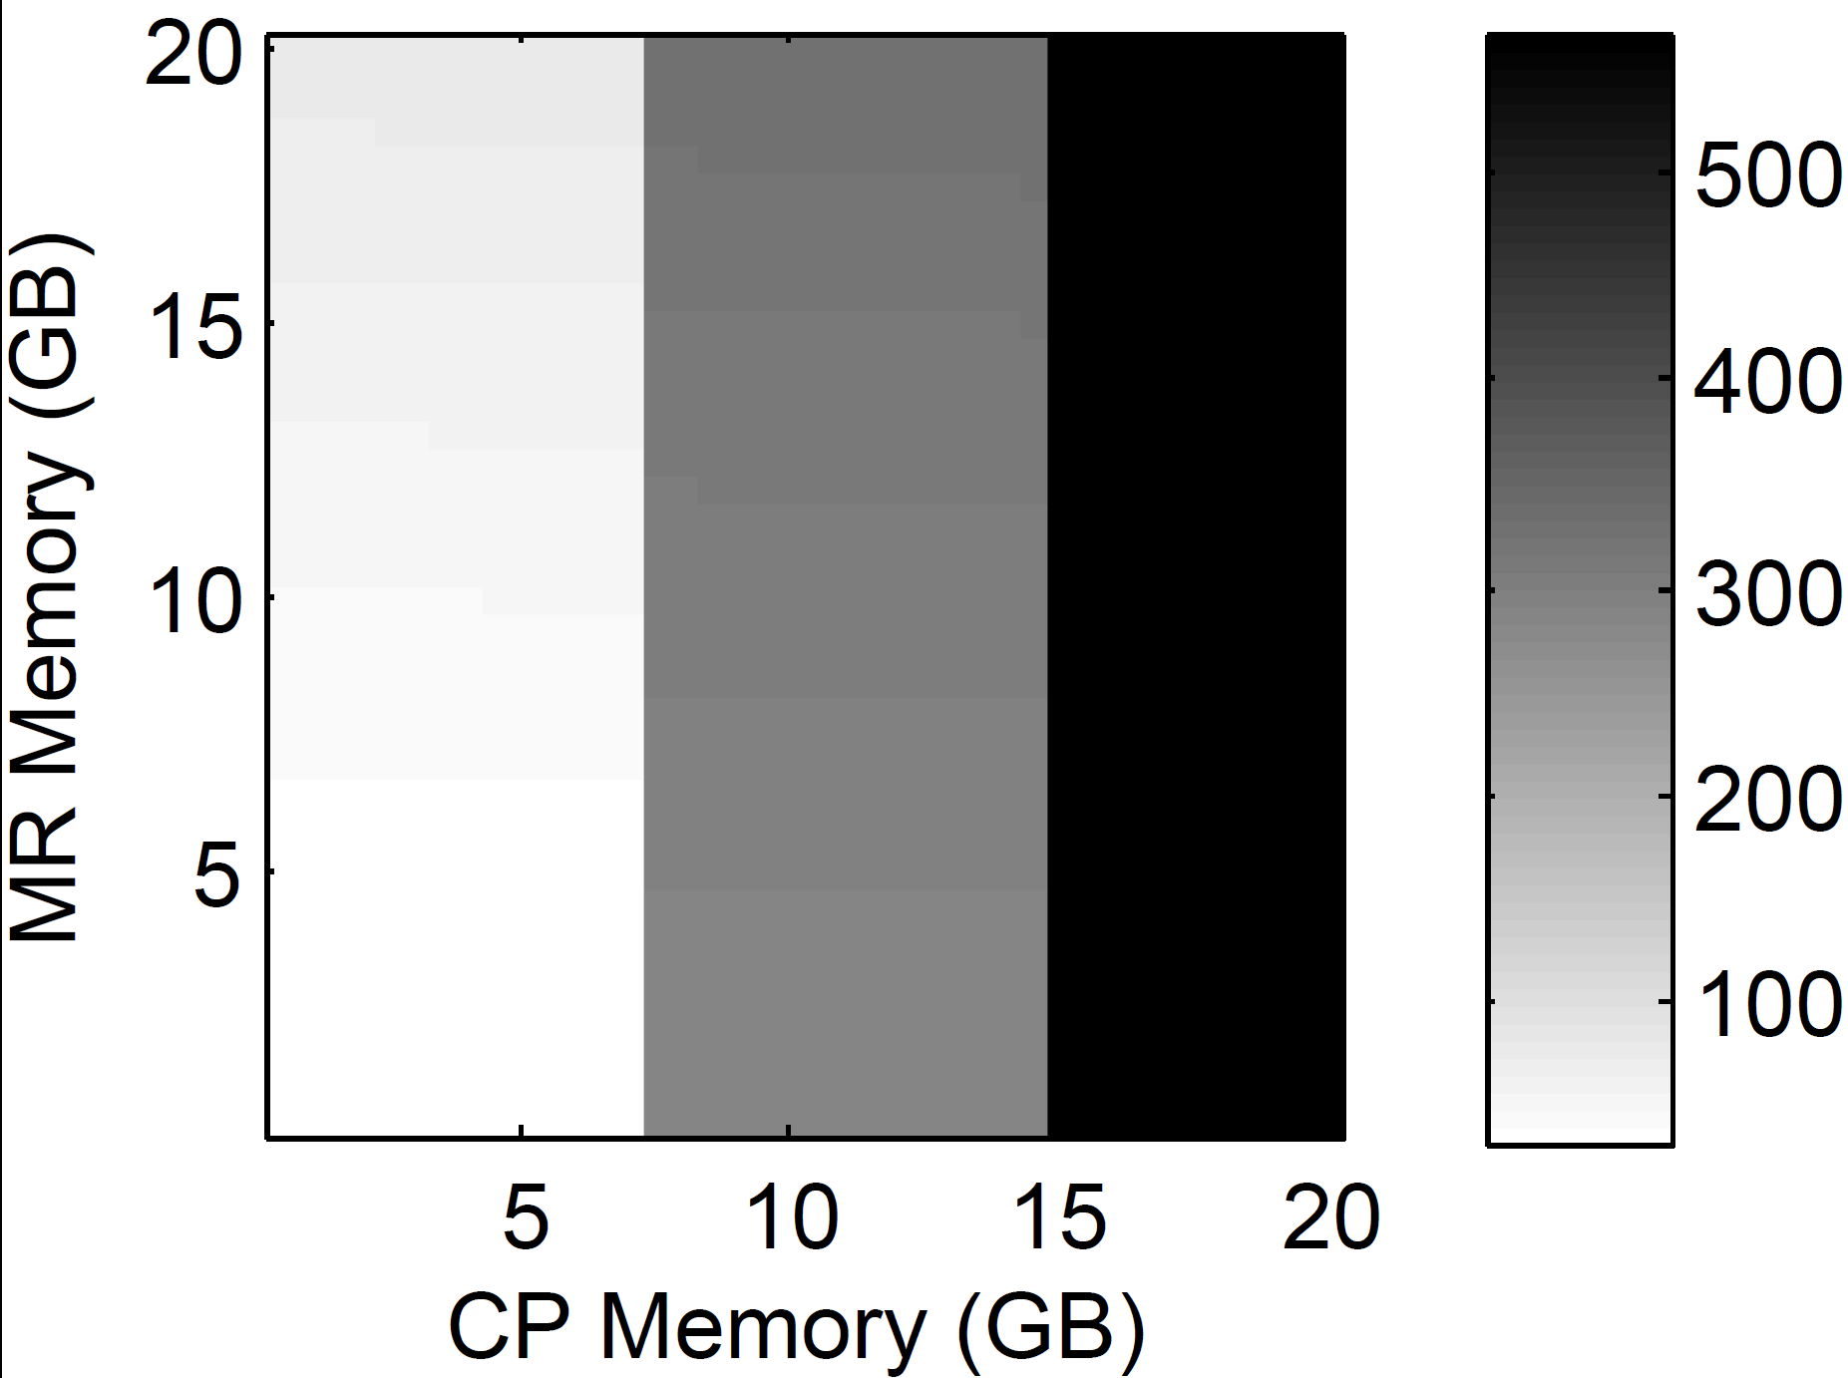
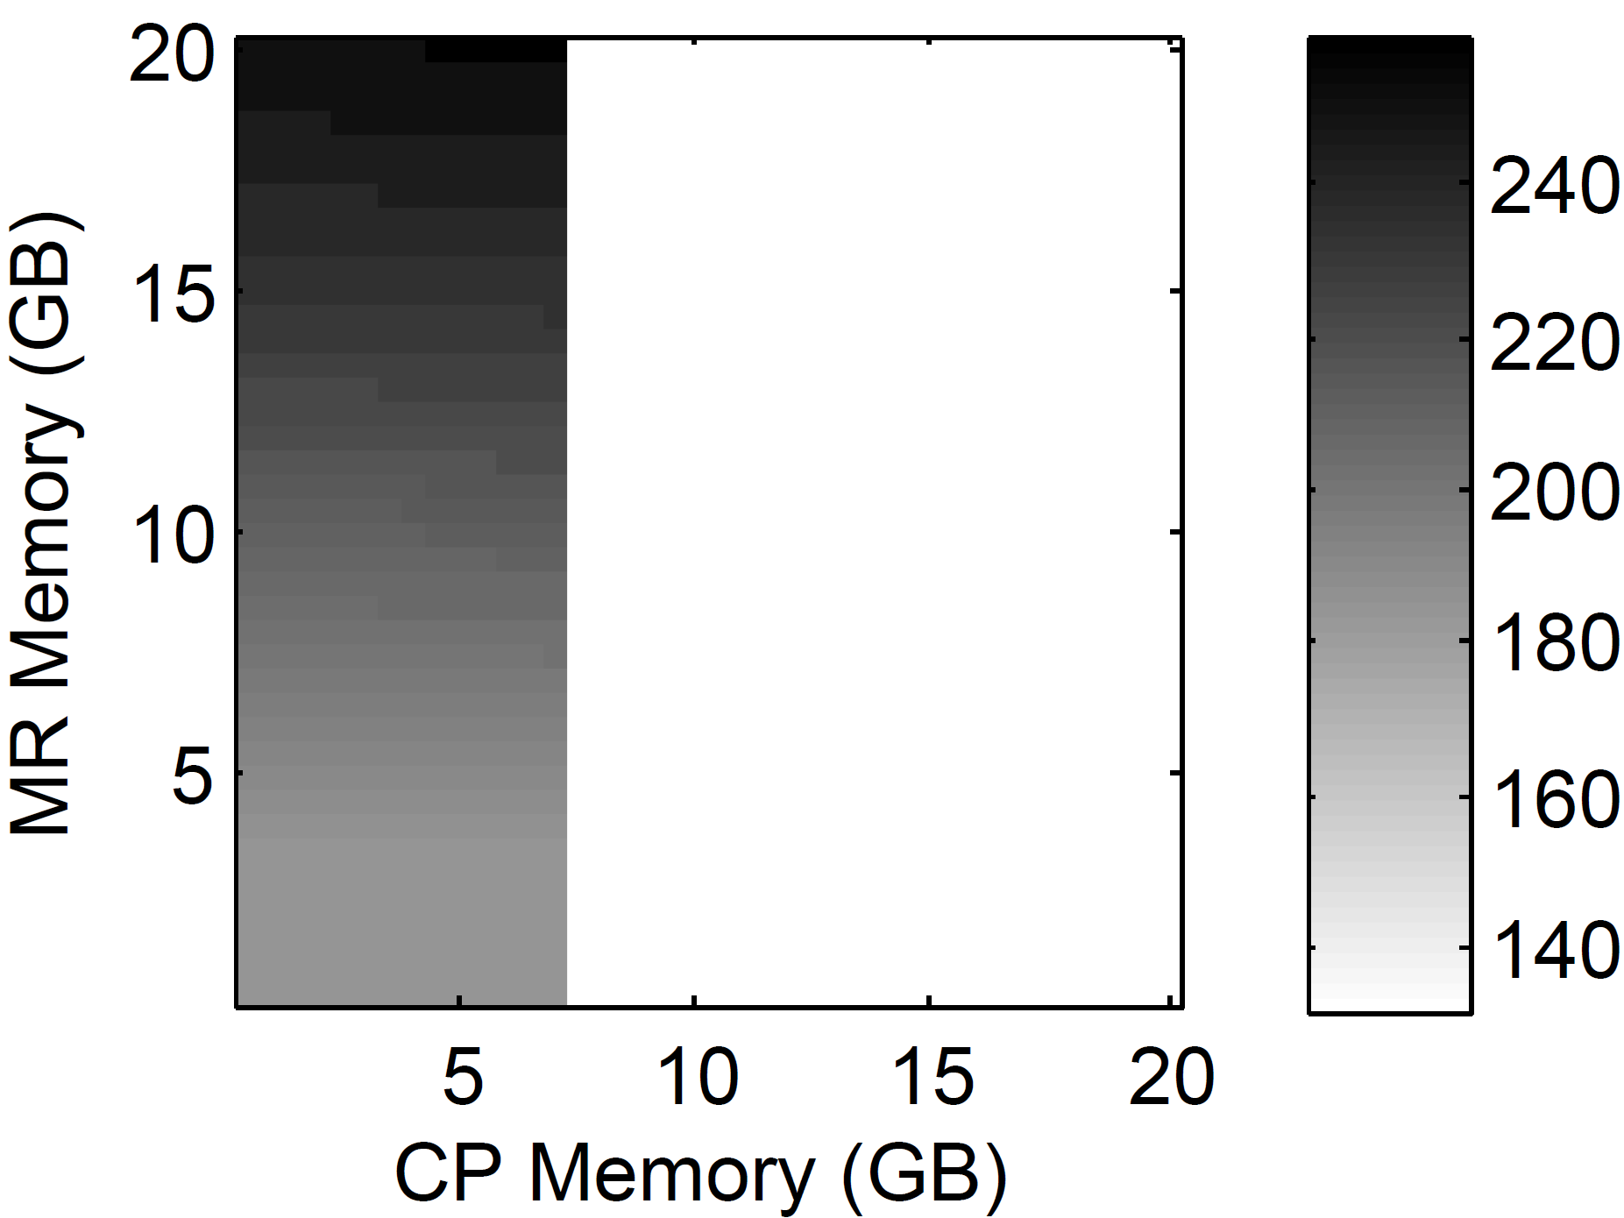
Motivation – Resource Elasticity
Scenario: X: 10⁶ x 10³, 10⁹ y: 10⁶ x 1, 10⁶
Example: Linear Regression (in SystemML‘s R-like syntax)
Estimated runtime costs w/ different memory configurations
Linreg DS (Direct Solve)
X = read($1);
y = read($2);
intercept = $3;
lambda = 0.001;
...
if( intercept == 1 ) {
ones = matrix(1,nrow(X),1);
X = append(X, ones);
}
I = matrix(1, ncol(X), 1);
A = t(X) %*% X + diag(I)*lambda;
b = t(X) %*% y;
beta = solve(A, b); ...
write(beta, $4);
Linreg CG (Conjugate Gradient)
X = read($1);
y = read($2);
intercept = $3;
lambda = 0.001;
...
r = -(t(X) %*% y);
while(i < maxi & norm_r2 > norm_r2_trgt) {
q = t(X) %*% (X %*% p) + lambda*p;
alpha = norm_r2 / (t(p) %*% q);
w = w + alpha * p;
old_norm_r2 = norm_r2;
r = r + alpha * q;
norm_r2 = sum(r * r);
beta = norm_r2 / old_norm_r2;
p = -r + beta * p;
i = i + 1; }
... write(w, $4);
O(m n) per iteration
O(m n²)
One Size Does Not Fit All
Variety of ML algorithms
Data and cluster characteristics
Multi-tenancy
Notes:
Problem of memory-sensitive plans
Issue #1: Users need to reason about plans and cluster configurations for best performance
Issue #2: Finding a good static cluster configuration is a hard problem (variety of ML algorithms and workloads / multi-tenancy)

Slide 5
Motivation – Resource Elasticity (2)
Problem of Memory-Sensitive Plans
Issue #1: Memory sensitive compilation steps (user needs to reason about plans and cluster configurations)
Issue #2: One size does not fit all (finding a good static cluster configuration is a hard problem)
Resource Negotiation Frameworks
YARN: resource container requests (mem, cpu, etc)
Mesos: resource container offers (mem, cpu, storage, etc)
➔ Resource Elasticity for Large-Scale ML
Automatic resource provisioning for ML programs
According to workload (ML script, input data, cluster)

Slide 6
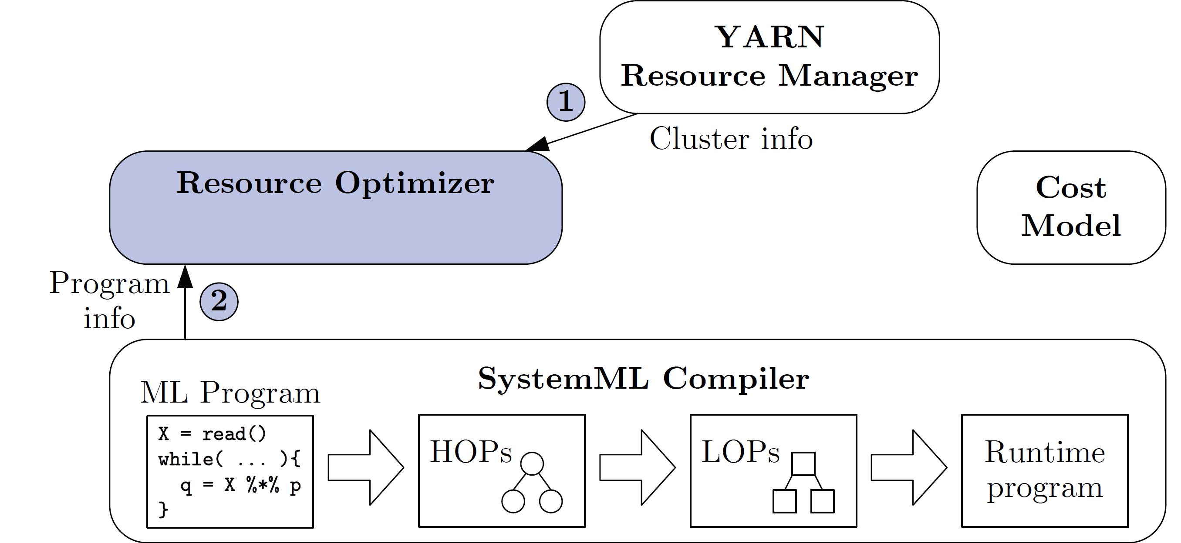
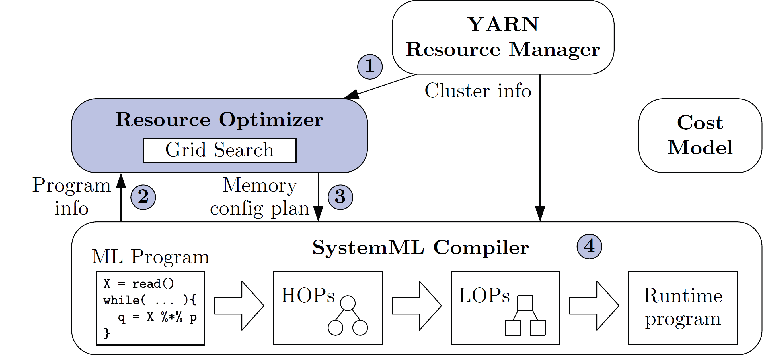
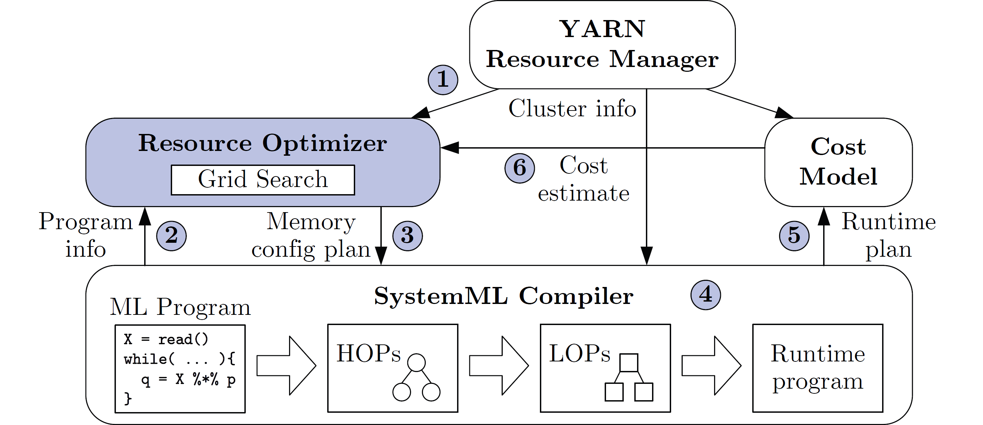
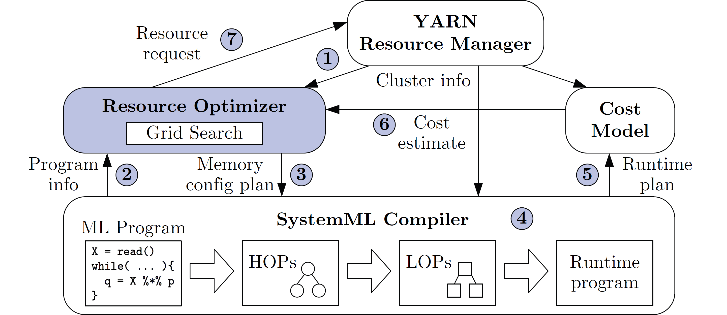
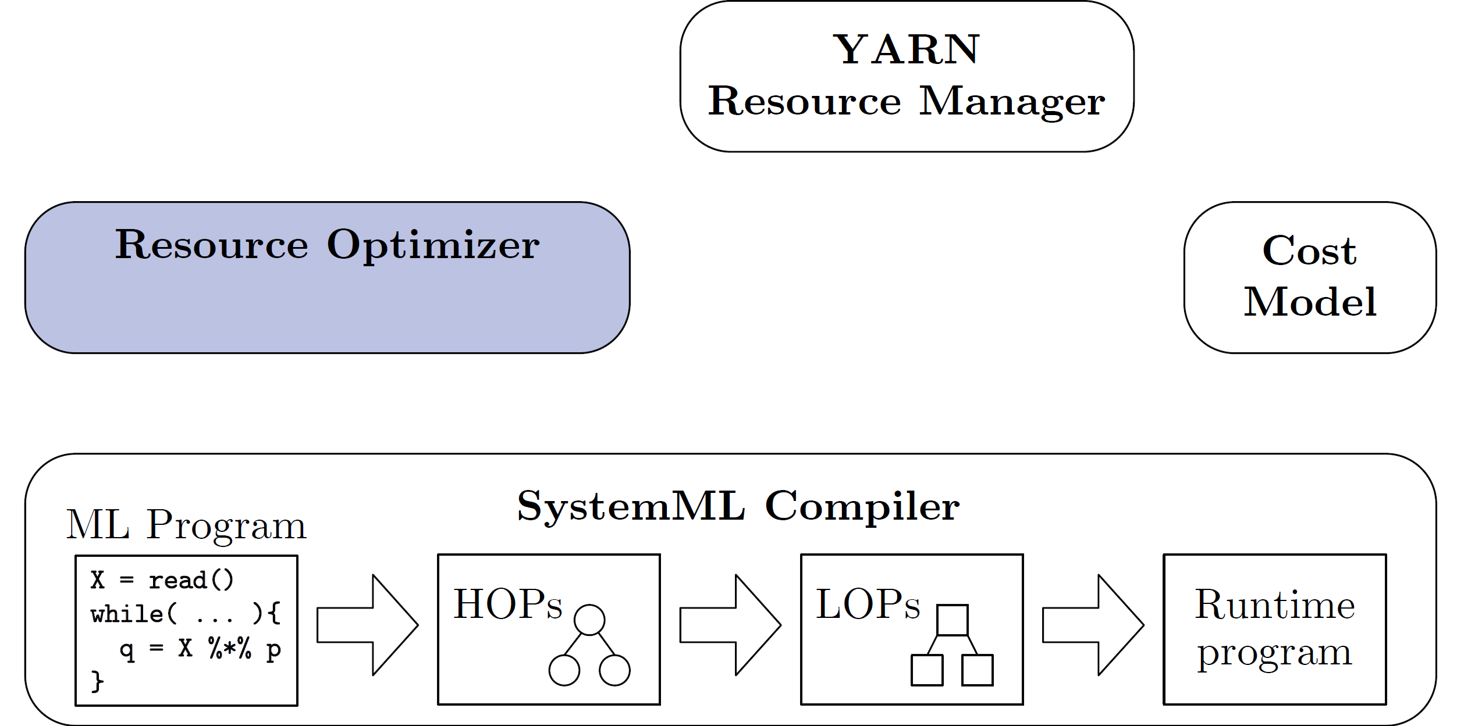
Resource Optimizer Overview
Basic Ideas
Optimize ML program resource configurations via online what-if analysis
Generating and costing runtime plans
Program-aware grid enumeration, pruning, and re-optimization techniques
Notes:
1) Goal: minimize costs w/o unnecessary over-provisioning
2) Costing of runtime plans in order to take all compilation steps into account

Slide 7
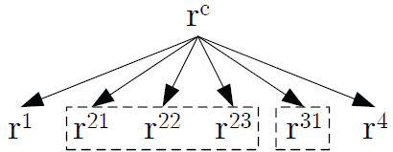
Optimization Framework
ML Program Resource Allocation Problem
Goal: minimize costs w/o unnecessary over-provisioning
Cost Model
White-box cost model based on generated runtime plans
C(P, R_{P}, cc) as estimated execution time of plan P
Single pass w/ tracking of sizes/states of live variables
Analytical model of IO (bandwidth), compute (FLOPs), latency (jobs / tasks)
Search Space Characterization
Def: resource dependency (cost influences of resources)
Resource configuration R_{P} = (r^{c}_{P}, r¹_{P}, …, r^{n}_{P})
P1: Monotonic Dependency Elimination ➔ Pruning
P2: Semi-Independent 2-Dim Problems ➔ Parallelization
(1) Performance
(2) Throughput / Monetary costs
[Matthias Boehm: Costing Generated Runtime Execution Plans for Large-Scale Machine Learning Programs, CoRR 2015]
Notes:
NOTE: P2 also leads to linear optimization time in the number of program blocks.

Slide 8
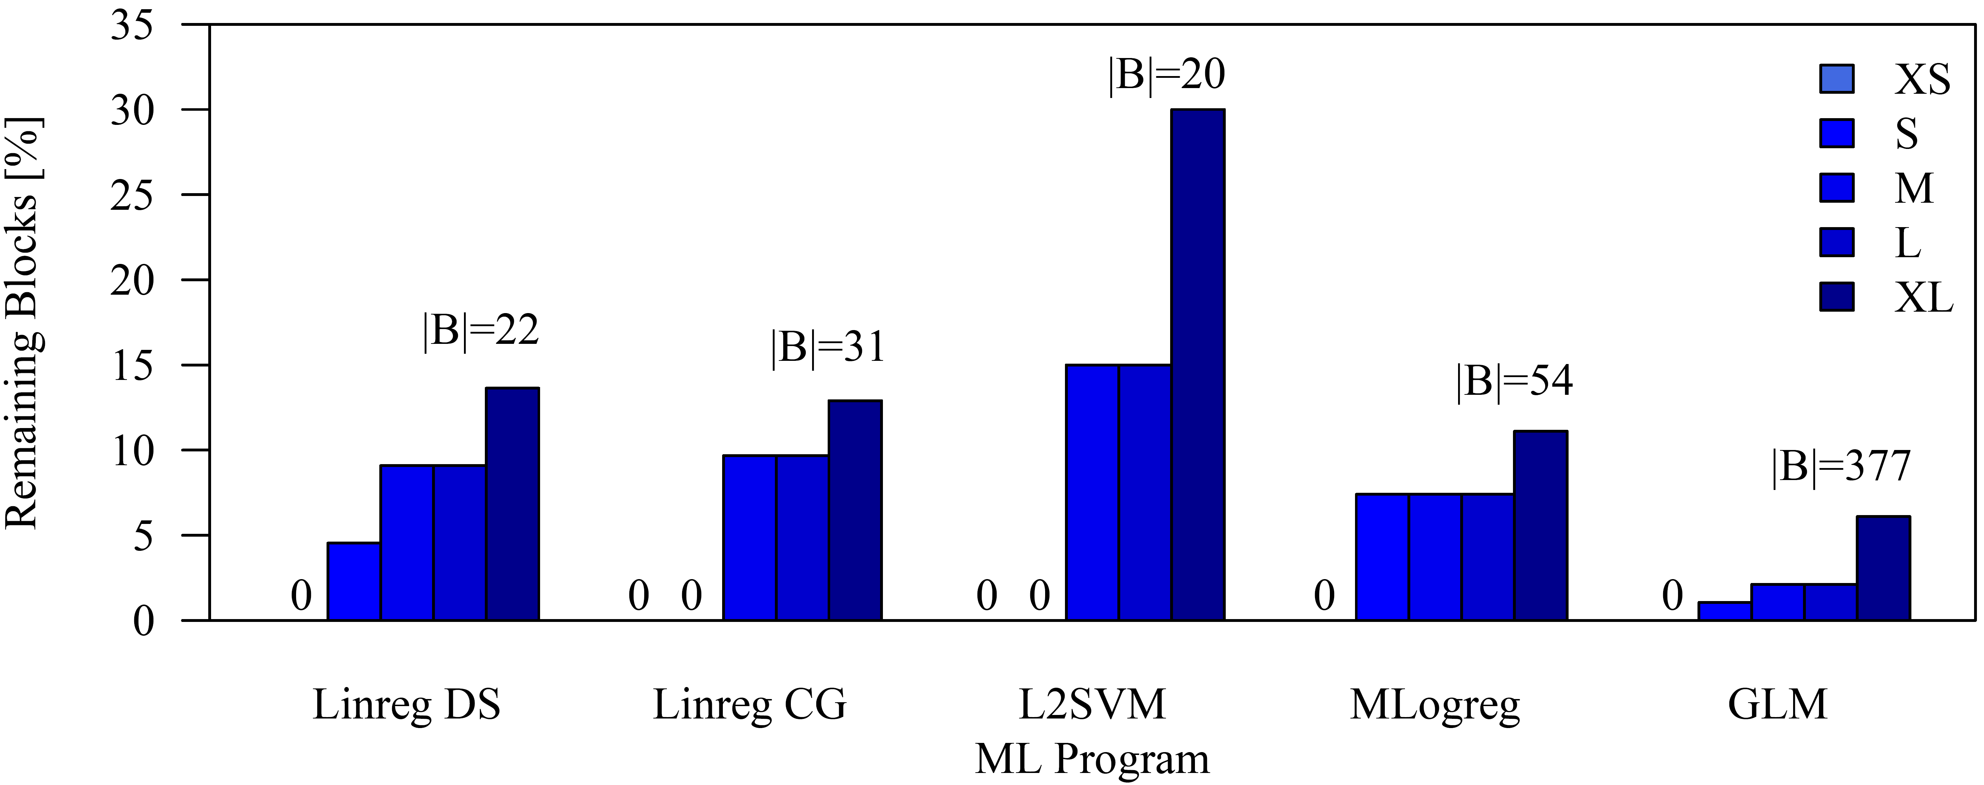
Grid Enumeration Algorithm
ALGORITHM 1: OPTIMIZERESOURCECONFIG
S_{rc} ← ENUMGRIDPOINTS(P, cc, t1, ASC)
S_{rm} ← ENUMGRIDPOINTS(P, cc, t1, ASC)
for all r^{c} ∈ S_{rc} do
B ← COMPILEPROGRAM(P, R=(r_{c}, MIN))
B’ ← PRUNEPROGRAMBLOCKS(B)
for all B’ ∈ B’ do
for all r^{i} ∈ S_{rm} do
B_{i} ← RECOMPILE(B_{i}, R=(r_{c},r_{i}))
MEMO ←| EVAL(C(B_{i}), r_{i}, MEMO)
P ← RECOMPILE(P, R=(r_{c}, MEMO))
R*_{P} ←| EVAL(C(P), MEMO) return R*_{P}
Overall Algorithm
Grid enumeration of CP/MR resources
Program-aware grid point generation and pruning techniques
Grid Point Generators
Systematic: Equi-/Exp-spaced grid
Directed: Memory-based grid
Composite grids (cross product/union)
Our default: (Exp ∪ Mem)
Pruning Techniques
Pruning blocks of small ops
Pruning blocks of unknowns
+ w/o PU
High impact of pruning strategies
Notes:
w/o pruning blocks of unknowns: Mlogreg (14/54 -> 26%) GLM (64/377 -> 17%)

Slide 9
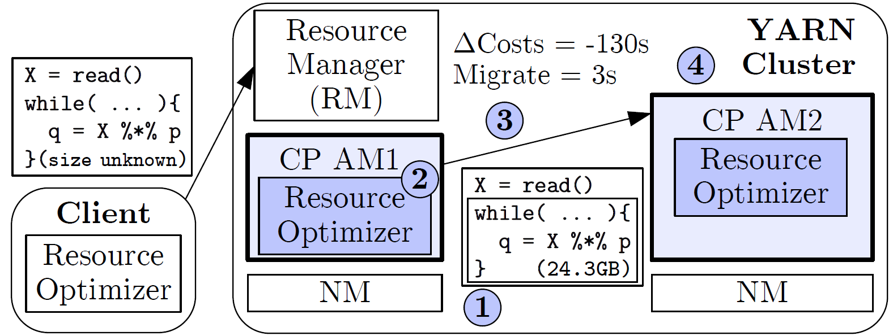
Runtime Resource Adaptation
Example MLogreg:
Y = table(seq(1,nrow(X)),y)
Problem of unknown/changing sizes
Unknown Dimensions / sparsity of intermediates
Examples
Conditional size and sparsity changes
UDFs with unknown output sizes
Data-dependent operations
Overview Resource Adaptation
Integrated w/ default dynamic recompilation
At granularity of last-level program blocks
1
11
1
1
1
1
3
4
223
while( !outer_converge ){
while( !inner_converge ){
Q = P * X %*% V;
}
grad = t(X) %*% (P - Y);
}
(1) Determine re-opt scope
(2) Resource re-optimization
(3) Adaptation decision
(4) Runtime migration

Slide 10
Experimental Setting
HW cluster: 1+6 nodes
1 head node: 2x4 Intel E5530, HT enabled, 64 GB RAM,
6 worker nodes: 2x6 Intel E5-2440, HT enabled, 96 GB RAM, 12x2 TB disks
10 Gb Ethernet, and Red Hat Enterprise Linux Server 6.5
Hadoop cluster
IBM Hadoop 2.2.0, IBM JDK 1.6.0 64bit SR12
YARN max allocation per node: 80 GB (1.5x -Xmx), HDFS blocksize 128 MB
SystemML (as of 10/2014)
ML Programs and Data
5 full-fledged ML scripts
Dense / sparse (1.0 / 0.01)
1000 / 100 features
XS-XL (10⁷-10¹¹ cells) → in dense: 80MB – 800GB
Baselines
B-SS (512MB), B-LS (54GB/512MB), B-SL (512MB/54GB), B-LL (54GB/4.4GB)
Program | # Blocks | Unknowns | Maxiter
Linreg DS | 22 | N | N/A
Linreg CG | 31 | N | 5
L2SVM | 20 | N | 5 / ∞
MLogReg | 54 | Y | 5 / 5
GLM | 377 | Y | 5 / 5
Notes:
Note: meanwhile max overhead still 1.5x Xmx but capped at 2GB
splitsize 128 MB, sort buffer 256 MB
SystemML
* SystemML AM
* Memory budget of 15% / 70% of the max heap size

Slide 11
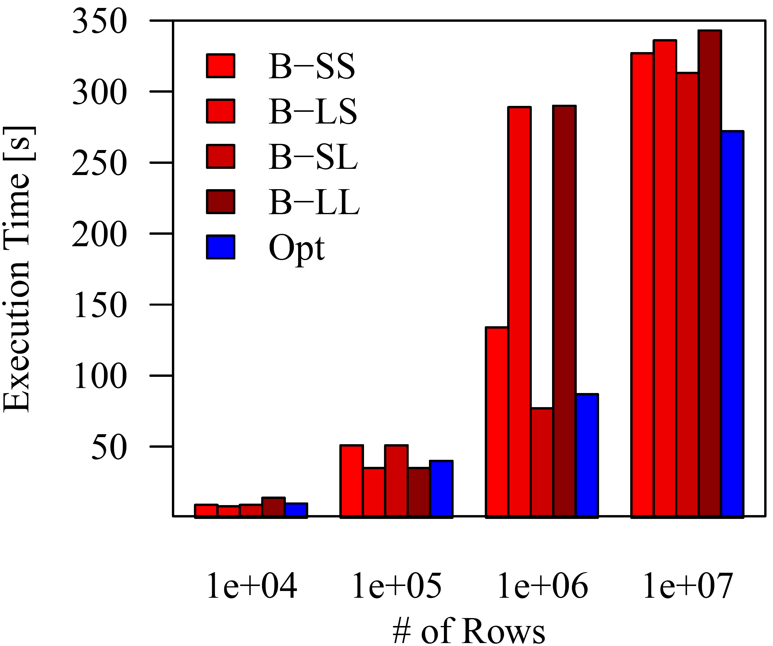
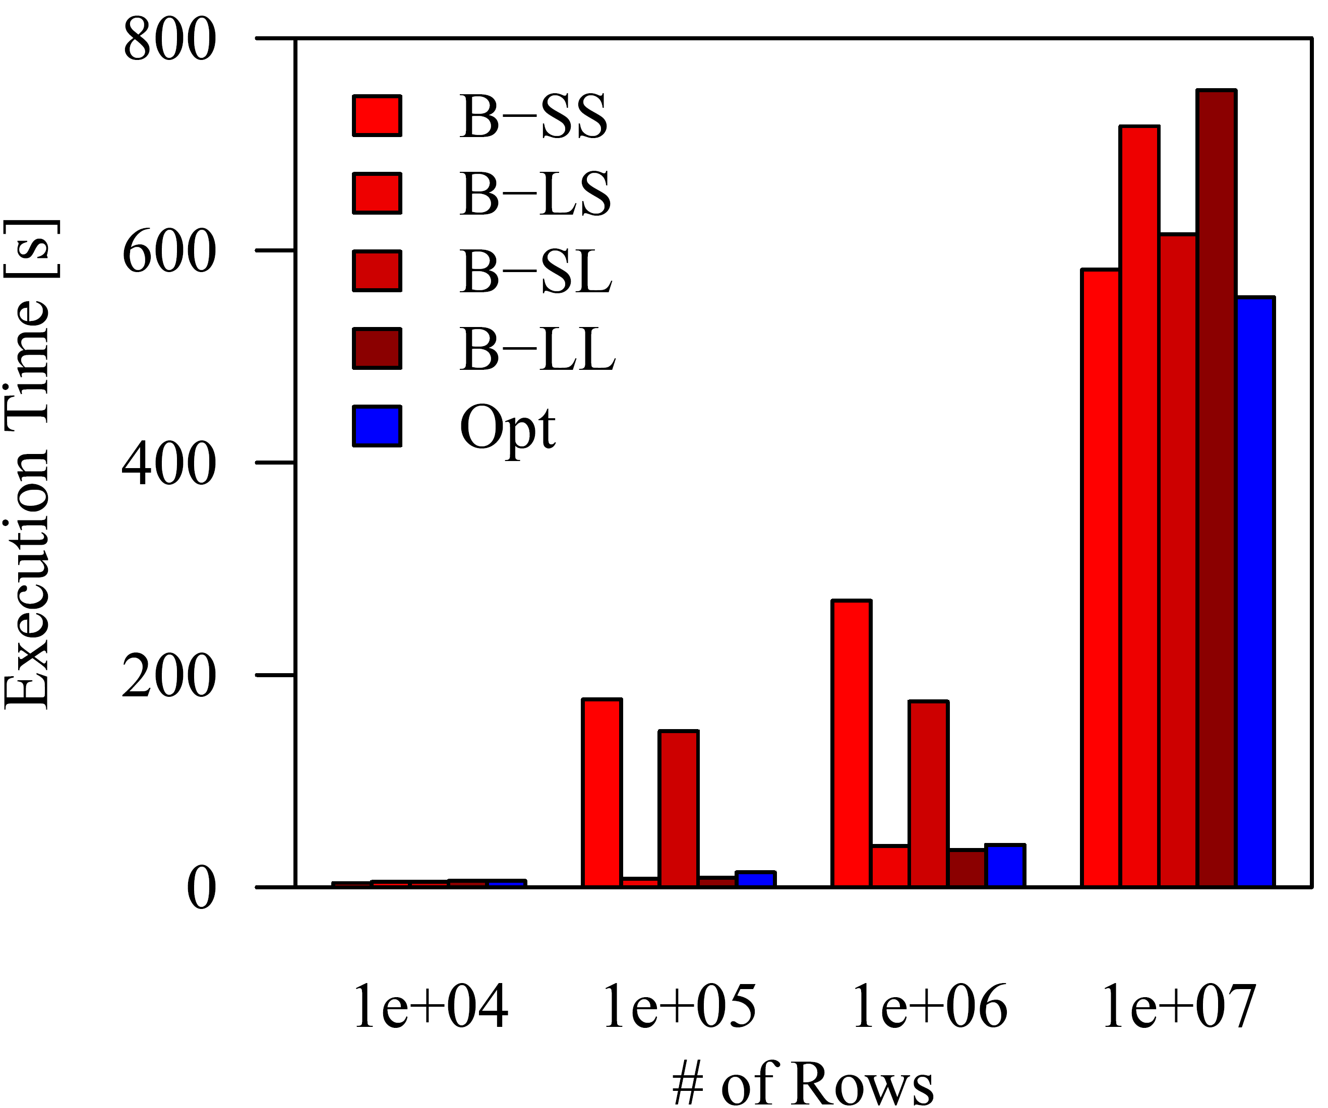
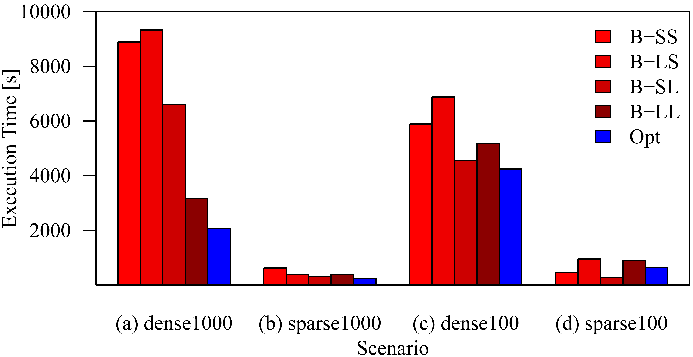
End-to-End Runtime Improvements
(1) Fit small/medium scenarios in memory
Linreg DS (XS-L), dense 1000
Linreg CG (XS-L), dense 1000
(2) Distribute compute-intensive scenarios
12.6x
6.8x
3.3x
Linreg DS (XL)
4.6x
(3) Pick right plan for large data

Slide 12
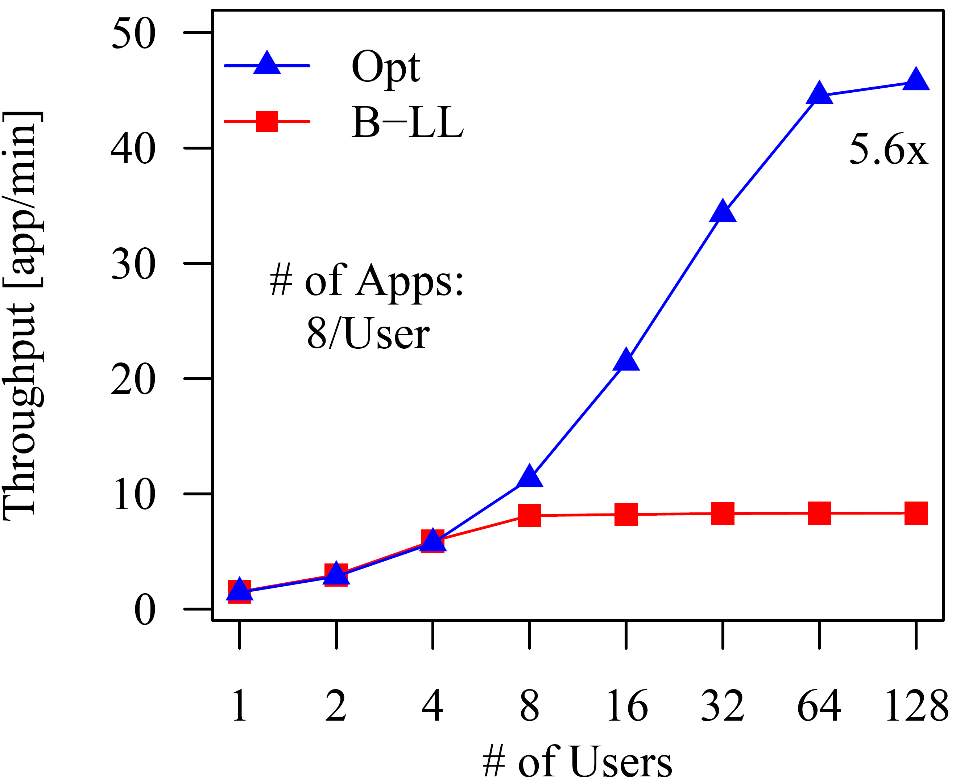
End-to-End Throughput Improvements
Secondary opt objective: no unnecessary over-provisioning
Quantification via cluster app throughput
Linreg DS, Scenario S, dense1000
B-LL: 53.3 GB / 4.4 GB → max parallelism: 6
Opt: 8GB / 2GB → max parallelism: 36
Throughput saturates at max parallelism
Improved max parallelism (and throughput) via moderate resource configurations

Slide 13
Optimization Overhead – Optimization Time
Linreg DS
Scenario dense1000
Linreg CG
Scenario dense1000
Worst overhead over all experiments
Relative: GLM, XS: 4.56s / 35.1%
Absolute: GLM, M: 11.17s / 2.4%
Scenario | # Comp. | # Cost. | Opt. Time | %
XS (80MB) | 352 | 8 | 0.35s | 3.5
S (800MB) | 417 | 30 | 0.41s | 1.0
M (8GB) | 678 | 168 | 0.71s | 0.8
L (80GB) | 448 | 104 | 0.56s | 0.2
XL (800GB) | 536 | 149 | 0.73s | <0.1
Scenario | # Comp. | # Cost. | Opt. Time | %
XS (80MB) | 496 | 8 | 0.43s | 7.2
S (800MB) | 558 | 9 | 0.47s | 3.3
M (8GB) | 924 | 192 | 0.88s | 2.2
L (80GB) | 640 | 152 | 0.66s | 0.1

Slide 14
Conclusions
Summary
Automatic resource optimization for ML programs via online what-if analysis
Program-aware enumeration / pruning / re-optimization techniques
03/2015: IBM BigInsights 4.0 GA, BigR/SystemML (opt level)
What else is in the paper?
Search space, Runtime migration strategies, Parallel resource optimizer,
Many more experiments (algorithms / data characteristics / overhead / adaptation / Spark comparison)
Conclusions
Another step towards declarative large-scale machine learning (memory-sensitive plans, one configuration does not fit all)
Higher performance, higher throughput, lower monetary costs (cloud)
Future work
Stateful frameworks like Spark (lazy evaluation)
Task-parallel ML programs / multi-threaded operations (CPU resources)
Extended runtime adaptation (cluster utilization, cloud settings)
Notes:
IBM Open Platform with Apache Hadoop (BigInsights)

Slide 16
Motivation – Resource Elasticity
Example: Linear regression (in SystemML‘s R-like syntax)
Estimated runtime costs w/ different memory configurations X: 10⁶ x 10³, dense (8GB); y: 10⁶ x 1, dense (8MB)
Linreg DS (Direct Solve)
X = read($1);
y = read($2);
intercept = $3;
lambda = 0.001;
...
if( intercept == 1 ) {
ones = matrix(1,nrow(X),1);
X = append(X, ones);
}
I = matrix(1, ncol(X), 1);
A = t(X) %*% X + diag(I)*lambda;
b = t(X) %*% y;
beta = solve(A, b); ...
write(beta, $4);
Linreg CG (Conjugate Gradient)
X = read($1);
y = read($2);
intercept = $3;
lambda = 0.001;
...
r = -(t(X) %*% y);
while(i < maxi & norm_r2 > norm_r2_trgt) {
q = t(X) %*% (X %*% p) + lambda*p;
alpha = norm_r2 / (t(p) %*% q);
w = w + alpha * p;
old_norm_r2 = norm_r2;
r = r + alpha * q;
norm_r2 = sum(r * r);
beta = norm_r2 / old_norm_r2;
p = -r + beta * p;
i = i + 1; }
... write(w, $4);
O(m n) per iteration
O(m n²)
Compilation of hybrid runtime plans for efficiency/scalability ➔ Key Observation: Problem of memory-sensitive plans
Notes:
Problem of memory-sensitive plans
Issue #1: Users need to reason about plans and cluster configurations for best performance
Issue #2: Finding a good static cluster configuration is a hard problem (variety of ML algorithms and workloads / multi-tenancy)

Slide 17
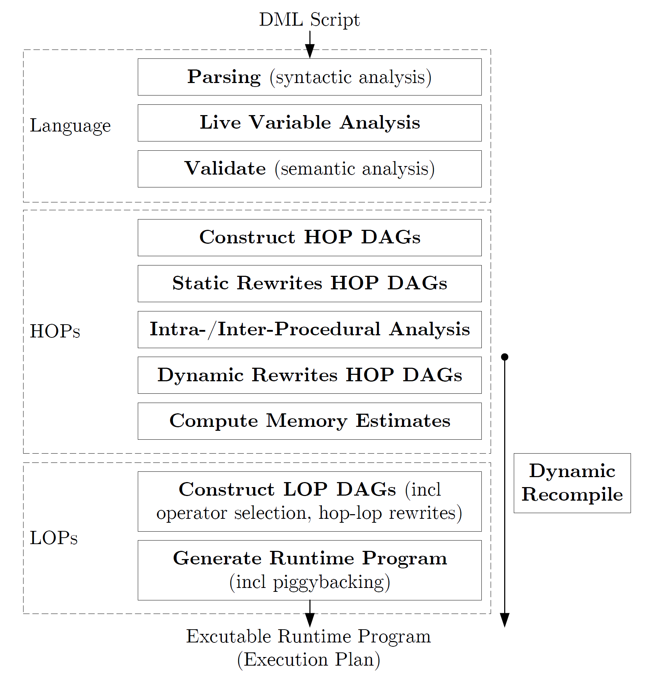
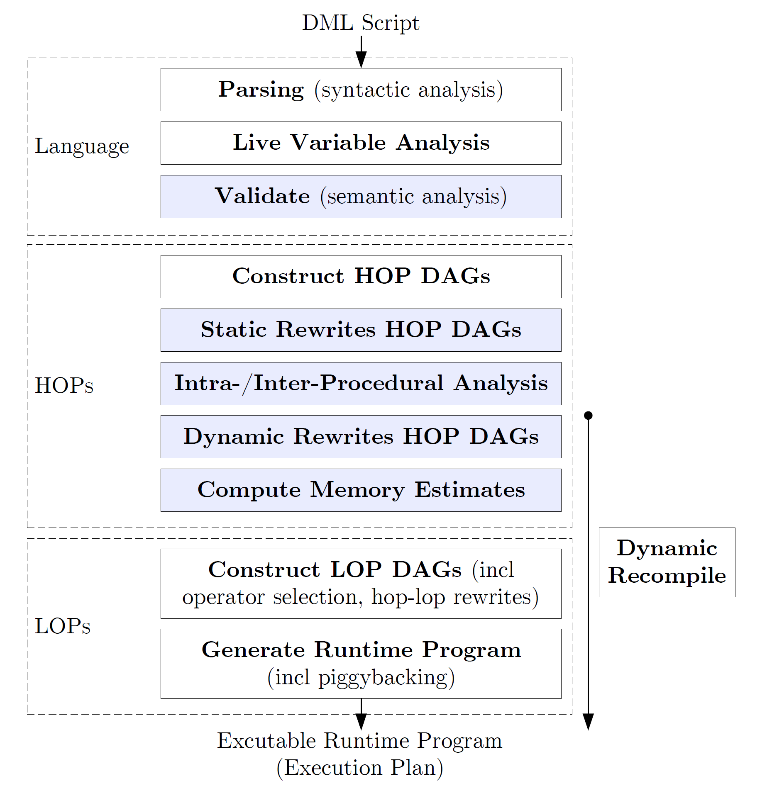
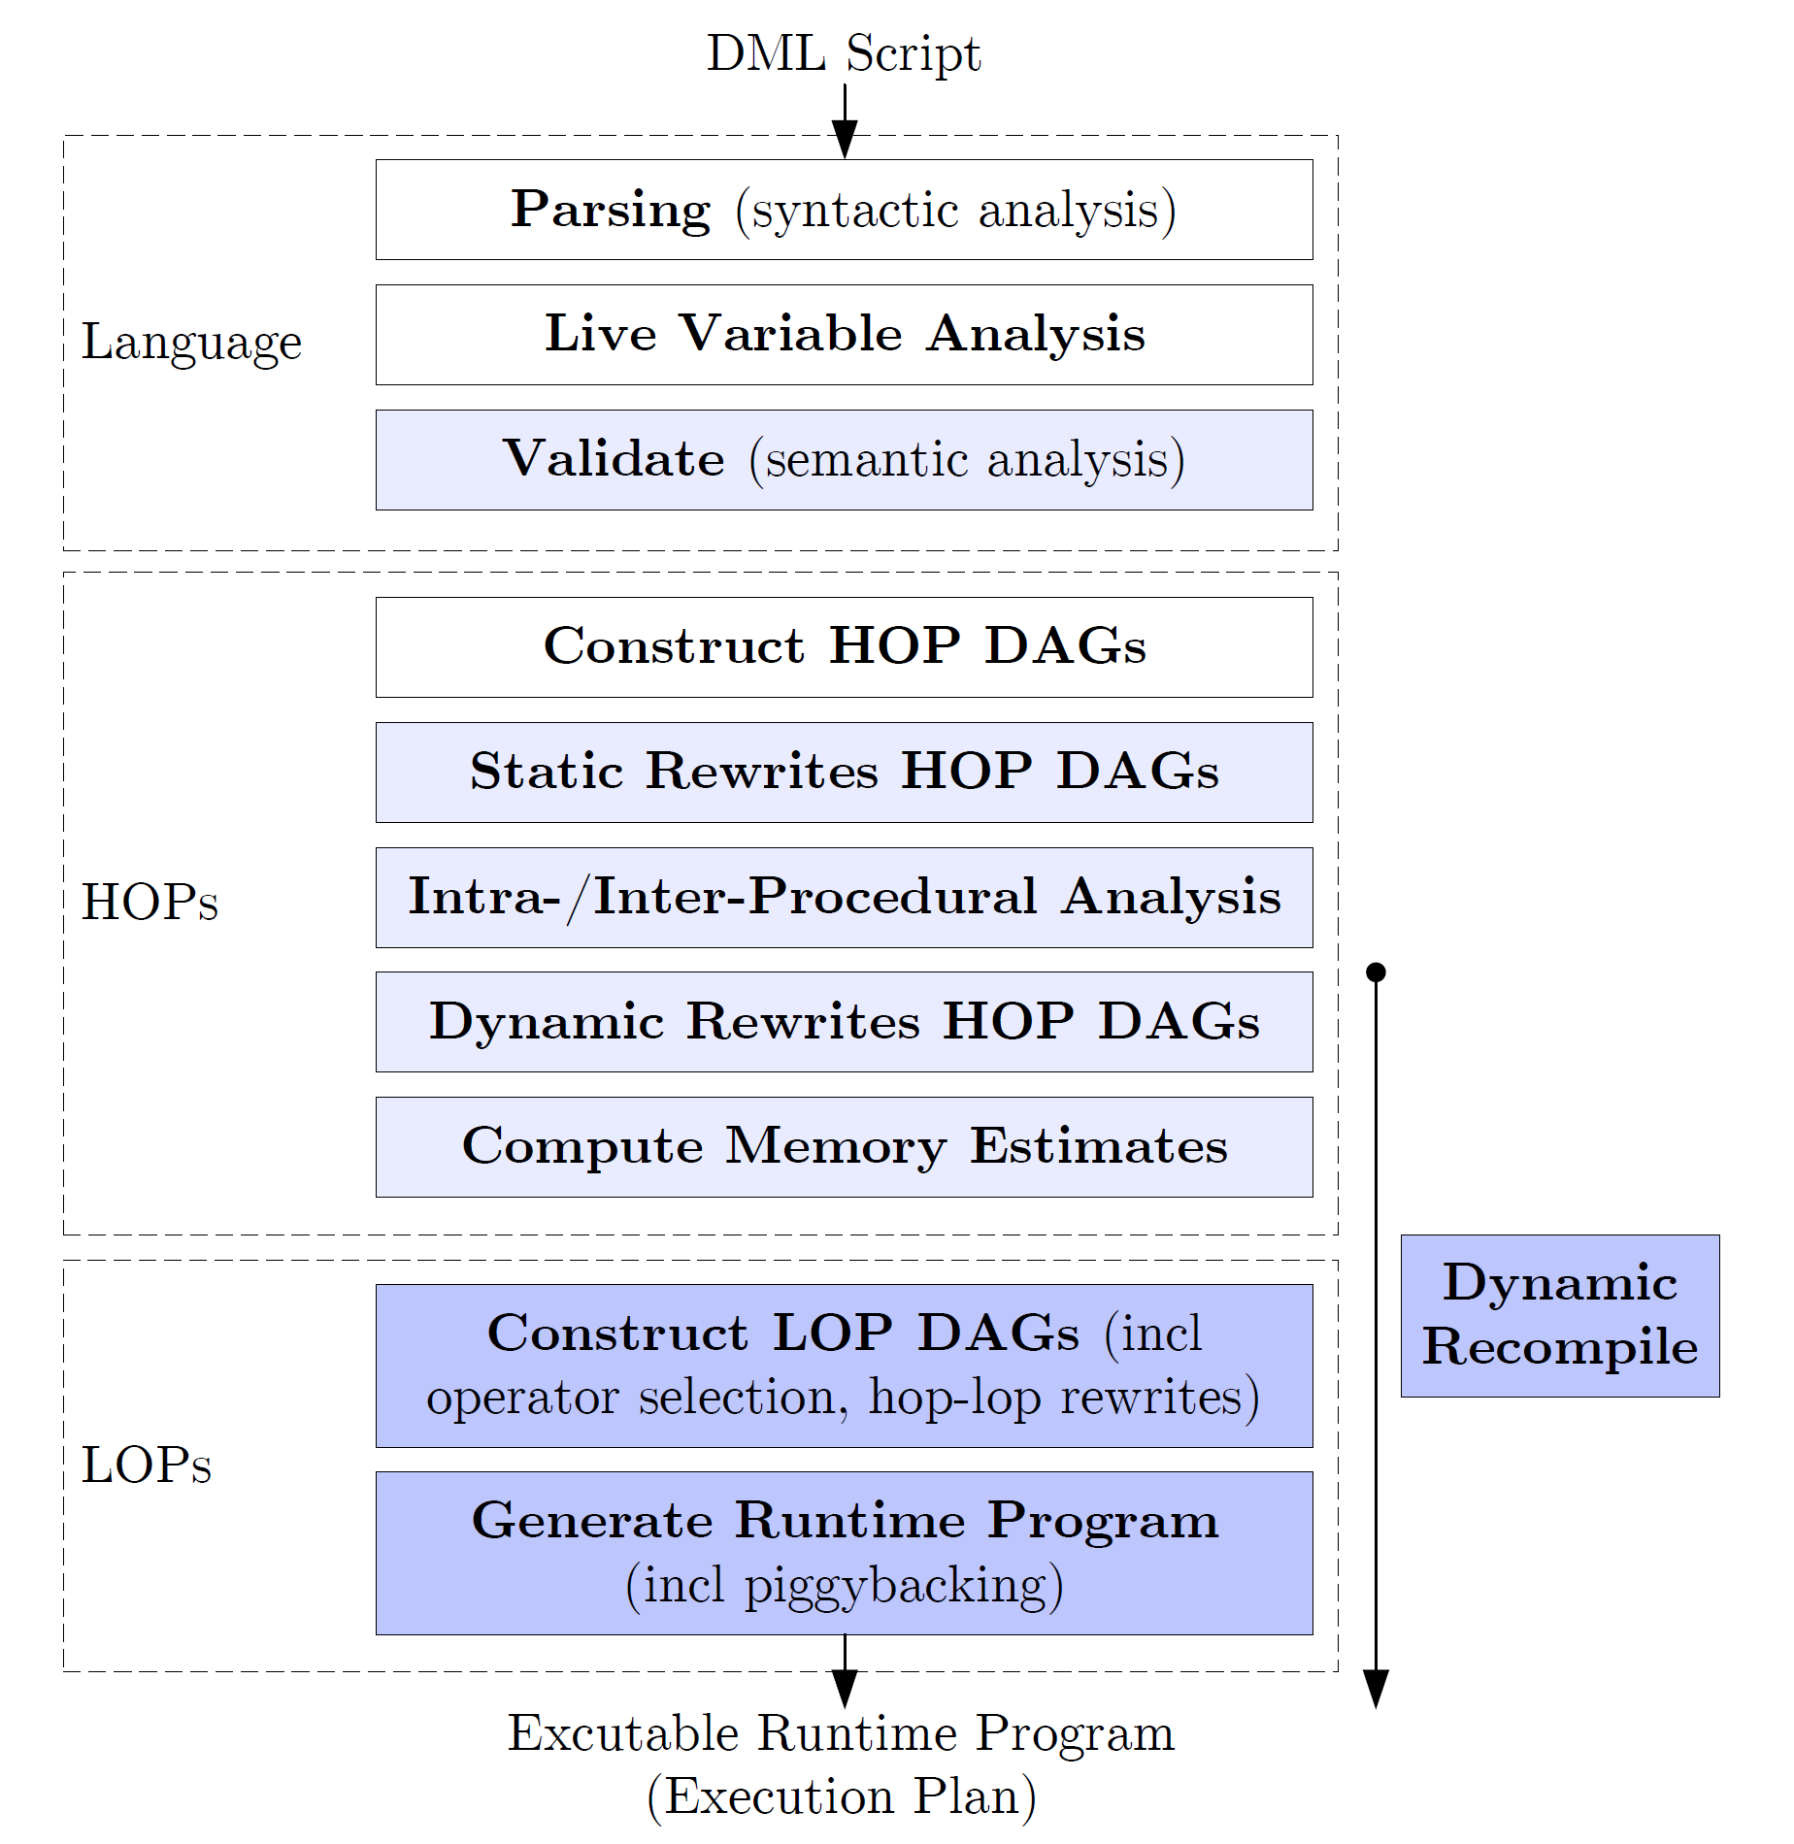
Background: SystemML’s Compilation Chain
Examples:
CP vs MR op selection
Physical op selection (mapmm, mapmmchain, pmm, map*, mappend, map/red wsloss)
Hop-lop rewrites (t-mm, partitioning)
Piggybacking bin constraints
(Parfor optimizer)
(1) Influences on Memory Estimates (input data, rewrites, size propagation)
[Matthias Boehm et al:
SystemML's Optimizer: Plan Generation for Large-Scale Machine Learning Programs. IEEE Data Eng. Bull 2014]
(2) Memory-Sensitive Compilation Steps
Resource negotiation frameworks like YARN, Mesos, or Omega allow us to tackle the problem of memory-sensitive plans

Slide 18
Backup: Spark Comparison Experiments
Resource optimization also important for Spark (high performance w/o over-provisioning)
Scenario
Simplified L2SVM, dense 1000
Spark 1.2 (Dec 2014), 1+6 executors w/ 24 cores and 55GB
Performance
w/ driver mem: 20GB
Throughput #users
w/ driver mem: 512MB
Preview
SystemML Spark BE (05/2015)
3s* (23s)
6s* (27s)
50s* (70s)
82s (102s)
5,156s (5,176s)
Scenario (* CP-only) | SystemML on MR w/ Opt | SystemML on Spark Plan 1 (Hyb) | Plan 2 (Full)
XS (80MB) | 6s* | 25s | 59s
S (800MB) | 12s* | 31s | 126s
M (8GB) | 40s* | 43s | 184s
L (80GB) | 836s | 167s | 347s
XL (800GB) | 12,376s | 10,119s | 13,661s
# of Users (Scenario S) | SystemML on MR w/ Opt | SystemML on Spark Plan 2 (Full)
1 | 5.1 app/min* | 0.48 app/min
8 | 35.6 app/min* (7.0x) | 0.84 app/min (1.8x)
32 | 69.8 app/min* (13.7x) | 0.83 app/min (1.7x)

Slide 19
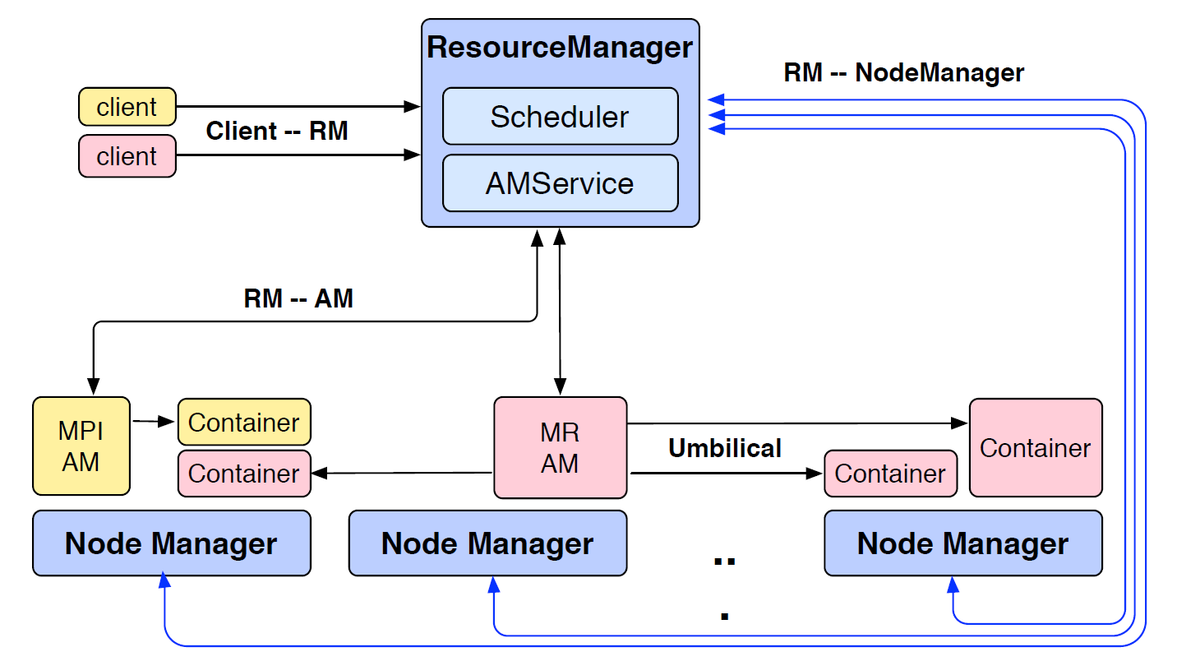
Backup: Yet Another Resource Negotiator (YARN)
[Vinod Kumar Vavilapalli, Arun C. Murthy, Chris Douglas, Sharad Agarwal, Mahadev Konar, Robert Evans, Thomas Graves, Jason Lowe, Hitesh Shah, Siddharth Seth, Bikas Saha, Carlo Curino, Owen O'Malley, Sanjay Radia, Benjamin Reed, Eric Baldeschwieler: Apache Hadoop YARN: yet another resource negotiator. SoCC 2013]

