Slide 1


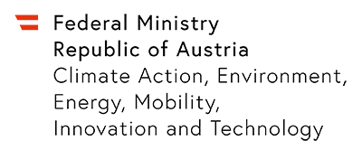




ExDRa: Exploratory Data Science
on Federated Raw Data
Sebastian Baunsgaard³, Matthias Boehm³, Ankit Chaudhary⁴, Behrouz Derakhshan²,
Stefan Geißelsöder¹, Philipp M. Grulich⁴, Michael Hildebrand¹, Kevin Innerebner³,
Volker Markl^{2,4}, Claus Neubauer¹, Sarah Osterburg¹, Olga Ovcharenko³, Sergey Redyuk⁴, Tobias Rieger³, Alireza Rezaei Mahdiraji², Sebastian Benjamin Wrede³, Steffen Zeuch²
1
2
3
4
SIGMOD ’21, June 20–25, 2021, Virtual Event, China

Slide 2
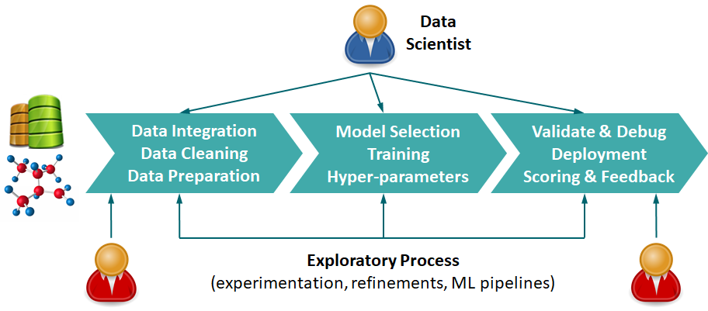


Motivation: Federated Raw Data
Exploratory Data Science
  Open-ended questions, under-specified objectives
  Acquire, clean, enrich raw data; build models; test
  Unknown business value → limited investment
Data Ownership and Privacy
  Limited access to relevant data sources
  #1 Privacy-preserving, decentralized data storage
  #2 Geo distribution (infeasible consolidation)
  #3 Data ownership and pay walls
Example Data Ownership Dilemma
  Thought experiment: middle person B uses machine
  of machine vendor A to test customer C’s equipment
Who owns the data?
XXXXXXXX
XXXXXXXXXXXXXXXXXXXXXXX
XXXXXXXX
XXXXX
Machine Vendor A
Middle Person B
Customer C
→ Bilateral contracts

Slide 3



Motivation: Federated Learning
Federated Learning
  Learn model w/o central data consolidation
  (personalization and sharing for bootstrap)
  Traditional parameter server architecture
  w/ client sampling + model averaging
  Handling of statistical heterogeneity
Enterprise Federated Learning
  Existence of legal agreements and
  coordination among involved parties
  ML pipelines on raw data
  Automatic plan optimization and
  federated data re-organization
  New spectrum of data ownership
  → new markets?
[Brendan McMahan et al: Communication-Efficient Learning of Deep Networks from Decentralized Data. AISTATS 2017]
W
W
ΔW
[Keith Bonawitz et al: Towards Federated Learning at Scale: System Design. MLSys 2019]
[Sashank J. Reddi et al: Adaptive Federated Optimization. CoRR 2020]
Federated Learning
& Data Science
“Query Processing” on Raw Data
W
W
ΔW
XXXXXXXX
XXXXXXXXXXXXXXXXXXXXXXX
XXXXXXXX
XXXXX
[Ioannis Alagiannis et al: NoDB: Efficient Query Execution on Raw Data Files, SIGMOD 2012]

Slide 4

Use Cases and Federated Data
Use Cases
  Fertilizer production:
  anomaly detection models (rare negative samples)
  Paper production:
  predict paper quality at end of pipeline
  ➔ Data from multiple, federated sites could
  improve data and model quality significantly
Federated Data
  #1 Row-partitioned
  (aka horizontal FL)
  #2 Column-partitioned
  (aka vertical FL)
  #3 Generic non-overlapping
X₁
Federated Privacy Models
  Key Property: no reconstruction
  of private raw data
  Aggregates (e.g., gradients)
  Encrypted communication
  Privacy enhancing technologies (FHE, MPC, differential privacy)
X₂
X₁
X₂
y
X₁
X₂

Slide 5
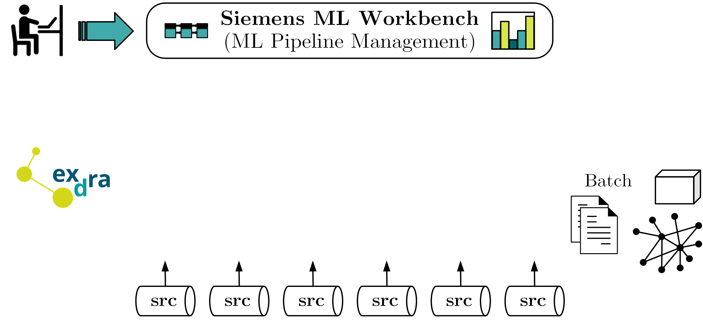
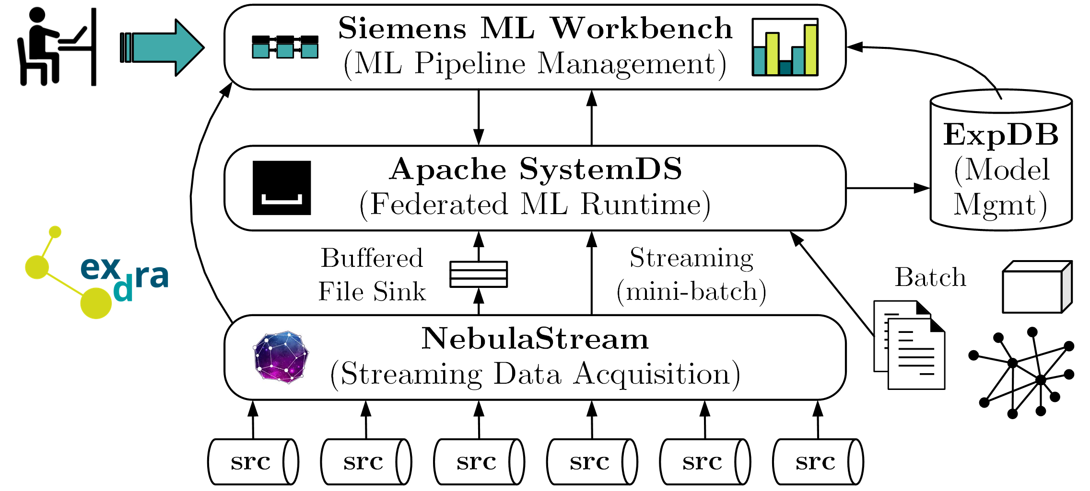
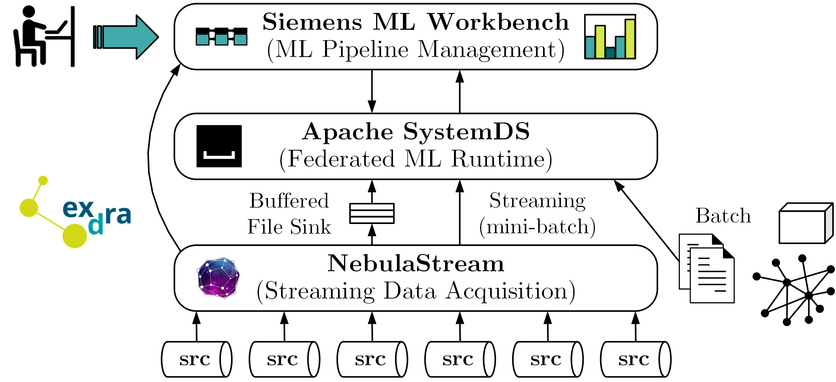
ExDRa System Architecture
https://github.com/
apache/systemds
https://www.nebula.stream

Slide 6
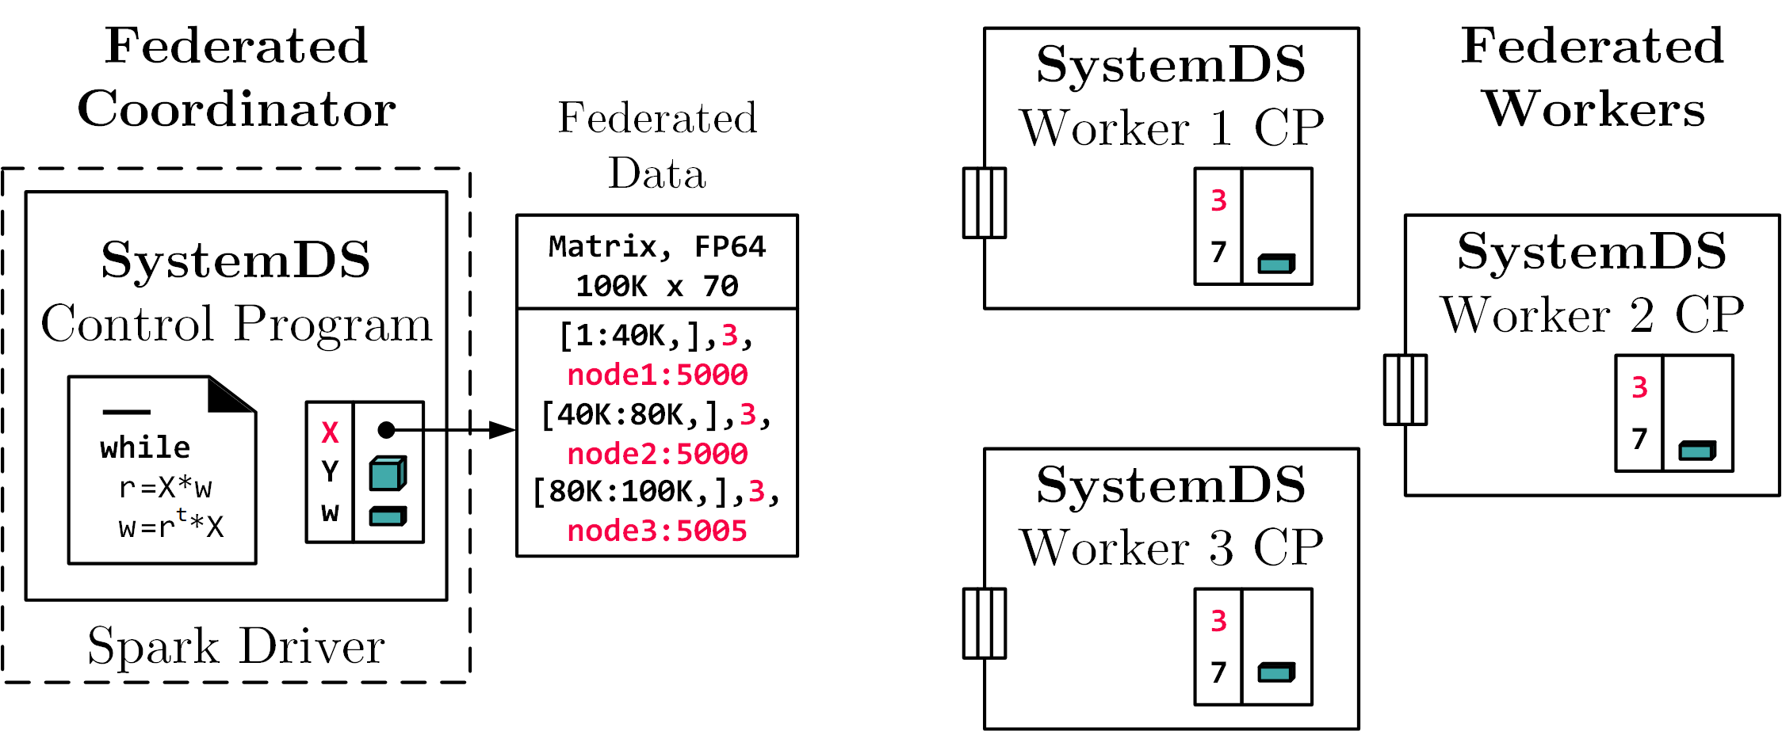
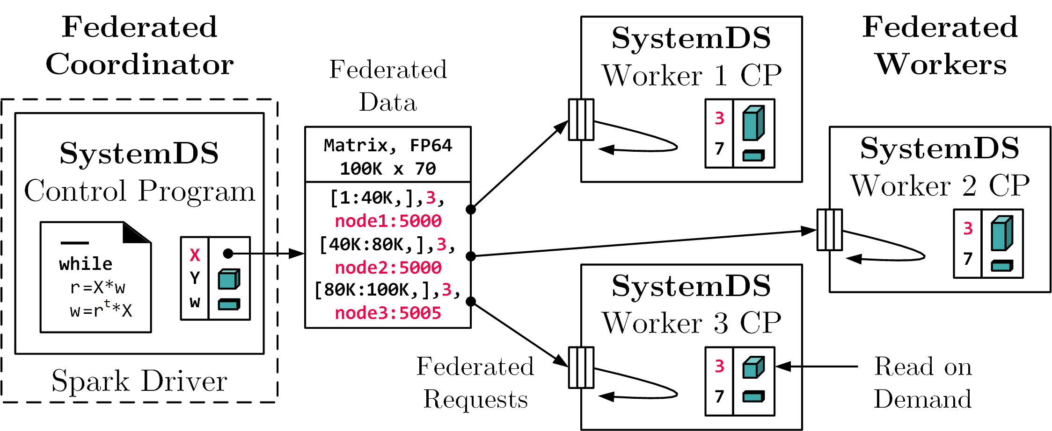
Runtime – Federated Data and Backend
Federated Data
and Workers
Federated Requests (RPC)
  READ(ID,fname) read data object from file, and put it in symbol table
  PUT(ID,data) receives transferred data object, and put it in symbol table
  GET(ID) return a data object from the federated site to coordinator
  EXEC_INST(inst) execute an instruction (inputs/outputs by ID)
  EXEC_UDF(udf) execute a user-defined function w/ symbol table
  CLEAR clean up execution contexts and variables
X = federated(
addresses=list(node1, node2,node3),
ranges=list(list(0,0),list(40K,70),
..., list(80K,0),list(100K,70)));
➔ Design Simplicity:
(1) reuse instructions
(2) federation hierarchies

Slide 7
Runtime – Federated Linear Algebra
Basic Approach
  Federated instructions for many LA operations
  Data-parallel processing of row/column partitions
Matrix-Vector Multiplication
  o = X %*% v, local v
  Row-partitioned,
  federated X
  Row-partitioned o
Vector-Matrix Multiplication
  o = v %*% X, local v
  Row-partitioned, federated X,
  local o (after aggregation)
Example K-Means
(data independent)
while( term_code == 0 ) {
D = -2 * (X %*% t(C))
+ t(rowSums(C ^ 2));
P = (D <= rowMins(D));
P = P / rowSums(P);
P_denom = colSums(P);
C_new = (t(P) %*% X)
/ t(P_denom);
# ...
}
b) Local MV (EXEC_INST, 3)
a) broadcast v
(PUT(v, 2))
X₁
c) Clean 2
(EXEC_INST)
X₂
a) broadcast sliced v
(PUT(v, 4))
b) Local MV
(EXEC_INST, 5)
X₁
c) Aggregate (GET, 5) +
X₂
d) Clean 4,5 (EXEC_INST)

Slide 8
Runtime – Federated Parameter Server
Background SystemDS PS
  Data-parallel parameter server
  Different data partitioning,
  update frequencies and types
System Architecture
  Multi-threaded workers at federated sites
  Parameter server at coordinator w/
  control thread per worker
  EXEC_UDF federated requests
Federated Processing
  Data partitioning: respect federated data, reshuffle locally
  Handling imbalance & skew (non-IID data): virtual replication of data + weighting
M = list(W1, W2, W3, W4, b1, b2, b3, b4, ... vW4); # model
params = list(lr=lr, mu=mu, stride=stride, pad=pad, ...);
Mp = paramserv(model=M, features=X, labels=y,
upd=updateGrad, agg=updateModel, utype=ASP,
freq=BATCH, epochs=200, batchsize=64, ...);
Federated
Worker 1
SystemDS Coordinator
CT1
X₁
Paramserv
Federated Requests
CT2
Federated
Worker 2
X₂

Slide 9
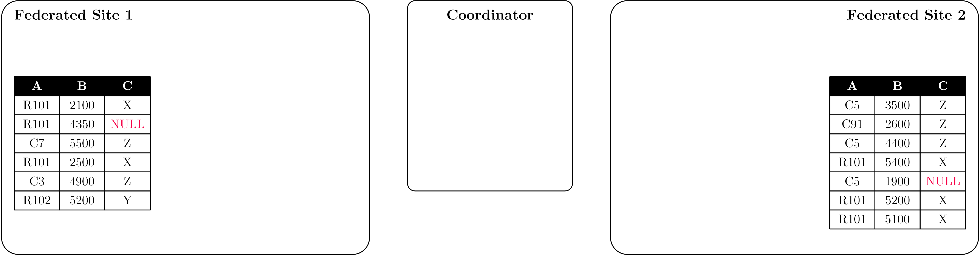
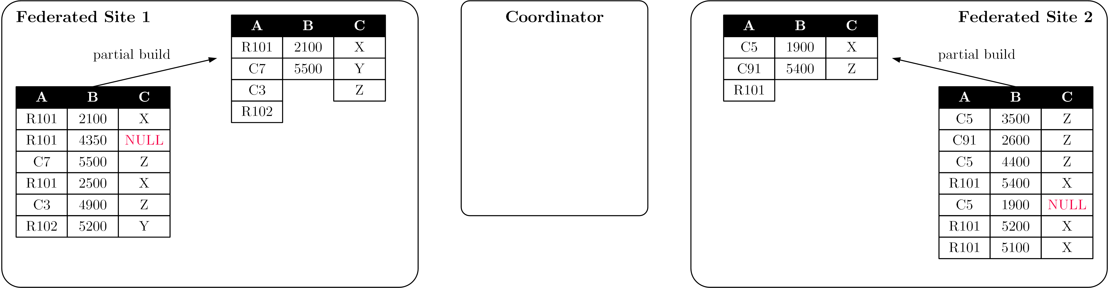
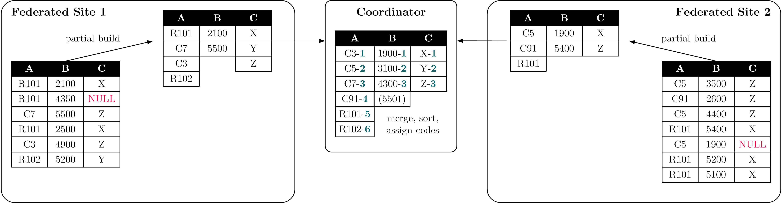
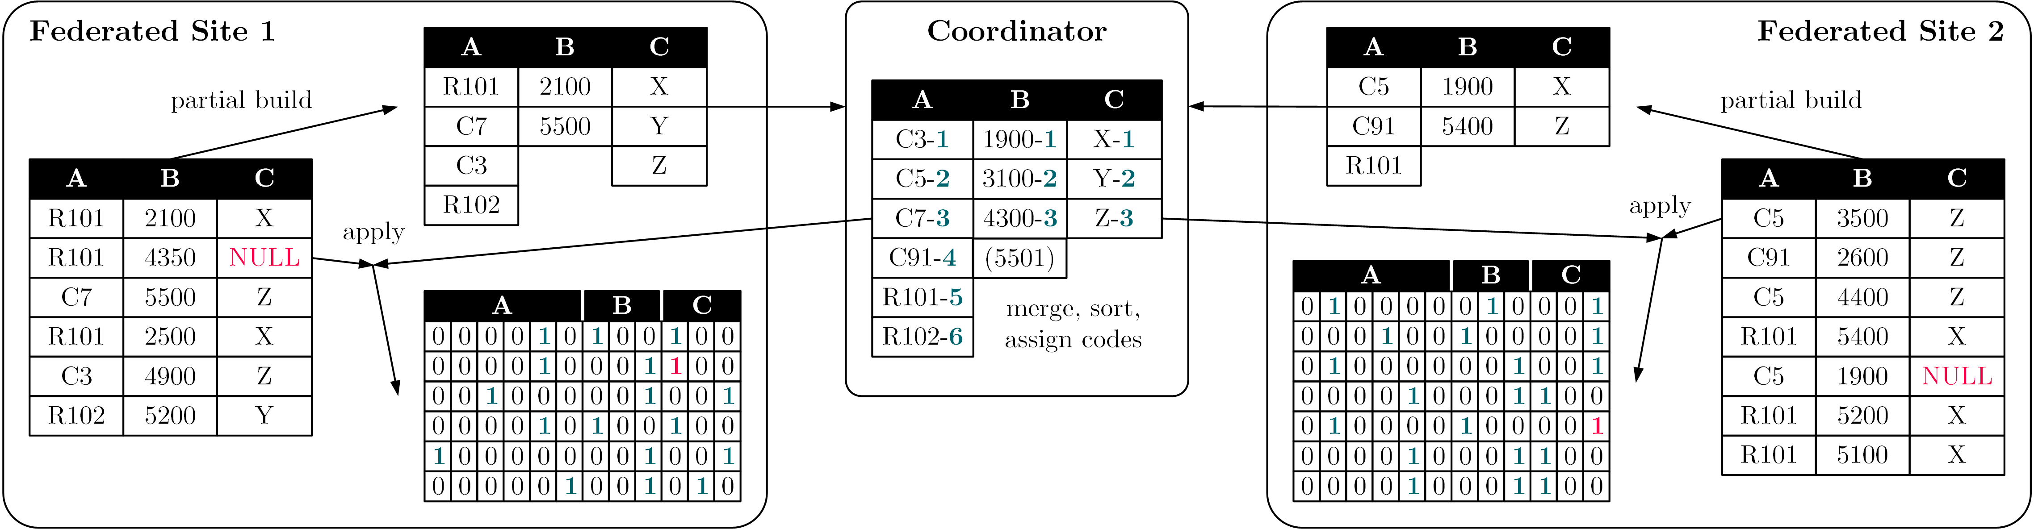
Runtime – Federated Data Preparation
ML-based Data Cleaning, Validation, and Preparation
Feature Selection & Transformations
Opportunity of Stateful Workers: Adaptive Data Reorganization
  Examples: lineage-based reuse, compression, incremental maintenance

Slide 10
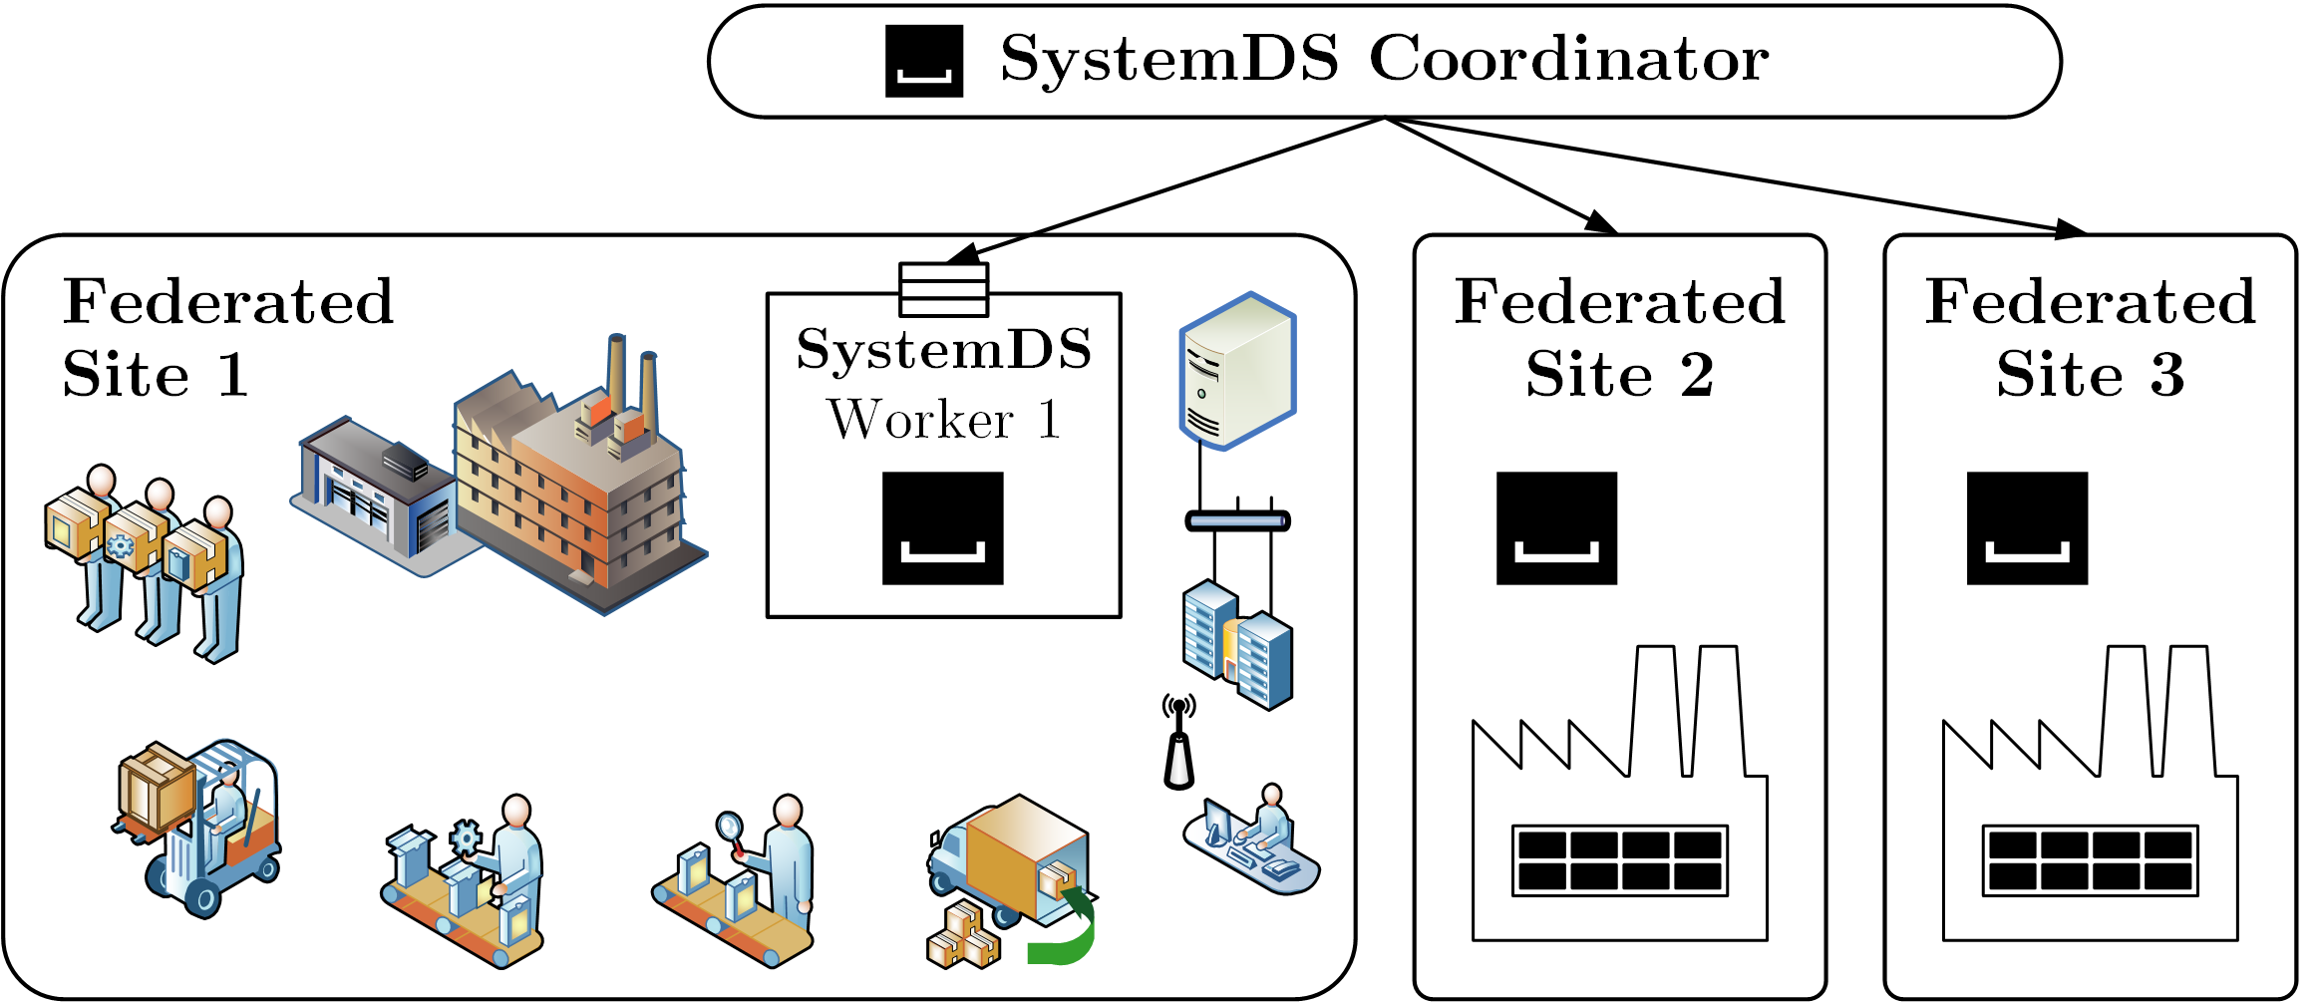
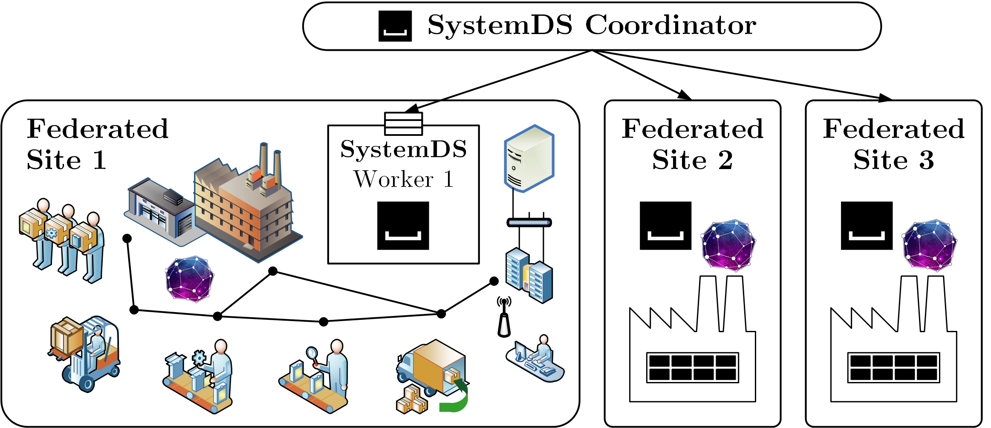
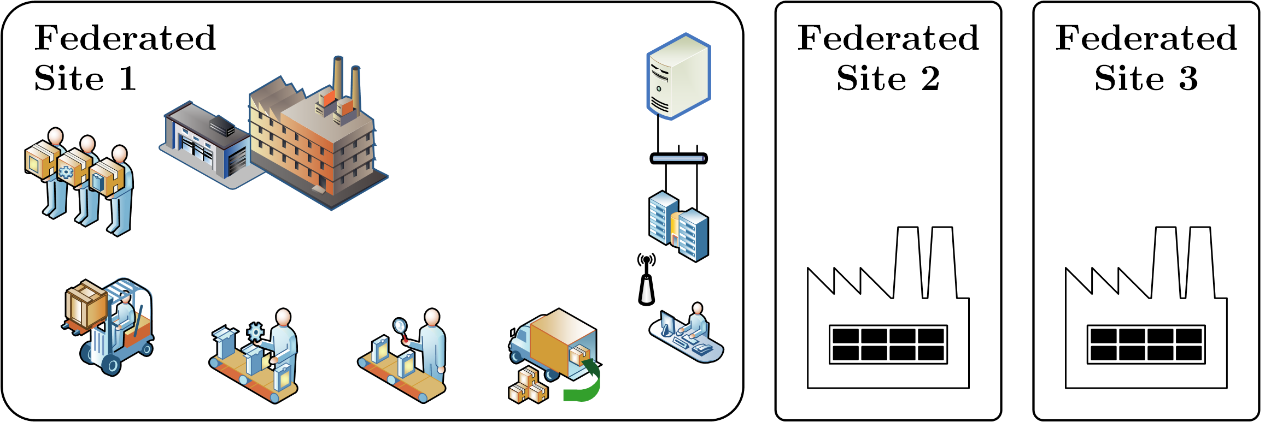
Towards Deployment in Practice
ExDRa not deployed in production yet
Envisioned Deployment: Private Data
Other Deployments: Private Models

Slide 11
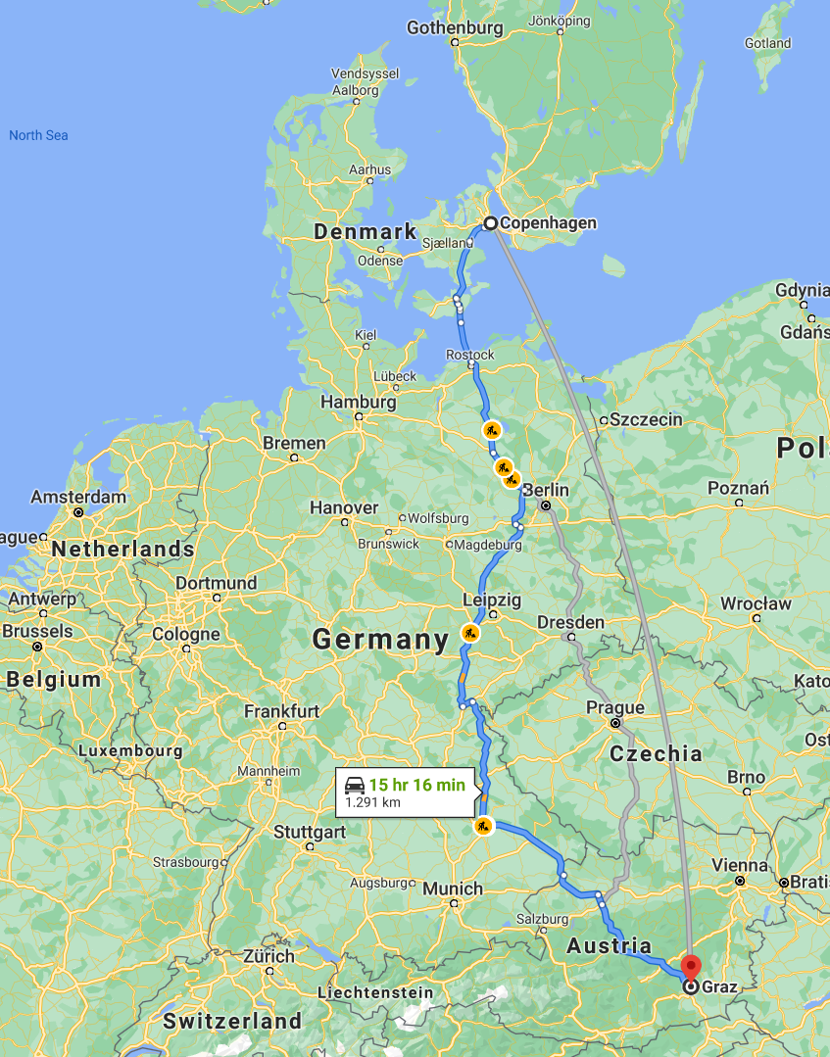
Experiments – Experimental Setting
Cluster Configuration
  Client/servers: 8 nodes of AMD EPYC 7302 CPU at 3.0-3.3GHz (32 vcores),
  128GB DDR4 RAM 2.933 GHz, 2x 480GB SSDs, 12 x 2TB HDDs, 2x 10Gb Eth
  Additional client: Dell XPS 15 w/ Intel i9-9980HK CPU at 2.4−5.0GHz (16 vcores), 32GB DDR4 RAM
  Ubuntu 20.04.01, OpenJDK 1.8.0, SystemDS 2.0.0++
Baselines
  Local: SystemDS with local operations
  Federated LAN: federated runtime in rack-local cluster
  Federated WAN: client in Copenhagen, Denmark
  → cluster in Graz, Austria (35-60ms latency, 1.4-2MB/s)
  Other ML Systems: Scikit-Learn 0.23, TensorFlow 2.3.1
Data
  Synthetic [1M x 1,050], MNIST [60K x 784]

Slide 12
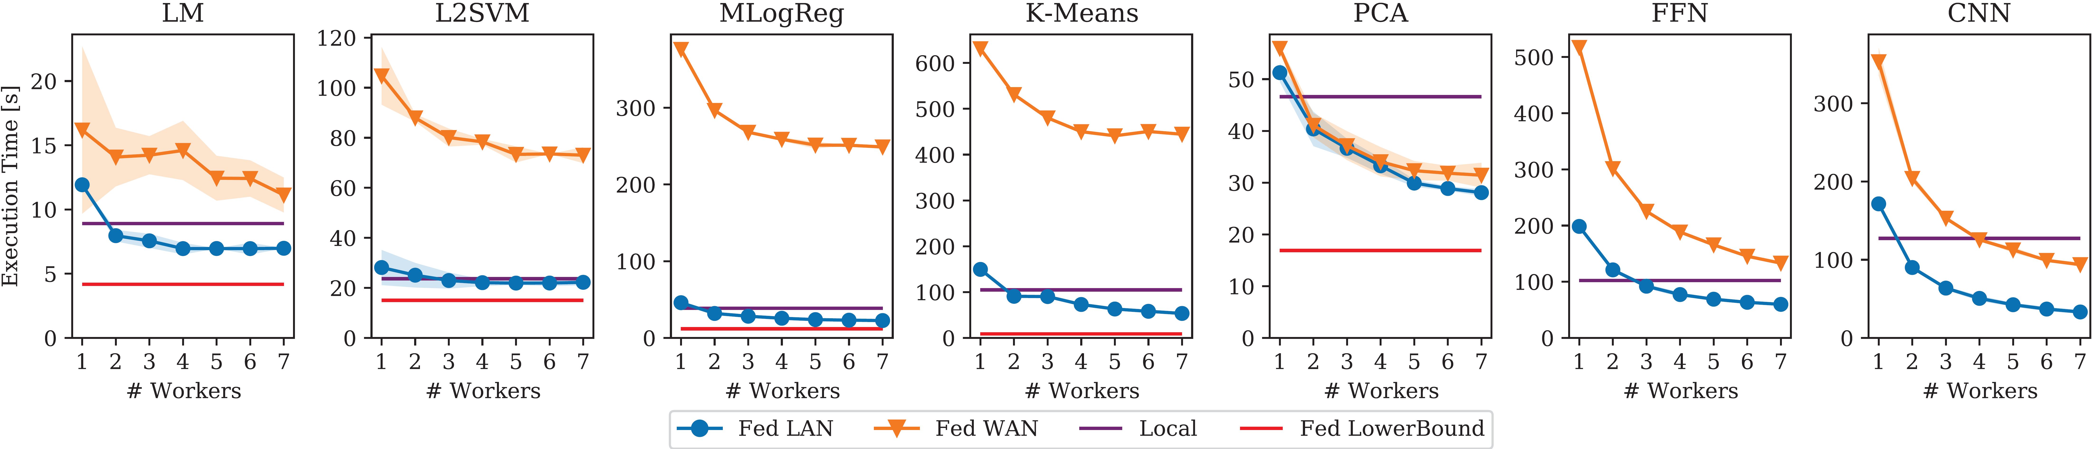
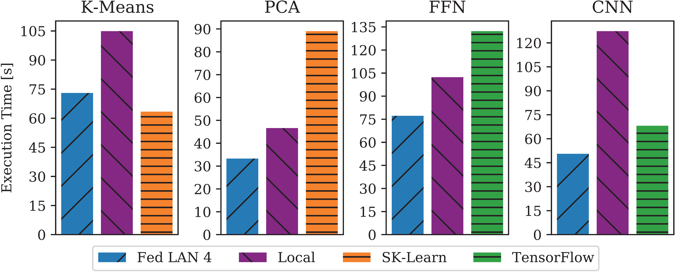
Experiments – ML Algorithms
Workloads and Baselines
  LM: linear regression, conjugate-gradient method
  L2SVM: l2-regularized support vector machine (SVM)
  MLogReg: multinomial (multi-class) logistic regression
  K-Means: Lloyd’s algorithm w/ K-Means++ initialization
  PCA: principal component analysis
  FFN: fully-connected feed-forward network
  CNN: convolutional neural network
Comparisons with
Scikit-learn and TensorFlow

Slide 13
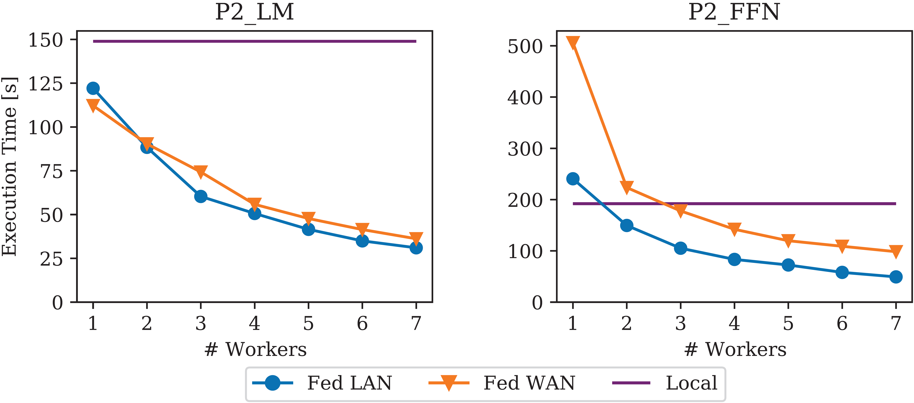
Experiments – Use Case ML Pipelines
Paper Production Pipeline
  Transformencode (recoding, one-hot encoding, pass-through)
  Clipping 1.5 stddev, normalization, train/test splitting
  LM/FFN train, predict, stats summary
Additional Experiments
with SSL Encryption
(Fed WAN SSL) in the paper
→ up to 15% overhead

Slide 14
Summary & Conclusions
Summary
  ExDRa system for exploratory data science on federated raw data
  Federated linear algebra and federated parameter servers
  Small to moderate overhead (via aggregates)
Conclusions
  Federated learning shows great promise for applicability in practice
  Automatic generation of execution plans crucial for reuse
  (data cleaning and preprocessing, ML algorithms, model debugging)
  Federated data nicely generalizes to multi-device settings
Future Work
  Deployment: legal frameworks, business models, trusted system infrastructure
  Generating federated execution plans under privacy constraints
  ML pipelines on raw data & automatic data reorganization
  Privacy enhancing technologies (FHE, MPC, differential privacy)
Available Open Source
https://github.com/apache/systemds
https://www.nebula.stream (soon)

