Slide 1
Optimizing Tensor Computations:
From Applications to Compilation and Runtime Techniques
Matthias Boehm
TU Berlin
Berlin, Germany
Matteo Interlandi
Microsoft GSL
Los Angeles, CA, USA
Chris Jermaine
Rice University
Houston, TX, USA
SIGMOD 2023
Fri Jun 23, 9am – 10.30am
Notes:
Tutorial Type: Survey
Preferred Duration: accepted as 1.5 hours (Jun 23, 8.30am-10.30am -> 2h?)
Target Audience:
Systems researchers and practitioners with basic applied ML background
(we do not expect prior knowledge of state-of-the-art algorithms or system internals)
Hands-on Tutorial: no HW/SW requirements.
Video Recording
Discussion requirement 13min video
Recording of in-person

Slide 2
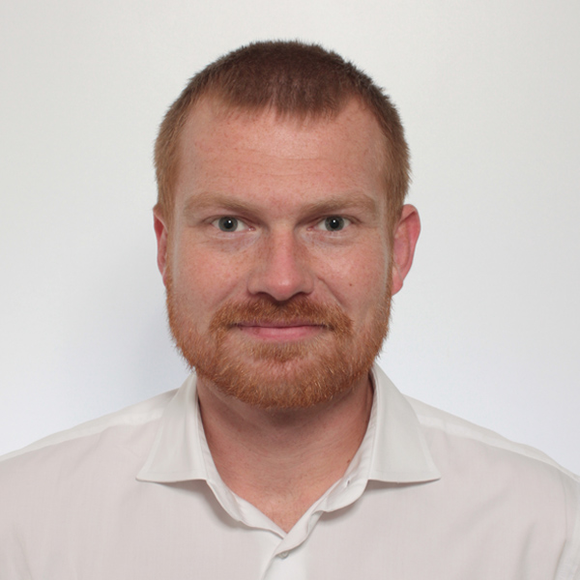
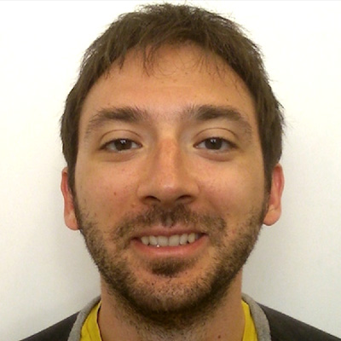
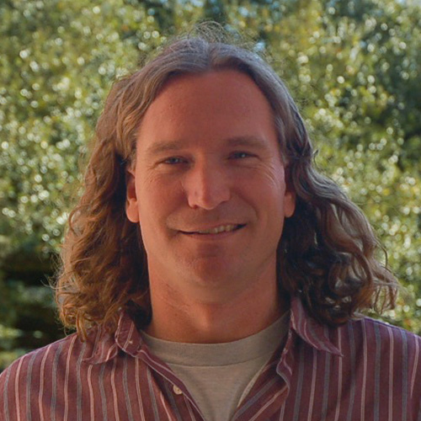







Who We Are
Matthias Boehm
TU Berlin
Berlin, Germany
Matteo Interlandi
Microsoft
Los Angeles, CA, USA
Chris Jermaine
Rice University
Houston, TX, USA
SimSQL, MCDB
TRA
SystemML → SystemDS
Notes:
Tutorial Type: Survey
Preferred Duration: accepted as 1.5 hours (Jun 23, 8.30am-10.30am -> 2h?)
Target Audience:
Systems researchers and practitioners with basic applied ML background
(we do not expect prior knowledge of state-of-the-art algorithms or system internals)
Hands-on Tutorial: no HW/SW requirements.
Video Recording
Discussion requirement 13min video
Recording of in-person

Slide 3
Agenda
A Case for Tensor Computations [15min]
Selected Applications [35min]
  Query Processing and Data Analytics
  Data Science Lifecycle Tasks
  Simulation and Sampling
Selected Runtime Backends [35min]
  Tensor Query Processor (TQP)
  Apache SystemML/SystemDS
  Tensor Relational Algebra

Slide 4
A Case for
Tensor Computations

Slide 5
Motivation: A Historic Perspective
Two Key Drivers of DB Research
  New analysis workloads (NLP, key/value, RDF/graphs,
  documents, time series, ML) and applications
  New HW/infrastructure (multi-/many-core, cloud/serverless,
  scale-up/out, NUMA/HBM, RDMA, SSD/NVM, FPGA/GPU/ASIC)
Past: Waves of General-purpose and Specialized Systems
  Goal #1: Avoid boundary crossing ➔ General-purpose
  Goal #2: New workload + Performance ➔ Specialized systems
  Some Examples
New Workloads
System
New HW/Env
RDF/
graphs
MR/Spark
NLP
OODBMS
XML
Docs
OLAP
Time
ML Systems
RDBMS
OR
Hybrid
JSON Datatype
HTAP
SQL on Hadoop
In-DB alternatives

Slide 6
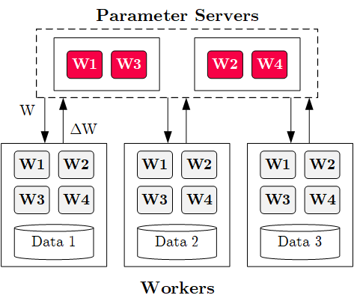
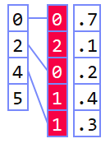

Motivation: Tensor Computations
Present: Narrow Focus (on Mini-batch SGD)
  Increasingly narrow training/inference focus on deep neural networks
  (DNN) mini-batch stochastic gradient descent (SGD)
  Parameter servers and similar distribution strategies
  Communication, security, acceleration primitives for narrow focus
Future: Broader Focus (on General Tensor Computations)
  General linear algebra programs and tensor computations
  Different architectures (parameter servers,
  data- & task-task parallel, hybrid, recursive)
  Wide variety of applications and workload characteristics
graph
dense
sparse
compressed

Slide 7
OLAP Queries / Data Frames / ML Systems
 | DBMS | Data Frames | ML Systems
Language Abstraction | SQL | Relational Algebra ++ | Linear Algebra ++
Workload | Repeated Queries | Explorative Operations | Iterative Algorithms
Infrastructure | Server (but RAWdb, DuckDB) | Stateless library (embedded) | Stateless library (embedded, but Serving)
Optimization | Join ordering, rewrites Phy. op selection Query compilation |  | mmchain opt, rewrites Phy. op selection Operation fusion/codegen
Runtime | Scans, large-small joins, aggregations; vectorization | Coarse-grained frame operations | Coarse-grained tensor operations vectorization / mini-batches
 | Variety of value types |  | Increasing number of specialized value types
Storage | Page layouts w/ SMAs and compression | Arrays, open formats (e.g., Arrow, Parquet) | Dense / sparse / compressed blocks
➔ Increasing Convergence of Optimization and Runtime Techniques

Slide 8
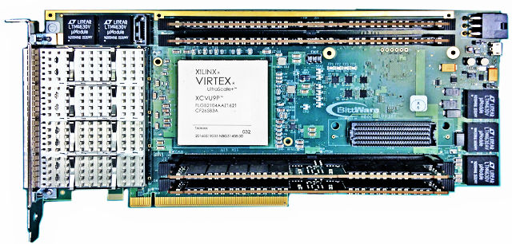
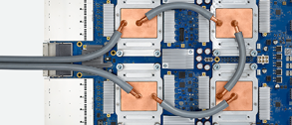
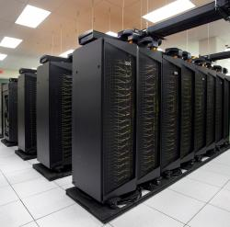
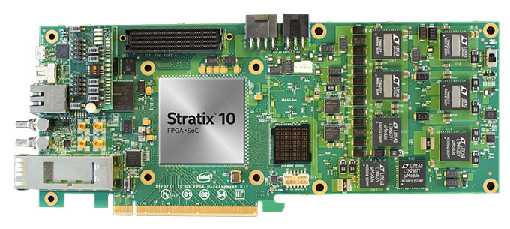
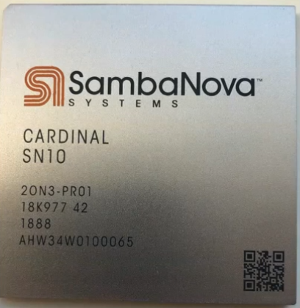
Long-term Benefits
Data Science
Query Processing
Simulation
Sampling
#1 Simplicity
  Coarse-grained frame/matrix/tensor
  data structures and operations
  Reduced system infrastructure complexity
  (boundary crossing)
#2 Reuse of Compiler/Runtime Techniques
  Focused work and reuse of commonly used compiler/runtime techniques
  Generality over hand-crafted specialized systems and algorithms
#3 Performance and Scalability
  Leverage HW Accelerators and distributed runtime backends
  ➔ Increasing specialization and rapid evolution
  Homogeneous arrays and simple parallelization strategies
Tensor Computations
Optimizing Compiler / Runtime
Build Libraries for Tensor Ops on HW X once and reuse

Slide 9
Selected Applications
Query Processing and Data Analytics
Data Science Lifecycle Tasks
Simulation and Sampling
[35 min]

Slide 10

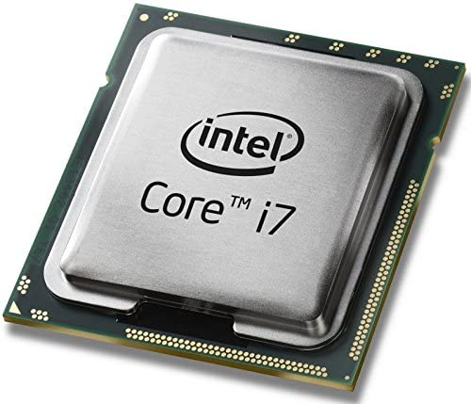

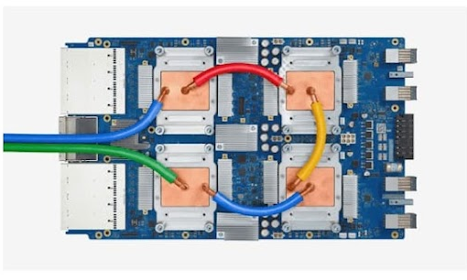


Query Processing and Data Analytics
Neural Networks
Tensor Computation Runtimes
CPU
GPU
TPU
Mobile
Browser
Notes:
The key realization here is that Tensor runtimes such as Pytorch and Tensorflow are the de-facto API for many hardware accelerators. You can use something like Pytorch as basically the front end to run your models over various hardware.
So Pytorch can be used to run over an AMD and Nvida GPU. You don't need new language or compilation framework. If you have it in pytorch, tensorflow, onnx, you can target to any of your backends and custom hardware. No need to do something new.

Slide 11

Query Processing and Data Analytics
TQP
[PVLDB’22]
Neural Networks
Relational (SQL)
Tensor Computation Runtimes
CPU
GPU
TPU
Mobile
Browser
Notes:
The key realization here is that Tensor runtimes such as Pytorch and Tensorflow are the de-facto API for many hardware accelerators. You can use something like Pytorch as basically the front end to run your models over various hardware.
So Pytorch can be used to run over an AMD and Nvida GPU. You don't need new language or compilation framework. If you have it in pytorch, tensorflow, onnx, you can target to any of your backends and custom hardware. No need to do something new.

Slide 12
Query Processing and Data Analytics
TQP
[PVLDB’22]
Hummingbird
[OSDI’22]
Neural Networks
Relational (SQL)
Classical
ML
Tensor Computation Runtimes
CPU
GPU
TPU
Mobile
Browser
Notes:
The key realization here is that Tensor runtimes such as Pytorch and Tensorflow are the de-facto API for many hardware accelerators. You can use something like Pytorch as basically the front end to run your models over various hardware.
So Pytorch can be used to run over an AMD and Nvida GPU. You don't need new language or compilation framework. If you have it in pytorch, tensorflow, onnx, you can target to any of your backends and custom hardware. No need to do something new.

Slide 13
Query Processing and Data Analytics
TQP
[PVLDB’22]
Hummingbird
[OSDI’22]
[PVLDB’21]
Neural Networks
Relational (SQL)
Classical
ML
…
Questions:
How do we represent tabular data as tensors?
How can we map SQL operations into tensor programs?
How can we map traditional ML model into tensor computations?
Tensor Computation Runtimes
CPU
GPU
TPU
Mobile
Browser
Notes:
The key realization here is that Tensor runtimes such as Pytorch and Tensorflow are the de-facto API for many hardware accelerators. You can use something like Pytorch as basically the front end to run your models over various hardware.
So Pytorch can be used to run over an AMD and Nvida GPU. You don't need new language or compilation framework. If you have it in pytorch, tensorflow, onnx, you can target to any of your backends and custom hardware. No need to do something new.

Slide 14
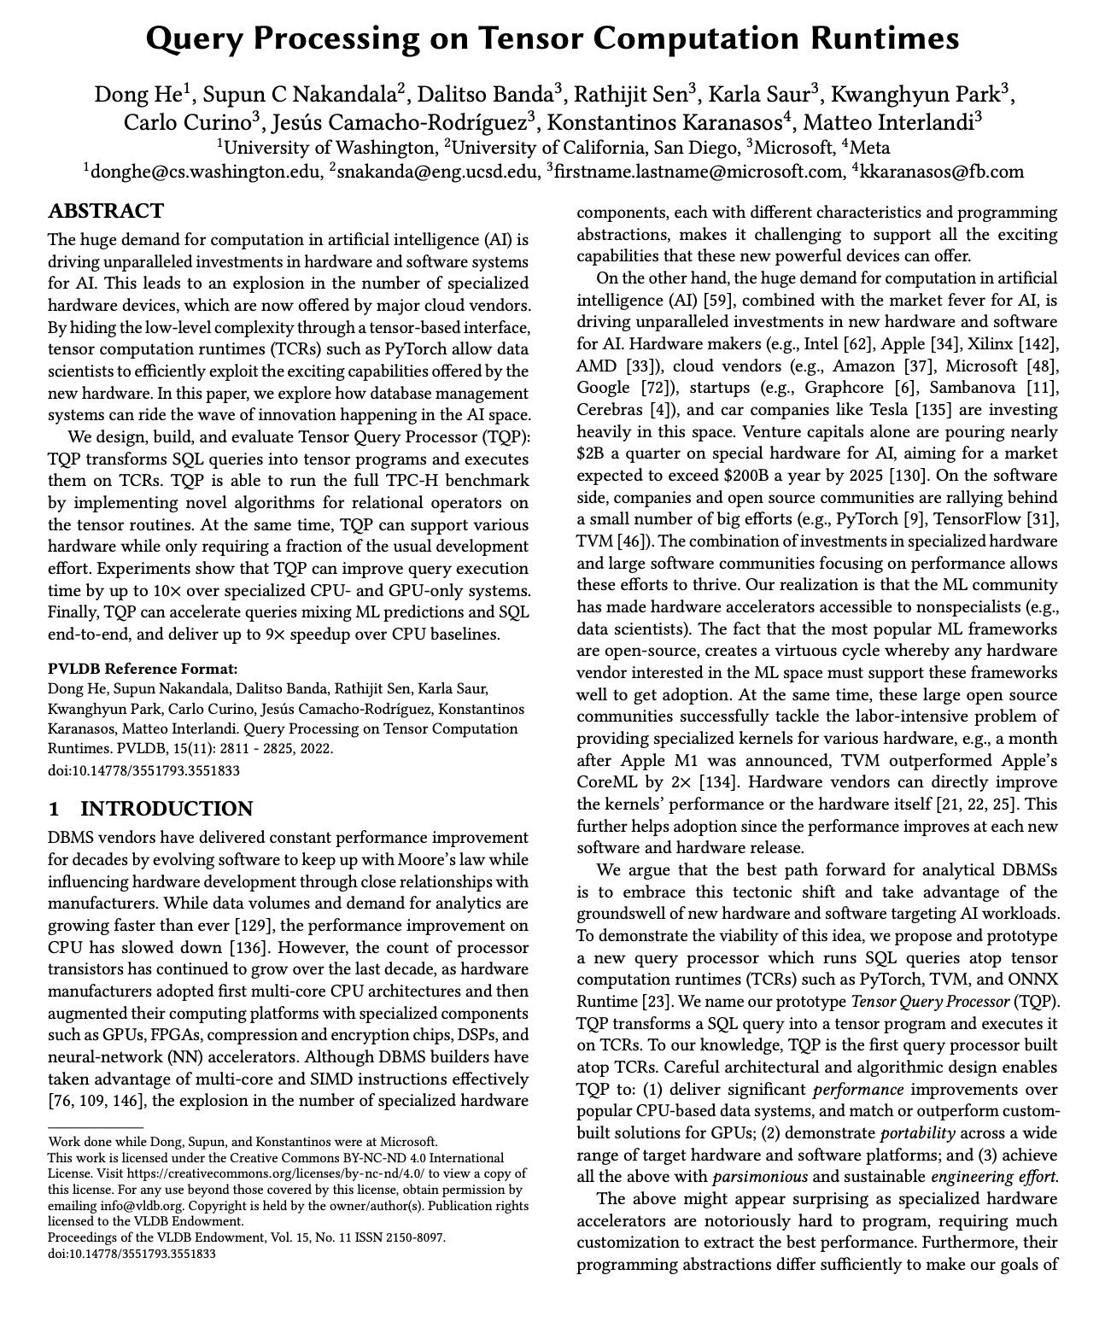
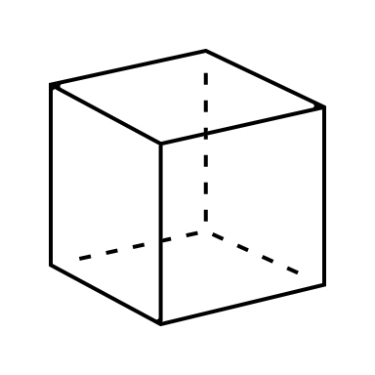

Tensor data representation
TQP
[PVLDB’22]
Numeric as
1-d tensor
Dates as 1-d numeric tensor
Strings as UTF-8
2-d tensor (N x max_len)
Def Tensor:
A multidimensional matrix that is a cornerstone data structure in AI
Sales
saleid
prodid
date
region
1
2
3
4
5
6
7
8
9
10
Notes:
Selection Vector

Slide 15
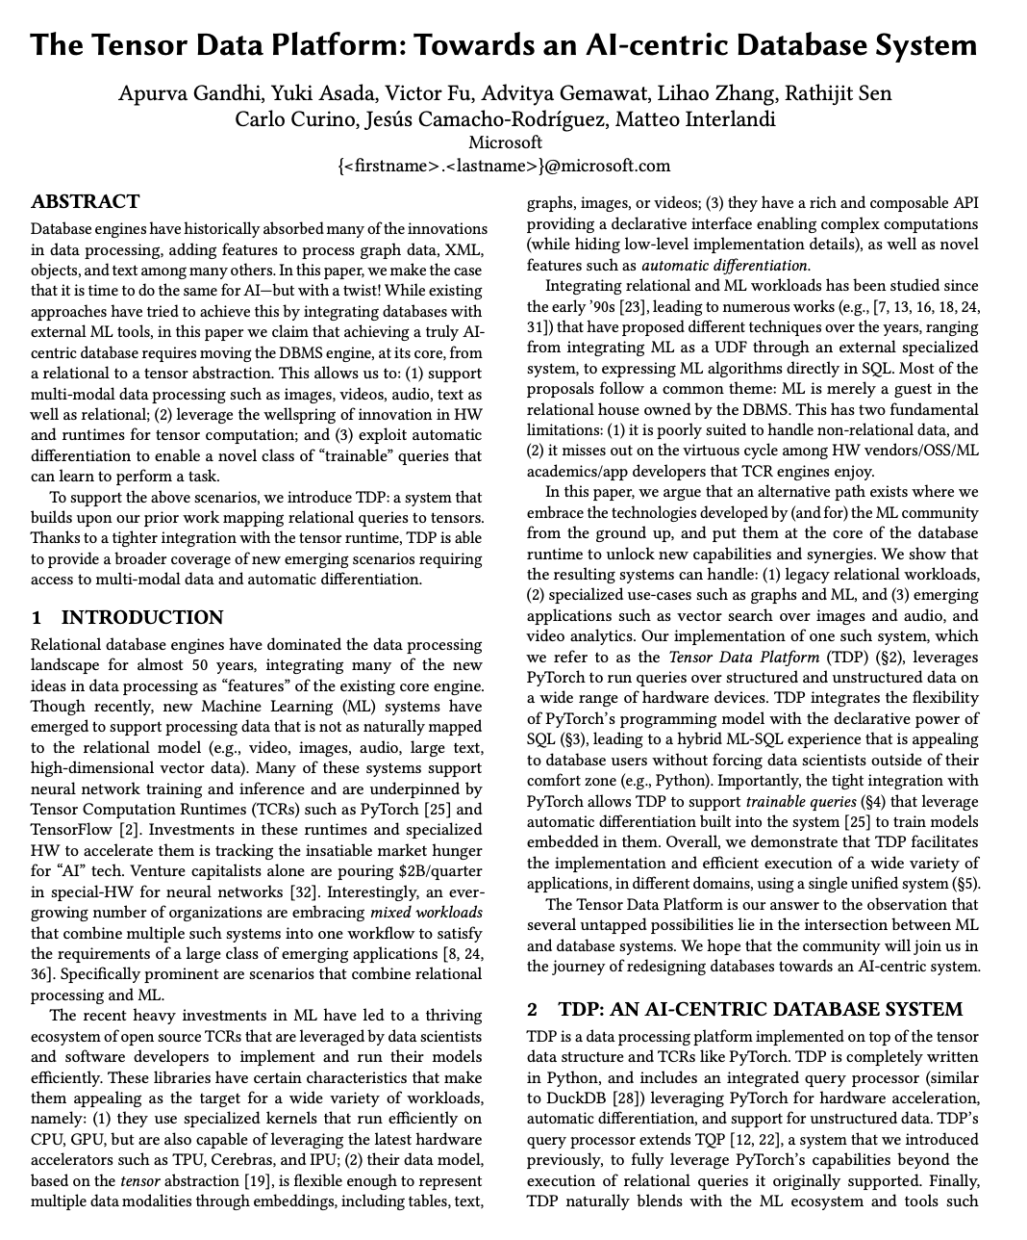
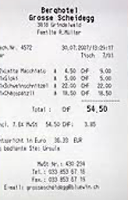
Tensor data representation
TQP
[CIDR’23]
Numeric as
1-d tensor
Dates as 1-d numeric tensor
Strings as UTF-8
2-d tensor (N x max_len)
Images as 3-d tensors
Def Tensor:
A multidimensional matrix that is a cornerstone data structure in AI
Sales
saleid
prodid
date
region
receipt
1
2
3
4
5
6
7
8
9
10
Notes:
Selection Vector

Slide 16
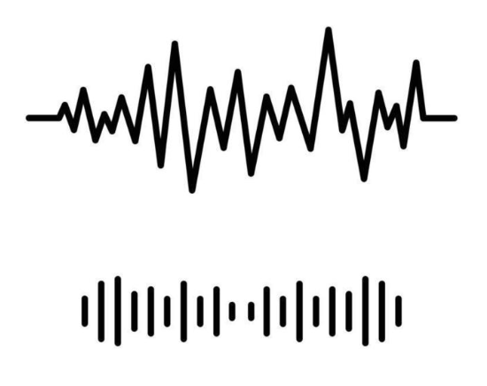
Tensor data representation
TQP
[CIDR’23]
Numeric as
1-d tensor
Dates as 1-d numeric tensor
Strings as UTF-8
2-d tensor (N x max_len)
Images as 3-d tensors
Def Tensor:
A multidimensional matrix that is a cornerstone data structure in AI
Sales
audio as 2-d tensors
Sales
Sales
prodid
comment
prodid
prodid
date
date
date
receipt
receipt
region
receipt
region
saleid
region
saleid
saleid
1
2
3
4
5
6
7
8
9
10
1
2
3
4
5
6
7
8
9
10
1
2
3
4
5
6
7
8
9
10
Notes:
Selection Vector

Slide 17

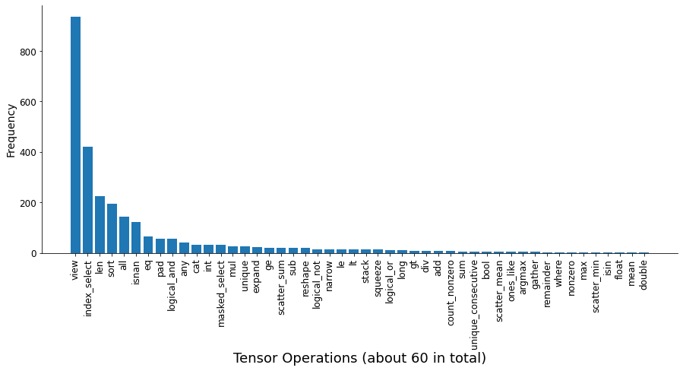
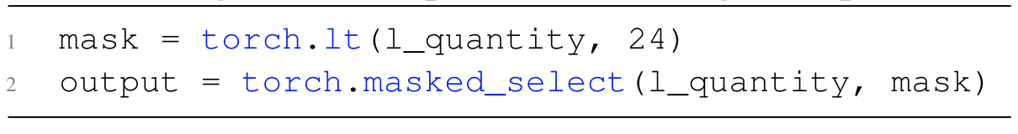
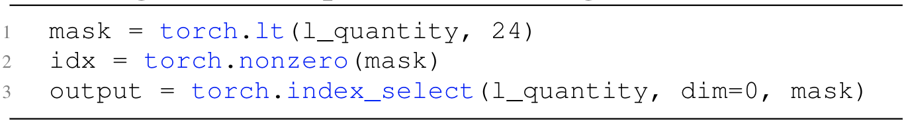

Implementing SQL operators using tensor ops
TQP
[PVLDB’22]
Opt 1:
Opt 2:
Notes:
Selection Vector

Slide 18
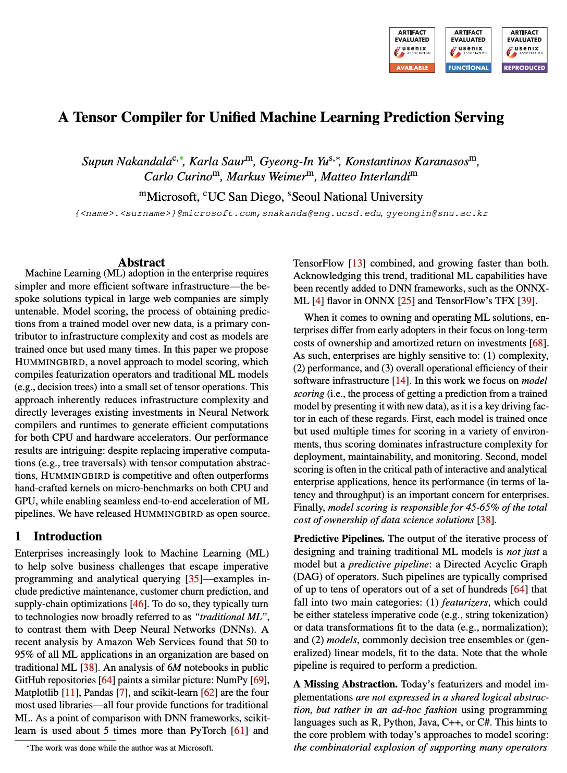





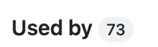
Traditional ML: Prediction Serving
Hummingbird
[OSDI’20]
Traditional ML models are composed by: featurizers and ML models
Each featurizer is defined by an algorithm
  e.g., compute the one-hot encoded version of the input feature
Each trained model is defined by a prediction function
  Prediction functions can be either algebraic (e.g., linear regression) or algorithmic (e.g., decision tree models)
  Algebraic models are easy to translate: just implement the same formula in tensor algebra!

Slide 19






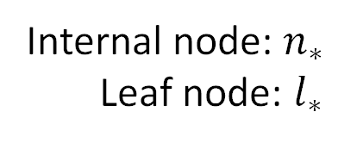








Translating Trees
Hummingbird
[OSDI’20]
$$𝕩∈ℝ^{6}$$
Internal node: $n_{∗}$
Leaf node: $l_{∗}$
$$n_{1}$$
$$𝕩_{3}>5.1$$
T
F
$$n_{2}$$
$$𝕩_{1}>1.8$$
$$n_{4}$$
$$𝕩_{5}>0.4$$
$$n_{3}$$
$$l_{1}$$
10
$$𝕩_{3}>2.4$$
$$l_{4}$$
40
50
$$l_{5}$$
$$l_{2}$$
20
30
$$l_{3}$$

Slide 20



















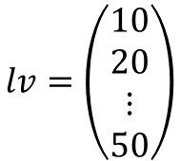


Translating Trees
Hummingbird
[OSDI’20]
$$n_{∗}, l_{∗}∈[0,1]$$
$$𝕩_{1}$$
$$l_{1}$$
$$𝕩∈ℝ^{6}$$
$$+1$$
$$𝕩_{2}$$
$$n_{1}$$
$$n_{1}$$
$$𝕩_{3}>5.1$$
$$+1$$
$$l_{2}$$
$$𝕩_{3}$$
$$n_{2}$$
T
F
$$n_{2}$$
$$𝕩_{1}>1.8$$
$$n_{4}$$
$$𝕩_{5}>0.4$$
$$+1$$
$$l_{3}$$
$$𝕩_{4}$$
$$n_{3}$$
$$n_{3}$$
10
$$𝕩_{3}>2.4$$
40
50
$$𝕩_{5}$$
$$l_{4}$$
$$l_{1}$$
$$l_{4}$$
$$l_{5}$$
$$+1$$
$$n_{4}$$
20
30
$$𝕩_{6}$$
$$l_{5}$$
$$l_{2}$$
$$l_{3}$$
$$lv=\left(\begin{matrix}10 \\ 20 \\ ⋮ \\ 50\end{matrix}\right)$$
$$+1$$
$$b=\left(\begin{matrix}−5.1 \\ −1.8 \\ −2.4 \\ −0.4\end{matrix}\right)$$

Slide 21
Translating Trees
Hummingbird
[OSDI’20]
Evaluate all conditions together
$$n_{∗}, l_{∗}∈[0,1]$$
$$𝕩_{1}$$
$$l_{1}$$
$$𝕩∈ℝ^{6}$$
$$+1$$
$$𝕩_{2}$$
$$n_{1}$$
$$n_{1}$$
$$𝕩_{3}>5.1$$
$$+1$$
$$l_{2}$$
$$𝕩_{3}$$
$$n_{2}$$
T
F
$$n_{2}$$
$$𝕩_{1}>1.8$$
$$n_{4}$$
$$𝕩_{5}>0.4$$
$$+1$$
$$l_{3}$$
$$𝕩_{4}$$
$$n_{3}$$
$$n_{3}$$
10
$$𝕩_{3}>2.4$$
40
50
$$𝕩_{5}$$
$$l_{4}$$
$$l_{1}$$
$$l_{4}$$
$$l_{5}$$
$$+1$$
$$n_{4}$$
20
30
$$𝕩_{6}$$
$$l_{5}$$
$$l_{2}$$
$$l_{3}$$
$$lv=\left(\begin{matrix}10 \\ 20 \\ ⋮ \\ 50\end{matrix}\right)$$
$$+1$$
$$b=\left(\begin{matrix}−5.1 \\ −1.8 \\ −2.4 \\ −0.4\end{matrix}\right)$$

Slide 22
Translating Trees
Hummingbird
[OSDI’20]
Evaluate all conditions together
$$n_{∗}, l_{∗}∈[0,1]$$
$$𝕩_{1}$$
$$l_{1}$$
$$𝕩∈ℝ^{6}$$
$$+1$$
$$𝕩_{2}$$
$$n_{1}$$
$$n_{1}$$
$$𝕩_{3}>5.1$$
$$+1$$
$$l_{2}$$
$$𝕩_{3}$$
$$n_{2}$$
T
F
$$n_{2}$$
$$𝕩_{1}>1.8$$
$$n_{4}$$
$$𝕩_{5}>0.4$$
$$+1$$
$$l_{3}$$
$$𝕩_{4}$$
$$n_{3}$$
$$n_{3}$$
10
$$𝕩_{3}>2.4$$
40
50
$$𝕩_{5}$$
$$l_{4}$$
$$l_{1}$$
$$l_{4}$$
$$l_{5}$$
$$+1$$
$$n_{4}$$
20
30
$$𝕩_{6}$$
$$l_{5}$$
$$l_{2}$$
$$l_{3}$$
$$lv=\left(\begin{matrix}10 \\ 20 \\ ⋮ \\ 50\end{matrix}\right)$$
$$+1$$
$$b=\left(\begin{matrix}−5.1 \\ −1.8 \\ −2.4 \\ −0.4\end{matrix}\right)$$
Evaluate all paths together

Slide 23
DS Lifecycle: Data Cleaning & Deduplication
[Xin Luna Dong, Theodoros Rekatsinas: Data Integration and Machine Learning: A Natural Synergy. SIGMOD 2018]
Key Observation
  State-of-the-art data cleaning based on ML (ML for DI, DI for ML)
  Examples: Data extraction, schema alignment, entity resolution, data validation,
  data cleaning, outlier detection, missing value imputation, semantic type detection,
  data augmentation, feature selection, feature engineering, feature transformations
Outliers
  Winsorizing
  Outlier by standard dev / quantiles
Missing Value Imputation
  Imputation by mean / mode [for MCAR]
  Imputation by mice() [for MAR]
# compute quantiles for lower and upper
ql = quantile(X, 0.05);
qu = quantile(X, 0.95);
# replace values outside [ql,qu] w/ ql and qu
Y = min(qu, max(ql, X));
Train X, y
[Jose Cambronero, John K. Feser, Micah Smith, Samuel Madden: Query Optimization for Dynamic Imputation. PVLDB 2017]
Score
Categorical attr. → classification
Numeric attr. → regression

Slide 24
DS Lifecycle: Data Cleaning & Deduplication, cont.
Entity Resolution Blocking
  Compute word/attribute embeddings + tuple embeddings
  Locality-Sensitive Hashing (LSH) for blocking
  K hash functions h(t) → k-dim hash-code
  L hash tables,
  each k hash functions
Deep Learning for ER
  Automatic representation learning
  from text (avoid feature engineering)
  Leverage pre-trained word embeddings for semantics
  (no syntactic limitations)
  Examples: DeepER, Magellan
[Muhammad Ebraheem et al: Distributed Representations of Tuples for Entity Resolution. PVLDB 2018]
[Saravanan Thirumuruganathan et al. Deep Learning for Blocking in Entity Matching […]. PVLDB 2021]
h1=[-1, 1,1], h2=[ 1,1, 1],
h3=[-1,-1,1], h4=[-1,1,-1],
V %*% H
v[t1]=[0.45,0.8,0.85]
v[t2]=[0.4,0.85,0.75]
[1.2,2.1,-0.4,-0.5]
[1.2,2.0,-0.5,-0.3]
[1,1,-1,-1]
[1,1,-1,-1]
[12]
[12]
Hash bucket
Abs Difference / Hadamard Prod.
Distributed Tuple Repr.

Slide 25

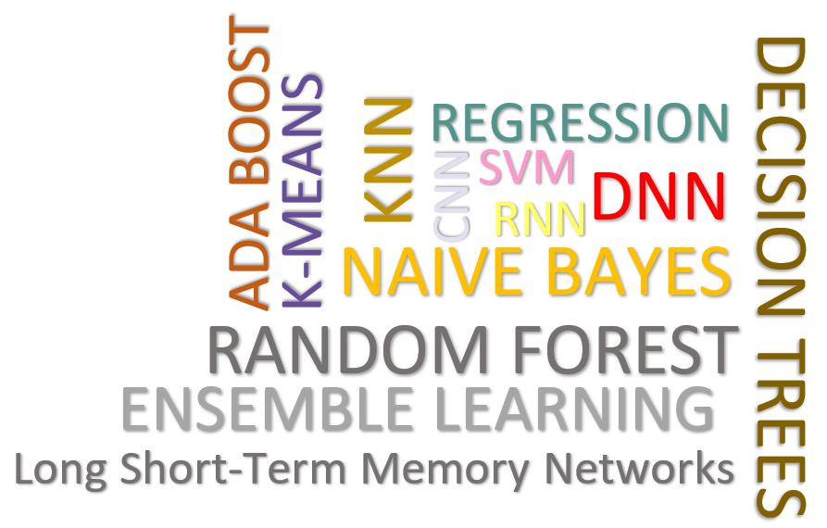
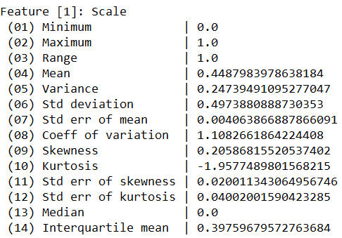
DS Lifecycle: Data Cleaning Pipelines
[SAGA @ SIGMOD’24a]
Automatic Generation of Cleaning Pipelines
  Library of robust, parameterized data cleaning primitives
  Enumeration of DAGs of primitives & hyper-parameter optimization (GA, HB)
Data- and Task-parallel Computation
Data Samples
Logical
O
Physical
LP₁
LP₂
…
LP_{n}
Top-k Pipelines
Target
App
…
…
…
PP₁
PP_{n}
PP₁
PP_{n}
PP₁
PP_{n}
Rules/Objectives
Outlier Detection → MVI → Deduplication → Resolve Mislabels
P_{1:} gmm → imputeFD → mergeDup → delML
P_{n:} outlierBySd→ mice → delDup → voting
Debugging
Other Systems:
BoostClean, HoloClean, Raha-Baran, Learn2Clean,
DiffPrep
University | Country
TU Graz | Austria
TU Graz | Austria
TU Graz | Germany
IIT | India
IIT | IIT
IIT | Pakistan
IIT | India
SIBA | Pakistan
SIBA | null
SIBA | null
University | Country
TU Graz | Austria
TU Graz | Austria
TU Graz | Austria
IIT | India
IIT | India
IIT | India
IIT | India
SIBA | Pakistan
SIBA | Pakistan
SIBA | Pakistan
A | B | C | D
0.77 | 0.80 | 1 | 1
0.96 | 0.12 | 1 | 1
0.66 | 0.09 | null | 1
0.23 | 0.04 | 17 | 1
0.91 | 0.02 | 17 | null
0.21 | 0.38 | 17 | 1
0.31 | null | 17 | 1
0.75 | 0.21 | 20 | 1
null | null | 20 | 1
0.19 | 0.61 | 20 | 1
0.64 | 0.31 | 20 | 1
A | B | C | D
0.77 | 0.80 | 1 | 1
0.96 | 0.12 | 1 | 1
0.66 | 0.09 | 17 | 1
0.23 | 0.04 | 17 | 1
0.91 | 0.02 | 17 | 1
0.21 | 0.38 | 17 | 1
0.31 | 0.29 | 17 | 1
0.75 | 0.21 | 20 | 1
0.41 | 0.24 | 20 | 1
0.19 | 0.61 | 20 | 1
0.64 | 0.31 | 20 | 1
Dirty Data
After imputeFD(0.5)
Dirty Data
After MICE

Slide 26
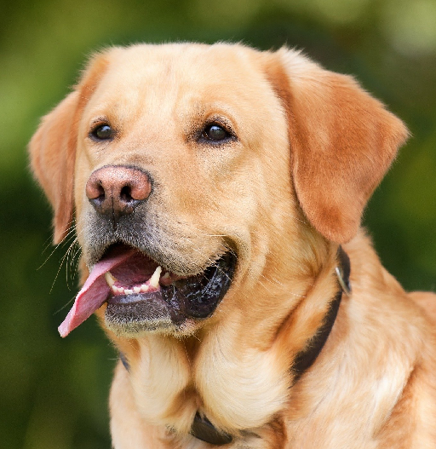
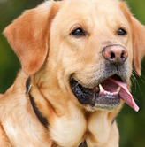
DS Lifecycle: Data Augmentation
[Alex Krizhevsky, Ilya Sutskever, Geoffrey E. Hinton: ImageNet Classification with Deep Convolutional Neural Networks. NIPS 2012]
Data Augmentation Overview
  Complex ML models / deep NNs need lots of
  labeled data to avoid overfitting ➔ expensive
  Augment training data by synthetic labeled data
  #1: Movement/selection
  (translation, rotation, reflection, cropping)
  #2: Distortions (stretching, shearing,
  lens distortions, color, mixup of images)
  ➔ Clean mapping to linear algebra operations
Effects of Data Augmentation
  #1 Regularization for reduced generalization error, not always training error
  #2 Invariance increase by averaging features of augmented data points
  ➔ Data Augmentation as a Kernel
    Kernel metric for augmentation selection
    Affine transforms on approx. kernel features
AlexNet
[Tri Dao, Albert Gu, Alexander Ratner, Virginia Smith, Chris De Sa, Christopher Ré: A Kernel Theory of Modern Data Augmentation. ICML 2019]

Slide 27
DS Lifecycle: Graph Processing
[[SIGMOD’10,
SIGMOD’20 Test of Time]
Connected Components
  Compute connected
  components (subgraphs)
  Vertex-centric processing
  Propagate max(current, msgs)
  if != current to neighbors, terminate if no msgs
Connected Components
in Linear Algebra
Other Examples
  Page Rank, Shortest Paths
Step 3
converged
Step 0
Step 1
Step 2
1
4
4
2
3
4
3
4
4
4
5
4
7
4
7
7
6
7
7
7
7
# initialize state with vertex ids
c = seq(1,nrow(G));
diff = Inf; iter = 1;
# iterative computation of connected components
while( diff > 0 & (maxi==0 | iter<=maxi) ) {
u = max(rowMaxs(G * t(c)), c);
diff = sum(u != c)
c = u; # update assignment
iter = iter + 1;
}

Slide 28
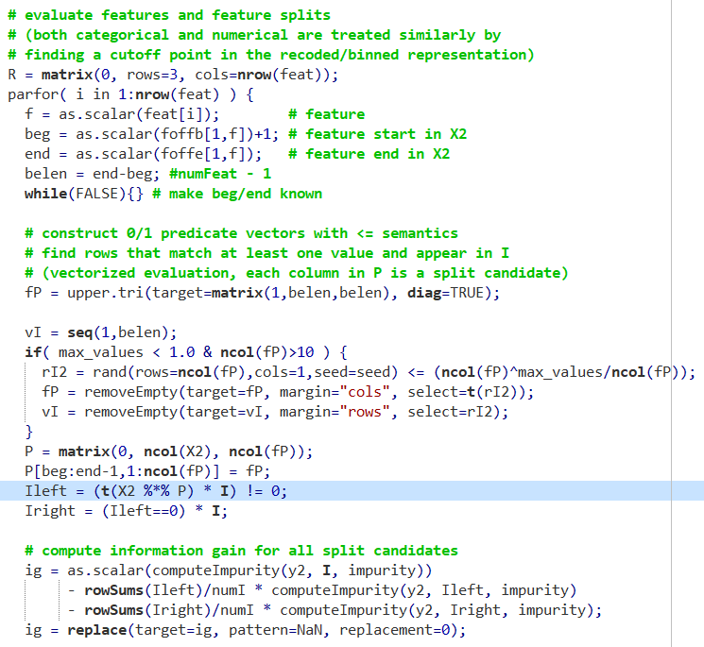
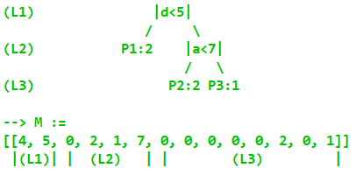
DS Lifecycle: Training Decision Trees
0 0 0 0 0 0 0
0 0 0 0 0 0 0
0 0 0 0 0 0 0
0 0 0 1 1 1 1
0 0 0 0 1 1 1
0 0 0 0 0 1 1
0 0 0 0 0 0 1
Feature Matrix X2
1 0 0 0 1 0 0
0 0 1 0 0 1 0
0 0 1 0 1 0 0
0 1 0 1 0 0 0
1 0 0 1 0 0 0
0 1 0 0 0 1 0
0 1 0 0 0 0 1
1 0 0 1 0 0 0
0 1 0 0 1 0 0
1 0 0 0 0 0 1
0 0 1 0 0 1 0
0 0 1 0 0 0 1
0 1 1 1
0 0 1 1
0 1 1 1
1 1 1 1
1 1 1 1
0 0 1 1
0 0 0 1
1 1 1 1
0 1 1 1
0 0 0 1
0 0 1 1
0 0 0 1
Input: X (recoded/binned)
Main Algorithm
Output:
linearized
tree
Task-parallel over features
X2 = encode(X);
while( length(queue) > 0 ) {
node0 = remove(queue, 1);
[...] = findBestSplit(X2, ...)
if( validSplit )
M[, 2*nID-1:2*nID] <- (f,v);
else
M[,2*nID] = labelLeaf(…);
putInQueueCond(ILeft);
putInQueueCond(IRight); }
Optional value sampling O(log m)
Vectorized <= split evaluation (matmult)
Vectorized information gain computation

Slide 29


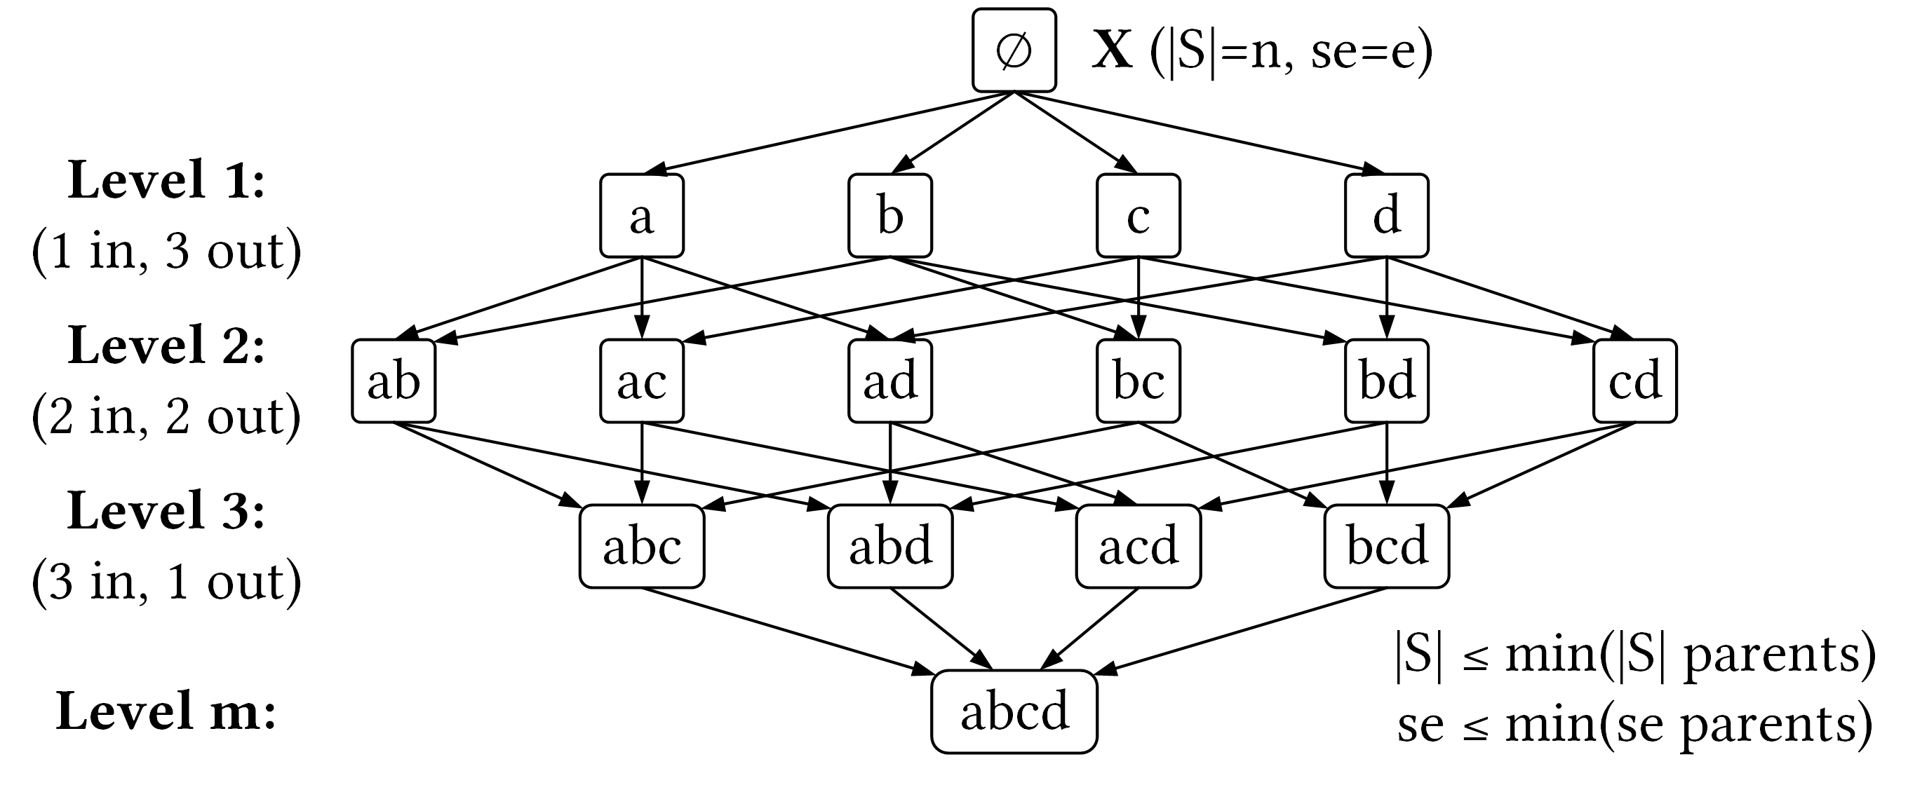
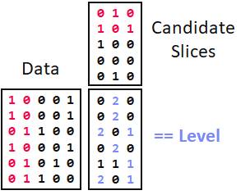
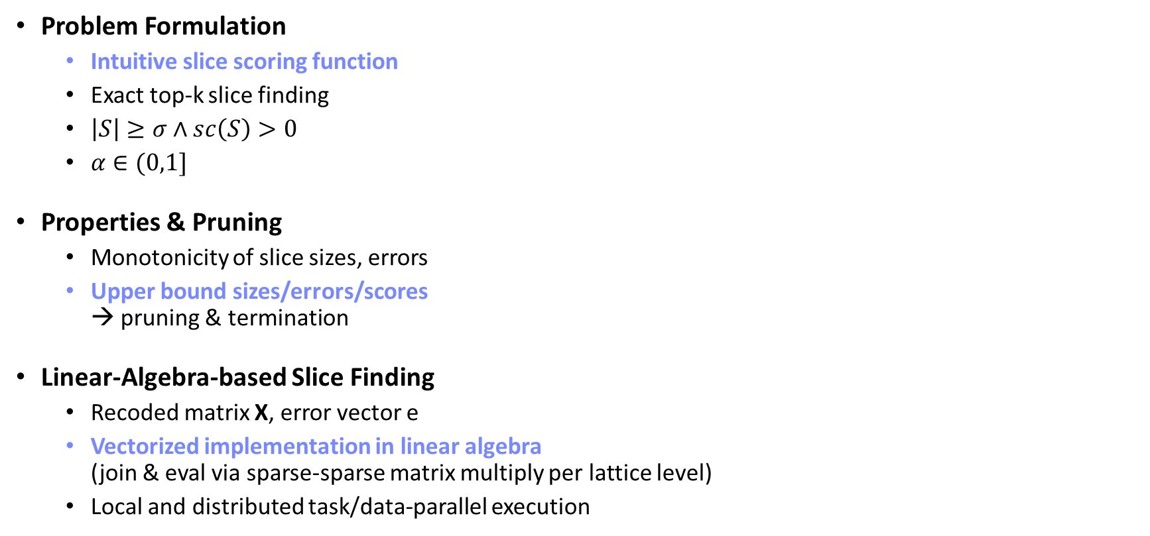
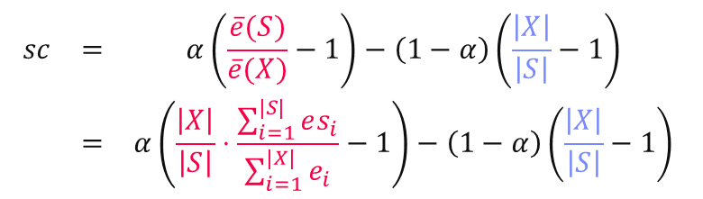
DS Lifecycle: Model Debugging
[SliceLine @ SIGMOD’21c]
[Credit: sliceline,
Silicon Valley, HBO]
$$\begin{matrix}sc & = & α\left(\frac{\overline{e}(S)}{\overline{e}(X)}−1\right)−\left(1−α\right)\left(\frac{\left|X\right|}{\left|S\right|}−1\right) \\ & = & α\left(\frac{\left|X\right|}{\left|S\right|}⋅\frac{\sum_{i=1}^{|S|}{es_{i}}}{\sum_{i=1}^{|X|}{e_{i}}}−1\right)−\left(1−α\right)\left(\frac{\left|X\right|}{\left|S\right|}−1\right)\end{matrix}$$
Problem Formulation
  Intuitive slice scoring function
  Exact top-k slice finding
  $\left|S\right|≥σ∧sc\left(S\right)>0$
  $α∈(0,1]$
Properties & Pruning
  Monotonicity of slice sizes, errors
  Upper bound sizes/errors/scores
  → pruning & termination
Linear-Algebra-based Slice Finding
  Recoded matrix X, error vector e
  Vectorized implementation in linear algebra
  (join & eval via sparse-sparse matrix multiply per lattice level)
  Local and distributed task/data-parallel execution
slice error
slice size

Slide 30
Fairness and Explainability
Fairness Problem Formulation
  A fairness specification given by a triplet (g, f, 𝜀) induces
  (|g(D)|choose 2) fairness constraints on pairs of groups
  A fairness specification is satisfied by a classifier ℎ on 𝐷 iff all
  induced fairness constraints are satisfied, i.e., ∀gi,gj ∈ g(D), |f(h,gi)−f(h,gj)| ≤ 𝜀
  Unconstrained
  optimization problem
Explainability via LIME
  Sample perturbations of prediction input
  (e.g., hide parts of image, attribute values)
  Locally weighted regression
[H. Zhang et al: OmniFair: A Declarative System for Model-Agnostic Group Fairness in Machine Learning, SIGMOD 2021]
max accuracy
s.t. fairness
max accuracy
+ fairness
Loss Function
Regularizer
[Marco Túlio Ribeiro, Sameer Singh, and Carlos Guestrin: Why Should I Trust You?: Explaining the Predictions of Any Classifier, KDD 2016]
Linear Models
Local Kernel

Slide 31
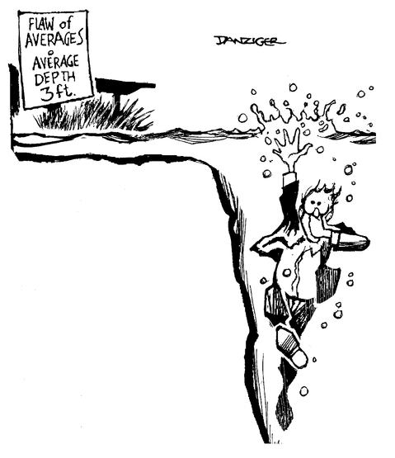

Sampling and Simulations
Classical data analysis assumes database data are correct
  Ex: I have a customer c who places an order x_{c}
  x_{c}[i] represents the dollars spent on the ith inventory item purchased
  We would typically assume that the x_{c}[i] value recorded in a database reflects reality
  But does it always? No!
  Can we afford to ignore the possibility x_{c}[i] is incorrect?
Even if correct on average, can’t afford to ignore the implications of the extremes…
Flaw of Averages
[Savage09]

Slide 32
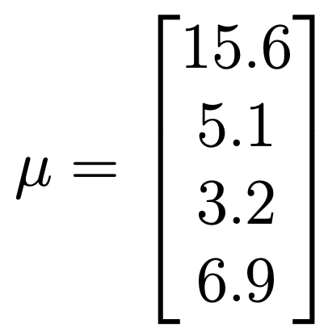
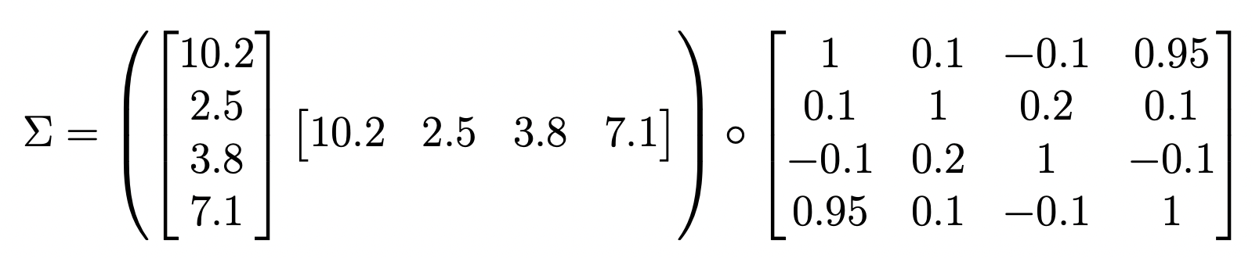
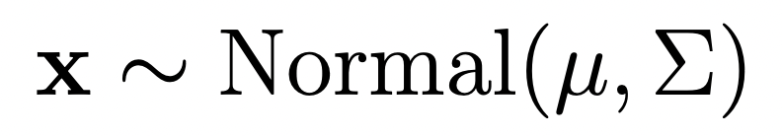
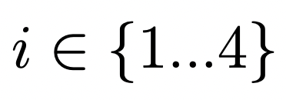
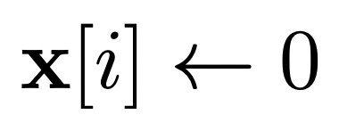
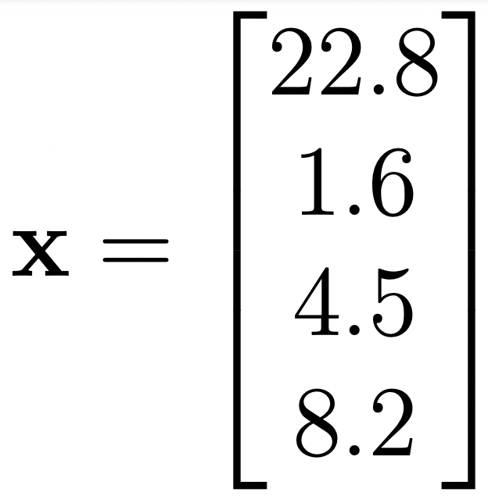
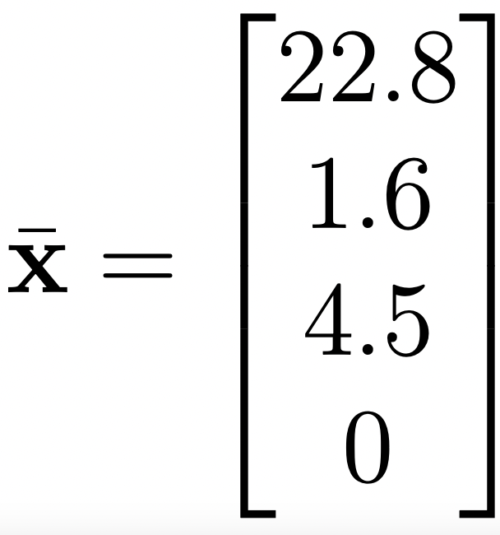

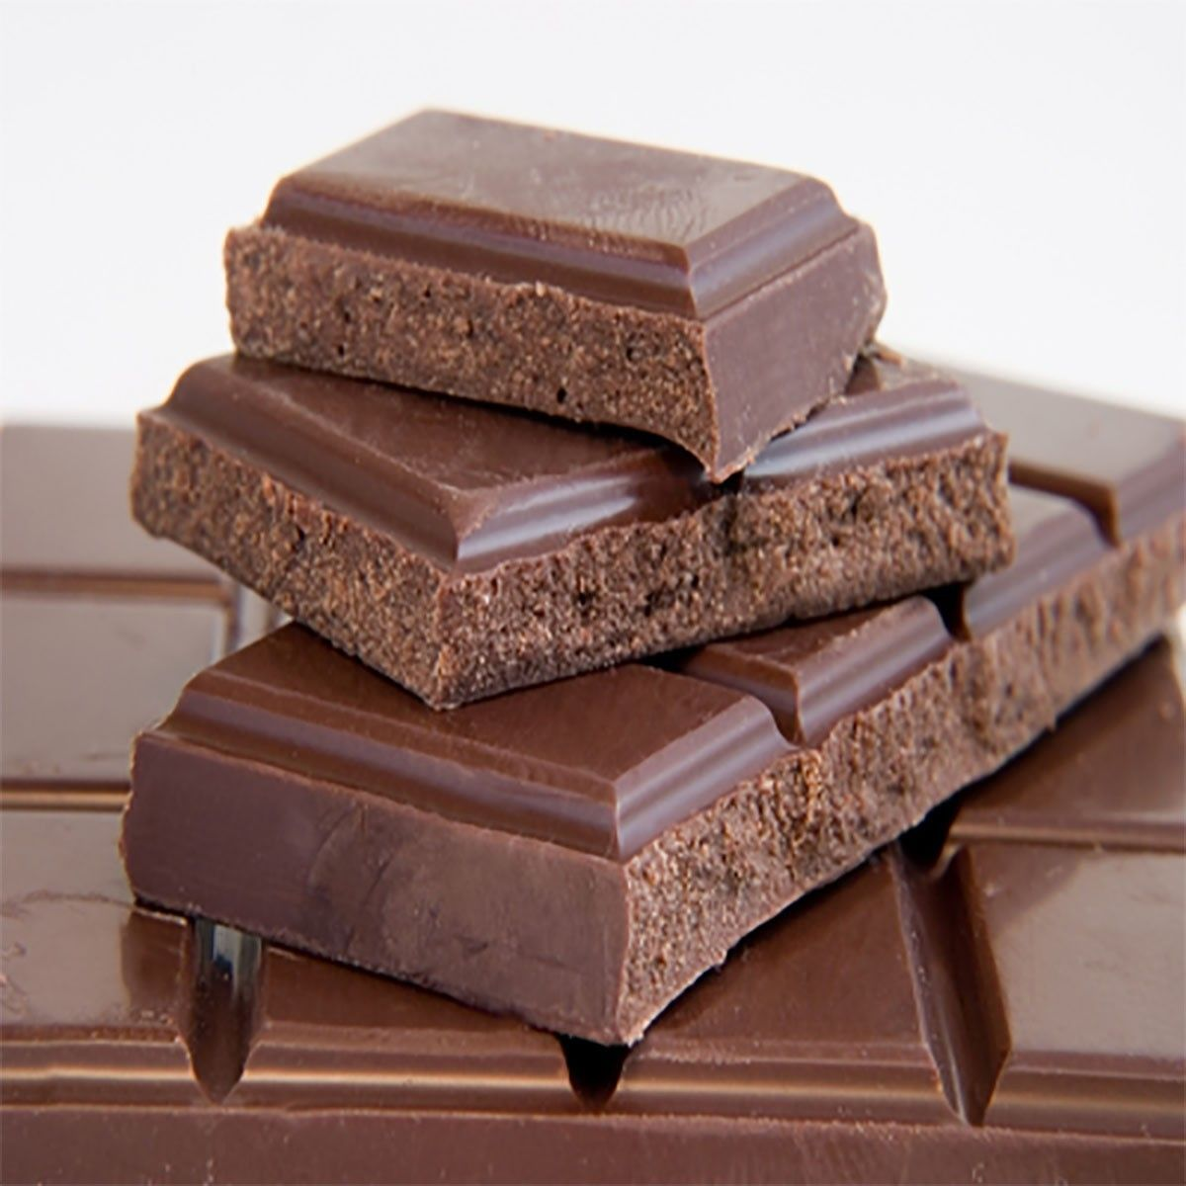
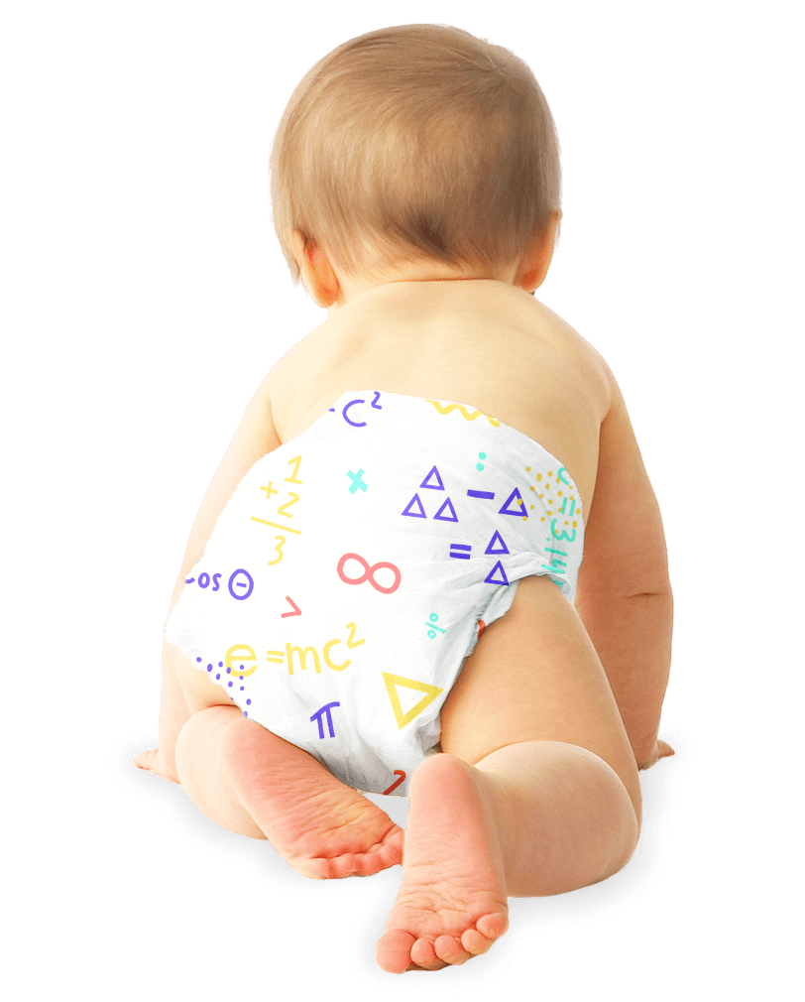

To Quantify Risk: Use a Statistical Model
Mean vector: gives average purchase $$ for this customer
Strong correlation between
Item 1 and item 4
To generate a purchase vector:
Sample
For
With probability 0.2
Covariance matrix: gives correlations in purchase $$ for this customer
Vector of std devs
Correlation matrix
Simulates the case where the 8.2 was never recorded

Slide 33

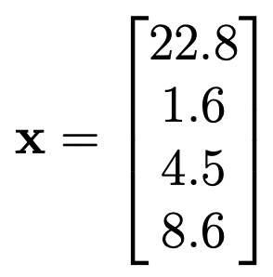
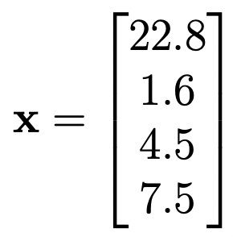
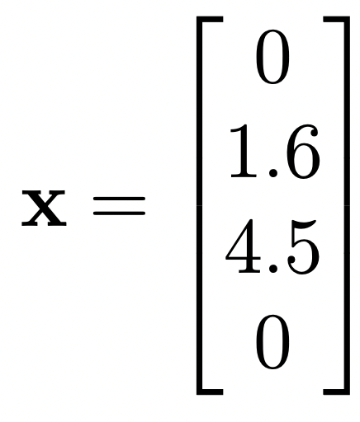
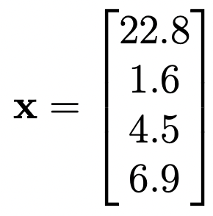
Given Such a Model
We can look at an observed purchase vector and “correct” it
  The first entry is high (22.8 vs mean of 15.6)
  But the last entry is low (0 vs mean of 6.9)
  How is this possible with a correlation of 0.95?
  According to our model: most likely the 0 is wrong
  But we don’t know the correct vector
  Go Bayesian! Use Bayes’ rule to sample from
Typically using MCMC

Slide 34
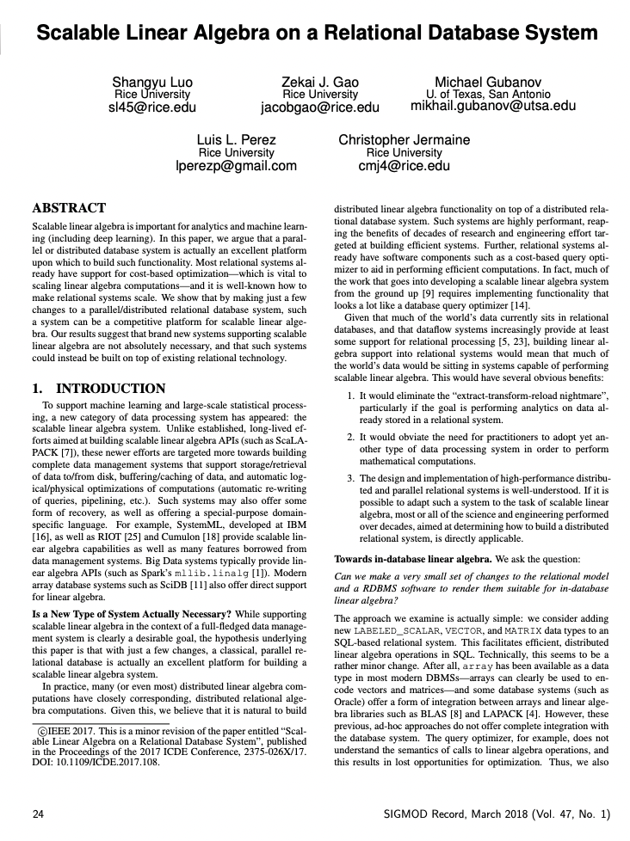
How to Facilitate in a Database?
Need the ability to move from relations to tensors
  Math uses tensors (vectors, matrices, etc.), not relations!
And the ability to sample random values from distributions
Assume sales data are stored relationally:
sale (cust_id, sale_date, prod_id, amt)
Agg function to create a vector from (int, numerical) pairs; the int is the dim
First step, transform into vectors:
CREATE VIEW vecs AS
SELECT VECTORIZE (label_scalar (prod_id, amt))
AS sale_vec, cust_id, sale_date
FROM sale
GROUP BY cust_id, sale_date
Creates a tuple of type (int, numerical)
Linear Algebra on an RDBMS
[ICDE17]

Slide 35
Now We Have a Set of Vectors
Compute observed mean and covariance on a per-customer basis
  Will serve as an empirical prior for each customer
  So-called “empirical Bayes”
We now have a view containing sales vectors
vecs (sale_vec, cust_id, sale_date)
And now one that has the empirical covariance matrix:
CREATE VIEW covers AS
SELECT AVG (outer_product (v.sale_vec - m.avg_sale,
v.sale_vec - m.avg_sale)) AS covar, v.cust_id
FROM vecs AS v, means AS m
WHERE v.cust_id = m.cust_id
GROUP BY v.cust_id
It’s easy to create a table having the mean vector for each customer:
CREATE VIEW means AS
SELECT AVG (sale_vec) AS avg_sale, cust_id
FROM vecs
GROUP BY cust_id

Slide 36

We Are Ready To Create a Simulated Table
Invoke a special UDF called a “VG function”
  In our case, ResampleVec encapsules an MCMC algorithm to “fix” sales vector
MCDB
[SIGMOD08]
Here are the views we’ve created:
vecs (sale_vec, cust_id, sale_date)
means (avg_sale, cust_id)
covars (covar, cust_id)
Now, queries over this simulated table return a distribution of results. Ex:
SELECT AVG (s.value)
FROM simulated_sales s, cust c
WHERE s.cust_id = c.cust_id AND
c.region = ‘northeast’ AND
s.sale_date = ‘12-23-22’
VG function accepts old vec
It’s easy to create a table having the mean vector for each cust:
CREATE TABLE simulated_sales AS
FOR EACH v IN vecs
WITH sale_vec AS ResampleVec (v.sale_vec,
(SELECT m.avg_sale FROM means AS m WHERE m.cust_id = v.cust_id),
(SELECT c.covar FROM covars AS c WHERE c.cust_id = v.cust_id))
SELECT v.cust_id, v.sale_date, s.value
FROM sale_vec s
Subquery to get the mean
For each sale, use VG function to sample new vec
ResampleVec is a VG function that simulates the sale
Subquery to get the covariance
Then stitch together output tuples

Slide 37

Stochastic Simulations
SimSQL
[SIGMOD13]
Can use these tools to build database-valued Markov chains
  Faciltates very large scale Bayesian machine learning
  Can illustrate with a toy example
Simulate the transitions out of each city:
CREATE TABLE transitions[i] (next_pos) AS
FOR EACH c in city
WITH next_pos AS Multinomial (
(SELECT l.cur_loc[c.city_id]
FROM locations[i - 1] AS l),
c. transition_probs)
SELECT n.value
FROM next_pos s
And aggregate over all of the source cities to find the number of people in each destination:
CREATE TABLE locations[i] AS
SELECT SUM (next_pos)
FROM transitions[i]
Initialize the simulation:
CREATE TABLE locations[0] (cur_loc) AS
SELECT * FROM people
This table has a single tuple:
people (start_loc)
This table has info on cities:
city (city_id, transition_probs)
Vector where start_loc[i] tells us how many people are currently located at city i
Vector where transition_probs[i] tells us probability of transitioning from city_id to city i
Goal: implement a simple Markov chain that has people moving from city to city accorging to the specified probabilities
Note how use of vectors makes this quite simple!

Slide 38
References
[SIGMOD'24] Shafaq Siddiqi, Matthias Boehm: Saga: A Scalable Framework for Optimizing Data Cleaning Pipelines for Machine Learning Applications, SIGMOD 2024
[SIGMOD'23] Peng Li, Zhiyi Chen, Xu Chu, Kexin Rong: DiffPrep: Differentiable Data Preprocessing Pipeline Search for Learning over Tabular Data, SIGMOD 2023
[PVLDB'22] Dong He, Supun Chathuranga Nakandala, Dalitso Banda, Rathijit Sen, Karla Saur, Kwanghyun Park, Carlo Curino, Jesús Camacho-Rodríguez, Konstantinos Karanasos, Matteo Interlandi: Query Processing on Tensor Computation Runtimes. Proc. VLDB Endow. 15(11): 2811-2825 (2022)
[PVLDB'21] Saravanan Thirumuruganathan, Han Li, Nan Tang, Mourad Ouzzani, Yash Govind, Derek Paulsen, Glenn Fung, AnHai Doan: Deep Learning for Blocking in Entity Matching: A Design Space Exploration. Proc. VLDB Endow. 14(11): 2459-2472 (2021)
[SIGMOD'21] Hantian Zhang, Xu Chu, Abolfazl Asudeh, Shamkant B. Navathe: OmniFair: A Declarative System for Model-Agnostic Group Fairness in Machine Learning. SIGMOD 2021
[SIGMOD’21] Svetlana Sagadeeva, Matthias Boehm: SliceLine: Fast, Linear-Algebra-based Slice Finding for ML Model Debugging. SIGMOD Conference 2021: 2290-2299
[OSDI'20] Supun Nakandala, Karla Saur, Gyeong-In Yu, Konstantinos Karanasos, Carlo Curino, Markus Weimer, Matteo Interlandi: A Tensor Compiler for Unified Machine Learning Prediction Serving. OSDI 2020
[ICML'19] Tri Dao, Albert Gu, Alexander Ratner, Virginia Smith, Chris De Sa, Christopher Ré: A Kernel Theory of Modern Data Augmentation. ICML 2019
[PVLDB'18] Muhammad Ebraheem, Saravanan Thirumuruganathan, Shafiq R. Joty, Mourad Ouzzani, Nan Tang: Distributed Representations of Tuples for Entity Resolution. PVLDB 2018
[SIGMOD'18] Xin Luna Dong, Theodoros Rekatsinas: Data Integration and Machine Learning: A Natural Synergy. SIGMOD 2018
[PVLDB'17] José Cambronero, John K. Feser, Micah J. Smith, Samuel Madden: Query Optimization for Dynamic Imputation. PVLDB 2017
[KDD'16] Marco Túlio Ribeiro, Sameer Singh, Carlos Guestrin: "Why Should I Trust You?": Explaining the Predictions of Any Classifier. KDD 2016
[NeurIPS'12] Alex Krizhevsky, Ilya Sutskever, Geoffrey E. Hinton: ImageNet Classification with Deep Convolutional Neural Networks. NeurIPS 2012
[SIGMOD'10] Grzegorz Malewicz, Matthew H. Austern, Aart J. C. Bik, James C. Dehnert, Ilan Horn, Naty Leiser, Grzegorz Czajkowski: Pregel: a system for large-scale graph processing. SIGMOD 2010

Slide 39
Selected Runtime Backends
Tensor Query Processor (RDBMS→MLSys)
Apache SystemDS (MLSys)
Tensor Relational Algebra (MLSys → RDBMS)
[35 min]

Slide 40




SQL to Tensor conversion: Tensor Query Processor (TQP)
TQP
[PVLDB’22]
SQL Query
Parser and Optimizer
Spark SQL Query Plan
Sort Operator
Converter
Primitive-based IR (PIR)
Sort PIR Operator
conversion time in the 10s of milliseconds
(w\o Spark parsing and optimization time)
Tensor program for Sort
Tensorizer
Tensor program for Join
Tensor program
…
Tensor program for Filter
Data
Ingestion
Executor
Hardware
CPU
AMD GPU
NVIDA GPU
Notes:
Of course the answer is yes, and this is what we call Tensor query processor. So TQP gets as input a SQL queries, it parses and optimizes into a query plan, and then it maps each sql operator in the query plan into a tensor program. So at the end of the conversion and tensorization process, we basically have as output a pytorch program that implements the input SQL query. So since now we are in pytorch land, we can run the SQL query on any HW supported by pytorch.
One surprising thing is that TQP can support the full TQP benchmark with only 20000 lines of python code.

Slide 41

Pros and Con of Tensor Query Processor
Pro:
Scalable Approach (no need to reimplement the query processor for each new hardware)
Leverage the massive investments in special HW
Low engineering effort: TQP + HB in 20k lines of Python code
Great performance
>70X
>30X
2.2s
4x
*
Limitations:
Can only target devices supported by PyTorch (e.g., no Xbox)
Sub-operators require many data materializations
Cannot take advantage of advanced neural network compilers techniques (e.g., no operator fusion, no kernel tuning)
Some operators are hard to implement efficiently
*indirect estimate
Notes:
Selection Vector

Slide 42
SQL to Tensor conversion: Tensor Query Processor (TQP)
TQP
[PVLDB’22]
SQL Query
Parser and Optimizer
Spark SQL Query Plan
Sort Operator
Converter
Primitive-based IR (PIR)
Sort PIR Operator
Tensor program for Sort
Tensorizer
Tensor program for Join
Tensor program
…
Tensor program for Filter
Data
Ingestion
Executor
Hardware
CPU
AMD GPU
NVIDA GPU
Notes:
Of course the answer is yes, and this is what we call Tensor query processor. So TQP gets as input a SQL queries, it parses and optimizes into a query plan, and then it maps each sql operator in the query plan into a tensor program. So at the end of the conversion and tensorization process, we basically have as output a pytorch program that implements the input SQL query. So since now we are in pytorch land, we can run the SQL query on any HW supported by pytorch.
One surprising thing is that TQP can support the full TQP benchmark with only 20000 lines of python code.

Slide 43










Antares is a Cross-compiling Engine for Microsoft 1st/2nd party devices
Extending TQP
SQL Query
Parser and Optimizer
TQP
[DAMON’23]
Query Plan
Sort Operator
Converter
Primitive-based IR (PIR)
Sort PIR Operator
Tensor program for Sort
TCUDB
[SIGMOD’22]
Tensorizer
Custom Tensor program for Join
Tensor program
…
Tensor program for Filter
TorchScript traces program execution using data samples
Tracing
TorchScript IR
Exporting
Antares IR
Fuser
Operator fusion plus kernel tuning
Fused IR
Code Generator
Data
Ingestion
Executor
https://github.com/microsoft/antares
Hardware
CPU
GPU
TPU
Xbox
FPGA

Slide 44

xCloud
Interesting HW configuration: APU design where CPU and GPU share HBM (no PCI-e)
Predictable usage pattern: gamers mostly play during the evenings (AKA dark time)

Slide 45

TPCH on Xbox (SF 10, P100)
TQP
[DAMON’23]
GPU: NVIDIA P100
Xbox: Series X
CPU: Xeon E5-2690 (14 cores)

Slide 46
TPCH on Xbox (SF 10, P100)
TQP
[DAMON’23]
789
20x
GPU: NVIDIA P100
Xbox: Series X
CPU: Xeon E5-2690 (14 cores)

Slide 47
TPCH on Xbox (SF 10, P100)
TQP
[DAMON’23]
789
3x
GPU: NVIDIA P100
Xbox: Series X
CPU: Xeon E5-2690 (14 cores)

Slide 48
TPCH on Xbox (SF 10, P100)
TQP
[DAMON’23]
789
GPU: NVIDIA P100
Xbox: Series X
CPU: Xeon E5-2690 (14 cores)

Slide 49


AI-Centric Database System
TQP DEMO
[PVLDB’22]
Broader implications of having a DBMS on an ML runtime backend
Integration with AI ecosystem
Notes:
Say that we exploit TQP ability to fuse ML and SQL into Tensor programs that can be end-to-end exeted on GPU

Slide 50


AI-Centric Database System
TQP
[CIDR’23]
Broader implications of having a DBMS on an ML runtime backend
Multi-modal data support
  SELECT
  input AS images,
  image_text_similarity_model("KFC Receipt", input) AS score
  FROM attachments
  ORDER BY score DESC
  LIMIT 1
Notes:
Say that we exploit TQP ability to fuse ML and SQL into Tensor programs that can be end-to-end exeted on GPU

Slide 51

AI-Centric Database System
TQP
[CIDR’23]
Broader implications of having a DBMS on an ML runtime backend
Example Query Outputs
Automatic Differentiation
Digit | Size | Count
0 | Small | 1
 | Large | 0
1 | Small | 1
 | Large | 0
2 | Small | 0
 | Large | 1
3 | Small | 0
 | Large | 1
4 | Small | 0
 | Large | 0
5 | Small | 0
 | Large | 1
6 | Small | 0
 | Large | 0
7 | Small | 2
 | Large | 0
8 | Small | 0
 | Large | 2
9 | Small | 0
 | Large | 0
Digit | Size | Count
0 | Small | 1
 | Large | 0
1 | Small | 1
 | Large | 0
2 | Small | 0
 | Large | 1
3 | Small | 0
 | Large | 1
4 | Small | 0
 | Large | 0
5 | Small | 0
 | Large | 1
6 | Small | 0
 | Large | 0
7 | Small | 2
 | Large | 0
8 | Small | 0
 | Large | 2
9 | Small | 0
 | Large | 2
SELECT Digit, Size, COUNT(*)
FROM parseImageToTable(Image)
GROUP BY Digit, Size
Trainable Table Value Function
Example Query Inputs
Notes:
Say that we exploit TQP ability to fuse ML and SQL into Tensor programs that can be end-to-end exeted on GPU

Slide 52
AI-Centric Database System
Broader implications of having a DBMS on an ML runtime backend
86X
Tensorframes
as accelerator for
Pandas Dataframes
64X
8X
Notes:
Say that we exploit TQP ability to fuse ML and SQL into Tensor programs that can be end-to-end exeted on GPU

Slide 53









Apache SystemDS
DML Scripts
APIs: Command line, JMLC,
Spark MLContext, Spark ML,
(20+ Scalable Algorithms)
Language
Compiler
[SIGMOD’15,’17,’19,’21abc,’23abc,‘24]
[PVLDB’14,’16ab,’18,’22]
[ICDE’11,’12,’15]
[CIDR’17,’20]
[VLDBJ’18]
[CIKM’22]
[DEBull’14]
[PPoPP’15]
07/2020 Renamed to SystemDS
05/2017 Apache Top-Level Project
11/2015 Apache Incubator Project
08/2015 Open Source Release
Runtime
Write Once, Run Anywhere
In-Memory Single Node
(scale-up)
Hadoop or Spark Cluster
(scale-out)
Federated
(LA progs, PS)
GPUs
Other Prototype Backends: Netezza
Apache Flink
since 2019
since 2014/16
since 2012
since 2010/11
since 2015

Slide 54
Apache SystemDS: Compilation & Execution
LinregDS (Direct Solve)
X = read($1);
y = read($2);
intercept = $3;
lambda = 0.001;
...
if( intercept == 1 ) {
ones = matrix(1, nrow(X), 1);
X = append(X, ones);
}
I = matrix(1, ncol(X), 1);
A = t(X) %*% X + diag(I)*lambda;
b = t(X) %*% y;
beta = solve(A, b);
...
write(beta, $4);
HOP DAG
(after rewrites)
8KB
Cluster Config:
driver mem: 20 GB
exec mem: 60 GB
CP
write
Scenario:
X: 10⁸ x 10³, 10¹¹
y: 10⁸ x 1, 10⁸
8MB
16MB
CP
b(solve)
CP
172KB
b(+)
1.6TB
CP
SP
800GB
r(diag)
ba(+*)
ba(+*)
SP
1.6TB
r(t)
8KB
SP
CP
800GB
800MB
dg(rand)
(10³x1,10³)
X
(10⁸x10³,10¹¹)
y
(10⁸x1,10⁸)
Distributed Matrices
  Fixed-size matrix blocks
  Data-parallel operations
LOP DAG
(after rewrites)
16KB
r’(CP)
mapmm(SP)
tsmm(SP)
X_{1,1}
Hybrid Runtime Plans:
  Size propagation / memory estimates
  Integrated CP / Spark runtime
  Dynamic recompilation during runtime
800MB
1.6GB
X_{2,1}
r’(CP)
X
(persisted in MEM_DISK)
X_{m,1}
Other Systems:
In-RDBMS, RIOT
y

Slide 55

Apache SystemDS: Rewrites
[DEBull’14, CIDR’17, SIGMOD’19]
trace(X%*%Y) → sum(X*t(Y))
Example Static Rewrites (size-independent)
  Common Subexpression Elimination
  Constant Folding / Branch Removal /
  Block Sequence Merge
  Static Simplification Rewrites
  Right/Left Indexing Vectorization
  For Loop Vectorization
  Spark checkpoint/repartition injection
Example Dynamic Rewrites (size-dependent)
  Dynamic Simplification Rewrites
  Matrix Mult Chain Optimization
Y
O(n³)
O(n²)
X
X
Y ┬
→
*
sum(λ*X) → λ*sum(X)
sum(X+Y) → sum(X)+sum(Y)
rowSums(X) → X, iff ncol(X)=1
sum(X^2) → X%*%t(X), iff ncol(X)=1
t(X)
1kx1k
X
1kx1k
Z
1
t(X)
1kx1k
X
1kx1k
p
1
→
Other Systems:
TensorFlow, PyTorch
Sparsity Estimation & Sparse DP Enum
[MNC @ SIGMOD’19]
2,002 MFLOPs
4 MFLOPs
Size propagation and sparsity estimation

Slide 56




Apache SystemDS: Operator Fusion & Codegen
[SPOOF @ CIDR’17, PVLDB’18]
Motivation: DAGs of linear algebra (LA) operations and statistical functions
with materialized intermediates → ubiquitous fusion opportunities
Examples
sum(X*Y*Z)
t(X)%*%(X%*%v)
→t(t(X%*%v)%*%X)
a) Intermediates
b) Single-Pass
c) Multi-
Aggregates
d) Sparsity Exploitation
Other Systems:
BTO, Tupleware, Kasen, Weld, TACO, Julia, TF XLA, JAX, TVM, DAPHNE, PyTorch, Triton

Slide 57

SystemDS: Operator Fusion & Codegen, cont.
MLogreg Inner Loop (main expr on feature matrix X)
1: Q = P[, 1:k] * (X %*% v)
2: H = t(X) %*% (Q - P[, 1:k] * rowSums(Q))
public final class TMP25 extends SpoofRow {
public TMP25() {
super(RowType.COL_AGG_B1_T, true, 5);
}
protected void genexecDense(double[] a, int ai,
SideInput[] b, double[] c,..., int len) {
double[] TMP11 = getVector(b[1].vals(rix),...);
double[] TMP12 = vectMatMult(a, b[0].vals(rix),...);
double[] TMP13 = vectMult(TMP11, TMP12, 0, 0,...);
double TMP14 = vectSum(TMP13, 0, TMP13.length);
double[] TMP15 = vectMult(TMP11, TMP14, 0,...);
double[] TMP16 = vectMinus(TMP13, TMP15, 0, 0,...);
vectOuterMultAdd(a, TMP16, c, ai, 0, 0,...); }
protected void genexecSparse(double[] avals, int[] aix,
int ai, SideInput[] b, ..., int len) {...}
}

Slide 58


Apache SystemDS: Lineage-based Reuse
[LIMA @ SIGMOD’21]
Lineage as Key Enabling Technique
  Trace lineage of ops (incl. non-determinism), dedup for loops/funcs
  Model versioning, data reuse, incr. maintenance, autodiff, debugging
Full Reuse of Intermediates
  Before executing instruction, probe output lineage in cache
  Map<Lineage, MatrixBlock>
  Cost-based/heuristic caching and eviction decisions (compiler-assisted)
Partial Reuse of Intermediates
  Problem: Often partial result overlap
  Reuse partial results via dedicated rewrites
  (compensation plans)
for( i in 1:numModels )
R[,i] = lm(X, y, lambda[i,], ...)
m_lmDS = function(...) {
l = matrix(reg,ncol(X),1)
A = t(X) %*% X + diag(l)
b = t(X) %*% y
beta = solve(A, b) ...}
Example:
steplm
m_steplm = function(...) {
while( continue ) {
parfor( i in 1:n ) {
if( !fixed[1,i] ) {
Xi = cbind(Xg, X[,i])
B[,i] = lm(Xi, y, ...)
} }
# add best to Xg (AIC)
} }
X
Other Systems:
COLUMBUS, KeystoneML, Helix, PRETZEL, MISTIQUE,
Alpine Meadow, Collaborative Optimizer
m>>n
t(X)

Slide 59



Apache SystemDS: Workload-aware CLA
[AWARE @ SIGMOD’23]
Lossless Matrix Compression
  Improved general applicability (adaptive compression time,
  new compression schemes, new kernels, intermediates, workload-aware)
  Sparsity → Redundancy exploitation
  (data redundancy, structural redundancy)
Workload-aware Compression
  Workload summary
  → compression
  Compressed Representation
  → execution planning
Other Systems:
TOC, Spark/Flink, NetCDF/HDF5, SciDB, TileDB, Sprintz, Grammar, Factorized

Slide 60



Runtime for Tensor-Relational Computations
Tensor-based computations can easily be specified relationally
  Why? Consider Einstein summation notation
These are all relational computations!
  Always an (optional) aggregation
  On top of a projection
  On top of an (optional) join tree
Example… multiplying two matrices:
Example… MLP:
Ex: MatMul
  First join A and B on j index
  Then projection to multiply matched entries
  Then aggregate, grouping on i and k indices
General Relativity
[Einstein16]

Slide 61



But Pure Relational Can Be Slow
Relational is good: we know how to scale relational computations
  But pure relational (each entry in a tensor is a tuple) will not perform well
  Why? Relational mult of two 80K by 80K matrices produces 512 trillion intermediate tuples
  Small overhead associated with each tuple means performance is poor
Tensor relations allow the best of both
Consider the matrix:
Tensor Relational Algebra
[VLDB21a]
Decompose into a set of (rowID, colID, chunk) triples:

Slide 62

Tensor Relations
These are relations
  So distributing to multiple machines/devices (GPUs) is easy
  Scaling to very large computations (operands don’t fit in GPU RAM) is also easy
  But actual data manipulations over sub-tensors done with efficient CPU/GPU kernels
Example: MatMul over tensor relations
Kernels
Imagine two 80K by 80K matrices decomposed into 1K by 1K chunks
Now only 80 X 80 X 80 = 512K intermediate tuples from join; low overhead, but plenty of parallelism

Slide 63

Tensor-Relational Computations: Use a DBMS?
DBMS engine can be improved. Consider MatMul on multiple machines/devices
Imagine two 80K by 80K matrices decomposed into 6400, 1K by 1K chunks; perform compute on 256 machines/devices
Agg’ed Join Trees
[VLDB21b]
Join produces 6400 x 80 result chunks
Hash partitioned into 6400 buckets to aggregate
Join can only keep 80 machines/devices busy (just 80 unique join keys)
Agg requires transferring approximately 6400 x 80 = 512000 chunks across machines/devices
However, there’s an algorithm that can do the mult with 3 x 8 x 6400 = 153600 xfers, all 256 busy

Slide 64




Can Do Much Better
3D MatMul
[IBM95]
Optimal 3D algorithm
Replicate A m^{1/3} times
Replicate B m^{1/3} times
Each proc. gets 6400/64 = 100 chunks of A
Reduce: m^{1/3} xfers of
partial outputs
Asymptotically less comm than relational by a m^{1/3} factor
Each processor performs pairwise mult of local chunks

Slide 65
What Is the Issue?
DBMS treats all relational ops as separate
  Best way to do the join: hash A, hash B—just xfer A and B once
  But this sets you up for a terrible aggregation…
  Xfer equivalent to 80x the size of input matrix in our example
  Compare to 8x in the case of the 3D in our example
3D multiply xfers A and B eight times during join---so join is more expensive
  But then aggregation is set up nicely, so much faster
  Trade-off: expensive join for inexpensive agg is not available to a DBMS

Slide 66


Tensor-Relational: New Engine Needed
Such computations are fundamentally different from classical relational
  Few tuples, but very large
  Computationally intensive part is running the kernels, not linking tuples
  Time required to transfer subtensors across machines dominates
How should a tensor-relational engine work?
  Use relational lineage as input to an optimization problem
  Where to place kernels
  So as to minimize communication, while ensuring load balancing
  Can plan everything, down to swaps in and out of device memory!
  Then execute on a specialized dataflow engine
Given this
First create variants of A, B that have tensor IDs, dropping tensors
Execute the computation over tuples with tensors removed, but only collect lineage

Slide 67

How Well Does This Work?
Simple comparison
  Tensor-relational runtime with lineage-based planning vs. broadcast matrix multiply
  CPU cluster, Amazon EC2
  Multiply non-square matrices of size 𝑁 × 𝐾 and 𝐾 × 𝑀, split into 1K by 1K chunks

Slide 68
References
[DaMoN'23] Wei Cui, Qianxi Zhang, Spyros Blanas, Jesús Camacho-Rodríguez, Brandon Haynes, Yinan Li, Ravi Ramamurthy, Peng Cheng, Rathijit Sen, Matteo Interlandi: Query Processing on Gaming Consoles. DaMoN 2023
[CIDR'23] Apurva Gandhi, Yuki Asada, Victor Fu, Advitya Gemawat, Lihao Zhang, Rathijit Sen, Carlo Curino, Jesus Camacho-Rodriguez, and Matteo Interlandi: The Tensor Data Platform: Towards an AI-centric Database System. CIDR 2023.
[SIGMOD’23] Sebastian Baunsgaard, Matthias Boehm: AWARE: Workload-aware, Redundancy-exploiting Linear Algebra. SIGMOD 2023
[CIDR’22] Patrick Damme et al:: DAPHNE: An Open and Extensible System Infrastructure for Integrated Data Analysis Pipelines. CIDR 2022
[CIKM'22] Sebastian Baunsgaard, Matthias Boehm, Kevin Innerebner, Mito Kehayov, Florian Lackner, Olga Ovcharenko, Arnab Phani, Tobias Rieger, David Weissteiner, Sebastian Benjamin Wrede: Federated Data Preparation, Learning, and Debugging in Apache SystemDS. CIKM 2022
[PVLDB'22a] Dong He, Supun Chathuranga Nakandala, Dalitso Banda, Rathijit Sen, Karla Saur, Kwanghyun Park, Carlo Curino, Jesús Camacho-Rodríguez, Konstantinos Karanasos, Matteo Interlandi: Query Processing on Tensor Computation Runtimes. PVLDB 15(11): 2811-2825 (2022)
[PVLDB'22b] Yuki Asada, Victor Fu, Apurva Gandhi, Advitya Gemawat, Lihao Zhang, Vivek Gupta, Ehi Nosakhare, Dalitso Banda, Rathijit Sen, Matteo Interlandi:
Share the Tensor Tea: How Databases can Leverage the Machine Learning Ecosystem. PVLDB 15(12): 3598-3601 (2022)
[PVLDB'22c] Arnab Phani, Lukas Erlbacher, Matthias Boehm: UPLIFT: Parallelization Strategies for Feature Transformations in Machine Learning Workloads. PVLDB 2022
[PVLDB21a] Binhang Yuan, Dimitrije Jankov, Jia Zou, Yuxin Tang, Daniel Bourgeois, Chris Jermaine: Tensor Relational Algebra for Distributed Machine Learning System Design. Proc. VLDB Endow. 14(8): 1338-1350 (2021)
[PVLDB21b] Dimitrije Jankov, Binhang Yuan, Shangyu Luo, Chris Jermaine: Distributed Numerical and Machine Learning Computations via Two-Phase Execution of Aggregated Join Trees. Proc. VLDB Endow. 14(7): 1228-1240 (2021)
[SIGMOD’21] Arnab Phani, Benjamin Rath, Matthias Boehm: LIMA: Fine-grained Lineage Tracing and Reuse in Machine Learning Systems. SIGMOD 2021
[SIGMOD'21] Sebastian Baunsgaard, Matthias Boehm, Ankit Chaudhary, Behrouz Derakhshan, Stefan Geißelsöder, Philipp M. Grulich, Michael Hildebrand, Kevin Innerebner, Volker Markl, Claus Neubauer, Sarah Osterburg, Olga Ovcharenko, Sergey Redyuk, Tobias Rieger, Alireza Rezaei Mahdiraji, Sebastian Benjamin Wrede, Steffen Zeuch: ExDRa: Exploratory Data Science on Federated Raw Data. SIGMOD 2021
[CIDR’20] Matthias Boehm, Iulian Antonov, Sebastian Baunsgaard, Mark Dokter, Robert Ginthör, Kevin Innerebner, Florijan Klezin, Stefanie N. Lindstaedt, Arnab Phani, Benjamin Rath, Berthold Reinwald, Shafaq Siddiqui, Sebastian Benjamin Wrede: SystemDS: A Declarative Machine Learning System for the End-to-End Data Science Lifecycle. CIDR 2020
[SIGMOD’19] Johanna Sommer, Matthias Boehm, Alexandre V. Evfimievski, Berthold Reinwald, Peter J. Haas: MNC: Structure-Exploiting Sparsity Estimation for Matrix Expressions. SIGMOD 2019

Slide 69
References, cont.
[PVLDB’18] Matthias Boehm, Berthold Reinwald, Dylan Hutchison, Prithviraj Sen, Alexandre V. Evfimievski, Niketan Pansare: On Optimizing Operator Fusion Plans for Large-Scale Machine Learning in SystemML. Proc. VLDB Endow. 11(12): 1755-1768 (2018)
[VLDBJ’18] Ahmed Elgohary, Matthias Boehm, Peter J. Haas, Frederick R. Reiss, Berthold Reinwald: Compressed linear algebra for large-scale machine learning. VLDB J. 27(5): 719-744 (2018)
[CIDR’17] Tarek Elgamal, Shangyu Luo, Matthias Boehm, Alexandre V. Evfimievski, Shirish Tatikonda, Berthold Reinwald, Prithviraj Sen: SPOOF: Sum-Product Optimization and Operator Fusion for Large-Scale Machine Learning. CIDR 2017
[ICDE17] Shangyu Luo, Zekai J. Gao, Michael N. Gubanov, Luis Leopoldo Perez, Christopher M. Jermaine: Scalable Linear Algebra on a Relational Database System. ICDE 2017: 523-534
[PVLDB’16b] Ahmed Elgohary, Matthias Boehm, Peter J. Haas, Frederick R. Reiss, Berthold Reinwald: Compressed Linear Algebra for Large-Scale Machine Learning. PVLDB 2016
[PVLDB’16a] Matthias Boehm, Michael Dusenberry, Deron Eriksson, Alexandre V. Evfimievski, Faraz Makari Manshadi, Niketan Pansare, Berthold Reinwald, Frederick Reiss, Prithviraj Sen, Arvind Surve, Shirish Tatikonda: SystemML: Declarative Machine Learning on Spark. PVLDB 9(13): 1425-1436 (2016)
Botong Huang, Matthias Boehm, Yuanyuan Tian, Berthold Reinwald, Shirish Tatikonda, Frederick R. Reiss: Resource Elasticity for Large-Scale Machine Learning. SIGMOD 2015
[DEBul’14] Matthias Boehm, Douglas R. Burdick, Alexandre V. Evfimievski, Berthold Reinwald, Frederick R. Reiss, Prithviraj Sen, Shirish Tatikonda, Yuanyuan Tian: SystemML's Optimizer: Plan Generation for Large-Scale Machine Learning Programs. IEEE Data Eng. Bull. 37(3): 52-62 (2014)
[PVLDB’14] Matthias Boehm, Shirish Tatikonda, Berthold Reinwald, Prithviraj Sen, Yuanyuan Tian, Douglas Burdick, Shivakumar Vaithyanathan: Hybrid Parallelization Strategies for Large-Scale Machine Learning in SystemML. PVLDB. 7(7): 553-564 (2014)
[SIGMOD13] Zhuhua Cai, Zografoula Vagena, Luis Leopoldo Perez, Subramanian Arumugam, Peter J. Haas, Christopher M. Jermaine: Simulation of database-valued Markov chains using SimSQL. SIGMOD Conference 2013: 637-648
[Savage09] Savage, Sam L., and Harry M. Markowitz. The flaw of averages: Why we underestimate risk in the face of uncertainty. John Wiley & Sons, 2009.
[SIGMOD08] Ravi Jampani, Fei Xu, Mingxi Wu, Luis Leopoldo Perez, Christopher M. Jermaine, Peter J. Haas: MCDB: a monte carlo approach to managing uncertain data. SIGMOD Conference 2008: 687-700
[IBM95] Agarwal, Ramesh C., et al. "A three-dimensional approach to parallel matrix multiplication." IBM Journal of Research and Development 39.5 (1995): 575-582.
[Einstein16] Einstein, Albert (1916). "The Foundation of the General Theory of Relativity". Annalen der Physik.

Slide 70
Conclusions
graph
Future: Broader Focus (on General Tensor Computations)
  General linear algebra programs and tensor computations
  Different architectures (parameter servers, data-/task-task parallel)
  Wide variety of applications and workload characteristics
Long-term Benefits
  Simplicity
  Reuse of Compilation and
  Runtime Techniques
  Performance and Scalability
Lots of Open Challenges
and Research Opportunities
dense
sparse
compressed
Data Science
Query Processing
Simulation
Sampling
Tensor Computations
Optimizing Compiler / Runtime

