Slide 1
Hybrid Parallelization Strategies for Large-Scale Machine Learning in SystemML
Matthias Boehm, Shirish Tatikonda, Berthold Reinwald, Prithviraj Sen, Yuanyuan Tian, Douglas R. Burdick, Shivakumar Vaithyanathan
IBM Research – Almaden

Slide 2
Motivation and Overview
Motivation
Analyzing large data
Advanced analytics / machine learning
Existing large-scale machine learning libraries
SystemML approach
Declarative machine learning (ML) on top of MapReduce
Flexibility, automatic optimization, data independence
Primarily data parallelism, potential for task parallelism
Hybrid parallelization strategies
Systematic approach for combining task and data parallelism for large-scale machine learning on top of MapReduce.

Slide 3
Motivation and Overview II
 | Single Model | Multiple Models
Disjoint Data | SQM, DataGen, SGD | Univariate Stats, Indep. Models
Overlapping Data | SQM, CSVM SGD* | Bivariate Stats, Meta, CV
All Data | Dist, kNN, EL | Meta, EL
Taxonomy
Task-parallel ML use cases
Challenges
#1: MR vs in-memory computations
#2: No support for task parallelism
Major challenge: efficiency and scalability for variety of use cases
Contributions
Complementary parfor parallelization strategies
Cost-based optimization framework for task-parallel ML
Key Observation: Challenges related because of memory constraints

Slide 4
Outline
Background and Foundations
Parallelization Strategies
Optimization Framework
Experimental Evaluation
Conclusions

Slide 5
SystemML Architecture
DML (R-like synax)
High-level language
Linear algebra, statistical functions
Optimizations
Stat./dyn. rewrites
Operator ordering
Operator selection
Piggybacking
Runtime
CP (singlenode) and MR
Sparse and dense
SystemML‘s compilation chain:
[M. Boehm, D. R. Burdick, A. V. Evfimievski, B. Reinwald, F. R. Reiss,
P. Sen, S. Tatikonda, and Y. Tian: SystemML’s Optimizer: Plan Generation
for Large-Scale Machine Learning Programs, Data Eng. Bull., 2014]

Slide 6
A Simple Example: Pearson Correlation
X = read( "./in/X" ); #data on HDFS
Y = read( "./in/Y" );
m = nrow(X);
sigmaX = sqrt( centralMoment(X,2)*(m/(m-1.0)) );
sigmaY = sqrt( centralMoment(Y,2)*(m/(m-1.0)) );
r = cov(X,Y) / (sigmaX * sigmaY);
write( r, "./out/r" );
DML Script
HOP DAG
Exploit MR data parallelism if beneficial

Slide 7
Running Example: Pairwise Pearson Correlation
Representative for more complex bivariate statistics (Pearson‘s R, Anova F, Chi-squared, Degree of freedom, P-value, Cramers V, Spearman, etc)
Challenges:
Triangular nested loop
Column-wise access on unordered distributed data
Bivariate all-to-all data shuffling pattern.
D = read("./input/D");
m = nrow(D);
n = ncol(D);
R = matrix(0, rows=n, cols=n);
parfor( i in 1:(n-1) ) {
X = D[ ,i];
m2X = centralMoment(X,2);
sigmaX = sqrt( m2X*(m/(m-1.0)) );
parfor( j in (i+1):n ) {
Y = D[ ,j];
m2Y = centralMoment(Y,2);
sigmaY = sqrt( m2Y*(m/(m-1.0)) );
R[i,j] = cov(X,Y) / (sigmaX*sigmaY);
}}
write(R, "./output/R");
Exploit task and
data parallelism if beneficial

Slide 8
Overview Parallelization Strategies
Conceptual Design: Master/worker
Task: group of parfor iterations
Task Partitioning
Fixed-size schemes: naive, static, fixed
Self-scheduling: factoring
Task Execution
Local (multi-core)
Remote (MR cluster)
Result Aggregation
W/ and w/o compare: local in-memory / local file / remote MR
Task overhead vs load balance?
n = 12
parfor( i in 1:(n-1) ) {
X = D[ ,i];
…
R[i,j] = …
}
Degree of parallelism / IO / latency?
Result locality / IO / latency?

Slide 9
Local and Remote Parallel Execution
Local execution (multicore)
Remote execution (cluster)
Hybrid parallelism: combinations of local/remote and data-parallel jobs

Slide 10
Runtime Optimization: Data Partitioning and Locality
parfor( i in 1:(n-1) ) {
X = D[ ,i]; …
parfor( j in (i+1):n ){
Y = D[ ,j]; …
}}
Data Partitioning
Problem: Repeated MR jobs for indexed access
Access-awareness (cost estimation, correct plan generation)
Operators: local file-based, remote MR job
Data Locality
Problem: Co-location of parfor tasks to partitions/matrices
Location reporting per logical parfor task (e.g., for parfor(i) → D[, i])

Slide 11
Optimization Framework – Problem Formulation
Design: Runtime optimization for each top-level parfor
Plan Tree P
Nodes N_{P}
Exec type et
Parallelism k
Attributes A
Height h
Exec contexts EC_{P}
Plan Tree Optimization Problem

Slide 12
Optimization Framework – Cost Model / Optimizer
Overview Heuristic Optimizer
Time- and memory-based cost model w/o shared reads
Heuristic high-impact rewrites
Transformation-based search strategy with global opt scope
Cost Model
HOP DAG size propagation
Worst-case memory estimates
Time estimates
Plan tree statistics aggregation
Plan Tree P
M=352MB
k=4
M=88MB
Mapped HOP DAGs

Slide 13
Experimental Setting
Test Cluster
5 nodes of 2x4 X5550@2.67GHz / X5560@2.80GHz
Each node: 1.5TB storage (6 disks in RAID-0), 1Gb Ethernet
IBM Hadoop Cluster 1.1.1, IBM JDK1.6.0 64bit
Map/reduce capacity: 80/40, w/o jvm reuse
JVM master/map/reduce: max/initial 1GB, 0.7 ratio
Experiments (SystemML as of 07/2013)
Synthetic data (dense/sparse), real-world use cases
B#1: SystemML's serial FOR
B#2: R 2.15.1 64bit, doMC (1x8), doSNOW (5x8),
B#3: Spark 0.8.0 (5x16, 16GB mem, HDFS)

Slide 14
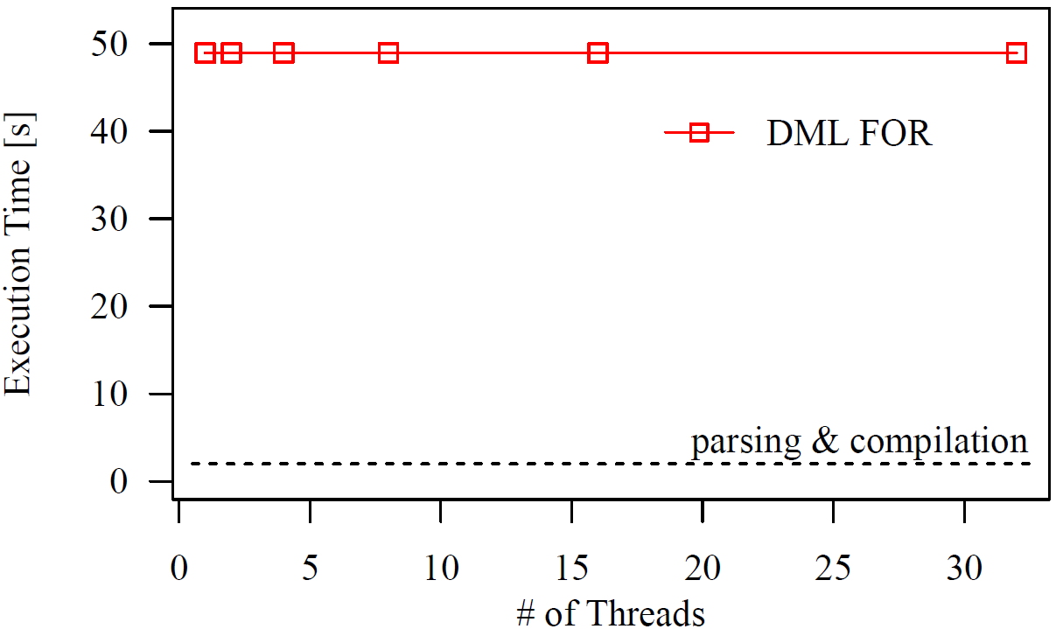
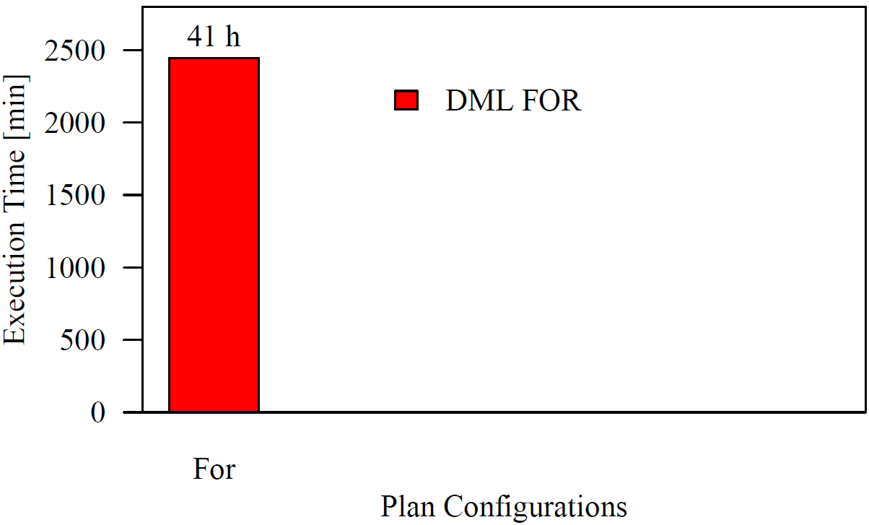
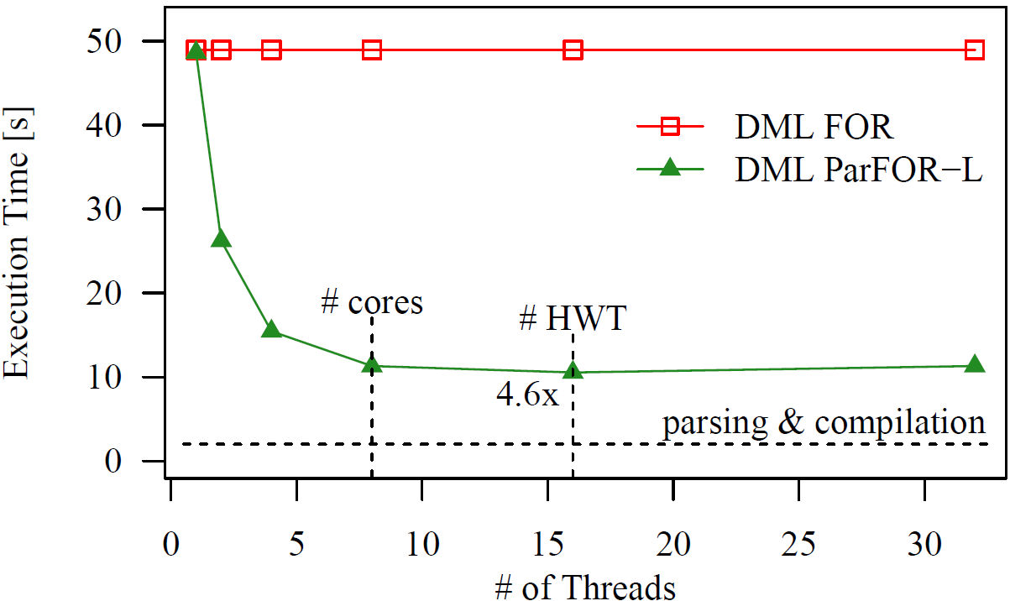
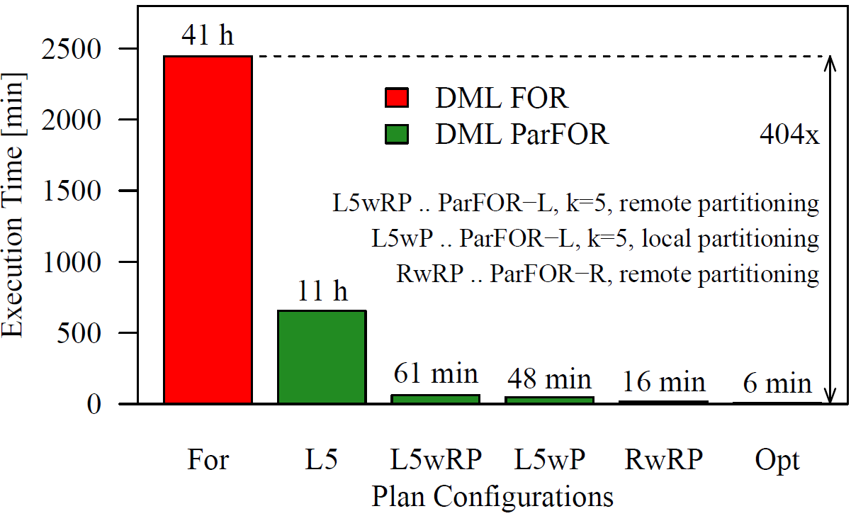
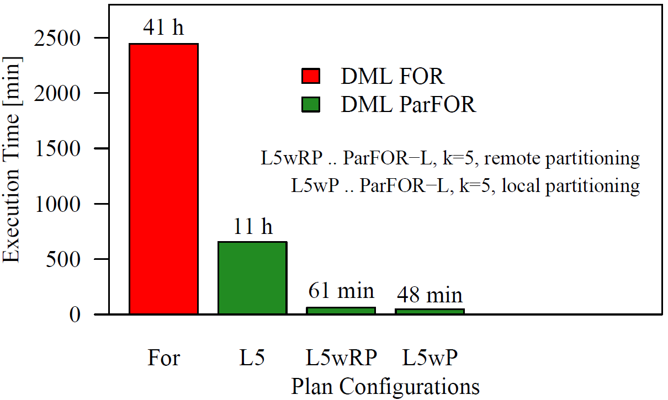
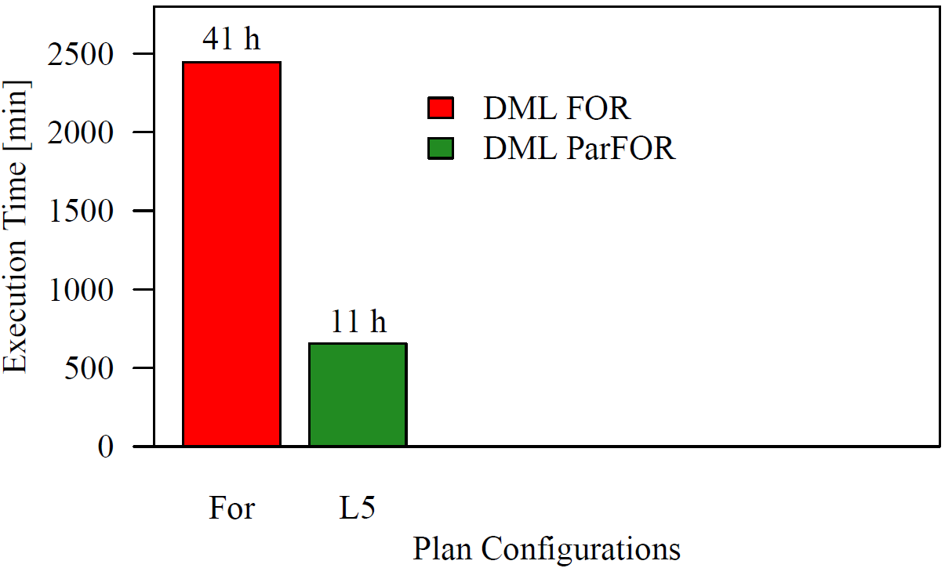
Experiments Bivariate Statistics
4,950 pairs
Scenario S – Local Parallelism
Scenario M – Plan Comparisons
Baseline comparisons with R and Spark:
 | SystemML | R | R doMC | R doSNOW | Spark DP | Spark TP
XS: 10³ x 10² | 3s | 3s | 3s | 19s | 176s | 6s / (11s)
S: 10⁵ x 10² | 30s | 21s | 6s | 45s | 319s | 13s / (20s)
M: 10⁷ x 10² | 363s | 2,109s | 751s* | 870s* | 7,875s | / (776s)
L: 10⁷ x 10³ | 17,231s |  |  |  | 7.4E7s** | /
XS: 10³ x 10²
S: 10⁵ x 10²
M: 10⁷ x 10²
L: 10⁷ x 10³
 | SystemML
XS: 10³ x 10² | 3s
S: 10⁵ x 10² | 30s
M: 10⁷ x 10² | 363s
L: 10⁷ x 10³ | 17,231s
CP, k=16
MR, k=80
MR, k=80, w/ part, rep=5

Slide 15
Conclusions
Summary
Parfor parallelization strategies and optimization framework
Hybrid runtime plans from in-memory to MR
High-level language primitive for new large-scale ML algorithms
Share cluster resources with other MR-based systems
Future Work
Extended runtime and optimization strategies
Resource elasticity on YARN (flexible constraints)

Slide 17
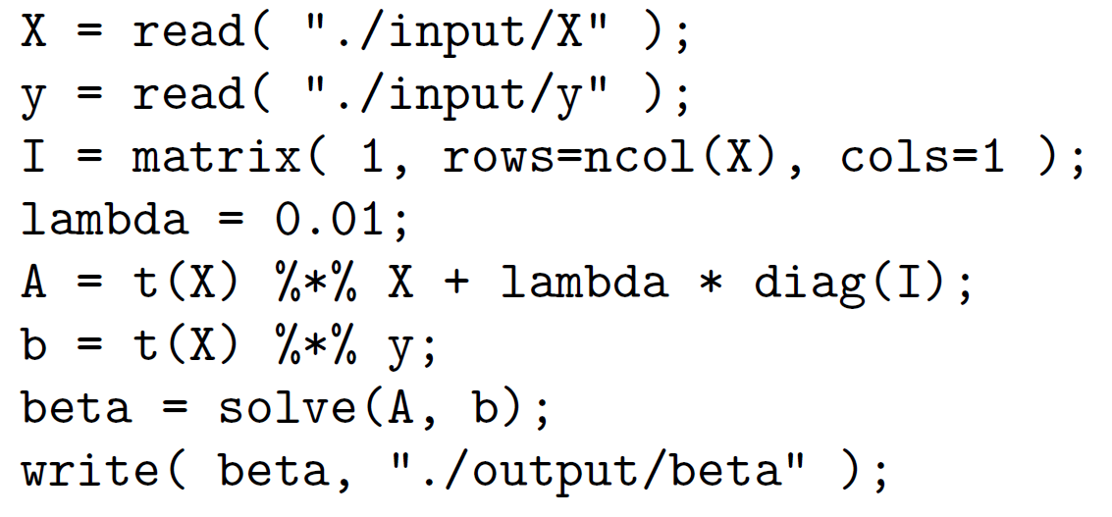
Backup: Scalability SystemML - Linear Regression DS
DML Script:
Cluster Setup (peak 691GFlop/s):
1+6 nodes 2x6 E5-2440@2.4GHz
Each node 12 disks, 10Gb Ethernet
IBM Hadoop Cluster 2.2,
IBM JDK1.6.0 64bit
Map/reduce capacity: 144/72,
w/o jvm reuse
JVM master/map/reduce: 2GB
Scenario |  |  | SystemML 08/2014 [s]
10³ x 10³ | 8 MB | 2 GFlop | 2s (1 GFlop/s)
10⁴ x 10³ | 80 MB | 20 GFlop | 5s (4 GFlop/s)
10⁵ x 10³ | 800 MB | 200 GFlop | 38s (5 GFlop/s)
10⁶ x 10³ | 8 GB | 2 TFlop | 44s (45 GFlop/s)
10⁷ x 10³ | 80 GB | 20 TFlop | 152s (131 GFlop/s)
10⁸ x 10³ | 800 GB | 200 TFlop | 1140s (175 GFlop/s)
CP
CP
CP/MR

Slide 18
SystemML in Production
SystemML 08/2014 part of IBM Biginsights 4.0 Beta
Various ParFor Usecases
Univariate Stats, Bivariate Stats, MDA Bivariate Stats,
Naïve Bayes,
Multirun-KMeans, Multiclass-SVM,
ARIMA, Decision Trees, LSML,
Meta Learning (CV, EL),
Data Generators

Slide 19
Declarative Machine Learning – Requirements
Goal: write ML algorithms independent of input data and cluster characteristics
R1: Full flexibility: specifying new ML algorithms / customization ➔ ML DSL
R2: Data independence: hide physical data representation (sparse/dense, row/column-major, blocking) ➔ coarse-grained semantic operations
Simplifies compilation /optimization (preserves semantics)
Simplifies runtime (physical operator implementations)
R3: Efficiency and scalability: very small to very large usecases ➔ automatic optimization and hybrid runtime plans
R4: Understand, debug, control: need to control algorithm semantics ➔ optimization for performance, not for performance and accuracy

