Slide 1
Compressed Linear Algebra for Large-Scale Machine Learning
Ahmed Elgohary², Matthias Boehm¹, Peter J. Haas¹, Frederick R. Reiss¹, Berthold Reinwald¹
¹ IBM Research – Almaden ² University of Maryland, College Park

Slide 2
Motivation
X
Problem of memory-centric performance
Iterative ML algorithms with read-only data access
Bottleneck: I/O-bound matrix vector multiplications
➔ Crucial to fit matrix into memory (single node, distributed, GPU)
Goal: Improve performance of declarative ML algorithms via lossless compression
Baseline solution
Employ general-purpose compression techniques
Decompress matrix block-wise for each operation
Heavyweight (e.g., Gzip): good compression ratio / too slow
Lightweight (e.g., Snappy): modest compression ratio / relatively fast
while(!converged) {
… q = X %*% v …
}

Slide 3
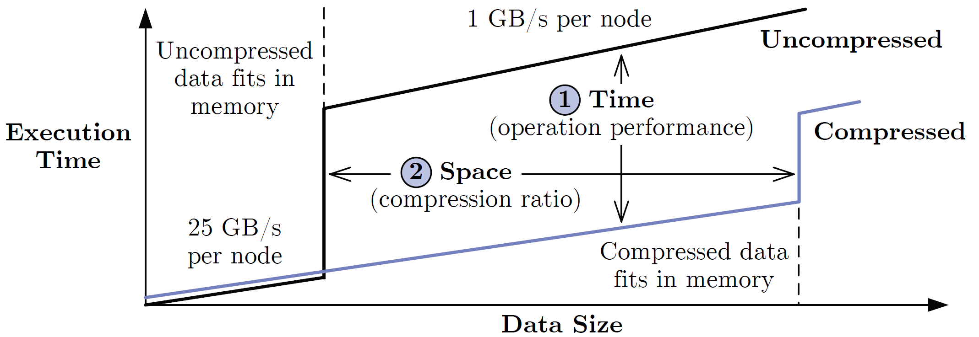
Our Approach: Compressed Linear Algebra (CLA)
Key idea
Use lightweight database compression techniques
Perform LA operations on compressed matrices
Goals of CLA
Operations performance close to uncompressed
Good compression ratios
X
while(!converged) {
… q = X %*% v …
}
10x - 100x

Slide 4
Our Setting: Apache SystemML
Overview
Declarative ML algorithms with R-like syntax
Hybrid runtime plans single-node + MR/Spark
ML Program Compilation
Statement blocks → DAGs
Optimizer rewrites
➔ Automatic compression
Distributed Matrices
Block matrices (dense/sparse)
Single node: matrix = block
➔ CLA integration via new block
Data Characteristics
Tall & skinny; non-uniform sparsity
Low col. card.; col. correlations
LinregCG (Conjugate Gradient)
1: X = read($1); # n x m matrix
2: y = read($2); # n x 1 vector
3: maxi = 50; lambda = 0.001; 4: intercept = $3;
5: ...
6: r = -(t(X) %*% y);
7: norm_r2 = sum(r * r); p = -r;
8: w = matrix(0, ncol(X), 1); i = 0;
9: while(i<maxi & norm_r2>norm_r2_trgt) {
10: q = (t(X) %*% (X %*% p))+lambda*p;
11: alpha = norm_r2 / sum(p * q);
12: w = w + alpha * p;
13: old_norm_r2 = norm_r2;
14: r = r + alpha * q;
15: norm_r2 = sum(r * r);
16: beta = norm_r2 / old_norm_r2;
17: p = -r + beta * p; i = i + 1;
18: }
19: write(w, $4, format="text");
Xv
v^{T}X
X^{T}(w *(Xv))
X^{T}X
➔ Column-based compression schemes

Slide 5
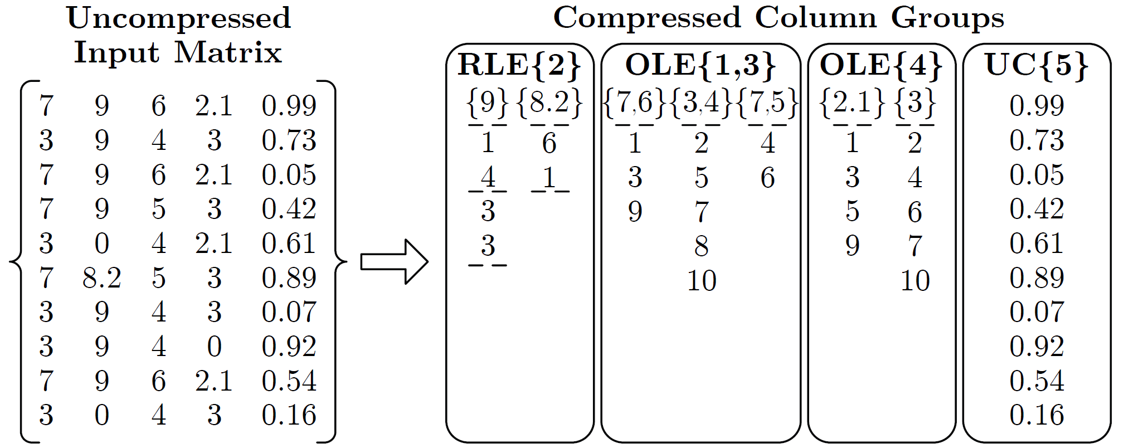
Matrix Compression Framework
Overview compression framework
Column-wise matrix compression (values + compressed offset lists)
Column co-coding (column groups, encoded as single unit)
Heterogeneous column encoding formats
Column encoding formats
Offset-List (OLE)
Run-Length (RLE)
Uncompressed Columns (UC)
Automatic compression planning
Selects column groups and encoding formats per group (data dependent)

Slide 6
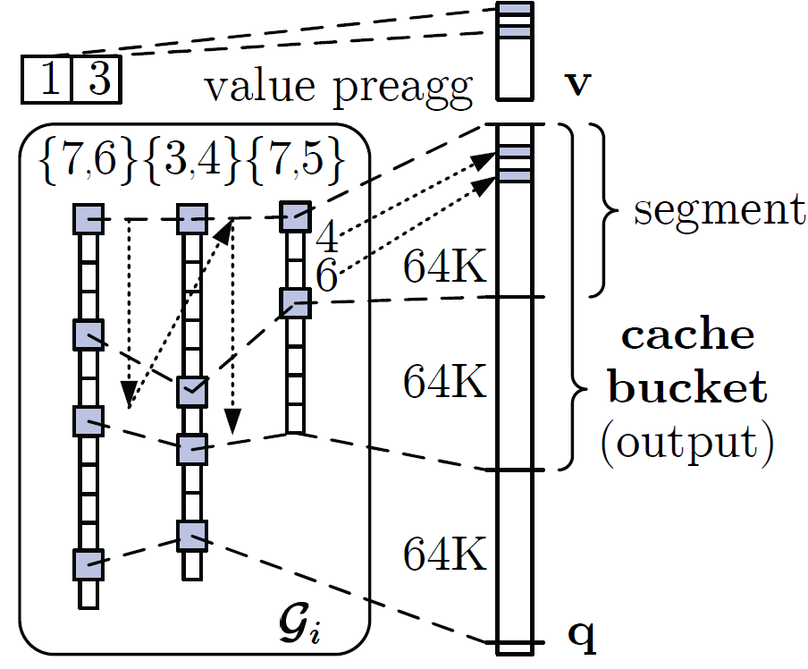
Operations over Compressed Matrix Blocks
Matrix-vector multiplication
Naïve: for each tuple, pre-aggregate values, add values at offsets to q
Example: q = X v, with
Cache-conscious: Horizontal, segment-aligned scans, maintain positions
Vector-matrix multiplication
Naïve: cache-unfriendly on input (v)
Cache-conscious: again use horizontal, segment-aligned scans
v = (7, 11, 1, 3, 2)
v = (7, 11, 1, 3, 2)
v = (7, 11, 1, 3, 2)
v = (7, 11, 1, 3, 2)
v = (7, 11, 1, 3, 2)
v = (7, 11, 1, 3, 2)
9*11=99
90.2
55
25
54
6.3
9
0
➔ cache unfriendly on output (q)
99
99
154
154
154
160.3
160.3
162.3
162.3
0
99
99
99
124
124
124
133
134.5
134.5
0
99
99
154
154
154
160.3
160.3
160.4
160.4
0
99
99
99
99
153
153
162
162.8
162.8
0
0
0
0
25
25
31.3
31.3
32.5
32.5
0
0
90.2
90.2
90.2
144.2
144.2
153.2
155
155
0
99
99
99
124
124
124
133
133.1
133.1
0
99
99
99
124
124
124
124
125.8
125.8
0
99
99
154
154
154
160.3
160.3
161.4
161.4
0
0
0
0
25
25
25
34
34.3
34.3

Slide 7
Compression Planning
Goals and general principles
Low planning costs ➔ Sampling-based techniques
Conservative approach ➔ Prefer underestimating S^{UC}/S^{C} + corrections
Estimating compressed size: S^{C} = min(S^{OLE}, S^{RLE})
# of distinct tuples d_{i}: “Hybrid generalized jackknife” estimator [JASA’98]
# of OLE segments b_{ij}: Expected value under maximum-entropy model
# of non-zero tuples z_{i}: Scale from sample with “coverage” adjustment
# of runs r_{ij}: maxEnt model + independent-interval approx. (r_{ijk} in interval k ~ Ising-Stevens + border effects)
Column Group Partitioning
Exhaustive grouping: O(m^{m})
Brute-force greedy grouping: O(m³)
Start with singleton groups, execute merging iterations
Merge groups with max compression ratio
➔ Bin-packing-based grouping

Slide 8
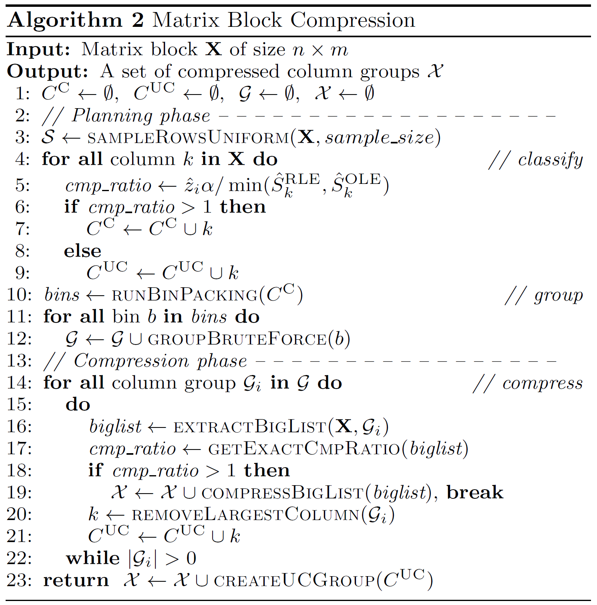
Compression Algorithm
Transpose input X
Draw random sample of rows S
Classify
For each column
Estimate compression ratio (with S^{UC} = z_{i}α)
Classify into C^{C} and C^{UC}
Group
Bin packing of columns
Brute-force greedy per bin
Compress
Extract uncomp. offset lists
Get exact compression ratio
Apply graceful corrections
Create UC Group

Slide 9
Experimental Setting
Cluster setup
1 head node (2x4 Intel E5530, 64GB RAM), and 6 worker nodes (2x6 Intel E5-2440, 96GB RAM, 12x2TB disks)
Spark 1.4 with 6 executors (24 cores, 60GB), 25GB driver memory
Implementation details
CLA integrated into SystemML (new rewrite injects compress operator)
For Spark/MR: individual matrix blocks compressed independently
ML programs and data
6 full-fledged ML algorithms
5 real-world data sets + InfiMNIST data generator (up to 1.1TB)
Selected baselines
Apache SystemML 0.9 (Feb 2016) with uncompressed LA ops (ULA)
General-purpose compression with ULA (Gzip, Snappy)
Notes:
Cluster setup, cont: OpenJDK 1.7.0 85 64bit, Hadoop 2.2.0, Spark 1.4 (yarn-client), 10Gb Ethernet, Red Hat Enterprise Linux Server 6.5
Additional baselines:
Sparse matrix format w/ dictionary encoding [CF’08] (CSR-VI, D-VI)
Compressed-size estimation based on first 0.01*n rows [CCP’11] (Excerpt)

Slide 10
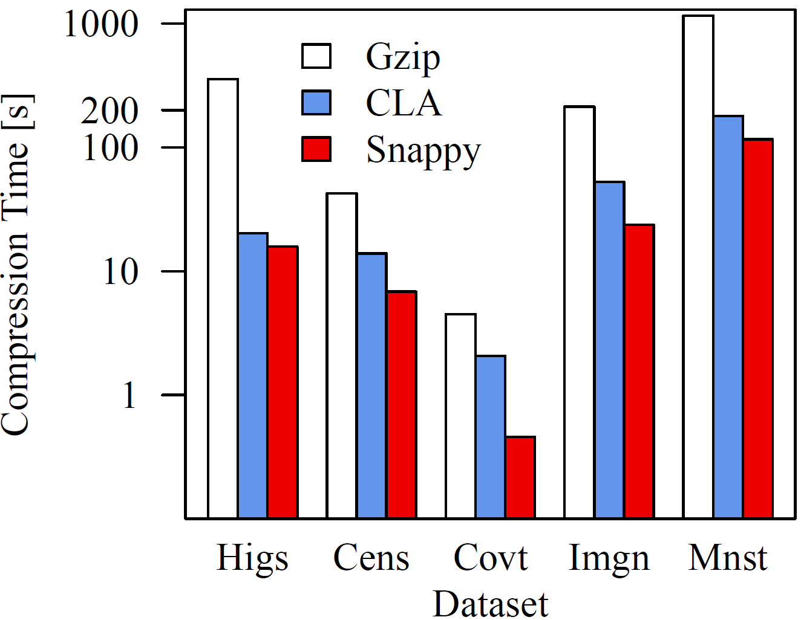
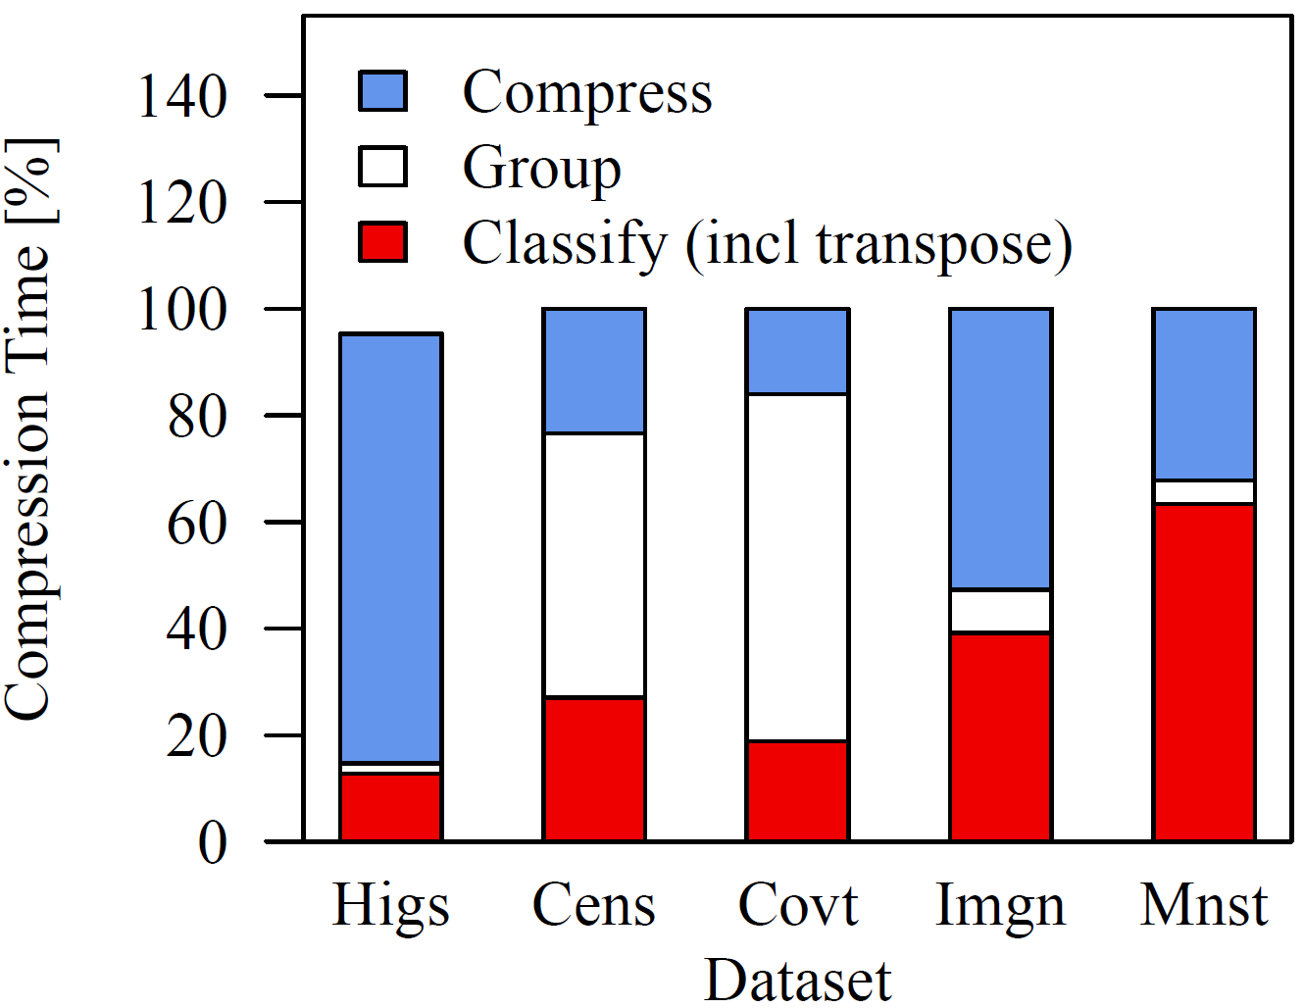
Micro-Benchmarks: Compression Ratios and Time
Compression ratios (S^{UC}/S^{C}, compared to uncompressed in-memory size)
Compression time
Dataset | Dimensions | Sparsity | Size (GB) |  | Gzip | Snappy | CLA
Higgs | 11M x 28 | 0.92 | 2.5 |  | 1.93 | 1.38 | 2.03
Census | 2.5M x 68 | 0.43 | 1.3 |  | 17.11 | 6.04 | 27.46
Covtype | 600K x 54 | 0.22 | 0.14 |  | 10.40 | 6.13 | 12.73
ImageNet | 1.2M x 900 | 0.31 | 4.4 |  | 5.54 | 3.35 | 7.38
Mnist8m | 8.1M x 784 | 0.25 | 19 |  | 4.12 | 2.60 | 6.14
Decompression Time (single-threaded, native libs, includes deserialization)
Gzip | 88-291 MB/s
Snappy | 232-639 MB/s
CLA | not required

Slide 11
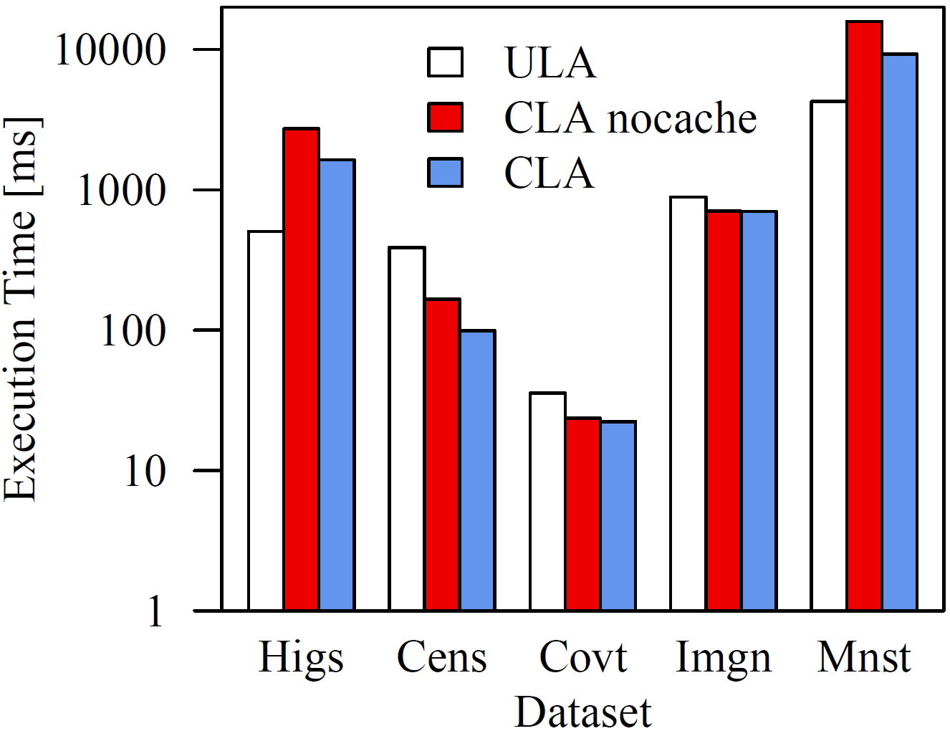
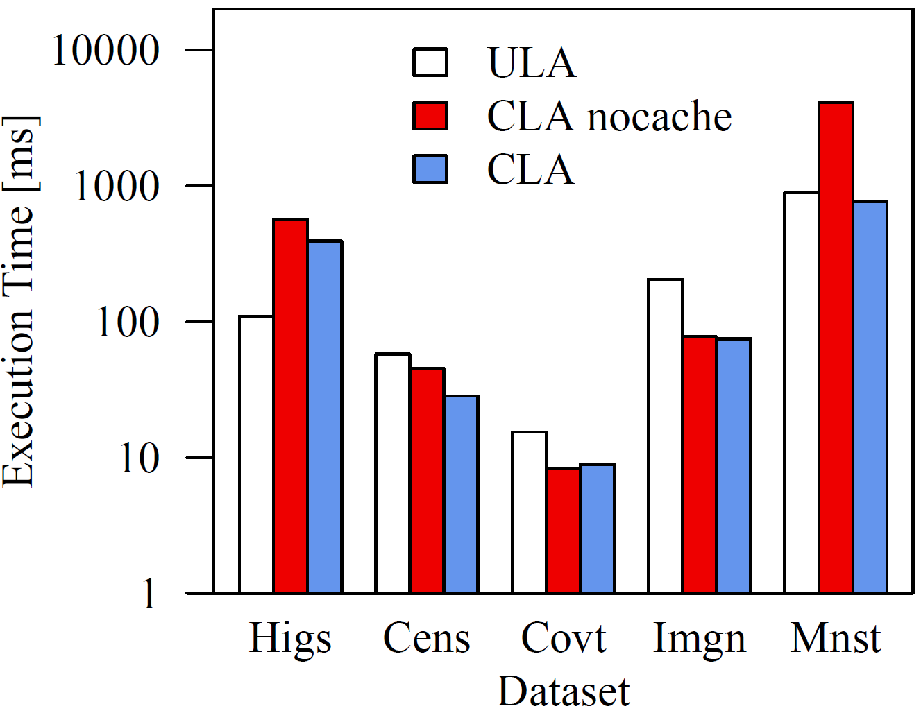
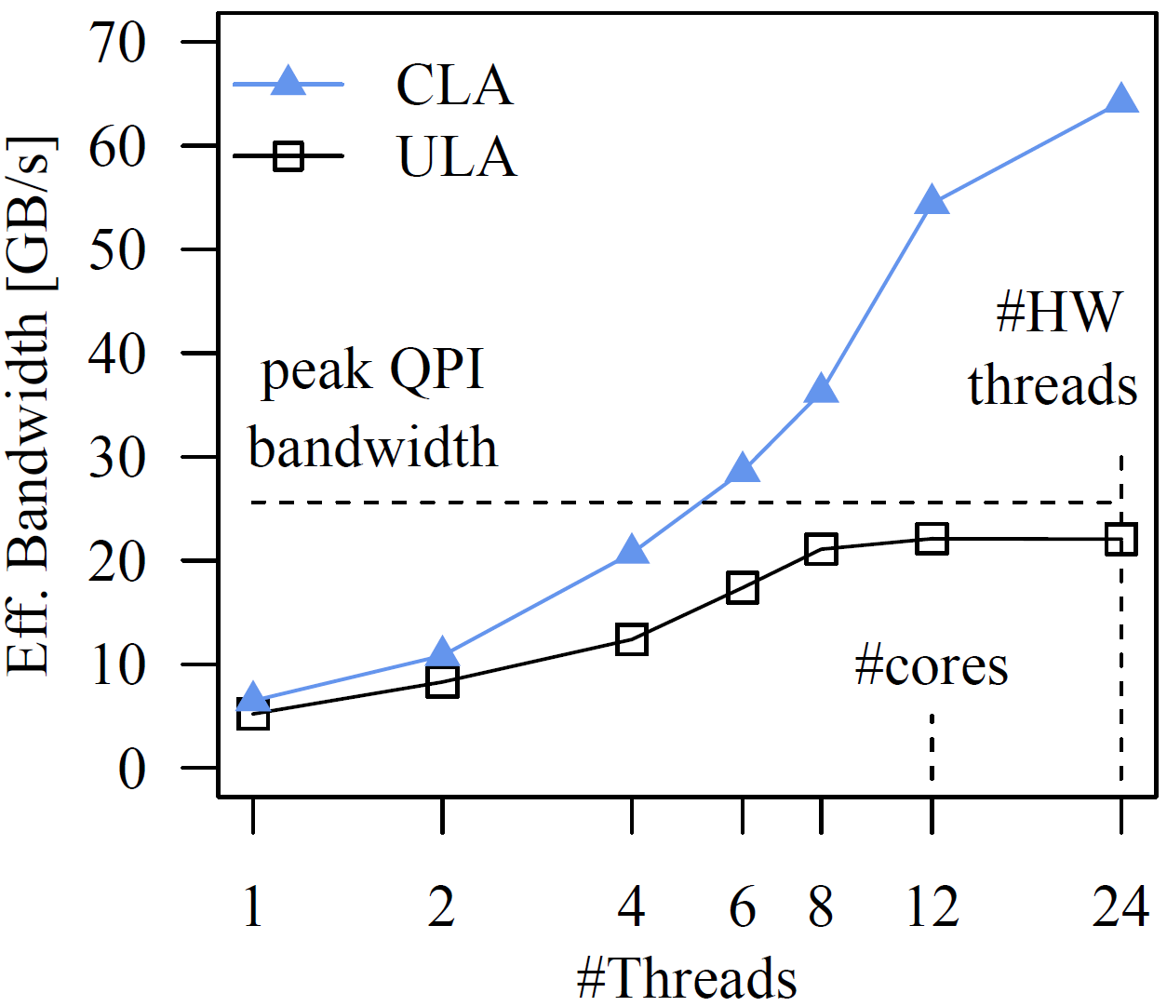
Micro-Benchmarks: Vector-Matrix Multiplication
Single-Threaded
Multi-Threaded
Up to 5.4x
➔ Smaller memory bandwidth requirements of CLA

Slide 12
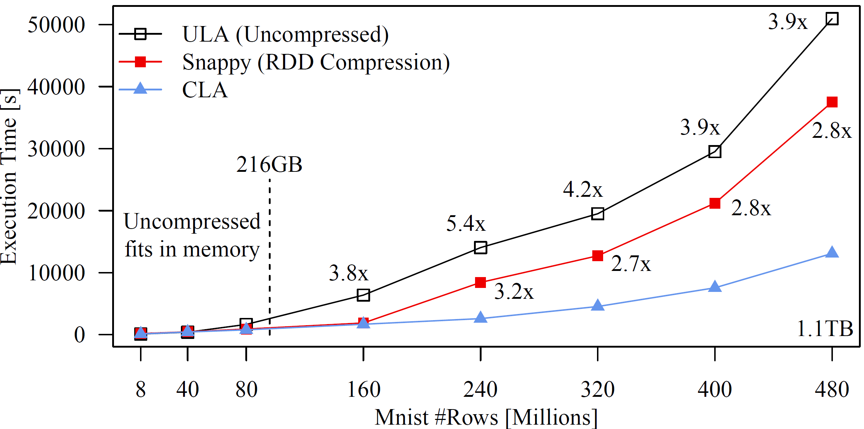
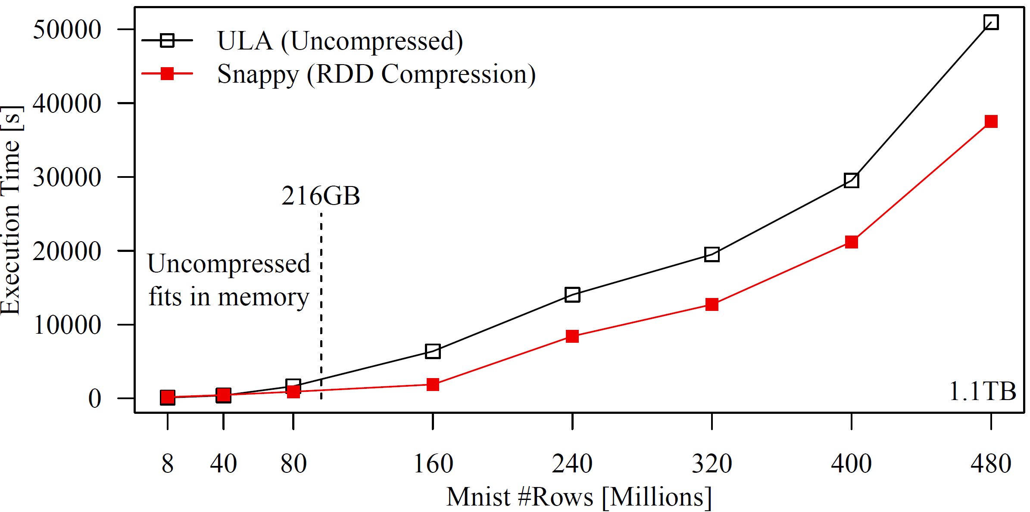
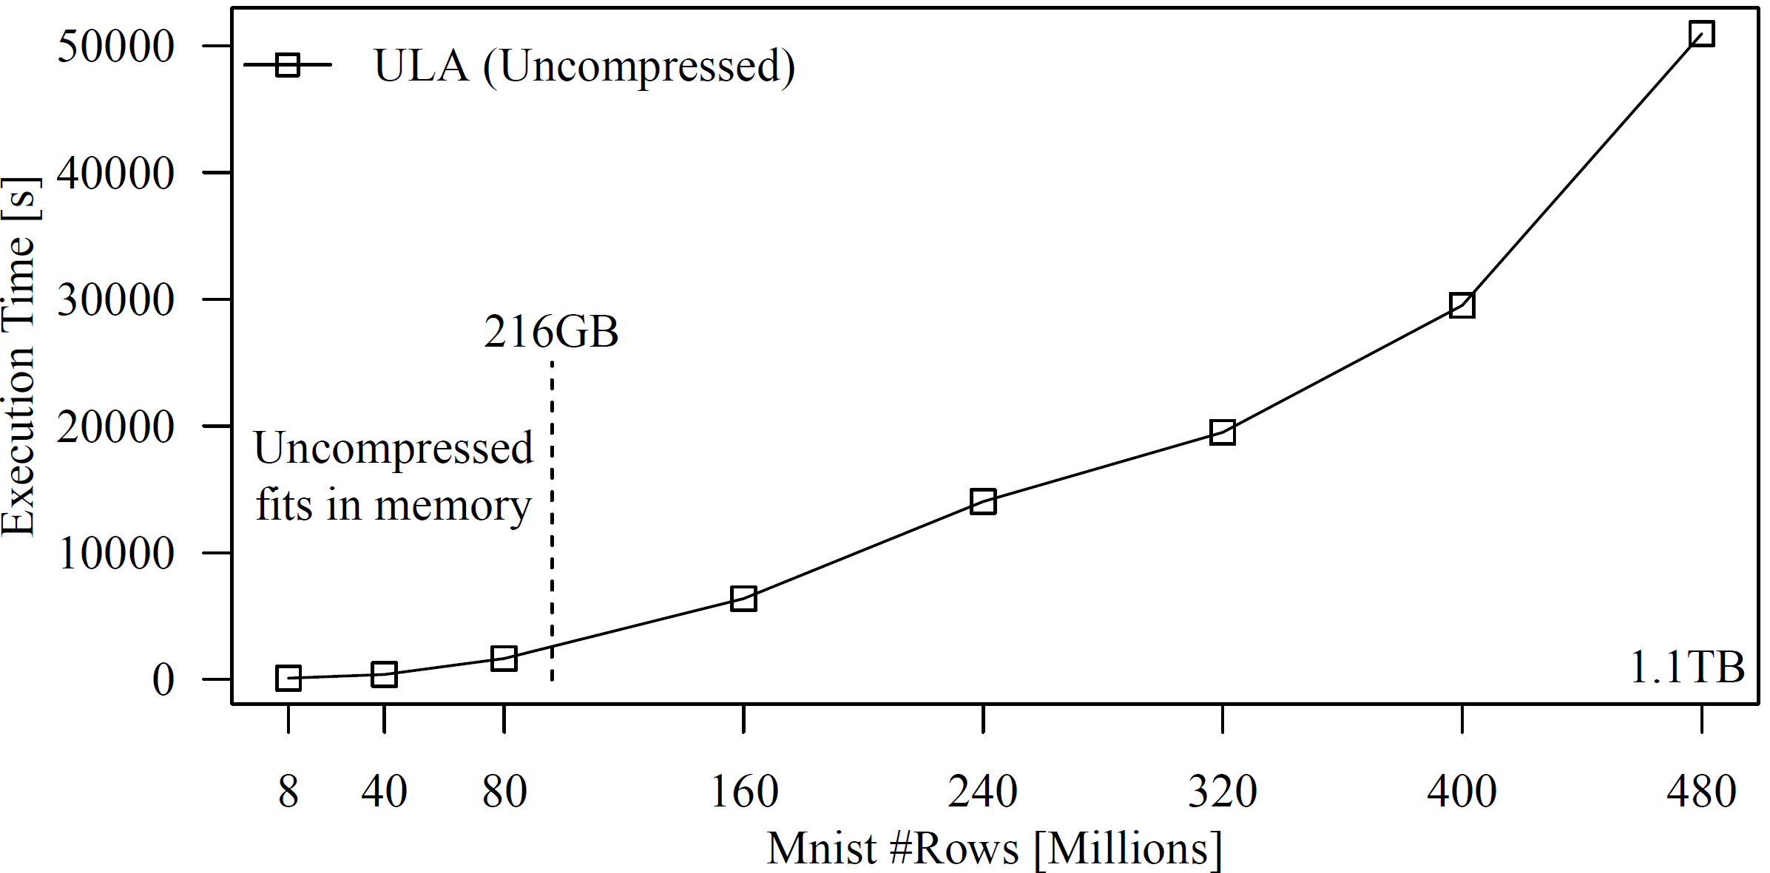
End-to-End Experiments: L2SVM
L2SVM over Mnist dataset
End-to-end runtime, including HDFS read + compression
Aggregated mem: 216GB

Slide 13
End-to-End Experiments: Other Iterative ML Algorithms
In-memory dataset Mnist40m (90GB)
Out-of-core dataset Mnist240m (540GB)
Up to 26x and 8x
Algorithm | ULA | Snappy | CLA
MLogreg | 630s | 875s | 622s
GLM | 409s | 647s | 397s
LinregCG | 173s | 220s | 176s
Algorithm | ULA | Snappy | CLA
MLogreg | 83,153s | 27,626s | 4,379s
GLM | 74,301s | 23,717s | 2,787s
LinregCG | 2,959s | 1,493s | 902s

Slide 14
Conclusions
Summary
CLA: Database compression + LA over compressed matrices
Column-compression schemes and ops, sampling-based compression
Performance close to uncompressed + good compression ratios
Conclusions
General feasibility of CLA, enabled by declarative ML
Broadly applicable (blocked matrices, LA, data independence)
SYSTEMML-449: Compressed Linear Algebra
Transferred back into upcoming Apache SystemML 0.11 release
Testbed for extended compression schemes and operations
Notes:
Conclusions
+ Generalization of sparse matrix representations (dense and sparse)
SystemML-449
Multi-threaded compression/decompression
Ongoing extensions for coverage of operations / full compiler integration
Additional interesting future work:
full optimizer integration,
(2) Global planning and physical design tuning,
(3) alternative compression schemes, and
(4) operations beyond matrix-vector

Slide 15
Upcoming: Tue Sep 6, 2pm I2: SystemML on Spark
Wed Sep 7, 11.15am D3b: CLA Poster
Fri Sep 9, 9am-5.30pm Tutorial @BOSS
SystemML is Open Source:
Apache Incubator Project since 11/2015
Website: http://systemml.apache.org/
Sources: https://github.com/apache/incubator-systemml

Slide 16
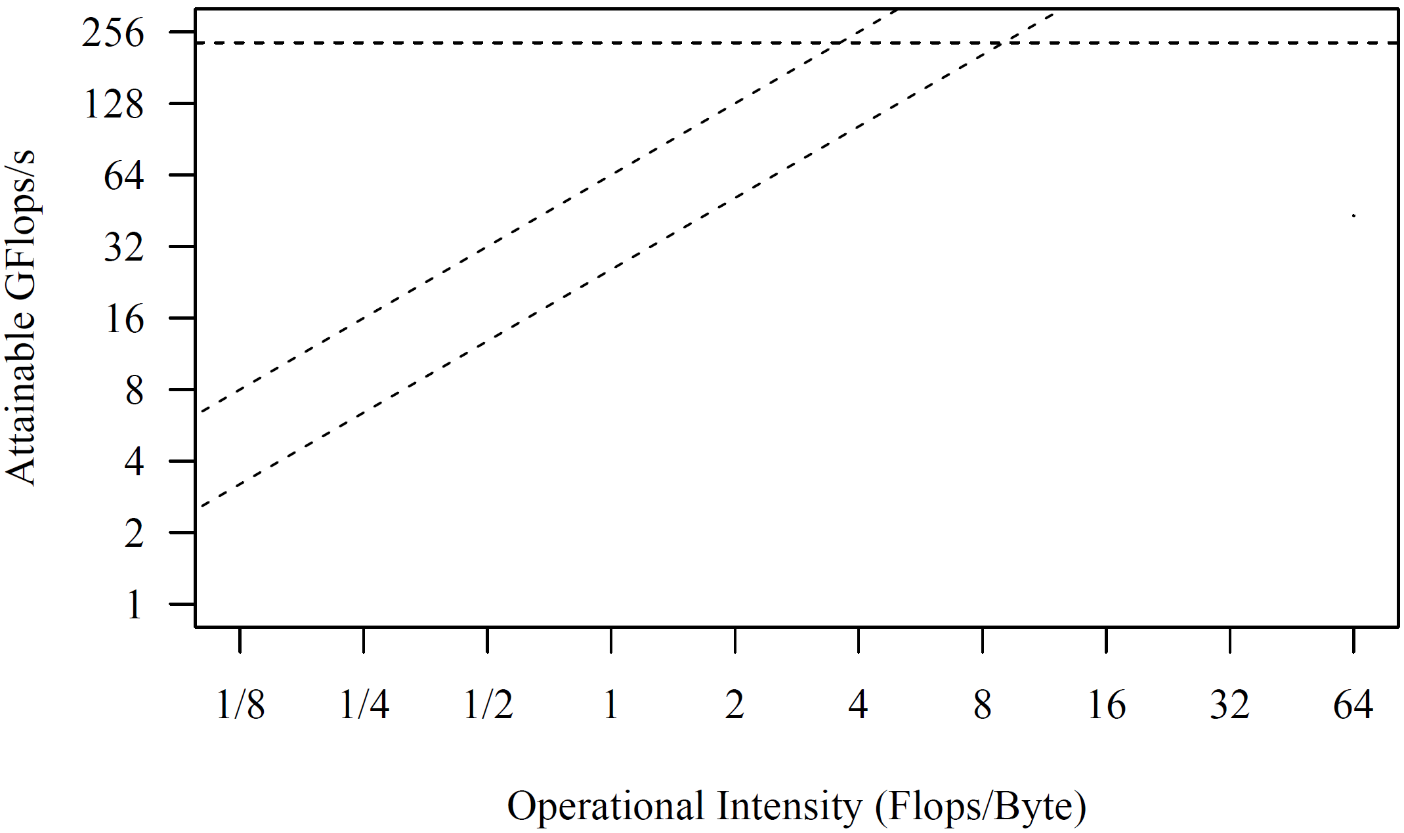
Backup: Roofline Analysis Matrix-Vector Multiply
Single Node: 2x6 E5-2440 @2.4GHz–2.9GHz, DDR3 RAM @1.3GHz (ECC)
Max mem bandwidth (local): 2 sock x 3 chan x 8B x 1.3G trans/s → 2 x 32GB/s
Max mem bandwidth (single-sock ECC / QPI full duplex) → 2 x 12.8GB/s
Max floating point ops: 12 cores x 2*4dFP-units x 2.4GHz → 2 x 115.2GFlops/s
Roofline Analysis
Processor performance
Off-chip memory traffic
36x
SystemML MM (n=768)
SystemML Mt(Mv)
[S. Williams, A. Waterman, D. A. Patterson: Roofline: An Insightful Visual Performance Model for Multicore Architectures. Commun. ACM 52(4): 65-76 (2009)]
SystemML Mv
➔ IO-bound matrix-vector mult
Notes:
Intel Xeon E5, Sandy Bridge, Q2’16; Mv = 347ms (23GB/s) MtMv = 348ms, MM = 21ms (43.1GFlops), with XX:+UseNUMA 30% better

Slide 17
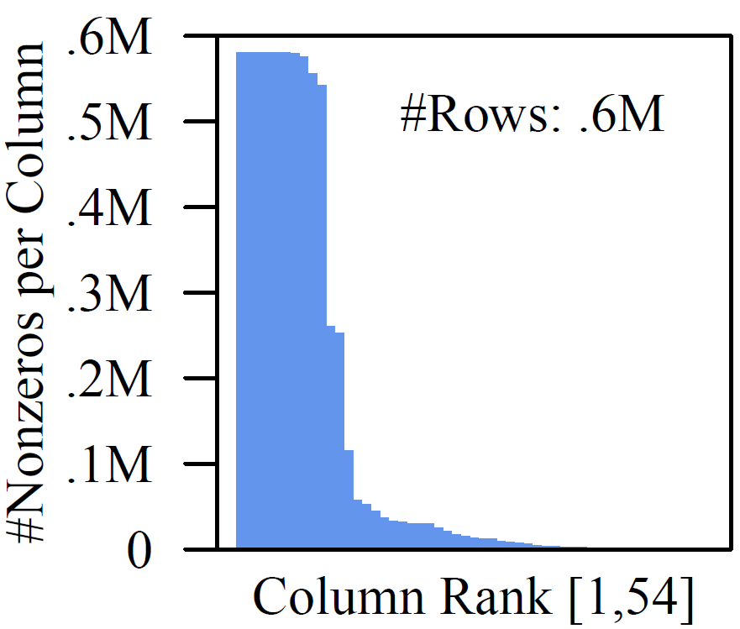
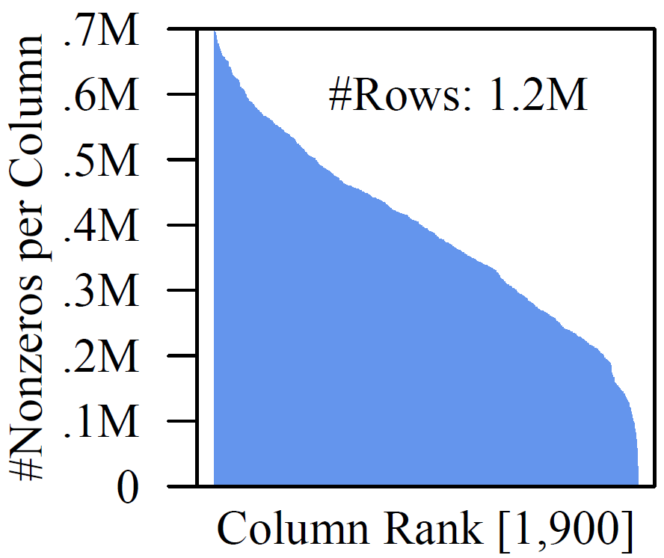
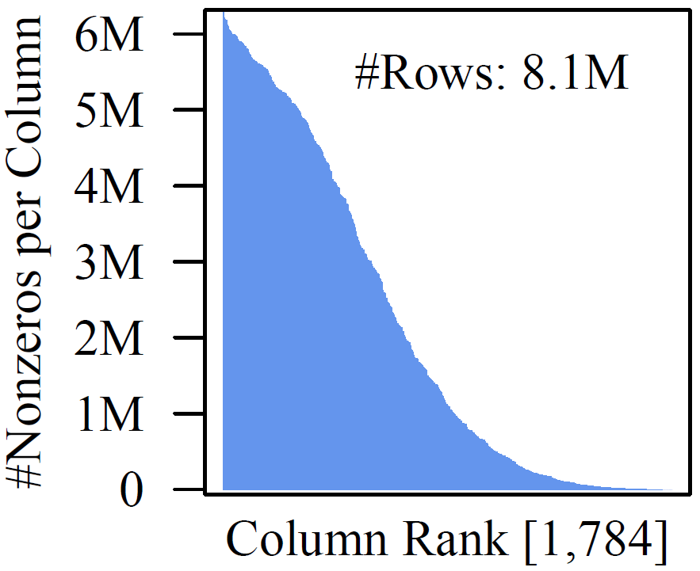
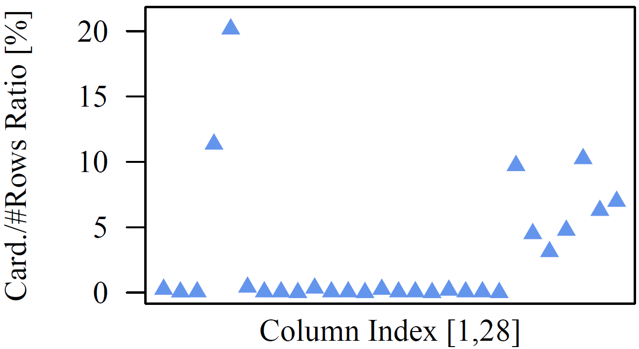
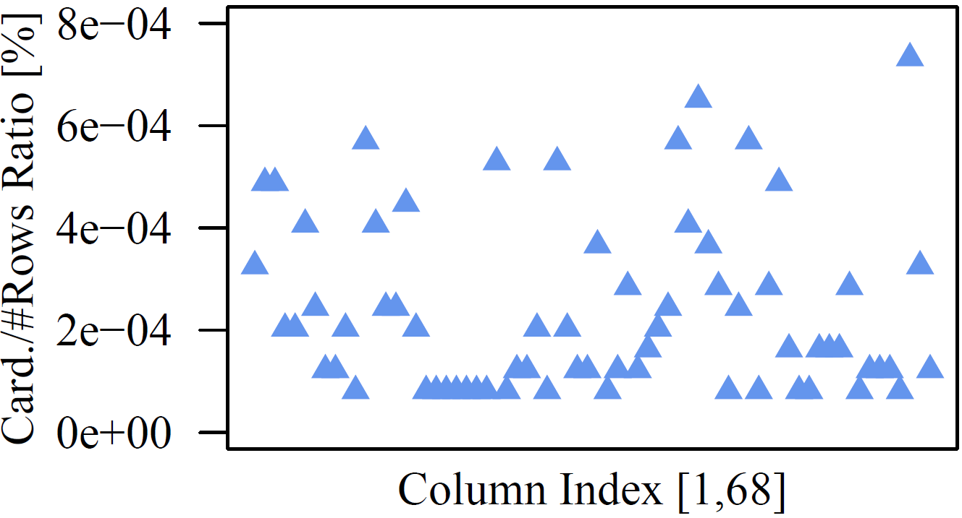
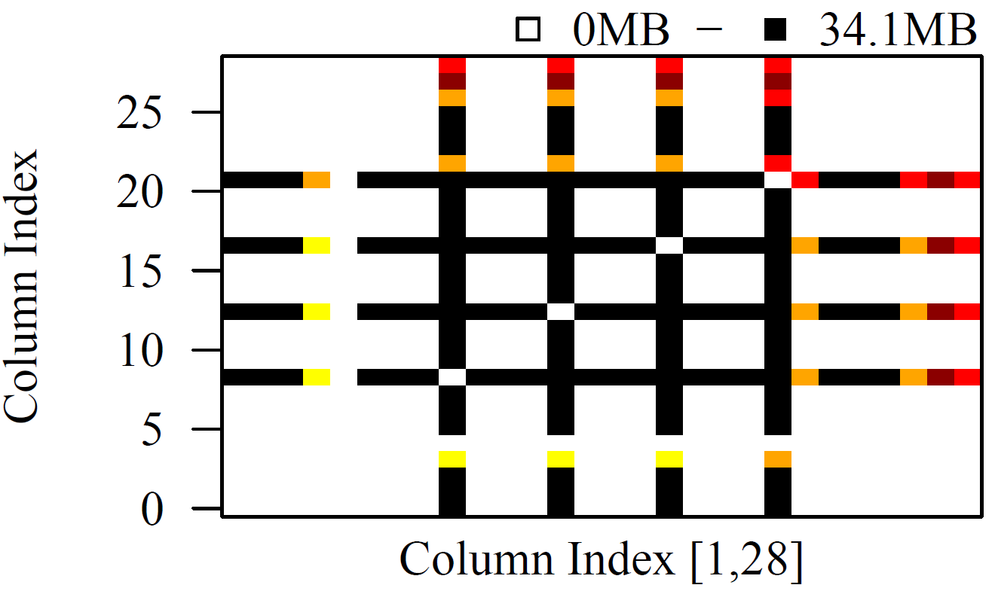
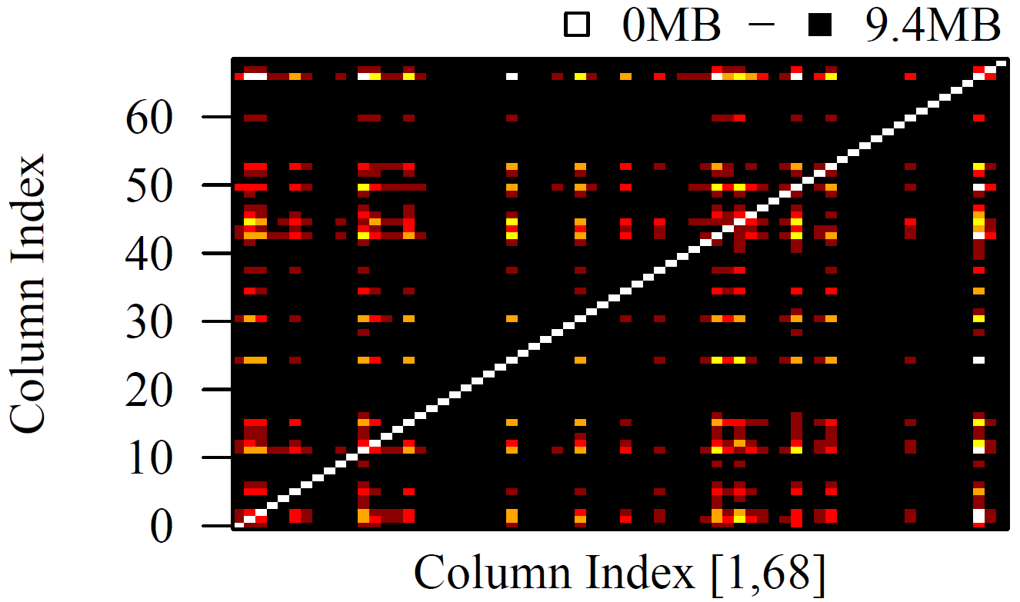
Backup: Common Data Characteristics
Covtype
ImageNet
Mnist8m
Non-Uniform Sparsity
Low Column cardinalities
Column Correlation
For Census: 10.1x → 27.4x
Higgs
Census

Slide 18
Backup: Column Encoding Formats
Data Layout
OLE
RLE
Offset-List Encoding
Offset range divided into segments of fixed length ∆^{s}=2¹⁶
Offsets encoded as diff to beginning of its segment
Each segments encodes length w/ 2B, followed by 2B per offset
Run-Length Encoding
Sorted list of offsets encoded as sequence of runs
Run starting offset encoded as diff to end of previous run
Runs encoded w/ 2B for starting offset and 2B for length
Empty/partitioned runs to deal with max 2¹⁶ diff

Slide 19
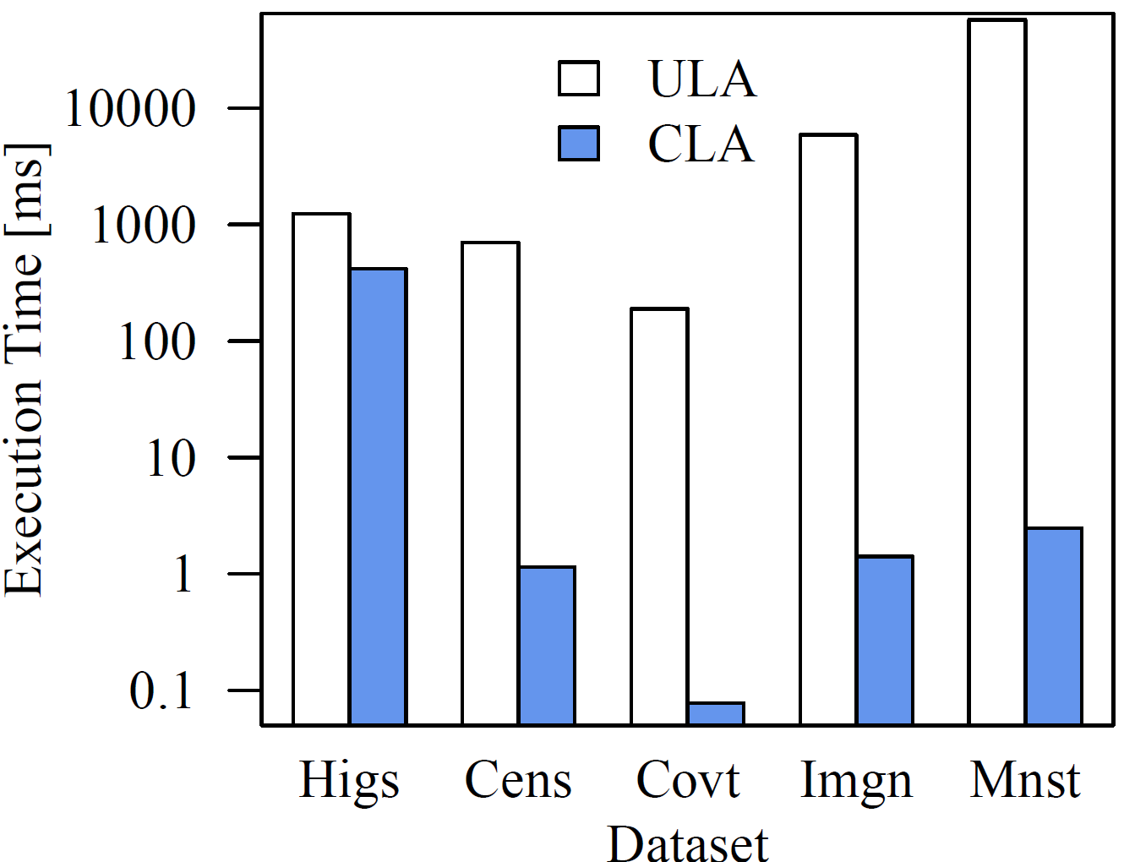
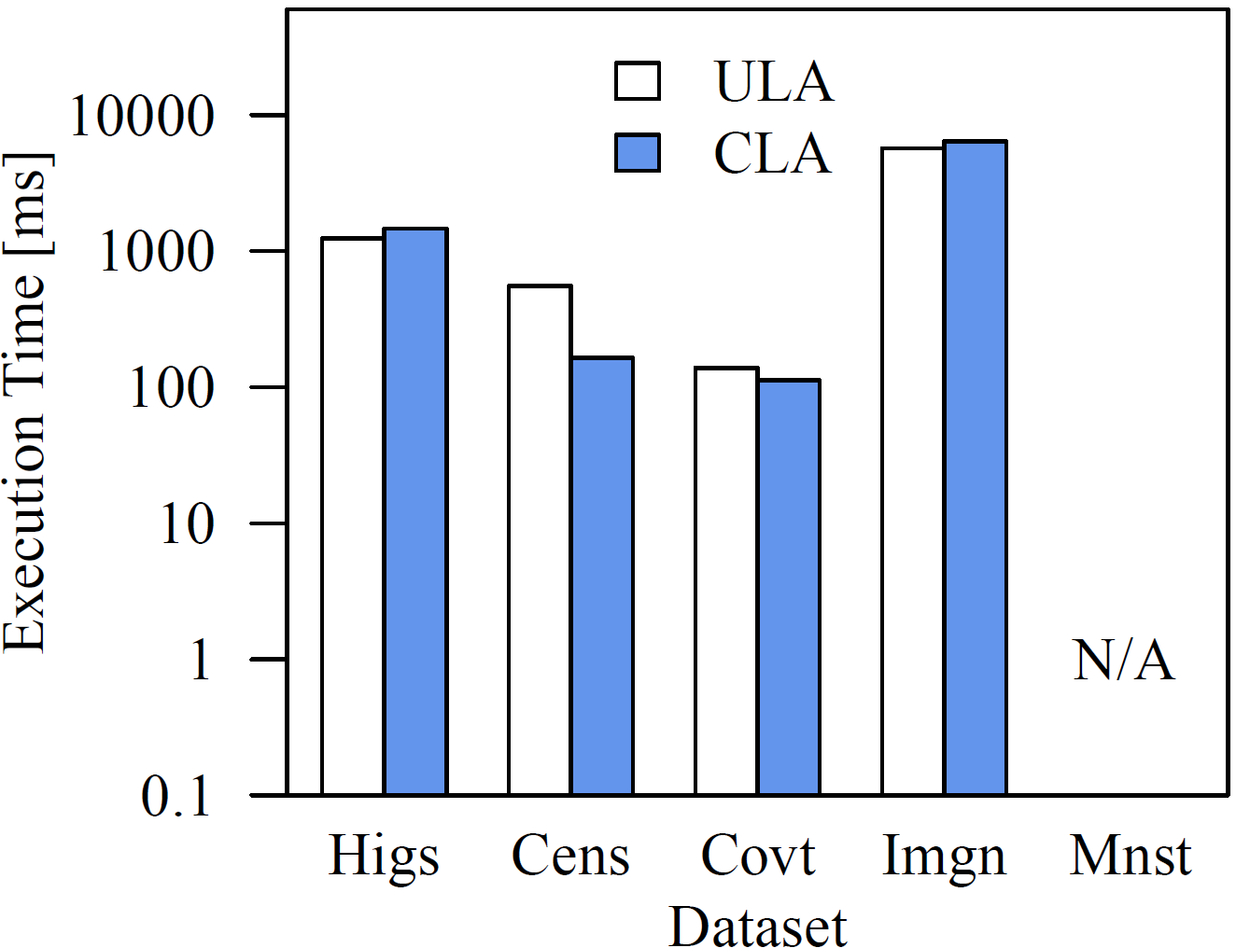
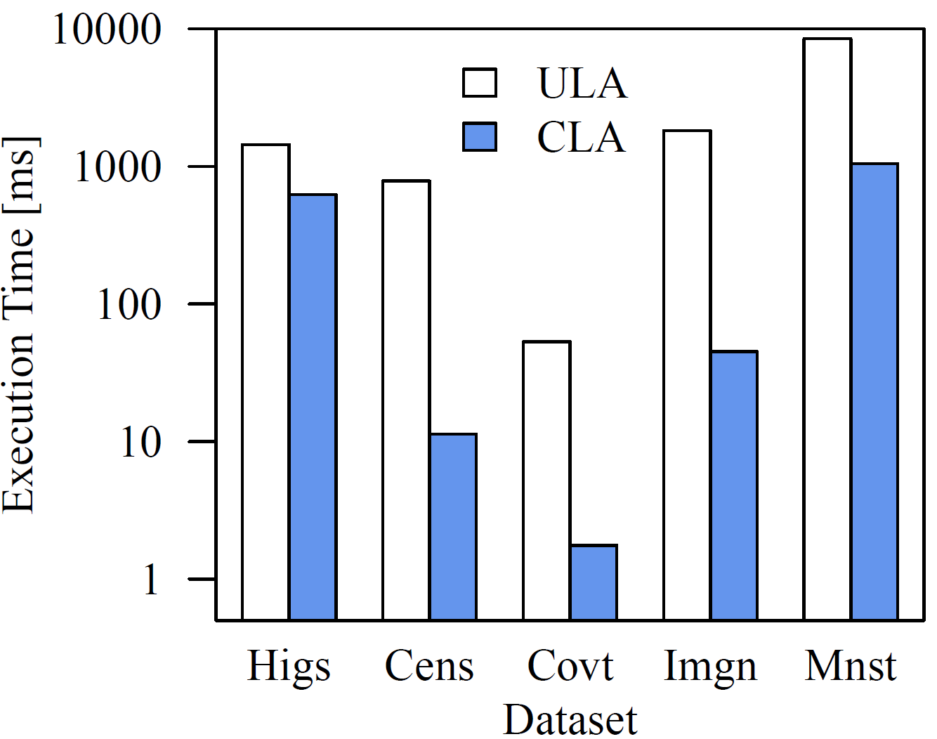
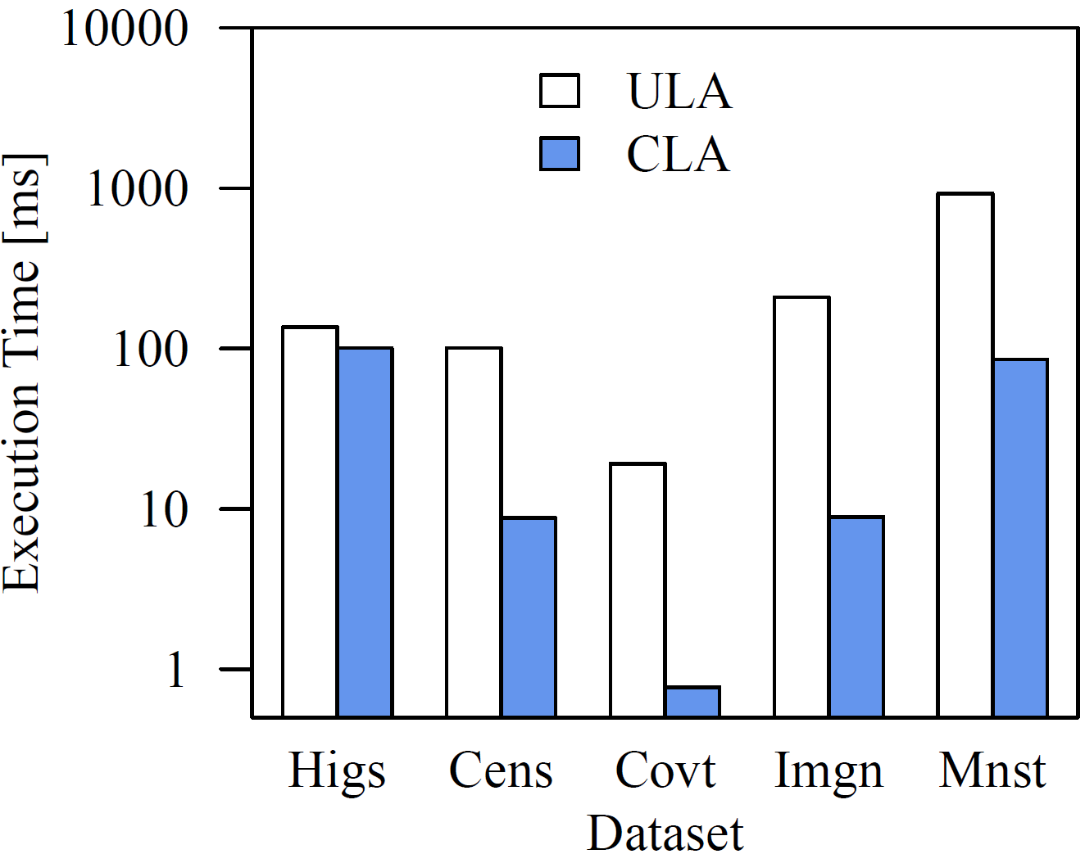
Backup: Scalar Operations and Aggregates
X^2 (sparse-safe)
X+7 (sparse-unsafe)
Scalar Operations
Single- threaded
Up to 1000x – 10,000x
Unary Aggregates
sum(X)
Up to 100x
Single-Threaded
Multi-Threaded

Slide 20
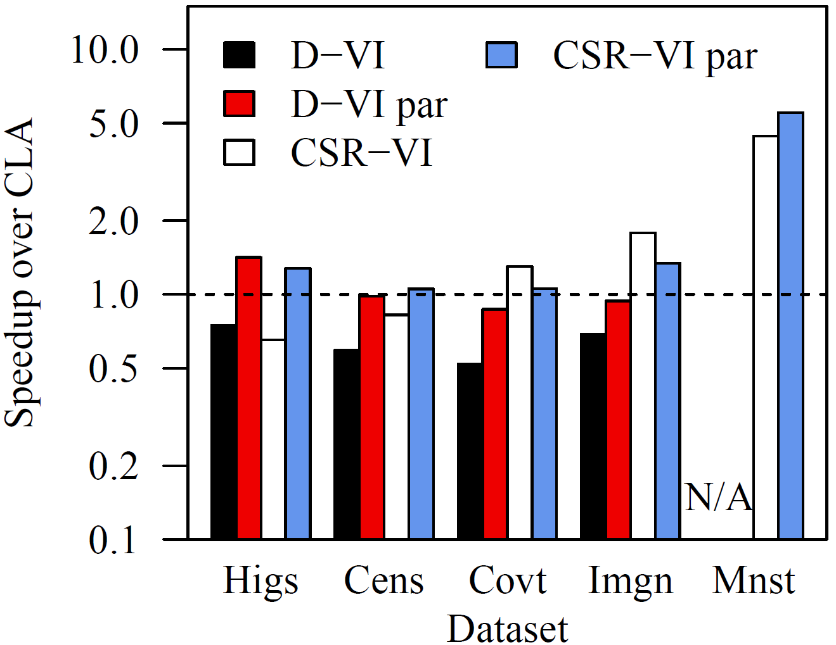
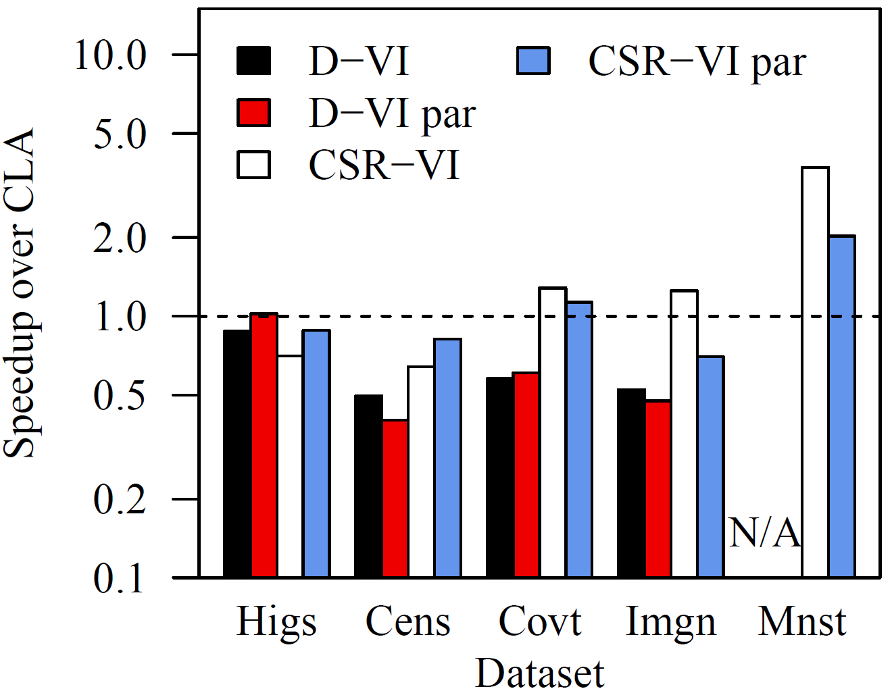
Backup: Comparison CSR-VI (CSR Value Indexed)
Compression Ratio
Operations Performance
Dataset | Sparse | #Distinct | CSR-VI | D-VI | CLA
Higgs | N | 8,083,944 | 1.04 | 1.90 | 2.03
Census | N | 46 | 3.62 | 7.99 | 27.46
Covtype | Y | 6,682 | 3.56 | 2.48 | 12.73
ImageNet | Y | 824 | 2.07 | 1.93 | 7.38
Mnist8m | Y | 255 | 2.53 | N/A | 6.14
MV
VM
[K. Kourtis, G. I. Goumas, N. Koziris: Optimizing Sparse Matrix-Vector Multiplication Using Index and Value Compression, CF 2008, 87-96]

Slide 21
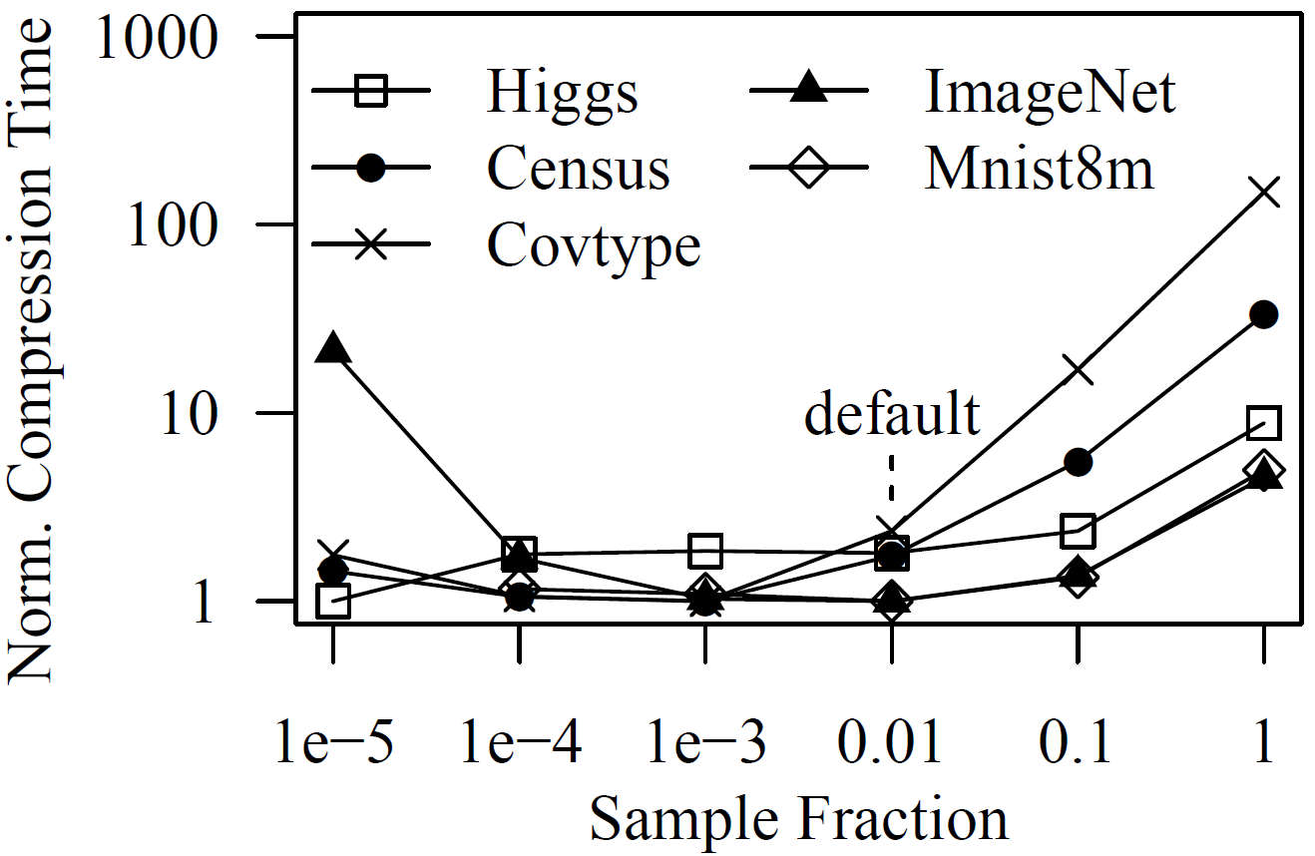
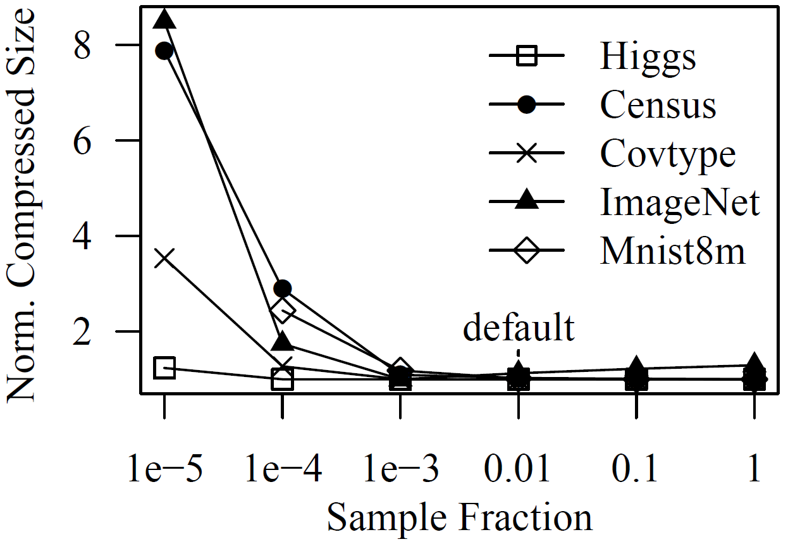
Backup: Parameter Influence and Accuracy
Sample Fraction
Estimation Accuracy
Compression Time (minimum normalized)
Compressed Size (minimum normalized)
Dataset | Higgs | Census | Covtype | ImageNet | Mnist8m
Excerpt | 28.8% | 173.8% | 111.2% | 24.6% | 12.1%
CLA Est. | 16.0% | 13.2% | 56.6% | 0.6% | 39.4%
[C. Constantinescu, M. Lu: Quick Estimation of Data Compression and De-duplication for Large Storage Systems. CCP 2011, 98-102]

