Slide 1




On Optimizing Operator Fusion Plans for Large-Scale Machine Learning in SystemML
Matthias Boehm¹, Berthold Reinwald¹, Dylan Hutchison²,
Prithviraj Sen¹, Alexandre V. Evfimievski¹, Niketan Pansare¹
¹ IBM Research – Almaden; San Jose, CA, USA
² University of Washington; Seattle, WA, USA
Acknowledgements: Apache SystemML Team, Tarek Elgamal

Slide 2





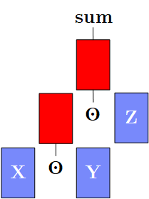
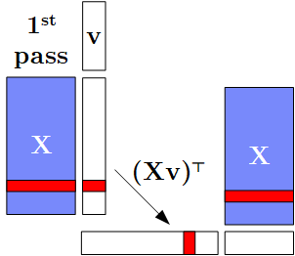
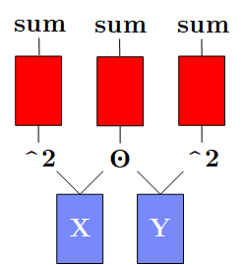
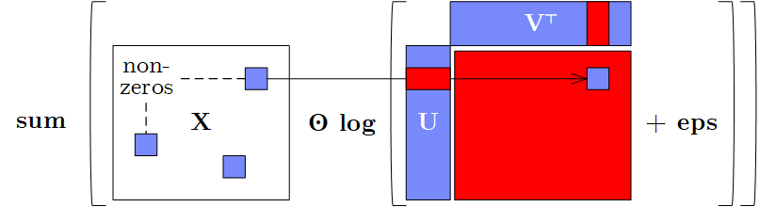
Motivation: Fusion Opportunities
State-of-the art ML systems
  DAGs of linear algebra (LA) operations and statistical functions
  Materialized intermediates → ubiquitous fusion opportunities
a) Intermediates
b) Single-Pass
c) Multi-Aggregates
sum(X*Y*Z)
t(X)%*%(X%*%v)
→t(t(X%*%v)%*%X)
d) Sparsity Exploitation

Slide 3
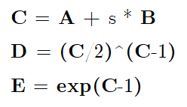
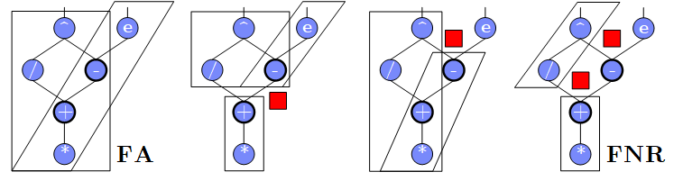
A Case for Optimizing Fusion Plans
Problem: Fusion heuristics → poor plans for complex DAGs (cost/structure), sparsity exploitation, and local/distributed operations
Goal: Principled approach for optimizing fusion plans
#1 Materialization Points
(e.g., for multiple consumers)
#2 Sparsity Exploitation
(and ordering of sparse inputs)
#3 Decisions on Fusion Patterns
(e.g., template types)
#4 Constraints
(e.g., memory budget and block sizes)
Y + X * (U %*% t(V))
sparse-safe over X
➔ Search Space that
requires optimization

Slide 4
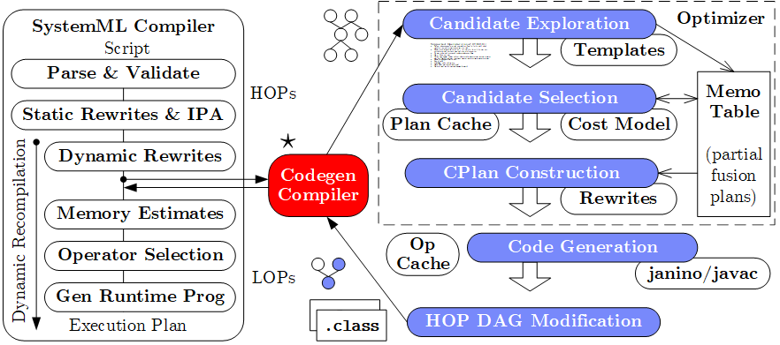
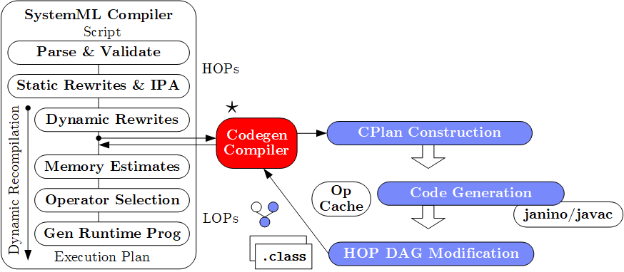
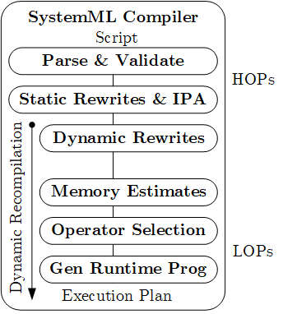

System Architecture
(Compiler Integration & Codegen Architecture)
Practical, exact, cost-based optimizer
[CIDR’17] (w/ fuse-all heuristic)
Lacked maintainability
Poor plans for complex DAGs
and local/distributed operations
Templates: Cell, Row, MAgg, Outer w/ different data bindings

Slide 5
Codegen Example L2SVM (Cell/MAgg) I
L2SVM Inner Loop
# of Vector Intermediates
  Base (w/o fused ops): 10
  Fused (w/ fused ops): 4
1: while(continueOuter & iter < maxi) {
2 #...
3: while(continueInner) {
4: out = 1-Y* (Xw+step_sz*Xd);
5: sv = (out > 0);
6: out = out * sv;
7: g = wd + step_sz*dd
- sum(out * Y * Xd);
8: h = dd + sum(Xd * sv * Xd);
9: step_sz = step_sz - g/h;
10: }} ...

Slide 6
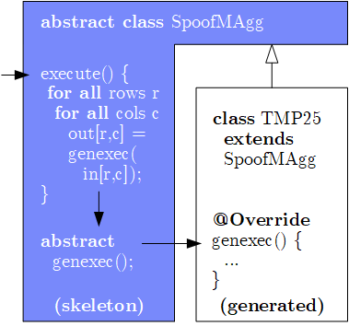
Codegen Example L2SVM (Cell/MAgg) II
Template Skeleton
  Data access, blocking
  Multi-threading
  Final aggregation
# of Vector Intermediates
  Gen (codegen ops): 0
public final class TMP25 extends SpoofMAgg {
public TMP25() {
super(false, AggOp.SUM, AggOp.SUM);
}
protected void genexec(double a, SideInput[] b,
double[] scalars, double[] c, ...) {
double TMP11 = getValue(b[0], rowIndex);
double TMP12 = getValue(b[1], rowIndex);
double TMP13 = a * scalars[0];
double TMP14 = TMP12 + TMP13;
double TMP15 = TMP11 * TMP14;
double TMP16 = 1 - TMP15;
double TMP17 = (TMP16 > 0) ? 1 : 0;
double TMP18 = a * TMP17;
double TMP19 = TMP18 * a;
double TMP20 = TMP16 * TMP17;
double TMP21 = TMP20 * TMP11;
double TMP22 = TMP21 * a;
c[0] += TMP19;
c[1] += TMP22;
}
}

Slide 7
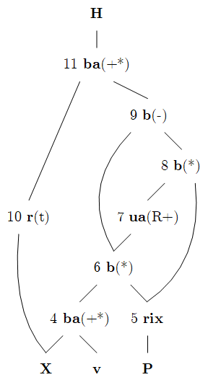
Codegen Example MLogreg (Row)
MLogreg Inner Loop
(main expression on feature matrix X)
1: Q = P[, 1:k] * (X %*% v)
2: H = t(X) %*% (Q - P[, 1:k] * rowSums(Q))
public final class TMP25 extends SpoofRow {
public TMP25() {
super(RowType.COL_AGG_B1_T, true, 5);
}
protected void genexecDense(double[] a, int ai,
SideInput[] b, double[] c,..., int len) {
double[] TMP11 = getVector(b[1].vals(rix),...);
double[] TMP12 = vectMatMult(a, b[0].vals(rix),...);
double[] TMP13 = vectMult(TMP11, TMP12, 0, 0,...);
double TMP14 = vectSum(TMP13, 0, TMP13.length);
double[] TMP15 = vectMult(TMP11, TMP14, 0,...);
double[] TMP16 = vectMinus(TMP13, TMP15, 0, 0,...);
vectOuterMultAdd(a, TMP16, c, ai, 0, 0,...); }
protected void genexecSparse(double[] avals, int[] aix,
int ai, SideInput[] b, ..., int len) {...}
}

Slide 8
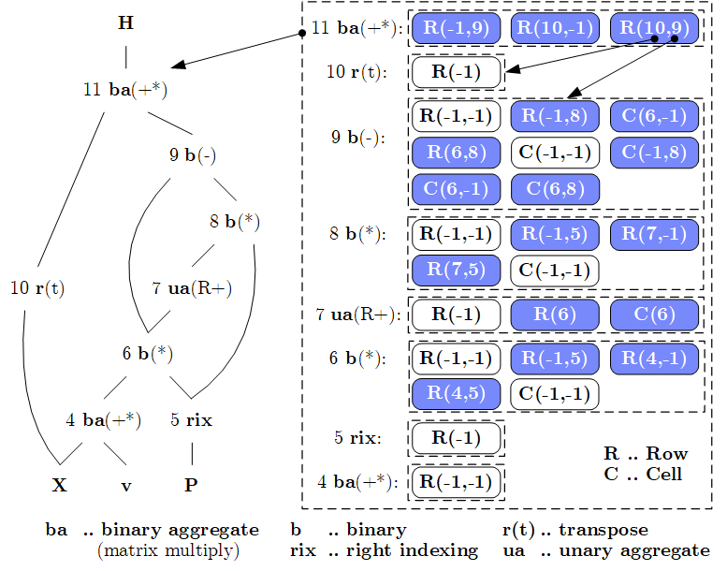
Candidate Exploration
(by example MLogreg Row template)
Memo Table
Memo Table for partial
fusion plans (candidates)
OFMC Template
Fusion API
  Open
  Fuse, Merge
  Close
OFMC
Algorithm
  Bottom-up
  Exploration
  (single-pass,
  template-
  agnostic)
  Linear space
  and time

Slide 9
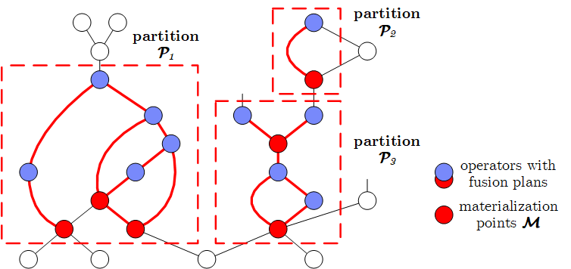
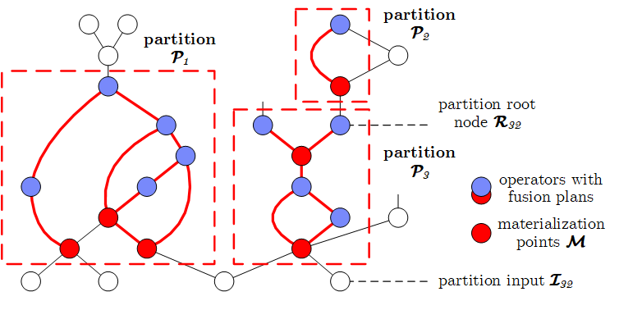
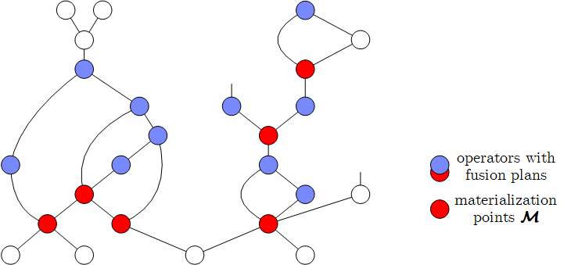
Candidate Selection I
(Plan Partitions and Interesting Points)
#1 Determine Plan Partitions
  Materialization
  Points M
  Connected components
  of fusion references
  Root and input nodes
  Optimize partitions
  independently
#2 Determine Interesting Points
  Materialization Point Consumers: Each data dependency on materialization points considered separately
  Template / Sparse Switches: Data dependencies where producer has templates that are non-existing for consumers
  ➔ Optimizer considers all 2^{|M’i|} plans (with |M’_{i}| ≥ |M_{i}|) per partition

Slide 10
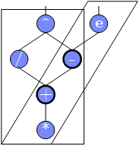
Candidate Selection II
(Costs and Constraints)
Overview Cost Model
  Cost partition with analytical cost model
  based on peak memory and compute bandwidth
  Plan comparisons / fusion errors don’t propagate / dynamic recompilation
#3 Evaluate Costs
  #1: Memoization of already processed sub-DAGs
  #2: Account for shared reads and CSEs within operators
  #3: Account for redundant computation (overlap)
  ➔ DAG traversal and cost vectors per fused operator
  (with memoization of pairs of operators and cost vectors)
#4 Handle Constraints
  Prefiltering violated constraints (e.g., row template in distributed ops)
  Assign infinite costs for violated constraints during costing

Slide 11
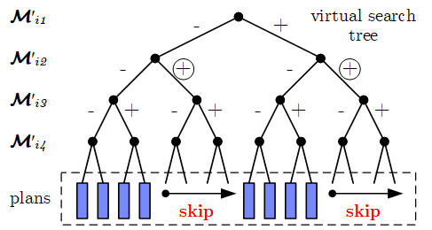
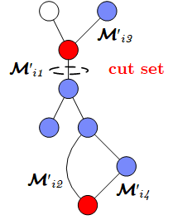
Candidate Selection III
(Enumeration Algorithm MPSkipEnum and Pruning)
#5 Basic Enumeration
  Linearized search space: from - to *
#6 Cost-Based Pruning
  Upper bound: cost C^{U} of best plan q* (monotonically decreasing)
  Opening heuristic: evaluate FA and FNR heuristics first
  Lower bound: C^{LS} (read input, write output, min compute) + dynamic C^{LD} (materialize intermediates q) ➔ skip subspace if C^{U} ≤ C^{LS +} C^{LD}
#7 Structural Pruning
  Observation: Assignments can create independent sub problems
  Build reachability graph to determine cut sets
  During enum: probe cut sets, recursive enum, combine, and skip
for( j in 1:pow(2,|M’_{i}|) )
q = createAssignment(j)
C = getPlanCost(P_{i}, q)
maintainBest(q, C)

Slide 12
Experimental Setting
Setup
  1+6 node cluster (head 2x4 Intel Xeon E5530, 64GB RAM; 6workers 2x6 Intel Xeon E5-2440, 96GB RAM, peak 2x32GB/s 2x115GFLOP/s, 10Gb Ethn)
  Modern scale-up server (2x20 Intel Xeon Gold 6138, 768GB RAM, peak 2x119 GB/s 2x1.25TFLOP/s)
  Java 1.8.0, Hadoop 2.7.3, Spark 2.2.0 (client w/ 35GB driver, 6 executors w/ 65 GB and 24 cores, aggregate cluster memory: 234 GB)
Baselines
  SystemML 1.0++ (Feb 2018): Base, Fused (hand-coded, default),
  Gen (optimizer), and heuristics FA (all) and FNR (no redundancy)
  Julia 0.6.2 (Dec 13 2017): LLVM code generation, Julia
  (without fusion) and JuliaGen (fusion via dot syntax)
  TensorFlow 1.5 (Jan 26 2018): TF (without fusion), and TFGen
  (fusion via TensorFlow XLA), limited support for sparse

Slide 13
Operations Performance
dense
Cell Template: sum(X*Y*Z)
sparse (0.1)
Row: t(X)%*%(w*(X%*%v))
Outer: sum(X*log(U%*%t(V)+1e-15))
TF w/ manual rewrite
→ t(t(w*(X%*%v))%*%X):
9.2 s to 1.6 s (compared to Gen 283ms)
dense
20K x 20K,
rank 100

Slide 14
L2SVM End-to-End Performance
(20 outer/∞ inner iterations, reg., tight eps)
Local and
Distributed
[seconds]
Julia Comparison
  Dataset: 10⁸ x 10 (8GB)
  Hand-tuned fusion
  script for JuliaGen
Data | Base | Fused* | Gen | FA | FNR
10⁸ x 10, D | 446 | 276 | 37 | 44 | 92
Airline78, D | 151 | 105 | 24 | 26 | 45
Mnist8m, S | 203 | 156 | 113 | 115 | 116
#1 Heuristics struggle w/ hybrid plans
2*10⁸ x 100, D | 1218 | 895 | 347 | 1433 | 539
2*10⁸ x 10³, S | 1481 | 1066 | 373 | 2205 | 575
Mnist80m, S | 1593 | 1114 | 552 | 1312 | 896

Slide 15
ALS-CG End-to-End Performance
(20 outer/20 inner iterations, rank 20)
ALG-CG
  Representative for many matrix factorization algorithms
  Requires sparsity exploitation in loss computation and update rules
Local single node [seconds]
Data | Base | Fused* | Gen | FA | FNR
10⁴ x 10⁴, S (0.01) | 426 | 20 | 25 | 215 | 226
10⁵ x 10⁵, S (0.01) | 23,585 | 96 | 80 | 13,511 | 12,353
10⁶ x 10⁶, S (0.01) | N/A | 860 | 722 | N/A | N/A
Netflix | N/A | 1,026 | 789 | N/A | N/A
Amazon Books | N/A | 17,335 | 7,420 | N/A | N/A
(8,026,324 x 2,330,066; sparsity=0.0000012)
#2 Heuristics struggle w/ sparsity exploitation
#3 Heuristics struggle w/ complex DAGs (see paper)

Slide 16
Conclusions
Summary
  Exact, cost-based optimizer for operator fusion plans over DAGs of LA ops
  End-to-end compiler and runtime integration into SystemML
Additional contributions (in the paper)
  Fused operators for sparsity-exploitation, and compressed matrices
  Graceful approximation, plan and operator caching, and rewrites
  Experiments for operations, compilation overhead, algorithms
Conclusions
  Significant end-to-end improvements due to generality and cost-awareness
  Low compilation overhead due to fast compiler, pruning, and op/plan caching
  Optimizing fusion plans is a corner-stone of future declarative ML systems
Available open source in SystemML
https://github.com/apache/systemml

Slide 17
Backup: Compilation Overhead
Java Class Compilation and Loading
Partitioning
and Pruning
w/ operator cache
- Total codegen overhead: 55ms 366ms 350ms 112ms 1067ms 491ms

