Slide 1

Architecture of ML Systems*
01 Introduction and System Landscape
Last update: Aug 25, 2022

Slide 2





About Me
Since 09/2022 TU Berlin, Germany
  University professor for Big Data Engineering (DAMS)
  https://github.com/apache/systemds
2018-2022 TU Graz, Austria
  BMK endowed chair for data management
  Data management for data science (DAMS)
  (ML systems internals, end-to-end data science lifecycle)
2012-2018 IBM Research – Almaden, USA
  Declarative large-scale machine learning
  Optimizer and runtime of Apache SystemML
2007-2011 PhD TU Dresden, Germany
  Cost-based optimization of integration flows
  Systems support for time series forecasting
  In-memory indexing and query processing
DB group

Slide 3
Agenda
Motivation and Goals
Course Organization, Outline, Exercise/Projects
Data Science Lifecycle & ML Systems Stack
Apache SystemDS and DAPHNE

Slide 4
Motivation and Goals

Slide 5
Example ML Applications (Past/Present)
Motivation and Goals
Transportation / Space
  Lemon car detection and reacquisition (classification, seq. mining)
  Airport passenger flows from WiFi data (time series forecasting)
  Data analysis for assisted driving (various use cases)
  Automotive vehicle development (ML-assisted simulations)
  Satellite senor analytics (regression and correlation)
  Earth observation and local climate zone classification and monitoring
Finance
  Water cost index based on various influencing factors (regression)
  Insurance claim cost per customer (model selection, regression)
  Financial analysts survey correlation (bivariate stats w/ new tests)
Health Care
  Breast cancer cell grow from histopathology images (classification)
  Glucose trends and warnings (clustering, classification)
  Emergency room diagnosis / patient similarity (classification, clustering)
  Patient survival analysis and prediction (Cox regression, Kaplan-Meier)

Slide 6
A Car Reacquisition Scenario
Motivation and Goals
Features
Labels
Machine
Learning
Algorithm
Class skew
Low precision
Warranty Claims
Algorithm
Predictive Models
Repair History
Algorithm
Diagnostic Readouts
Algorithm
➔ 25x
improved precision
+ custom loss functions
+ hyper-parameter tuning

Slide 7
Example ML Applications (Past/Present), cont.
Motivation and Goals
Production/Manufacturing
  Paper and fertilizer production (regression/classification, anomalies)
  Semiconductor manufacturing, and material degradation modeling
  Mixed waste sorting and recycling (composition, alignment, quality)
Other Domains
  Machine data: errors and correlation (bivariate stats, seq. mining)
  Smart grid: energy demand/RES supply, weather models (forecasting)
  Elastic flattening via sparse linear algebra (spring-mass system)
Information Extraction
  NLP contracts → rights/obligations (classification, error analysis)
  PDF table recognition and extraction, OCR (NMF clustering, custom)
  Learning explainable linguistic expressions (learned FOL rules, classification)
Algorithm Research (+ various state-of-the art algorithms)
  User/product recommendations via various forms of NMF
  Localized, supervised metric learning (dim reduction and classification)
  Learning word embeddings via orthogonalized skip-gram

Slide 8
What is an ML System?
Motivation and Goals
Classification
Regression
Recommenders
Clustering
Dim Reduction
Neural Networks
Statistics
Data Mining
Machine Learning (ML)
ML Applications
(entire KDD/DS lifecycle)
Rapidly Evolving
Runtime Techniques (Execution, Data Access)
ML System
Compilation Techniques
Distributed Systems
HPC
Data Management
Accelerators
Operating Systems
Prog. Language Compilers
HW Architecture

Slide 9
What is an ML System?, cont.
Motivation and Goals
ML System
  Narrow focus: SW system that executes ML applications
  Broad focus: Entire system (HW, compiler/runtime, ML application)
  Trade-off runtime/resources vs accuracy
  Early days: no standardizations (except some exchange formats), lots of different languages and system architectures, but many shared concepts
Course Objectives
  Architecture and internals of modern (large-scale) ML systems
    Macroscopic view of ML pipelines and data science lifecycle
    Microscopic view of ML system internals
  #1 Understanding of characteristics → better evaluation / usage
  #2 Understanding of effective techniques → build/extend ML systems

Slide 10
Course Organization, Outline, and Exercise/Projects
Partially based on
[Matthias Boehm, Arun Kumar, Jun Yang: Data Management in Machine Learning Systems. Synthesis Lectures on Data Management, Morgan & Claypool Publishers 2019]
Updates in SS2019, SS2020, SS2021, and SS2022

Slide 11
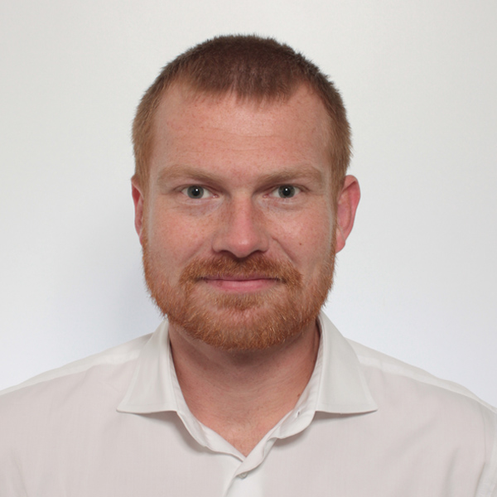


Basic Course Organization & Logistics
Course Organization, Outline, Exercise/Projects
Staff
  Lecturer: Univ.-Prof. Dr.-Ing. Matthias Boehm, ISDS
  Assistants: M.Sc. Sebastian Baunsgaard, M.Tech. Arnab Phani
Language
  Lectures and slides: English
  Communication and examination: English/German/Danish
Course Format
  Block lectures August 29 and 30, 8am-5pm (with informal language)
  5 and 4 sessions per day with 15/30min breaks
  Website: https://mboehm7.github.io/teaching/fs22_amls/index.htm
  Grading: Pass/fail (with mandatory exercise/programming project)
Prerequisites (preferred)
  Basic courses Data Management/Databases, and
  Basic courses on applied ML / Knowledge Discovery and Data Mining

Slide 12
Course Outline
Course Organization, Outline, Exercise/Projects
A: ML Lifecycle Systems (August 29)
01 Introduction and System Landscape [Aug 29, 8am]
02 Data Preparation, Cleaning, and Augmentation [Aug 29, 10.15am]
03 Model Selection, Debugging/Explainability/Fairness [Aug 29, 12.45pm]
Discussion/Implementation Programming Projects [Aug 29, 3pm]
04 Model Deployment and Serving [Aug 29, 3.30pm]
B: ML System Internals (August 30)
05 Compilation and Optimization Techniques [Aug 30, 8am]
06 Execution and Parallelization Strategies [Aug 30, 10.15am]
07 HW Accelerators and Data Access Methods [Aug 30, 12.45am]
Discussion/Implementation Programming Projects [Aug 30, 3pm]

Slide 13


Exercise / Projects (due Sep 20)
Course Organization, Outline, Exercise/Projects
#1 Exercise on ML Pipelines
  https://mboehm7.github.io/teaching/fs22_amls/AMLS_2022_Exercise.pdf
  Data Prep: Setup train/test/validation splits; perform
  data validation, data augmentation, feature engineering
  Modeling: Compare multiple baseline models using an OSS ML system
  Tuning: hyper-parameter tuning and cross validation
  Parallelization: parallelize your ML pipeline (at least the tuning part)
  Debugging: Perform model debugging and investigate explainability
#2 Apache SystemDS Projects
  https://issues.apache.org/jira/secure/Dashboard.jspa?selectPageId=12335852#Filter-Results/12365413
  Features across the stack (built-in scripts, APIs, compiler, runtime)
#3 DAPHNE Projects
  https://mboehm7.github.io/teaching/ss22_amls/AMLS_DAPHNE_projects.pdf
  OSS since 03/2022; Features at level of runtime, compiler, tools

Slide 14
Data Science Lifecycle and System Landscape

Slide 15




The Data Science Lifecycle
Data Science Lifecycle
Data-centric View:
Application perspective
Workload perspective
System perspective
Data Scientist
Data Integration
Data Cleaning
Data Preparation
Model Selection
Training
Hyper-parameters
Validate & Debug
Deployment
Scoring & Feedback
Exploratory Process
(experimentation, refinements, ML pipelines)
Data/SW Engineer
DevOps Engineer

Slide 16
The Data Science Lifecycle, cont.
Data Science Lifecycle
Classic KDD Process (Knowledge Discovery in Databases)
  Descriptive (association rules, clustering) and predictive
  1990-2010
Evaluate
Mining
Transform
Preprocess
Select
[Usama M. Fayyad, Gregory Piatetsky-Shapiro, Padhraic Smyth: From Data Mining to Knowledge Discovery in Databases. AI Magazine 17(3) (1996)]

Slide 17
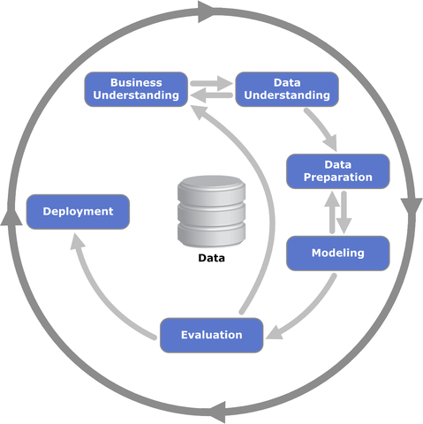
The Data Science Lifecycle, cont.
Data Science Lifecycle
CRISP-DM
  CRoss-Industry
  Standard Process for
  Data Mining
  Additional focus on
  business understanding
  and deployment
[https://statistik-dresden.de/archives/1128]

Slide 18
The 80% Argument
Data Science Lifecycle
Data Sourcing Effort
  Data scientists spend 80-90% time on finding
  relevant datasets and data integration/cleaning.
Technical Debts in ML Systems
  Glue code, pipeline jungles, dead code paths
  Plain-old-data types, multiple languages, prototypes
  Abstraction and configuration debts
  Data testing, reproducibility, process management, and cultural debts
[Michael Stonebraker, Ihab F. Ilyas: Data Integration: The Current Status and the Way Forward.
IEEE Data Eng. Bull. 41(2) (2018)]
ML
[D. Sculley et al.: Hidden Technical Debt in Machine Learning Systems. NIPS 2015]

Slide 19
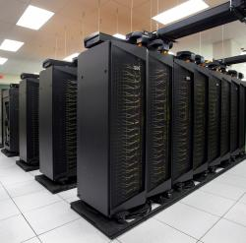
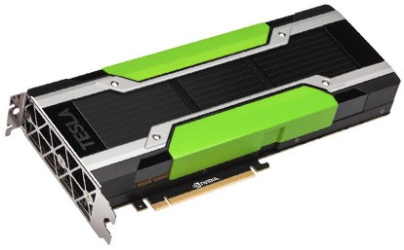
Driving Factors for ML
ML Systems Stack
[Credit: Andrew Ng’14]
Improved Algorithms and Models
  Success across data and application domains
  (e.g., health care, finance, transport, production)
  More complex models which leverage large data
Availability of Large Data Collections
  Increasing automation and monitoring ➔ data
  (simplified by cloud computing & services)
  Feedback loops, simulation/data prog./augmentation
  → Trend: self-supervised learning
HW & SW Advancements
  Higher performance of hardware and infrastructure (cloud)
  Open-source large-scale computation frameworks,
  ML systems, and vendor-provides libraries
Feedback Loop
Data
Usage
Model

Slide 20
Stack of ML Systems
ML Systems Stack
Deployment & Scoring
Validation & Debugging
Training
Hyper-parameter Tuning
ML Apps & Algorithms
Supervised, unsupervised, RL
linear algebra, libs, AutoML
Model and Feature Selection
Language Abstractions
Eager interpretation, lazy evaluation, prog. compilation
Data Programming & Augmentation
Fault Tolerance
Approximation, lineage, checkpointing, checksums, ECC
Execution Strategies
Local, distributed, cloud
(data, task, parameter server)
Data Preparation
(e.g., one-hot, binning)
Data Representations
Dense & sparse tensor/matrix;
compress, partition, cache
Data Integration & Data Cleaning
CPUs, NUMA, GPUs, FPGAs, ASICs, RDMA, SSD/NVM
HW & Infrastructure
Improve accuracy vs. performance vs. resource requirements
➔ Specialization & Heterogeneity

Slide 21
Accelerators (GPUs, FPGAs, ASICs)
ML Systems Stack
Apps
Lang
Faults
Memory- vs Compute-intensive
  CPU: dense/sparse, large mem, high
  mem-bandwidth, moderate compute
  GPU: dense, small mem, slow PCI,
  very high mem-bandwidth / compute
Graphics Processing Units (GPUs)
  Extensively used for deep learning training and scoring
  NVIDIA Volta: “tensor cores” for 4x4 mm → 64 2B FMA instruction
Field-Programmable Gate Arrays (FPGAs)
  Customizable HW accelerators for prefiltering, compression, DL
  Examples: Microsoft Catapult/Brainwave Neural Processing Units (NPUs)
Application-Specific Integrated Circuits (ASIC)
  Spectrum of chips: DL accelerators to computer vision
  Examples: Google TPUs (64K 2B FMA), NVIDIA DLA, Intel NNP, IBM TrueNorth
Quantum Computers?
  Examples: IBM Q (Qiskit), Google Sycamore (Cirq → TensorFlow Quantum)
DL
Exec
Data
Ops
Roofline Analysis
HW
ML
Operational Intensity

Slide 22
Data Representation
ML Systems Stack
Apps
Lang
Faults
ML- vs DL-centric Systems
  ML: dense and sparse matrices or tensors, different sparse
  formats (CSR, CSC, COO), frames (heterogeneous)
  DL: mostly dense tensors, relies
  on embeddings for NLP, graphs
Data-Parallel Operations for ML
  Distributed matrices: RDD<MatrixIndexes,MatrixBlock>
  Data properties: distributed caching,
  partitioning, compression
Lossy Compression ➔ Acc/Perf-Tradeoff
  Sparsification (reduce non-zero values)
  Quantization (reduce value domain), learned
  Data types: bfloat16, Intel Flexpoint (mantissa, exp)
Exec
Data
HW
vec(Berlin) – vec(Germany)
+ vec(France) ≈ vec(Paris)
Node1
Node2
[Credit: Song Han’16]

Slide 23



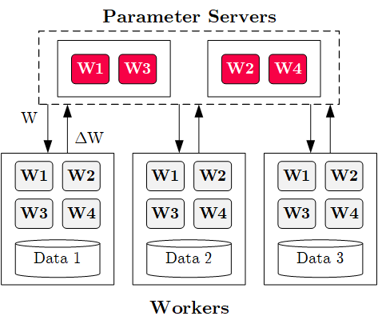



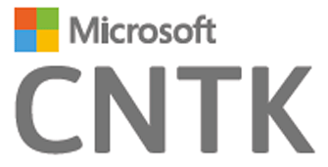
Execution Strategies
ML Systems Stack
Apps
Lang
Faults
Batch Algorithms: Data and Task Parallel
  Data-parallel operations
  Different physical operators
Mini-Batch Algorithms: Parameter Server
  Data-parallel and model-parallel PS
  Update strategies (e.g.,
  async, sync, backup)
  Data partitioning strategies
  Federated ML (trend 2018)
Lots of PS Decisions ➔ Acc/Perf-Tradeoff
  Configurations (#workers, batch size/param schedules, update type/freq)
  Transfer optimizations: lossy compression, sparsification, residual accumulation, gradient clipping, and momentum corrections
Exec
Data
HW

Slide 24
Fault Tolerance & Resilience
ML Systems Stack
Apps
Lang
Faults
Resilience Problem
  Increasing error rates at scale
  (soft/hard mem/disk/net errors)
  Robustness for preemption
  Need cost-effective resilience
Fault Tolerance in Large-Scale Computation
  Block replication (min=1, max=3) in distributed file systems
  ECC; checksums for blocks, broadcast, shuffle
  Checkpointing (MapReduce: all task outputs; Spark/DL: on request)
  Lineage-based recomputation for recovery in Spark
ML-specific Schemes (exploit app characteristics)
  Estimate contribution from lost partition to avoid strugglers
  Example: user-defined “compensation” functions
Exec
Data
HW

Slide 25
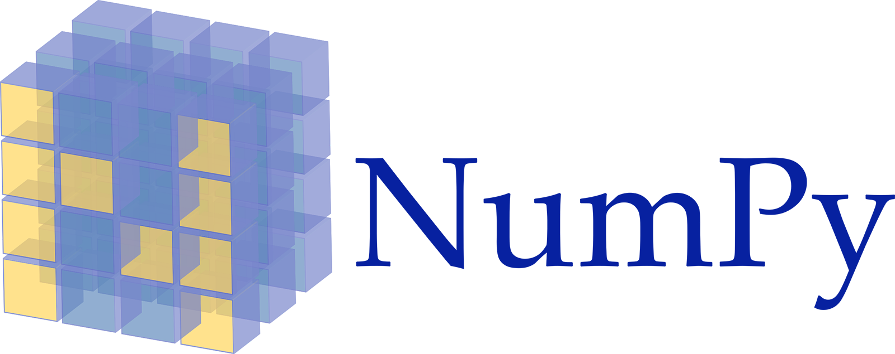

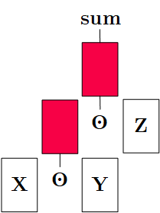
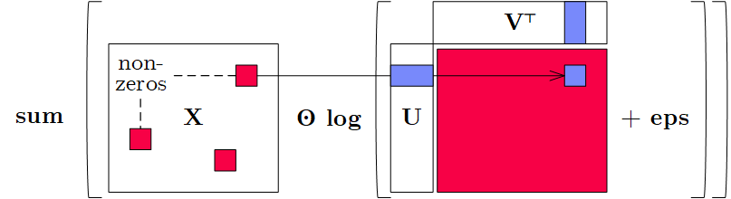
Language Abstractions
ML Systems Stack
Apps
Lang
Faults
Optimization Scope
  #1 Eager Interpretation (debugging, no opt)
  #2 Lazy expression evaluation
  (some opt, avoid materialization)
  #3 Program compilation (full opt, difficult)
Optimization Objective
  Most common: min time s.t. memory constraints
  Multi-objective: min cost s.t. time, min time s.t. acc, max acc s.t. time
Trend: Fusion and Code Generation
  Custom fused operations
  Examples: SystemML,
  Weld, Taco, Julia,
  TF XLA,TVM, TensorRT
Exec
Data
HW
Sparsity-Exploiting Operator

Slide 26

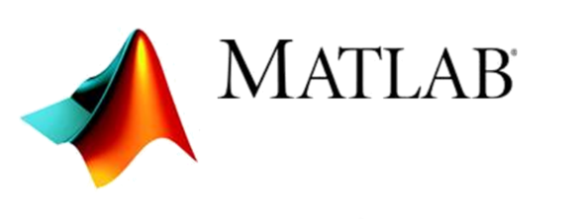


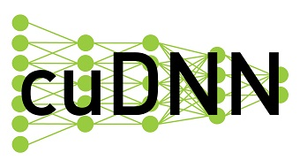
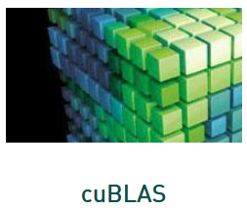



Landscape of ML Systems, cont.
Language Abstractions and System Architectures
#1 Language Abstraction
#2 Execution Strategies
Linear Algebra Programs
Other Language Abstractions
UDF-based Systems
Graph-based Systems
Linear Algebra Systems
ML Libraries
DNN Frameworks
Feature-centric Frameworks
Parameter Server
(Modell-Parallel)
Computation Graphs
Task-Parallel Constructs
Algorithm Libraries
Data-Parallel Operations
Operator Libraries
Collections
Local (single node)
Graphs
Matrices
HW accelerators (GPUs, FPGAs, ASICs)
Tensors
Frames
Distributed
#4 Data Types
#3 Distribution

Slide 27
ML Applications
ML Systems Stack
Apps
Lang
Faults
ML Algorithms (cost/benefit – time vs acc)
  Unsupervised/supervised; batch/mini-batch; first/second-order ML
  Mini-batch DL: variety of NN architectures and SGD optimizers
Specialized Apps: Video Analytics
in NoScope (time vs acc)
  Difference detectors / specialized
  models for “short-circuit evaluation”
AutoML (time vs acc)
  Not algorithms but tasks (e.g., doClassify(X, y) + search space)
  Examples: MLBase, Auto-WEKA, TuPAQ, Auto-sklearn, Auto-WEKA 2.0
  AutoML services at Microsoft Azure, Amazon AWS, Google Cloud
Data Programming and Augmentation (acc?)
  Generate noisy labels for pre-training
  Exploit expert rules, simulation models,
  rotations/shifting, and labeling IDEs (Software 2.0)
Exec
Data
HW
[Credit: Daniel Kang‘17]
[Credit: Jonathan Tremblay‘18]

Slide 28


Apache SystemDS:
A Declarative ML System for the
End-to-End Data Science Lifecycle
Background and System Architecture
https://github.com/apache/systemds

Slide 29


Landscape of ML Systems
Overview Apache SystemDS
Existing ML Systems
  #1 Numerical computing frameworks
  #2 ML Algorithm libraries (local, large-scale)
  #3 Linear algebra ML systems (large-scale)
  #4 Deep neural network (DNN) frameworks
  #5 Model management, and deployment
Exploratory Data-Science Lifecycle
  Open-ended problems w/ underspecified objectives
  Hypotheses, data integration, run analytics
  Unknown value → lack of system infrastructure
  → Redundancy of manual efforts and computation
Data Preparation Problem
  80% Argument: 80-90% time for finding, integrating, cleaning data
  Diversity of tools ➔ boundary crossing, lack of optimization
“Take these datasets and show value or competitive advantage”
[NIPS 2015]
[DEBull 2018]

Slide 30
The Data Science Lifecycle aka KDD Process aka CRISP-DM
Overview Apache SystemDS
Data-centric View:
Application perspective
Workload perspective
System perspective
Data extraction, schema alignment, entity resolution, data validation, data cleaning, outlier detection, missing value imputation, semantic type detection, data augmentation, feature selection, feature engineering, feature transformations
Data Scientist
Data Integration
Data Cleaning
Data Preparation
Data Integration
Data Cleaning
Data Preparation
Model Selection
Training
Hyper-parameters
Validate & Debug
Deployment
Scoring & Feedback
Exploratory Process
(experimentation, refinements, ML pipelines)
Data/SW Engineer
DevOps Engineer
Key observation: SotA
data integration/cleaning based on ML

Slide 31
Example: Linear Regression Conjugate Gradient
Overview Apache SystemDS
1: X = read($1); # n x m matrix
2: y = read($2); # n x 1 vector
3: maxi = 50; lambda = 0.001;
4: intercept = $3;
5: ...
6: r = -(t(X) %*% y);
7: norm_r2 = sum(r * r); p = -r;
8: w = matrix(0, ncol(X), 1); i = 0;
9: while(i<maxi & norm_r2>norm_r2_trgt)
10: {
11: q = (t(X) %*% (X %*% p))+lambda*p;
12: alpha = norm_r2 / sum(p * q);
13: w = w + alpha * p;
14: old_norm_r2 = norm_r2;
15: r = r + alpha * q;
16: norm_r2 = sum(r * r);
17: beta = norm_r2 / old_norm_r2;
18: p = -r + beta * p; i = i + 1;
19: }
20: write(w, $4, format="text");
Note:
#1 Data Independence
#2 Implementation-Agnostic Operations
Read matrices from HDFS/S3
Compute initial gradient
Compute conjugate gradient
Compute
step size
Update model and residuals
➔ “Separation
of Concerns”

Slide 32
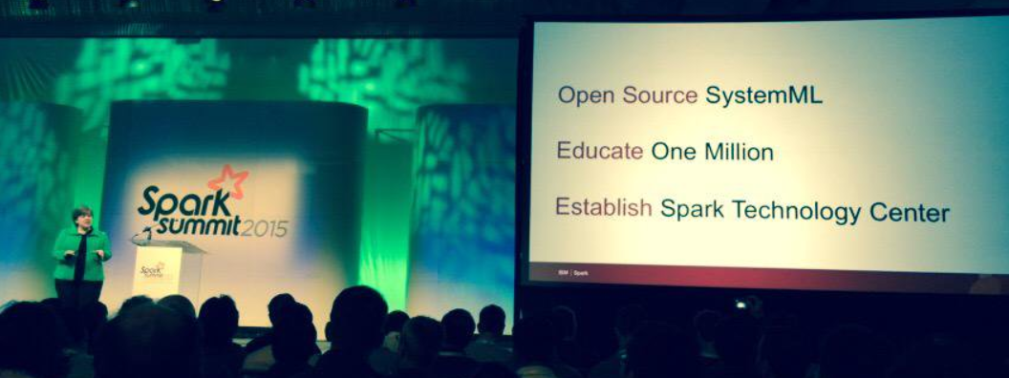



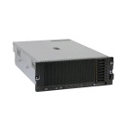
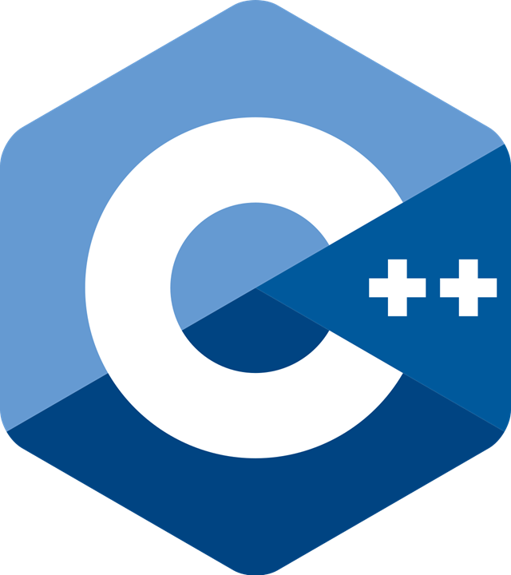
Apache SystemML/SystemDS
Overview Apache SystemDS
DML Scripts
APIs: Command line, JMLC,
Spark MLContext, Spark ML,
(20+ Scalable Algorithms)
Language
Compiler
[SIGMOD’15,’17,’19,’21abc,’23]
[PVLDB’14,’16ab,’18,’22]
[ICDE’11,’12,’15]
[CIDR’17,’20]
[VLDBJ’18]
[CIKM’22]
[DEBull’14]
[PPoPP’15]
07/2020 Renamed to SystemDS
05/2017 Apache Top-Level Project
11/2015 Apache Incubator Project
08/2015 Open Source Release
Runtime
Write Once, Run Anywhere
In-Memory Single Node
(scale-up)
Hadoop or Spark Cluster
(scale-out)
In-Progress:
GPU
since 2014/16
since 2012
since 2010/11
since 2015

Slide 33
Basic HOP and LOP DAG Compilation
Overview Apache SystemDS
LinregDS (Direct Solve)
X = read($1);
y = read($2);
intercept = $3;
lambda = 0.001;
...
if( intercept == 1 ) {
ones = matrix(1, nrow(X), 1);
X = append(X, ones);
}
I = matrix(1, ncol(X), 1);
A = t(X) %*% X + diag(I)*lambda;
b = t(X) %*% y;
beta = solve(A, b);
...
write(beta, $4);
Cluster Config:
driver mem: 20 GB
exec mem: 60 GB
Scenario:
X: 10⁸ x 10³, 10¹¹
y: 10⁸ x 1, 10⁸
HOP DAG
(after rewrites)
8KB
CP
write
8MB
16MB
CP
b(solve)
CP
172KB
b(+)
1.6TB
CP
SP
800GB
r(diag)
ba(+*)
ba(+*)
SP
1.6TB
r(t)
8KB
SP
CP
800GB
800MB
dg(rand)
(10³x1,10³)
X
(10⁸x10³,10¹¹)
y
(10⁸x1,10⁸)
LOP DAG
(after rewrites)
16KB
r’(CP)
Hybrid Runtime Plans:
  Size propagation / memory estimates
  Integrated CP / Spark runtime
  Dynamic recompilation during runtime
Distributed Matrices
  Fixed-size (squared) matrix blocks
  Data-parallel operations
mapmm(SP)
tsmm(SP)
800MB
1.6GB
r’(CP)
X
X_{1,1}
(persisted in MEM_DISK)
y
X_{2,1}
X_{m,1}

Slide 34
Static and Dynamic Rewrites
Overview Apache SystemDS
Example Static Rewrites (size-indep.)
  Common Subexpression Elimination
  Constant Folding / Branch Removal /
  Block Sequence Merge
  Static Simplification Rewrites
  Right/Left Indexing Vectorization
  For Loop Vectorization
  Spark checkpoint/repartition injection
Example Dynamic Rewrites (size-dep.)
  Dynamic Simplification Rewrites
  Matrix Mult Chain Optimization
trace(X%*%Y) → sum(X*t(Y))
Y
O(n³)
O(n²)
X
X
Y ┬
→
*
sum(λ*X) → λ*sum(X)
sum(X+Y) → sum(X)+sum(Y)
rowSums(X) → X, iff ncol(X)=1
sum(X^2) → X%*%t(X), iff ncol(X)=1
t(X)
1kx1k
X
1kx1k
Z
1
t(X)
1kx1k
X
1kx1k
p
1
Size propagation and sparsity estimation
→
2,002 MFLOPs
4 MFLOPs

Slide 35
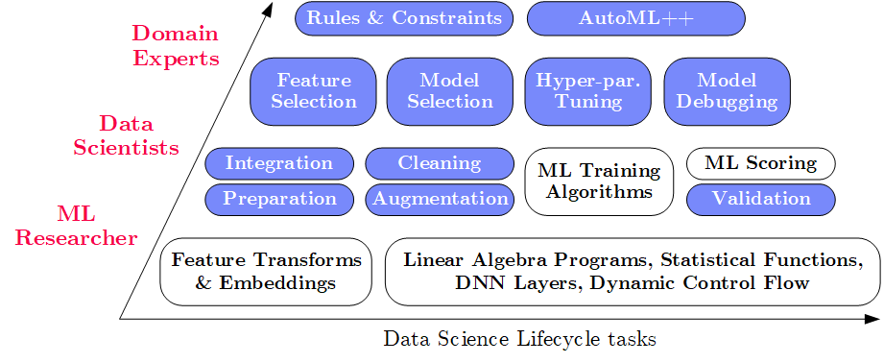
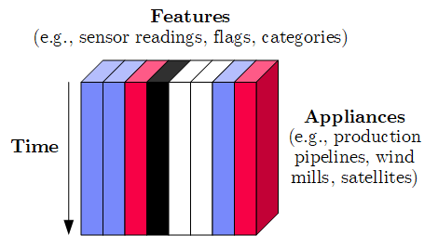
Apache SystemDS Design
Overview Apache SystemDS
Apache SystemML (since 2010)
→ SystemDS (09/2018)
→ Apache SystemDS (07/2020)
Objectives
  Effective and efficient data preparation, ML, and model debugging at scale
  High-level abstractions for different lifecycle tasks and users
#1 Based on DSL for ML Training/Scoring
  Hierarchy of abstractions for DS tasks
  ML-based SotA, interleaved, performance
#2 Hybrid Runtime Plans and Optimizing Compiler
  System infrastructure for diversity of algorithm classes
  Different parallelization strategies and new architectures (Federated ML)
  Abstractions → redundancy → automatic optimization
#3 Data Model: Heterogeneous Tensors
  Data integration/prep requires generic data model

Slide 36
Language Abstractions and APIs, cont.
Overview Apache SystemDS
Example: Stepwise Linear Regression
User Script
Built-in Functions
X = read(‘features.csv’)
Y = read(‘labels.csv’)
[B,S] = steplm(X, Y,
icpt=0, reg=0.001)
write(B, ‘model.txt’)
m_steplm = function(...) {
while( continue ) {
parfor( i in 1:n ) {
if( !fixed[1,i] ) {
Xi = cbind(Xg, X[,i])
B[,i] = lm(Xi, y, ...)
} }
# add best to Xg
# (AIC)
} }
m_lmCG = function(...) {
while( i<maxi&nr2>tgt ) {
q = (t(X) %*% (X %*% p))
+ lambda * p
beta = ... }
}
m_lm = function(...) {
if( ncol(X) > 1024 )
B = lmCG(X, y, ...)
else
B = lmDS(X, y, ...)
}
Linear Algebra Programs
Feature Selection
Facilitates optimization across data science lifecycle tasks
ML Algorithms
m_lmDS = function(...) {
l = matrix(reg,ncol(X),1)
A = t(X) %*% X + diag(l)
b = t(X) %*% y
beta = solve(A, b) ...}

Slide 37
Apache SystemDS Architecture
Overview Apache SystemDS
> 83,400 tests
> 8,500 DSL tests
[M. Boehm, I. Antonov, S. Baunsgaard, M. Dokter, R. Ginthör, K. Innerebner, F. Klezin, S. N. Lindstaedt,
A. Phani, B. Rath, B. Reinwald, S. Siddiqui, S. Benjamin Wrede: SystemDS: A Declarative Machine Learning System for the End-to-End Data Science Lifecycle. CIDR 2020]

Slide 38

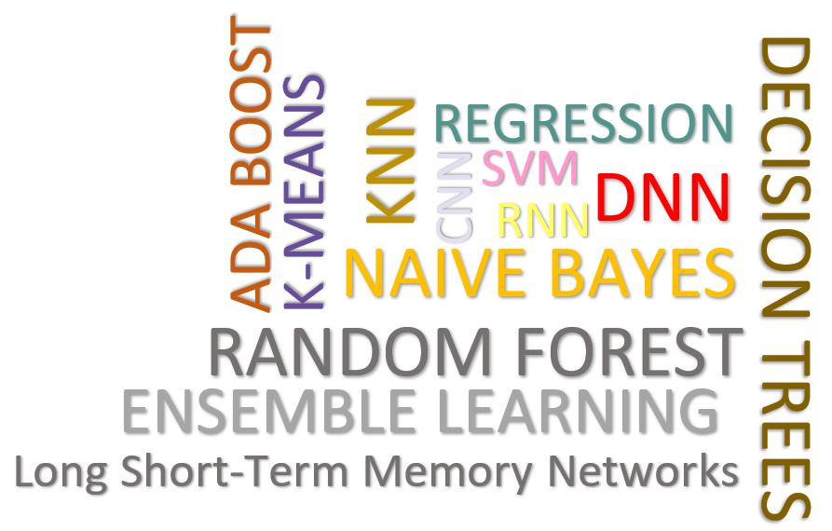
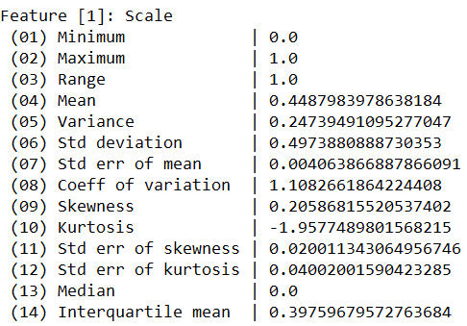
Data Cleaning Pipelines
Apache SystemDS: Selected Features and Research
[WIP] WashHouse:
Data Cleaning Benchmark
[under submission]
Automatic Generation of Cleaning Pipelines
  Library of robust, parameterized data cleaning primitives
  Enumeration of DAGs of primitives & hyper-parameter optimization (HB, BO)
Data Samples
Logical
Data- and Task-parallel Computation
O
Physical
LP₁
LP₂
…
LP_{n}
Top-k Pipelines
Target
App
…
…
…
PP₁
PP_{n}
PP₁
PP_{n}
PP₁
PP_{n}
Rules/Objectives
Outlier Detection → MVI → Deduplication → Resolve Mislabels
P_{1:} gmm → imputeFD → mergeDup → delML
P_{n:} outlierBySd→ mice → delDup → voting
Debugging
University | Country
TU Graz | Austria
TU Graz | Austria
TU Graz | Germany
IIT | India
IIT | IIT
IIT | Pakistan
IIT | India
SIBA | Pakistan
SIBA | null
SIBA | null
University | Country
TU Graz | Austria
TU Graz | Austria
TU Graz | Austria
IIT | India
IIT | India
IIT | India
IIT | India
SIBA | Pakistan
SIBA | Pakistan
SIBA | Pakistan
A | B | C | D
0.77 | 0.80 | 1 | 1
0.96 | 0.12 | 1 | 1
0.66 | 0.09 | null | 1
0.23 | 0.04 | 17 | 1
0.91 | 0.02 | 17 | null
0.21 | 0.38 | 17 | 1
0.31 | null | 17 | 1
0.75 | 0.21 | 20 | 1
null | null | 20 | 1
0.19 | 0.61 | 20 | 1
0.64 | 0.31 | 20 | 1
A | B | C | D
0.77 | 0.80 | 1 | 1
0.96 | 0.12 | 1 | 1
0.66 | 0.09 | 17 | 1
0.23 | 0.04 | 17 | 1
0.91 | 0.02 | 17 | 1
0.21 | 0.38 | 17 | 1
0.31 | 0.29 | 17 | 1
0.75 | 0.21 | 20 | 1
0.41 | 0.24 | 20 | 1
0.19 | 0.61 | 20 | 1
0.64 | 0.31 | 20 | 1
Dirty Data
After imputeFD(0.5)
Dirty Data
After MICE

Slide 39


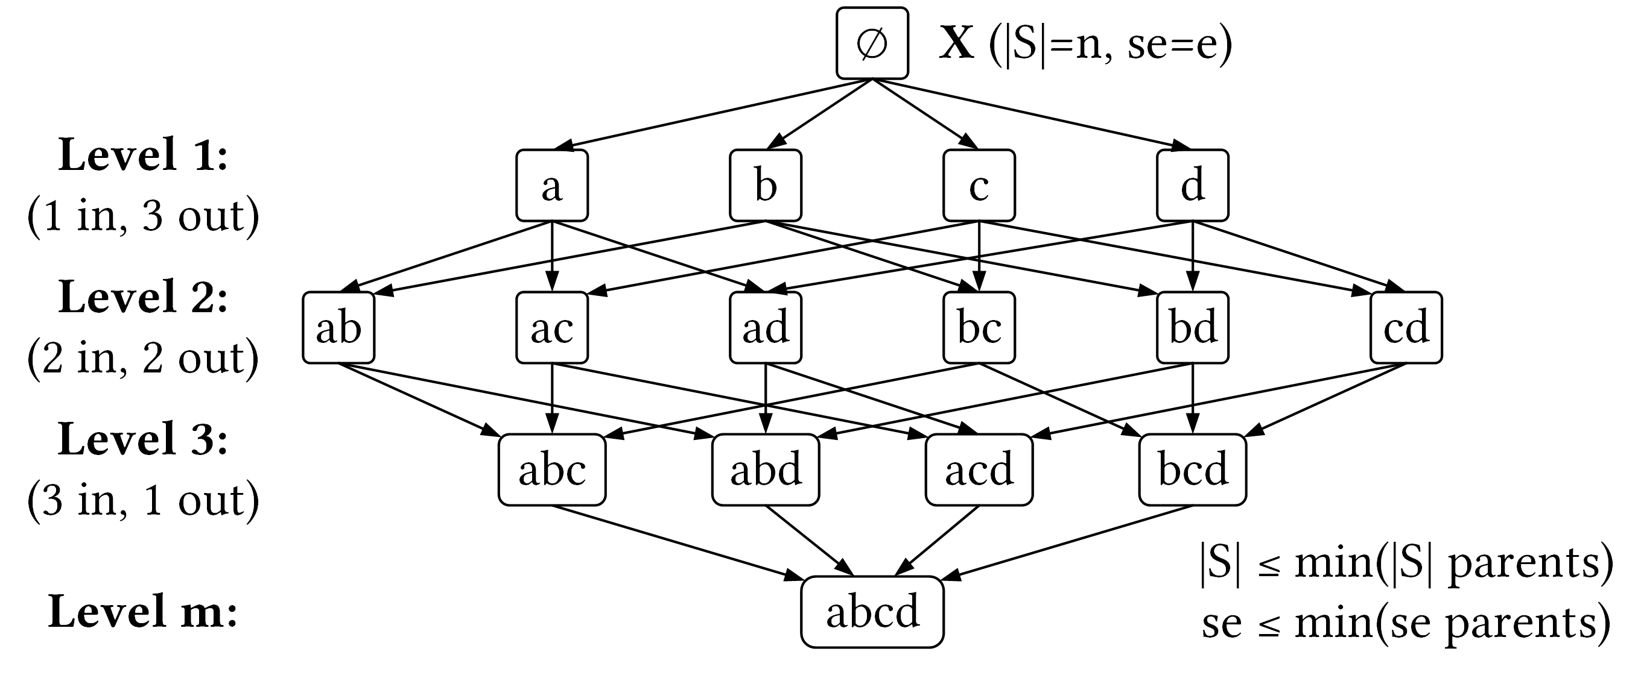
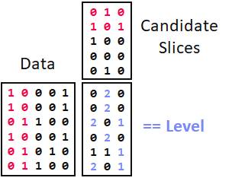
SliceLine for Model Debugging
Apache SystemDS: Selected Features and Research
[SIGMOD’21c]
[Credit: sliceline,
Silicon Valley, HBO]
Problem Formulation
  Intuitive slice
  scoring function
  Exact top-k slice finding
  $\left|S\right|≥σ∧sc\left(S\right)>0$
  $α∈(0,1]$
Properties & Pruning
  Monotonicity of slice sizes, errors
  Upper bound sizes/errors/scores
  → pruning & termination
Linear-Algebra-based Slice Finding
  Recoded matrix X, error vector e
  Vectorized implementation in linear algebra
  (join & eval via sparse-sparse matrix multiply)
  Local and distributed task/data-parallel execution
$$\begin{matrix}sc & = & α\left(\frac{\overline{e}(S)}{\overline{e}(X)}−1\right)−\left(1−α\right)\left(\frac{\left|X\right|}{\left|S\right|}−1\right) \\ & = & α\left(\frac{\left|X\right|}{\left|S\right|}⋅\frac{\sum_{i=1}^{|S|}{es_{i}}}{\sum_{i=1}^{|X|}{e_{i}}}−1\right)−\left(1−α\right)\left(\frac{\left|X\right|}{\left|S\right|}−1\right)\end{matrix}$$
slice error
slice size

Slide 40

Multi-Level Lineage Tracing & Reuse
Apache SystemDS: Selected Features and Research
[SIGMOD’21a]
Lineage as Key Enabling Technique
  Trace lineage of operations (incl. non-determinism), dedup for loops/functions
  Model versioning, data reuse, incremental maintenance, autodiff, debugging
Full Reuse of Intermediates
  Before executing instruction,
  probe output lineage in cache
  Map<Lineage, MatrixBlock>
  Cost-based/heuristic caching
  and eviction decisions (compiler-assisted)
Partial Reuse of Intermediates
  Problem: Often partial result overlap
  Reuse partial results via dedicated
  rewrites (compensation plans)
  Example: steplm
for( i in 1:numModels )
R[,i] = lm(X, y, lambda[i,], ...)
m_lmDS = function(...) {
l = matrix(reg,ncol(X),1)
A = t(X) %*% X + diag(l)
b = t(X) %*% y
beta = solve(A, b) ...}
m_steplm = function(...) {
while( continue ) {
parfor( i in 1:n ) {
if( !fixed[1,i] ) {
Xi = cbind(Xg, X[,i])
B[,i] = lm(Xi, y, ...)
} }
# add best to Xg
# (AIC)
} }
X
m>>n
t(X)

Slide 41
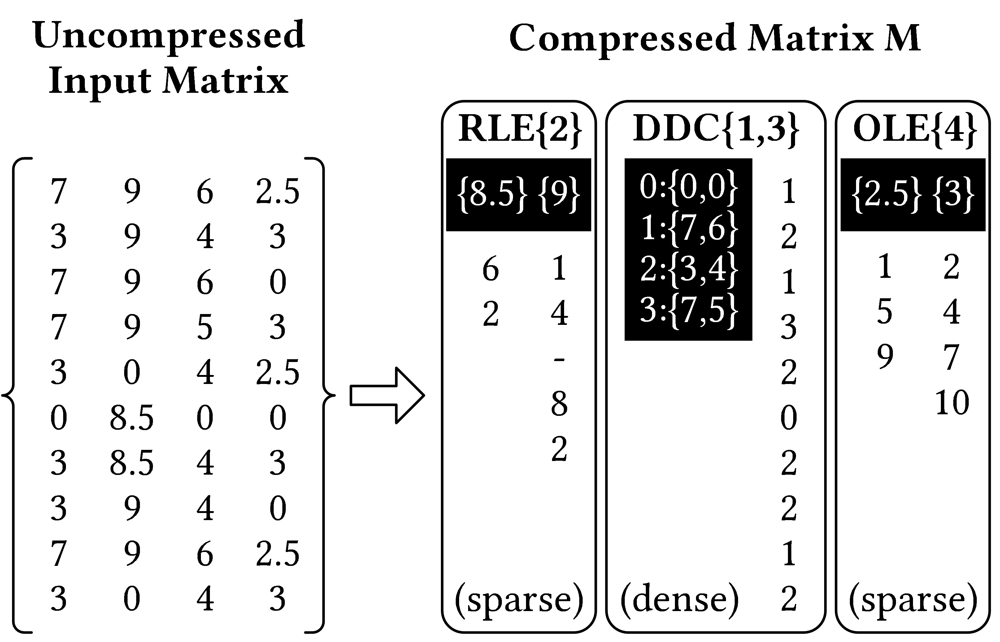
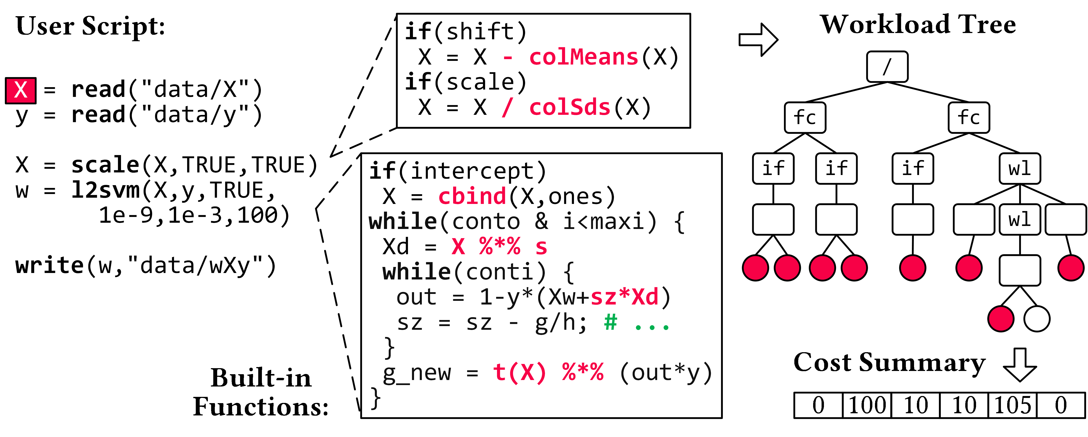
Compressed Linear Algebra Extended
Apache SystemDS: Selected Features and Research
[SIGMOD 2023]
Lossless Matrix Compression
  Improved general applicability (compression time, new compression schemes, new kernels, intermediates, workload-aware)
  Sparsity → Redundancy exploitation
  (data redundancy, structural redundancy)
Workload-aware Compression
  Workload summary → compression
  Compression → execution planning

Slide 42






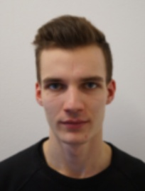



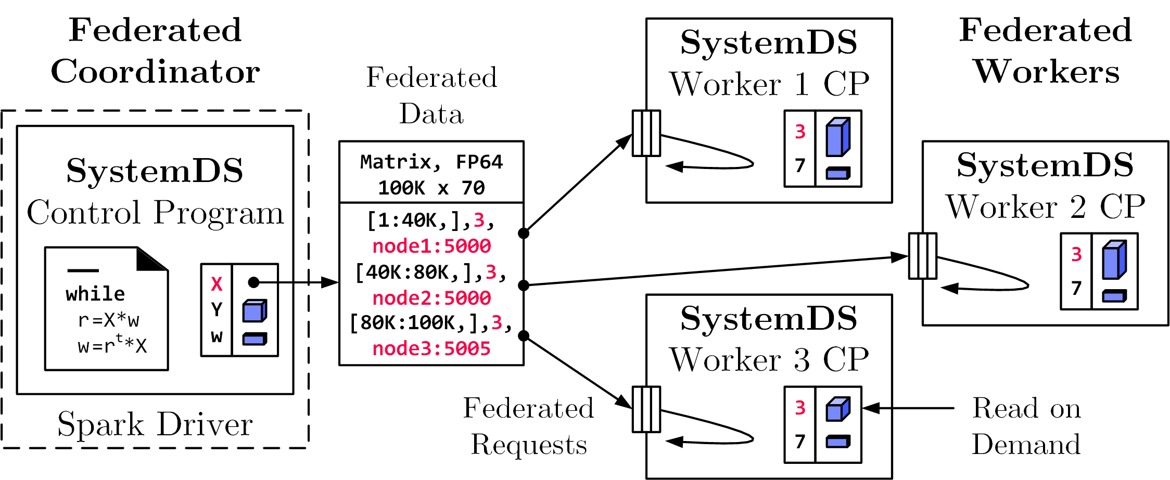
Federated Learning
Apache SystemDS
[SIGMOD 2021b, CIKM 2022]
Federated Backend
  Federated data (matrices/frames) as meta data objects
  Federated linear algebra, (and federated parameter server)
Federated Requests: READ, PUT, GET, EXEC_INST, EXEC_UDF, CLEAR
X = federated(addresses=list(node1, node2, node3),
ranges=list(list(0,0), list(40K,70), ..., list(80K,0), list(100K,70)));

Slide 43
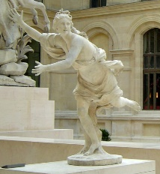















An Open and Extensible System Infrastructure for Integrated Data Analysis Pipelines https://daphne-eu.eu/
Integrated Data Analysis Pipelines
for Large-scale Data Management,
HPC, and Machine Learning;
DAPHNE daughter of river god Peneus (fountains, streams), chased by Apollo
The DAPHNE project is funded by the European Union's Horizon 2020 research and innovation program under grant agreement number 957407 for the time period from Dec/2020 through Nov/2024.
[Louvre, Paris]

Slide 44
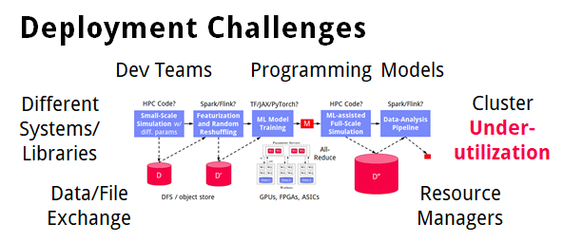
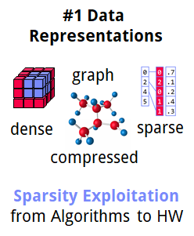
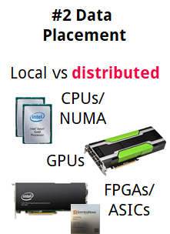
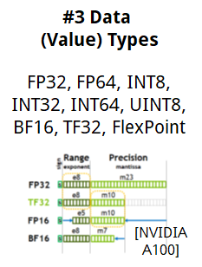
Motivation
➔ DAPHNE Overall Objective:
Open and extensible system infrastructure
DAPHNE Project
Integrated Data Analysis Pipelines
  Open data formats, query processing
  Data preprocessing and cleaning
  ML model training and scoring
  HPC, custom codes, and simulations
Hardware Challenges
  DM+ML+HPC share compilation
  and runtime techniques /
  converging cluster hardware
  End of Dennard scaling:
  P = α CFV² (power density 1)
  End of Moore’s law
  Amdahl’s law: sp = 1/s
  ➔ Increasing Specialization

Slide 45
DAPHNE Use Cases
DAPHNE Project
[Xiao Xiang Zhu et al: So2Sat LCZ42: A Benchmark Dataset for the Classification of Global Local Climate Zones. GRSM 2020]
DLR Earth Observation
  ESA Sentinel-1/2 datasets → 4PB/year
  Training of local climate zone classifiers on
  So2Sat LCZ42 (15 experts, 400K instances,
  10 labels each, 85% confidence, ~55GB H5)
  ML pipeline: preprocessing, ResNet18,
  climate models
IFAT Semiconductor Ion Beam Tuning
KAI Semiconductor Material Degradation
AVL Vehicle Dev Process (ejector geometries, KPIs)
ML-assisted simulations, data cleaning, augmentation
[So2Sat LC42 Dataset
https://mediatum.ub.tum.de/1454690]

Slide 46
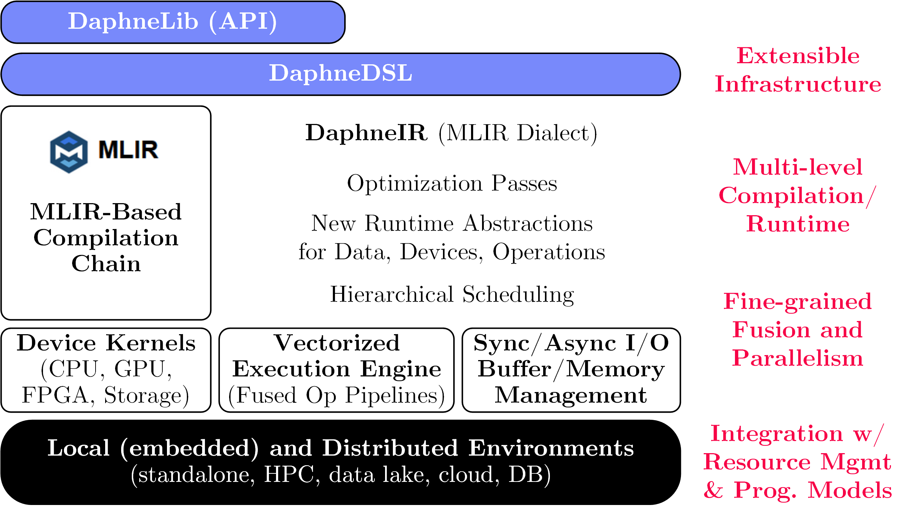
DAPHNE System Architecture
DAPHNE Project
[Patrick Damme et al.: DAPHNE: An Open and Extensible System Infrastructure for Integrated Data Analysis Pipelines, CIDR 2022]

Slide 47
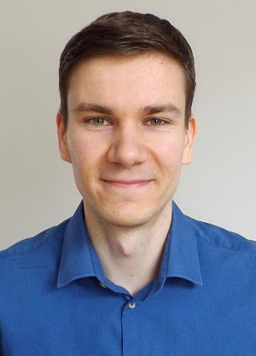

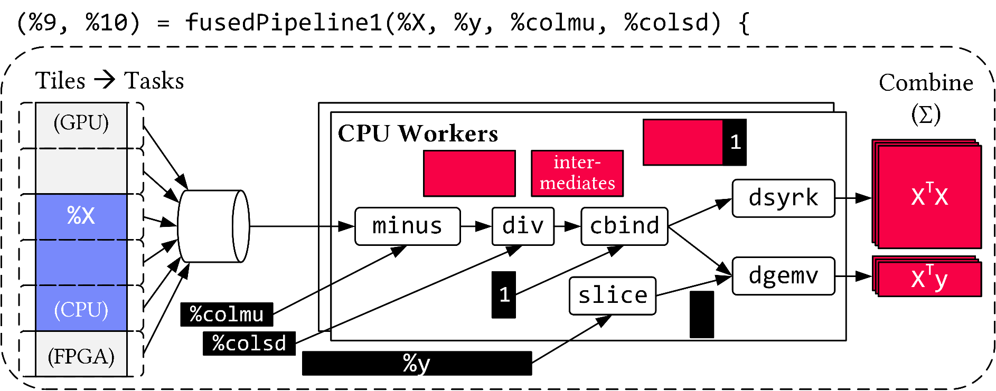
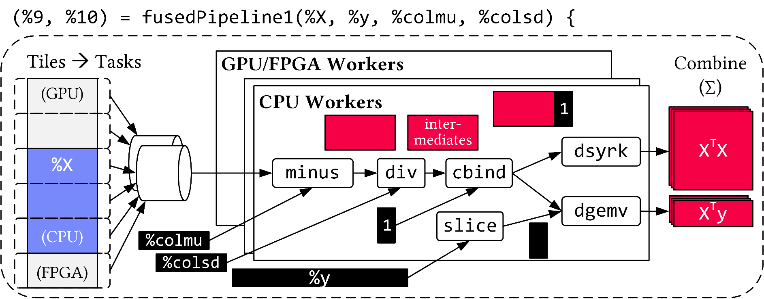
Vectorized (Tiled) Execution
DAPHNE Project
AH
AK
Default Parallelization
Frame & Matrix Ops
Locality-aware,
Multi-device Scheduling
Fused Operator Pipelines
on Tiles/Scalars + Codegen

Slide 48
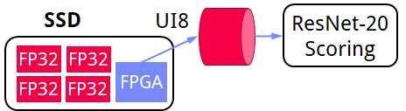
Vectorized (Tiled) Execution, cont.
DAPHNE Project
#1 Zero-copy Input Slicing
  Create view on sliced input (no-op)
  All kernels work on views
#2 Sparse Intermediates
  Reuse dense/sparse kernels
  Sparse pipeline intermediates for free
#3 Fine-grained Control
  Task sizes (dequeue, data access) vs data binding (cache-conscious ops)
  Scheduling for load balance (e.g., sparse operations)
#4 Computational Storage
  Task queues connect eBPF programs,
  async I/O into buffers, and op pipelines
Notes:
eBPF … Extended Berkeley Packet Filter

Slide 49
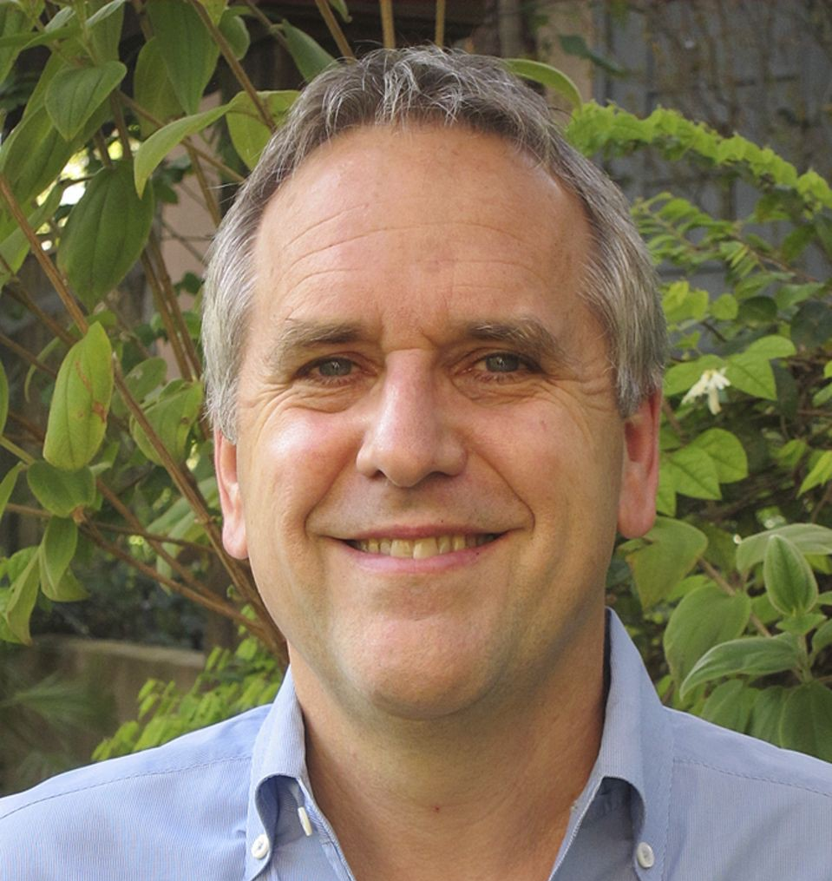
Summary and Q&A
Thanks
Motivation and Goals
Course Organization, Outline, Exercise/Projects
Data Science Lifecycle & ML Systems Stack
Apache SystemDS and DAPHNE
Recommended Reading (a critical perspective
on a broad sense of ML systems)
  [M. Jordan: SysML: Perspectives and
  Challenges. Keynote at SysML 2018]
  “ML […] is far from being a solid engineering
  discipline that can yield robust, scalable solutions
  to modern data-analytic problems”
  https://www.youtube.com/watch?v=4inIBmY8dQI

