Slide 1

Architecture of ML Systems*
02 Data Preparation, Cleaning, and Augmentation
Last update: Aug 25, 2022

Slide 2




Recap: The Data Science Lifecycle
Data Science Lifecycle
Data-centric View:
Application perspective
Workload perspective
System perspective
Data Scientist
Data Integration
Data Cleaning
Data Preparation
Model Selection
Training
Hyper-parameters
Validate & Debug
Deployment
Scoring & Feedback
Exploratory Process
(experimentation, refinements, ML pipelines)
Data/SW Engineer
DevOps Engineer

Slide 3
Agenda
Data Acquisition, Integration, and Validation
Feature Transformations and Engineering
Data Preparation and Cleaning
Data Augmentation
“least enjoyable tasks in data science lifecycle”

Slide 4
Data Acquisition, Integration, and Data Validation
Data Integration for ML and
ML for Data Integration

Slide 5
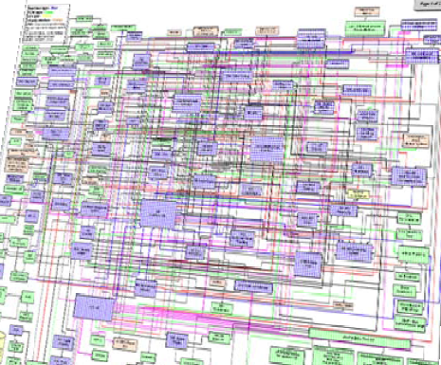
Data Sources and Heterogeneity
Data Acquisition, Integration, and Data Validation
Terminology
  Integration (Latin integer = whole): consolidation of data objects / sources
  Homogeneity (Greek homo/homoios = same): similarity
  Heterogeneity: dissimilarity, different representation / meaning
Heterogeneous IT Infrastructure
  Common enterprise IT infrastructure contains >100s of
  heterogeneous and distributed systems and applications
  E.g., health care data management: 20 - 120 systems
Multi-Modal Data (example health care)
  Structured patient data, patient records incl. prescribed drugs
  Knowledge base drug APIs (active pharmaceutical ingredients) + interactions
  Doctor notes (text), diagnostic codes, outcomes
  Radiology images (e.g., MRI scans), patient videos
  Time series (e.g., EEG, ECoG, heart rate, blood pressure)
[Credit:
Albert Maier]

Slide 6
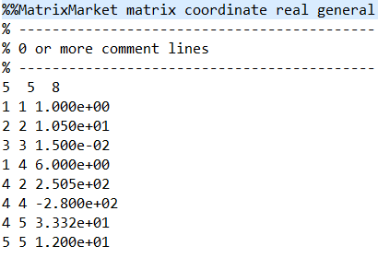
Types of Data Formats
Data Acquisition, Integration, and Data Validation
General-Purpose Formats
  CSV (comma separated values), JSON (javascript object notation), XML, Protobuf
  CLI/API access to DBs, KV-stores, doc-stores, time series DBs, etc
Sparse Matrix Formats
  Matrix market: text IJV (row, col, value)
  Libsvm: text compressed sparse rows
  Scientific formats: NetCDF, HDF5
Large-Scale Data Formats
  Parquet (columnar file format)
  Arrow (cross-platform columnar in-memory data)
Domain-Specific Formats
  Health care: DICOM images, HL7 messages (health-level seven, XML)
  Automotive: MDF (measurements), CDF (calibrations), ADF (auto-lead XML)
  Smart production: OPC (open platform communications)

Slide 7
Types of Heterogeneity
Data Acquisition, Integration, and Data Validation
[J. Hammer, M. Stonebraker, and O. Topsakal: THALIA: Test Harness for the Assessment of Legacy Information Integration Approaches. U Florida, TR05-001, 2005]
Heterogeneity
Semantic Heterogeneity
Structural Heterogeneity
Attribute Heterogeneity
Missing
Data
1. Synonyms/homonyms
6. Nulls (Missing Values)
9. Same attribute in different structure
2. Simple mapping (mathematical)
7. Virtual columns
8. Semantic incompatibility
10. Handling Sets
3. Different data types
11. Attribute name
w/o semantics
4. Complex mappings
5. Language expressions
12. Attribute composition

Slide 8
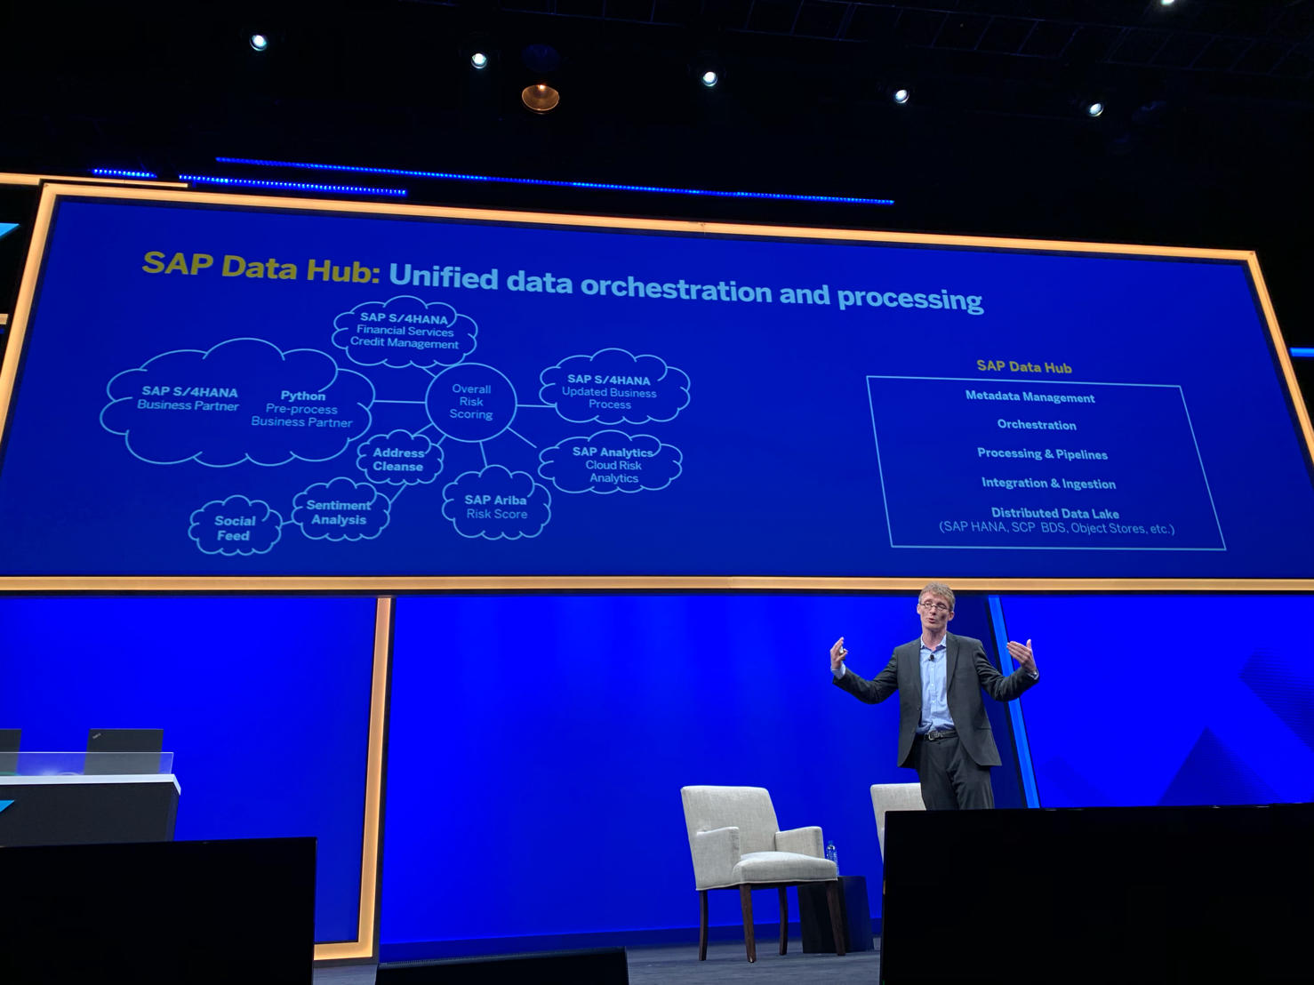
Identification of Data Sources
Data Acquisition, Integration, and Data Validation
Data Catalogs
  Data curation in repositories for finding relevant datasets in data lakes
  Metadata and provenance
  Augment data with open
  and linked data sources
Examples
[Alon Y. Halevy et al: Goods: Organizing Google's Datasets. SIGMOD 2016]
[Dan Brickley, Matthew Burgess, Natasha F. Noy: Google Dataset Search: Building a search engine for datasets in an open Web ecosystem. WWW 2019]
SAP Data Hub
Google Dataset Search
[SAP Sapphire Now 2019]

Slide 9
Schema Detection and Integration
Data Acquisition, Integration, and Data Validation
./data/players.csv:
pid,name,pos,jnum,ncid,tid
5435,Miroslav Klose,FW,11,789,144
6909,Manuel Neuer,GK,1,163,308
Syntactic Schema Detection
  Sample of the input dataset
  Extract basic data types via
  rules, and regular expressions
Feature Type Detection
  Numerical vs Categorical vs Ordinal
  Rules and trained ML models
Semantic Type Detection
  Extract common feature types
  (e.g., location, date, rank, name)
Dataset<Row> ds = sc.read()
.format("csv")
.option("header", true)
.option("inferSchema", true)
.option("samplingRatio", 0.001)
.load("./data/players.csv");
StructType(
StructField(pid,IntegerType,true),
StructField(name,StringType,true),
StructField(pos,StringType,true),
StructField(jnum,IntegerType,true),
StructField(ncid,IntegerType,true),
StructField(tid,IntegerType,true))
[Vraj Shah, Jonathan Lacanlale, Premanand Kumar, Kevin Yang, Arun Kumar: Towards Benchmarking Feature Type Inference for AutoML Platforms, SIGMOD 2021]
[Madelon Hulsebos et al: Sherlock: A Deep Learning Approach to Semantic Data Type Detection. KDD 2019]
GitTables (Uni Amsterdam) https://gittables.github.io/
Notes:
Note: semantic schema detection http://webdatacommons.org/webtables/goldstandardV2.html

Slide 10
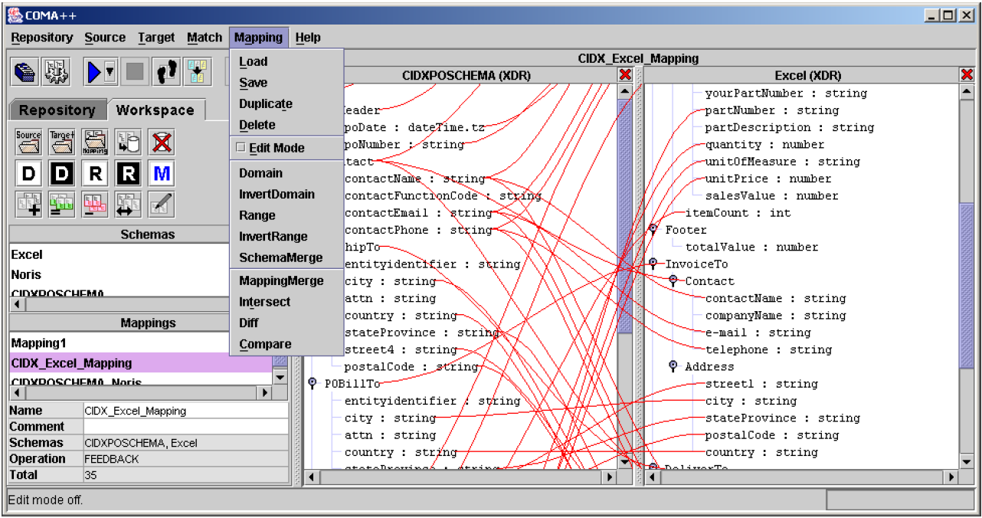
Schema Detection and Integration, cont.
Data Acquisition, Integration, and Data Validation
Schema Detection
Schema Matching
Schema Mapping
Schema Matching
  Semi-automatic mapping of schema S1 to schema S2
  → output: schema correspondences
  Approaches: Schema- vs instance-based;
  element- vs structure-based; linguistic vs rules
  Global schema matching
    One-to-one: stable marriage problem
    Many-to-one: hospitals-residents / college-admission problems
Schema Mapping
  Given two schemas and correspondences, generate transformation program
  → output: executable data transformation
  Challenges: complex mappings (1:N cardinality), new values, PK-FK relations and nesting, creation of duplicates, different data types, sematic preserving
INSERT INTO Orders
SELECT BELNR,
SUMME, DATUM
FROM Bestellungen
[Credit: Erhard Rahm]

Slide 11
Corrupted Data
Data Acquisition, Integration, and Data Validation
Heterogeneity of Data Sources
  Update anomalies on denormalized data / eventual consistency
  Changes of app/preprocessing over time (US vs us) → inconsistencies
Human Error
  Errors in semi-manual data collection, laziness (see default values), bias
  Errors in data labeling (especially if large-scale: crowd workers / users)
Measurement/Processing Errors
  Unreliable HW/SW and measurement equipment (e.g., batteries)
  Harsh environments (temperature, movement) → aging
Uniqueness & duplicates
Contradictions & wrong values
Missing Values
[Credit: Felix Naumann]
Ref. Integrity
ID | Name | BDay | Age | Sex | Phone | Zip
3 | Smith, Jane | 05/06/1975 | 44 | F | 999-9999 | 98120
3 | John Smith | 38/12/1963 | 55 | M | 867-4511 | 11111
7 | Jane Smith | 05/06/1975 | 24 | F | 567-3211 | 98120
Zip | City
98120 | San Jose
90001 | Lost Angeles
Typos

Slide 12
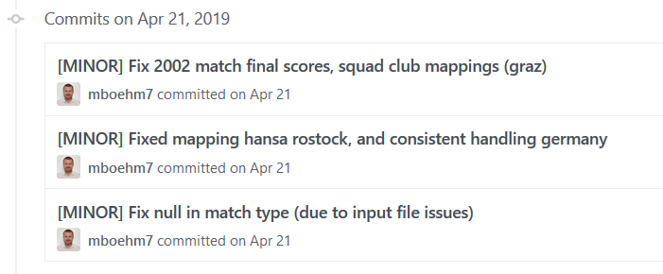
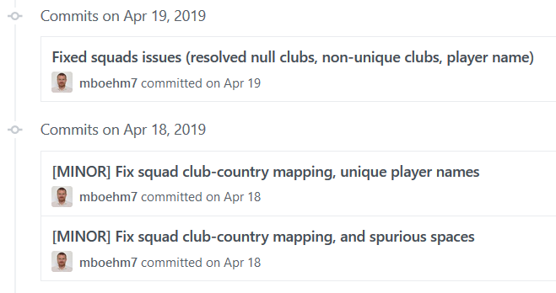
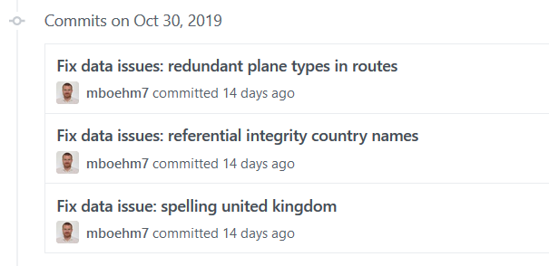





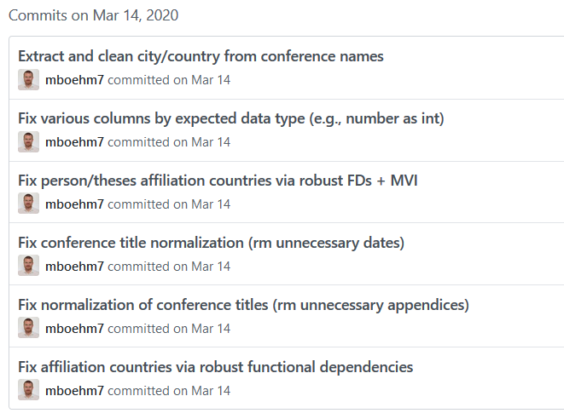
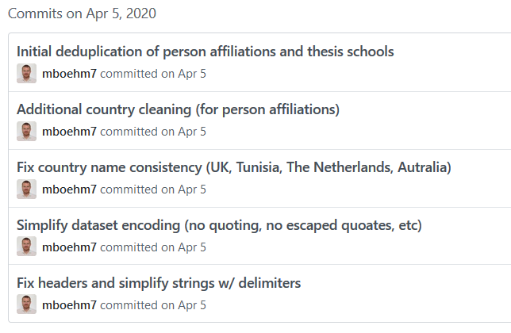
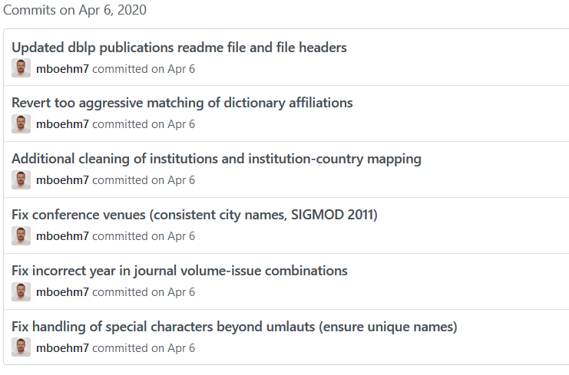
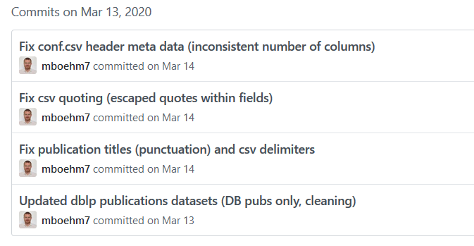
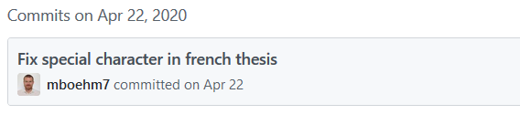
Examples (aka errors are everywhere)
Data Acquisition, Integration, and Data Validation
DM SS’19
(Soccer
World Cups)
DM WS’19/20
(Airports and Airlines)
DM SS’20
(DBLP Publications)
☺

Slide 13
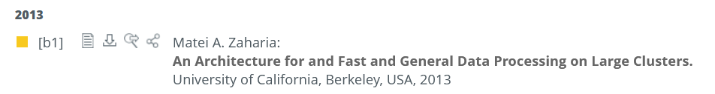


Examples (aka errors are everywhere), cont.
Data Acquisition, Integration, and Data Validation
DM SS’20, cont.
(DBLP Publications) → as a great, curated dataset
Wrong meta data from UC Berkeley
Misplaced data (wrong affiliation, MIT)
DM WS’20/21
(Movies and Actors)
DM SS’21 (Summer Olympics)
DM WS’21/22 (AT Elections)
DM SS’22 (Graz Districts)
Best-effort automated cleaning
Reference impl data ingestion into relational
schema + expected results of query processing
Decentralized validation (~600 students)

Slide 14
Data Integration for ML and ML for DI
Data Acquisition, Integration, and Data Validation
#1 Data Extraction
  Extracting structured data
  from un/semi-structured data
  Rule- and ML-based extractors, combination w/ CNN
#2 Schema Alignment
  Schema matching for consolidating data from heterogeneous systems
  Spatial and Temporal alignment via provenance and query processing
  (e.g., sensor readings for object along a production pipeline)
#3 Entity Linking
  Linking records to entities (deduplication)
  Blocking, pairwise matching, clustering, ML, Deep ML (via entity embedding)
#4 Data Fusion
  Resolve conflicts, necessary in presence of erroneous data
  Rule- and ML-based, probabilistic GM, Deep ML (RBMs, graph embeddings)
[Xin Luna Dong, Theodoros Rekatsinas: Data Integration and Machine Learning: A Natural Synergy. SIGMOD 2018]

Slide 15
Data Validation
Data Acquisition, Integration, and Data Validation
Sanity checks on expected shape
before training first model
Check a feature’s min, max, and most common value
  Ex: Latitude values must be within the range [-90, 90] or [-π/2, π/2]
The histograms of continuous or categorical values are as expected
  Ex: There are similar numbers of positive and negative labels
Whether a feature is present in enough examples
  Ex: Country code must be in at least 70% of the examples
Whether a feature has the right number of values (i.e., cardinality)
  Ex: There cannot be more than one age of a person
[Neoklis Polyzotis, Sudip Roy, Steven Euijong Whang, Martin Zinkevich: Data Management Challenges in Production Machine Learning. Tutorial, SIGMOD 2017]
(Google Research)

Slide 16
Data Validation, cont.
Data Acquisition, Integration, and Data Validation
[Sebastian Schelter, Dustin Lange, Philipp Schmidt, Meltem Celikel, Felix Bießmann, Andreas Grafberger: Automating Large-Scale Data Quality Verification. PVLDB 2018]
Constraints
and Metrics
for quality
check UDFs
Approach
  #1 Quality checks on basic metrics, computed in Apache Spark
  #2 Incremental maintenance of metrics and quality checks
(Amazon Research)
Organizational Lesson: benefit of shared vocabulary/procedures
Technical Lesson: fast/scalable; reduce manual and ad-hoc analysis

Slide 17
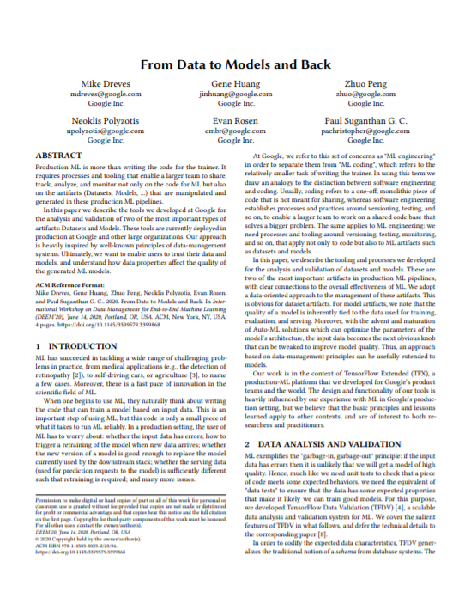
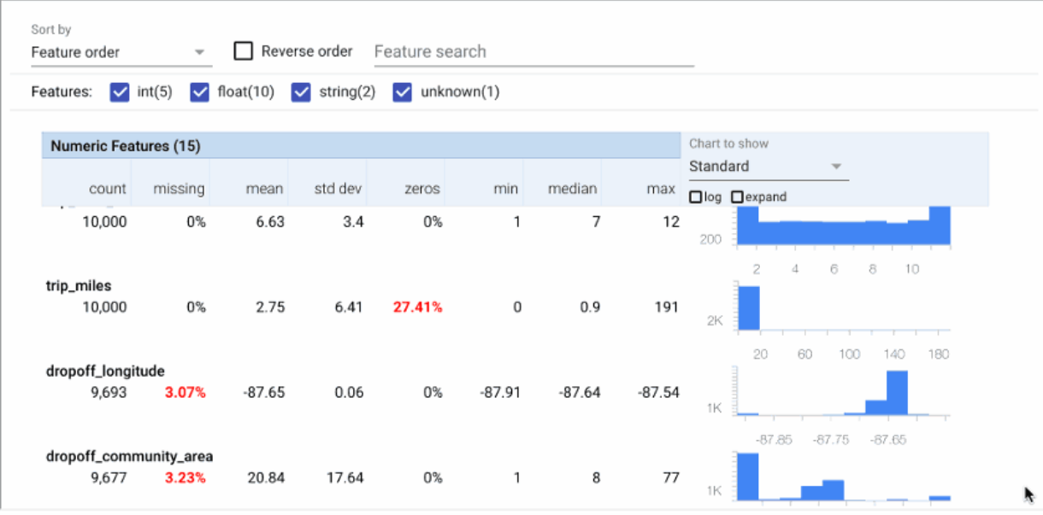

Data Validation, cont.
Data Acquisition, Integration, and Data Validation
[Mike Dreves; Gene Huang; Zhuo Peng; Neoklis Polyzotis; Evan Rosen; Paul Suganthan: From Data to Models and Back. DEEM 2020]
TensorFlow Data Validation (TFDV)
  Library or TFX components
  Stats computation, schema extraction,
  validation checks, anomaly detection
[Eric Breck, Neoklis Polyzotis, Sudip Roy, Steven Whang, Martin Zinkevich: Data Validation for Machine Learning. MLSys 2019]
[Emily Caveness et al: TensorFlow Data Validation: Data Analysis and Validation in Continuous ML Pipelines. SIGMOD 2020]
(Google)

Slide 18
Feature Transformations and
Feature Engineering

Slide 19
Overview Feature Engineering
Feature Transformations and Feature Engineering
Terminology
  Matrix X of m observations (rows) and n features (columns)
  Continuous features: numerical values (aka scale features)
  Categorical features: non-numerical values, represent groups
  Ordinal features: non-numerical values, associated ranking
  Feature space: multi-dimensional space of features → curse of dimensionality
Feature Engineering
  Bring multi-modal data and features into numeric representation
  Use domain expertise to expose predictive features to ML model training
Excursus: Representation Learning
  Neural networks can be viewed as combined representation learning and model training (pros and cons: learned, repeatable)
  Mostly homogeneous inputs (e.g., image), research on multi-modal learning
➔ Principle: If same accuracy, prefer simple model (cheap, robust, explainable)

Slide 20
Recoding
Feature Transformations and Feature Engineering
Summary
  Numerical encoding of categorical features (arbitrary strings)
  Map distinct values to integer domain (potentially combined w/ one-hot)
City | State
San Jose | CA
New York | NY
San Francisco | CA
Seattle | WA
New York | NY
Boston | MA
San Francisco | CA
Los Angeles | CA
Seattle | WA
Dictionaries
City | State
1 | 1
2 | 2
3 | 1
4 | 3
2 | 2
5 | 4
3 | 1
6 | 1
4 | 3
{San Jose : 1,
New York : 2,
San Francisco : 3,
Seattle : 4,
Boston : 5,
Los Angeles : 6}
{CA : 1,
NY : 2,
WA : 3,
MA : 4}

Slide 21
Feature Hashing
Feature Transformations and Feature Engineering
Summary
  Numerical encoding of categorical features (arbitrary strings)
  Hash input to k buckets via hash(value) % k (often combined w/ one-hot)
City
San Jose
New York
San Francisco
Seattle
New York
Boston
San Francisco
Los Angeles
Seattle
City
1
0
1
1
1
4
1
3
1
for
k = 5:
1993955031 % 5 → 1
1382994575 % 5 → 0
1540367136 % 5 → 1
-661909336 % 5 → 1
1993955031 % 5 → 1
1995575789 % 5 → 4
Efficient, but collisions
1540367136 % 5 → 1
-425347233 % 5 → 3
-661909336 % 5 → 1

Slide 22
Binning (see also Quantization, Binarization)
Feature Transformations and Feature Engineering
Summary
  Encode of numerical features to integer domain (often combined w/ one-hot)
  Equi-width: split (max-min)-range into k equal-sized buckets
  Equi-height: compute data-driven ranges for k balanced buckets
Sqft
928.5
451
570.3
1,273
1,239
711.3
1,114
867
Equal-sized numerical buckets
(with k=3)
Sqft-Bins
2
1
1
3
3
1
3
2
min = 451
max = 1,273
range = 822
[451, 725) → 1
[725, 999) → 2
[999, 1,273] → 3
Allows modelling small, medium, large apartments

Slide 23
One-hot Encoding (see also Dummy Coding)
Feature Transformations and Feature Engineering
Summary
  Encode integer feature of cardinality d into sparse 0/1 vector of length d
  Feature vectors of input features concatenated in sequence
City | State
1 | 1
2 | 2
3 | 1
4 | 3
2 | 2
5 | 4
3 | 1
6 | 1
4 | 3
C1 | C2 | C3 | C4 | C5 | C6 | S1 | S2 | S3 | S4
1 | 0 | 0 | 0 | 0 | 0 | 1 | 0 | 0 | 0
0 | 1 | 0 | 0 | 0 | 0 | 0 | 1 | 0 | 0
0 | 0 | 1 | 0 | 0 | 0 | 1 | 0 | 0 | 0
0 | 0 | 0 | 1 | 0 | 0 | 0 | 0 | 1 | 0
0 | 1 | 0 | 0 | 0 | 0 | 0 | 1 | 0 | 0
0 | 0 | 0 | 0 | 1 | 0 | 0 | 0 | 0 | 1
0 | 0 | 1 | 0 | 0 | 0 | 1 | 0 | 0 | 0
0 | 0 | 0 | 0 | 0 | 1 | 1 | 0 | 0 | 0
0 | 0 | 0 | 1 | 0 | 0 | 0 | 0 | 1 | 0

Slide 24
Hybrid Feature Transformations
Feature Transformations and Feature Engineering
Combinations
  Different encoders for different columns
  Binning + one-hot encoding
  Recoding + one-hot encoding
  Feature hashing + one-hot encoding
Top-K Recoding/Feature Hashing
  Recoding top-k most frequent values
  (no collisions in frequent values)
  Feature Hashing for others
  (collisions, but bounded #)
  “Vocabulary encoding”
Infrequent / Unknown Values
  E.g., sk-learn OneHotEncoder → values below min_frequency in single category
Pipelines of Encoders and Data Preparation
Primitives
City | Count
New York | 8,336,817
San Jose | 1,026,350
San Francisco | 883,305
Seattle | 704,352
Boston | 684,379
… | …
Graz | 291,072
1
2
3
Feature Hashing k=2
[Doris Xin et al: Production Machine Learning Pipelines: Empirical Analysis and Optimization Opportunities, SIGMOD 2021]
Notes:
Note: Google paper finds that on average 53% of the features are categorical (per feature, on average 10.6 million unique values)

Slide 25
Derived Features
Feature Transformations and Feature Engineering
#1 Intercept Computation
  Add a column of ones to X for
  computing the intercept as a weight
  Applies to regression and classification
#2 Non-Linear Relationships
  Can be explicitly materialized
  as feature combinations
  Example: Assumptions of underlying physical system
  Arbitrary complex feature interactions: e.g., X₁^2 * X₂
#3 Windowing
  Tumbling or sliding window over time series
  Compute aggregates or existence of events
X = cbind(X,
matrix(1, nrow(X), 1));
// y ~ b1*X1 + b2*X1^2
X = cbind(X, X^2);

Slide 26
NLP Features
Feature Transformations and Feature Engineering
Basic NLP Feature Extraction
  Sentence/word tokenization: split into sentences/words (e.g., via stop words)
  Part of Speech (PoS) tagging: label words verb, noun, adjectives (syntactic)
  Semantic role labeling: label entities with their roles in actions (semantic)
Bag of Words (BOW) and N-Grams
  Represent sentences
  as bag (multisets)
  Bi-grams: bag-of-words for 2-sequences of words (order preserving)
  N-grams: generalization of bi-grams to arbitrary-length sequences
Who did what to whom at where?
A | B | C | D | E
2 | 2 | 1 | 0 | 1
1 | 0 | 0 | 3 | 2
A B C A B E.
A D E D E D.

Slide 27

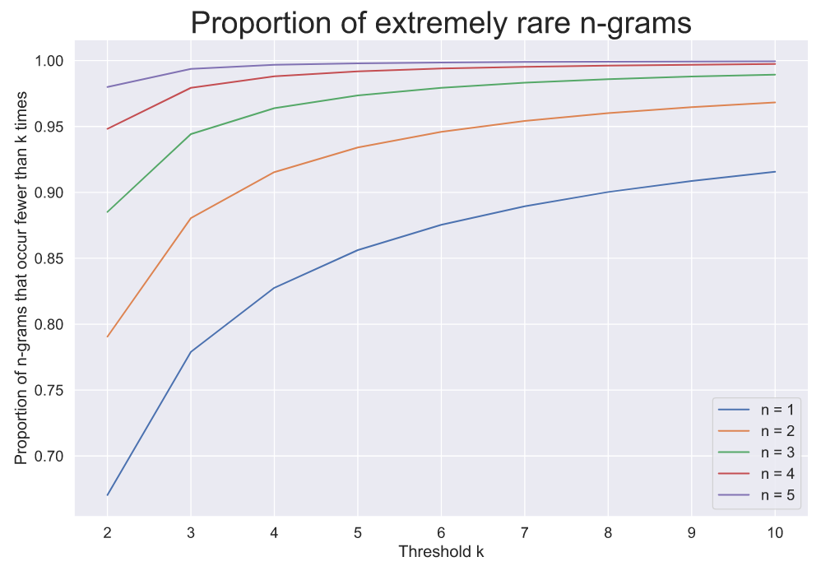
NLP Features, cont.
Feature Transformations and Feature Engineering
[John Hallman: Efficient Featurization of Common N-grams via Dynamic Programming. https://sisudata.com/blog/efficient-featurization-common-ngrams-via-dynamic-programming, 2021]
Common N-Grams
  Prune n-grams that appear <5 times, → 99.3% reduction
  Lattice-based pruning (Apriori monotonicity property)
Example
  Amazon Reviews
  Dataset
  67% of words
  appear just once

Slide 28
NLP Features, cont.
Feature Transformations and Feature Engineering
[Tomas Mikolov, Kai Chen, Greg Corrado, Jeffrey Dean: Efficient Estimation of Word Representations in Vector Space. ICLR (Workshop) 2013]
github.com/dav/word2vec
Word Embeddings
  Trained (word → vector)
  mappings (~ 50-300 dims)
  Word2vec: continuous
  bag-of-words (CBOW) or
  continuous skip-gram
  Subsampling frequent words
  Semantic preserving
  arithmetic operations
  (+ ~ * of context distributions)
Follow-up Work
  Often pre-trained word embeddings; fine-tuning if necessary for task/domain
  Various extensions/advancements: Sentence2Vec, Doc2Vec, Node2Vec
  BERT, RoBERTa, ALBERT, StructBERT
w_{t-2}
Skip-gram
w_{t-2}
CBOW
w_{t-1}
w_{t-1}
∑
w
w
∑
w_{t+1}
w_{t+1}
w_{t+2}
w_{t+2}
vec(Paris) ≈ vec(Berlin)
– vec(Germany) + vec(France)
[Jacob Devlin et al. : BERT: Pre-training of Deep Bidirectional Transformers for Language Understanding. NAACL-HLT (1) 2019]
Notes:
Note: Word2vec later published at NIPS 2013 (Tomas Mikolov, Ilya Sutskever, Kai Chen, Gregory S. Corrado, Jeffrey Dean: Distributed Representations of Words and Phrases and their Compositionality. NIPS 2013: 3111-3119)
Transformer: architecture like LSTM, but higher parallelism

Slide 29

Example Spark ML
Feature Transformations and Feature Engineering
API Design
  Transformers: Feature transformations and learned models
  Estimators: Algorithm that can be fit to produce a transformer
  Compose ML pipelines from chains of transformers and estimators
Example Pipeline
// define pipeline stages
tokenizer = Tokenizer(inputCol="text", outputCol="words")
hashingTF = HashingTF(inputCol=tokenizer.getOutputCol(),
outputCol="features")
lr = LogisticRegression(maxIter=10, regParam=0.001)
// create pipeline transformer via fit
pipeline = Pipeline(stages=[tokenizer, hashingTF, lr])
model = pipeline.fit(training)
// use of resulting ML pipeline
prediction = model.transform(test)
[https://spark.apache.org/docs/
2.4.3/ml-pipeline.html]

Slide 30

Example SystemML/SystemDS
Feature Transformations and Feature Engineering
Feature Transformation
during Training
FX
transformencode
X
Y
FY
Training
B
MX
MY
# read tokenized words
FX = read(“./input/FX”, data_type=FRAME); # sentence id, word, count
FY = read(“./input/FY”, data_type=FRAME); # sentence id, labels
# encode and one-hot encoding
[X0, MX] = transformencode(target=FX, spec=“{recode:[2]}”);
[Y0, MY] = transformencode(target=FY, spec=“{recode:[2]}”);
X = table(X0[,1], X0[,2], X0[,3]); # bag of words
Y = table(Y0[,1], Y0[,2]); # bag of words
# model training via multi-label, multi-nominal logical regression
B = mlogreg(X, Y);

Slide 31
Example SystemML/SystemDS, cont.
Feature Transformations and Feature Engineering
MX
MY
B
Feature Transformation
during Scoring
ΔFX
transformapply
ΔX
Scoring
ΔFŶ
transformdecode
ΔŶ
# read tokenized words of test sentences
dFX = read(“./input/dFX”, data_type=FRAME); # sentence id, word, count
# encode and one-hot encoding
dX0 = transformapply(target=dFX, spec=“{recode:[2]}”, meta=MX);
dX = table(dX0[,1], dX0[,2], dX0[,3]); # bag of words
# model scoring and postprocessing (reshape, attach sentence ID, etc)
dYhat = (X %*% B) >= theta; ...;
# decode output labels: sentence id, label word
dFYhat = transformdecode(target=dYhat, spec=“{recode:[2]}”, meta=MY);

Slide 32


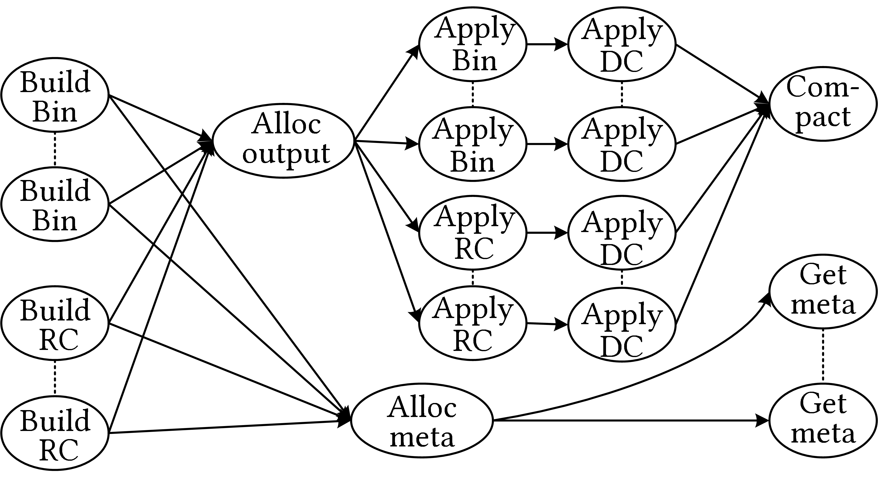
Parallelizing Feature Transformations
Feature Transformations and Feature Engineering
[PVLDB 2022]
Feature Transformations
  Numeric: pass-through, H/W binning + one-hot;
  Categorical: recoding, feature hashing + one-hot
  Text/Graph embeddings
Parallelization
  Fine-grained,
  future-based
  task graph
  Optimization via
  task graph rewrites
  (s.t. mem budget)
  Different operations
  and parallelization
  strategies
large dictionaries;
many build (groupby, sort) and apply (FK-PK join) ops

Slide 33
Data Preparation and Cleaning

Slide 34

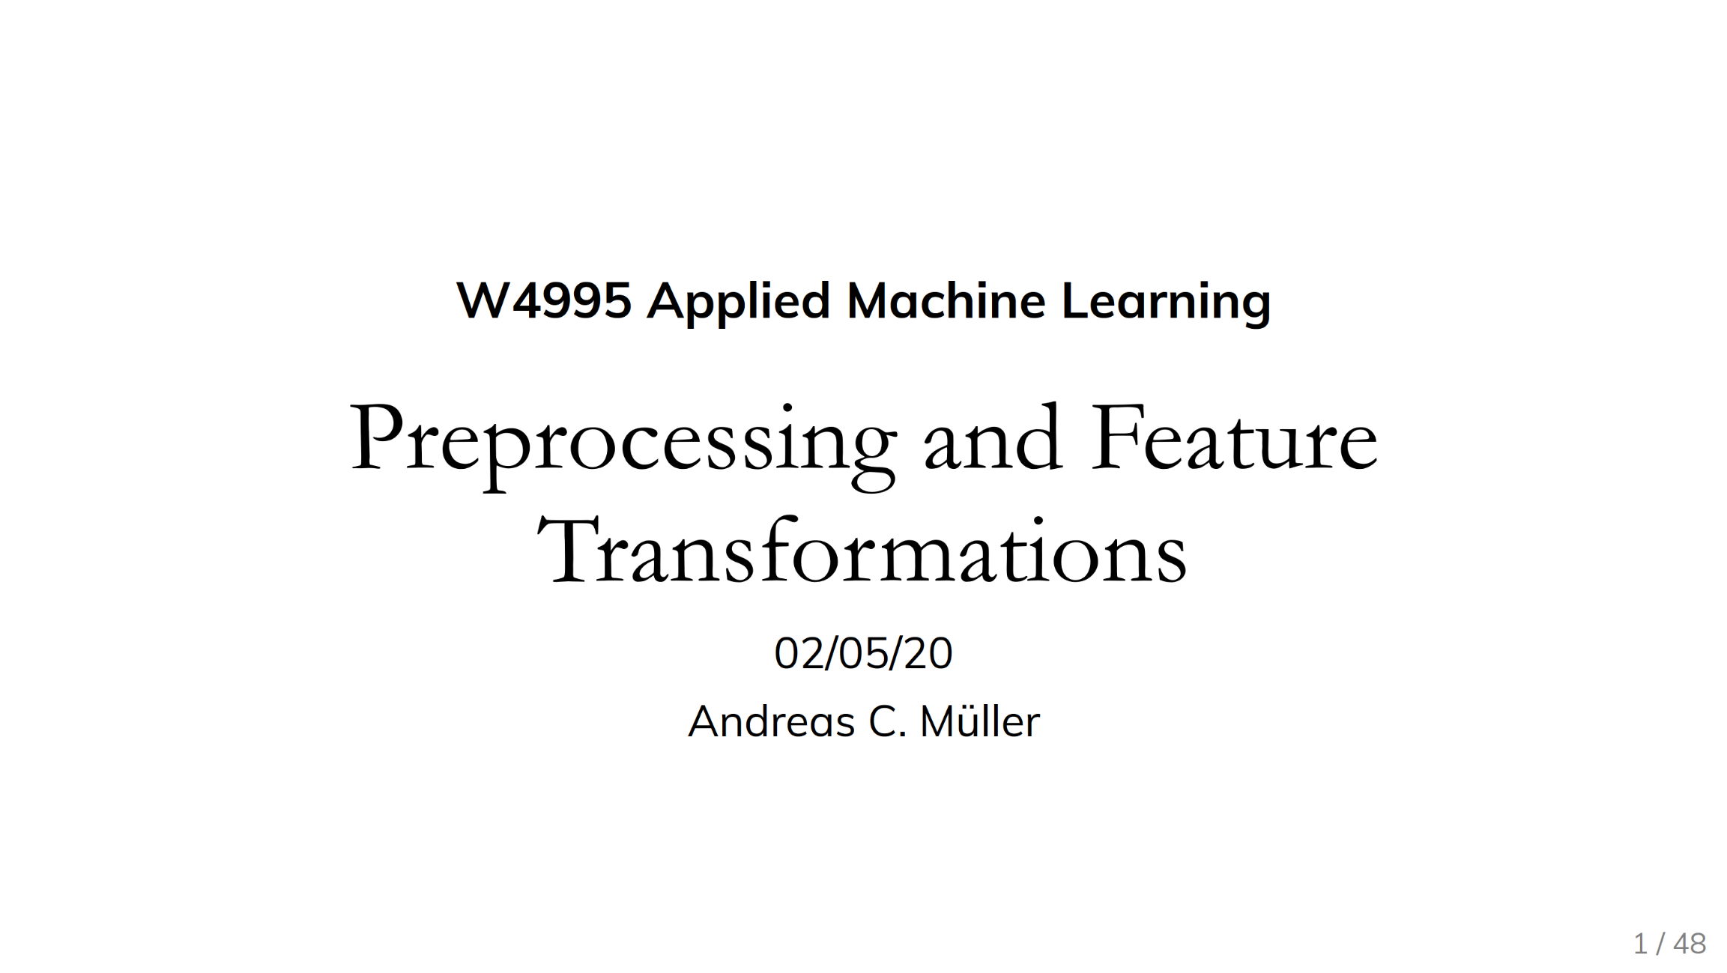
Standardization/Normalization
Data Preparation and Cleaning
#1 Standardization
  Centering and scaling to
  mean 0 and variance 1
  Ensures well-behaved training
  (and distance computation)
  Densifying operation / NaNs
  Batch normalization in DNN: standardization of activations
#2 (Min-Max) Normalization
  Rescale values into
  common range [0,1]
  Avoid bias to large-scale features
  Does not handle outliers
X = X – colMeans(X);
X = X / sqrt(colVars(X));
X = replace(X, pattern=NaN,
replacement=0); #robustness
X = (X – colMins(X))
/ (colMaxs(X) – colMins(X));
Recommended Reading
[Andreas C. Mueller: Preprocessing and Feature Transformations, Applied ML Lecture 2020, https://www.youtube.com/watch?v=XpOBSaktb6s]

Slide 35

Standardization/Normalization, cont.
Data Preparation and Cleaning
[Credit: Alexandre (Sasha) V. Evfimievski]
#3 Deferred Standardization
  Avoid densifying dataset upfront by pushing
  standardization into inner loop iterations
  Let matrix-multiplication chain optimization + rewrites do the rest
Example
GLM/lmCG
# operation w/ early standardized X
q = t(X) %*% diag(w) %*% X %*% B;
Input w/ column of ones (intercept)
Substitute X with
X %*% S
X
# operation w/ deferred standardization
q = t(S) %*% t(X) %*% diag(w)
%*% X %*% S %*% B;
Scale
S
q = t(S) %*% (t(X) %*% (diag(w)
%*% (X %*% (S %*% B))));
Shift

Slide 36
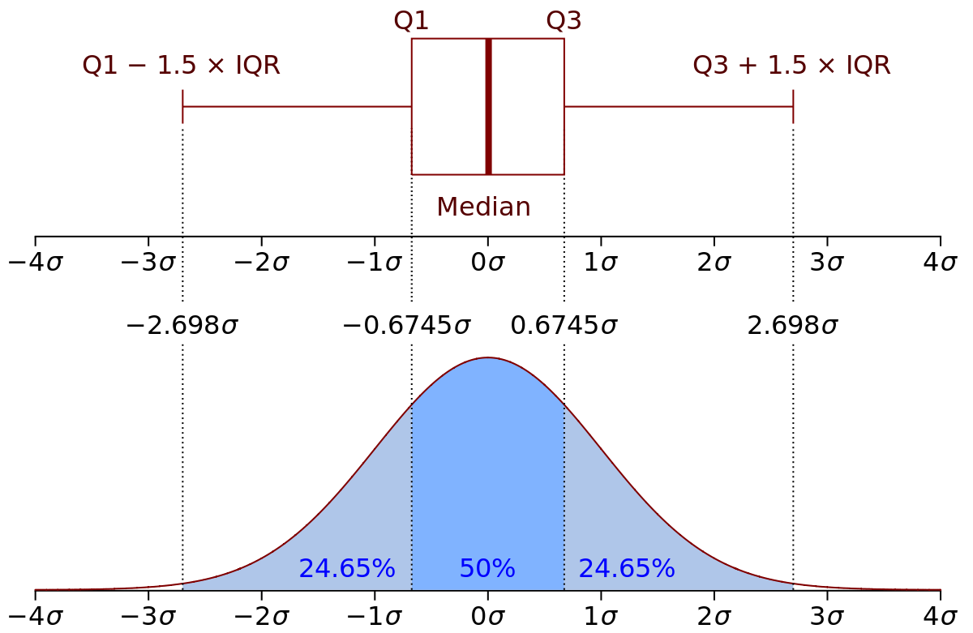
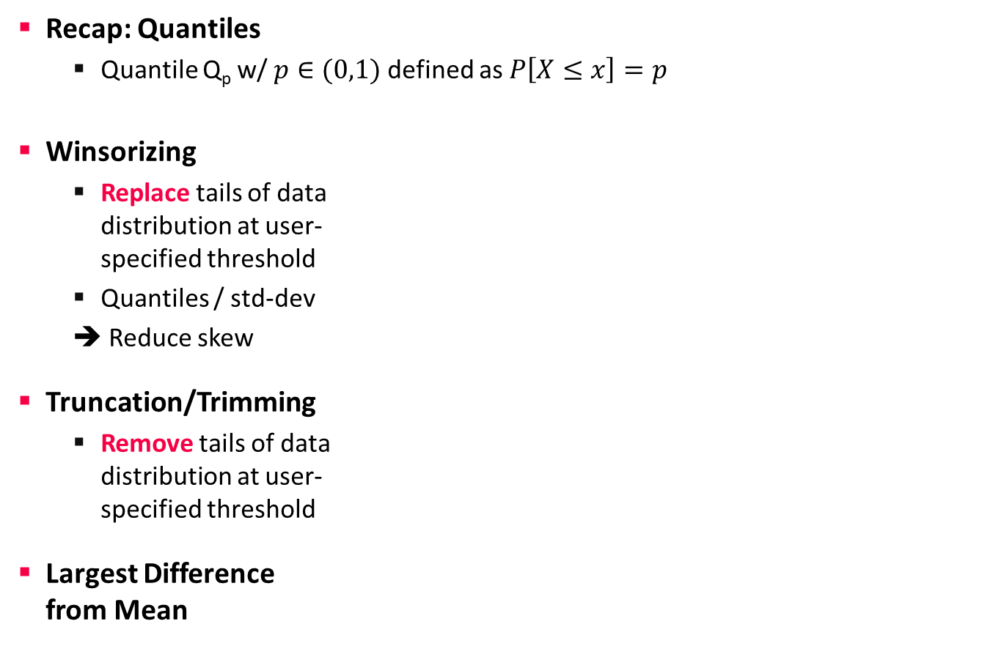
Winsorizing and Trimming
Data Preparation and Cleaning
Recap: Quantiles
  Quantile Q_{p} w/ $p∈(0,1)$ defined as $P\left[X≤x\right]=p$
Winsorizing
  Replace tails of data
  distribution at user-
  specified threshold
  Quantiles / std-dev
  ➔ Reduce skew
Truncation/Trimming
  Remove tails of data
  distribution at user-
  specified threshold
Largest Difference
from Mean
[Credit: https://en.wikipedia.org]
# compute quantiles for lower and upper
ql = quantile(X, 0.05);
qu = quantile(X, 0.95);
# replace values outside [ql,qu] w/ ql and qu
Y = ifelse(X < ql, ql, X);
Y = ifelse(Y > qu, qu, Y);
SystemDS: winsorize() outlier()
outlierByIQR()
outlierBySd()
# remove values outside [ql,qu]
I = X < qu | X > ql;
Y = removeEmpty(X, “rows”, select = I);
# determine largest diff from mean
I = (colMaxs(X)-colMeans(X))
> (colMeans(X)-colMins(X));
Y = ifelse(xor(I,op), colMaxs(X), colMins(X));
Notes:
Box and whisker plots
SystemDS: quantiles via sort+pick, quickselect possible
Iterative winsoring/trimming to X std-devs of mean also possible

Slide 37
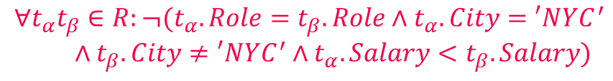
Constraints and Outliers
Data Preparation and Cleaning
Route
(Airline, From, To)
Planes
(Semi-)Automatic Approach: Expectations!
  PK → Values must be unique and defined (not null)
  Exact PK-FK → Inclusion dependencies
  Noisy PK-FK → Robust inclusion dependencies |R[X]∈S[Y]| / |R[X]| > δ
  Semantics of attributes → Value ranges / # distinct values
  Invariant to capitalization
  Patterns → regular expressions
Formal Constraints
  Functional dependencies (FD), conditional FDs (CFD), metric dependencies
  Inclusion dependencies, matching dependencies
  Denial constraints
Outlier Terminology
  Outlier Detection: detect and remove unwanted data points
  Anomaly Detection: detect and extract rare/unusual/interesting events
Age=9999?
2019-11-15 vs Nov 15, 2019
$$∀t_{α}t_{β}∈R:¬(t_{α}.Role=t_{β}.Role∧t_{α}.City=′NYC^{′}$$
$∧t_{β}.City≠′NYC^{′}∧t_{α}.Salary<t_{β}.Salary)$

Slide 38
Outliers and Outlier Detection
Data Preparation and Cleaning
Types of Outliers
  Point outliers: single data points
  far from the data distribution
  Contextual outliers: noise or other systematic anomalies in data
  Sequence (contextual) outliers: sequence of values w/ abnormal shape/agg
  Univariate vs multivariate analysis
  Beware of underlying assumptions (distributions)
Types of Outlier Detection
  Type 1 Unsupervised: No prior knowledge
  of data, similar to unsupervised clustering
  → expectations: distance, # errors
  Type 2 Supervised: Labeled normal and abnormal
  data, similar to supervised classification
  Type 3 Normal Model: Represent normal behavior,
  similar to pattern recognition → expectations: rules/constraints
[Varun Chandola, Arindam Banerjee, Vipin Kumar: Anomaly detection: A survey. ACM Comput. Surv. 2009]
[Victoria J. Hodge, Jim Austin: A Survey of Outlier Detection Methodologies. Artif. Intell. Rev. 2004]

Slide 39
Missing Value Imputation
Data Preparation and Cleaning
Missing Value
  Application context defines if 0 is missing value or not
  If differences between 0 and missing values, use NA or NaN
Basic Value Imputation
  General-purpose: replace by user-specified constant
  Continuous variables: replace by mean
  Categorical variables: replace by median or mode
Iterative Algorithms (chained-equation imputation)
  Train ML model to predict missing information
  (feature k → label, split data into observed/missing)
  Noise reduction: feature subsets + averaging
Dynamic Imputation
  Data exploration w/ on-the-fly imputation
  Optimal placement of imputation operations
MCAR
SystemDS: mice()
Train X, y
MAR
Score
[Jose Cambronero, John K. Feser, Micah Smith, Samuel Madden:
Query Optimization for Dynamic Imputation. PVLDB 2017]

Slide 40

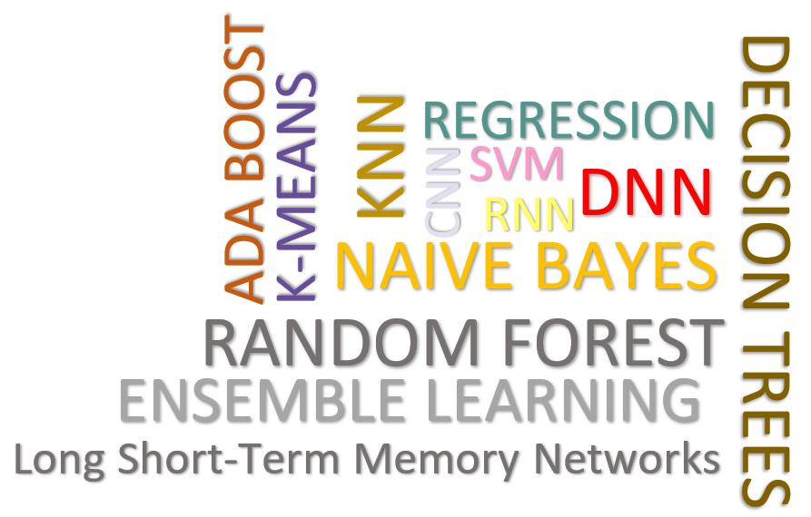
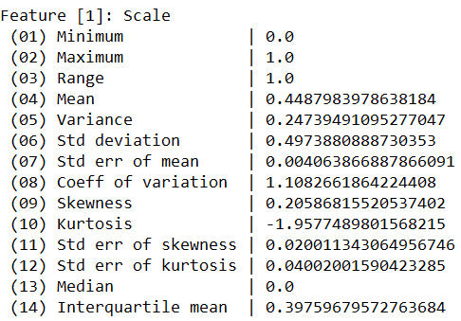
Data Cleaning Pipelines
Data Preparation and Cleaning
[under submission]
Automatic Generation of Cleaning Pipelines
  Library of robust, parameterized data cleaning primitives
  Enumeration of DAGs of primitives & hyper-parameter optimization (GA, HB)
Data Samples
Logical
Data- and Task-parallel Computation
O
Physical
LP₁
LP₂
…
LP_{n}
Top-k Pipelines
Target
App
…
…
…
PP₁
PP_{n}
PP₁
PP_{n}
PP₁
PP_{n}
Rules/Objectives
Outlier Detection → MVI → Deduplication → Resolve Mislabels
P_{1:} gmm → imputeFD → mergeDup → delML
P_{n:} outlierBySd→ mice → delDup → voting
Debugging
University | Country
TU Graz | Austria
TU Graz | Austria
TU Graz | Germany
IIT | India
IIT | IIT
IIT | Pakistan
IIT | India
SIBA | Pakistan
SIBA | null
SIBA | null
University | Country
TU Graz | Austria
TU Graz | Austria
TU Graz | Austria
IIT | India
IIT | India
IIT | India
IIT | India
SIBA | Pakistan
SIBA | Pakistan
SIBA | Pakistan
A | B | C | D
0.77 | 0.80 | 1 | 1
0.96 | 0.12 | 1 | 1
0.66 | 0.09 | null | 1
0.23 | 0.04 | 17 | 1
0.91 | 0.02 | 17 | null
0.21 | 0.38 | 17 | 1
0.31 | null | 17 | 1
0.75 | 0.21 | 20 | 1
null | null | 20 | 1
0.19 | 0.61 | 20 | 1
0.64 | 0.31 | 20 | 1
A | B | C | D
0.77 | 0.80 | 1 | 1
0.96 | 0.12 | 1 | 1
0.66 | 0.09 | 17 | 1
0.23 | 0.04 | 17 | 1
0.91 | 0.02 | 17 | 1
0.21 | 0.38 | 17 | 1
0.31 | 0.29 | 17 | 1
0.75 | 0.21 | 20 | 1
0.41 | 0.24 | 20 | 1
0.19 | 0.61 | 20 | 1
0.64 | 0.31 | 20 | 1
Dirty Data
After imputeFD(0.5)
Dirty Data
After MICE

Slide 41
Data Augmentation

Slide 42
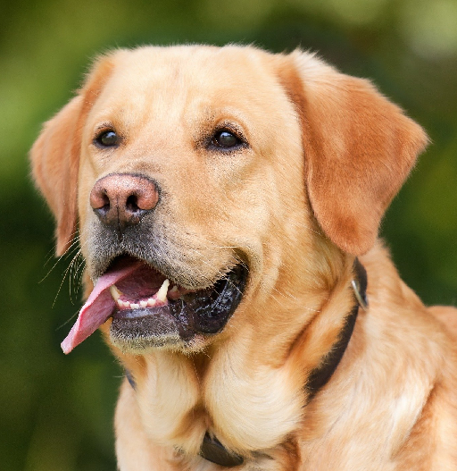
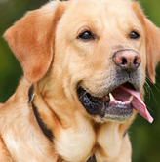
Motivation and Basic Data Augmentation
Data Augmentation
AlexNet
Motivation Data Augmentation
  Complex ML models / deep NNs need lots of
  labeled data to avoid overfitting ➔ expensive
  Augment training data by synthetic labeled data
Translations & Reflections
  Random 224x224 patches
  and their reflections
  (from 256x256 images
  with known labels)
  Increased data by 2048x
  Test: corner/center patches
  + reflections → prediction
Alternating Intensities
  Intuition: object identity is invariant to illumination and color intensity
  PCA on dataset → add eigenvalues times a random variable N(0,0.1)
[Alex Krizhevsky, Ilya Sutskever, Geoffrey E. Hinton: ImageNet Classification with Deep Convolutional Neural Networks. NIPS 2012]

Slide 43
Basic Data Augmentation
Data Augmentation
Scaling and Normalization
  Standardization: subtract per-channel global pixel means
  Normalization: normalized to range [-1,1] (see min-max)
General Principles
  #1: Movement/selection (translation, rotation, reflection, cropping)
  #2: Distortions (stretching, shearing, lens distortions, color)
  In many different combinations ➔ often trial & error / domain expertise
Excursus: Reducing Training Time
  Transfer learning: Use pre-trained model on ImageNet;
  freeze lower NN layers, fine-tune last layers w/ domain-specific data
  Multi-scale learning: Use cropping and scaling
  to train 256 x 256 model as starting point for a
  more compute-intensive 384x384 model
[Karen Simonyan, Andrew Zisserman: Very Deep Convolu-tional Networks for Large-Scale Image Recognition. ICLR 2015]
Notes:
Note multi-scale learning: model is trained to recognize objects over a wide range of scales

Slide 44
Basic Data Augmentation, cont.
Data Augmentation
Distortions
  Translations, rotations, skewing
  Compute for every pixel a new target
  location via rand displacement fields)
Cutout
  Randomly masking out square
  regions of input images
  Size more important than shape
[Patrice Y. Simard, David Steinkraus, John C. Platt: Best Practices for Convolutional Neural Networks Applied to Visual Document Analysis. ICDAR 2003]
[Terrance Devries, Graham W. Taylor: Improved Regularization of Convolutional Neural Networks with Cutout. CoRR 2017]
Notes:
Others: Mixup (combine images and one-hot labels with weights): https://keras.io/examples/vision/mixup/

Slide 45
Domain Randomization
Data Augmentation
Training on Simulated Images
  Random rendering of objects
  with non-realistic textures
  Large variability for generalization
  to real world objects
Pre-Training on Simulated Images
  Random 3D objects and flying
  distractors w/ random textures
  Random lights and rendered
  onto random background
[Josh Tobin et al.: Domain randomization for transferring deep neural networks from simulation to the real world. IROS 2017]
[Jonathan Tremblay et al.: Training Deep Networks With Synthetic Data: Bridging the Reality Gap by Domain Randomization. CVPR Workshops 2018]

Slide 46
Learning Data Augmentation Policies
Data Augmentation
Bachelor Thesis David Woergoetter
AutoAugment
  Search space of DA policies
  Goal: Find best augmentation policy
  (e.g., via reinforcement learning)
  #1: Image processing functions
  (translation, rotation, color normalization)
  #2: Probabilities of applying these functions
Data Augmentation GAN (DAGAN)
  Image-conditional generative model for
  creating within-class images from inputs
  No need for known invariants
[Ekin Dogus Cubuk, Barret Zoph, Dandelion Mané, Vijay Vasudevan, Quoc V. Le: AutoAugment: Learning Augmentation Policies from Data. CVPR 2019]
➔ New state-of-the art top-1 error on ImageNet and CIFAR10
Real input image
[Antreas Antoniou, Amos J. Storkey, Harrison Edwards: Augmenting Image Classifiers Using Data Augmentation Generative Adversarial Networks. ICANN 2018]
Notes:
Note AutoAugment: sample policies (of 5 sub policies of 2 image operations each, probability and magnitude): shearX, Invert, Solarize, AutoContrast, Equalize + hyper parameters

Slide 47
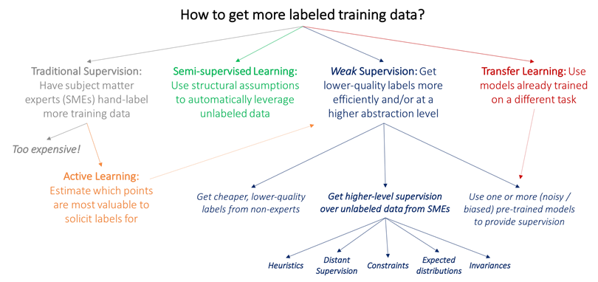
Weak Supervision
Data Augmentation
[Alex Ratner, Paroma Varma, Braden Hancock,
Chris Ré, and others: Weak Supervision: A New Programming Paradigm for Machine Learning, ai.stanford.edu/blog/weak-supervision/, 2019]
Heuristically Generated Training Data
  Hand labeling expensive and time consuming, but abundant unlabeled data
  Changing labeling guidelines ➔ labeling heuristics
basic data augmentation

Slide 48
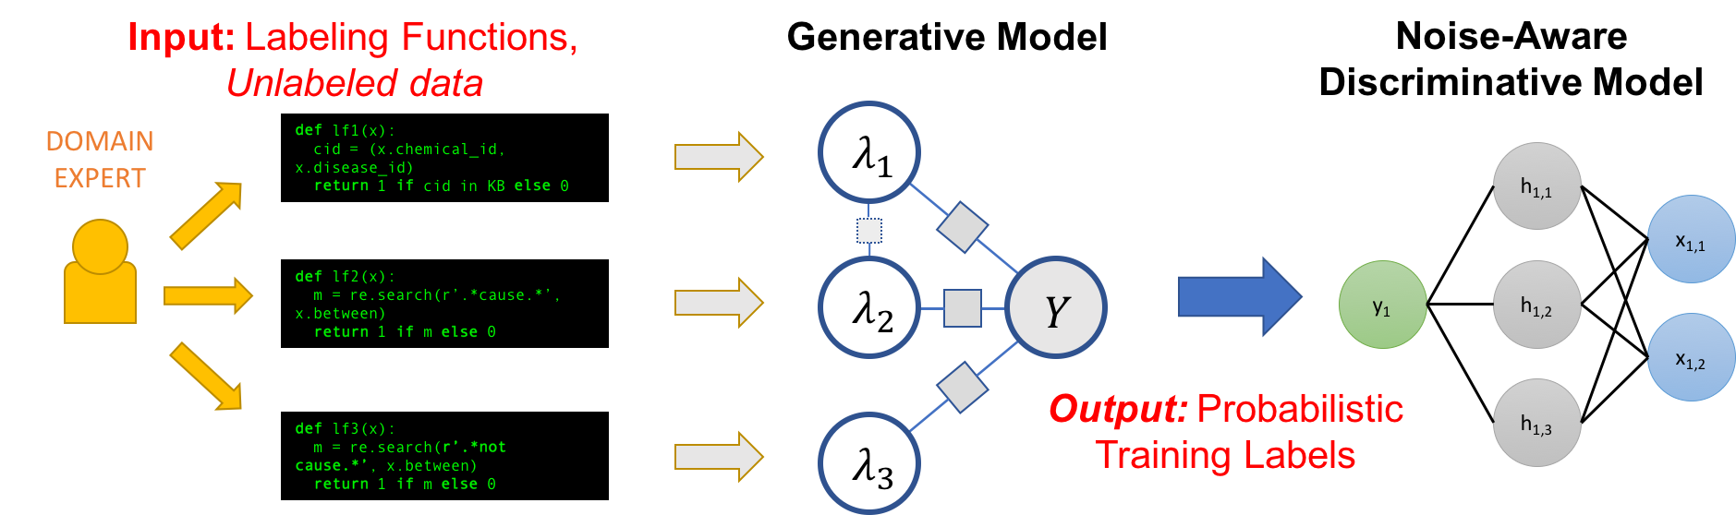
Weak Supervision, cont.
Data Augmentation
(coverage α_{i}, accuracy β_{i})
Data
Programming
Overview
[Alexander J. Ratner, Christopher De Sa, Sen Wu, Daniel Selsam, Christopher Ré: Data Programming: Creating Large Training Sets, Quickly. NIPS 2016]
[Alexander Ratner, Stephen H. Bach, Henry R. Ehrenberg, Jason Alan Fries, Sen Wu, Christopher Ré: Snorkel: Rapid Training Data Creation with Weak Supervision. PVLDB 2017]
[Paroma Varma, Christopher Ré: Snuba: Automating Weak Supervision to Label Training Data. PVLDB 2018]
[Stephen H. Bach, Daniel Rodriguez, Yintao Liu, Chong Luo, Haidong Shao, Cassandra Xia, Souvik Sen, Alexander Ratner, Braden Hancock, Houman Alborzi, Rahul Kuchhal, Christopher Ré, Rob Malkin: Snorkel DryBell: A Case Study in Deploying Weak Supervision at Industrial Scale. SIGMOD 2019]

Slide 49
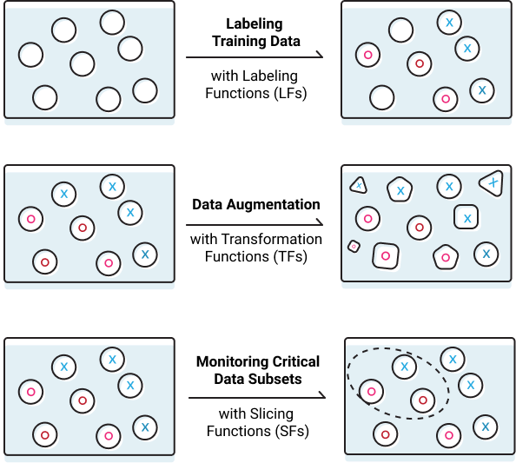

Weak Supervision, cont.
Data Augmentation
Excursus: Snorkel
[https://www.snorkel.org/]
  Programmatically
  Building and Managing
  Training Data
Effects of Augmentation
  #1 Regularization for reduced generalization error, not always training error
  (penalization of model complexity)
  #2 Invariance increase by averaging features of augmented data points
  ➔ Data Augmentation as a Kernel
    Kernel metric for augmentation selection
    Affine transforms on approx. kernel features
10 Model Selection & Management
11 Model Debugging Techniques
[Tri Dao et al: A Kernel Theory of Modern Data Augmentation. ICML 2019]

Slide 50
Summary and Q&A
[Andreas C. Mueller: Preprocessing and Feature Transformations, Applied ML Lecture 2020]
Data Acquisition, Integration,
and Validation
Feature Transformations
and Feature Engineering
Data Preparation and Cleaning
Data Augmentation
“Coming up with features is difficult, time-consuming, requires expert knowledge. "Applied machine learning" is basically feature engineering”
– Andrew Ng
➔ Trend towards “Data-centric AI”
(since 2021/2022)
Notes:
Note: Andreas Mueller dabl: https://github.com/dabl/dabl
https://www.youtube.com/watch?v=h92RMJi4mRM

