Slide 1

Architecture of ML Systems*
03 Model Selection and Debugging
Last update: Aug 25, 2022

Slide 2




Recap: The Data Science Lifecycle
Data Science Lifecycle
Data-centric View:
Application perspective
Workload perspective
System perspective
Data Scientist
Data Integration
Data Cleaning
Data Preparation
Model Selection
Training
Hyper-parameters
Validate & Debug
Deployment
Scoring & Feedback
Exploratory Process
(experimentation, refinements, ML pipelines)
Data/SW Engineer
DevOps Engineer

Slide 3
Agenda
Model Selection Techniques
Model Management & Provenance
Model Debugging and Explainability
Model Bias & Fairness Constraints

Slide 4
Model Selection Techniques

Slide 5
AutoML Overview
Model Selection Techniques
[Chris Thornton, Frank Hutter, Holger H. Hoos, Kevin Leyton-Brown: Auto-WEKA: combined selection and hyperparameter optimization of classification algorithms. KDD 2013]
#1 Model Selection
  Given a dataset and ML task
  (e.g., classification or regression)
  Select the model (type) that performs best
  (e.g.: LogReg, Naïve Bayes, SVM, Decision Tree, Random Forest, DNN)
#2 Hyper Parameter Tuning
  Given a model and dataset,
  find best hyper parameter values
  (e.g., learning rate, regularization, kernels, kernel parameters, tree params)
Validation: Generalization Error
  Goodness of fit to held-out data (e.g., 80-20 train/test)
  Cross validation (e.g., leave one out → k=5 runs w/ 80-20 train/test)
AutoML Systems/Services
  Often providing both model selection and hyper parameter search
  Integrated ML system, often in distributed/cloud environments

Slide 6


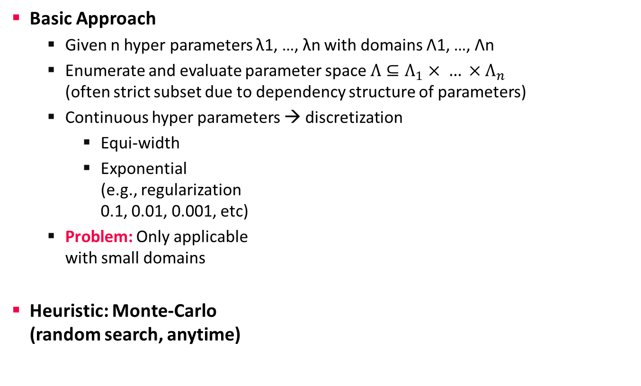
Basic Grid Search
Model Selection Techniques
gridSearch()
GridSearchCV()
Basic Approach
  Given n hyper parameters λ1, …, λn with domains Λ1, …, Λn
  Enumerate and evaluate parameter space $Λ⊆Λ_{1}× … ×Λ_{n}$
  (often strict subset due to dependency structure of parameters)
  Continuous hyper parameters → discretization
    Equi-width
    Exponential
    (e.g., regularization
    0.1, 0.01, 0.001, etc)
  Problem: Only applicable
  with small domains
Heuristic: Monte-Carlo
(random search, anytime)
Non-convex or unknown parameter space
1
β
0
α
1

Slide 7
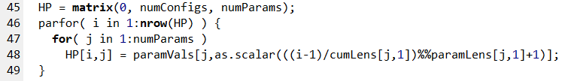
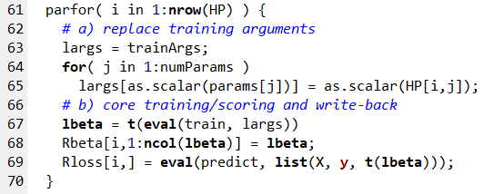
Basic Grid Search, cont.
Model Selection Techniques
Example Adult Dataset (train 32,561 x 14)
  Binary classification (>50K), https://archive.ics.uci.edu/ml/datasets/adult
  #1 MLogReg defaults w/ one-hot categoricals Accuracy (%): 82.35
  #2 MLogReg defaults w/ one-hot + binning Accuracy (%): 84.73
  #3 GridSearch MLogReg: Accuracy (%): 90.07
Example
SystemDS
gridSearch
params = list("icpt", "reg", "numBins");
paramRanges = list(seq(0,2), 10^seq(3,-6), 10^seq(1,4));
# Materialize Configs
05 Data- and Task-Parallel Execution
Notes:
Note: shown training loss, but w/ grid search on train/val up to ~87%

Slide 8
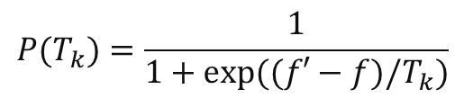
Basic Iterative Algorithms
Model Selection Techniques
Simulated Annealing
  Decaying temperature schedules: T_{k+1} = α ∙ T_{k}
  #1 Generate neighbor in ε-env of old point
  #2 Accept better points and worse points w/
Recursive Random Search
  Repeated restart
  Sample and evaluate points
  Determine best and shrink
  area if optimum unchanged
  Realign area if new
  optimum found
Exploration vs exploitation
$$P(T_{k})=\frac{1}{1+exp⁡((f′−f)/T_{k})}$$
[Tao Ye, Shivkumar Kalyanaraman: A recursive random search algorithm for large-scale network parameter configuration. SIGMETRICS 2003]
Parameter Space

Slide 9
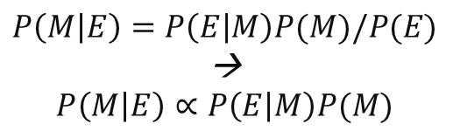
Bayesian Optimization
Model Selection Techniques
[Chris Thornton, Frank Hutter, Holger H. Hoos, Kevin Leyton-Brown: Auto-WEKA: combined selection and hyperparameter optimization of classification algorithms. KDD 2013]
Overview BO
  Sequential Model-Based Optimization
  Fit a probabilistic model based on the
  first n-1 evaluated hyper parameters
  Use model to select next candidate
  Gaussian process (GP) models, or
  tree-based Bayesian Optimization
Underlying Foundations
  The posterior probability of a model M given
  evidence E is proportional to the likelihood of
  E given M multiplied by prior probability of M
  Prior knowledge: e.g., smoothness, noise-free
  Maximize acquisition function:
  GP high objective (exploitation) and high prediction uncertainty (exploration)
$$P\left(M | E\right)=P\left(E | M\right)P(M)/P(E)$$
→
$$P\left(M | E\right)∝P\left(E | M\right)P(M)$$
after
next
before
Notes:
Note: posterior P(M|E) encodes updated beliefs, from prior P(M) and observed samples P(E|M)

Slide 10
Bayesian Optimization, cont
Model Selection Techniques
Example 1D Problem
  Gaussian Process
  4 iterations
[Eric Brochu, Vlad M. Cora, Nando de Freitas: A Tutorial on Bayesian Optimization of Expensive Cost Functions, with Application to Active User Modeling and Hierarchical Reinforcement Learning. CoRR 2010]

Slide 11
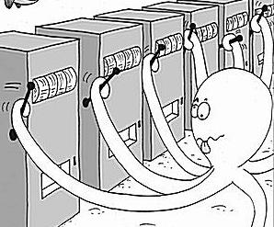
Multi-armed Bandits and Hyperband
Model Selection Techniques
[Credit:
blogs.mathworks.com]
Overview Multi-armed Bandits
  Motivation: model types have different quality
  Select among k model types → k-armed bandit problem
  Running score for each arm → scheduling policy
Hyperband
  Non-stochastic setting, without parametric assumptions
  Pure exploration algorithm for infinite-armed bandits
  Based on Successive Halving
    Successively discarding the
    worst-performing half of arms
    Extended by doubling budget of arms
    in each iteration (no need to configure k, random search included)
[Sébastien Bubeck, Nicolò Cesa-Bianchi: Regret Analysis of Stochastic and Nonstochastic Multi-armed Bandit Problems. Foundations and Trends in Machine Learning 2012]
[Lisha Li, Kevin G. Jamieson, Giulia DeSalvo, Afshin Rostamizadeh, Ameet Talwalkar: Hyperband: A Novel Bandit-Based Approach to Hyperparameter Optimization. JMLR 2017]

Slide 12
Selected AutoML Systems
Model Selection Techniques
[Chris Thornton et al: Auto-WEKA: combined selection and hyperparameter optimization of classification algorithms. KDD 2013]
Auto Weka
  Bayesian optimization with
  28 learners, 11 ensemble/meta methods
Auto Sklearn
  Bayesian optimization with
  15 classifiers, 14 feature prep, 4 data prep
TuPaQ
  Multi-armed bandit and large-scale
TPOT
  Genetic programming
Other Services
  Azure ML, Amazon ML
  Google AutoML, H20 AutoML
[Lars Kotthoffet al: Auto-WEKA 2.0:
Automatic model selection and hyper-parameter optimization in WEKA. JMLR 2017]
[Matthias Feurer et al: Auto-sklearn: Efficient and Robust Automated Machine Learning. Automated Machine Learning 2019]
[Evan R. Sparks, Ameet Talwalkar, Daniel Haas, Michael J. Franklin, Michael I. Jordan, Tim Kraska: Automating model search for large scale machine learning. SoCC 2015]
[Randal S. Olson, Jason H. Moore: TPOT: A Tree-Based Pipeline Optimization Tool for Automating Machine Learning. Automated Machine Learning 2019]
[Hantian Zhang, Luyuan Zeng, Wentao Wu, Ce Zhang: How Good Are Machine Learning Clouds for Binary Classification with Good Features? CoRR 2017]

Slide 13
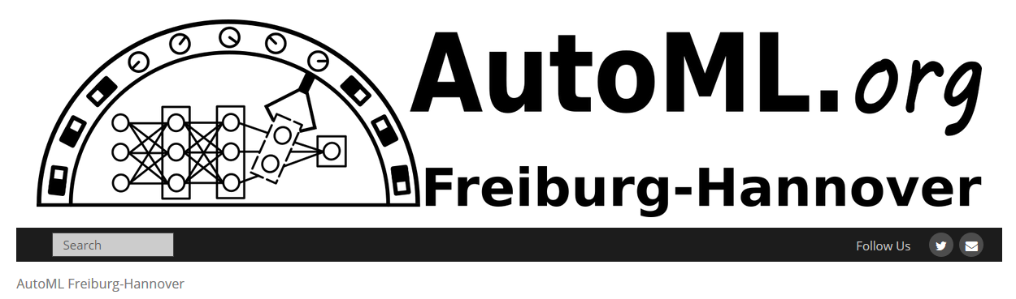
Selected AutoML Systems, cont.
Model Selection Techniques
Alpine Meadow
  Logical and physical ML pipelines
  Multi-armed bandit for pipeline selection
  Bayesian optimization for hyper-parameters
Dabl (Data Analysis Baseline Library)
  Tools for simple data preparation and ML training
  Hyperband (successive halving) for optimization
BOHB
  Bayesian optimization & hyperband
  Queue-based parallelization of successive halving
AutoML (https://www.automl.org/)
Paper Collections/Benchmarks
  HPOBench/NASBench
[Zeyuan Shang et al: Democratizing Data Science through Interactive Curation of ML Pipelines. SIGMOD 2019]
[https://amueller.github.io/
dabl/dev/user_guide.html]
[Stefan Falkner, Aaron Klein, Frank Hutter: BOHB: Robust and Efficient Hyper-parameter Optimization at Scale. ICML 2018]
Notes:
BOHB: combine BO and HB to get fast convergence and strong anytime performance

Slide 14
Neural Architecture Search
Model Selection Techniques
Motivation
  Design neural networks (type of layers / network) is often trial & error process
  Accuracy vs necessary computation characterizes an architecture
  ➔ Automatic neural architecture search
#1 Search Space of Building Blocks
  Define possible operations
  (e.g., identity, 3x3/5x5 separable
  convolution, avg/max pooling)
  Define approach for connecting
  operations (pick 2 inputs, apply op,
  and add results)
Exploration of cell designs
[Hieu Pham, Melody Y. Guan, Barret Zoph, Quoc V. Le, Jeff Dean: Efficient Neural Architecture Search via Parameter Sharing. ICML 2018]

Slide 15
Neural Architecture Search, cont.
Model Selection Techniques
#2 Search Strategy
  Classical evolutionary algorithms
  Recurrent neural networks (e.g., LSTM)
  Bayesian optimization (with
  special distance metric)
#3 Optimization Objective
  Max accuracy (min error)
  Multi-objective (accuracy and runtime)
Excursus: Model Scaling
  Automatically scale-up small
  model for better accuracy
  EfficientNet
[Barret Zoph, Quoc V. Le: Neural Architecture Search with Reinforcement Learning. ICLR 2017]
[Kirthevasan Kandasamy, Willie Neiswanger, Jeff Schneider, Barnabás Póczos, Eric P. Xing: Neural Architecture Search with Bayesian Optimisation and Optimal Transport. NeurIPS 2018]
[Mingxing Tan, Quoc V. Le: EfficientNet: Rethinking Model Scaling for Convolutional Neural Networks. ICML 2019]
Notes:
NASNet (1800GPU days, 5 years GPU utilization)

Slide 16
Neural Architecture Search, cont.
Model Selection Techniques
Problem: Computational Resources
  Huge computational requirements for NAS (even on small datasets)
  ➔ #1 Difficult to reproduce, and #2 barrier-to-entry
Excursus: NAS-Bench-101
  423K unique convolutional architectures
  Training and evaluated ALL architectures,
  multiple times on CIFAR-10
  Shared dataset: 5M trained models
Outer Skeleton
[Chris Ying, Aaron Klein, Eric Christiansen, Esteban Real, Kevin Murphy, Frank Hutter: NAS-Bench-101: Towards Reproducible Neural Architecture Search. ICML 2019]

Slide 17
Model Management & Provenance

Slide 18
Overview Model Management
Model Management & Provenance
How did you create that model?
Did you consider X?
Motivation
  Exploratory data science process → trial and error
  (preparation, feature engineering, model selection)
  Different personas (data engineer, ML expert, devops)
Problems
  No record of experiments, insights lost along the way
  Difficult to reproduce results
  Cannot search for or query models
  Difficult to collaborate
Overview
  Experiment tracking and visualization
  Coarse-grained ML pipeline provenance and versioning
  Fine-grained data provenance (data-/ops-oriented)
[Manasi Vartak: ModelDB: A system to manage machine learning models, Spark Summit 2017]

Slide 19

Model Management Systems (MLOps)
Model Management & Provenance
ModelHub
  Versioning system for DNN models,
  including provenance tracking
  DSL for model exploration and enumeration
  queries (model selection + hyper parameters)
  Model versions stored as deltas
ModelDB → Verta.ai
  Model and provenance logging for ML
  pipelines via programmatic APIs
  Support for different ML systems
  (e.g., spark.ml, scikit-learn, others)
  GUIs for capturing meta data and
  metric visualization
[Hui Miao, Ang Li, Larry S. Davis, Amol Deshpande: ModelHub: Deep Learning Lifecycle Management. ICDE 2017]
[Manasi Vartak, Samuel Madden: MODELDB: Opportunities and Challenges in Managing Machine Learning Models. IEEE Data Eng. Bull. 2018]
[Verta Enterprise
MLOps Platform https://www.verta.ai/
platform/ ]

Slide 20



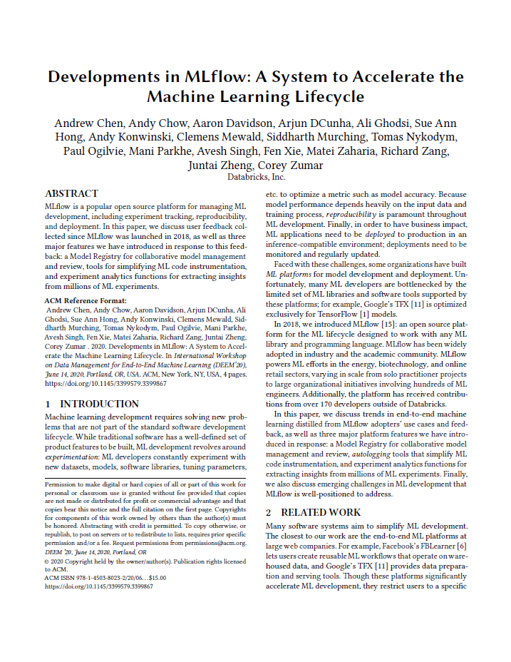
Model Management Systems (MLOps), cont.
Model Management & Provenance
MLflow
  An open source platform for
  the machine learning lifecycle
  Use of existing ML systems
  and various language bindings
  MLflow Tracking: logging and querying experiments
  MLflow Projects: packaging/reproduction of ML pipeline results
  MLflow Models: deployment of models in various services/tools
  MLflow Model Registry: cataloging models and managing deployment
[Matei Zaharia, Andrew Chen, Aaron Davidson, Ali Ghodsi, Sue Ann Hong, Andy Konwinski, Siddharth Murching, Tomas Nykodym, Paul Ogilvie, Mani Parkhe, Fen Xie, Corey Zumar: Accelerating the Machine Learning Lifecycle with MLflow. IEEE Data Eng. Bull. 41(4) 2018]
[Andrew Chen, Andy Chow, Aaron Davidson, Arjun DCunha, Ali Ghodsi, Sue Ann Hong, Andy Konwinski, Clemens Mewald, Siddharth Murching, Tomas Nykodym, Paul Ogilvie, Mani Parkhe, Avesh Singh, Fen Xie, Matei Zaharia, Richard Zang, Juntai Zheng, Corey Zumar: Developments in MLflow: A System to Accelerate the Machine Learning Lifecycle. DEEM@SIGMOD 2020]

Slide 21
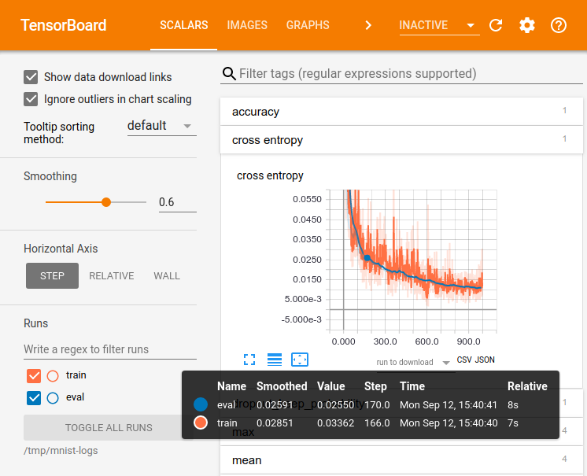
Experiment Tracking
Model Management & Provenance
TensorFlow: TensorBoard
  Suite of visualization tools
  Explicitly track and write
  summary statistics
  Visualize behavior over
  time and across experiments
  Different folders for
  model versioning?
Other Tools:
  Integration w/ TensorBoard
  Lots of custom logging
  and plotting tools
[Credit: https://www.tensorflow.org/guide/ summaries_and_tensorboard]

Slide 22
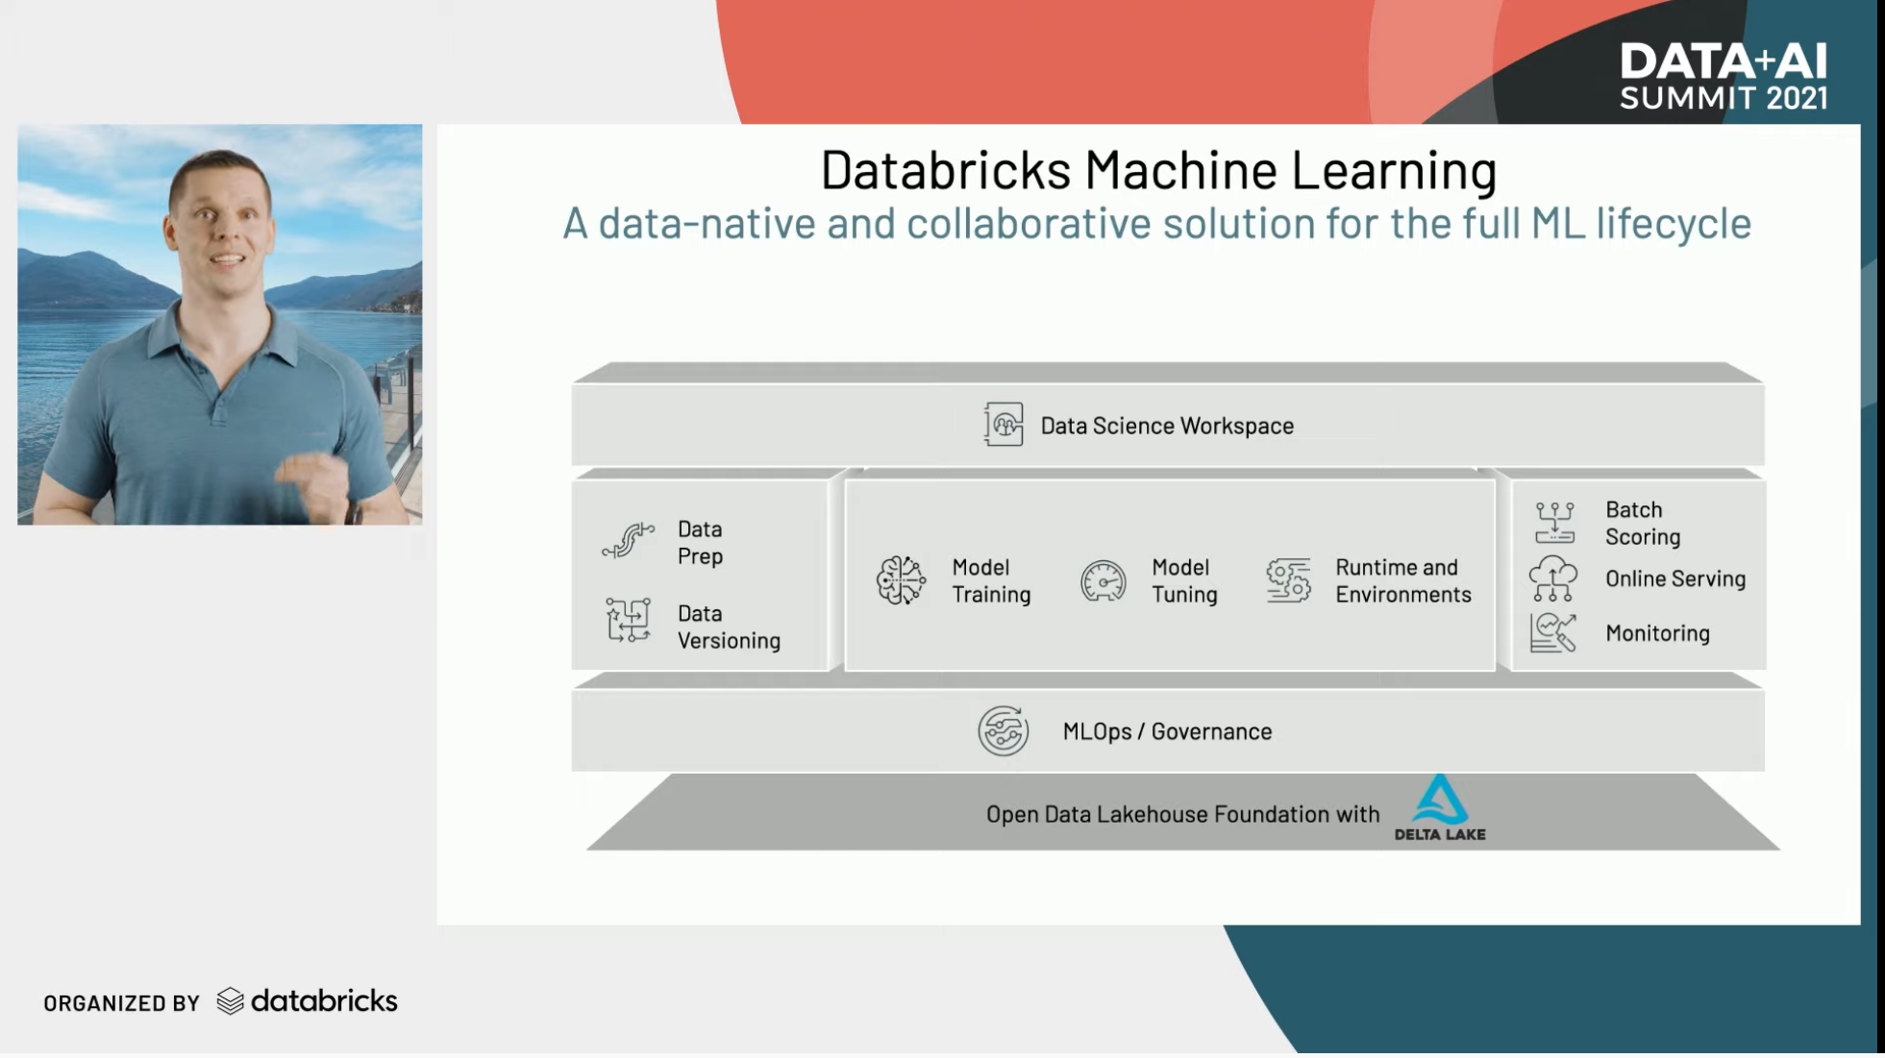
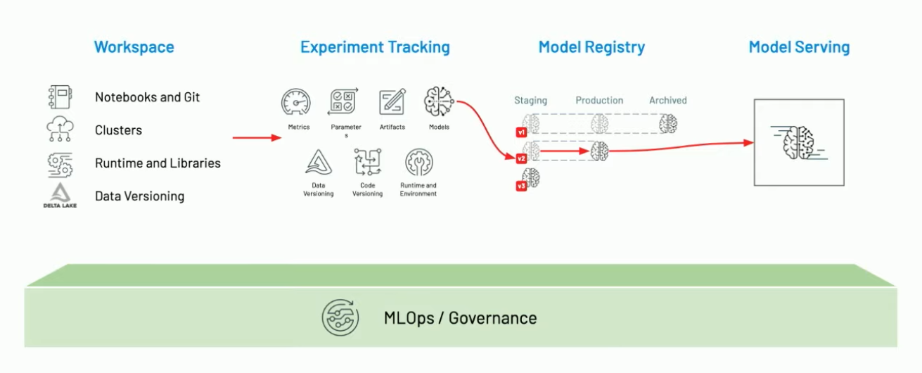
ML Lifecycle Management
Model Management & Provenance
Databricks Machine Learning
  MLOps, Feature Store, AutoML
[Clemens Mewald: Announcing Databricks Machine Learning, Feature Store, AutoML, Keynote Data+ AI Summit 2021]
MLOps = DataOps + DevOps + ModelOps

Slide 23
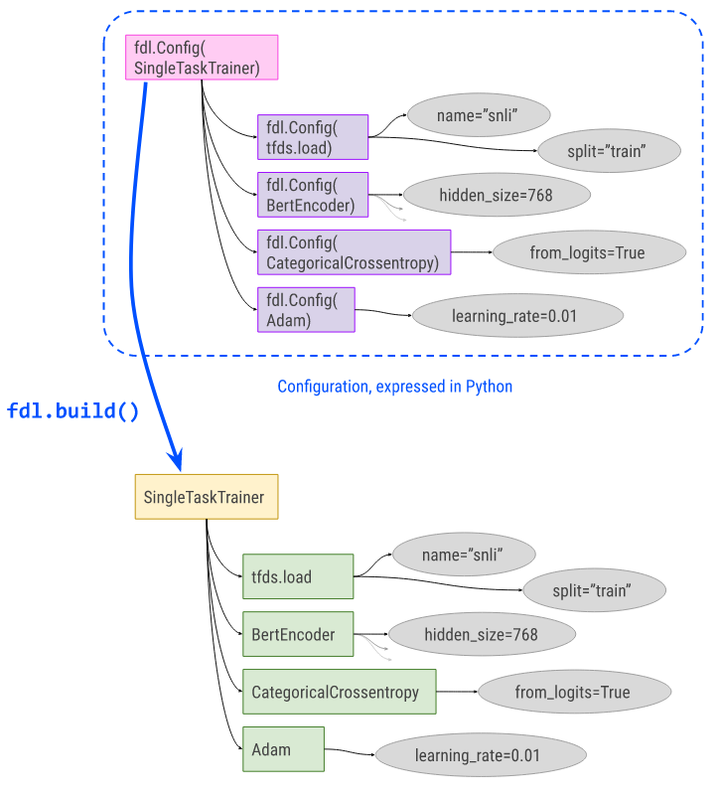
Configuration Management
Model Management & Provenance
#1 ML Collections
  Dictionary-like data structures for
  configurations of experiments and models
  (hyper-parameters, loss, optimizer)
  ConfigDict and FrozenConfigDict
#2 Fiddle
  Configurations for model training
  with build() for creating training instances
  Auto-config for creating a config object
  from a (control-flow-free) function
  Explain and visualization
https://github.com/
google/ml_collections
https://github.com/
google/fiddle

Slide 24

Provenance for ML Pipelines (fine-grained)
Model Management & Provenance
DEX: Dataset Versioning
  Versioning of datasets, stored with delta encoding
  Checkout, intersection, union queries over deltas
  Query optimization for finding efficient plans
MISTIQUE: Intermediates of ML Pipelines
  Capturing, storage, querying of intermediates
  Lossy deduplication and compression
  Adaptive querying/materialization for finding efficient plans
Linear Algebra Provenance
  Provenance propagation by decomposition
  Annotate parts w/ provenance polynomials
  (identifiers of contributing inputs + impact)
[Amit Chavan, Amol Deshpande: DEX: Query Execution in a Delta-based Storage System. SIGMOD 2017]
[Manasi Vartak et al: MISTIQUE: A System to Store and Query Model Intermediates for Model Diagnosis. SIGMOD 2018]
A
B
C
D
E
S_{x}
S_{y}
$$A=S_{x}BT_{u}+S_{x}CT_{v}+S_{y}DT_{u}+S_{y}ET_{v}$$
T_{u}
[Zhepeng Yan, Val Tannen, Zachary G. Ives: Fine-grained Provenance for Linear Algebra Operators. TaPP 2016]
T_{v}

Slide 25
Provenance for ML Pipelines (coarse-grained)
Model Management & Provenance
[Credit: https://databricks.com/
blog/2018/06/05 ]
MLflow
  Programmatic API for
  tracking parameters,
  experiments, and results
  autolog() for specific params
Flor (on Ground)
  DSL embedded in python for managing the
  workflow development phase of the ML lifecycle
  DAGs of actions, artifacts, and literals
  Data context generated by activities in Ground
Dataset Relationship Management
  Reuse, reveal, revise, retarget, reward
  Code-to-data relationships (data provenance)
  Data-to-code relationships (potential transforms)
import mlflow
mlflow.log_param("num_dimensions", 8)
mlflow.log_param("regularization", 0.1)
mlflow.log_metric("accuracy", 0.1)
mlflow.log_artifact("roc.png")
[Credit: https://rise.cs.berkeley.edu/
projects/jarvis/ ]
[Joseph M. Hellerstein et al: Ground: A Data Context Service. CIDR 2017]
[Zachary G. Ives, Yi Zhang, Soonbo Han, Nan Zheng,: Dataset Relationship Management. CIDR 2019]

Slide 26
Provenance for ML Pipelines (coarse-grained), cont.
Model Management & Provenance
HELIX
  Goal: focus on iterative development
  w/ small modifications (trial & error)
  Caching, reuse, and recomputation
  Reuse as Max-Flow problem → NP-hard → heuristics
  Materialization to disk
  for future reuse
Collaborative
Optimizer
[Doris Xin, Stephen Macke, Litian Ma, Jialin Liu, Shuchen Song, Aditya G. Parameswaran: Helix: Holistic Optimization for Accelerating Iterative Machine Learning. PVLDB 2018]
load
recompute
[Behrouz Derakhshan, Alireza Rezaei Mahdiraji, Ziawasch Abedjan, Tilmann Rabl, Volker Markl: Optimizing Machine Learning Workloads in Collaborative Environments. SIGMOD 2020]
Notes:
Note: reuse poly, but materialization opt NP-hard

Slide 27


Lineage Tracing & Reuse in SystemDS
Model Management & Provenance
Problem
  Exploratory data science (data preprocessing, model configurations)
  Reproducibility and explainability of trained models (data, parameters, prep)
  Lineage/Provenance as Key Enabling Technique:
  Model versioning, reuse of intermediates, incremental maintenance,
  auto differentiation, and debugging (query processing over lineage)
Efficient Lineage Tracing
  Tracing of inputs, literals,
  and non-determinism
  Trace lineage of
  logical operations
  Deduplication for loops/functions
  Program/output reconstruction
Lineage-Based Reuse
[Arnab Phani, Benjamin Rath, Matthias Boehm: LIMA: Fine-grained Lineage Tracing and Reuse in Machine Learning Systems, SIGMOD 2021]

Slide 28
Model Debugging and Explainability
Similar to Software Testing
Focus on Benchmarks, Assessment, Monitoring,
Model Improvements, Model Understanding

Slide 29
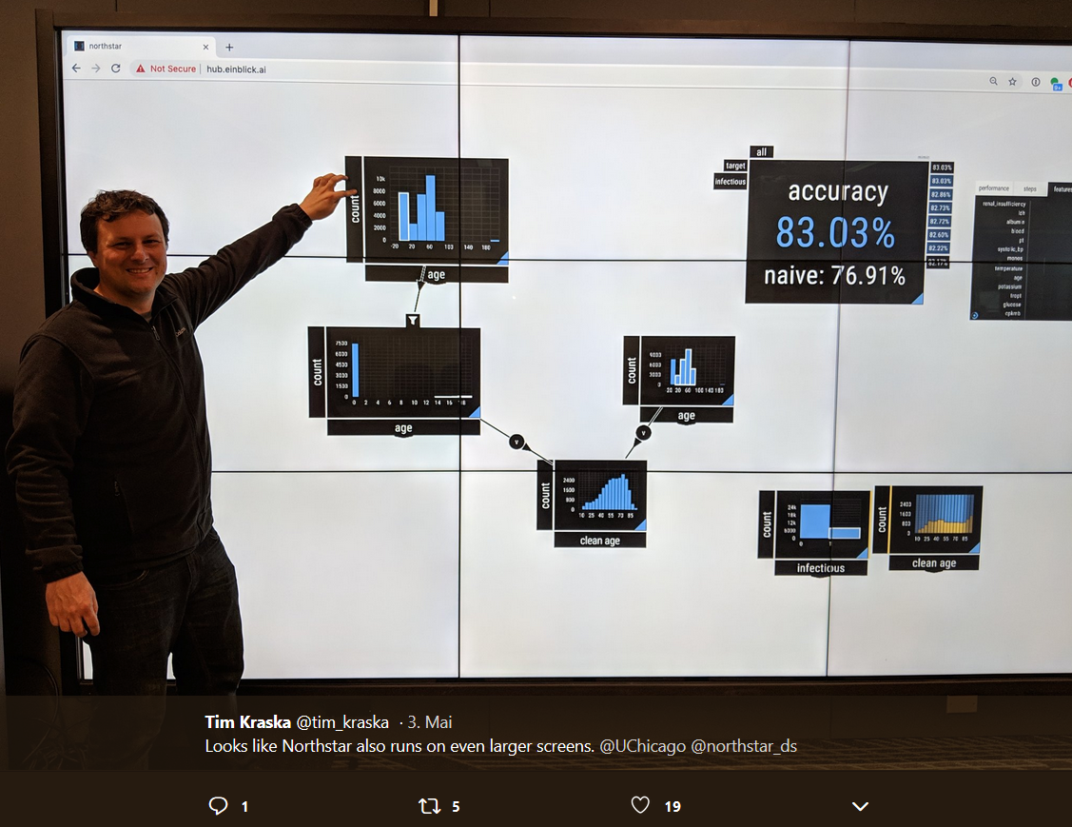
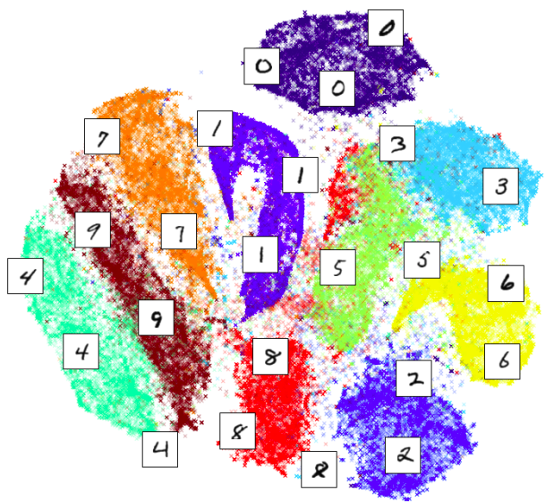
Overview Model Debugging
Model Debugging and Explainability
[Credit: twitter.com/tim_kraska]
[Andrew Crotty et al: Vizdom: Interactive Analytics through Pen and Touch. PVLDB 2015]
#1 Understanding via Visualization
  Plotting of predictions / interactions
  Combination with dimensionality
  reduction into 2D:
    Autoencoder
    PCA (principal component analysis)
    t-SNE (T-distributed Stochastic Neighbor Embedding)
  Input, intermediate, and output layers of DNNs
#2 Validation, Explainability, Fairness via Constraints
  Establish assertions and thresholds for automatic validation and alerts
  w.r.t. accuracy, bias, and other metrics
  Generate succinct representations (e.g., rules) as explanation
  Impose constraints like monotonicity for ensuring fairness
[Credit: nlml.github.io/in-raw-numpy/in-raw-numpy-t-sne/]

Slide 30
Basic Model-Specific Statistics
Model Debugging and Explainability
Regression Statistics
  Average response and stddev, average residuals stddev residuals
  R2 (coeff of determination) with and without bias, etc
Classification Statistics
  Classical: recall, precision, F1-score
  Visual: confusion matrix
  (correct vs predicated classes)
  ➔ understand performance
  wrt individual classes /
  bins of continuous vars
  Example Mnist
  Mispredictions might
  also be visualized via
  dimensionality reduction
predicted label
0 | 1 | 2 | 3 | 4 | 5 | 6 | 7 | 8 | 9
21
 | 25
 |  | 15
 |  |  | 76
 |  |  |  | 23 |  |  |  |  | 12
 |  |  |  |  | 36
 |  |  |  |  |  | 24
 |  |  |  |  |  |  | 31 |  | 37
 |  |  |  |  |  |  |  | 42
 |  |  |  | 8 |  |  | 11 |  | 53
0
1
2
3
4
5
6
7
8
9
correct label

Slide 31
Excursus: DLR Earth Observation Use Case
Model Debugging and Explainability
[Xiao Xiang Zhu et al: So2Sat LCZ42: A Benchmark Dataset for the Classification of Global Local Climate Zones. GRSM 2020]
Data and ML Pipelines
  ESA Sentinel-1/2 datasets → 4PB/year
  Training of local climate zone classifiers on
  So2Sat LCZ42 (15 experts, 400K instances,
  10 labels each, 85% confidence, ~55GB H5)
  ML pipeline: preprocessing, ResNet18,
  climate models
Label Creation/ Validation
  Team learning
  Labeling w/ checks
  Label validation
  Quantitative
  validation w/ 10
  expert votes on correctness
[So2Sat LC42 Dataset
https://mediatum.ub.tum.de/1454690]
Notes:
Notes: Confusion matrices (values in %) of the original labels the final labels (refined by majority voting) vs. the votes cast bythe label validation crew for the polygons of the evaluation cities selected in Tables II and III: (a) original labels polygon-wise assessment, (b) original labels pixel-wise, (c) final labels polygon-wise, and (d) final labels pixel-wise
Unfortunately, not many European cities contain LCZ class 7 (light-weight low-rise), which mostly describes informal settlements (e.g., slums). Therefore, we included the polygons of class 7 for an additional 9 cities that are representative of the 9 major non-European geographical regions of the world

Slide 32
Confusion Matrices, cont.
Model Debugging and Explainability
Generalized Confusion Matrices
  Hierarchical, Multi-label Data
  Transform multi-label data:
  conditioning, marginalization (aggregation), and nesting
[Jochen Görtler et al: Neo: Generalizing Confusion Matrix Visualization to Hierarchical and Multi-Output Labels. CHI 2022 (1/25 best papers)]
Notes:
Neo by Apple

Slide 33
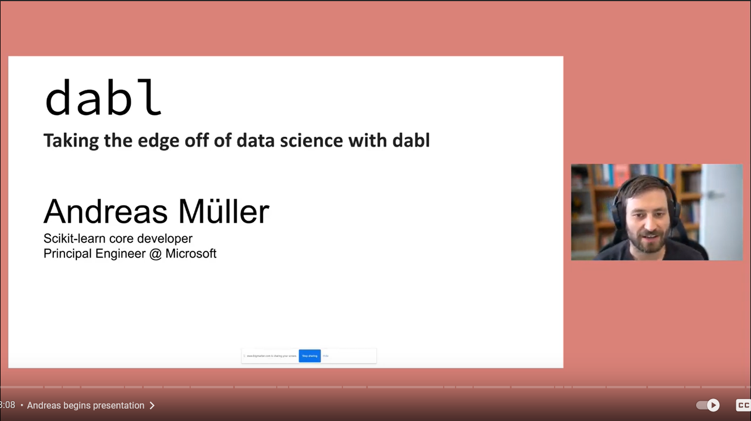
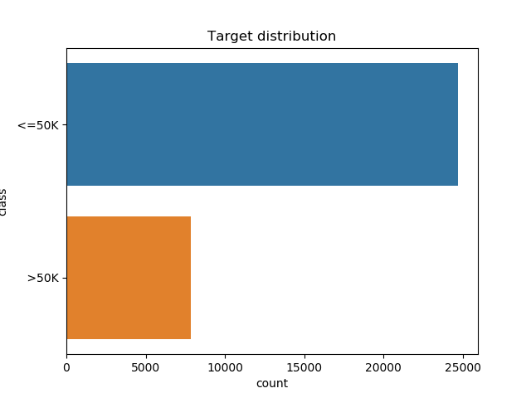
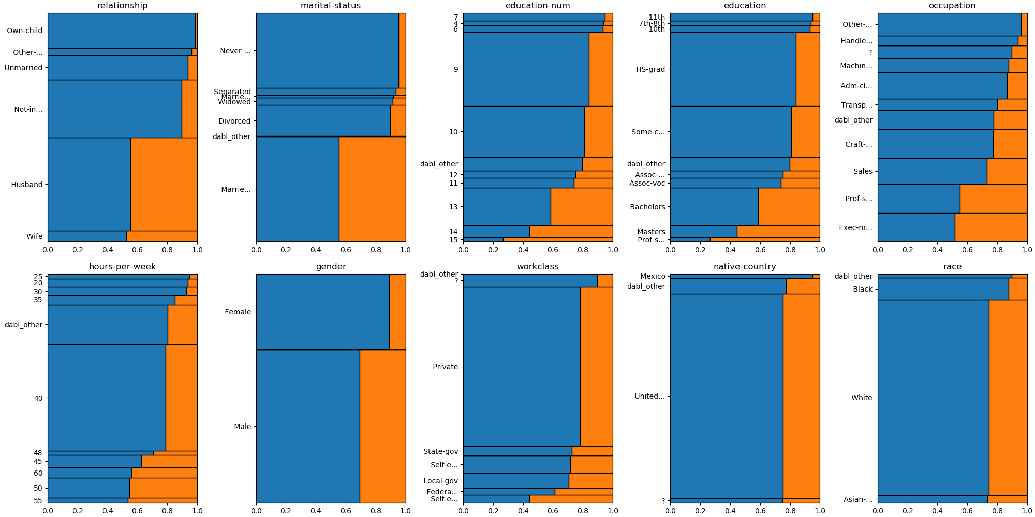
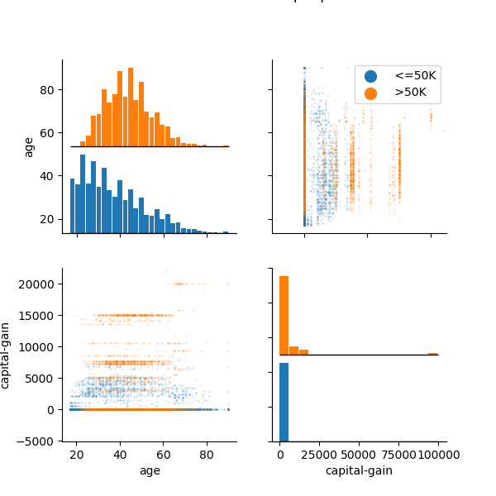
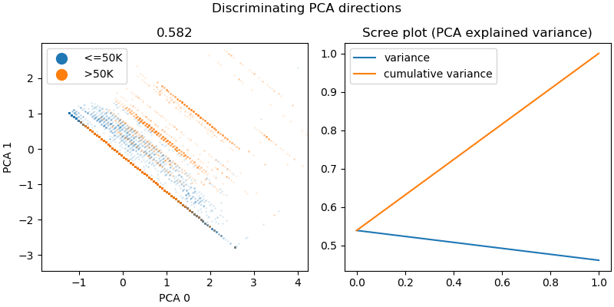
Excursus: dabl.plot
Model Debugging and Explainability
[Andreas Mueller: dabl – Taking the edge off
of data science with dabl, Data Umbrella 2022, https://www.youtube.com/watch?v=h92RMJi4mRM]
# adult dataset (>50K vs <=50K income)
data = pd.read_csv("adult.csv")
plot(data, "income")
[https://amueller.github.io/dabl/dev/auto_examples/
plot/plot_adult.html]
(mosaic plots)

Slide 34
Occlusion-Based Explanations
Model Debugging and Explainability
Occlusion Explanations
  Slide gray square over inputs
  Measure how feature maps
  and classifier output changes
Incremental Computation
of Occlusion Explanations
  View CNN as white-box operator
  graph and operators as views
  Materialize intermediate tensors
  and apply incremental view maintenance
[Matthew D. Zeiler, Rob Fergus: Visualizing and Understanding Convolutional Networks. ECCV 2014]
[Supun Nakandala, Arun Kumar, and Yannis Papakonstantinou: Incremental and Approximate Inference forFaster Occlusion-based Deep CNN Explanations, SIGMOD 2019]
SIGMOD 2020 Research Highlight
Notes:
Deconvolutional network (deconvnet): map feature activity in intermediate layers back to the input pixel space;
Reveals: that text in care more important, owner faces dominate dog bread classification

Slide 35


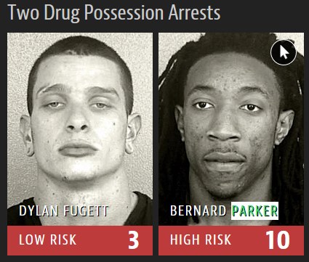
Example Model Anomalies
Model Debugging and Explainability
“silent but severe problems”
12/27
→
25/27
#1 Wolf Detection based on snow cover
#2 Horse Detection
based on image watermarks
  Layer-wise relevance propagation
#3 Race-biased Jail
Risk Assessment
[Marco Túlio Ribeiro, Sameer Singh, and Carlos Guestrin: Why Should I Trust You?: Explaining the Predictions of Any Classifier, KDD 2016]
[Sebastian Lapuschkin et al.: Analyzing Classifiers: Fisher Vectors and Deep Neural Networks, CVPR 2016]
[Julia Angwin et al: Machine Bias – There’s software used across the country to predict future criminals. And it’s biased against blacks, 2016, https://www.propublica.org/article/
machine-bias-risk-assessments-in-criminal-sentencing]
Notes:
Husky classification: # persons believing ‘snow as a potential feature’
FV: fisher vectors, user study with and without explanation by occlusion
Racial bias; white 86$ Home Depot before armed robbery and attempted armed robbery (low risk) vs similar price range, but black (high risk); example person 3x arrests

Slide 36
SliceFinder
Model Debugging and Explainability
[Yeounoh Chung, Tim Kraska, Neoklis Polyzotis, Ki Hyun Tae, Steven Euijong Whang: Automated Data Slicing for Model Validation: A Big Data - AI Integration Approach. ICDE2019/TKDE2020]
Problem Formulation
  Data slice: S^{DG} := D=PhD AND G=female (subsets of features)
  Find top-k data slices where model performs worse than average
  Ordering by
    Increasing number of literals,
    Decreasing slice size, and decreasing effect size (difference 𝑆 vs ¬𝑆)
  Subject to: minimum effect size threshold 𝑇, statistical significance (Welch’s t-test), a dominance constraint (no coarser slice satisfies 1 and 2) via
Existing Algorithms
  Preparation: Binning + One-Hot Encoding
  #1 Clustering → slices
  #2 Decision tree training
  #3 Lattice search with
  heuristic, level-wise termination
“find largest error vs find large slices”
Notes:
Note: As SliceFinder searches through a large number of slices, some slices might appear problematic by chance (i.e., multiple comparisons problem [20]). SliceFinder controls such a risk by applying a marginal false discovery rate (mFDR) controlling procedure called \alpha-investing

Slide 37


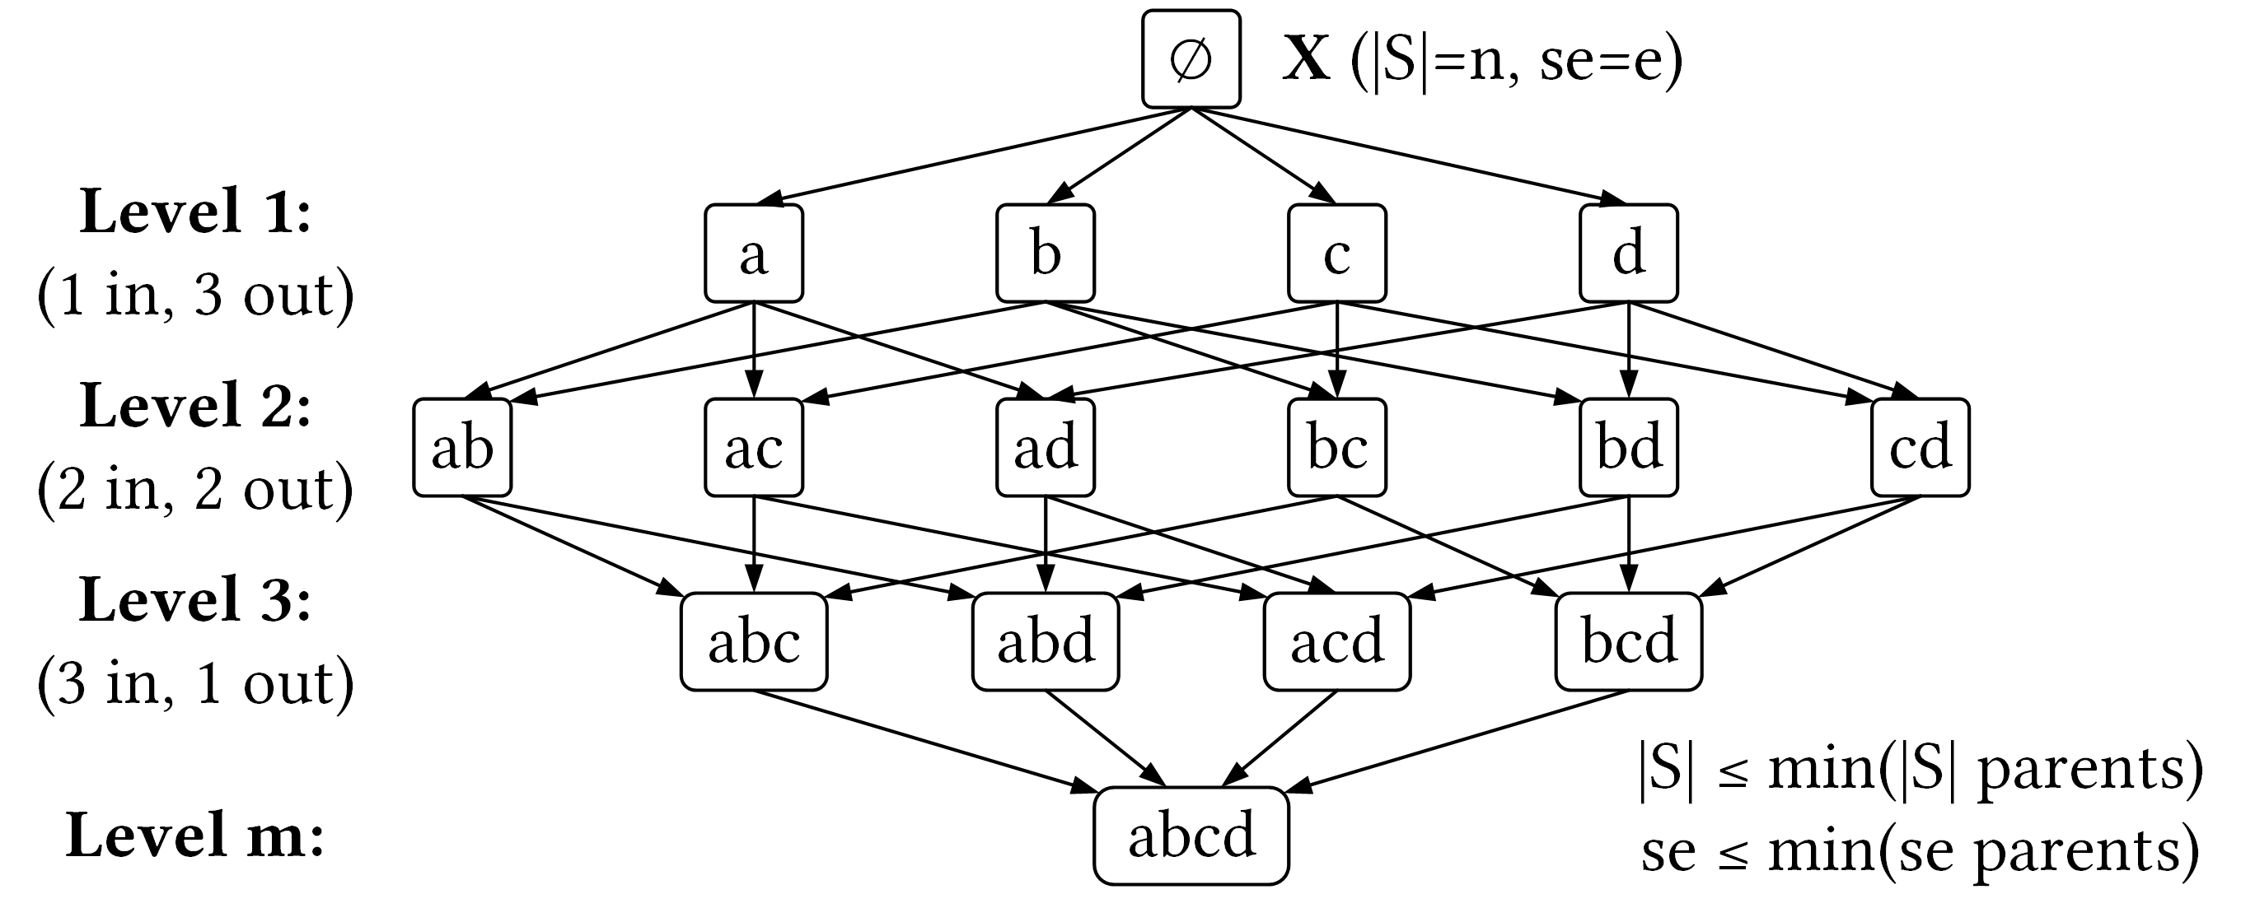
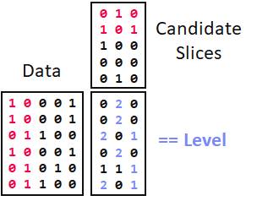
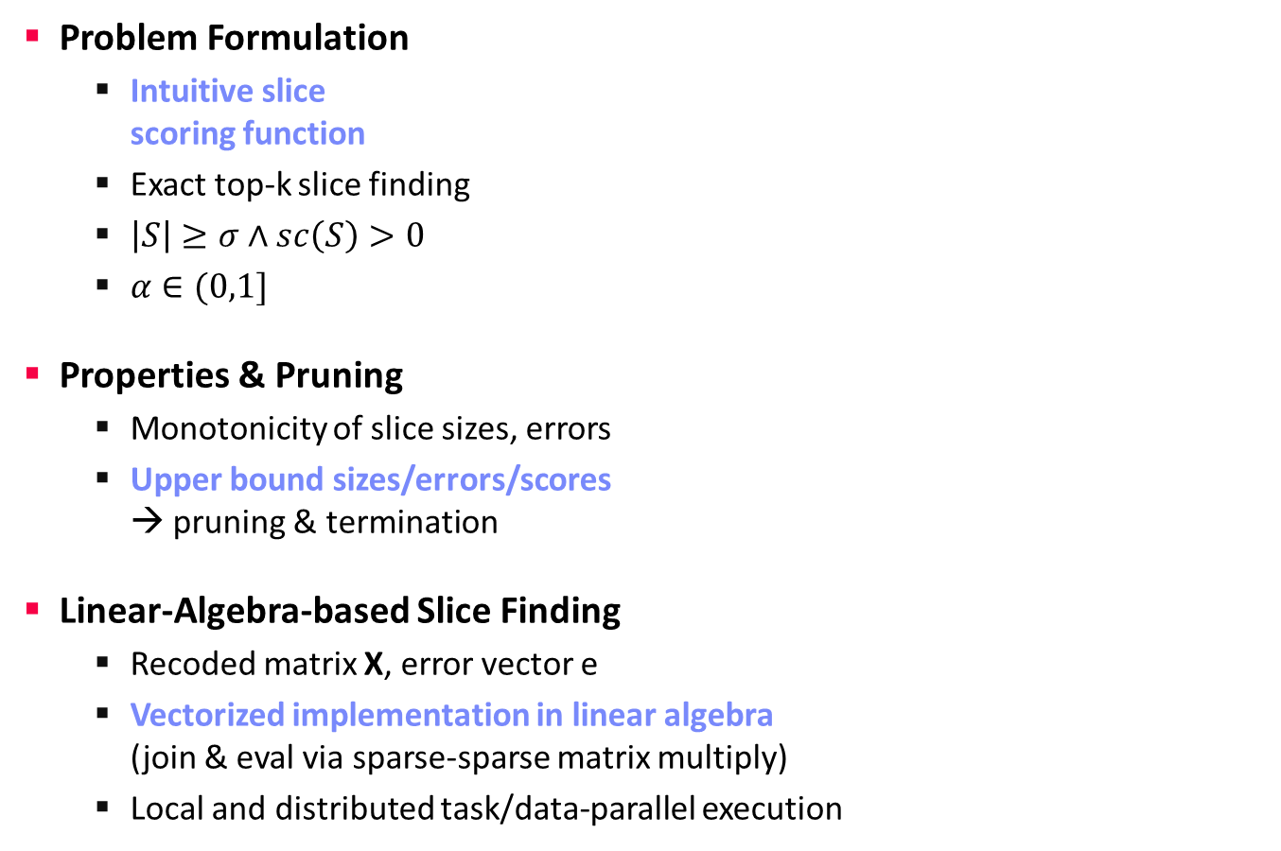
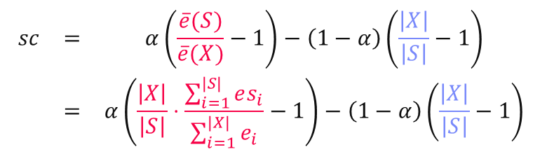
SliceLine for Model Debugging
Model Debugging and Explainability
[Credit: sliceline,
Silicon Valley, HBO]
Problem Formulation
  Intuitive slice
  scoring function
  Exact top-k slice finding
  $\left|S\right|≥σ∧sc\left(S\right)>0$
  $α∈(0,1]$
Properties & Pruning
  Monotonicity of slice sizes, errors
  Upper bound sizes/errors/scores
  → pruning & termination
Linear-Algebra-based Slice Finding
  Recoded matrix X, error vector e
  Vectorized implementation in linear algebra
  (join & eval via sparse-sparse matrix multiply)
  Local and distributed task/data-parallel execution
$$\begin{matrix}sc & = & α\left(\frac{\overline{e}(S)}{\overline{e}(X)}−1\right)−\left(1−α\right)\left(\frac{\left|X\right|}{\left|S\right|}−1\right) \\ & = & α\left(\frac{\left|X\right|}{\left|S\right|}⋅\frac{\sum_{i=1}^{|S|}{es_{i}}}{\sum_{i=1}^{|X|}{e_{i}}}−1\right)−\left(1−α\right)\left(\frac{\left|X\right|}{\left|S\right|}−1\right)\end{matrix}$$
slice error
slice size
Notes:
Compelling properties:
The components are balanced under α = 0.5.
The score of the original X is always sc = 0.
For α = 0 (all weight on size), the maximum feasible score is 0, and no slice smaller than X can reach it.
All components of Equation (1) are either constants, or slice errors and sizes, which makes this function amenable to pruning.

Slide 38
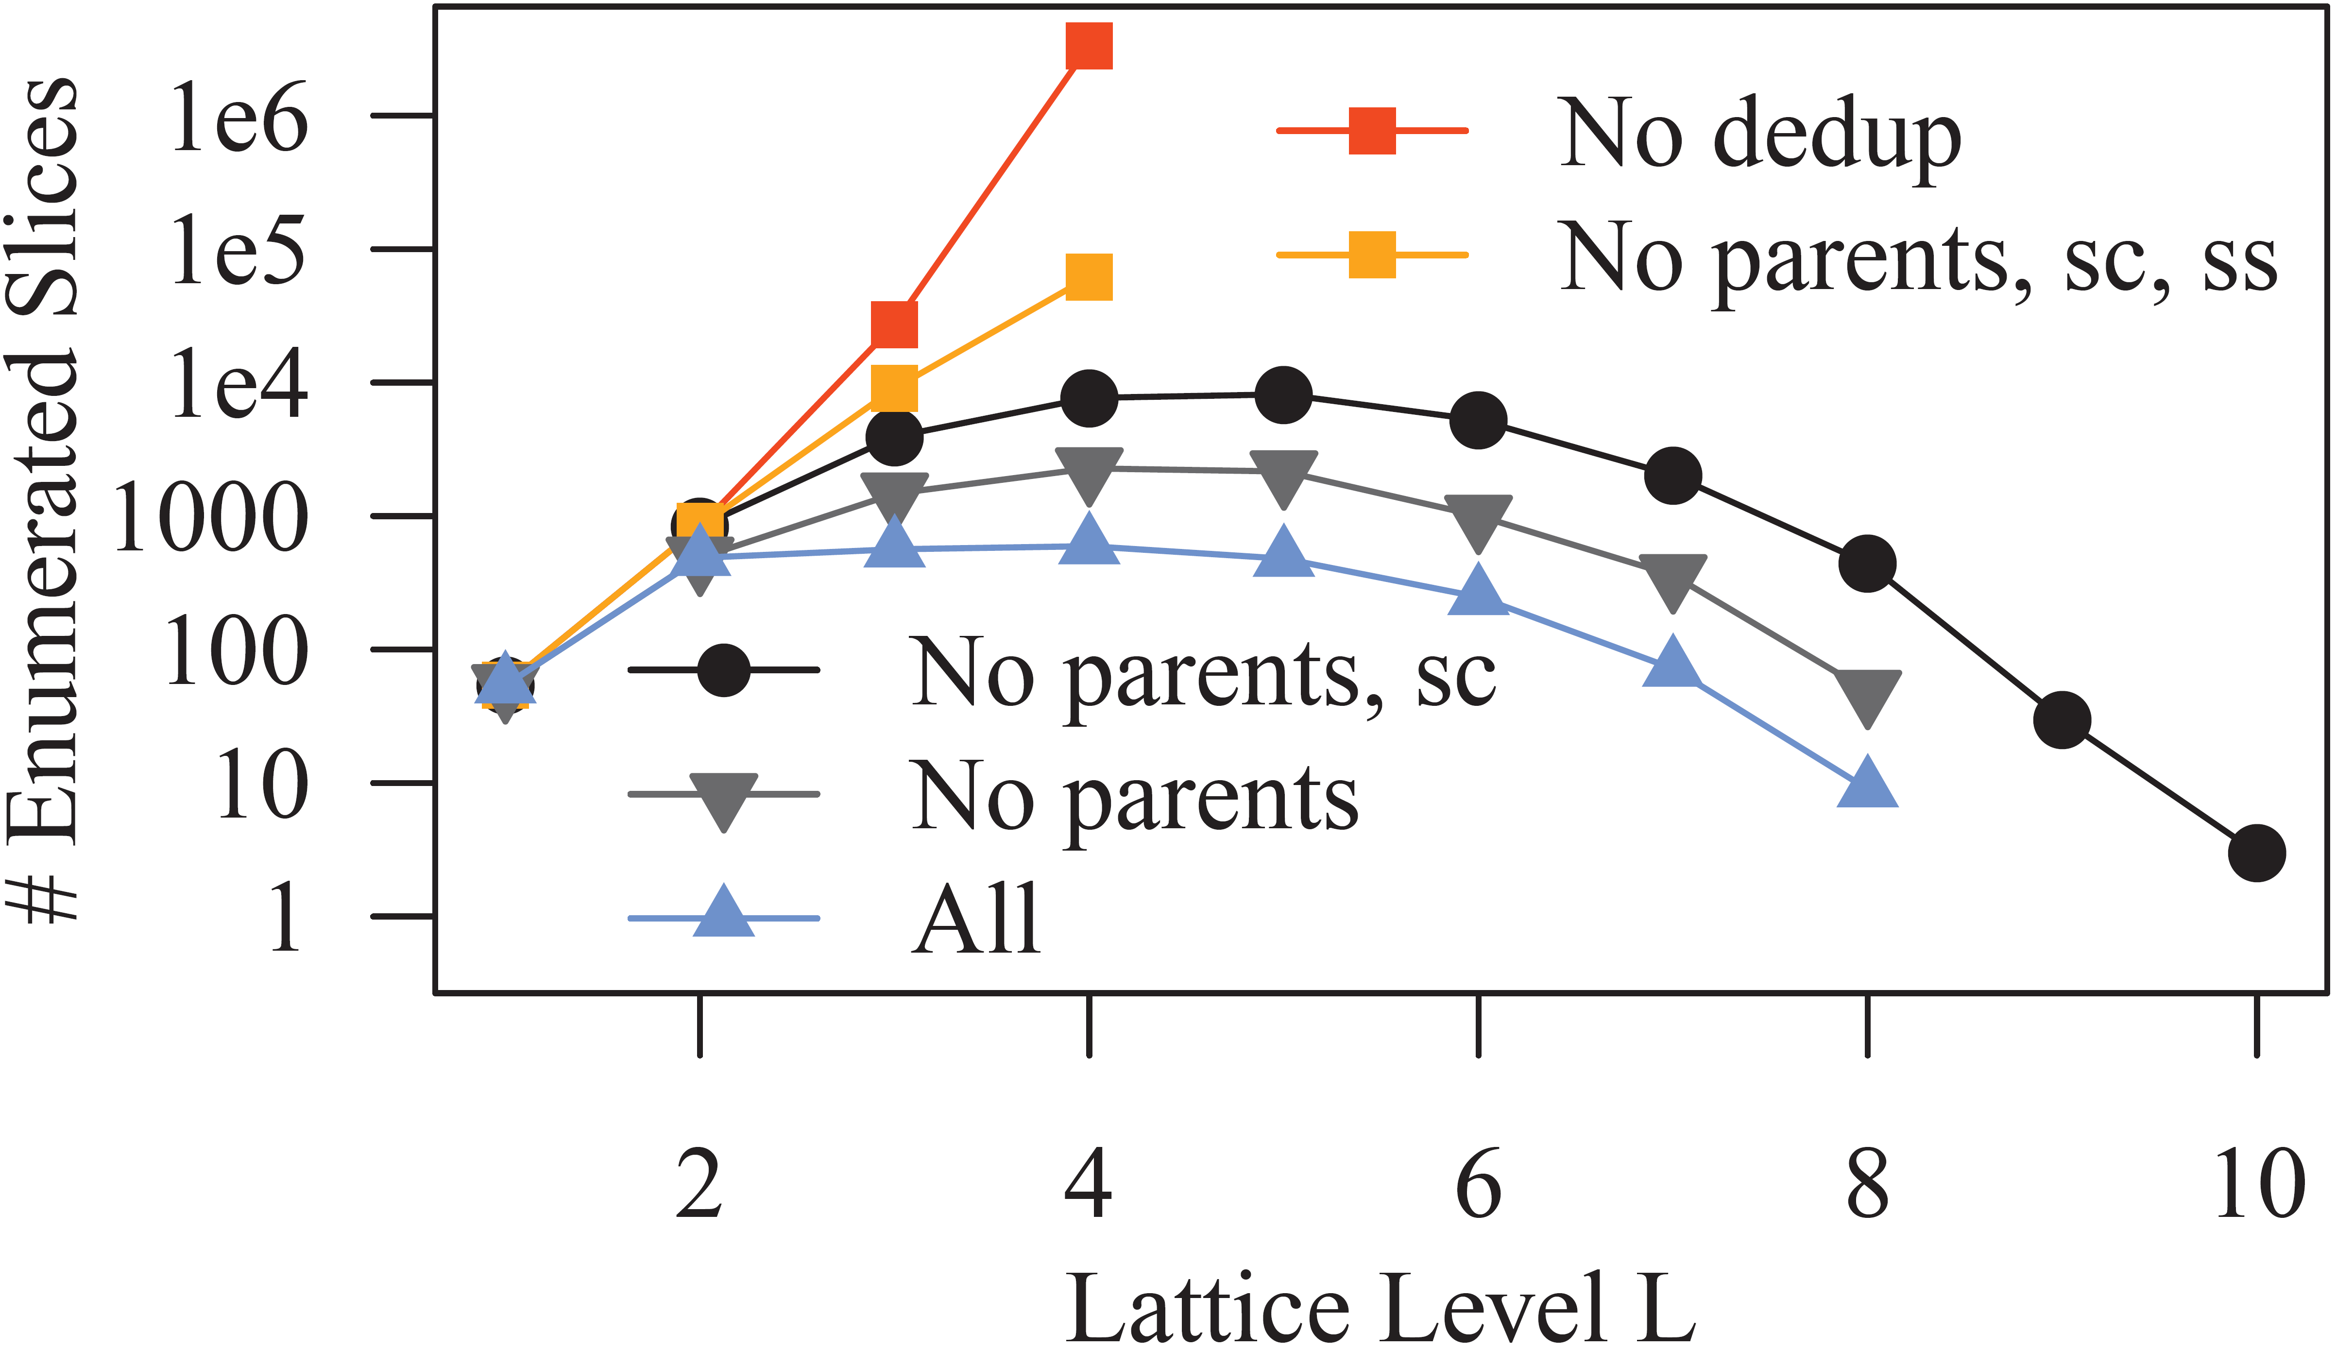
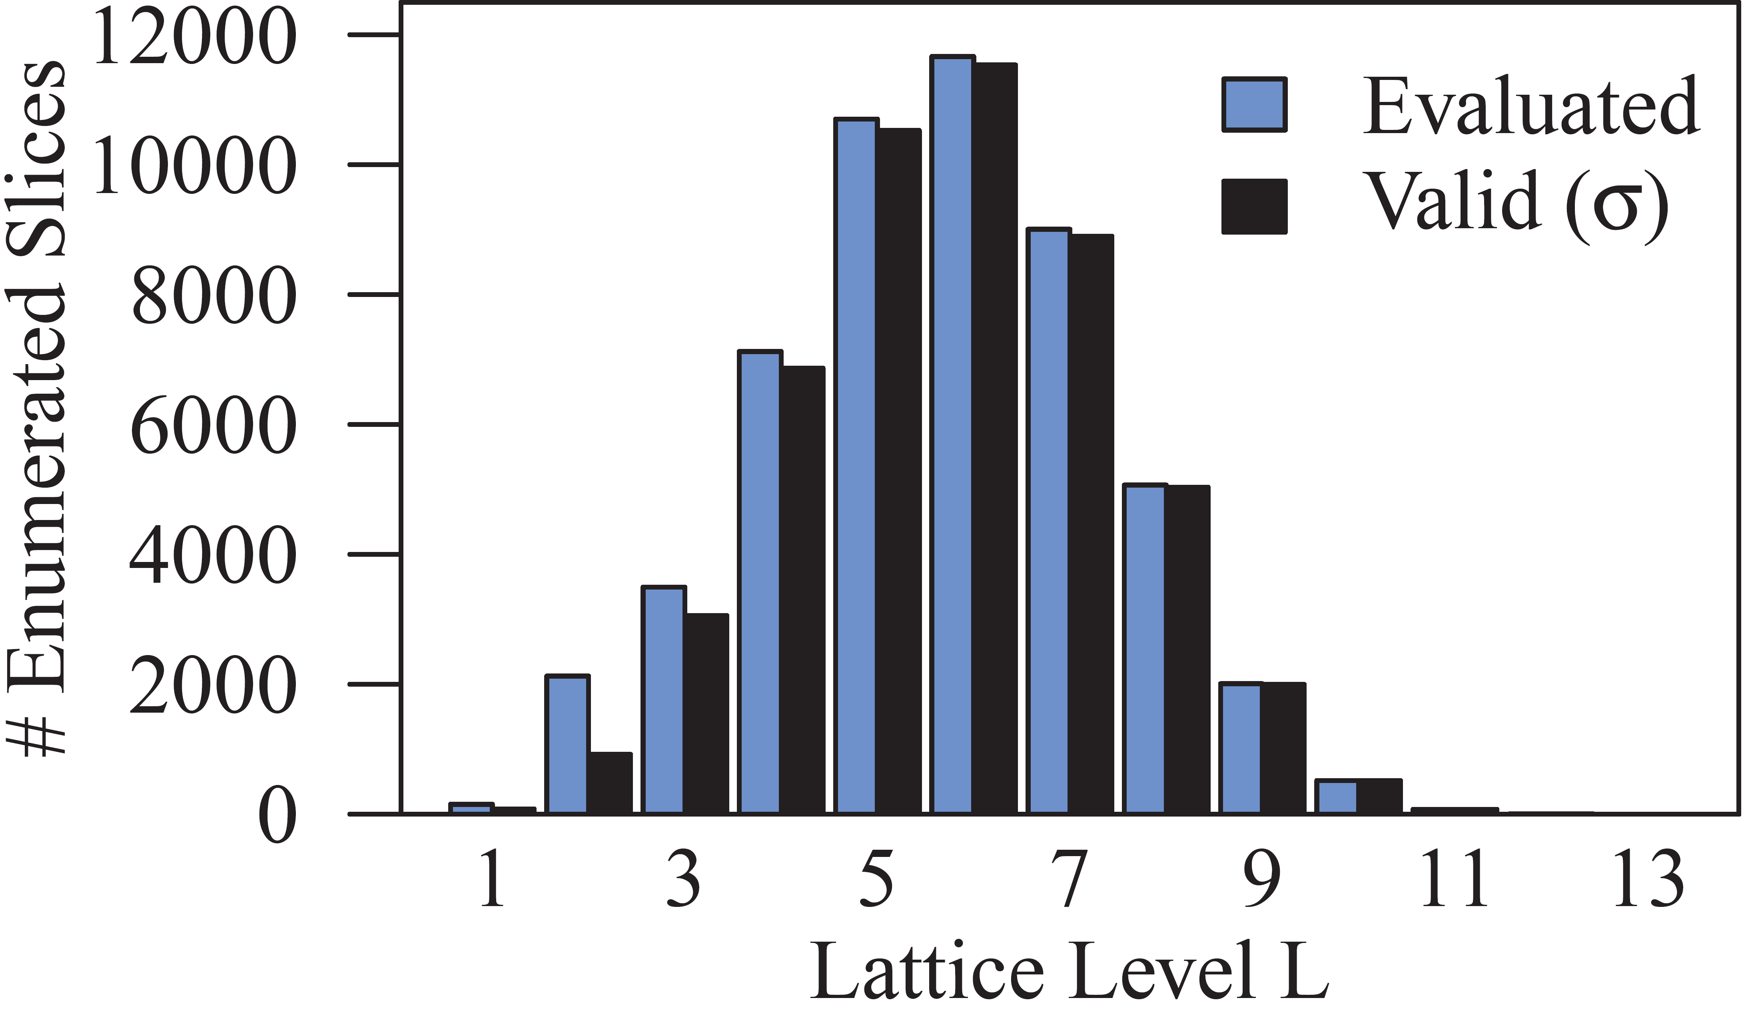
SliceLine – Experiments
Model Debugging and Explainability
[Svetlana Sagadeeva, Matthias Boehm: SliceLine: Fast, Linear-Algebra-based Slice Finding for ML Model Debugging, SIGMOD 2021]
Salaries 2x2
Adult
Effective Pruning (#evaluated
close to #valid)
Practical Performance
(39s until termination
at level 12)

Slide 39
Slice Tuner
Model Debugging and Explainability
[Ki Hyun Tae, Steven Euijong Whang: Slice Tuner: A Selective Data Acquisition Framework for Accurate and Fair Machine Learning Models, SIGMOD 2021]
Motivation
  Root cause of unfairness: bias in training data
  Selective Data Acquisition for
  model accuracy and fairness
  Different slices w/ different learning curves
  → Learning curve fitting
Problem Formulation
Minimize total loss of slices
Penalize underperforming slices
Convex optimization problem
Budget of acquisition costs
Notes:
Note: experiments with Fashion-MNIST, UTKFace → Mechanical Turk

Slide 40
Continuous Integration
Model Debugging and Explainability
[Cedric Renggli, Bojan Karlaš, Bolin Ding, Feng Liu, Kevin Schawinski, Wentao Wu, Ce Zhang: Continuous Integration of Machine Learning Models with ease.ml/ci: Towards a Rigorous Yet Practical Treatment, SysML 2019]
System Architecture
ease.ml/ci
Notes:
Others: model assertions

Slide 41
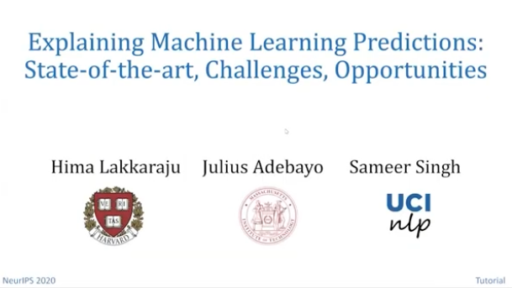
Explainability
Model Debugging and Explainability
[Hima Lakkaraju, Julius Adebayo, Sameer Singh: Explaining Machine Learning Predictions: State-of-the-art, Challenges, and Opportunities, NeurIPS 2020 Tutorial, https://explainml-tutorial.github.io/neurips20]
Motivation
  Explain predictions via inputs for model understanding & transparency
  Utilize model debugging and other tools
#1 Interpretable Models
  Linear models, tree-based models,
  rule-based models
  Weights and decision rules
#2 Post-hoc Explanations
  Complex deep neural networks or very large models → black box models
  Build simple models for explaining any complex models
Types of Explanations
  Model parameters, example predictions, summarization
  Most important features/data, how to flip model predictions
Interpretability ⬅ ➔ Accuracy
Prefer simpler models
if accuracy sufficient!
Multi-modal Interpretability: https://captum.ai/

Slide 42
LIME: Sparse, Linear Explanations
Model Debugging and Explainability
[Marco Túlio Ribeiro, Sameer Singh, and Carlos Guestrin: Why Should I Trust You?: Explaining the Predictions of Any Classifier, KDD 2016]
LIME Overview
  Model agnostic explanations
  Identify important dimension and
  present their relative importance
  Sample perturbations of prediction input
  (e.g., hide parts of image, attribute values)
  Locally weighted regression
LIME Objective
  Various hyper-parameters
  Heuristics /
  HP optimization
Loss Function
Regularizer
Linear Models
Local Kernel

Slide 43
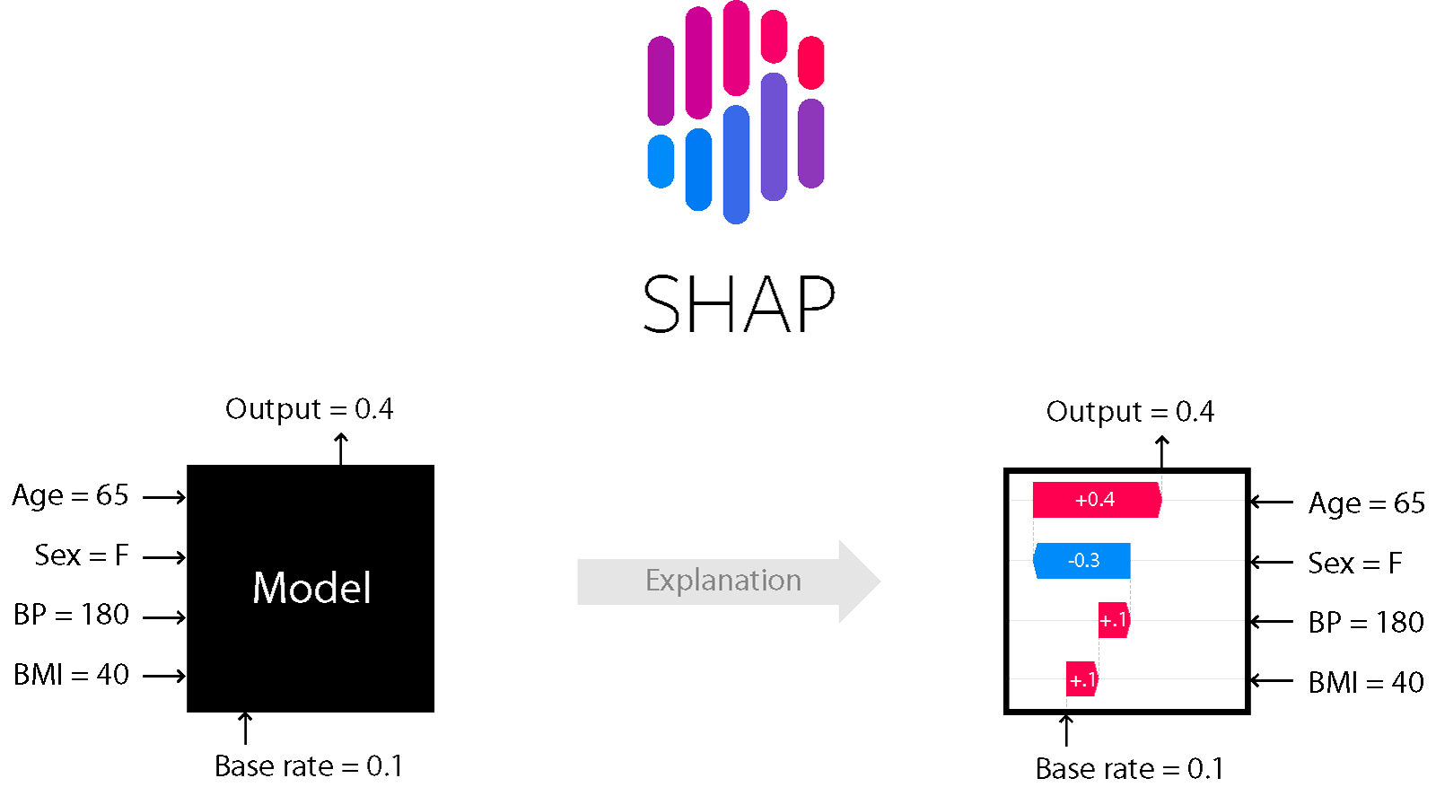
SHAP: Shapley Additive Explanations
Model Debugging and Explainability
[Scott M. Lundberg, Su-In Lee: A Unified Approach to Interpreting Model Predictions. NIPS 2017]
SHAP Overview
  Additive feature importance (local accuracy)
  Unification of LIME, Shapley sampling/regression values, QII,
  DeepLIFT, layer-wise relevance propagation, tree interpreter
  Estimate Shapley values using linear regression
SHAP Tooling
[Scott M. Lundberg: Explainable AI for Science and Medicine,
https://www.youtube.com/watch?v=B-c8tIgchu0]
(Avg Output)
[https://shap.readthedocs.io/en/latest/index.html]
Marginal contributions
Notes:
Note: core contribution: new weighting kernel to estimate shapely values using dense/sparse linear regression (LIME parameters forced to one valid solution by Shapley axioms local accuracy / consistency)

Slide 44
Model Bias & Fairness
Focus on Applications, Fairness, Ethics, Responsibility
Fairness Metrics and Constraints
Employs Model Debugging & Explainability
Techniques

Slide 45
Sources of Bias
Model Bias & Fairness
Environment
  Selection Bias: Differences in study participation, data availability, and measurement effort
  Test environment, project team, cultural context → different context
Data Collection
  Sample Bias: collected data not representative of application
  Observer Bias / Confirmation Bias: subjective judgment leaks
  into measurement and analysis → transparency and critical feedback
Training Dataset
  Data Bias: e.g., not missing at random (NMAR) values
  Feature Selection Bias: manual or automatic during data preparation
➔ Design ML Systems & applications w/ awareness of potential bias

Slide 46
Excursus: DLR Earth Observation Use Case, cont.
Model Bias & Fairness
[Xiao Xiang Zhu et al: So2Sat LCZ42: A Benchmark Dataset for the Classification of Global Local Climate Zones. GRSM 2020]
Environment / Context
→ Biased Data Collection
→ Awareness and
Conscious Bias Mitigation
→ Remaining Bias?

Slide 47
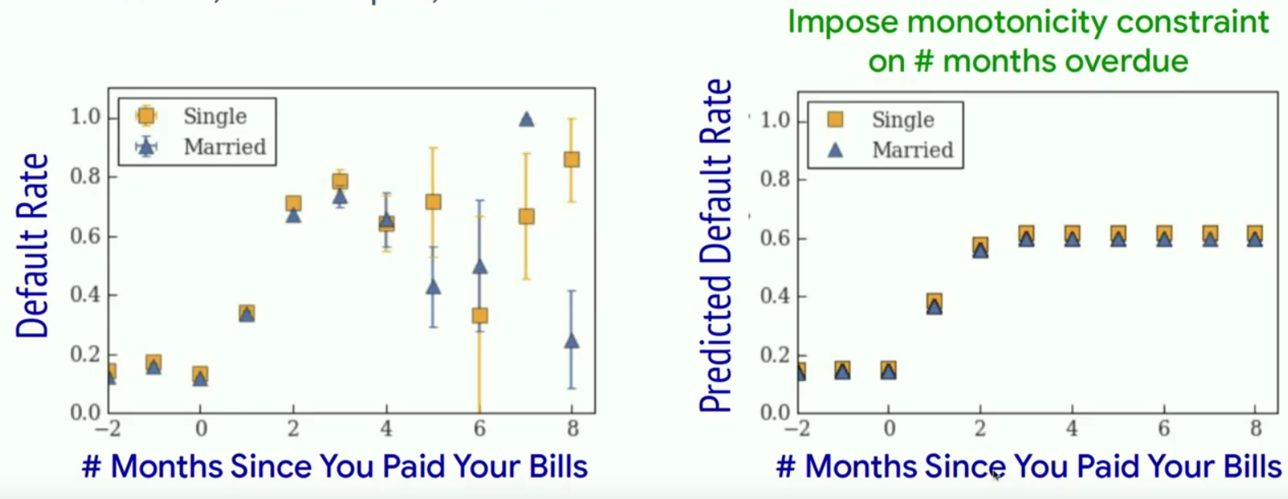
Debugging Bias and Fairness
Model Bias & Fairness
Fairness
  Validate and ensure fairness with regard to sensitive features (unbiased)
  Use occlusion and saliency maps to characterize and compare groups
Enforcing Fairness
  Use constraints to enforce certain properties (e.g., monotonicity, smoothness)
  Example: late payment → credit score
[Maya Gupta: How Do We Make AI Fair? SysML 2019]

Slide 48
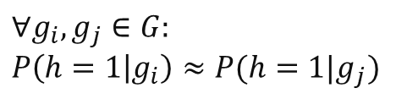



Group Fairness Constraints
Model Bias & Fairness
[H. Zhang et al: OmniFair: A Declarative System for Model-Agnostic Group Fairness in Machine Learning, SIGMOD 2021]
#1 Statistical Parity
  Independence of model from groups
  Equal probability outcome across groups
#2 False Positive Rate Parity
  Independence of model from groups
  Conditioned on true label y=0
#3 False Negative Rate Parity
  Independence of model from groups
  Conditioned on true label y=1
#4 False Omission Rate Parity
  Independence of true labels from groups
  Conditioned on negative prediction h=0
$$∀g_{i},g_{j}∈G: \\ P\left(h=1 | g_{i}\right)≈P(h=1|g_{j})$$
$$∀g_{i},g_{j}∈G: \\ P\left(h=1 | g_{i},y=0\right) \\ ≈P(h=1|g_{j},y=0)$$
#2+#3 Equalized Odds
$$∀g_{i},g_{j}∈G: \\ P\left(h=0 | g_{i},y=1\right) \\ ≈P(h=0|g_{j},y=1)$$
$$∀g_{i},g_{j}∈G: \\ P\left(y=1 | g_{i},h=0\right) \\ ≈P(y=1|g_{j},h=0)$$

Slide 49
Ensuring Fairness
Model Bias & Fairness
[H. Zhang et al: OmniFair: A Declarative System for Model-Agnostic Group Fairness in Machine Learning, SIGMOD 2021]
Problem Formulation
  A fairness specification is given by a triplet (g, f, 𝜀) and induces
  (|g(D)|choose 2) fairness constraints on pairs of groups
  A fairness specification is satisfied by a classifier ℎ on 𝐷 iff all
  induced fairness constraints are satisfied, i.e., ∀gi,gj ∈ g(D), |f(h,gi)−f(h,gj)| ≤ 𝜀
  Unconstrained
  optimization problem
Results
  Adult dataset
  Model-
  agnostic
  Similar
  Accuracy
max accuracy
s.t. fairness
max accuracy
+ fairness

Slide 50
Excursus: EU Policy
Model Bias & Fairness
[European Commission: LAYING DOWN HARMONISED RULES ON ARTIFICIAL INTELLIGENCE
(ARTIFICIAL INTELLIGENCE ACT) AND AMENDING CERTAIN UNION LEGISLATIVE ACTS, 04/2021]
➔ “The preferred option is option 3+, a regulatory framework for high-risk AI systems only, with the possibility for […] non-high-risk AI systems to follow a code of conduct.”
Notes:
Resources on Responsible Data Science:
https://dataresponsibly.github.io/courses/spring20/

Slide 51
Summary and Q&A
Model Selection Techniques
Model Management & Provenance
Model Debugging and Explainability
Model Bias & Fairness Constraints

