Slide 1

Architecture of ML Systems*
05 Compilation and Optimization
Last update: Aug 25, 2022

Slide 2



Agenda
Compilation Overview
Size Inference and Cost Estimation
Rewrites (and Operator Selection)
Runtime Adaptation
Operator Fusion & JIT Compilation
SystemDS, and several other ML systems

Slide 3
Compilation Overview

Slide 4
Recap: Linear Algebra Systems
Compilation Overview
Comparison Query Optimization
  Rule- and cost-based rewrites and operator ordering
  Physical operator selection and query compilation
  Linear algebra / other ML operators, DAGs,
  control flow, sparse/dense formats
#1 Interpretation (operation at-a-time)
  Examples: R, PyTorch, Morpheus [PVLDB’17]
#2 Lazy Expression Compilation (DAG at-a-time)
  Examples: RIOT [CIDR’09], TensorFlow [OSDI’16]
  Mahout Samsara [MLSystems’16], Dask
  Examples w/ control structures: Weld [CIDR’17],
  OptiML [ICML’11], Emma [SIGMOD’15]
#3 Program Compilation (entire program)
  Examples: SystemML [ICDE’11/PVLDB’16], Julia,
  Cumulon [SIGMOD’13], Tupleware [PVLDB’15]
DB
PL
HPC
Compilers for Large-scale ML
Optimization Scope
1: X = read($1); # n x m matrix
2: y = read($2); # n x 1 vector
3: maxi = 50; lambda = 0.001;
4: intercept = $3;
5: ...
6: r = -(t(X) %*% y);
7: norm_r2 = sum(r * r); p = -r;
8: w = matrix(0, ncol(X), 1); i = 0;
9: while(i<maxi & norm_r2>norm_r2_trgt) 10: {
11: q = (t(X) %*% X %*% p)+lambda*p;
12: alpha = norm_r2 / sum(p * q);
13: w = w + alpha * p;
14: old_norm_r2 = norm_r2;
15: r = r + alpha * q;
16: norm_r2 = sum(r * r);
17: beta = norm_r2 / old_norm_r2;
18: p = -r + beta * p; i = i + 1;
19: }
20: write(w, $4, format="text");

Slide 5
ML Program Compilation / Graphs
Compilation Overview
Script:
Operator DAG
(today’s lecture)
  a.k.a. “graph”
  (data flow graph)
  a.k.a. intermediate
  representation (IR)
Runtime Plan
  Compiled runtime plans
  Interpreted plans
while(...) {
q = t(X) %*% (w * (X %*% v)) ...
}
Statement Block Hierarchy
q
[Multiple] DAG roots (outputs)
Operation
ba+*
Data Dependency
r(t)
b(*)
[Multiple] Consumers of Intermediates
ba+*
w
No cycles
X
v
[Multiple] DAG leafs (inputs)
SPARK mapmmchain X.MATRIX.DOUBLE w.MATRIX.DOUBLE
v.MATRIX.DOUBLE _mVar4.MATRIX.DOUBLE XtwXv

Slide 6
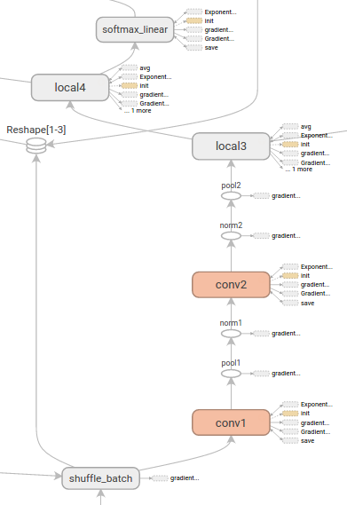
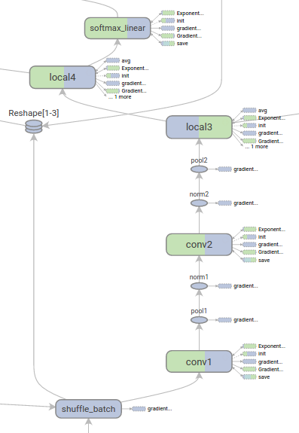
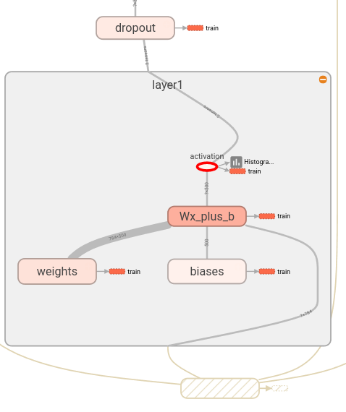
ML Program Compilation / Graphs, cont.
Compilation Overview
Example TF TensorBoard
Tensor Shapes and
Runtime Statistics (time, mem)
(Node) Structure View
Device View (CPU, GPU)
Edge thickness → size,
Color intensity → time
Same color, same internal structure
Same color, same device
[https://github.com/tensorflow/tensorboard/blob/master/docs/r1/graphs.md]

Slide 7
Compilation Chain
Compilation Overview
Script
[Matthias Boehm et al:
SystemML's Optimizer: Plan Generation for Large-Scale Machine Learning Programs. IEEE Data Eng. Bull 2014]
Language
Parsing (syntactic analysis)
Live Variable Analysis
Validate (semantic analysis)
HOPs
Construct HOP DAGs
Multiple
Rounds
Static/Dynamic Rewrites
Intra-/Inter-Procedural Analysis
Static/Dynamic Rewrites
Compute Memory Estimates
Dynamic Recompilation
LOPs
Construct LOP DAGs
(incl operator selection, hop-lop rewrites)
Generate Runtime Program
Execution Plan

Slide 8
Recap: Basic HOP and LOP DAG Compilation
Compilation Overview
LinregDS (Direct Solve)
X = read($1);
y = read($2);
intercept = $3;
lambda = 0.001;
...
if( intercept == 1 ) {
ones = matrix(1, nrow(X), 1);
X = append(X, ones);
}
I = matrix(1, ncol(X), 1);
A = t(X) %*% X + diag(I)*lambda;
b = t(X) %*% y;
beta = solve(A, b);
...
write(beta, $4);
Cluster Config:
driver mem: 20 GB
exec mem: 60 GB
Scenario:
X: 10⁸ x 10³, 10¹¹
y: 10⁸ x 1, 10⁸
HOP DAG
(after rewrites)
8KB
CP
write
8MB
16MB
CP
b(solve)
CP
172KB
b(+)
1.6TB
CP
SP
800GB
r(diag)
ba(+*)
ba(+*)
SP
1.6TB
r(t)
8KB
SP
CP
800GB
800MB
dg(rand)
(10³x1,10³)
X
(10⁸x10³,10¹¹)
y
(10⁸x1,10⁸)
LOP DAG
(after rewrites)
16KB
r’(CP)
Hybrid Runtime Plans:
  Size propagation / memory estimates
  Integrated CP / Spark runtime
  Dynamic recompilation during runtime
Distributed Matrices
  Fixed-size (squared) matrix blocks
  Data-parallel operations
mapmm(SP)
tsmm(SP)
800MB
1.6GB
r’(CP)
X
X_{1,1}
(persisted in MEM_DISK)
y
X_{2,1}
X_{m,1}

Slide 9
Size Inference and Cost Estimation
Crucial for Generating Valid Execution Plans
& Cost-based Optimization

Slide 10
Constant and Size Propagation
Size Inference and Cost Estimation
Size Information
  Dimensions (#rows, #columns)
  Sparsity (#nnz/(#rows * #columns))
  ➔ memory estimates and costs
Principle: Worst-case Assumption
  Necessary for guarantees (memory)
DAG-level Size Propagation
  Input: Size information for leaves
  Output: size information for
  all operators, -1 if still unknown
  Propagation based on
  operation semantics (single
  bottom-up pass over DAG)
X = read($1);
y = read($2);
I = matrix(0.001, ncol(X), 1);
A = t(X) %*% X + diag(I);
b = t(X) %*% y;
beta = solve(A, b);
(10³x1,-1)
write
(10³x1,-1)
(10³x10³,-1)
b(solve)
(10³x10³,10³)
b(+)
(10³x10³,
-1)
(10³x1,
-1)
r(diag)
ba(+*)
ba(+*)
(10³x10⁸,
10¹¹)
(10³x1,10³)
r(t)
dg(rand)
y
(10⁸x1,10⁸)
0.001
u(ncol)
X
(10⁸x10³,10¹¹)

Slide 11
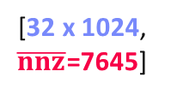
Constant and Size Propagation, cont.
Size Inference and Cost Estimation
Example Relu
(rectified linear unit)
Example SystemDS
  Hop refreshSizeInformation() (exact)
  Hop inferOutputCharacteristics()
  Compiler explicitly differentiates between
  exact and other size information
  Note: ops like aggregate, ctable, rmEmpty
  challenging but w/ upper bounds
Example TensorFlow
  Operator registrations
  Shape inference functions
[32 x 1024, $\overline{nnz}$=7645]
b(max)
[32 x 1024, nnz=7645]
X
0
REGISTER_OP(“Relu”)
.Input(“features: T”)
.Output(“activations: T”)
.Attr(“T: {realnumbertype, qint8}”)
.SetShapeFn(
shape_inference::UnchangedShape)
[Alex Passos: Inside TensorFlow – Eager execution runtime, https://www.youtube.com/watch?v=qjx65mD6nrc, Dec 2019]

Slide 12
Constant and Size Propagation, cont.
Size Inference and Cost Estimation
Constant Propagation
  Relies on live variable analysis
  Propagate constant literals into
  read-only statement blocks
Program-level Size Propagation
  Relies on constant propagation
  and DAG-level size propagation
  Propagate size information across
  conditional control flow: size in leafs,
  DAG-level prop, extract roots
  if: reconcile if and else branch outputs
  while/for: reconcile pre and post loop,
  reset if pre/post different
X = read($1); # n x m matrix
y = read($2); # n x 1 vector
maxi = 50; lambda = 0.001;
if(...){ }
r = -(t(X) %*% y);
r2 = sum(r * r);
p = -r;
w = matrix(0, ncol(X), 1);
i = 0;
while(i<maxi & r2>r2_trgt) {
q = (t(X) %*% X %*% p)+lambda*p;
alpha = norm_r2 / sum(p * q);
w = w + alpha * p;
old_norm_r2 = norm_r2;
r = r + alpha * q;
r2 = sum(r * r);
beta = norm_r2 / old_norm_r2;
p = -r + beta * p;
i = i + 1;
}
write(w, $4, format="text");
# m x 1
# m x 1
# m x 1
# m x 1

Slide 13
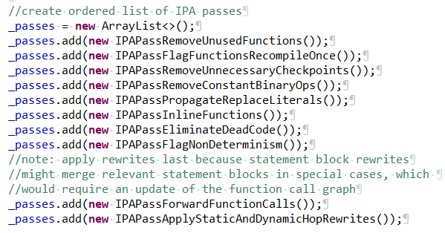
Inter-Procedural Analysis
Size Inference and Cost Estimation
Intra/Inter-Procedural Analysis (IPA)
  Integrates all size propagation techniques (DAG+program, size+constants)
  Intra-function and inter-function size propagation
  (called once, consistent sizes, consistent literals)
Additional IPA Passes (selection)
  Inline functions (single statement block, small)
  Dead code elimination and simplification rewrites
  Remove unused functions & flag recompile-once
1M x 1
X = read($X1)
X = foo(X);
if( $X2 != “ ” ) {
X2 = cbind(X,
matrix(1,n,1));
X2 = foo(X2);
}...
eval(“foo”, X)
foo = function (Matrix[Double] A)
return (Matrix[Double] B)
{
B = A – colSums(A);
if( sum(B!=B)>0 )
print(“NaNs encountered.”);
}
1M x 2
? x ?

Slide 14
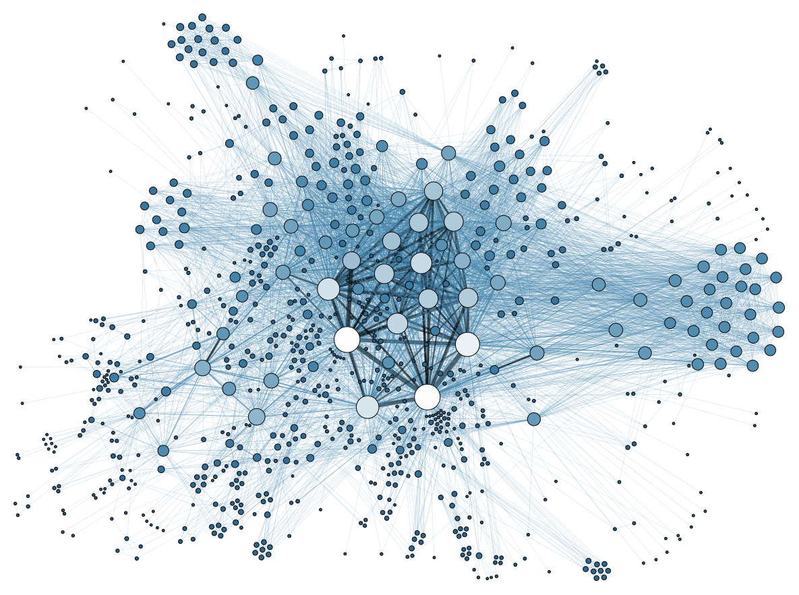
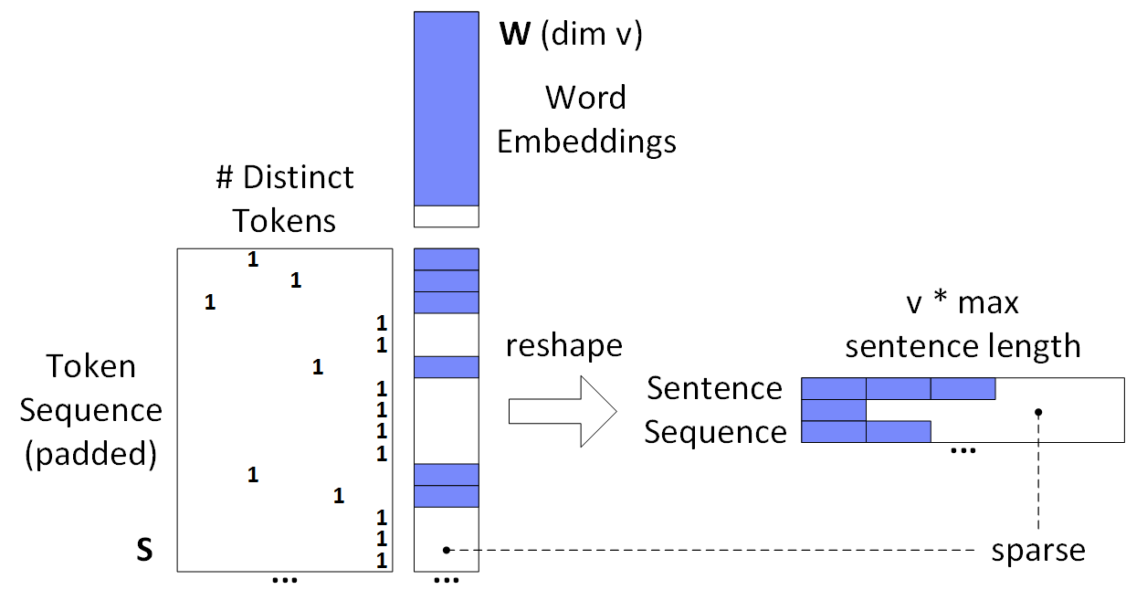
Sparsity Estimation Overview
Size Inference and Cost Estimation
Motivation
  Sparse input matrices from NLP,
  graph analytics, recommender
  systems, scientific computing
  Sparse intermediates
  (transform, selection, dropout)
  Selection/permutation matrices
Problem Definition
  Sparsity estimates used for format decisions, output allocation, cost estimates
  Matrix A with sparsity s_{A} = nnz(A)/(mn) and matrix B with s_{B} = nnz(B)/(nl)
  Estimate sparsity s_{C} = nnz(C)/(ml) of matrix product C = A B; d=max(m,n,l)
  Assumptions
    A1: No cancellation errors
    A2: No not-a-number (NaN)
NLP Example
(SentenceCNN)
Common assumptions
➔ Boolean matrix product

Slide 15
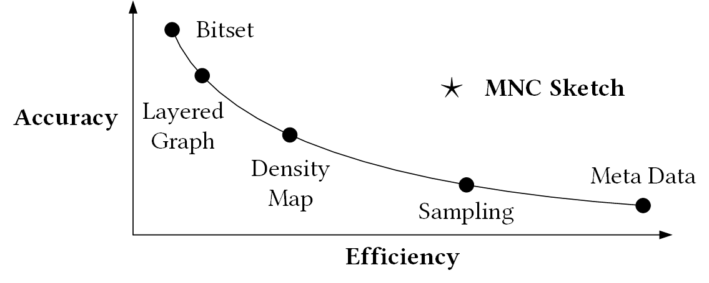
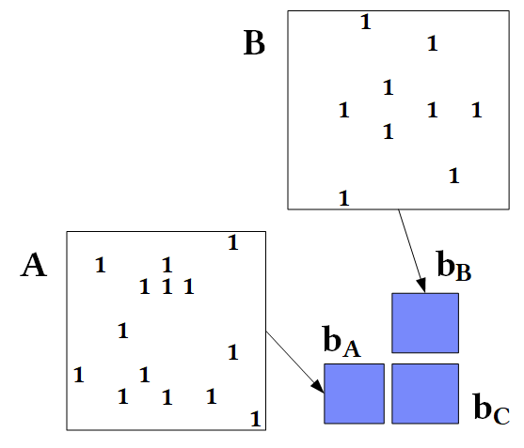
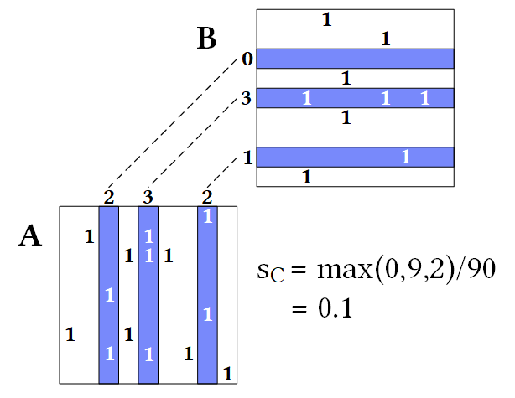
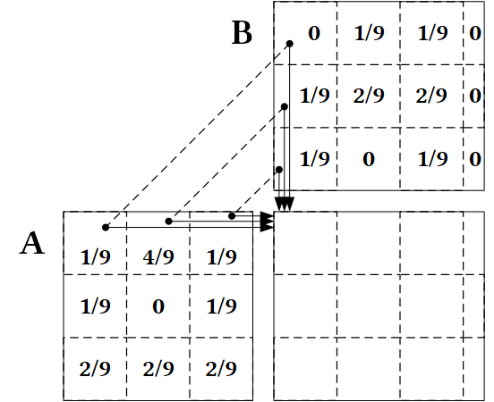

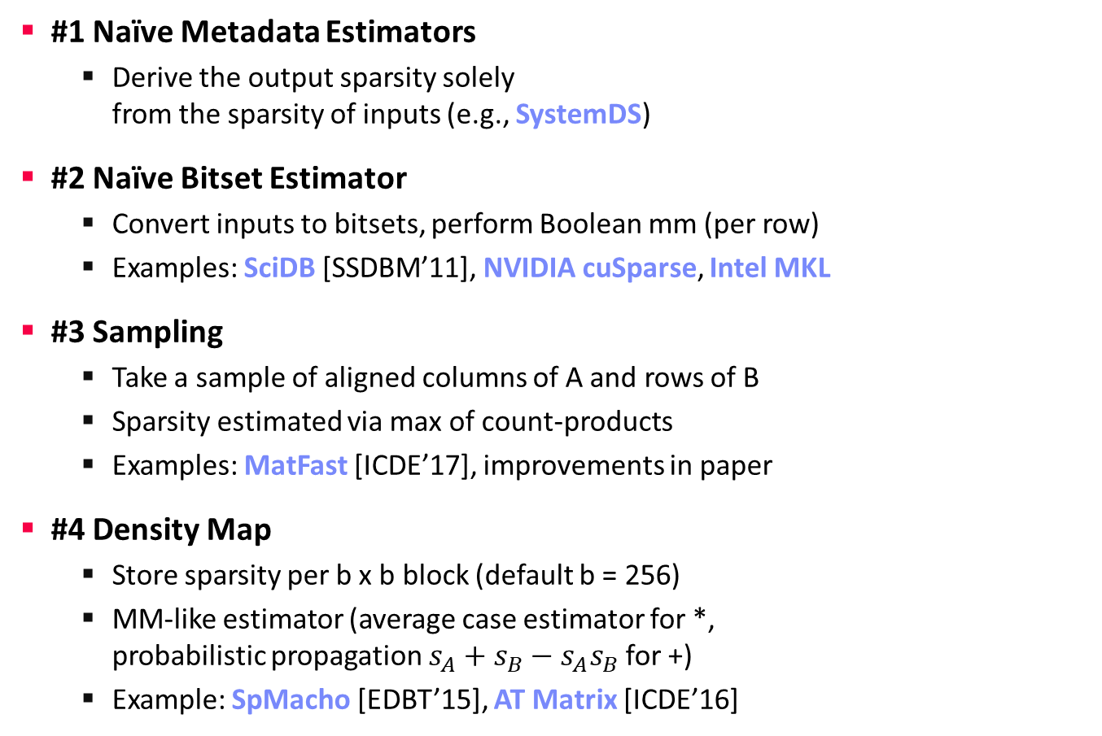

Sparsity Estimation – Estimators
Size Inference and Cost Estimation
Tradeoffs
#1 Naïve Metadata Estimators
  Derive the output sparsity solely
  from the sparsity of inputs (e.g., SystemDS)
#2 Naïve Bitset Estimator
  Convert inputs to bitsets, perform Boolean mm (per row)
  Examples: SciDB [SSDBM’11], NVIDIA cuSparse, Intel MKL
#3 Sampling
  Take a sample of aligned columns of A and rows of B
  Sparsity estimated via max of count-products
  Examples: MatFast [ICDE’17], improvements in paper
#4 Density Map
  Store sparsity per b x b block (default b = 256)
  MM-like estimator (average case estimator for *,
  probabilistic propagation $s_{A}+s_{B}−s_{A}s_{B}$ for +)
  Example: SpMacho [EDBT’15], AT Matrix [ICDE’16]
$${\hat{s}}_{c}=1−{(1−s_{A}s_{B})}^{n}$$
$${\hat{s}}_{c}=\min\left(1,s_{A}n\right)⋅\min{(1, s_{B}n)}$$

Slide 16
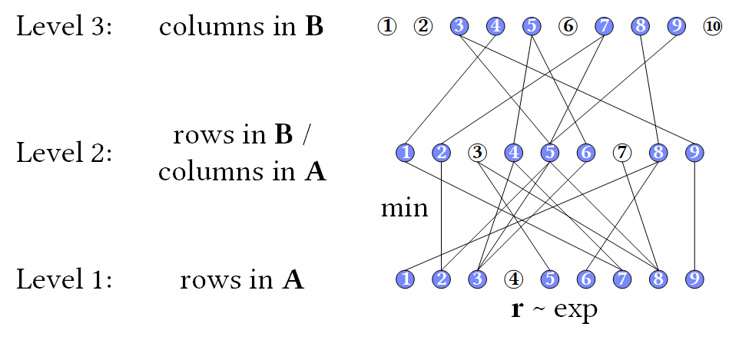
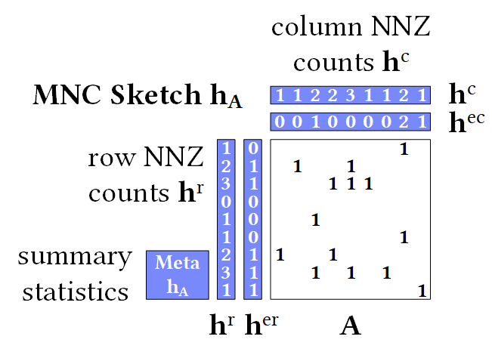
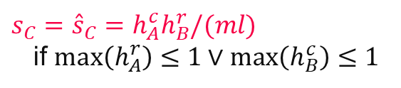
Sparsity Estimation – Estimators, cont.
Size Inference and Cost Estimation
#5 Layered Graph [J.Comb.Opt.’98]
  Nodes: rows/columns in mm chain
  Edges: non-zeros connecting rows/columns
  Assign r-vectors ~ exp and propagate via min
  Estimate over roots (output columns)
#6 MNC Sketch (Matrix Non-zero Count)
  Create MNC sketch for inputs A and B
  Exploitation of structural properties
  (e.g., 1 non-zero per row, row sparsity)
  Support for matrix expressions
  (reorganizations, elementwise ops)
  Sketch propagation and estimation
[Johanna Sommer, Matthias Boehm, Alexandre V. Evfimievski, Berthold Reinwald, Peter J. Haas: MNC: Structure-Exploiting Sparsity Estimation for Matrix Expressions. SIGMOD 2019]
$s_{C}={\hat{s}}_{C}=h_{A}^{c}h_{B}^{r}/(ml)$
if $max\left(h_{A}^{r}\right)≤1∨\max\left(h_{B}^{c}\right)≤1$

Slide 17
Memory Estimates and Costing
Size Inference and Cost Estimation
Memory Estimates
  Matrix memory estimate := based on the dimensions and sparsity, decide the format (sparse, dense) and estimate the size in memory
  Operation memory estimate := input, intermediates, output
  Worst-case sparsity estimates (upper bound)
#1 Costing at Logical vs Physical Level
  Costing at physical level takes physical ops
  and rewrites into account but is much more costly
#2 Costing Operators/Graphs vs Plans
  Costing plans requires heuristics for
  # iterations, branches in general
#3 Analytical vs Trained Cost Models
  Analytical: estimate I/O and compute workload
  Training: build regression models for individual ops
A Personal War Story
Physical, Plans,
Trained
[PVLDB 2014]
Physical, Plans,
Analytical
[SIGMOD 2015]
Logical, Graphs, Analytical
[PVDLB 2018]

Slide 18
Rewrites and Operator Selection

Slide 19
Traditional PL Rewrites
Rewrites and Operator Selection
#1 Common Subexpression Elimination (CSE)
  Step 1: Collect and replace leaf nodes (variable reads and literals)
  Step 2: recursively remove CSEs bottom-up starting at the leafs
  by merging nodes with same inputs (beware non-determinism)
  Example:
R1 = 7 – abs(A * B)
R2 = abs(A * B) + rand()
R1
R2
R1
R2
R1
R2
-
+
-
+
-
+
7
abs
abs
rand
7
abs
abs
rand
7
abs
rand
*
*
*
*
*
A
B
A
B
A
B
A
B

Slide 20
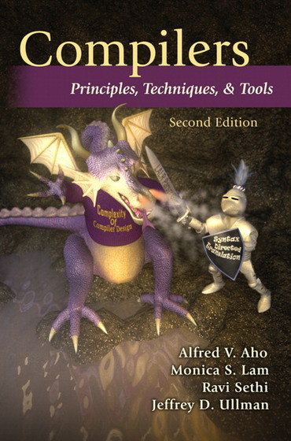
Traditional PL Rewrites, cont.
Rewrites and Operator Selection
#2 Constant Folding
  After constant propagation, fold sub-DAGs over literals into a single literal
  Approach: recursively compile and
  execute runtime instructions with
  special handling of one-side constants
  Example (GLM
  Binomial probit):
[A. V. Aho, M. S. Lam, R. Sethi, and J. D. Ullman. Compilers – Principles, Techniques, & Tools. Addison-Wesley, 2007]
Turing Award ‘20
ncol_y == 2 & dist_type == 2
& link_type >= 1 & link_type <= 5
2 == 2 & 2 == 2 & 3 >= 1 & 3 <= 5
&
&
TRUE
&
<=
3
5
&
TRUE
&
>=
==
==
3
1
&
TRUE
2
2
2
2
TRUE
TRUE

Slide 21
Traditional PL Rewrites, cont.
Rewrites and Operator Selection
#3 Branch Removal
  Applied after constant propagation
  and constant folding
  True predicate: replace if statement
  block with if-body blocks
  False predicate: replace if statement
  block with else-body block, or remove
#4 Merge of Statement Blocks
  Merge sequences of unconditional
  blocks (s1,s2) into a single block
  Connect matching DAG roots of s1
  with DAG inputs of s2
LinregDS (Direct Solve)
X = read($1);
y = read($2);
intercept = 0;
lambda = 0.001;
...
if( intercept == 1 ) {
ones = matrix(1, nrow(X), 1);
X = cbind(X, ones);
}
I = matrix(1, ncol(X), 1);
A = t(X) %*% X + diag(I)*lambda;
b = t(X) %*% y;
beta = solve(A, b);
...
write(beta, $4);
FALSE

Slide 22
Static/Dynamic Simplification Rewrites
Rewrites and Operator Selection
Examples of Static Rewrites
  trace(X%*%Y) → sum(X*t(Y))
  sum(X+Y) → sum(X)+sum(Y)
  (X%*%Y)[7,3] → X[7,]%*%Y[,3]
  sum(t(X)) → sum(X)
  rand()*7 → rand(,min=0,max=7)
  sum(lambda*X) → lambda * sum(X);
Examples of Dynamic Rewrites
  t(X) %*% y → t(t(y) %*% X) s.t. costs
  X[a:b,c:d]=Y → X = Y iff dims(X)=dims(Y)
  (...) * X → matrix(0, nrow(X), ncol(X)) iff nnz(X)=0
  sum(X^2) → t(X)%*%X; rowSums(X) → X iff ncol(X)=1
  sum(X%*%Y) → sum(t(colSums(X))*rowSums(Y)) iff ncol(X)>t
Y
O(n³)
O(n²)
X
X
Y ┬
→
*
[Matthias Boehm et al: SystemML's Optimizer: Plan Generation for Large-Scale Machine Learning Programs. IEEE Data Eng. Bull 2014]

Slide 23
Static/Dynamic Simplification Rewrites, cont.
Rewrites and Operator Selection
TF Constant Push-Down
  Add(c1,Add(x,c2)) → Add(x,c1+c2)
  ConvND(c1*x,c2) → ConvND(x,c1*c2)
TF Arithmetic Simplifications
  Flattening: a+b+c+d → AddN(a, b, c, d)
  Hoisting: AddN(x * a, b * x, x * c) → x * AddN(a+b+c)
  Reduce Nodes Numeric: x+x+x → 3*x
  Reduce Nodes Logicial: !(x > y) → x <= y
TF Broadcast Minimization
  (M1+s1) + (M2+s2) → (M1+M2) + (s1+s2)
TF Better use of Intrinsics
  Matmul(Transpose(X), Y) → Matmul(X, Y, transpose_x=True)
[Rasmus Munk Larsen, Tatiana Shpeisman: TensorFlow Graph Optimizations,
Guest Lecture Stanford 2019]
SystemML/SystemDS
RewriteElementwise-MultChainOptimization
(orders and collapses matrix, vector, scalar op chains)

Slide 24
Static/Dynamic Simplification Rewrites, cont.
Rewrites and Operator Selection
Relaxed DNN Graph Substitutions
  Allow substitutions that preserve
  semantics, no matter if faster/slower
  Backtracking search
Additional Algorithms
  Partial order of substitutions w/ pruning
  Dynamic programming → substitutions
[Zhihao Jia, James J. Thomas, Todd Warszawski, Mingyu Gao, Matei Zaharia, Alex Aiken: Optimizing DNN Computation with Relaxed Graph Substitutions. MLSys 2019]
Increased conv2d
kernel size via padding
ResNet module
1.3x faster on V100 GPUs
[Jingzhi Fang, Yanyan Shen, Yue Wang, Lei Chen: Optimizing DNN Computation Graph using Graph Substitutions. PVLDB 13(11) 2020]
Notes:
Note: MetaFlow w/ backtracking search

Slide 25
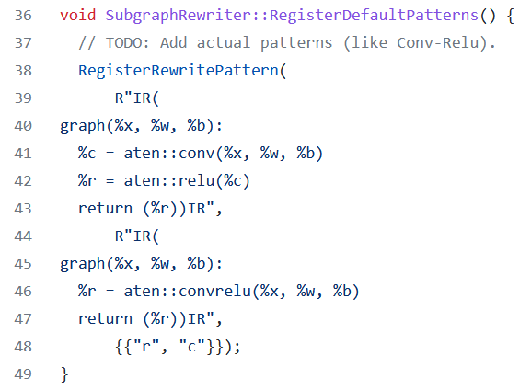
Static/Dynamic Simplification Rewrites, cont.
Rewrites and Operator Selection
Rewrites in PyTorch (Torch Script JIT)
  Misc: Canonicalization,
  erase number types and no-ops
  Fuse linear, fuse relu, fuse graph pipeline
  Peephole simplifications
  (e.g., for dtype management)
  Inlining and loop unrolling
  Concatenation and fusion
  rewrites:
[https://github.com/pytorch/pytorch/blob/master/torch/csrc/jit/passes/subgraph_rewrite.cpp]
subgraph_rewrite.cpp (extracted Mar 17, 2022)

Slide 26


Vectorization and Incremental Computation
Rewrites and Operator Selection
Loop Transformations
(e.g., OptiML, SystemML)
  Loop vectorization
  Loop hoisting
Incremental Computations
  Delta update rules (e.g., LINVIEW, factorized)
  Incremental iterations (e.g., Flink)
Update In-Place
  SystemDS: via rewrites (guaranteed applicability)
  R: via reference counting
  Julia: by default, otherwise explicit B = copy(A) necessary
for(i in a:b)
X[i,1] = Y[i,2] + Z[i,1]
X[a:b,1] = Y[a:b,2] + Z[a:b,1]
X
y
A = t(X) %*% X + t(∆X) %*% ∆X
b = t(X) %*% y + t(∆X) %*% ∆y
t(X)
Notes:
Note: “HedgeCut is a variation of the well-established “Extremely Randomised Trees” (ERT) approach [17], which learns an ensemble of randomized decision trees where attributes and cut-off points to split the data are chosen at random.” ref bottom-right
“It essentially consists of randomizing strongly both attribute and cut-point choice while splitting a tree node. In the extreme case, it builds totally randomized trees whose structures are independent of the output values of the learning sample. The strength of the randomization can be tuned to problem specifics by the appropriate choice of a parameter.”
https://orbi.uliege.be/bitstream/2268/9357/1/geurts-mlj-advance.pdf

Slide 27
Excursus: Automatic Rewrite Generation
Rewrites and Operator Selection
SPOOF/SPORES (Sum-Product Optim.)
  Break up LA ops into basic ops (RA)
  Elementary sum-product/RA rewrites
  Example:
  sum(W%*%H)
TASO (Super Optimization)
  List of operator specifications and properties
  Automatic generation/verification of graph
  substitutions and data layouts via cost-based backtracking search
[Tarek Elgamal et al: SPOOF: Sum-Product Optimization and Operator Fusion for
Large-Scale Machine Learning. CIDR 2017]
[Yisu Remy Wang et al: SPORES: Sum-Product Optimization via Relational Equality Saturation for Large Scale Linear Algebra. PVLDB 13(11) 2020]
[Zhihao Jia et al: TASO: optimizing deep learning computation with automatic generation of graph substitutions. SOSP 2019]

Slide 28
Matrix Multiplication Chain Optimization
Rewrites and Operator Selection
Optimization Problem
  Matrix multiplication chain of n matrices M₁, M₂, …M_{n} (associative)
  Optimal parenthesization of the product M₁M₂ … M_{n}
Search Space Characteristics
  Naïve exhaustive: Catalan numbers → Ω(4^{n} / n^{3/2}))
  DP applies: (1) optimal substructure,
  (2) overlapping subproblems
  Textbook DP algorithm: Θ(n³) time, Θ(n²) space
    Examples: SystemML ‘14,
    RIOT (‘09 I/O costs), SpMachO (‘15 sparsity)
  Best known: O(n log n)
t(X)
1kx1k
X
1kx1k
Z
1
t(X)
1kx1k
X
1kx1k
p
1
Size propagation and sparsity estimation
→
2,002 MFLOPs
4 MFLOPs
n | C_{n-1}
5 | 14
10 | 4,862
15 | 2,674,440
20 | 1,767,263,190
25 | 1,289,904,147,324
  [T. C. Hu, M. T. Shing: Computation of Matrix Chain Products. Part II. SIAM J. Comput. 13(2): 228-251, 1984]
Notes:
Ω .. Lower bound, Θ tight bound, O upper bound

Slide 29
Matrix Multiplication Chain Optimization, cont.
Rewrites and Operator Selection
M1 | M2 | M3 | M4 | M5
10x7 | 7x5 | 5x1 | 1x3 | 3x9
Cost matrix m
5
1
m[1,3] = min(
m[1,1] + m[2,3] + p1p2p4,
m[1,2] + m[3,3] + p1p3p4 )
4
222
2
j
i
135
125
= min(
0 + 35 + 10*7*1,
350 + 0 + 10*5*1 )
3
3
= min(
105,
400 )
2
105
56
72
4
1
350
35
15
27
5
0
0
0
0
0
  [T. H. Cormen, C. E. Leiserson, R. L. Rivest, C. Stein: Introduction to Algorithms, Third Edition, The MIT Press, pages 370-377, 2009]
M1
M2
M3
M4
M5

Slide 30
Matrix Multiplication Chain Optimization, cont.
Rewrites and Operator Selection
M1 | M2 | M3 | M4 | M5
10x7 | 7x5 | 5x1 | 1x3 | 3x9
Optimal split matrix s
getOpt(s,1,5)
Cost matrix m
5
1
getOpt(s,1,3)
3
getOpt(s,4,5)
4
222
2
3
3
j
i
3
135
125
3
2
1
3
3
4
105
56
72
1
2
3
4
2
4
1
350
35
15
27
5
0
0
0
0
0
( M1 M2 M3 M4 M5 )
( ( M1 M2 M3 ) ( M4 M5 ) )
M1
M2
M3
M4
M5
( ( M1 ( M2 M3 ) ) ( M4 M5 ) )
➔ ((M1 (M2 M3)) (M4 M5))
➔ Open questions: DAGs; other operations, sparsity
joint opt w/ rewrites, CSE, fusion, and physical operators

Slide 31

Matrix Multiplication Chain Optimization, cont.
Rewrites and Operator Selection
Cost matrix M
Optimal split matrix S
Sketch matrix E
Sparsity-aware
mmchain Opt
  Additional n x n
  sketch matrix e
  Sketch propagation for optimal subchains (currently for all chains)
  Modified cost computation via MNC sketches
  (number FLOPs for sparse instead of dense mm)
Example: n=20 matrices
$$C_{i,j}=\min_{k∈\left[i,j−1\right]}{\begin{aligned}(C_{i,k}+C_{k+1,j} \\ +E_{i,k}.h^{c}E_{k+1,j}.h^{r})\end{aligned}}$$
[Johanna Sommer, Matthias Boehm, Alexandre V. Evfimievski, Berthold Reinwald, Peter J. Haas: MNC: Structure-Exploiting Sparsity Estimation for Matrix Expressions. SIGMOD 2019]

Slide 32
Physical Operator Selection
Rewrites and Operator Selection
Common Selection Criteria
  Data and cluster characteristics (e.g., data size/shape, memory, parallelism)
  Matrix/operation properties (e.g., diagonal/symmetric, sparse-safe ops)
  Data flow properties (e.g., co-partitioning, co-location, data locality)
#0 Local Operators
  SystemML mm, tsmm, mmchain; Samsara/Mllib local
#1 Special Operators (special patterns/sparsity)
  SystemML tsmm, mapmmchain; Samsara AtA
#2 Broadcast-Based Operators (aka broadcast join)
  SystemML mapmm, mapmmchain
#3 Co-Partitioning-Based Operators (aka improved repartition join)
  SystemML zipmm; Emma, Samsara OpAtB
#4 Shuffle-Based Operators (aka repartition join)
  SystemML cpmm, rmm; Samsara OpAB
t(X) %*% (X%*%v)
1st
pass
v
2nd
pass
X
q┬
X

Slide 33
Sparsity-Exploiting Operators
Rewrites and Operator Selection
Goal: Avoid dense intermediates and unnecessary computation
#1 Fused Physical Operators
  E.g., SystemML [PVLDB’16]
  wsloss, wcemm, wdivmm
  Selective computation
  over non-zeros of
  “sparse driver”
#2 Masked Physical Operators
  E.g., Cumulon MaskMult [SIGMOD’13]
  Create mask of “sparse driver”
  Pass mask to single masked
  matrix multiply operator
sum(W * (X – U %*% t(V))^2)
^2
W
X
U V┬
sum
*
–
O / (C %*% E %*% t(B))
/
mm
C
mm
O
M
E
t(B)

Slide 34
Runtime Adaptation
ML Systems w/ Optimizing Compiler

Slide 35


Terminology Ahead-of-Time / Just-in-Time
Runtime Adaptation
Ahead-of-Time Compilation
  Originating from compiled languages like C, C++
  #1 Program compilation at different abstraction levels
  #2 Inference program compilation & packaging
Just-In-Time Compilation (at runtime for specific data/HW)
  Originating from JIT-compiled languages like Java, C#
  #1 Lazy expression evaluation + optimization
  #2 Program/function compilation with recompilation
Excursus: Java JIT
  #1 Start w/ Java bytecode interpretation by JVM ➔ fast startup
  #2 Tiered JIT compile (cold, warm, hot, very hot, scorching) ➔ performance
  Trace statistics (frequency, time) at method granularity
  Note: -XX:+PrintCompilation
(LLVM)
PL

Slide 36
Issues of Unknown or Changing Sizes
Runtime Adaptation
Problem of unknown/changing sizes
  Unknown or changing sizes and sparsity of intermediates
  These unknowns lead to very conservative fallback plans (distributed ops)
#1 Control Flow
  Branches and loops
  Complex function call graphs
  User-Defined Functions
#2 Data-Dependencies
  Data-dependent operators
  (e.g., table, rmEmpty, aggregate)
  Computed size expressions
X = read(‘/tmp/X.csv’);
if( intercept )
X = cbind(X, matrix(1,nrow(X),1));
Z = foo(X) + X; # size of + and Z?
Y = table(seq(1,nrow(X)), y);
grad = t(X) %*% (P - Y);
1
11
1
1
1
1
3
4
223
Ex.: Multinomial
Logistic Regression
d = dout[,(t-2)*M+1:(t-1)*M];
cur_Q = matrix (0, 1, 2*ncur);
cur_S = matrix (0, 1, ncur*dist);
Y
y

Slide 37
Issues of Unknown or Changing Sizes, cont.
Runtime Adaptation
#3 Changing Dims and Sparsity
  Iterative feature selection workloads
  Changing dimensions or sparsity
  ➔ Same code with different data
#4 API Limitations
  Precompiled scripts/programs
  (inputs unavailable)
(#5 Compiler Limitations)
➔ Dynamic recompilation techniques as robust fallback strategy
  Shares goals and challenges with adaptive query processing
  However, ML domain-specific techniques and rewrites
Ex: Stepwise LinReg
while( continue ) {
parfor( i in 1:n ) {
if( !fixed[1,i] ) {
Xi = cbind(Xg, X[,i])
B[,i] = lm(Xi,y)
}
}
# add best to Xg (AIC)
}
Notes:
AIC .. Akaike Information Criterion

Slide 38
Recompilation
Runtime Adaptation
Script
[Matthias Boehm et al:
SystemML's Optimizer: Plan Generation for Large-Scale Machine Learning Programs. IEEE Data Eng. Bull 2014]
~100
ms
Language
Parsing (syntactic analysis)
Live Variable Analysis
Validate (semantic analysis)
~10
ms
HOPs
Construct HOP DAGs
Multiple
Rounds
Static/Dynamic Rewrites
Intra-/Inter-Procedural Analysis
~1
ms
Static/Dynamic Rewrites
Static/Dynamic Rewrites
Compute Memory Estimates
Dynamic Recompilation
Compute Memory Estimates
LOPs
Construct LOP DAGs
(incl operator selection, hop-lop rewrites)
Construct LOP DAGs
(incl operator selection, hop-lop rewrites)
Other systems w/ recompile:
SciDB, MatFast
Generate Runtime Program
Generate Runtime Program
Execution Plan

Slide 39
Dynamic Recompilation
Runtime Adaptation
Compile-time Decisions
  Split HOP DAGs for recompilation: prevent unknowns but keep DAGs as large as possible; split after reads w/ unknown sizes and specific operators
  Mark HOP DAGs for recompilation: Spark due to unknown sizes / sparsity
Control flow → statement blocks
→ initial recompilation granularity
R2
R3
R4
R2
*
rm
abs
*
R3
R4
s
tmp1
tmp2
tmp3
R1
abs
(recursive rewrite)
tmp1
s
rm
rm
R1
rm
tmp3
abs
rm
tmp2
+
rm
abs
+
rm
rm
A
B
C
A
A
B
C
A
rm .. removeEmpty(X, [margin=“rows”,select=I])

Slide 40
Dynamic Recompilation, cont.
Runtime Adaptation
Dynamic Recompilation at Runtime on recompilation hooks
(last level program blocks, predicates, recompile once functions)
  Deep Copy DAG
  Replace Literals
  Update DAG Statistics
  Dynamic Rewrites
  Recompute Memory
  Estimates
  [Codegen]
  Generate
  Runtime Instructions
Symbol Table
X | 1Mx100,99M
P | 1Mx7,7M
Y | 1Mx7,7M
[100x-1,-1]
[100x7,-1]
SP
CP
ba(+*)
[100x1M,-1]
[1Mx-1,-1]
[100x1M,99M]
CP
SP
[1Mx7,-1]
CP
r(t)
b(-)
X
P
Y
[1Mx100,99M]
[1Mx100,-1]
[1Mx-1,-1]
[1Mx7,7M]
[1Mx-1,-1]
[1Mx7,7M]

Slide 41
Dynamic Recompilation, cont.
Runtime Adaptation
Recompile Once Functions
  Unknowns due to inconsistent or
  unknown call size information
  IPA marks functions as “recompile
  once”, if it contains loops
  Recompile the entire function on entry
  + disable unnecessary recompile
Recompile parfor Loops
  Unknown sizes and iterations
  Recompile parfor loop on entry
  + disable unnecessary recompile
  Create independent DAGs for
  individual parfor workers
foo = function(Matrix[Double] A)
# recompiled w/ size of A
return (Matrix[Double] C)
{
C = rand(nrow(A),1) + A;
while(...)
C = C / rowSums(C) * s
}
while( continue ) {
parfor( i in 1:n ) {
if( !fixed[1,i] ) {
Xi = cbind(Xg, X[,i])
B[,i] = lm(Xi,y)
}
}
# add best to Xg (AIC)
}

Slide 42



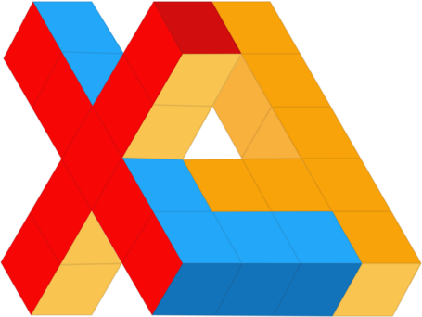

Operator Fusion & JIT Compilation
(aka Code Generation)
Many State-of-the-Art ML Systems,
especially for DNNs and numerical computation

Slide 43
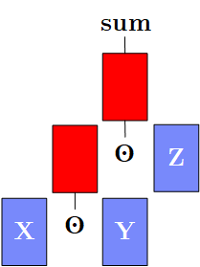
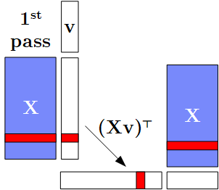
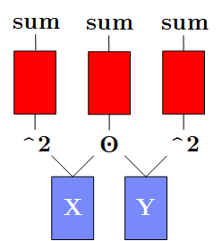
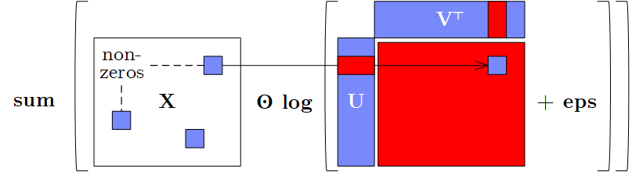
Motivation: Fusion
Operator Fusion & JIT Compilation
[Matthias Boehm et al.: On Optimizing Operator Fusion Plans for Large-Scale ML in SystemML. PVLDB 2018]
Data Flow Graphs (better data access)
  DAGs of linear algebra (LA) operations and statistical functions
  Materialized intermediates → ubiquitous fusion opportunities
a) Intermediates
b) Single-Pass
c) Multi-Aggregates
sum(X*Y*Z)
t(X)%*%(X%*%v)
→t(t(X%*%v)%*%X)
d) Sparsity Exploitation

Slide 44
Motivation: Fusion, cont.
Operator Fusion & JIT Compilation
Beware: SystemML 1.0,
Julia 0.6.2, TensorFlow 1.5
dense
Cell Template: sum(X*Y*Z)
sparse (0.1)
Row: t(X)%*%(w*(X%*%v))
Outer: sum(X*log(U%*%t(V)+1e-15))
TF w/ manual rewrite
→ t(t(w*(X%*%v))%*%X):
9.2 s to 1.6 s (compared to Gen 283ms)
dense
20K x 20K,
rank 100

Slide 45
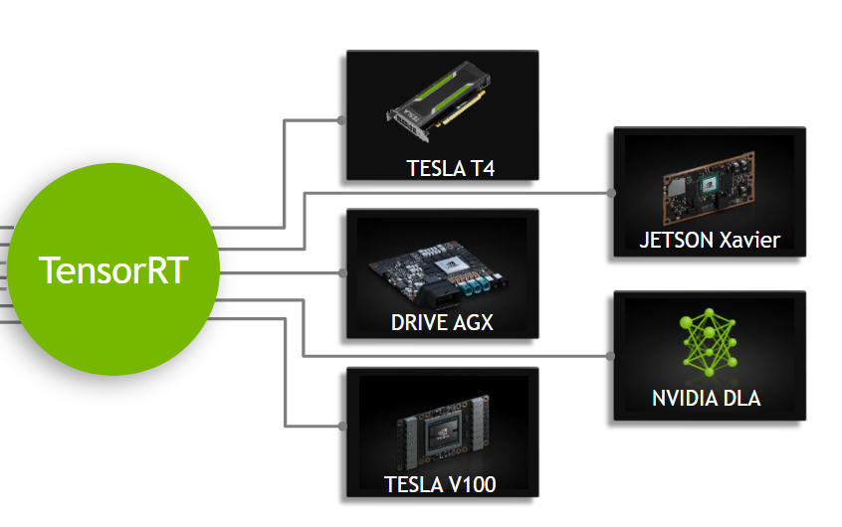
Motivation: Just-In-Time Compilation
Operator Fusion & JIT Compilation
Operator Kernels (better code)
  Specialization opportunities: data types, shapes, and operator graphs
  Heterogeneous hardware: CPUs, GPUs, FPGAs, ASICs x architectures
#1 CPU Architecture
  Specialize to available instructions sets
  Register allocation and assignment, etc
#2 Heterogeneous Hardware
  JIT compilation for custom-build
  ASICs with HW support for ML ops
  Different architectures of devices
#3 Custom ML Program
  Operator graphs and sizes
Examples: x86-64, sparc, amd64, arm, ppc
Example: NVIDIA TensorRT
GPU Platforms
[https://docs.nvidia.com/
deeplearning/sdk/tensorrt-developer-guide/index.html]
Notes:
Notes: tesla (P4 inference, V100 training) -> datacenter, drive -> automotive; jetson -> embedded (e.g., robotics)

Slide 46
Operator Fusion Overview
Operator Fusion & JIT Compilation
Related Research Areas
  DB: query compilation
  HPC: loop fusion, tiling, and distribution (NP complete)
  ML: operator fusion (dependencies given by data flow graph)
Example Operator Fusion
Memory Bandwidth:
L1 core: 1TB/s
L3 socket: 400GB/s
Mem: 100 GB/s
R
for( i in 1:n )
tmp1[i,1] = s * B[i,1];
for( i in 1:n )
tmp2[i,1] = A[i,1] + tmp1[i,1];
for( i in 1:n )
R[i,1] = tmp2[i,1] * C[i,1];
*
[https://software.intel.com/
en-us/articles/memory-performance-in-a-nutshell]
+
C
A
*
s
B
for( i in 1:n )
R[i,1] = (A[i,1] + s*B[i,1]) * C[i,1];

Slide 47
Automatic Operator Fusion System Landscape
Operator Fusion & JIT Compilation
System | Year | Approach | Sparse | Distr. | Optimization
BTO | 2009 | Loop Fusion | No | No | k-Greedy, cost-based
Tupleware | 2015 | Loop Fusion | No | Yes | Heuristic
Kasen | 2016 | Templates | (Yes) | Yes | Greedy, cost-based
SystemML | 2017 | Templates | Yes | Yes | Exact, cost-based
Weld | 2017 | Templates | (Yes) | Yes | Heuristic
Taco | 2017 | Loop Fusion | Yes | No | Manuel
Julia | 2017 | Loop Fusion | Yes | No | Manuel
Tensorflow XLA | 2017 | Loop Fusion | No | No | Manuel/Heuristic
Tensor Comprehensions | 2018 | Loop Fusion | No | No | Evolutionary, cost-based
TVM | 2018 | Loop Fusion | No | No | ML/cost-based
PyTorch | 2019 | Loop Fusion | No | No | Manual/Heuristic
JAX | 2019 | N/A | No | No | See TF XLA
JIT
Notes:
#1 Micro Optimizations
Hybrid tile-at-a-time loop fusion, predication, and result allocation
Examples: Tupleware
#2 Cross-Library Optimization
Generic IR based on parallel loops and builders
Examples: Weld
#3 Sparsity Exploitation
Exploit sparsity over chains of operations (compute, size of intermediates)
Examples: SystemML
#4 Iteration Schedules
Decisions on loop ordering (e.g., tensor storage formats, join ordering)
Examples: Taco, TVM, Mateev et al
#5 Optimizing Fusion Plans
Example: SystemML
#6 Autodifferentiation Native Python Code
Example: JAX (Autograd + XLA JIT)

Slide 48
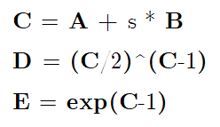
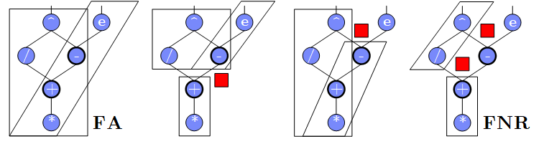
A Case for Optimizing Fusion Plans
Operator Fusion & JIT Compilation
Problem: Fusion heuristics → poor plans for complex DAGs (cost/structure), sparsity exploitation, and local/distributed operations
Goal: Principled approach for optimizing fusion plans
#1 Materialization Points
(e.g., for multiple consumers)
#2 Sparsity Exploitation
(and ordering of sparse inputs)
#3 Decisions on Fusion Patterns
(e.g., template types)
#4 Constraints
(e.g., memory budget and block sizes)
Y + X * (U %*% t(V))
sparse-safe over X
➔ Search Space that
requires optimization

Slide 49
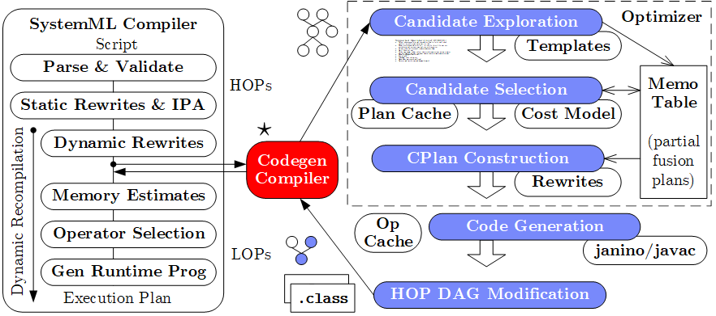
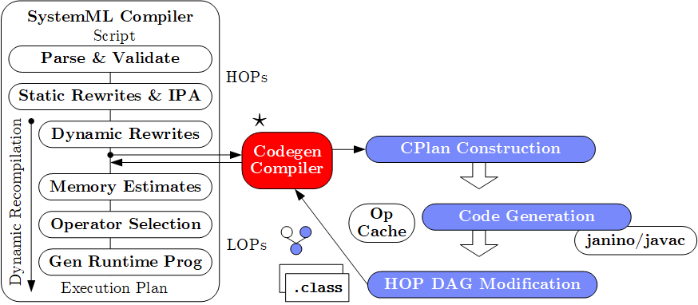
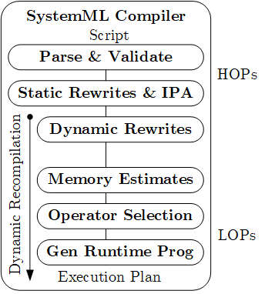

System Architecture (Compiler & Codegen Architecture)
Operator Fusion & JIT Compilation
Practical, exact, cost-based optimizer
[CIDR’17] (w/ fuse-all heuristic)
Lacked maintainability
Poor plans for complex DAGs
and local/distributed operations
CPlan representation/construction and codegen similar in TF XLA
(HLO primitives, pre-clustering of nodes, caching, LLVM codegen)
Templates: Cell, Row, MAgg, Outer w/ different data bindings

Slide 50
Codegen Example L2SVM (Cell/MAgg)
Operator Fusion & JIT Compilation
L2SVM Inner Loop
# of Vector Intermediates
  Base (w/o fused ops): 10
  Fused (w/ fused ops): 4
1: while(continueOuter & iter < maxi) {
2 #...
3: while(continueInner) {
4: out = 1-Y* (Xw+step_sz*Xd);
5: sv = (out > 0);
6: out = out * sv;
7: g = wd + step_sz*dd
- sum(out * Y * Xd);
8: h = dd + sum(Xd * sv * Xd);
9: step_sz = step_sz - g/h;
10: }} ...

Slide 51
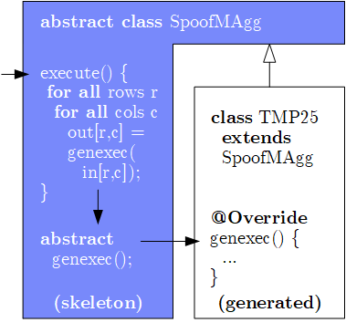
Codegen Example L2SVM, cont. (Cell/MAgg)
Operator Fusion & JIT Compilation
Template Skeleton
  Data access, blocking
  Multi-threading
  Final aggregation
# of Vector Intermediates
  Gen (codegen ops): 0
public final class TMP25 extends SpoofMAgg {
public TMP25() {
super(false, AggOp.SUM, AggOp.SUM);
}
protected void genexec(double a, SideInput[] b,
double[] scalars, double[] c, ...) {
double TMP11 = getValue(b[0], rowIndex);
double TMP12 = getValue(b[1], rowIndex);
double TMP13 = a * scalars[0];
double TMP14 = TMP12 + TMP13;
double TMP15 = TMP11 * TMP14;
double TMP16 = 1 - TMP15;
double TMP17 = (TMP16 > 0) ? 1 : 0;
double TMP18 = a * TMP17;
double TMP19 = TMP18 * a;
double TMP20 = TMP16 * TMP17;
double TMP21 = TMP20 * TMP11;
double TMP22 = TMP21 * a;
c[0] += TMP19;
c[1] += TMP22;
}
}

Slide 52
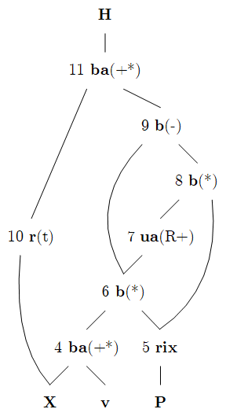
Codegen Example MLogreg (Row)
Operator Fusion & JIT Compilation
MLogreg Inner Loop
(main expression on feature matrix X)
1: Q = P[, 1:k] * (X %*% v)
2: H = t(X) %*% (Q - P[, 1:k] * rowSums(Q))
public final class TMP25 extends SpoofRow {
public TMP25() {
super(RowType.COL_AGG_B1_T, true, 5);
}
protected void genexecDense(double[] a, int ai,
SideInput[] b, double[] c,..., int len) {
double[] TMP11 = getVector(b[1].vals(rix),...);
double[] TMP12 = vectMatMult(a, b[0].vals(rix),...);
double[] TMP13 = vectMult(TMP11, TMP12, 0, 0,...);
double TMP14 = vectSum(TMP13, 0, TMP13.length);
double[] TMP15 = vectMult(TMP11, TMP14, 0,...);
double[] TMP16 = vectMinus(TMP13, TMP15, 0, 0,...);
vectOuterMultAdd(a, TMP16, c, ai, 0, 0,...); }
protected void genexecSparse(double[] avals, int[] aix,
int ai, SideInput[] b, ..., int len) {...}
}

Slide 53
Ahead-of-Time Compilation
Operator Fusion & JIT Compilation
TensorFlow tf.compile
  Compile entire TF graph into binary function w/ low footprint
  Input: Graph, config (feeds+fetches w/ fixes shape sizes)
  Output: x86 binary and C++ header (e.g., inference)
  Specialization for frozen model and sizes
PyTorch Compile
  Compile Python functions into ScriptModule/ScriptFunction
  Lazily collect operations,
  optimize, and JIT compile
  Explicit jit.script call
  or @torch.jit.script
[Chris Leary, Todd Wang:
XLA – TensorFlow, Compiled!, TF Dev Summit 2017]
a = torch.rand(5)
def func(x):
for i in range(10):
x = x * x # unrolled into graph
return x
jitfunc = torch.jit.script(func) # JIT
jitfunc.save("func.pt")
[Vincent Quenneville-Bélair: How PyTorch Optimizes
Deep Learning Computations, Guest Lecture Stanford 2020]

Slide 54
Excursus: MLIR
Operator Fusion & JIT Compilation
[Rasmus Munk Larsen, Tatiana Shpeisman: TensorFlow Graph Optimizations,
Guest Lecture Stanford 2019]
Motivation TF Compiler Ecosystem
  Different IRs and compilation
  chains for runtime backends
  Duplication of infrastructure
  and fragile error handling
  Adoption:
MLIR (Multi-level, Machine Learning IR)
  SSA-based IR, similar to LLVM
  Hierarchy of modules, functions,
  regions, blocks, and operations
  Dialects for different backends
  (defined ops, customization)
  Systematic lowering
[https://github.com/llvm/torch-mlir]
func @testFunction(%arg0: i32) {
%x = call @thingToCall(%arg0)
: (i32) -> i32
br ^bb1
^bb1:
%y = addi %x, %x : i32
return %y : i32
}
[Chris Lattner et al.: MLIR: Scaling Compiler Infrastructure for Domain Specific Computation. CGO 2021, https://arxiv.org/pdf/2002.11054.pdf]
Notes:
Note: Regions consist of a CFG of blocks with arguments, blocks contain list of operations, ops can contain nested regions.

Slide 55
Excursus: MLIR, cont.
(DAPHNE pre-project prototype)
Operator Fusion & JIT Compilation
while(i < max_iter) { # PageRank
p = alpha*(G%*%p) + (1-alpha)*(e%*%u%*%p);
i += 1;
}
func @main() {
%G = daphne.rand {rows=50, cols=50, seed=-1, sparsity=0.07} : ...
%initP = daphne.rand {rows=50, cols=1, seed=-1, sparsity=1.0} : ...
%e, %u ...
%alpha = daphne.constant 0.5 : f64
%initI = daphne.constant 0 : i64
%loop:2 = daphne.while(%p = %initP, %i = %initI) :
(!daphne.matrix<?x?xf64>, i64) -> (!daphne.matrix<?x?xf64>, i64) condition: {
%max_iteration = daphne.constant 10 : i64
%c = cmpi "ult", %i, %max_iteration : i64
daphne.yield %c : i1
} body: {
%1 = daphne.mat_mul %G, %p : (!daphne.matrix<?x?xf64>, !daphne.matrix<?x?xf64>) -> !daphne.matrix<?x?xf64>
%2 = daphne.mul %alpha, %1 : (f64, !daphne.matrix<?x?xf64>) -> !daphne.matrix<?x?xf64>
%3 = daphne.mat_mul %e, %u : (!daphne.matrix<?x?xf64>, !daphne.matrix<?x?xf64>) -> !daphne.matrix<?x?xf64>
%4 = daphne.mat_mul %3, %p : (!daphne.matrix<?x?xf64>, !daphne.matrix<?x?xf64>) -> !daphne.matrix<?x?xf64>
%cst1f = daphne.constant 1.0 : f64
%5 = daphne.sub %cst1f, %alpha : (f64, f64) -> f64
%6 = daphne.mul %5, %4 : (f64, !daphne.matrix<?x?xf64>) -> !daphne.matrix<?x?xf64>
%newP = daphne.add %2, %6 : (!daphne.matrix<?x?xf64>, !daphne.matrix<?x?xf64>) -> !daphne.matrix<?x?xf64>
%cst1 = daphne.constant 1 : i64
%nextI = daphne.add %i, %cst1 : (i64, i64) -> i64
daphne.yield %newP, %nextI : !daphne.matrix<?x?xf64>, i64
}
daphne.print %loop#0 : !daphne.matrix<?x?xf64>
daphne.return
}
Initial translation w/o
much optimization
module {
func @main() {
%0 = daphne.constant 5.000000e-01 : f64
%1 = daphne.constant 0 : i64
%2 = daphne.constant 1.000000e+00 : f64
%3 = daphne.constant 1 : i64
%4 = daphne.constant 10 : i64
%5 = daphne.rand {cols = 50 : i64, rows = 50 : i64, seed = -1 : i64, sparsity = 7.000000e-02 : f64} : () -> ...
%6, %7, %8 = ...
%9 = daphne.sub %2, %0 : (f64, f64) -> f64
%10:2 = daphne.while (%arg0 = %6, %arg1 = %1) : (!daphne.matrix<50x1xf64>, i64) -> (same) condition: {
%11 = cmpi "ult", %arg1, %4 : i64
daphne.yield %11 : i1
} body: {
%11 = daphne.mat_mul %5, %arg0 : (!daphne.matrix<50x50xf64>, !daphne.matrix<50x1xf64>) -> !daphne.matrix<50x1xf64>
%12 = daphne.mul %11, %0 : (!daphne.matrix<50x1xf64>, f64) -> !daphne.matrix<50x1xf64>
%13 = daphne.mat_mul %8, %arg0 : (!daphne.matrix<1x50xf64>, !daphne.matrix<50x1xf64>) -> !daphne.matrix<1x1xf64>
%14 = daphne.mat_mul %7, %13 : (!daphne.matrix<50x1xf64>, !daphne.matrix<1x1xf64>) -> !daphne.matrix<50x1xf64>
%15 = daphne.mul %9, %14 : (f64, !daphne.matrix<50x1xf64>) -> !daphne.matrix<50x1xf64>
%16 = daphne.add %12, %15 : (!daphne.matrix<50x1xf64>, !daphne.matrix<50x1xf64>) -> !daphne.matrix<50x1xf64>
%17 = daphne.add %arg1, %3 : (i64, i64) -> i64
daphne.yield %16, %17 : !daphne.matrix<50x1xf64>, i64
}
daphne.print %10#0 : !daphne.matrix<50x1xf64>
daphne.return
}
}
After Several Optimization Passes
3) Code motion outside loop
1) Shape inference of dimensions
2) Matrix multiplication chain reordered

Slide 56
Summary and Q&A
Compilation Overview
Size Inference and Cost Estimation
Rewrites (and Operator Selection)
Runtime Adaptation
Operator Fusion & JIT Compilation
➔ Impact of Size Inference and Costs
  Advanced optimization of LA programs requires size inference
  for cost estimation and validity constraints
➔ Ubiquitous Rewrite Fusion, and Codegen/JIT Opportunities
  Linear algebra programs have plenty of room for optimization
  Potential for changed asymptotic behavior
Recommended Reading
[Chris Leary, Todd Wang: XLA –
TensorFlow, Compiled!, TF Dev Summit 2017, https://www.youtube.com/watch?v=kAOanJczHA0]

