Slide 1

Architecture of ML Systems*
06 Execution and Parallelization
Last update: Aug 25, 2022

Slide 2
Agenda
Motivation and Terminology
Data-Parallel Execution
Task-Parallel Execution
Parameter Servers
Federated Machine Learning

Slide 3
Motivation and Terminology

Slide 4
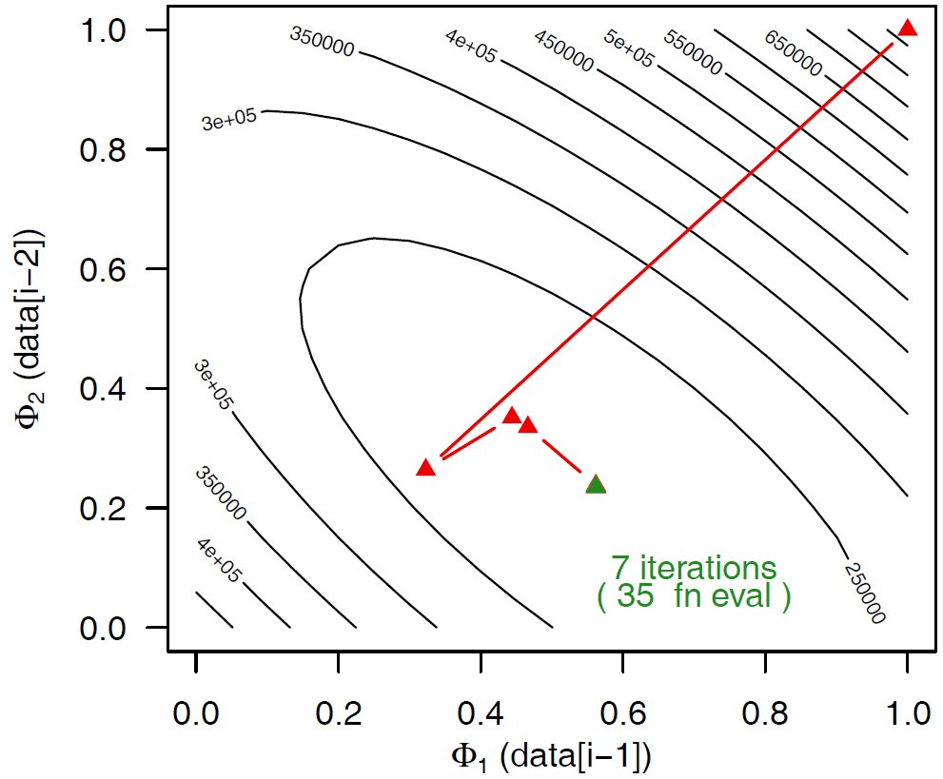
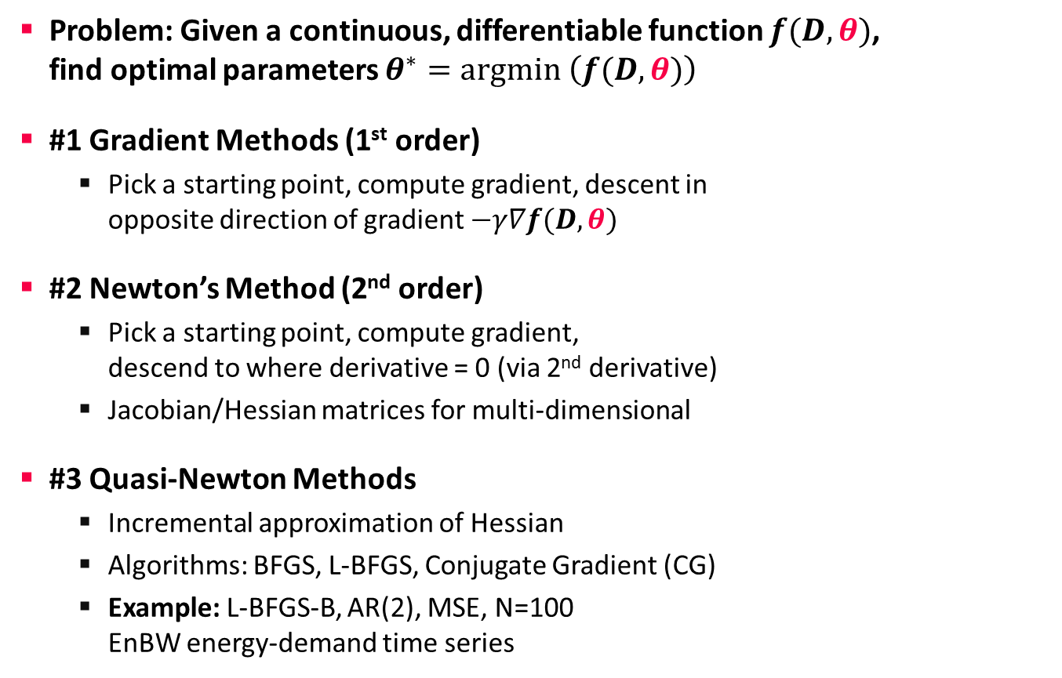
Terminology Optimization Methods
Motivation and Terminology
Problem: Given a continuous, differentiable function $f(D,θ)$,
find optimal parameters $θ^{∗}=argmin \left(f(D,θ)\right)$
#1 Gradient Methods (1st order)
  Pick a starting point, compute gradient, descent in
  opposite direction of gradient $−γ∇f(D,θ)$
#2 Newton’s Method (2nd order)
  Pick a starting point, compute gradient,
  descend to where derivative = 0 (via 2nd derivative)
  Jacobian/Hessian matrices for multi-dimensional
#3 Quasi-Newton Methods
  Incremental approximation of Hessian
  Algorithms: BFGS, L-BFGS, Conjugate Gradient (CG)
  Example: L-BFGS-B, AR(2), MSE, N=100
  EnBW energy-demand time series
θ₂
θ₁
x₂
x₃
x₁
x₀
θ₁
Notes:
BFGS vs CG: https://pubsonline.informs.org/doi/abs/10.1287/moor.3.3.244

Slide 5
Terminology Batch/Mini-batch
Motivation and Terminology
Batch ML Algorithms
  Iterative ML algorithms, where each iteration
  uses the entire dataset to compute gradients ΔW
  For (pseudo-)second-order methods, many features
  Dedicated optimizers for traditional ML algorithms
Mini-batch ML Algorithms
  Iterative ML algorithms, where each iteration
  only uses a batch of rows to make the
  next model update (in epochs or w/ sampling)
  For large and highly redundant training sets
  Applies to almost all iterative, model-based
  ML algorithms (LDA, reg., class., factor., DNN)
  Stochastic Gradient Descent (SGD)
Data
W’
Data
Batch 1
W’
Batch 2
W’’
Epoch

Slide 6
Terminology Parallelism
Motivation and Terminology
Single Data
Multiple Data
Flynn’s Classification
  SISD, SIMD
  (MISD), MIMD
Example: SIMD Processing
  Streaming SIMD Extensions (SSE)
  Process the same operation on
  multiple elements at a time
  (packed vs scalar SSE instructions)
  Data parallelism
  (aka: instruction-level parallelism)
  Example: VFMADD132PD
SISD
(uni-core)
SIMD
(vector)
Single Instruction
[Michael J. Flynn, Kevin W. Rudd: Parallel Architectures. ACM Comput. Surv. 28(1) 1996]
MISD
(pipelining)
MIMD
(multi-core)
Multiple Instruction
2009 Nehalem: 128b (2xFP64)
2012 Sandy Bridge: 256b (4xFP64)
2017 Skylake: 512b (8xFP64)
c = _mm512_fmadd_pd(a, b);
a
b
c

Slide 7
Terminology Parallelism, cont.
Motivation and Terminology
Distributed, Data-Parallel
Computation
  Parallel computation of function foo() ➔ single instruction
  Collection X of data items (key-value pairs) ➔ multiple data
  Data parallelism similar to SIMD but more coarse-grained notion of
  “instruction” and “data” ➔ SPMD (single program, multiple data)
Additional Terminology
  BSP: Bulk Synchronous Parallel (global barriers)
  ASP: Asynchronous Parallel (no barriers, often with accuracy impact)
  SSP: Stale-synchronous parallel (staleness constraint on fastest-slowest)
  Other: Fork&Join, Hogwild!, event-based, decentralized
Beware: data parallelism used in very different contexts (e.g., Param Server)
Y = X.map(x -> foo(x))
[Frederica Darema: The SPMD Model : Past, Present and Future. PVM/MPI 2001]

Slide 8
Categories of Execution Strategies
Motivation and Terminology
Batch/Mini-batch, Independent Tasks MIMD
Batch
SIMD/SPMD
Mini-batch
05_{a} Data-Parallel Execution
[Apr 03]
05_{b} Task-Parallel Execution
[Apr 03]
06_{c} Parameter Servers (data, model)
06_{a} Data-Parallel Execution
06_{b} Task-Parallel Execution
07_{a} Hybrid Execution and HW Accelerators
07_{b} Caching, Partitioning, Indexing, and Compression

Slide 9




Data-Parallel Execution
Batch ML Algorithms

Slide 10

Hadoop History and Architecture
Data-Parallel Collection Processing
[Jeffrey Dean, Sanjay Ghemawat: MapReduce: Simplified Data Processing on Large Clusters. OSDI 2004]
Recap: Brief History
  Google’s GFS [SOSP’03] + MapReduce
  → Apache Hadoop (2006)
  Apache Hive (SQL), Pig (ETL), Mahout (ML), Giraph (Graph)
Hadoop Architecture / Eco System
  Management (Ambari)
  Coordination / workflows
  (Zookeeper, Oozie)
  Storage (HDFS)
  Resources (YARN)
  [SoCC’13]
  Processing
  (MapReduce)
Worker Node 1
Worker Node n
MR AM
MR task
MR task
MR task
Head Node
MR task
MR task
MR task
MR task
Resource Manager
Node Manager
Node Manager
NameNode
MR Client
DataNode
DataNode
1
3
2
3
2
9

Slide 11
MapReduce – Programming Model
Data-Parallel Collection Processing
Overview Programming Model
  Inspired by functional programming languages
  Implicit parallelism (abstracts distributed storage and processing)
  Map function: key/value pair → set of intermediate key/value pairs
  Reduce function: merge all intermediate values by key
Example
SELECT Dep, count(*) FROM csv_files GROUP BY Dep
Name | Dep
X | CS
Y | CS
A | EE
Z | CS
map(Long pos, String line) {
parts ← line.split(“,”)
emit(parts[1], 1)
}
CS | 1
CS | 1
EE | 1
CS | 1
reduce(String dep,
Iterator<Long> iter) {
total ← iter.sum();
emit(dep, total)
}
Collection of key/value pairs
CS | 3
EE | 1

Slide 12
MapReduce – Execution Model
Data-Parallel Collection Processing
#1 Data Locality (delay sched., write affinity)
#2 Reduced shuffle (combine)
#3 Fault tolerance (replication, attempts)
Input CSV files (stored in HDFS)
Map-Phase
map
task
[Reduce-Phase]
Output Files (HDFS)
CSV File 1
Split 11
map
task
Split 12
reduce
task
Out 1
Split 21
map
task
CSV File 2
reduce
task
Out 2
Split 22
map
task
reduce
task
Out 3
CSV File 3
Split 31
map
task
Split 32
map
task
Shuffle, Merge, [Combine]
Sort, [Combine], [Compress]
w/ #reducers = 3

Slide 13
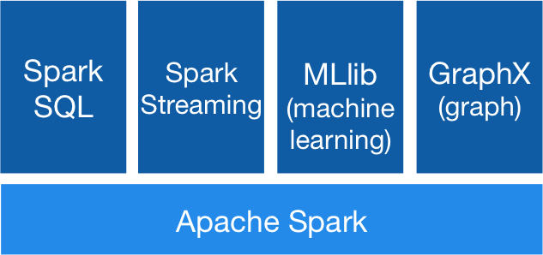



Spark History and Architecture
Data-Parallel Collection Processing
High-Level Architecture
  Different language bindings:
  Scala, Java, Python, R
  Different libraries:
  SQL, ML, Stream, Graph
  Spark core (incl RDDs)
  Different cluster managers:
  Standalone, Mesos,
  Yarn, Kubernetes
  Different file systems/
  formats, and data sources:
  HDFS, S3, SWIFT, DBs, NoSQL
Focus on a unified platform
for data-parallel computation (Apache Flink w/ similar goals)
[https://spark.apache.org/]
Standalone
MESOS
YARN
Kubernetes
Notes:
Summary MapReduce
Large-scale & fault-tolerant processing w/ UDFs and files ➔ Flexibility
Restricted functional APIs ➔ Implicit parallelism and fault tolerance
Criticism: #1 Performance, #2 Low-level APIs, #3 Many different systems
Evolution to Spark (and Flink)
Spark [HotCloud’10] + RDDs [NSDI’12] → Apache Spark (2014)
Design: standing executors with in-memory storage,
lazy evaluation, and fault-tolerance via RDD lineage
Performance: In-memory storage and fast job scheduling (100ms vs 10s)
APIs: Richer functional APIs and general computation DAGs,
high-level APIs (e.g., DataFrame/Dataset), unified platform
➔ But many shared concepts/infrastructure
Implicit parallelism through dist. collections (data access, fault tolerance)
Resource negotiators (YARN, Mesos, Kubernetes)
HDFS and object store connectors (e.g., Swift, S3)

Slide 14
Spark Resilient Distributed Datasets (RDDs)
Data-Parallel Collection Processing
RDD Abstraction
  Immutable, partitioned
  collections of key-value pairs
  Coarse-grained deterministic operations (transformations/actions)
  Fault tolerance via lineage-based re-computation
Operations
  Transformations:
  define new RDDs
  Actions: return
  result to driver
Distributed Caching
  Use fraction of worker memory for caching
  Eviction at granularity of individual partitions
  Different storage levels (e.g., mem/disk x serialization x compression)
JavaPairRDD<MatrixIndexes,MatrixBlock>
Type | Examples
Transformation (lazy) | map, hadoopFile, textFile, flatMap, filter, sample, join, groupByKey, cogroup, reduceByKey, cross, sortByKey, mapValues
Action | reduce, save, collect, count, lookupKey
Node1
Node2

Slide 15
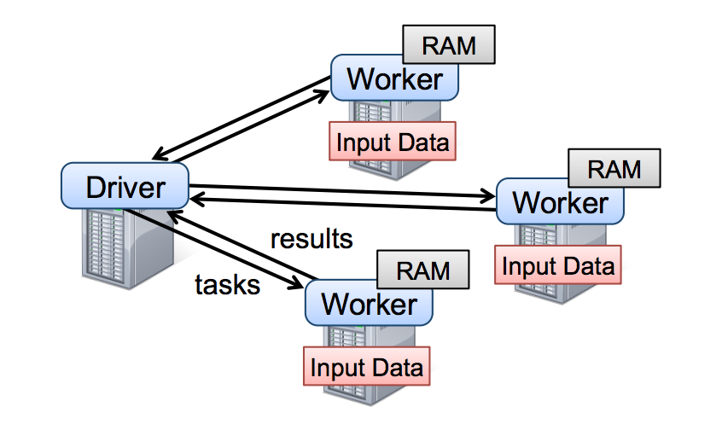
Spark Resilient Distributed Datasets (RDDs), cont.
Data-Parallel Collection Processing
Lifecycle of an RDD
  Note: can’t broadcast
  an RDD directly
X.filter(foo())
X.mapValues(foo())
X.reduceByKey(foo())
X.cache()/X.persist(…)
sc.parallelize(lst)
Local Data
(value, collection)
Distributed Collection
lst = X.collect()
v = X.reduce(foo())
sc.hadoopFile(f)
sc.textFile(f)
X.saveAsObjectFile(f)
X.saveAsTextFile(f)
File on DFS

Slide 16
Spark Partitions and Implicit/Explicit Partitioning
Data-Parallel Collection Processing
Spark Partitions
  Logical key-value collections are split into physical partitions
  Partitions are granularity of tasks, I/O, shuffling, evictions
Partitioning via Partitioners
  Implicitly on every data shuffling
  Explicitly via R.repartition(n)
Partitioning-Preserving
  All operations that are guaranteed to keep keys unchanged
  (e.g. mapValues(), mapPartitions() w/ preservesPart flag)
Partitioning-Exploiting
  Join: R3 = R1.join(R2)
  Lookups:
  v = C.lookup(k)
~128MB
Example Hash Partitioning:
For all (k,v) of R:
pid = hash(k) % n
Hash partitioned
⋈
⋈
0: 8, 1, 6
0: 1, 2
% 3
0: 3, 6
0: 6, 3
2: 2, 3, 4
2: 3, 4
2: 2, 5, 8
2: 5, 2
1: 7, 5
1: 5, 6
1: 4, 7, 1
1: 4, 1

Slide 17
Spark Lazy Evaluation, Caching, and Lineage
Data-Parallel Collection Processing
A
B
partitioning- aware
G
Stage 1
groupBy
C
D
F
reduce
map
union
E
join
Stage 2
Stage 3
cached
[Matei Zaharia, Mosharaf Chowdhury, Tathagata Das, Ankur Dave, Justin Ma, Murphy McCauly, Michael J. Franklin, Scott Shenker, Ion Stoica: Resilient Distributed Datasets: A Fault-Tolerant Abstraction for In-Memory Cluster Computing. NSDI 2012]
Notes:
Notes:
Dryad-­‐like DAGs
Pipelines functions within a stage
Locality & data reuse aware
Partitioning-­‐aware to avoid shuffles

Slide 18
Background: Matrix Formats
Data-Parallel Execution
Example
3x3 Matrix
Matrix Block (m x n)
  A.k.a. tiles/chunks, most operations defined here
  Local matrix: single block, different representations
Common Block Representations
  Dense (linearized arrays)
  MCSR (modified CSR)
  CSR (compressed sparse rows), CSC
  COO (Coordinate matrix)
.7
.1
.2
.4
.3
MCSR
CSR
COO
0
2
0
0
.7
0
0
.7
Dense (row-major)
.7
.1
2
2
.1
0
2
.1
.7
0
.1
.2
.4
0
0
.3
0
0
1
4
0
.2
1
0
.2
.2
.4
O(mn)
5
1
.4
1
1
.4
1
1
.3
2
1
.3
.3
O(m + nnz(X))
O(nnz(X))

Slide 19
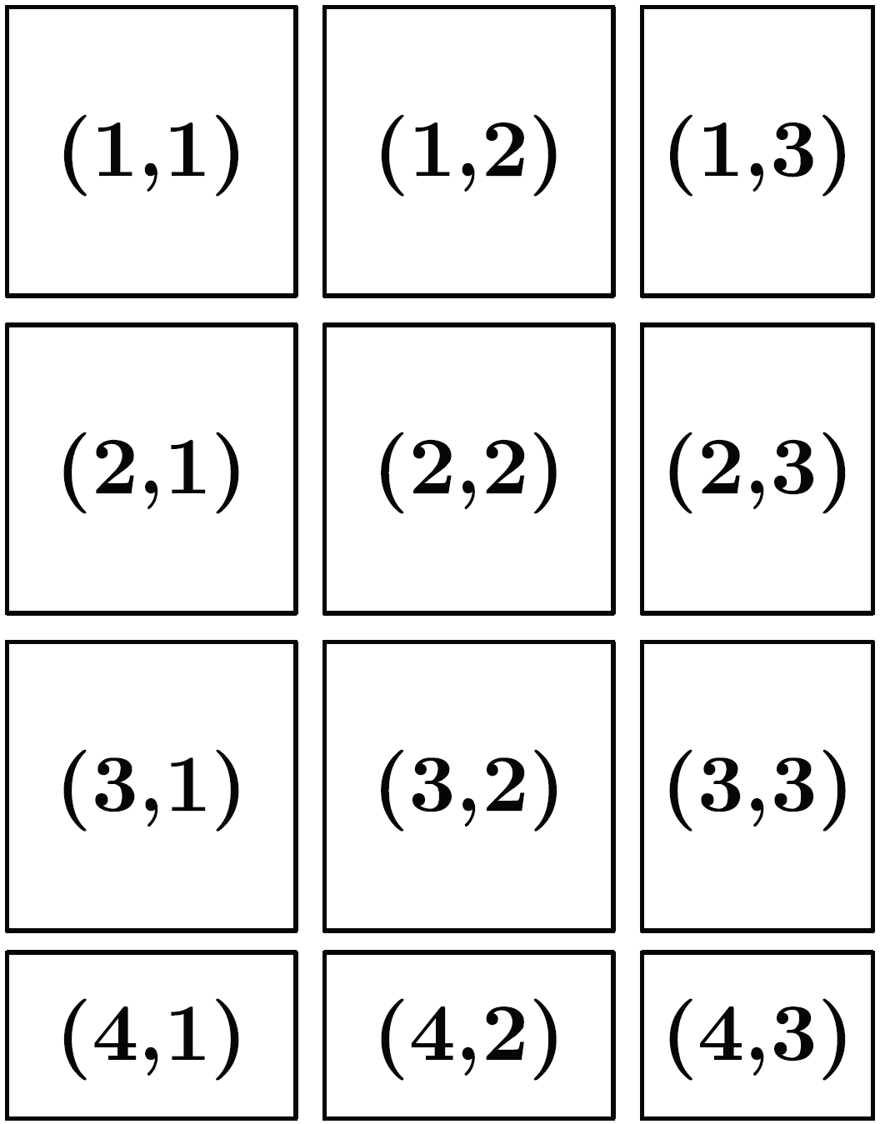
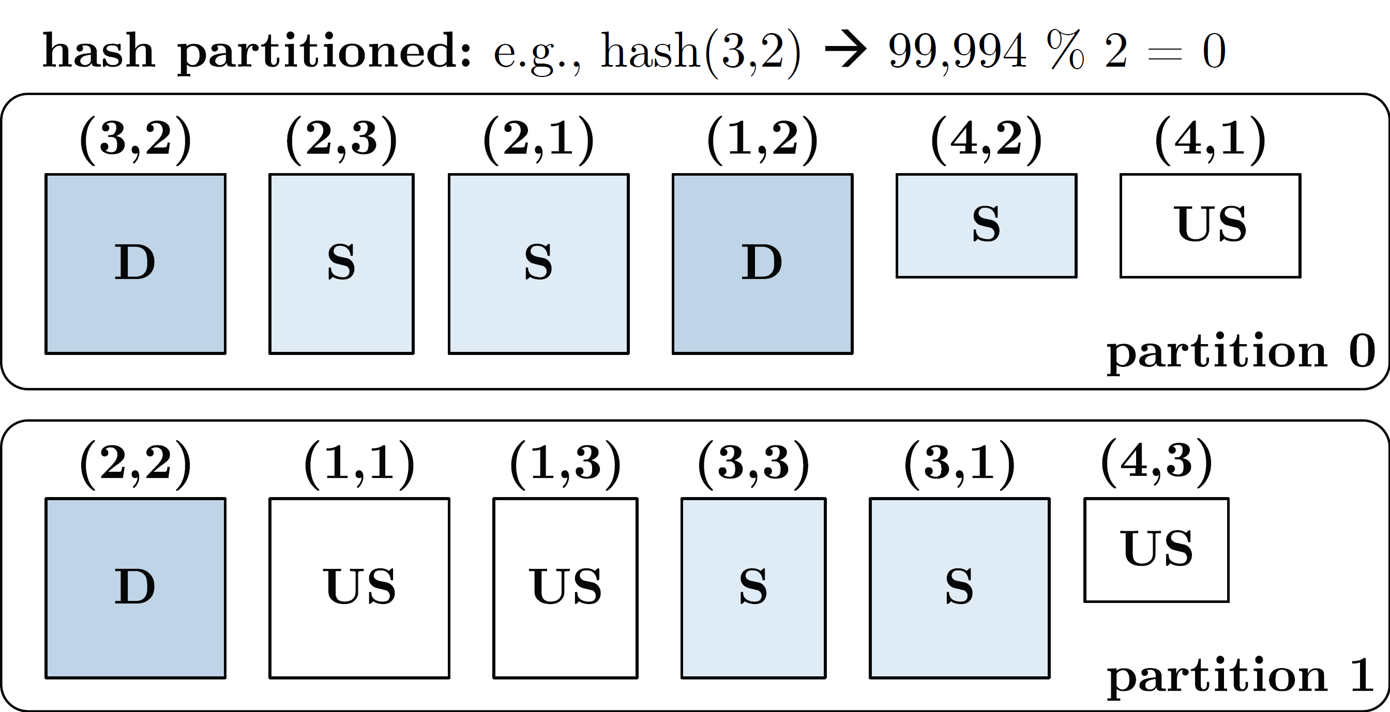
Distributed Matrix Representations
Data-Parallel Execution
Logical Blocking 3,400x2,700 Matrix
(w/ B_{c}=1,000)
Collection of “Matrix Blocks” (and keys)
  Bag semantics (duplicates, unordered)
  Logical (Fixed-Size) Blocking
  + join processing / independence
  - (sparsity skew)
  E.g., SystemML on Spark:
  JavaPairRDD<MatrixIndexes,MatrixBlock>
  Blocks encoded independently (dense/sparse)
Partitioning
  Logical Partitioning
  (e.g., row-/column-wise)
  Physical Partitioning
  (e.g., hash / grid)
Physical Blocking and Partitioning

Slide 20
Distributed Matrix Representations, cont.
Data-Parallel Execution
#1 Block-partitioned Matrices
  Fixed-size, square or rectangular blocks
  Pros: Input/output alignment, block-local transpose,
  amortize block overheads, bounded mem, cache-conscious
  Cons: Converting row-wise inputs (e.g., text) requires shuffle
  Examples: RIOT, PEGASUS, SystemML, SciDB, Cumulon,
  Distributed R, DMac, Spark Mllib, Gilbert, MatFast, and SimSQL
#2 Row/Column-partitioned Matrices
  Collection of row indexes and rows (or columns respectively)
  Pros: Seamless data conversion and access to entire rows
  Cons: Storage overhead in Java, and cache unfriendly operations
  Examples: Spark MLlib, Mahout Samsara, Emma, SimSQL
#3 Algorithm-specific Partitioning
  Operation and algorithm-centric data representations
  Examples: matrix inverse, matrix factorization

Slide 21
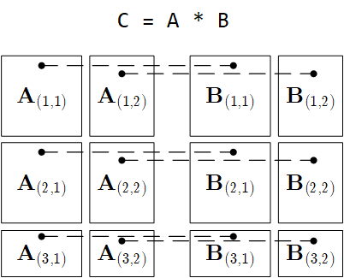
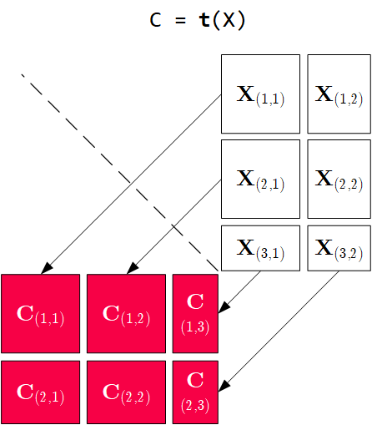
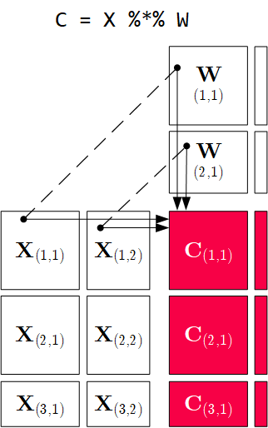
Distributed Matrix Operations
Data-Parallel Execution
Elementwise Multiplication
(Hadamard Product)
Matrix
Multiplication
Transposition
Note: also with row/column vector rhs
Note: 1:N join

Slide 22
Physical MM Operator Selection, cont.
Data-Parallel Execution
Examples Distributed MM Operators
Y
_{1,1}
Y_{1,1}
Y_{1,2}
Broadcast-based MM (mapmm)
Shuffle-based MM (cpmm)
Y
_{2,1}
Y_{2,1}
Y_{2,2}
X_{1,1}
X_{1,2}
Y_{3,1}
Y_{3,2}
X_{2,1}
X_{2,2}
Y_{4,1}
Y_{4,2}
X_{3,1}
X_{3,2}
X_{1,1}
X_{1,2}
X_{1,3}
X_{1,4}
X_{4,1}
X_{4,2}
X_{2,1}
X_{2,2}
X_{2,3}
X_{2,4}

Slide 23
Partitioning-Preserving Operations
Data-Parallel Execution
Shuffle is major bottleneck for ML on Spark
Preserve Partitioning
  Op is partitioning-preserving if keys unchanged (guaranteed)
  Implicit: Use restrictive APIs (mapValues() vs mapToPair())
  Explicit: Partition computation w/ declaration of partitioning-preserving
Exploit Partitioning
  Implicit: Operations based on join, cogroup, etc
  Explicit: Custom operators (e.g., zipmm)
Example:
Multiclass SVM
  Vectors fit
  neither into
  driver nor
  broadcast
  ncol(X) ≤ B_{c}
repart, chkpt X MEM_DISK
parfor(iter_class in 1:num_classes) {
Y_local = 2 * (Y == iter_class) - 1
g_old = t(X) %*% Y_local
...
while( continue ) {
Xd = X %*% s
... inner while loop (compute step_sz)
Xw = Xw + step_sz * Xd;
out = 1 - Y_local * Xw;
out = (out > 0) * out;
g_new = t(X) %*% (out * Y_local) ...
chkpt y_local MEM_DISK
chkpt Xd, Xw MEM_DISK
zipmm

Slide 24
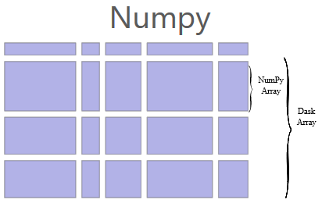
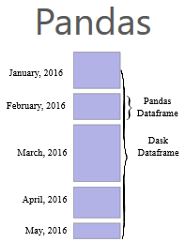
Dask
Data-Parallel Execution
[Matthew Rocklin: Dask: Parallel Computation with Blocked algorithms and Task Scheduling, Python in Science 2015]
[Dask Development Team: Dask: Library for dynamic task scheduling, 2016, https://dask.org]
Overview Dask
  Multi-threaded and distributed operations for arrays, bags, and dataframes
  dask.array:
  list of numpy n-dim arrays
  dask.dataframe:
  list of pandas data frames
  dask.bag:unordered list of tuples (second order functions)
  Local and distributed schedulers:
  threads, processes, YARN, Kubernetes, containers, HPC, and cloud, GPUs
Execution
  Lazy evaluation
  Limitation: requires
  static size inference
  Triggered via
  compute()
import dask.array as da
x = da.random.random(
(10000,10000), chunks=(1000,1000))
y = x + x.T
y.persist() # cache in memory
z = y[::2, 5000:].mean(axis=1) # colMeans
ret = z.compute() # returns NumPy array
Notes:
Note: somewhat in competition w/ PySpark (but not out-of-core), scalable ML algorithms via https://ml.dask.org/ (partnering with scikit-learn, XGBoost)

Slide 25
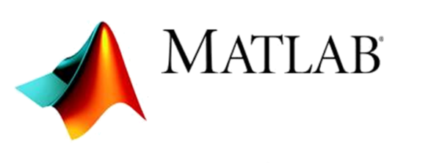




Task-Parallel Execution
Parallel Computation of Independent Tasks,
Emulation of Data-Parallel Operations/Programs

Slide 26

Overview Task-Parallelism
Task-Parallel Execution
Historic Perspective
  Since 1980s: various parallel Fortran extensions, especially in HPC
  DOALL parallel loops (independent iterations)
  OpenMP (since 1997,
  Open Multi-Processing)
Motivation: Independent Tasks in ML Workloads
  Use cases: Ensemble learning, cross validation, hyper-parameter tuning,
  complex models with disjoint/overlapping/all data per task
  Challenge #1: Adaptation to data and cluster characteristics
  Challenge #2: Combination with data-parallelism
#pragma omp parallel for reduction(+: nnz)
for (int i = 0; i < N; i++) {
int threadID = omp_get_thread_num();
R[i] = foo(A[i]);
nnz += (R[i]!=0) ? 1 : 0;
}

Slide 27
Parallel For Loops (ParFor)
Task-Parallel Execution
[M. Boehm et al.: Hybrid Parallelization Strategies for Large-Scale Machine Learning in SystemML. PVLDB 2014]
Hybrid Parallelization Strategies
  Combination of data- and task-parallel ops
  Combination of local and distributed computation
Key Aspects
  Dependency Analysis
  Task partitioning
  Data partitioning, scan
  sharing, various rewrites
  Execution strategies
  Result agg strategies
  ParFor optimizer
reg = 10^(seq(-1,-10))
B_all = matrix(0, nrow(reg), n)
parfor( i in 1:nrow(reg) ) {
B = lm(X, y, reg[i,1]);
B_all[i,] = t(B);
}
Local ParFor
(multi-threaded),
w/ local ops
Remote ParFor
(distributed
Spark job)
Local ParFor,
w/ concurrent distributed ops
Notes:
NOTE: dependency analysis (constant, greatest common denominator if dependency possible, Banerjee if dependencies in loop bounds)

Slide 28
Additional ParFor Examples
Task-Parallel Execution
Pairwise Pearson Correlation
  In practice: uni/bivariate stats
  Pearson‘s R, Anova F, Chi-squared,
  Degree of freedom, P-value,
  Cramers V, Spearman, etc)
Batch-wise CNN Scoring
  Emulate data-parallelism
  for complex functions
➔ Conceptual Design:
Coordinator/worker (task: group of parfor iterations)
D = read("./input/D");
R = matrix(0, ncol(D), ncol(D));
parfor(i in 1:(ncol(D)-1)) {
X = D[ ,i];
sX = sd(X);
parfor(j in (i+1):ncol(D)) {
Y = D[ ,j];
sY = sd(Y);
R[i,j] = cov(X,Y)/(sX*sY);
} }
write(R, "./output/R");
prob = matrix(0, Ni, Nc)
parfor( i in 1:ceil(Ni/B) ) {
Xb = X[((i-1)*B+1):min(i*B,Ni),];
prob[((i-1)*B+1):min(i*B,Ni),] =
... # CNN scoring
}

Slide 29
ParFor Execution Strategies
Task-Parallel Execution
#1 Task Partitioning
  Fixed-size schemes:
  naive (1) , static (n/k), fixed (m)
  Self-scheduling: e.g.,
  guided self scheduling, factoring
#2 Data Partitioning
  Local or remote row/column
  partitioning (incl locality)
#3 Task Execution
  Local (multi-core) execution
  Remote (MR/Spark) execution
#4 Result Aggregation
  With and without compare (non-empty output variable)
  Local in-memory / remote MR/Spark result aggregation
Factoring (n=101, k=4)
(13,13,13,13, 7,7,7,7, 3,3,3,3, 2,2,2,2, 1)
parfor(i in 1:(ncol(D)-1)) {
X = D[ ,i];
sX = sd(X);
parfor(j in (i+1):ncol(D)) {
Y = D[ ,j];

Slide 30
Task-Parallelism in R
Task-Parallel Execution
Multi-Threading
  doMC as multi-threaded
  foreach backend
  Foreach w/ parallel (%dopar%)
  or sequential (%do%) execution
Distribution
  doSNOW as distributed
  foreach backend
  MPI/SOCK as comm methods
library(doMC)
registerDoMC(32)
R <- foreach(i=1:(ncol(D)-1),
.combine=rbind) %dopar% {
X = D[,i]; sX = sd(X);
Ri = matrix(0, 1, ncol(D))
for(j in (i+1):ncol(D)) {
Y = D[,j]; sY = sd(Y)
Ri[1,j] = cov(X,Y)/(sX*sY);
}
return(Ri);
}
[https://cran.r-project.org/web/packages/
doMC/vignettes/gettingstartedMC.pdf]
library(doSNOW)
clust = makeCluster(
c(“192.168.0.1”, “192.168.0.2”,
“192.168.0.3”), type=“SOCK”);
registerDoSNOW(clust);
... %dopar% ...
stopCluster(clust);
[https://cran.r-project.org/web/packages/
doSNOW/doSNOW.pdf]

Slide 31
Task-Parallelism in Other Systems
Task-Parallel Execution
MATLAB
  Parfor loops for
  multi-process &
  distributed loops
  Use-defined par
Julia
  Dedicated macros:
  @threads
  @distributed
TensorFlow
  User-defined parallel iterations, responsible for
  correct results or acceptable approximate results
matlabpool 32
c = pi; z = 0;
r = rand(1,10)
parfor i = 1 : 10
z = z+1; # reduction
b(i) = r(i); # sliced
end
[Gaurav Sharma, Jos Martin: MATLAB®: A Language for Parallel Computing. Int. Journal on Parallel Prog. 2009]
a = zeros(1000)
@threads for i in 1:1000
a[i] = rand(r[threadid()])
end
[https://docs.julialang.
org/en/v1/manual/
parallel-computing/]
[https://www.tensorflow.org/
api_docs/python/tf/while_loop]
tf.while_loop(cond, body, loop_vars, parallel_iterations=10,
swap_memory=False, maximum_iterations=None, ...)

Slide 32
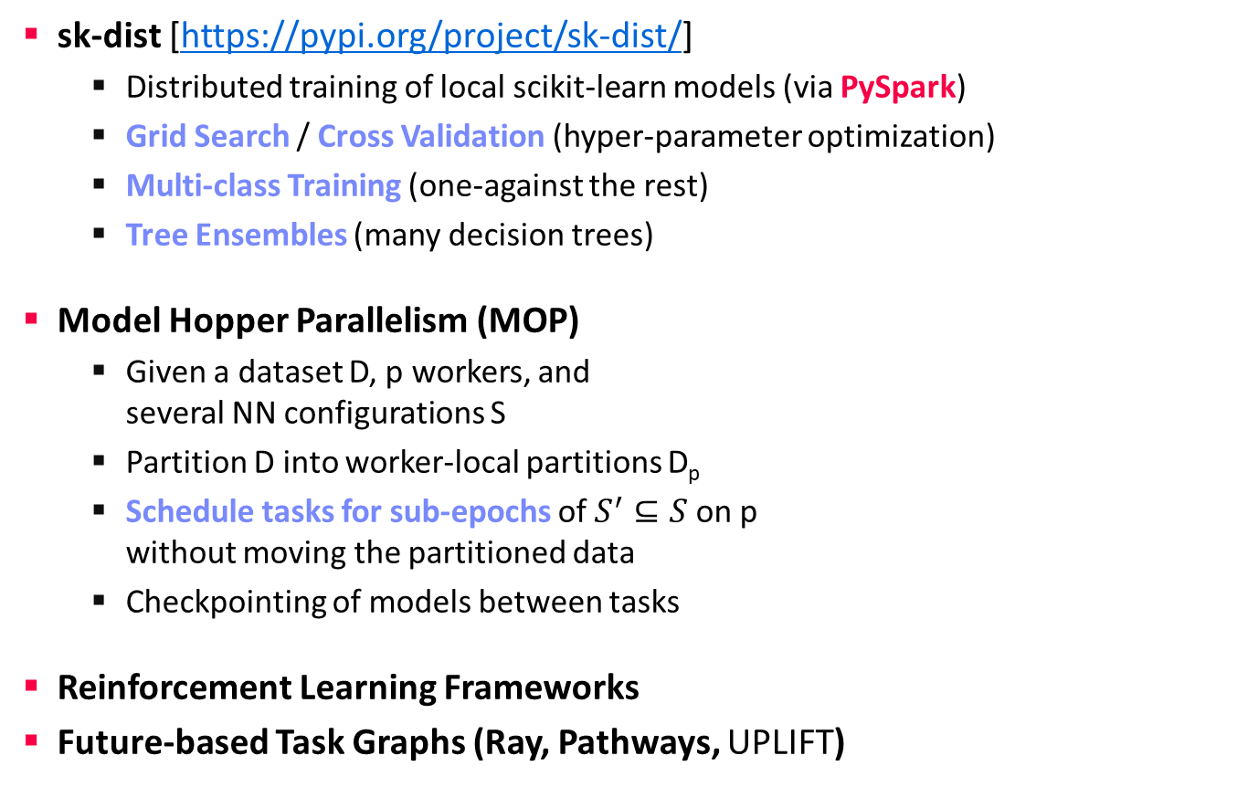
Task-Parallelism in Other Systems, cont.
Task-Parallel Execution
sk-dist [https://pypi.org/project/sk-dist/]
  Distributed training of local scikit-learn models (via PySpark)
  Grid Search / Cross Validation (hyper-parameter optimization)
  Multi-class Training (one-against the rest)
  Tree Ensembles (many decision trees)
Model Hopper Parallelism (MOP)
  Given a dataset D, p workers, and
  several NN configurations S
  Partition D into worker-local partitions D_{p}
  Schedule tasks for sub-epochs of $S^{′}⊆S$ on p
  without moving the partitioned data
  Checkpointing of models between tasks
Reinforcement Learning Frameworks
Future-based Task Graphs (Ray, Pathways, UPLIFT)
[Supun Nakandala, Yuhao Zhang, Arun Kumar: Cerebro: Efficient and Reproducible Model Selection on Deep Learning Systems. DEEM@SIGMOD 2019]
[Supun Nakandala, Yuhao Zhang, Arun Kumar: Cerebro: A Data System for Optimized Deep Learning Model Selection. PVLDB 2020]
Part of
Next Lecture
Notes:
Pathways paper: https://arxiv.org/pdf/2203.12533.pdf

Slide 33
Data-Parallel Parameter Servers

Slide 34
Background: Mini-batch DNN Training (LeNet)
Data-Parallel Parameter Servers
[Yann LeCun, Leon Bottou, Yoshua Bengio, and Patrick Haffner: Gradient-Based Learning Applied to Document Recognition, Proc of the IEEE 1998]
# Initialize W1-W4, b1-b4
# Initialize SGD w/ Nesterov momentum optimizer
iters = ceil(N / batch_size)
for( e in 1:epochs ) {
for( i in 1:iters ) {
X_batch = X[((i-1) * batch_size) %% N + 1:min(N, beg + batch_size - 1),]
y_batch = Y[((i-1) * batch_size) %% N + 1:min(N, beg + batch_size - 1),]
## layer 1: conv1 -> relu1 -> pool1
## layer 2: conv2 -> relu2 -> pool2
## layer 3: affine3 -> relu3 -> dropout
## layer 4: affine4 -> softmax
outa4 = affine::forward(outd3, W4, b4)
probs = softmax::forward(outa4)
## layer 4: affine4 <- softmax
douta4 = softmax::backward(dprobs, outa4)
[doutd3, dW4, db4] = affine::backward(douta4, outr3, W4, b4)
## layer 3: affine3 <- relu3 <- dropout
## layer 2: conv2 <- relu2 <- pool2
## layer 1: conv1 <- relu1 <- pool1
# Optimize with SGD w/ Nesterov momentum W1-W4, b1-b4
[W4, vW4] = sgd_nesterov::update(W4, dW4, lr, mu, vW4)
[b4, vb4] = sgd_nesterov::update(b4, db4, lr, mu, vb4)
}
}
NN Forward
Pass
NN Backward
Pass
→ Gradients
Model
Updates
Notes:
Note: number of layers = layer ops w/ weights

Slide 35
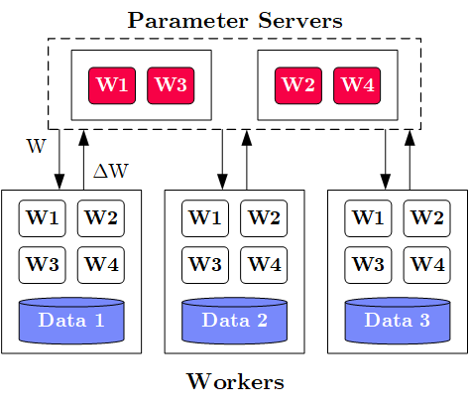
Overview Parameter Servers
Data-Parallel Parameter Servers
M
System
Architecture
  M Parameter
  Servers
  N Workers
  Optional
  Coordinator
Key Techniques
  Data partitioning D → workers Di (e.g., disjoint, reshuffling)
  Updated strategies (e.g., synchronous, asynchronous)
  Batch size strategies (small/large batches, hybrid methods)
W .. Model
ΔW .. Gradient
N
Notes:
Note: Nabla vs Delta operators

Slide 36
History of Parameter Servers
Data-Parallel Parameter Servers
1st Gen: Key/Value
  Distributed key-value store for
  parameter exchange and synchronization
  Relatively high overhead
2nd Gen: Classic Parameter Servers
  Parameters as dense/sparse matrices
  Different update/consistency strategies
  Flexible configuration and fault tolerance
3rd Gen: Parameter Servers w/
improved data communication
  Prefetching and range-based pull/push
  Lossy or lossless compression w/ compensations
Examples
  TensorFlow, MXNet, PyTorch, CNTK, Petuum
[Alexander J. Smola, Shravan M. Narayanamurthy: An Architecture for Parallel Topic Models. PVLDB 2010]
[Jeffrey Dean et al.: Large Scale Distributed Deep Networks. NIPS 2012]
[Mu Li et al: Scaling Distributed Machine Learning with the Parameter Server. OSDI 2014]
[Jiawei Jiang, Bin Cui, Ce Zhang, Lele Yu: Heterogeneity-aware Distributed Parameter Servers. SIGMOD 2017]
[Jiawei Jiang et al: SketchML: Accelerating Distributed Machine Learning with Data Sketches. SIGMOD 2018]

Slide 37
Basic Worker Algorithm (batch)
Data-Parallel Parameter Servers
for( i in 1:epochs ) {
for( j in 1:iterations ) {
params = pullModel(); # W1-W4, b1-b4 lr, mu
batch = getNextMiniBatch(data, j);
gradient = computeGradient(batch, params);
pushGradients(gradient);
}
}
[Jeffrey Dean et al.: Large Scale Distributed Deep Networks. NIPS 2012]

Slide 38
Extended Worker Algorithm (nfetch batches)
Data-Parallel Parameter Servers
gradientAcc = matrix(0,...);
for( i in 1:epochs ) {
for( j in 1:iterations ) {
if( step mod nfetch = 0 )
params = pullModel();
batch = getNextMiniBatch(data, j);
gradient = computeGradient(batch, params);
gradientAcc += gradient;
params = updateModel(params, gradients);
if( step mod nfetch = 0 ) {
pushGradients(gradientAcc); step = 0;
gradientAcc = matrix(0, ...);
}
step++;
} }
nfetch batches require
local gradient accrual and local model update
[Jeffrey Dean et al.: Large Scale Distributed Deep Networks. NIPS 2012]

Slide 39
Update Strategies
Data-Parallel Parameter Servers
Bulk Synchronous
Parallel (BSP)
  Update model w/
  accrued gradients
  Barrier for N workers
Asynchronous
Parallel (ASP)
  Update model
  for each gradient
  No barrier
Synchronous w/
Backup Workers
  Update model w/
  accrued gradients
  Barrier for N of
  N+b workers
Batch 1
Batch 2
Batch 3
Batch 1
Batch 2
Batch 3
Batch 1
Batch 2
Batch 3
Batch 1
Batch 2
Batch 3
Batch 1
Batch 2
Batch 3
but, stale model updates
Batch 1
Batch 2
Batch 3
Batch 1
Batch 2
Batch 3
Batch 1
Batch 2
Batch 3
Batch 1
Batch 2
Batch 3
Batch 1
Batch 2
Batch 3
Batch 1
Batch 2
Batch 3
Batch 1
Batch 2
Batch 3
[Martín Abadi et al: TensorFlow: A System for Large-Scale Machine Learning. OSDI 2016]

Slide 40
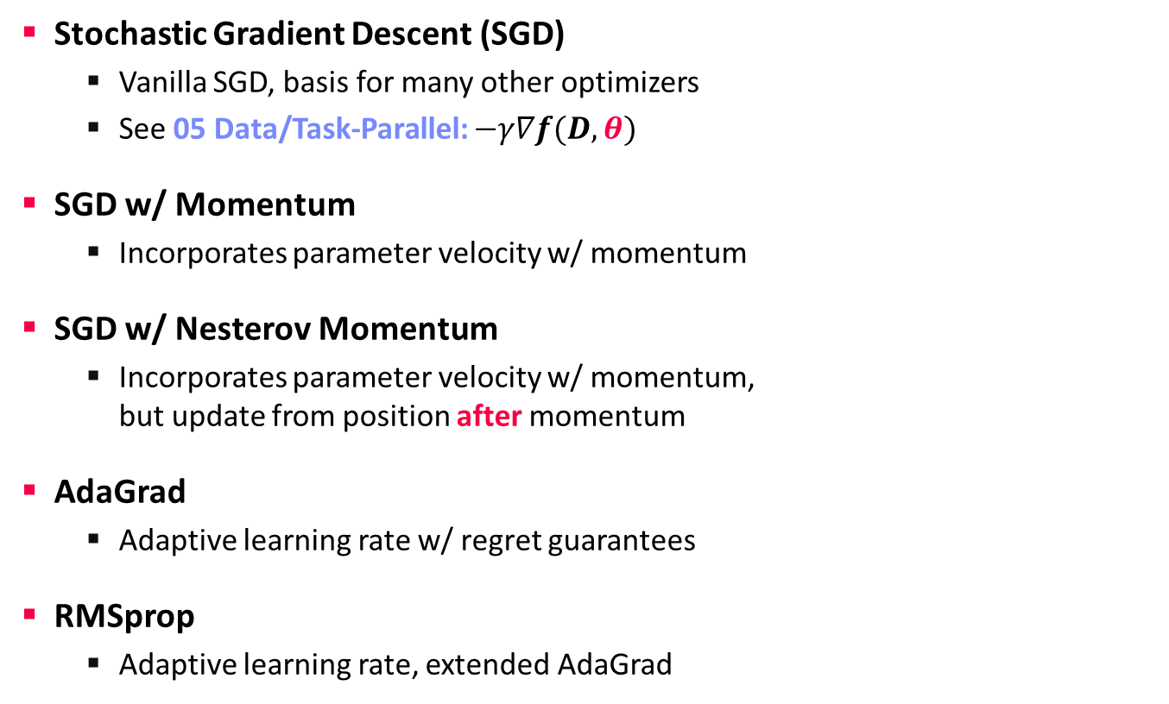
Selected Optimizers (updateModel)
Data-Parallel Parameter Servers
Stochastic Gradient Descent (SGD)
  Vanilla SGD, basis for many other optimizers
  See 05 Data/Task-Parallel: $−γ∇f(D,θ)$
SGD w/ Momentum
  Incorporates parameter velocity w/ momentum
SGD w/ Nesterov Momentum
  Incorporates parameter velocity w/ momentum,
  but update from position after momentum
AdaGrad
  Adaptive learning rate w/ regret guarantees
RMSprop
  Adaptive learning rate, extended AdaGrad
X = X – lr*dX
v = mu*v – lr*dX
X = X + v
v0 = v
v = mu*v – lr*dX
X = X – mu*v0 + (1+mu)*v
[John C. Duchi et al: Adaptive Subgradient Methods for
Online Learning and Stochastic Optimization. JMLR 2011]
c = dr*c+(1-dr)*dX^2
X = X-(lr*dX/(sqrt(c)+eps))
Notes:
Regret: loss incurred during learning, loss difference to loss w/ optimal weights (applicability to exercise?)

Slide 41
Selected Optimizers (updateModel), cont.
Data-Parallel Parameter Servers
Adam
  Individual adaptive learning rates for
  different parameters
Shampoo
  Preconditioned gradient method
  (Newton’s method, Quasi-Newton)
  Retains gradients tensor structure by
  maintaining a preconditioner per dim
  O(m²n²) → O(m² + n²)
[Diederik P. Kingma, Jimmy Ba: Adam: A Method for Stochastic Optimization. ICLR 2015]
t = t + 1
m = beta1*m + (1-beta1)*dX # update biased 1st moment est
v = beta2*v + (1-beta2)*dX^2 # update biased 2nd raw moment est
mhat = m / (1-beta1^t) # bias-corrected 1st moment est
vhat = v / (1-beta2^t) # bias-corrected 2nd raw moment est
X = X - (lr * mhat/(sqrt(vhat)+epsilon)) # param update
[Vineet Gupta, Tomer Koren, Yoram Singer: Shampoo: Preconditioned Stochastic Tensor Optimization. ICML 2018]
L = L + dX %*% t(dX)
R = R + t(dX) %*% dX
X = X – lr * pow(L,1/4)
%*% dX %*% pow(R,1/4))
Notes:
Note: Newton’s method employs the local Hessian as a preconditioner
“Shampoo maintains an m×m matrix L1/4t to precondition the rows of Gt and R1/4t for its columns. The ¼ exponent arises from our analysis; intuitively, it is a sensible choice as it induces an overall step-size decay rate of O(1/√t), which is common in stochastic optimization methods.”

Slide 42
Batch Size Configuration
Data-Parallel Parameter Servers
What is the right batch size for my data?
  Maximum useful batch size is dependent on
  data redundancy and model complexity
Additional Heuristics/Hybrid Methods
  #1 Increase the batch size instead
  of decaying the learning rate
  #2 Combine batch and mini-batch
  algorithms (full batch + n online updates)
[Christopher J. Shallue et al.: Measuring the Effects of Data Parallelism on Neural Network Training. CoRR 2018]
ResNet-50 on ImageNet
Simple CNN on
MNIST
vs
[Samuel L. Smith, Pieter-Jan Kindermans, Chris Ying, Quoc V. Le: Don't Decay the Learning Rate, Increase the Batch Size. ICLR 2018]
[Ashok Cutkosky, Róbert Busa-Fekete: Distributed Stochastic Optimization via Adaptive SGD. NeurIPS 2018]

Slide 43
Reducing Communication Overhead
Data-Parallel Parameter Servers
Large Batch Sizes
  Larger batch sizes reduce the
  relative communication overhead
Overlapping Computation/Communication
  For deep NN w/ many weight/bias matrices,
  compute and comm. can be overlapped
  Collective operations: all-Reduce / ring all-reduce / hierarchical all-reduce
Sparse and Compressed Communication
  Mini-batches of sparse data → sparse dW
  Lossy (mantissa truncation, quantization), and
  lossless (delta, bitpacking) for W and dW
  Gradient sparsification/clipping (send gradients larger than a threshold)
In-Network Aggregation (SwitchML)
  Aggregate worker updates in prog. switches
  32b fix-point, coordinated updates
[Priya Goyal et al: Accurate, Large Minibatch SGD: Training ImageNet in 1 Hour. CoRR 2017 (kn=8K, 256 GPUs)]
tf.distribute:
MirroredStrategy
MultiWorkerMirroredStrategy
[Frank Seide et al: 1-bit stochastic gradient descent and its application to data-parallel distributed training of speech DNNs. INTERSPEECH 2014]
[Amedeo Sapio et al: Scaling Distributed Machine Learning with In-Network Aggregation, NSDI 2021]
Notes:
Large-batches: synchronous SGD with k=256 workers * n=32 per-worker batch size = 8K

Slide 44
Federated Machine Learning

Slide 45


Problem Setting and Overview
Federated Machine Learning
Motivation Federated ML
  Learn model w/o central data consolidation
  Privacy + data/power caps vs personalization and sharing
  Applications Characteristics
    #1 On-device data more relevant than server-side data
    #2 On-device data is privacy-sensitive or large
    #3 Labels can be inferred naturally from user interaction
  Example: Language modeling for mobile keyboards and voice recognition
Challenges
  Massively distributed (data stored across many devices)
  Limited and unreliable communication
  Unbalanced data (skew in data size, non-IID )
  Unreliable compute nodes / data availability
W
ΔW
[Jakub Konečný: Federated Learning - Privacy-Preserving Collaborative Machine Learning without Centralized Training Data, UW Seminar 2018]

Slide 46
Excursus: Spectrum of Data Sharing
Federated Machine Learning
Fine-grained Spectrum
  Spectrum of technologies with performance/privacy/utility tradeoffs
  Different applications with different requirements
  Potential: New markets for data-driven services in this spectrum
Increasing Utility/Perf
Increasing Privacy
Private Data (no sharing)
Privacy-
enhancing Technologies
(FHE, MPC, Differential Privacy)
Aggregates (Federated ML, Federated w/
secure comm.)
Anonymized
Data
(k-anonymity, pseudonyms)
Surrogate
Data
(char-preserving
synthetic data, dataset distillation)
Public Data (full sharing, sharing w/ partners)
  Key Property: no reconstruction of private raw data

Slide 47
A Federated ML Training Algorithm
Federated Machine Learning
while( !converged ) {
1. Select random subset (e.g. 1000)
of the (online) clients
2. In parallel, send current parameters θ_{t}
to those clients
2a. Receive parameters θ_{t} from server [pull]
2b. Run some number of minibatch SGD steps,
producing θ’
2c. Return θ’-θ_{t} (model averaging) [push]
3. θ_{t+1} = θ_{t} + data-weighted average of client updates
}
At each client
[Brendan McMahan, Eider Moore, Daniel Ramage, Seth Hampson, Blaise Agüera y Arcas: Communication-Efficient Learning of Deep Networks from Decentralized Data. AISTATS 2017]

Slide 48
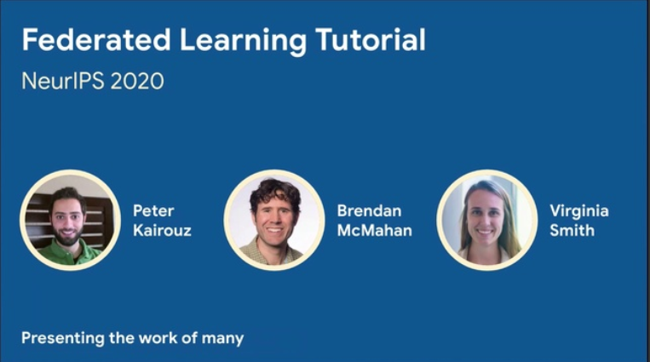
Algorithmic PS Extensions
Federated Machine Learning
#1 Client Sampling (FedAvg w/ model averaging)
#2 Decentralized, Fault-tolerant Aggregation
#3 Peer-to-peer Gradient and Model Exchange
#4 Meta-learning for Private Models
#5 Handling Statistical Heterogeneity (non-IID data)
  Reducing variance
  Selecting relevant subsets of data
  Tolerating partial client work
  Partitioning clients into congruent groups
  Adaptive Optimization (FedOpt, FedAvgM)
[Peter Kairouz, Brendan McMahan, Virginia Smith: Federated Learning
Tutorial. NeurIPS 2020, https://slideslive.com/38935813/
federated-learningtutorial]
[Sashank J. Reddi et al: Adaptive Federated Optimization. CoRR 2020]

Slide 49
Federated Learning Protocol
Federated Machine Learning
Recommended Reading
  [Keith Bonawitz, Hubert Eichner, Wolfgang Grieskamp, Dzmitry Huba, Alex Ingerman, Vladimir Ivanov, Chloé Kiddon, Jakub Konecný, Stefano Mazzocchi, H. Brendan McMahan, Timon Van Overveldt, David Petrou, Daniel Ramage, Jason Roselander: Towards Federated Learning at Scale: System Design. MLSys 2019]
Android Phones

Slide 50




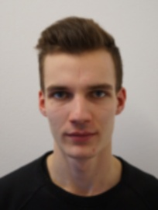



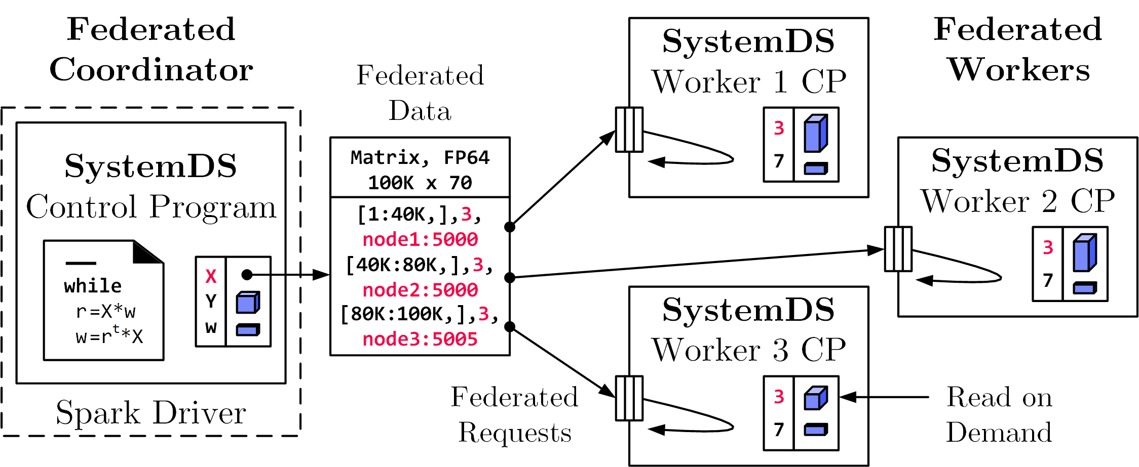
Federated Learning
Federated Machine Learning in SystemDS
[SIGMOD 2021b]
Federated Backend
  Federated data (matrices/frames) as meta data objects
  Federated linear algebra, (and federated parameter server)
Federated Requests: READ, PUT, GET, EXEC_INST, EXEC_UDF, CLEAR
X = federated(addresses=list(node1, node2, node3),
ranges=list(list(0,0),list(40K,70), ..., list(80K,0),list(100K,70)));

Slide 51
Example Federated Operations
Federated Machine Learning in SystemDS
b) Local MV (EXEC_INST, 3)
Matrix-Vector Multiplication
  o = X %*% v, local v
  Row-partitioned, federated X
  Row-partitioned, federated o
Vector-Matrix Multiplication
  o = v %*% X, local v
  Row-partitioned,
  federated X, local o
  New broadcast handling
Data Preparation
  [X,M] = transformencode(F,spec)
  Recoding, feature hashing, binning,
  one-hot encoding
a) broadcast v
(PUT(v, 2))
X₁
c) Clean 2
(EXEC_INST)
X₂
a) broadcast sliced v
(PUT(v, 4))
b) Local MV
(EXEC_INST, 5)
X₁
c) Aggregate (GET, 5) +
X₂
d) Clean 4,5 (EXEC_INST)
1) Build local record maps
(EXEC_UDF)
X₁: D B C D C
2) Aggregate, broadcast, recode
X₂: A B B C C

Slide 52

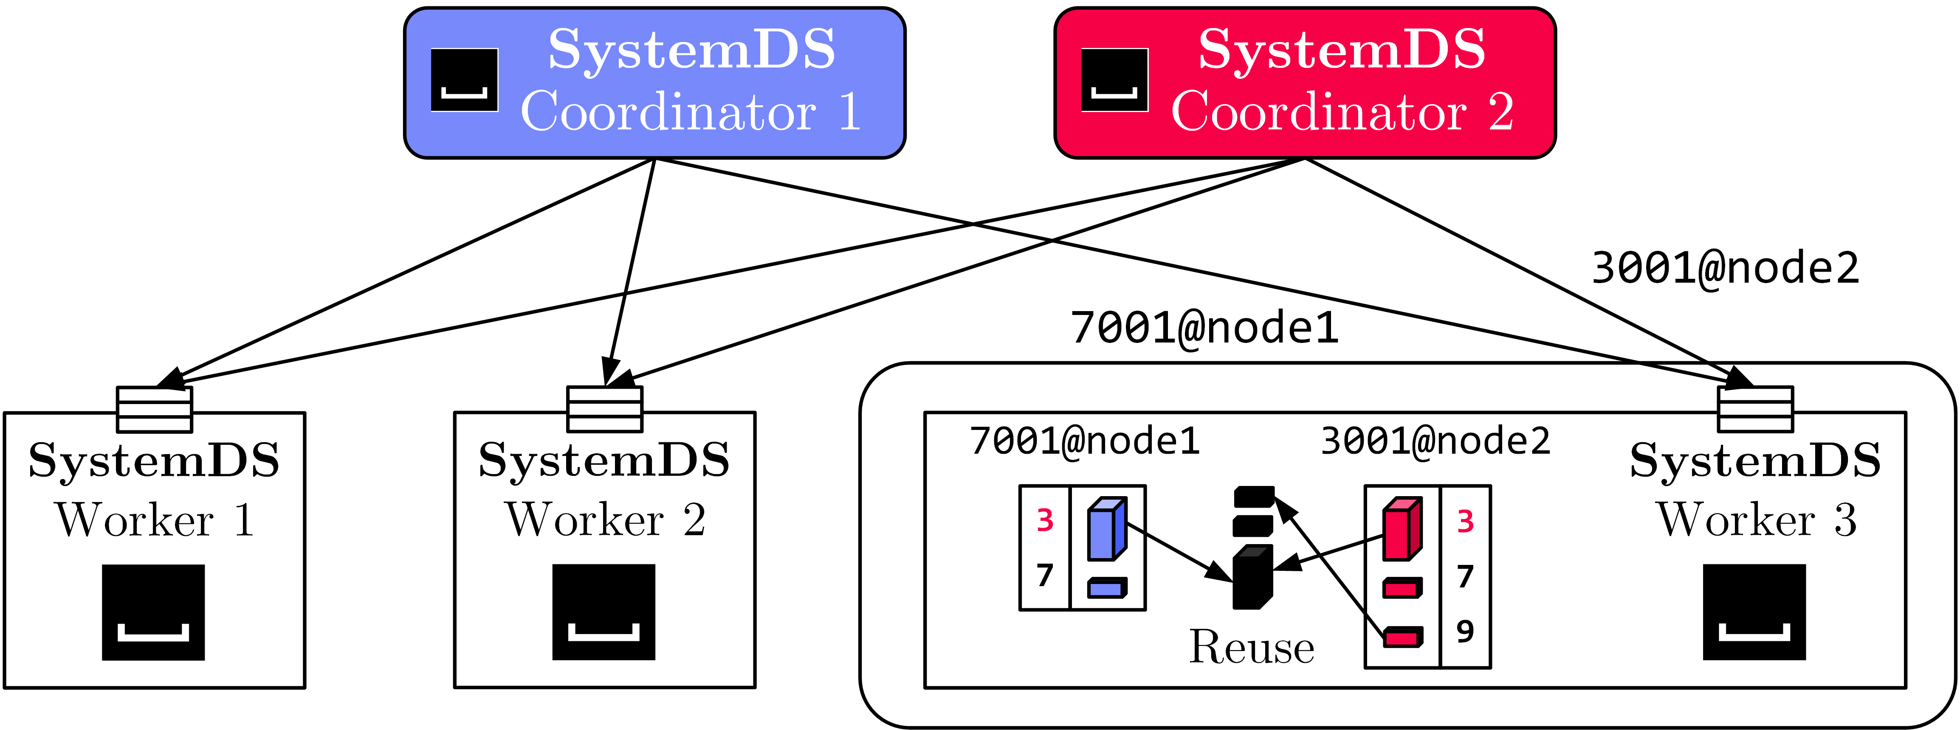
Federated Data Preparation,
Learning, and Debugging
Federated Machine Learning in SystemDS
Federated Feature Transformations
Federated Linear-algebra-based Data Cleaning,
Data Preparation, and Model Debugging (e.g., federated quantiles)
Multi-tenant
Federated Learning
  Tenant Isolation
Lineage-based Reuse
Asynchronous Compression

Slide 53
TensorFlow Federated
Federated Machine Learning
[https://www.tensorflow.org/federated/]
Overview TFF
  Federated PS algorithms and federated second order functions
  Primarily for simulating federated training, no OSS federated runtime
#1 Federated PS
#2 Federated Analytics
  r = t(y) %*% X
  User-level composition
  of federated algorithms
  PET primitives
iterative_process = tff.learning.build_federated_averaging_process(
model_fn, # function for created federated models
client_optimizer_fn=lambda: tf.keras.optimizers.SGD(learning_rate=0.02),
server_optimizer_fn=lambda: tf.keras.optimizers.SGD(learning_rate=1.0))
X = ... # tff.type_at_clients(tf.float32)
by = tff.federated_broadcast(y)
R = tff.federated_sum(
tff.federated_map(X, by, foo_mm), foo_s)
# note: tff.federated_secure_sum

Slide 54
Summary and Q&A
Data-Parallel Parameter Servers
Model-Parallel Parameter Servers
Distributed Reinforcement Learning
Federated Machine Learning
#1 Different strategies (and systems) for different ML workloads
➔ Specialization and abstraction
#2 Awareness of underlying execution frameworks
#3 Awareness of effective compilation and runtime techniques

