Slide 1
Architecture of ML Systems
02 Languages, Architectures, and System Landscape
Last update: Mar 10, 2022

Slide 2



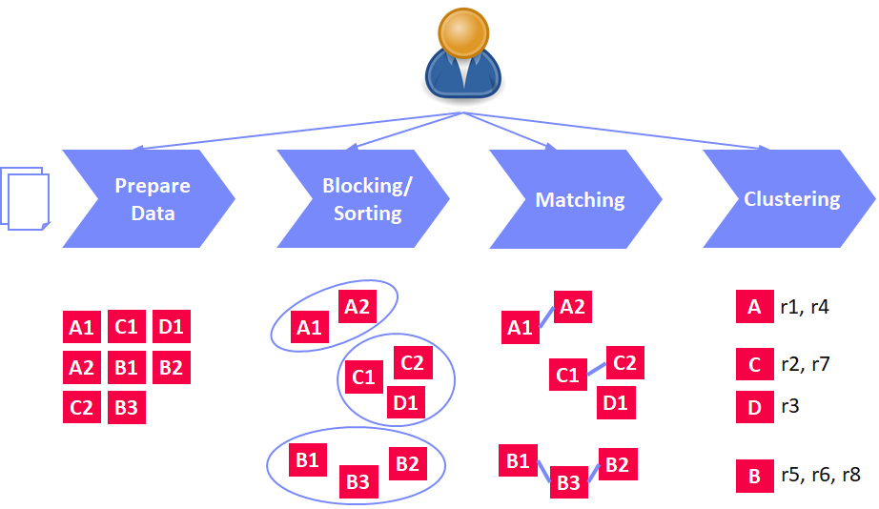
Announcements/Org
#1 Video Recording
  Link in TeachCenter & TUbe (lectures will be public)
  https://tugraz.webex.com/meet/m.boehm
#2 Course Registrations (as of Mar 10)
  Architecture of Machine Learning Systems (AMLS)
#3 SIGMOD Programming Context 2022
  Task: entity resolution blocking (recall, runtime limit)
  http://sigmod2022contest.eastus.cloudapp.azure.com/index.shtml
  Submission deadline: Apr 30
  Organized by: Georgia Tech / University of Modena
  Awards: XXX USD sponsored by Microsoft
113 (9)

Slide 3
Projects / Exercises (project selection by Mar 31)
Programming Projects or Exercises
#1 Apache SystemDS Projects
  https://issues.apache.org/jira/secure/Dashboard.jspa?selectPageId=12335852#Filter-Results/12365413 (to be cleaned up by Mar 18)
  Features across the stack (built-in scripts, APIs, compiler, runtime)
#2 DAPHNE Projects
  https://mboehm7.github.io/teaching/ss22_amls/AMLS_DAPHNE_projects.pdf
  OSS end 03/2022; Features at level of runtime, compiler, tools
#3 Alternative 1: SIGMOD Programming Contest
  http://sigmod2022contest.eastus.cloudapp.azure.com/index.shtml
  Participate and build an ML-based ER blocking system
#4 Alternative 2: Exercise on ML Pipelines
  https://mboehm7.github.io/teaching/ss22_amls/AMLS_2022_Exercise.pdf

Slide 4
Agenda
Data Science Lifecycle
ML Systems Stack
Language Abstractions
ML Systems Benchmarks

Slide 5
Data Science Lifecycle

Slide 6




The Data Science Lifecycle
Data Science Lifecycle
Data-centric View:
Application perspective
Workload perspective
System perspective
Data Scientist
Data Integration
Data Cleaning
Data Preparation
Model Selection
Training
Hyper-parameters
Validate & Debug
Deployment
Scoring & Feedback
Exploratory Process
(experimentation, refinements, ML pipelines)
Data/SW Engineer
DevOps Engineer

Slide 7
The Data Science Lifecycle, cont.
Data Science Lifecycle
Classic KDD Process (Knowledge Discovery in Databases)
  Descriptive (association rules, clustering) and predictive
  1990-2010
Evaluate
Mining
Transform
Preprocess
Select
[Usama M. Fayyad, Gregory Piatetsky-Shapiro, Padhraic Smyth: From Data Mining to Knowledge Discovery in Databases. AI Magazine 17(3) (1996)]

Slide 8
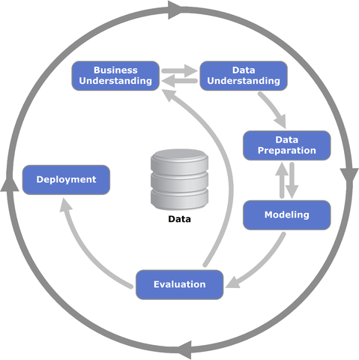
The Data Science Lifecycle, cont.
Data Science Lifecycle
CRISP-DM
  CRoss-Industry
  Standard Process for
  Data Mining
  Additional focus on
  business understanding
  and deployment
[https://statistik-dresden.de/archives/1128]

Slide 9
The 80% Argument
Data Science Lifecycle
Data Sourcing Effort
  Data scientists spend 80-90% time on finding
  relevant datasets and data integration/cleaning.
Technical Debts in ML Systems
  Glue code, pipeline jungles, dead code paths
  Plain-old-data types, multiple languages, prototypes
  Abstraction and configuration debts
  Data testing, reproducibility, process management, and cultural debts
[Michael Stonebraker, Ihab F. Ilyas: Data Integration: The Current Status and the Way Forward.
IEEE Data Eng. Bull. 41(2) (2018)]
ML
[D. Sculley et al.: Hidden Technical Debt in Machine Learning Systems. NIPS 2015]

Slide 10
A Text Classification Scenario
Data Science Lifecycle
Token Features
Example ML Pipeline
Training and Scoring
Sentences
ΔFX
Feature Extraction
(e.g., doc structure, sentences, tokenization, n-grams)
Sentence Classification
Sentence Classification
…
(e.g., ⨝, ∪)
M
“Model”
(weights, meta data)
FX
transformencode
X
Y
large-scale, distributed training
FY
Training
B
MX
MY
ΔFX
transformapply
ΔX
embedded scoring
Scoring
ΔFŶ
transformdecode
ΔŶ

Slide 11
ML Systems Stack

Slide 12
What is an ML System?
ML Systems Stack
Classification
Regression
Recommenders
Clustering
Dim Reduction
Neural Networks
Statistics
Data Mining
Machine Learning (ML)
ML Applications
(entire KDD/DS lifecycle)
Rapidly Evolving
Runtime Techniques (Execution, Data Access)
ML System
Compilation Techniques
Distributed Systems
HPC
Data Management
Accelerators
Operating Systems
Prog. Language Compilers
HW Architecture

Slide 13
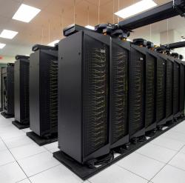
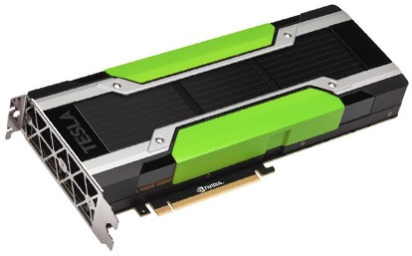
Driving Factors for ML
ML Systems Stack
[Credit: Andrew Ng’14]
Improved Algorithms and Models
  Success across data and application domains
  (e.g., health care, finance, transport, production)
  More complex models which leverage large data
Availability of Large Data Collections
  Increasing automation and monitoring ➔ data
  (simplified by cloud computing & services)
  Feedback loops, simulation/data prog./augmentation
  → Trend: self-supervised learning
HW & SW Advancements
  Higher performance of hardware and infrastructure (cloud)
  Open-source large-scale computation frameworks,
  ML systems, and vendor-provides libraries
Feedback Loop
Data
Usage
Model

Slide 14
Stack of ML Systems
ML Systems Stack
Deployment & Scoring
Validation & Debugging
Training
Hyper-parameter Tuning
ML Apps & Algorithms
Supervised, unsupervised, RL
linear algebra, libs, AutoML
Model and Feature Selection
Language Abstractions
Eager interpretation, lazy evaluation, prog. compilation
Data Programming & Augmentation
Fault Tolerance
Approximation, lineage, checkpointing, checksums, ECC
Execution Strategies
Local, distributed, cloud
(data, task, parameter server)
Data Preparation
(e.g., one-hot, binning)
Data Representations
Dense & sparse tensor/matrix;
compress, partition, cache
Data Integration & Data Cleaning
CPUs, NUMA, GPUs, FPGAs, ASICs, RDMA, SSD/NVM
HW & Infrastructure
Improve accuracy vs. performance vs. resource requirements
➔ Specialization & Heterogeneity

Slide 15
Accelerators (GPUs, FPGAs, ASICs)
ML Systems Stack
Apps
Lang
Faults
Memory- vs Compute-intensive
  CPU: dense/sparse, large mem, high
  mem-bandwidth, moderate compute
  GPU: dense, small mem, slow PCI,
  very high mem-bandwidth / compute
Graphics Processing Units (GPUs)
  Extensively used for deep learning training and scoring
  NVIDIA Volta: “tensor cores” for 4x4 mm → 64 2B FMA instruction
Field-Programmable Gate Arrays (FPGAs)
  Customizable HW accelerators for prefiltering, compression, DL
  Examples: Microsoft Catapult/Brainwave Neural Processing Units (NPUs)
Application-Specific Integrated Circuits (ASIC)
  Spectrum of chips: DL accelerators to computer vision
  Examples: Google TPUs (64K 2B FMA), NVIDIA DLA, Intel NNP, IBM TrueNorth
Quantum Computers?
  Examples: IBM Q (Qiskit), Google Sycamore (Cirq → TensorFlow Quantum)
DL
Exec
Data
Ops
Roofline Analysis
HW
ML
Operational Intensity

Slide 16
Data Representation
ML Systems Stack
Apps
Lang
Faults
ML- vs DL-centric Systems
  ML: dense and sparse matrices or tensors, different sparse
  formats (CSR, CSC, COO), frames (heterogeneous)
  DL: mostly dense tensors, relies
  on embeddings for NLP, graphs
Data-Parallel Operations for ML
  Distributed matrices: RDD<MatrixIndexes,MatrixBlock>
  Data properties: distributed caching,
  partitioning, compression
Lossy Compression ➔ Acc/Perf-Tradeoff
  Sparsification (reduce non-zero values)
  Quantization (reduce value domain), learned
  Data types: bfloat16, Intel Flexpoint (mantissa, exp)
Exec
Data
HW
vec(Berlin) – vec(Germany)
+ vec(France) ≈ vec(Paris)
Node1
Node2
[Credit: Song Han’16]

Slide 17




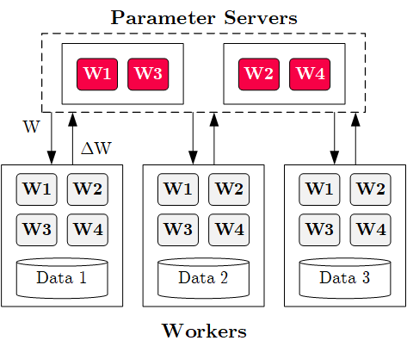



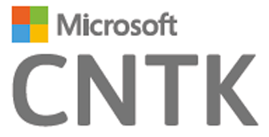
Execution Strategies
ML Systems Stack
Apps
Lang
Faults
Batch Algorithms: Data and Task Parallel
  Data-parallel operations
  Different physical operators
Mini-Batch Algorithms: Parameter Server
  Data-parallel and model-parallel PS
  Update strategies (e.g.,
  async, sync, backup)
  Data partitioning strategies
  Federated ML (trend 2018)
Lots of PS Decisions ➔ Acc/Perf-Tradeoff
  Configurations (#workers, batch size/param schedules, update type/freq)
  Transfer optimizations: lossy compression, sparsification, residual accumulation, gradient clipping, and momentum corrections
Exec
Data
HW

Slide 18
Fault Tolerance & Resilience
ML Systems Stack
Apps
Lang
Faults
Resilience Problem
  Increasing error rates at scale
  (soft/hard mem/disk/net errors)
  Robustness for preemption
  Need cost-effective resilience
Fault Tolerance in Large-Scale Computation
  Block replication (min=1, max=3) in distributed file systems
  ECC; checksums for blocks, broadcast, shuffle
  Checkpointing (MapReduce: all task outputs; Spark/DL: on request)
  Lineage-based recomputation for recovery in Spark
ML-specific Schemes (exploit app characteristics)
  Estimate contribution from lost partition to avoid strugglers
  Example: user-defined “compensation” functions
Exec
Data
HW

Slide 19
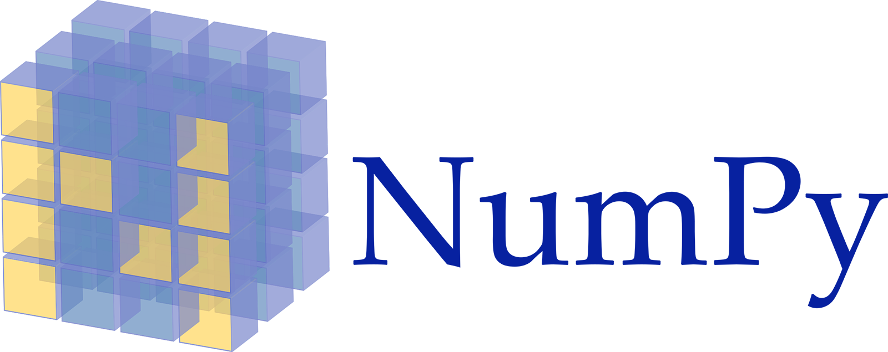

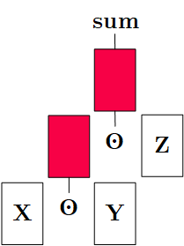
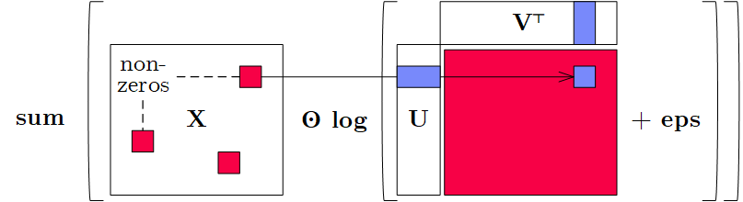
Language Abstractions
ML Systems Stack
Apps
Lang
Faults
Optimization Scope
  #1 Eager Interpretation (debugging, no opt)
  #2 Lazy expression evaluation
  (some opt, avoid materialization)
  #3 Program compilation (full opt, difficult)
Optimization Objective
  Most common: min time s.t. memory constraints
  Multi-objective: min cost s.t. time, min time s.t. acc, max acc s.t. time
Trend: Fusion and Code Generation
  Custom fused operations
  Examples: SystemML,
  Weld, Taco, Julia,
  TF XLA,TVM, TensorRT
Exec
Data
HW
Sparsity-Exploiting Operator

Slide 20
ML Applications
ML Systems Stack
Apps
Lang
Faults
ML Algorithms (cost/benefit – time vs acc)
  Unsupervised/supervised; batch/mini-batch; first/second-order ML
  Mini-batch DL: variety of NN architectures and SGD optimizers
Specialized Apps: Video Analytics
in NoScope (time vs acc)
  Difference detectors / specialized
  models for “short-circuit evaluation”
AutoML (time vs acc)
  Not algorithms but tasks (e.g., doClassify(X, y) + search space)
  Examples: MLBase, Auto-WEKA, TuPAQ, Auto-sklearn, Auto-WEKA 2.0
  AutoML services at Microsoft Azure, Amazon AWS, Google Cloud
Data Programming and Augmentation (acc?)
  Generate noisy labels for pre-training
  Exploit expert rules, simulation models,
  rotations/shifting, and labeling IDEs (Software 2.0)
Exec
Data
HW
[Credit: Daniel Kang‘17]
[Credit: Jonathan Tremblay‘18]

Slide 21
Language Abstractions and
System Architectures

Slide 22
Landscape of ML Systems
Language Abstractions and System Architectures
JAX
AIDA
Dask
Ludwig
TUPAQ
Mlbase
Tupleware
Kasen
GraphLab
HP Distributed R
Emma
Cümülön(-D)
OptiML
Glade
RIOT-DB
Cumulon
SystemDS
DMac
LINVIEW
Photon ML
RIOT
SystemML
Hemingway
Mahout Samsara
SAP HANA
MS (Rev) R
Velox
F
Brainwash
BigR
SciDB
ORE
Longview
TensorDB
DeepDive
Fa
AzureML
R4ML
SimSQL
Columbus
Orion
Zombie
ScalOps
MXNet
R
BUDS
Matlab
Santoku
LibFM
KeystoneML
Torch
PyTorch
Julia
scikit-learn
Sherlock
ModelHub
BigDL
TensorFlow
Weka
ModelDB
Hamlet
Mahout
CNTK
Theano
SPSS
Spark ML
MADlib
Bismarck
VW
Keras
Singa
SAS
Spark R
Flink ML
RAPIDS
DL4J
Caffe

Slide 23

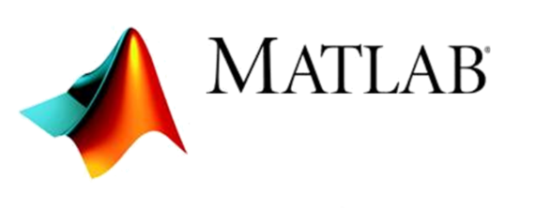


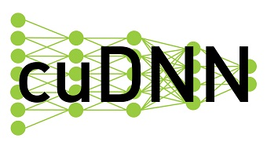
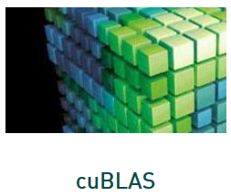



Landscape of ML Systems, cont.
Language Abstractions and System Architectures
#1 Language Abstraction
#2 Execution Strategies
Linear Algebra Programs
Parameter Server
(Modell-Parallel)
Computation Graphs
Task-Parallel Constructs
Algorithm Libraries
Data-Parallel Operations
Operator Libraries
Collections
Local (single node)
Graphs
Matrices
HW accelerators (GPUs, FPGAs, ASICs)
Tensors
Frames
Distributed
#4 Data Types
#3 Distribution

Slide 24

UDF-based Systems
Language Abstractions and System Architectures
User-defined Functions (UDF)
  Data type: Input usually collections of cells, rows, or blocks
  Implement loss and overall optimizer by yourself / UDF abstractions
  Examples: data-parallel (e.g., Spark MLlib)
  or In-DBMS analytics (MADlib, AIDA)
Example SQL
Matrix Product in SQL
SELECT A.i, B.j,
SUM(A.val*B.val)
FROM A, B
WHERE A.j = B.i
GROUP BY A.i, B.j;
Matrix Product w/ UDF
SELECT A.i, B.j,
dot(A.row, B.col)
FROM A, B;
Optimization w/ UDA
Init(state)
Accumulate(state,data)
Merge(state,data)
Finalize(state,data)

Slide 25
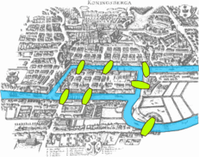
Graph-based Systems
Language Abstractions and System Architectures
[Grzegorz Malewicz et al: Pregel: a system for large-scale graph processing. SIGMOD 2010]
Google Pregel
  Name: Seven Bridges of Koenigsberg (Euler 1736)
  “Think-like-a-vertex” (vertex-centric processing)
  Iterative processing in super steps, comm.: message passing
Programming Model
  Represent graph as collection of
  vertices w/ edge (adjacency) lists
  Implement algorithms via Vertex API
  Terminate if all vertices halted / no more msgs
1
2
3
4
5
7
6
public abstract class Vertex {
public String getID();
public long superstep();
public VertexValue getValue();
public compute(Iterator<Message> msgs);
public sendMsgTo(String v, Message msg);
public void voteToHalt();
}
2
[1, 3, 4]
7
[5, 6]
Worker 1
4
[1, 2]
1
[1, 2, 4]
5
[6, 7]
[2]
Worker 2
3
6
[5, 7]
Notes:
Note: Euler showed 1736 that there cannot be a route that crosses every bridge just once (Seven Bridges of Koenigsberg) because there can be at most 2 nodes (begin, end) that have an uneven number of bridges (enter,exit).

Slide 26
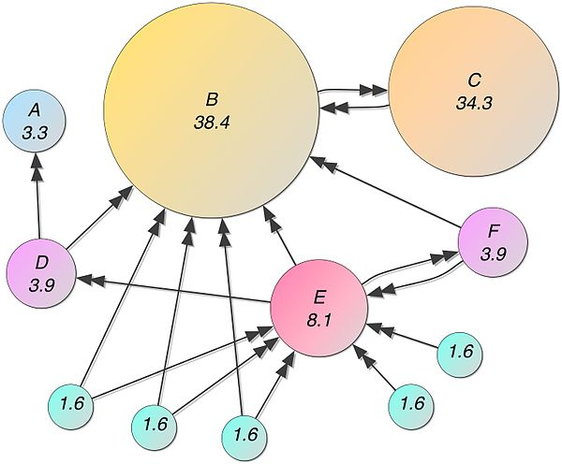
Graph-based Systems, cont.
Language Abstractions and System Architectures
Example1: Connected Components
  Determine connected components of a graph (subgraphs of connected nodes)
  Propagate max(current, msgs) if != current to neighbors, terminate if no msgs
Example 2: Page Rank
  Ranking of webpages by importance / impact
  #1: Initialize vertices to 1/numVertices()
  #2: In each super step
    Compute current vertex value:
    value = 0.15/numVertices()+0.85*sum(msg)
    Send to all neighbors:
    value/numOutgoingEdges()
Step 0
Step 1
Step 2
Step 3
converged
1
4
4
2
3
4
3
4
4
4
5
4
7
4
7
7
6
7
7
7
7
[Credit: https://en.
wikipedia.org/wiki/PageRank ]

Slide 27
Graph-based Systems, cont.
Language Abstractions and System Architectures
Excursus: Graph Processing via Sparse Linear Algebra
  SystemDS’
  components()
  SystemDS’
  pageRank()
# initialize state with vertex ids
c = seq(1,nrow(G));
diff = Inf;
iter = 1;
# iterative computation of connected components
while( diff > 0 & (maxi==0 | iter<=maxi) ) {
u = max(rowMaxs(G * t(c)), c);
diff = sum(u != c)
c = u; # update assignment
iter = iter + 1;
}
alpha = ifdef(argAlpha, 0.85);
while( i < maxi ) {
# power iteration on G w/ Gij = 1/degree
p = alpha*(G %*% p) + (1-alpha)*(e %*% u %*% p);
i += 1;
}
[Jure Leskovec, Anand Rajaraman, Jeffrey D. Ullman: Mining of Massive Datasets, Stanford 2014]

Slide 28
Linear Algebra Systems
Language Abstractions and System Architectures
Comparison Query Optimization
  Rule- and cost-based rewrites and operator ordering
  Physical operator selection and query compilation
  Linear algebra / other ML operators, DAGs,
  control flow, sparse/dense formats
#1 Interpretation (operation at-a-time)
  Examples: R, PyTorch, Morpheus [PVLDB’17]
#2 Lazy Expression Compilation (DAG at-a-time)
  Examples: RIOT [CIDR’09], TensorFlow [OSDI’16]
  Mahout Samsara [MLSystems’16]
  Examples w/ control structures: Weld [CIDR’17],
  OptiML [ICML’11], Emma [SIGMOD’15]
#3 Program Compilation (entire program)
  Examples: SystemML [PVLDB’16], Julia
  Cumulon [SIGMOD’13], Tupleware [PVLDB’15]
DB
PL
HPC
Compilers for Large-scale ML
Optimization Scope
1: X = read($1); # n x m matrix
2: y = read($2); # n x 1 vector
3: maxi = 50; lambda = 0.001;
4: intercept = $3;
5: ...
6: r = -(t(X) %*% y);
7: norm_r2 = sum(r * r); p = -r;
8: w = matrix(0, ncol(X), 1); i = 0;
9: while(i<maxi & norm_r2>norm_r2_trgt) 10: {
11: q = (t(X) %*% X %*% p)+lambda*p;
12: alpha = norm_r2 / sum(p * q);
13: w = w + alpha * p;
14: old_norm_r2 = norm_r2;
15: r = r + alpha * q;
16: norm_r2 = sum(r * r);
17: beta = norm_r2 / old_norm_r2;
18: p = -r + beta * p; i = i + 1;
19: }
20: write(w, $4, format="text");

Slide 29
Linear Algebra Systems, cont.
Language Abstractions and System Architectures
Note: TF 2.0
[Dan Moldovan et al.: AutoGraph: Imperative-style Coding with Graph-based Performance. SysML 2019.]
Some Examples …
(1.x)
X = read("./X");
y = read("./y");
p = t(X) %*% y;
w = matrix(0,ncol(X),1);
while(...) {
q = t(X) %*% X %*% p;
...
}
var X = drmFromHDFS("./X")
val y = drmFromHDFS("./y")
var p = (X.t %*% y).collect
var w = dense(...)
X = X.par(256).checkpoint()
while(...) {
q = (X.t %*% X %*% p)
.collect
...
}
# read via queues
sess = tf.Session()
# ...
w = tf.Variable(tf.zeros(...,
dtype=tf.float64))
while ...:
v1 = tf.matrix_transpose(X)
v2 = tf.matmult(X, p)
v3 = tf.matmult(v1, v2)
q = sess.run(v3)
...
(Custom DSL
w/ R-like syntax;
program compilation)
(Embedded DSL in Scala;
lazy evaluation)
(Embedded DSL in Python;
lazy [and eager] evaluation)

Slide 30
ML Libraries
Language Abstractions and System Architectures
Fixed algorithm implementations
  Often on top of existing linear algebra or UDF abstractions
SparkML/ MLlib
Single-node Example (Python)
from numpy import genfromtxt
from sklearn.linear_model \
import LinearRegression
X = genfromtxt('X.csv')
y = genfromtxt('y.csv')
reg = LinearRegression()
.fit(X, y)
out = reg.score(X, y)
Distributed Example (Spark Scala)
import org.apache.spark.ml
.regression.LinearRegression
val X = sc.read.csv('X.csv')
val y = sc.read.csv('y.csv')
val Xy = prepare(X, y).cache()
val reg = new LinearRegression()
.fit(Xy)
val out reg.transform(Xy)

Slide 31


DNN Frameworks
Language Abstractions and System Architectures
High-level DNN Frameworks
  Language abstraction for DNN construction and model fitting
  Examples: Caffe, Keras
Low-level DNN Frameworks
  Examples: TensorFlow, MXNet, PyTorch, CNTK
model = Sequential()
model.add(Conv2D(32, (3, 3), padding='same',
input_shape=x_train.shape[1:]))
model.add(Activation('relu'))
model.add(Conv2D(32, (3, 3)))
model.add(Activation('relu'))
model.add(
MaxPooling2D(pool_size=(2, 2)))
model.add(Dropout(0.25))
...
opt = keras.optimizers.rmsprop(
lr=0.0001, decay=1e-6)
# Let's train the model using RMSprop
model.compile(loss='cat…_crossentropy',
optimizer=opt,
metrics=['accuracy'])
model.fit(x_train, y_train,
batch_size=batch_size,
epochs=epochs,
validation_data=(x_test, y_test),
shuffle=True)

Slide 32
Feature-centric Tools
Language Abstractions and System Architectures
DeepDive
  Knowledge base construction via SQL/MLNs
  Grounding: SQL queries → factor graph
  Inference: statistical inference on factor graph
  Incremental maintenance via sampling / variational approach
Overton (Apple)
  Building, monitoring, improving ML pipelines
  High-level abstractions: tasks and payloads
  Data slicing, multi-task learning, data augmentation
Ludwig (Uber AI)
  Data types and configuration files
  Encoders, combiners, decoders
  Example “visual question answering”:
[Jaeho Shin et al: Incremental Knowledge Base Construction Using DeepDive. PVLDB 2015]
[Christopher Ré et al: Overton: A Data System for Monitoring and Improving Machine-Learned Products, CIDR 2020]
[Piero Molino, Yaroslav Dudin, Sai Sumanth Miryala: Ludwig: a type-based declarative deep learning toolbox. CoRR 2019]
Notes:
MLN: markov logic networks
Bi-LSTM: bidirectional long-term short-term memory
Variational approach: store sparse factor graph (with fewer factors) to approximate distribution

Slide 33
ML Systems Benchmarks

Slide 34
“Big Data” Benchmarks w/ ML Components
ML Systems Benchmarks
BigBench
  30 workloads (6 statistics, 17 data mining)
  Different data sources, processing types
  Note: TPCx-BB, TPCx-HS [TPCTC 2016]
HiBench (Intel)
  MapReduce Micro benchmarks (WC, TeraSort)
  IR/ML (e.g., PageRank, K-means, Naïve Bayes)
GenBase
  Preprocessing and ML in array databases
SparkBench
  Existing library algorithms (ML, Graph, SQL, stream)
  ML: LogReg, SVM, matrix factorization, PageRank
[Ahmad Ghazal et al: BigBench: towards an industry standard benchmark for big data analytics. SIGMOD 2013]
[Lan Yi, Jinquan Dai: Experience from Hadoop Benchmarking with HiBench: From Micro-Benchmarks Toward End-to-End Pipelines. WBDB 2013]
[Rebecca Taft et al: GenBase: a complex analytics genomics benchmark. SIGMOD 2014]
[Dakshi Agrawal et al:
SparkBench - A Spark Performance Testing Suite. TPCTC 2015]

Slide 35

Linear Algebra and DNN Benchmarks
ML Systems Benchmarks
SLAB: Scalable LA Benchmark (UCSD)
  Ops: TRANS, NORM, GRM, MVM, ADD, GMM
  Pipelines/Decompositions: MMC, SVD
  Algorithms: OLS, LogReg, NMF, HRSE
DAWNBench (Stanford)
  Image Classification ImageNet: 93% top-5 val err
  Image Classification CIFAR10: 94% test accuracy
  Question Answering SQuAD: 0.75 F1 measure
MLPerf
  Image classification ImageNet, object detection
  COCO, translation WMT En-Ger, recommendation
  MovieLens, reinforcement learning GO
  Train to target accuracy
  Open (diff model) vs closed divisions
[Anthony Thomas, Arun Kumar: A Comparative Evaluation of Systems for Scalable Linear Algebra-based Analytics. PVLDB 2018]
[Cody Coleman et al.: DAWNBench: An End-to-End Deep Learning Benchmark and Competition, ML Systems Workshop 2017]
[Peter Mattson et al.: MLPerf Training
Benchmark, MLSys 2020]
[https://mlcommons.org/en/training-normal-11/, https://mlcommons.org/en/training-hpc-10/]

Slide 36
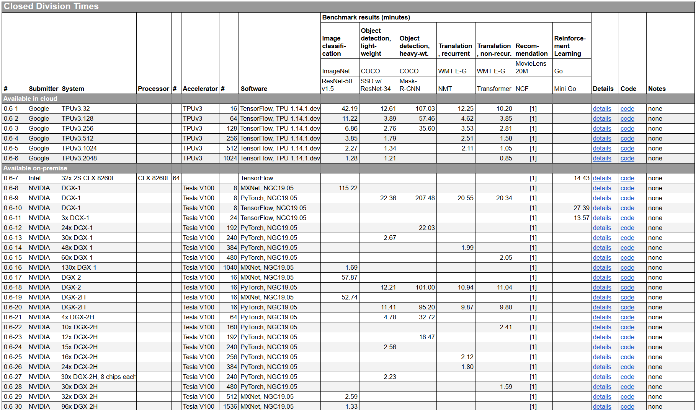
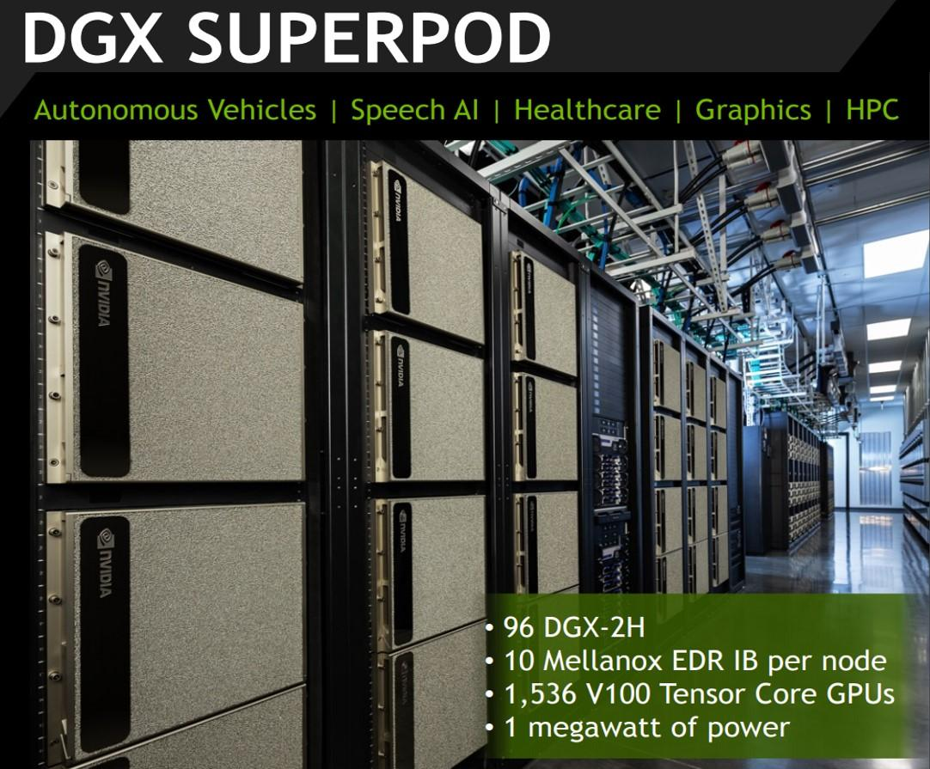
DNN Benchmarks, cont.
ML Systems Benchmarks
[MLPerf v0.6: https://mlperf.org/training-results-0-6/,
MLPerf v0.7: https://mlperf.org/training-results-0-7]
V0.6
96 x DGX-2H = 96 * 16 = 1536 V100 GPUs
➔ ~ 96 * $400K = $35M – $40M
[https://www.forbes.com/sites/tiriasresearch/2019/06/19/nvidia-offers-a-turnkey-supercomputer-the-dgx-superpod/#693400f43ee5]
Notes:
V07: up to 4096 (regular), 16384 (HPC)

Slide 37
AutoML and Data Cleaning
ML Systems Benchmarks
MLBench
  Compare AutoML w/ human experts (Kaggle)
  Classification, regression; AUC vs Runtime
(Open Source) AutoML Benchmark
  39 classification datasets, AUC metric, 10-fold CV
  Extensible metrics, OS AutoML frameworks, datasets
CleanML
  Train/Test on dirty vs clean data (2x2)
  Missing values, outliers, duplicates, mislabels
Meta Worlds Benchmark
  Meta-reinforcement and multi-task learning
  50 robotic tasks (e.g., get coffee, open window)
Feature Type Inference
  Dirty/clean ML model training/test
[Yu Liu et.al: MLBench: Benchmarking Machine Learning Services Against Human Experts. PVLDB 2018]
[Pieter Gijsbers et al.:
An Open Source AutoML Benchmark. Automated ML Workshop 2019]
[Peng Li et al: CleanML: A Benchmark for Joint Data Cleaning and Machine Learning, ICDE 2021]
[Tianhe Yu et al: Meta-World: A Bench-mark and Evaluation for Multi-Task and Meta Reinforce-ment Learning, CoRL 2019]
[Vraj Shah et al.: Towards Benchmarking Feature Type Inference for AutoML Platforms, SIGMOD 2021]

Slide 38
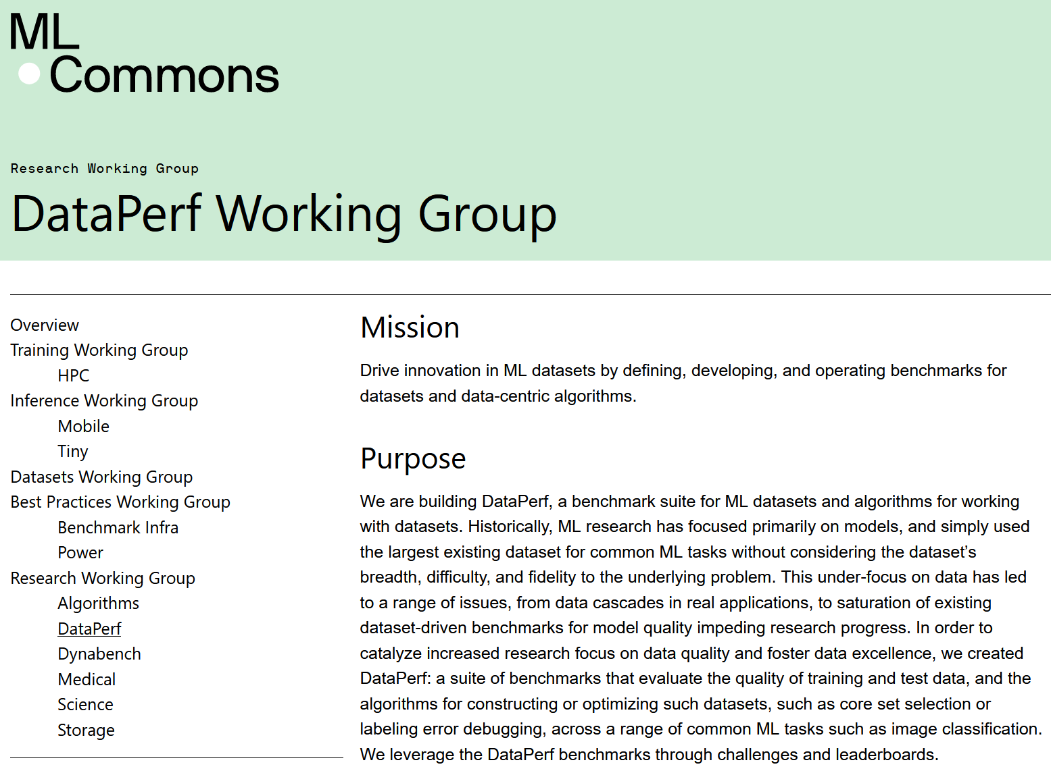
AutoML and Data Cleaning, cont.
ML Systems Benchmarks
Excursus: ML-Commons Working Groups
  Including DataPerf
  Working Group
[https://mlcommons.org/en/groups/research-dataperf/]

Slide 39
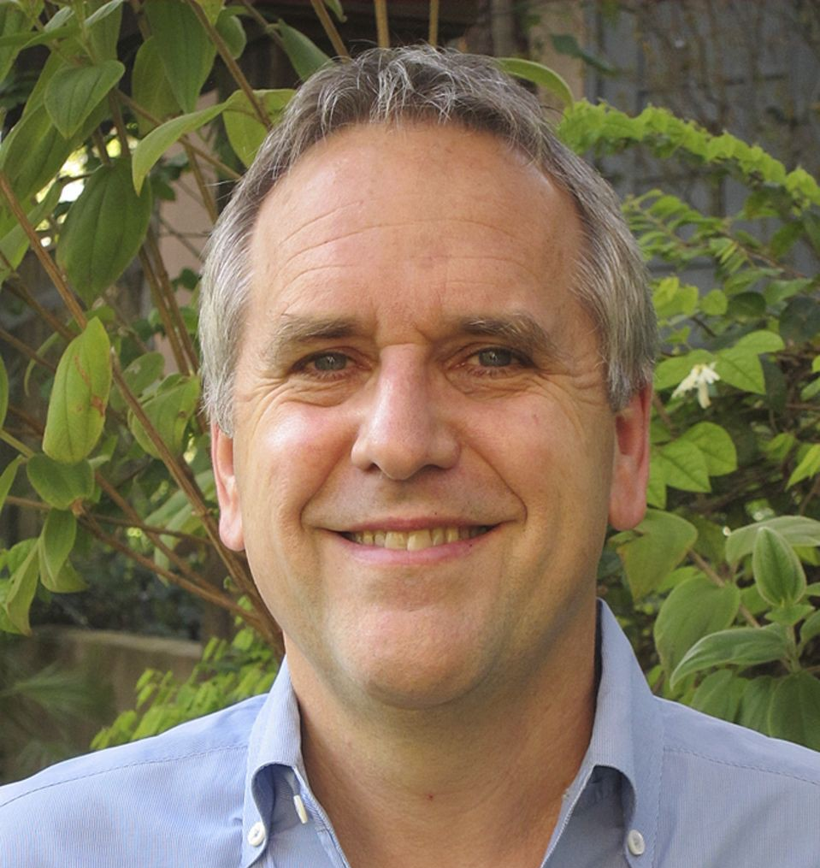
Summary and Q&A
Data Science Lifecycle
ML Systems Stack
Language Abstractions
ML System Benchmarks
Recommended Reading (a critical perspective
on a broad sense of ML systems)
  [M. Jordan: SysML: Perspectives and
  Challenges. Keynote at SysML 2018]
  “ML […] is far from being a solid engineering
  discipline that can yield robust, scalable solutions
  to modern data-analytic problems”
  https://www.youtube.com/watch?v=4inIBmY8dQI
Others: https://nautil.us/deep-learning-is-hitting-a-wall-14467/ (Mar 10, 2022)

