Slide 1

Architecture of ML Systems
03 Size Inference and Rewrites
Last update: Mar 17, 2022

Slide 2


Announcements/Org
#1 Video Recording
  Link in TeachCenter & TUbe (lectures will be public)
  https://tugraz.webex.com/meet/m.boehm
#2 AMLS Project Selections
  Project selection by Mar 31 (see Lecture 02 for four alternatives)
  Discussion current status project selection (~6 students assigned)
  https://issues.apache.org/jira/secure/Dashboard.jspa?selectPageId=12335852#Filter-Results/12365413
  https://mboehm7.github.io/teaching/ss22_amls/AMLS_DAPHNE_projects.pdf
  http://sigmod2022contest.eastus.cloudapp.azure.com/index.shtml
  https://mboehm7.github.io/teaching/ss22_amls/AMLS_2022_Exercise.pdf

Slide 3



Agenda
Compilation Overview
Size Inference and Cost Estimation
Rewrites (and Operator Selection)
SystemDS, and several other ML systems

Slide 4
Compilation Overview

Slide 5
Recap: Linear Algebra Systems
Compilation Overview
Comparison Query Optimization
  Rule- and cost-based rewrites and operator ordering
  Physical operator selection and query compilation
  Linear algebra / other ML operators, DAGs,
  control flow, sparse/dense formats
#1 Interpretation (operation at-a-time)
  Examples: R, PyTorch, Morpheus [PVLDB’17]
#2 Lazy Expression Compilation (DAG at-a-time)
  Examples: RIOT [CIDR’09], TensorFlow [OSDI’16]
  Mahout Samsara [MLSystems’16], Dask
  Examples w/ control structures: Weld [CIDR’17],
  OptiML [ICML’11], Emma [SIGMOD’15]
#3 Program Compilation (entire program)
  Examples: SystemML [ICDE’11/PVLDB’16], Julia,
  Cumulon [SIGMOD’13], Tupleware [PVLDB’15]
DB
PL
HPC
Compilers for Large-scale ML
Optimization Scope
1: X = read($1); # n x m matrix
2: y = read($2); # n x 1 vector
3: maxi = 50; lambda = 0.001;
4: intercept = $3;
5: ...
6: r = -(t(X) %*% y);
7: norm_r2 = sum(r * r); p = -r;
8: w = matrix(0, ncol(X), 1); i = 0;
9: while(i<maxi & norm_r2>norm_r2_trgt) 10: {
11: q = (t(X) %*% X %*% p)+lambda*p;
12: alpha = norm_r2 / sum(p * q);
13: w = w + alpha * p;
14: old_norm_r2 = norm_r2;
15: r = r + alpha * q;
16: norm_r2 = sum(r * r);
17: beta = norm_r2 / old_norm_r2;
18: p = -r + beta * p; i = i + 1;
19: }
20: write(w, $4, format="text");

Slide 6
ML Program Compilation / Graphs
Compilation Overview
Script:
Operator DAG
(today’s lecture)
  a.k.a. “graph”
  (data flow graph)
  a.k.a. intermediate
  representation (IR)
Runtime Plan
  Compiled runtime plans
  Interpreted plans
while(...) {
q = t(X) %*% (w * (X %*% v)) ...
}
Statement Block Hierarchy
q
[Multiple] DAG roots (outputs)
Operation
ba+*
Data Dependency
r(t)
b(*)
[Multiple] Consumers of Intermediates
ba+*
w
No cycles
X
v
[Multiple] DAG leafs (inputs)
SPARK mapmmchain X.MATRIX.DOUBLE w.MATRIX.DOUBLE
v.MATRIX.DOUBLE _mVar4.MATRIX.DOUBLE XtwXv

Slide 7
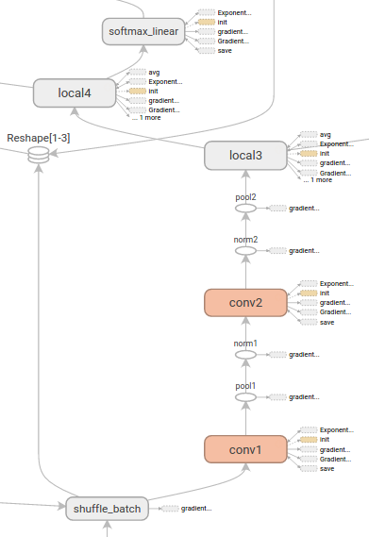
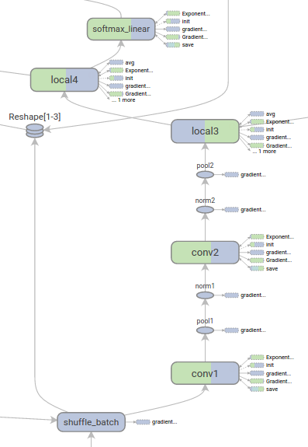
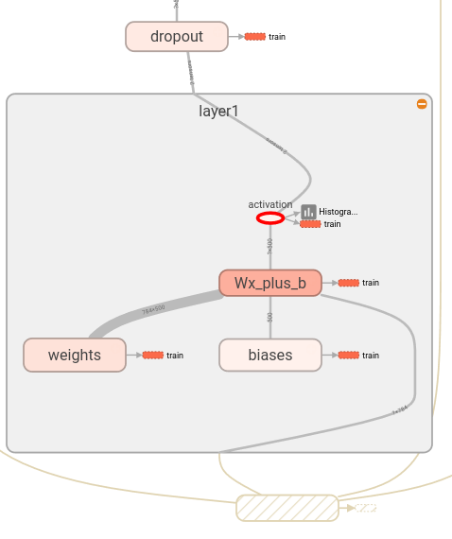
ML Program Compilation / Graphs, cont.
Compilation Overview
Example TF TensorBoard
Tensor Shapes and
Runtime Statistics (time, mem)
(Node) Structure View
Device View (CPU, GPU)
Edge thickness → size,
Color intensity → time
Same color, same internal structure
Same color, same device
[https://github.com/tensorflow/tensorboard/blob/master/docs/r1/graphs.md]

Slide 8
Compilation Chain
Compilation Overview
Script
[Matthias Boehm et al:
SystemML's Optimizer: Plan Generation for Large-Scale Machine Learning Programs. IEEE Data Eng. Bull 2014]
Language
Parsing (syntactic analysis)
Live Variable Analysis
Validate (semantic analysis)
HOPs
Construct HOP DAGs
Multiple
Rounds
Static/Dynamic Rewrites
Intra-/Inter-Procedural Analysis
Static/Dynamic Rewrites
Compute Memory Estimates
Dynamic Recompilation
(lecture 04)
LOPs
Construct LOP DAGs
(incl operator selection, hop-lop rewrites)
Generate Runtime Program
Execution Plan

Slide 9
Recap: Basic HOP and LOP DAG Compilation
Compilation Overview
LinregDS (Direct Solve)
X = read($1);
y = read($2);
intercept = $3;
lambda = 0.001;
...
if( intercept == 1 ) {
ones = matrix(1, nrow(X), 1);
X = append(X, ones);
}
I = matrix(1, ncol(X), 1);
A = t(X) %*% X + diag(I)*lambda;
b = t(X) %*% y;
beta = solve(A, b);
...
write(beta, $4);
Cluster Config:
driver mem: 20 GB
exec mem: 60 GB
Scenario:
X: 10⁸ x 10³, 10¹¹
y: 10⁸ x 1, 10⁸
HOP DAG
(after rewrites)
8KB
CP
write
8MB
16MB
CP
b(solve)
CP
172KB
b(+)
1.6TB
CP
SP
800GB
r(diag)
ba(+*)
ba(+*)
SP
1.6TB
r(t)
8KB
SP
CP
800GB
800MB
dg(rand)
(10³x1,10³)
X
(10⁸x10³,10¹¹)
y
(10⁸x1,10⁸)
LOP DAG
(after rewrites)
16KB
r’(CP)
Hybrid Runtime Plans:
  Size propagation / memory estimates
  Integrated CP / Spark runtime
  Dynamic recompilation during runtime
Distributed Matrices
  Fixed-size (squared) matrix blocks
  Data-parallel operations
mapmm(SP)
tsmm(SP)
800MB
1.6GB
r’(CP)
X
X_{1,1}
(persisted in MEM_DISK)
y
X_{2,1}
X_{m,1}

Slide 10
Size Inference and Cost Estimation
Crucial for Generating Valid Execution Plans
& Cost-based Optimization

Slide 11
Constant and Size Propagation
Size Inference and Cost Estimation
Size Information
  Dimensions (#rows, #columns)
  Sparsity (#nnz/(#rows * #columns))
  ➔ memory estimates and costs
Principle: Worst-case Assumption
  Necessary for guarantees (memory)
DAG-level Size Propagation
  Input: Size information for leaves
  Output: size information for
  all operators, -1 if still unknown
  Propagation based on
  operation semantics (single
  bottom-up pass over DAG)
X = read($1);
y = read($2);
I = matrix(0.001, ncol(X), 1);
A = t(X) %*% X + diag(I);
b = t(X) %*% y;
beta = solve(A, b);
(10³x1,-1)
write
(10³x1,-1)
(10³x10³,-1)
b(solve)
(10³x10³,10³)
b(+)
(10³x10³,
-1)
(10³x1,
-1)
r(diag)
ba(+*)
ba(+*)
(10³x10⁸,
10¹¹)
(10³x1,10³)
r(t)
dg(rand)
y
(10⁸x1,10⁸)
0.001
u(ncol)
X
(10⁸x10³,10¹¹)

Slide 12
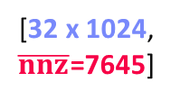
Constant and Size Propagation, cont.
Size Inference and Cost Estimation
Example Relu
(rectified linear unit)
Example SystemDS
  Hop refreshSizeInformation() (exact)
  Hop inferOutputCharacteristics()
  Compiler explicitly differentiates between
  exact and other size information
  Note: ops like aggregate, ctable, rmEmpty
  challenging but w/ upper bounds
Example TensorFlow
  Operator registrations
  Shape inference functions
[32 x 1024, $\overline{nnz}$=7645]
b(max)
[32 x 1024, nnz=7645]
X
0
REGISTER_OP(“Relu”)
.Input(“features: T”)
.Output(“activations: T”)
.Attr(“T: {realnumbertype, qint8}”)
.SetShapeFn(
shape_inference::UnchangedShape)
[Alex Passos: Inside TensorFlow – Eager execution runtime, https://www.youtube.com/watch?v=qjx65mD6nrc, Dec 2019]

Slide 13
Constant and Size Propagation, cont.
Size Inference and Cost Estimation
Constant Propagation
  Relies on live variable analysis
  Propagate constant literals into
  read-only statement blocks
Program-level Size Propagation
  Relies on constant propagation
  and DAG-level size propagation
  Propagate size information across
  conditional control flow: size in leafs,
  DAG-level prop, extract roots
  if: reconcile if and else branch outputs
  while/for: reconcile pre and post loop,
  reset if pre/post different
X = read($1); # n x m matrix
y = read($2); # n x 1 vector
maxi = 50; lambda = 0.001;
if(...){ }
r = -(t(X) %*% y);
r2 = sum(r * r);
p = -r;
w = matrix(0, ncol(X), 1);
i = 0;
while(i<maxi & r2>r2_trgt) {
q = (t(X) %*% X %*% p)+lambda*p;
alpha = norm_r2 / sum(p * q);
w = w + alpha * p;
old_norm_r2 = norm_r2;
r = r + alpha * q;
r2 = sum(r * r);
beta = norm_r2 / old_norm_r2;
p = -r + beta * p;
i = i + 1;
}
write(w, $4, format="text");
# m x 1
# m x 1
# m x 1
# m x 1

Slide 14
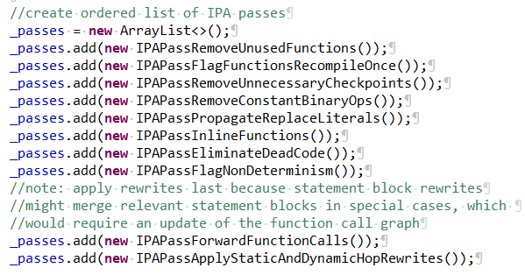
Inter-Procedural Analysis
Size Inference and Cost Estimation
Intra/Inter-Procedural Analysis (IPA)
  Integrates all size propagation techniques (DAG+program, size+constants)
  Intra-function and inter-function size propagation
  (called once, consistent sizes, consistent literals)
Additional IPA Passes (selection)
  Inline functions (single statement block, small)
  Dead code elimination and simplification rewrites
  Remove unused functions & flag recompile-once
1M x 1
X = read($X1)
X = foo(X);
if( $X2 != “ ” ) {
X2 = cbind(X,
matrix(1,n,1));
X2 = foo(X2);
}...
eval(“foo”, X)
foo = function (Matrix[Double] A)
return (Matrix[Double] B)
{
B = A – colSums(A);
if( sum(B!=B)>0 )
print(“NaNs encountered.”);
}
1M x 2
? x ?

Slide 15
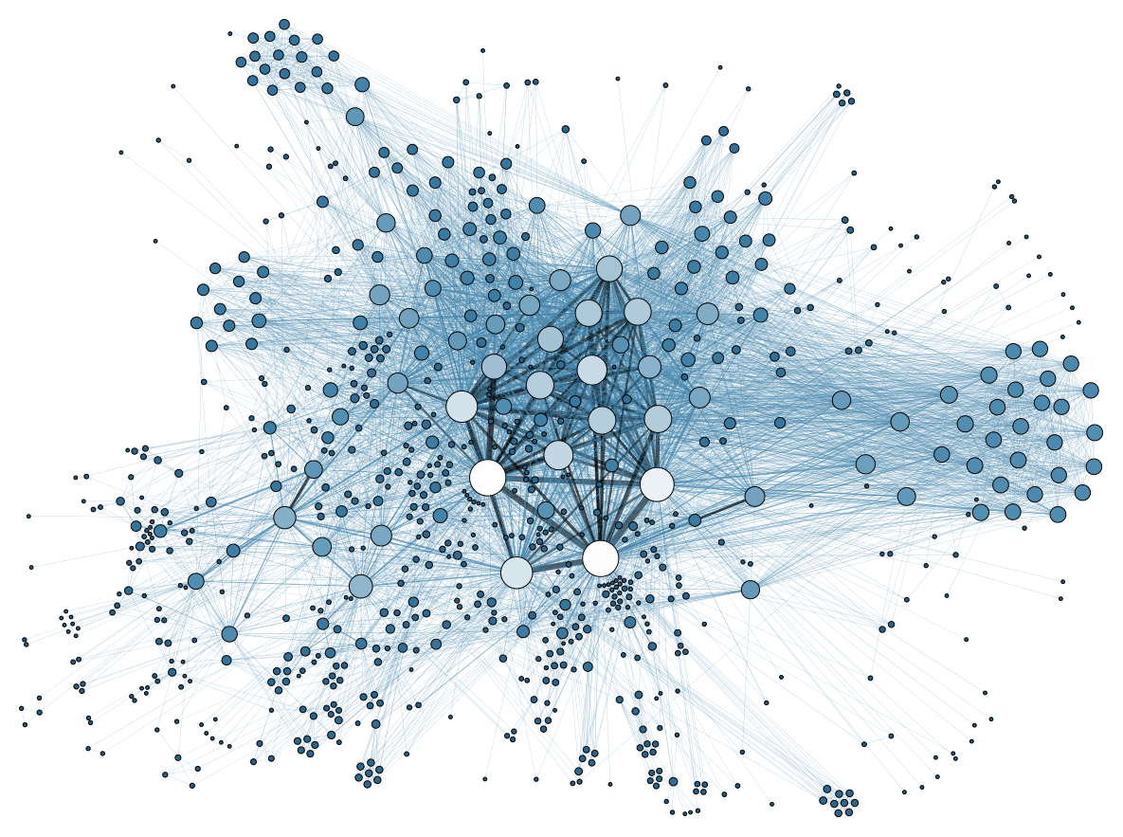
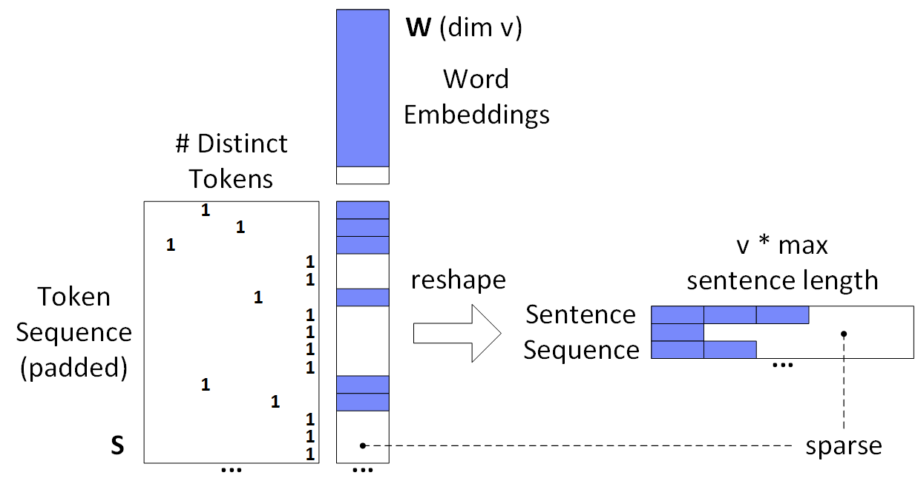
Sparsity Estimation Overview
Size Inference and Cost Estimation
Motivation
  Sparse input matrices from NLP,
  graph analytics, recommender
  systems, scientific computing
  Sparse intermediates
  (transform, selection, dropout)
  Selection/permutation matrices
Problem Definition
  Sparsity estimates used for format decisions, output allocation, cost estimates
  Matrix A with sparsity s_{A} = nnz(A)/(mn) and matrix B with s_{B} = nnz(B)/(nl)
  Estimate sparsity s_{C} = nnz(C)/(ml) of matrix product C = A B; d=max(m,n,l)
  Assumptions
    A1: No cancellation errors
    A2: No not-a-number (NaN)
NLP Example
(SentenceCNN)
Common assumptions
➔ Boolean matrix product

Slide 16
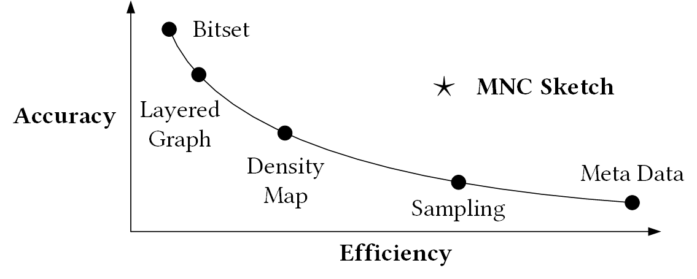
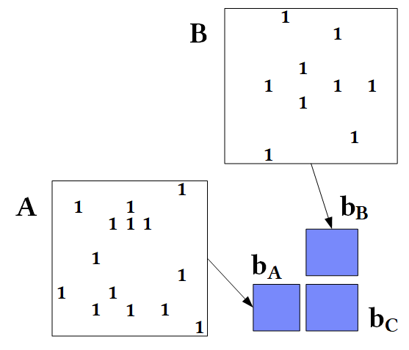
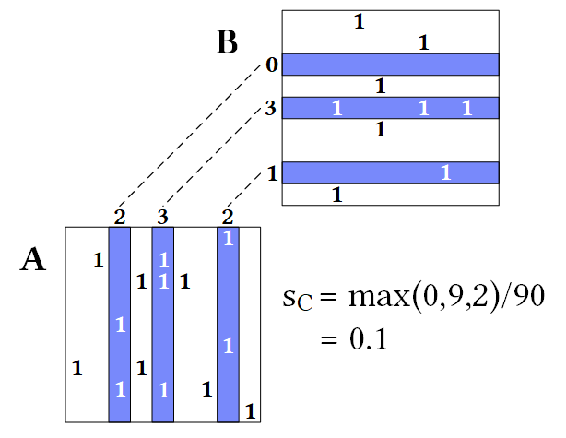
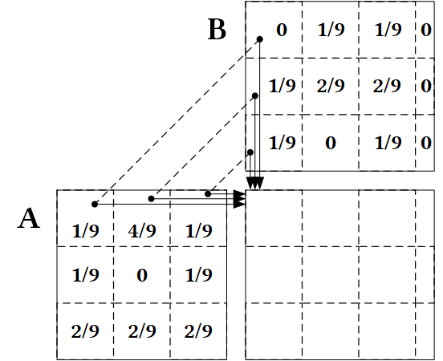

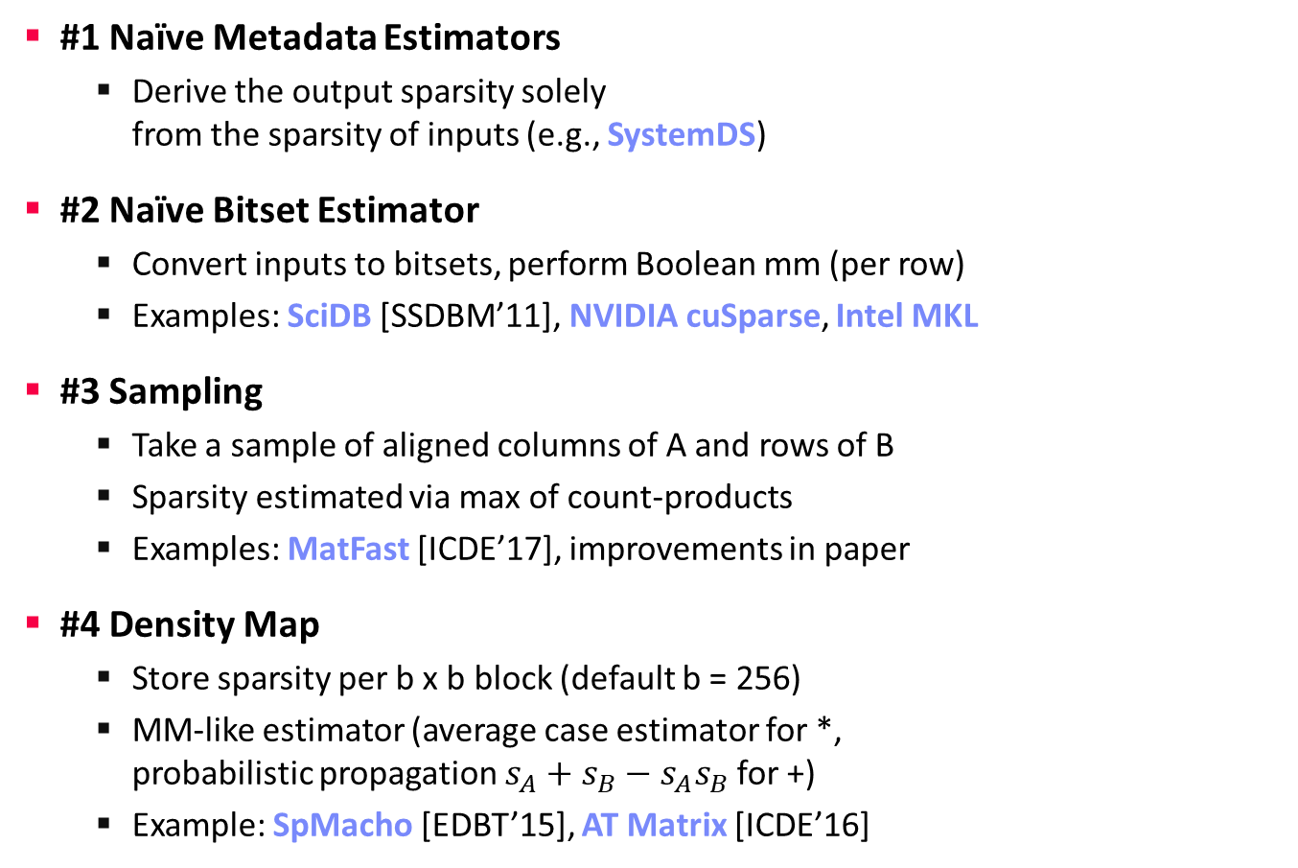

Sparsity Estimation – Estimators
Size Inference and Cost Estimation
Tradeoffs
#1 Naïve Metadata Estimators
  Derive the output sparsity solely
  from the sparsity of inputs (e.g., SystemDS)
#2 Naïve Bitset Estimator
  Convert inputs to bitsets, perform Boolean mm (per row)
  Examples: SciDB [SSDBM’11], NVIDIA cuSparse, Intel MKL
#3 Sampling
  Take a sample of aligned columns of A and rows of B
  Sparsity estimated via max of count-products
  Examples: MatFast [ICDE’17], improvements in paper
#4 Density Map
  Store sparsity per b x b block (default b = 256)
  MM-like estimator (average case estimator for *,
  probabilistic propagation $s_{A}+s_{B}−s_{A}s_{B}$ for +)
  Example: SpMacho [EDBT’15], AT Matrix [ICDE’16]
$${\hat{s}}_{c}=1−{(1−s_{A}s_{B})}^{n}$$
$${\hat{s}}_{c}=\min\left(1,s_{A}n\right)⋅\min{(1, s_{B}n)}$$

Slide 17
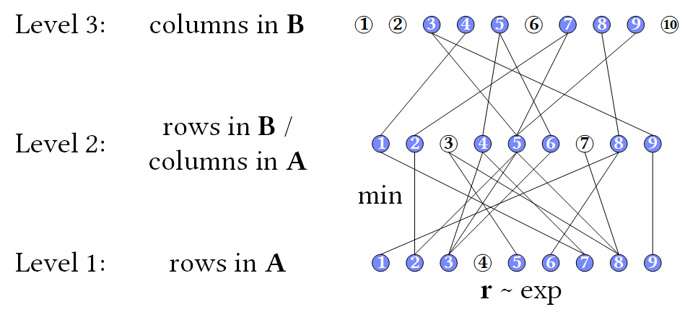
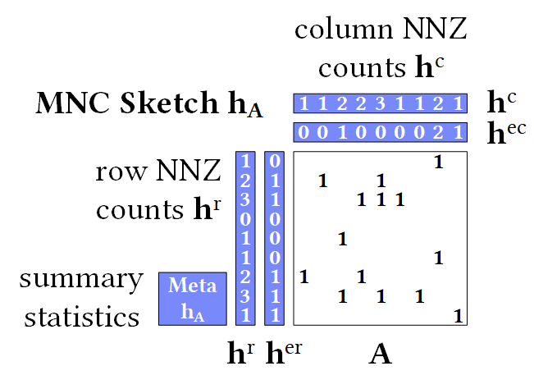
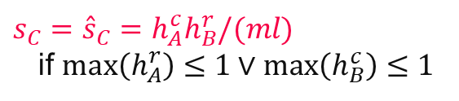
Sparsity Estimation – Estimators, cont.
Size Inference and Cost Estimation
#5 Layered Graph [J.Comb.Opt.’98]
  Nodes: rows/columns in mm chain
  Edges: non-zeros connecting rows/columns
  Assign r-vectors ~ exp and propagate via min
  Estimate over roots (output columns)
#6 MNC Sketch (Matrix Non-zero Count)
  Create MNC sketch for inputs A and B
  Exploitation of structural properties
  (e.g., 1 non-zero per row, row sparsity)
  Support for matrix expressions
  (reorganizations, elementwise ops)
  Sketch propagation and estimation
[Johanna Sommer, Matthias Boehm, Alexandre V. Evfimievski, Berthold Reinwald, Peter J. Haas: MNC: Structure-Exploiting Sparsity Estimation for Matrix Expressions. SIGMOD 2019]
$s_{C}={\hat{s}}_{C}=h_{A}^{c}h_{B}^{r}/(ml)$
if $max\left(h_{A}^{r}\right)≤1∨\max\left(h_{B}^{c}\right)≤1$

Slide 18
Memory Estimates and Costing
Size Inference and Cost Estimation
Memory Estimates
  Matrix memory estimate := based on the dimensions and sparsity, decide the format (sparse, dense) and estimate the size in memory
  Operation memory estimate := input, intermediates, output
  Worst-case sparsity estimates (upper bound)
#1 Costing at Logical vs Physical Level
  Costing at physical level takes physical ops
  and rewrites into account but is much more costly
#2 Costing Operators/Graphs vs Plans
  Costing plans requires heuristics for
  # iterations, branches in general
#3 Analytical vs Trained Cost Models
  Analytical: estimate I/O and compute workload
  Training: build regression models for individual ops
A Personal War Story
Physical, Plans,
Trained
[PVLDB 2014]
Physical, Plans,
Analytical
[SIGMOD 2015]
Logical, Graphs, Analytical
[PVDLB 2018]

Slide 19
Excursus: Differentiable Programming
Size Inference and Cost Estimation
Overview Differentiable Programming
  Adoption of auto differentiation concept from ML systems to PLs
  Yann LeCun
  (Jan 2018)
Example DBMS Fitting
  Implement DBMS components
  as differentiable functions
  E.g.: cost model components
  Q: What about guarantees
  (memory, size)?
“It's really very much like a regular prog[r]am, except it's parameterized, automatically differentiated, and trainable/optimizable.”
[Benjamin Hilprecht et al: DBMS Fitting: Why should we learn what we already know? CIDR 2020]

Slide 20
Rewrites and Operator Selection

Slide 21
Traditional PL Rewrites
Rewrites and Operator Selection
#1 Common Subexpression Elimination (CSE)
  Step 1: Collect and replace leaf nodes (variable reads and literals)
  Step 2: recursively remove CSEs bottom-up starting at the leafs
  by merging nodes with same inputs (beware non-determinism)
  Example:
R1 = 7 – abs(A * B)
R2 = abs(A * B) + rand()
R1
R2
R1
R2
R1
R2
-
+
-
+
-
+
7
abs
abs
rand
7
abs
abs
rand
7
abs
rand
*
*
*
*
*
A
B
A
B
A
B
A
B

Slide 22
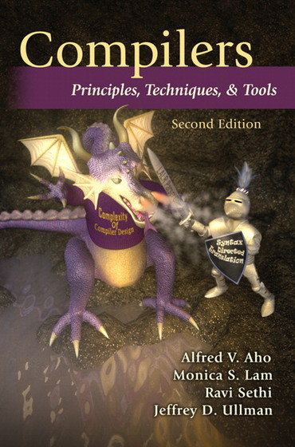
Traditional PL Rewrites, cont.
Rewrites and Operator Selection
#2 Constant Folding
  After constant propagation, fold sub-DAGs over literals into a single literal
  Approach: recursively compile and
  execute runtime instructions with
  special handling of one-side constants
  Example (GLM
  Binomial probit):
[A. V. Aho, M. S. Lam, R. Sethi, and J. D. Ullman. Compilers – Principles, Techniques, & Tools. Addison-Wesley, 2007]
Turing Award ‘20
ncol_y == 2 & dist_type == 2
& link_type >= 1 & link_type <= 5
2 == 2 & 2 == 2 & 3 >= 1 & 3 <= 5
&
&
TRUE
&
<=
3
5
&
TRUE
&
>=
==
==
3
1
&
TRUE
2
2
2
2
TRUE
TRUE

Slide 23
Traditional PL Rewrites, cont.
Rewrites and Operator Selection
#3 Branch Removal
  Applied after constant propagation
  and constant folding
  True predicate: replace if statement
  block with if-body blocks
  False predicate: replace if statement
  block with else-body block, or remove
#4 Merge of Statement Blocks
  Merge sequences of unconditional
  blocks (s1,s2) into a single block
  Connect matching DAG roots of s1
  with DAG inputs of s2
LinregDS (Direct Solve)
X = read($1);
y = read($2);
intercept = 0;
lambda = 0.001;
...
if( intercept == 1 ) {
ones = matrix(1, nrow(X), 1);
X = cbind(X, ones);
}
I = matrix(1, ncol(X), 1);
A = t(X) %*% X + diag(I)*lambda;
b = t(X) %*% y;
beta = solve(A, b);
...
write(beta, $4);
FALSE

Slide 24
Static/Dynamic Simplification Rewrites
Rewrites and Operator Selection
Examples of Static Rewrites
  trace(X%*%Y) → sum(X*t(Y))
  sum(X+Y) → sum(X)+sum(Y)
  (X%*%Y)[7,3] → X[7,]%*%Y[,3]
  sum(t(X)) → sum(X)
  rand()*7 → rand(,min=0,max=7)
  sum(lambda*X) → lambda * sum(X);
Examples of Dynamic Rewrites
  t(X) %*% y → t(t(y) %*% X) s.t. costs
  X[a:b,c:d]=Y → X = Y iff dims(X)=dims(Y)
  (...) * X → matrix(0, nrow(X), ncol(X)) iff nnz(X)=0
  sum(X^2) → t(X)%*%X; rowSums(X) → X iff ncol(X)=1
  sum(X%*%Y) → sum(t(colSums(X))*rowSums(Y)) iff ncol(X)>t
Y
O(n³)
O(n²)
X
X
Y ┬
→
*
[Matthias Boehm et al: SystemML's Optimizer: Plan Generation for Large-Scale Machine Learning Programs. IEEE Data Eng. Bull 2014]

Slide 25
Static/Dynamic Simplification Rewrites, cont.
Rewrites and Operator Selection
TF Constant Push-Down
  Add(c1,Add(x,c2)) → Add(x,c1+c2)
  ConvND(c1*x,c2) → ConvND(x,c1*c2)
TF Arithmetic Simplifications
  Flattening: a+b+c+d → AddN(a, b, c, d)
  Hoisting: AddN(x * a, b * x, x * c) → x * AddN(a+b+c)
  Reduce Nodes Numeric: x+x+x → 3*x
  Reduce Nodes Logicial: !(x > y) → x <= y
TF Broadcast Minimization
  (M1+s1) + (M2+s2) → (M1+M2) + (s1+s2)
TF Better use of Intrinsics
  Matmul(Transpose(X), Y) → Matmul(X, Y, transpose_x=True)
[Rasmus Munk Larsen, Tatiana Shpeisman: TensorFlow Graph Optimizations,
Guest Lecture Stanford 2019]
SystemML/SystemDS
RewriteElementwise-MultChainOptimization
(orders and collapses matrix, vector, scalar op chains)

Slide 26
Static/Dynamic Simplification Rewrites, cont.
Rewrites and Operator Selection
Relaxed DNN Graph Substitutions
  Allow substitutions that preserve
  semantics, no matter if faster/slower
  Backtracking search
Additional Algorithms
  Partial order of substitutions w/ pruning
  Dynamic programming → substitutions
[Zhihao Jia, James J. Thomas, Todd Warszawski, Mingyu Gao, Matei Zaharia, Alex Aiken: Optimizing DNN Computation with Relaxed Graph Substitutions. MLSys 2019]
Increased conv2d
kernel size via padding
ResNet module
1.3x faster on V100 GPUs
[Jingzhi Fang, Yanyan Shen, Yue Wang, Lei Chen: Optimizing DNN Computation Graph using Graph Substitutions. PVLDB 13(11) 2020]
Notes:
Note: MetaFlow w/ backtracking search

Slide 27
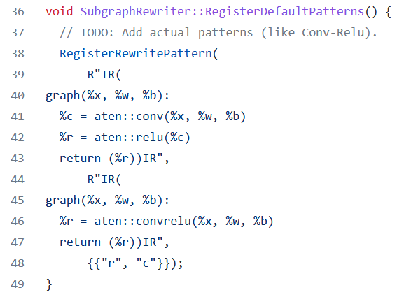
Static/Dynamic Simplification Rewrites, cont.
Rewrites and Operator Selection
Rewrites in PyTorch (Torch Script JIT)
  Misc: Canonicalization,
  erase number types and no-ops
  Fuse linear, fuse relu, fuse graph pipeline
  Peephole simplifications
  (e.g., for dtype management)
  Inlining and loop unrolling
  Concatenation and fusion
  rewrites:
[https://github.com/pytorch/pytorch/blob/master/torch/csrc/jit/passes/subgraph_rewrite.cpp]
subgraph_rewrite.cpp (extracted Mar 17, 2022)

Slide 28
Vectorization and Incremental Computation
Rewrites and Operator Selection
Loop Transformations
(e.g., OptiML, SystemML)
  Loop vectorization
  Loop hoisting
Incremental Computations
  Delta update rules (e.g., LINVIEW, factorized)
  Incremental iterations (e.g., Flink)
“Decremental”/Unlearning (GDPR)
for(i in a:b)
X[i,1] = Y[i,2] + Z[i,1]
X[a:b,1] = Y[a:b,2] + Z[a:b,1]
X
y
A = t(X) %*% X + t(∆X) %*% ∆X
b = t(X) %*% y + t(∆X) %*% ∆y
t(X)
[Sebastian Schelter: "Amnesia" – Machine Learning Models That Can Forget User Data Very Fast. CIDR 2020]
[Sebastian Schelter, Stefan Grafberger, Ted Dunning: HedgeCut: Maintaining Randomised Trees for Low-Latency Machine Unlearning. SIGMOD 2021]
Notes:
Note: “HedgeCut is a variation of the well-established “Extremely Randomised Trees” (ERT) approach [17], which learns an ensemble of randomized decision trees where attributes and cut-off points to split the data are chosen at random.” ref bottom-right
“It essentially consists of randomizing strongly both attribute and cut-point choice while splitting a tree node. In the extreme case, it builds totally randomized trees whose structures are independent of the output values of the learning sample. The strength of the randomization can be tuned to problem specifics by the appropriate choice of a parameter.”
https://orbi.uliege.be/bitstream/2268/9357/1/geurts-mlj-advance.pdf

Slide 29


Update-in-place
Rewrites and Operator Selection
Example: Cumulative Aggregate via Strawman Scripts
  But: R, Julia, Matlab, SystemDS, NumPy all provide cumsum(X), etc
Update in place (w/ O(n))
  SystemDS: via rewrites (why do the above scripts apply?)
  R: via reference counting
  Julia: by default, otherwise explicit B = copy(A) necessary
1: cumsumN2 = function(Matrix[Double] A)
2: return(Matrix[Double] B)
3: {
4: B = A; csums = matrix(0,1,ncol(A));
5: for( i in 1:nrow(A) ) {
6: csums = csums + A[i,];
7: B[i,] = csums;
8: }
9: }
1: cumsumNlogN = function(Matrix[Double] A)
2: return(Matrix[Double] B)
3: {
4: B = A; m = nrow(A); k = 1;
5: while( k < m ) {
6: B[(k+1):m,] = B[(k+1):m,] + B[1:(m‐k),];
7: k = 2 * k;
8: }
9: }
copy-on-write → O(n^2)
→ O(n log n)

Slide 30
Excursus: Automatic Rewrite Generation
Rewrites and Operator Selection
SPOOF/SPORES (Sum-Product Optim.)
  Break up LA ops into basic ops (RA)
  Elementary sum-product/RA rewrites
  Example:
  sum(W%*%H)
TASO (Super Optimization)
  List of operator specifications and properties
  Automatic generation/verification of graph
  substitutions and data layouts via cost-based backtracking search
[Tarek Elgamal et al: SPOOF: Sum-Product Optimization and Operator Fusion for
Large-Scale Machine Learning. CIDR 2017]
[Yisu Remy Wang et al: SPORES: Sum-Product Optimization via Relational Equality Saturation for Large Scale Linear Algebra. PVLDB 13(11) 2020]
[Zhihao Jia et al: TASO: optimizing deep learning computation with automatic generation of graph substitutions. SOSP 2019]

Slide 31
Matrix Multiplication Chain Optimization
Rewrites and Operator Selection
Optimization Problem
  Matrix multiplication chain of n matrices M₁, M₂, …M_{n} (associative)
  Optimal parenthesization of the product M₁M₂ … M_{n}
Search Space Characteristics
  Naïve exhaustive: Catalan numbers → Ω(4^{n} / n^{3/2}))
  DP applies: (1) optimal substructure,
  (2) overlapping subproblems
  Textbook DP algorithm: Θ(n³) time, Θ(n²) space
    Examples: SystemML ‘14,
    RIOT (‘09 I/O costs), SpMachO (‘15 sparsity)
  Best known: O(n log n)
t(X)
1kx1k
X
1kx1k
Z
1
t(X)
1kx1k
X
1kx1k
p
1
Size propagation and sparsity estimation
→
2,002 MFLOPs
4 MFLOPs
n | C_{n-1}
5 | 14
10 | 4,862
15 | 2,674,440
20 | 1,767,263,190
25 | 1,289,904,147,324
  [T. C. Hu, M. T. Shing: Computation of Matrix Chain Products. Part II. SIAM J. Comput. 13(2): 228-251, 1984]
Notes:
Ω .. Lower bound, Θ tight bound, O upper bound

Slide 32
Matrix Multiplication Chain Optimization, cont.
Rewrites and Operator Selection
M1 | M2 | M3 | M4 | M5
10x7 | 7x5 | 5x1 | 1x3 | 3x9
Cost matrix m
5
1
m[1,3] = min(
m[1,1] + m[2,3] + p1p2p4,
m[1,2] + m[3,3] + p1p3p4 )
4
222
2
j
i
135
125
= min(
0 + 35 + 10*7*1,
350 + 0 + 10*5*1 )
3
3
= min(
105,
400 )
2
105
56
72
4
1
350
35
15
27
5
0
0
0
0
0
  [T. H. Cormen, C. E. Leiserson, R. L. Rivest, C. Stein: Introduction to Algorithms, Third Edition, The MIT Press, pages 370-377, 2009]
M1
M2
M3
M4
M5

Slide 33
Matrix Multiplication Chain Optimization, cont.
Rewrites and Operator Selection
M1 | M2 | M3 | M4 | M5
10x7 | 7x5 | 5x1 | 1x3 | 3x9
Optimal split matrix s
getOpt(s,1,5)
Cost matrix m
5
1
getOpt(s,1,3)
3
getOpt(s,4,5)
4
222
2
3
3
j
i
3
135
125
3
2
1
3
3
4
105
56
72
1
2
3
4
2
4
1
350
35
15
27
5
0
0
0
0
0
( M1 M2 M3 M4 M5 )
( ( M1 M2 M3 ) ( M4 M5 ) )
M1
M2
M3
M4
M5
( ( M1 ( M2 M3 ) ) ( M4 M5 ) )
➔ ((M1 (M2 M3)) (M4 M5))
➔ Open questions: DAGs; other operations, sparsity
joint opt w/ rewrites, CSE, fusion, and physical operators

Slide 34

Matrix Multiplication Chain Optimization, cont.
Rewrites and Operator Selection
Cost matrix M
Optimal split matrix S
Sketch matrix E
Sparsity-aware
mmchain Opt
  Additional n x n
  sketch matrix e
  Sketch propagation for optimal subchains (currently for all chains)
  Modified cost computation via MNC sketches
  (number FLOPs for sparse instead of dense mm)
Example: n=20 matrices
$$C_{i,j}=\min_{k∈\left[i,j−1\right]}{\begin{aligned}(C_{i,k}+C_{k+1,j} \\ +E_{i,k}.h^{c}E_{k+1,j}.h^{r})\end{aligned}}$$
[Johanna Sommer, Matthias Boehm, Alexandre V. Evfimievski, Berthold Reinwald, Peter J. Haas: MNC: Structure-Exploiting Sparsity Estimation for Matrix Expressions. SIGMOD 2019]

Slide 35
Physical Rewrites and Optimizations
Rewrites and Operator Selection
Distributed Caching
  Redundant compute vs. memory consumption and I/O
  #1 Cache intermediates w/ multiple refs (Emma)
  #2 Cache initial read and read-only loop vars (SystemML)
Partitioning
  Many frameworks exploit co-partitioning for efficient joins
  #1 Partitioning-exploiting operators (SystemML, Emma, Samsara)
  #2 Inject partitioning to avoid shuffle per iteration (SystemML)
  #3 Plan-specific data partitioning (SystemML, Dmac, Kasen)
Other Data Flow Optimizations (Emma)
  #1 Exists unnesting (e.g., filter w/ broadcast → join)
  #2 Fold-group fusion (e.g., groupByKey → reduceByKey)
Physical Operator Selection

Slide 36
Physical Operator Selection
Rewrites and Operator Selection
Common Selection Criteria
  Data and cluster characteristics (e.g., data size/shape, memory, parallelism)
  Matrix/operation properties (e.g., diagonal/symmetric, sparse-safe ops)
  Data flow properties (e.g., co-partitioning, co-location, data locality)
#0 Local Operators
  SystemML mm, tsmm, mmchain; Samsara/Mllib local
#1 Special Operators (special patterns/sparsity)
  SystemML tsmm, mapmmchain; Samsara AtA
#2 Broadcast-Based Operators (aka broadcast join)
  SystemML mapmm, mapmmchain
#3 Co-Partitioning-Based Operators (aka improved repartition join)
  SystemML zipmm; Emma, Samsara OpAtB
#4 Shuffle-Based Operators (aka repartition join)
  SystemML cpmm, rmm; Samsara OpAB
t(X) %*% (X%*%v)
1st
pass
v
2nd
pass
X
q┬
X

Slide 37
Sparsity-Exploiting Operators
Rewrites and Operator Selection
Goal: Avoid dense intermediates and unnecessary computation
#1 Fused Physical Operators
  E.g., SystemML [PVLDB’16]
  wsloss, wcemm, wdivmm
  Selective computation
  over non-zeros of
  “sparse driver”
#2 Masked Physical Operators
  E.g., Cumulon MaskMult [SIGMOD’13]
  Create mask of “sparse driver”
  Pass mask to single masked
  matrix multiply operator
sum(W * (X – U %*% t(V))^2)
^2
W
X
U V┬
sum
*
–
O / (C %*% E %*% t(B))
/
mm
C
mm
O
M
E
t(B)

Slide 38
Conclusions
Summary
  Basic compilation overview
  Size inference and cost estimation
  Rewrites and operator selection
➔ Impact of Size Inference and Costs
  Advanced optimization of LA programs requires size inference
  for cost estimation and validity constraints
➔ Ubiquitous Rewrite Opportunities
  Linear algebra programs have plenty of room for optimization
  Potential for changed asymptotic behavior
Next Lectures (next week: bye)
  04 Operator Fusion and Runtime Adaptation [Apr 01]
  (advanced compilation, operator scheduling, JIT compilation,
  operator fusion / codegen, MLIR)

