Slide 1

Architecture of ML Systems
04 Adaptation, Fusion, and JIT
Last update: Mar 28, 2022

Slide 2




Announcements/Org
#1 Video Recording
  Link in TeachCenter & TUbe (lectures will be public)
  Hybrid: HSi5 / https://tugraz.webex.com/meet/m.boehm
#2 AMLS Project Selections
  Project selection by Mar 31 (see Lecture 02 for four alternatives)
  Discussion current status project selection (~18 students assigned)
#3 DAPHNE OSS Release
  Public code repository since Mar 31 EOD
  https://github.com/daphne-eu/daphne
  Apache v2 license

Slide 3
Agenda
Motivation and Terminology
Runtime Adaptation
Operator Fusion & JIT Compilation

Slide 4
Motivation and Terminology

Slide 5
Recap: Linear Algebra Systems
Motivation and Terminology
Comparison Query Optimization
  Rule- and cost-based rewrites and operator ordering
  Physical operator selection and query compilation
  Linear algebra / other ML operators, DAGs,
  control flow, sparse/dense formats
#1 Interpretation (operation at-a-time)
  Examples: R, PyTorch, Morpheus [PVLDB’17]
#2 Lazy Expression Compilation (DAG at-a-time)
  Examples: RIOT [CIDR’09], TensorFlow [OSDI’16]
  Mahout Samsara [MLSystems’16], Dask
  Examples w/ control structures: Weld [CIDR’17],
  OptiML [ICML’11], Emma [SIGMOD’15]
#3 Program Compilation (entire program)
  Examples: SystemML [ICDE’11/PVLDB’16], Julia,
  Cumulon [SIGMOD’13], Tupleware [PVLDB’15]
DB
PL
HPC
Compilers for Large-scale ML
Optimization Scope
1: X = read($1); # n x m matrix
2: y = read($2); # n x 1 vector
3: maxi = 50; lambda = 0.001;
4: intercept = $3;
5: ...
6: r = -(t(X) %*% y);
7: norm_r2 = sum(r * r); p = -r;
8: w = matrix(0, ncol(X), 1); i = 0;
9: while(i<maxi & norm_r2>norm_r2_trgt) 10: {
11: q = (t(X) %*% X %*% p)+lambda*p;
12: alpha = norm_r2 / sum(p * q);
13: w = w + alpha * p;
14: old_norm_r2 = norm_r2;
15: r = r + alpha * q;
16: norm_r2 = sum(r * r);
17: beta = norm_r2 / old_norm_r2;
18: p = -r + beta * p; i = i + 1;
19: }
20: write(w, $4, format="text");

Slide 6
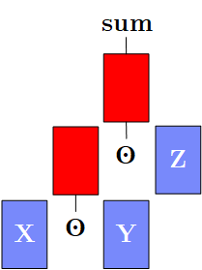
Major Compilation/Runtime Challenges
Motivation and Terminology
#1 Unknown/Changing Sizes
  Sizes inference crucial for cost-estimation and
  validity constraints (e.g., rewrites)
  Tradeoff: optimization scope vs size inference effort
  Challenge: Unknowns ➔ conservative fallback plans
#2 Operator Runtime Overhead
  Operators great for programmability, size inference,
  simple compilation, and efficient kernel implementations
  (sparse, dense, compressed)
  Tradeoff: general-purpose vs specialization
  Challenges: intermediates, parallelization,
  complexity of operator combinations
Y = foo(X)
Z = Y[Ix,]
# nrow(Z)?

Slide 7






Terminology Ahead-of-Time / Just-in-Time
Motivation and Terminology
Ahead-of-Time Compilation
  Originating from compiled languages like C, C++
  #1 Program compilation at different abstraction levels
  #2 Inference program compilation & packaging
Just-In-Time Compilation (at runtime for specific data/HW)
  Originating from JIT-compiled languages like Java, C#
  #1 Lazy expression evaluation + optimization
  #2 Program/function compilation with recompilation
Excursus: Java JIT
  #1 Start w/ Java bytecode interpretation by JVM ➔ fast startup
  #2 Tiered JIT compile (cold, warm, hot, very hot, scorching) ➔ performance
  Trace statistics (frequency, time) at method granularity
  Note: -XX:+PrintCompilation
(LLVM)
PL

Slide 8
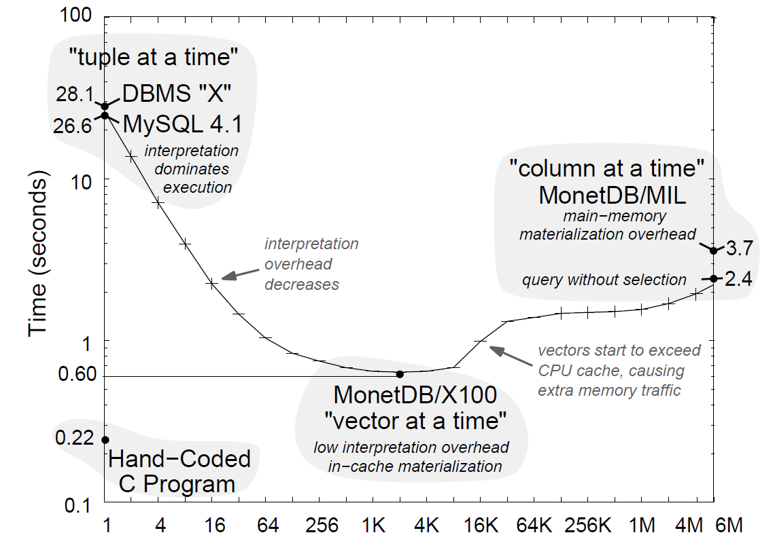
Terminology Runtime Adaptation & JIT
Motivation and Terminology
[Amol Deshpande, Joseph M. Hellerstein, Shankar Raman: Adaptive query proc-essing: why, how, when, what next. SIGMOD 2006]
Excursus: Adaptive Query Processing
  Spectrum of
  Adaptivity
Excursus: Query Execution Strategies
  #1 Volcano Iterator Model
  #2 Materialized Intermediates
  #3 Vectorized (Batched) Execution
  #4 Query Compilation
  Similar: Loop fusion, fission, tiling
DB
DB
HPC
[Peter A. Boncz, Marcin Zukowski, Niels Nes: MonetDB/X100: Hyper-Pipelining Query Execution. CIDR 2005]
Vector Size

Slide 9
Runtime Adaptation
ML Systems w/ Optimizing Compiler

Slide 10
Issues of Unknown or Changing Sizes
Runtime Adaptation
Problem of unknown/changing sizes
  Unknown or changing sizes and sparsity of intermediates
  These unknowns lead to very conservative fallback plans (distributed ops)
#1 Control Flow
  Branches and loops
  Complex function call graphs
  User-Defined Functions
#2 Data-Dependencies
  Data-dependent operators
  (e.g., table, rmEmpty, aggregate)
  Computed size expressions
X = read(‘/tmp/X.csv’);
if( intercept )
X = cbind(X, matrix(1,nrow(X),1));
Z = foo(X) + X; # size of + and Z?
Y = table(seq(1,nrow(X)), y);
grad = t(X) %*% (P - Y);
1
11
1
1
1
1
3
4
223
Ex.: Multinomial
Logistic Regression
d = dout[,(t-2)*M+1:(t-1)*M];
cur_Q = matrix (0, 1, 2*ncur);
cur_S = matrix (0, 1, ncur*dist);
Y
y

Slide 11
Issues of Unknown or Changing Sizes, cont.
Runtime Adaptation
#3 Changing Dims and Sparsity
  Iterative feature selection workloads
  Changing dimensions or sparsity
  ➔ Same code with different data
#4 API Limitations
  Precompiled scripts/programs
  (inputs unavailable)
(#5 Compiler Limitations)
➔ Dynamic recompilation techniques as robust fallback strategy
  Shares goals and challenges with adaptive query processing
  However, ML domain-specific techniques and rewrites
Ex: Stepwise LinReg
while( continue ) {
parfor( i in 1:n ) {
if( !fixed[1,i] ) {
Xi = cbind(Xg, X[,i])
B[,i] = lm(Xi,y)
}
}
# add best to Xg (AIC)
}
Notes:
AIC .. Akaike Information Criterion

Slide 12
Recompilation
Runtime Adaptation
Script
[Matthias Boehm et al:
SystemML's Optimizer: Plan Generation for Large-Scale Machine Learning Programs. IEEE Data Eng. Bull 2014]
~100
ms
Language
Parsing (syntactic analysis)
Live Variable Analysis
Validate (semantic analysis)
~10
ms
HOPs
Construct HOP DAGs
Multiple
Rounds
Static/Dynamic Rewrites
Intra-/Inter-Procedural Analysis
~1
ms
Static/Dynamic Rewrites
Static/Dynamic Rewrites
Compute Memory Estimates
Dynamic Recompilation
Compute Memory Estimates
LOPs
Construct LOP DAGs
(incl operator selection, hop-lop rewrites)
Construct LOP DAGs
(incl operator selection, hop-lop rewrites)
Other systems w/ recompile:
SciDB, MatFast
Generate Runtime Program
Generate Runtime Program
Execution Plan

Slide 13
Dynamic Recompilation
Runtime Adaptation
Compile-time Decisions
  Split HOP DAGs for recompilation: prevent unknowns but keep DAGs as large as possible; split after reads w/ unknown sizes and specific operators
  Mark HOP DAGs for recompilation: Spark due to unknown sizes / sparsity
Control flow → statement blocks
→ initial recompilation granularity
R2
R3
R4
R2
*
rm
abs
*
R3
R4
s
tmp1
tmp2
tmp3
R1
abs
(recursive rewrite)
tmp1
s
rm
rm
R1
rm
tmp3
abs
rm
tmp2
+
rm
abs
+
rm
rm
A
B
C
A
A
B
C
A
rm .. removeEmpty(X, [margin=“rows”,select=I])

Slide 14
Dynamic Recompilation, cont.
Runtime Adaptation
Dynamic Recompilation at Runtime on recompilation hooks
(last level program blocks, predicates, recompile once functions)
  Deep Copy DAG
  Replace Literals
  Update DAG Statistics
  Dynamic Rewrites
  Recompute Memory
  Estimates
  [Codegen]
  Generate
  Runtime Instructions
Symbol Table
X | 1Mx100,99M
P | 1Mx7,7M
Y | 1Mx7,7M
[100x-1,-1]
[100x7,-1]
SP
CP
ba(+*)
[100x1M,-1]
[1Mx-1,-1]
[100x1M,99M]
CP
SP
[1Mx7,-1]
CP
r(t)
b(-)
X
P
Y
[1Mx100,99M]
[1Mx100,-1]
[1Mx-1,-1]
[1Mx7,7M]
[1Mx-1,-1]
[1Mx7,7M]

Slide 15
Dynamic Recompilation, cont.
Runtime Adaptation
Recompile Once Functions
  Unknowns due to inconsistent or
  unknown call size information
  IPA marks functions as “recompile
  once”, if it contains loops
  Recompile the entire function on entry
  + disable unnecessary recompile
Recompile parfor Loops
  Unknown sizes and iterations
  Recompile parfor loop on entry
  + disable unnecessary recompile
  Create independent DAGs for
  individual parfor workers
foo = function(Matrix[Double] A)
# recompiled w/ size of A
return (Matrix[Double] C)
{
C = rand(nrow(A),1) + A;
while(...)
C = C / rowSums(C) * s
}
while( continue ) {
parfor( i in 1:n ) {
if( !fixed[1,i] ) {
Xi = cbind(Xg, X[,i])
B[,i] = lm(Xi,y)
}
}
# add best to Xg (AIC)
}

Slide 16



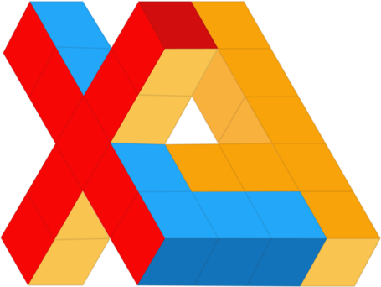

Operator Fusion & JIT Compilation
(aka Code Generation)
Many State-of-the-Art ML Systems,
especially for DNNs and numerical computation

Slide 17
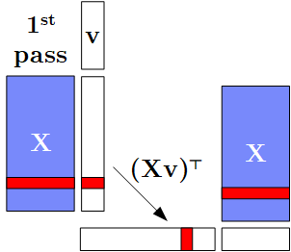
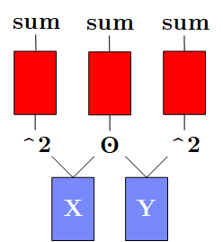
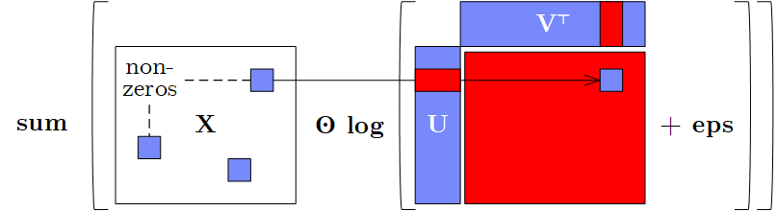
Motivation: Fusion
Operator Fusion & JIT Compilation
[Matthias Boehm et al.: On Optimizing Operator Fusion Plans for Large-Scale ML in SystemML. PVLDB 2018]
Data Flow Graphs (better data access)
  DAGs of linear algebra (LA) operations and statistical functions
  Materialized intermediates → ubiquitous fusion opportunities
a) Intermediates
b) Single-Pass
c) Multi-Aggregates
sum(X*Y*Z)
t(X)%*%(X%*%v)
→t(t(X%*%v)%*%X)
d) Sparsity Exploitation

Slide 18
Motivation: Fusion, cont.
Operator Fusion & JIT Compilation
Beware: SystemML 1.0,
Julia 0.6.2, TensorFlow 1.5
dense
Cell Template: sum(X*Y*Z)
sparse (0.1)
Row: t(X)%*%(w*(X%*%v))
Outer: sum(X*log(U%*%t(V)+1e-15))
TF w/ manual rewrite
→ t(t(w*(X%*%v))%*%X):
9.2 s to 1.6 s (compared to Gen 283ms)
dense
20K x 20K,
rank 100

Slide 19
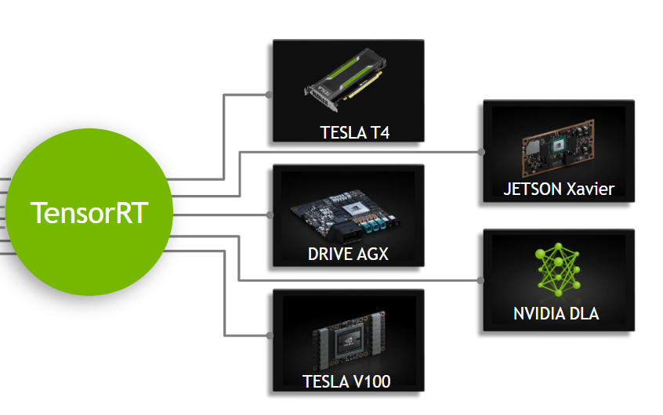
Motivation: Just-In-Time Compilation
Operator Fusion & JIT Compilation
Operator Kernels (better code)
  Specialization opportunities: data types, shapes, and operator graphs
  Heterogeneous hardware: CPUs, GPUs, FPGAs, ASICs x architectures
#1 CPU Architecture
  Specialize to available instructions sets
  Register allocation and assignment, etc
#2 Heterogeneous Hardware
  JIT compilation for custom-build
  ASICs with HW support for ML ops
  Different architectures of devices
#3 Custom ML Program
  Operator graphs and sizes
Examples: x86-64, sparc, amd64, arm, ppc
Example: NVIDIA TensorRT
GPU Platforms
[https://docs.nvidia.com/
deeplearning/sdk/tensorrt-developer-guide/index.html]
Notes:
Notes: tesla (P4 inference, V100 training) -> datacenter, drive -> automotive; jetson -> embedded (e.g., robotics)

Slide 20
Operator Fusion Overview
Operator Fusion & JIT Compilation
Related Research Areas
  DB: query compilation
  HPC: loop fusion, tiling, and distribution (NP complete)
  ML: operator fusion (dependencies given by data flow graph)
Example Operator Fusion
Memory Bandwidth:
L1 core: 1TB/s
L3 socket: 400GB/s
Mem: 100 GB/s
R
for( i in 1:n )
tmp1[i,1] = s * B[i,1];
for( i in 1:n )
tmp2[i,1] = A[i,1] + tmp1[i,1];
for( i in 1:n )
R[i,1] = tmp2[i,1] * C[i,1];
*
[https://software.intel.com/
en-us/articles/memory-performance-in-a-nutshell]
+
C
A
*
s
B
for( i in 1:n )
R[i,1] = (A[i,1] + s*B[i,1]) * C[i,1];

Slide 21
Evolution of Operator Fusion in ML Systems
Operator Fusion & JIT Compilation
1st Gen: Handwritten Fused Operators
  [BLAS (since 1979): e.g., alpha * X + Y → AXPY]
  Rewrites: e.g., A+B+C → AddN(A, B, C),
  t(X) %*% (w * (X %*% v)) → MMCHAIN
  Sparsity exploiting fused ops:
  e.g., sum(X*log(U%*%t(V)+eps))
2nd Gen: Fusion Heuristics
  Automatic operator fusion via elementary ops
  Heuristics for replacing sub-DAGs w/ fused ops
3rd Gen: Optimized Fusion Plans
  Greedy/exact fusion plan (sub-DAG) selection
  [Greedy/evolutionary kernel implementations]
[Arash Ashari: On optimizing machine learning workloads via kernel fusion. PPOPP 2015]
[Matthias Boehm: SystemML: Declarative Machine Learning on Spark. PVLDB 2016]
[Tarek Elgamal et al: SPOOF: Sum-Product Optimization and Operator Fusion for Large-Scale Machine Learning. CIDR 2017]
[Matthias Boehm et al.: On Optimizing Operator Fusion Plans for Large-Scale ML in SystemML. PVLDB 2018]

Slide 22
Automatic Operator Fusion System Landscape
Operator Fusion & JIT Compilation
System | Year | Approach | Sparse | Distr. | Optimization
BTO | 2009 | Loop Fusion | No | No | k-Greedy, cost-based
Tupleware | 2015 | Loop Fusion | No | Yes | Heuristic
Kasen | 2016 | Templates | (Yes) | Yes | Greedy, cost-based
SystemML | 2017 | Templates | Yes | Yes | Exact, cost-based
Weld | 2017 | Templates | (Yes) | Yes | Heuristic
Taco | 2017 | Loop Fusion | Yes | No | Manuel
Julia | 2017 | Loop Fusion | Yes | No | Manuel
Tensorflow XLA | 2017 | Loop Fusion | No | No | Manuel/Heuristic
Tensor Comprehensions | 2018 | Loop Fusion | No | No | Evolutionary, cost-based
TVM | 2018 | Loop Fusion | No | No | ML/cost-based
PyTorch | 2019 | Loop Fusion | No | No | Manual/Heuristic
JAX | 2019 | N/A | No | No | See TF XLA
JIT
Notes:
#1 Micro Optimizations
Hybrid tile-at-a-time loop fusion, predication, and result allocation
Examples: Tupleware
#2 Cross-Library Optimization
Generic IR based on parallel loops and builders
Examples: Weld
#3 Sparsity Exploitation
Exploit sparsity over chains of operations (compute, size of intermediates)
Examples: SystemML
#4 Iteration Schedules
Decisions on loop ordering (e.g., tensor storage formats, join ordering)
Examples: Taco, TVM, Mateev et al
#5 Optimizing Fusion Plans
Example: SystemML
#6 Autodifferentiation Native Python Code
Example: JAX (Autograd + XLA JIT)

Slide 23
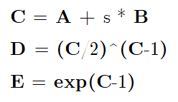
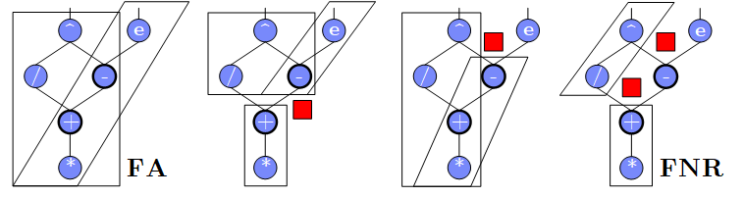
A Case for Optimizing Fusion Plans
Operator Fusion & JIT Compilation
Problem: Fusion heuristics → poor plans for complex DAGs (cost/structure), sparsity exploitation, and local/distributed operations
Goal: Principled approach for optimizing fusion plans
#1 Materialization Points
(e.g., for multiple consumers)
#2 Sparsity Exploitation
(and ordering of sparse inputs)
#3 Decisions on Fusion Patterns
(e.g., template types)
#4 Constraints
(e.g., memory budget and block sizes)
Y + X * (U %*% t(V))
sparse-safe over X
➔ Search Space that
requires optimization

Slide 24
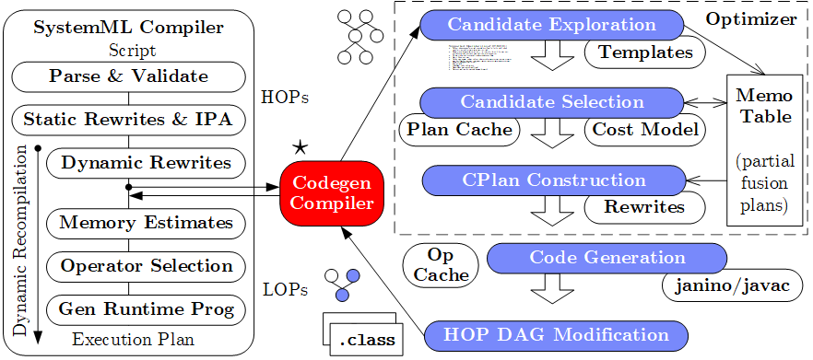
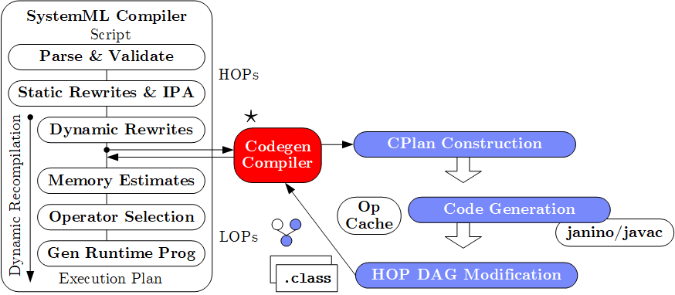
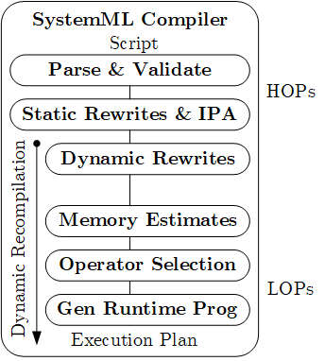

System Architecture (Compiler & Codegen Architecture)
Operator Fusion & JIT Compilation
Practical, exact, cost-based optimizer
[CIDR’17] (w/ fuse-all heuristic)
Lacked maintainability
Poor plans for complex DAGs
and local/distributed operations
CPlan representation/construction and codegen similar in TF XLA
(HLO primitives, pre-clustering of nodes, caching, LLVM codegen)
Templates: Cell, Row, MAgg, Outer w/ different data bindings

Slide 25
Codegen Example L2SVM (Cell/MAgg)
Operator Fusion & JIT Compilation
L2SVM Inner Loop
# of Vector Intermediates
  Base (w/o fused ops): 10
  Fused (w/ fused ops): 4
1: while(continueOuter & iter < maxi) {
2 #...
3: while(continueInner) {
4: out = 1-Y* (Xw+step_sz*Xd);
5: sv = (out > 0);
6: out = out * sv;
7: g = wd + step_sz*dd
- sum(out * Y * Xd);
8: h = dd + sum(Xd * sv * Xd);
9: step_sz = step_sz - g/h;
10: }} ...

Slide 26
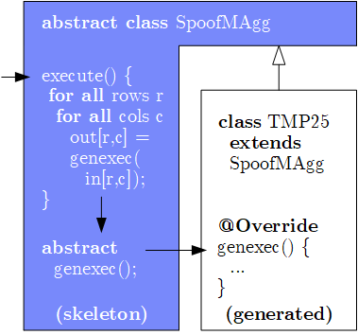
Codegen Example L2SVM, cont. (Cell/MAgg)
Operator Fusion & JIT Compilation
Template Skeleton
  Data access, blocking
  Multi-threading
  Final aggregation
# of Vector Intermediates
  Gen (codegen ops): 0
public final class TMP25 extends SpoofMAgg {
public TMP25() {
super(false, AggOp.SUM, AggOp.SUM);
}
protected void genexec(double a, SideInput[] b,
double[] scalars, double[] c, ...) {
double TMP11 = getValue(b[0], rowIndex);
double TMP12 = getValue(b[1], rowIndex);
double TMP13 = a * scalars[0];
double TMP14 = TMP12 + TMP13;
double TMP15 = TMP11 * TMP14;
double TMP16 = 1 - TMP15;
double TMP17 = (TMP16 > 0) ? 1 : 0;
double TMP18 = a * TMP17;
double TMP19 = TMP18 * a;
double TMP20 = TMP16 * TMP17;
double TMP21 = TMP20 * TMP11;
double TMP22 = TMP21 * a;
c[0] += TMP19;
c[1] += TMP22;
}
}

Slide 27
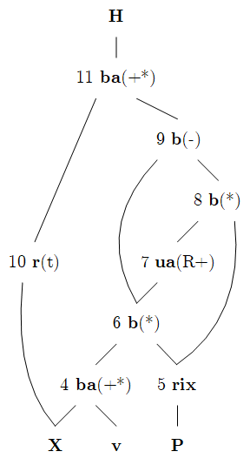
Codegen Example MLogreg (Row)
Operator Fusion & JIT Compilation
MLogreg Inner Loop
(main expression on feature matrix X)
1: Q = P[, 1:k] * (X %*% v)
2: H = t(X) %*% (Q - P[, 1:k] * rowSums(Q))
public final class TMP25 extends SpoofRow {
public TMP25() {
super(RowType.COL_AGG_B1_T, true, 5);
}
protected void genexecDense(double[] a, int ai,
SideInput[] b, double[] c,..., int len) {
double[] TMP11 = getVector(b[1].vals(rix),...);
double[] TMP12 = vectMatMult(a, b[0].vals(rix),...);
double[] TMP13 = vectMult(TMP11, TMP12, 0, 0,...);
double TMP14 = vectSum(TMP13, 0, TMP13.length);
double[] TMP15 = vectMult(TMP11, TMP14, 0,...);
double[] TMP16 = vectMinus(TMP13, TMP15, 0, 0,...);
vectOuterMultAdd(a, TMP16, c, ai, 0, 0,...); }
protected void genexecSparse(double[] avals, int[] aix,
int ai, SideInput[] b, ..., int len) {...}
}

Slide 28
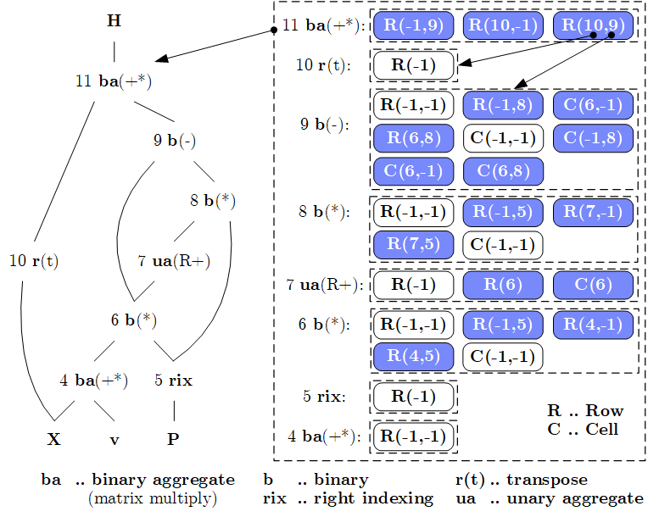
Candidate Exploration (by example MLogreg)
Operator Fusion & JIT Compilation
Memo Table for partial
fusion plans (candidates)
OFMC Template
Fusion API
  Open
  Fuse, Merge
  Close
OFMC
Algorithm
  Bottom-up
  Exploration
  (single-pass,
  template-
  agnostic)
  Linear space
  and time
Memo Table

Slide 29
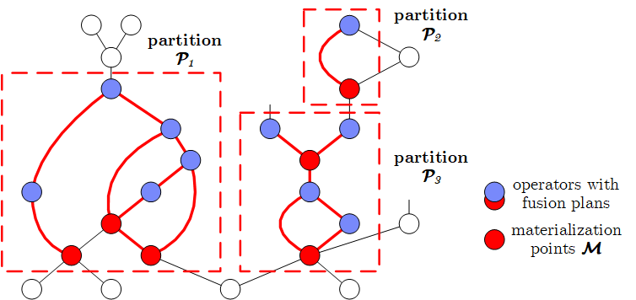
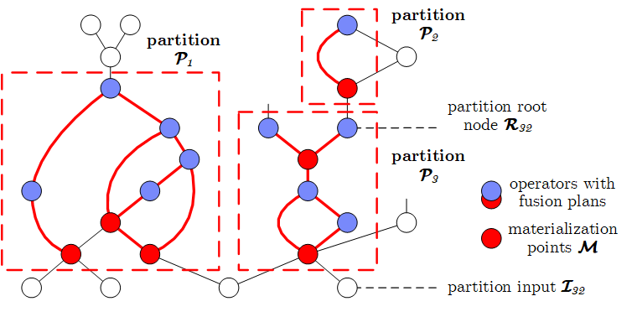
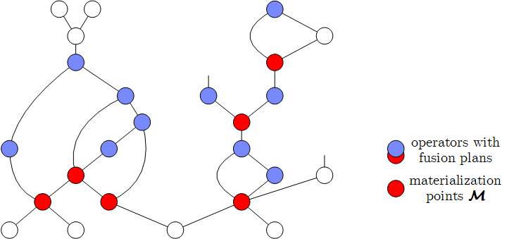
Candidate Selection (Partitions and Interesting Points)
Operator Fusion & JIT Compilation
#1 Determine Plan Partitions
  Materialization
  Points M
  Connected components
  of fusion references
  Root and input nodes
  Optimize partitions
  independently
#2 Determine Interesting Points
  Materialization Point Consumers: Each data dependency on materialization points considered separately
  Template / Sparse Switches: Data dependencies where producer has templates that are non-existing for consumers
  ➔ Optimizer considers all 2^{|M’i|} plans (with |M’_{i}| ≥ |M_{i}|) per partition

Slide 30
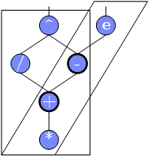
Candidate Selection, cont. (Costs and Constraints)
Operator Fusion & JIT Compilation
Overview Cost Model
  Cost partition with analytical cost model
  based on peak memory and compute bandwidth
  Plan comparisons / fusion errors don’t propagate / dynamic recompilation
#3 Evaluate Costs
  #1: Memoization of already processed sub-DAGs
  #2: Account for shared reads and CSEs within operators
  #3: Account for redundant computation (overlap)
  ➔ DAG traversal and cost vectors per fused operator
  (with memoization of pairs of operators and cost vectors)
#4 Handle Constraints
  Prefiltering violated constraints (e.g., row template in distributed ops)
  Assign infinite costs for violated constraints during costing

Slide 31
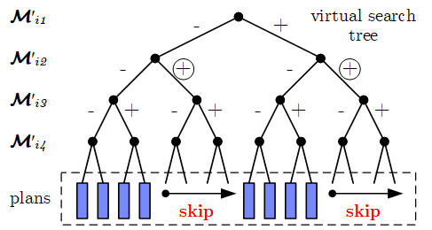
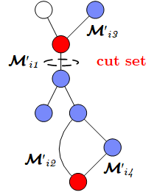
Candidate Selection, cont. (MPSkipEnum and Pruning)
Operator Fusion & JIT Compilation
#5 Basic Enumeration
  Linearized search space: from - to *
#6 Cost-Based Pruning
  Upper bound: cost C^{U} of best plan q* (monotonically decreasing)
  Opening heuristic: evaluate FA and FNR heuristics first
  Lower bound: C^{LS} (read input, write output, min compute) + dynamic C^{LD} (materialize intermediates q) ➔ skip subspace if C^{U} ≤ C^{LS +} C^{LD}
#7 Structural Pruning
  Observation: Assignments can create independent sub problems
  Build reachability graph to determine cut sets
  During enum: probe cut sets, recursive enum, combine, and skip
for( j in 1:pow(2,|M’_{i}|) )
q = createAssignment(j)
C = getPlanCost(P_{i}, q)
maintainBest(q, C)

Slide 32
Ahead-of-Time Compilation
Operator Fusion & JIT Compilation
TensorFlow tf.compile
  Compile entire TF graph into binary function w/ low footprint
  Input: Graph, config (feeds+fetches w/ fixes shape sizes)
  Output: x86 binary and C++ header (e.g., inference)
  Specialization for frozen model and sizes
PyTorch Compile
  Compile Python functions into ScriptModule/ScriptFunction
  Lazily collect operations,
  optimize, and JIT compile
  Explicit jit.script call
  or @torch.jit.script
[Chris Leary, Todd Wang:
XLA – TensorFlow, Compiled!, TF Dev Summit 2017]
a = torch.rand(5)
def func(x):
for i in range(10):
x = x * x # unrolled into graph
return x
jitfunc = torch.jit.script(func) # JIT
jitfunc.save("func.pt")
[Vincent Quenneville-Bélair: How PyTorch Optimizes
Deep Learning Computations, Guest Lecture Stanford 2020]

Slide 33
Excursus: MLIR
Operator Fusion & JIT Compilation
[Rasmus Munk Larsen, Tatiana Shpeisman: TensorFlow Graph Optimizations,
Guest Lecture Stanford 2019]
Motivation TF Compiler Ecosystem
  Different IRs and compilation
  chains for runtime backends
  Duplication of infrastructure
  and fragile error handling
  Adoption:
MLIR (Multi-level, Machine Learning IR)
  SSA-based IR, similar to LLVM
  Hierarchy of modules, functions,
  regions, blocks, and operations
  Dialects for different backends
  (defined ops, customization)
  Systematic lowering
[https://github.com/llvm/torch-mlir]
func @testFunction(%arg0: i32) {
%x = call @thingToCall(%arg0)
: (i32) -> i32
br ^bb1
^bb1:
%y = addi %x, %x : i32
return %y : i32
}
[Chris Lattner et al.: MLIR: Scaling Compiler Infrastructure for Domain Specific Computation. CGO 2021, https://arxiv.org/pdf/2002.11054.pdf]
Notes:
Note: Regions consist of a CFG of blocks with arguments, blocks contain list of operations, ops can contain nested regions.

Slide 34
Excursus: MLIR, cont.
(DAPHNE pre-project prototype)
Operator Fusion & JIT Compilation
while(i < max_iter) { # PageRank
p = alpha*(G%*%p) + (1-alpha)*(e%*%u%*%p);
i += 1;
}
func @main() {
%G = daphne.rand {rows=50, cols=50, seed=-1, sparsity=0.07} : ...
%initP = daphne.rand {rows=50, cols=1, seed=-1, sparsity=1.0} : ...
%e, %u ...
%alpha = daphne.constant 0.5 : f64
%initI = daphne.constant 0 : i64
%loop:2 = daphne.while(%p = %initP, %i = %initI) :
(!daphne.matrix<?x?xf64>, i64) -> (!daphne.matrix<?x?xf64>, i64) condition: {
%max_iteration = daphne.constant 10 : i64
%c = cmpi "ult", %i, %max_iteration : i64
daphne.yield %c : i1
} body: {
%1 = daphne.mat_mul %G, %p : (!daphne.matrix<?x?xf64>, !daphne.matrix<?x?xf64>) -> !daphne.matrix<?x?xf64>
%2 = daphne.mul %alpha, %1 : (f64, !daphne.matrix<?x?xf64>) -> !daphne.matrix<?x?xf64>
%3 = daphne.mat_mul %e, %u : (!daphne.matrix<?x?xf64>, !daphne.matrix<?x?xf64>) -> !daphne.matrix<?x?xf64>
%4 = daphne.mat_mul %3, %p : (!daphne.matrix<?x?xf64>, !daphne.matrix<?x?xf64>) -> !daphne.matrix<?x?xf64>
%cst1f = daphne.constant 1.0 : f64
%5 = daphne.sub %cst1f, %alpha : (f64, f64) -> f64
%6 = daphne.mul %5, %4 : (f64, !daphne.matrix<?x?xf64>) -> !daphne.matrix<?x?xf64>
%newP = daphne.add %2, %6 : (!daphne.matrix<?x?xf64>, !daphne.matrix<?x?xf64>) -> !daphne.matrix<?x?xf64>
%cst1 = daphne.constant 1 : i64
%nextI = daphne.add %i, %cst1 : (i64, i64) -> i64
daphne.yield %newP, %nextI : !daphne.matrix<?x?xf64>, i64
}
daphne.print %loop#0 : !daphne.matrix<?x?xf64>
daphne.return
}
Initial translation w/o
much optimization
module {
func @main() {
%0 = daphne.constant 5.000000e-01 : f64
%1 = daphne.constant 0 : i64
%2 = daphne.constant 1.000000e+00 : f64
%3 = daphne.constant 1 : i64
%4 = daphne.constant 10 : i64
%5 = daphne.rand {cols = 50 : i64, rows = 50 : i64, seed = -1 : i64, sparsity = 7.000000e-02 : f64} : () -> ...
%6, %7, %8 = ...
%9 = daphne.sub %2, %0 : (f64, f64) -> f64
%10:2 = daphne.while (%arg0 = %6, %arg1 = %1) : (!daphne.matrix<50x1xf64>, i64) -> (same) condition: {
%11 = cmpi "ult", %arg1, %4 : i64
daphne.yield %11 : i1
} body: {
%11 = daphne.mat_mul %5, %arg0 : (!daphne.matrix<50x50xf64>, !daphne.matrix<50x1xf64>) -> !daphne.matrix<50x1xf64>
%12 = daphne.mul %11, %0 : (!daphne.matrix<50x1xf64>, f64) -> !daphne.matrix<50x1xf64>
%13 = daphne.mat_mul %8, %arg0 : (!daphne.matrix<1x50xf64>, !daphne.matrix<50x1xf64>) -> !daphne.matrix<1x1xf64>
%14 = daphne.mat_mul %7, %13 : (!daphne.matrix<50x1xf64>, !daphne.matrix<1x1xf64>) -> !daphne.matrix<50x1xf64>
%15 = daphne.mul %9, %14 : (f64, !daphne.matrix<50x1xf64>) -> !daphne.matrix<50x1xf64>
%16 = daphne.add %12, %15 : (!daphne.matrix<50x1xf64>, !daphne.matrix<50x1xf64>) -> !daphne.matrix<50x1xf64>
%17 = daphne.add %arg1, %3 : (i64, i64) -> i64
daphne.yield %16, %17 : !daphne.matrix<50x1xf64>, i64
}
daphne.print %10#0 : !daphne.matrix<50x1xf64>
daphne.return
}
}
After Several Optimization Passes
3) Code motion outside loop
1) Shape inference of dimensions
2) Matrix multiplication chain reordered

Slide 35
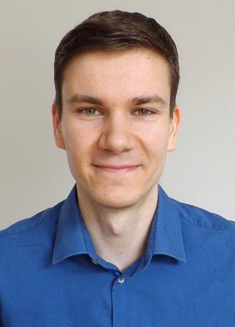

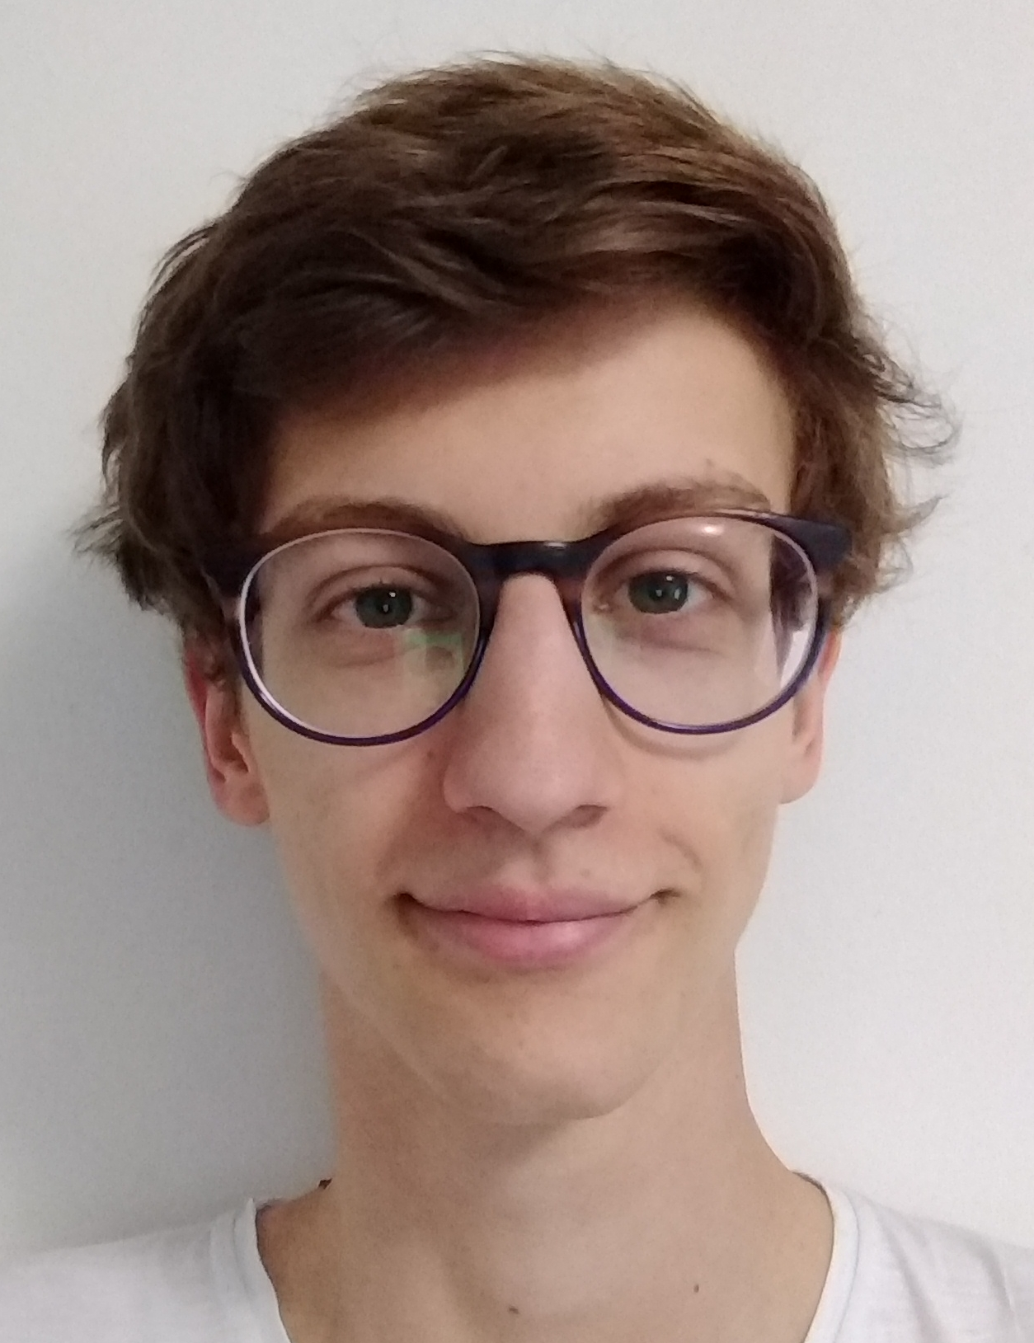
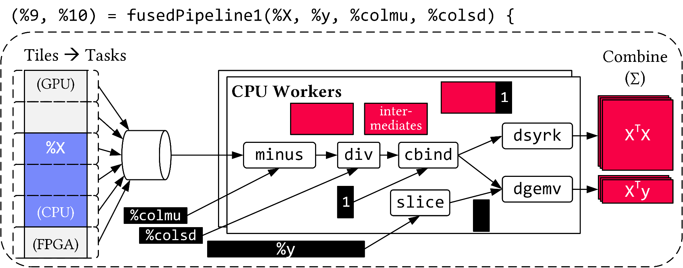
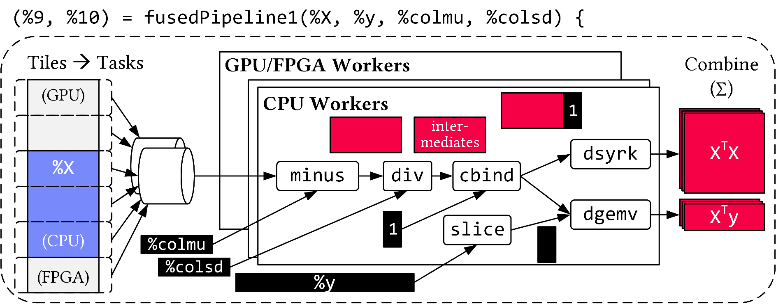
DAPHNE – Vectorized Execution
Operator Fusion & JIT Compilation
AH
AK
Default Parallelization
Frame & Matrix Ops
Locality-aware,
Multi-device Scheduling
Fused Operator Pipelines
on Tiles/Scalars + Codegen

Slide 36
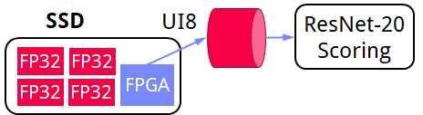
DAPHNE – Vectorized Execution, cont.
Operator Fusion & JIT Compilation
#1 Zero-copy Input Slicing
  Create view on sliced input (no-op)
  All kernels work on views
#2 Sparse Intermediates
  Reuse dense/sparse kernels
  Sparse pipeline intermediates for free
#3 Fine-grained Control
  Task sizes (dequeue, data access) vs data binding (cache-conscious ops)
  Scheduling for load balance (e.g., sparse operations)
#4 Computational Storage
  Task queues connect eBPF programs,
  async I/O into buffers, and op pipelines
Notes:
eBPF … Extended Berkeley Packet Filter

Slide 37
Conclusions
Summary
  Motivation and Terminology
  Runtime Adaptation
  Operator Fusion & JIT
➔ Impact of Size Inference and Costs (lecture 03)
➔ Ubiquitous Rewrite, Fusion, and Codegen/JIT Opportunities
Next Lectures (Runtime Aspects)
  05 Data- and Task-Parallel Execution (batch/prog) [Apr 08]
  Easter break
  06 Parameter Servers (mini-batch) [Apr 29]
  07 Hybrid Execution and HW Accelerators [May 06]
  08 Caching, Partitioning, Indexing and Compression [May 13]
Recommended Reading
[Chris Leary, Todd Wang: XLA –
TensorFlow, Compiled!, TF Dev Summit 2017, https://www.youtube.com/watch?v=kAOanJczHA0]

