Slide 1

Architecture of ML Systems
05 Data- and Task-Parallel Execution
Last update: Apr 05, 2022

Slide 2


Announcements/Org
#1 Video Recording
  Link in TeachCenter & TUbe (lectures will be public)
  Hybrid: HSi5 / https://tugraz.webex.com/meet/m.boehm
#2 Programming Projects / Exercises (25/114)
  #1 Apache SystemDS
  #2 DAPHNE
  #3 SIGMOD Programming Contest / custom projects
  #4 Exercise on ML Pipelines → TeachCenter
  Project Registration: Mar 31
  Project/Exercise Deadline: June 17, 11.59pm
Q&A

Slide 3
Agenda
Motivation and Terminology
Background MapReduce and Spark
Data-Parallel Execution
Task-Parallel Execution

Slide 4
Motivation and Terminology

Slide 5
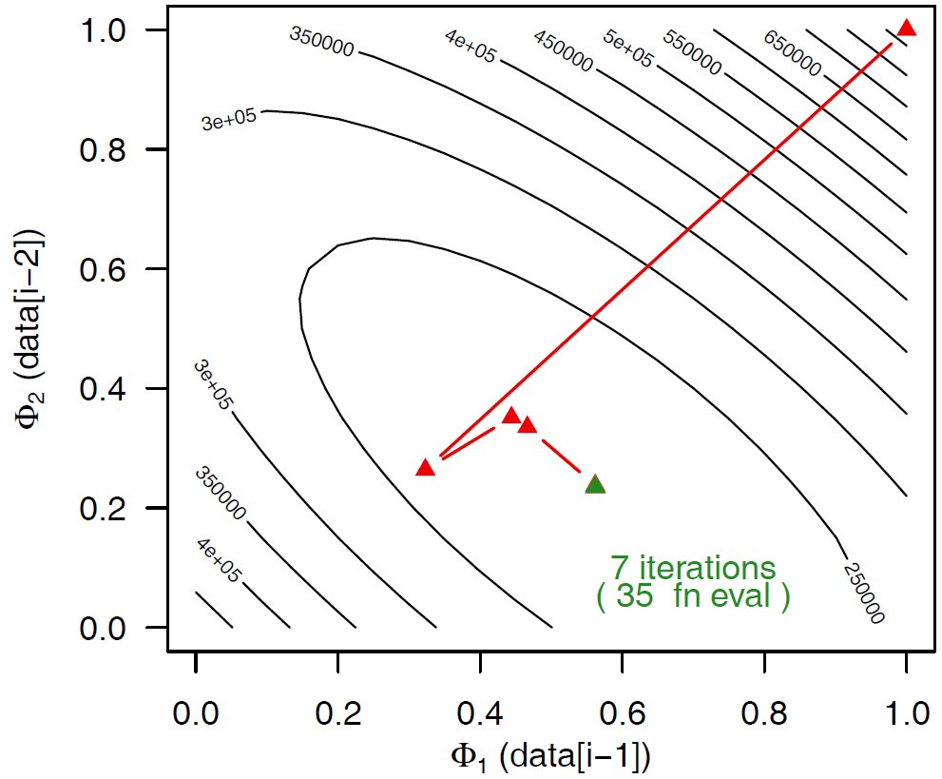
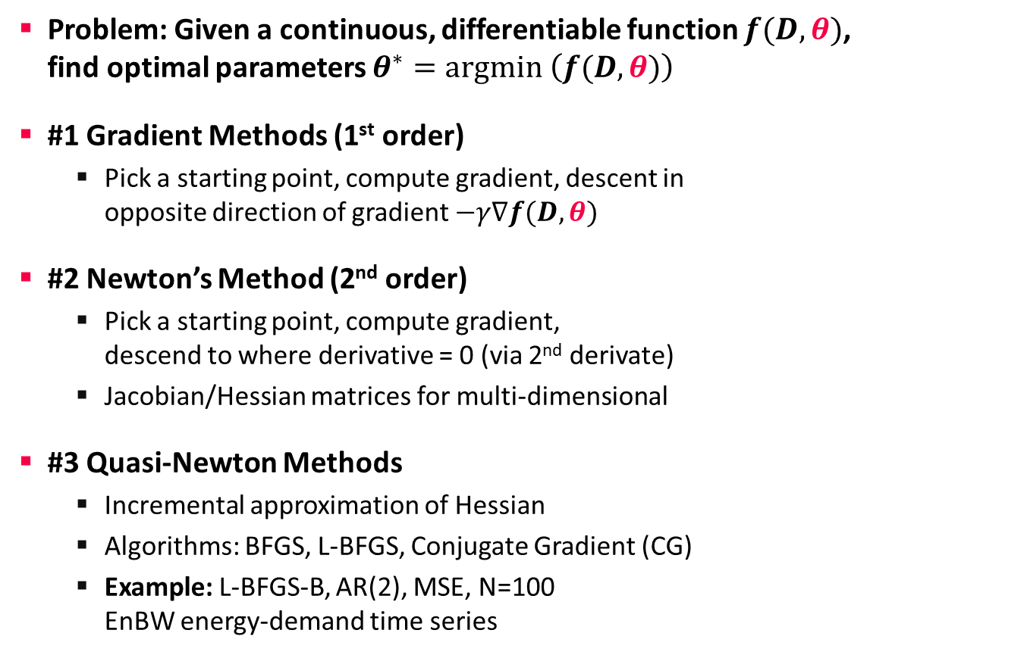
Terminology Optimization Methods
Motivation and Terminology
Problem: Given a continuous, differentiable function $f(D,θ)$,
find optimal parameters $θ^{∗}=argmin \left(f(D,θ)\right)$
#1 Gradient Methods (1st order)
  Pick a starting point, compute gradient, descent in
  opposite direction of gradient $−γ∇f(D,θ)$
#2 Newton’s Method (2nd order)
  Pick a starting point, compute gradient,
  descend to where derivative = 0 (via 2nd derivate)
  Jacobian/Hessian matrices for multi-dimensional
#3 Quasi-Newton Methods
  Incremental approximation of Hessian
  Algorithms: BFGS, L-BFGS, Conjugate Gradient (CG)
  Example: L-BFGS-B, AR(2), MSE, N=100
  EnBW energy-demand time series
θ₂
θ₁
x₂
x₃
x₁
x₀
θ₁
Notes:
BFGS vs CG: https://pubsonline.informs.org/doi/abs/10.1287/moor.3.3.244

Slide 6
Terminology Batch/Mini-batch
Motivation and Terminology
Batch ML Algorithms
  Iterative ML algorithms, where each iteration
  uses the entire dataset to compute gradients ΔW
  For (pseudo-)second-order methods, many features
  Dedicated optimizers for traditional ML algorithms
Mini-batch ML Algorithms
  Iterative ML algorithms, where each iteration
  only uses a batch of rows to make the
  next model update (in epochs or w/ sampling)
  For large and highly redundant training sets
  Applies to almost all iterative, model-based
  ML algorithms (LDA, reg., class., factor., DNN)
  Stochastic Gradient Descent (SGD)
Data
W’
Data
Batch 1
W’
Batch 2
W’’
Epoch

Slide 7
Recap: Central Data Abstractions
Motivation and Terminology
#1 Files and Objects
  File: Arbitrarily large sequential data in specific file format (CSV, binary, etc)
  Object: binary large object, with certain meta data
#2 Distributed Collections
  Logical multi-set (bag) of key-value pairs
  (unsorted collection)
  Different physical representations
  Easy distribution of pairs
  via horizontal partitioning
  (aka shards, partitions)
  Can be created from single file,
  or directory of files (unsorted)
Key | Value
4 | Delta
2 | Bravo
1 | Alfa
3 | Charlie
5 | Echo
6 | Foxtrot
7 | Golf
1 | Alfa

Slide 8
Terminology Parallelism
Motivation and Terminology
Single Data
Multiple Data
Flynn’s Classification
  SISD, SIMD
  (MISD), MIMD
Example: SIMD Processing
  Streaming SIMD Extensions (SSE)
  Process the same operation on
  multiple elements at a time
  (packed vs scalar SSE instructions)
  Data parallelism
  (aka: instruction-level parallelism)
  Example: VFMADD132PD
SISD
(uni-core)
SIMD
(vector)
Single Instruction
[Michael J. Flynn, Kevin W. Rudd: Parallel Architectures. ACM Comput. Surv. 28(1) 1996]
MISD
(pipelining)
MIMD
(multi-core)
Multiple Instruction
2009 Nehalem: 128b (2xFP64)
2012 Sandy Bridge: 256b (4xFP64)
2017 Skylake: 512b (8xFP64)
c = _mm512_fmadd_pd(a, b);
a
b
c

Slide 9
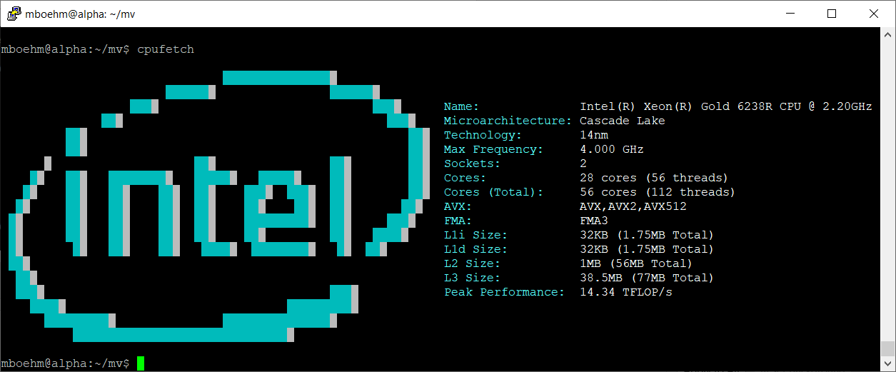
Excursus: Peak Performance
Motivation and Terminology
Example Scale-up Node (DM cluster)
  Peak := 2 Sockets * 28 Cores * 2.2 GHz
  * 2 FMA units * 16 FP32 slots (AVX512) * 2 (FMA)
  = 7.7 TFLOP/s (FP32) = 3.85 TFLOP/s (FP64)
SystemDS matmult w/ BLAS (Intel MKL):
2.23 TFLOP/s (FP64)

Slide 10
Terminology Parallelism, cont.
Motivation and Terminology
Distributed, Data-Parallel
Computation
  Parallel computation of function foo() ➔ single instruction
  Collection X of data items (key-value pairs) ➔ multiple data
  Data parallelism similar to SIMD but more coarse-grained notion of
  “instruction” and “data” ➔ SPMD (single program, multiple data)
Additional Terminology
  BSP: Bulk Synchronous Parallel (global barriers)
  ASP: Asynchronous Parallel (no barriers, often with accuracy impact)
  SSP: Stale-synchronous parallel (staleness constraint on fastest-slowest)
  Other: Fork&Join, Hogwild!, event-based, decentralized
Beware: data parallelism used in very different contexts (e.g., Param Server)
Y = X.map(x -> foo(x))
[Frederica Darema: The SPMD Model : Past, Present and Future. PVM/MPI 2001]

Slide 11
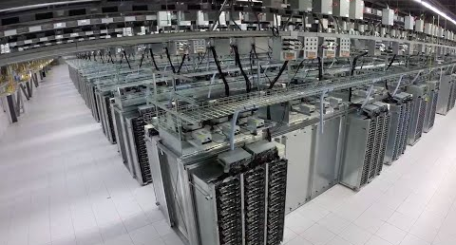
Recap: Fault Tolerance & Resilience
Motivation and Terminology
[Google Data Center: https://www.youtube.com/watch?v=XZmGGAbHqa0]
Resilience Problem
  Increasing error rates at scale
  (soft/hard mem/disk/net errors)
  Robustness for preemption
  Need for cost-effective resilience
Fault Tolerance in Large-Scale Computation
  Block replication in distributed file systems
  ECC; checksums for blocks, broadcast, shuffle
  Checkpointing (all task outputs / on request)
  Lineage-based recomputation for recovery in Spark
ML-specific Approaches (exploit app characteristics)
  Estimate contribution from lost partition to avoid strugglers
  Example: user-defined “compensation” functions

Slide 12
Categories of Execution Strategies
Motivation and Terminology
Batch/Mini-batch, Independent Tasks MIMD
Batch
SIMD/SPMD
Mini-batch
05_{a} Data-Parallel Execution
[Apr 03]
05_{b} Task-Parallel Execution
[Apr 03]
06 Parameter Servers (data, model)
05_{a} Data-Parallel Execution
05_{b} Task-Parallel Execution
07 Hybrid Execution and HW Accelerators
08 Caching, Partitioning, Indexing, and Compression

Slide 13
Background MapReduce and Spark
(Data-Parallel Collection Processing)
Abstractions for Fault-tolerant,
Distributed Storage and Computation

Slide 14

Hadoop History and Architecture
Data-Parallel Collection Processing
[Jeffrey Dean, Sanjay Ghemawat: MapReduce: Simplified Data Processing on Large Clusters. OSDI 2004]
Recap: Brief History
  Google’s GFS [SOSP’03] + MapReduce
  → Apache Hadoop (2006)
  Apache Hive (SQL), Pig (ETL), Mahout (ML), Giraph (Graph)
Hadoop Architecture / Eco System
  Management (Ambari)
  Coordination / workflows
  (Zookeeper, Oozie)
  Storage (HDFS)
  Resources (YARN)
  [SoCC’13]
  Processing
  (MapReduce)
Worker Node 1
Worker Node n
MR AM
MR task
MR task
MR task
Head Node
MR task
MR task
MR task
MR task
Resource Manager
Node Manager
Node Manager
NameNode
MR Client
DataNode
DataNode
1
3
2
3
2
9

Slide 15
MapReduce – Programming Model
Data-Parallel Collection Processing
Overview Programming Model
  Inspired by functional programming languages
  Implicit parallelism (abstracts distributed storage and processing)
  Map function: key/value pair → set of intermediate key/value pairs
  Reduce function: merge all intermediate values by key
Example
SELECT Dep, count(*) FROM csv_files GROUP BY Dep
Name | Dep
X | CS
Y | CS
A | EE
Z | CS
map(Long pos, String line) {
parts ← line.split(“,”)
emit(parts[1], 1)
}
CS | 1
CS | 1
EE | 1
CS | 1
reduce(String dep,
Iterator<Long> iter) {
total ← iter.sum();
emit(dep, total)
}
Collection of key/value pairs
CS | 3
EE | 1

Slide 16
MapReduce – Execution Model
Data-Parallel Collection Processing
#1 Data Locality (delay sched., write affinity)
#2 Reduced shuffle (combine)
#3 Fault tolerance (replication, attempts)
Input CSV files (stored in HDFS)
Map-Phase
map
task
[Reduce-Phase]
Output Files (HDFS)
CSV File 1
Split 11
map
task
Split 12
reduce
task
Out 1
Split 21
map
task
CSV File 2
reduce
task
Out 2
Split 22
map
task
reduce
task
Out 3
CSV File 3
Split 31
map
task
Split 32
map
task
Shuffle, Merge, [Combine]
Sort, [Combine], [Compress]
w/ #reducers = 3

Slide 17

Spark History and Architecture
Data-Parallel Collection Processing
Summary MapReduce
  Large-scale & fault-tolerant processing w/ UDFs and files ➔ Flexibility
  Restricted functional APIs ➔ Implicit parallelism and fault tolerance
  Criticism: #1 Performance, #2 Low-level APIs, #3 Many different systems
Evolution to Spark (and Flink)
  Spark [HotCloud’10] + RDDs [NSDI’12] → Apache Spark (2014)
  Design: standing executors with in-memory storage,
  lazy evaluation, and fault-tolerance via RDD lineage
  Performance: In-memory storage and fast job scheduling (100ms vs 10s)
  APIs: Richer functional APIs and general computation DAGs,
  high-level APIs (e.g., DataFrame/Dataset), unified platform
➔ But many shared concepts/infrastructure
  Implicit parallelism through dist. collections (data access, fault tolerance)
  Resource negotiators (YARN, Mesos, Kubernetes)
  HDFS and object store connectors (e.g., Swift, S3)

Slide 18
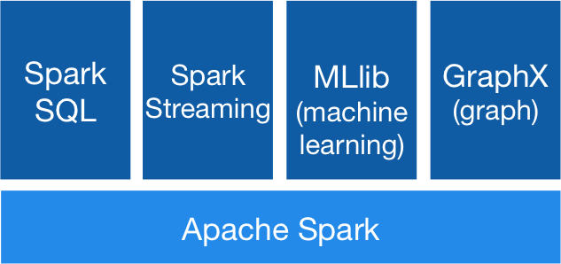


Spark History and Architecture, cont.
Data-Parallel Collection Processing
High-Level Architecture
  Different language bindings:
  Scala, Java, Python, R
  Different libraries:
  SQL, ML, Stream, Graph
  Spark core (incl RDDs)
  Different cluster managers:
  Standalone, Mesos,
  Yarn, Kubernetes
  Different file systems/
  formats, and data sources:
  HDFS, S3, SWIFT, DBs, NoSQL
Focus on a unified platform
for data-parallel computation (Apache Flink w/ similar goals)
[https://spark.apache.org/]
Standalone
MESOS
YARN
Kubernetes

Slide 19
Spark Resilient Distributed Datasets (RDDs)
Data-Parallel Collection Processing
RDD Abstraction
  Immutable, partitioned
  collections of key-value pairs
  Coarse-grained deterministic operations (transformations/actions)
  Fault tolerance via lineage-based re-computation
Operations
  Transformations:
  define new RDDs
  Actions: return
  result to driver
Distributed Caching
  Use fraction of worker memory for caching
  Eviction at granularity of individual partitions
  Different storage levels (e.g., mem/disk x serialization x compression)
JavaPairRDD<MatrixIndexes,MatrixBlock>
Type | Examples
Transformation (lazy) | map, hadoopFile, textFile, flatMap, filter, sample, join, groupByKey, cogroup, reduceByKey, cross, sortByKey, mapValues
Action | reduce, save, collect, count, lookupKey
Node1
Node2

Slide 20
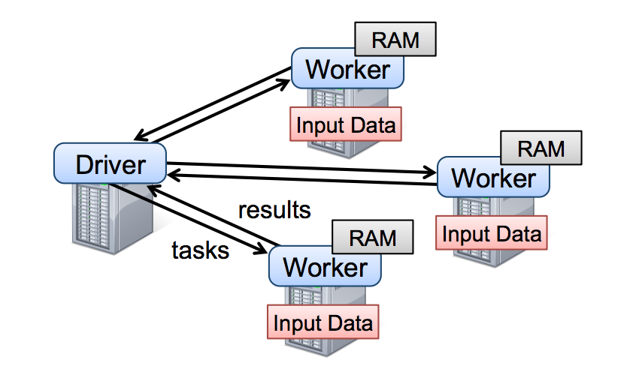
Spark Resilient Distributed Datasets (RDDs), cont.
Data-Parallel Collection Processing
Lifecycle of an RDD
  Note: can’t broadcast
  an RDD directly
X.filter(foo())
X.mapValues(foo())
X.reduceByKey(foo())
X.cache()/X.persist(…)
sc.parallelize(lst)
Local Data
(value, collection)
Distributed Collection
lst = X.collect()
v = X.reduce(foo())
sc.hadoopFile(f)
sc.textFile(f)
X.saveAsObjectFile(f)
X.saveAsTextFile(f)
File on DFS

Slide 21
Spark Partitions and Implicit/Explicit Partitioning
Data-Parallel Collection Processing
Spark Partitions
  Logical key-value collections are split into physical partitions
  Partitions are granularity of tasks, I/O, shuffling, evictions
Partitioning via Partitioners
  Implicitly on every data shuffling
  Explicitly via R.repartition(n)
Partitioning-Preserving
  All operations that are guaranteed to keep keys unchanged
  (e.g. mapValues(), mapPartitions() w/ preservesPart flag)
Partitioning-Exploiting
  Join: R3 = R1.join(R2)
  Lookups:
  v = C.lookup(k)
~128MB
Example Hash Partitioning:
For all (k,v) of R:
pid = hash(k) % n
Hash partitioned
⋈
⋈
0: 8, 1, 6
0: 1, 2
% 3
0: 3, 6
0: 6, 3
2: 2, 3, 4
2: 3, 4
2: 2, 5, 8
2: 5, 2
1: 7, 5
1: 5, 6
1: 4, 7, 1
1: 4, 1

Slide 22
Spark Lazy Evaluation, Caching, and Lineage
Data-Parallel Collection Processing
A
B
partitioning- aware
G
Stage 1
groupBy
C
D
F
reduce
map
union
E
join
Stage 2
Stage 3
cached
[Matei Zaharia, Mosharaf Chowdhury, Tathagata Das, Ankur Dave, Justin Ma, Murphy McCauly, Michael J. Franklin, Scott Shenker, Ion Stoica: Resilient Distributed Datasets: A Fault-Tolerant Abstraction for In-Memory Cluster Computing. NSDI 2012]
Notes:
Notes:
Dryad-­‐like DAGs
Pipelines functions within a stage
Locality & data reuse aware
Partitioning-­‐aware to avoid shuffles

Slide 23




Data-Parallel Execution
Batch ML Algorithms

Slide 24
Background: Matrix Formats
Data-Parallel Execution
Example
3x3 Matrix
Matrix Block (m x n)
  A.k.a. tiles/chunks, most operations defined here
  Local matrix: single block, different representations
Common Block Representations
  Dense (linearized arrays)
  MCSR (modified CSR)
  CSR (compressed sparse rows), CSC
  COO (Coordinate matrix)
.7
.1
.2
.4
.3
MCSR
CSR
COO
0
2
0
0
.7
0
0
.7
Dense (row-major)
.7
.1
2
2
.1
0
2
.1
.7
0
.1
.2
.4
0
0
.3
0
0
1
4
0
.2
1
0
.2
.2
.4
O(mn)
5
1
.4
1
1
.4
1
1
.3
2
1
.3
.3
O(m + nnz(X))
O(nnz(X))

Slide 25
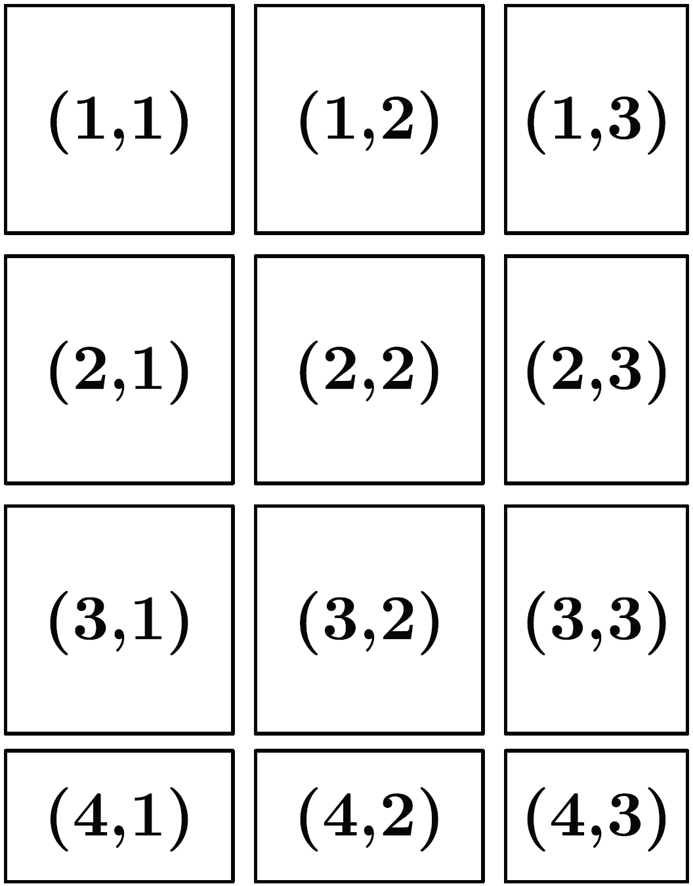
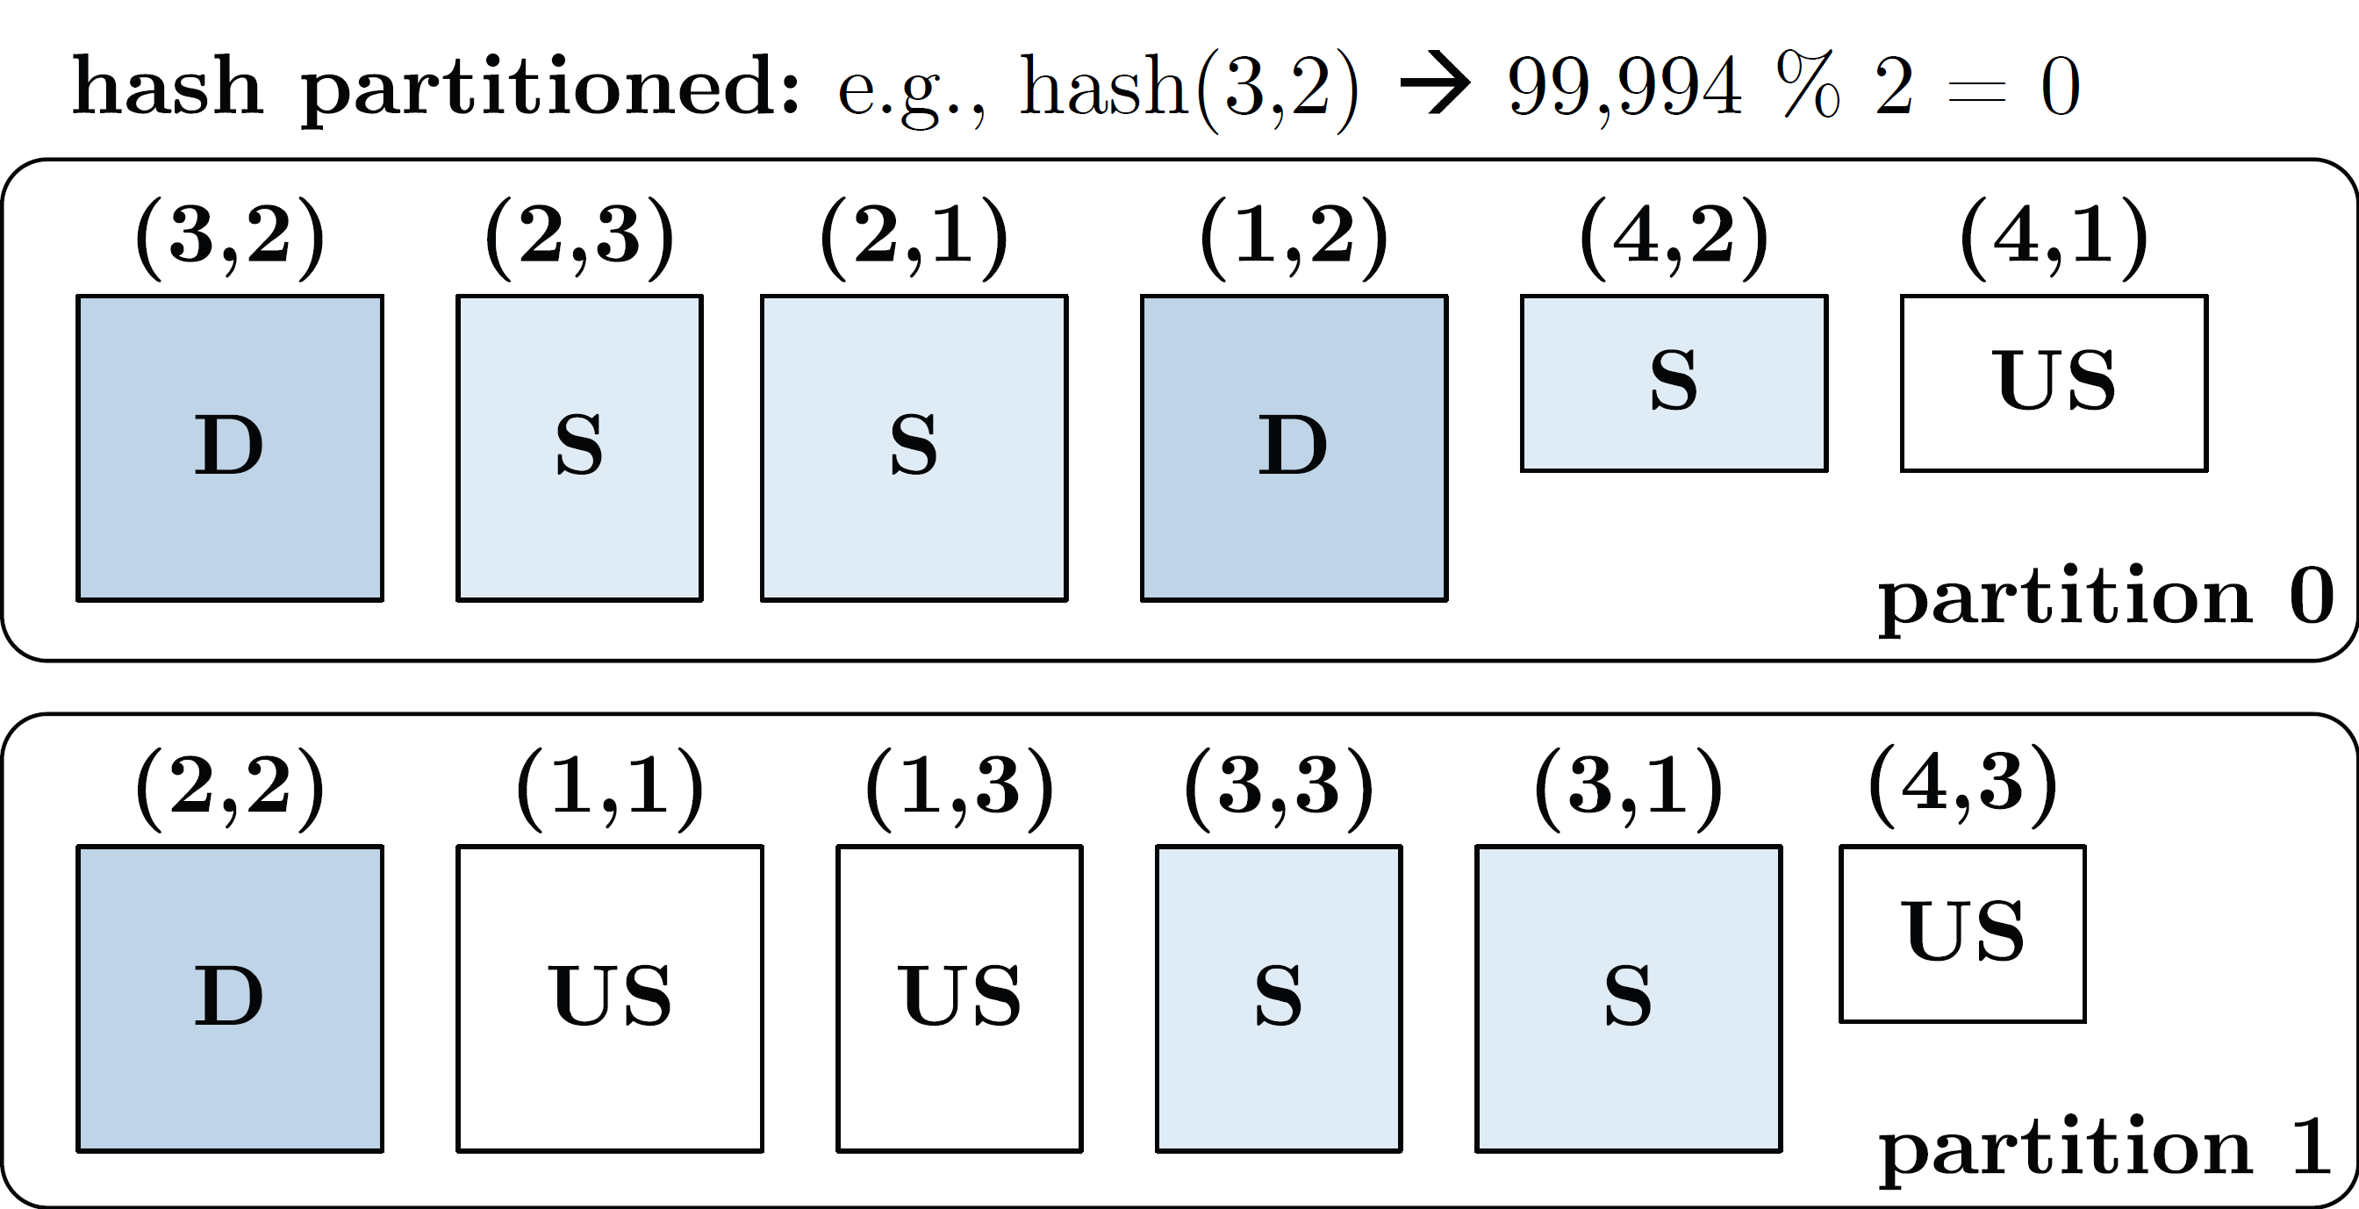
Distributed Matrix Representations
Data-Parallel Execution
Logical Blocking 3,400x2,700 Matrix
(w/ B_{c}=1,000)
Collection of “Matrix Blocks” (and keys)
  Bag semantics (duplicates, unordered)
  Logical (Fixed-Size) Blocking
  + join processing / independence
  - (sparsity skew)
  E.g., SystemML on Spark:
  JavaPairRDD<MatrixIndexes,MatrixBlock>
  Blocks encoded independently (dense/sparse)
Partitioning
  Logical Partitioning
  (e.g., row-/column-wise)
  Physical Partitioning
  (e.g., hash / grid)
Physical Blocking and Partitioning

Slide 26
Distributed Matrix Representations, cont.
Data-Parallel Execution
#1 Block-partitioned Matrices
  Fixed-size, square or rectangular blocks
  Pros: Input/output alignment, block-local transpose,
  amortize block overheads, bounded mem, cache-conscious
  Cons: Converting row-wise inputs (e.g., text) requires shuffle
  Examples: RIOT, PEGASUS, SystemML, SciDB, Cumulon,
  Distributed R, DMac, Spark Mllib, Gilbert, MatFast, and SimSQL
#2 Row/Column-partitioned Matrices
  Collection of row indexes and rows (or columns respectively)
  Pros: Seamless data conversion and access to entire rows
  Cons: Storage overhead in Java, and cache unfriendly operations
  Examples: Spark MLlib, Mahout Samsara, Emma, SimSQL
#3 Algorithm-specific Partitioning
  Operation and algorithm-centric data representations
  Examples: matrix inverse, matrix factorization

Slide 27
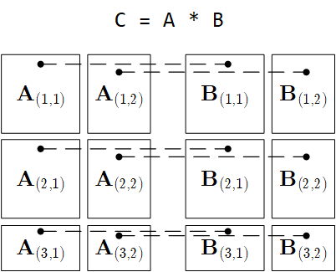
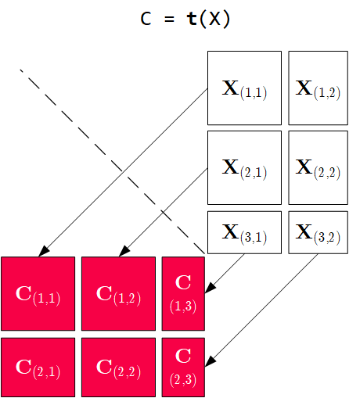
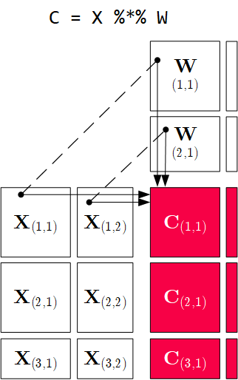
Distributed Matrix Operations
Data-Parallel Execution
Elementwise Multiplication
(Hadamard Product)
Matrix
Multiplication
Transposition
Note: also with row/column vector rhs
Note: 1:N join

Slide 28
Physical MM Operator Selection
Data-Parallel Execution
Common Selection Criteria
  Data and cluster characteristics (e.g., data size/shape, memory, parallelism)
  Matrix/operation properties (e.g., diagonal/symmetric, sparse-safe ops)
  Data flow properties (e.g., co-partitioning, co-location, data locality)
#0 Local Operators
  SystemML mm, tsmm, mmchain; Samsara/Mllib local
#1 Special Operators (special patterns/sparsity)
  SystemML tsmm, mapmmchain; Samsara AtA
#2 Broadcast-Based Operators (aka broadcast join)
  SystemML mapmm, mapmmchain
#3 Co-Partitioning-Based Operators (aka improved repartition join)
  SystemML zipmm; Emma, Samsara OpAtB
#4 Shuffle-Based Operators (aka repartition join)
  SystemML cpmm, rmm; Samsara OpAB
t(X) %*% (X%*%v)
1st
pass
v
2nd
pass
X
q┬
X

Slide 29
Physical MM Operator Selection, cont.
Data-Parallel Execution
Examples Distributed MM Operators
Y
_{1,1}
Y_{1,1}
Y_{1,2}
Broadcast-based MM (mapmm)
Shuffle-based MM (cpmm)
Y
_{2,1}
Y_{2,1}
Y_{2,2}
X_{1,1}
X_{1,2}
Y_{3,1}
Y_{3,2}
X_{2,1}
X_{2,2}
Y_{4,1}
Y_{4,2}
X_{3,1}
X_{3,2}
X_{1,1}
X_{1,2}
X_{1,3}
X_{1,4}
X_{4,1}
X_{4,2}
X_{2,1}
X_{2,2}
X_{2,3}
X_{2,4}

Slide 30
Partitioning-Preserving Operations
Data-Parallel Execution
Shuffle is major bottleneck for ML on Spark
Preserve Partitioning
  Op is partitioning-preserving if keys unchanged (guaranteed)
  Implicit: Use restrictive APIs (mapValues() vs mapToPair())
  Explicit: Partition computation w/ declaration of partitioning-preserving
Exploit Partitioning
  Implicit: Operations based on join, cogroup, etc
  Explicit: Custom operators (e.g., zipmm)
Example:
Multiclass SVM
  Vectors fit
  neither into
  driver nor
  broadcast
  ncol(X) ≤ B_{c}
repart, chkpt X MEM_DISK
parfor(iter_class in 1:num_classes) {
Y_local = 2 * (Y == iter_class) - 1
g_old = t(X) %*% Y_local
...
while( continue ) {
Xd = X %*% s
... inner while loop (compute step_sz)
Xw = Xw + step_sz * Xd;
out = 1 - Y_local * Xw;
out = (out > 0) * out;
g_new = t(X) %*% (out * Y_local) ...
chkpt y_local MEM_DISK
chkpt Xd, Xw MEM_DISK
zipmm

Slide 31
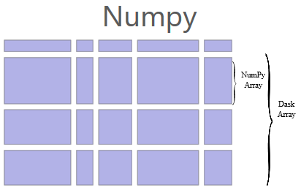
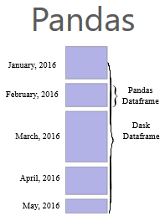
Dask
Data-Parallel Execution
[Matthew Rocklin: Dask: Parallel Computation with Blocked algorithms and Task Scheduling, Python in Science 2015]
[Dask Development Team: Dask: Library for dynamic task scheduling, 2016, https://dask.org]
Overview Dask
  Multi-threaded and distributed operations for arrays, bags, and dataframes
  dask.array:
  list of numpy n-dim arrays
  dask.dataframe:
  list of pandas data frames
  dask.bag:unordered list of tuples (second order functions)
  Local and distributed schedulers:
  threads, processes, YARN, Kubernetes, containers, HPC, and cloud, GPUs
Execution
  Lazy evaluation
  Limitation: requires
  static size inference
  Triggered via
  compute()
import dask.array as da
x = da.random.random(
(10000,10000), chunks=(1000,1000))
y = x + x.T
y.persist() # cache in memory
z = y[::2, 5000:].mean(axis=1) # colMeans
ret = z.compute() # returns NumPy array
Notes:
Note: somewhat in competition w/ PySpark (but not out-of-core), scalable ML algorithms via https://ml.dask.org/ (partnering with scikit-learn, XGBoost)

Slide 32
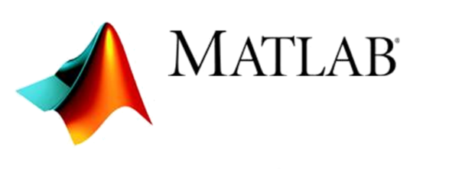




Task-Parallel Execution
Parallel Computation of Independent Tasks,
Emulation of Data-Parallel Operations/Programs

Slide 33

Overview Task-Parallelism
Task-Parallel Execution
Historic Perspective
  Since 1980s: various parallel Fortran extensions, especially in HPC
  DOALL parallel loops (independent iterations)
  OpenMP (since 1997,
  Open Multi-Processing)
Motivation: Independent Tasks in ML Workloads
  Use cases: Ensemble learning, cross validation, hyper-parameter tuning,
  complex models with disjoint/overlapping/all data per task
  Challenge #1: Adaptation to data and cluster characteristics
  Challenge #2: Combination with data-parallelism
#pragma omp parallel for reduction(+: nnz)
for (int i = 0; i < N; i++) {
int threadID = omp_get_thread_num();
R[i] = foo(A[i]);
nnz += (R[i]!=0) ? 1 : 0;
}

Slide 34
Parallel For Loops (ParFor)
Task-Parallel Execution
[M. Boehm et al.: Hybrid Parallelization Strategies for Large-Scale Machine Learning in SystemML. PVLDB 2014]
Hybrid Parallelization Strategies
  Combination of data- and task-parallel ops
  Combination of local and distributed computation
Key Aspects
  Dependency Analysis
  Task partitioning
  Data partitioning, scan
  sharing, various rewrites
  Execution strategies
  Result agg strategies
  ParFor optimizer
reg = 10^(seq(-1,-10))
B_all = matrix(0, nrow(reg), n)
parfor( i in 1:nrow(reg) ) {
B = lm(X, y, reg[i,1]);
B_all[i,] = t(B);
}
Local ParFor
(multi-threaded),
w/ local ops
Remote ParFor
(distributed
Spark job)
Local ParFor,
w/ concurrent distributed ops
Notes:
NOTE: dependency analysis (constant, greatest common denominator if dependency possible, Banerjee if dependencies in loop bounds)

Slide 35
Additional ParFor Examples
Task-Parallel Execution
Pairwise Pearson Correlation
  In practice: uni/bivariate stats
  Pearson‘s R, Anova F, Chi-squared,
  Degree of freedom, P-value,
  Cramers V, Spearman, etc)
Batch-wise CNN Scoring
  Emulate data-parallelism
  for complex functions
➔ Conceptual Design:
Coordinator/worker (task: group of parfor iterations)
D = read("./input/D");
R = matrix(0, ncol(D), ncol(D));
parfor(i in 1:(ncol(D)-1)) {
X = D[ ,i];
sX = sd(X);
parfor(j in (i+1):ncol(D)) {
Y = D[ ,j];
sY = sd(Y);
R[i,j] = cov(X,Y)/(sX*sY);
} }
write(R, "./output/R");
prob = matrix(0, Ni, Nc)
parfor( i in 1:ceil(Ni/B) ) {
Xb = X[((i-1)*B+1):min(i*B,Ni),];
prob[((i-1)*B+1):min(i*B,Ni),] =
... # CNN scoring
}

Slide 36
ParFor Execution Strategies
Task-Parallel Execution
#1 Task Partitioning
  Fixed-size schemes:
  naive (1) , static (n/k), fixed (m)
  Self-scheduling: e.g.,
  guided self scheduling, factoring
#2 Data Partitioning
  Local or remote row/column
  partitioning (incl locality)
#3 Task Execution
  Local (multi-core) execution
  Remote (MR/Spark) execution
#4 Result Aggregation
  With and without compare (non-empty output variable)
  Local in-memory / remote MR/Spark result aggregation
Factoring (n=101, k=4)
(13,13,13,13, 7,7,7,7, 3,3,3,3, 2,2,2,2, 1)
parfor(i in 1:(ncol(D)-1)) {
X = D[ ,i];
sX = sd(X);
parfor(j in (i+1):ncol(D)) {
Y = D[ ,j];

Slide 37
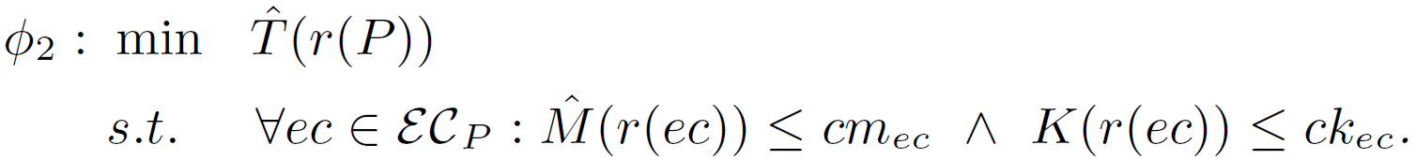
ParFor Optimizer Framework
Task-Parallel Execution
Design: Runtime optimization for each top-level parfor
Plan Tree P
  Nodes N_{P}
    Exec type et
    Parallelism k
    Attributes A
  Height h
  Exec contexts EC_{P}
Plan Tree
Optimization
Objective
Heuristic optimizer w/ transformation-based search strategy
  Cost and memory estimates w/ plan tree aggregate statistics

Slide 38
Task-Parallelism in R
Task-Parallel Execution
Multi-Threading
  doMC as multi-threaded
  foreach backend
  Foreach w/ parallel (%dopar%)
  or sequential (%do%) execution
Distribution
  doSNOW as distributed
  foreach backend
  MPI/SOCK as comm methods
library(doMC)
registerDoMC(32)
R <- foreach(i=1:(ncol(D)-1),
.combine=rbind) %dopar% {
X = D[,i]; sX = sd(X);
Ri = matrix(0, 1, ncol(D))
for(j in (i+1):ncol(D)) {
Y = D[,j]; sY = sd(Y)
Ri[1,j] = cov(X,Y)/(sX*sY);
}
return(Ri);
}
[https://cran.r-project.org/web/packages/
doMC/vignettes/gettingstartedMC.pdf]
library(doSNOW)
clust = makeCluster(
c(“192.168.0.1”, “192.168.0.2”,
“192.168.0.3”), type=“SOCK”);
registerDoSNOW(clust);
... %dopar% ...
stopCluster(clust);
[https://cran.r-project.org/web/packages/
doSNOW/doSNOW.pdf]

Slide 39
Task-Parallelism in Other Systems
Task-Parallel Execution
MATLAB
  Parfor loops for
  multi-process &
  distributed loops
  Use-defined par
Julia
  Dedicated macros:
  @threads
  @distributed
TensorFlow
  User-defined parallel iterations, responsible for
  correct results or acceptable approximate results
matlabpool 32
c = pi; z = 0;
r = rand(1,10)
parfor i = 1 : 10
z = z+1; # reduction
b(i) = r(i); # sliced
end
[Gaurav Sharma, Jos Martin: MATLAB®: A Language for Parallel Computing. Int. Journal on Parallel Prog. 2009]
a = zeros(1000)
@threads for i in 1:1000
a[i] = rand(r[threadid()])
end
[https://docs.julialang.
org/en/v1/manual/
parallel-computing/]
[https://www.tensorflow.org/
api_docs/python/tf/while_loop]
tf.while_loop(cond, body, loop_vars, parallel_iterations=10,
swap_memory=False, maximum_iterations=None, ...)

Slide 40
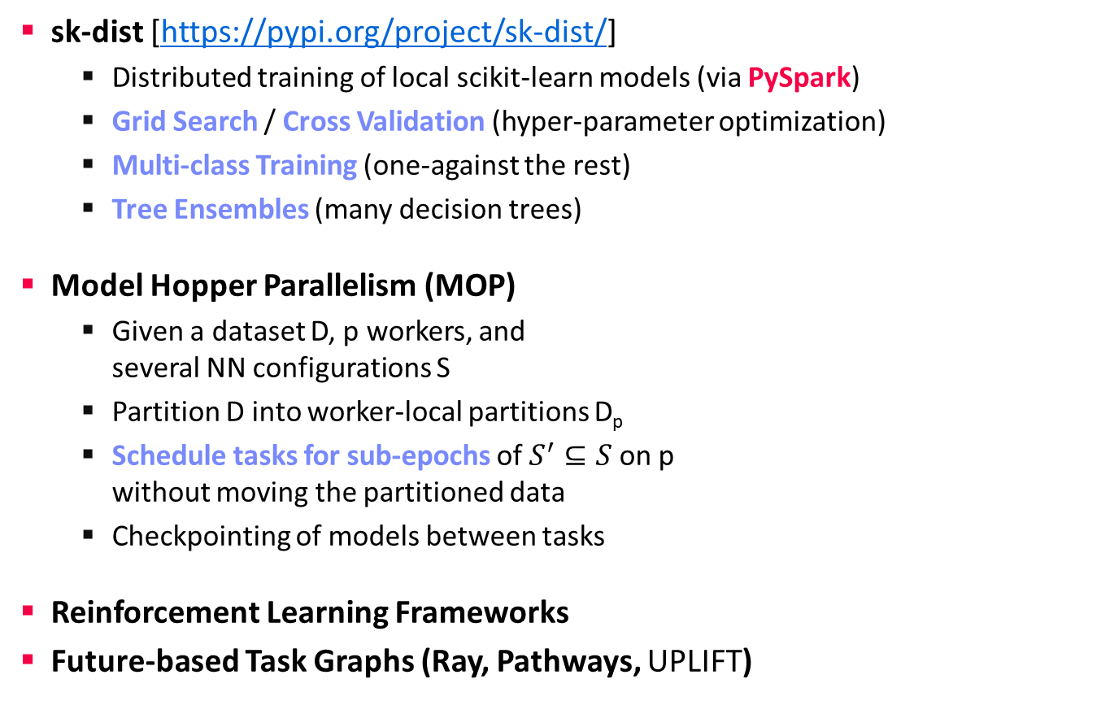
Task-Parallelism in Other Systems, cont.
Task-Parallel Execution
sk-dist [https://pypi.org/project/sk-dist/]
  Distributed training of local scikit-learn models (via PySpark)
  Grid Search / Cross Validation (hyper-parameter optimization)
  Multi-class Training (one-against the rest)
  Tree Ensembles (many decision trees)
Model Hopper Parallelism (MOP)
  Given a dataset D, p workers, and
  several NN configurations S
  Partition D into worker-local partitions D_{p}
  Schedule tasks for sub-epochs of $S^{′}⊆S$ on p
  without moving the partitioned data
  Checkpointing of models between tasks
Reinforcement Learning Frameworks
Future-based Task Graphs (Ray, Pathways, UPLIFT)
[Supun Nakandala, Yuhao Zhang, Arun Kumar: Cerebro: Efficient and Reproducible Model Selection on Deep Learning Systems. DEEM@SIGMOD 2019]
[Supun Nakandala, Yuhao Zhang, Arun Kumar: Cerebro: A Data System for Optimized Deep Learning Model Selection. PVLDB 2020]
Part of
Next Lecture
Notes:
Pathways paper: https://arxiv.org/pdf/2203.12533.pdf

Slide 41
Summary and Q&A
Categories of Execution Strategies
  Data-parallel execution for batch ML algorithms
  Task-parallel execution for custom parallelization of independent tasks
  Parameter servers (data-parallel vs model-parallel)
  for mini-batch ML algorithms
#1 Different strategies (and systems) for different ML workloads
➔ Specialization and abstraction
#2 Awareness of underlying execution frameworks
#3 Awareness of effective compilation and runtime techniques
Next Lectures (after Easter Break)
  06 Parameter Servers [Apr 29]
  07 Hybrid Execution and HW Accelerators [May 06]
  08 Caching, Partitioning, Indexing and Compression [May 13]

