Slide 1

Architecture of ML Systems
06 Parameter Servers
Last update: Apr 27, 2022

Slide 2



Announcements/Org
#1 Video Recording
  Link in TeachCenter & TUbe (lectures will be public)
  Hybrid: HSi13 / https://tugraz.webex.com/meet/m.boehm
  Apr 25: no more COVID restrictions at TU Graz
#2 Course Evaluations and Exam
  Evaluation period: Jun 15 – Jul 31
  Oral Exams (45min each), doodle in June → exams in July
  (close to submission of projects/exercises)

Slide 3
Categories of Execution Strategies
Motivation and Terminology
Batch/Mini-batch, Independent Tasks MIMD
Batch
SIMD/SPMD
Mini-batch
05_{a} Data-Parallel Execution
05_{b} Task-Parallel Execution
06 Parameter Servers (data, model)
07 Hybrid Execution and HW Accelerators
08 Caching, Partitioning, Indexing, and Compression

Slide 4
Agenda
Data-Parallel Parameter Servers
Model-Parallel Parameter Servers
Distributed Reinforcement Learning
Federated Machine Learning

Slide 5
Data-Parallel Parameter Servers

Slide 6
Recap: Mini-batch ML Algorithms
Data-Parallel Parameter Servers
Mini-batch ML Algorithms
  Iterative ML algorithms, where each iteration
  only uses a batch of rows to make the
  next model update (in epochs or w/ sampling)
  For large and highly redundant training sets
  Applies to almost all iterative, model-based
  ML algorithms (LDA, reg., class., factor., DNN)
  Stochastic Gradient Descent (SGD)
Statistical vs Hardware Efficiency (batch size)
  Statistical efficiency: # accessed data points to achieve certain accuracy
  Hardware efficiency: number of independent computations to
  achieve high hardware utilization (parallelization at different levels)
  Beware higher variance / class skew for too small batches!
➔ Training Mini-batch ML algorithms sequentially is hard to scale
Data
Batch 1
W’
Batch 2
W’’
Epoch

Slide 7
Background: Mini-batch DNN Training (LeNet)
Data-Parallel Parameter Servers
[Yann LeCun, Leon Bottou, Yoshua Bengio, and Patrick Haffner: Gradient-Based Learning Applied to Document Recognition, Proc of the IEEE 1998]
# Initialize W1-W4, b1-b4
# Initialize SGD w/ Nesterov momentum optimizer
iters = ceil(N / batch_size)
for( e in 1:epochs ) {
for( i in 1:iters ) {
X_batch = X[((i-1) * batch_size) %% N + 1:min(N, beg + batch_size - 1),]
y_batch = Y[((i-1) * batch_size) %% N + 1:min(N, beg + batch_size - 1),]
## layer 1: conv1 -> relu1 -> pool1
## layer 2: conv2 -> relu2 -> pool2
## layer 3: affine3 -> relu3 -> dropout
## layer 4: affine4 -> softmax
outa4 = affine::forward(outd3, W4, b4)
probs = softmax::forward(outa4)
## layer 4: affine4 <- softmax
douta4 = softmax::backward(dprobs, outa4)
[doutd3, dW4, db4] = affine::backward(douta4, outr3, W4, b4)
## layer 3: affine3 <- relu3 <- dropout
## layer 2: conv2 <- relu2 <- pool2
## layer 1: conv1 <- relu1 <- pool1
# Optimize with SGD w/ Nesterov momentum W1-W4, b1-b4
[W4, vW4] = sgd_nesterov::update(W4, dW4, lr, mu, vW4)
[b4, vb4] = sgd_nesterov::update(b4, db4, lr, mu, vb4)
}
}
NN Forward
Pass
NN Backward
Pass
→ Gradients
Model
Updates
Notes:
Note: number of layers = layer ops w/ weights

Slide 8
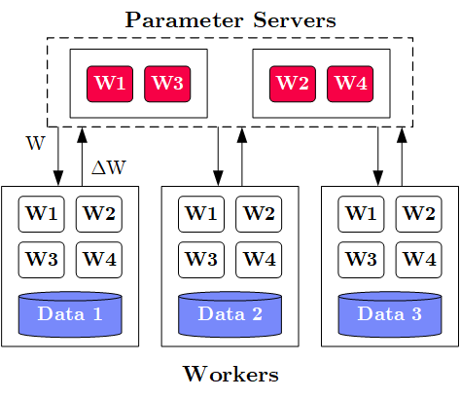
Overview Parameter Servers
Data-Parallel Parameter Servers
M
System
Architecture
  M Parameter
  Servers
  N Workers
  Optional
  Coordinator
Key Techniques
  Data partitioning D → workers Di (e.g., disjoint, reshuffling)
  Updated strategies (e.g., synchronous, asynchronous)
  Batch size strategies (small/large batches, hybrid methods)
W .. Model
ΔW .. Gradient
N
Notes:
Note: Nabla vs Delta operators

Slide 9
History of Parameter Servers
Data-Parallel Parameter Servers
1st Gen: Key/Value
  Distributed key-value store for
  parameter exchange and synchronization
  Relatively high overhead
2nd Gen: Classic Parameter Servers
  Parameters as dense/sparse matrices
  Different update/consistency strategies
  Flexible configuration and fault tolerance
3rd Gen: Parameter Servers w/
improved data communication
  Prefetching and range-based pull/push
  Lossy or lossless compression w/ compensations
Examples
  TensorFlow, MXNet, PyTorch, CNTK, Petuum
[Alexander J. Smola, Shravan M. Narayanamurthy: An Architecture for Parallel Topic Models. PVLDB 2010]
[Jeffrey Dean et al.: Large Scale Distributed Deep Networks. NIPS 2012]
[Mu Li et al: Scaling Distributed Machine Learning with the Parameter Server. OSDI 2014]
[Jiawei Jiang, Bin Cui, Ce Zhang, Lele Yu: Heterogeneity-aware Distributed Parameter Servers. SIGMOD 2017]
[Jiawei Jiang et al: SketchML: Accelerating Distributed Machine Learning with Data Sketches. SIGMOD 2018]

Slide 10
Basic Worker Algorithm (batch)
Data-Parallel Parameter Servers
for( i in 1:epochs ) {
for( j in 1:iterations ) {
params = pullModel(); # W1-W4, b1-b4 lr, mu
batch = getNextMiniBatch(data, j);
gradient = computeGradient(batch, params);
pushGradients(gradient);
}
}
[Jeffrey Dean et al.: Large Scale Distributed Deep Networks. NIPS 2012]

Slide 11
Extended Worker Algorithm (nfetch batches)
Data-Parallel Parameter Servers
gradientAcc = matrix(0,...);
for( i in 1:epochs ) {
for( j in 1:iterations ) {
if( step mod nfetch = 0 )
params = pullModel();
batch = getNextMiniBatch(data, j);
gradient = computeGradient(batch, params);
gradientAcc += gradient;
params = updateModel(params, gradients);
if( step mod nfetch = 0 ) {
pushGradients(gradientAcc); step = 0;
gradientAcc = matrix(0, ...);
}
step++;
} }
nfetch batches require
local gradient accrual and local model update
[Jeffrey Dean et al.: Large Scale Distributed Deep Networks. NIPS 2012]

Slide 12
Update Strategies
Data-Parallel Parameter Servers
Bulk Synchronous
Parallel (BSP)
  Update model w/
  accrued gradients
  Barrier for N workers
Asynchronous
Parallel (ASP)
  Update model
  for each gradient
  No barrier
Synchronous w/
Backup Workers
  Update model w/
  accrued gradients
  Barrier for N of
  N+b workers
Batch 1
Batch 2
Batch 3
Batch 1
Batch 2
Batch 3
Batch 1
Batch 2
Batch 3
Batch 1
Batch 2
Batch 3
Batch 1
Batch 2
Batch 3
but, stale model updates
Batch 1
Batch 2
Batch 3
Batch 1
Batch 2
Batch 3
Batch 1
Batch 2
Batch 3
Batch 1
Batch 2
Batch 3
Batch 1
Batch 2
Batch 3
Batch 1
Batch 2
Batch 3
Batch 1
Batch 2
Batch 3
[Martín Abadi et al: TensorFlow: A System for Large-Scale Machine Learning. OSDI 2016]

Slide 13
Update Strategies, cont.
Data-Parallel Parameter Servers
Stale-Synchronous Parallel (SSP)
  Similar to backup workers,
  weak synchronization barrier
  Maximum staleness of s clocks between fastest
  and slowest worker → if violated, block fastest
Hogwild!
  Even the model update
  completely unsynchronized
  Shown to converge for sparse model updates
Decentralized
  #1: Exchange partial gradient updates
  with local peers
  #2: Peer-to-peer re-assignment of work
  Other Examples: Ako, FlexRR
[Qirong Ho et al: More Effective Distributed ML via a Stale Synchronous Parallel Parameter Server. NIPS 2013]
[Benjamin Recht, Christopher Ré, Stephen J. Wright, Feng Niu: Hogwild: A Lock-Free Approach to Parallelizing Stochastic Gradient Descent. NIPS 2011]
[Xiangru Lian et al: Can Decentralized Algorithms Outperform Centralized Algorithms? A Case Study for Decentralized Parallel Stochastic Gradient Descent. NIPS 2017]

Slide 14
Data Partitioning Schemes
Data-Parallel Parameter Servers
Goals Data Partitioning
  Even distribute data across workers
  Avoid skew regarding model updates → shuffling/randomization
#1 Disjoint Contiguous
  Contiguous row partition of features/labels
#2 Disjoint Round Robin
  Rows of features distributed round robin
#3 Disjoint Random
  Random non-overlapping selection of rows
#4 Overlap Reshuffle
  Each worker receives a reshuffled
  copy of the whole dataset
Xp = X[id*blocksize+1:
(id+1)*blocksize,];
Xp = X[seq(1,nrow(X))%%N==id),];
P = table(seq(1,nrow(X)),
sample(nrow(X),nrow(X),FALSE));
Xp = P[id*blocksize+1: (id+1)*blocksize,] %*% X
Xp = Pi %*% X

Slide 15
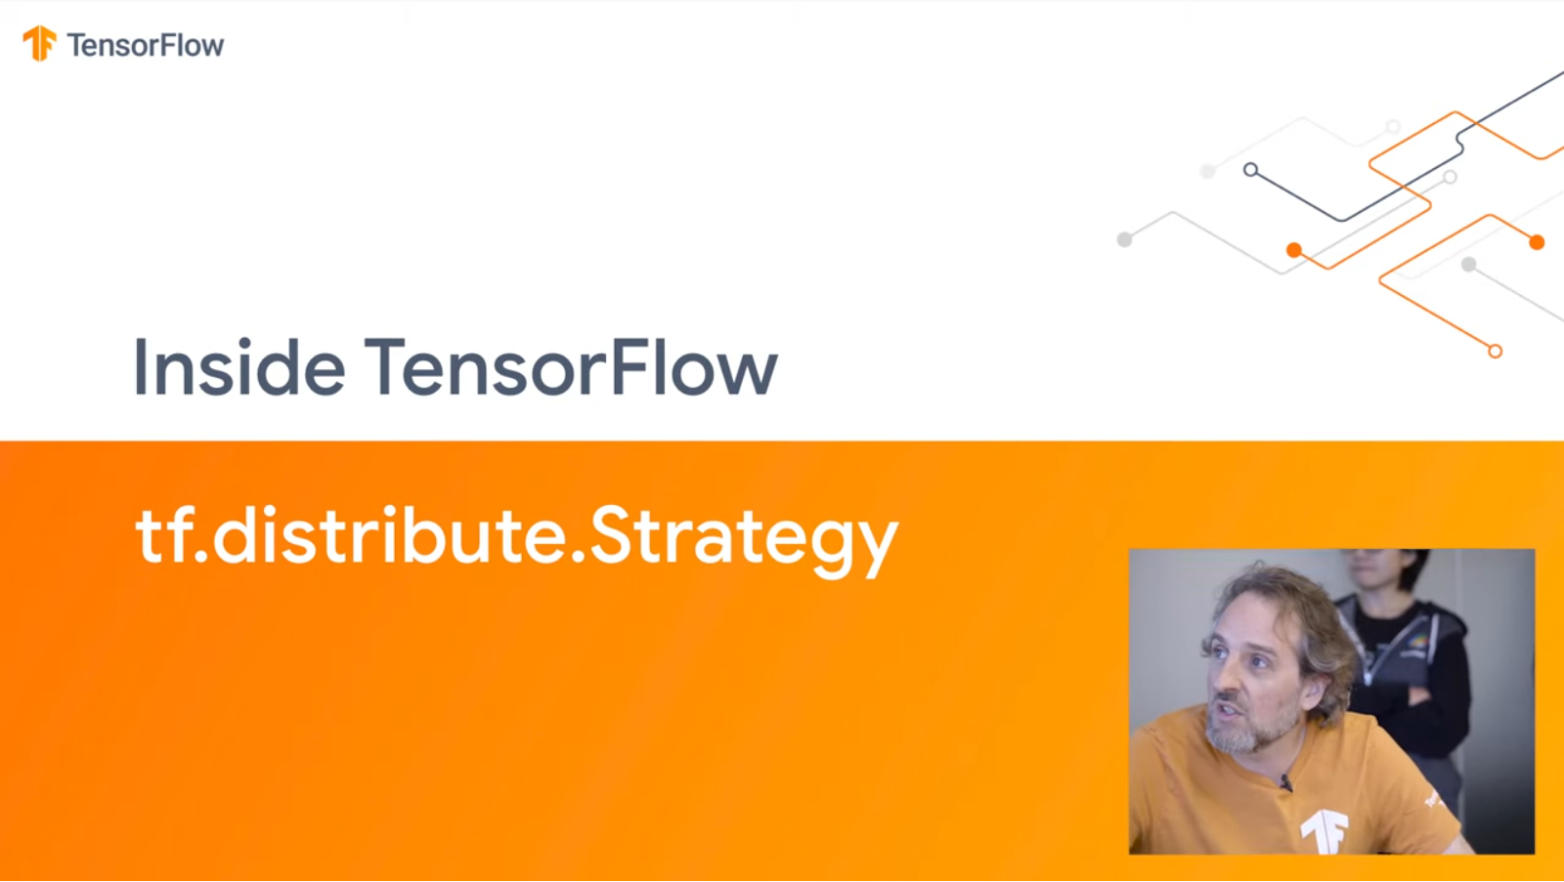
Example Distributed TensorFlow DP
Data-Parallel Parameter Servers
# Create a cluster from the parameter server and worker hosts
cluster = tf.train.ClusterSpec({"ps": ps_hosts, "worker": worker_hosts})
# Create and start a server for the local task.
server = tf.train.Server(cluster, job_name=..., task_index=...)
# On worker: initialize loss
train_op = tf.train.AdagradOptimizer(0.01).minimize(
loss, global_step=tf.contrib.framework.get_or_create_global_step())
# Create training session and run steps asynchronously
hooks=[tf.train.StopAtStepHook(last_step=1000000)]
with tf.train.MonitoredTrainingSession(master=server.target,
is_chief=(task_index == 0), checkpoint_dir=..., hooks=hooks) as sess:
while not mon_sess.should_stop():
sess.run(train_op)
# Program needs to be started on ps and worker
But new experimental APIs and Keras Frontend
[Inside TensorFlow: tf.distribute.Strategy, 2019, https://www.youtube.com/watch?v=jKV53r9-H14]

Slide 16
Example SystemDS Parameter Server
Data-Parallel Parameter Servers
# Initialize SGD w/ Adam optimizer
[W1, mW1, vW1] = adam::init(W1);
[b1, mb1, vb1] = adam::init(b1); ...
# Create the model object
modelList = list(W1, W2, W3, W4, b1, b2, b3, b4, vW1, vW2, vW3, vW4,
vb1, vb2, vb3, vb4, mW1, mW2, mW3, mW4, mb1, mb2, mb3, mb4);
# Create the hyper parameter list
params = list(lr=0.001, beta1=0.9, beta2=0.999, epsilon=1e-8, t=0,
C=C, Hin=Hin, Win=Win, Hf=Hf, Wf=Wf, stride=1, pad=2, lambda=5e-04,
F1=F1, F2=F2, N3=N3)
# Use paramserv function
modelList2 = paramserv(model=modelList, features=X, labels=Y,
upd=fGradients, aggregation=fUpdate, mode=REMOTE_SPARK, utype=ASP,
freq=BATCH, epochs=200, batchsize=64, k=144, scheme=DISJOINT_RANDOM,
hyperparams=params)

Slide 17
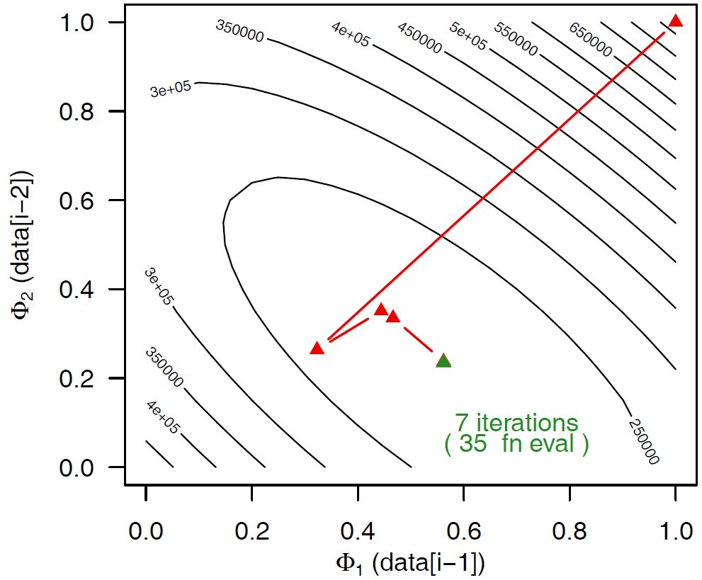
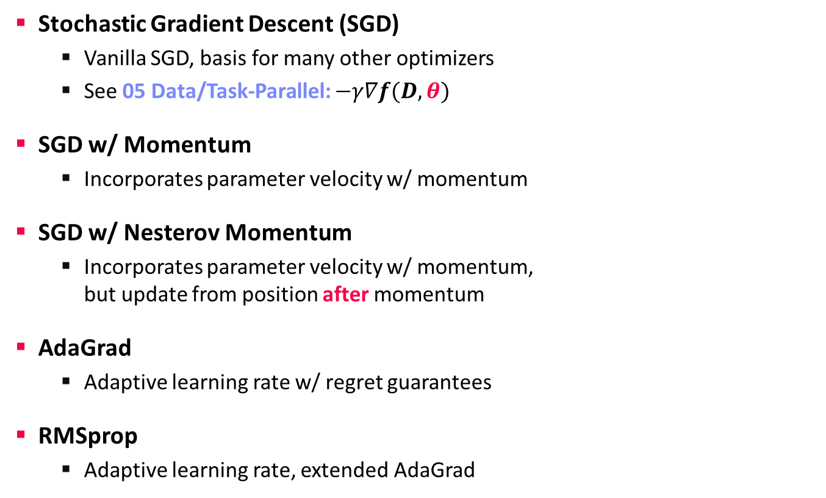
Selected Optimizers (updateModel)
Data-Parallel Parameter Servers
Stochastic Gradient Descent (SGD)
  Vanilla SGD, basis for many other optimizers
  See 05 Data/Task-Parallel: $−γ∇f(D,θ)$
SGD w/ Momentum
  Incorporates parameter velocity w/ momentum
SGD w/ Nesterov Momentum
  Incorporates parameter velocity w/ momentum,
  but update from position after momentum
AdaGrad
  Adaptive learning rate w/ regret guarantees
RMSprop
  Adaptive learning rate, extended AdaGrad
X = X – lr*dX
v = mu*v – lr*dX
X = X + v
v0 = v
v = mu*v – lr*dX
X = X – mu*v0 + (1+mu)*v
[John C. Duchi et al: Adaptive Subgradient Methods for
Online Learning and Stochastic Optimization. JMLR 2011]
c = dr*c+(1-dr)*dX^2
X = X-(lr*dX/(sqrt(c)+eps))
Notes:
Regret: loss incurred during learning, loss difference to loss w/ optimal weights (applicability to exercise?)

Slide 18
Selected Optimizers (updateModel), cont.
Data-Parallel Parameter Servers
Adam
  Individual adaptive learning rates for
  different parameters
Shampoo
  Preconditioned gradient method
  (Newton’s method, Quasi-Newton)
  Retains gradients tensor structure by
  maintaining a preconditioner per dim
  O(m²n²) → O(m² + n²)
[Diederik P. Kingma, Jimmy Ba: Adam: A Method for Stochastic Optimization. ICLR 2015]
t = t + 1
m = beta1*m + (1-beta1)*dX # update biased 1st moment est
v = beta2*v + (1-beta2)*dX^2 # update biased 2nd raw moment est
mhat = m / (1-beta1^t) # bias-corrected 1st moment est
vhat = v / (1-beta2^t) # bias-corrected 2nd raw moment est
X = X - (lr * mhat/(sqrt(vhat)+epsilon)) # param update
[Vineet Gupta, Tomer Koren, Yoram Singer: Shampoo: Preconditioned Stochastic Tensor Optimization. ICML 2018]
L = L + dX %*% t(dX)
R = R + t(dX) %*% dX
X = X – lr * pow(L,1/4)
%*% dX %*% pow(R,1/4))
Notes:
Note: Newton’s method employs the local Hessian as a preconditioner
“Shampoo maintains an m×m matrix L1/4t to precondition the rows of Gt and R1/4t for its columns. The ¼ exponent arises from our analysis; intuitively, it is a sensible choice as it induces an overall step-size decay rate of O(1/√t), which is common in stochastic optimization methods.”

Slide 19
Batch Size Configuration
Data-Parallel Parameter Servers
What is the right batch size for my data?
  Maximum useful batch size is dependent on
  data redundancy and model complexity
Additional Heuristics/Hybrid Methods
  #1 Increase the batch size instead
  of decaying the learning rate
  #2 Combine batch and mini-batch
  algorithms (full batch + n online updates)
[Christopher J. Shallue et al.: Measuring the Effects of Data Parallelism on Neural Network Training. CoRR 2018]
ResNet-50 on ImageNet
Simple CNN on
MNIST
vs
[Samuel L. Smith, Pieter-Jan Kindermans, Chris Ying, Quoc V. Le: Don't Decay the Learning Rate, Increase the Batch Size. ICLR 2018]
[Ashok Cutkosky, Róbert Busa-Fekete: Distributed Stochastic Optimization via Adaptive SGD. NeurIPS 2018]

Slide 20
Reducing Communication Overhead
Data-Parallel Parameter Servers
Large Batch Sizes
  Larger batch sizes reduce the
  relative communication overhead
Overlapping Computation/Communication
  For deep NN w/ many weight/bias matrices,
  compute and comm. can be overlapped
  Collective operations: all-Reduce / ring all-reduce / hierarchical all-reduce
Sparse and Compressed Communication
  Mini-batches of sparse data → sparse dW
  Lossy (mantissa truncation, quantization), and
  lossless (delta, bitpacking) for W and dW
  Gradient sparsification/clipping (send gradients larger than a threshold)
In-Network Aggregation (SwitchML)
  Aggregate worker updates in prog. switches
  32b fix-point, coordinated updates
[Priya Goyal et al: Accurate, Large Minibatch SGD: Training ImageNet in 1 Hour. CoRR 2017 (kn=8K, 256 GPUs)]
tf.distribute:
MirroredStrategy
MultiWorkerMirroredStrategy
[Frank Seide et al: 1-bit stochastic gradient descent and its application to data-parallel distributed training of speech DNNs. INTERSPEECH 2014]
[Amedeo Sapio et al: Scaling Distributed Machine Learning with In-Network Aggregation, NSDI 2021]
Notes:
Large-batches: synchronous SGD with k=256 workers * n=32 per-worker batch size = 8K

Slide 21
Model-Parallel Parameter Servers

Slide 22
Problem Setting
Model-Parallel Parameter Servers
Limitations Data-Parallel Parameter Servers
  Need to fit entire model and activations into each worker node/device
  (or overhead for repeated eviction & restore)
  Very deep and wide networks (e.g., ResNet-1001)
Model-Parallel Parameter Servers
  Workers responsible for disjoint partitions of the network/model
  Exploit pipeline parallelism and independent subnetworks
  Examples: recurrent neural networks, pre-processing tasks
Hybrid Parameter Servers
  “To be successful, however, we believe that model
  parallelism must be combined with clever distributed
  optimization techniques that leverage data parallelism.”
  “[…] it is possible to use tens of thousands of CPU cores
  for training a single model”
[Kaiming He, Xiangyu Zhang, Shaoqing Ren, Jian Sun: Identity Mappings in Deep Residual Networks. ECCV 2016]
[Jeffrey Dean et al.: Large Scale Distributed Deep Networks. NIPS 2012]

Slide 23
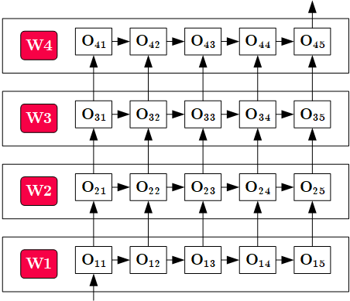
Overview Model-Parallel Execution
Model-Parallel Parameter Servers
System
Architecture
  Nodes act as
  workers and
  parameter servers
  Data Transfer for
  boundary-crossing
  data dependencies
Pipeline
Parallelism
Workers w/ disjoint
network/model partitions

Slide 24
Example Distributed TensorFlow MP
Model-Parallel Parameter Servers
# Place variables and ops on devices
with tf.device("/gpu:0"):
a = tf.Variable(tf.random.uniform(...))
a = tf.square(a)
with tf.device("/gpu:1"):
b = tf.Variable(tf.random.uniform(...))
b = tf.square(b)
with tf.device("/cpu:0"):
loss = a+b
# Declare optimizer and parameters
opt = tf.train.GradientDescentOptimizer(learning_rate=0.1)
train_op = opt.minimize(loss)
# Force distributed graph evaluation
ret = sess.run([loss, train_op]))
Explicit Placement of Operations
(shown via toy example)

Slide 25
Pathways: Asynchronous, Distributed Data Flow
Model-Parallel Parameter Servers
[Paul Barham et al: Pathways: Asynchronous Distributed Dataflow for ML, MLSys 2022]
System Overview
  TF and JAX programs (e.g., JAX pmap())
  Virtual device requests → device islands
  MLIR dialect, lowering to physical devices
  PLAQUE shared data-flow system w/
  sharded buffer, sparse comm., gang scheduling
Resource Management and Scheduling
Notes:
https://blog.google/technology/ai/introducing-pathways-next-generation-ai-architecture/
(model distributed across devices in sharded buffer)

Slide 26
Distributed Reinforcement Learning
Hybrid Data- and Task- Parallel Execution
Data-Parallel Parameter Servers
Nested Parallelism

Slide 27
Reinforcement Learning
Distributed Reinforcement Learning
[Richard S. Sutton, Andrew G. Barto: Reinforcement Learning: An Introduction, MIT Press, 2015]
RL Characteristics
  Closed-loop: goal-directed learning from interaction
  Time-delayed reward: map situations → actions, max reward
  No instructions: exploitation (known actions) vs exploration (find actions)
RL Elements
  Policy: stimulus-response rules (perceived environment state → actions)
  Reward Signal: scalar reward at each time step (direct vs indirect)
  Value Function: long-term desirability of states (expected reward)
  Model of the environment: expected behavior of environment → planning
Action
Agent
Environment
(real/sim)
Reward/State
Notes:
Q-Learning: off-policy TD control algorithm, w/ action-value functions (Q-functions)

Slide 28
Distributed RL in RLlib
Distributed Reinforcement Learning
[Eric Liang, Richard Liaw et al: RLlib: Abstractions for Distributed Reinforcement Learning. ICML 2018]
Framework Overview
  RLlib on tasks/actors in Ray
  Interleaved policy training, simulations, etc
Parallelization Strategies
  Hierarchical Parallel Task Model
  (locally, centralized control)
  Policy optimizer step methods
  (All-reduce, local multi-GPU,
  async, parameter server)
  Policy graph (algorithm-specific)
  on multiple remote evaluator replicas
[Philipp Moritz, Robert Nishihara et al.: Ray: A Distributed Framework for Emerging AI Applications. OSDI 2018]
Example Parameter Server
(task stream, wait for #updates)

Slide 29
Podracer RL Architectures
Distributed Reinforcement Learning
[Matteo Hessel, Manuel Kroiss, et al: Podracer architectures for scalable Reinforcement Learning, CoRR 2021]
Use of TPU Pods via JAX/TF XLA
#1 Anakin
  Agent-environment interaction can be compiled into a single XLA program
  Scalability: replicate basic setup to larger TPU slices
TPU Core
CPU
Notes:
Note: “One CPU host [56 cores] is connected to 8 TPU cores (grouped into 4 chips). All TPU cores are connected to each other via high speed network.”

Slide 30
Podracer RL Architectures, cont.
Distributed Reinforcement Learning
[Matteo Hessel, Manuel Kroiss, et al: Podracer architectures for scalable Reinforcement Learning, CoRR 2021]
#2 Sebulba
  Decomposed actors and learners
  Support for arbitrary environments
Notes:
Note: parameter updates at learners, action selection at actors, batch of parallel environments

Slide 31
Federated Machine Learning

Slide 32


Problem Setting and Overview
Federated Machine Learning
Motivation Federated ML
  Learn model w/o central data consolidation
  Privacy + data/power caps vs personalization and sharing
  Applications Characteristics
    #1 On-device data more relevant than server-side data
    #2 On-device data is privacy-sensitive or large
    #3 Labels can be inferred naturally from user interaction
  Example: Language modeling for mobile keyboards and voice recognition
Challenges
  Massively distributed (data stored across many devices)
  Limited and unreliable communication
  Unbalanced data (skew in data size, non-IID )
  Unreliable compute nodes / data availability
W
ΔW
[Jakub Konečný: Federated Learning - Privacy-Preserving Collaborative Machine Learning without Centralized Training Data, UW Seminar 2018]

Slide 33
A Federated ML Training Algorithm
Federated Machine Learning
while( !converged ) {
1. Select random subset (e.g. 1000)
of the (online) clients
2. In parallel, send current parameters θ_{t}
to those clients
2a. Receive parameters θ_{t} from server [pull]
2b. Run some number of minibatch SGD steps,
producing θ’
2c. Return θ’-θ_{t} (model averaging) [push]
3. θ_{t+1} = θ_{t} + data-weighted average of client updates
}
At each client
[Brendan McMahan, Eider Moore, Daniel Ramage, Seth Hampson, Blaise Agüera y Arcas: Communication-Efficient Learning of Deep Networks from Decentralized Data. AISTATS 2017]

Slide 34
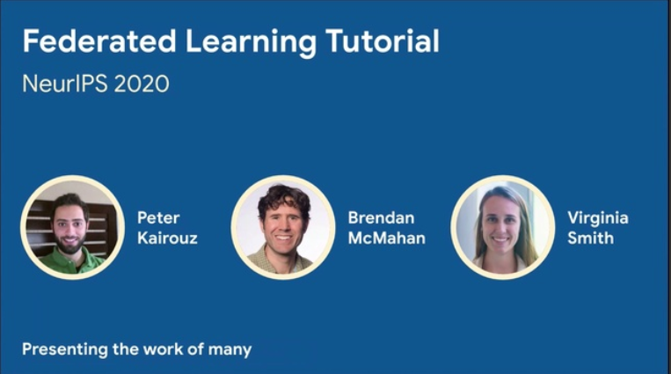
Algorithmic PS Extensions
Federated Machine Learning
#1 Client Sampling (FedAvg w/ model averaging)
#2 Decentralized, Fault-tolerant Aggregation
#3 Peer-to-peer Gradient and Model Exchange
#4 Meta-learning for Private Models
#5 Handling Statistical Heterogeneity (non-IID data)
  Reducing variance
  Selecting relevant subsets of data
  Tolerating partial client work
  Partitioning clients into congruent groups
  Adaptive Optimization (FedOpt, FedAvgM)
[Peter Kairouz, Brendan McMahan, Virginia Smith: Federated Learning
Tutorial. NeurIPS 2020, https://slideslive.com/38935813/
federated-learningtutorial]
[Sashank J. Reddi et al: Adaptive Federated Optimization. CoRR 2020]

Slide 35
Federated Learning Protocol
Federated Machine Learning
Recommended Reading
  [Keith Bonawitz, Hubert Eichner, Wolfgang Grieskamp, Dzmitry Huba, Alex Ingerman, Vladimir Ivanov, Chloé Kiddon, Jakub Konecný, Stefano Mazzocchi, H. Brendan McMahan, Timon Van Overveldt, David Petrou, Daniel Ramage, Jason Roselander: Towards Federated Learning at Scale: System Design. MLSys 2019]
Android Phones

Slide 36
Federated Learning at the Device
Federated Machine Learning
Data Collection
  Maintain repository of
  locally collected data
  Apps make data available
  via dedicated API
Configuration
  Avoid negative impact on
  data usage or battery life
  Training and evaluation tasks
Multi-Tenancy
  Coordination between multiple
  learning tasks (apps and services)

Slide 37
Federated Learning at the Server
Federated Machine Learning
Actor Programming Model
  Comm. via message passing
  Actors sequentially process
  stream of events/messages
  ➔ Scaling w/ # actors
Coordinators
  Driver of overall
  learning algorithm
  Orchestration of aggregators
  and selectors (conn handlers)
Robustness
  Pipelined selection
  and aggregation rounds
  Fault Tolerance at aggregator/
  master aggregator levels

Slide 38


Excursus: Data Ownership
Federated Machine Learning
Limited Access to Data Sources
  #1 Infeasible data consolidation (privacy, economically/technically)
  #2 Data ownership (restricted data enrichment and consolidation)
Example Data Ownership
  Thought experiment:
  B uses machine from A
  to test C’s equipment.
  Who owns the data?
A Thought on a Spectrum of Rights and Responsibilities
  Federated ML creates new spectrum for data ownership
  that might create new markets (no reselling of data)
  #1 Data stays private with the customer
  #2 Gradients/Aggregates shared with the vendor
  #3 Data completely shared with the vendor
XXXXXXXX
XXXXXXXXXXXXXXXXXXXXXXX
XXXXXXXX
XXXXX
Machine Vendor A
Middle Person B
Customer C
Data Privacy
Ability to
train models
Notes:
Note: example data ownership → usually negotiated in bilateral contracts!

Slide 39









Federated ML in SystemDS
Federated Machine Learning
[Sebastian Baunsgaard et al.:
ExDRa: Exploratory Data Science on Federated Raw Data, SIGMOD 2021]
ExDRa Project
  Basic approach: Federated ML + ML over raw data
  System infra, integration, data org & reuse, Exp DB, geo-dist.
Federated ML Architecture
  Multiple control programs w/ single master
  Federated tensors (metadata handles)
  Federated linear algebra and
  federated parameter server
Privacy Enhancing Technologies (PET)
  Federated ML w/ data exchange constraints
  PET (homomorphic encryption, multi-party computation, differential privacy)
Gefördert im Programm "IKT der Zukunft"
CP 1*
CP 2
FT
X1
X
CP 3
X2

Slide 40



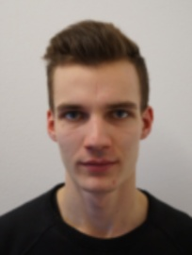


Federated Data
Federated ML in SystemDS – Federated Runtime
Federated Runtime Backend
  Federated data (matrices/frames) as meta data objects
  Federated linear algebra, (and federated parameter server)
X = federated(addresses=list(node1, node2, node3),
ranges=list(list(0,0),list(40K,70), ..., list(80K,0),list(100K,70)));

Slide 41
Federated Requests
Federated ML in SystemDS – Federated Runtime
Federation Protocol
  Batch federated requests
  Single federated response
Federated Request Types
  READ(ID,fname): read data object from file, and put it in symbol table
  PUT(ID,data): receives transferred data object, and put it in symbol table
  GET(ID): return a data object from the federated site to coordinator
  EXEC_INST(inst): execute an instruction (inputs/outputs by ID)
  EXEC_UDF(udf): execute a user-defined function w/ access to symbol table
  CLEAR: clean up execution contexts and variables
➔ Design Simplicity: (1) reuse instructions, (2) federation hierarchies

Slide 42
Example Federated Operations
Federated ML in SystemDS – Federated Runtime
b) Local MV (EXEC_INST, 3)
Matrix-Vector Multiplication
  o = X %*% v, local v
  Row-partitioned, federated X
  Row-partitioned, federated o
Vector-Matrix Multiplication
  o = v %*% X, local v
  Row-partitioned,
  federated X, local o
Data Preparation
  [X,M] = transformencode(F,spec)
  Recoding, feature hashing, binning,
  one-hot encoding
a) broadcast v
(PUT(v, 2))
X₁
c) Clean 2
(EXEC_INST)
X₂
a) broadcast sliced v
(PUT(v, 4))
b) Local MV
(EXEC_INST, 5)
X₁
c) Aggregate (GET, 5) +
X₂
d) Clean 4,5 (EXEC_INST)
1) Compute local record maps
(EXEC_UDF)
X₁: D B C D C
2) Aggregate, broadcast, recode
X₂: A B B C C

Slide 43

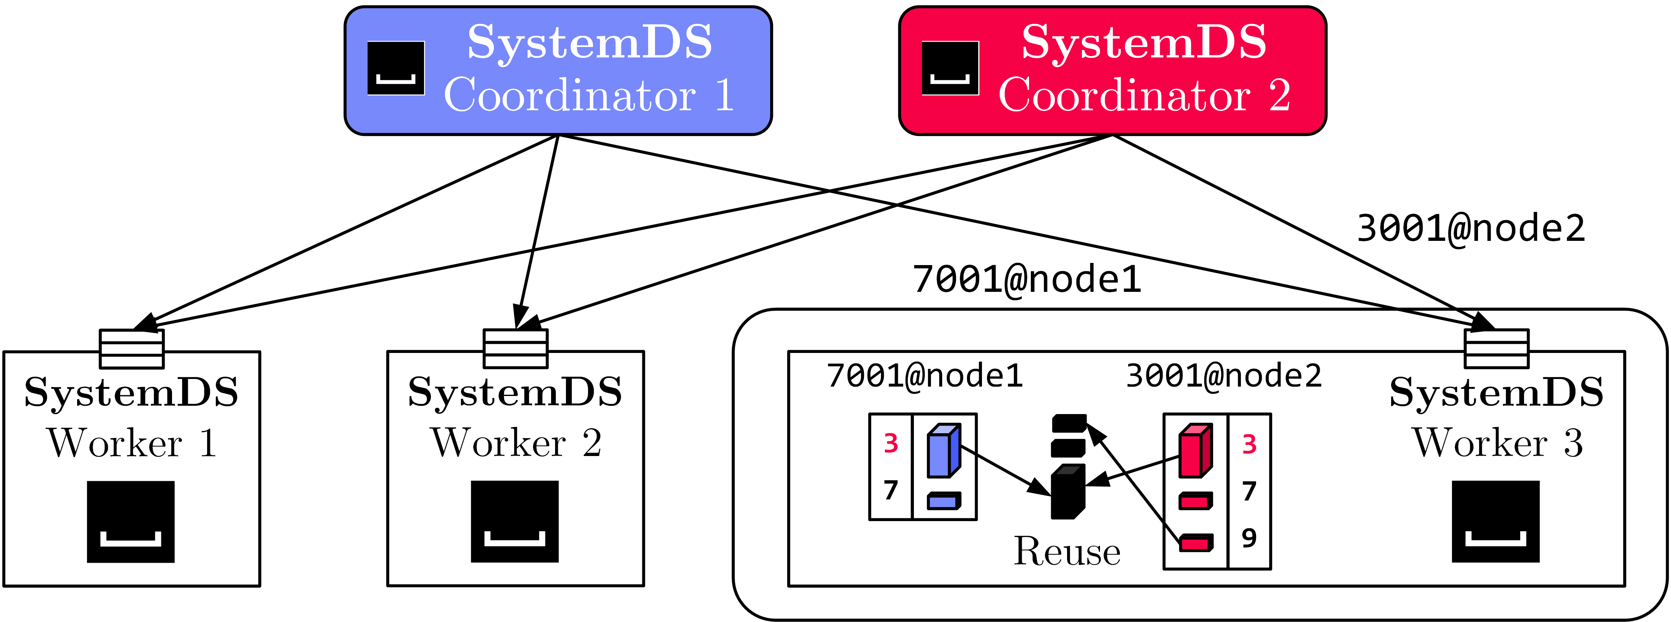
Federated Data Preparation,
Learning, and Debugging
Federated ML in SystemDS – Federated Runtime
Federated Feature Transformations
Federated Linear-algebra-based Data Cleaning,
Data Preparation, and Model Debugging (e.g., federated quantiles)
Multi-tenant
Federated Learning
  Tenant Isolation
Lineage-based Reuse
Asynchronous Compression

Slide 44

TensorFlow Federated
Federated Machine Learning
[https://www.tensorflow.org/federated/]
Overview TFF
  Federated PS algorithms and federated second order functions
  Primarily for simulating federated training, no OSS federated runtime
#1 Federated PS
#2 Federated Analytics
  r = t(y) %*% X
  User-level composition
  of federated algorithms
  PET primitives
iterative_process = tff.learning.build_federated_averaging_process(
model_fn, # function for created federated models
client_optimizer_fn=lambda: tf.keras.optimizers.SGD(learning_rate=0.02),
server_optimizer_fn=lambda: tf.keras.optimizers.SGD(learning_rate=1.0))
X = ... # tff.type_at_clients(tf.float32)
by = tff.federated_broadcast(y)
R = tff.federated_sum(
tff.federated_map(X, by, foo_mm), foo_s)
# note: tff.federated_secure_sum

Slide 45
Summary and Q&A
Data-Parallel Parameter Servers
Model-Parallel Parameter Servers
Distributed Reinforcement Learning
Federated Machine Learning
Next Lectures (Part A)
  07 Hybrid Execution and HW Accelerators [May 06]
  08 Caching, Partitioning, Indexing and Compression [May 13]

