Slide 1

Architecture of ML Systems
07 Hardware Accelerators
Last update: May 04, 2022

Slide 2



Announcements/Org
#1 Video Recording
  Link in TeachCenter & TUbe (lectures will be public)
  Hybrid: HSi13 / https://tugraz.webex.com/meet/m.boehm
  Apr 25: no more COVID restrictions at TU Graz
#2 Course Evaluations and Exam
  Evaluation period: Jun 15 – Jul 31
  Oral Exams (45min each), doodle in June → exams in July
  (close to submission of projects/exercises)
#3 Projects and Exercises
  SIGMOD programming contest, completed
  SystemDS and DAPHNE projects, ongoing
  Alternative exercises (also see SS21 slides) → Jun 17
Q&A

Slide 3
Categories of Execution Strategies
Motivation and Terminology
Batch/Mini-batch, Independent Tasks MIMD
Batch
SIMD/SPMD
Mini-batch
05_{a} Data-Parallel Execution
05_{b} Task-Parallel Execution
06 Parameter Servers (data, model)
07 Hybrid Execution and HW Accelerators
08 Caching, Partitioning, Indexing, and Compression

Slide 4
Agenda
Motivation and Terminology
GPUs in ML Systems
FPGAs in ML Systems
ASICs and other HW Accelerators

Slide 5
Motivation and Terminology

Slide 6
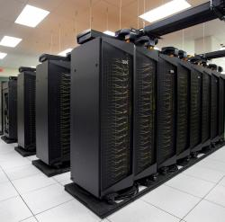
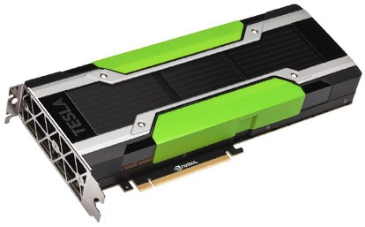
Recap: Driving Factors for ML
Motivation and Terminology
[Credit: Andrew Ng’14]
Improved Algorithms and Models
  Success across data and application domains
  (e.g., health care, finance, transport, production)
  More complex models which leverage large data
Availability of Large Data Collections
  Increasing automation and monitoring ➔ data
  (simplified by cloud computing & services)
  Feedback loops, data programming/augmentation
HW & SW Advancements
  Higher performance of hardware and infrastructure (cloud)
  Open-source large-scale computation frameworks,
  ML systems, and vendor-provides libraries
Feedback Loop
Data
Usage
Model

Slide 7
DNN Challenges
Motivation and Terminology
#1 Larger Models
and Scoring Time
#2 Training Time
  ResNet18: 10.76% error, 2.5 days training
  ResNet50: 7.02% error, 5 days training
  ResNet101: 6.21% error, 1 week training
  ResNet152: 6.16% error, 1.5 weeks training
#3 Energy Efficiency
[Song Han: Efficient Methods and Hardware for Deep Learning, Stanford cs231n, 2017]

Slide 8
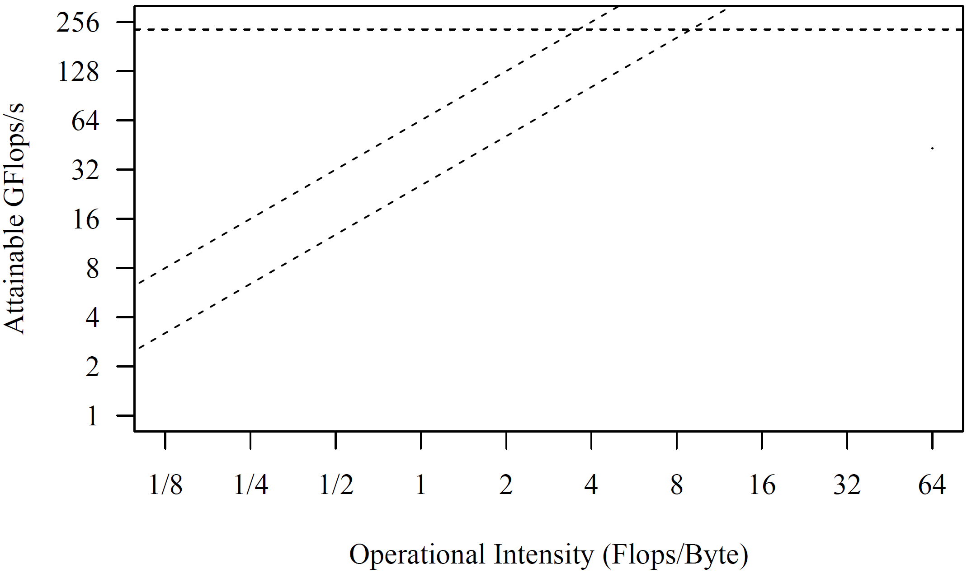
Excursus: Roofline Analysis
Motivation and Terminology
Setup: 2x6 E5-2440 @2.4GHz–2.9GHz, DDR3 RAM @1.3GHz (ECC)
  Max mem bandwidth (local): 2 sock x 3 chan x 8B x 1.3G trans/s → 2 x 32GB/s
  Max mem bandwidth (QPI, full duplex) → 2 x 12.8GB/s
  Max floating point ops: 12 cores x 2*4dFP-units x 2.4GHz → 2 x 115.2GFlops/s
Roofline
Analysis
  Off-chip
  memory
  traffic
  Peak
  compute
SystemML BLAS
36x
SystemML
MM (n=768)
SystemML
Mt(Mv)
SystemML
Mv
➔ IO-bound traditional ML
➔ compute-bound DNN
[S. Williams, A. Waterman, D. A. Patterson: Roofline: An Insightful Visual Performance Model for Multicore Architectures. Commun. ACM 2009]
(Experiments from 2017)

Slide 9
HW Challenges
Motivation and Terminology
[S. Markidis, E. Laure, N. Jansson, S. Rivas-Gomez and S. W. D. Chien: Moore’s Law and Dennard Scaling]
#1 End of Dennard Scaling (~2005)
  Law: power stays proportional
  to the area of the transistor
  Ignored leakage current / threshold voltage
  → increasing power density S² (power wall, heat) → stagnating frequency
#2 End of Moore’s Law (~2010-20)
  Law: #transistors/performance/
  CPU frequency doubles every
  18/24 months
  Original: # transistors per chip
  doubles every two years
  at constant costs
  Now increasing costs (10/7/5nm)
➔ Consequences: Dark Silicon and Specialization
P = α CFV² (power density 1)
(P .. Power, C .. Capacitance,
F .. Frequency, V .. Voltage)
Notes:
Dennard Scaling: (scaling factor S of transistors)
* # transistors: S^2
* Capacitance: 1/S
* Frequency: S
* Device power V: 1/(S^2)
* Alpha 1/2
(but V cannot be further reduced due to leakage (noise of neighboring transistors); capacity (current) of transistor -> the smaller the transistor, the smaller the frequency)
Gordon Moore (co-founder of Intel)

Slide 10
Towards Specialized Hardware
Motivation and Terminology
HW Specialization
Additional Specialization
  Data Transfer & Types: e.g., low-precision, quantization
  Sparsity Exploitation: e.g., sparsification, exploit across ops,
  defer weight decompression just before instruction execution
  Near-Data Processing: e.g., operations in main memory, storage class memory (SCM), secondary storage (e.g., SSDs), and tertiary storage (e.g., tapes)
HW Devices
General Purpose
Specialized HW
CPU
GPU
FPGAs
ASICs
SIMD
Throughput-oriented, specialized instructions
programmable
logic
fixed logic
08 Caching, Indexing and Compression
Notes:
Tradeoff: reconfiguration (CPU high, ASIC impossible) vs energy efficiency (ASIC high, CPU low)

Slide 11
Graphics Processing Units
(GPUs) in ML Systems

Slide 12
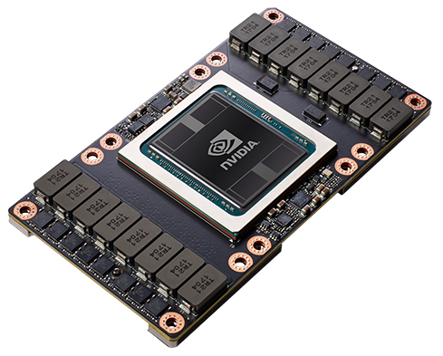
NVIDIA Volta V100 – Specifications
Graphics Processing Units (GPUs) in ML Systems
Tesla V100 NVLink
  FP64: 7.8 TFLOPs, FP32: 15.7 TFLOPs
  DL FP16: 125 TFLOPs
  NVLink: 300GB/s
  Device HBM: 32 GB (900 GB/s)
  Power: 300 W
Tesla V100 PCIe
  FP64: 7 TFLOPs, FP32: 14 TFLOPs
  DL FP16: 112 TFLOPs
  PCIe: 32 GB/s
  Device HBM: 16 GB (900 GB/s)
  Power: 250 W
[Credit: https://nvidia.com/de-de/
data-center/tesla-v100/]

Slide 13
NVIDIA Volta V100 – Architecture
Graphics Processing Units (GPUs) in ML Systems
6 GPU Processing Clusters (GPCs)
  7 Texture Processing Clusters (TPC)
  14 Streaming Multiprocessors (SM)
[NVIDIA Tesla V100 GPU Architecture, Whitepaper, Aug 2017]

Slide 14
NVIDIA Volta V100 – SM Architecture
Graphics Processing Units (GPUs) in ML Systems
FP64 cores: 32
FP32 cores: 64
INT32 cores: 64
“Tensor cores”: 8
Max warps /SM: 64
Threads/warp: 32

Slide 15
Single Instruction Multiple Threads (SIMT)
Graphics Processing Units (GPUs) in ML Systems
32 Threads grouped to warps and execute in SIMT model
Pascal P100
Execution Model
  Warps use a
  single program
  counter +
  active mask
Volta V100
Execution Model
  Independent
  thread scheduling
  Per-thread
  program counters
  and call stacks
  New __syncwarp() primitive (if needed) + convergence optimizer
Thread Divergence

Slide 16
NVIDIA Volta V100 – Tensor Cores
Graphics Processing Units (GPUs) in ML Systems
“Tensor Core”
  Specialized instruction for 4x4 by 4x4 fused matrix multiply
  Two FP16 inputs and FP32 accumulator
  Exposed as warp-level matrix operations w/ special load, mm, acc, and store
[Bill Dally: Hardware for Deep Learning. SysML 2018]
64 FMA
operations
D = A %*% B + C

Slide 17
NVIDIA Ampere A100
Graphics Processing Units (GPUs) in ML Systems
[NVIDIA A100 Tensor Core GPU Architecture - UNPRECEDENTED ACCELERATION AT
EVERY SCALE, Whitepaper, Aug 2020]
Specification
  7nm, 8 GPC x 8 TPC * 2 SM = 128 SMs, 40GB HBM
  FP64: 9.7 TFLOPs / FP64 TensorCore: 19.5 TFLOPs
  FP32 19.5 TFLOPs, FP16: 78 TFLOPs, BF16: 39 TFLOPs
  TF32 TensorCore 156 TFLOPs / 312 TFLOPs (sparse)
  FP16 TensorCore 312 TFLOPs / 624 TFLOPs (sparse), INT8, INT4
New Features
  New generation of “TensorCores” (FP64, new data types: TF32, BF16)
  Fine-grained sparsity exploitation
  Multi-instance GPU (MIG) virtualization: up to 7 virtual GPU instances
  Link technologies: NVLink 3 (25GB/s bidirectional) x 12 links = 600GB/s
  Submission of task graphs (launch a workflow of kernels)

Slide 18

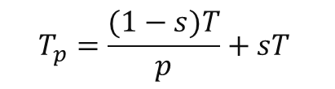
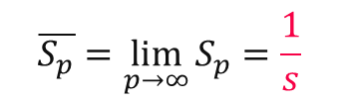
Excursus: Amdahl’s Law
Graphics Processing Units (GPUs) in ML Systems
Amdahl’s law
  Given a fixed problem size, Amdahl’s law gives the maximum speedup
  T is the execution time, s is the serial fraction, and p the number of processors
Examples
  Serial fraction s = 0.01 → max S_{p} = 100
  Serial fraction s = 0.05 → max S_{p} = 20
  Serial fraction s = 0.1 → max S_{p} = 10
  Serial fraction s = 0.5 → max S_{p} = 2
Execution Time
$$T_{p}=\frac{(1−s)T}{p}+sT$$
Speedup
$$S_{p}=\frac{T}{T_{p}}$$
Upper-Bound Speedup
$$\overline{S_{p}}=\lim_{p→∞}{S_{p}}=\frac{1}{s}$$

Slide 19
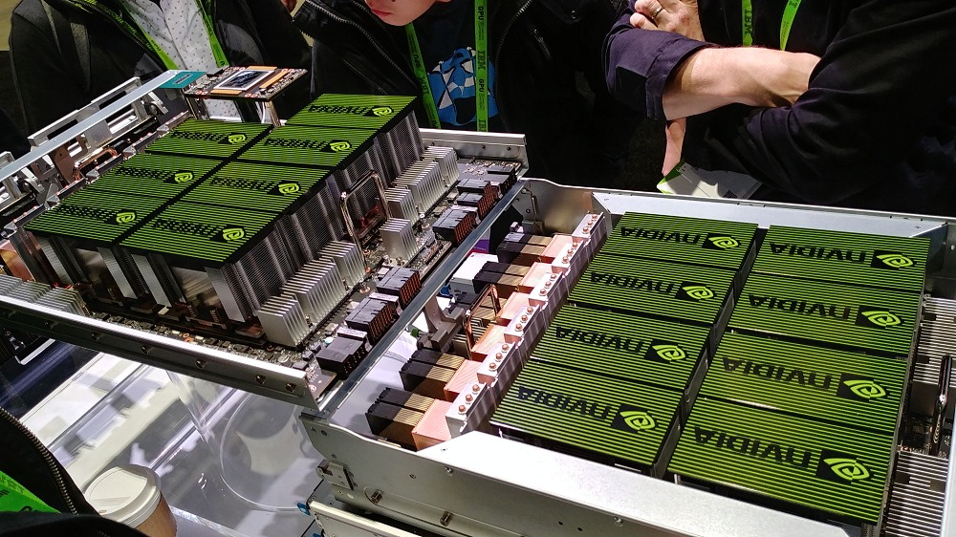
GPUs for DNN Training
Graphics Processing Units (GPUs) in ML Systems
GPUs for DNN Training (2009)
  Deep belief networks
  Sparse coding
Multi-GPU Learning (Now)
  Exploit multiple GPUs with a mix of
  data- and model-parallel parameter servers
  Dedicated ML systems for multi-GPU learning
  Dedicated HW: e.g., NVIDIA DGX-1 (8xP100),
  NVIDIA DGX-2 (16xV100, NVSwitch),
  NVIDIA DGX A100 (8x A100, NVSwitch, Mellanox)
DNN Framework support
  All specialized DNN frameworks have very good support for GPU training
  Most of them also support multi-GPU training
[Rajat Raina, Anand Madhavan, Andrew Y. Ng: Large-scale deep unsupervised learning using graphics processors. ICML 2009]

Slide 20
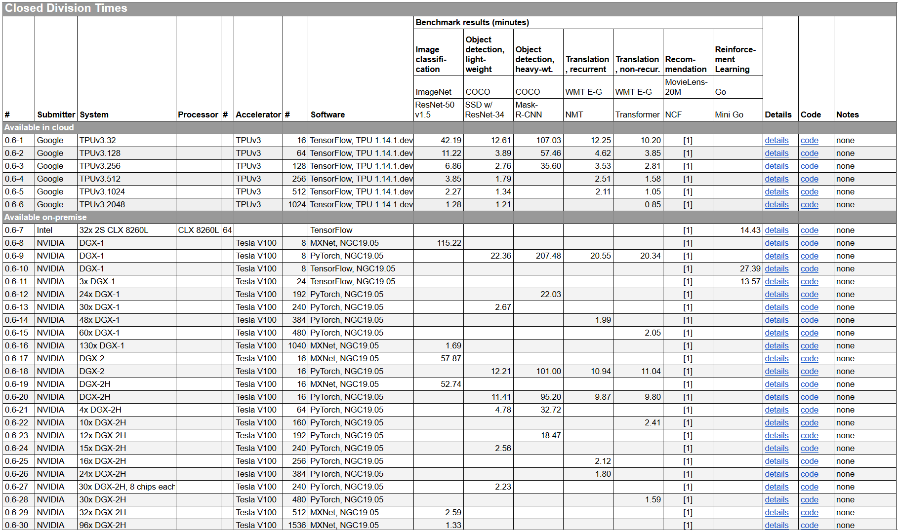
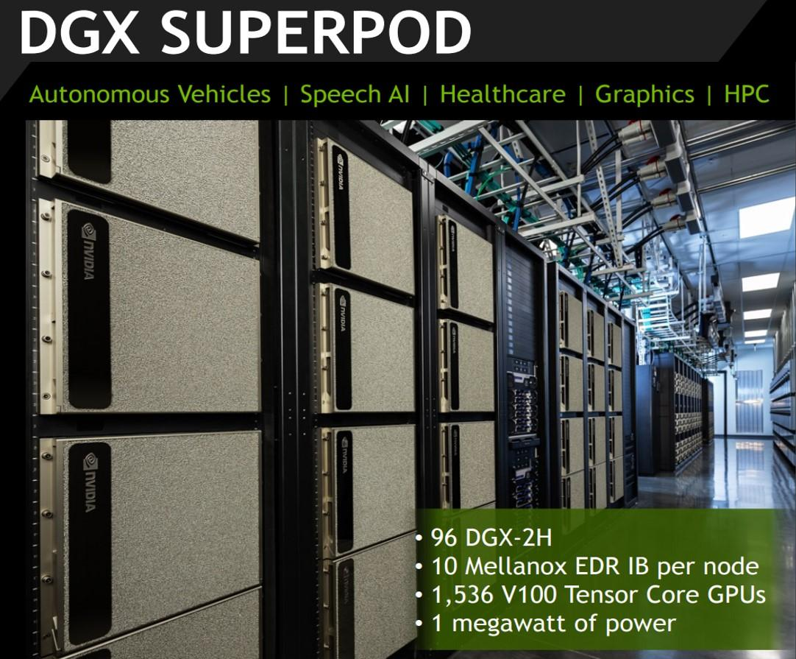
Recap: DNN Benchmarks
Graphics Processing Units (GPUs) in ML Systems
[MLPerf v0.6: https://mlperf.org/training-results-0-6/,
MLPerf v0.7: https://mlperf.org/training-results-0-7]
V0.6
96 x DGX-2H = 96 * 16 = 1536 V100 GPUs
➔ ~ 96 * $400K = $35M – $40M
[https://www.forbes.com/sites/tiriasresearch/2019/06/19/nvidia-offers-a-turnkey-supercomputer-the-dgx-superpod/#693400f43ee5]
Notes:
V07: up to 4096 (regular), 16384 (HPC)

Slide 21
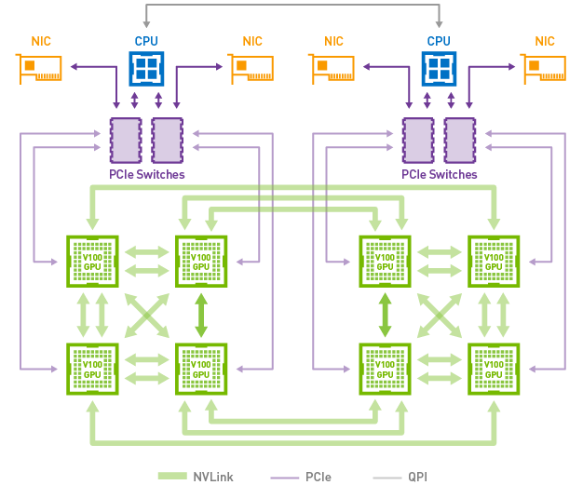
GPU Link Technologies
Graphics Processing Units (GPUs) in ML Systems
Classic PCI Express
  Peripheral Component Interconnect Express (default)
  v3 x16 lanes: 16GB/s, v4 (2017) x16 lanes: 32GB/s, v5 (2019) x16 lanes: 64GB/s
#1 NVLink
  Proprietary technology
  Requires NVLink-enabled CPU
  (e.g., IBM Power 8/9)
  Connect GPU-GPU and GPU-CPU
  NVLink 1: 80+80 GB/s
  NVLink 2: 150+150 GB/s
#1 NVSwitch
  Fully connected GPUs, each communicating at 300GB/s

Slide 22
GPU Link Technologies, cont.
Graphics Processing Units (GPUs) in ML Systems
Recap: Amdahl’s Law
Experimental Setup
  SnapML, 4 IBM Power x 4 V100 GPUs, NVLink 2.0
  200 million training examples of the Criteo dataset (> GPU mem)
  Train a logistic regression model
[Celestine Dünner et al.: Snap ML: A Hierarchical Framework for Machine Learning.
NeurIPS 2018]
PCIe v3 Interconnect
NVLink Interconnect

Slide 23
Handling Memory Constraints
Graphics Processing Units (GPUs) in ML Systems
Problem: Limited Device Memory
#1 Live Variable Analysis
  Remove intermediates ASAP
  Examples: SystemML, TensorFlow, MXNet, Superneurons, MONeT
#2 GPU-CPU Eviction
  Evict variables from GPU to CPU memory under memory pressure
  Examples: SystemML, Superneurons, GeePS, (TensorFlow)
#3 Recomputation
  Recompute inexpensive operations (e.g., activations of forward pass)
  Examples: MXNet, Superneurons, MONet
#4 Reuse Allocations
  Reuse allocated matrices and tensors via free lists, but fragmentation
  Examples: SystemML, Superneurons, MONet
#5 Physical Operator Selection
  Different tradeoffs of performance and size of intermediates (MONet)
[Linnan Wang et al: Superneurons: dynamic GPU memory management for training deep neural networks. PPOPP 2018]
Notes:
MONeT: Aashaka Shah, Chao-Yuan Wu, Jayashree Mohan, Vijay Chidambaram, Philipp Krähenbühl: Memory Optimization for Deep Networks. ICLR 2021

Slide 24
Hybrid CPU/GPU Execution
Graphics Processing Units (GPUs) in ML Systems
Manual Placement
  Most DNN frameworks allow manual placement of
  variables and operations on individual CPU/GPU devices
  Heuristics and intuition of human experts
Automatic Placement
  Sequence-to-sequence model to predict
  which operations should run on which device
  Examples:
  [Azalia Mirhoseini et al: Device Placement Optimization with Reinforcement Learning.
  ICML 2017]
Neural
MT graph
Inception V3
Notes:
Note: white: CPU; colors: different GPU devices
Sequence-to-sequence model with attention (encoder-decoder → operator sequence to device sequence)

Slide 25


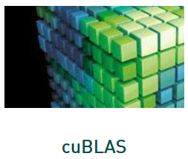

Sparsity in DNN
Graphics Processing Units (GPUs) in ML Systems
State-of-the-art
  Very limited support of sparse tensors in TensorFlow, PyTorch, etc
  GPU operations for linear algebra (cuSparse), early support in ASICs
  Problem: Irregular structures of sparse matrices/tensors
Common Techniques
  #1: Blocking/clustering of rows/columns by number of non-zeros
  #2: Padding rows/columns to common number of non-zeros
Example A100 Sparsity Exploitation
  Constraint: 2 non-zeros in block of 4
  Structured valued pruning → accuracy impact
  Regular access pattern
[NVIDIA A100 Tensor Core GPU Architecture, Whitepaper, Aug 2020]
Notes:
Open Problem
Many sources of sparsity (inputs, transformations, selections)
Broader support for efficient sparsity exploitation required

Slide 26
Field-Programmable Gate Arrays
(FPGAs) in ML Systems

Slide 27
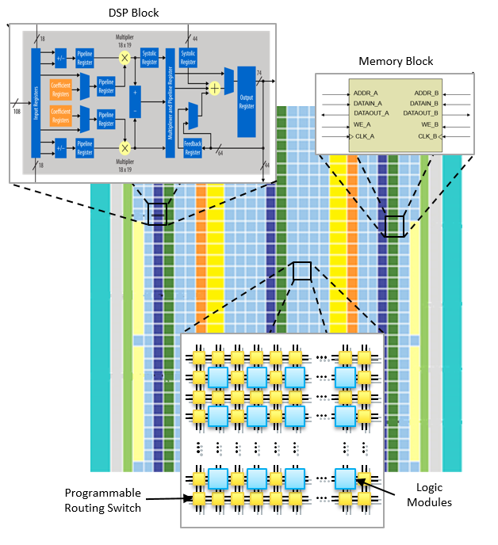
FPGA Overview
Field-Programmable Gate Arrays (FPGAs) in ML Systems
[Credit: https://intel.com]
FPGA Definition
  Integrated circuit that
  allows configuring
  custom hardware designs
  Reconfiguration in <1s
  HW description language:
  e.g.., VHDL, Verilog
FPGA Components
  #1 lookup table (LUT)
  as logic gates
  #2 flip-flops (registers)
  #3 interconnect network
  Additional memory
  and DSP blocks
Notes:
VHDL: Very High Speed Integrated Circuit Hardware Description Language
LUTs (bit-oriented logic, 4-input, 6-input lookup tables) → 24x17bits 403 LUTs multiply vs 17 LUTs add
DSP (word-oriented multiply-accumulate)

Slide 28
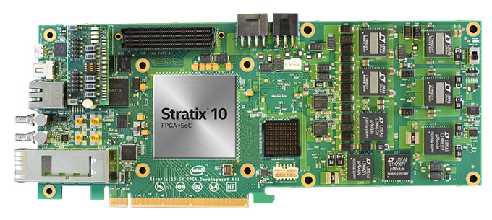
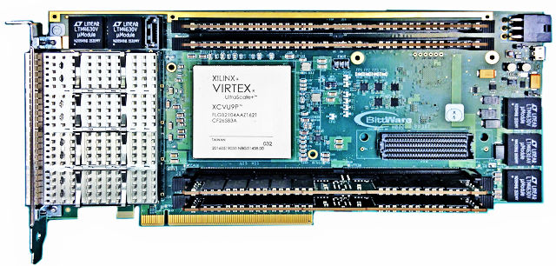
Example FPGA Characteristics
Field-Programmable Gate Arrays (FPGAs) in ML Systems
Intel (Altera) Stratix 10 SoC FPGA
  64bit quad-core ARM
  10 TFLOPs FP32
  80GFLOPs/W
  Other configurations w/ HBM2
Xilinx Virtex UltraSCALE+
  DSP: 21.2 TMACs
  64MB on-chip memory
  8GB HBM2 w/ 460GB/s
Notes:
Other Intel FPGA families: Stratix (high-end), Arria (embedded), Cyclone (cost), MAX (mobile)

Slide 29
FPGAs in Microsoft’s Data Centers
Field-Programmable Gate Arrays (FPGAs) in ML Systems
[Adrian M. Caulfield et al.: A cloud-scale acceleration architecture. MICRO 2016]
Microsoft Catapult
  Dual-socket Xeon w/ PCIe-attached FPGA
  Pre-filtering neural networks, compression, and other workloads
Notes:
NIC .. network interface card

Slide 30
FPGAs in Microsoft’s Data Centers, cont.
Field-Programmable Gate Arrays (FPGAs) in ML Systems
[Eric S. Chung et al: Serving DNNs in Real Time at Datacenter Scale with Project Brainwave. IEEE Micro 2018]
Microsoft Brainwave
  ML serving w/ low latency (e.g., Bing)
  Intel Stratix 10 FPGA
  Distributed
  model parallelism,
  precision-adaptable
  Peak 39.5 TFLOPs
Brainwave NPU
  Neural
  processing unit
  Dense matrix-vector
  multiplication

Slide 31
FPGAs in other ML Systems
Field-Programmable Gate Arrays (FPGAs) in ML Systems
In-DB Acceleration of Advanced Analytics (DAnA)
  Compilation of python DSL into micro instructions
  for multi-threaded FPGA-execution engine
  Striders to directly interact with the buffer pool
MLWeaving
  Adapted BitWeaving to numeric matrices
  Data layout basis for Any-Precision Learning
  Related FPGA implementation of SGD,
  matrix-vector multiplication for GLM
  Manual Selection + Heuristics
Efficient FPGA implementations
of specific operations and algorithms
Specialized neural network topologies
[Divya Mahajan et al: In-RDBMS Hardware Acceleration of Advanced Analytics. PVLDB 2018]
[Zeke Wang et al: Accelerating Generalized Linear Models with MLWeaving. PVLDB 2019]

Slide 32

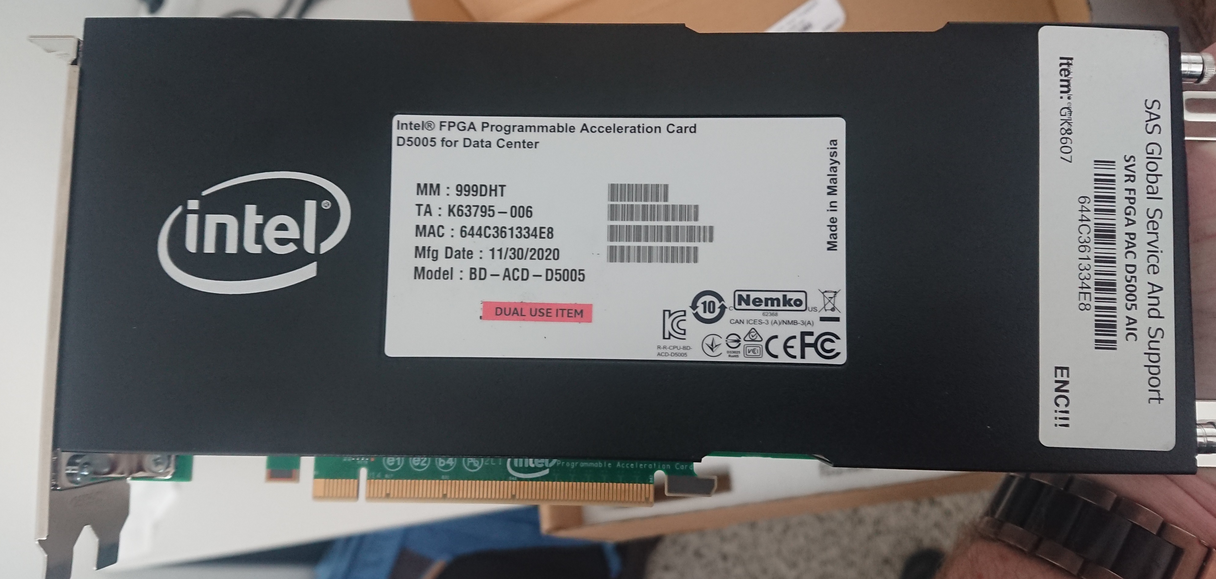
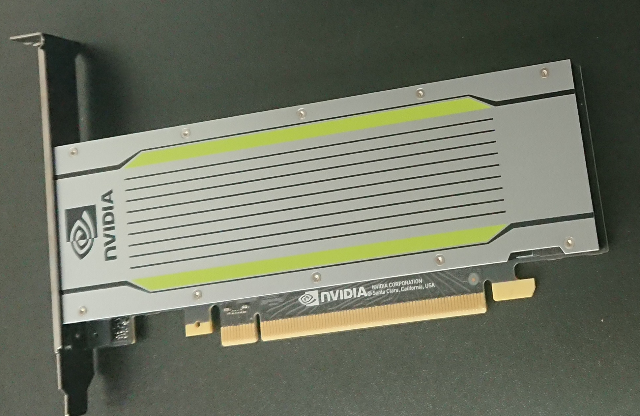
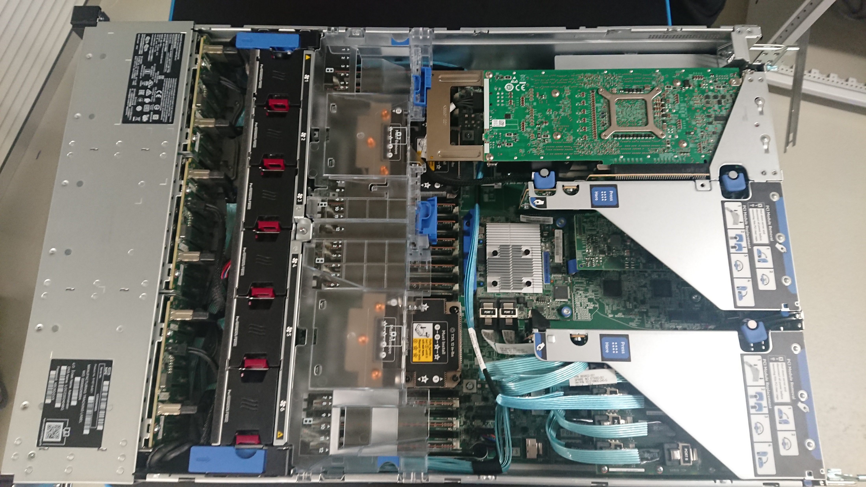
Example DM Cluster Node
Field-Programmable Gate Arrays (FPGAs) in ML Systems
2x Intel Xeon Gold 6238 (112 vcores, 7.7 TFLOP/s),
768 GB DDR4 RAM, 12x 2TB SSDs, NVIDIA T4 GPU (8.1 TFLOP/s,
16 GB), and Intel FPGA PAC D5005 (w/ Stratix 10SX FPGA, 32 GB)
Intel PAC D5005
Stratix 10 FPGA
2 x Intel Xeon
Gold 6238R
Broadcom 2x10G
RDMA Ethernet
12+2 x SSD: 25TB
768 GB RAM
Adaptec 12G SAS
Nvidia Tesla T4

Slide 33
Application-Specific Integrated Circuit
(ASICs) and other HW Accelerators

Slide 34
Overview ASICs
ASICs and other HW Accelerators
Motivation
  Additional improvements of performance, power/energy
  ➔ Additional specialization via custom hardware
#1 General ASIC DL Accelerators
  HW support for matrix multiply, convolution and activation functions
  Examples: Google TPU, NVIDIA DLA (in NVIDIA Xavier SoC), Intel Nervana NNP
#2 Specialized ASIC Accelerators
  Custom instructions for specific domains such as computer vision
  Example: (Cadence) Tensilica Vision processor (image processing)
#3 Other Accelerators/Technologies (some skepticism)
  a) Neuromorphic computing / spiking neural networks
  (e.g., SyNAPSE → IBM TrueNorth, HP memristor for computation storage)
  b) Analog computing (especially for ultra-low precision/quantization)

Slide 35
Tensor Processing Unit (TPU v1)
ASICs and other HW Accelerators
Motivation
  Cost-effective ML scoring (no training)
  Latency- and throughput-oriented
  Improve cost-performance over GPUs by 10x
Architecture
  256x256 8bit
  matrix multiply unit
  (systolic array
  → pipelining)
  64K MAC per cycle
  (92 TOPs at 8 bit)
  50% if one input 16bit
  25% if all inputs 16 bit
[Norman P. Jouppi et al:
In-Datacenter Performance Analysis of a Tensor Processing Unit. ISCA 2017]

Slide 36
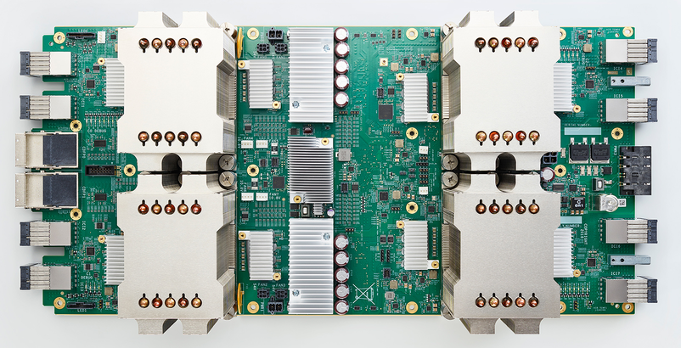
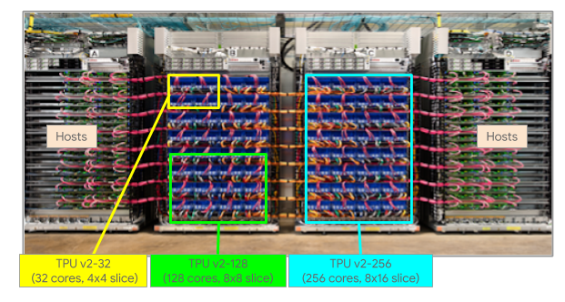
Tensor Processing Unit (TPU v2)
ASICs and other HW Accelerators
Motivation
  Cost effective ML training (not scoring)
  because edge device w/ custom inference
  but training in data centers
  Unveiled at Google I/O 2017
  Board w/ 4 TPU chips
  Pod w/ 64 boards
  and custom
  high-speed network
  Shelf w/ 2 boards or
  1 processor
Cloud Offering (beta)
  Min 32 cores
  Max 512 cores

Slide 37
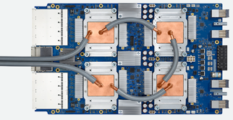
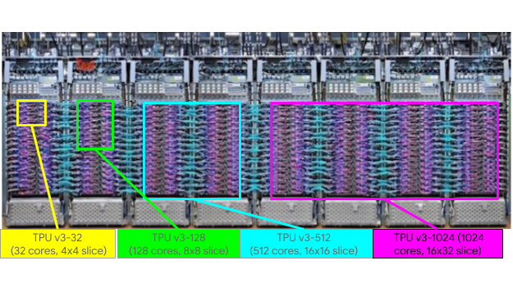
Tensor Processing Unit (TPU v3)
ASICs and other HW Accelerators
Motivation
  Competitive cost-performance compared
  to state-of-the-art GPUs
  Unveiled at Google I/O 2018
  Added liquid cooling
  Twice as many racks per pod, twice as many TPUs per rack
  ➔ TPUv3 promoted as 8x higher performance than TPUv2
Cloud Offering
(beta)
  Min 32 cores
  Max 2048 cores
  (~100PFLOPs)
[TOP 500 Supercomputers:
Summit @ Oak Ridge NL (‘18):
200.7 PFLOP/s (2.4M cores)]

Slide 38

Recap: Operator Fusion and Code Generation
ASICs and other HW Accelerators
TVM: Code Generation for HW Accelerators
  Graph- /operator-level optimizations for
  embedded and HW accelerators
  Lack of low-level instruction set!
  Schedule Primitives
    Loop
    Transform
    Thread
    Binding
    Compute
    Locality
    Tensorization
    Latency
    Hiding
➔ Apache
[Tianqi Chen et al: TVM:
An Automated End-to-End Optimizing Compiler for Deep Learning. OSDI 2018]

Slide 39
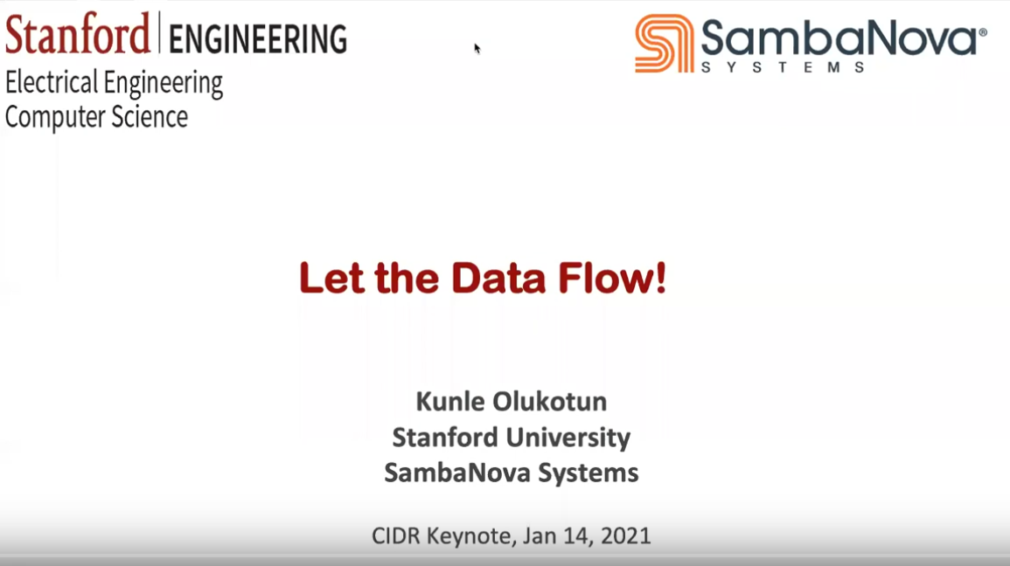
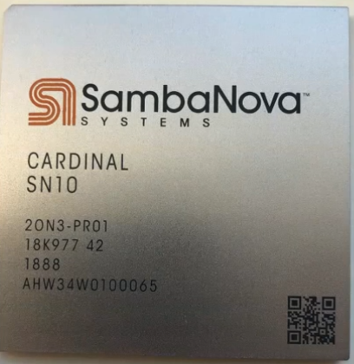
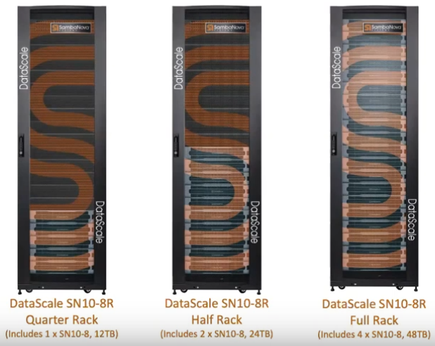
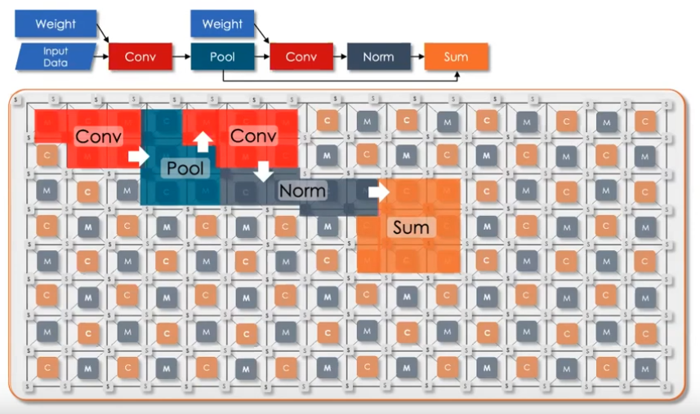
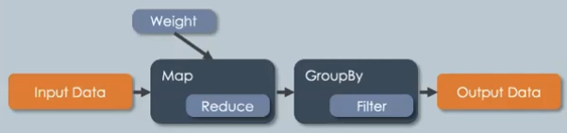
SambaNova
ASICs and other HW Accelerators
[Kunle Olukotun: Let the Data Flow!,
CIDR 2021, https://www.youtube.com/watch?v=iHhHHBuk3W4,
SDSC 2020, https://www.youtube.com/watch?v=E7se0KEa4BY]
Overview
  Reconfigurable data flow architecture
  Based on hierarchical parallel patterns
  (map, zip, reduce, flatMap, groupBy)
  Reconfigurable Dataflow Unit (RDU),
  100s of TFLOPs, 100s MB on chip
Mapping of Dataflow
Computation
  DNN / ML
  Graph processing
  SQL query processing
reconfigure
in ~1-10ms
Notes:
VC capital: total $1.1B funding (676M by Apr 13 2021), $5B valuation (2021)
https://www.crunchbase.com/organization/sambanova-systems

Slide 40
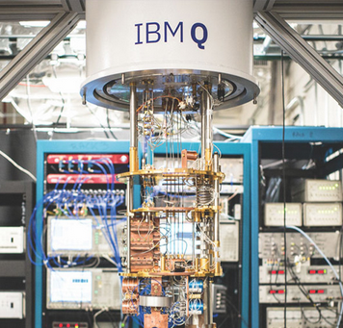
Excursus: Quantum Machine Learning
ASICs and other HW Accelerators
Background (Schrödinger's cat)
  Concepts: superposition, entanglement, de-coherence / uncertainty
IBM Q
  Hardware and software stack for quantum computing
  Qiskit: OSS Python framework [https://qiskit.org/]
  Experiment w/ quantum computers up to 20 qubit
  Gates: Hadamard, NOT, Phases, Pauli, barriers
  transposed conjugate, if, measurement
Early ML (Systems) Work
  Training quantum neural networks
  (relied on quantum search in O(√N)
  SVM classification w/ large feature space
  TensorFlow Quantum (TFQ), on OSS Cirq
  for hybrid models [https://www.tensorflow.org/quantum]
[Bob Ricks, Dan Ventura: Training a Quantum Neural Network. NIPS 2003]
[Vojtěch Havlíček et al: Supervised learning with quantum-enhanced feature spaces. Nature 2019]
Notes:
* Note on contradiction in Schrödinger's cat thought experiment (missing entanglement): https://arxiv.org/pdf/1603.07986.pdf
* Grover quantum search → polynomial speedup to exponential problem → randomized search
* SVM: quantum variational classifier + quantum kernel estimator
* TFQ for hybrid DNN models and circuits

Slide 41
ML Hardware Fallacies and Pitfalls
ASICs and other HW Accelerators
Recommended Reading
  [Jeff Dean, David A. Patterson, Cliff Young: A New Golden Age in Computer
  Architecture: Empowering the Machine-Learning Revolution. IEEE Micro 2018]
#1 Fallacy: Throughput over Latency
  Given the large size of the ML problems, the HW focus should be op/s (throughput) rather than time to solution (latency)
#2 Fallacy: Runtime over Accuracy
  Given large speedup, ML researchers would be willing to sacrifice accuracy
#3 Pitfall: Designing HW using last year’s models
  MNIST, CIFAR-10 datasets too easy, AlexNet no longer representative
  See 02 System Architecture & Landscape – ML System Benchmarks
#4 Pitfall: Designing ML HW assuming ML system is untouchable
  Towards hardware-software co-design (algorithm, system internals)

Slide 42
Trend: ML-based Chip Placement
ASICs and other HW Accelerators
[Azalia Mirhoseini, Anna Goldie, et al: Chip Placement with Deep
Reinforcement Learning. CoRR 2020]
Motivation
  ASICs: custom chips for ML
  ML for improved chip placement
  (part of chip design process
Deep RL for Chip Design
  Goal: optimize power, performance, and area s.t.
  constraints on routing congestion and density
  Approximate reward functions for effective evaluation ~100K (wire length,
  grid rows/columns, macro order, cell placement, routing congestion)
Example TPUv4 Block
  White macros (e.g., mem)
  Green standard cells
[Azalia Mirhoseini, Anna Goldie, et al: A Graph Placement Methodology for Fast Chip Design. Nature 2021]
https://www.youtube.com/watch?v=gSBYf25bWyo
Notes:
Note: NYT story on Satrajit Chatterjee – May 2, 2022; anonymous paper (Mar 2022) “Stronger Baselines for Evaluating Deep Reinforcement Learning in Chip Placement”

Slide 43
Summary and Conclusions
Increasing importance of specialization:
End of Moore’s Law
End of Dennard Scaling
Different Levels of Hardware Specialization
  General-purpose CPUs and GPUs
  FPGAs, DNN ASICs, and other technologies
Next Lectures
  08 Caching, Partitioning, Indexing and Compression [May 13]
  09 Data Acquisition, Cleaning, and Preparation [May 20]
  May 26/27: Ascension Day (Christi Himmelfahrt) + “Rektorstag”
  10 Model Selection and Management [Jun 03]
  11 Model Debugging, Fairness, Explainability [Jun 10]
  12 Model Serving Systems and Techniques [Jun 17]
(Part A: Overview and ML System Internals)
(Part B:
ML Lifecycle Systems)

