Slide 1

Architecture of ML Systems
08 Data Access Methods
Last update: May 09, 2022

Slide 2


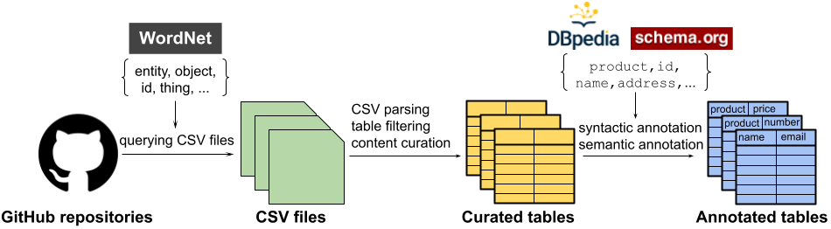

Announcements/Org
#1 Video Recording
  Link in TeachCenter & TUbe (lectures will be public)
  Hybrid: HSi13 / https://tugraz.webex.com/meet/m.boehm
  Apr 25: no more COVID restrictions at TU Graz
#2 GitTables (Uni Amsterdam)
  Corpus with >1M relational tables
  Annotated syntactic and semantic types
  https://gittables.github.io/
#3 CS Talks
  Eva Galperin (Director of Cybersecurity at EFF):
  Who Deserves Cybersecurity
  Aula Alte Technik; Jun 07, 5.30pm

Slide 3
Categories of Execution Strategies
Motivation and Terminology
Batch/Mini-batch, Independent Tasks MIMD
Batch
SIMD/SPMD
Mini-batch
05_{a} Data-Parallel Execution
05_{b} Task-Parallel Execution
06 Parameter Servers (data, model)
07 Hybrid Execution and HW Accelerators
08 Caching, Partitioning, Indexing, and Compression

Slide 4
Agenda
Motivation, Background, and Overview
Caching, Partitioning, and Indexing
Lossy and Lossless Compression
Iterative, I/O-bound ML algorithms ➔ Data access crucial for performance
X
while(!converged) {
… q = X %*% v …
}
Data
Weights
Notes:
Note:
* train -> data read-only, weights updated
* score -> stream of new data, weights read-only

Slide 5
Motivation, Background, and
Overview

Slide 6
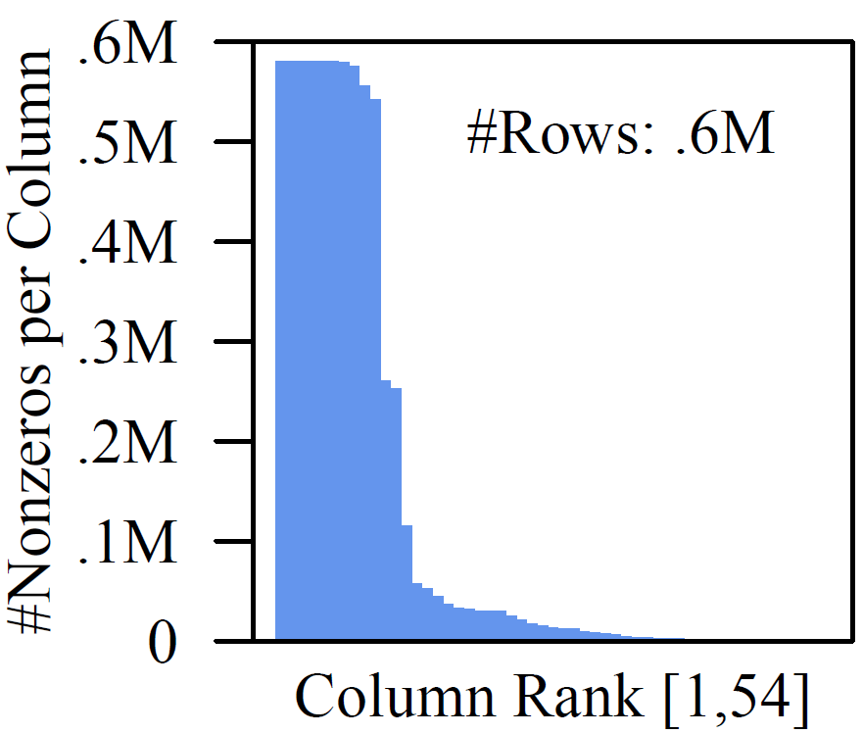
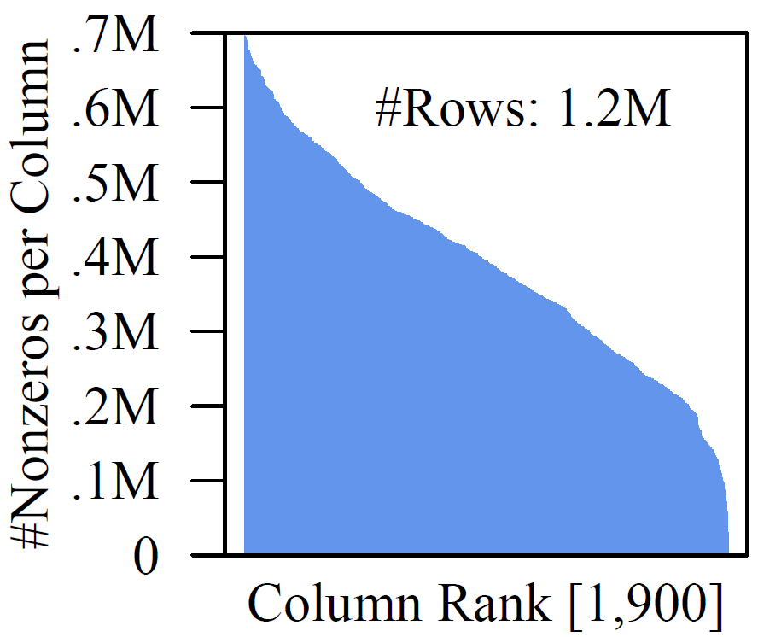
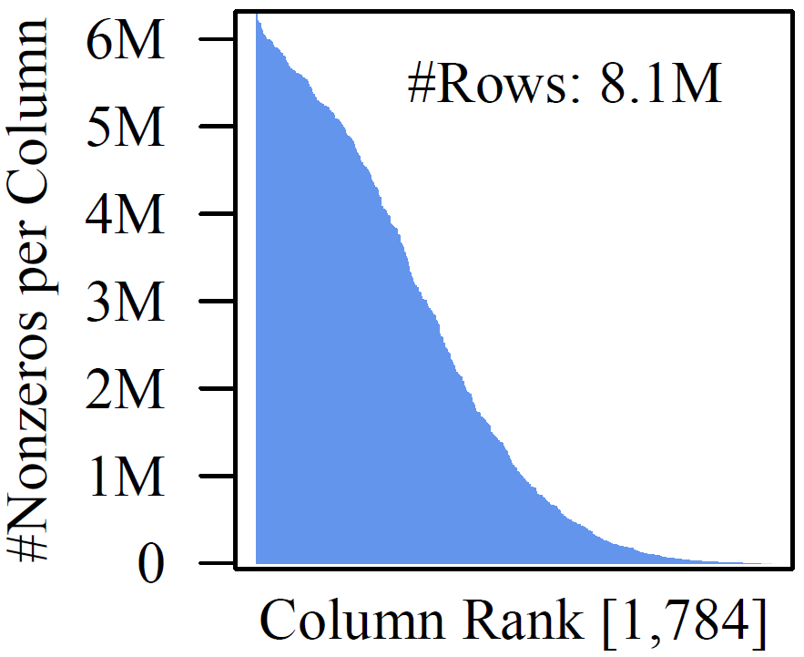
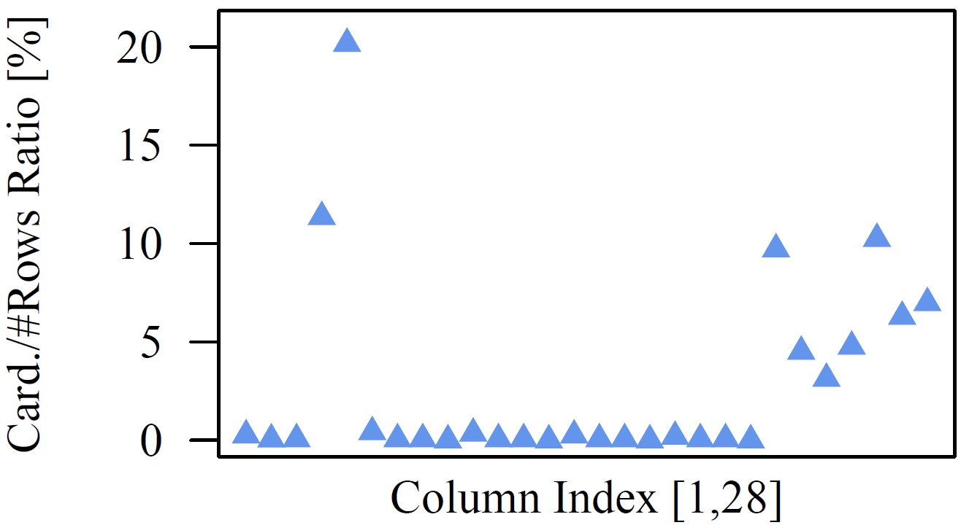
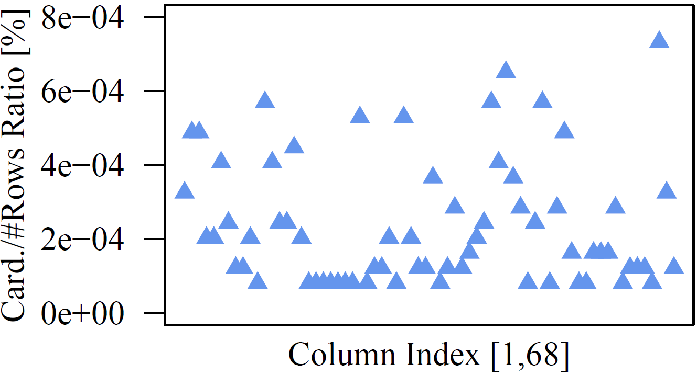
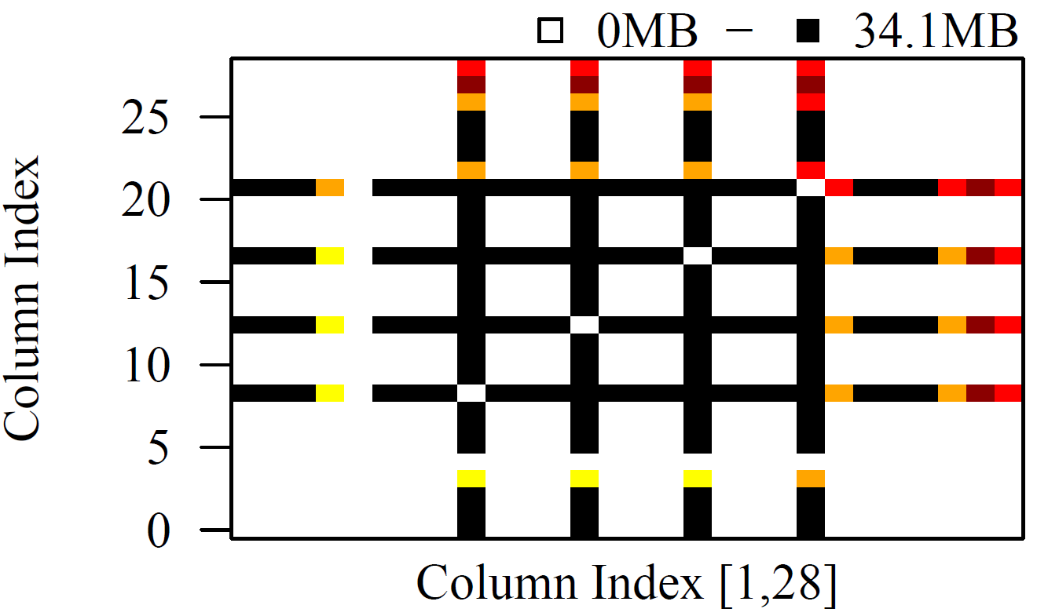
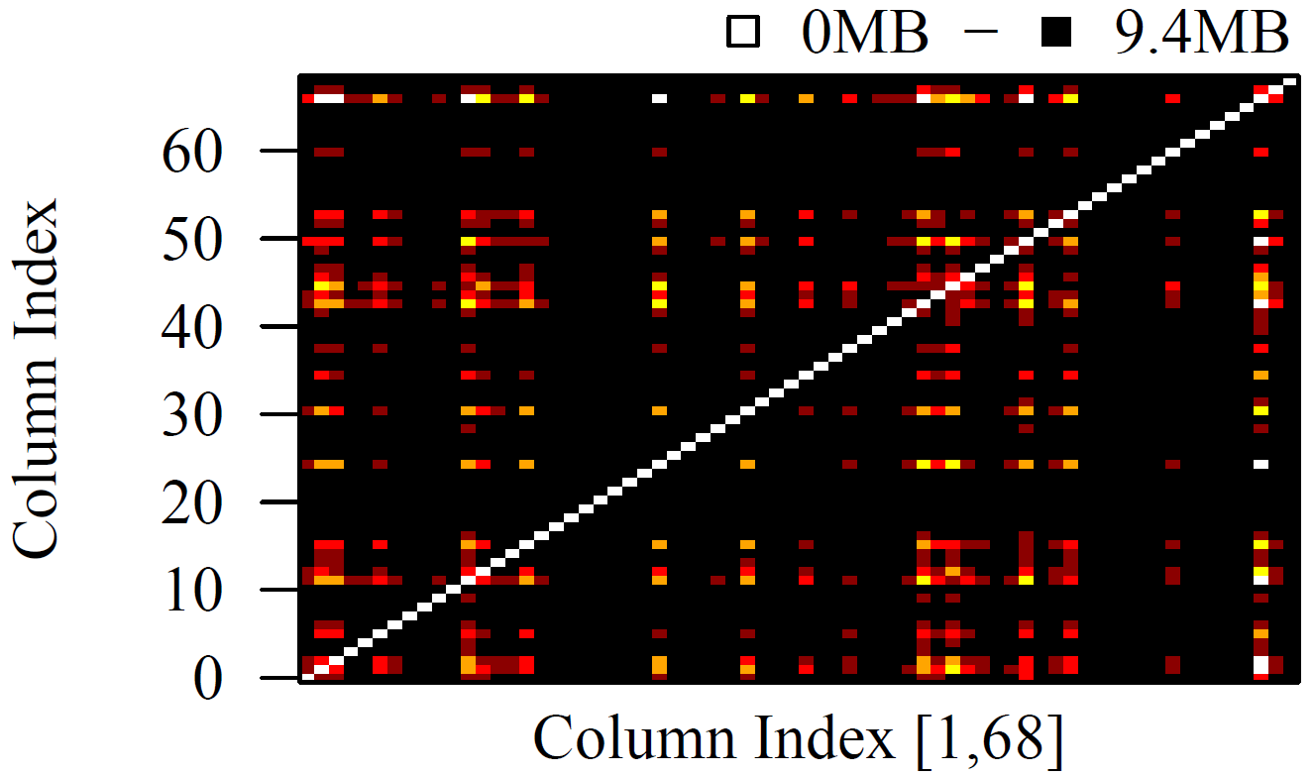
Motivation: Data Characteristics
Motivation, Background, and Overview
Covtype
ImageNet
Mnist8m
Tall and Skinny
(#rows >> #cols)
Non-Uniform
Sparsity
Small Column
Cardinalities
Small Val Range
Column
Correlations
(on census:
12.8x → 35.7x)
Higgs
Census
Notes:
Note: small column cardinalities (e.g., categorical, dummy-coded)

Slide 7
Recap: Matrix Formats
Motivation, Background, and Overview
Example
3x3 Matrix
Matrix Block (m x n)
  A.k.a. tiles/chunks, most operations defined here
  Local matrix: single block, different representations
Common Block Representations
  Dense (linearized arrays)
  MCSR (modified CSR)
  CSR (compressed sparse rows), CSC
  COO (Coordinate matrix)
.7
.1
.2
.4
.3
MCSR
CSR
COO
0
2
0
0
.7
0
0
.7
Dense (row-major)
.7
.1
2
2
.1
0
2
.1
.7
0
.1
.2
.4
0
0
.3
0
0
1
4
0
.2
1
0
.2
.2
.4
O(mn)
5
1
.4
1
1
.4
1
1
.3
2
1
.3
.3
O(m + nnz(X))
O(nnz(X))

Slide 8
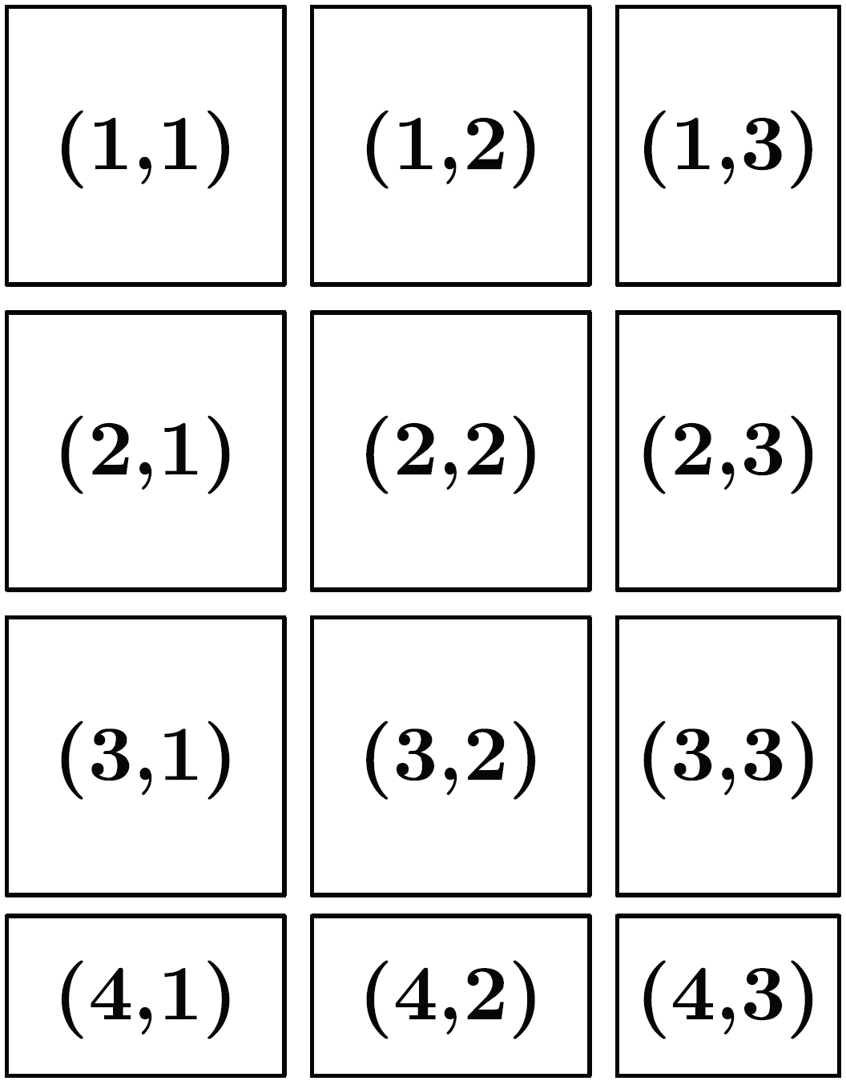
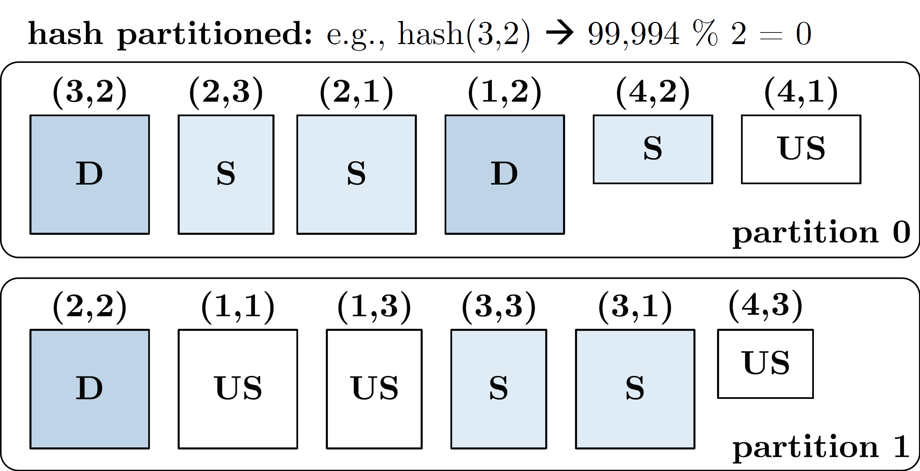
Recap: Distributed Matrix Representations
Motivation, Background, and Overview
Logical Blocking 3,400x2,700 Matrix
(w/ B_{c}=1,000)
Collection of “Matrix Blocks” (and keys)
  Bag semantics (duplicates, unordered)
  Logical (Fixed-Size) Blocking
  + join processing / independence
  - (sparsity skew)
  E.g., SystemDS on Spark:
  JavaPairRDD<MatrixIndexes,MatrixBlock>
  Blocks encoded independently (dense/sparse)
Partitioning
  Logical Partitioning
  (e.g., row-/column-wise)
  Physical Partitioning
  (e.g., hash / grid)
Physical Blocking and Partitioning

Slide 9

Overview Data Access Methods
Motivation, Background, and Overview
Node1
Node2
#1 (Distributed) Caching
  Keep read only feature matrix in (distributed) memory
#2 Buffer Pool Management
  Graceful eviction of intermediates, out-of-core ops
#3 Scan Sharing (and operator fusion)
  Reduce the number of scans as well as read/writes
#4 NUMA-Aware Partitioning and Replication
  Matrix partitioning / replication → data locality
#5 Index Structures
  Out-of-core data, I/O-aware ops, updates
#6 Compression
  Fit larger datasets into available memory
Socket1
Socket2

Slide 10
Caching, Partitioning, and
Indexing
#2 Buffer Pool Management
#3 Scan Sharing (and operator fusion)
#4 NUMA-Aware Partitioning and Replication
#5 Index Structures

Slide 11
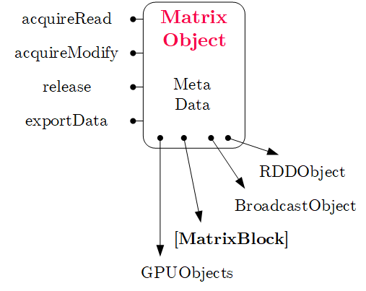
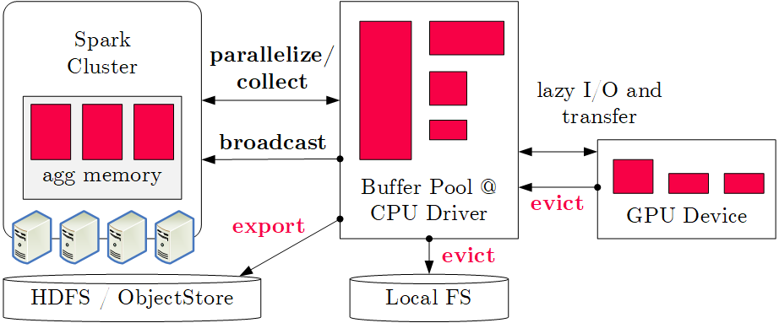
Buffer Pool Management
Caching, Partitioning, and Indexing
#1 Classic Buffer Management (SystemDS)
  Hybrid plans of in-memory and distributed ops
  Graceful eviction of intermediate variables
#2 Algorithm-Specific Buffer Management
  Operations/algorithms over out-of-core matrices and factor graphs
  Examples: RIOT [CIDR’2009] (ops), Elementary [SIGMOD’13] (factor graphs)

Slide 12
Scan Sharing
Caching, Partitioning, and Indexing
k
#1 Batching
  One-pass evaluation of multiple configurations
  Use cases: EL, CV, feature selection,
  hyper parameter tuning, multi-user scoring
  E.g.: TUPAQ [SoCC’16], Columbus [SIGMOD’14]
#2 Fused Operator DAGs
  Avoid unnecessary scans, (e.g., mmchain)
  Avoid unnecessary writes / reads
  Multi-aggregates, redundancy
  E.g.: SystemML codegen [PVLDB’18]
#3 Runtime Piggybacking
  Merge concurrent data-parallel jobs
  “Wait-Merge-Submit-Return”-loop
  E.g.: SystemML parfor [PVLDB’14]
n
X
O(m*n) read
O(m*n*k) compute
m >> n >> k
m
Multi-Aggregate
sum
sum
sum
u(^2)
b(*)
u(^2)
a = sum(X^2)
b = sum(X*Y)
c = sum(Y^2)
X
Y
parfor( i in 1:numModels )
while( !converged )
q = X %*% v; ...

Slide 13
In-Memory Partitioning (NUMA-aware)
Caching, Partitioning, and Indexing
NUMA-Aware Model and Data Replication
  Model Replication (06 Parameter Servers)
    PerCore (BSP epoch), PerMachine
    (Hogwild!), PerNode (hybrid)
  Data Replication
    Partitioning (sharding)
    Full replication
AT MATRIX (Adaptive Tile Matrix)
  Recursive NUMA-aware partitioning
  into dense/sparse tiles
  Inter-tile (worker teams) and intra-tile
  (threads in team) parallelization
  Job scheduling framework from SAP HANA
  (horizontal range partitioning, socket-local
  queues with task-stealing)
[Ce Zhang, Christopher Ré: DimmWitted: A Study of Main-Memory Statistical Analytics. PVLDB 2014]
Machine
Node 1
Node 2
C1
C2
C3
C4
RAM
RAM
[David Kernert, Wolfgang Lehner, Frank Köhler: Topology-aware optimization of big sparse matrices and matrix multiplications on main-memory systems. ICDE 2016]

Slide 14
Distributed Partitioning
Caching, Partitioning, and Indexing
Spark RDD Partitioning
  Implicitly on every data shuffling
  Explicitly via R.repartition(n)
Distributed Joins
  R3 = R1.join(R2)
Single-Key Lookups v = C.lookup(k)
  Without partitioning: scan all keys (reads/deserializes out-of-core data)
  With partitioning: lookup partition, scan keys of partition
Multi-Key Lookups
  Without partitioning:
  scan all keys
  With partitioning:
  lookup relevant partitions
Example Hash Partitioning:
For all (k,v) of R:
hash(k) % numPartitions → pid
0: 8, 1, 6
0: 1, 2
% 3
0: 3, 6
0: 6, 3
2: 2, 3, 4
2: 3, 4
2: 2, 5, 8
2: 5, 2
1: 7, 5
1: 5, 6
1: 4, 7, 1
1: 4, 1
//build hashset of required partition ids
HashSet<Integer> flags = new HashSet<>();
for( MatrixIndexes key : filter )
flags.add(partitioner.getPartition(key));
//create partition pruning rdd
ppRDD = PartitionPruningRDD.create(in.rdd(),
new PartitionPruningFunction(flags));

Slide 15
Recap: B-Tree Overview
Caching, Partitioning, and Indexing
[Rudolf Bayer, Edward M. McCreight: Organization and Maintenance of Large Ordered Indices. Acta Inf. (1) 1972]
History B-Tree
  Bayer and McCreight 1972, Block-based, Balanced, Boeing Labs
  Multiway tree (node size = page size); designed for DBMS
  Extensions: B+-Tree/B*-Tree (data only in leafs, double-linked leaf nodes)
Definition B-Tree (k, h)
  All paths from root to leafs have equal length h
  All nodes (except root) have [k, 2k] key entries
  All nodes (except root, leafs) have [k+1, 2k+1] successors
  Data is a record or a reference to the record (RID)
All nodes adhere to max constraints
k=2
P₀
Key K₁
Data D₁
P₁
Key K₂
Data D₂
P₂
Key K₃
Data D₃
P₃
Key K₄
Data D₄
P₄
Subtree w/
keys ≤ K₁
Subtree w/
K₂ < keys ≤ K₃

Slide 16
Recap: B-Tree Overview, cont.
Caching, Partitioning, and Indexing
B-Tree Search
  Scan/binary search
  within nodes
  Descend along
  matching
  key ranges
B-Tree Insertion
  Insert into leaf nodes
  Split the 2k+1 entries into two leaf nodes
B-Tree Deletion
  Lookup key and delete if existing
  Move entry from fullest successor; if underflow merge with sibling
25
10
20
30
40
2
5
7
8
41
42
45
46
13
14
15
18
32
35
38
22
24
26
27
28

Slide 17
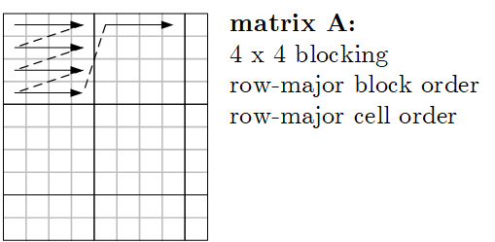
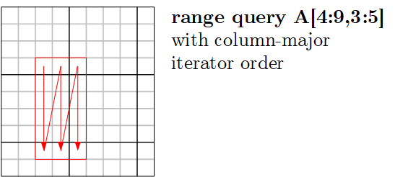
Linearized Array B-Tree (LAB-Tree)
Caching, Partitioning, and Indexing
[Yi Zhang, Kamesh Munagala, Jun Yang: Storing Matrices on Disk: Theory and Practice Revisited. PVLDB 2011]
Basic Ideas
  B-tree over linearized array representation
  (e.g., row-/col-major, Z-order, UDF)
  New leaf splitting strategies; dynamic leaf storage format (sparse and dense)
  Various flushing policies for update batching (all, LRU, smallest page, largest page, largest page probabilistically, largest group)
#1 Example linearized storage order
#2 Example linearized iterator order

Slide 18
Adaptive Tile (AT) Matrix
Caching, Partitioning, and Indexing
[David Kernert, Wolfgang Lehner, Frank Köhler: Topology-aware optimization of big sparse matrices and matrix multiplications on main-memory systems. ICDE 2016]
Basic Ideas
  Two-level blocking and NUMA-aware
  range partitioning (tiles, blocks)
  Z-order linearization, and recursive
  quad-tree partitioning to find var-sized tiles (tile contains N blocks)
Density Map
(see sparsity est.)
Input Matrix
Z-ordering
block
tiles

Slide 19
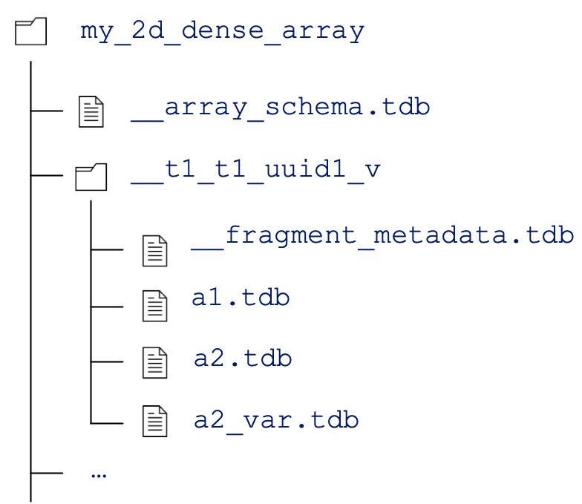
TileDB Storage Manager
Caching, Partitioning, and Indexing
[Stavros Papadopoulos, Kushal Datta, Samuel Madden, Timothy G. Mattson: The TileDB Array Data Storage Manager. PVLDB 2016]
Basic Ideas
  Storage manager for 2D arrays of
  different data types (incl. vector, 3D)
  Two-level blocking (space/data tiles), update batching via fragments
https://docs.tiledb.com
Notes:
TileDB Inc startup, $20M funding: TileDB Cloud, a commercial SaaS offering for planet-scale data sharing and serverless distributed computations.

Slide 20
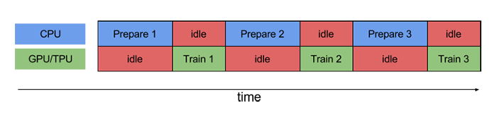
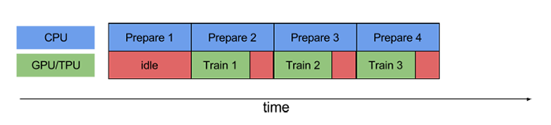

Pipelining for Mini-batch Algorithms
Caching, Partitioning, and Indexing
Motivation
  Overlap data access and computation in mini-batch algorithms (e.g., DNN)
  ➔ Simple pipelining of I/O and compute via queueing / prefetching
Example TensorFlow
  #1 Queueing
  and Threading
  #2 Dataset API
  Prefetching
  #3 Reuse via
  Data Echoing
dataset = dataset.batch(batch_size=32)
dataset = dataset.prefetch(buffer_size=1)
[https://www.tensorflow
.org/guide/performance/
datasets]
[https://ai.googleblog.com/
2020/05/speeding-up-neural-network-training.html]

Slide 21
Lossy and Lossless Compression
#6 Compression

Slide 22
Recap: Database Compression Schemes
Lossy and Lossless Compression
106
Null Suppression
  Compress integers by omitting
  leading zero bytes/bits (e.g., NS, gamma)
Run-Length Encoding
  Compress sequences of equal values by
  runs of (value, start, run length)
Dictionary Encoding
  Compress column w/ few distinct values
  as pos in dictionary (→ code size)
Delta Encoding
  Compress sequence w/ small changes
  by storing deltas to previous value
Frame-of-Reference Encoding
  Compress values by storing delta to
  reference value (outlier handling)
00000000
00000000
00000000
01101010
11
01101010
1 1 1 1 7 7 7 7 7 3 3 3 3 3 3 ...
1,1,4
7,5,5
3,10,6
1 7 7 3 1 7 1 3 3 7 1 3 3 7 3 ...
1,3,7
dictionary (code size 2 bit)
1 3 3 2 1 3 1 2 2 3 1 2 2 3 2 ...
20 21 22 20 19 18 19 20 21 20 ...
0 1 1 -2 -1 -1 1 1 1 -1...
20 21 22 20 71 70 71 69 70 21 ...
21
70
22
-1 0 1 -1 1 0 1 -1 0 -1 ...

Slide 23
Overview Lossless Compression Techniques
Lossy and Lossless Compression
#1 Block-Level General-Purpose Compression
  Heavyweight or lightweight compression schemes
  Decompress matrices block-wise for each operation
  E.g.: Spark RDD compression (Snappy/LZ4),
  SciDB SM [SSDBM’11], TileDB SM [PVLDB’16],
  scientific formats NetCDF, HDF5 at chunk granularity
#2 Block-Level Matrix Compression
  Compress matrix block with homogeneous encoding scheme
  Perform LA ops over compressed representation
  E.g.: CSR-VI (dict) [CF’08], cPLS (grammar) [KDD’16],
  TOC (LZW w/ trie) [SIGMOD’19]
#3 Column-Group-Level Matrix Compression
  Compress column groups w/ heterogeneous schemes
  Perform LA ops over compressed representation
  E.g.: SystemML CLA (RLE, OLE, DDC, UC) [PVLDB’16]
decompress
& deserialize
M
Storage
Manager
Dict.
comp. M
comp.
M
D1
D2

Slide 24
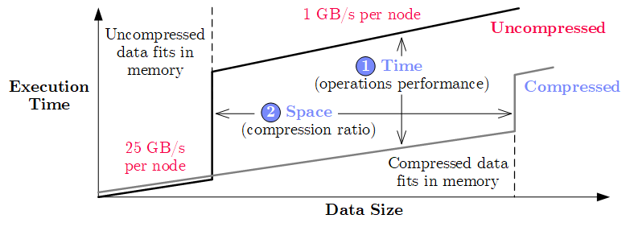
CLA: Compressed Linear Algebra
Lossy and Lossless Compression
[Ahmed Elgohary et al: Compressed Linear Algebra for Large-Scale Machine Learning. PVLDB 2016]
Key Idea
  Use lightweight database compression techniques
  Perform LA operations on compressed matrices
Goals of CLA
  Operations performance close to uncompressed
  Good compression ratios
X
while(!converged) {
… q = X %*% v …
}
[SIGMOD Record’17, VLDBJ’18, CACM’19]

Slide 25
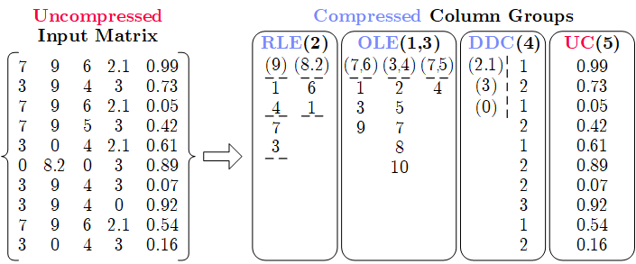
CLA: Compressed Linear Algebra, cont. (2)
Lossy and Lossless Compression
Overview Compression Framework
  Column-wise matrix compression (values + compressed offsets / references)
  Column co-coding (column groups, encoded as single unit)
  Heterogeneous column encoding formats (w/ dedicated physical encodings)
Column Encoding
Formats
  Offset-List (OLE)
  Run-Length (RLE)
  Dense Dictionary
  Coding (DDC)*
  Uncompressed
  Columns (UC)
Automatic Compression Planning (sampling-based)
  Select column groups and formats per group (data dependent)
* DDC1/2 in VLDBJ’18

Slide 26
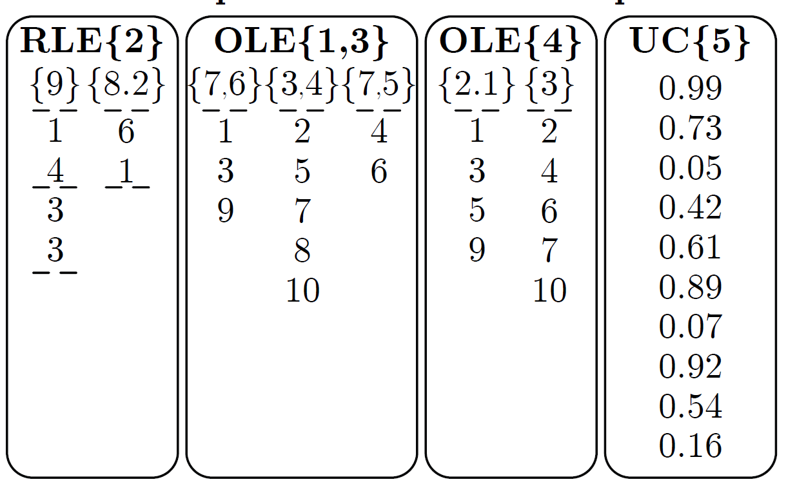
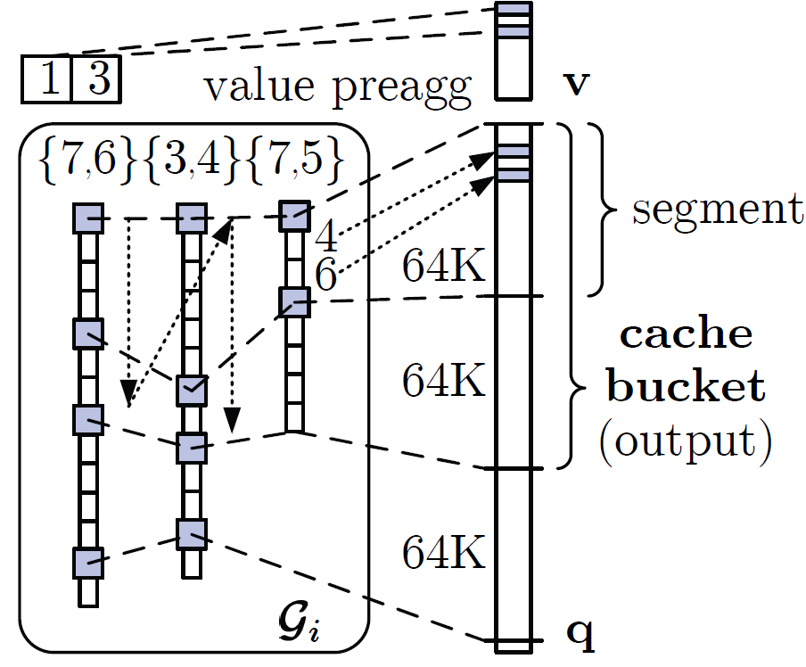
CLA: Compressed Linear Algebra, cont. (3)
Lossy and Lossless Compression
Matrix-Vector Multiplication
  Naïve: for each tuple, pre-aggregate values, add values at offsets to q
  Example: q = X v, with
  Cache-conscious: Horizontal,
  segment-aligned scans, maintain positions
Vector-Matrix Multiplication
  Naïve: cache-unfriendly on input (v)
  Cache-conscious: again use horizontal, segment-aligned scans
v = (7, 11, 1, 3, 2)
v = (7, 11, 1, 3, 2)
v = (7, 11, 1, 3, 2)
v = (7, 11, 1, 3, 2)
v = (7, 11, 1, 3, 2)
v = (7, 11, 1, 3, 2)
9*11=99
➔ cache unfriendly
on output (q)
90.2
55
25
54
6.3
9
0
99
99
154
154
154
160.3
160.3
162.3
162.3
0
99
99
99
124
124
124
133
134.5
134.5
0
99
99
154
154
154
160.3
160.3
160.4
160.4
0
99
99
99
99
153
153
162
162.8
162.8
0
0
0
0
25
25
31.3
31.3
32.5
32.5
0
0
90.2
90.2
90.2
144.2
144.2
153.2
155
155
0
99
99
99
124
124
124
133
133.1
133.1
0
99
99
99
124
124
124
124
125.8
125.8
0
99
99
154
154
154
160.3
160.3
161.4
161.4
0
0
0
0
25
25
25
34
34.3
34.3

Slide 27
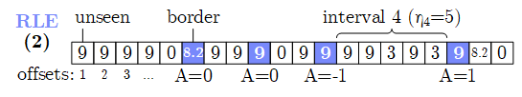
CLA: Compressed Linear Algebra, cont. (4)
Lossy and Lossless Compression
Estimating Compressed Size: S^{C} = min(S^{OLE}, S^{RLE}, S^{DDC})
  # of distinct tuples d_{i}: “Hybrid generalized jackknife” estimator [JASA’98]
  # of non-zero tuples z_{i}: Scale from sample with “coverage” adjustment
  # of runs r_{ij}: maxEnt model + independent-interval approx. (~ Ising-Stevens)
Compression Planning
  #1 Classify compressible columns
    Draw random sample of rows (from transposed X)
    Classify C^{C} and C^{UC} based on estimate compression ratio
  #2 Group compressible columns (exhaustive O(m^{m}), greedy O(m³))
    Bin-packing-based column partitioning
    Greedy grouping per bin w/ pruning and memoization O(m²)
  #3 Compression
    Extract uncompressed offset lists and exact compression ratio
    Graceful corrections and UC group creation

Slide 28
CLA: Compressed Linear Algebra, cont. (5)
Lossy and Lossless Compression
Experimental Setup
  LinregCG, 10 iterations (incl. compression), InfiMNIST data generator
  1+6 node cluster (216GB aggregate memory), Spark 2.3, SystemML 1.1
Open Challenges
  Ultra-sparse datasets, tensors, automatic operator fusion
  Operations beyond matrix-vector/unary, applicability to deep learning?
Compression Ratios
End-to-End Performance [sec]
Dataset |  | Gzip | Snappy | CLA
Higgs |  | 1.93 | 1.38 | 2.17
Census |  | 17.11 | 6.04 | 35.69
Covtype |  | 10.40 | 6.13 | 18.19
ImageNet |  | 5.54 | 3.35 | 7.34
Mnist8m |  | 4.12 | 2.60 | 7.32
Airline78 |  | 7.07 | 4.28 | 7.44
90GB
540GB
1.1TB

Slide 29

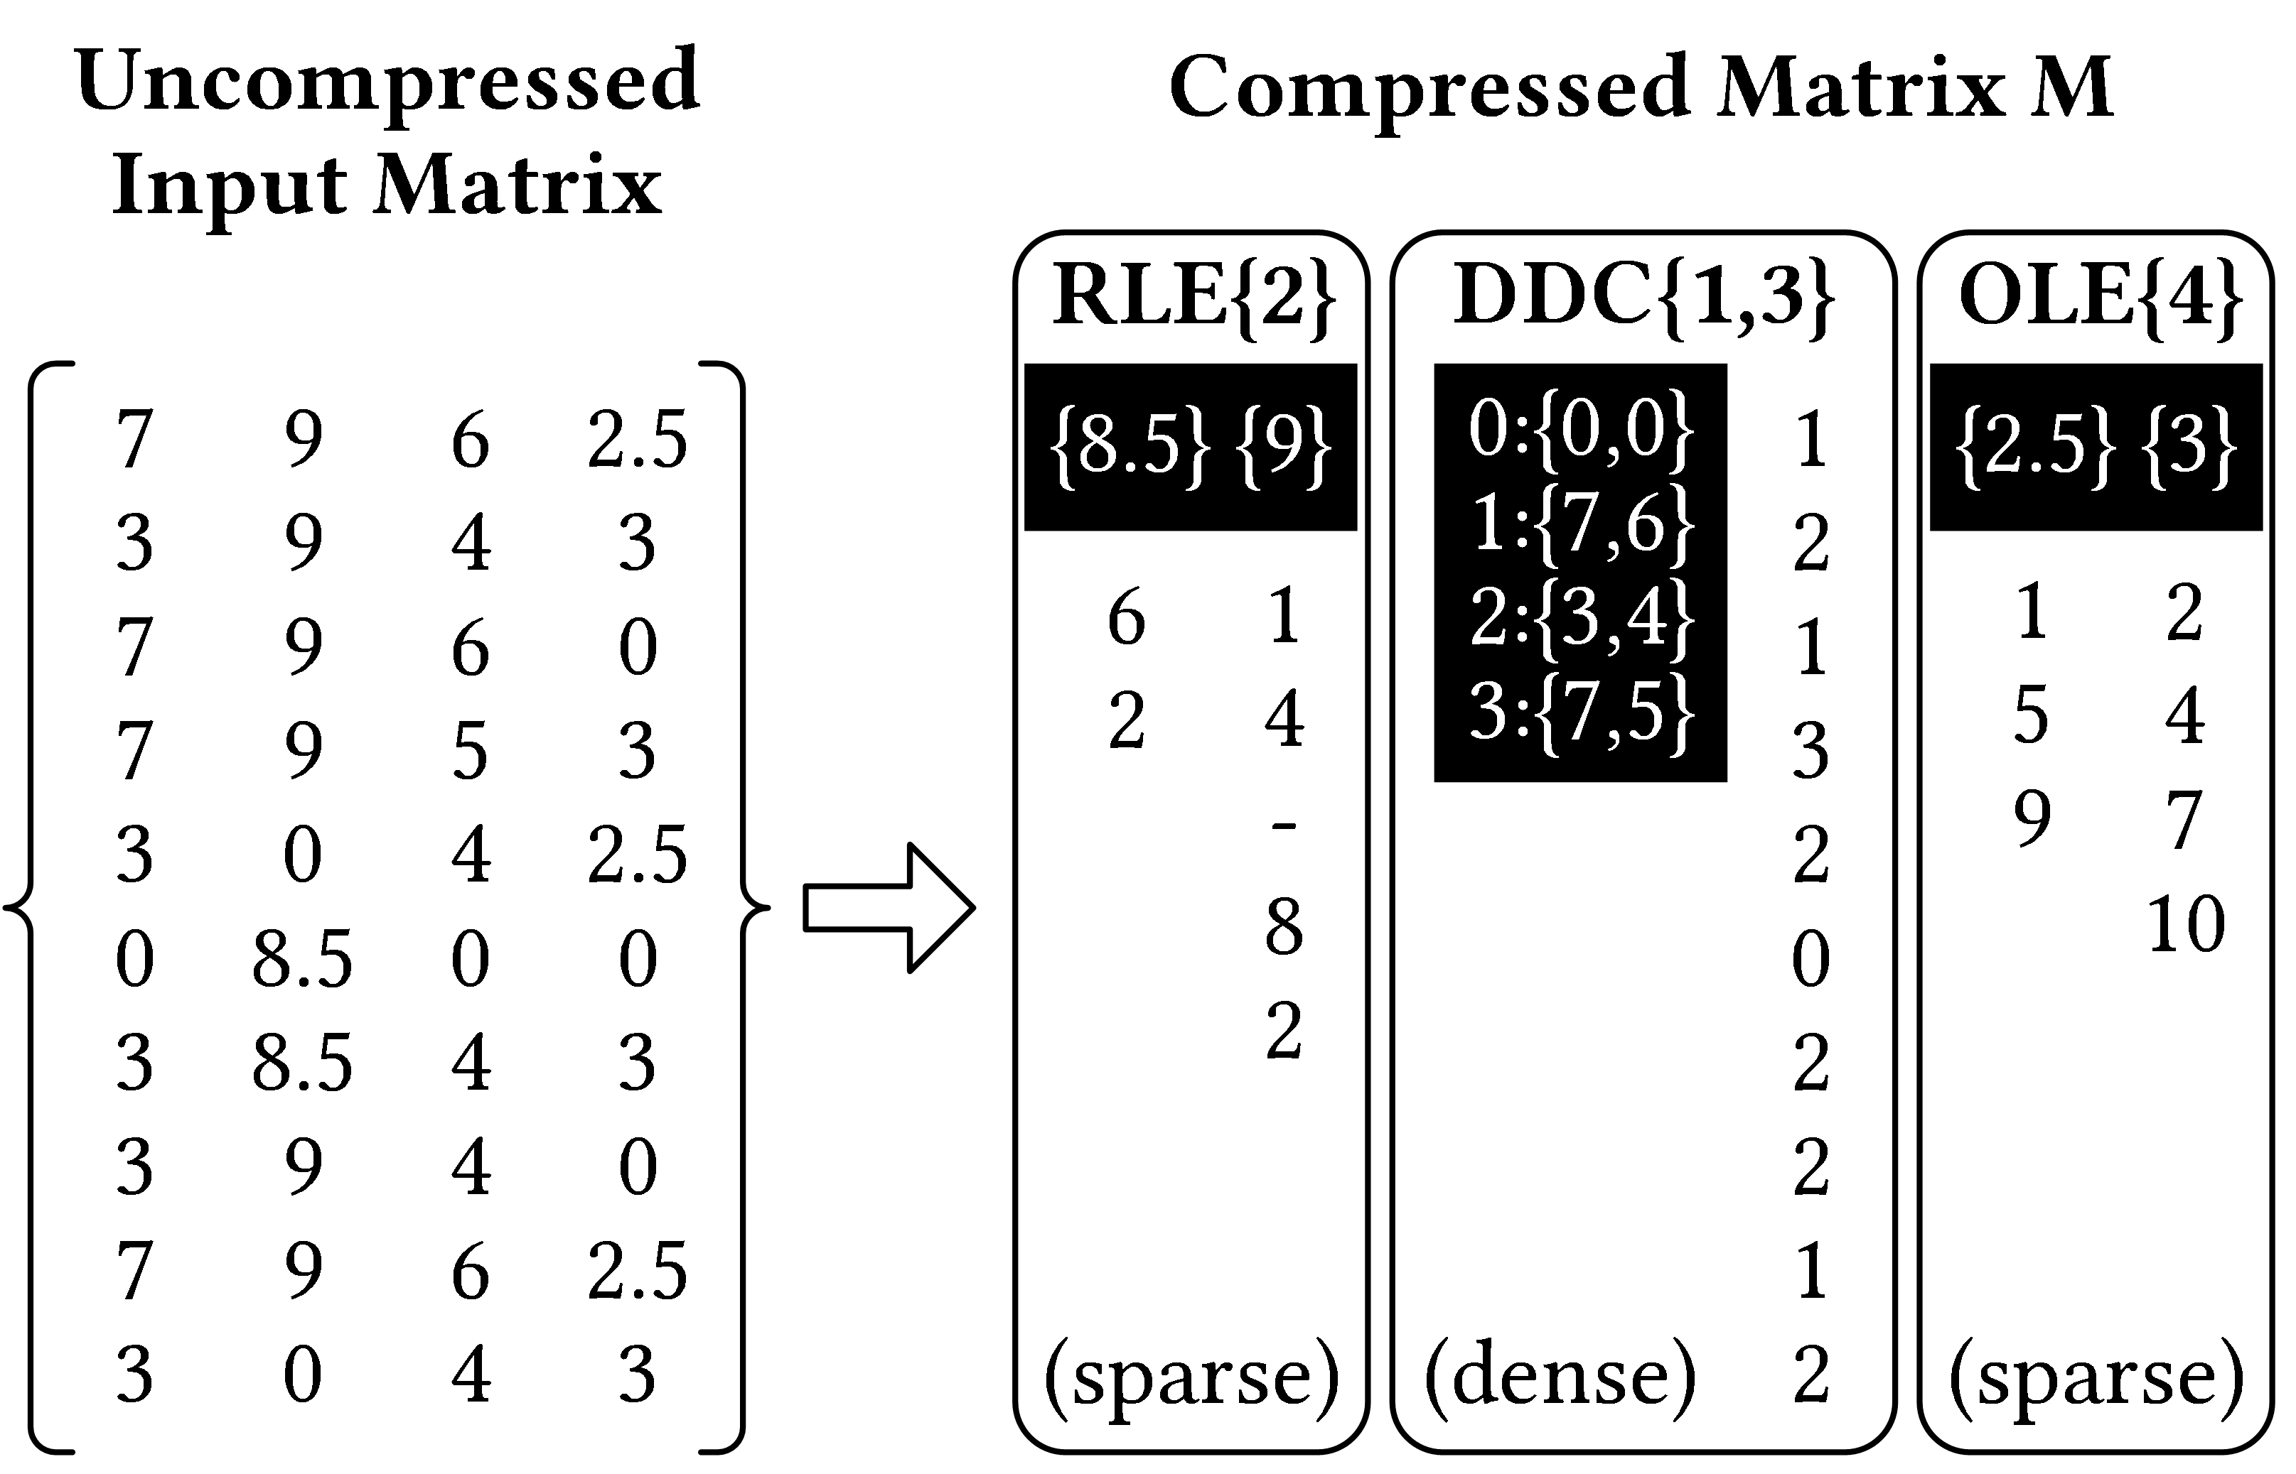
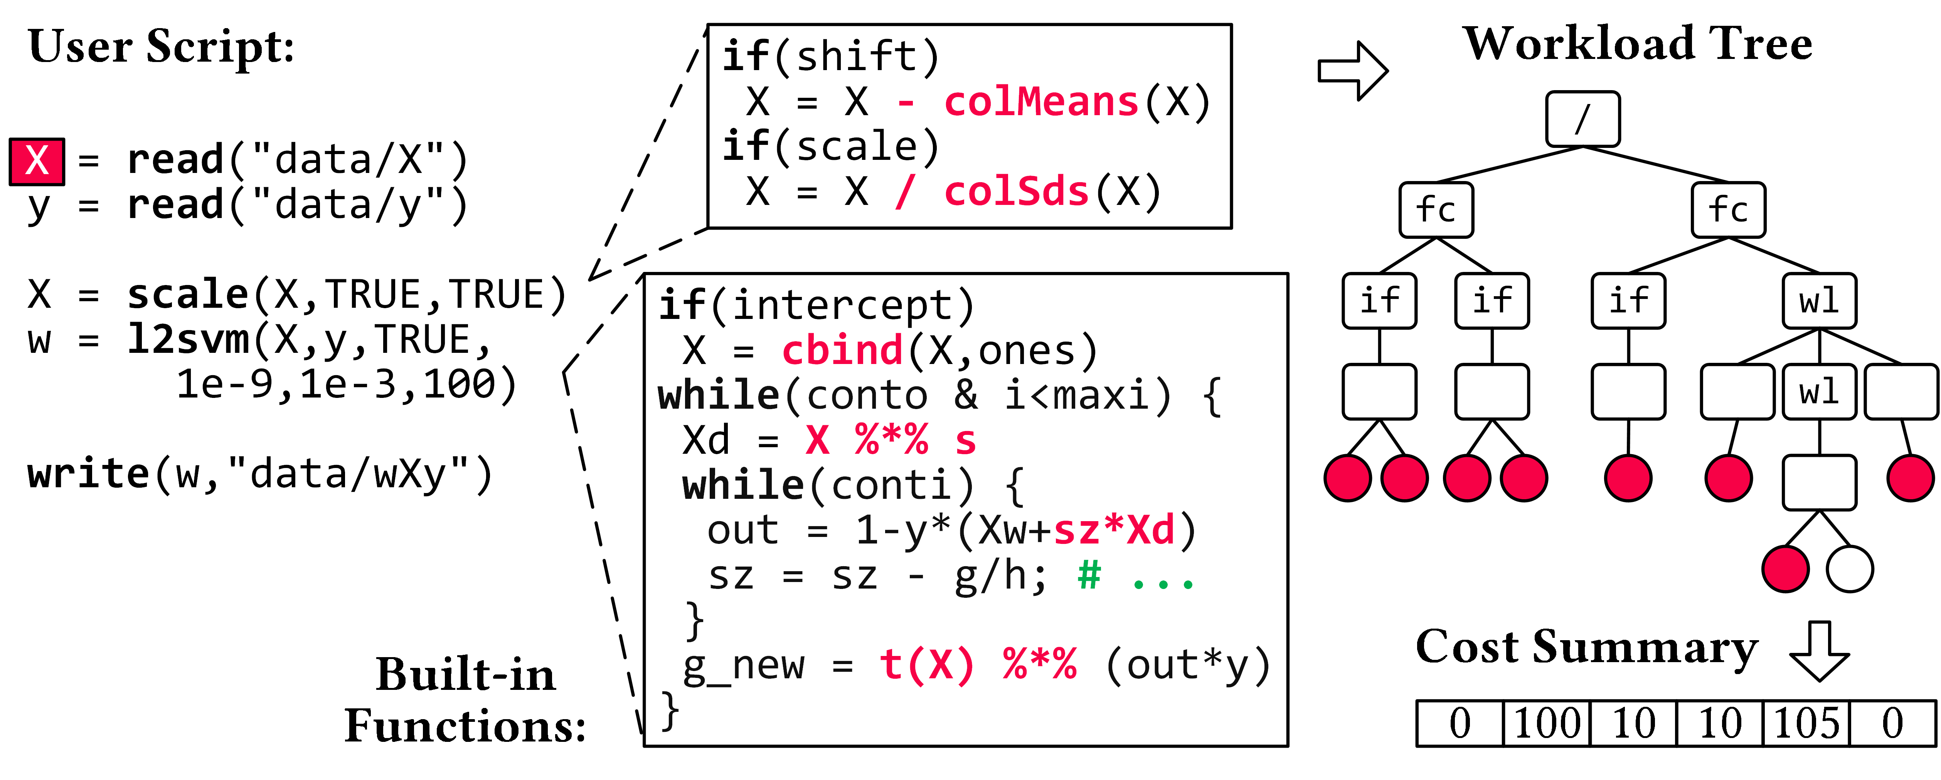
Compressed Linear Algebra Extended
Lossy and Lossless Compression
[under submission]
Lossless Matrix Compression
  Improved general applicability (compression time, new compression schemes, new kernels, intermediates, workload-aware)
  Sparsity → Redundancy exploitation
  (data redundancy, structural redundancy)
Workload-aware Compression
  Workload summary → compression
  Compression → execution planning

Slide 30
Block-level Compression w/ D-VI, CSR-VI, CSX
Lossy and Lossless Compression
[Kornilios Kourtis, Georgios I. Goumas, Nectarios Koziris: Optimizing sparse matrix-vector multiplication using index and value compression. CF 2008]
CSR-VI (CSR-Value Indexed) / D-VI
  Create dictionary for distinct values
  Encode 8 byte values as 1, 2, or 4-byte codes
  (positions in the dictionary)
  Extensions w/ delta coding of indexes
  Example CSR-VI matrix-vector multiply
  c = A %*% b
[Vasileios Karakasis et al.: An Extended Compression Format for the Optimization of Sparse Matrix-Vector Multiplication. IEEE Trans. Parallel Distrib. Syst. 2013]
for(int i=0; i<a.nrow; i++) {
int pos = A.rptr[i];
int end = A.rptr[i+1];
for(int k=pos; k<end; k++)
b[i] += dict[A.val[k]] * b[A.ix[k]];
}
CSR
0
0
.7
2
2
.1
4
0
.2
value decoding
(MV over compressed representation)
5
1
.4
1
.3

Slide 31
Tuple-oriented Compression (TOC)
Lossy and Lossless Compression
[Fengan Li, Lingjiao Chen, Yijing Zeng, Arun Kumar, Xi Wu, Jeffrey F. Naughton, Jignesh M. Patel: Tuple-oriented Compression for Large-scale Mini-batch Stochastic Gradient Descent, SIGMOD 2019]
Motivation
  DNN and ML often trained
  with mini-batch SGD
  Effective compression for small batches (#rows)

Slide 32
Tuple-oriented Compression (TOC), cont.
Lossy and Lossless Compression
[Fengan Li, Lingjiao Chen, Yijing Zeng, Arun Kumar, Xi Wu, Jeffrey F. Naughton, Jignesh M. Patel: Tuple-oriented Compression for Large-scale Mini-batch Stochastic Gradient Descent, SIGMOD 2019]
Example
Compression Ratios
dense baseline?
Take-away: specialized lossless matrix compression
➔ reduce memory bandwidth requirements and #FLOPs

Slide 33
Lossy Compression
Lossy and Lossless Compression
Overview
  Extensively used in DNN (runtime vs accuracy) ➔ data format + compute
  Careful manual application regarding data and model
  Note: ML algorithms approximate by nature + noise generalization effect
Background Floating Point Numbers (IEEE 754)
  Sign s, Mantissa m, Exponent e: value = s * m * 2e (simplified)
Precision | Sign | Mantissa | Exponent
Double (FP64) | 1 | 52 | 11
Single (FP32) | 1 | 23 | 8
Half (FP16) | 1 | 10 | 5
Quarter (FP8) | 1 | 3 | 4
Half-Quarter (FP4) | 1 | 1 | 2
[bits]

Slide 34
Low and Ultra-low FP Precision
Lossy and Lossless Compression
see 05 Execution Strategies, SIMD
→ speedup/reduced energy
Model Training w/ low FP Precision
  Trend: from FP32/FP16 to FP8
  #1: Precision of intermediates (weights, act, errors, grad) → loss in accuracy
  #2: Precision of accumulation → impact on convergence (swamping s+L)
  #3: Precision of weight updates → loss in accuracy
Example ResNet18 over ImageNet
[Naigang Wang et al.: Training Deep Neural Networks with 8-bit Floating Point Numbers. NeurIPS 2018]
#1
#2
#3

Slide 35


Low and Ultra-low FP Precision, cont.
Lossy and Lossless Compression
[Yuanyuan Tian, Shirish Tatikonda, Berthold Reinwald: Scalable and Numerically Stable Descriptive Statistics in SystemML. ICDE 2012]
Numerical Stable Accumulation
  #1 Sorting ASC + Summation
  #2 Kahan Summation
  w/ error independent
  of number of values n
  #3 Pairwise Summation
  (divide & conquer)
#4 Chunk-based Accumulation
  Divide long dot products into smaller chunks
  Hierarchy of partial sums → FP16 accumulators
#5 Stochastic Rounding
  Replace nearest w/ prob. rounding
sumOld = sum;
sum = sum + (input + corr);
corr = (input + corr) – (sum – sumOld);
uak+: 5.000000005E17 //sum(seq(1,1e9))
ua+: 5.0000000109721722E17
ua+: 5.0000000262154688E17 //rev
[N. Wang et al.: Training
Deep Neural Networks with
8-bit Floating Point Numbers. NeurIPS 2018]
Notes:
Note: reproducibility of example Kahan addition
n = 1e9
x1 = seq(1,n);
x2 = seq(n,1);
ones = matrix(1,n,1)
print("baseline: "+(n*(n+1)/2));
print("agg1 : "+as.scalar(t(ones)%*%x1));
print("agg2 : "+as.scalar(t(ones)%*%x2));
print("kagg1 : "+sum(x1));
print("kagg2 : "+sum(x2));

Slide 36
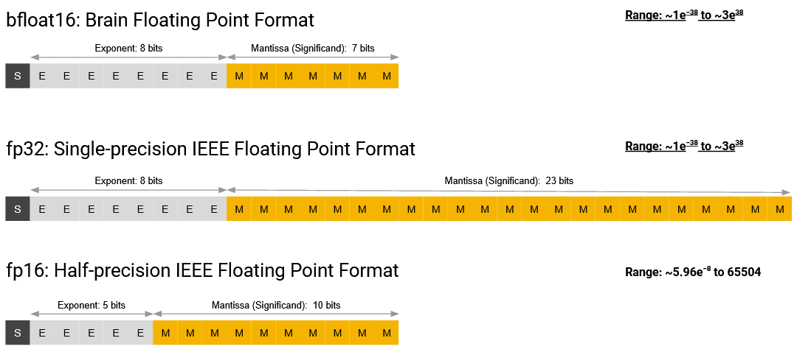

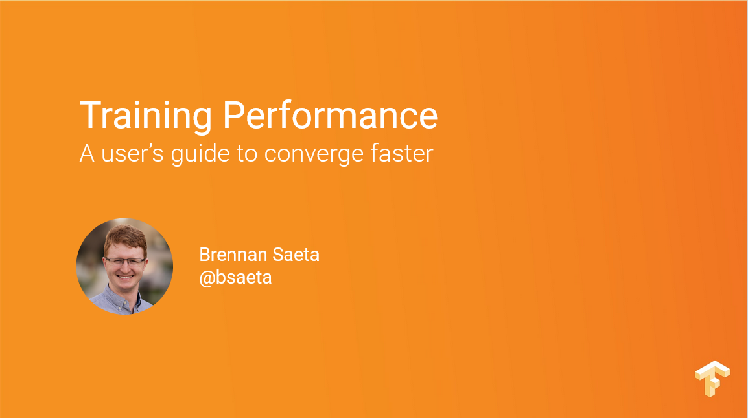
Low and Ultra-low FP Precision – New Datatypes
Lossy and Lossless Compression
Google bfloat16
  “Brain” Float16 w/ range of FP32
  Drop in replacement for FP32,
  no need for loss scaling
Intel FlexPoint
  Blocks of values w/ shared exponent
  (N=16bit w/ M=5bit exponent)
  Example: flex16+5
NVIDIA TF32
  Range of FP32
  w/ precision of FP16
[Brennan Saeta: Training
Performance A user’s guide to converge faster, TF Dev Summit 2018]
[Urs Köster et al.: Flexpoint: An Adaptive Numerical Format for Efficient Training of Deep Neural Networks. NeurIPS 2017]
[NVIDIA A100 Tensor Core GPU Architecture - UNPRECEDENTED ACCELERATION AT EVERY SCALE, Whitepaper, Aug 2020]

Slide 37
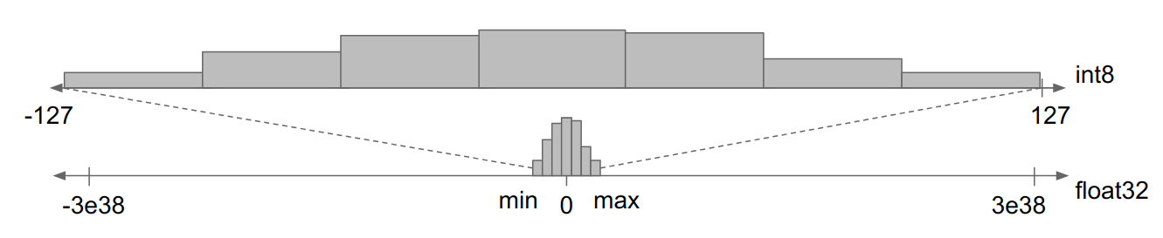
Fixed-Point Arithmetic
Lossy and Lossless Compression
Recommended “Reading”
[Inside TensorFlow: Model Optimization Toolkit (Quantization and Pruning), YouTube, 2020]
Motivation
  Forward-pass for model scoring (inference) can be done in UINT8 and below
  Static, dynamic, and learned quantization schemes (weights and inputs)
Quantization (reduce value domain)
  Split value domain into N buckets
  such that k = log₂ N can encode the data
  a) Static Quantization (e.g., min/max)
  per tensor or per tensor channel
  b) Learned Quantization Schemes
    Dynamic programming
    Various heuristics
    Example systems:
    ZipML, SketchML
[https://blog.tensorflow.org/2020/04/
quantization-aware-training-with-tensorflow-model-optimization-toolkit.html]
[Hantian Zhang, Jerry Li, Kaan Kara, Dan Alistarh, Ji Liu, Ce Zhang: ZipML: Training Linear Models with End-to-End Low Precision, and a Little Bit of Deep Learning. ICML 2017]

Slide 38
Other Lossy Techniques
Lossy and Lossless Compression
[https://blog.tensorflow.org/2019/05/tf-model-optimization-toolkit-pruning-API.html]
#1 Sparsification/Pruning (reduce #non-zeros)
  Value clipping: zero-out very small values
  below a threshold to reduce size of weights
  Training w/ target sparsity: remove connections
#2 Mantissa Truncation
  Truncate m of FP32 from 23bit to 16bit
  E.g., TensorFlow (transfers), PStore
#3 Aggregated Data Representations
  a) Dim reduction (e.g., auto encoders)
  b) No FK-PK joins in Factorized Learning
  (foreign key as lossy compressed rep)
#4 Sampling
  User specifies approximation contract for
  error (regression/classification) and scale
  Min sample size for max likelihood estimators
Sparse Accuracy | NNZ
78.1% @ sp=1.0 | 27.1M
78.0% @ sp=0.5 | 13.6M
76.1% @ sp=0.25 | 6.8M
74.6% @ sp=0.125 | 3.3M
[Souvik Bhattacherjee et al: PStore: an efficient storage framework for managing scientific data. SSDBM 2014]
[Amir Ilkhechi et al: DeepSqueeze: Deep Semantic Compression for Tabular Data, SIGMOD 2020]
[Arun Kumar et al: To Join or Not to Join?: Thinking Twice about Joins before Feature Selection. SIGMOD 2016]
[Yongjoo Park et al: BlinkML: Efficient Maximum Likelihood Estimation with Probabilistic Guarantees. SIGMOD 2019]

Slide 39
Summary and Conclusions
Motivation, Background, and Overview
Caching, Partitioning, and Indexing
Lossy and Lossless Compression
Next Lectures
  09 Data Acquisition, Cleaning, and Preparation [May 20]
  May 26/27: Ascension Day (Christi Himmelfahrt) + “Rektorstag”
  10 Model Selection and Management [Jun 03]
  11 Model Debugging, Fairness, Explainability [Jun 10]
  12 Model Serving Systems and Techniques [Jun 17, Arnab]
High Impact on Performance/Energy
(Part B:
ML Lifecycle Systems)

