Slide 1

Architecture of ML Systems
11 Model Debugging & Fairness
Last update: June 06, 2022

Slide 2




Announcements/Org
#1 Video Recording
  Link in TeachCenter & TUbe (lectures will be public)
  Hybrid: HS i5 / https://tugraz.webex.com/meet/m.boehm
#2 Projects and Oral Exams
  Precondition: completed exercise/project by Jun 17 EOD
  (so far: 3x SIGMOD, 2x SystemDS, 1x Exercise completed)
  Doodle for exam slot selection (~ 29/35) by Jun 17 EOD
  https://doodle.com/meeting/participate/id/eER4P10a
#3 Course Evaluation
  Please participate; open period: June 1 – July 15
#4 Open Position
  Exploratory data analysis on vehicle video/time series data
  4 months for 20h/week, preferred start July 1
Q&A

Slide 3




Recap: The Data Science Lifecycle aka KDD Process aka CRISP-DM
Data Science Lifecycle
Data-centric View:
Application perspective
Workload perspective
System perspective
Data Scientist
Data Integration
Data Cleaning
Data Preparation
Model Selection
Training
Hyper-parameters
Validate & Debug
Deployment
Scoring & Feedback
Exploratory Process
(experimentation, refinements, ML pipelines)
Data/SW Engineer
DevOps Engineer

Slide 4
Agenda
Model Debugging and Explainability
Model Bias & Fairness Constraints

Slide 5
Model Debugging and Explainability
Similar to Software Testing
Focus on Benchmarks, Assessment, Monitoring,
Model Improvements, Model Understanding

Slide 6
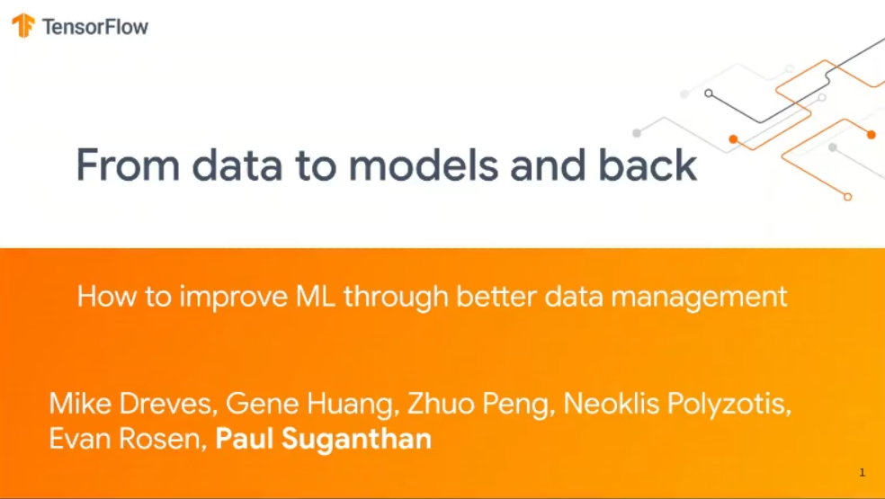
Recap: Data Validation
Model Debugging and Explainability
[Neoklis Polyzotis, et al: Data Management Challenges in Production Machine Learning. Tutorial, SIGMOD 2017]
Sanity checks on expected shape
before training first model
Check a feature’s min, max, and most common value
  Ex: Latitude values must be within the range [-90, 90] or [-π/2, π/2]
The histograms of continuous or categorical values are as expected
  Ex: There are similar numbers of positive and negative labels
Whether a feature is present in enough examples
  Ex: Country code must be in at least 70% of the examples
Whether a feature has the right number of values (i.e., cardinality)
  Ex: There cannot be more than one age of a person
Others
(Google Research)
[Sebastian Schelter et al: Automating Large-Scale Data Quality Verification. PVLDB 2018]
[Mike Dreves et al: From Data to Models and Back DEEM@SIGMOD 2020,
http://deem-workshop.org/videos/
2020/8_dreves.mp4]
(Amazon Research)
(Google)
Notes:
Amazon: validation on Spark
TFDV: descriptive statistics on BEAM

Slide 7
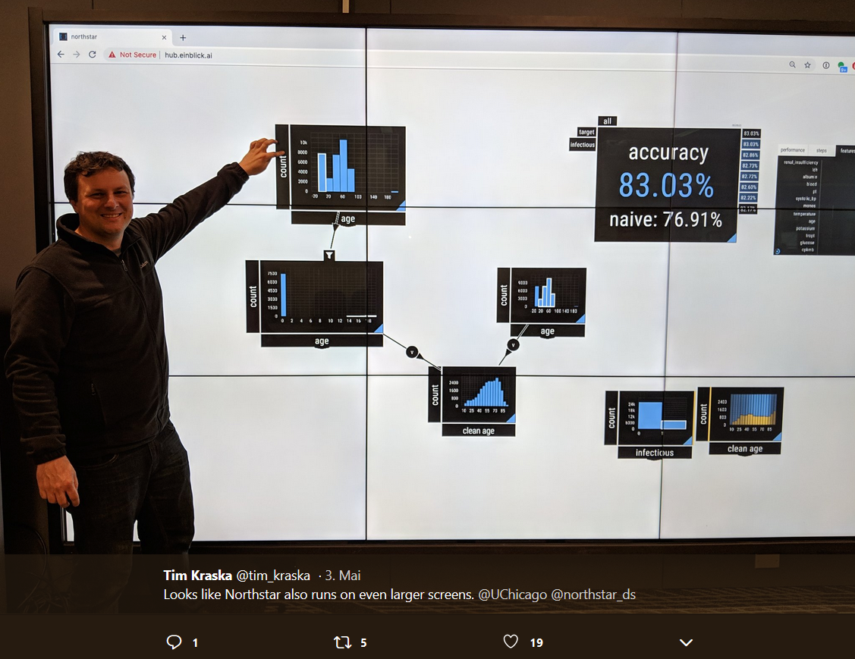
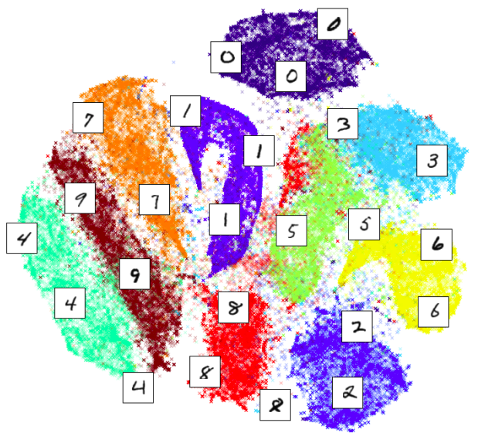
Overview Model Debugging
Model Debugging and Explainability
[Credit: twitter.com/tim_kraska]
[Andrew Crotty et al: Vizdom: Interactive Analytics through Pen and Touch. PVLDB 2015]
#1 Understanding via Visualization
  Plotting of predictions / interactions
  Combination with dimensionality
  reduction into 2D:
    Autoencoder
    PCA (principal component analysis)
    t-SNE (T-distributed Stochastic Neighbor Embedding)
  Input, intermediate, and output layers of DNNs
#2 Validation, Explainability, Fairness via Constraints
  Establish assertions and thresholds for automatic validation and alerts
  w.r.t. accuracy, bias, and other metrics
  Generate succinct representations (e.g., rules) as explanation
  Impose constraints like monotonicity for ensuring fairness
[Credit: nlml.github.io/in-raw-numpy/in-raw-numpy-t-sne/]

Slide 8
Basic Model-Specific Statistics
Model Debugging and Explainability
Regression Statistics
  Average response and stddev, average residuals stddev residuals
  R2 (coeff of determination) with and without bias, etc
Classification Statistics
  Classical: recall, precision, F1-score
  Visual: confusion matrix
  (correct vs predicated classes)
  ➔ understand performance
  wrt individual classes
  Example Mnist
  Mispredictions might
  also be visualized via
  dimensionality reduction
predicted label
0 | 1 | 2 | 3 | 4 | 5 | 6 | 7 | 8 | 9
21
 | 25
 |  | 15
 |  |  | 76
 |  |  |  | 23 |  |  |  |  | 12
 |  |  |  |  | 36
 |  |  |  |  |  | 24
 |  |  |  |  |  |  | 31 |  | 37
 |  |  |  |  |  |  |  | 42
 |  |  |  | 8 |  |  | 11 |  | 53
0
1
2
3
4
5
6
7
8
9
correct label

Slide 9
Excursus: DLR Earth Observation Use Case
Model Debugging and Explainability
[Xiao Xiang Zhu et al: So2Sat LCZ42: A Benchmark Dataset for the Classification of Global Local Climate Zones. GRSM 2020]
Data and ML Pipelines
  ESA Sentinel-1/2 datasets → 4PB/year
  Training of local climate zone classifiers on
  So2Sat LCZ42 (15 experts, 400K instances,
  10 labels each, 85% confidence, ~55GB H5)
  ML pipeline: preprocessing, ResNet18,
  climate models
Label Creation/ Validation
  Team learning
  Labeling w/ checks
  Label validation
  Quantitative
  validation w/ 10
  expert votes on correctness
[So2Sat LC42 Dataset
https://mediatum.ub.tum.de/1454690]
Notes:
Notes: Confusion matrices (values in %) of the original labels the final labels (refined by majority voting) vs. the votes cast bythe label validation crew for the polygons of the evaluation cities selected in Tables II and III: (a) original labels polygon-wise assessment, (b) original labels pixel-wise, (c) final labels polygon-wise, and (d) final labels pixel-wise
Unfortunately, not many European cities contain LCZ class 7 (light-weight low-rise), which mostly describes informal settlements (e.g., slums). Therefore, we included the polygons of class 7 for an additional 9 cities that are representative of the 9 major non-European geographical regions of the world

Slide 10
Confusion Matrices, cont.
Model Debugging and Explainability
Generalized Confusion Matrices
  Hierarchical, Multi-label Data
  Transform multi-label data:
  conditioning, marginalization (aggregation), and nesting
[Jochen Görtler et al: Neo: Generalizing Confusion Matrix Visualization to Hierarchical and Multi-Output Labels. CHI 2022 (1/25 best papers)]
Notes:
Neo by Apple

Slide 11
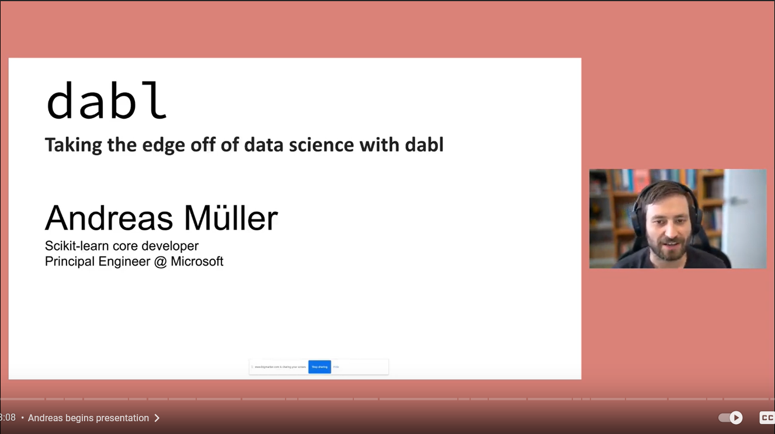
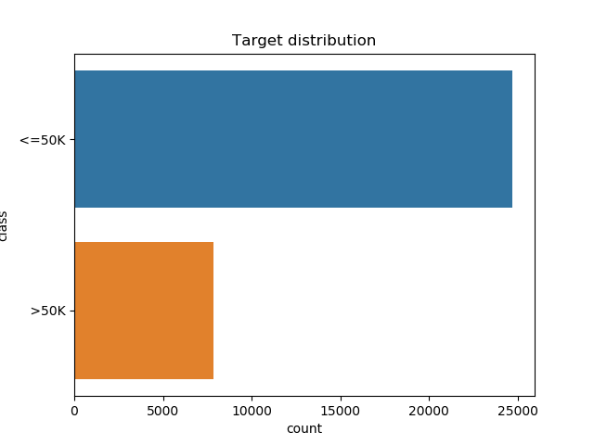
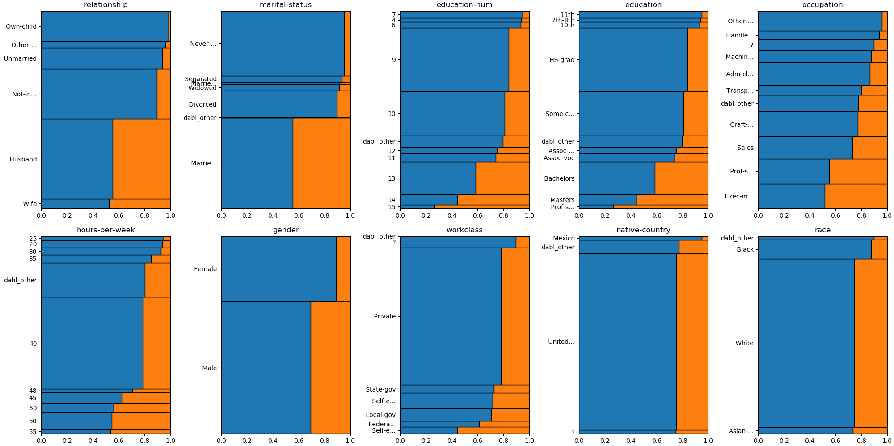
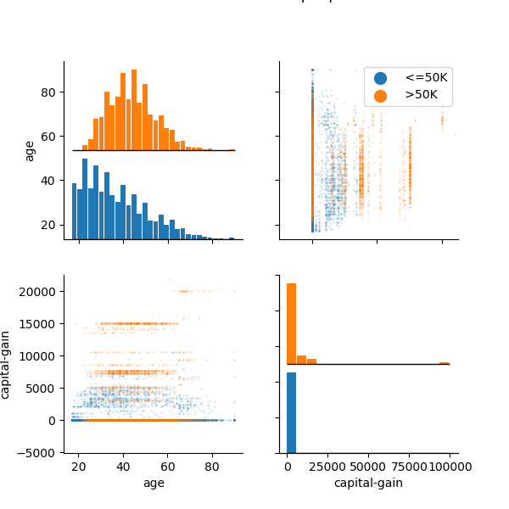
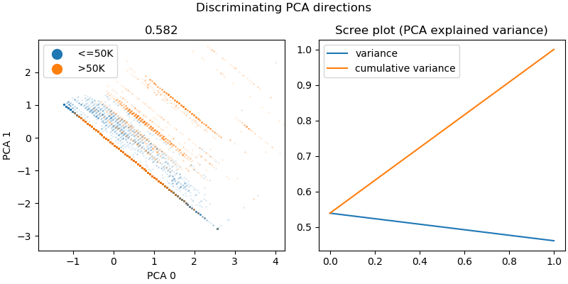
Excursus: dabl.plot
Model Debugging and Explainability
[Andreas Mueller: dabl – Taking the edge off
of data science with dabl, Data Umbrella 2022, https://www.youtube.com/watch?v=h92RMJi4mRM]
# adult dataset (>50K vs <=50K income)
data = pd.read_csv("adult.csv")
plot(data, "income")
[https://amueller.github.io/dabl/dev/auto_examples/
plot/plot_adult.html]
(mosaic plots)

Slide 12
Understanding Other Basic Issues
Model Debugging and Explainability
Overfitting / Imbalance
  Compare train and test performance
  ➔ Algorithm-specific techniques: regularization, pruning, loss, etc
Data Leakage
  Example: time-shifted external time series data (e.g., weather)
  Compare performance train/test vs production setting
Covariance Shift (features)
  Distribution of features in training/test data different from production data
  Reasons: out-of-domain prediction, sample selection bias
  Examples: NLP, speech recognition, face/age recognition
Concept Drift (features → labels)
  Gradual change of statistical properties / dependencies (features-labels)
  Requires re-training, parametric approaches for deciding when to retrain

Slide 13
Occlusion-Based Explanations
Model Debugging and Explainability
Occlusion Explanations
  Slide gray square over inputs
  Measure how feature maps
  and classifier output changes
Incremental Computation
of Occlusion Explanations
  View CNN as white-box operator
  graph and operators as views
  Materialize intermediate tensors
  and apply incremental view maintenance
[Matthew D. Zeiler, Rob Fergus: Visualizing and Understanding Convolutional Networks. ECCV 2014]
[Supun Nakandala, Arun Kumar, and Yannis Papakonstantinou: Incremental and Approximate Inference forFaster Occlusion-based Deep CNN Explanations, SIGMOD 2019]
SIGMOD 2020 Research Highlight
Notes:
Deconvolutional network (deconvnet): map feature activity in intermediate layers back to the input pixel space;
Reveals: that text in care more important, owner faces dominate dog bread classification

Slide 14
Saliency Maps
Model Debugging and Explainability
[Karen Simonyan, Andrea Vedaldi, Andrew Zisserman: Deep Inside Convolutional Networks: Visualising Image Classification Models and Saliency Maps. ICLR Workshop 2014]
Saliency Map
  Given input image
  and specific class
  Compute saliency
  map of class
  derivatives wrt
  input image
  Approximated w/
  a linear function
  (Taylor expansion)
Unsupervised
Image
Segmentation
Notes:
Saliency map: each pixels unique quality -> impact on score for this class and input image

Slide 15


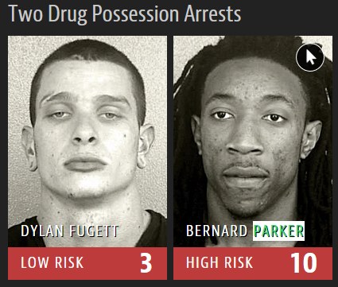
Example Model Anomalies
Model Debugging and Explainability
“silent but severe problems”
12/27
→
25/27
#1 Wolf Detection based on snow cover
#2 Horse Detection
based on image watermarks
  Layer-wise relevance propagation
#3 Race-biased Jail
Risk Assessment
[Marco Túlio Ribeiro, Sameer Singh, and Carlos Guestrin: Why Should I Trust You?: Explaining the Predictions of Any Classifier, KDD 2016]
[Sebastian Lapuschkin et al.: Analyzing Classifiers: Fisher Vectors and Deep Neural Networks, CVPR 2016]
[Julia Angwin et al: Machine Bias – There’s software used across the country to predict future criminals. And it’s biased against blacks, 2016, https://www.propublica.org/article/
machine-bias-risk-assessments-in-criminal-sentencing]
Notes:
Husky classification: # persons believing ‘snow as a potential feature’
FV: fisher vectors, user study with and without explanation by occlusion
Racial bias; white 86$ Home Depot before armed robbery and attempted armed robbery (low risk) vs similar price range, but black (high risk); example person 3x arrests

Slide 16
Explanation Tables
Model Debugging and Explainability
Motivation
  Generate succinct
  decision rules from data
  Problem: Decision tree
  rules do not overlap by def
  Example athlete’s exercise log:
  “Goal met” → 7 vs 7
Explanation Tables
  Find smallest explanation
  table subject to max KL
  divergence threshold
  Greedy and sampling algorithms
[Kareem El Gebaly, Parag Agrawal, Lukasz Golab, Flip Korn, Divesh Srivastava: Interpretable and Informative Explanations of Outcomes. PVLDB 2014]
Notes:
KL Divergence .. Kullback Leibler Divergence (relative entropy)

Slide 17
SliceFinder
Model Debugging and Explainability
[Yeounoh Chung, Tim Kraska, Neoklis Polyzotis, Ki Hyun Tae, Steven Euijong Whang: Automated Data Slicing for Model Validation: A Big Data - AI Integration Approach. ICDE2019/TKDE2020]
Problem Formulation
  Data slice: S^{DG} := D=PhD AND G=female (subsets of features)
  Find top-k data slices where model performs worse than average
  Ordering by
    Increasing number of literals,
    Decreasing slice size, and decreasing effect size (difference 𝑆 vs ¬𝑆)
  Subject to: minimum effect size threshold 𝑇, statistical significance (Welch’s t-test), a dominance constraint (no coarser slice satisfies 1 and 2) via
Existing Algorithms
  Preparation: Binning + One-Hot Encoding
  #1 Clustering → slices
  #2 Decision tree training
  #3 Lattice search with
  heuristic, level-wise termination
“find largest error vs find large slices”
Notes:
Note: As SliceFinder searches through a large number of slices, some slices might appear problematic by chance (i.e., multiple comparisons problem [20]). SliceFinder controls such a risk by applying a marginal false discovery rate (mFDR) controlling procedure called \alpha-investing

Slide 18


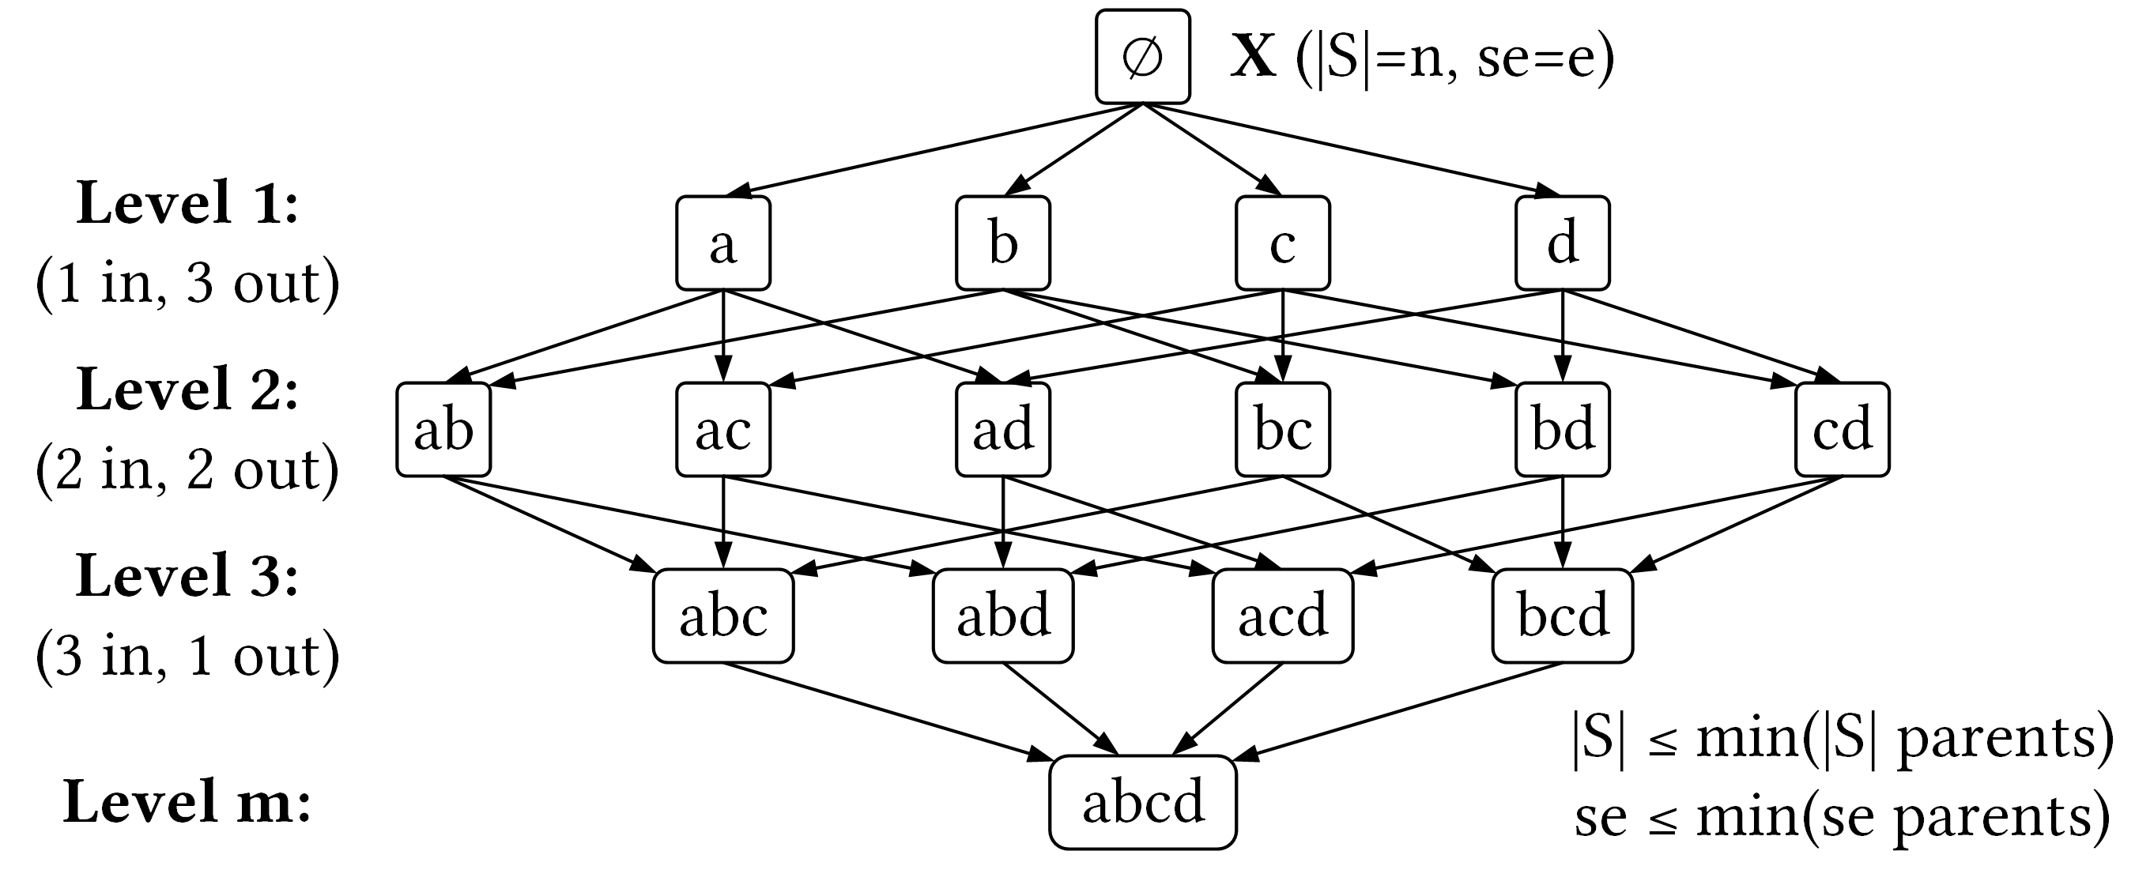
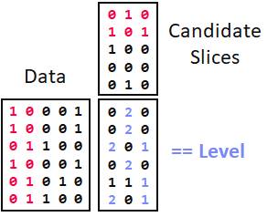
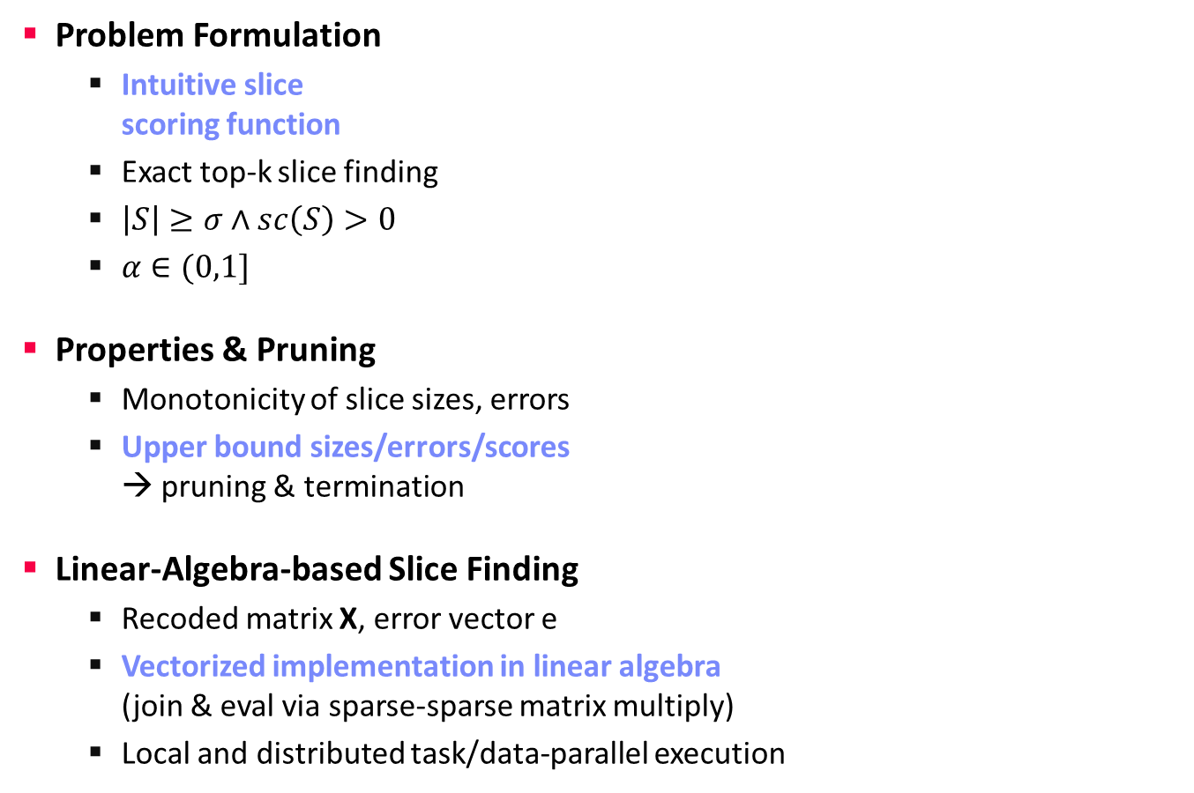
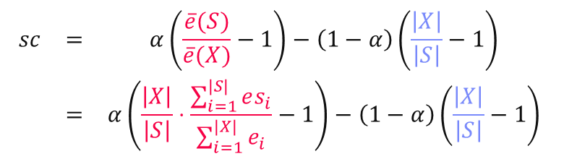
SliceLine for Model Debugging
Model Debugging and Explainability
[Credit: sliceline,
Silicon Valley, HBO]
Problem Formulation
  Intuitive slice
  scoring function
  Exact top-k slice finding
  $\left|S\right|≥σ∧sc\left(S\right)>0$
  $α∈(0,1]$
Properties & Pruning
  Monotonicity of slice sizes, errors
  Upper bound sizes/errors/scores
  → pruning & termination
Linear-Algebra-based Slice Finding
  Recoded matrix X, error vector e
  Vectorized implementation in linear algebra
  (join & eval via sparse-sparse matrix multiply)
  Local and distributed task/data-parallel execution
$$\begin{matrix}sc & = & α\left(\frac{\overline{e}(S)}{\overline{e}(X)}−1\right)−\left(1−α\right)\left(\frac{\left|X\right|}{\left|S\right|}−1\right) \\ & = & α\left(\frac{\left|X\right|}{\left|S\right|}⋅\frac{\sum_{i=1}^{|S|}{es_{i}}}{\sum_{i=1}^{|X|}{e_{i}}}−1\right)−\left(1−α\right)\left(\frac{\left|X\right|}{\left|S\right|}−1\right)\end{matrix}$$
slice error
slice size
Notes:
Compelling properties:
The components are balanced under α = 0.5.
The score of the original X is always sc = 0.
For α = 0 (all weight on size), the maximum feasible score is 0, and no slice smaller than X can reach it.
All components of Equation (1) are either constants, or slice errors and sizes, which makes this function amenable to pruning.

Slide 19
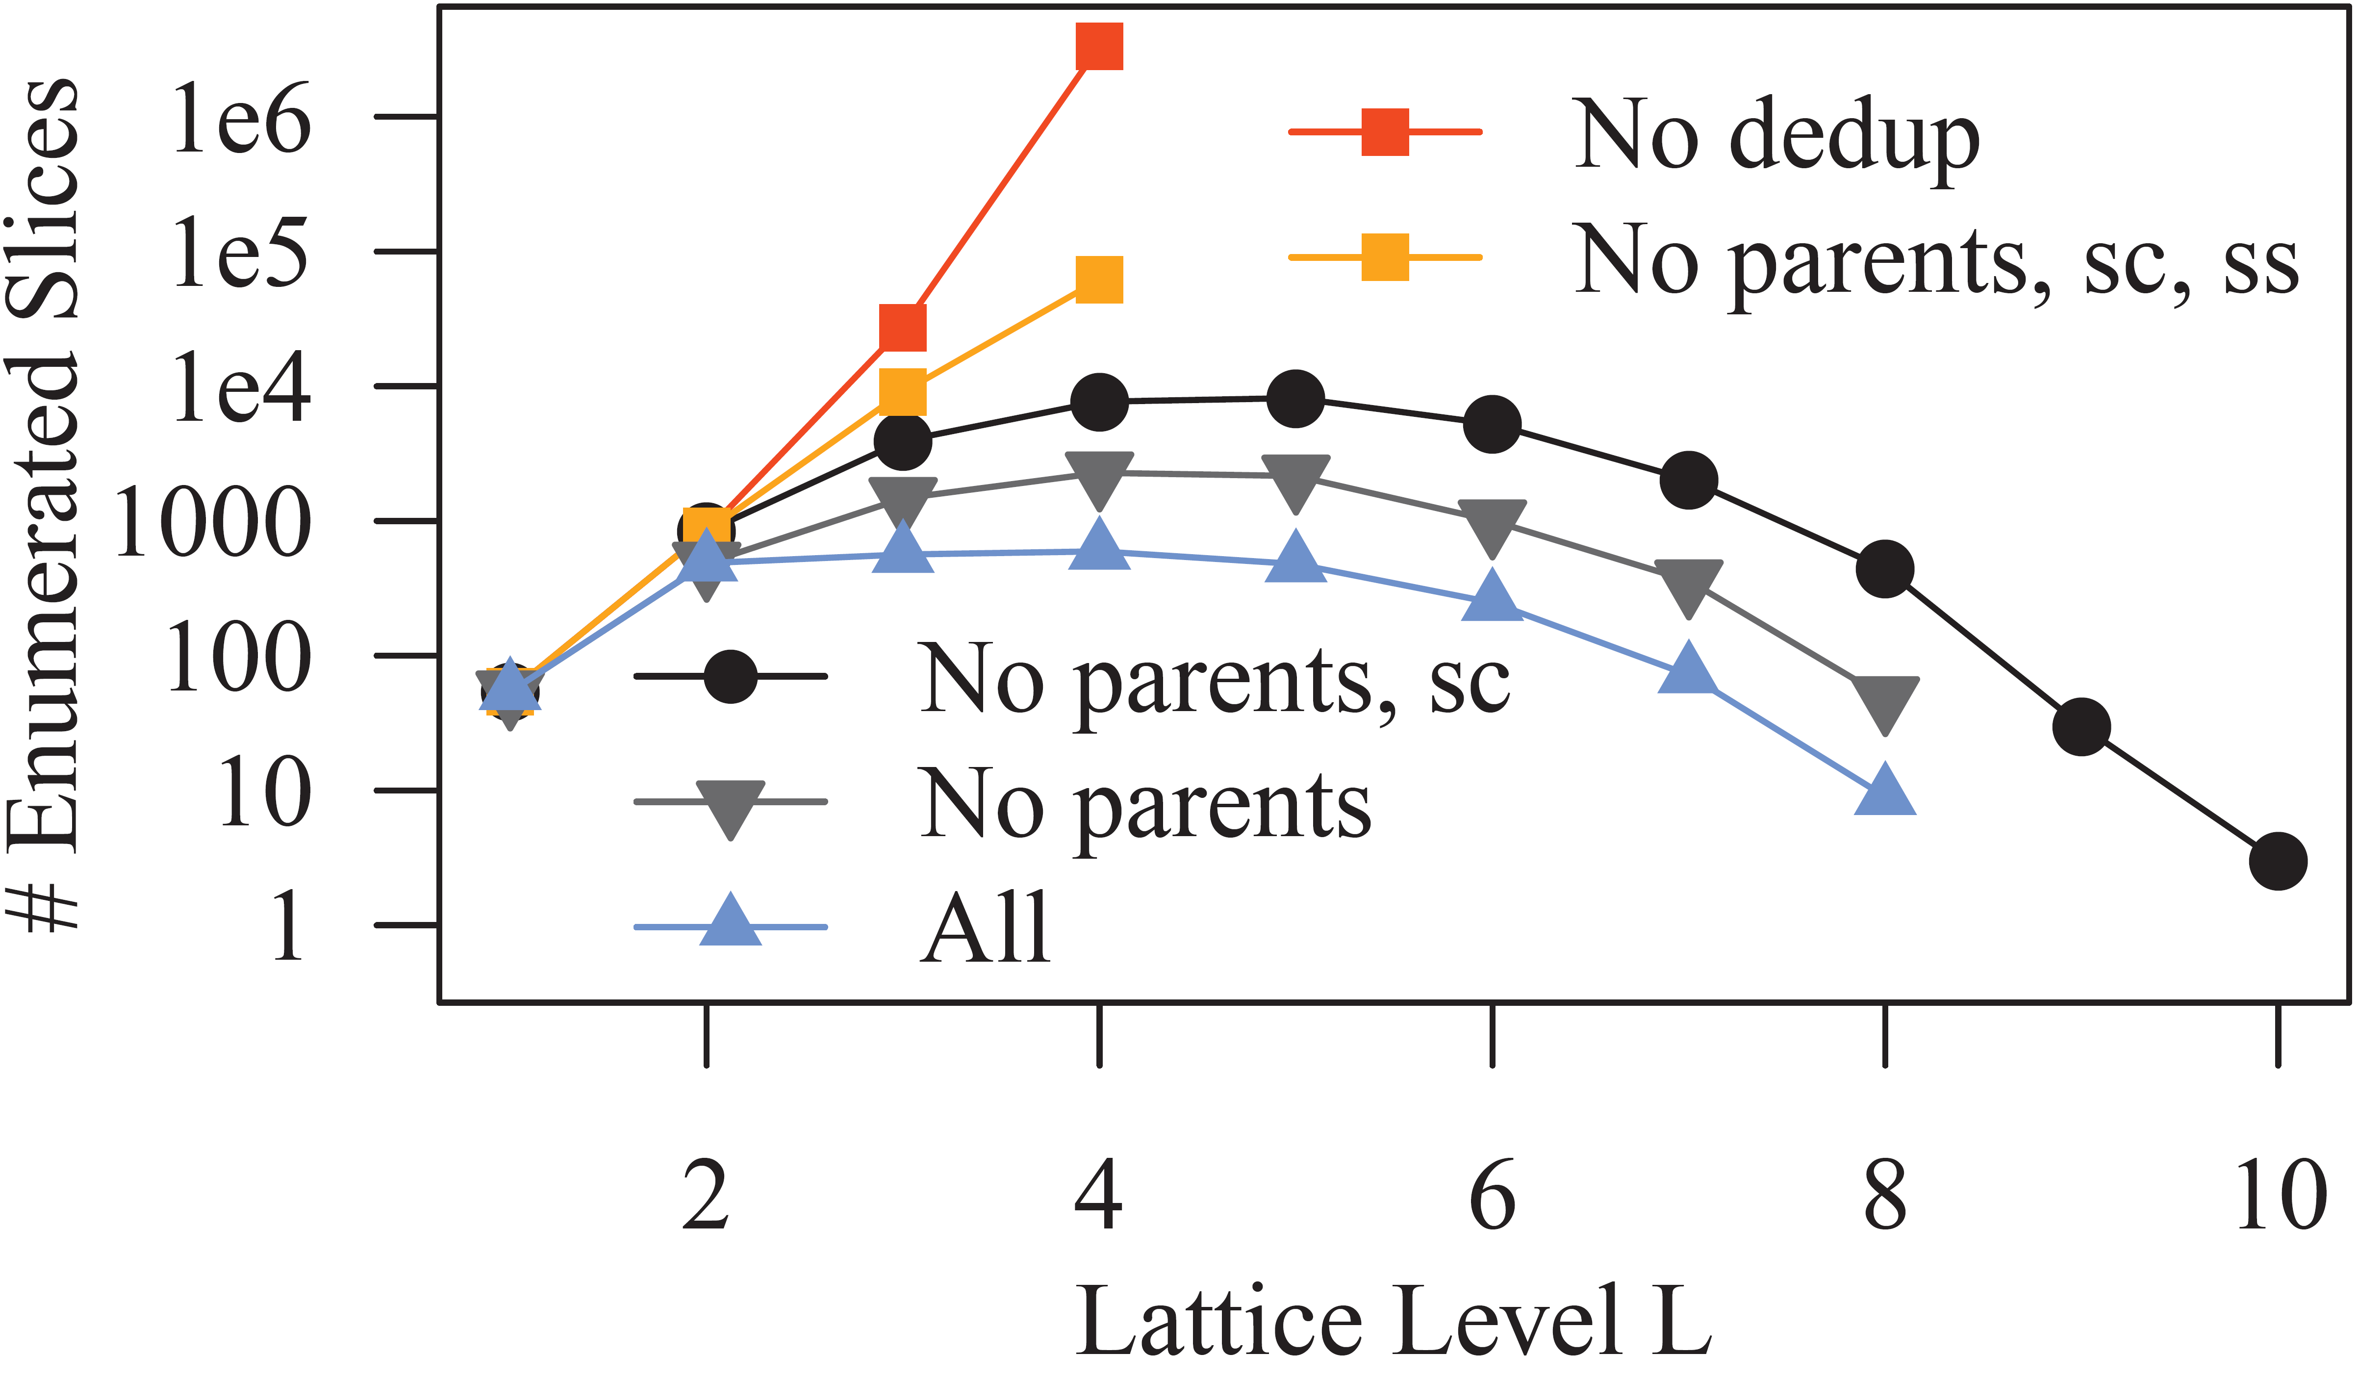
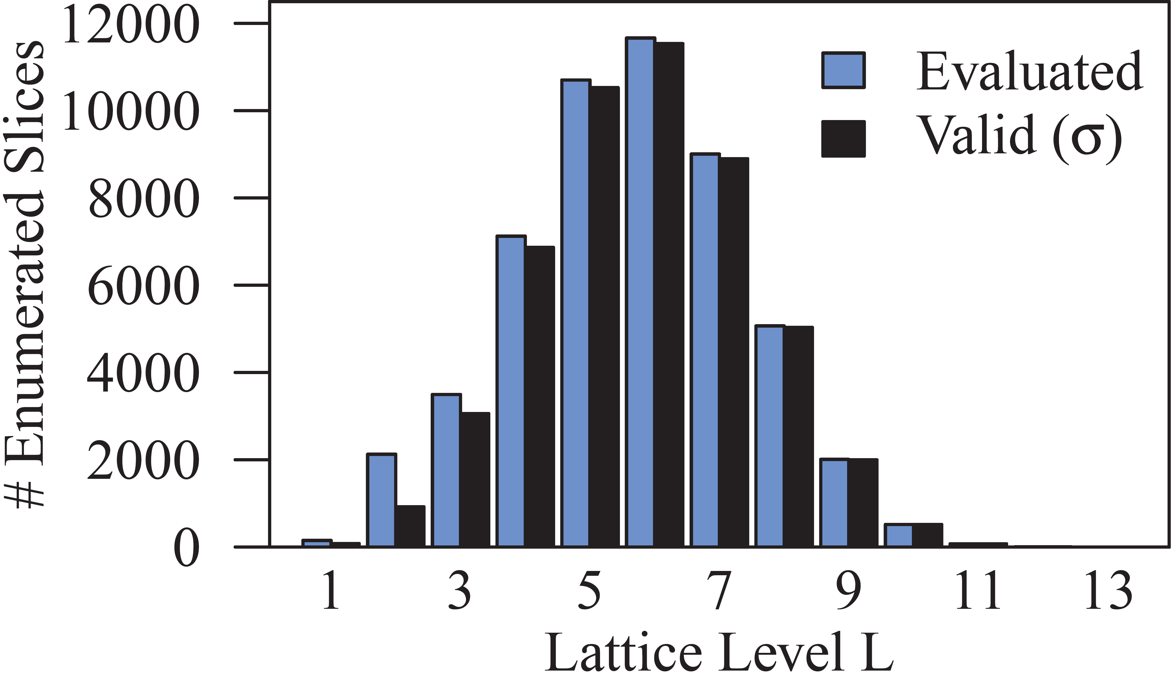
SliceLine – Experiments
Model Debugging and Explainability
[Svetlana Sagadeeva, Matthias Boehm: SliceLine: Fast, Linear-Algebra-based Slice Finding for ML Model Debugging, SIGMOD 2021]
Salaries 2x2
Adult
Effective Pruning (#evaluated
close to #valid)
Practical Performance
(39s until termination
at level 12)

Slide 20
Slice Tuner
Model Debugging and Explainability
[Ki Hyun Tae, Steven Euijong Whang: Slice Tuner: A Selective Data Acquisition Framework for Accurate and Fair Machine Learning Models, SIGMOD 2021]
Motivation
  Root cause of unfairness: bias in training data
  Selective Data Acquisition for
  model accuracy and fairness
  Different slices w/ different learning curves
  → Learning curve fitting
Problem Formulation
Minimize total loss of slices
Penalize underperforming slices
Convex optimization problem
Budget of acquisition costs
Notes:
Note: experiments with Fashion-MNIST, UTKFace → Mechanical Turk

Slide 21
Model Assertions
Model Debugging and Explainability
[Daniel Kang, Deepti Raghavan, Peter Bailis, Matei Zaharia: Model Assertions for Debugging Machine Learning, NIPS Workshop ML Systems, 2018]
Motivation
  ML models might fail in complex ways that are not captured in loss function
  Inspired by assertions in SW dev → Model assertions via Python rules
Assertion Use Cases
  #1 Runtime monitoring (collect statistics on incorrect behavior)
  #2 Corrective Action (trigger corrections at runtime) ➔ but how in retrospect?
  #3 Active Learning (decide which difficult data points to give to user)
  #4 Weak supervision (propose alternative labels and use for retraining)
Example: Flickering of object detection

Slide 22
Continuous Integration
Model Debugging and Explainability
[Cedric Renggli, Bojan Karlaš, Bolin Ding, Feng Liu, Kevin Schawinski, Wentao Wu, Ce Zhang: Continuous Integration of Machine Learning Models with ease.ml/ci: Towards a Rigorous Yet Practical Treatment, SysML 2019]
System Architecture
ease.ml/ci

Slide 23
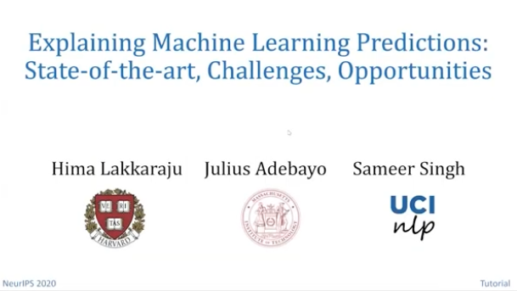
Explainability
Model Debugging and Explainability
[Hima Lakkaraju, Julius Adebayo, Sameer Singh: Explaining Machine Learning Predictions: State-of-the-art, Challenges, and Opportunities, NeurIPS 2020 Tutorial, https://explainml-tutorial.github.io/neurips20]
Motivation
  Explain predictions via inputs for model understanding & transparency
  Utilize model debugging and other tools
#1 Interpretable Models
  Linear models, tree-based models,
  rule-based models
  Weights and decision rules
#2 Post-hoc Explanations
  Complex deep neural networks or very large models → black box models
  Build simple models for explaining any complex models
Types of Explanations
  Model parameters, example predictions, summarization
  Most important features/data, how to flip model predictions
Interpretability ⬅ ➔ Accuracy
Prefer simpler models
if accuracy sufficient!
Multi-modal Interpretability: https://captum.ai/

Slide 24
LIME: Sparse, Linear Explanations
Model Debugging and Explainability
[Marco Túlio Ribeiro, Sameer Singh, and Carlos Guestrin: Why Should I Trust You?: Explaining the Predictions of Any Classifier, KDD 2016]
LIME Overview
  Model agnostic explanations
  Identify important dimension and
  present their relative importance
  Sample perturbations of prediction input
  (e.g., hide parts of image, attribute values)
  Locally weighted regression
LIME Objective
  Various hyper-parameters
  Heuristics /
  HP optimization
Loss Function
Regularizer
Linear Models
Local Kernel

Slide 25
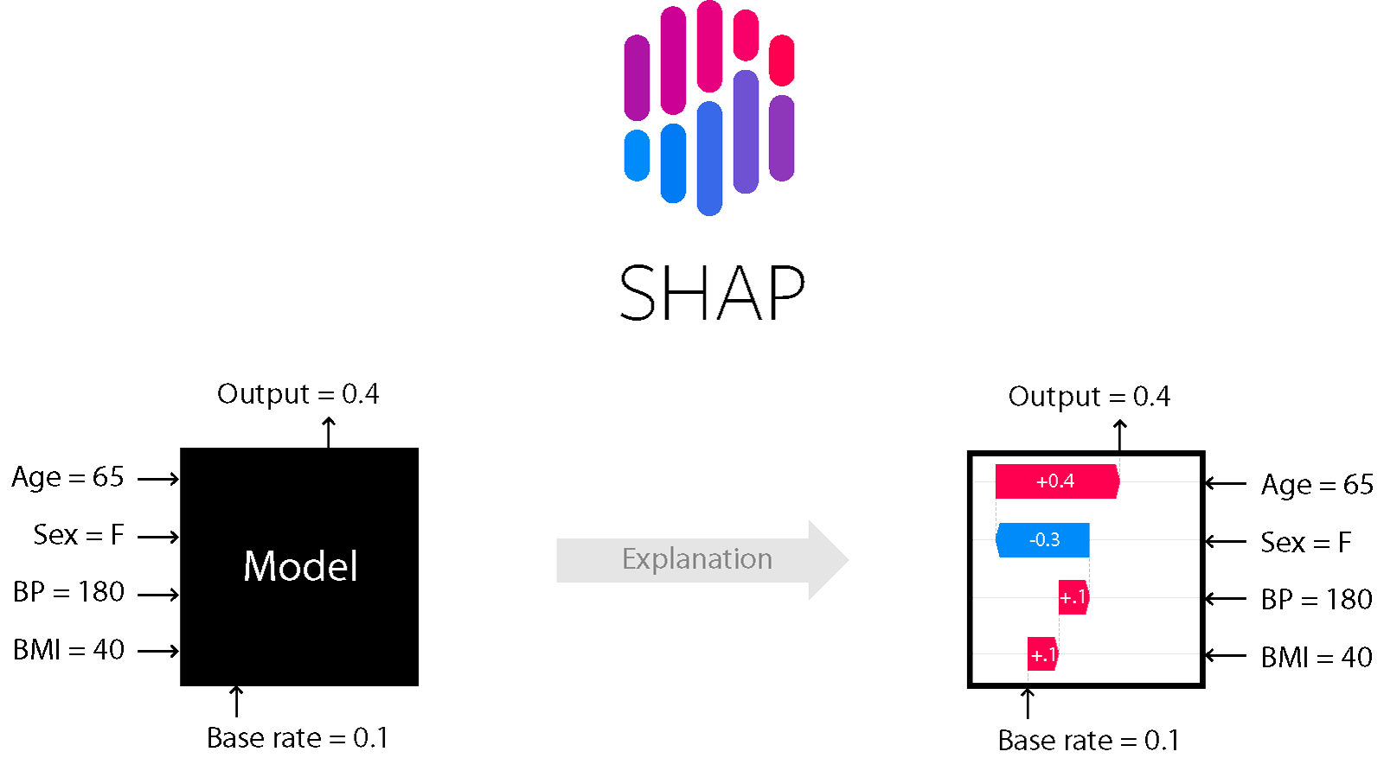
SHAP: Shapley Additive Explanations
Model Debugging and Explainability
[Scott M. Lundberg, Su-In Lee: A Unified Approach to Interpreting Model Predictions. NIPS 2017]
SHAP Overview
  Additive feature importance (local accuracy)
  Unification of LIME, Shapley sampling/regression values, QII,
  DeepLIFT, layer-wise relevance propagation, tree interpreter
  Estimate Shapley values using linear regression
SHAP Tooling
[Scott M. Lundberg: Explainable AI for Science and Medicine,
https://www.youtube.com/watch?v=B-c8tIgchu0]
(Avg Output)
[https://shap.readthedocs.io/en/latest/index.html]
Marginal contributions
Notes:
Note: core contribution: new weighting kernel to estimate shapely values using dense/sparse linear regression (LIME parameters forced to one valid solution by Shapley axioms local accuracy / consistency)

Slide 26
SHAP: Shapley Additive Explanations, cont.
Model Debugging and Explainability
[Scott M. Lundberg, Su-In Lee: A Unified Approach to Interpreting Model Predictions. NIPS 2017]

Slide 27
Model Bias & Fairness
Focus on Applications, Fairness, Ethics, Responsibility
Fairness Metrics and Constraints
Employs Model Debugging & Explainability
Techniques

Slide 28
Sources of Bias
Model Bias & Fairness
Environment
  Selection Bias: Differences in study participation, data availability, and measurement effort
  Test environment, project team, cultural context → different context
Data Collection
  Sample Bias: collected data not representative of application
  Observer Bias / Confirmation Bias: subjective judgment leaks
  into measurement and analysis → transparency and critical feedback
Training Dataset
  Data Bias: e.g., not missing at random (NMAR) values
  Feature Selection Bias: manual or automatic during data preparation
➔ Design ML Systems & applications w/ awareness of potential bias

Slide 29
Excursus: DLR Earth Observation Use Case, cont.
Model Bias & Fairness
[Xiao Xiang Zhu et al: So2Sat LCZ42: A Benchmark Dataset for the Classification of Global Local Climate Zones. GRSM 2020]
Environment / Context
→ Biased Data Collection
→ Awareness and
Conscious Bias Mitigation
→ Remaining Bias?

Slide 30
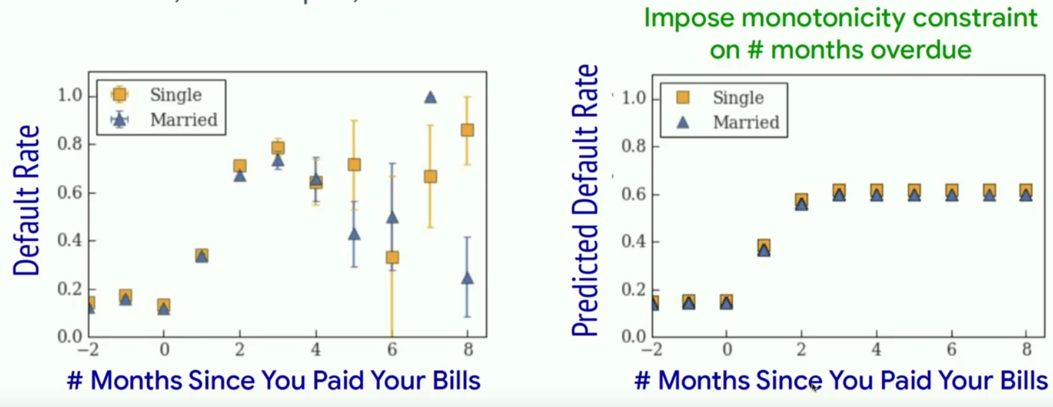
Debugging Bias and Fairness
Model Bias & Fairness
Fairness
  Validate and ensure fairness with regard to sensitive features (unbiased)
  Use occlusion and saliency maps to characterize and compare groups
Enforcing Fairness
  Use constraints to enforce certain properties (e.g., monotonicity, smoothness)
  Example: late payment → credit score
[Maya Gupta: How Do We Make AI Fair? SysML 2019]

Slide 31
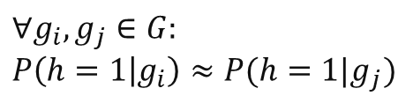



Group Fairness Constraints
Model Bias & Fairness
[H. Zhang et al: OmniFair: A Declarative System for Model-Agnostic Group Fairness in Machine Learning, SIGMOD 2021]
#1 Statistical Parity
  Independence of model from groups
  Equal probability outcome across groups
#2 False Positive Rate Parity
  Independence of model from groups
  Conditioned on true label y=0
#3 False Negative Rate Parity
  Independence of model from groups
  Conditioned on true label y=1
#4 False Omission Rate Parity
  Independence of true labels from groups
  Conditioned on negative prediction h=0
$$∀g_{i},g_{j}∈G: \\ P\left(h=1 | g_{i}\right)≈P(h=1|g_{j})$$
$$∀g_{i},g_{j}∈G: \\ P\left(h=1 | g_{i},y=0\right) \\ ≈P(h=1|g_{j},y=0)$$
#2+#3 Equalized Odds
$$∀g_{i},g_{j}∈G: \\ P\left(h=0 | g_{i},y=1\right) \\ ≈P(h=0|g_{j},y=1)$$
$$∀g_{i},g_{j}∈G: \\ P\left(y=1 | g_{i},h=0\right) \\ ≈P(y=1|g_{j},h=0)$$

Slide 32
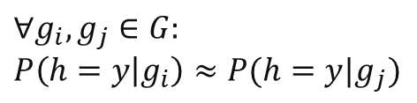

Group Fairness Constraints, cont.
Model Bias & Fairness
#5 False Discovery Rate Parity
  Independence of true labels from groups
  Conditioned on negative prediction h=1
  #4+#5 Predictive Parity
#6 Misclassification Rate Parity
  Equal misclassification rate across groups
Others
  Individual fairness
  → relationship to differential privacy
  Causal fairness
$$∀g_{i},g_{j}∈G: \\ P\left(y=1 | g_{i},h=1\right) \\ ≈P(y=1|g_{j},h=1)$$
$$∀g_{i},g_{j}∈G: \\ P\left(h=y | g_{i}\right)≈P(h=y|g_{j})$$
[Cynthia Dwork, Moritz Hardt, Toniann Pitassi, Omer Reingold, Richard S. Zemel: Fairness through awareness. ITCS 2012]

Slide 33
Ensuring Fairness
Model Bias & Fairness
[H. Zhang et al: OmniFair: A Declarative System for Model-Agnostic Group Fairness in Machine Learning, SIGMOD 2021]
Problem Formulation
  A fairness specification is given by a triplet (g, f, 𝜀) and induces
  (|g(D)|choose 2) fairness constraints on pairs of groups
  A fairness specification is satisfied by a classifier ℎ on 𝐷 iff all
  induced fairness constraints are satisfied, i.e., ∀gi,gj ∈ g(D), |f(h,gi)−f(h,gj)| ≤ 𝜀
  Unconstrained
  optimization problem
Results
  Adult dataset
  Model-
  agnostic
  Similar
  Accuracy
max accuracy
s.t. fairness
max accuracy
+ fairness

Slide 34
Excursus: EU Policy
Model Bias & Fairness
[European Commission: LAYING DOWN HARMONISED RULES ON ARTIFICIAL INTELLIGENCE
(ARTIFICIAL INTELLIGENCE ACT) AND AMENDING CERTAIN UNION LEGISLATIVE ACTS, 04/2021]
➔ “The preferred option is option 3+, a regulatory framework for high-risk AI systems only, with the possibility for […] non-high-risk AI systems to follow a code of conduct.”
Notes:
Resources on Responsible Data Science:
https://dataresponsibly.github.io/courses/spring20/

Slide 35
Summary and Q&A
Model Debugging and Explainability
Model Bias & Fairness Constraints
Next Lectures
  12 Model Serving Systems and Techniques [Jun 17, Arnab]
  Doodle for oral exam slots until Jun 17 EOD

