Slide 1

Data Management
01 Introduction and Overview
Last update: Mar 04, 2022

Slide 2



Announcements/Org
#1 Video Recording
  Link in TeachCenter & TUbe (lectures will be public)
  Hybrid, in-person (optional), TUbe video-recording, and
  webex live: https://tugraz.webex.com/meet/m.boehm
  Update: status ORANGE, max 50% capacity, 2.5G rule
#2 Course Registrations (as of Mar 04)
  Data Management VO: 459 (4)
  Data Management KU: 447 (2)
  Databases VU: 67 (0), incl. CSS
#3 Gründungsgarage Volume XVIII
  Academic Startup Accelerator
  https://www.gruendungsgarage.at/
  Next application deadline: Mar 13, 2022
526 (4)

Slide 3

Announcements/Org, cont.
#4 Learning Analytics – Students in Focus
  Self-regulated Learning Strategies
  Learner's Corner (overview, consent form)
  https://tc.tugraz.at/main/course/view.php?id=4390
  5min-overview by Carla Souta Barreiros

Slide 4
Agenda
Data Management Group
Course Motivation, Goals, and Outline
Course Organization and Logistics
History of Data Management

Slide 5
Data Management Group
https://damslab.github.io/

Slide 6




About Me
Data Management Group
2018-2022 TU Graz, Austria
  BMK endowed chair for data management
  Data management for data science
  (ML systems internals, end-to-end data science lifecycle)
2012-2018 IBM Research – Almaden, USA
  Declarative large-scale machine learning
  Optimizer and runtime of Apache SystemML
2011 PhD TU Dresden, Germany
  Cost-based optimization of integration flows
  Systems support for time series forecasting
  In-memory indexing and query processing
https://github.com/
apache/systemds
DB group

Slide 7
Data Management Courses
Data Management Group
Architecture of
Database Systems
(ADBS, WS)
DB system internals
+ prog. project
Architecture of
ML Systems
(AMLS, SS)
ML system internals
Prog. projects in SystemDS
[github.com/apache/systemds]
Master
Data Integration and Large-Scale Analysis
(DIA, WS)
Distributed
Data Management
Bachelor
Intro to Scientific Writing (WS)
Data Management / Databases
(DM, SS+WS)
Data management from user/application perspective

Slide 8
Course Motivation, Goals, and Outline
Database Systems and Modern Data Management

Slide 9
Definition and Impact
Motivation and Goals
User 2
User 1
User 3
Def: Database System
  Overall system of DBMS + DBs
  DBMS: Database Management
  System (SW to handle DBs)
  DBs: Database (data/metadata
  collection of conceptual mini-world)
  Note: DB also a short for DBS/DBMS
Importance in Practice
  Market Volume: 10-100B $US
  Foundation of many applications
  in various domains
DBS
DBMS
DBs
[Marianne Winslett: Bruce Lindsay speaks out: […]. SIGMOD Record 34(2), 2005]
“Relational databases
are the foundation of western civilization”

Slide 10
Motivation Database Systems
Motivation and Goals
Application development and maintenance costs
  Declarative queries (what not how) and data independence
  Efficient, correct, and independent data organization, size, access
Multi-user operations and access control
  Synchronization of concurrent user queries and updates
  Enforce access control (e.g., permissions on tables, views)
Consistency and data integrity
  Eliminates redundancy and thus, enforces consistency
  Enforces integrity constraints (e.g., semantic rules)
Logging and Recovery
  Recovery of consistent state after HW or SW failure
Performance and Scalability
  High performance for large datasets or high transaction throughput
  Scale to large datasets with low memory requirements

Slide 11
Goals
Motivation and Goals
INF.01017UF
(VO)
Data Mgmt.
INF.02018UF
(KU)
Data Mgmt.
Course Goals
  A: Understanding of
  database systems
  (from user perspective)
  B: Understanding of
  modern data management
  (from user perspective)
Meta Goals
  Understand, use, debug, and evaluate data management systems
  Awareness of system alternatives and their tradeoffs
  Fundamental concepts as basis for advanced courses and other areas
706.010
(VU)
Databases
Part A
9 Lectures
Part A
3 Exercises
3(2) ECTS
Part B
3 Lectures
Part B
1 Exercise
3 ECTS
1 ECTS
Notes:
Note: (different ECTS if taken as “Freifach”), work on consolidating this mess

Slide 12
Part A: Database System Fundamentals
Course Outline
01 Introduction and Overview [Mar 07]
02 Conceptual Architecture and Design [Mar 14]
03 Data Models and Normalization [Mar 21]
04 Relational Algebra and Tuple Calculus [Mar 28]
05 Query Languages (SQL, XML, JSON) [Apr 04]
06 APIs (ODBC, JDBC, OR frameworks) [Apr 25]
07 Physical Design and Tuning [May 02]
08 Query Processing [May 09]
09 Transaction Processing and Concurrency [May 16]
Exercise 1:
Data Modeling
[Mar 29]
Exercise 2: Queries
[May 03]
Exercise 3: Tuning
[May 31]
For course Databases:
part of Exercise 3 is extra credit

Slide 13
Part B: Modern Data Management
Course Outline
10 NoSQL (key-value, document, graph, time series) [May 23]
11 Distributed Storage and Data Analysis [May 30]
12 Data Stream Processing Systems [Jun 13]
13 Q&A and exam preparation [Jun 13]
Final written exam [TBD, Jan 20 / Jan 27?]
Exercise 4:
Spark (extra credit)
[Jun 21]
since WS2020/21:
Automated Grading System
for Exercises 2, 3, 4
(grading time, and consistent grading)

Slide 14
Course Organization

Slide 15








Basic Course Organization
Course Organization
Staff
  Lecturer: Univ.-Prof. Dr.-Ing. Matthias Boehm, ISDS
  Assistant Lecturer: M.Tech. Arnab Phani, ISDS
  Teaching Assistants:
  Nives Križanec, Luca Winkler, Katharina Aschbacher
  Ema Salkić, Alexander C. Friessnig, Adnan Karamehić,
  Harald Semmelrock
Language
  Lectures and slides: English
  Communication and exams: English/German
Course Format
  DM VO + KU 2/1 (3+1 ECTS), DB VU 1/1 (3(2) ECTS)
  Weekly lectures (start 4.10pm, including Q&A), attendance optional
  3+1 exercises (introduced in lecture) as individual assignments
HS

Slide 16
Course Logistics
Course Organization
Communication
  Informal language (first name is fine)
  Please, immediate feedback (unclear content, missing background)
  Newsgroup: news://news.tugraz.at/tu-graz.lv.dbase (email for private issues)
  Office hour: Mo 12.30pm (via https://tugraz.webex.com/meet/m.boehm),
  or after lecture
Website
  https://mboehm7.github.io/teaching/ss22_dbs/index.htm
  All course material (lecture slides, exercises) and dates
Exam
  Completed mandatory exercises (Mar 29, May 03, May 31, [Jun 21])
  Final written exam (TBD, doodle for oral exams)
  DB Grading (30% exercises, 70% final), DM Grading (separate courses)

Slide 17

Course Logistics, cont.
Course Organization
Exercises
  Written and programming assignments, submitted through TeachCenter
  Assignments completed if >50% points in total (but all submitted)
  Deadlines are important (at most 7 late days in total)
  Individual assignments (academic honesty / no plagiarism)
SW Tools and Languages
  Open Source PostgreSQL DBMS (setup on your own)
  Distributed FS/object storage and Apache Spark for distributed computation
  Languages for local/distributed programs (of your choice):
  e.g., Python, Java, Scala, C, C++, C#, Rust, Go, etc.

Slide 18

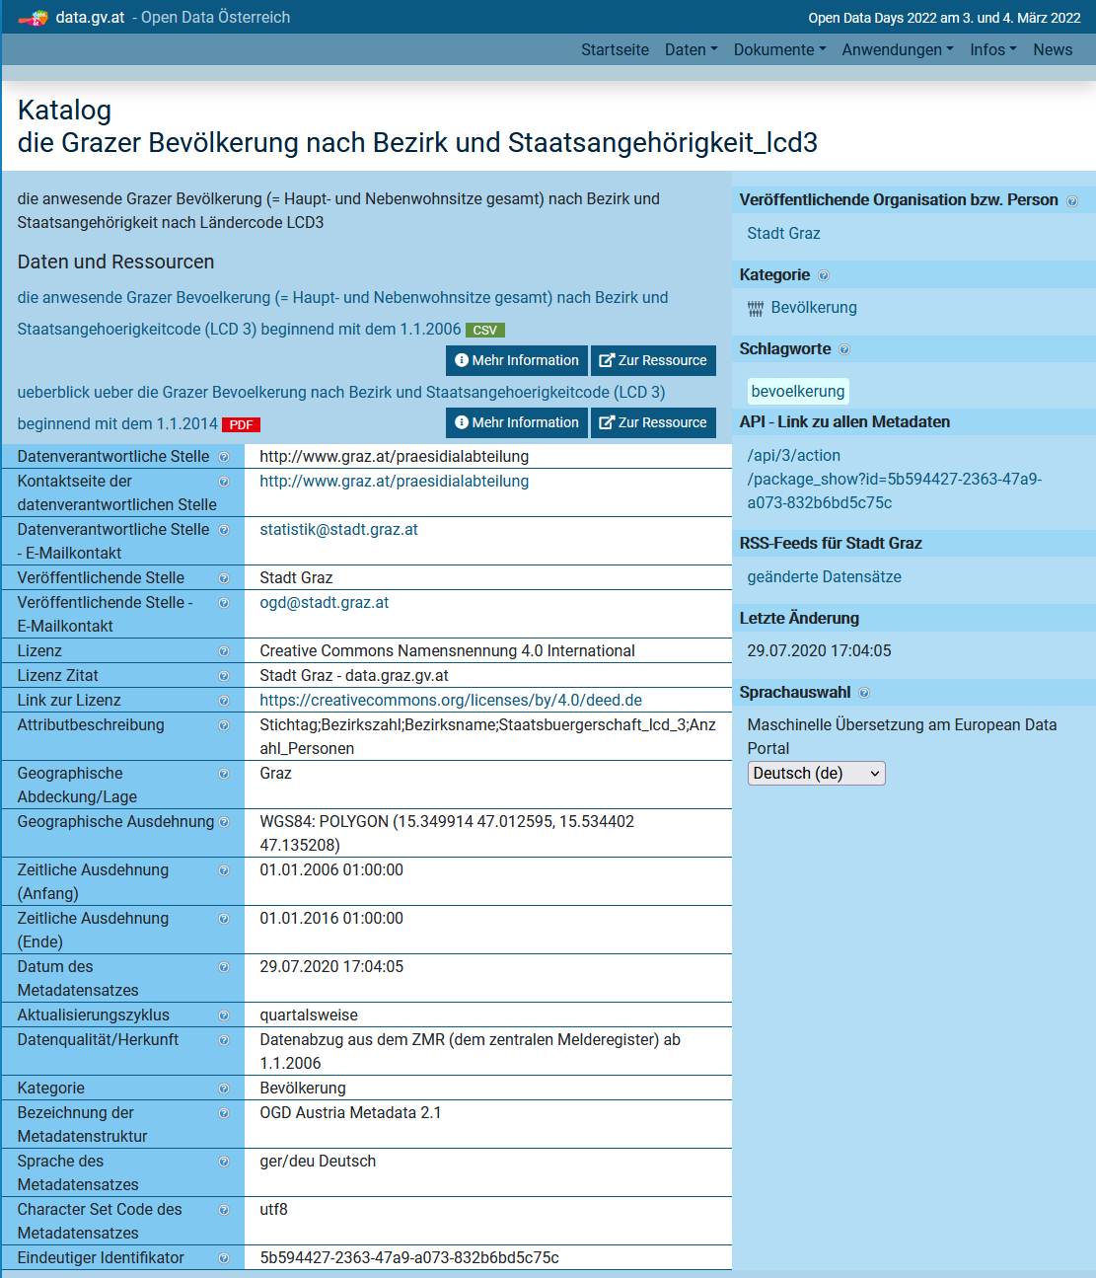
Exercises: Graz Districts
Course Organization
New
Dataset
  Graz districts, streets, schools, universities,
  population counts by age and country
  (to be cleaned and prepared → Ex 02)
  Clone or download your copy from
  https://github.com/tugraz-isds/datasets.git
  Find CSV files in <datasets>/districts_graz
Exercises
  01 Data modeling (relational schema)
  02 Data ingestion and SQL query processing
  03 Physical design tuning, query processing,
  and transaction processing
  04 Large-scale data analysis (distributed
  query processing and ML model training – anomalies?)
www.data.gv.at

Slide 19
Literature
Course Organization
Not needed for lectures / exercises (course is self-contained),
but second perspective on covered topics of first part
Raghu Ramakrishnan, Johannes Gehrke: Database Management Systems (3. ed.). McGraw-Hill 2003, ISBN 978-0-07-115110-8, pp. I-XXXII, 1-1065
Jeffrey D. Ullman, Jennifer Widom: A first course in database systems (2. ed.). Prentice Hall 2002, ISBN 978-0-13-035300-9, pp. I-XVI, 1-511
Ramez Elmasri, Shamkant B. Navathe: Fundamentals of Database Systems, 3rd Edition. Addison-Wesley-Longman 2000, ISBN 978-0-8053-1755-8, pp. I-XXVII, 1-955
Alfons Kemper, André Eickler: Datenbanksysteme - Eine Einführung, 10. Auflage. De Gruyter Studium, de Gruyter Oldenbourg 2015, ISBN
978-3-11-044375-2, pp. 1-879
[Zachary G. Ives, Rachel Pottinger, Arun Kumar, Johannes Gehrke, Jana Giceva: The future of data(base) education: Is the "cow book" dead?, VLDB 2021]
Additional Perspective:

Slide 20
History of Data Management

Slide 21
History 1960/70s (pre-relational)
History of Data Management
CODASYL … Conference on Data Systems Languages
Hierarchical Model
  Tree of records
  E.g., IBM Information Management
  System (IMS) – IMS 15 (Oct 2017)
Network Model
  CODASYL (COBOL, DB interfaces)
  Graph of records
  Charles Bachman (Turing Award ‘73)
  E.g., Integrated Data Store (IDS)
Pros and Cons (see NoSQL Doc-Stores)
  Performance by directly traversing static links
  Duplicates → inconsistencies on updates, data dependence
Dep
Cust
Emp
Mgr
Parts
Ordr
Parts
Mgr
Dep
Cust
Emp
Ordr
Parts
Notes:
CODASYL: Conference on Data Systems Languages
COBOL: Common Business Oriented Language

Slide 22

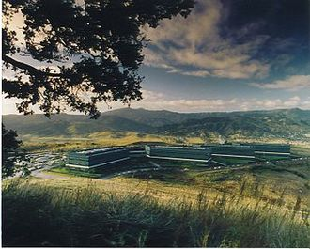
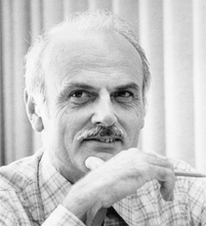
History 1970/80s
(relational)
History of Data Management
SQL Standard
(SQL-86)
Oracle, IBM DB2, Informix, Sybase → MS SQL
SEQUEL
QUEL
System R @ IBM Research – Almaden
(Jim Gray et al.,
Turing Award ‘98)
Ingres @ UC Berkeley (Stonebraker et al.,
Turing Award ‘14)
Tuple Calculus
Relational Algebra
Relational Model
Edgar F. “Ted” Codd @ IBM
Research (Turing Award ‘81)
Goal: Data Independence
(physical data independence)
  Ordering Dependence
  Indexing Dependence
  Access Path Depend.
[E. F. Codd: A Relational Model of Data for Large Shared Data Banks.
Comm. ACM 13(6), 1970]

Slide 23
Success of SQL / Relational Model
History of Data Management
Query:
SELECT O_OID, sum(L_Price)
FROM Orders, Lineitem, Customer
WHERE O_OID = L_OID AND O_CID = C_CID
AND O_Odate >= ‘2018-11-14’
AND C_Msegment = ‘AUTOMOBILE’
GROUP BY O_OID
#1 Declarative: what not how
#2 Flexibility:
closure property → composability
Logical Query Plans
C(P)=2.2G
Physical Query Plan
C(P)=1.32M
C(P)=0.34M
#4 Physical Data
Independence
Γ
Hash
GrpJoin
sum(Price)
Γ
Γ
0.001
σ
>=2018-11-14
Hash
Join
⋈
⋈
0.2
σ
TScan L
AUTOMOBILE
⋈
L
⋈
σ
⋈
IXScan
O
σ
σ
σ
σ
L
C
10K
⋈
C
Date
TScan C
O
C
O
O
1G
L
#3 Automatic Optimization
100M
Notes:
Cost model: cout

Slide 24
Excursus: PostgreSQL
History of Data Management
History of PostgreSQL (used in the exercises)
  Postgres is the successor project of commercialized Ingres
  Focus on abstract data types, commercialized as Illustra
  Prototype w/ SQL open sourced as Postgres95 → PostgreSQL
  Heavily used as basis for research projects / startups
Recommended Reading
  Michael Stonebraker: The land sharks are on the squawk box.
  Commun. ACM 59(2): 74-83 (2016), Turing Award Lecture, https://dl.acm.org/citation.cfm?doid=2886013.2869958
  Video: http://www.youtube.com/watch?v=sEPTZVGk3WY
  Slides: http://vldb.org/2015/wp-content/uploads/2015/09/stonebraker.pdf

Slide 25
History 1980/90/2000s
History of Data Management
OLTP … Online Transaction Processing
OLAP … Online Analytical Processing
ETL … Extract, Transform, Load
Enterprise DBMS
  Heavy investment in research and development ➔ adoption
  Oracle, IBM DB2, Informix, Sybase, MS SQL, PostgreSQL, MySQL
  Other technologies: OODBMS, Multimedia, Spatiotemporal, Web, XML
Information/Data Warehousing (DWH)
  Workload separation into OLTP and OLAP
  Classical DWH architecture: operational,
  staging, DWH, data marts + mining
  ETL Process (Extract, Transform, Load)
Different Personas
  Domain Experts (e.g., BI Tools, SAP R/3)
  DB Application Developers (e.g., ABAP)
  DB Developers and DB Admins
DWH
analytical
ETL
DSS
SCM, MM, ERP, CRM
transactional
SQL

Slide 26



History 2000s / Early 2010s
History of Data Management
[M. Stonebraker, S. Madden, D. J. Abadi, S. Harizopoulos, N. Hachem, P. Helland: The End of an Architectural Era (It's Time for a Complete Rewrite). VLDB 2007]
Specialized Systems
  Column stores + compression for OLAP
  Main memory systems for OLTP and OLAP
  Data streaming, scientific and graph databases
  Information extraction / retrieval, and XML
Other Research Trends
  Approximate QP / Adaptive QP / tuning tools
  Large-scale data management (DFS, MR) / cloud computing
Toward Flexible, Large-Scale
Data Management (DWH … a bygone era)
  MAD Skills (magnetic, agile, deep), MADlib
  Integration of R, Python in data analysis
  Open data and its integration
  Query processing over raw data files
[J. Cohen, B. Dolan, M. Dunlap, J. M. Hellerstein, C. Welton: MAD Skills: New Analysis Practices for Big Data. PVLDB 2(2) 2009]

Slide 27
History 2010s – Present
History of Data Management
Two Key Drivers of DB Research
  New analysis workloads (NLP, key/value, RDF/graphs,
  documents, time series, ML) and applications
  New HW/infrastructure (multi-/many-core, cloud, scale-up/
  scale-out, NUMA/HBM, RDMA, SSD/NVM, FPGA/GPU/ASIC)
Excursus: A retrospective view of specialized systems
  Goal #1: Avoid boundary crossing ➔ General-purpose
  Goal #2: New workload + Performance ➔ Specialized systems
  Some Examples
New Workloads
DBMS
New HW/Env
RDF/
graphs
MR/Spark
NLP
OODBMS
XML
Docs
OLAP
Time
ML Sys
RDBMS
OR
Hybrid
JSON Datatype
HTAP
SQL on Hadoop
In-DB alternatives

Slide 28
History 2010s – Present, cont.
History of Data Management
Motivation NoSQL Systems
  Flexible schema (no upfront costs), scalability, or specific data types
  Relaxed ACID (atomicity, consistency, isolation, durability) requirements
  ➔ BASE (basically available, soft state, eventual consistency)
Example NoSQL Systems (local and distributed):
  Key/Value-Stores: simple put/get/delete, massive scalability
  Document-Stores: store nested documents (tree)
  RDF Stores: store subject-predicate-object triples
  Graph DBs: store nodes/edges/attributes, vertex-centric
  Time Series DBs: store sequences of observations

Slide 29
History 2010s – Present, cont.
History of Data Management
Motivation Large-Scale Data Management
  Massive scalability (data/compute)
  on demand, fault tolerance, flexibility
  Example Facebook 2014:
  300PB DWH, 600TB daily ingest
  Cost-effective commodity hardware
  Error rate increases with increasing scale
Examples Large-Scale Data Management
  Distributed file systems w/ replication (e.g., GPFS, HDFS)
  Cloud object storage (e.g., Amazon s3, OpenStack Swift)
  Data-parallel data analysis with Spark/Flink, incl streaming
  Automatic cloud resource elasticity (pay as you go)
Data Lake

Slide 30
Summary and Q&A
#1 Database Systems
  Mature and established technology ➔ broadly applicable & eco system
  General concepts: abstraction, data modeling, query optimization &
  processing, transaction processing and recovery, physical design and tuning
#2 Modern Data Management
  Multiple specialized systems for specific scale / data types
  General trend toward less upfront cost, flexibility, and higher scalability
➔ Variety of data management tools → Course meta goals
  Understand, use, debug, and evaluate data management systems
  Fundamental concepts as basis for advanced courses and other areas
Next Lectures
  02 Conceptual Architecture and Design [Mar 14] (ER Diagrams)
  03 Data Models and Normalization [Mar 21] (ERD → Relational Model)

