Slide 1

Data Management
02 Conceptual Design
Last update: Mar 11, 2022

Slide 2



Announcements/Org
#1 Video Recording
  Link in TeachCenter & TUbe (lectures will be public)
  Hybrid: HSi13 / https://tugraz.webex.com/meet/m.boehm
#2 Course Registrations SS22
  Data Management (lectures/exercises): 471 (4)
  Databases (combined lectures/exercises): 70 (0)
#3 Exercise 1 Published
  Task description published last Tuesday (discussed today)
  Deadline: Mar 29, 11.59pm in TeachCenter
#4 SIGMOD Programming Context 2022 (Apr 30)
  Task: entity resolution blocking (recall, runtime limit)
  http://sigmod2022contest.eastus.cloudapp.azure.com/index.shtml
  Organized by: Georgia Tech / University of Modena → Awards: XXX USD (MS)
Total:
541
Extra-curricular
Activity

Slide 3

Agenda
DB Design Lifecycle
ER Model and Diagrams
Exercise 01 – Data Modeling
[Credit: Alfons Kemper, André Eickler: Datenbanksysteme - Eine Einführung, 10. Auflage. De Gruyter Studium, de Gruyter Oldenbourg 2015, ISBN 978-3-11-044375-2, pp. 1-879]

Slide 4
DB Design Lifecycle

Slide 5
Data Modeling
DB Design Lifecycle
Data Model
  Concepts for describing data objects and their relationships (meta model)
  Schema: Description (structure, semantics) of specific data collection
Discourse of real mini world
Lecture 02
Manual Modeling
Conceptual Schema
(ER diagram)
Semi-automatic Transformation
Lecture 03
Relational Schema
XML
Schema
Network Schema
Object-ori.
Schema

Slide 6
Data Models
DB Design Lifecycle
Conceptual Data Models
  Entity-Relationship Model (ERM), focus on data, ~1975
  Unified Modeling Language (UML), focus on data and behavior, ~1990
Logical Data Models
  Relational (Object/Relational)
  Key-Value
  Document (XML, JSON)
  Graph
  Time Series
  Matrix/Tensor
  Object-oriented
  Network
  Hierarchical
Partly covered
in part B
Mostly obsolete

Slide 7

DB Design Lifecycle Phases
DB Design Lifecycle
Employee DB
#1 Requirements engineering
  Collect and analyze data and application requirements
  ➔ Specification documents
#2 Conceptual Design (lecture 02, exercise 1)
  Model data semantics and structure, independent of logical data model
  ➔ ER model / diagram
#3 Logical Design (lecture 03, exercise 1)
  Model data with implementation primitives of concrete data model
  ➔ e.g., relational schema + integrity constraints, views, permissions, etc
#4 Physical Design (lecture 07, exercise 3)
  Model user-level data organization in a specific DBMS (and data model)
  Account for deployment environment and performance requirements

Slide 8
Relevance in Practice
DB Design Lifecycle
Analogy ERM-UML
  Model-driven development (self-documenting, but quickly outdated)
  But: Once data is loaded, data model and schema harder to change
Observation: Full-fledged ER modeling rarely used in practice
  Often the logical schema (relational schema) is directly created,
  maintained and used for documentation
  Reasons: redundancy, indirection, single target (relational)
  Simplified ER modeling used for brainstorming and early ideas
Goals
  Understanding of proper database design from conceptual to physical schema
  ER modeling as a helpful tool in database design
  Schema transformation and normalization as blueprint for good designs

Slide 9
Tool Support
DB Design Lifecycle
#1 Visual Design Tools
  Draw ER diagrams in any presentation software
  (e.g., MS PowerPoint, LibreOffice)
  Many desktop or web-based tools support ER diagrams directly
  (e.g., MS Visio, creately.com)
#2 Design Tools w/ Code Generation
  Draw and validate ER diagrams
  Generate relational schemas as SQL DDL scripts
  Examples: SAP (Sybase) PowerDesigner,
  MS Visual Studio plugins (SQL server), etc.
➔ Note: For the exercises, please use basic drawing tools
(existing tools use slightly diverging notations)

Slide 10

Entity-Relationship (ER)
Model and Diagrams
[Peter P. Chen: The Entity-Relationship Model - Toward a Unified View of Data. ACM Trans. Database Syst. 1(1) 1976]
[Peter P. Chen: The Entity-Relationship Model: Toward a Unified View of Data. VLDB 1975]

Slide 11

ER Diagram Components (Chen Notation)
Entity-Relationship (ER) Model and Diagrams
Entity Type (noun)
  Entities are objects of the real world
  An entity type (or entity set) represents
  a collection of entities
Relationship Type (verb)
  Relationships are concrete associations
  of entities
  Relationship type (or relationship set)
  or relationship of entity types
Attribute
  Entities or relationships are characterized
  by attribute-value pairs
  Attribute types (or value sets) describe entity
  and relationship types
  Extended attributes: composite, multi-valued, derived
Weak entities
Employee
works in
$$works⊆A×B$$
Multi-valued
attributes
First Name

Slide 12
ER Diagram Components (Chen Notation), cont.
Entity-Relationship (ER) Model and Diagrams
Keys
  Attributes that uniquely identify an entity
  Every entity type must have such a key
  Natural or surrogate (artificial) keys
Role
  Optional description of relationship types
  Useful for recursive relationships
EmpID
employed
works in
employs

Slide 13
An EmployeeDB Example
Entity-Relationship (ER) Model and Diagrams
[Peter P. Chen: The Entity-Relationship Model - Toward a Unified View of Data. ACM Trans. Database Syst. 1(1) 1976]
Name
Department
Name
Dept-Emp
Percentage
Start
End
EmpID
works
in
First Name
Employee
Project
manage
Last Name
DoB

Slide 14
Multiplicity/Cardinality in Chen Notation
Entity-Relationship (ER) Model and Diagrams
1 .. [0,1]
N ... [0,1,N]
E1
R
E2
R ⊆ E1×E2
1:1 (one-to-one)
  Each e1 relates to at most one e2
  Each e2 relates to at most one e1
1:N (one-to-many)
  Each e1 relates to many e2 (0,1,…N)
  Each e2 relates to at most one e1
N:1 (many-to-one)
  Symmetric to 1:N
N:M (many-to-many)
  Each e1 relates to many e2 (0,1,…M)
  Each e2 related to many e1 (0,1,…N)
…
…
E1
E2
E1
E2
E1
E2
E1
E2

Slide 15
An EmployeeDB Example, cont.
Entity-Relationship (ER) Model and Diagrams
[Peter P. Chen: The Entity-Relationship Model - Toward a Unified View of Data. ACM Trans. Database Syst. 1(1) 1976]
Department
Partial Function
Employee ↛ Department
(an employee belongs to 1 department)
1
Dept-Emp
(a project is done by M employees)
(an employee can work on N projects)
(a department contains N employees)
works
in
N
M
N
Employee
Project
1
manage
N
(a project is managed by 1 employee)
(an employee can manage N projects)

Slide 16

Multiplicity in Modified Chen Notation
Entity-Relationship (ER) Model and Diagrams
Extension: C (“choice”/“can”) to model 0 or 1, while 1 means
exactly 1 and M means at least 1.
1:1 – [1] to [1]
1:C – [1] to [0 or 1]
1:M – [1] to [at least 1]
1:MC – [1] to [arbitrary many]
C:C – [0 or 1] to [0 or 1] → see 1:1 in Chen
C:M – [0 or 1] to [at least 1]
C:MC – [0 or 1] to [arbitrary many] → see 1:N in Chen
M:M – [at least 1] to [at least 1]
M:MC – [at least 1] to [arbitrary many]
MC:MC – [arbitrary many] to [arbitrary many] → see M:N in Chen
4 alternatives (1, C, M, MC)
→ 4*4 = 16 combinations
(symmetric combinations omitted)
1 1 1 1
0 1 1 1
0 0 1 1
0 0 0 1
$$\frac{n⋅(n+1)}{2}$$
Notes:
Note: whenever unspecified, pick the more general form (e.g., C instead of 1)

Slide 17
(min,max)-Notation
Entity-Relationship (ER) Model and Diagrams
(min₁,max₁)
(min₂,max₂)
Alternative Cardinality Notation
  Indicate concrete min/max constraints
  (each entity is part of at least/at most x relationships)
  Chen and (min,max) notation generally incomparable
  Wildcard * indicates arbitrary many (i.e., N)
Examples
E1
R
E2
(each department has
1 – 70 employees)
(each employee in exactly one department)
(1,70)
(1,1)
(0,*)
(0,1)
Department
Dept-Emp
Employee
Chen notation (for comparison)
1
N

Slide 18
(min,max)-Notation, cont.
Entity-Relationship (ER) Model and Diagrams
Problem: Where do these conflicting notations come from?
Understanding (min, max)-Notation
  Focus on relationships!
  Describes number of outgoing
  relationships for each entity
Understanding Chen- /
Modified-Chen-Notation
  Focus on entities!
  Describes number of target entities
  (over relationships) for each entity
(0,*)
(0,1)
E1
E2
1
N
E1
E2

Slide 19
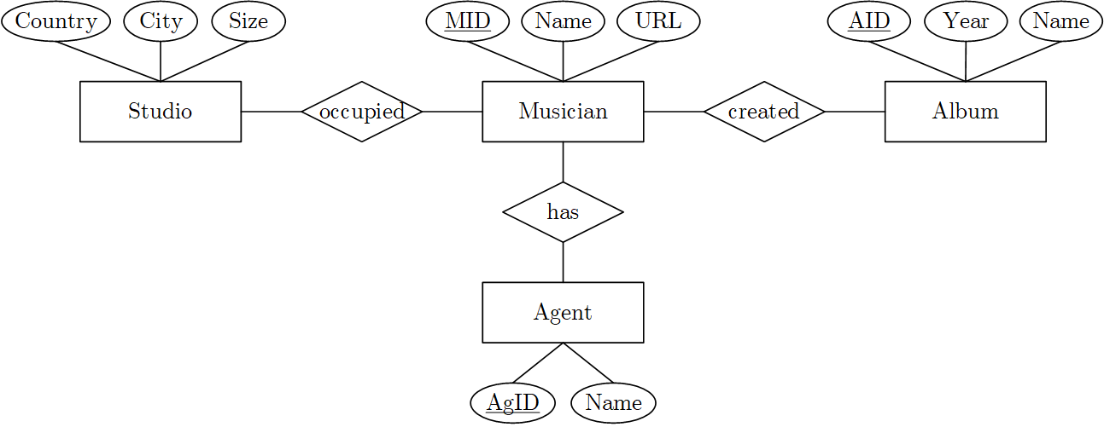
BREAK (and Test Yourself)
Entity-Relationship (ER) Model and Diagrams
Task: Cardinalities in Modified-Chen Notation (prev. exam 6/100 points)
  A musician might have created none or arbitrary many albums, and any album is created by at least one musician.
  Every musician has exactly one agent, and an agent might be responsible for one to ten musicians.
  Every musician occupies exactly one studio, and musicians never share a studio.
Task: Cardinalities
in (min,max) Notation
(5/100 points)
1
C
M
MC
(0,1)
(1,1)
(0,*)
(1,*)
(1,1)
M
(1,10)
1
Note: In practice/exams, consistently use only one
[Exam June 24, 2019]

Slide 20
BREAK (and Test Yourself), cont.
Entity-Relationship (ER) Model and Diagrams
Task: Cardinalities in Modified-Chen Notation (prev. exam 9/100 points)
  An actor may play roles in an arbitrary number of movies (incl. none), every movie has a cast of at least one but potentially many actors
  A movie is directed by 1 director, directors produce arbitrary many movies
  A movie review refers to 1 movie, but there can be 0-many reviews per movie
  Actors (incl a single actor) may receive multiple awards for a single movie. An actor can receive only 1 per movie. Awards to 1-many actors are possible.
M
MC
MC
1
M
1
1
MC
MC
[Exam July 29, 2020]

Slide 21
Weak Entity Types
Entity-Relationship (ER) Model and Diagrams
Existence Dependencies
  Entities E2 whose existence depends on the other entities E1
  Visualized as a special rectangle with double border
  Primary key of E2 contains primary key of E1
  Relationship between strong and weak entity types 1:N (sometimes 1:1)
Examples
  Dependents of an employee (spouse, children)
  Rooms of a building
Employee
1
dep.
Dependent

Slide 22
N-ary Relationships
Entity-Relationship (ER) Model and Diagrams
Use of n-ary relationships
  Relationship type among multiple entity types
  N-ary relationship can be converted to binary relationships
  Design choice: simplicity and consistency constraints
Multiplicity
  1 Project and 1 Supplier → supply P parts
  1 Project and 1 Part → supplied by N suppliers (1 instead of N?)
  1 Supplier and 1 Part → supply for M projects
Supplier
N
Project
M
SPP
P
Part
Notes:
Note: many ternary cardinality patterns convertible but not all (e.g., if attributes attached)

Slide 23
Recursive Relationships
Entity-Relationship (ER) Model and Diagrams
Definition
  Recursive relationships are relations between entities of the same type
  Use roles to differentiate cardinalities
Examples
Beware of [at least 1] constraints in recursive relationships
(e.g., (min,max)-notation, or MC notation)
parent
Part
n-ary possible
1
N
1
part
subpart
Person
M
N
comp.
1
1
married
Notes:
Note: infinite recursion if [at least 1] requirement

Slide 24
An EmployeeDB Example, cont.
Entity-Relationship (ER) Model and Diagrams
[Peter P. Chen: The Entity-Relationship Model - Toward a Unified View of Data. ACM Trans. Database Syst. 1(1) 1976]
Department
Supplier
1
N-ary
relationship type
N
Dept-Emp
SPP
M
P
N
works
in
M
N
Employee
Project
M
PP
N
Part
1
1
manage
N
M
N
Emp-Dep.
comp.
Recursive
relationship type
Dependent
Weak
entity type

Slide 25
Specialization and Aggregation
Entity-Relationship (ER) Model and Diagrams
Specialization via Subclasses
  Tree of specialized entity types
  (no multi-inheritance)
  Graphical symbol: triangle
  (or hexagon, or subset)
  Each entity of subclass is entity
  of superclass, but not vice versa
Aggregation (composition, not specialization)
  #1: Recursive relationship types, or
  #2: Explicit tree of entity and relationship types
  Design choice: number of types known
  and finite, and heterogeneous attributes
Beware: Simplicity is key
Employee
isa
Manager
Researcher
Admin
Car
Engine
Chassis
Frame
Wheel
Notes:
“Perfection is achieved, not when there is nothing more to add, but when there is nothing left to take away.”
Antoine de Saint-Exupery

Slide 26
Types of Attributes
Entity-Relationship (ER) Model and Diagrams
First Name
Employee
Last Name
Atomic Attributes
  Basic, single-valued attributes
Composite Attributes
  Attributes as structured data types
  Can be represented as a hierarchy
Derived Attributes
  Attributes derived from other data
  Examples: Number of employees in dep,
  employee age, employee yearly salary
Multi-valued Attributes
  Attributes with list of homogeneous entries
DoB
First Name
Employee
Name
Last Name
DoB
Employee
Age
Employee
Phone

Slide 27
Excursus: Influence of Chinese Characters?
Entity-Relationship (ER) Model and Diagrams
“What does the Chinese character construction principles have to do with ER modeling? The answer is: both Chinese characters and the ER model are trying to model the world – trying to use graphics to represent the entities in the real world. […]”
[Peter Pin-Shan Chen: Entity-Relationship Modeling: Historical Events, Future Trends, and Lessons Learned. Software Pioneers 2002]
Chinese characters
representing
real-world entities
Composition of two
Chinese characters

Slide 28
Design Decisions
Entity-Relationship (ER) Model and Diagrams
Avoid redundancy
Avoid unnecessary complexity
Meta-Level:
  Which notations to use (Chen, Modified Chen, (min,max)-notation)?
Entities
  What are the entity types (entity vs relationship vs attribute)?
  What are the attributes of each entity type?
  What are key attributes (one or many)?
  What are weak entities (with partial keys)?
Relationships
  What are the relationship types between entities (binary, n-ary)?
  What are the attributes of each relationship type?
  What are the cardinalities?
Attributes
  What are composite, multi-valued, or derived attributes?

Slide 29
Design Decisions – Examples of Poor Choices
Entity-Relationship (ER) Model and Diagrams
#1 Overuse of weak entity types
#2 Redundant attributes
  Redundant supplier name
  in Part and Supplier
#3 Repeated information
  Missing person entity type
  → redundancy per purchase
#4 Unnecessary Complexity
  Unnecessary entity
  type Date
  Avoid single-attribute
  entity types unless
  in many relationships
Name
Supplier
Name
Part
PS
Supplier
Address
Date
Product
buy
Store
Person Name
PersonAddress
Product
Store
buy
Person
Date
Date

Slide 30
A UniversityDB Example
Entity-Relationship (ER) Model and Diagrams
Discourse of Real Mini World
  Students (with SID, name, and semester) attend courses (CID, title, ECTS),
  and take graded exams per course
  Professors teach courses and have positions, assistants work for professors
  A course may have another course as prerequisites
  Both professors and assistants are university employees (EID, name,
  and room number); professors also have a position
Task: Create an ER diagram in Chen notation
  Include entity types, relationship types, attributes, and generalizations
  Mark primary keys, roles for recursive relationships, and derived attributes

Slide 31
A UniversityDB Example, cont.
Entity-Relationship (ER) Model and Diagrams
prereq.
is
req.
req.
M
N
SID
CID
Student
M
attend
N
Course
Name
Title
M
N
N
ECTS
Start
Grade
exam
teach
Semester
1
1
Assistant
N
work
1
Professor
Position
Name
EID
Employee
Room

Slide 32
Exercise 01 – Data Modeling
Published: Mar 08, 2022
Deadline: Mar 29, 2022

Slide 33

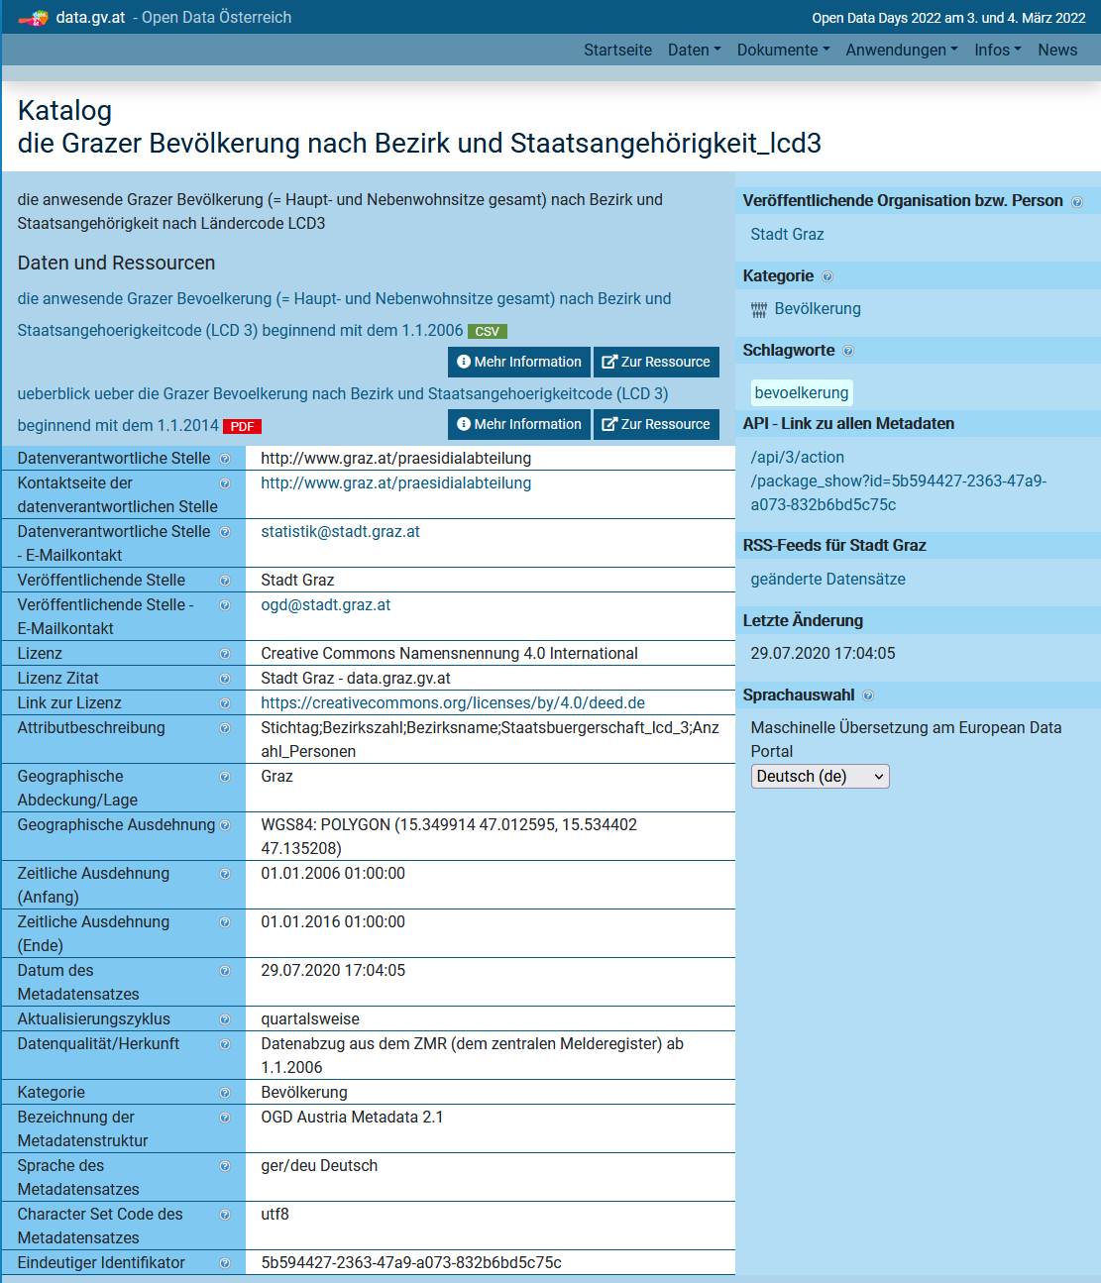
Exercises: Graz Districts
Course Organization
New
Dataset
  Graz districts, streets, schools, universities,
  population counts by age and country
  (to be cleaned and prepared → Ex 02)
  Clone or download your copy from
  https://github.com/tugraz-isds/datasets.git
  Find CSV files in <datasets>/districts_graz
Exercises
  01 Data modeling (relational schema)
  02 Data ingestion and SQL query processing
  03 Physical design tuning, query processing,
  and transaction processing
  04 Large-scale data analysis (distributed
  query processing and ML model training – anomalies?)
www.data.gv.at

Slide 34

Overview Exercise 1 Tasks
Exercise 01 – Data Modeling
[https://mboehm7.github.io/
teaching/ss22_dbs/
01_ExerciseModeling.pdf]
Task 1.1: ER Modeling (14/25)
  Graz districts / census: 17 districts, 1627 streets, addresses, schools/universities, persons, countries
  Create an ER diagram in Modified Chen (MC) notation
  Partial Result: ERDiagram.pdf
Task 1.2: Mapping ER Diagram into Relational Model (11/25)
  Create a relational schema in 3NF for the ER diagram from Task 1.1
  a) text-based schema, OR b) SQL DDL script
  Partial Result: Schema.txt or CreateSchema.sql
Expected result (for all three subtasks)
  DBExercise01_<studentID>.zip
<Table>(<Attribute 1>:<type>(PK), <Attribute 2>:<type>, ..., <Attribute n>(FK))
Don’t get your own studentID wrong

Slide 35
Overview Exercise 1 – Discourse
Exercise 01 – Data Modeling
(person counts potentially different from population count)

Slide 36
Summary and Q&A
Summary
  DB Design lifecycle from requirements to physical design
  Entity-Relationship (ER) Model and Diagrams
Importance of Good Database Design
  Poor database design ➔ development and maintenance costs,
  as well as performance problems
  Once data is loaded, schema changes very difficult
  (data model, or conceptual and logical schema)
Exercise 1: Data Modeling
  Published: Mar 08, 2022; deadline: Mar 29, 2022
  Recommendation: start with task 1.1 this week;
  ask questions in upcoming lectures or on news group
Next lecture: 03 Data Models and Normalization [Oct 14]
Notes:
Note: Lectures 02/03 contain everything needed for Exercise 1

