Slide 1

Data Management
05 Query Languages (SQL)
Last update: Apr 03, 2022

Slide 2


Announcements/Org
#1 Video Recording
  Link in TeachCenter & TUbe (lectures will be public)
  Hybrid: HSi13 / https://tugraz.webex.com/meet/m.boehm
#2 Exercise 1
  Deadline: Mar 29 + 7 late days in TeachCenter
  Grading starts Apr 06, drafts are fine – do not resubmit
#3 Exercise 2
  Task description published last weekend, discussed today
  Deadline: May 03 + 7 late days in TeachCenter
#4 (Tentative) Exams Dates
  July 07, 2.30pm-4.30pm in HS i13 + HS i12 (108 → 213 seats)
  July 07, 5.30pm-7.30pm in HS i13 + HS i12 (108 → 213 seats)
  July 28, 5.30pm-7.30pm in HS i13 (76 → 151 seats)
Q&A

Slide 3
Agenda
Structured Query Language (SQL)
Other Query Languages (XML, JSON)
Exercise 2: Query Languages and APIs

Slide 4
Structured Query Language (SQL)

Slide 5
What is a(n) SQL Query?
SELECT Firstname, Lastname, Affiliation, Location
FROM Participant AS R, Locale AS S
WHERE R.LID = S.LID
AND Location LIKE '%, GER'
#1 Declarative: what not how
Firstname | Lastname | Affiliation | Location
Volker | Markl | TU Berlin | Berlin, GER
Thomas | Neumann | TU Munich | Munich, GER
#2 Flexibility:
closed → composability
#3 Automatic Optimization
#4 Physical Data
Independence

Slide 6
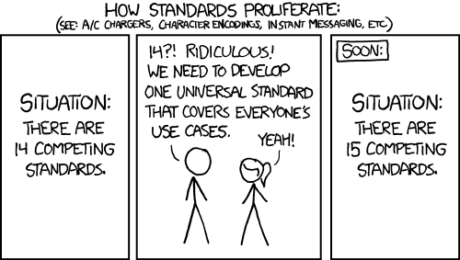



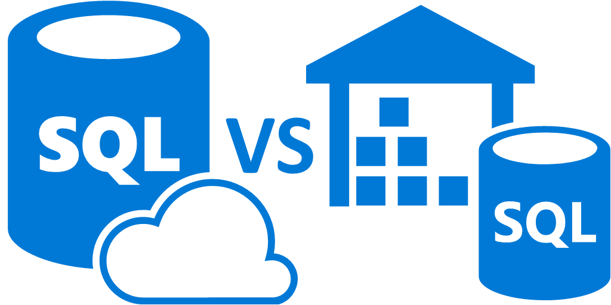
Why should I care?
SQL as a Standard
  Standards ensure interoperability,
  avoid vendor lock-in,
  and protect application investments
  Mature standard with heavy
  industry support for decades
  Rich eco system (existing apps, BI tools,
  services, frameworks, drivers, design tools, systems)
SQL is here to stay
  Foundation of mobile/server application data management
  Adoption of existing standard by new systems
  (e.g., SQL on Hadoop, cloud DBaaS)
  Complemented by NoSQL abstractions,
  see lecture 10 NoSQL (key-value, document, graph)
[https://xkcd.com/927/]
Microsoft

Slide 7
Overview SQL
Structured Query Language (SQL)
Structured Query Language (SQL)
  Current Standard: ISO/IEC 9075:2016 (SQL:2016)
  Data Definition Language (DDL) → Manipulate the database schema
  Data Manipulation Language (DML) → Update and query database
  Data Control Language (DCL) → Modify permissions
Dialects
  Spectrum of system-specific dialects
  for non-core features
  Data types and size constraints
  Catalog, builtin functions, and tools
  Support for new/optional features
  Case-sensitive identifiers
Name | Examples
T-SQL | Microsoft, Sybase
PL/SQL | Oracle, (IBM)
PL/pgSQL | PostgreSQL, derived
Unnamed | Most systems

Slide 8
The History of the SQL Standard
Structured Query Language (SQL)
[C. J. Date: A Critique of the SQL Database Language. SIGMOD Record 1984]
SQL:1986
  Database Language SQL, ANSI X3.135-1986, ISO-9075-1987(E)
  ‘87 international edition
SQL:1989 (120 pages)
  Database Language SQL with Integrity Enhancements,
  ANSI X3.135-1989, ISO-9075-1989(E)
SQL:1992 (580 pages)
  Database Language SQL, ANSI X3-1992, ISO/IEC-9075 1992, DIN 66315
  ‘95 SQL/CLI (part 3), ‘96 SQL/PSM (part 4)
SQL:1999 (2000 pages)
  Information Technology – Database Language – SQL, ANSI/ISO/IEC-9075 1999
  Complete reorg, ’00 OLAP, ’01 SQL/MED, ’01 SQL/OLB, ‘02 SQL/JRT
SQL:2003 (3764 pages)
  Information Technology – Database Language – SQL, ANSI/ISO/IEC-9075 2003

Slide 9
The History of the SQL Standard, cont.
Structured Query Language (SQL)
Overview SQL:2003
x: ... a part
(x) ... a package
1: Framework
3: CLI
4: PSM
9: MED
10: OLB
13: JRT
14: XML
Call Level Interface
Persistent Stored Modules
Management
of External Data
Object Language Bindings
Java Routines and Types
Extensible Markup Language
11: Schemata
2: Foundation
(2) Enhanced Integrity Management
(7) Enhanced Objects
optional features
(1) Enhanced Date/Time Fac.
(8) Active Databases
(6) Basic Objects
(10) OLAP
mandatory features
Core SQL (all SQL:92 entry, some extended SQL:92/SQL:99)
Notes:
NOTE: Part 7 SQL/Temporal SQL:2003 withdrawn, integrated in SQL:2011

Slide 10
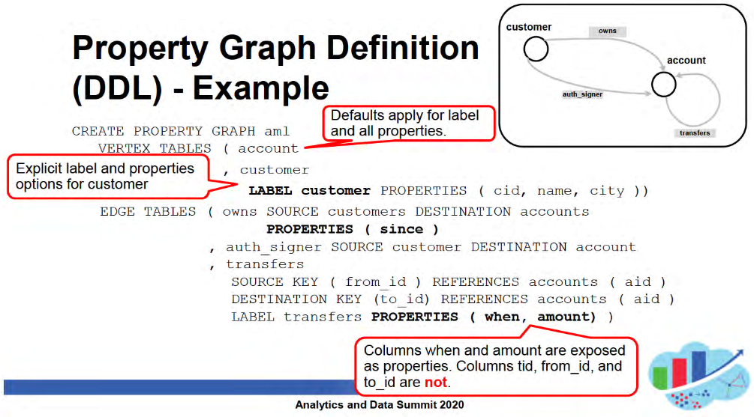
The History of the SQL Standard, cont.
Structured Query Language (SQL)
Since SQL:2003 overall structure remained unchanged ...
SQL:2008 (???? pages)
    Information Technology – Database Language – SQL, ANSI/ISO/IEC-9075 2003
  E.g., XML XQuery extensions, case/trigger extension
SQL:2011 (4079 pages)
  Information Technology – Database Language – SQL, ANSI/ISO/IEC-9075 2011
  E.g., time periods, temporal constraints, time travel queries
SQL:2016 (???? pages)
  Information Technology – Database Language – SQL, ANSI/ISO/IEC-9075 2016
  E.g., JSON documents and functions (optional)
SQL:2023 (upcoming)
  E.g., SQL:PGQ (property graph definition and querying)
➔ Note: We only discuss common primitives
[Working Draft SQL:2011:
https://www.wiscorp.com/
SQLStandards.html]
[https://download.oracle.com/otndocs/products/spatial/pdf/AnD2020/AD_Develop_Graph_Apps_SQL_PGQ.pdf]
Notes:
Note: current working draft 2023 includes SQL/PGQ (property graphs) and SQL/MDA (nd arrays)

Slide 11
Data Types in SQL:2003
Structured Query Language (SQL)
Large Variety of Types
  With support for
  multiple spellings
Added in SQL:1999 / SQL:2003
SQL data types
Deleted in SQL:2003
Composite
Data Types
Predefined
Data Types
User-defined Types (UDT)
Numeric
Interval
String
Boolean
Datetime
Exact
Approximate
Bit
Blob
Character
Date
Time
Timestamp
NUMERIC
DECIMAL
REAL
Fixed
Varying
Fixed
Varying
Clob
SMALLINT
FLOAT
INTEGER
DOUBLE PRECISION
➔ Implicit casts among numeric types
and among character types
BIGINT

Slide 12
Data Types in PostgreSQL
Structured Query Language (SQL)
Appropriate, Brief, Complete
Strings
  CHAR(n) → fixed-length character sequence (padded to n)
  VARCHAR(n) → variable-length character sequence (n max)
  TEXT → variable-length character sequence
Numeric
  SMALLINT → 2 byte integer (signed short)
  INT/INTEGER → 4 byte integer (signed int)
  SERIAL → INTEGER w/ auto increment
  NUMERIC(p, s) → exact real with p digits and s after decimal point
Time
  DATE → date
  TIMESTAMP/TIMESTAMPTZ → date and time, timezone-aware if needed
JSON
  JSON → text JSON representation (requires reparsing)
  JSONB → binary JSON representation
Notes:
Note 1: common record layouts: #1 fixed-size fields, #2 offsets, #3 embedded length fields, #4 partitioned (fixed, var w/ length fields)
Note 2: http://databasearchitects.blogspot.com/2015/01/fun-with-char.html

Slide 13
Create, Alter, and Delete Tables
Structured Query Language (SQL)
Templates in SQL
Examples in PostgreSQL
Create Table
  Typed attributes
  Primary and foreign keys
  NOT NULL, UNIQUE constraints
  DEFAULT values
  CHECK constraints
Alter Table
  ADD/DROP columns
  ALTER data type, defaults,
  constraints, etc
Delete Table
  Delete table
  Note: order of tables matters
  due to referential integrity
CREATE TABLE Students (
SID INTEGER PRIMARY KEY,
Fname VARCHAR(128) NOT NULL,
Lname VARCHAR(128) NOT NULL,
Mtime DATE DEFAULT CURRENT_DATE
);
CREATE TABLE Students AS SELECT …;
ALTER TABLE Students ADD DoB DATE;
ALTER TABLE Students ADD CONSTRAINT
PKStudent PRIMARY KEY(SID);
DROP TABLE Students; -- sorry
DROP TABLE Students CASCADE;
DROP TABLE IF EXISTS Countries,
Cities, Airports, Airlines,
Routes, Planes, Routes_Planes;

Slide 14
Create and Delete Indexes
Structured Query Language (SQL)
Create Index
  Create a secondary (nonclustered)
  index on a set of attributes
  Clustered: tuples sorted by index
  Non-clustered: sorted attribute with tuple references
  Can specify uniqueness, order, and indexing method
  PostgreSQL methods: btree, hash, gist, and gin
  ➔ see lecture 07 Physical Design and Tuning
Delete Index
  Drop indexes by name
Tradeoffs
  Indexes often automatically created for primary keys / unique attributes
  Lookup/scan performance vs insert performance
CREATE INDEX ixStudLname
ON Students USING btree
(Lname ASC NULLS FIRST);
ix
table data
DROP INDEX ixStudLname;

Slide 15
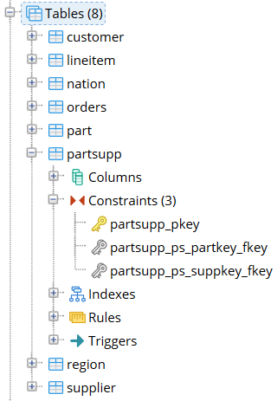
Database Catalog
Structured Query Language (SQL)
[Meikel Poess: TPC-H. Encyclopedia of Big Data Technologies 2019]
Catalog Overview
  Meta data of all database objects
  (tables, constraints, indexes) → mostly read-only
  Accessible through SQL
  Organized by schemas (CREATE SCHEMA tpch;)
SQL Information_Schema
  Schema with tables
  for all tables, views, constraints, etc
  Example: check for existence of accessible table
pgAdmin
graphical representation
SELECT 1 FROM information_schema.tables
WHERE table_schema = ‘tpch’
AND table_name = ‘customer’
(defined as views over PostgreSQL catalog tables)

Slide 16
Insert
Structured Query Language (SQL)
Insert Tuple
  Insert a single tuple with implicit or explicit attribute assignment
  Insert attribute key-value pairs to use auto increment, defaults, NULLs, etc
Insert Table
  Redirect query result into
  INSERT (append semantics)
INSERT INTO Students (SID, Lname, Fname, MTime, DoB)
VALUES (7,'Boehm','Matthias','2002-10-01','1982-06-25');
INSERT INTO Students (Lname, Fname, DoB)
VALUES ('Boehm','Matthias','1982-06-25'),
(...), (...);
SERIAL SID,
DEFAULT MTime
INSERT INTO Students
SELECT * FROM NewStudents;
Analogy Linux redirect (append):
cat NewStudents.txt >> Students.txt

Slide 17
Update and Delete
Structured Query Language (SQL)
Update Tuple/Table
  Set-oriented update of attributes
  Update single tuple via predicate
  on primary key
Delete Tuple/Table
  Set-oriented delete of tuples
  Delete single tuple via predicate
  on primary key
Note: Time travel and multi-version concurrency control
  Deleted tuples might be just marked as inactive
  See lecture 09 Transaction Processing and Concurrency
UPDATE Students
SET MTime = ‘2002-10-02’
WHERE LName = ‘Boehm’;
DELETE FROM Students
WHERE extract(year
FROM mtime) < 2010;

Slide 18
Basic Queries
Structured Query Language (SQL)
Basic Query Template
  Select-From-Where
  Grouping and Aggregation
  Having and ordering
  Duplicate elimination
Example
  SELECT Fname, Affil, Location
  FROM Participant AS P,
  Locale AS L
  WHERE P.LID = L.LID;
SELECT [DISTINCT] <column_list>
FROM [<table_list> |
<table1> [RIGHT | LEFT | FULL] JOIN
<table2> ON <condition>]
[WHERE <predicate>]
[GROUP BY <column_list>]
[HAVING <grouping predicate>]
[ORDER BY <column_list> [ASC | DESC]]
π_{Fname,Affil,Location}
σ_{P.LID=L.LID}
×
Participant
Location

Slide 19
Basic Queries, cont.
Structured Query Language (SQL)
Distinct and All
  Distinct and all alternatives
  Projection w/ bag semantics by default
Sorting
  Convert a bag into a sorted list of
  tuples; order lost if used in other ops
  Single order: (Lname, Fname) DESC
  Evaluated last in a query tree
Set Operations
  See 04 Relational Algebra and Calculus
  → UNION, INTERSECT, EXCEPT
  Set operations set semantics by default
  → DISTINCT (set) vs ALL (bag)
SELECT DISTINCT Lname, Fname
FROM Students;
SELECT * FROM Students
ORDER BY Lname DESC,
Fname DESC;
(SELECT Firstname, Lastname
FROM Participant2018)
UNION DISTINCT
(SELECT Firstname, Lastname
FROM Participant2013)

Slide 20
Grouping and Aggregation
Structured Query Language (SQL)
Grouping and Aggregation
  Grouping: determines the distinct groups
  Aggregation: compute aggregate f(B) per group
  Column list can only contain grouping columns, aggregates, or literals
  Having: selection predicate on groups and aggregates
Example
  Sales (Customer, Location, Product, Quantity, Price)
  Q: Compute number of sales sumQ
  and revenue per product sumQP
Product | SumQ | SumQP
A | 3 | 30
B | 4 | 80
SELECT Product,
sum(Quantity) AS SumQ,
sum(Quantity*Price) AS SumQP
FROM Sales
GROUP BY Product
Product | Quantity | Price
A | 1 | 10
B | 3 | 20
A | 2 | 10
B | 1 | 20

Slide 21
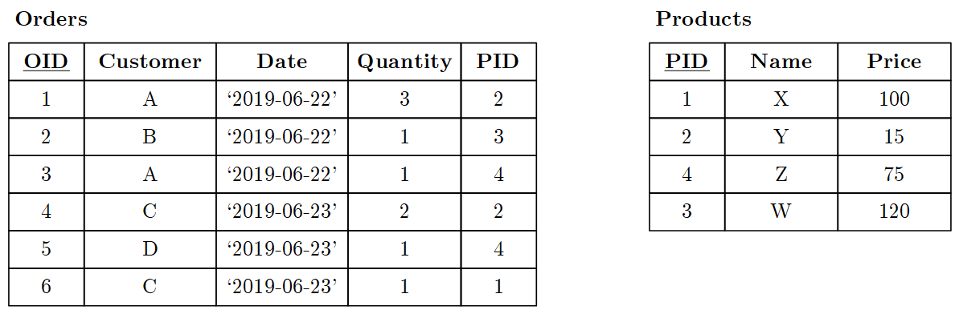
BREAK (and Test Yourself)
Structured Query Language (SQL)
Task: SQL queries
for the following
query trees.
δ
π_{Customer,Date}
σ_{O.PID=P.PID}
Customer | Date
A | ‘2019-06-22’
C | ‘2019-06-23’
D | ‘2019-06-23’
γ_{Customer,}
_{sum(O.Quantity*P.Price)}
Customer | Sum
A | 120
B | 120
C | 130
D | 75
×
⨝_{O.PID=P.PID}
Orders
O
σ_{Name∈{Y,Z}}
Orders
O
Products
P
Products
P
SELECT Customer,
sum(O.Quantity * P.Price)
FROM Orders O, Products P
WHERE O.PID = P.PID
GROUP BY Customer
SELECT DISTINCT Customer, Date
FROM Orders O, Products P
WHERE O.PID = P.PID
AND Name IN('Y','Z')

Slide 22
Subqueries
Structured Query Language (SQL)
Subqueries in Table List
  Use a subquery result
  like a base table
  Modularization with
  WITH C AS (SELECT …)
Subqueries w/ IN
  Check containment of values
  in result set of sub query
Other subqueries
  EXISTS: existential quantifier ∃x for correlated subqueries
  ALL: comparison (w/ universal quantifier ∀x)
  SOME/ANY: comparison (w/ existential quantifier ∃x)
SELECT S.Fname, S.Lname, C.Name FROM Students AS S,
(SELECT CID, Name FROM Country
WHERE …) AS C
WHERE S.CID=C.CID;
SELECT Product, Quantity, Price
FROM Sales
WHERE Product NOT IN(
SELECT Product FROM Sales
GROUP BY Product
HAVING sum(Quantity*Price)>1e6)

Slide 23
Correlated and Uncorrelated Subqueries
Structured Query Language (SQL)
Correlated Subquery
  Evaluated subquery for every tuple
  of outer query
  Use of attribute from table bound
  in outer query inside subquery
Uncorrelated Subquery
  Evaluate subquery just once
  No attribute correlations between
  subquery and outer query
Query Unnesting (de-correlation)
  Rewrite during query compilation
  See lecture 08 Query Processing
SELECT P.Fname, P.Lname
FROM Professors P,
WHERE NOT EXISTS(
SELECT * FROM Courses C
WHERE C.PID=P.PID);
SELECT P.Fname, P.Lname
FROM Professors P,
WHERE P.PID NOT IN(
SELECT PID FROM Courses);
[Thomas Neumann, Alfons Kemper: Unnesting Arbitrary Queries. BTW 2015]

Slide 24
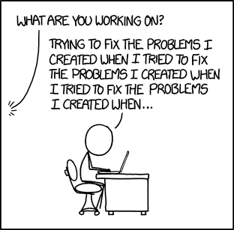
Recursive Queries
Structured Query Language (SQL)
Approach
  WITH RECURSIVE <name> (<arguments>)
  Compose recursive table from non-recursive term,
  union all/distinct, and recursive term
  Terminates when recursive term yields empty result
Example
  Courses(CID, Name),
  Precond(pre REF CID, suc REF CID)
  Dependency graph (pre→suc)
[https://xkcd.com/1739/]
WITH RECURSIVE rPrereq(p,s) AS(
(SELECT pre, suc
FROM Precond WHERE suc=5)
UNION DISTINCT
(SELECT B.pre, B.suc
FROM Precond B, rPrereq R
WHERE B.suc = R.p)
)
SELECT DISTINCT p FROM rPrereq
4
1
3
2
3
1
4
2
5

Slide 25
Procedures and Functions
Structured Query Language (SQL)
Overview Procedures and Functions
    Stored programs, written in PL/pgSQL or other languages
    Control flow (loops, branches) and SQL queries
(Stored) Procedures
  Can be called standalone via
  CALL <proc_name>(<args>);
  Procedures return no outputs
Functions
  Can be called standalone or
  inside queries
  Functions are value mappings
  Table functions can return sets
  of records with multiple attributes
CREATE PROCEDURE prepStud(a INT)
LANGUAGE PLPGSQL AS $$
BEGIN
DELETE FROM Students;
INSERT INTO Students
SELECT * FROM NewStudents;
END; $$;
CREATE FUNCTION sampleProp(FLOAT)
RETURNS FLOAT
AS 'SELECT $1 * (1 - $1);'
LANGUAGE SQL;

Slide 26
Triggers
Structured Query Language (SQL)
Overview Trigger
  Similar to stored procedure but register ON INSERT, DELETE, or UPDATE
  Allows complex check constraints and active behavior such as replication, auditing, etc (good and bad)
Trigger
Template
CREATE TRIGGER <triggername>
BEFORE | AFTER | INSTEAD OF
INSERT | DELETE | (UPDATE OF <column_list>)
ON <tablename>
[REFERENCING <old_new_alias_list>]
[FOR EACH {ROW | STATEMENT}]
[WHEN (<search condition>)]
<SQL procedure statement> |
BEGIN ATOMIC
{<SQL Procedure statement>;}...
END
Event
Condition
Not supported in PostgreSQL
(need single UDF)
Action

Slide 27
Views and Authorization
Structured Query Language (SQL)
Creating Views
  Create a logical table from a query
  Inserts can be propagated back to
  base relations only in special cases
  Allows authorization for subset of tuples
Access Permissions Tables/Views
  Grant query/modification rights on
  database objects for specific users, roles
  Revoke access rights from users, roles
  (recursively revoke permissions of
  dependent views via CASCADE)
CREATE VIEW TeamDM AS
SELECT * FROM
Employee E, Employee M
WHERE E.MgrID = M.EID
AND M.login = ‘mboehm’;
GRANT SELECT
ON TABLE TeamDM
TO mboehm;
REVOKE SELECT
ON TABLE TeamDM
FROM mboehm;

Slide 28

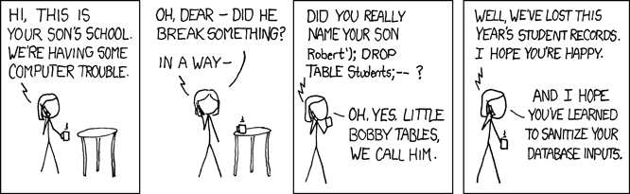
Beware of SQL Injection
Structured Query Language (SQL)
Problematic SQL String Concatenation
  INSERT INTO Students (Lname, Fname)
  VALUES (‘“+ @lname +”‘,’“+ @fname +”’);”;
Possible SQL-Injection Attack
  INSERT INTO Students (Lname, Fname) VALUES (‘Smith‘,’Robert’);
  DROP TABLE Students; --’);
[https://xkcd.com/327/]

Slide 29
Other Query Languages
(XML, JSON)

Slide 30
No really, why should I care?
Other Query Languages (XML, JSON)
Semi-structured XML and JSON
  Self-contained documents for representing nested data
  Common data exchange formats without redundancy of flat files
  Human-readable formats → often used for SW configuration
Goals
  Awareness of XML and JSON as data models
  Query languages and embedded querying in SQL

Slide 31
XML (Extensible Markup Language)
Other Query Languages (XML, JSON)
XML Data Model
  Meta language to define
  specific exchange formats
  Document format for
  semi-structured data
  Well formedness
  XML schema / DTD
XPath (XML Path Language)
  Query language for
  accessing collections of nodes of an XML document
  Axis specifies for ancestors, descendants, siblings, etc
XSLT (XML Stylesheet Language Transformations)
  Schema mapping (transformation) language for XML documents
XQuery
  Query language to extract, transform, and analyze XML documents
<?xml version=“1.0“ encoding=“UTF-8“?>
<data>
<student id=“1”>
<course id=“INF.01017UF” name=“DM”/>
<course id=“706.550” name=“AMLS”/>
</student>
<student id=“5”>
<course id=“706.520” name=“DIA”/>
</student>
</data>
/data/student[@id=‘1’]/course/@name
“DM”
“AMLS”

Slide 32
XML in PostgreSQL, cont.
Other Query Languages (XML, JSON)
Overview XML in PostgreSQL
  Data types TEXT or XML (well-formed, type-safe operations)
  ISO/IEC 9075-14 XML-related specifications (SQL/XML)
Creating XML
  Various built-in functions to parse
  documents, and create elements/attributes
  XMLPARSE(<xml_document>) → XML type
  XMLELEMENT / XMLATTRIBUTES
Processing XML
  Execute XPath expressions on XML types
  XMLEXIST with XPath instead of XQuery
  XPATH with optional namespace handling
INSERT INTO Students
(Fname,Lname,Doc)
VALUES(‘John’,’Smith’,
xmlparse(<source_doc>));
SELECT Fname, Lname,
xpath(‘/student/@id’,Doc)
FROM Students

Slide 33

JSON (JavaScript Object Notation)
Other Query Languages (XML, JSON)
JSON Data Model
  Data exchange format for
  semi-structured data
  Not as verbose as XML
  (especially for arrays)
  Popular format (e.g., Twitter)
Query Languages
  Most common: libraries for
  tree traversal and data extraction
  JSONiq: XQuery-like query language
  JSONPath: XPath-like query language
{“students:”[
{“id”: 1, “courses”:[
{“id“:“INF.01017UF”, “name“:“DM”},
{“id“:“706.550”, “name“:“AMLS”}]},
{“id”: 5, “courses”:[
{“id“:“706.520”, “name“:“DIA”}]},
]}
JSONiq Example:
declare option jsoniq-version “…”;
for $x in collection(“students”)
where $x.id lt 10
let $c := count($x.courses)
return {“sid”:$x.id, “count”:$c}
[http://www.jsoniq.org/docs/JSONiq/html-single/index.html]
[Ingo Müller, Ghislain Fourny, Stefan Irimescu, Can Berker Cikis, Gustavo Alonso: Rumble: Data Independence for Large Messy Data Sets. PVLDB 2020, https://github.com/RumbleDB/rumble]

Slide 34
JSON in PostgreSQL, cont.
Other Query Languages (XML, JSON)
Overview JSON in PostgreSQL
  Alternative data types: JSON (text), JSONB (binary, with restrictions)
  Implements RFC 7159, built-ins for conversion and access
Creating JSON
  Built-in functions for creating
  JSON from tables and tables
  from JSON input
Processing JSON
  Specialized operators for
  tree traversal and data extraction
  -> operator: get JSON array element/object
  ->> operator: get JSON array element/object as text
  Built-in functions for extracting json (e.g., json_each)
SELECT row_to_json(t) FROM
(SELECT Fname, Lname
FROM Students) t
SELECT Fname, Lname,
Doc->students->>id
FROM Students

Slide 35
Exercise 2:
Query Languages and APIs
https://mboehm7.github.io/teaching/ss22_dbs/
02_ExerciseQueriesAPIs.pdf
Published: Apr 03, 2022
(data cleaning / ref solutions already completed)
Deadline: May 03, 2022

Slide 36

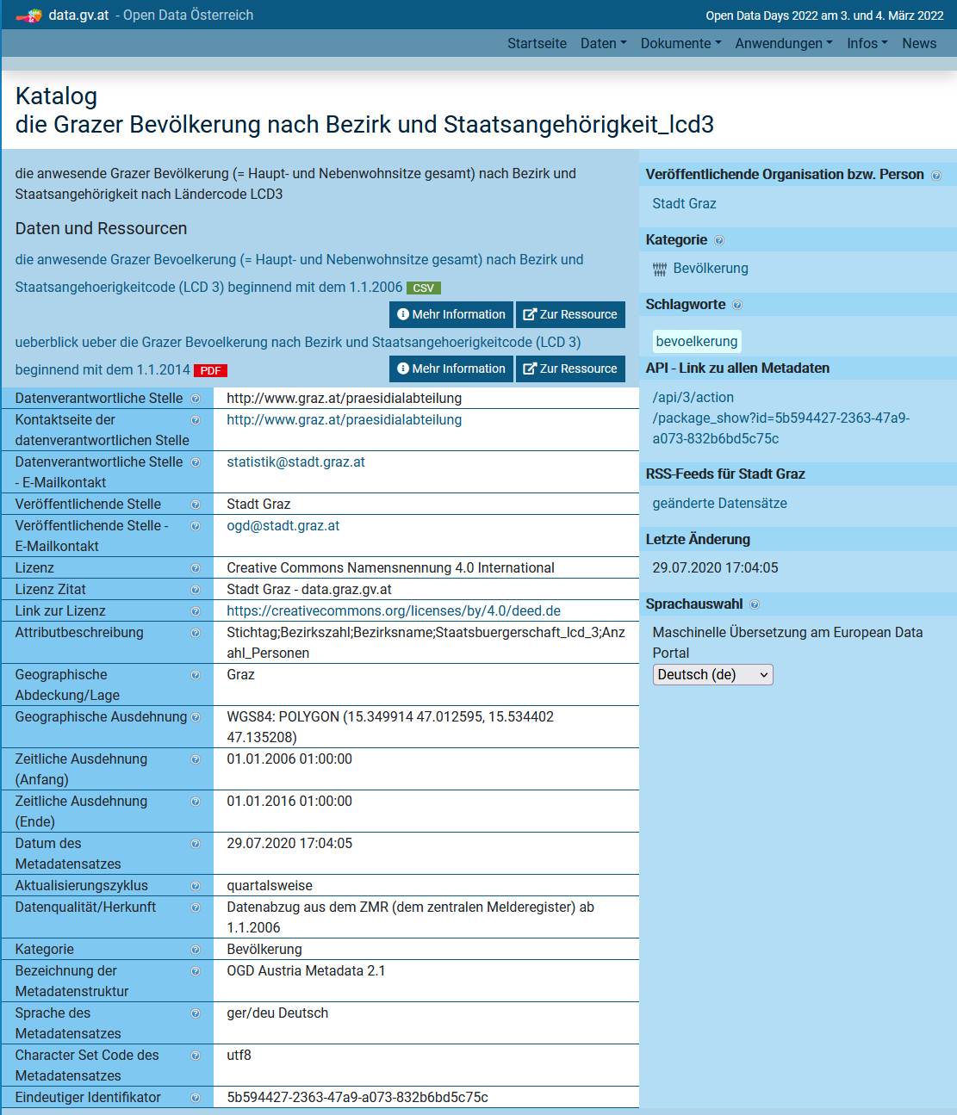
Exercises: Graz Districts
Course Organization
New
Dataset
  Graz districts, streets, schools, universities,
  population counts by age and country
  (to be cleaned and prepared → Ex 02)
  Clone or download your copy from
  https://github.com/tugraz-isds/datasets.git
  Find CSV files in <datasets>/districts_graz
Exercises
  01 Data modeling (relational schema)
  02 Data ingestion and SQL query processing
  03 Physical design tuning, query processing,
  and transaction processing
  04 Large-scale data analysis (distributed
  query processing and ML model training – anomalies?)
www.data.gv.at

Slide 37
Task 2.1: Schema Creation via SQL (3/25 points)
Exercise 2: Query Languages and APIs
Schema creation via SQL
  Relies on lectures 04 Relational Algebra and 05 Query Languages (SQL)
  Setup DBMS PostgreSQL, and start pgAdmin (UI), or psql (terminal)
  Docker container w/ basic setup in next days
  Create database db<studentID> and setup relational schema,
  including primary keys, foreign keys, NOT NULL, UNIQUE
Recommended Schema
  Feel free to use and submit the provided schema
  https://mboehm7.github.io/teaching/ss22_dbs/CreateSchema.sql
Partial Results
  CreateSchema.sql
CREATE TABLE PopByCitizenship(
DKey INT REFERENCES Districts,
CKey INT REFERENCES Countries,
PopDate DATE,
PopCount INT NOT NULL,
PRIMARY KEY(DKey, CKey, PopDate)
)

Slide 38
Task 2.2 Data Ingestion via CLI (10/25 points)
Exercise 2: Query Languages and APIs
Data Ingestion Program via ODBC/JDBC
  Relies on lectures 05 Query Languages (SQL) and 06 APIs (ODBC, JDBC)
  Write a program that performs deduplication and data ingestion
  Programming language of your choosing (Python, Java, C#, C++ recommended)
Data Ingestion Process
  Data: https://github.com/tugraz-isds/datasets/tree/master/districts_graz
  Invoke your ingestion program as follows → script to compile and run
Partial Results
  Source code IngestData.*, and
  Script runIngestData.sh
./runIngestData.sh ./Districts.csv ./Institutions.csv ./Streets.csv \
./PopulationByCitizenship.csv ./PopulationByGender.csv \
<host> <port> <database> <user> <password>
(e.g., localhost 5432 db1234567 postgres postgres)

Slide 39
Task 2.3: SQL Query Processing (10/25 points)
Exercise 2: Query Languages and APIs
SQL Query Processing
  Relies on lecture 05 Query Languages (SQL)
  Expected results: https://mboehm7.github.io/teaching/ss22_dbs/Results.zip
List of Queries
  Q01: Which districts have the postal code 8051? (return Districts.Name)
  Q02: Which institutions have an address on Leonhardstrasse? (return Institutions.Name, Addresses.PostalCode, Addresses.StNumber)
  Q03: Compute, for each district, its relative area (in percent) of the total Graz area (sum of district areas). (return Districts.Name, relative area)
  Q04: Count, for each district, the number of streets that belong entirely to this district(filter out streets that belong to more than one district). (return Districts.Name, Districts.Area, street count; sorted descending by street count)
  Q05: How many distinct countries were represented (by people's citizenships) between 2010-01-01 and 2014-12-31 in each district? (return Districts.Name, country count; sorted descending by country count)
TODO: this week

Slide 40
Task 2.3: SQL Query Processing (10/25 points)
Exercise 2: Query Languages and APIs
List of Queries, cont.
  Q06: Obtain the population count for all N-EU countries represented in Jakomini as of 2022-01-01? (return Countries.Name, PopByCitizenship.PopCount; sorted descending by PopCount)
  Q07: Compute the top-10 countries (by people's citizenship) with the largest absolute change in total population count over time. (return Countries.Name, date maximum, maximum, date minimum, minimum, difference max-min; sorted descending by difference)
  Q08: Find all pairs of distinct districts that had at the same date, the same population count of the same gender (e.g. Wetzelsdorf and Strassgang both having 6970 males as of 2008-04-01). (return PByG.Date,
  Districts.Name 1, Districts.Name 2, PByG.Gender, PByG.PopCount)
Partial Results
  SQL Script for each query: Q01.sql, Q02.sql, …, Q08.sql

Slide 41
Task 2.4: Query Plans (2/25 points)
Exercise 2: Query Languages and APIs
Explain Query Plans
  Relies on lecture 04 Relational Algebra and 05 Query Languages (SQL)
  Obtain and analyze execution plans of Q06
Example
Partial Results
  ExplainQ06.sql
"HashAggregate (...)" // grouping
" Output: l.location, count(*)"
" Group Key: l.location"
" Filter: (count(*) > 1)" // selection
" -> Hash Join (...)" // join
" Output: l.location" // projection
" Hash Cond: (l.lid = p.lid)"
" -> Seq Scan on Locale l (...)"
" Output: l.lid, l.location"
" -> Hash (...)"
" Output: p.lid" // projection
" -> Seq Scan on Participant p (...)"
" Output: p.lid"
EXPLAIN VERBOSE
SELECT L.location, count(*)
FROM Participant P,
Locale L
WHERE P.lid = L.lid
GROUP BY L.location
HAVING count(*)>1

Slide 42
Conclusions and Q&A
Summary
  History and fundamentals of the Structured Query Language (SQL)
  Awareness of XML and JSON (data model and querying)
Exercise Submissions
  Exercise 1: Mar 29 + 7 late days, grading starts soon
  Exercise 2: May 03, published Apr 03
Next Lectures (Part A)
  06 APIs (ODBC, JDBC, OR frameworks) [Apr 25]
  07 Physical Design and Tuning [May 02]
  08 Query Processing [May 09]
  09 Transaction Processing and Concurrency [May 16]

