Slide 1

Data Management
07 Physical Design & Tuning
Last update: Apr 30, 2022

Slide 2



Announcements/Org
#1 Video Recording
  Link in TeachCenter & TUbe (lectures will be public)
  Hybrid: HSi13 / https://tugraz.webex.com/meet/m.boehm
  Apr 25: no more COVID restrictions at TU Graz
#2 Course Evaluation and Exam
  Evaluation period: Jun 15 – Jul 31
  Exams: Jun 27, 4pm (i13), Jul 07, 2.30pm (i12+i13),
  Jul 07, 5.30pm (i12+13), Jul 28, 5.30pm (i13)
#3 Exercises
  Exercise 1 in progress of being graded
  Exercise 2: May 03 + 7 late days in TeachCenter
Q&A

Slide 3
Physical Design, and why should I care?
Performance Tuning via Physical Design
  Select physical data structures for relational schema and query workload
  #1: User-level, manual physical design by DBA (database administrator)
  #2: User/system-level automatic physical design via advisor tools
Example
Base
Tables
SELECT * FROM R, S, T
WHERE R.c = S.d AND S.e = T.f
AND R.b BETWEEN 12 AND 73
R
S
T
⋈
Mat
Views
MV₁
MV₂
⋈_{e=f}
⋈_{c=d}
Parti-
tioning
T
10
σ_{12≤R.b≤73}
S
Physical
Access Paths
1000000
B⁺-Tree
BitMap
Hash
R
Compression
Notes:
Mat views and partitioning → logical access paths
Index structures and compression → physical access paths

Slide 4
Agenda
Compression Techniques
Index Structures
Table Partitioning
Materialized Views
More details in 706.543 ADBS

Slide 5
Compression Techniques

Slide 6
Background Storage System
Compression Techniques
Segments, Pages, Blocks
  Segments: storage unit of DB objects
  like relations (heap) and indexes
  Page: fixed-size memory region
  Block: smallest addressable unit
  on disk (e.g., POSIX block devices)
Buffer & Storage Management
  Buffer management at
  granularity of pages
  PostgreSQL default: 8KB
  Different table/page layouts
  (e.g., NSM, DSM, PAX, column)
  TID/RID Concept (pageID, slotID)
  → stable ID, even if records reorganized
Segment / Tablespace
Page 1
Page 2
Page 3
Blk 1
Blk 2
Blk 3
Blk 4
Blk 5
Blk 6
115
136
81
136
Header
115
175
Header
tuple
tuple
tuple offsets
TID/RID Concept
(pageID, slotID)

Slide 7
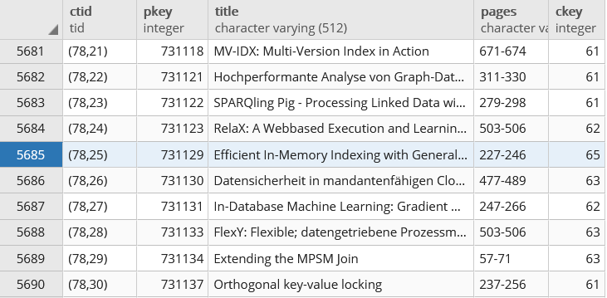
Background Storage System, cont.
Compression Techniques
TID Concept (p, s)
  TID := (page number, slot index)
  Page slot directory holds tuple offsets (byte position) within page
Example PostgreSQL
  Recap: Papers(PKey, Title, Pages, CKey, JKey)
  Hidden CTID system column (not shown on *, but usable)
SELECT CTID, PKey,
Title, Pages
FROM Papers

Slide 8
Overview Database Compression
Compression Techniques
Compression Overview
  Fit larger datasets in memory, less I/O, better cache utilization
  Some allow query processing directly on the compressed data
  #1 Page-level compression (general-purpose GZIP, Snappy, LZ4)
  #2 Row-level heavyweight/lightweight compression (e.g., Huffman)
  #3 Column-level lightweight compression
  (NS, RLE, DICT, Delta, FOR → next slide)
  #4 Specialized log and index compression
[Patrick Damme et al: Lightweight Data Compression Algorithms: An Experimental Survey. EDBT 2017]
Notes:
Page header: e.g., page type, log version numbers, flags, checksums

Slide 9
Lightweight Database Compression Schemes
Compression Techniques
106
Null Suppression
  Compress integers by omitting
  leading zero bytes/bits (e.g., NS, gamma)
Run-Length Encoding
  Compress sequences of equal values by
  runs of (value, start, run length)
Dictionary Encoding
  Compress column w/ few distinct values
  as pos in dictionary (→ code size)
Delta Encoding
  Compress sequence w/ small changes
  by storing deltas to previous value
Frame-of-Reference Encoding
  Compress values by storing delta to
  reference value (outlier handling)
00000000
00000000
00000000
01101010
11
01101010
1 1 1 1 7 7 7 7 7 3 3 3 3 3 3 ...
1,1,4
7,5,5
3,10,6
1 7 7 3 1 7 1 3 3 7 1 3 3 7 3 ...
1,3,7
dictionary (code size 2 bit)
1 3 3 2 1 3 1 2 2 3 1 2 2 3 2 ...
20 21 22 20 19 18 19 20 21 20 ...
0 1 1 -2 -1 -1 1 1 1 -1...
20 21 22 20 71 70 71 69 70 21 ...
21
70
22
-1 0 1 -1 1 0 1 -1 0 -1 ...

Slide 10
Index Structures

Slide 11

Overview Index Structures
Index Structures
Table Scan
Index Scan
Table Scan vs Index Scan
  For highly selective predicates, index scan
  asymptotically much better than table scan
  Index scan higher per tuple overhead
  (break even ~5% output ratio)
  Multi-column predicates: fetch/RID-list intersection
Use Cases for Indexes
ix
sorted
Lookups /
Range Scans
Unique
Constraints
Index Nested Loop Joins
Aggregates
(count, min/max)
contains
key 107?
$$\text{⋈}$$
ix
size=
7100
table data
ix
R
ix
ix
S

Slide 12
Additional Terminology
Index Structures
Create Index
  Create a secondary (nonclustered)
  index on a set of attributes
  Clustered: tuples sorted by index
  Non-clustered: sorted attribute with tuple references
  Can specify uniqueness, order, and indexing method
  PostgreSQL methods: btree, hash, gist, and gin
Binary Search
  pos = binarySearch(data,key=23)
  Given sorted data, find key position
  (insert position if non-existing)
  k-ary search for SIMD data-parallelism
  Interpolation search: probe expected pos in key range
  (e.g., search([1:10000], 9700))
CREATE INDEX ixStudLname
ON Students USING btree
(Lname ASC NULLS FIRST);
DROP INDEX ixStudLname;
ix
TID refs
table data
10 13 14 17 18 19 23 25 27 29
10 13 14 17 18 19 23 25 27 29
10 13 14 17 18 19 23 25 27 29

Slide 13

Classification of Index Structures
Index Structures
[Theo Härder, Erhard Rahm: Datenbanksysteme: Konzepte und Techniken der Implementierung, 2001]
1D Access Methods
ND Access Methods
  Linearization of ND key space + 1D indexing (Z order, Gray code, Hilbert curve)
  Multi-dimensional trees and hashing (e.g., UB tree, k-d tree, gridfile)
  Spatial index structures (e.g., R tree)
1D Access Methods
Key Comparison
Key Transformation
Sequential
Tree-Based
Sort-Based
Hash-Based
Sequential Lists
Linked Lists
Binary Search Trees
Multiway Trees (B-Tree)
Prefix Trees (Tries)
Static
Dynamic

Slide 14
B-Tree Overview
Index Structures
[Rudolf Bayer, Edward M. McCreight: Organization and Maintenance of Large Ordered Indices. Acta Inf. (1) 1972]
History B-Tree
  Bayer and McCreight 1972, Block-based, Balanced, Boeing Labs
  Multiway tree (node size = page size); designed for DBMS
  Extensions: B+-Tree/B*-Tree (data only in leafs, double-linked leaf nodes)
Definition B-Tree (k, h)
  All paths from root to leafs have equal length h
  All nodes (except root) have [k, 2k] key entries
  All nodes (except root, leafs) have [k+1, 2k+1] successors
  Data is a record or a reference to the record (RID)
All nodes adhere to max constraints
k=2
P₀
Key K₁
Data D₁
P₁
Key K₂
Data D₂
P₂
Key K₃
Data D₃
P₃
Key K₄
Data D₄
P₄
Subtree w/
keys ≤ K₁
Subtree w/
K₂ < keys ≤ K₃

Slide 15
B-Tree Search
Index Structures
25
Example B-Tree k=2
  Get 38 → D38
  Get 20 → D20
  Get 6 → NULL
Lookup Q_{K} within a node
  Scan / binary search keys for Q_{K}, if K_{i}=Q_{K}, return D_{i}
  If node does not contain key
    If leaf node, abort search w/ NULL (not found), otherwise
    Decent into subtree Pi with K_{i} < Q_{K} ≤ K_{i+1}
Range Scan Q_{L<K<U}
  Lookup Q_{L} and call next K while K<Q_{U} (keep current position and node stack)
10
20
30
40
2
5
7
8
41
42
45
46
13
14
15
18
32
35
38
22
24
26
27
28

Slide 16
B-Tree Insert
Index Structures
Basic Insertion Approach
  Always insert into leaf nodes!
  Find position similar to lookup, insert and maintain sorted order
  If node overflows (exceeds 2k entries) ➔ node splitting
Node Splitting Approach
  Split the 2k+1 entries into two leaf nodes
  Left node: first k entries
  Right node: last k entries
  (k+1)th entry inserted into parent node
  ➔ can cause recursive splitting
  Special case: root split (h++)
B-Tree is self-balancing
30
40
2k+1
41
42
45
46
47
overflow
30
40
45
1
41
42
46
47
first k
last k

Slide 17
B-Tree Insert, cont. (Example w/ k=1)
Index Structures
Insert 1
Insert 5
Insert 2
(split)
Insert 6
Insert 7
(split)
Insert 4
Insert 8
Insert 3
(2x split)
Note: Exercise 03?
(B-tree insertion and deletion)
1
2
6
1
4
5
7
1
5
2
6
2
1
4
5
7
8
1
5
4
2
2
6
1
5
6
1
3
5
7
8
2
6
1
5
7

Slide 18
B-Tree Delete
Index Structures
Basic Deletion Approach
  Lookup deletion key, abort if non-existing
  Case inner node: move entry from fullest successor node into position
  Case leaf node: if underflows (<k entries) ➔ merge w/ sibling
Example
  Case
  inner
  Case
  leaf
4
4
2
6
2
7
1
3
5
7
8
1
3
5
8
4
under-
flow
4
2
7
7
4
7
1
3
5
8
1
2
5
8
1
2
5
8
underflow
Notes:
Note: in case inner, direct merge of 2 and 4 not possible, as 6 separates the two leaf nodes 5 and (7,8)

Slide 19
B-Tree Insert and Delete w/ k=2
Index Structures
10
20
Insert/Delete Examples
  Original
  Insert 16
  Insert 26
  Delete 20
  Delete 16
3
5
7
4
11
18
19
25
28
30
31
10
20
3
5
7
4
11
16
18
25
28
30
31
10
20
28
3
5
7
4
11
16
18
25
26
30
31
30
31
30
31
10
18
28
3
5
7
4
11
16
18
25
26
30
31
30
31
30
31
10
28
3
5
7
4
11
18
25
26
30
31
30
31

Slide 20
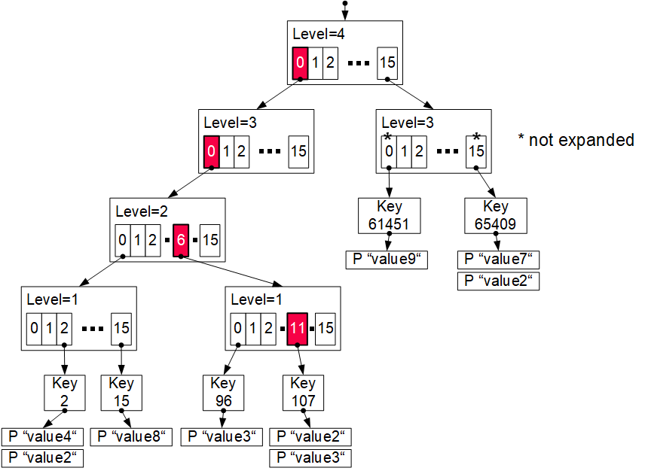
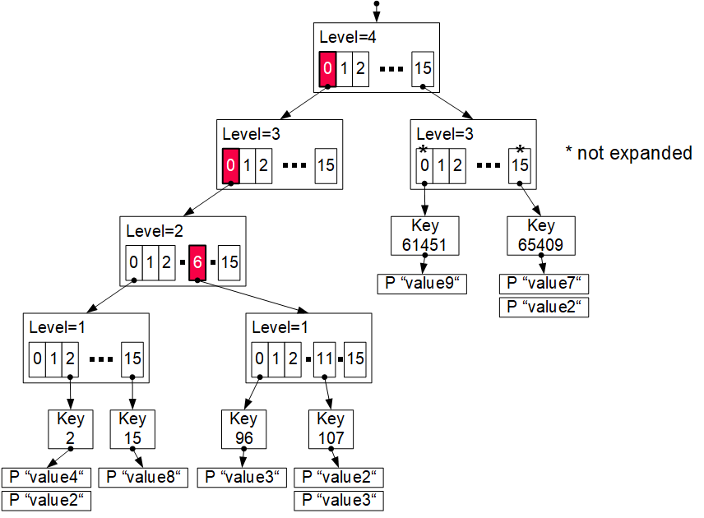
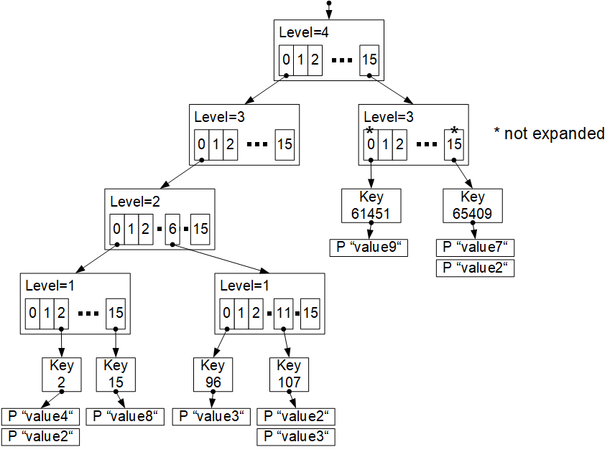
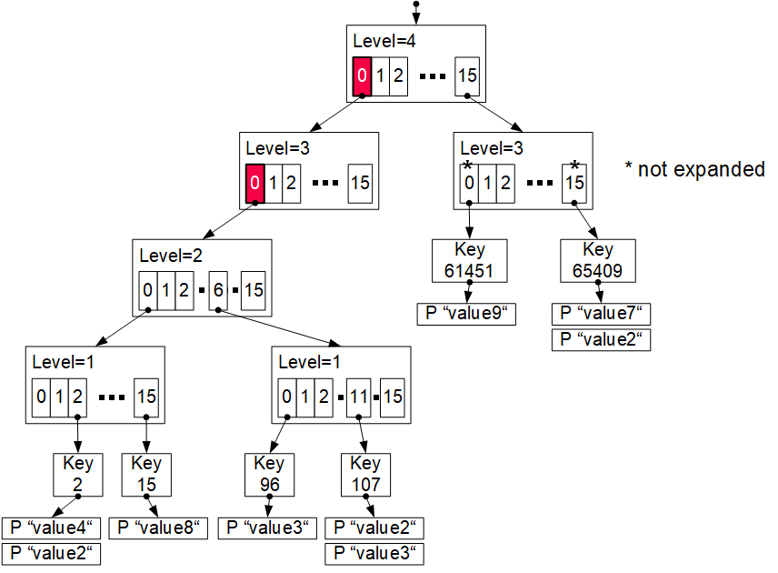
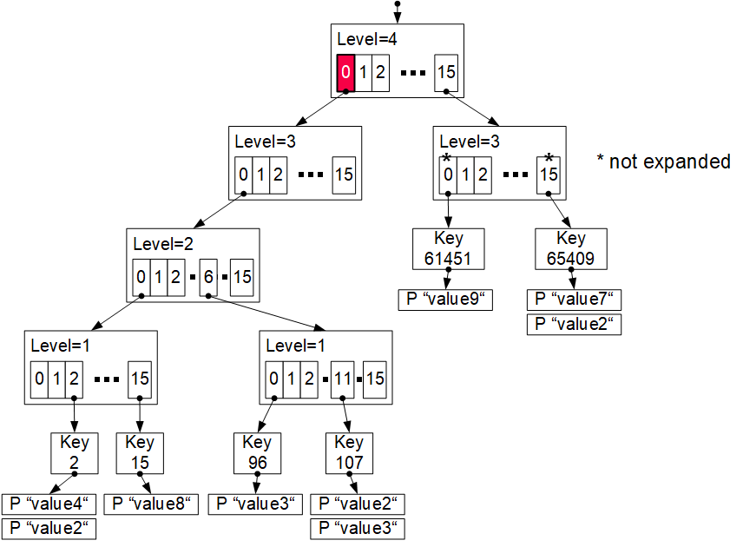
Excursus: Prefix Trees (Radix Trees, Tries)
Index Structures
insert (107,value4)
Generalized Prefix Tree
  Arbitrary data types (byte sequences)
  Configurable prefix length k’
  Node size: s = 2^{k’} references
  Fixed maximum height h = k/k‘
  Secondary index structure
Characteristics
  Partitioned data structure
  Order-preserving
  (for range scans)
  Update-friendly
Properties
  Deterministic paths
  Worst-case complexity O(h)
0000
0000
0110
1011
0000
0000
0110
1011
k = 16
k’ = 4
Bypass array
Adaptive trie expansion
Memory preallocation + reduced pointers

Slide 21
Excursus: Learned Index Structures
Index Structures
[Tim Kraska, Alex Beutel, Ed H. Chi, Jeffrey Dean, Neoklis Polyzotis: The Case for Learned Index Structures. SIGMOD 2018]
A Case For Learned Index Structures
  Sorted data array, predict position of key
  Hierarchy of simple models (stages models)
  Tries to approximate the CDF similar to interpolation search (uniform data)
Follow-up Work
on SageDBMS
Systems for ML,
ML for Systems
[Tim Kraska, Mohammad Alizadeh, Alex Beutel, Ed H. Chi, Ani Kristo, Guillaume Leclerc, Samuel Madden, Hongzi Mao, Vikram Nathan: SageDB: A Learned Database System. CIDR 2019]

Slide 22
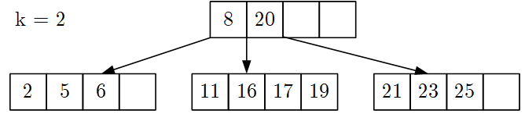
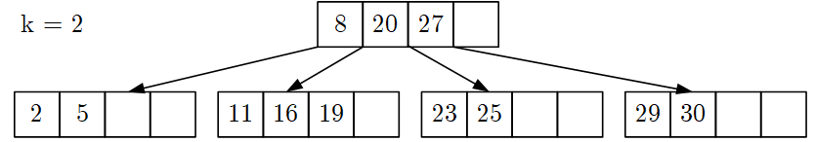
BREAK (and Test Yourself)
Index Structures
Given B-tree below, insert key 9 and draw resulting B-tree (7/100 points)
Given B-tree below, delete key 27, and draw resulting B-tree (8/100 points)
8
16
20
2
5
6
4
9
11
17
19
21
23
25
8
20
2
5
6
4
11
16
19
23
25
29
30

Slide 23


BREAK (and Test Yourself), cont.
Index Structures
Which of the following trees are valid – i.e., satisfy the constraints of –
B-trees with k=1? Mark each tree as valid or invalid and name the violations (4/100 points)
(empty leaf node, underflow)
(invalid #
of pointers and subtrees)
(invalid ordering of data items, 6>5 but in left subtree)

Slide 24
Table Partitioning

Slide 25
Overview Partitioning Strategies
Table Partitioning
Horizontal Partitioning
  Relation partitioning into disjoint subsets
Vertical Partitioning
  Partitioning of attributes with
  similar access pattern
Hybrid Partitioning
  Combination of horizontal and vertical
  fragmentation (hierarchical partitioning)
Derived Horizontal
Partitioning
⋊

Slide 26
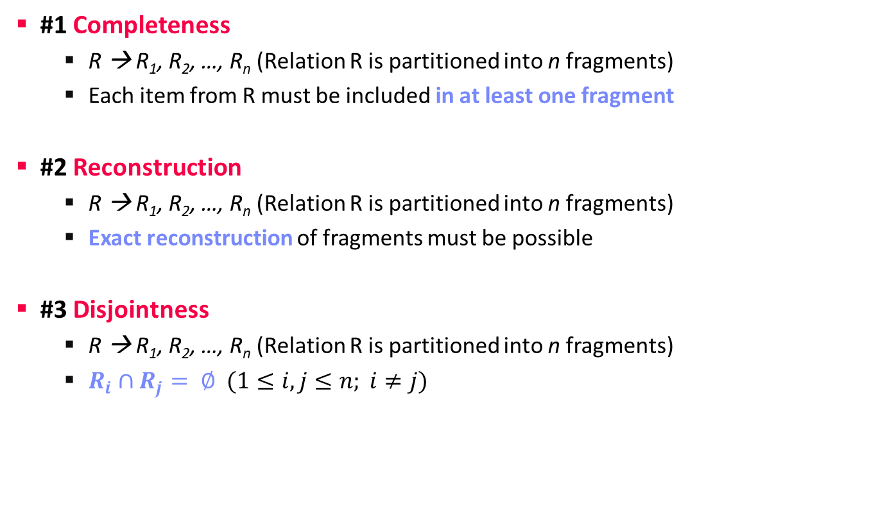
Correctness Properties
Table Partitioning
#1 Completeness
  R → R₁, R₂, …, R_{n} (Relation R is partitioned into n fragments)
  Each item from R must be included in at least one fragment
#2 Reconstruction
  R → R₁, R₂, …, R_{n} (Relation R is partitioned into n fragments)
  Exact reconstruction of fragments must be possible
#3 Disjointness
  R → R₁, R₂, …, R_{n} (Relation R is partitioned into n fragments)
  $R_{i}∩R_{j}= ∅ (1≤i,j≤n; i≠j)$

Slide 27

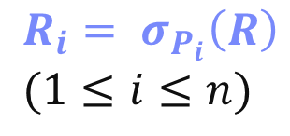
Horizontal Partitioning
Table Partitioning
Row Partitioning into n Fragments R_{i}
  Complete, disjoint, reconstructable
  Schema of fragments is equivalent
  to schema of base relation
Partitioning
  Split table by n selection predicates P_{i}
  (partitioning predicate) on attributes of R
  Beware of attribute domain and skew
Reconstruction
  Union of all fragments
  Bag semantics, but no
  duplicates across partitions
$$R_{i}= σ_{P_{i}}\left(R\right) \\ (1≤i≤n)$$
$$R=\bigcup_{1≤i≤n}{R_{i}}$$
∪
∪
R3
R1
R2

Slide 28
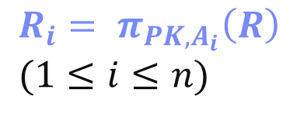
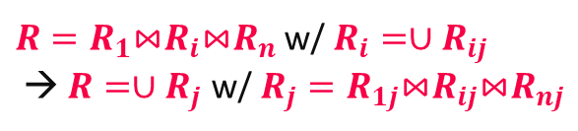
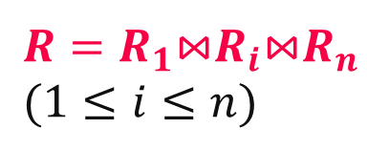
Vertical Fragmentation
Table Partitioning
Column Partitioning into n Fragments Ri
  Complete, reconstructable, but not disjoint
  (primary key for reconstruction via join)
  Completeness: each attribute must
  be included in at least one fragment
Partitioning
  Partitioning via projection
  Redundancy of primary key
Reconstruction
  Natural join over primary key
Hybrid horizontal/vertical partitioning
PK
A1
A2
PK
A1
$$R_{i}= π_{{PK,A}_{i}}\left(R\right) \\ (1≤i≤n)$$
PK
A2
$R=R_{1}$⋈$R_{i}$⋈$R_{n}$
$$(1≤i≤n)$$
$R=R_{1}$⋈$R_{i}$⋈$R_{n}$ w/ $R_{i}=∪R_{ij}$
→ $R=∪R_{j}$ w/ $R_{j}=R_{1j}$⋈$R_{ij}$⋈$R_{nj}$

Slide 29

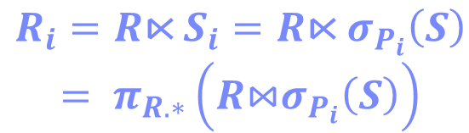
Derived Horizontal Fragmentation
Table Partitioning
Row Partitioning R into n fragements
R_{i}, with partitioning predicate on S
  Potentially complete (not guaranteed),
  restructable, disjoint
  Foreign key / primary key relationship determines correctness
Partitioning
  Selection on independent relation S
  Semi-join with dependent relation R
  to select partition R_{i}
Reconstruction
  Equivalent to horizontal partitioning
  Union of all fragments
⋊
Austria
$R_{i}=R\text{⋉}$ $S_{i}=R\text{⋉} σ_{P_{i}}\left(S\right)$
$$= π_{R.∗}\left(R\text{⋈}σ_{P_{i}}\left(S\right)\right)$$
$$R=\bigcup_{1≤i≤n}{R_{i}}$$

Slide 30
Exploiting Table Partitioning
Table Partitioning
Partitioning and query rewriting
  #1 Manual partitioning and rewriting
  #2 Automatic rewriting (spec. partitioning)
  #3 Automatic partitioning and rewriting
Example PostgreSQL (#2)
J# | Pos | Name
1 | GK | Manuel Neuer
12 | GK | Ron-Robert Zieler
22 | GK | Roman Weidenfeller
2 | DF | Kevin Großkreutz
4 | DF | Benedikt Höwedes
5 | DF | Mats Hummels
15 | DF | Erik Durm
16 | DF | Philipp Lahm
17 | DF | Per Mertesacker
20 | DF | Jérôme Boateng
3 | MF | Matthias Ginter
6 | MF | Sami Khedira
7 | MF | Bastian Schweinsteiger
8 | MF | Mesut Özil
9 | MF | André Schürrle
13 | MF | Thomas Müller
14 | MF | Julian Draxler
18 | MF | Toni Kroos
19 | MF | Mario Götze
21 | MF | Marco Reus
23 | MF | Christoph Kramer
10 | FW | Lukas Podolski
11 | FW | Miroslav Klose
CREATE TABLE Squad(
JNum INT PRIMARY KEY,
Pos CHAR(2) NOT NULL,
Name VARCHAR(256)
) PARTITION BY RANGE(JNum);
CREATE TABLE Squad10 PARTITION OF Squad
FOR VALUES FROM (1) TO (10);
CREATE TABLE Squad20 PARTITION OF Squad
FOR VALUES FROM (10) TO (20);
CREATE TABLE Squad24 PARTITION OF Squad
FOR VALUES FROM (20) TO (24);
Notes:
Note: error on non-existing partition range, default partition possible.

Slide 31
Exploiting Table Partitioning, cont.
Table Partitioning
Example, cont.
SELECT * FROM Squad
WHERE JNum > 11 AND JNum < 20
σ_{JNum>11 ∧ JNum<20}
∪
∪
∪
σ_{JNum>11}
_{∧ JNum<20}
σ_{JNum>11}
∪
S24
σ_{JNum>11}
_{∧ JNum<20}
σ_{JNum>11}
_{∧ JNum<20}
S24
S10
S20
JNum in [20,24)
S20
S10
S20
JNum in [1,10)
JNum in [10,20)

Slide 32
Excursus: Database Cracking
Table Partitioning
[Pedro Holanda et al: Progressive Indexes: Indexing for Interactive Data Analysis. PVLDB 2019]
Core Idea: Queries trigger physical
reorganization (partitioning and indexing)
[Stratos Idreos, Martin L.
Kersten, Stefan Manegold: Database Cracking. CIDR 2007]
A
17
3
8
6
2
12
13
4
15
A_{CRK}
3
4
2
the more we crack, the more we learn
A_{CRK}
2
4
3
8
6
8
6
copy
in-place
12
15
17
13
12
13
#1 Automatic Partitioning
#2 AVL/B-tree over Partitions
17
15

Slide 33
Materialized Views

Slide 34
Overview Materialized Views
Materialized Views
Core Idea of Materialized Views
  Identification of frequently re-occuring queries (views)
  Precompute subquery results once, store and reuse many times
The MatView
Lifecycle
#1 View Selection
(automatic selection via advisor tools,
approximate algorithms)
Materialized
Views
#3 View Maintenance
(maintenance time and strategy,
when and how)
#2 View Usage
(transparent query rewrite for full/partial matches)

Slide 35
View Selection and Usage
Materialized Views
Motivation
  Shared subexpressions very common in
  analytical workloads
  Ex. Microsoft’s Analytics Clusters
  (typical daily use -> 40% CSE saving)
#1 View Selection
  Exact view selection (query
  containment) is NP-hard
  Heuristics, greedy and
  approximate algorithms
#2 View Usage
  Given query and set of materialized view, decide which views to use and rewrite the query for produce correct results
  Generation of compensation plans
[Alekh Jindal, Konstantinos Karanasos, Sriram Rao, Hiren Patel: Selecting Subexpressions to Materialize at Datacenter Scale. PVLDB 2018]
[Leonardo Weiss Ferreira Chaves, Erik Buchmann, Fabian Hueske, Klemens Boehm: Towards materialized view selection for distributed databases. EDBT 2009]

Slide 36
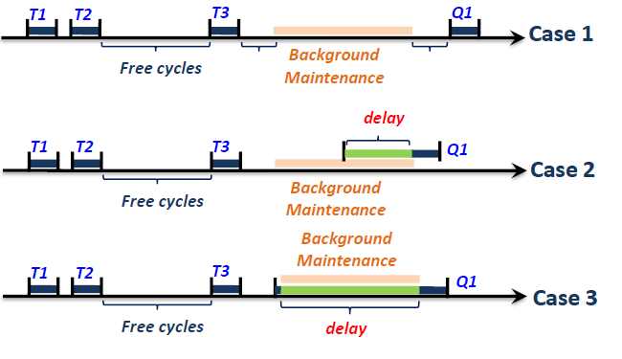
View Maintenance – When?
Materialized Views
Materialized view creates redundancy → Need for #3 View Maintenance
Eager Maintenance (writer pays)
  Immediate refresh: updates are directly handled (consistent view)
  On Commit refresh: updates are forwarded at end of successful TXs
Deferred Maintenance (reader pays)
  Maintenance on explicit user request
  Potentially inconsistent base tables and views
Lazy Maintenance (async/reader pays)
  Same guarantees as eager maintenance
  Defer maintenance until free cycles or view
  required (invisible for updates and queries)
[Jingren Zhou, Per-Åke Larson, Hicham G. Elmongui: Lazy Maintenance of Materialized Views. VLDB 2007]

Slide 37
View Maintenance – How?
Materialized Views
Example View:
SELECT A, SUM(B)
FROM Sales
GROUP BY CUBE(A)
A | SUM
NULL | 107
X | 30
Y | 77
Incremental Maintenance
  Propagate: Compute required updates
  Apply: apply collected updates to the view
Global Net Delta
∆R
Local View Delta
∆V_{L}
[Global View Delta]
∆V_{G}
Super Delta
∆V_{S}
Apply Delta
∆V_{A}
A | B
+ X | 3
+ Z | 9
A | SUM
+ NULL | 3
+ X | 3
+ NULL | 9
+ Z | 9
A | SUM
+ NULL | 12
+ X | 3
+ Z | 9
A | SUM | SUM2
NULL | 12 | 107
X | 3 | 30
Z | 9 | NULL
A | SUM
Update NULL | 119
Update X | 33
Insert Z | 9
Incremental Propagate
Incremental Apply

Slide 38
Materialized Views in PostgreSQL
Materialized Views
View Selection
  Manual definition of
  materialized view only
  With or without data
View Usage
  Manual use of view
  No automatic query rewriting
View Maintenance
  Manual (deferred) refresh
  Complete, no incremental maintenance
  Note: Community work on IVM
CREATE MATERIALIZED VIEW TopScorer AS
SELECT P.Name, Count(*)
FROM Players P, Goals G
WHERE P.Pid=G.Pid AND G.GOwn=FALSE
GROUP BY P.Name
ORDER BY Count(*) DESC
WITH DATA;
REFRESH MATERIALIZED VIEW TopScorer;
Name | Count
James Rodríguez | 6
Thomas Müller | 5
Robin van Persie | 4
Neymar | 4
Lionel Messi | 4
Arjen Robben | 3
[Yugo Nagata: Implementing Incremental View
Maintenance on PostgreSQL, PGConf 2018], patch in 2019
[Yugo Nagata: The Way for Updating Materialized Views
Rapidly, PGConf 2020, https://www.pgcon.org/events/pgcon_2020/sessions/session/56/
slides/47/pgcon2020_nagata_the_way_to_update_materialized_views_rapidly.pdf]

Slide 39
Conclusions and Q&A
Compression Techniques
Index Structures
Table Partitioning
Materialized Views
Next Lectures (Part A)
  08 Query Processing [May 09]
  09 Transaction Processing and Concurrency [May 16]
Next Lectures (Part B)
  10 NoSQL (key-value, document, graph) [May 23]
  11 Distributed Storage and Data Analysis [May 30]
  12 Data Stream Processing Systems [Jun 13, Patrick]

