Slide 1

Architecture of ML Systems (AMLS)
01 Introduction and Overview
Prof. Dr. Matthias Boehm
Technische Universität Berlin
Berlin Institute for the Foundations of Learning and Data
Big Data Engineering (DAMS Lab)
Last update: Apr 18, 2024

Slide 2

Announcements / Org
#1 Hybrid & Video Recording
  Hybrid lectures (in-person, zoom) with optional attendance
  https://tu-berlin.zoom.us/j/9529634787?pwd=R1ZsN1M3SC9BOU1OcFdmem9zT202UT09
  Zoom video recordings, links from website
  https://mboehm7.github.io/teaching/ss23_amls/index.htm
#2 Course Registrations
  TU Berlin: 135 (2023) → 215 (2024, TUB ISIS registrations)
  Bachelor/Master/PhD ratio? CS/other ratio?
#3 BLISS e.V.: https://bliss.berlin/
  Non-profit Berlin student initiative focused on AI
  AI speaker series of researchers and practitioners from academia and industry
  Next: Apr 16: Thomas Unterthiner (Deepmind), Apr 30: Daniel Zuegner (Microsoft)
~215
Notes:
Note VASA-1 Microsoft

Slide 3
Agenda
FG Big Data Engineering (DAMS Lab)
Motivation and Goals
Course Organization and Logistics
Course Outline, and Projects
Apache SystemDS and DAPHNE

Slide 4
FG Big Data Engineering (DAMS Lab)
https://www.tu.berlin/dams

Slide 5





About Me
Since 09/2022 TU Berlin, Germany
  University professor for Big Data Engineering (DAMS)
2018-2022 TU Graz, Austria
  BMK endowed chair for data management + research area manager
  Data management for data science (DAMS), SystemDS & DAPHNE
2012-2018 IBM Research – Almaden, CA, USA
  Declarative large-scale machine learning
  Optimizer and runtime of Apache SystemML
2007-2011 PhD TU Dresden, Germany
  Cost-based optimization of integration flows
  Time series forecasting / in-memory indexing & query processing
DB group

Slide 6
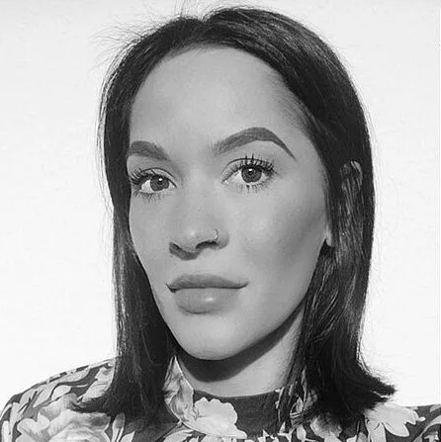
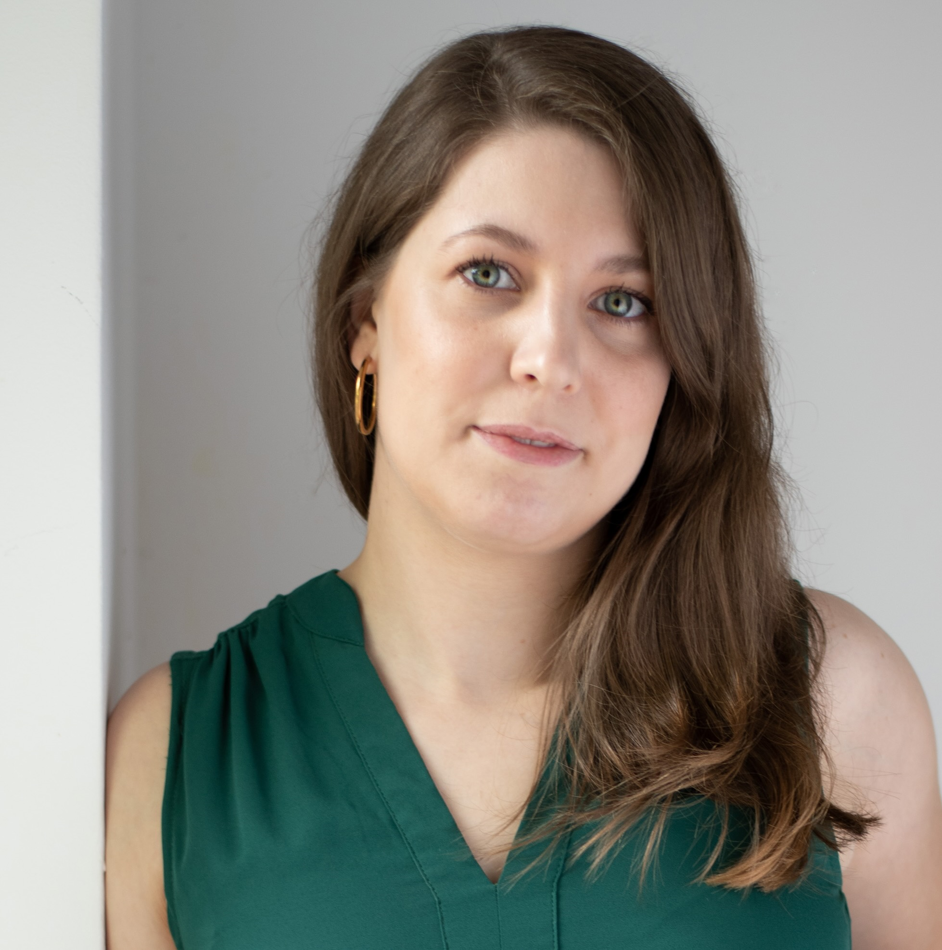
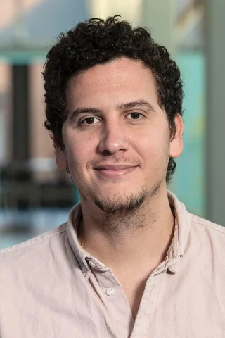

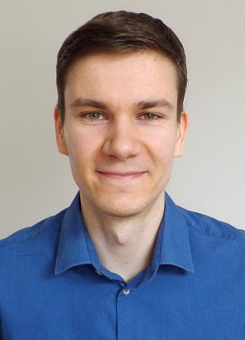
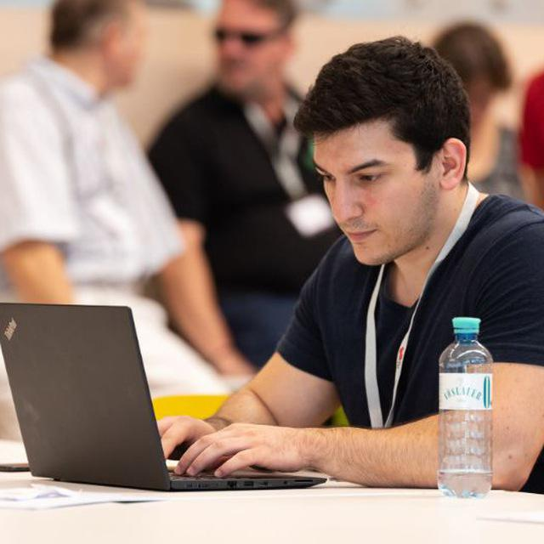
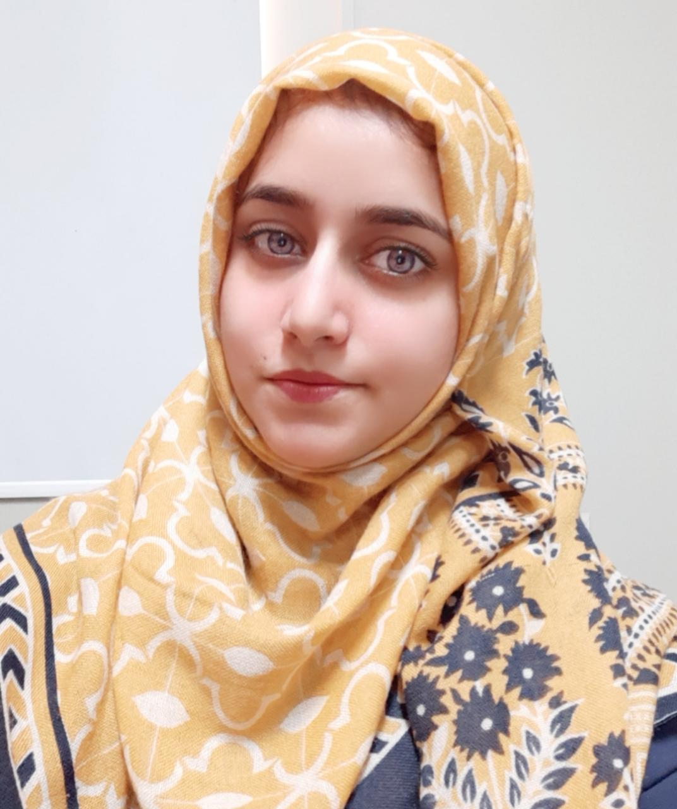

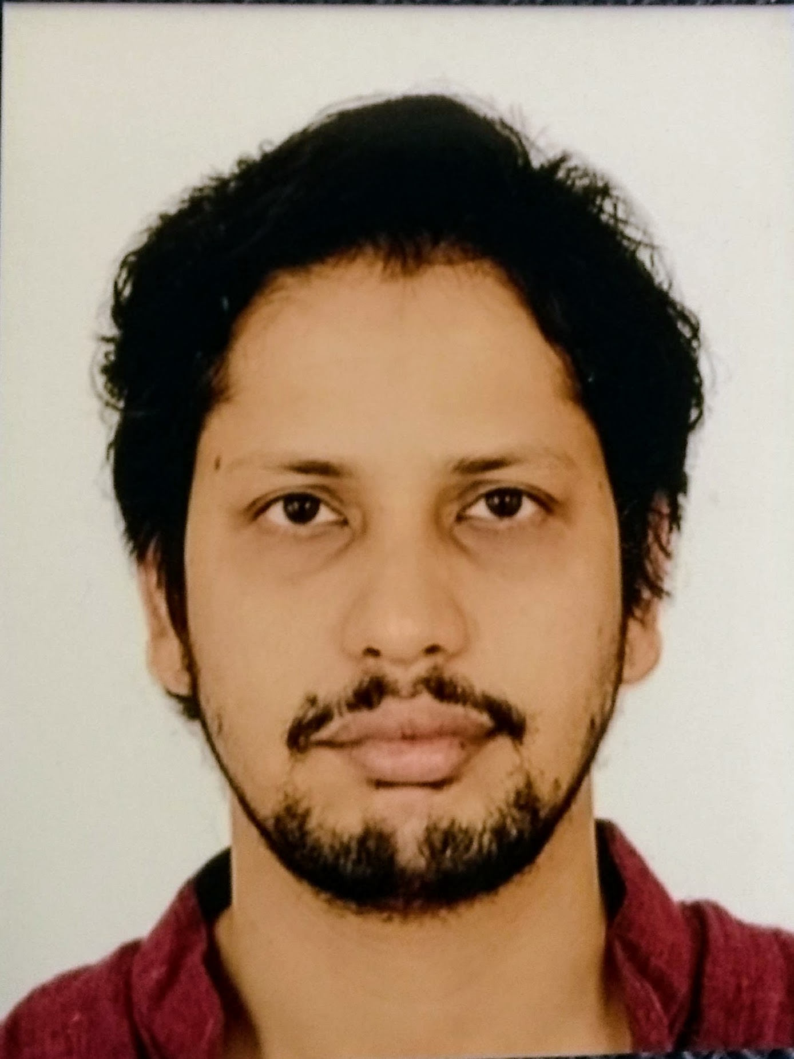

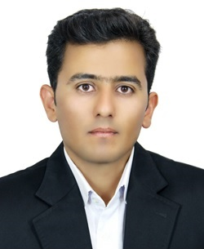



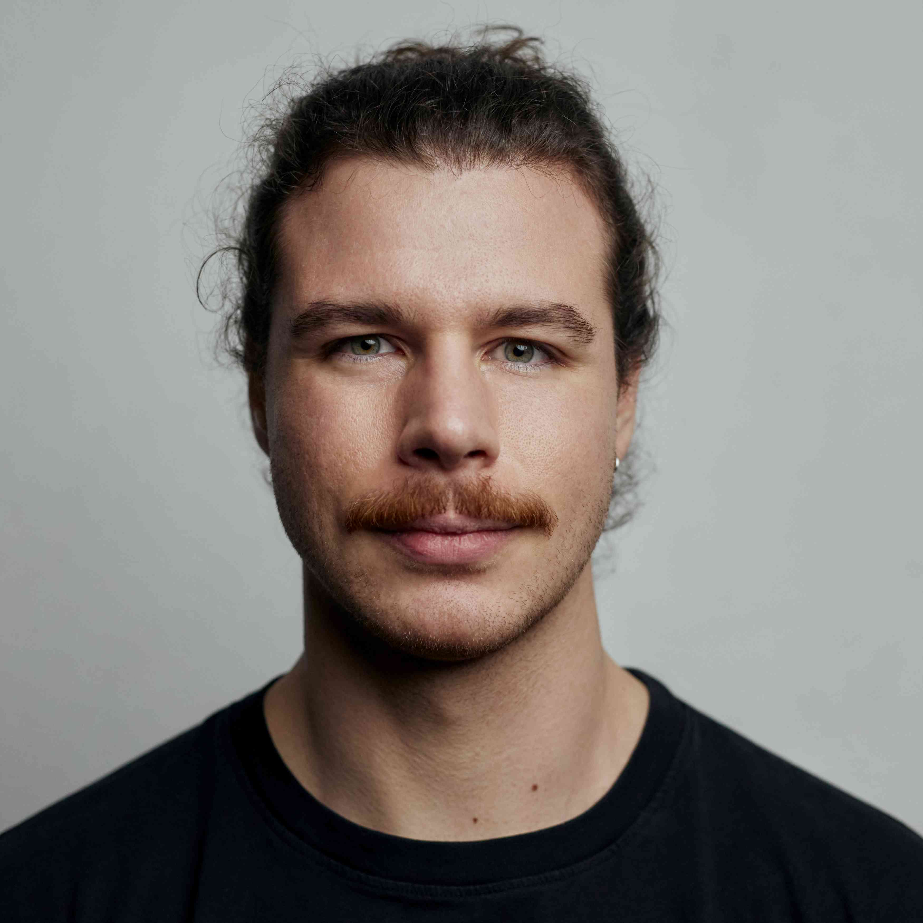

FG Big Data Engineering (DAMS Lab) – Team
Secretary (09/2023)
Sarah Hashmi
Postdoc (01/2021)
Patrick Damme
PhD Student (04/2019)
Arnab Phani
PhD Student (01/2020)
Sebastian Baunsgaard
PhD Student (10/2023)
Christina Dionysio
PhD Student (10/2023)
Philipp Ortner
PhD Student (03/2023)
David Justen
PhD Student (01/2024)
Ramon Schöndorf
PhD Student (02/2023)
Carlos E. Muniz Cuza
PhD Student (09/2019)
Shafaq Siddiqi
PhD Student (04/2021)
Saeed Fathollahzadeh
4+4x Student Assistants
25x Bachelor/Master Students
long-term visitor
external
Graduating 2024
→ BIFOLD GS
external

Slide 7
FG Big Data Engineering (DAMS Lab) – Teaching
Successfully Established TUB Teaching Portfolio (modules, slides)
Architecture of
Database Systems
(ADBS, WS)
DB system internals
+ prog. project
Architecture of
ML Systems
(AMLS, SoSe)
ML system internals,
data science lifecycle
+ prog. project
WS23/24 @ TUG
~20
Architecture of
ML Systems
(AMLS, SS)
16+25 completed
SE Joint ML and DM (MLDM, SoSe+WiSe)
~85 completed
Master
Data Integration and Large-Scale Analysis
(DIA, WS)
SE/PR Large-scale Data Engineering
(LDE, SoSe+WiSe)
Data Integration and Large-Scale Analysis
(DIA, WiSe)
~25
completed
Distributed
Data Management
Bachelor
Intro to Scientific Methods (WS)
Data Management / Databases
(DM, SS+WS)
Data management from user/application perspective
PP Prog.-Practicals Data Systems
(PPDS, SoSe+WiSe)
~45
completed

Slide 8
Motivation and Goals

Slide 9
Example ML Applications (Past/Present)
Transportation / Space
  Lemon car detection and reacquisition (classification, seq. mining)
  Airport passenger flows from WiFi data (time series forecasting)
  Data analysis for driving assistance (blind spot detection, emergency braking, lane centering)
  Automotive vehicle development (ML-assisted simulations, hyper-parameter tuning, ejector optimization)
  Earth observation and local climate zone classification and monitoring, compression
Finance
  Insurance claim cost per customer (model selection, regression)
  Financial analysts survey correlation (bivariate stats w/ new tests)
Health Care
  Breast / lunch / stomach cancer from histopathology images (classification)
  Glucose trends and warnings (clustering, classification)
  Emergency room diagnosis / patient similarity (classification, clustering)
  Patient survival analysis and prediction (Cox regression, Kaplan-Meier)

Slide 10
A Car Reacquisition Scenario
Features
Labels
Machine
Learning
Algorithm
Class skew
Low precision
Warranty Claims
Algorithm
Predictive Models
➔ 25x
improved precision
Repair History
Algorithm
Diagnostic Readouts
Algorithm
+ custom loss functions
+ hyper-parameter tuning

Slide 11
Example ML Applications
Production/Manufacturing
  Paper and fertilizer production (regression/classification, anomalies)
  Semiconductor manufacturing (ion beam tuning), and material degradation modeling (survival analysis)
  Mixed waste stream sorting and recycling (composition, alignment, quality)
Other Domains
  Machine data: errors and correlation (bivariate stats, seq. mining)
  Smart grid: energy demand/RES supply, weather models (forecasting)
Information Extraction
  NLP contracts → rights/obligations (classification, error analysis)
  PDF table recognition and extraction, OCR (NMF clustering, custom)
  Learning explainable linguistic expressions (learned FOL rules, classification)
Algorithm Research (+ various state-of-the art algorithms)
  User/product recommendations via various forms of NMF; word-embeddings via orthogonalized skip-gram
  Localized, supervised metric learning (dim reduction and classification)

Slide 12
What is an ML System?
Classification
Regression
Recommenders
Clustering
Dim Reduction
Neural Networks
Statistics
Data Mining
Machine Learning (ML)
ML Applications
(entire KDD/DS lifecycle)
Rapidly Evolving
Runtime Techniques (Execution, Data Access)
ML System
Compilation Techniques
Distributed Systems
HPC
Data Management
Accelerators
Operating Systems
Prog. Language Compilers
HW Architecture

Slide 13
What is an ML System?, cont.
ML System
  Narrow focus: SW system that executes ML applications
  Broad focus: Entire system (HW, compiler/runtime, ML application)
  Trade-off runtime/resources vs accuracy
  Early days: no standardizations (except some exchange formats), lots of different languages and system architectures, but many shared concepts
Course Objectives
  Architecture and internals of modern (large-scale) ML systems
    Microscopic view of ML system internals
    Macroscopic view of ML pipelines and data science lifecycle
  #1 Understanding of characteristics → better evaluation / usage
  #2 Understanding of effective techniques → build/extend ML systems

Slide 14
Course Organization and Logistics

Slide 15
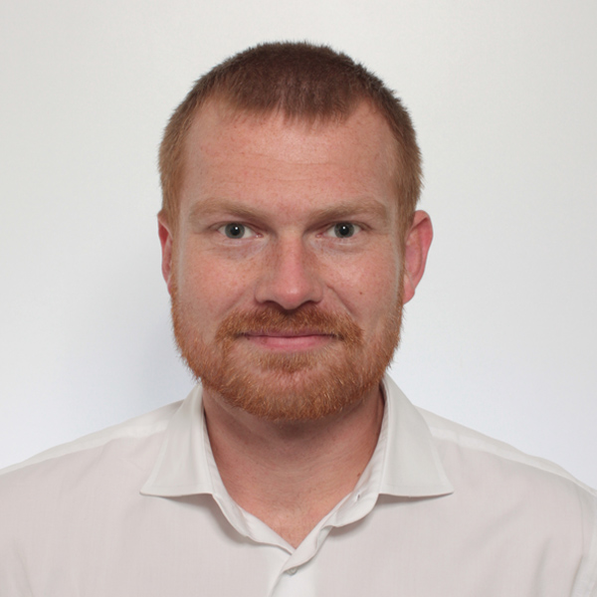
Basic Course Organization
Staff
  Lecturer: Prof. Dr. Matthias Boehm (replacement: Dr. Patrick Damme)
  Teaching Assistants: M.Sc. Sebastian Baunsgaard (projects/exercises)
Language
  Lectures and slides: English
  Communication and examination: English/German
Course Format
  TU Berlin: VL+UE 3+2 SWS, 6 ECTS (3x 1 ECTS + 2x 1.5 ECTS), master / TU Graz: VU 3 SWS, 5 ECTS
  Weekly lectures (start 4.15pm sharp, including Q&A), attendance optional
  Mandatory programming project or exercises (~3 ECTS)
  Recommended papers for additional reading on your own
Prerequisites (preferred)
  Basic courses: data management/databases, distributed systems, applied ML
  Completed bachelor (not mandatory)

Slide 16

Course Logistics
Website
  https://mboehm7.github.io/teaching/ss24_amls/index.htm
  All course material (lecture slides) and dates
Video Recording / Live Streaming Lectures (zoom)
Communication
  Informal language (first name is fine)
  Please, immediate feedback (unclear content, missing background)
  ISIS forum for offline questions, after lecture, and via email/PR discussions
  Office hours: Tue 4pm-5.30pm (Sebastian in TEL 811) or after lecture
Exam
  Completed project / exercise (checked by me/staff, no plagiarism incl *-GPT)
  Final exam (written exam or delegated oral exams, if >70 students take the exam)
  Grading (project/exercises completion, 100% exam) → new: +5 exam points if exercises >=90 points

Slide 17
Course Logistics, cont.
Course Applicability TU Berlin
  Master programs computer engineering, computer science, electrical engineering,
  information systems management
    Area Data and Software Engineering
    Area Cognitive Systems
    Area Distributed Systems
Course Applicability TU Graz (remote – offered in exceptions)
  Master programs computer science (CS), as well as software engineering and management (SEM)
    Catalog Data Science (compulsory course in major, and elective)
    Catalog Machine Learning (elective course)
    Catalog Interactive and Visual Information Systems (elective course)
    Catalog Software Technology (elective course)
  PhD CS doctoral school list of courses
Free subject course in any other study program

Slide 18
Outline and Projects
Created SoSe 2019, partially based on
[Matthias Boehm, Arun Kumar, Jun Yang: Data Management in Machine Learning Systems. Synthesis Lectures on Data Management, Morgan & Claypool Publishers 2019]
Major updates in
SoSe 2020 – SoSe 2024

Slide 19
Part A: Overview and ML System Internals
01 Introduction and Overview [Apr 18]
02 Languages, Architectures, and System Landscape [Apr 25]
03 Size Inference, Rewrites, and Operator Selection [May 02]
04 Operator Fusion and Runtime Adaptation [May 16]
05 Data- and Task-Parallel Execution [May 23]
06 Parameter Servers [May 30]
07 Hybrid Execution and HW Accelerators [Jun 06]
08 Caching, Partitioning, Indexing, and Compression [Jun 13]

Slide 20
Part B: ML Lifecycle Systems
09 Data Acquisition, Cleaning, and Preparation [Jun 20]
10 Model Selection and Management [Jun 27]
11 Model Debugging, Fairness, and Explainability [Jul 04]
12 Model Serving Systems and Techniques [Jul 11]
Q&A and Exam Preparation
Planned Written Exams
  Thu Jul 18, 4pm (in H 0107)
  Sa Aug 10, 2pm (in A 053 and EB 301)
  Sa Oct 12, 1pm (in PTZ S001)

Slide 21


Programming Projects
Open Source Projects
  Programming project in context of open source projects
    Apache SystemDS: https://github.com/apache/systemds
    DAPHNE: https://github.com/daphne-eu/daphne
    Other OSS projects possible, but harder to merge PRs
  Commitment to open source and open communication (PRs, mailing list)
  Remark: Don’t be afraid to ask questions / develop code in public
Objectives
  Non-trivial feature in an ML system (3 ECTS → 75-90 hours)
  OSS processes: Break down into subtasks,
  code/tests/docs, one or more pull-requests per project,
  code review, incorporate review comments, etc
Team
  Individuals or up to three-person teams (w/ separated responsibilities)
Lists of projects available on website and partially discussed in 2nd lecture
Project/Exercise Selection by Apr 29 EOD:
https://tinyurl.com/3vsnrant

Slide 22
Alternative Exercise (published: Apr 15, submission: Jul 08)
Task: Sentinel-2 Building Segmentation
  Task Description: https://mboehm7.github.io/
  teaching/ss24_amls/AMLS_2024_Exercise.pdf
  Data Prep: data acquisition, projection
  and basic plotting, patches, train/val/test sets
  Training: train classifiers/segmentation models,
  hyper-parameter tuning, model debugging
  Data Aug: synthetically generated
  high-quality dataset with good coverage
Objectives
  End-to-end development of an ML pipeline on real data
  Handle data issues, under-specified objectives, model training and debugging
Team
  Individuals or up to three-person teams (w/ separated responsibilities)

Slide 23



Apache SystemDS and DAPHNE
https://github.com/apache/systemds
https://github.com/daphne-eu/daphne

Slide 24
Apache SystemDS: A Declarative ML System for the End-to-End Data Science Lifecycle
https://github.com/apache/systemds

Slide 25

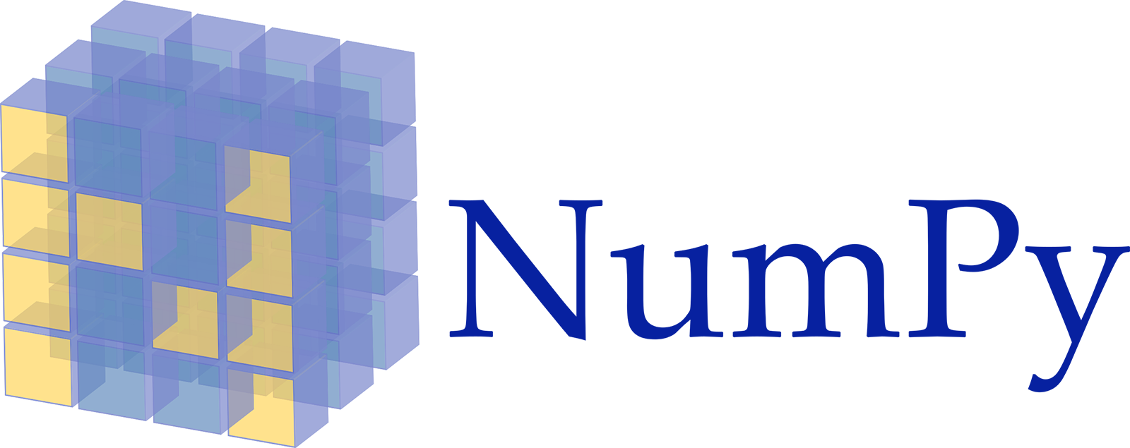











Landscape of ML Systems
Existing ML Systems
  #1 Numerical computing frameworks
  #2 ML Algorithm libraries (local, large-scale)
  #3 Linear algebra ML systems (large-scale)
  #4 Deep neural network (DNN) frameworks
  #5 Model management, and deployment
Exploratory Data-Science Lifecycle
  Open-ended problems w/ underspecified objectives
  Hypotheses, data integration, run analytics
  Unknown value → lack of system infrastructure
  → Redundancy of manual efforts and computation
Data Preparation Problem
  80% Argument: 80-90% time for finding, integrating, cleaning data
  Diversity of tools ➔ boundary crossing, lack of optimization
“Take these datasets and show value or competitive advantage”
[NIPS 2015]
[DEBull 2018]

Slide 26




The Data Science Lifecycle
(aka KDD Process, aka CRISP-DM)
Data extraction, schema alignment, entity resolution, data validation, data cleaning, outlier detection, missing value imputation, semantic type detection, data augmentation, feature selection, feature engineering, feature transformations
Key observation: SotA data integration/cleaning based on ML
Data Scientist
Data Integration
Data Cleaning
Data Preparation
Data Integration
Data Cleaning
Data Preparation
Model Selection
Training
Hyper-parameters
Validate & Debug
Deployment
Scoring & Feedback
Exploratory Process
(experimentation, refinements, ML pipelines)
Data/SW Engineer
DevOps Engineer

Slide 27
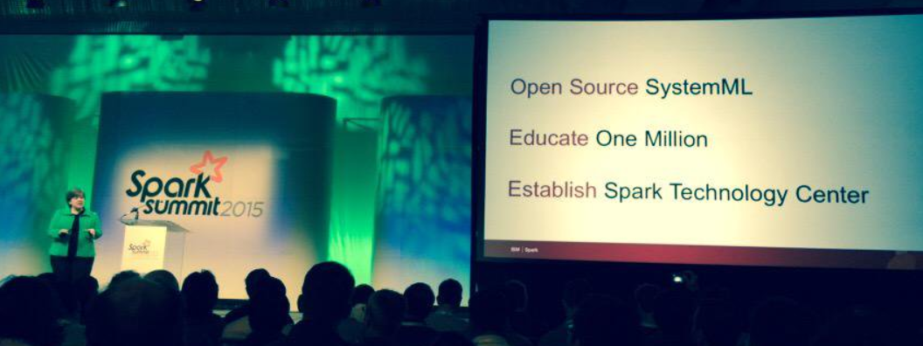




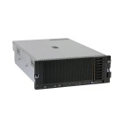
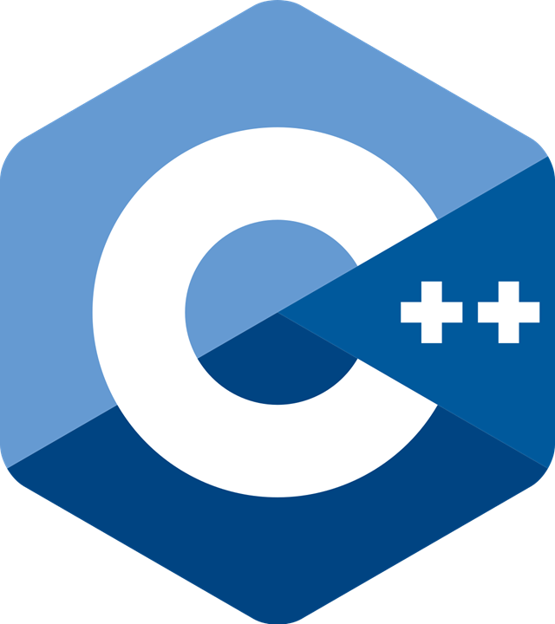
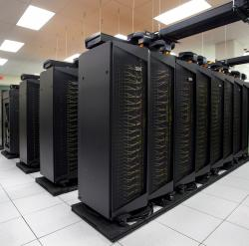
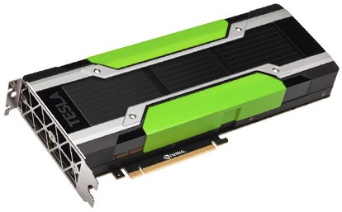
Apache SystemDS [https://github.com/apache/systemds]
DML Scripts
APIs: Command line, JMLC, Python
Spark MLContext, Spark ML,
(Scalable Algorithms + Primitives)
Language
Compiler
07/2020 Renamed to Apache SystemDS
05/2017 Apache Top-Level Project
11/2015 Apache Incubator Project
08/2015 Open Source Release
[SIGMOD’15,’17,’19,’21abc,’23abc]
[PVLDB’14,’16ab,’18,’22]
[ICDE’11,’12,’15]
[CIDR’17,’20]
[VLDBJ’18]
[CIKM’22]
[DEBull’14]
[PPoPP’15]
Runtime
Write Once, Run Anywhere
In-Memory Single Node
(scale-up)
Hadoop or Spark Cluster
(scale-out)
Federated
(LA progs, PS)
In-Progress:
GPU
since 2019
since 2014/16
since 2012
since 2010/11
since 2015

Slide 28
Language Abstractions and APIs
Data Independence + Impl-Agnostic Ops
➔ “Separation of Concerns”
User Script
Built-in Functions
Example:
Stepwise
Linear
Regression
X = read(‘features.csv’)
Y = read(‘labels.csv’)
[B,S] = steplm(X, Y,
icpt=0, reg=0.001)
write(B, ‘model.txt’)
m_steplm = function(...) {
while( continue ) {
parfor( i in 1:n ) {
if( !fixed[1,i] ) {
Xi = cbind(Xg, X[,i])
B[,i] = lm(Xi, y, ...)
} }
# add best to Xg
# (AIC)
} }
m_lmCG = function(...) {
while( i<maxi&nr2>tgt ) {
q = (t(X) %*% (X %*% p))
+ lambda * p
beta = ... }
}
m_lm = function(...) {
if( ncol(X) > 1024 )
B = lmCG(X, y, ...)
else
B = lmDS(X, y, ...)
}
Linear Algebra Programs
Feature Selection
Facilitates optimization across data science lifecycle tasks
ML Algorithms
m_lmDS = function(...) {
l = matrix(reg,ncol(X),1)
A = t(X) %*% X + diag(l)
b = t(X) %*% y
beta = solve(A, b) ...}

Slide 29
Basic HOP and LOP DAG Compilation
LinregDS (Direct Solve)
X = read($1);
y = read($2);
intercept = $3;
lambda = 0.001;
...
if( intercept == 1 ) {
ones = matrix(1, nrow(X), 1);
X = append(X, ones);
}
I = matrix(1, ncol(X), 1);
A = t(X) %*% X + diag(I)*lambda;
b = t(X) %*% y;
beta = solve(A, b);
...
write(beta, $4);
HOP DAG
(after rewrites)
8KB
Cluster Config:
driver mem: 20 GB
exec mem: 60 GB
CP
write
Scenario:
X: 10⁸ x 10³, 10¹¹
y: 10⁸ x 1, 10⁸
8MB
16MB
CP
b(solve)
CP
172KB
b(+)
1.6TB
CP
SP
800GB
r(diag)
ba(+*)
ba(+*)
SP
1.6TB
r(t)
8KB
SP
CP
800GB
800MB
dg(rand)
(10³x1,10³)
X
(10⁸x10³,10¹¹)
y
(10⁸x1,10⁸)
Distributed Matrices
  Fixed-size matrix blocks
  Data-parallel operations
LOP DAG
(after rewrites)
16KB
r’(CP)
mapmm(SP)
tsmm(SP)
X_{1,1}
Hybrid Runtime Plans:
  Size propagation / memory estimates
  Integrated CP / Spark runtime
  Dynamic recompilation during runtime
800MB
1.6GB
X_{2,1}
r’(CP)
X
(persisted in MEM_DISK)
X_{m,1}
y

Slide 30
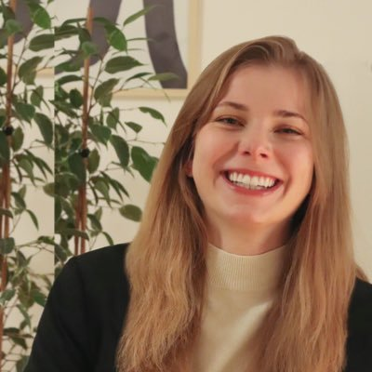
Static and Dynamic Rewrites
trace(X%*%Y) → sum(X*t(Y))
Example Static Rewrites (size-independent)
  Common Subexpression Elimination
  Constant Folding / Branch Removal /
  Block Sequence Merge
  Static Simplification Rewrites
  Right/Left Indexing Vectorization
  For Loop Vectorization
  Spark checkpoint/repartition injection
Example Dynamic Rewrites (size-dependent)
  Dynamic Simplification Rewrites
  Matrix Mult Chain Optimization
Y
O(n³)
O(n²)
X
X
Y ┬
→
*
sum(λ*X) → λ*sum(X)
sum(X+Y) → sum(X)+sum(Y)
rowSums(X) → X, iff ncol(X)=1
sum(X^2) → X%*%t(X), iff ncol(X)=1
t(X)
1kx1k
X
1kx1k
Z
1
t(X)
1kx1k
X
1kx1k
p
1
→
Sparsity Estimation & Sparse DP Enum
[SIGMOD’19]
2,002 MFLOPs
4 MFLOPs
Size propagation and sparsity estimation

Slide 31
Apache SystemDS Architecture
> 125,200 tests
> 8,100 DSL tests
[CIDR’20]

Slide 32
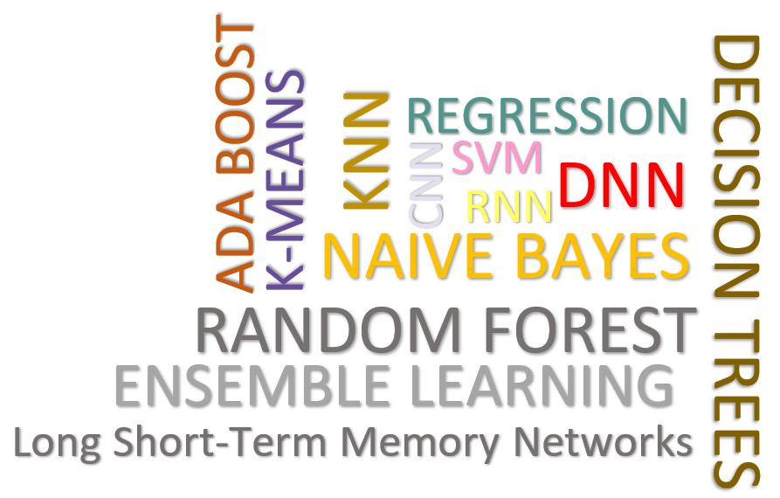
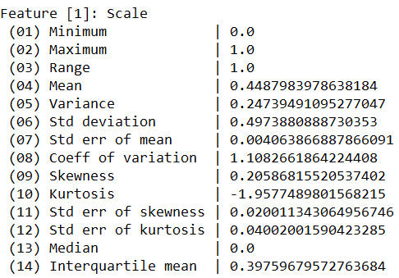
Data Cleaning Pipelines
[SIGMOD’24]
Automatic Generation of Cleaning Pipelines
  Library of robust, parameterized data cleaning primitives
  Enumeration of DAGs of primitives & hyper-parameter optimization (evolutionary, HB)
Data- and Task-parallel Computation
Data Samples
Logical
O
Physical
LP₁
LP₂
…
LP_{n}
Top-k Pipelines
Target
App
…
…
…
PP₁
PP_{n}
PP₁
PP_{n}
PP₁
PP_{n}
Rules/Objectives
Outlier Detection → MVI → Deduplication → Resolve Mislabels
P_{1:} gmm → imputeFD → mergeDup → delML
P_{n:} outlierBySd→ mice → delDup → voting
Debugging
University | Country
TU Graz | Austria
TU Graz | Austria
TU Graz | Germany
IIT | India
IIT | IIT
IIT | Pakistan
IIT | India
SIBA | Pakistan
SIBA | null
SIBA | null
University | Country
TU Graz | Austria
TU Graz | Austria
TU Graz | Austria
IIT | India
IIT | India
IIT | India
IIT | India
SIBA | Pakistan
SIBA | Pakistan
SIBA | Pakistan
A | B | C | D
0.77 | 0.80 | 1 | 1
0.96 | 0.12 | 1 | 1
0.66 | 0.09 | null | 1
0.23 | 0.04 | 17 | 1
0.91 | 0.02 | 17 | null
0.21 | 0.38 | 17 | 1
0.31 | null | 17 | 1
0.75 | 0.21 | 20 | 1
null | null | 20 | 1
0.19 | 0.61 | 20 | 1
0.64 | 0.31 | 20 | 1
A | B | C | D
0.77 | 0.80 | 1 | 1
0.96 | 0.12 | 1 | 1
0.66 | 0.09 | 17 | 1
0.23 | 0.04 | 17 | 1
0.91 | 0.02 | 17 | 1
0.21 | 0.38 | 17 | 1
0.31 | 0.29 | 17 | 1
0.75 | 0.21 | 20 | 1
0.41 | 0.24 | 20 | 1
0.19 | 0.61 | 20 | 1
0.64 | 0.31 | 20 | 1
Dirty Data
After imputeFD(0.5)
Dirty Data
After MICE

Slide 33


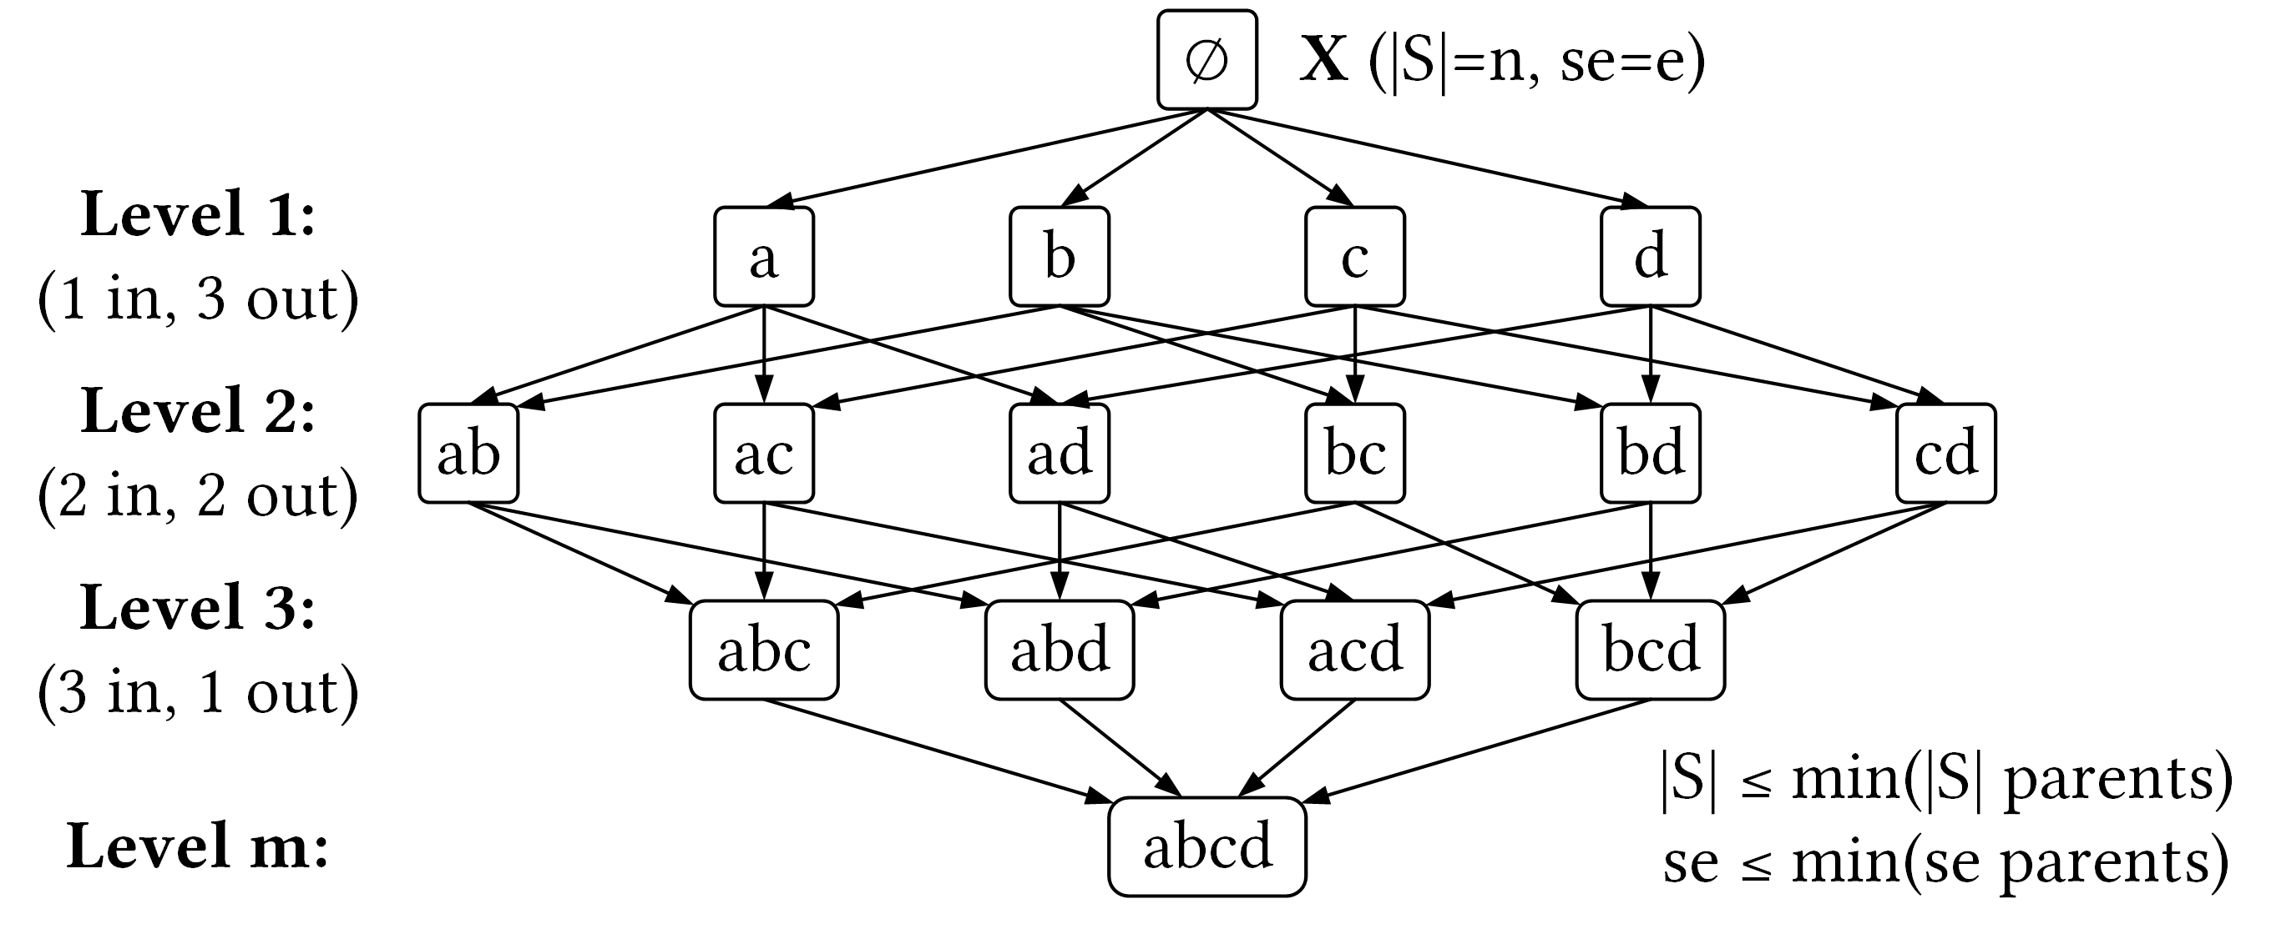
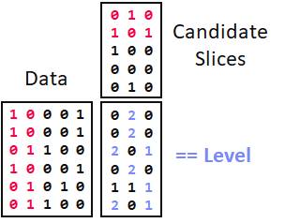

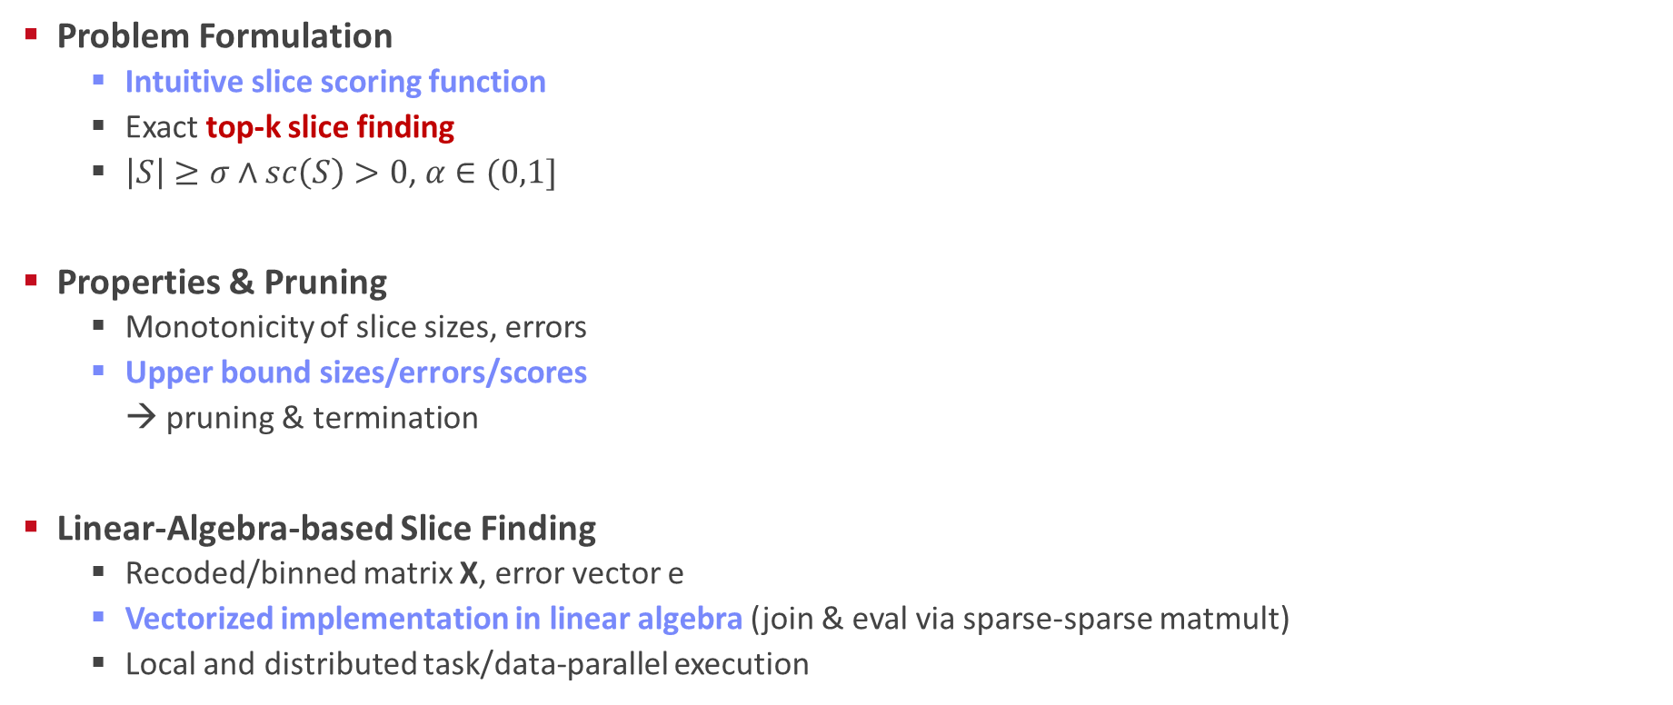
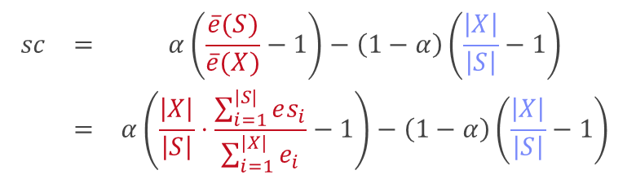
SliceLine for Model Debugging
[SIGMOD’21b]
[Credit: sliceline,
Silicon Valley, HBO]
Problem Formulation
  Intuitive slice scoring function
  Exact top-k slice finding
  $\left|S\right|≥σ∧sc\left(S\right)>0$, $α∈(0,1]$
Properties & Pruning
  Monotonicity of slice sizes, errors
  Upper bound sizes/errors/scores
  → pruning & termination
Linear-Algebra-based Slice Finding
  Recoded/binned matrix X, error vector e
  Vectorized implementation in linear algebra (join & eval via sparse-sparse matmult)
  Local and distributed task/data-parallel execution
$$\begin{matrix}sc & = & α\left(\frac{\overline{e}(S)}{\overline{e}(X)}−1\right)−\left(1−α\right)\left(\frac{\left|X\right|}{\left|S\right|}−1\right) \\ & = & α\left(\frac{\left|X\right|}{\left|S\right|}⋅\frac{\sum_{i=1}^{|S|}{es_{i}}}{\sum_{i=1}^{|X|}{e_{i}}}−1\right)−\left(1−α\right)\left(\frac{\left|X\right|}{\left|S\right|}−1\right)\end{matrix}$$
slice error
slice size
$$O(2^{l}−\sum_{j=1}^{m}{2^{d_{j}}}+ l+m)$$
Notes:
Compelling properties:
The components are balanced under α = 0.5.
The score of the original X is always sc = 0.
For α = 0 (all weight on size), the maximum feasible score is 0, and no slice smaller than X can reach it.
All components of Equation (1) are either constants, or slice errors and sizes, which makes this function amenable to pruning.

Slide 34

Multi-level Lineage Tracing & Reuse
[CIDR’20, SIGMOD’21a]
Lineage as Key Enabling Technique
  Trace lineage of ops (incl. non-determinism), dedup for loops/funcs
  Model versioning, data reuse, incr. maintenance, autodiff, debugging
Full Reuse of Intermediates
  Before executing instruction, probe output lineage in cache
  Map<Lineage, MatrixBlock>
  Cost-based/heuristic caching and eviction decisions
  (compiler-assisted)
Partial Reuse of Intermediates
  Problem: Often partial result overlap
  Reuse partial results via dedicated rewrites (compensation plans)
  Example: steplm
Next Steps: multi-backend, unified mem mgmt
for( i in 1:numModels )
R[,i] = lm(X, y, lambda[i,], ...)
m_lmDS = function(...) {
l = matrix(reg,ncol(X),1)
A = t(X) %*% X + diag(l)
b = t(X) %*% y
beta = solve(A, b) ...}
m_steplm = function(...) {
while( continue ) {
parfor( i in 1:n ) {
if( !fixed[1,i] ) {
Xi = cbind(Xg, X[,i])
B[,i] = lm(Xi, y, ...)
} }
# add best to Xg (AIC)
} }
X
m>>n
t(X)

Slide 35
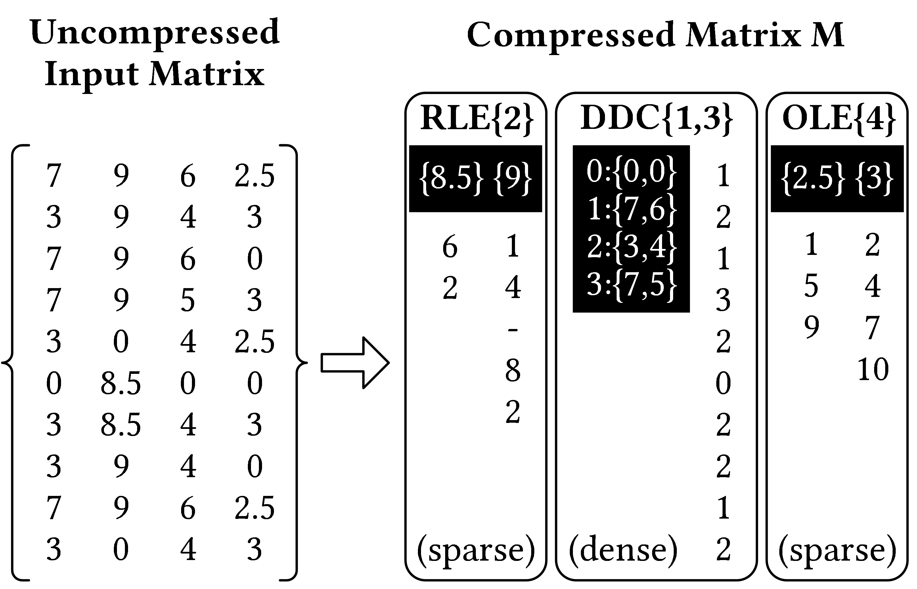
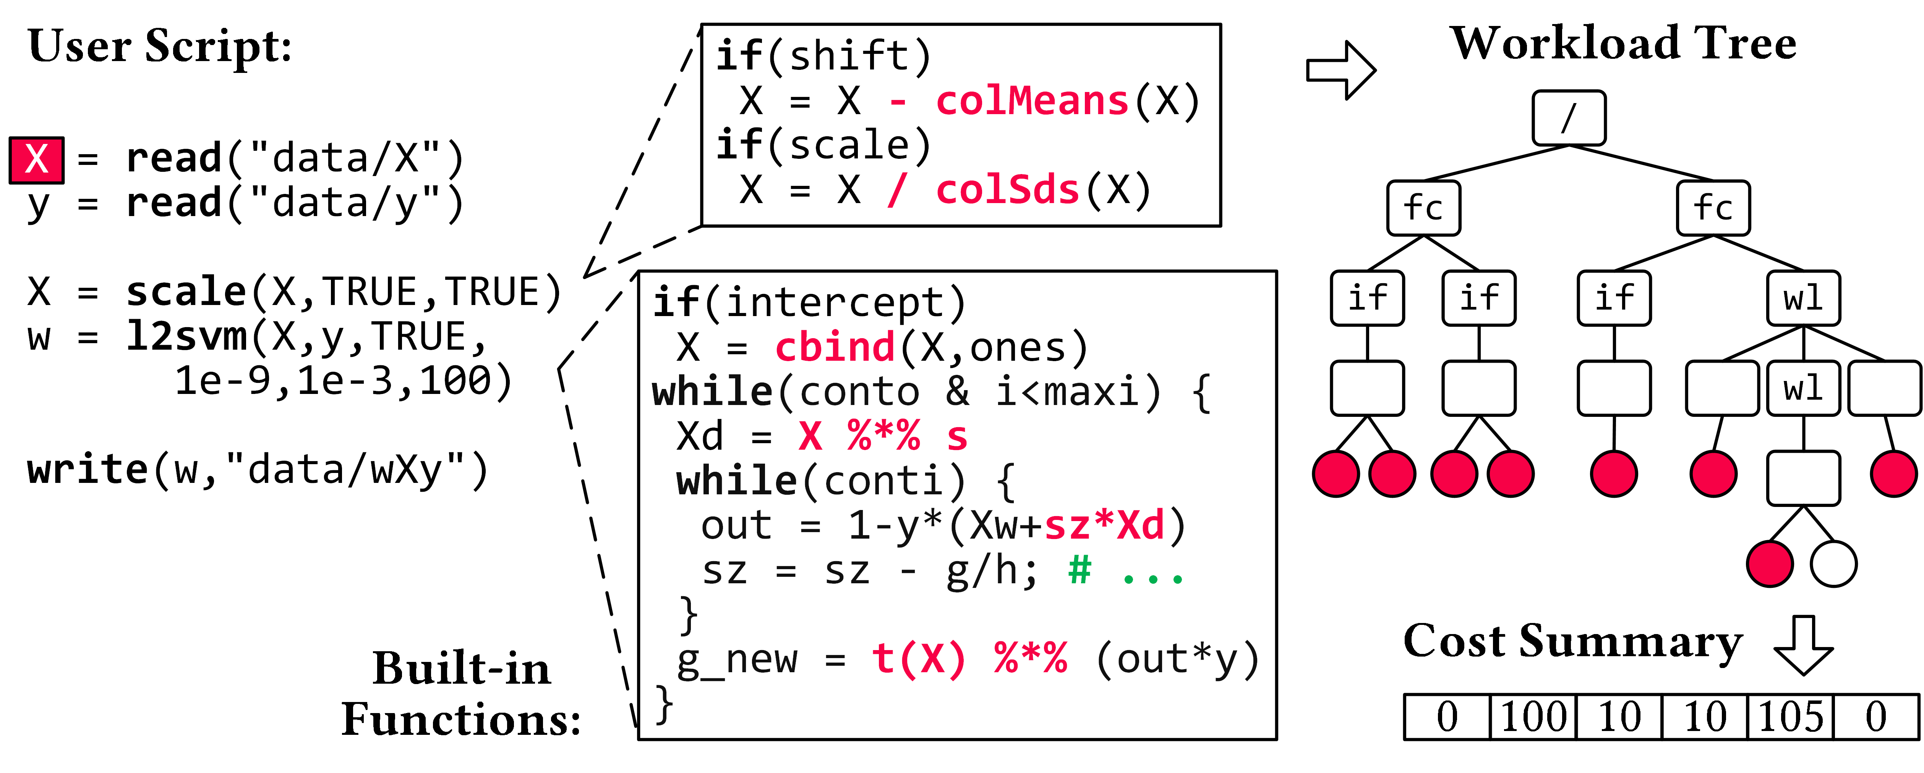
Compressed Linear Algebra Extended
[PVLDB’16a, VLDBJ’18, SIGMOD’23a]
Lossless Matrix Compression
  Improved general applicability (adaptive compression time,
  new compression schemes, new kernels, intermediates, workload-aware)
  Sparsity → Redundancy exploitation
  (data redundancy, structural redundancy)
Workload-aware Compression
  Workload summary
  → compression
  Compressed Representation
  → execution planning
Next Steps
  Frame compression, compressed I/O
  Compressed feature transformations
  Morphing of compressed data

Slide 36




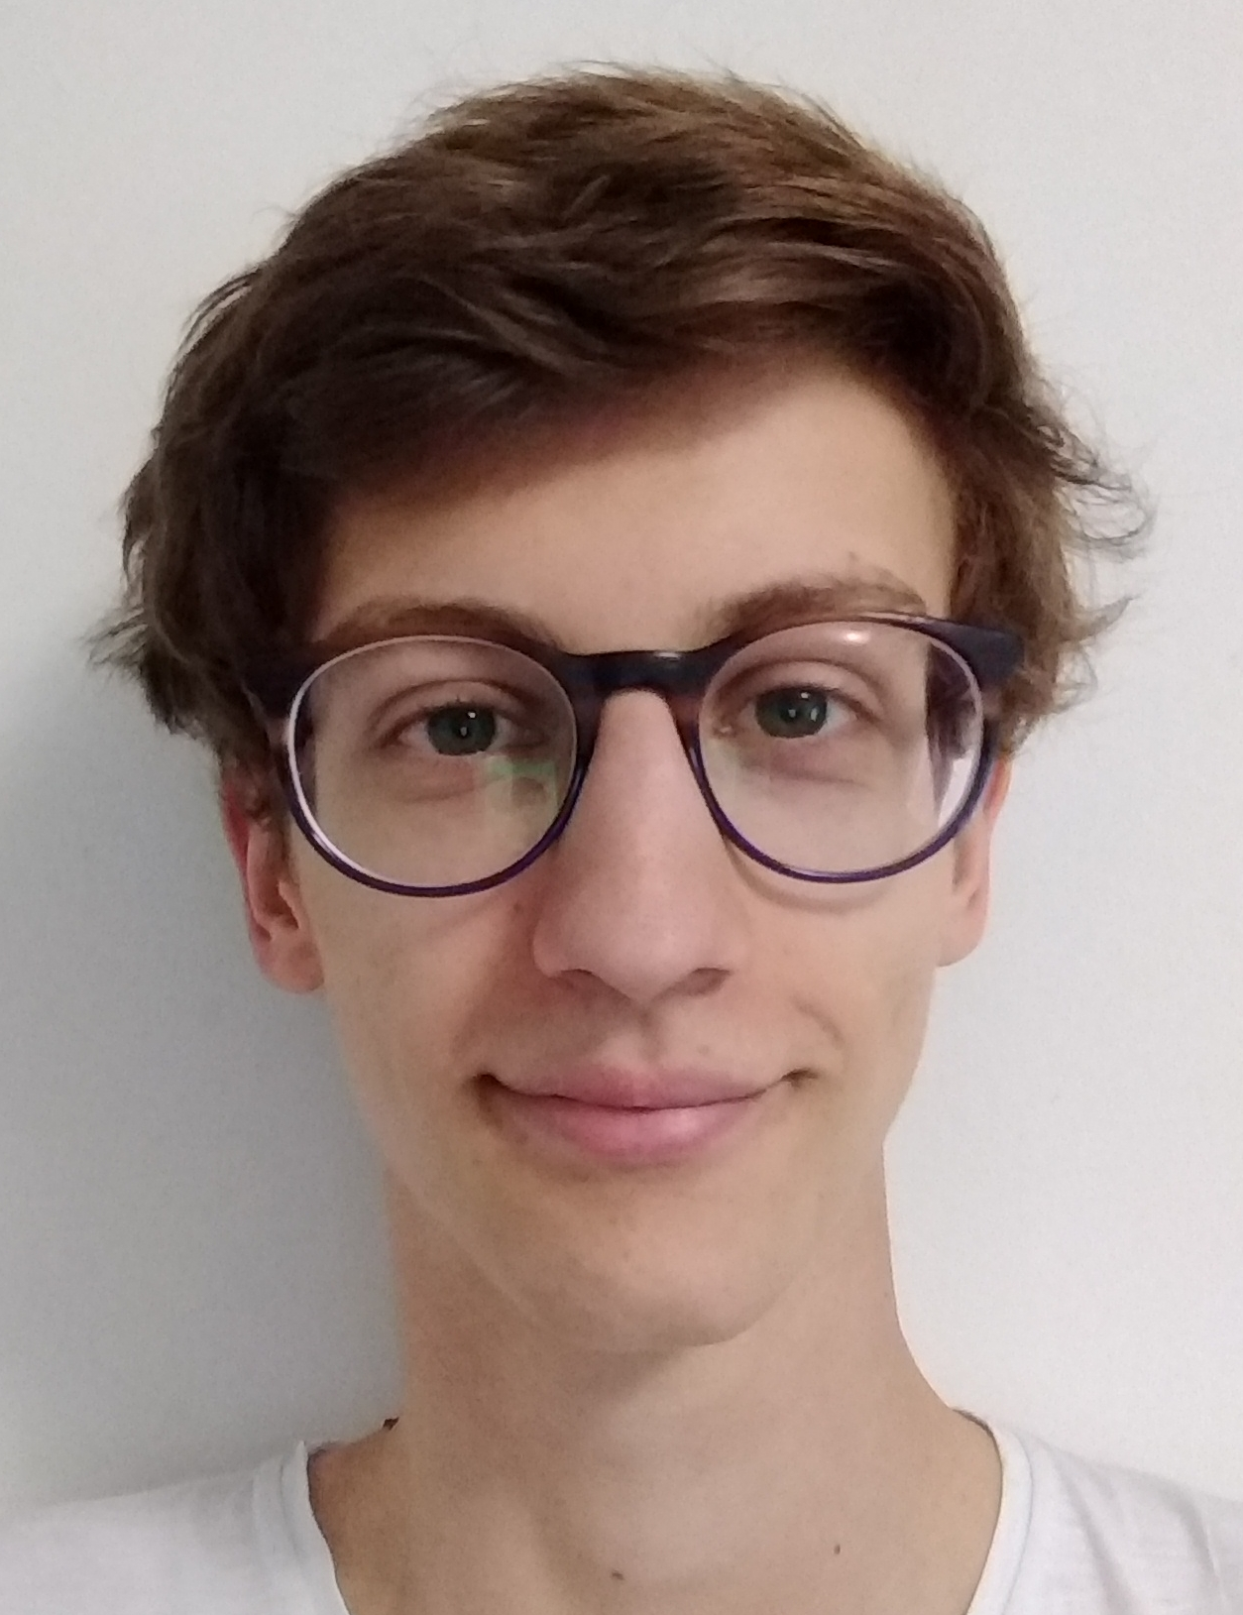
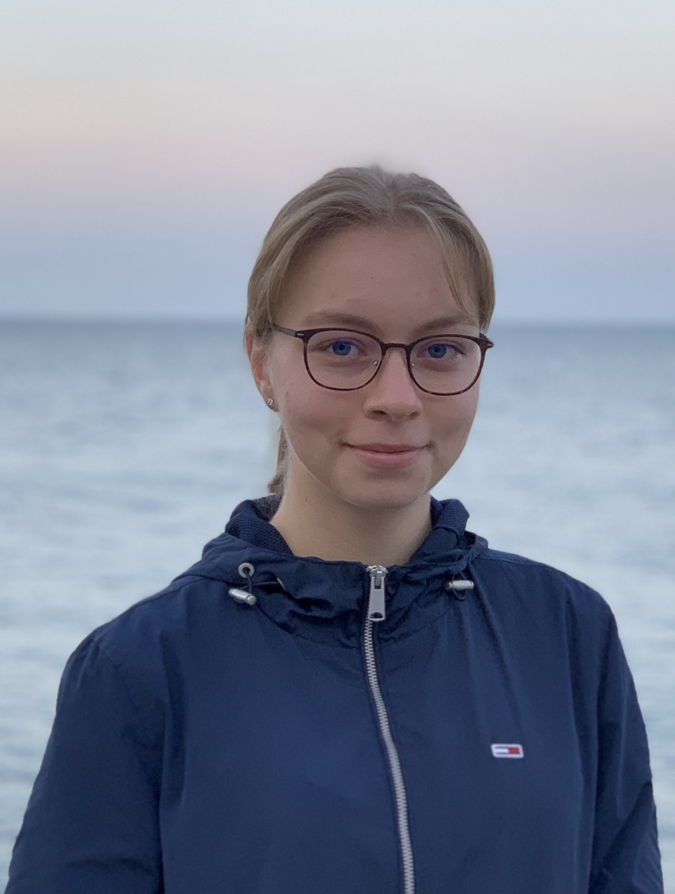
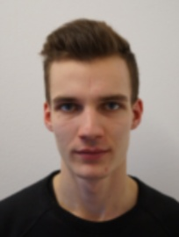

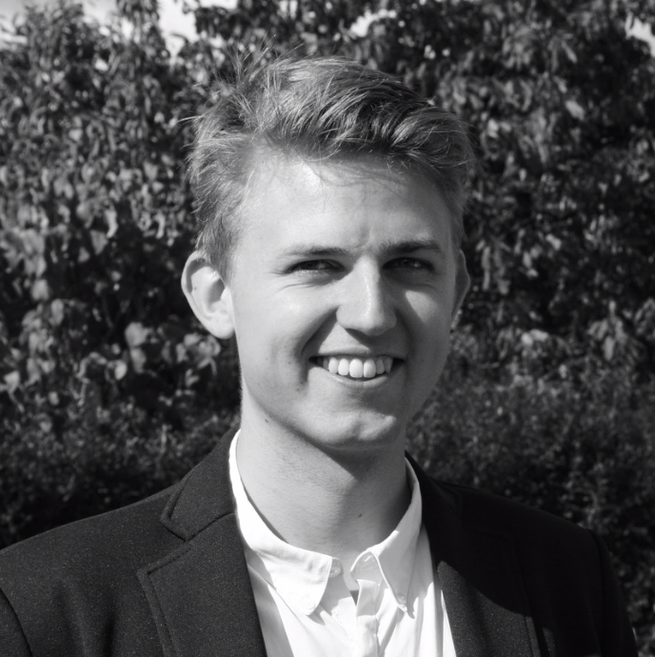
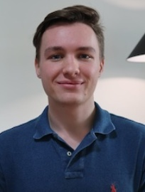
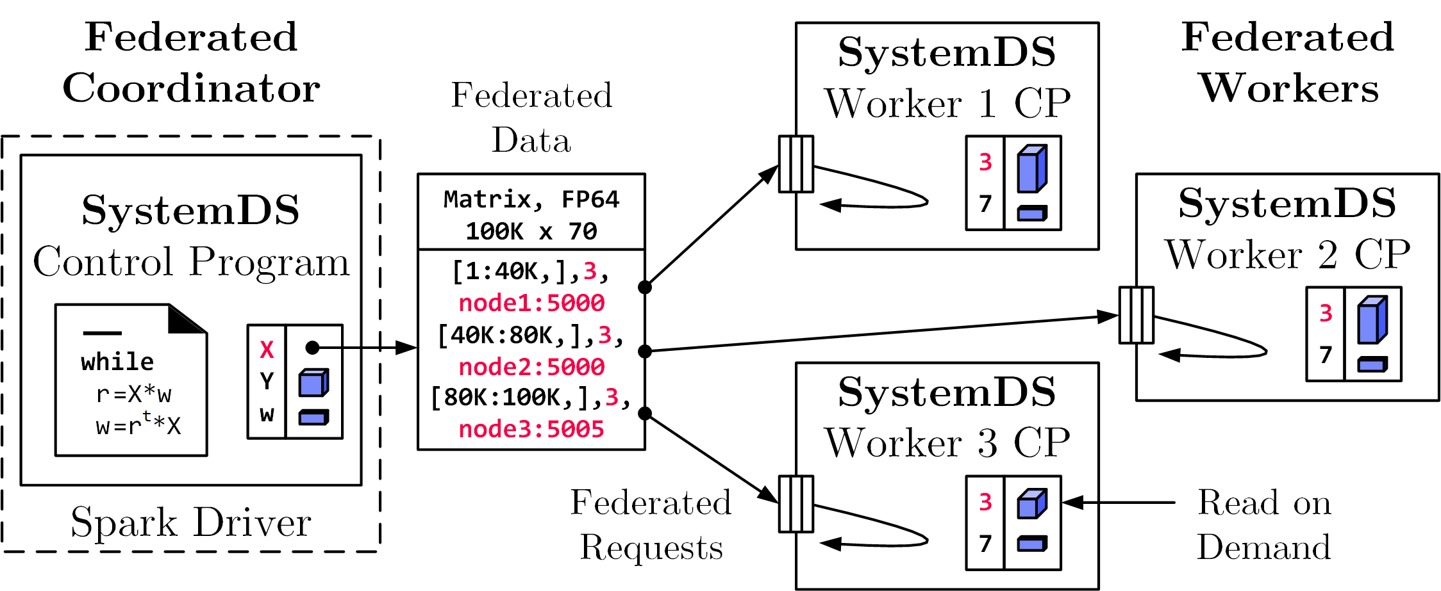
Federated Learning
[SIGMOD’21c]
Federated Backend
  Federated data (matrices/frames) as meta data objects
  Federated linear algebra, (and federated parameter server)
X = federated(addresses=list(node1, node2, node3),
ranges=list(list(0,0), list(40K,70), ..., list(80K,0), list(100K,70)));
Federated Requests:
READ, PUT, GET, EXEC_INST,
EXEC_UDF, CLEAR
➔ Design Simplicity:
(1) reuse instructions
(2) federation hierarchies

Slide 37













DAPHNE: An Open and Extensible System Infrastructure for Integrated Data Analysis Pipelines
https://github.com/daphne-eu/daphne

Slide 38
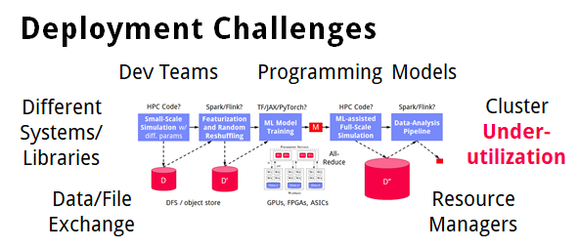
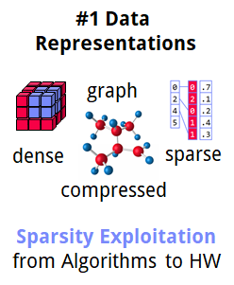
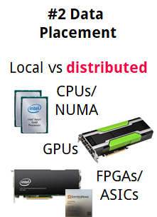
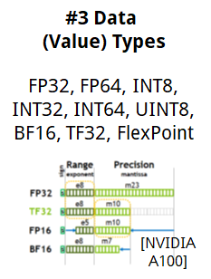
➔ DAPHNE Overall Objective:
Open and extensible system infrastructure
Motivation
Integrated Data Analysis Pipelines
  Open data formats, query processing
  Data preprocessing and cleaning
  ML model training and scoring
  HPC, custom codes, and simulations
Hardware Challenges
  DM+ML+HPC share compilation
  and runtime techniques /
  converging cluster hardware
  End of Dennard scaling:
  P = α CFV² (power density 1)
  End of Moore’s law
  Amdahl’s law: sp = 1/s
  ➔ Increasing Specialization

Slide 39




DAPHNE Use Cases
[Xiao Xiang Zhu et al: So2Sat LCZ42: A Benchmark Dataset for the Classification of Global Local Climate Zones. GRSM 8(3) 2020]
[So2Sat LC42: https://mediatum.ub.tum.de/1454690]
DLR Earth Observation
  ESA Sentinel-1/2 datasets → 4PB/year
  Training of local climate zone classifiers on So2Sat LCZ42
  (15 experts, 400K instances, 10 labels each, 85% confidence, ~55GB H5)
  ML pipeline: preprocessing, ResNet20,
  climate models
IFAT Semiconductor Ion Beam Tuning
KAI Semiconductor Material Degradation
AVL Vehicle Development Process (ejector geometries, KPIs)
ML-assisted simulations, data cleaning, augmentation

Slide 40

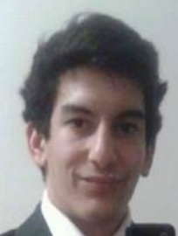
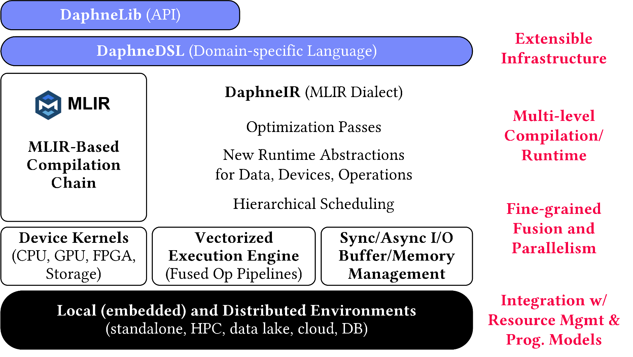
DAPHNE System Architecture
AH
[CIDR’22]
AK
Python API w/ lazy evaluation
MLIR Dialects, Extension Catalog (new data types, kernels,
scheduling algs)
Sideways Entry, DSL-level constraints
(e.g., data/op placement)
LLVM

Slide 41
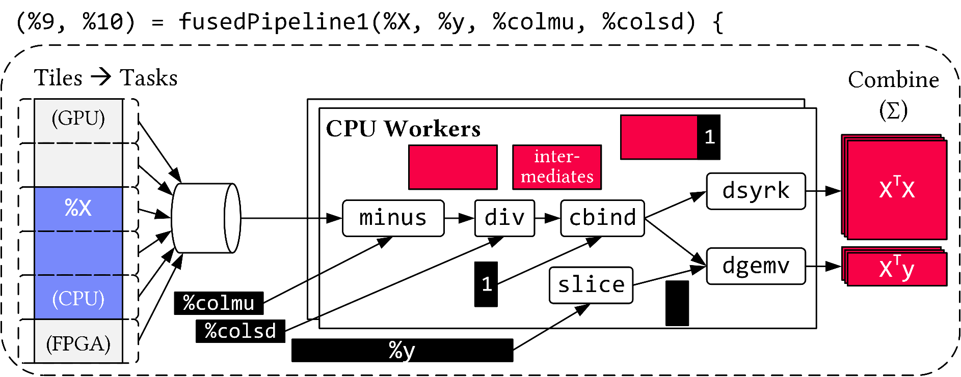
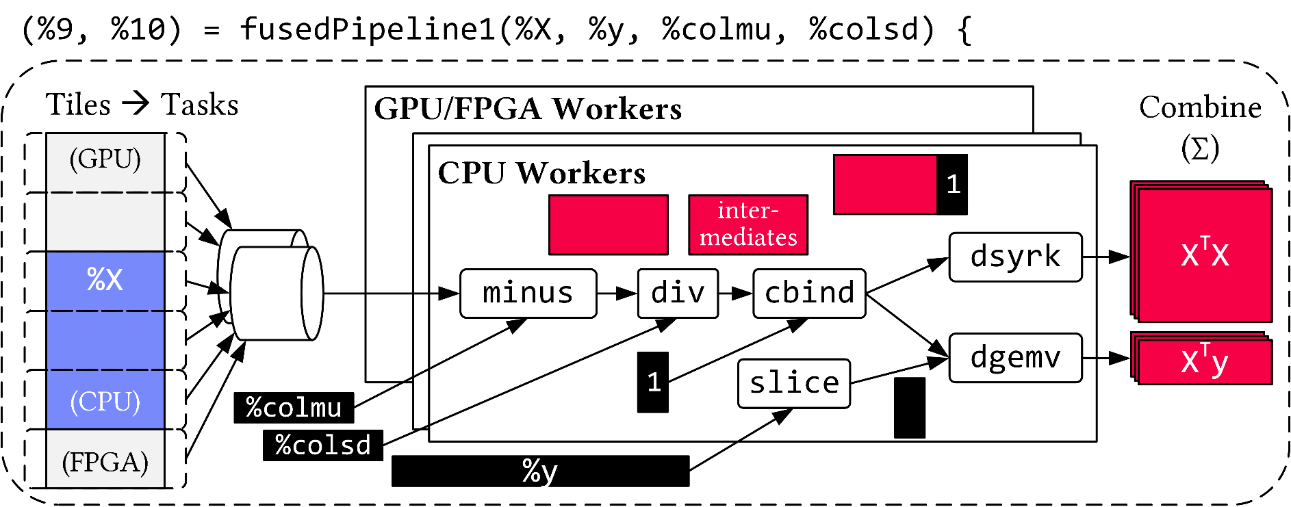
Vectorized (Tiled) Execution
Default Parallelization
Frame & Matrix Ops
Locality-aware,
Multi-device Scheduling
Fused Operator Pipelines
on Tiles/Scalars + Codegen

Slide 42
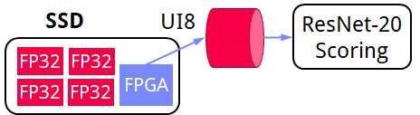
Vectorized (Tiled) Execution, cont.
#1 Zero-copy Input Slicing
  Create view on sliced input (no-op)
  All kernels work on views
#2 Sparse Intermediates
  Reuse dense/sparse kernels
  Sparse pipeline intermediates for free
#3 Fine-grained Control
  Task sizes (dequeue, data access) vs data binding (cache-conscious ops)
  Scheduling for load balance (e.g., sparse operations)
#4 Computational Storage
  Task queues connect eBPF programs,
  async I/O into buffers, and op pipelines

Slide 43
Thanks
Summary & QA
FG Big Data Engineering (DAMS Lab)
Motivation and Goals
Course Organization and Logistics
Course Outline, and Projects
Apache SystemDS and DAPHNE
Next Lectures (Part A)
  02 Languages, Architectures, and System Landscape [Apr 25] + projects
  03 Size Inference, Rewrites, and Operator Selection [May 02]
  04 Operator Fusion and Runtime Adaptation [May 16]
  05 Data- and Task-Parallel Execution [May 23]
  06 Parameter Servers [May 30]
Programming Projects in
SystemDS/DAPHNE, or Alternative Exercise
Project/Exercise Selection by Apr 29 EOD:
https://tinyurl.com/3vsnrant

