Slide 1

Architecture of DB Systems
03 Data Layouts and Bufferpools
Last update: Oct 20, 2021

Slide 2


Announcements/Org
#1 Video Recording
  Link in TUbe & TeachCenter (lectures will be public)
  Optional attendance (independent of COVID)
  Hybrid, in-person but video-recorded lectures
    HS i5 + Webex: https://tugraz.webex.com/meet/m.boehm
#2 COVID-19 Precautions (HS i5)
  Room capacity: 24/48 (green/yellow), 12/48 (orange/red)
  TC lecture registrations (limited capacity, contact tracing)
#3 Programming Projects
  Initial test suite, benchmark, and make file on website
  Reference implementations Naïve (Baseline 0)
  https://mboehm7.github.io/teaching/ws2122_adbs/Project_Setup_v1.zip
max
24/90

Slide 3
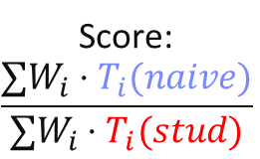
Announcements/Org, cont.
test case 7.47: PASS
test case 7.48: PASS
SUMMARY
=======
passed 684/684 test cases
all tests passed
Unit Tests
  make unit_test
  ./unit_test
Speed Tests
  make speed_test
  ./speed_test
Preliminary Perf
Target: #pcores/2
#1 SUM: 1 grp (INT32), 1K dist. values, 1 agg (INT32), 30000000
-- Time to complete run 1: 1290 milliseconds.
-- Time to complete run 2: 1327 milliseconds.
-- Time to complete run 3: 1330 milliseconds.
-- Average time to complete (3 runs): 1315 milliseconds.
#2 SUM: 1 grp (INT32), 10K dist. values, 1 agg (INT32), 30000000
-- Average time to complete (3 runs): 1733 milliseconds.
#3 SUM: 1 grp (INT32), 100K dist. values, 1 agg (INT32), 30000000
-- Average time to complete (3 runs): 3677 milliseconds.
#4 SUM: 1 grp (INT32), 1M dist. values, 1 agg (INT32), and 30000000
-- Average time to complete (3 runs): 16904 milliseconds.
#5 SUM: 2 grp (INT32), 1M dist. values (each), 1 agg (INT32), 30000000
-- Average time to complete (3 runs): 18766 milliseconds.
#6 SUM: 1 grp (INT64), 1M dist. values (each), 1 agg (INT32), 30000000
-- Average time to complete (3 runs): 17763 milliseconds.
#7 SUM: 2 grp (INT64), 1M dist. values (each), 1 agg (INT32), 30000000
-- Average time to complete (3 runs): 21437 milliseconds.
#8 SUM: 1 grp (INT16), 1M dist. values (each), 1 agg (INT32), 30000000
-- Average time to complete (3 runs): 4526 milliseconds.
#9 SUM: 2 grp (INT16), 1M dist. values (each), 1 agg (INT32), 30000000
-- Average time to complete (3 runs): 6208 milliseconds.
#10 SUM: 1 grp (INT32, sorted), 1M dist. values, 1 agg (INT32), 30000000
-- Average time to complete (3 runs): 2932 milliseconds.
Score:
$$\frac{∑W_{i}⋅T_{i}(naive)}{∑W_{i}⋅T_{i}(stud)}$$

Slide 4
Caching – An Old and Fundamental CS Concept
Motivation
[Arthur W. Burks, Herman H. Goldstine, John von Neumann: Preliminary Discussion of the Logical Design of an Electronic Computing Instrument, Part I, Vol. I, Report prepared for U.S. Army Ord. Dept., 28 June 1946]
[Credit: Nimrod Megiddo and Dharmendra S. Modha (ARC paper)]

Slide 5

DBMS Architecture, cont.
Motivation
[Theo Härder, Erhard Rahm: Datenbanksysteme: Konzepte und Techniken der Implementierung, 2001]
Q_{i}
Set-Oriented Interface
SELECT * FROM R
Data
System
Data System (Nonprocedural access)
Record-Oriented Interface
FIND NEXT record
(Data) Access System
(Navigational access)
Internal Record Interface
B-Tree
getNext
Access
System
(Record) Storage System
(Access path mgmt)
ACCESS
page j
System buffer Interface
Storage
System
Buffer Management
(Propagation control)
File Interface
READ
block k
Operating System
(File Mgmt)
Device Interface

Slide 6
Agenda
Page Layouts and Record Management
Buffer Pool Management
Page Replacement Strategies
In-Memory DBMS Eviction

Slide 7
Page Layout and
Record Management

Slide 8
Segments, Pages, and Blocks
Page Layout and Record Management
Segment
  Storage unit of DB objects like
  relations (heap), and indexes
  Allocate/iterate pages, drop all
  Often separate file
Page
  Smallest unit in DB buffer pool
  Page: fixed-sized memory region
  Frame: meta data on data page
Block (and/or disk sector)
  Smallest addressable unit on disk
  (e.g., POSIX block devices)
Segment / Tablespace
Page 1
Page 2
Page 3
Blk 1
Blk 2
Blk 3
Blk 4
Blk 5
Blk 6

Slide 9
Recap: Page Layout of Row Stores
Page Layout and Record Management
115
136
Background: Storage System
  Buffer and storage management
  (incl. I/O) at granularity of pages
  PostgreSQL default: 8KB
  Different table/page layouts
Row Storage
  NSM (nary storage model)
  Store tuple attributes in
  contiguous form
  Fast get/insert/delete
  Slow column aggregates
Other: DSM, PAX
81
136
Header
115
175
Header
tuple
tuple
tuple offsets
Header
1234
Jane
Smith
1237
John
Smith
1242
John
Doe

Slide 10
Motivation Fixed-size Pages
Page Layout and Record Management
#1 Alignment with Disk Blocks
  Typically 512B to 4KB (AF) blocks as minimum storage unit
  A single DB page should map to 1..N physical disk blocks/sectors
#2 Sequential Reads/Writes
  Recap: HDD seek times vs sequential read/write
  Similar: SSD sequential read/write w/ higher bandwidth
#3 Simplified Buffer Manager
  Fixed-size pages removes need for reasoning about sizes for eviction
  Fixed-size pages avoid main memory fragmentation
Recent Perspective: Variable-Size Pages
  Large objects (strings, dictionaries) across
  pages complicates/slows down DBMS components
[Thomas Neumann, Michael J. Freitag: Umbra: A Disk-Based System with In-Memory Performance. CIDR 2020]

Slide 11
Classification of Record Addressing Schemes
Page Layout and Record Management
Addressing Schemes
Direct Addressing
Indirect Addressing
Logical Offset
in Segment
Tuple Identifier
Mapping Table
[Dirk Habich: Advanced Query Processing in Database Systems –
Record Management, TU Dresden, WS 2019]

Slide 12
TID (Tuple Identifier) Concept
Page Layout and Record Management
Problem: Internal TID should be stable, even if records reorganized
TID Concept (p, s)
  TID := (page number, slot index)
  Page slot directory holds tuple
  offsets (byte position) within page
  Variable number of slots
  Single page access for internal row
Reorganization
  Compact free space between records
  via page-local record movements
  ➔ Updates of page-local directory sufficient
  Inserts: use free slot or add new slot
(7, 3)
1234
Jane
Smith
1237
John
Smith
1242
John
Doe
1242
John
Doe
1234
Jane
Smith
1237
John
Smith
1301
Md
Li

Slide 13
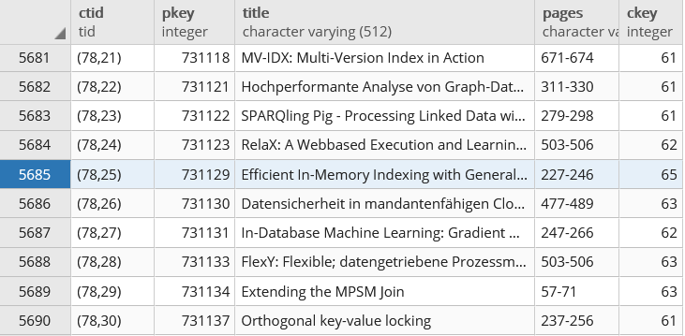
TID (Tuple Identifier) Concept, cont.
Page Layout and Record Management
Example PostgreSQL
  Recap: Papers(PKey, Title, Pages, CKey, JKey)
  Hidden CTID system column (not shown on *, but usable)
Other Hidden
System Columns
  oid, tableoid
  xmin, cmin (insert), xmax, cmax (delete)
SELECT CTID, PKey,
Title, Pages
FROM Papers

Slide 14
TID (Tuple Identifier) Concept, cont.
Page Layout and Record Management
Overflow Handling
  On updates, tuple might need additional
  space (more than available on page)
  Example: Rename “Smith” to “Smith-EvenLonger”
  Reference new page, to preserve original TID
  (chains longer than 1 can be internally avoided)
Page 7
1242
John
Doe
1234
Jane
Smith
1237
John
Smith
1301
Md
Li
(7,2)
Page 7
(5,4)
Page 5
(5,4)
1237
John
Smith-EvenLonger

Slide 15
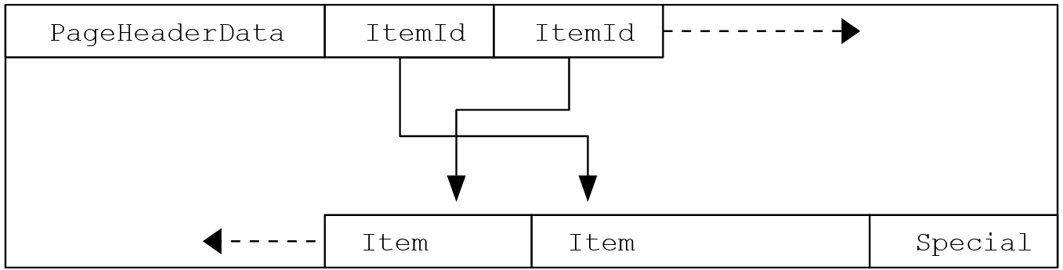
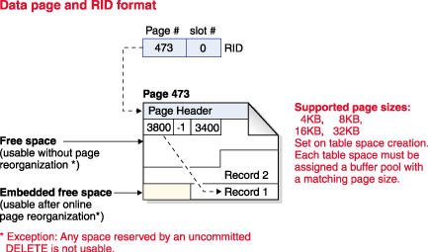
Example Page Layouts
Page Layout and Record Management
(LSN, checksum, flags, region offsets, sizes)
PostgreSQL 13.5
  Uses TID concept
IBM DB2 11.5
  Uses TID (aka RID) concept
[https://www.postgresql
.org/docs/13/
storage-page-layout.html]
(access-method data)
[https://www.ibm.com/support/
knowledgecenter/SSEPGG_11.5.0/
com.ibm.db2.luw.admin.perf.doc/
doc/c0005424.html]
Notes:
Postgres special area: e.g., index pages w/ left and right siblings

Slide 16
Common Record Layouts
Page Layout and Record Management
#1 Fixed-Size Fields
  Concatenated fields, directly accessible
#2 Offsets
  Prefix with relative offsets of all fields
#3 Embedded Length Fields
  Length fields only for variable-size fields
  Cannot access a specific field w/o record scan
#4 Partitioned
  Partition 1: Fixed-sized fields
  Partition 2: Offsets and variable-sized fields
Other: Sometimes bitmap field (#cols/8 bytes) for NULL indicator, etc
F1
F2
F3
F4
F1
V2
F3
V4
F1
V2
F3
V4
F1
F3
V2
V4

Slide 17
Buffer Pool Management

Slide 18
Buffer Pool Overview
Buffer Pool Management
Buffer Pool
  Holds fraction of DB pages in memory
  Find pages via addressing scheme
  Allocate memory (local, global)
  Page replacement (exact, approximate)
Example Configuration (PostgreSQL)
  block_size: size of disk block, i.e., page (default 8KB)
  shared_buffers: size of cross-session buffer pool (default 128MB)
  → Recommended tuning: 25% of available memory
  temp_buffers: size of session-local memory for tmp tables (default 8MB)
  work_mem: size of operation-local memory for sort/hash tables (default 4MB)
DBMS
DB Buffer
Log Buffer
P7
P3’
P1
P7
P3
Data
Log
[https://www.postgresql.org/docs/13/runtime-config.html]

Slide 19
DB Buffer Pool vs Operating System
Buffer Pool Management
#1 Why not Memory-Mapped Files (mmap)
  ACID Atomicity and Durability (flush TX log before dirty pages)
  ACID Isolation (locking of pages)
  Context knowledge of query processing / access paths; portability
#2 Why no Swapping
  No durability of changes after restart
  With DB buffer pool danger of double page faults
  (requested page not in DB buffer - load, victim page swapped – load, replace)
#3 Why no OS File Cache
  #1 Bypass via direct I/O (O_DIRECT) to avoid redundant caching
  #2 Leverage via small buffer pool and otherwise OS file cache (see Postgres)

Slide 20
Buffer Pool Interface
Buffer Pool Management
[Thomas Neumann: Datenbanksysteme und moderne CPU-Architekturen - Storage, TU Munich, 2019]
Pin/Fix
  fix(pageID, exclusive)
  Pins page for read/write access, guards against replacement
  If page not in buffer, read and replace victim page in buffer pool
Unpin/Unfix
  unfix(pageID, dirty)
  Unpins page to release guard against replacement
  Dirty flag indicates if page has been modified → async write to disk
Others Aspects
  Additional operations: Get via fix(pageNo,false), Mark dirty, Flush
  Lookup via hash map (pageID, buffer frame), load/replace via put/remove

Slide 21
Buffer Frame Allocation
Buffer Pool Management
Global and Local Memory Allocation
  Global: shared buffer pool used by all transactions, sessions, and users
  Local: transaction/session-local buffers for temporary tables and operations
PostgreSQL Buffer Frame (Buffer Descriptor)
  Access to data page via buf_id (hash table lookup)
[https://github.com/postgres/
postgres/blob/master/src/
include/storage/buf_internals.h]
// Extracted as of Oct 18, 2020
typedef struct BufferDesc {
BufferTag tag; /* ID of page contained in buffer */
int buf_id; /* buffer's index number (from 0) */
pg_atomic_uint32 state; /* tag state, flags, ref/usage counts */
int wait_backend_pid; /* backend PID of pin-count waiter */
int freeNext; /* link in freelist chain */
LWLock content_lock; /* to lock access to buffer contents */
} BufferDesc;

Slide 22
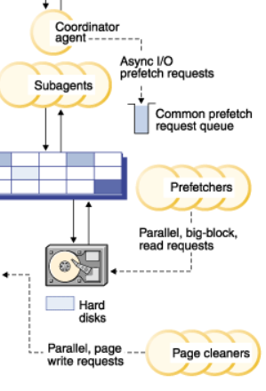
Pre-Fetching, Cleaning, and Scan Sharing
Buffer Pool Management
Pre-Fetching (Async)
  Overlay computation w/ speculative sequential
  read of multiple pages
  Based on physical data structures, and query plan
Cleaning (Async)
  Asynchronous sequential write of changed (dirty)
  pages → moved out of critical path of TX processing
Scan Sharing
  Multiple queries can piggyback on
  existing table scan, w/ compensations
  Red Brick: coordinated table scan
  Crescando: continuous scan
[Phillip M. Fernandez: Red Brick Warehouse: A Read-Mostly RDBMS for Open SMP Platforms. SIGMOD 1994]
[Philipp Unterbrunner, Georgios Giannikis, Gustavo Alonso, Dietmar Fauser, Donald Kossmann: Predictable Performance for Unpredictable Workloads. PVLDB 2(1) 2009]

Slide 23
Excursus: Automatic Buffer Pool Tuning
Buffer Pool Management
IBM DB
  Self-tuning memory manager
  Caches, ops, buffer pool
Oracle
  Automatic tuning of SGA/PGA
  (System/Process Global Memory)
Microsoft
  Multi-tenant page
  replacement (MR-LRU)
OtterTune
  ML-based tuning of
  DB configurations
[Adam J. Storm, Christian Garcia-Arellano, Sam Lightstone, Yixin Diao, Maheswaran Surendra: Adaptive Self-tuning Memory in DB2. VLDB 2006]
[Benoît Dageville, Mohamed Zaït: SQL Memory Management in Oracle9i. VLDB 2002]
[Vivek R. Narasayya, Ishai Menache, Mohit Singh, Feng Li, Manoj Syamala, Surajit Chaudhuri: Sharing Buffer Pool Memory in Multi-Tenant Relational Database-as-a-Service. PVLDB 8(7), 2015]
[Dana Van Aken, Andrew Pavlo, Geoffrey J. Gordon, Bohan Zhang: Automatic Database Management System Tuning Through Large-scale Machine Learning. SIGMOD 2017]

Slide 24
Page Replacement Strategies

Slide 25
Classification of Replacement Strategies
Page Replacement Strategies
Replacement Strategy
Exact Methods
Approximate
Methods
Age
Usage
FIFO
ARC
LFU
LRU
CLOCK
CAR/
CART
others:
FBR, LRFU
# refs
latest refs
[Dirk Habich: Advanced Query Processing in Database Systems –
Storage Management and System Buffer, TU Dresden, WS 2019]
Notes:
FBR (frequency based replacement)
LRFU (Least recently used, least frequently used)
CAR (Adaptive replacement)
CART (Adaptive replacement with temporal filtering)

Slide 26
FIFO (First-in, first-out)
Page Replacement Strategies
add
new pages
evict
old pages
Strategy
  Evict oldest page (time in buffer) from pool
  Implementation as basic ring buffer of size c (capacity)
  Ignores frequent and recent page references
Empty
Add
Evict & Add
1
7
2
6
8
5
9
4
evict 4, add 10,
move clockwise
10

Slide 27
CLOCK (Second Chance)
Page Replacement Strategies
Strategy
  Each page has a reference bit R, indicating if it was referenced in the last cycle
  Evict oldest page (time in buffer) with R=0 from pool
  FIFO extension with coarse-grained accounting of page references
  Variant: GCLOCK (Generalized CLOCK) w/ ref counter (PostgreSQL clock sweep)
Before Eviction
After Eviction
9
0
10
9
0
8
1
4
1
8
1
4
0
reference bits reset
7
0
5
1
7
0
5
0
6
0
10
0
10 added to first valid slot

Slide 28
LRU (Least Recently Used)
Page Replacement Strategies
Strategy
  Evict least recently used page (last page reference)
  Implementation as basic list/queue (head: new pages, tail: LRU page)
  Equivalent to FIFO for sequential scans (might evict hot data pages)
head
tail
capacity
c
42
5
17
3
7
add page 8
8
42
5
17
3
7
reference page 17
17
8
42
5
3
7
add page 33
→ evict page 7
33
17
8
42
5
3

Slide 29
LRU-K (Least Recently Used K)
Page Replacement Strategies
Strategy
  Evict page with max backward K-distance (k^{th}-last reference, ∞ if <k refs)
  LRU-1 equivalent to LRU, in practice: often LRU-2
  Variants: timestamp as of page reference, or of page UNFIX operation
head
tail
capacity
c
8
42
5
17
3
7
K last references
(23,
17)
(24,
15)
(14,
12)
(15,
9)
(10,
7)
(5)
K=2 Distance
at T=25
8
10
13
16
18
∞

Slide 30
LFU (Least Frequently Used)
Page Replacement Strategies
Strategy
  Evict page with min reference count since brought in buffer pool
  Draws resolved with secondary strategy (e.g., FIFO)
  Implement as list with swaps of neighbors on access
head
7
6
4
3
2
2
tail
capacity
c
8
42
5
17
3
7
1
add page 33
→ evict page 7
8
42
5
17
3
33
Difficult to remove pages that have been frequently accessed
in the past

Slide 31
ARC (Adaptive Replacement Cache)
Page Replacement Strategies
[Nimrod Megiddo, Dharmendra S. Modha: ARC: A Self-Tuning, Low Overhead Replacement Cache. FAST 2003]
Strategy
  Maintain two LRU lists of pages: L1 and L2
  Keep cache directory of length c (cache size) for both lists
  Keep c pages in cache, p in L1 and (c-p) L2
  Replacement: evict LRU L1 if |L1|>p, evict LRU L2 if |L1|<p
  Adaptively tune p based on hits and size of L1/L2 lists w/o pages
Note: Linux page cache w/ ‘active’ and ‘inactive’ LRU page lists + migration
LRU L1 (1 ref)
Recency
ARC
p
LRU L2 (≥2 refs)
Frequency
c-p
Notes:
BIG SQL

Slide 32
In-Memory DBMS Eviction

Slide 33
Motivation In-Memory DBMS
In-Memory DBMS Eviction
Common Misconception: So an in-memory database system is just a regular database system with unlimited buffer pool capacity?
Disk-based DBMS Overhead
  OLTP workloads bottlenecked on
  buffer pool, latching, locking, logging
  Evaluated on Shore-MT research prototype
In-Memory DBMS
  Eliminates one of the main bottlenecks (disk I/O, and buffer pool)
  Requires improvements for modern hardware, locking/latching, etc
  However, storage cost-perf trade-off (DRAM vs SSD/HDD)
  ➔ How to enable graceful evictions, without reintroducing overhead?
[Stavros Harizopoulos, Daniel J. Abadi, Samuel Madden, Michael Stonebraker: OLTP through the looking glass, and what we found there. SIGMOD 2008]
34.6%
6.8%

Slide 34
Anti Caching (Andy Pavlo et al.)
In-Memory DBMS Eviction
Fine-grained Eviction
  Online identification of cold tuples
  Threshold of ~80% triggers anti-caching
  Abort TX on “page fault”, retrieve,
  and restart TX (no blocking of other TXs)
  Pre-pass to identify all page faults of TX
Anti-Cache
  Construct fixed-size blocks via LRU chain
  Evicted Table: in-mem map of evicted tuples
  (granularity of individual data accesses)
  Block Table: on-disk map of evicted blocks
Excursus: SystemDS Buffer Pool
  Similarly, eviction of live variables under memory pressure
  DIA projects: #44 Lineage‐Exploitation in Buffer Pool
[Justin DeBrabant, Andrew Pavlo, Stephen Tu, Michael Stonebraker, Stanley B. Zdonik: Anti-Caching: A New Approach to Database Management System Architecture. PVLDB 6(14) 2013]

Slide 35
LeanStore (Viktor Leis et al.)
In-Memory DBMS Eviction
Coarse-Grained Eviction
  Motivation: avoid buffer pool overhead
  Pointer swizzling (direct page references)
  Avoid LRU overhead per page access by
  tracking infrequently accessed pages
  Speculative unswizzling w/o eviction
  (randomly page from pool)
  CLOCK eviction unswizzled pages
Experimental Results
  TPC-C 10 WH (initially 10GB)
[Viktor Leis, Michael Haubenschild, Alfons Kemper, Thomas Neumann: LeanStore:
In-Memory Data Management beyond Main Memory. ICDE 2018]
10% of pages
High Impact w/ multi-threading

Slide 36
Summary and Q&A
Page Layouts and Record Management
Buffer Pool Management
Page Replacement Strategies
In-Memory DBMS Eviction
Programming Projects
  Initial test suite, benchmark, make file, and reference implementation
  Try compiling/running it, and start your own implementation in next weeks
Next Lectures (Part A)
  04 Index Structures and Partitioning [Oct 27]
  05 Compression Techniques [Nov 03]

