Slide 1

Architecture of DB Systems
05 Compression Techniques
Last update: Nov 02, 2021

Slide 2


Announcements/Org
#1 Video Recording
  Link in TUbe & TeachCenter (lectures will be public)
  Optional attendance (independent of COVID)
  Hybrid, in-person but video-recorded lectures
    HS i5 + Webex: https://tugraz.webex.com/meet/m.boehm
#2 COVID-19 Precautions (HS i5)
  Room capacity: 24/48 (green/yellow), 12/48 (orange/red)
  TC lecture registrations (limited capacity, contact tracing)
#3 Exams
  Planned as oral exams (beginning of February)
  # submitted projects → change to written exam if necessary
max
24/90

Slide 3
Agenda
Motivation and Terminology
Compression Techniques
Compressed Query Processing

Slide 4
Motivation and Terminology

Slide 5
Recap: Access Methods and Physical Design
Motivation and Terminology
Performance Tuning via Physical Design
  Select physical data structures for relational schema and query workload
  #1: User-level, manual physical design by DBA (database administrator)
  #2: User/system-level automatic physical design via advisor tools
Example
Base
Tables
SELECT * FROM R, S, T
WHERE R.c = S.d AND S.e = T.f
AND R.b BETWEEN 12 AND 73
R
S
T
⋈
Mat
Views
MV₁
MV₂
⋈_{e=f}
⋈_{c=d}
Parti-
tioning
T
10
σ_{12≤R.b≤73}
S
Physical
Access Paths
1000000
B⁺-Tree
BitMap
Hash
R
Compression
Notes:
Mat views and partitioning → logical access paths
Index structures and compression → physical access paths

Slide 6
Motivation Storage Hierarchy
Motivation and Terminology
#1 Capacity
  Limited capacity of fast storage
  Keep larger datasets higher in storage hierarchy
  Avoid unnecessary I/O
#2 Bandwidth
  Memory Wall: increasing gap
  CPU vs Memory latency/bandwidth
  Reduce bandwidth requirements
Caches
Memory
SSD
HDD
[Stefan Manegold, Peter A. Boncz, Martin L. Kersten: Optimizing database architecture for the new bottleneck: memory access. VLDB J. 9(3) 2000]

Slide 7
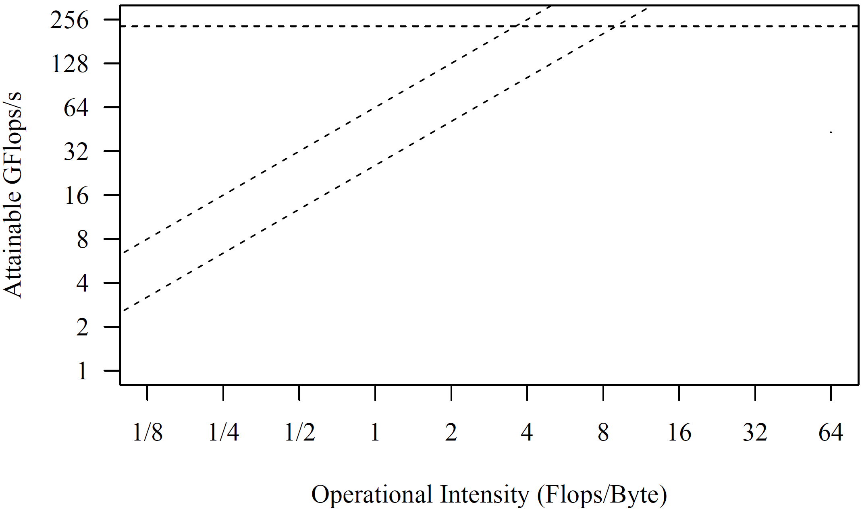
Excursus: Roofline Analysis
Motivation and Terminology
Setup: 2x6 E5-2440 @2.4GHz–2.9GHz, DDR3 RAM @1.3GHz (ECC)
  Max mem bandwidth (local): 2 sock x 3 chan x 8B x 1.3G trans/s → 2 x 32GB/s
  Max mem bandwidth (QPI, full duplex) → 2 x 12.8GB/s
  Max floating point ops: 12 cores x 2*4dFP-units x 2.4GHz → 2 x 115.2GFlops/s
Roofline
Analysis
  Off-chip
  memory
  traffic
  Peak
  compute
SystemML BLAS
36x
compression
SystemML
MM (n=768)
SystemML
Mt(Mv)
SystemML
Mv
bandwidth bound
compute-bound
[S. Williams, A. Waterman, D. A. Patterson: Roofline: An Insightful Visual Performance Model for Multicore Architectures. Commun. ACM 2009]
(Experiments from 2017)

Slide 8
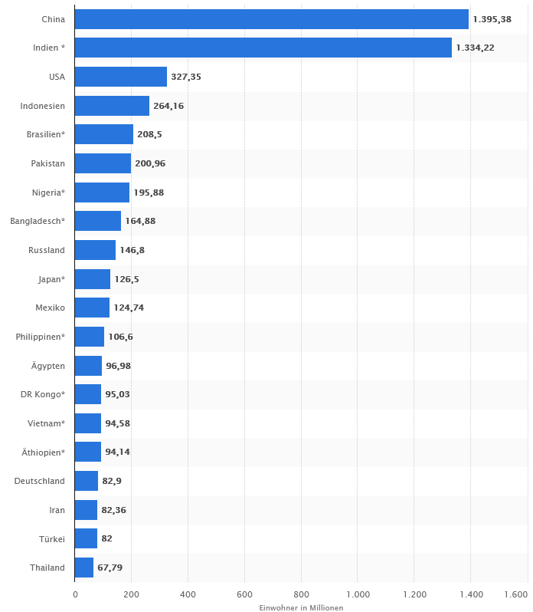
Motivation Data Characteristics
Motivation and Terminology
Skew
  Highly skewed value distributions
  (frequencies of distinct values)
  Small number of distinct items
Correlation
  Correlation between tuple attributes
  Co-occurrences of attribute values
Lack of Tuple Order
  Relations are multi-sets of tuples (no ordering requirements)
  Flexibility for internal reorganization
China 1.4
India 1.3
USA 0.33
Germany 0.08
Austria 0.009
OrderDate < ReceiptDate
(usually 2-3 days)
[Vijayshankar Raman, Garret Swart: How to Wring a Table Dry: Entropy Compression of Relations and Querying of Compressed Relations. VLDB 2006]

Slide 9
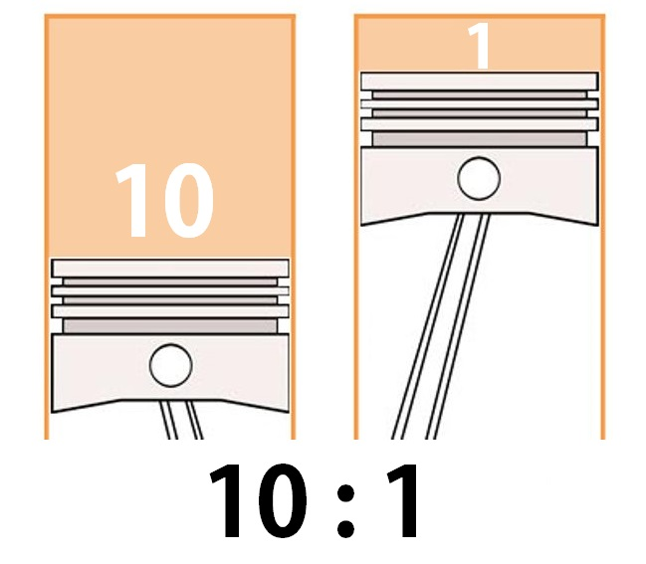
Compression Overview
Motivation and Terminology
Compression Codec
  Encoder
  Decoder
Lossless vs Lossy
  Lossless: guaranteed recovery of uncompressed data
  Lossy: moderate degradation / approximation
  → Images, video, audio; ML training/scoring
Compression Ratio
  CR = Size-Uncompressed / Size-compressed
  Ineffective compression: CR < 1
Metrics
  Compression ratio vs encode/decode time vs encode/decode space
  Block-wise vs random access, operation performance, etc
Encoding
Uncompressed Data
Comp. Data
Decoding

Slide 10
Classification of Compression Techniques
Motivation and Terminology
Lossless Compression Schemes
General-Purpose
Techniques
DB-Centric Techniques
Heavy-Weight
Light-Weight
GZIP
zstd
LZ4
Snappy
Huffman + Lempel-Ziv

Slide 11
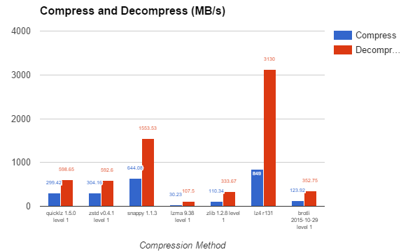
Excursus: General-purpose Compression
Motivation and Terminology
Compression/
Decompression
  CR zstd: 5.24
  CR snappy: 3.65
  CR LZ4: 3.89
Example Apache Spark RDD Compression
  org.apache.spark.io.LZ4CompressionCodec (default in 2.x, 3.x)
  org.apache.spark.io.SnappyCompressionCodec (default in 1.x)
  org.apache.spark.io.LZFCompressionCodec (default in 0.x)
  org.apache.spark.io.ZStdCompressionCodec
snappy
LZ4
zstd
[https://web.archive.org/web/20200229161007/https://www.percona.com/blog/2016/04/13/evaluating-database-compression-methods-update/]

Slide 12
Classification of Compression Techniques, cont.
Motivation and Terminology
Lossless Compression Schemes
General-Purpose
Techniques
DB-Centric Techniques
Heavy-Weight
Light-Weight
GZIP
zstd
LZ4
Snappy
NS
RLE
DICT
FOR
DELTA
Huffman 52 + Lempel-Ziv 77
PDICT
PFOR
PFOR-DELTA
(all heavy-weight from a DB perspective)
Notes:
Huffman code: ‘52 count frequency of symbols, recursively merge least frequent nodes to build binary tree

Slide 13
Compression Techniques

Slide 14
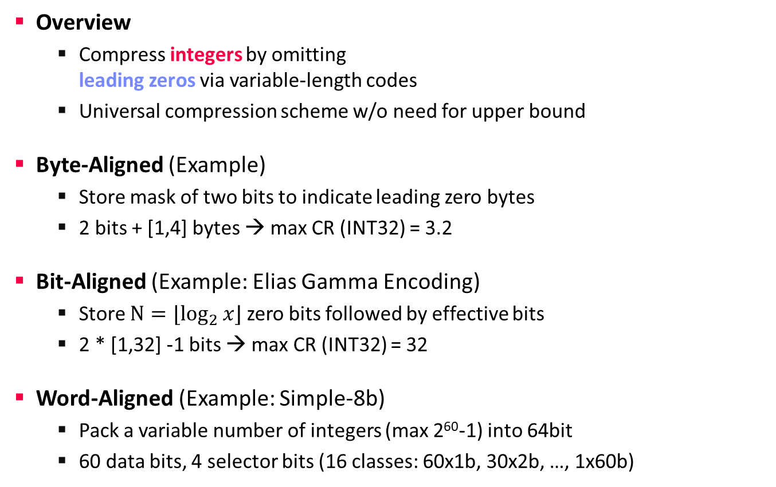
Null Suppression (NS)
Compression Techniques
[Benjamin Schlegel, Rainer Gemulla, Wolfgang Lehner: Fast integer compression using SIMD instructions. DaMoN 2010]
Overview
  Compress integers by omitting
  leading zeros via variable-length codes
  Universal compression scheme w/o need for upper bound
Byte-Aligned (Example)
  Store mask of two bits to indicate leading zero bytes
  2 bits + [1,4] bytes → max CR (INT32) = 3.2
Bit-Aligned (Example: Elias Gamma Encoding)
  Store $N=⌊\log_{2}{x}⌋$ zero bits followed by effective bits
  2 * [1,32] -1 bits → max CR (INT32) = 32
Word-Aligned (Example: Simple-8b)
  Pack a variable number of integers (max 2⁶⁰-1) into 64bit
  60 data bits, 4 selector bits (16 classes: 60x1b, 30x2b, …, 1x60b)
42
00000000
00000000
00000000
00101010
42
11
00101010
7
11
00000111
42
00000
101010
7
00
111
42
10x6b
7
20x3b

Slide 15
Null Suppression (NS), cont.
Compression Techniques
[Jeff Dean: Challenges in Building Large-Scale Information Retrieval Systems, Keynote WSDM 2009]
Varint (Variable-Length Integers)
[also Byte-Aligned]
  Base 128 Varint
  (continuation bits)
  Prefix Varint
  (2 bit #bytes)
  Group Varint
  Examples:
    Google Protobuf messages, SQLite custom varint
Zig-Zag Encoding
  Map signed integers to unsigned integers to have small varint byte length
0
0000001
1
1111111
0
0000011
1
1111111
1
1111111
0
0000111
1
511
131071
00
000001
01
111111
00000111
10
111111
11111111
00000111
1
511
131071
00
01
10
00
00000001
11111111
00000001
11111111
11111111
00000001
00000011
131071

Slide 16
Run-Length Encoding (RLE)
Compression Techniques
Overview
  Compress sequences of equal values via runs of (value[,start],run-length)
  Redundant ‘start’ allows parallelization / unordered storage
  Applicable to arbitrary data types (defined equals())
Example
  Uncompressed
  Compressed
    Different physical encodings for values and lengths:
    E.g., split runs w/ length ≥ 2¹⁶ to fit into fixed 2 byte
C | C | C | C | C | A | A | A | A | F | F | F | F | F | B | B | B
C | 5
A | 4
F | 5
B | 3

Slide 17
Dictionary Encoding (DICT)
Compression Techniques
Overview
  Build dictionary of distinct items and encode values as dictionary positions
  Applicable to arbitrary data types → integer codes
Example
  Uncompressed
  Compressed
        Explicit or implicit (position) codes
        Fixed bit width: log₂ |Dict|
        Different ordering of dictionary (alphanumeric, frequency)
A | C | B | B | A | C | D | A | A | D | C | B | A | B | B | C | D
Dict
0 | A
1 | C
2 | B
3 | D
0 | 1 | 2 | 2 | 0 | 1 | 3 | 0 | 0 | 3 | 1 | 2 | 0 | 2 | 2 | 1 | 3

Slide 18
Dictionary Encoding (DICT), cont.
Compression Techniques
Order-preserving Dictionaries
  Create sorted dictionary where
  order(codes) = order(values)
  Support for updates via sparse code assignment (e.g., 10, 20, 30)
  CS-Array-Trie / CS-Prefix-Tree as encode/decode index w/ shared leafs
Mostly Order-preserving Dictionaries
  Ordered and disordered dictionary sections
[Carsten Binnig, Stefan Hildenbrand, Franz Färber: Dictionary-based order-preserving string compression for main memory column stores. SIGMOD 2009]
[Chunwei Liu et al: Mostly Order Preserving Dictionaries. ICDE 2019]
Ordered Section
Disordered Section

Slide 19
Frame of Reference Encoding (FOR)
Compression Techniques
Overview
  Compress values by storing delta (difference) to reference value
  Mostly integer types → smaller integer domain
Example
  Uncompressed
  Compressed
701 | 698 | 702 | 700 | 699 | 698 | 700 | 701 | 701 | 700 | 703 | 702
700
1 | -2 | 2 | 0 | -1 | -2 | 0 | 1 | 1 | 0 | 3 | 2
Cannot handle trends very well

Slide 20
Delta Encoding (DELTA)
Compression Techniques
Overview
  Compress values by storing delta (difference) to previous value
  Mostly integer types (good when sorted) → smaller integer domain
  Dedicated techniques for differences of file contents (diff/git)
Example
  Uncompressed
  Compressed
    Delta
    Double Delta (differences of differences)
5 | 5 | 6 | 6 | 7 | 7 | 7 | 9 | 9 | 12 | 13 | 14 | 15 | 16 | 17 | 17 | 18
5 | 0 | 1 | 0 | 1 | 0 | 0 | 2 | 0 | 3 | 1 | 1 | 1 | 1 | 1 | 0 | 1
Can create RLE opportunities
for linear trend

Slide 21
Patched Compression Methods (PFOR)
Compression Techniques
Patched Frame of Reference (PFOR)
  Store positive offsets to reference value
  Exceptions in uncompressed form
  (accessible via entry points and offsets to next exception)
  Branchless two-pass decoding
Example
  Uncompressed
  Compressed
[Marcin Zukowski, Sándor Héman, Niels Nes, Peter A. Boncz: Super-Scalar RAM-CPU Cache Compression. ICDE 2006]
Outliers would destroy fixed-width codes
22 | 982 | 21 | 20 | 23 | 20 | 24 | 850 | 21 | 22 | 867 | 21
20
Base
2 | 5 | 1 | 0 | 3 | 0 | 4 | 2 | 1 | 2 |  | 1
982
850
867
Exceptions

Slide 22
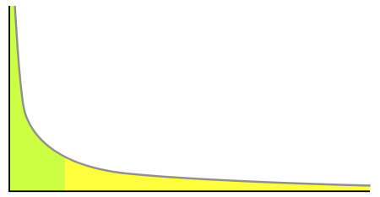
Patched Compression Methods (Others)
Compression Techniques
PFOR-DELTA
  Apply cascade of DELTA – PFOR
  (PFOR on differences)
  Handling of exceptions to handle large differences of subsequent values
Patched Dictionary Compression (PDICT)
  Dictionary encoding, where only frequent values are encoded
  Exceptions for infrequent values, previous/new dictionary per block
  Reduces
  dictionary size
[Marcin Zukowski, Sándor Héman, Niels Nes, Peter A. Boncz: Super-Scalar RAM-CPU Cache Compression. ICDE 2006]
Removes long tail of infrequent
distinct items from dictionary

Slide 23
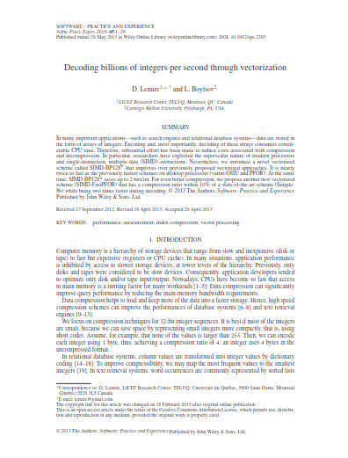
Excursus: SIMD Implementation
Compression Techniques
How to reduce overhead of (de)compression?
  Vectorization of (de)compression by SIMD instructions
  (De)compress several data elements at once
  Main driver of research on database-centric lightweight compression for years
SIMD-BP128
  Targets compression of 32-bit ints
  using Intel’s SSE with 128-bit vectors (16 byte)
  Sub-divide integer sequence into blocks of 128 integers
  Determine maximum bit width in a block by bitwise OR
  Pack all integers in a block using that number of bits
  Dedicated vectorized (un)packing routine for each bit width
  Store bit width in [0, 32] as one byte, combine 16 of those in memory
[Daniel Lemire, Leonid Boytsov: Decoding billions of integers per second through vectorization. Softw. Pract. Exp. 45(1) (2015)]
1
0
…
3
16 byte
…
16 byte
16 byte
16 byte
bit widths: 16x 1 byte
block 0 (1 bit/int)
block 1 (0 bit/int)
block 15 (3 bit/int)

Slide 24
Excursus: SIMD Implementation, cont.
Compression Techniques
[Daniel Lemire, Leonid Boytsov: Decoding billions of integers per second through vectorization. Softw. Pract. Exp. 45(1) (2015)]
Vectorized (un)packing
Compressed (9 bit/int)
Uncompressed (32 bit/int)
Compressed (9 bit/int)
scalar codec,
value-by-value
v0
SIMD codec,
vector-by-vector
…v3
v2
v1
v0
v1
…v12
v8
v4
v0
…v7
v6
v5
v4
v3…
v2
…v13
v9
v5
v1
…v10
v9
v8
v7…
1. Load
2. Bit l-shift
3. Bit OR
v3
1. Load
2. Bit l-shift
3. Bit OR
…v14
v10
v6
v2
…v14
v13
v12
v11
v10…
v4
…v15
v11
v7
v3
v15
v14…
v5
v12…
v6
v13…
v7
v14…
1. Bit r-shift
2. Bit AND
3. Store
v8
1. Bit r-shift
2. Bit AND
3. Store
v15…
v9
v10
v11
Horizontal layout
Codes of consecutive values
in consecutive bytes
Natural for scalar codecs
v12
k-way vertical layout
Codes of consecutive values
in consecutive words
Natural for SIMD codecs
Common #bits for k values
Adopted by many vectorized
compression algorithms
v13
v14
v15
32 bit word

Slide 25
Comparative Evaluation
Compression Techniques
Experimental Survey
  Different data characteristics
  Compression methods:
  DELTA, RLE, FOR, RLE, DICT,
  SIMD-BP128, SIMD-FastPFOR,
  4-Wise NS, 4-Gamma, Masked VByte,
  Simple-8b, SIMD-GroupSimple
  Cascades of compression methods
Towards a Cost-based Selection
  Logical and physical level
  Cost estimation functions
[Patrick Damme, Dirk Habich, Juliana Hildebrandt, Wolfgang Lehner: Lightweight Data Compression Algorithms: An Experimental Survey (Experiments and Analyses). EDBT 2017]
“[…] there is no single-best lightweight integer compression algorithm. The compression rates and performances of all algorithms differ significantly, depending on the data characteristics and the employed SIMD extension.”
[Patrick Damme, Annett Ungethüm, Juliana Hildebrandt, Dirk Habich, Wolfgang Lehner: From a Comprehensive Experimental Survey to a Cost-based Selection Strategy for Lightweight Integer Compression Algorithms.
ACM Trans. Database Syst. 44(3) 2019]

Slide 26
Selecting Compression Methods
Compression Techniques
Inspired by
C-Store Compression Paper
[Peter Boncz: Column-Oriented Database Systems, adapted from VLDB’09 tutorial]
[Daniel J. Abadi, Samuel Madden, Miguel Ferreira: Integrating compression and execution in column-oriented database systems. SIGMOD 2006]
Notes:
TODO further slide extensions:
White box compression: Bogdan Ghita, Diego G. Tomé, Peter A. Boncz: White-box Compression: Learning and Exploiting Compact Table Representations. CIDR 2020
FSST: Peter A. Boncz, Thomas Neumann, Viktor Leis: FSST: Fast Random Access String Compression. Proc. VLDB Endow. 13(11): 2649-2661 (2020)

Slide 27
Compressed Query Processing

Slide 28
Selection Predicates
Compressed Query Processing
Equivalence Predicates σ_{attr=‘D’}(R)
  DICT:
  code lookup
  RLE:
  return RLE runs
Range Predicates σ_{3<a<7} (R)
  #1 sort the dictionary by value (insert tradeoff)
  #2 expand small integer domains + dictionary lookup (e.g., σ_{a=4 ∨ a=5 ∨ a=6} (R))
  #3 decompress otherwise
Dict
0 | A
1 | C
2 | B
3 | D
D → 3
0 | 1 | 2 | 2 | 0 | 1 | 3 | 0 | 0 | 3 | 1 | 2 | 0 | 2 | 2 | 1 | 3
position vector
6 | 9 | 16
C | 5
A | 4
D | 5
F | 3

Slide 29
Selection Predicates, cont.
Compressed Query Processing
Order Preserving Dictionaries
  Direct support for range predicates on encoded data
  Support for LIKE predicates (suffix)
[Carsten Binnig, Stefan Hildenbrand, Franz Färber: Dictionary-based order-preserving string compression for main memory column stores. SIGMOD 2009]

Slide 30
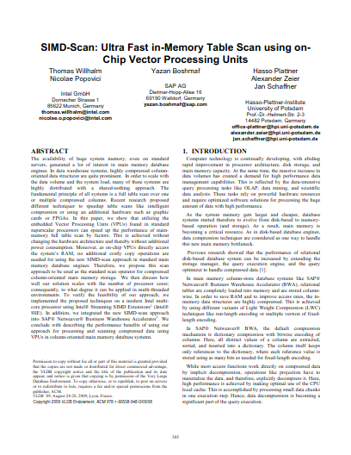
Selection on Bit-packed Data
Compressed Query Processing
[Thomas Willhalm, Nicolae Popovici, Yazan Boshmaf, Hasso Plattner, Alexander Zeier, Jan Schaffner:
SIMD-Scan: Ultra Fast in-Memory Table Scan using on-Chip Vector Processing Units. PVLDB 2(1) (2009)]
SIMD-Scan (2009)
  Horizontal bit-packing
  Point and range predicates
  SIMD processing (SSE)
  32-bit comparisons
  No full decompression, predicate’s constant is shifted accordingly in the beginning
  Sub-optimal
  bit-level parallelism
BitWeaving (2013)
  Bit-parallel methods
  Early pruning
ByteSlice (2015)
  More SIMD-friendly
Load from memory
vector register: 128 bit = 16 byte = 4 32-bit integers
v13
v12
v11
v10
v9
v8
v7
v6
v5
v4
v3
v2
v1
v0
Byte permutation
v3
v2
v2
v1
v1
v0
Mask (AND)
v3
v2
v1
v0
c
c
c
c
Compare
All 1s (hit)
All 0s (miss)
All 1s (hit)
All 0s (miss)

Slide 31
Grouping and Aggregations
Compressed Query Processing
Basic Hash Aggregates
  Grouping directly with
  compressed codes
  DICT, FOR, RLE, etc
Encoding-Specific Aggregation
  RLE sum → agg += run-length*run-value
  RLE min → agg = min(agg, run-value)
  FOR sum → for all codes: agg += code; agg += |codes| * base-value
Dict
0 | A
1 | C
2 | B
3 | D
Hash Table
0 | Agg A
3 | Agg D
1 | Agg C
2 | Agg B
0 | 1 | 2 | 2 | 0 | 1 | 3 | 0 | 0 | 3 | 1 | 2 | 0 | 2 | 2 | 1 | 3

Slide 32
Joins
Compressed Query Processing
⋈_{RID=SID}
Overview Compressed Joins
  (Equi-)Joins directly over compressed data
  Beware: binary operation
  → encodings need to match (global code)
  Recoding of one of the inputs if necessary
  (e.g., DB2 BLU recode inner)
Encoding-Specific Aggregation
  One input RLE: decompress other
  and output RLE encoded data
  One input bitvector: decompress other
  and output RLE encoded data (obtained from bitvector)
R | RID
 | 9
 | 1
 | 7
SID | S
7
3
1
9
7
inner
recode inner (smaller)
outer

Slide 33
Abstractions for Simpler Code
Compressed Query Processing
Motivation
  Code complexity for combinations of encoding schemes
  Affects all operators → maintenance operators/compression schemes
Compressed Block Properties
  isOneValue(): block contains just
  one value and many positions for that value
  isValueSorted(): all values of the block are sorted
  isPosContig(): block contains consecutive subset of column
Iterator Access:
getNext(), asArray()
Block Information:
getSize(), getStartValue(),
getEndPosition()
[Daniel J. Abadi, Samuel Madden, Miguel Ferreira: Integrating compression and execution in column-oriented database systems. SIGMOD 2006]

Slide 34
Abstractions for Simpler Code, cont.
Compressed Query Processing
[Patrick Damme, Annett Ungethüm, Johannes Pietrzyk, Alexander Krause, Dirk Habich, Wolfgang Lehner: MorphStore: Analytical Query Engine with a Holistic Compression-Enabled Processing Model. PVLDB 13(11) 2020]
Motivation
  Improve query performance by
  (re)compressing intermediates
  Change from one compressed format to another

Slide 35
Data Layout – Compression Granularity
Compressed Query Processing
Column Coding
  Select encoding for individual attributes (column values) – tradeoffs
Tuple Coding
  Combine column codes into tuple codes (fixed, variable)
Block Coding
  Compress a sequence of tuples into a compressed block (concat, diff)
[Allison L. Holloway, Vijayshankar Raman, Garret Swart, David J. DeWitt: How to barter bits for chronons: compression and bandwidth trade offs for database scans. SIGMOD 2007]
“All the results have shown that the Huffman coded and delta coded formats compress better but normally take more CPU time. […] When I/O and memory subsystem times are also included in the decision, the format to choose becomes less clear-cut. If a physical format optimizer or system administrator had this information and a fast scan generator, they could make a more informed choice as to the best way to store the data.”
03 Buffer Pool Management

Slide 36
Data Layout – Example Block Layouts
Compressed Query Processing
DB2 BLU
Data Blocks
[Vijayshankar Raman et al: DB2 with BLU Acceleration: So Much More than Just a Column Store.
PVLDB 6(11) 2013]
[Harald Lang: Data Blocks: Hybrid OLTP and OLAP on Compressed Storage using both Vectorization and Compilation. SIGMOD 2016]
03 Buffer Pool
Management
04 Index Structures and Partitioning
07 Query Compilation
and Parallelization

Slide 37
DB-Compression Beyond Relational Databases
Compressed Query Processing
Information Retrieval
  (web) search engines
  Inverted index, postings lists (sorted lists of document ids)
Time Series
  Internet of Things, sensor networks, server/application metrics, etc.
  Sequences of data points (measurement + time)
Machine Learning
  Various application fields
  Matrices/tensors of various characteristics
Graph Databases
  Social networks, road networks, proteins, etc.
  Graphs represented as adjacency lists, matrices
Also benefit from the compression techniques discussed today

Slide 38
Summary and Q&A
Motivation and Terminology
Compression Techniques
Compressed Query Processing
Next Lectures (Part B)
  06 Query Processing (operators, execution models) [Nov 10]
  07 Query Compilation and Parallelization [Nov 17]
  08 Query Optimization (rewrites, costs, join ordering) [Nov 24]
  10 Adaptive Query Processing [Dec 01]
Notes:
Note: some recent work on learned compression (but error threshold, aims for compression ratio but very slow)
Amir Ilkhechi, Andrew Crotty, Alex Galakatos, Yicong Mao, Grace Fan, Xiran Shi, Ugur Çetintemel:
DeepSqueeze: Deep Semantic Compression for Tabular Data. SIGMOD Conference 2020: 1733-1746

