Slide 1

Architecture of DB Systems
09 Adaptive Query Processing
Last update: Dec 01, 2021

Slide 2



Announcements/Org
#1 Video Recording
  Link in TUbe & TeachCenter (lectures will be public)
  Optional attendance (independent of COVID)
  Virtual lectures (recorded) until end of the year
  https://tugraz.webex.com/meet/m.boehm
#2 Oral Exams
  Oral exams, 45min each, via
  https://tugraz.webex.com/meet/m.boehm
  Exam Slots: Feb 7 and Feb 8
  https://doodle.com/poll/zqiat5svr4xng7g4

Slide 3
Recap: Overview Query Processing
Overview Query Processing
SELECT * FROM TopScorer
WHERE Count>=4
Name | Count
James Rodríguez | 6
Thomas Müller | 5
Robin van Persie | 4
Neymar | 4
Parsing
AST/IR
Semantic Analysis
IR
Query Rewrites
Plan Execution
IR
Plan Optimization
QEP
Plan Caching
Compile Time
Runtime

Slide 4
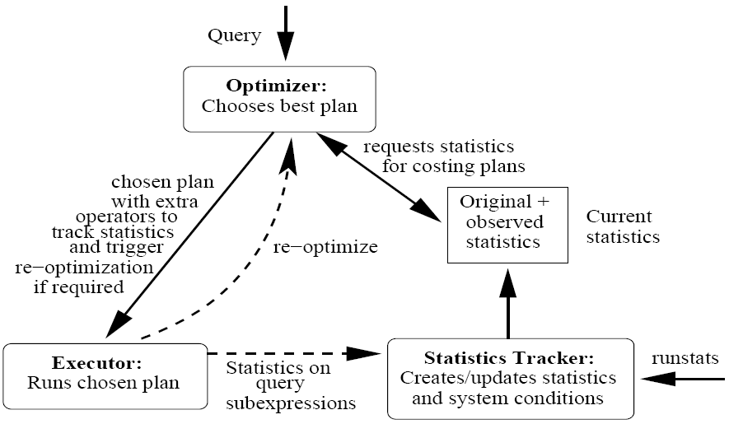
Agenda
Recap: Join Enumeration / Ordering
AQP Fundamentals
Learned Cardinalities
Intra-Query Adaptivity
[Shivnath Babu, Pedro Bizarro: Adaptive Query Processing in the Looking Glass. CIDR 2005]
[Amol Deshpande, Zachary G. Ives, Vijayshankar Raman: Adaptive Query Processing.
Found. Trends Databases 1(1) 2007]

Slide 5
Join Enumeration / Ordering

Slide 6
Plan Optimization Overview
Join Enumeration / Ordering
Plan Generation Overview
  Selection of physical access path and plan operators
  Selection of execution order of plan operators (joins, group-by)
  Input: logical query plan → Output: optimal physical query plan
  Costs of query optimization should not exceed yielded improvements
Interesting Properties
  Interesting orders (sorted vs unsorted),
  partitioning (e.g., join column), pipelining
  Avoid unnecessary sorting operations
Simple Cost Functions
  Join-specific cost functions (Cnlj, Chj, Csmj)
  Cardinalities
  Cout
[Ihab F. Ilyas, Jun Rao, Guy M. Lohman, Dengfeng Gao, Eileen Tien Lin: Estimating Compilation Time of a Query Optimizer. SIGMOD 2003]
[Guido Moerkotte, Building Query Compilers, 2020]

Slide 7
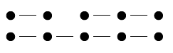
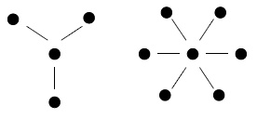
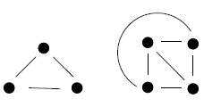
Query and Plan Types
Join Enumeration / Ordering
[Guido Moerkotte, Building Query Compilers, 2020]
Query Types
  Nodes: Tables
  Edges: Join conditions
  Determine hardness
  of query optimization (w/o cross products)
Join Tree Types / Plan Types
  Data flow graph of tables and joins (logical/physical query trees)
  Edges: data dependencies (fixed execution order: bottom-up)
Chains
Stars
Cliques
Left-Deep Tree
Right-Deep Tree
Zig-Zag Tree
Bushy Tree

Slide 8
Join Ordering Problem
Join Enumeration / Ordering
[Guido Moerkotte, Building Query Compilers, 2020]
Join Ordering
  Given a join query graph, find the optimal join ordering
  In general, NP-hard; but polynomial algorithms exist for special cases
Search Space
  Dependent on query and plan types
  Note: if we allow cross products similar to cliques (fully connected)
 | Chain (no CP) |  |  | Star (no CP)
 | left-deep | zig-zag | bushy | left- deep | zig-zag/ bushy
n | 2^{n-1} | 2^{2n-3} | 2^{n-1}C(n-1) | 2(n-1)! | 2^{n-1}(n-1)!
5 | 16 | 128 | 224 | 48 | 384
10 | 512 | ~131K | ~2.4M | ~726K | ~186M
Clique / CP (cross product)
left- deep | zig-zag | bushy
n! | 2^{n-2}n! | n! C(n-1)
120 | 960 | 1,680
~3.6M | ~929M | ~17.6G
C(n) … Catalan Numbers

Slide 9
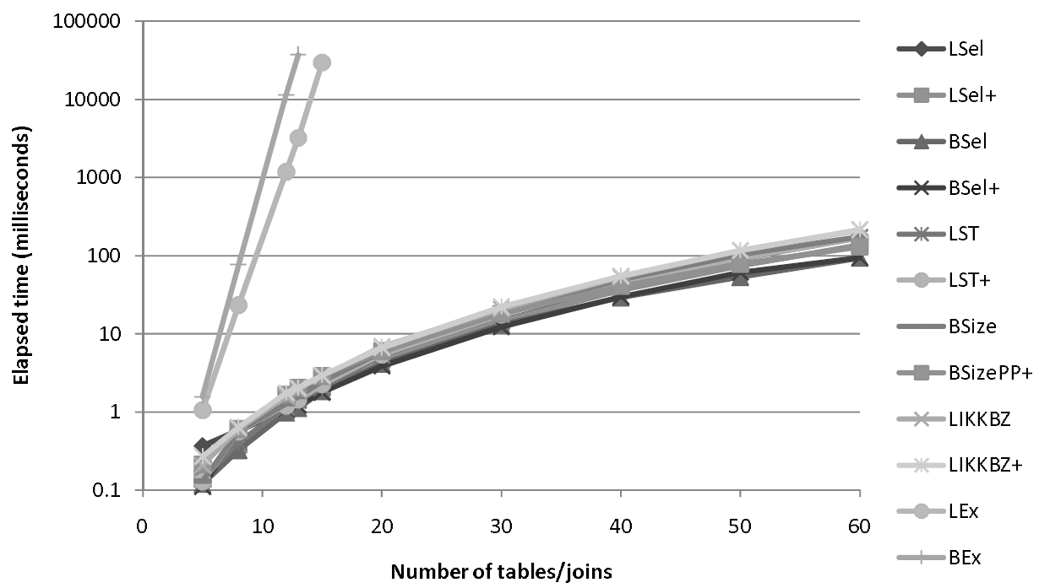
Join Order Search Strategies
Join Enumeration / Ordering
All (unknown)
Actual
Tradeoff: Optimal (or good) plan vs compilation time
#1 Naïve Full Enumeration
  Infeasible for reasonably large queries (long tail up to 1000s of joins)
#2 Exact Dynamic Programming / Memoization
  Guarantees optimal plan, often too expensive (beyond 20 relations)
  Bottom-up vs top-down approaches
#3 Greedy / Heuristic Algorithms
#4 Approximate Algorithms
  E.g., Genetic algorithms, simulated
  annealing, mixed-integer linear prog.
Example PostgreSQL
  Exact optimization (DPSize) if < 12
  relations (geqo_threshold)
  Genetic algorithm for larger queries
  Join methods: NLJ, SMJ, HJ
Explored
DP Enum
Heuristics
[Nicolas Bruno, César A. Galindo-Legaria, Milind Joshi: Polynomial heuristics for query optimization. ICDE 2010]

Slide 10
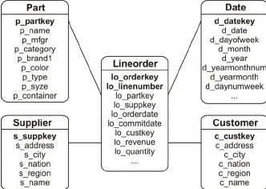
Greedy Join Ordering
Join Enumeration / Ordering
Star Schema Benchmark
Example
  Part ⋈ Lineorder ⋈ Supplier ⋈ σ(Customer) ⋈ σ(Date), left-deep plans
# | Plan | Costs
1 | Lineorder ⋈ Part | 30M
 | Lineorder ⋈ Supplier | 20M
 | Lineorder ⋈ σ(Customer) | 90K
 | Lineorder ⋈ σ(Date) | 40K
 | Part ⋈ Customer | N/A
 | … | …
# | Plan | Costs
3 | ((Lineorder ⋈ σ(Date)) ⋈ σ(Customer)) ⋈ Part | 120M
 | ((Lineorder ⋈ σ(Date)) ⋈ σ(Customer)) ⋈ Supplier | 105M
4 | (((Lineorder ⋈ σ(Date)) ⋈ σ(Customer)) ⋈ Supplier) ⋈ Part | 135M
2 | (Lineorder ⋈ σ(Date)) ⋈ Part | 150K
 | (Lineorder ⋈ σ(Date)) ⋈ Supplier | 100K
 | (Lineorder ⋈ σ(Date)) ⋈ σ(Customer) | 75K
Note: Simple O(n²) algorithm for left-deep trees;
O(n³) algorithms for bushy trees existing (e.g., GOO)
Notes:
GOO .. Greedy operator ordering

Slide 11
Greedy Join Ordering, cont.
Join Enumeration / Ordering
[Guido Moerkotte, Building Query Compilers, 2020]
Basic Algorithms
  GreedyJO-1: sort by relation weights (e.g., card)
  GreedyJO-2: greedy selection of next best relation
  GreedyJO-3: Greedy-JO-2 w/ start from each relation
GOO
Algorithm
Previous example as a hybrid w/ O(n²)
// Greedy Operator Ordering
[Leonidas Fegaras: A New Heuristic for Optimizing Large Queries. DEXA 1998]

Slide 12
Dynamic Programming Join Ordering
Join Enumeration / Ordering
Exact Enumeration via Dynamic Programming
  #1: Optimal substructure (Bellman’s Principle of Optimality)
  #2: Overlapping subproblems allow for memorization
Bottom-Up (Dynamic Programming)
  Split in independent sub-problems (optimal plan per set of quantifiers
  and interesting properties), solve sub-problems, combine solutions
  Algorithms: DPsize, DPsub, DPcpp
Top-Down (Memoization)
  Recursive generation of join trees
  w/ memorization and pruning
  Algorithms: Cascades, MinCutLazy,
  MinCutAGat, MinCutBranch
[Guido Moerkotte, Thomas Neumann: Analysis of Two Existing and One New Dynamic Programming Algorithm for the Generation of Optimal Bushy Join Trees without Cross Products. VLDB 2006]
[Goetz Graefe: The Cascades Framework for Query Optimization. IEEE Data Eng. Bull. 18(3) 1995]
[Pit Fender: Algorithms for Efficient Top-Down Join Enumeration. PhD Thesis, University of Mannheim 2014]

Slide 13
Dynamic Programming Join Ordering, cont.
Join Enumeration / Ordering
DPSize Algorithm
  Pioneered by Pat Selinger et al.
  Implemented in IBM DB2, Postgres, etc
[Patricia G. Selinger et al.: Access Path Selection in a Relational Database Management System. SIGMOD 1979]
[Wook-Shin Han, Wooseong Kwak, Jinsoo Lee, Guy M. Lohman, Volker Markl: Parallelizing query optimization. PVLDB 1(1) 2008]
disjoint
connected

Slide 14
Dynamic Programming Join Ordering, cont.
Join Enumeration / Ordering
DPSize Example
  Simplified: no interesting properties
Q1+Q3, Q2+Q2, Q3+Q1
Q1+Q2, Q2+Q1
Q1+Q1
Q4 | Plan
{C,D,L,P} | ((L⋈C)⋈D)⋈P, P⋈((L⋈C)⋈D)
{C,D,L,S} | …
{C,L,P,S} | …
{D,L,P,S} | …
Q3 | Plan
{C,D,L} | (L⋈C)⋈D, D⋈(L⋈C), (L⋈D)⋈C, C⋈(L⋈D)
{C,L,P} | (L⋈C)⋈P, P⋈(L⋈C), (P⋈L)⋈C, C⋈(P⋈L)
{C,L,S} | …
{D,L,P} | …
{D,L,S} | …
{L,P,S} | …
Q2 | Plan
{C,L} | L⋈C, C⋈L
{D,L} | L⋈D, D⋈L
{L,P} | L⋈P, P⋈L
{L,S} | L⋈S, S⋈L
{C,D} | N/A
… | …
Q1 | Plan
{C} | Tbl, IX
{D} | Tbl, IX
{L} | …
{P} | …
{S} | …
Q1+Q4, Q2+Q3,
Q3+Q2, Q4+Q1
Q5 | Plan
{C,D,L,P,S} | …
Notes:
NOTE: The plan generation algorithm also includes the selection of physical operators (NLJ, SMJ, HJ)

Slide 15
Graceful Degradation
Join Enumeration / Ordering
Problem Bottom-Up
  Until end of optimization no valid full QEP created (no anytime algorithm)
  Fallback: resort to heuristic if ran out of memory / time budget
#1 Query Simplification
  Simplify query with heuristics until
  solvable via dynamic programming
  Choose plans to avoid (restrictions), not to join
#2 Search Space Linearization
  Small queries: count connected
  subgraphs, optimized exactly
  Medium queries (<100): restrict
  algorithm to consider connected sub-chains of linear relation ordering
  Large queries: greedy algorithm, then Medium on sub-trees of size K
[Thomas Neumann: Query simplification: graceful degradation for join-order optimization. SIGMOD 2009]
[Thomas Neumann, Bernhard Radke: Adaptive Optimization of Very Large Join Queries. SIGMOD 2018]
DP
O(n³)

Slide 16
Join Order Benchmark (JOB)
Join Enumeration / Ordering
Data: Internet Movie Data Bases (IMDB)
Workload: 33 query templates, 2-6 variants / 3-16 joins per query
underestimate
[Viktor Leis, Andrey Gubichev, Atanas Mirchev, Peter A. Boncz, Alfons Kemper, Thomas Neumann: How Good Are Query Optimizers, Really? PVLDB 9(3) 2015]

Slide 17
AQP Fundamentals

Slide 18

Motivation
AQP Fundamentals
[Zachary G. Ives, Amol Deshpande, Vijayshankar Raman: Adaptive query processing: Why, How, When, and What Next? VLDB 2007,
http://www.cs.umd.edu/~amol/
talks/VLDB07-AQP-Tutorial.pdf]
Recap: Success of SQL/Relational Model
  Declarative: what not how
  Flexibility: closure property → composition
  Automatic optimization
  Physical data independence
Problems
  Unknown statistics (e.g., unreliable
  cost model assumptions uniformity, independence)
  Changing data / environment characteristics
  (e.g., data integration, streams)
Adaptivity
  Query optimization/processing adapts implementation to runtime conditions
  ➔ Adaptive query processing for fine-grained adaptivity
[Guy Lohman: Query Optimization:
Are We There Yet?, BTW 2017]
$$\frac{Δapp}{Δt}≪\frac{Δenv}{Δt}$$
Notes:
Note: cardinality underestimation due to redundant attributes

Slide 19

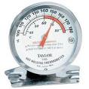
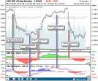

AQP Control Loop
AQP Fundamentals
[IBM: An architectural blueprint for autonomic computing, Technical Report, 2005]
MAPE (Measure/Monitor,
Analyze, Plan, Execute/Actuate)
[Zachary G. Ives, Amol Deshpande, Vijayshankar Raman: Adaptive query processing: Why, How, When, and What Next? VLDB 2007]
Measure
Actuate
Analyze
Plan
Measure what?
Measure when?
Measurement overhead?
Actuation: How to switch plans / routing?
Actuation overhead?
Analyze / plan what?
Analyze / plan when?
Plan how far ahead?
Planning overhead?

Slide 20
Classification of AQP Techniques
AQP Fundamentals
[Amol Deshpande, Joseph M. Hellerstein, Vijayshankar Raman: Adaptive query processing: why, how, when, what next. SIGMOD 2006]
Spectrum of Adaptivity
  Temporal classification
#1 Inter-Query Optimization
  As established in System R
  Update statistics (ANALZE, RUNSTATS)
  (cardinalities, histograms, index low/high keys)
  Rewrites, join ordering, pruning, etc
[Patricia G. Selinger, Morton M. Astrahan, Donald D. Chamberlin, Raymond A. Lorie, Thomas G. Price: Access Path Selection in a Relational Database Management System. SIGMOD 1979]

Slide 21
Recap: ANALYZE and EXPLAIN
AQP Fundamentals
Step 1: EXPLAIN SELECT * FROM Participant AS R, Locale AS S
WHERE R.LID=S.LID;
Step 2: ANALYZE Participant, Locale;
Step 3: EXPLAIN SELECT * FROM Participant AS R, Locale AS S
WHERE R.LID=S.LID;
Hash Join (.. rows=70 width=1592)
Hash Cond:(s.lid = r.lid)
-> Seq Scan on locale s (.. rows=140 width=520)
-> Hash (.. rows=70 width=1072)
-> Seq Scan on participant r (.. rows=70 width=1072)
build side
Hash Join (.. rows=17 width=47)
Hash Cond:(r.lid = s.lid)
-> Seq Scan on participant r (.. rows=17 width=30)
-> Hash (.. rows=11 width=17)
-> Seq Scan on locale s (.. rows=11 width=17)
WHY?
Notes:
CREATE TABLE Locale (
LID INTEGER PRIMARY KEY,
Location VARCHAR(256)
);
CREATE TABLE Participant (
PID INTEGER PRIMARY KEY,
Firstname VARCHAR(128),
Lastname VARCHAR(128),
Affiliation VARCHAR(256),
LID INTEGER REFERENCES Locale
);
INSERT INTO Locale VALUES(1, 'Lausanne, SUI'),(2, 'Amsterdam, NLD'),(3, 'Seattle, USA'),(4, 'Stanford, USA'),(5, 'New York, USA'),(6, 'Berkley, USA'),(7, 'Cambridge, USA'),(8, 'Berlin, GER'),(9, 'Tel Aviv, ISR'),(10, 'San Jose, USA'),(11, 'Munich, GER');
INSERT INTO Participant(102, 'Anastasia', 'Ailamaki', 'EPFL', 1),(104, 'Peter', 'Bailis', 'Stanford', NULL),(105, 'Magdalena', 'Balazinska', 'U Washington', 3),(107, 'Peter', 'Boncz', 'CWI', 2),(108, 'Surajit', 'Chaudhuri', 'MS Research', 3),(111, 'Luna', 'Dong', 'Amazon', 3),(113, 'Juliana', 'Freire', 'NYU', 5),(115, 'Joe', 'Hellerstein', 'UC Berkley', 6),(116, 'Stratos', 'Idreos', 'Harvard', 7),(117, 'Donald', 'Kossman', 'MS Research', NULL), (118, 'Tim', 'Kraska', 'MIT', 7), (120, 'Volker', 'Markl', 'TU Berlin', 8), (122, 'Tova', 'Milo', 'Tel Aviv University', 9), (123, 'C.', 'Mohan', 'IBM Research', 10), (124, 'Thomas', 'Neumann', 'TU Munich', 11), (126, 'Fatma', 'Ozcan', 'IBM Research', 10), (130, 'Christopher', 'Re', 'Stanford', 4);

Slide 22
#1 Inter-Query Optimization
AQP Fundamentals
runstats
runstats
Q₁
Q₂
Q₃
Q₄
Q₅
Q₆
SELECT *
FROM R, S, T, U
WHERE R.a=S.a
AND R.a=T.a
AND R.a=U.a
Update Statistics
RUNSTATS ON TABLE R
RUNSTATS ON TABLE S
RUNSTATS ON TABLE T
RUNSTATS ON TABLE U
SELECT *
FROM R, S, T, U
WHERE R.a=S.a
AND R.a=T.a
AND R.a=U.a
⋈
⋈
⋈
U
Plan cache invalidation and full optimization after statistics update
⋈
S
⋈
T
⋈
U
R
S
R
T

Slide 23
#2 Late Binding (Staged Execution)
AQP Fundamentals
Basic Idea
  Use natural blocking/materialization points (sort, group-by)
  within a plan for reoptimization and plan change
γ
⋈
γ
⋈
T
SELECT *
FROM R, S, T, U
WHERE R.a=S.a
AND R.a=T.a
AND R.a=U.a
GROUP BY R.a
⋈
tmp
U
⋈
U
γ
T
re-optimization of remaining subplan
γ
⋈
⋈
R
S
⋈
tmp
U
T
Notes:
Note: SparkSQL reopt after shuffling, SystemDS recompilation

Slide 24
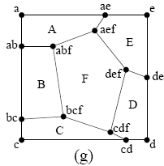
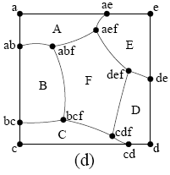
#2 Late Binding (Parameters)
AQP Fundamentals
Problem
  Unknown predicates at query compile-time
  (e.g., prepared statements)
  Similar to unknown or misestimated statistics
  Re-optimization for each query (Optimize-Always) causes unnecessary overhead
Basic Idea: Parametic Query Optimization
  Proactively optimize a query into a set of candidate plans
  Each candidate is optimal for some region of the parameter space
  Pick appropriate plan during query execution when parameters known
Approaches
  Progressive PQO (pay-as-you-go)
  PQO for linear cost functions
  AniPQO for non-linear cost functions
[Pedro Bizarro, Nicolas Bruno, David J. DeWitt: Progressive Parametric Query Optimization. IEEE Trans. Knowl. Data Eng. 21(4) 2009]

Slide 25
Learned Cardinalities

Slide 26
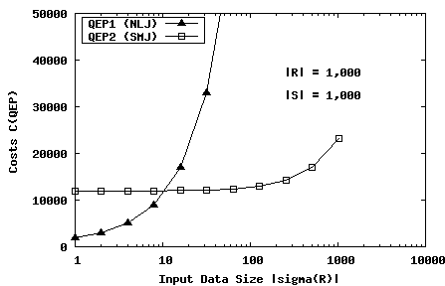
Cardinality Estimation Problems
Learned Cardinalities
Motivation
  Assumptions: uniformity of value distributions, and independence
  Multi-dimensional histograms: too expensive, unclear bucket boundaries
Sources of Estimation Errors
  Correlated attributes (predicates, joins)
  Redundant predicates
Plan Sensitivity
  Recap: Plan Diagrams
  Example
[Guy Lohman: Query Optimization: Are We There Yet?, BTW 2017]
100
⋈
10
σ_{A=x}
S
R
QEP1 (NLJ)
C(NLJ) = |σ(R)|+ |σ(R)|·|S|
QEP2 (SMJ)
C(SMJ) = |σ(R)|·log₂|σ(R)|
+ |S|·log₂|S|+ |σ(R)|+|S|

Slide 27
Monitoring Actual Cardinalities
Learned Cardinalities
LEO: DB2 Learning Optimizer
  Monitor and compare estimated
  and true cardinalites
  Consistently adjust statistics
  (e.g., for correlations)
ASE: Adaptive Selectivity Estimation
  Approximate real attribute value distribution
  by curve-fitting function on query feedback
SIT: Statistics on Query Expressions
  Exploit statistics for intermediates in
  order to avoid the propagation of errors
[Michael Stillger, Guy M. Lohman, Volker Markl, Mokhtar Kandil: LEO - DB2's LEarning Optimizer. VLDB 2001]
[Chung-Min Chen, Nick Roussopoulos: Adaptive Selectivity Estimation Using Query Feedback. SIGMOD 1994]
[Nicolas Bruno, Surajit Chaudhuri: Exploiting statistics on query expressions for optimization. SIGMOD 2002]

Slide 28
Sparse Monitored Information
Learned Cardinalities
Danger w/ Actuals
  “Fleeing from Knowledge to Ignorance”
  Statistics of correlated attributes usually
  adjusted to larger cardinalities
  Plan selection favors small, non-adjusted estimates (independence)
Example
  Plan 1: (((R ⋈ S) ⋈ U) ⋈ T)
  Plan 2: ((R ⋈ U) ⋈ (T ⋈ S))
  Plan 3: (((R ⋈ T) ⋈ U) ⋈ S)
Relation to Search Space
  Intermediates (not concrete plan) relevant for cardinalities
  Example: ((R ⋈ S) ⋈ T) and (R ⋈ (S ⋈ T)) produce the same results
  Still exponential (power set)
[Guy Lohman: Query Optimization:
Are We There Yet?, BTW 2017]
200
20
R
10
100
U
40
S
50
T
30
300

Slide 29
ML For Cardinality Estimation
Learned Cardinalities
Common Approach
  Featurization of attributes, tables, and joins
  Concatenation/aggregation of sub-models
  Augmentation by samples for training and/or corrections
Examples
[Andreas Kipf, Thomas Kipf, Bernhard Radke, Viktor Leis, Peter A. Boncz, Alfons Kemper: Learned Cardinalities: Estimating Correlated Joins with Deep Learning. CIDR 2019]
[Anshuman Dutt, Chi Wang, Azade Nazi, Srikanth Kandula, Vivek R. Narasayya, Surajit Chaudhuri: Selectivity Estimation for Range Predicates using Lightweight Models. PVLDB 12(9) 2019]
[Zongheng Yang, Eric Liang, Amog Kamsetty, Chenggang Wu, Yan Duan, Peter Chen, Pieter Abbeel, Joseph M. Hellerstein, Sanjay Krishnan, Ion Stoica: Deep Unsupervised Cardinality Estimation. PVLDB 13(3) 2019]

Slide 30
Intra-Query Adaptivity

Slide 31
#3 Inter-Operator Re-optimization
Intra-Query Adaptivity
[Navin Kabra, David J. DeWitt: Efficient Mid-Query Re-Optimization of Sub-Optimal Query Execution Plans. SIGMOD 1998]
Basic Idea
  Insert artificial materialization points for
  reoptimization at arbitrary points between plan operators
SELECT *
FROM R,S,T,U
WHERE R.a=S.a
AND R.a=T.a
AND R.a=U.a
Optimal remaining sub-plans and resource allocation
⋈
⋈
U
Re-Optimization
⋈
T
CHECKPOINT
⋈
U
⋈
⋈
Re-Optimization
T
CHECKPOINT
S
cardinalities, selectivities, #distinct (single pass)
R
S
R
Notes:
Note: first checkpoint after filter

Slide 32
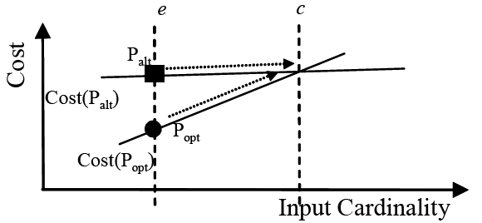
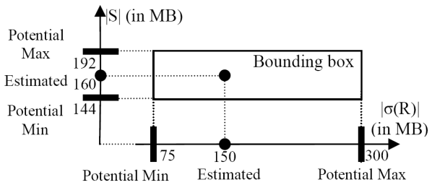
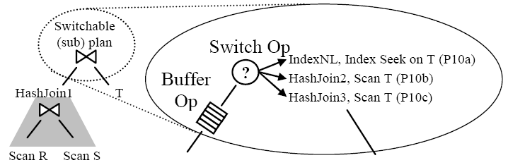
#3 Inter-Operator Re-optimization, cont.
Intra-Query Adaptivity
Problem
  Expensive checkpointing / wasted intermediates
  Trigger re-optimization only if violated validity ranges
Reactive Reoptimization
Proactive Reoptimization
1) Compute Validity
Range (BLACK BOX)
1) Bounding box
around estimates
2) Place Checkpoint
operators
⋈
⋈
T
2) Use bounding boxes to compute a
switchable plan
for (lo, est, hi)
3) Re-optimization
on CHECK error
S
CHECK
R
[Volker Markl, V. Raman, D. E. Simmen, G. M. Lohman, H. Pirahesh: Robust Query Processing through Progressive Optimization. SIGMOD 2004]
[Shivnath Babu, Pedro Bizarro, David J. DeWitt: Proactive Re-optimization. SIGMOD 2005]
Notes:
Note Bounding Boxes and Plans: four cases
Single optimal plan
Single robust plan
Switchable plan (set S of plans p, w/ buffered decision point)
None of the above

Slide 33
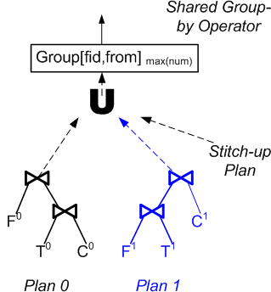
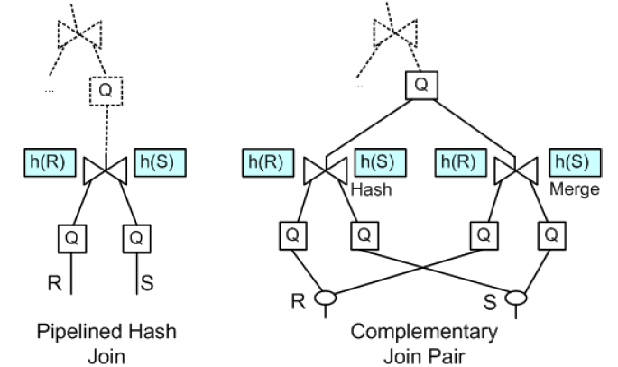
#4 Intra-Operator Adaptivity
Intra-Query Adaptivity
[Zachary G. Ives, Alon Y. Halevy, Daniel S. Weld: Adapting to Source Properties in Processing Data Integration Queries. SIGMOD 2004]
Basic Idea (Corrective Query Processing)
  Use different plans for different partitions of the data
  Combine the results of subplans in stich-up-phases
(a) aggregation/join query as combined results of two plans
(b) Complementary Join Pair (Generalized of Pipelined Hash Join)

Slide 34

#4 Intra-Operator Adaptivity, cont.
Intra-Query Adaptivity
Algebraic Key Property
  Distribute relational UNION through PSJ operations
  Joins
Example
  If R = R₁ ∪ R₂, (horizontal partitioning)
  S = S₁ ∪ S₂
  then: R ⋈ S ≡ (R₁ ∪ R₂) ⋈ (S₁ ∪ S₂)
    ≡ (R₁ ⋈ S₁) ∪ (R₁ ⋈ S₂) ∪ (R₂ ⋈ S₁) ∪ (R₂ ⋈ S₂)
R
S
R₁
S₁
⋈
≡
R₂
S₂

Slide 35
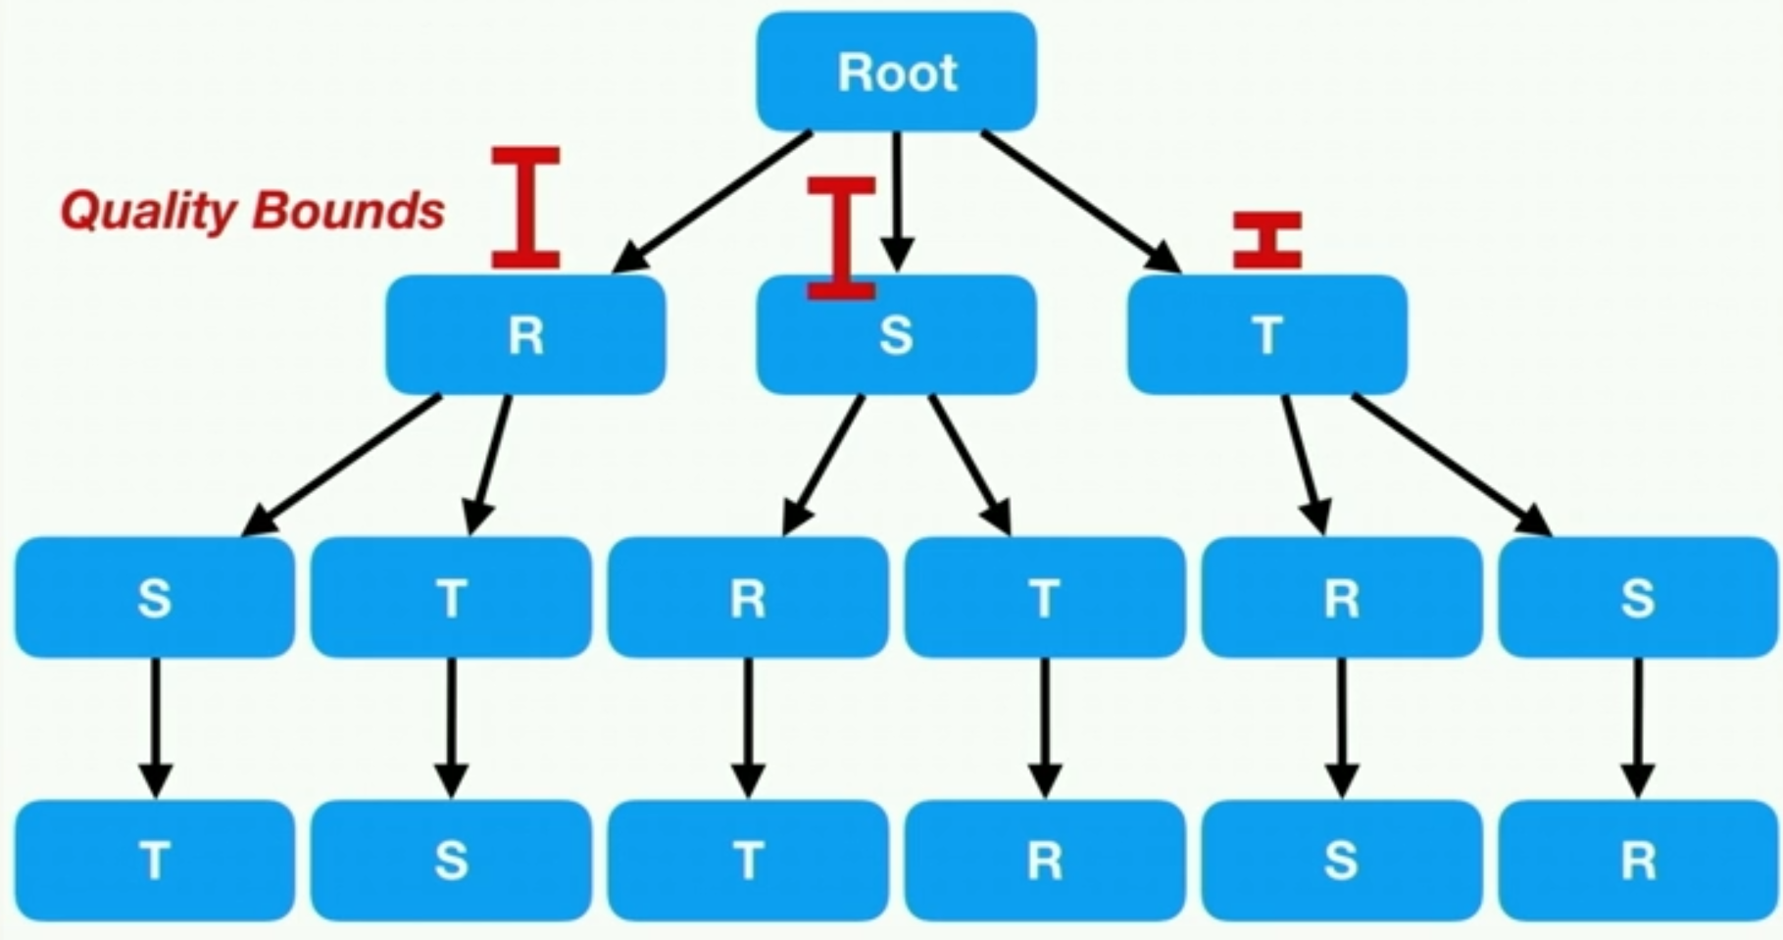
Intra-Query Learning
Intra-Query Adaptivity
[Immanuel Trummer, Junxiong Wang, Deepak Maram, Samuel Moseley, Saehan Jo, Joseph Antonakakis: SkinnerDB: Regret-Bounded Query Evaluation via Reinforcement Learning. SIGMOD 2019]
Basic Idea
  Micro-episodes (time slices), run plans with different join orders,
  evaluate reward, stitch-up partial results (no cost model, good for UDFs)
  Exploitation vs exploration via reinforcement learning
UCT for Join Ordering
  Build tree of join orders gradually
  from root to bottom
  Store statistics in nodes of tree
  Pick next best order via UCT algorithm
  (w/ guarantees on cumulative regret)
Multi-way Joins
  Evaluate entire join order in given time slices
  Reuse previous state (e.g., hash tables)
Notes:
Regret: the difference between the sum of obtained rewards to the sum of rewards for optimal choices

Slide 36
#5 Tuple Routing (Eddies)
Intra-Query Adaptivity
[Ron Avnur, Joseph M. Hellerstein: Eddies: Continuously Adaptive Query Processing, SIGMOD 2000]
Basic Idea
  No plan (no fixed execution order)
  Tuples routed to relevant operators using routing policies
Query Execution via Tuple Routing
  Eddy operator routes tuples
  to applicable operators
  Read/done bit vectors
  Encapsulates all aspects of adaptivity
  in a “standard” dataflow operator
⋈
⋈
U
NLJ
⋈
T
A
R
S
a | b | c | … | ready | done
15 | 10 | ABC | … | 111 | 000
Eddy
NLJ
R
B
result
NLJ
[Amol Deshpande: An initial study of overheads of eddies. SIGMOD Rec. 33(1) 2004]
C

Slide 37
#5 Tuple Routing (Eddies) – Routing Policies
Intra-Query Adaptivity
Deterministic
  Monitor costs & selectivities continuously
  Re-optimize periodically using rank ordering
  (or A-Greedy for correlated predicates)
Lottery Scheduling
  Operators run in threads with input queue
  Tickets assigned according to input/output
  Route tuple to next eligible operator with
  room in queue, based on #tickets and backpressure
Content-based Routing
  Different routes for different data
  Based on attribute values (i.e., correlation)
[Remzi H. Arpaci-Dusseau: Run-time adaptation in River. ACM Trans. Comput. Syst. TOCS 2003]
[Ron Avnur, Joseph M. Hellerstein: Eddies: Continuously Adaptive Query Processing, SIGMOD 2000]
[Pedro Bizarro, Shivnath Babu, David J. DeWitt, Jennifer Widom: Content-Based Routing: Different Plans for Different Data. VLDB 2005]

Slide 38
Summary and Q&A
[Marianne Winslett: Pat Selinger Speaks Out. SIGMOD Rec. 32(4) 2003 https://sigmod.org/
publications/interview/pat-selinger/ ]
Recap: Join Enumeration / Ordering
AQP Fundamentals
Learned Cardinalities
Intra-Query Adaptivity
Next Lectures (Part C)
  10 Cloud Database Systems [Jan 12]
  11 Modern Concurrency Control [Jan 19]
  12 Modern Storage and HW Accelerators [Jan 26]
“Query optimizers have been 25 years in development, with enhancements of the cost-based query model and the optimization that goes with it, and a richer and richer variety of execution techniques that the optimizer chooses from. We just have to keep working on this. It’s a never-ending quest for an increasingly better model and repertoire of optimization and execution techniques. So the more the model can predict what’s really happening in the data and how the data is really organized, the closer and closer we will come [to the ideal system]”
[Surajit Chaudhuri: Query optimizers: time to rethink the contract? SIGMOD 2009]
(constraints, directives, anytime algorithms,
adaptivity, new environments)
Happy
Holidays

