Slide 1

Architecture of DB Systems
11 Modern Concurrency Control
Last update: Jan 18, 2022

Slide 2



Announcements/Org
#1 Video Recording
  Link in TUbe & TeachCenter (lectures will be public)
  Optional attendance (independent of COVID)
  Virtual lectures (recorded) until end of the year
  https://tugraz.webex.com/meet/m.boehm
#2 Programming Projects
  Deadline Reminder: Jan 21, 11.59pm, submission in TeachCenter
  Preliminary Perf Target: #pcores/2 (see 03 Data Layouts and Bufferpools)
  Team size has impact on quality/effort threshold but not on score
  https://mboehm7.github.io/teaching/ws2122_adbs/Project_Setup_v4.zip
#3 Oral Exams
  Oral exams, 45min each, via
  https://tugraz.webex.com/meet/m.boehm
  Exam Slots: Feb 7/8, Feb 24/25
  https://doodle.com/poll/zqiat5svr4xng7g4

Slide 3
Agenda
TX Processing Background
Pessimistic and Optimistic Concurrency Control
Multi-Version Concurrency Control
Excursus: Coordination Avoidance

Slide 4
TX Processing Background

Slide 5
Transaction (TX) Processing
TX Processing Background
User 2
Goal: Transaction Processing
  #1 Locking and concurrency control to ensure #1 correctness
  #2 Logging and recovery to ensure #2 reliability
User 1
User 3
read/write TXs
#1 Multiple users
➔ Correctness?
DBS
DBMS
#2 Various failures
(TX, system, media)
➔ Reliability?
Deadlocks
Constraint violations
DBs
Network failure
Crash/power failure
Disk failure

Slide 6
Terminology of Transactions
TX Processing Background
Database Transaction
  A transaction (TX) is a series of steps that brings a database from
  a consistent state into another (not necessarily different) consistent state
  ACID properties (atomicity, consistency, isolation, durability)
Terminology
by Example
#1 Isolation level (defined by addressed anomalies)
#2 Start/begin of TX (BOT/BT)
START TRANSACTION ISOLATION LEVEL SERIALIZABLE;
UPDATE Account SET Balance=Balance-100
WHERE AID = 107;
UPDATE Account SET Balance=Balance+100
WHERE AID = 999;
SELECT Balance INTO lbalance
FROM Account WHERE AID=107;
IF lbalance < 0 THEN
ROLLBACK TRANSACTION;
END IF
COMMIT TRANSACTION;
#3 Reads and writes of data objects
#6 Savepoints (checkpoint for partial rollback)
#4 Abort/rollback TX (unsuccessful end of transaction, EOT/ET)
#5 Commit TX (successful end of transaction, EOT/ET)

Slide 7
Database (Transaction) Log
TX Processing Background
User 2
User 1
User 3
Database Architecture
  Page-oriented storage on disk and
  in memory (DB buffer)
  Dedicated eviction algorithms
  Modified in-memory pages marked as
  dirty, flushed by cleaner thread
  Log: append-only TX changes
  Data/log often placed on different devices
  and periodically archived (backup + truncate)
Write-Ahead Logging (WAL)
  The log records representing changes to some (dirty)
  data page must be on stable storage before the data page (UNDO - atomicity)
  Force-log on commit or full buffer (REDO - durability)
  Recovery: forward (REDO) and
  backward (UNDO) processing
  Log sequence number (LSN)
DBMS
DB Buffer
Log Buffer
P7
P3’
P1
P7
P3
Data
Log
[C. Mohan, Donald J. Haderle, Bruce G. Lindsay, Hamid Pirahesh, Peter M. Schwarz: ARIES: A Transaction Recovery Method Supporting Fine-Granularity Locking and Partial Rollbacks Using Write-Ahead Logging. TODS 1992]

Slide 8
Isolation Levels
TX Processing Background
Different Isolation Levels
  Tradeoff Isolation vs performance per session/TX
  SQL standard requires guarantee against lost updates for all
SQL Standard Isolation Levels
  Serializable w/ highest guarantees
  (pseudo-serial execution)
How can we enforce these isolation levels?
  User: set default/transaction isolation level (mixed TX workloads possible)
  System: dedicated concurrency control strategies + scheduler
SET TRANSACTION
ISOLATION LEVEL
READ COMMITTED
Isolation Level | Lost Update | Dirty Read (P1) | Unrepeatable Read (P2) | Phantom Read (P3)
READ UNCOMMITTED | No* | Yes | Yes | Yes
READ COMMITTED | No* | No | Yes | Yes
REPEATABLE READ | No* | No | No | Yes
[SERIALIZABLE] | No* | No | No | No
* Lost update potentially w/ different semantics in standard
Notes:
SQL Standard (02 Foundations WD2011, page 134): The four transaction isolation levels guarantee that each SQL-transaction will be executed completely or not at all, and that no updates will be lost. The transaction isolation levels are different with respect to phenomena P1, P2, and P3. Table 8, “SQL-transaction isolation levels and the three phenomena” specifies the phenomena that are possible and not possible for a given transaction isolation level.

Slide 9
Excursus: A Critique of SQL Isolation Levels
TX Processing Background
Summary
  Criticism: SQL standard isolation levels are
  ambiguous (strict/broad interpretations)
  Additional anomalies: dirty write, cursor lost update,
  fuzzy read, read skew, write skew
  Additional isolation levels: cursor stability and snapshot isolation
Snapshot Isolation (< Serializable)
  Type of optimistic concurrency control via multi-version concurrency control
  TXs reads data from a snapshot of committed data when TX started
  TXs never blocked on reads, other TXs data invisible
  TX T1 only commits if no other TX wrote the same data items
  in the time interval of T1
Current Status?
  “SQL standard that fails to accurately define database isolation levels and database vendors that attach liberal and non-standard semantics”
[Hal Berenson, Philip A. Bernstein, Jim Gray, Jim Melton, Elizabeth J. O'Neil, Patrick E. O'Neil: A Critique of ANSI SQL Isolation Levels. SIGMOD 1995]
[http://dbmsmusings.blogspot.com/2019/05/
introduction-to-transaction-isolation.html]
Notes:
Problems SQL: only three anomalies considered, no precise definition of state to expect, no handling of snapshot isolation, different definitions of serializable (serial order, none of the three anomalies)
Examples:
Dirty writes: T1 and T2 write to objects that together → might violate constraints
Write skew: T1 reads x and y, T2 reads x and y and writes x, T1 writes y → again constraint violations

Slide 10
Excursus: Isolation Levels in Practice
TX Processing Background
Default and Maximum
Isolation Levels for “ACID”
and “NewSQL” DBs
[as of 2013]
  3/18 SERIALIZABLE
  by default
  8/18 did not provide
  SERIALIZABLE at all
[Peter Bailis, Alan Fekete, Ali Ghodsi, Joseph M. Hellerstein, Ion Stoica: HAT, Not CAP: Towards Highly Available Transactions. HotOS 2013]
Beware of defaults, even though the SQL standard says SERIALIZABLE is the default

Slide 11



Serializability Theory
TX Processing Background
Operations of Transaction T_{j}
  Read and write operations of A by T_{j}: r_{j}(A) w_{j}(A)
  Abort of transaction T_{j}: a_{j} (unsuccessful termination of T_{j})
  Commit of transaction T_{j}: c_{j} (successful termination of T_{j})
Schedule S
  Operations of a transaction T_{j} are executed in order
  Multiple transactions may be executed concurrently
  ➔ Schedule describes the total ordering of operations
Equivalence of Schedules S1 and S2
  Read-write, write-read, and write-write dependencies on data object A
  executed in same order:
T_{i}
T_{j}
S
$$r_{i}\left(A\right)<_{S1}w_{j}(A)⇔r_{i}\left(A\right)<_{S2}w_{j}(A)$$
$$w_{i}\left(A\right)<_{S1}r_{j}(A)⇔w_{i}\left(A\right)<_{S2}r_{j}(A)$$
$$w_{i}\left(A\right)<_{S1}w_{j}(A)⇔w_{i}\left(A\right)<_{S2}w_{j}(A)$$

Slide 12

Serializability Theory, cont.
TX Processing Background
Example Serializable Schedules
  Input TXs
  Serial
  execution
  Equivalent
  schedules
  Wrong
  schedule
Serializability Graph (conflict graph)
  Operation dependencies (read-write, write-read, write-write) aggregated
  Nodes: transactions; edges: transaction dependencies
  Transactions are serializable (via topological sort) if the graph is acyclic
  Beware: Serializability Theory considers only successful transactions,
  which disregards anomalies like dirty read that might happen in practice
T1: BOT r₁(A) w₁(A) r₁(B) w₁(B) c₁
T2: BOT r₂(C) w₂(C) r₂(A) w₂(A) c₂
r₁(A) w₁(A) r₁(B) w₁(B) c₁ r₂(C) w₂(C) r₂(A) w₂(A) c₂
r₁(A) r₂(C) w₁(A) w₂(C) r₁(B) r₂(A) w₁(B) w₂(A) c₁ c₂
r₁(A) w₁(A) r₂(C) w₂(C) r₁(B) w₁(B) r₂(A) w₂(A) c₁ c₂
r₁(A) r₂(C) w₂(C) r₂(A) w₁(A) r₁(B) w₁(B) w₂(A) c₁ c₂

Slide 13
Pessimistic and Optimistic Concurrency Control

Slide 14
Overview Concurrency Control
Pessimistic and Optimistic Concurrency Control
Terminology
  Lock: logical synchronization of TXs access to database objects (row, table, etc)
  Latch: physical synchronization of access to shared data structures
#1 Pessimistic Concurrency Control
  Locking schemes (lock-based database scheduler)
  Full serialization of transactions
#2 Optimistic Concurrency Control (OCC)
  Optimistic execution of operations, check of conflicts (validation)
  Optimistic and timestamp-based database schedulers
#3 Mixed Concurrency Control (e.g., PostgreSQL)
  Combines locking and OCC
  Might return synchronization errors
ERROR: could not serialize access
due to concurrent update
ERROR: deadlock detected

Slide 15
Locking Schemes
Pessimistic and Optimistic Concurrency Control
Compatibility of Locks
  X-Lock (exclusive/write lock)
  S-Lock (shared/read lock)
Multi-Granularity Locking
  Hierarchy of DB objects
  Additional intentional IX and IS locks
Existing Lock
 | None | S | X
S | Yes | Yes | No
X | Yes | No | No
Requested Lock
IS
DB
IS
Table
IS
 | None | S | X | IS | IX
S | Yes | Yes | No | Yes | No
X | Yes | No | No | No | No
IS | Yes | Yes | No | Yes | Yes
IX | Yes | No | No | Yes | Yes
Page
S
Row

Slide 16
Two-Phase Locking (2PL)
Pessimistic and Optimistic Concurrency Control
Overview
  2PL is a concurrency protocol that guarantees SERIALIZABLE
  Expanding phase (growing): acquire locks needed by the TX
  Shrinking phase: release locks acquired by the TX
  (can only start if all needed locks acquired)
Dirty Read Problem
TX1
TX2
Phase 1
Expanding
Phase 2
Shrinking
lock R
lock S
update R
unlock R
# of locks
lock R
read R
abort
Dirty R
Time
BOT
EOT

Slide 17
Two-Phase Locking, cont.
Pessimistic and Optimistic Concurrency Control
Strict 2PL (S2PL) and Strong Strict 2PL (SS2PL)
  Problem: Transaction rollback can cause (Dirty Read)
  Release all X-locks (S2PL) or X/S-locks (SSPL) at end of transaction (EOT)
Strict 2PL w/ pre-claiming (aka conservative 2PL)
  Problem: incremental expanding can cause deadlocks for interleaved TXs
  Pre-claim all necessary locks (only possible if entire TX known + latches)
Strict 2PL prevents dirty reads and thus cascading abort
# of locks
Time
BOT
EOT
# of locks
Strict 2PL w/ preclaiming prevents deadlocks
Time
BOT
EOT

Slide 18
2PL – Deadlocks
Pessimistic and Optimistic Concurrency Control
TX1
TX2
lock R
lock S
Deadlock Scenario
  Deadlocks of concurrent transactions
  Deadlocks happen due to cyclic
  dependencies without pre-claiming
  (wait for exclusive locks)
#1 Deadlock Prevention
  Pre-claiming (guarantee if TX known upfront)
#2 Deadlock Avoidance
  Preemptive vs non-preemptive strategies
  NO_WAIT (if deadlock suspected wrt timestamp TS, abort lock-requesting TX)
  WOUND-WAIT (T1 locks something held by T2 → if T1<T2, restart T2)
  WAIT-DIE (T1 locks something held by T2 → if T1>T2, abort T1 but keep TS)
#3 Deadlock Detection (DL_DETECT)
  Maintain a wait-for graph (WFG) of blocked TX (similar to serializability graph)
  Detection of cycles in graph (on timeout) → abort one or many TXs
lock S
lock R
blocks until TX2 releases S
blocks until TX1 releases R
Time
DEADLOCK, as this will never happen
[Philip A. Bernstein, Nathan Goodman: Concurrency Control in Distributed Database Systems. ACM Comput. Surv. 1981]
Notes:
Wound-wait: If older txn locks R held by younger txn -> restart younger
if younger txn locks R held by older txn -> younger waits until older finishes
Wait-die: If older txn locks R held by younger txn -> older waits
if younger txn locks R held by older txn -> abort & restart younger with same TS

Slide 19
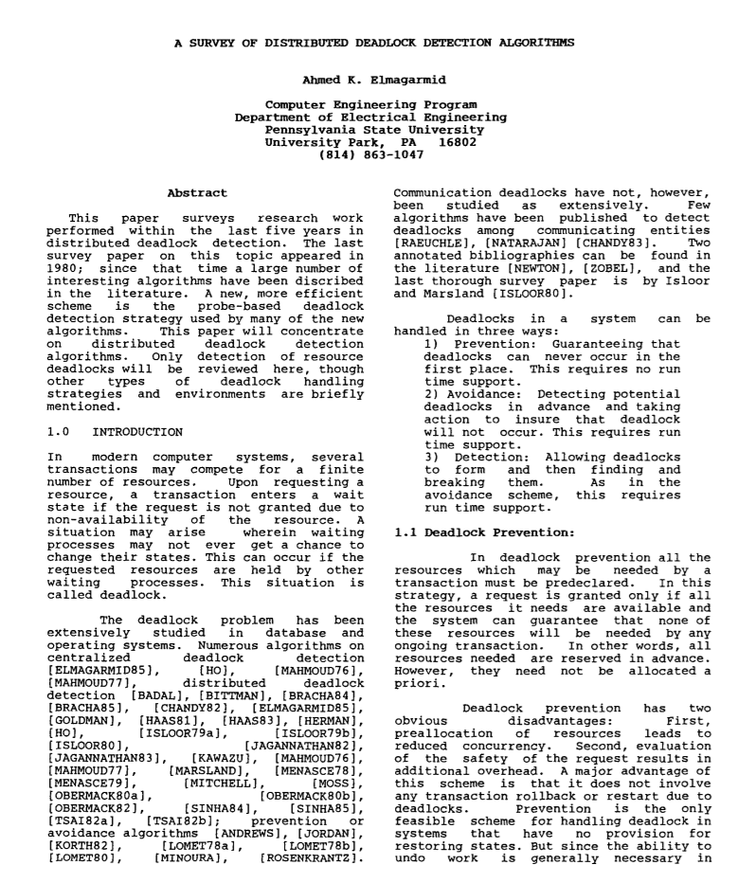
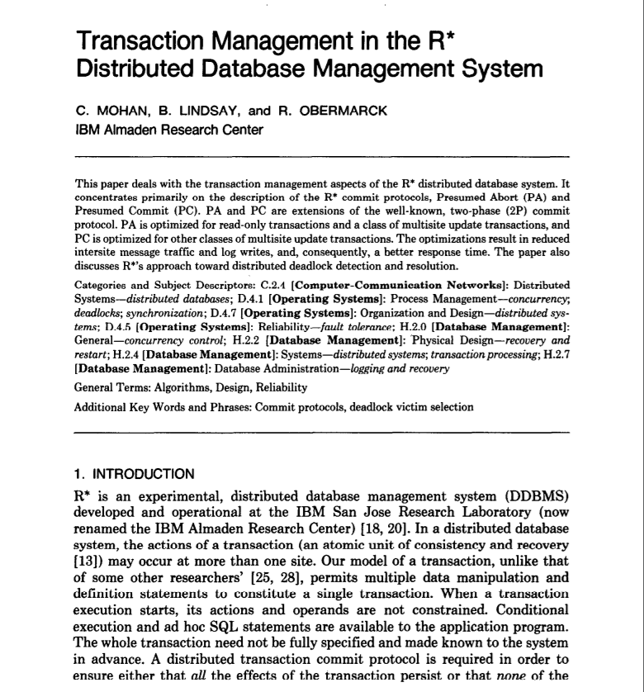
Excursus: Deadlocks in Distributed TXs
Pessimistic and Optimistic Concurrency Control
Deadlock Scenario
  Transmission delay
  Distributed cyclic dependencies
  without pre-claiming
  (wait for exclusive locks)
#1 Deadlock Prevention
  Pre-claiming via a gatekeeper
#2 Deadlock Avoidance
  WOUND-DIE and WOUND-WAIT with broadcasting states
#3 Deadlock Detection
  Centralized: Build a global WFG from
  all local WFGs
  Hierarchical: Cascade merge the local WFGs
  Distributed: Detect deadlocks locally
  and transmit
Node1
Node2
TX1 locks R
TX2 locks R
TX2 locks R
TX1 locks R
blocks until TX1 releases R
blocks until TX2 releases R
TX1
Node1
TX2
[Elmagarmid A.K.: A Survey of Distributed
Deadlock Detection Algorithms.
ACM SIGMOD Record 1986]
[C. Mohan, B. Lindsay, R. Obermarck:
Transaction Management in the R*
Distribute Database Management System.
ACM Trans. Database Syst. 1986]
Notes:
Hierarchical deadlock detection algorithms incur less communication overheads compared to centralized.

Slide 20
Basic Timestamp Ordering (BTO)
Pessimistic and Optimistic Concurrency Control
[Philip A. Bernstein, Nathan Goodman: Concurrency Control in Distributed Database Systems. ACM Comput. Surv. 1981]
Synchronization Scheme
  Transactions get timestamp (or version) TS(T_{j}) at BOT
  Each data object A has readTS(A) and writeTS(A)
  Use timestamp comparison to validate access → serialized schedule
Read Protocol T_{j}(A)
  If TS(T_{j}) >= writeTS(A): allow read, set readTS(A) = max(TS(T_{j}), readTS(A))
  If TS(T_{j}) < writeTS(A): abort T_{j} (older than last modifying TX)
Write Protocol T_{j}(A)
  If TS(T_{j}) >= readTS(A) & TS(T_{j}) >= writeTS(A): allow write, set writeTS(A)=TS(T_{j})
  If TS(T_{j}) < readTS(A): abort T_{j} (older than last reading TX)
  If TS(T_{j}) < writeTS(A): abort T_{j} (older than last modifying TX)
BEWARE: BTO requires handling of dirty reads, recoverability in general
(e.g., via abort or versions)
  Strict Timestamp Ordering (dirty bit)
  w/ deadlock avoidance techniques
[Stephan Wolf et al: An Evaluation of Strict Timestamp Ordering Concurrency Control for Main-Memory Database Systems. IMDM@ VLDB 2013 (Revised Selected Papers)]
Notes:
“It generates serializable schedules, but does not guarantee recoverability. In fact, aborted transactions can cause inconsistency, as another transaction which accessed dirty data could have already committed.”

Slide 21
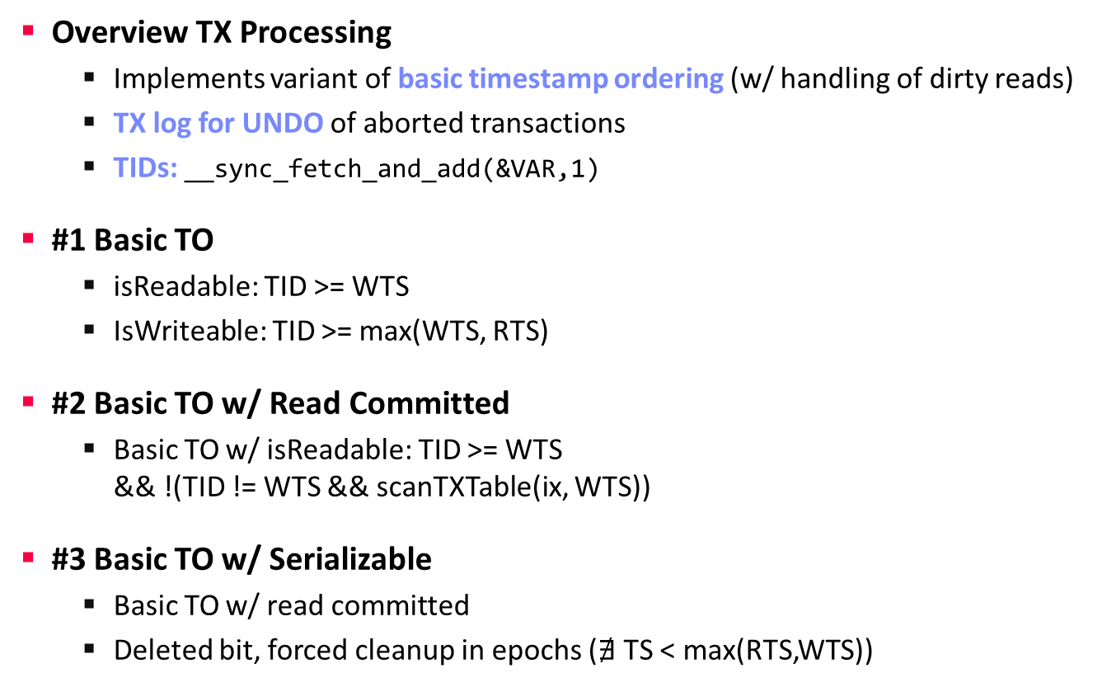
Excursus: BTO in Project WS20/21 Ref Impl
Pessimistic and Optimistic Concurrency Control
Overview TX Processing
  Implements variant of basic timestamp ordering (w/ handling of dirty reads)
  TX log for UNDO of aborted transactions
  TIDs: __sync_fetch_and_add(&VAR,1)
#1 Basic TO
  isReadable: TID >= WTS
  IsWriteable: TID >= max(WTS, RTS)
#2 Basic TO w/ Read Committed
  Basic TO w/ isReadable: TID >= WTS
  && !(TID != WTS && scanTXTable(ix, WTS))
#3 Basic TO w/ Serializable
  Basic TO w/ read committed
  Deleted bit, forced cleanup in epochs ($∄$ TS < max(RTS,WTS))
./speed_test 1468 0 0 0 0 \
4000 160000 100
NUM_TXN_FAIL: 0
NUM_TXN_COMP: 16,000,000
Time to run: 15.223s.
NUM_TXN_FAIL: 0
NUM_TXN_COMP: 16,000,000
Time to run: 15.394s.
NotImplementedException

Slide 22
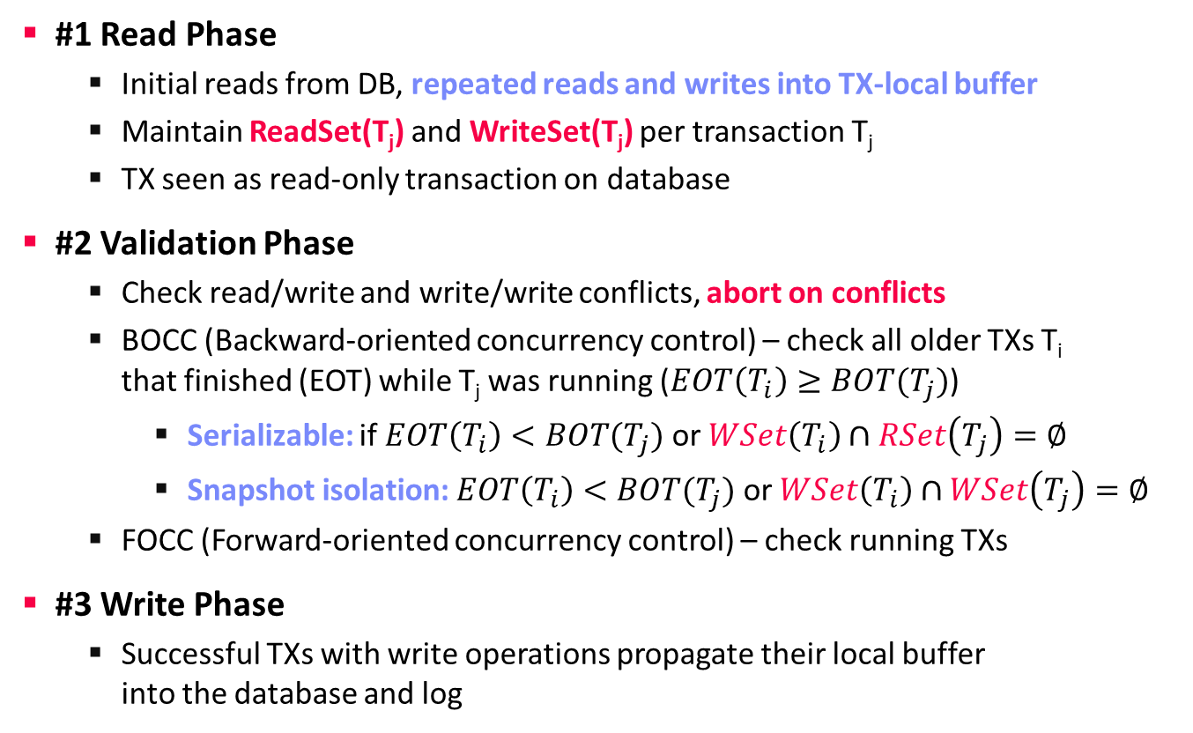
Optimistic Concurrency Control (OCC)
Pessimistic and Optimistic Concurrency Control
#1 Read Phase
  Initial reads from DB, repeated reads and writes into TX-local buffer
  Maintain ReadSet(T_{j}) and WriteSet(T_{j}) per transaction T_{j}
  TX seen as read-only transaction on database
#2 Validation Phase
  Check read/write and write/write conflicts, abort on conflicts
  BOCC (Backward-oriented concurrency control) – check all older TXs T_{i}
  that finished (EOT) while T_{j} was running ($EOT\left(T_{i}\right)≥BOT(T_{j})$)
    Serializable: if $EOT\left(T_{i}\right)<BOT(T_{j})$ or $WSet\left(T_{i}\right)∩RSet\left(T_{j}\right)=∅$
    Snapshot isolation: $EOT\left(T_{i}\right)<BOT(T_{j})$ or $WSet\left(T_{i}\right)∩WSet\left(T_{j}\right)=∅$
  FOCC (Forward-oriented concurrency control) – check running TXs
#3 Write Phase
  Successful TXs with write operations propagate their local buffer
  into the database and log
Notes:
Write Phase: unsuccessful TXs -> simply discard the TX-local buffer

Slide 23
Timestamp Allocation
Pessimistic and Optimistic Concurrency Control
[Xiangyao Yu, George Bezerra, Andrew Pavlo, Srinivas Devadas, Michael Stonebraker: Staring into the Abyss: An Evaluation of Concurrency Control with One Thousand Cores. PVLDB 8(3) 2014]
#1 Mutex
#2 Atomic add / Batched Atomics
#3 Decentralized / CPU Clock
#4 Hardware (CPU HW counter)
[Stephen Tu, Wenting Zheng, Eddie Kohler, Barbara Liskov, Samuel Madden: Speedy transactions in multicore in-memory databases. SOSP 2013]
Notes:
#4 Decentralized / Clock
Worker-local on validate
Worker-local time + threadID

Slide 24
Multi-Version Concurrency Control
(MVCC)

Slide 25
Snapshot Isolation w/ Snapshots
Multi-Version Concurrency Control
#1 Shadow Storage
#2 Snapshots via Fork
  Partitioned, single-threaded OLTP ops
  Snapshots via fork()
  + copy-on-write
Excursus: Query Processing
on Prefix Trees (via fork)
[Alfons Kemper, Thomas Neumann: HyPer: A hybrid OLTP&OLAP main memory database system based on virtual memory snapshots. ICDE 2011]
[Matthias Boehm Patrick Lehmann Peter Benjamin Volk Wolfgang Lehner: Query Processing on Prefix Trees,
HPI Future SOC Lab 2011]

Slide 26
MVCC Overview
Multi-Version Concurrency Control
MVCC Motivation
  Read TXs without need for locks, read sets, or copies
  (fine-grained management of individual versions)
  Copy-on-write (readers never block writers), garbage collection when safe
  Additional benefits: time travel, clear semantics, snapshot isolation
  Mixed HTAP workloads → focus of many recent systems
Design Decisions
  #1 Concurrency Control Protocol
  #2 Version Storage
    Append-only, time-travel, delta
    Oldest-to-newest/newest-to-oldest
  #3 Garbage Collection
    Tuple (background, coop), TX-level
  #4 Index Management
    Logical, physical pointers
[Andy Pavlo: Advanced Database Systems – Multi-Version Concurrency Control (Design Decisions), CMU 2020]
[Yingjun Wu, Joy Arulraj, Jiexi Lin, Ran Xian, Andrew Pavlo: An Empirical Evaluation of In-Memory Multi-Version Concurrency Control. PVLDB 10(7) 2017]

Slide 27
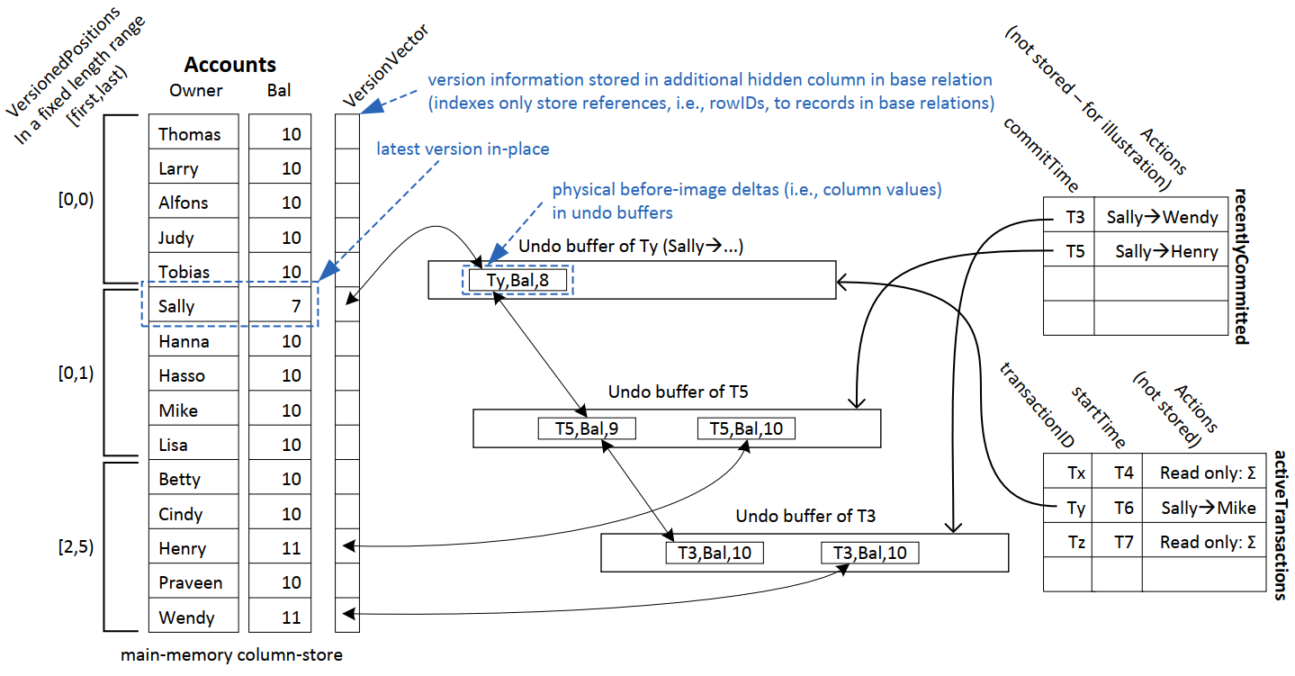
Version Storage
Multi-Version Concurrency Control
[Thomas Neumann, Tobias Mühlbauer, Alfons Kemper: Fast Serializable Multi-Version Concurrency Control for Main-Memory Database Systems. SIGMOD 2015]
Example Hyper
  In-place update, backward delta in UNDO buffer
  Almost no storage overhead (VersionVector), TX-local commit processing
  Newest-to-oldest (preference for fast analytical queries)
Recently Committed
Active TX
→ Transfers of 1 unit
Abort TX write-write conflicts on uncommitted changes

Slide 28

Serializability Validation
Multi-Version Concurrency Control
[Thomas Neumann, Tobias Mühlbauer, Alfons Kemper: Fast Serializable Multi-Version Concurrency Control for Main-Memory Database Systems. SIGMOD 2015]
(Extended) Precision Locking
  Predicate logging: Instead of maintaining read-set, store read predicates of index and table scan of validated T_{i} in predicate tree (PT)
  Recap: Serializable: if $EOT\left(T_{i}\right)<BOT(T_{j})$ or $WSet\left(T_{i}\right)∩RSet\left(T_{j}\right)=∅$
  Probe UNDO buffers (write set) of all T_{j} against predicate tree
Predicate Tree of T_{i}
OR
AND
Abort Ti if a single UNDO buffer’s data point matches

Slide 29
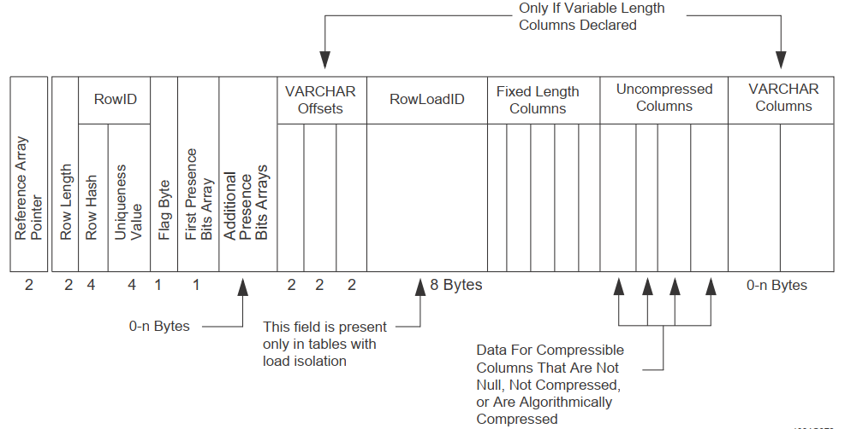
Excursus: Load Isolation in Teradata DB
Multi-Version Concurrency Control
Overview
  Single loader/writer, multiple readers
  Writer session can select MVCC or Serializability
  Append only version storage in the main table
  Read condition (compiled as selection predicates)
[https://docs.teradata.com/r/
w4DJnG9u9GdDlXzsTXyItA/
S~gx1XKjg4ROKw2~8c01jQ]
Reader w/ ReadLoadID = 2
RLId | Cols
1,0 | 1,2,3
3,0 | 2,2,3
1,3 | 1,2,3
ins,del
ins_loaded <= ReadLoadID and del_loaded > ReadLoadID
Notes:
Designed for read-heavy analytical query processing with periodic data loading.

Slide 30
Garbage Collection
Multi-Version Concurrency Control
[Yingjun Wu, Joy Arulraj, Jiexi Lin, Ran Xian, Andrew Pavlo: An Empirical Evaluation of In-Memory Multi-Version Concurrency Control. PVLDB 10(7) 2017]
#1 Tuple-level
Garbage Collection
  Background vacuuming
  Cooperative cleaning
  on traversal)
#2 Transaction-level
  E.g., by epoch
Deferred Action Framework (DAF)
  Maintenance tasks for GC, plan cache
  invalidation, data transformation
R/W: 80/20
R/W: 20/80
R/W: 80/20
R/W: 20/80
[Ling Zhang et al: Everything is a Transaction: Unifying Logical Concurrency Control and Physical Data Structure Maintenance in Database Management Systems, CIDR 2021]

Slide 31
Comparison (simulated)
Multi-Version Concurrency Control
[Xiangyao Yu, George Bezerra, Andrew Pavlo, Srinivas Devadas, Michael Stonebraker: Staring into the Abyss: An Evaluation of Concurrency Control with One Thousand Cores. PVLDB 8(3) 2014]
Read-only
Workload
Write-intensive
Workload
(medium contention)
Timestamp Allocation
Abort Rates
Lock Thrashing
Notes:
Workload: YCSB (key-value store)

Slide 32
Excursus: Coordination Avoidance

Slide 33
Overview Coordination Avoidance
Excursus: Coordination Avoidance
Overview
  Ensure application-level invariants and convergence instead of (serializability vs weaker) with as little coordination as possible (different approaches)
With Transactions
Without Transactions
[Peter Bailis, Ali Ghodsi, Joseph M. Hellerstein, Ion Stoica: Bolt-on causal consistency. SIGMOD 2013]
[Peter Alvaro, Neil Conway, Joseph M. Hellerstein, William R. Marczak: Consistency Analysis in Bloom: a CALM and Collected Approach. CIDR 2011]
[Peter Bailis et al.: Coordination Avoidance in Database Systems. PVLDB 8(3) 2014]
[Peter Alvaro: Data-centric Programming for Distributed Systems. PHD UC Berkeley 2015]
[Peter Bailis: Coordination Avoidance in Distributed Databases. PhD UC Berkeley 2015]
[Chenggang Wu, Jose M. Faleiro, Yihan Lin, Joseph M. Hellerstein: Anna: A KVS for Any Scale. ICDE 2018]
[Chenggang Wu, Vikram Sreekanti, Joseph M. Hellerstein: Autoscaling Tiered Cloud Storage in Anna. PVLDB 12(6) 2019]
Notes:
Peter Bailis 2017 SIGMOD Jim Gray Doctoral Dissertation Award
CALM: Consistency and Logical Monotonicity

Slide 34
Summary and Q&A
TX Processing Background
Pessimistic and Optimistic Concurrency Control
Multi-Version Concurrency Control
Excursus: Coordination Avoidance
Next Lectures (Part C)
  12 Modern Storage and HW Accelerators [Jan 26]

