Slide 1

Architecture of DB Systems
12 Modern Storage & HW Accelerators
Last update: Jan 25, 2022

Slide 2




Announcements/Org
#1 Video Recording
  Link in TUbe & TeachCenter (lectures will be public)
  Optional attendance (independent of COVID)
  Virtual lectures (recorded) until end of the year
  https://tugraz.webex.com/meet/m.boehm
#2 Course Evaluation and Exam
  Evaluation period: Dec 15 – Jan 31
  Oral exams, 45min each, via
  https://tugraz.webex.com/meet/m.boehm
  Exam Slots: Feb 7/8, Feb 24/25 (10/77)
  https://doodle.com/poll/zqiat5svr4xng7g4

Slide 3

Summary Programming Projects
Summary
  10 submissions by 14 students
  Achieved weighted speedups:
  [0.13x, 18.69x] @ 16 pcores
  Spurious bugs and test failures
  ➔ Modified grading scheme
Results (available in TeachCenter)
  3 projects met the original performance threshold, but good effort
  Results: 100, 100, 100, 99, 91, 82, 80, 77, 71 | 1x revision
  Top 3 Projects
    #1 Artem Kroviakov 18.69x
    #2 Alexander Hiebl / Julian Goeschl 10.25x
    #3 Kevin Innerebner 8.12x
100
up to +5 points
Points
50
1
#pcores/2
Score
Offers for
part-time
RA positions
in DAPHNE

Slide 4
Agenda
Recap: Basic HW Background
Compute: DBMS on GPUs, FPGAs, ASICs
Memory: DBMS on Non-volatile Memory
Storage: DBMS on Computational Storage

Slide 5
Recap: Basic HW Background

Slide 6
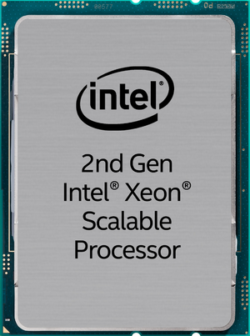
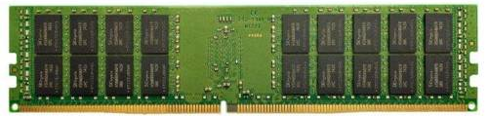
Basic CPU/Memory Architecture
Basic Hardware Background
[https://en.wikichip.org/wiki/intel/xeon_gold/
6238r]
Example DM Cluster (scale-up)
  Scale-up Intel Xeon Gold 6238R @ 2.2-4 Ghz (2 x 28 pcores, 2 x 56 vcores)
  768 GB HPE DDR4 RAM @ 2.933 GHz (12 x 64GB 2Rx4 PC4-2933Y-R)
NUMA: Non-Uniform Memory Architecture
Ultra Path Interconnect
(UPI)
2 x 20.4 GB/s
6 x 21.9 GB/s
(132 GB/s)
6 x 21.9 GB/s
(132 GB/s)
ECC RAM
ECC RAM
6 memory channels
6 memory channels

Slide 7
Basic CPU/Memory Architecture, cont.
Basic Hardware Background
Example DM Cluster
  Scale-up Intel Xeon Gold 6238R @ 2.2-4 GHz (2 x 28 pcores, 2 x 56 vcores)
  768 GB HPE DDR4 RAM @ 2.933 GHz (12 x 64GB 2Rx4 PC4-2933Y-R)
Cache Coherence Protocols (e.g., dictionary, snooping)
Core 0
Core 26
Core 27
L1i (32KB)
L1d
(32KB)
…
L2 Cache (1MB)
Shared L3 Cache (38.5 MB)
Micro Architecture:
Cascade Lake ‘19
Why do we need a cache hierarchy?
Notes:
* SRAM caches
* Cache coherence (dict: bitmaps for cachelines, snoopers/core listen on bus, trigger actions on modifications)

Slide 8
CPU (Core) Microarchitecture
Basic Hardware Background
Example Nehalem
  Frontend: Instruction Fetch,
  Pre-Decode, and Decode
  Backend: Rename/Allocate,
  Scheduler, Execute
  Out-of-Order Execution
  Engine (128b FP Mult/Add)
SIMD Processing
  Single-instruction, multiple data
  Process the same operation on
  multiple elements at a time
  Data/instruction parallelism
  Example: VFMADD132PD
[M. E. Thomadakis: The Architecture of the Nehalem Processor and Nehalem EP SMP Platforms, Report, 2010]
2009 Nehalem: 128b (2xFP64)
2012 Sandy Bridge: 256b (4xFP64)
2017 Skylake: 512b (8xFP64)
c = _mm512_fmadd_pd(a, b);
a
b
c
Notes:
Note: hyper-threading replicated frontend

Slide 9
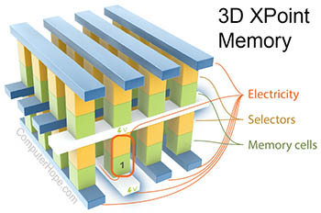
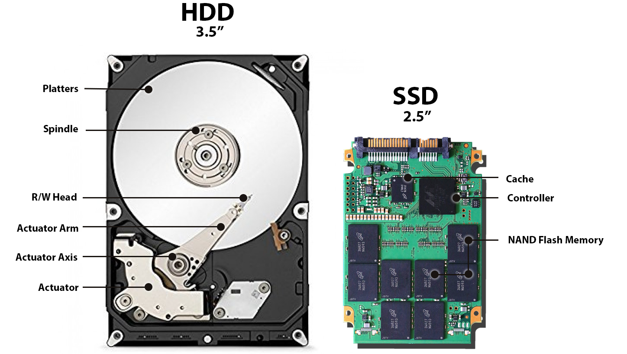
Basic Storage Architecture
Basic Hardware Background
Perf ←→ Cost per GB
Primary Storage
  Main Memory (volatile, often charge-based)
  Capacitors leak charge → periodic refresh (~64ms)
Secondary Storage (non-volatile storage)
  HDD: hard disk drive (magnetic, rotating platters)
  SSD: solid-state drives (flash memory)
  NVM: non-volatile memory (flash/resistive)
Tertiary Storage (archival mass storage)
  Optical disks (special materials), Magneto-optical disks
  Tape drives: magnetic tape w/ high capacity cartridges
Why do we need a storage hierarchy?
[Thomas Hahmann, Hans Weber, Erhard Diedrich, Gunter Schreier: SENTINEL-1 AND SENTINEL-3-OLCI PAC AT DLR, ESA-SP 722, 2013]
50PB tape library

Slide 10
HW Challenges
Basic Hardware Background
[S. Markidis, E. Laure, N. Jansson, S. Rivas-Gomez and S. W. D. Chien: Moore’s Law and Dennard Scaling]
#1 End of Dennard Scaling (~2005)
  Law: power stays proportional
  to the area of the transistor
  Ignored leakage current / threshold voltage
  → increasing power density S² (power wall, heat) → stagnating frequency
#2 End of Moore’s Law (~2010-20)
  Law: #transistors/performance/
  CPU frequency doubles every
  18/24 months
  Original: # transistors per chip
  doubles at constant costs
  Now increasing costs (10/7/5nm)
#3 Amdahl’s Law (speedup limitations)
➔ Consequences: Dark Silicon and Specialization
P = α CFV² (power density 1)
(P .. Power, C .. Capacitance,
F .. Frequency, V .. Voltage)
Notes:
Dennard Scaling: (scaling factor S of transistors)
* # transistors: S^2
* Capacitance: 1/S
* Frequency: S
* Device power V: 1/(S^2)
* Alpha 1/2
* Dennard scaling: V cannot be further reduced due to leakage (noise of neighboring transistors); capacity (current) of transistor -> the smaller the transistor, the smaller the frequency
* higher power density -> dark silicon
* Gordon Moore (co-founder of Intel)

Slide 11
Compute:
DBMS on GPUs, FPGAs, ASICs

Slide 12
Towards Specialized Hardware
Compute: DBMS on GPUs, FPGAs, ASICs
HW Specialization
Interconnect
  PCI Express (PCI-e): v3 x16: 16GB/s, v4 x16: 32GB/s
  New link technologies: GPUs via NVLink, FPGAs via QPI/UPI, all via OpenCAPI
Additional Specialization
  Data Transfer & Types: e.g., compressed representations
  Near-Data Processing: e.g., operations in memory or storage
HW Devices
General Purpose
Specialized HW
CPU
GPU
FPGAs
ASICs
Throughput-oriented, specialized instructions
programmable
logic
fixed logic
Notes:
PCIe … Peripheral Component Interconnect Express

Slide 13
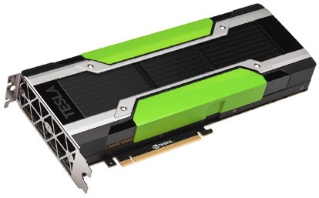
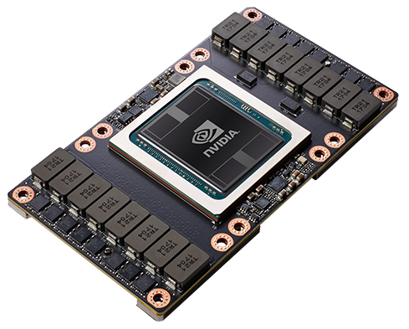
Graphics Processing Units (GPUs)
Compute: DBMS on GPUs, FPGAs, ASICs
GPU Characteristics
  Separate (PCIe, NVLink) or integrated devices
  High compute throughout
  (e.g., NVIDIA V100 FP64: 7.8 TFLOPs, FP32: 15.7 TFLOPs, DL FP16: 125 TFLOPs)
  High bandwidth memory (e.g., NVIDIA V100 16/32 GB (900 GB/s)
V100 Architecture
  6 GPU Processing Clusters
  with 7x2 SMs
  Streaming Multiprocessors
    32 FP64 cores
    64 FP32 cores, 64 INT32 cores, 8 Tensor cores
    Thread blocks → N warps (32 SIMT threads/warp)
    Control flow causes thread divergence
    (V100 new __syncwarp() primitive)
[NVIDIA Tesla V100 GPU Architecture, Whitepaper, Aug 2017]

Slide 14
GPU Join Processing
Compute: DBMS on GPUs, FPGAs, ASICs
Data Transfer
  Transfer often ignored although dominating
  Overlapped transfer and compute to
  reach PCIe max throughput (non-trivial)
  CUDA Unified Virtual Addressing (UVA)
Join Implementation
  Column-oriented (ID, RID) representation
  Partitioned hash join (06 Query Processing)
Query Plan Decomposition
  Most time spent in joins and group-by
  GPU kernels for binary join and group-by
  (only one hash table on small GPU device mem)
  Other operators on host CPU
[Tim Kaldewey, Guy M. Lohman, René Müller, Peter Benjamin Volk: GPU join processing revisited. DaMoN@SIGMOD 2012]
[René Müller, Tim Kaldewey, Guy M. Lohman, John McPherson: WOW: what the world of (data) warehousing can learn from the World of Warcraft. SIGMOD 2013]

Slide 15
GPU Query Compilation
Compute: DBMS on GPUs, FPGAs, ASICs
Recap: Query Compilation
  Modern in-memory DBMS → CPU/memory efficiency crucial
  Generation of data-centric tuple-at-a-time pipelines (often LLVM)
  How to generate code for GPUs and HW accelerators in general?
Voodoo
  Vector algebra w/ knobs for parallelization
  (e.g., load, add/mult, scatter/gather, zip, fold)
  OpenCL/interpreter backends for CPU/GPU
HorseQC
  Vectorized execution of fused operators
  Data-parallel prefix sums for write positions
  Single data pass w/ exploitation of GPU
  memory hierarchy (CPU, PCIe, global, shared)
[Holger Pirk, Oscar R. Moll, Matei Zaharia, Sam Madden: Voodoo - A Vector Algebra for Portable Database Performance on Modern Hardware. PVLDB 9(14) 2016]
[Henning Funke, Sebastian Breß, Stefan Noll, Volker Markl, Jens Teubner: Pipelined Query Processing in Coprocessor Environments. SIGMOD 2018]

Slide 16
GPU Query Processing on new Link Technologies
Compute: DBMS on GPUs, FPGAs, ASICs
New Link Technologies
  NVLink for CPU-mem/GPU and GPU-GPU communication
  OpenCAPI for cache-coherent accelerator integration
#1 H²TAP (EPFL)
  HTAP system (OLTP on CPU, OLAP on GPU)
  LLVM code generation for operator fusion
  Lazy transfers (UVA) and transfer sharing
#2 Experimental Analysis (TU Berlin)
  In-depth analysis of NVLink 2 vs PCIe 3
[Aunn Raza et al: GPU-accelerated data management under the test of time. CIDR 2020]
[Clemens Lutz et al.: Pump Up the Volume: Processing Large Data on GPUs with Fast Interconnects. SIGMOD 2020 (best paper award)]

Slide 17
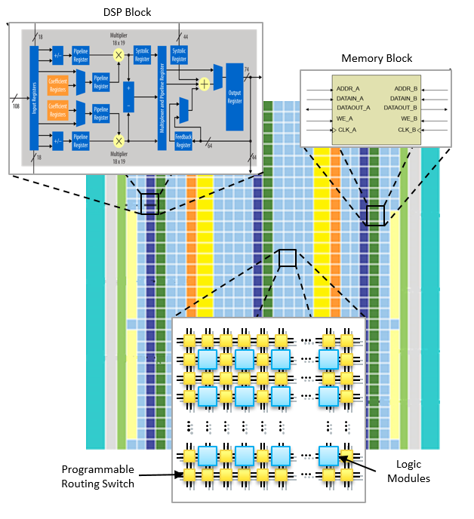
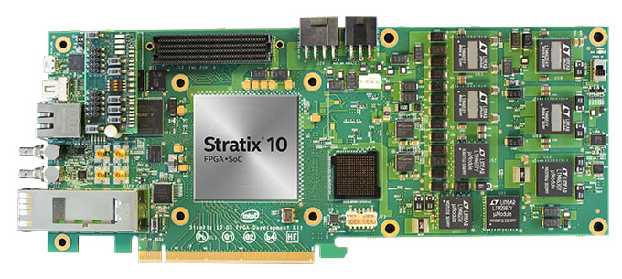
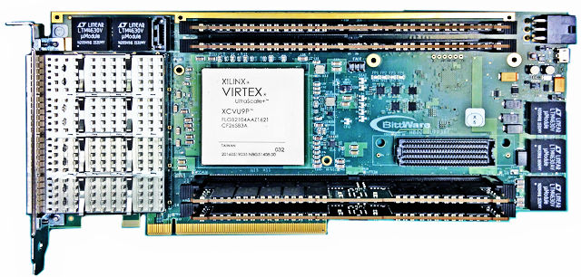
Field-Programmable Gate Arrays (FPGAs)
Compute: DBMS on GPUs, FPGAs, ASICs
[Credit:
https://intel.com]
FPGA Characteristics
  Integrated circuit that allows
  configuring custom hardware designs
  Reconfiguration in <1s
  HW description language:
  e.g., VHDL, Verilog (RTL)
FPGA Components
  #1 lookup table (LUT) as logic gates
  #2 flip-flops (registers)
  #3 interconnect network
  Additional memory and DSP blocks
Examples
  Intel (Altera) Stratix 10 SoC FPGA
  Xilinx Virtex UltraSCALE+
Notes:
RTL .. Register transfer level, (above gate level)

Slide 18
FPGAs in Microsoft’s Data Centers
Compute: DBMS on GPUs, FPGAs, ASICs
[Adrian M. Caulfield et al.: A cloud-scale acceleration architecture. MICRO 2016]
Microsoft Catapult
  Dual-socket Xeon w/ PCIe-attached FPGA
  Pre-filtering neural networks, compression, and other workloads
At data center level, FPGA flexibility very valuable
Notes:
NIC .. network interface card

Slide 19
FPGA Query Processing
Compute: DBMS on GPUs, FPGAs, ASICs
Motivation
  FPGA on data path from network/disk/stream to CPU for offloading
  Performance and energy efficiency (e.g., Netezza → IBM, discontinued)
FPGAs for Data Processing
  Specialized stream operators (e.g.,
  window median – sorting network)
  Glacier: Library and query compiler
  for continuous (streaming) queries
Many Specialized Operators
  Frequent item set mining
  Regular expression matching
  Complex event processing
[René Müller, Jens Teubner, Gustavo Alonso: Data Processing on FPGAs. PVLDB 2(1) 2009]
[René Müller, Jens Teubner, Gustavo Alonso: Streams on Wires - A Query Compiler for FPGAs. PVLDB 2(1) 2009]
[Louis Woods, Jens Teubner, Gustavo Alonso: Complex Event Detection at Wire Speed with FPGAs. PVLDB 3(1) 2010]
Notes:
Note: https://www.theregister.com/2019/07/03/rip_netezza_ibms_fpgapowered_data_warehousing_dream/ (new technology, cloud and virtualization difficult)

Slide 20
Application-Specific Integrated Circuit (ASICs)
Compute: DBMS on GPUs, FPGAs, ASICs
Gamma Database Machine
  Long history of HW-accelerated DB workloads
  Unsuccessful due to need for continuous
  improvements (Moore’s Law)
#1 TUD Tomahawk
  Specialized ops (sorted set intersection)
#2 Oracle DAX
  M7 chip with 8 Data Analytics engines
  Specialized ops (decompress, selections)
#3 Oracle DPU (RAPID, discontinued)
  Data Processing Unit (shared-mem many core)
  Data movement system, atomic TX engine
  Partitioning and partitioned hash join (kernels)
[David J. DeWitt: DIRECT - A Multiprocessor Organization for Supporting Relational Database Management Systems.
IEEE Trans. Computers 28(6) 1979]
[Oliver Arnold et al: An application-specific instruction set for accelerating set-oriented database primitives. SIGMOD 2014]
[Kathirgamar Aingaran et al.: M7: Oracle's Next-Generation Sparc Processor. IEEE Micro 35(2) 2015]
[Cagri Balkesen et al.: RAPID: In-Memory Analytical Query Processing Engine with Extreme Performance per Watt. SIGMOD 2018]

Slide 21
Memory:
DBMS on Non-volatile Memory
[Joy Arulraj, Andrew Pavlo: How to Build a Non-Volatile Memory Database Management System. SIGMOD 2017]
[Ismail Oukid, Wolfgang Lehner: Data Structure Engineering For Byte-Addressable Non-Volatile Memory. SIGMOD 2017]

Slide 22
Overview Non-Volatile Memory (NVM)
Memory: DBMS on Non-volatile Memory
DRAM Scaling Limits
  Decreasing feature sizes → increasing failure rates (e.g., RowHammer)
  DRAM DIMM cost per GB scales super-linearly (~ 9.5x for 4x capacity)
  DRAM major energy consumer (charge-based, requires refresh ~64ms)
Non-Volatile Memory (NVM)
  Aka Storage-Class Memory (SCM) → non-volatile storage
  Higher capacity, lower energy, and cheaper than DRAM (~3x bandwidth)
  Byte-addressable read and write (unlike SSD/HDD)
  High random write throughput
  Read/write asymmetry and wear leveling

Slide 23
Overview Non-Volatile Memory (NVM), cont.
Memory: DBMS on Non-volatile Memory
Different System Integration Approaches
  NVDIMM-N: DIMM with flash storage and DRAM
  NVDIMM-F: DIMM with flash storage
  NVDIMM-P: DIMM with NVM technologies (e.g., PCM)
File System Support
  Access NVRAM via mmap
  (zero-copy via bypassing
  OS page cache)
  Dedicated file systems
  (NOVA, PMFS, SCMFS)

Slide 24
NVM Durability Guarantees
Memory: DBMS on Non-volatile Memory
NVM Durability Challenges
  Little control when data is persisted
  Examples: CPU Cache evictions,
  memory reordering, partial writes,
  (at cache line granularity)
NVM-relevant Instructions
  CLFLUSH (flush cache line from every
  level of the cache hierarchy, write on demand)
  CLWB (write back cache line)
  MFENCE (serializes global visibility),
  SFENCE (store fence), LFENCE (load fence)
  MOVNT (write bypassing the caches)
  Special handling for draining store buffers
Core 0
write
L1i (32KB)
L1d
(32KB)
L2 Cache (1MB)
Shared L3 Cache
NVM (persistent)
Additional Challenges
Persistent Memory Leaks
Persistent Data Corruption
Persistent Memory Management

Slide 25
NVM Logging and Recovery
Memory: DBMS on Non-volatile Memory
[Ismail Oukid, Wolfgang Lehner, Thomas Kissinger, Thomas Willhalm, Peter Bumbulis: Instant Recovery for Main Memory Databases. CIDR 2015]
SOFORT: DB Recovery on NVM
  Simulated DBMS on NVM
  Instant recovery by trading
  TX throughput vs recovery time
  (% of data structures on SCM)
  No need for logging
  (everything is durable)
  Continue TXs on recovery
Recovery Simulation
Wait for Rebuild
Continue TX, Async Rebuild
0%
40%
100%
Lower throughput

Slide 26
NVM Logging and Recovery, cont.
Memory: DBMS on Non-volatile Memory
Motivation
  NVM with higher write throughput
  Smaller gap sequential vs random write throughput
  Byte-addressable NVM (no need for pages)
Write-Behind Logging
  Leverage byte-addressable
  NVM to reduce amount of
  logged data on changes
  Dirty tuple table (DTT) for tracking changes → never written to NVM
  Update persistent data (SCM) + DTT on commit, log change metadata
    c_{p} timestamp – TXs durable on NVM → log entry
    c_{d} timestamp – TX commit timestamp
  Recovery: Ignore and GC TX changes in (c_{p},c_{d})
[Joy Arulraj, Matthew Perron, Andrew Pavlo: Write-Behind Logging. PVLDB 10(4) 2016]
Notes:
Comparison to SOFORT: The engine is designed to not perform any logging and uses MVCC. Similar to SOFORT, we also make useof non-volatile pointers [3], but we use these pointers in a different way. SOFORT’s non-volatile pointers are a combination of pageID and offset. We eschew the page abstraction in our engines since NVM is byte-addressable, and thus we userawpointers that map todata’s location in NVM

Slide 27
NVM Index Structures
Memory: DBMS on Non-volatile Memory
[Ismail Oukid, Johan Lasperas, Anisoara Nica, Thomas Willhalm, Wolfgang Lehner: FPTree: A Hybrid SCM-DRAM Persistent and Concurrent B-Tree for Storage Class Memory. SIGMOD 2016]
FPTree (Fingerprinting Persistent Tree)
  Selective persistence:
  Hybrid B⁺-Tree with volatile
  inner and durable leaf nodes
  Unsorted leaves for
  reduce # of writes
  Fingerprinting
  (1B hashes of in-leaf keys)
  Recovery: rebuild inner nodes
BzTree
  Latch-free B-tree for NVM
  Multi-word compare-and-swap w/
  persistence guarantees (PMwCAS)
[BTW’2019]
[Joy Arulraj, Justin J. Levandoski, Umar Farooq Minhas, Per-Åke Larson: BzTree: A High-Performance Latch-free Range Index for Non-Volatile Memory. PVLDB 11(5) 2018]
Notes:
Note: additional work on Joins and Sorting on NVM (with aim of trading write/read)

Slide 28
Storage:
DBMS on Computational Storage

Slide 29
Overview Computational Storage
Storage: DBMS on Computational Storage
Different SSD Architectures
  (a) SSDs (solid-state drive)
  (b) Smart SSDs
  (c) Accelerators in the SSD I/O path (e.g., Netezza)
Background: FTL (flash translation layer)
  SW or HW (controller) FTL for mapping of logical to physical addresses,
  wear-leveling, ECC, and bad block management
[Antonio Barbalace, Jaeyoung Do: Computational Storage: Where
Are We Today?, CIDR 2021]
(a) SSD w/ controller
(b) SSD w/ co-processors

Slide 30
Query Processing on (Smart)SSDs
Storage: DBMS on Computational Storage
Query Processing on SSDs
  Wide spectrum of work (index structures, out-of-core operations)
  Handle read/write asymmetry and other properties → perf/energy efficiency
OLAP Query Processing on SmartSSDs
  Session-based protocol for SATA/SAS (PCIe) interface
  OPEN/CLOSE/GET (results, 10ms poll)
  Coordinator/worker threads
  Flash pages pinned into DRAM
  Projection, selection and aggregation
OLTP Query Processing on SmartSSDs
  Small random writes cause huge write
  overhead on SSDs (write amplification)
  Flash-append features, delta record area
  via controlled data placement
[Jaeyoung Do, Yang-Suk Kee, Jignesh M. Patel, Chanik Park, Kwanghyun Park, David J. DeWitt: Query processing on smart SSDs: opportunities and challenges. SIGMOD 2013]
[Sergey Hardock, Ilia Petrov, Robert Gottstein, Alejandro P. Buchmann: From In-Place Updates to In-Place Appends: Revisiting Out-of-Place Updates
on Flash. SIGMOD 2017]

Slide 31
KV Stores on SSDs
Storage: DBMS on Computational Storage
Open Channel SSDs
  Storage devices that let hosts control
  data placement and I/O scheduling
FTL Specialization for
Log-structured
Merge Trees (LSM)
Batched Writes @ MS
  Log structuring in SSD controller
[Ivan Luiz Picoli, Niclas Hedam, Philippe Bonnet, Pinar Tözün: Open-Channel SSD (What is it Good For). CIDR 2020]
[Ivan Luiz Picoli, Philippe Bonnet, Pinar Tözün: LSM Management on Computational Storage. DaMoN@SIGMOD 2019]
[Jaeyoung Do, David B. Lomet, Ivan Luiz Picoli: Improving CPU I/O Performance via SSD Controller FTL Support for Batched Writes. DaMoN@SIGMOD 2019]
Notes:
Note: Open channel SSDs largely dead? ZNS?

Slide 32
Zoned Namespaces (ZNS)
Storage: DBMS on Computational Storage
[Javier González: Zoned Namespaces - Use Cases, Standard and Linux Ecosystem, SDC SNIA EMEA 20]
Zoned Namespace
  Motivation: log-structured merge trees (KV-store), log-structured FS,
  with user-space data placement, garbage collection, metadata
  Divide logical block device (LBA) into fixed-size zones, sequential write per zone
Linux Stack
  Zoned FS (e.g., F2FS)
  ZNS-specific features
  (append, ZRWA,
  Simple Copy)
  2 I/O paths
    Zoned FS
    Zoned Apps
[Dev Purandare et al.: Append is Near: Log-based Data Management on ZNS SSDs, CIDR 2022]

Slide 33
Copy in Memory / Storage
Storage: DBMS on Computational Storage
[Javier González: Zoned Namespaces - Use Cases, Standard and Linux Ecosystem, SDC SNIA EMEA 20]
ZNS Simple Copy
  Offload copy operation to SSD
  Data moved directly by SSD controller
  No PCIe data transfer, no CPU cycles spent
  Applications: garbage collection
  Under discussion in NVMe
DRAM RowClone
  Copy memory rows
  via row buffer
  Within/across banks
  Also used for
  row initialization
  (e.g., memset(0))
  Low-cost HW ext.
multiple sources
single target
[Vivek Seshadri et al: RowClone: fast and energy-efficient in-DRAM bulk data copy and initialization. MICRO 2013]
Notes:
Note: RowClone proposed on simulator, low-cost HW extension
1) Activating the row containing the cache line – this copies the data from the row of DRAM cells to the row buffer,
2) reading/writing the cache line – this transfers the data from/to the corresponding sense amplifiers within the row buffer to/from the processor through the internal bus shared by all the banks, and
3) Precharging the subarray – this clears the sense amplifiers and prepares the subarray for a subsequent access

Slide 34
Problems and Challenges
Storage: DBMS on Computational Storage
#1 Caching
  Buffer pools and distributed caching unaware of push-down
  Prefiltering in storage destroys caching and reuse → cold analysis tasks
#2 Granularity
  Page-oriented (fixed size) buffer pool for sequential I/O
  Pre-filtering in storage destroys blocks → variable length
#3 Practicability
  Programmability/usability
  Multi-tenant environments
  Security concerns
[Antonio Barbalace, Jaeyoung Do: Computational Storage: Where
Are We Today?, CIDR 2021]

Slide 35












Excursus: DAPHNE EU Project
DAPHNE: Integrated Data Analysis Pipelines for Large-Scale
Data Management, HPC, and Machine Learning (12/20-11/24)
  https://daphne-eu.eu/ (old: https://daphne-eu.github.io/)
Use Cases
(ML4Sim, pipelines)
Benchmarking
and Analysis
DaphneLib and DaphneDSL
System Architecture
DSL Abstraction and Compilation
DaphneIR
(MLIR-based?)
DSL Runtime and Lib /
Framework Integration
Scheduling and Resource Sharing
Computational Storage (Mem, SSD, Tape)
HW Accelerator
Integration (GPU, FPGA)

Slide 36
Summary and Q&A
Thanks
(please, participate in the
course evaluation)
Recap: Basic HW Background
Compute: DBMS on GPUs, FPGAs, ASICs
Memory: DBMS on Non-volatile Memory
Storage: DBMS on Computational Storage
#2 Course Evaluation and Exam
  Evaluation period: Dec 15 – Jan 31 (1/77)
  Exam dates: Feb 07/08, 24/25 (oral exams)

