Slide 1

Data Management
03 Data Models & Normalization
Last update: Oct 15, 2021

Slide 2


Announcements/Org
#1 Video Recording
  Link in TeachCenter & TUbe (lectures will be public)
  Currently via https://tugraz.webex.com/meet/m.boehm
#2 CSS Feedback?
#3 Exercise 1
  Task description published and discussed last week
  Deadline: Nov 02 + 7 late days in TeachCenter
Q&A

Slide 3

Recap: DB Design Lifecycle Phases
DB Design Lifecycle
Employee DB
#1 Requirements engineering
  Collect and analyze data and application requirements
  ➔ Specification documents
#2 Conceptual Design (lecture 02, exercise 1)
  Model data semantics and structure, independent of logical data model
  ➔ ER model / diagram
#3 Logical Design (lecture 03, exercise 1)
  Model data with implementation primitives of concrete data model
  ➔ e.g., relational schema + integrity constraints, views, permissions, etc
#4 Physical Design (lecture 07, exercise 2)
  Model user-level data organization in a specific DBMS (and data model)
  Account for deployment environment and performance requirements

Slide 4

Agenda
Relational Data Model
ER-Diagram to Relational Schema
Normalization
[Credit: Alfons Kemper, André Eickler: Datenbanksysteme - Eine Einführung, 10. Auflage. De Gruyter Studium, de Gruyter Oldenbourg 2015, ISBN 978-3-11-044375-2, pp. 1-879]

Slide 5
Relational Data Model

Slide 6

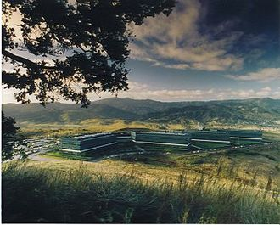
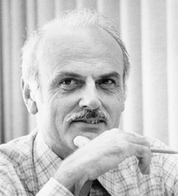
Recap: History 1970/80s
(relational)
Relational Data Model
SQL Standard
(SQL-86)
Oracle, IBM DB2, Informix, Sybase → MS SQL
SEQUEL
QUEL
System R @ IBM Research – Almaden
(Jim Gray et al.,
Turing Award ‘98)
Ingres @ UC Berkeley (Stonebraker et al.,
Turing Award ‘14)
Tuple Calculus
Relational Algebra
Relational Model
Recommended Reading
Edgar F. “Ted” Codd @ IBM
Research (Turing Award ‘81)
Goal: Data Independence
(physical data independence)
  Ordering Dependence
  Indexing Dependence
  Access Path Depend.
[E. F. Codd: A Relational Model of Data for Large Shared Data Banks.
Comm. ACM 13(6), 1970]

Slide 7
Relations and Terminology
Relational Data Model
Domain D (value domain): e.g., Set S, INT, Char[20]
Relation R
  Relation schema RS:
  Set of k attributes {A₁,…,A_{k}}
  Attribute A_{j}: value domain D_{j} = dom(A_{j})
  Relation: subset of the Cartesian product
  over all value domains D_{j}
  R ⊆ D₁ × D₂ × ... × D_{k}, k ≥ 1
Additional Terminology
  Tuple: row of k elements of a relation
  Cardinality of a relation: number of tuples in the relation
  Rank of a relation: number of attributes
  Semantics: Set := no duplicate tuples (in practice: Bag := duplicates allowed)
  Order of tuples and attributes is irrelevant
Attribute
A1 INT | A2 INT | A3 BOOL
3 | 7 | T
1 | 2 | T
3 | 4 | F
1 | 7 | T
Tuple
cardinality: 4
rank: 3

Slide 8
Relations and Terminology, cont.
Relational Data Model
Database Schema
  Set of relation (table) schemas and constraints
Database
  Set of actual relations, including data
  Database instance: current status of database
NULL
  Special NULL value for unknown or missing values
  Part of every domain, unless NOT NULL constraint specified
  Special semantics for specific operations, e.g., three-value Boolean logic
TRUE OR NULL → TRUE
FALSE OR NULL → NULL
TRUE AND NULL → NULL
FALSE AND NULL → FALSE
Comparisons
WHERE X = NULL → NULL
WHERE X IS NULL

Slide 9
Example UniversityDB
Relational Data Model
Professors
Courses
PID | Title | Firstname | Lastname
1 | Univ.-Prof. Dipl.-Inf. Dr. | Stefanie | Lindstaedt
3 | Assoc.Prof. Dipl.-Ing. Dr.techn. | Viktoria | Pammer-Schindler
7 | Univ.-Prof. Dr.-Ing. | Matthias | Boehm
CID | Title | ECTS
INF.01017UF | Data Management (VO) | 3
INF.02018UF | Data Management (KU) | 1
706.010 | Databases | 3
706.520 | Data Integration and Large-Scale Analysis | 5
706.543 | Architecture of Database Systems | 5
706.550 | Architecture of Machine Learning Systems | 5
Summer/
Winter
Winter
Summer

Slide 10


Primary and Foreign Keys
Relational Data Model
Primary Key X
  Minimal set of attributes X that uniquely identifies tuples in a relation R
  E.g., PID=1 ➔
  #1 Unique:
  #2 Defined:
  #3 Minimal: no attribute can be removed wrt #1
  Super key: #1-2, candidate key: #1-3,
  primary key: pick one of the candidate keys
Foreign Key
  Reference of a primary key in another relation
1 | Univ.-Prof. Dipl.-Inf. Dr. | Stefanie | Lindstaedt
$$∀ t_{i},t_{j}∈R:t_{i}\left[X\right]=t_{j}\left[X\right]⇒i=j$$
Super key
$$∀ t_{i}∈R:t_{i}\left[X\right]≠NULL$$
Candidate key
Primary key
1
Professors
PID | Title | First Name | Last Name
N
Courses
CID | Title | ECTS | PID

Slide 11
Primary and Foreign Keys, cont.
Relational Data Model
Example Airports
  Airport Name
  IATA (International Air Transport Association) code
  ICAO (International Civil Aviation Organization) code
  Latitude
  Longitude
  Altitude
Q: Candidate Keys
  Natural candidate keys: IATA, ICAO
  [Surrogate (artificial) candidate key]
Q: Primary Keys
  IATA or ICAO, or
  [Surrogate key]
Graz Airport
GRZ
LOWG
46.9911
15.4396
1115 [ft]
Notes:
CREATE TABLE Airports(
AirID SERIAL PRIMARY KEY,
Name VARCHAR(256),
IATA VARCHAR(128) CHECK(LENGTH(IATA)=3) UNIQUE,
ICAO VARCHAR(128) CHECK(LENGTH(ICAO)=4) UNIQUE,
latitude DECIMAL NOT NULL,
Longitude DECIMAL NOT NULL,
Altitude SMALLINT NOT NULL,
CityID INT NOT NULL REFERENCES Cities(CityID)
);

Slide 12
Preview Next Lectures
Relational Data Model
Relational Algebra [Lecture 04]
  Operands: relations (variables for computing new values)
  Operators: traditional set operations and specific relational operations (symbols representing the computation)
Structured Query Language (SQL) [Lecture 05]
  Data Definition Language (DDL) → Manipulate the database schema
  Data Manipulation Language (DML) → Update and query database

Slide 13
Example CREATE TABLE
Relational Data Model
CREATE TABLE Professors (
PID INTEGER PRIMARY KEY,
Title VARCHAR(128),
Firstname VARCHAR(128),
Lastname VARCHAR(128)
);
CREATE TABLE Courses (
CID INTEGER PRIMARY KEY,
Title VARCHAR(256),
ECTS INTEGER NOT NULL,
PID INTEGER
REFERENCES Professors
);
Alternative for composite
primary key:
CREATE TABLE R (
...,
PRIMARY KEY(A1, A2)
);
Alternative for composite
foreign key:
CREATE TABLE S (
...,
FOREIGN KEY(A1, A2)
REFERENCES R(A1, A2)
);

Slide 14
Referential Integrity Constraints
Relational Data Model
Foreign Keys:
  Reference of a primary key in another relation
  Referential integrity: FK need to reference existing tuples or NULL
Enforcing Referential Integrity
  #1 Error (default)
  #2 Propagation on request
    E.g., for existential
    dependence
  #2 Set NULL on request
    E.g., for independent
    entities
DELETE FROM Professors WHERE PID=7
Professor
1
N
Course
teach
CREATE TABLE Courses (...
PID INTEGER REFERENCES Professors
ON DELETE CASCADE);
CREATE TABLE Courses (...
PID INTEGER REFERENCES Professors
ON DELETE SET NULL);

Slide 15
Domain and Semantic Constraints
Relational Data Model
Domain/Semantic Constraints
  Value constraints of individual
  attributes (single and
  multi-column constraints)
  CHECK: Value ranges or
  enumerated valid values
  Explicit naming via CONSTRAINT
UNIQUE Constraints
  Enforce uniqueness of non-primary key attribute
NOT NULL Constraints
  Enforce known / existing values, potentially with DEFAULT
Triggers (in lecture 05)
  Run stored procedures on insert/delete/update
  Full flexibility to specify arbitrary complex constraints
CREATE TABLE Courses (
CID INTEGER PRIMARY KEY,
ECTS INTEGER
CHECK (ECTS BETWEEN 1 AND 10)
);
(In ProstgreSQL: no subqueries in CHECK constraints)

Slide 16
BREAK (and Test Yourself), cont.
Relational Data Model
Task: Assume Student(SID, Name, DoB), where SID is unique and defined (not null). List valid super and candidate keys (2/100 points)
Super Keys
  (SID)
  (SID, Name)
  (SID, DoB)
  (SID, Name, DoB)
Candidate Keys
  (SID)
Super key
Candidate key
Primary key

Slide 17
ER-Diagram to Relational Schema
ER Diagram
Relational Schema
Normalized
Relational Schema

Slide 18
Recap: UniversityDB
ER-Diagram to Relational Schema
prereq.
is
req.
req.
M
N
SID
CID
Student
M
attend
N
Course
Name
Title
M
N
N
ECTS
DoB
Grade
exam
teach
1
1
EID
EID
Assistant
N
work
1
Professor
Title
Name
Name

Slide 19
Step 1: Mapping Entity Types
ER-Diagram to Relational Schema
Each entity type directly maps to a relation
  Introduce surrogate (artificial) keys if needed
Examples
Student
Students(
SID:INTEGER, Name:VARCHAR(128), Semester:INTEGER)
Course
Course(
CID:INTEGER, Title:VARCHAR(256), ECTS:INTEGER)
Professor
Professor(
EID:INTEGER, Title:VARCHAR(128), Name:VARCHAR(256))
Assistant
Assistant(
EID:INTEGER, Name:VARCHAR(256))

Slide 20
Step 2: Mapping Attributes
ER-Diagram to Relational Schema
Atomic Attributes
  Direct mapping to attributes of relation
  Choice of data types and constraints
Composite Attributes
  Split into atomic attributes,
  Composite value, or
  Object-relational data types
Derived Attributes
  Generated columns or via views
Multi-valued Attributes
  Relation with FK to
  originating relation
First Name
Employee
Name
Last Name
View?
Age
Employee
DoB
Employee
Phone

Slide 21
Step 3: Mapping Relationship Types
ER-Diagram to Relational Schema
CID
M
N
Generic Solution
  Map every relationship
  type to a relation
  Compose primary key of keys from
  involved entity types (foreign keys)
  Append attributes of relationship type
  Recursive relationships: careful naming
SID
Student
Course
exam
Grade
1
EID
Professor
Exams (foreign keys: {SID}, {CID}, {EID}; primary key: {SID, CID, EID})
SID^{FK} | CID^{FK} | EID^{FK} | Grade
12345 | 706.010 | 7 | 1.0
12399 | 706.550 | 7 | 1.7
12399 | 706.010 | 7 | 1.3
12282 | INF.01017UF | 7 | 1.0

Slide 22
Step 4: Simplification
ER-Diagram to Relational Schema
Issue: Unnecessary Relation per Relationship Type
➔ Simplify 1:1, 1:N, N:1 relationship types
Examples
Fused Step 3-4
  For E1 – R – E2
  Modified Chen
Merge relations with equivalent PK
N
Course(CID)
Course(CID)
minimal PK
Course(CID, EID)
Teaching(CID, EID)
Teaching(CID, EID)
Professor(EID)
1
Professor(EID)
Professor(EID)
Cardinality | Implementation
1:1 | One relation E12, PK from E1 or E2
C:1 | One relation E12 (or two), PK from E2
1:M | Two relations E1 + E2, E2 w/ FK to E1 (see Professor-Course above)
MC:MC | Three relations E1, R, E2; R w/ FKs to E1/E2

Slide 23
Step 5: Mapping Specializations
ER-Diagram to Relational Schema
Title
Assistant
N
work
1
Professor
#1 Universal Relation
  One relation, NULL assigned for
  non-applicable attributes
  ➔ Employee
#2 Object-oriented
  One relation per specialized entity
  Horizontally partitioned
  ➔ Employee, Assistant, Professor
#3 ER-oriented
  One relation per
  specialized entity
  Vertically partitioned
  ➔ Employee, Assistant, Professor
EID
Employee
Name
EID | Name
EID | Title | Name
7 | Univ.-Prof. Dr.-Ing. | Matthias Boehm
EID | Name
7 | Matthias Boehm
EID | Title
7 | Univ.-Prof. Dr.-Ing.
[Jeffrey D. Ullman: CS145 Introduction to Databases - Entity-Relationship Model, Stanford 2007]

Slide 24
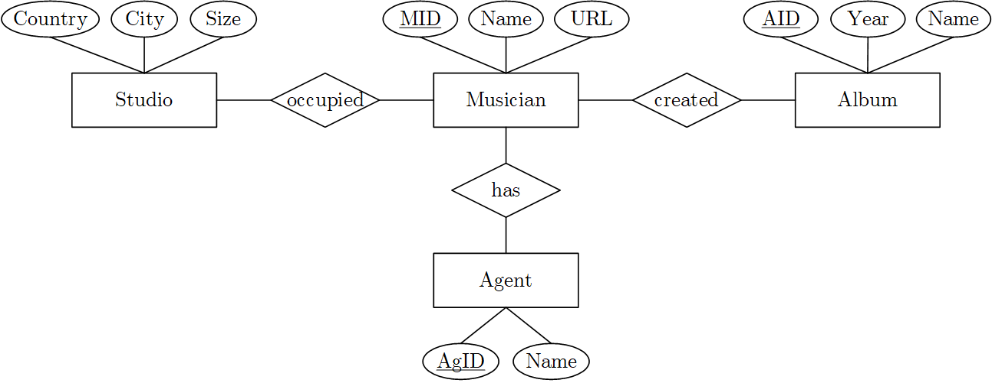
BREAK (and Test Yourself)
ER-Diagram to Relational Schema
Task: Map the given ER diagram into a relational schema, including data types, primary keys, and foreign keys (9/100 points)
Solution
1
C
M
MC
M
Studio(SID:int, City:varchar,
Country:varchar, size:int)
Agent(AgID:int, Name:varchar)
Musician(MID:int, Name:varchar,
URL:varchar, SID^{FK}:int, AgID^{FK}:int)
Album(AID:int, Year:int, Name:varchar)
Created(MID^{FK}:int, AID^{FK}:int)
1
5x relations
1x data types
1x primary keys
1x FKs in Musician
1x Composite PK in Created

Slide 25
Normalization
ER Diagram
Relational Schema
Normalized
Relational Schema

Slide 26
Motivation Poor Relational Schemas
Normalization
ProfCourse (mixed entity types ➔ redundancy)
Insert Anomaly: How to insert a new lecture or prof?
Update Anomaly: How to update “Boehm” → “Böhm”?
Delete Anomaly: What if we delete all data management lectures?
➔ Normalization: Find good schema to avoid redundancy,
ensure consistency, and prevent information loss
EID | Name | CID | Title | ECTS
7 | Boehm | INF.01014UF | Data Management (VO) | 3
7 | Boehm | INF.02018UF | Data Management (KU) | 1
7 | Boehm | 706.010 | Databases | 3
7 | Boehm | 706.520 | Data Integration and Large-Scale Analysis | 5
7 | Boehm | 706.543 | Architecture of Database Systems | 5
7 | Boehm | 706.550 | Architecture of Machine Learning Systems | 5

Slide 27
Overview Normalization
Normalization
Normalization Process
  “[…] reversible process of replacing a given collection of relations […]
  a progressively simpler and more regular structure”
  Principled approach of improving the quality (redundancy, inconsistencies)
  Input: DB-Schema and functional dependencies
1st Normal Form: no multi-valued attributes
2nd Normal Form: all non-key attributes
fully functional dependent on primary key
3rd Normal Form: no dependencies
among non-key attributes
Boyce-Codd Normal Form (BCNF)
4th, 5th,6th Normal Form
All relations
1. NF
2. NF
3. NF
BCNF
4.NF
…
[E. F. Codd: Normalized Data Structure: A Brief Tutorial. SIGFIDET Workshop 1971]
[E. F. Codd: Further Normalization of the Data Base Relational Model. IBM Research Report, San Jose, California RJ909 (1971)]
Notes:
Examples from 1971 paper
BCNF: any X→Y either trivial (Y subset) or super key (unique and defined) … handles overlapping candidates keys
4NF: multi-valued dependencies (generalization of functional dependencies)

Slide 28
Unnormalized Relation
Normalization
M
SPP
N
Part
Project
Relation PartProject
Issues
  Column ‘Project’ is not atomic, but set of tuples
  Redundancy across projects appearing in multiple parts
Solution:
  Create multiple tables with PK-FK relationships
P# | PDesc | Qty | Project (J#, JDesc, Mgr, Qty)
203 | CAM | 30 | 12 | Sorter | 007 | 5
 |  |  | 73 | Collator | 086 | 7
206 | COG | 155 | 12 | Sorter | 007 | 33
 |  |  | 29 | Punch | 086 | 25
 |  |  | 36 | Reader | 111 | 16
Notes:
CAM: Nockenwelle
COG: Zahnrad

Slide 29
1st Normal Form
Normalization
Definition and Approach
  Relation is in 1NF if all its attributes are atomic
  ➔ Split relations with 1:N and M:N relationships (lossless)
Example
Issues
  Insert anomaly (e.g., no project without parts)
  Update anomaly (e.g., redundant updated Mgr)
  Delete anomaly (e.g., project deleted on last part)
FK
Relation Project
P# | J# | JDesc | Mgr | Qty
203 | 12 | Sorter | 007 | 5
203 | 73 | Collator | 086 | 7
206 | 12 | Sorter | 007 | 33
206 | 29 | Punch | 086 | 25
206 | 36 | Reader | 111 | 16
Relation Part
P# | PDesc | Qty
203 | CAM | 30
206 | COG | 155
depend on J#
depends on (J#,P#)

Slide 30
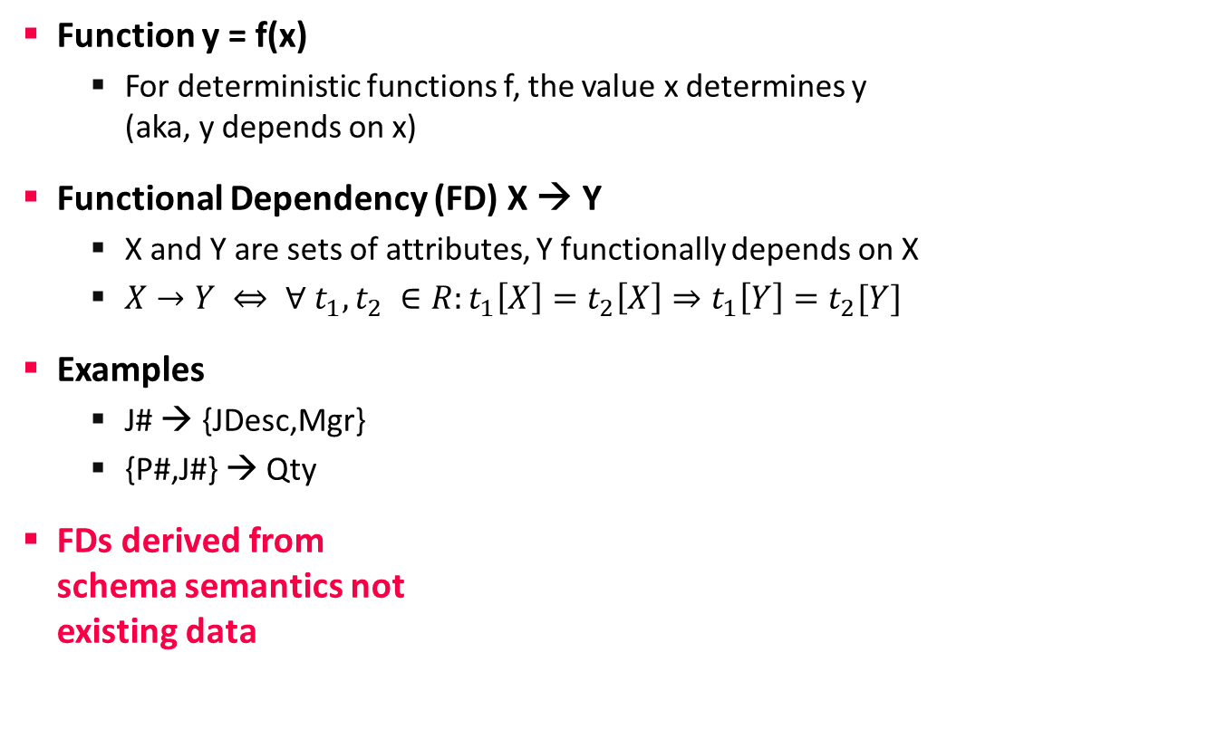
Background: Functional Dependency
Normalization
Function y = f(x)
  For deterministic functions f, the value x determines y
  (aka, y depends on x)
Functional Dependency (FD) X → Y
  X and Y are sets of attributes, Y functionally depends on X
  $X→Y ⇔ ∀ t_{1}, t_{2} ∈R:t_{1}\left[X\right]=t_{2}\left[X\right]⇒t_{1}\left[Y\right]=t_{2}[Y]$
Examples
  J# → {JDesc,Mgr}
  {P#,J#} → Qty
FDs derived from
schema semantics not
existing data
y
x
P# | J# | JDesc | Mgr | Qty
203 | 12 | Sorter | 007 | 5
203 | 73 | Collator | 086 | 7
206 | 12 | Sorter | 007 | 33
206 | 29 | Punch | 086 | 25
206 | 36 | Reader | 111 | 16

Slide 31
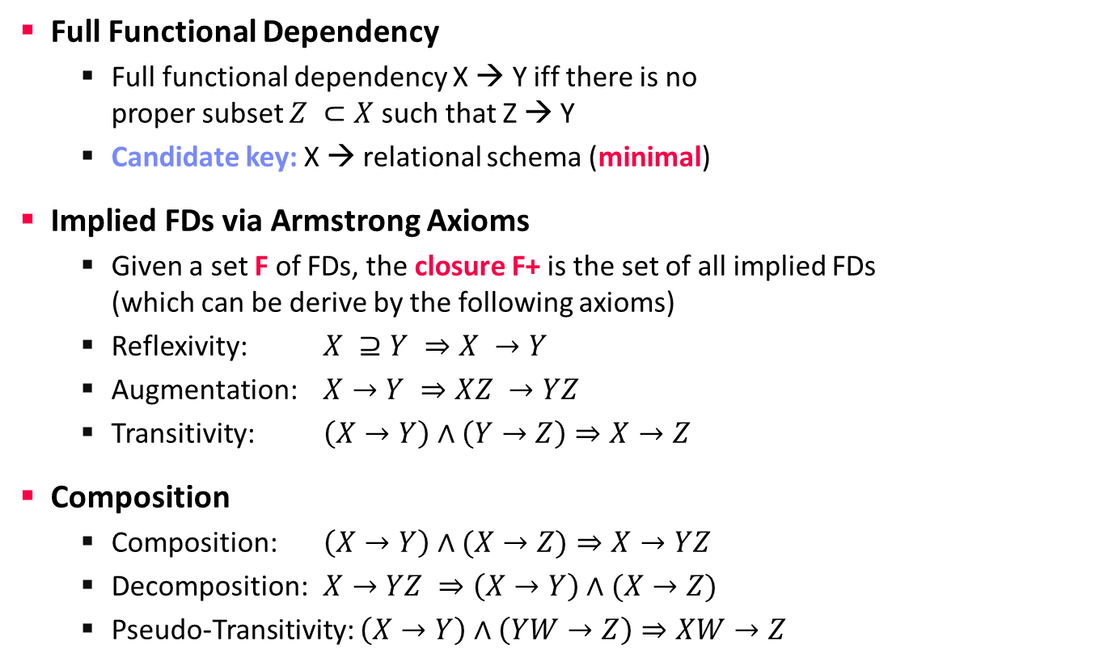
Background: Functional Dependency, cont.
Normalization
Full Functional Dependency
  Full functional dependency X → Y iff there is no
  proper subset $Z ⊂X$ such that Z → Y
  Candidate key: X → relational schema (minimal)
Implied FDs via Armstrong Axioms
  Given a set F of FDs, the closure F+ is the set of all implied FDs
  (which can be derive by the following axioms)
  Reflexivity: $X ⊇Y ⇒X →Y$
  Augmentation: $X→Y ⇒XZ →YZ$
  Transitivity: $\left(X→Y\right)∧\left(Y→Z\right)⇒X→Z$
Composition
  Composition: $\left(X→Y\right)∧(X→Z)⇒X→YZ$
  Decomposition: $X→YZ ⇒\left(X→Y\right)∧(X→Z)$
  Pseudo-Transitivity: $\left(X→Y\right)∧\left(YW→Z\right)⇒XW→Z$
Super key
Candidate Key
Primary key
Example:
  (J# → JDesc, J# → Mgr)
  ➔ (J# → {JDesc,Mgr})

Slide 32
2nd Normal Form
Normalization
Definition and Approach
  Relation is in 2NF if it’s in 1NF and every
  non-key attribute fully functional dependent from every candidate key
  ➔ Split relations with 1:N and M:N relationships (lossless)
Example
K
Relation Project
Relation PJ
J# | JDesc | Mgr
12 | Sorter | 007
73 | Collator | 086
29 | Punch | 086
36 | Reader | 111
Relation Part
FK
FK
P# | PDesc | Qty
203 | CAM | 30
206 | COG | 155
P# | J# | Qty
203 | 12 | 5
203 | 73 | 7
206 | 12 | 33
206 | 29 | 25
206 | 36 | 16
Split PJ and Project because J# → {JDesc, Mgr}, instead of {P#,J#} → {JDesc, Mgr}

Slide 33
3rd Normal Form
Normalization
Definition and Approach
  Relation is in 3NF if it’s in 2NF and every non-key attribute is non-transitively dependent from every candidate key (➔ no non-key dependencies)
  ➔ Split relations with 1:N and M:N relationships (lossless)
  Preserves all dependencies but might still contain anomalies (→ BCNF)
Example
NOT in 3NF
  E# → D#
  D#→DMgr
  D#→CType
Relation Employee
E# | JCode | D# | DMgr | CType
1 | A | X | 11 | G
2 | C | X | 11 | G
3 | A | Y | 12 | N
4 | B | X | 11 | G
5 | B | Y | 12 | N
6 | C | Y | 12 | N
7 | A | Z | 13 | N
8 | C | Z | 13 | N

Slide 34
3rd Normal Form, cont.
Normalization
N
ED
1
Employee
Department
Example
Relation Employee
FK
Relation Department
E# | JCode | D#
1 | A | X
2 | C | X
3 | A | Y
4 | B | X
5 | B | Y
6 | C | Y
7 | A | Z
8 | C | Z
D# | DMgr | CType
X | 11 | G
Y | 12 | N
Z | 13 | N
➔ “Denormalization”:
Conscious creation of materialized views in non-3NF/2NF to improve performance
(primarily for read-only DBs)

Slide 35
BREAK (and Test Yourself #2)
Normalization
Task: Assume the functional dependency City→Country. Bring your schema into 3NF and explain why it is in 3NF (prev. exam 10/100 points)
Solution
  1st Normal Form: no multi-valued attributes
  2nd Normal Form: all non-key attributes fully functional dependent on PK
  3rd Normal Form: no dependencies among non-key attributes
Studio(SID:int, City:varchar, Country:varchar, size:int)
Studio(SID:int, CName^{FK}:varchar, size:int)
Cities(CName:varchar, Country:varchar)

Slide 36
Conclusions and Q&A
Summary
  Fundamentals of the relational data model + SQL DDL
  Mapping ER diagrams into relational schemas
  Relational normalization (1NF, 2NF, 3NF)
Exercise 1 Reminder
  All background to solve tasks 1.1 and 1.2 (25/25)
  Deadline: Nov 02, 11.59pm in TeachCenter, draft submissions are fine
  Make use of the news group and office hours
Next lectures
  04 Relational Algebra and Tuple Calculus [Oct 25]
  All Saints’ Day (Allerheiligen) [Nov 01]
  05 Query Languages (SQL) [Nov 08]

