Slide 1

Data Management
10 NoSQL Systems
Last update: Dec 13, 2021

Slide 2



Announcements/Org
#1 Video Recording
  Link in TUbe & TeachCenter (lectures will be public)
  Optional attendance (independent of COVID)
  Virtual lectures (recorded) until end of the year
  https://tugraz.webex.com/meet/m.boehm
#2 Exercise Submissions
  Exercise 2: in process of begin graded (→ before Xmas)
  Exercise 3: due Dec 21, 11.59pm, provided data
  Exercise 4: extra credit, published Dec 11
#3 Course Evaluation and Exam
  Evaluation period: Jan 01 – Feb 15
  Exam dates: Feb 04, 12.30pm and Feb 04, 5.30pm
  (90+min written exam, start 10 late)
Q&A
[https://mboehm7.github.io/
teaching/ws2122_dbs/T3_data.zip]

Slide 3
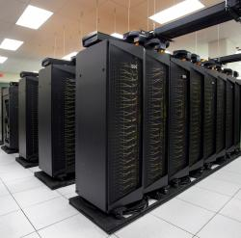
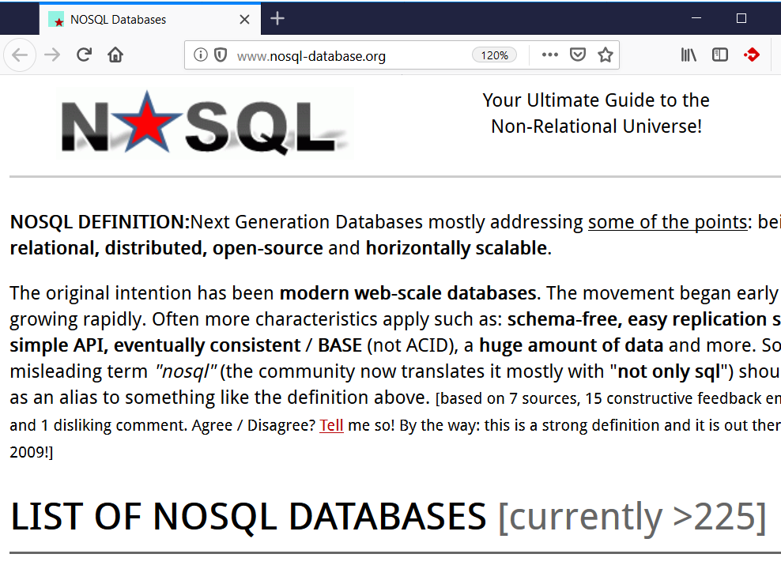
SQL vs NoSQL Motivation
#1 Data Models/Schema
  Non-relational: key-value, graph, doc, time series
  (logs, social media, documents/media, sensors)
  Impedance mismatch / complexity
  Pay-as-you-go/schema-free (flexible/implicit)
#2 Scalability
  Scale-up vs simple scale-out
  Horizontal partitioning (sharding) and scaling
  Commodity hardware, network, disks ($)
NoSQL Evolution
  Late 2000s: Non-relational, distributed, open source DBMSs
  Early 2010s: NewSQL: modern, distributed, relational DBMSs
  Not Only SQL: combination with relational techniques
  ➔ RDBMS and specialized systems (consistency/data models)
[Credit: http://nosql-database.org/]

Slide 4
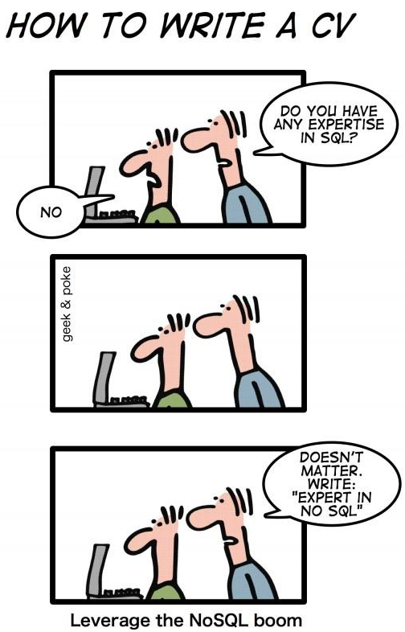
Agenda
Consistency and Data Models
Key-Value Stores
Document Stores
Graph Processing
Time Series Databases
Exercise 4: Large-Scale Data Analysis
Lack of standards
and imprecise classification
[Wolfram Wingerath, Felix Gessert, Norbert Ritter:
NoSQL & Real-Time Data Management in Research & Practice. BTW 2019]
[http://geek-and-poke.com/]

Slide 5
Consistency and Data Models

Slide 6
Recap: ACID Properties
Consistency and Data Models
Atomicity
  A transaction is executed atomically (completely or not at all)
  If the transaction fails/aborts no changes are made to the database (UNDO)
Consistency
  A successful transaction ensures that all consistency constraints are met
  (referential integrity, semantic/domain constraints)
Isolation
  Concurrent transactions are executed in isolation of each other
  Appearance of serial transaction execution
Durability
  Guaranteed persistence of all changes made by a successful transaction
  In case of system failures, the database is recoverable (REDO)

Slide 7
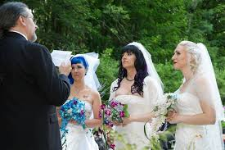
Two-Phase Commit (2PC) Protocol
Consistency and Data Models
Distributed TX Processing
  N nodes with logically related but physically distributed data
  (e.g., vertical data partitioning)
  Distributed TX processing to ensure consistent view (atomicity/durability)
Two-Phase Commit (via 2N msgs)
  Phase 1 PREPARE: check for
  successful completion, logging
  Phase 2 COMMIT: release locks,
  and other cleanups
  Problem: Blocking protocol
Excursus: Wedding Analogy
  Coordinator: marriage registrar
  Phase 1: Ask for willingness
  Phase 2: If all willing, declare marriage
DBS 2
coordinator
DBS 1
DBS 3
DBS 4

Slide 8
CAP Theorem
Consistency and Data Models
Consistency
  Visibility of updates to distributed data (atomic or linearizable consistency)
  Different from ACIDs consistency in terms of integrity constraints
Availability
  Responsiveness of a services (clients reach available service, read/write)
Partition Tolerance
  Tolerance of temporarily unreachable network partitions
  System characteristics (e.g., latency) maintained
CAP Theorem
Proof
”You can have AT MOST TWO of these properties for a networked shared-data systems.”
[Eric A. Brewer: Towards robust distributed systems (abstract). PODC 2000]
[Seth Gilbert, Nancy A. Lynch: Brewer's conjecture and the feasibility of consistent, available, partition-tolerant web services. SIGACT News 2002]

Slide 9
CAP Theorem, cont.
Consistency and Data Models
write A
1
CA: Consistency & Availability (ACID single node)
  Network partitions cannot be tolerated
  Visibility of updates (consistency) in conflict
  with availability ➔ no distributed systems
CP: Consistency & Partition Tolerance (ACID distributed)
  Availability cannot be guaranteed
  On connection failure, unavailable
  (wait for overall system to become consistent)
AP: Availability & Partition Tolerance (BASE)
  Consistency cannot be guaranteed, use of optimistic strategies
  Simple to implement, main concern: availability to ensure revenue ($$$)
  ➔ BASE consistency model
2
3
4
7
5
6
read A

Slide 10
BASE Properties
Consistency and Data Models
Basically Available
  Major focus on availability, potentially with outdated data
  No guarantee on global data consistency across entire system
Soft State
  Even without explicit state updates, the data might change due to asynchronous propagation of updates and nodes that become available
Eventual Consistency
  Updates eventually propagated, system would reach consistent state if no further updates, and network partitions fixed
  No temporal guarantees on changes are propagated
Notes:
NOTE: ACID vs BASE

Slide 11
Eventual Consistency
Consistency and Data Models
[Peter Bailis, Ali Ghodsi: Eventual consistency today: limitations, extensions, and beyond. Commun. ACM 2013]
Basic Concept
  Changes made to a copy eventually migrate to all
  If update activity stops, replicas will
  converge to a logically equivalent state
  Metric: time to reach consistency
  (probabilistic bounded staleness)
#1 Monotonic Read Consistency
  After reading data object A, the client never reads an older version
#2 Monotonic Write Consistency
  After writing data object A, it will never be replaced with an older version
#3 Read Your Own Writes / Session Consistency
  After writing data object A, a client never reads an older version
#4 Causal Consistency
  If client 1 communicated to client 2 that data object A has been updated, subsequent reads on client 2 return the new value
Amazon SimpleDB | 500ms
Cassandra | 200ms
Amazon S3 | 12s

Slide 12
Key-Value Stores

Slide 13

Motivation and Terminology
Key-Value Stores
Motivation
  Basic key-value mapping via simple API (more complex data models
  can be mapped to key-value representations)
  Reliability at massive scale on commodity HW (cloud computing)
System Architecture
  Key-value maps, where values
  can be of a variety of data types
  APIs for CRUD operations
  (create, read, update, delete)
  Scalability via sharding
  (horizontal partitioning)
Example Systems
  Dynamo (2007, AP) → Amazon DynamoDB (2012)
  Redis (2009, CP/AP)
users:1:a
“Inffeldgasse 13, Graz”
users:1:b
“[12, 34, 45, 67, 89]”
users:2:a
“Mandellstraße 12, Graz”
users:2:b
“[12, 212, 3212, 43212]”
[Giuseppe DeCandia et al: Dynamo: amazon's highly available key-value store. SOSP 2007]
Notes:
Notes:
* Dynamo (consistent hashing) + SimpleDB → DynamoDB
* Dynamo with consistent hashing

Slide 14










Example Systems
Key-Value Stores
Redis Data Types
  Redis is not a plain KV-store, but “data structure server” with
  persistent log (appendfsync no/everysec/always)
  Key: ASCII string (max 512MB, common key schemes: comment:1234:reply.to)
  Values: strings, lists, sets, sorted sets, hashes (map of string-string), etc
Redis APIs
  SET/GET/DEL: insert a key-value pair, lookup value by key, or delete by key
  MSET/MGET: insert or lookup multiple keys at once
  INCRBY/DECBY: increment/decrement counters
  Others: EXISTS, LPUSH, LPOP, LRANGE, LTRIM, LLEN, etc
Other systems
  Classic KV stores (AP): Riak, Aerospike, Voldemort,
  LevelDB, RocksDB, FoundationDB, Memcached
  Wide-column stores: Google BigTable (CP),
  Apache HBase (CP), Apache Cassandra (AP)

Slide 15
Log-structured Merge Trees
Key-Value Stores
[Patrick E. O'Neil, Edward Cheng, Dieter Gawlick, Elizabeth J. O'Neil: The Log-Structured Merge-Tree (LSM-Tree). Acta Inf. 1996]
LSM Overview
  Many KV-stores rely on LSM-trees as their storage engine
  (e.g., BigTable, DynamoDB, LevelDB, Riak, RocksDB, Cassandra, HBase)
  Approach: Buffers writes in memory, flushes data as sorted runs to storage,
  merges runs into larger runs of next level (compaction)
System Architecture
  Writes in C0
  Reads against
  C0 and C1 (w/
  buffer for C1)
  Compaction
  (rolling merge):
  sort, merge,
  including
  deduplication
C0
in-memory
buffer (C0)
max capacity T
writes
reads
compaction
C1_{t}
on-disk storage (C1)
C1_{t+1}
Notes:
Note: LSM write optimized by buffering writes, read-optimized by sort-merging on-disk runs
C1 and Ci also trees similar to B-tree but nodes kept 100% full single node pages packed into multi-page blocks
→ Better insert performance, worse lookup costs

Slide 16
Log-structured Merge Trees, cont.
Key-Value Stores
write-optimized
LSM Tiering
  Keep up to T-1 runs per level L
  Merge all runs of L_{i} into 1 run of L_{i+1}
    L1
    L2
    L3
LSM Leveling
  Keep 1 run per level L
  Merge run of Li with Li+1
    L1
    L2
    L3
read-optimized
[Niv Dayan: Log-Structured-Merge Trees, Comp115 guest lecture, 2017]
[Stratos Idreos, Mark Callaghan: Key-Value Storage Engines (Tutorial), SIGMOD 2020]

Slide 17
Document Stores

Slide 18

Recap: JSON (JavaScript Object Notation)
Other Query Languages (XML, JSON)
JSON Data Model
  Data exchange format for
  semi-structured data
  Not as verbose as XML
  (especially for arrays)
  Popular format (e.g., Twitter)
Query Languages
  Most common: libraries for
  tree traversal and data extraction
  JSONig: XQuery-like query language
  JSONPath: XPath-like query language
{“students:”[
{“id”: 1, “courses”:[
{“id“:“INF.01017UF”, “name“:“DM”},
{“id“:“706.550”, “name“:“AMLS”}]},
{“id”: 5, “courses”:[
{“id“:“706.520”, “name“:“DIA”}]},
]}
JSONiq Example:
declare option jsoniq-version “…”;
for $x in collection(“students”)
where $x.id lt 10
let $c := count($x.courses)
return {“sid”:$x.id, “count”:$c}
[http://www.jsoniq.org/docs/JSONiq/html-single/index.html]

Slide 19



Motivation and Terminology
Document Stores
Motivation
  Application-oriented management of structured, semi-structured, and unstructured information (pay-as-you-go, schema evolution)
  Scalability via parallelization on commodity HW (cloud computing)
System Architecture
  Collections of (key, document)
  Scalability via sharding
  (horizontal partitioning)
  Custom SQL-like or
  functional query languages
Example Systems
  MongoDB (C++, 2007, CP) → RethinkDB, Espresso,
  Amazon DocumentDB (Jan 2019)
  CouchDB (Erlang, 2005, AP) → CouchBase
1234
{customer:”Jane Smith”,
items:[{name:”P1”,price:49},
{name:”P2”,price:19}]}
1756
{customer:”John Smith”, ...}
989
{customer:”Jane Smith”, ...}

Slide 20
Example MongoDB
Document Stores
[Credit: https://api.mongodb.com/
python/current]
Creating
a Collection
Inserting into
a Collection
Querying
a Collection
import pymongo as m
conn = m.MongoClient(“mongodb://localhost:123/”)
db = conn[“dbs19”] # database dbs19
cust = db[“customers”] # collection customers
mdict = {
“name“: “Jane Smith”,
“address”: “Inffeldgasse 13, Graz”
}
id = cust.insert_one(mdict).inserted_id
# ids = cust.insert_many(mlist).inserted_ids
print(cust.find_one({"_id": id}))
ret = cust.find({"name": "Jane Smith"})
for x in ret:
print(x)

Slide 21
BREAK (and Test Yourself)
NoSQL Systems (10/100 points)
  Describe the concept and system architecture of a key-value store, including techniques for achieving high write throughput, and scale-out in distributed environments. […]
Solution
  Key-value store
  system architecture [4]
  Write-throughput via LSM
  (log-structured merge tree) [3]
  Horizontal partitioning [3]
  (see 07 Physical Design)
R
k | v
1 | Blob1
2 | Blob2
4 | Blob4
7 | Blob7
15 | Blob15
9 | Blob9
14 | Blob14
8 | Blob8
R1 = σ_{k<=5}(R)
R2 = σ_{k>5Λk<=10}(R)
R3 = σ_{k>10Λk<=15}(R)
R = (R1 ∪ R2) ∪ R3)

Slide 22
Graph Processing

Slide 23
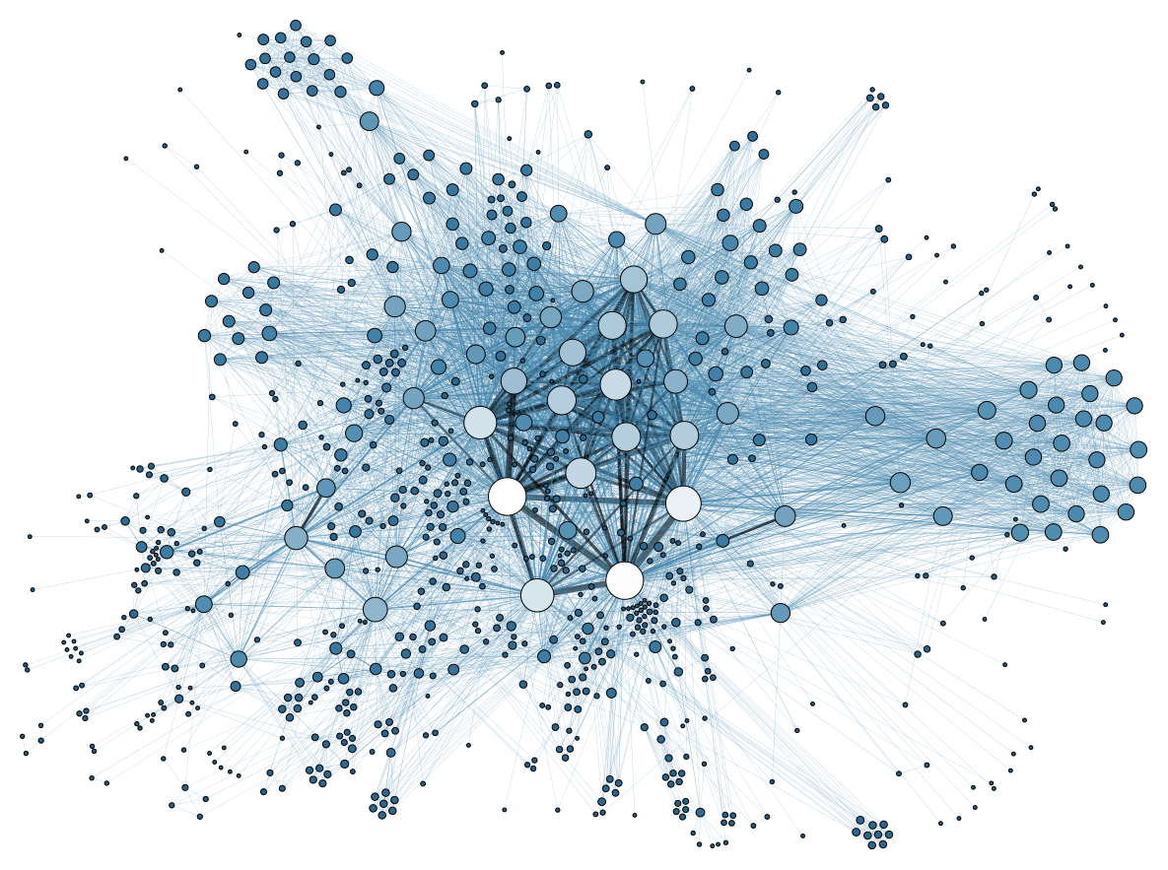
Motivation and Terminology
Graph Processing
Ubiquitous Graphs
  Domains: social networks, open/linked data, knowledge bases, bioinformatics
  Applications: influencer analysis, ranking, topology analysis
Terminology
  Graph G = (V, E) of vertices V (set of nodes)
  and edges E (set of links between nodes)
  Different types of graphs
Undirected Graph
Directed
Graph
Multi
Graph
Labeled
Graph
Data/Property
Graph
k1=v1
k2=v2
Gene
inter-acts
k2=v3

Slide 24
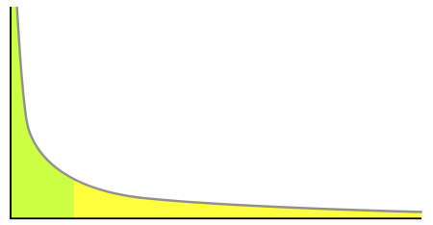
Terminology and Graph Characteristics
Graph Processing
Terminology, cont.
  Path: Sequence of edges and vertices (walk: allows repeated edges/vertices)
  Cycle: Closed walk, i.e., a walk that starts and ends at the same vertex
  Clique: Subgraph of vertices where every two distinct vertices are adjacent
Metrics
  Degree (in/out-degree): number of
  incoming/outgoing edges of that vertex
  Diameter: Maximum distance of pairs of vertices
  (longest shortest-path)
Power Law Distribution
  Degree of most real graphs follows
  a power law distribution
in-
degree 3
out-
degree 2
Tall head
e.g., 80-20 rule
Long tail

Slide 25
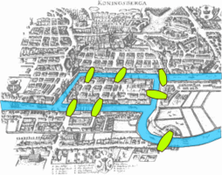
Vertex-Centric Processing
Graph Processing
[Grzegorz Malewicz et al: Pregel:
a system for large-scale graph processing. SIGMOD 2010
SIGMOD 2020 Test of Time Award]
Google Pregel
  Name: Seven Bridges of Koenigsberg (Euler 1736)
  “Think-like-a-vertex” computation model
  Iterative processing in super steps, comm.: message passing
Programming Model
  Represent graph as collection of
  vertices w/ edge (adjacency) lists
  Implement algorithms via Vertex API
  Terminate if all vertices halted / no more msgs
1
2
3
4
5
7
6
public abstract class Vertex {
public String getID();
public long superstep();
public VertexValue getValue();
public compute(Iterator<Message> msgs);
public sendMsgTo(String v, Message msg);
public void voteToHalt();
}
2
[1, 3, 4]
7
[5, 6]
Worker 1
4
[1, 2]
1
[1, 2, 4]
5
[6, 7]
[2]
Worker 2
3
6
[5, 7]
Notes:
Note: Euler showed 1736 that there cannot be a route that crosses every bridge just once (Seven Bridges of Koenigsberg) because there can be at most 2 nodes (begin, end) that have an uneven number of bridges (enter,exit).

Slide 26
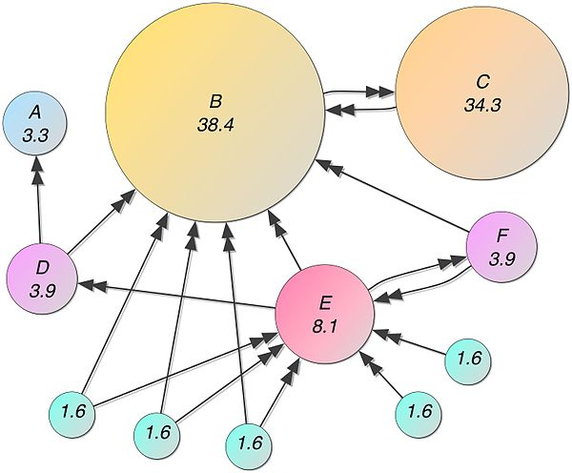
Vertex-Centric Processing, cont.
Graph Processing
Example1: Connected Components
  Determine connected components of a graph (subgraphs of connected nodes)
  Propagate max(current, msgs) if != current to neighbors, terminate if no msgs
Example 2: Page Rank
  Ranking of webpages by importance / impact
  #1: Initialize vertices to 1/numVertices()
  #2: In each super step
    Compute current vertex value:
    value = 0.15/numVertices()+0.85*sum(msg)
    Send to all neighbors:
    value/numOutgoingEdges()
Step 0
Step 1
Step 2
Step 3
converged
1
4
4
2
3
4
3
4
4
4
5
4
7
4
7
7
6
7
7
7
7
[Credit: https://en.
wikipedia.org/wiki/PageRank ]

Slide 27
Graph-Centric Processing
Graph Processing
Motivation
  Exploit graph structure for algorithm-specific optimizations
  (number of network messages, scheduling overhead for super steps)
  Large diameter / average vertex degree
Programming Model
  Partition graph into subgraphs (block/graph)
  Implement algorithm directly against
  subgraphs (internal and boundary nodes)
  Exchange messages in super steps only
  between boundary nodes ➔ faster convergence
1
2
3
4
5
7
6
Worker 1
Worker 2
[Yuanyuan Tian, Andrey Balmin, Severin Andreas Corsten, Shirish Tatikonda, John McPherson: From "Think Like a Vertex" to "Think Like a Graph". PVLDB 2013]
1
2
3
4
[Da Yan, James Cheng, Yi Lu, Wilfred Ng: Blogel: A Block-Centric Framework for Distributed Computation on Real-World Graphs. PVLDB 2014]
5
Worker 3
7
6

Slide 28
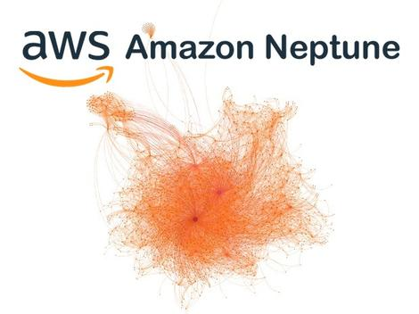




Resource Description Framework (RDF)
Graph Processing
uri1:Bayern
Munich
RDF Data
  Data and meta data description via triples
  Triple: (subject, predicate, object)
  Triple components can be URIs or literals
  Formats: e.g., RDF/XML, RDF/JSON, Turtle
  RDF graph is a directed, labeled multigraph
Querying RDF Data
  SPARQL (SPARQL
  Protocol And RDF
  Query Language)
  Subgraph matching
Selected
Example Systems
uri4#worksFor
uri2:T.Mueller
rdf#type
uri4#age
uri3:Player
29
SELECT ?person
WHERE {
?person rdf:type uri3:Player ;
uri4:worksFor uri1:”Bayern Munich” .
}

Slide 29






Excursus: Example Systems
Graph Processing
Understanding Use in Practice
  Types of graphs user have
  Graph computations run
  Types of graph systems used
Summary of State of the Art
Runtime Techniques
[Siddhartha Sahu, Amine Mhedhbi, Semih Salihoglu, Jimmy Lin, M. Tamer Özsu: The Ubiquity of Large Graphs and Surprising Challenges of Graph Processing. PVLDB 2017]
Graph X
[Da Yan, Yingyi Bu, Yuanyuan Tian, Amol Deshpande, James Cheng: Big Graph Analytics Systems. SIGMOD 2016]
Notes:
•Variety: Graphs in practice represent a very wide variety of entities, many of which are not naturally thought of as vertices and edges. Most surprisingly, traditional enterprise data comprised of products, orders, and transactions, which are typically seen as the perfect fit for relational systems, appear to be a very common form of data represented in participants’ graphs.
•Ubiquity of Very Large Graphs: Many graphs in practice are very large, often containing over a billion edges. These large graphs represent a very wide range of entities and belong to organizations at all scales from very small enterprises to very large ones. This refutes the sometimes heard assumption that large graphs are a problem for only a few large organizations such as Google, Facebook, and Twitter.
•Challenge of Scalability: Scalability is unequivocally the most pressing challenge faced by participants. The ability to process very large graphs efficiently seems to be the biggest limitation of existing software.
•Visualization: Visualization is a very popular and central task in participants’ graph processing pipelines. After scalability, participants indicated visualization as their second most pressing challenge, tied with challenges in graph query languages.
•Prevalence of RDBMSes: Relational databases still play an important role in managing and processing graphs

Slide 30
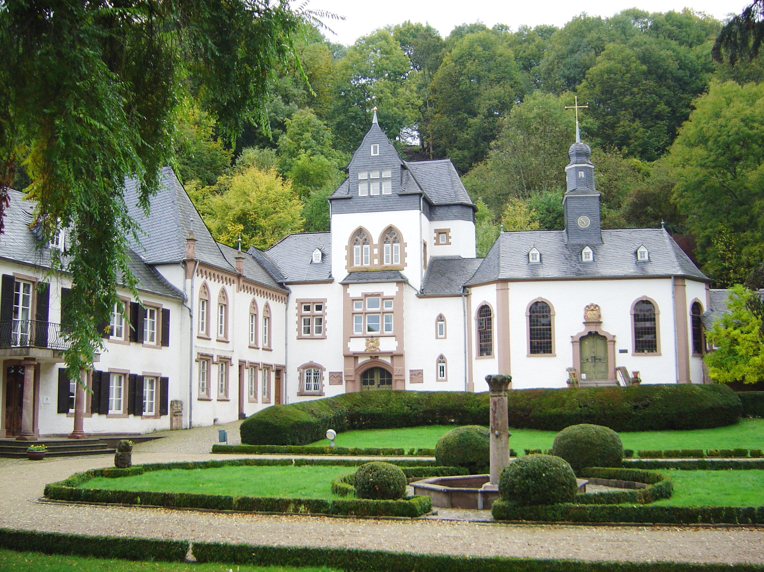
Excursus: Future Graph Processing Systems
Graph Processing
Community Perspective
  2019 Dagstuhl Seminar on Big Graph Processing Systems
  Opportunities and challenges:
  Abstractions, Ecosystems, and Performance
[Credit:
https://commons.wikimedia.org/
wiki/File:Dagstuhl_DSC02285.jpg]
[Sherif Sakr et al: The future is big graphs: a community view on graph processing systems. CACM 64(9), 2021]

Slide 31
Time Series Databases

Slide 32
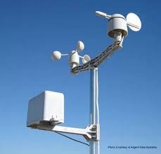


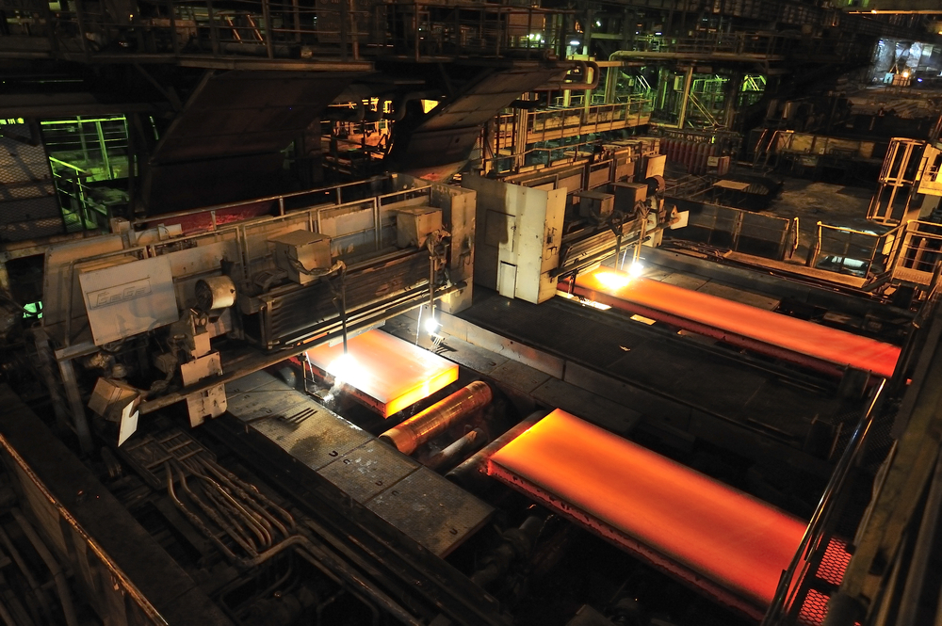
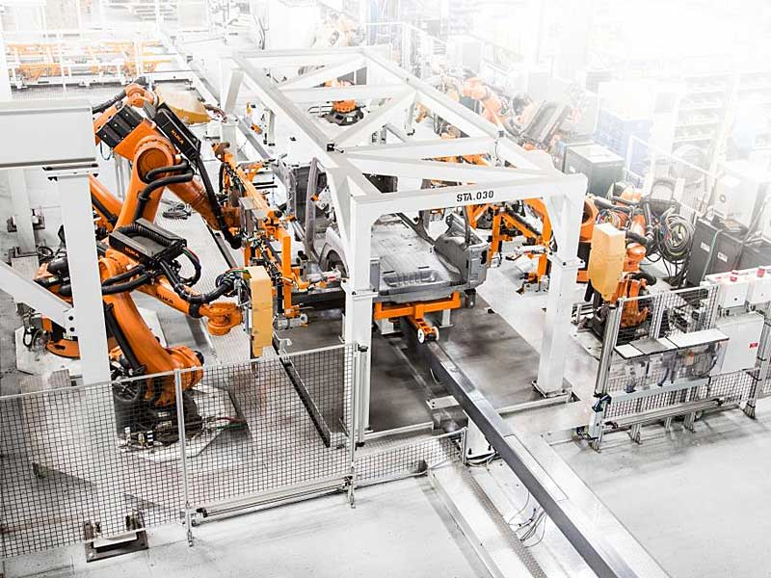
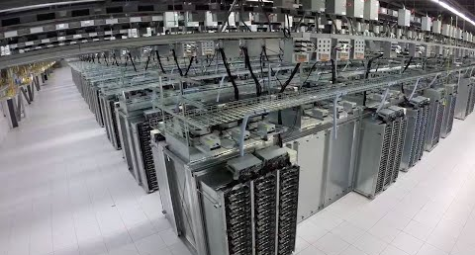
Motivation and Terminology
Time Series Databases
Ubiquitous Time Series
  Domains: Internet-of-Things (IoT), sensor networks, smart production/planet,
  telemetry, stock trading, server/application metrics, event/log streams
  Applications: monitoring, anomaly detection, time series forecasting
  Dedicated storage and analysis techniques ➔ Specialized systems
Terminology
  Time series X is a sequence of data
  points x_{i} for a specific measurement
  identity (e.g., sensor) and time granularity
  Regular (equidistant) time series (x_{i})
  vs irregular time series (t_{i}, x_{i})
regular
1s
1s
irregular

Slide 33

Example InfluxDB
Time Series Databases
Measurement
Tags
[Paul Dix: InfluxDB Storage Engine Internals, CMU Seminar, 09/2017]
Input Data
System Architecture
  Written in Go, originally key-value store, now dedicated storage engine
  Time Structured Merge Tree (TSM), similar to LSM
  Organized in shards, TSM indexes and inverted index for reads
cpu,region=west,host=A
user=85,sys=2,idle=10 1443782126
Fields (values)
Time
append-only
fsync
Index per TSM file:
Header | Blocks | Index | Footer
Write
WAL
KeyLen | Key | Type | Min T | Max T| Off | …
In-Mem
Index
periodic flushes
compaction & compression
periodic drop of shards (files) according to retention policy
TSM Indexes

Slide 34
Example InfluxDB, cont.
Time Series Databases
Compression (of blocks)
  Compress up to 1000 values per block (Type | Len | Timestamps | Values)
  Timestamps: Delta + Run-length encoding for regular time series;
  Simple8B or uncompressed for irregular
  Values: double delta for FP64, bits for Bool, double delta + zig zag for INT64, Snappy for strings
Query Processing
  SQL-like and functional APIs for
  filtering (e.g., range) and aggregation
  Inverted indexes
SELECT percentile(90, user)
FROM cpu WHERE time>now()-12h
AND “region”=‘west’
GROUP BY time(10m), host
Posting lists:
cpu → [1,2,3,4,5,6]
host=A → [1,2,3]
host=B → [4,5,6]
region=west → [1,2,3]
Measurement to fields:
cpu → [user,sys,idle]
host → [A, B]
Region → [west, east]

Slide 35




Other Systems
Time Series Databases
Prometheus
  Metrics, high-dim data model, sharding and federation
  custom storage and query engine, implemented in Go
OpenTSDB
  TSDB on top of HBase or Google BigTable, Hadoop
TimescaleDB
  TSDB on top of PostgreSQL, standard SQL and reliability
Druid
  Column-oriented storage for time series, OLAP, and search
IBM Event Store
  HTAP system for high data ingest rates,
  and data-parallel analytics via Spark
  Shard-local logs → groomed data
[Ronald Barber et al: Evolving Databases for New-Gen Big Data Applications. CIDR 2017]
[Christian Garcia-Arellano et al:
Db2 Event Store: A Purpose-Built IoT Database Engine. PVLDB 13(12) 2020]

Slide 36
Exercise 4:
Large-Scale Data Analysis
Published: Dec 11
Deadline: Jan 18
Entire Exercise is Extra Credit

Slide 37
Task 4.1 Apache Spark Setup
Exercise 4: Large-Scale Data Analysis
3/25 points
#1 Pick your Spark Language Binding
  Java, Scala, Python
#2 Install Dependencies
  Java: Maven
  spark-core, spark-sql
  Python:
  pip install pyspark
(#3 Win Environment)
  Download https://github.com/steveloughran/winutils/tree/master/hadoop-2.7.1/bin/winutils.exe (or https://github.com/cdarlint/winutils)
  Create environment variable HADOOP_HOME=“<some-path>/hadoop”
<dependency>
<groupId>org.apache.spark</groupId>
<artifactId>spark-core_2.11</artifactId>
<version>2.4.7</version>
</dependency>
<dependency>
<groupId>org.apache.spark</groupId>
<artifactId>spark-sql_2.11</artifactId>
<version>2.4.7</version>
</dependency>

Slide 38
Task 4.2 Query Processing via Spark RDDs
Exercise 4: Large-Scale Data Analysis
11/25 points
#1 Spark Context Creation
  Create a spark context sc w/ local master (local[*])
#2 Implement Q09 via RDD Operations
  Implement Q09 in self-contained executeQ09RDD()
  All reads should use sc.textFile(fname)
  RDD operations only → stdout
Note: Query will be shared by Dec 28
https://spark.apache.org/docs/latest/rdd-programming-guide.html

Slide 39
Task 4.3 Query Processing via Spark SQL
Exercise 4: Large-Scale Data Analysis
5/25 points
#1 Spark Session Creation
  Create a spark session via a spark session builder
  and w/ local master (local[*])
#2 Implement Q09 via Dataset Operations
  Implement Q09 self-contained in executeQ09Dataset()
  All reads should use sc.read().format("csv")
  SQL or Dataset operations only → out07.json
WebUI
➔ SQL processing of high importance in modern
data management
INFO Utils: Successfully started service 'SparkUI' on port 4040.
INFO SparkUI: Bound SparkUI to […] http://192.168.108.220:4040

Slide 40


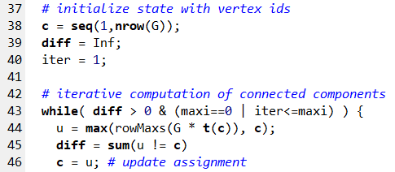
Task 4.4 Graph Processing
Exercise 4: Large-Scale Data Analysis
6/25 points
Input Co-author graph
  AuthPapersCOO.csv
  (coordinate format)
  AuthPapersCSR.csv
  (compressed sparse row)
#1 Compute Connected Components
  Leverage Spark to compute assignment
  of vertices to components
  Write output to text file, print #components to stdout
  APIs up to you (e.g., Spark RDDs, Spark SQL, Spark GraphX)
  Example
  Apache
  SystemDS
1
2
3
4
5
7
6

Slide 41
Conclusions and Q&A
Summary 10 NoSQL Systems
  Consistency and Data Models
  Key-Value and Document Stores
  Graph and Time Series Databases
Next Lectures (Part B: Modern Data Management)
  11 Distributed Storage and Data Analysis [Jan 10]
  12 Data stream processing systems, Q&A [Jan 17]

