Slide 1

Data Management
11 Distributed Storage & Analysis
Last update: Jan 05, 2022

Slide 2



Announcements/Org
#1 Video Recording
  Link in TUbe & TeachCenter (lectures will be public)
  Optional attendance (independent of COVID)
  Virtual lectures (recorded) until end of semester
  https://tugraz.webex.com/meet/m.boehm
#2 Exercise Submissions
  Exercise 3: in progress of being graded (target Jan 16)
  Exercise 4: extra credit, due Jan 18 + 7 late days
#3 Course Evaluation and Exam
  Evaluation period: Jan 01 – Feb 15
  (thanks for the nomination for price of excellent teaching)
  Exam dates: Feb 04, 12.30pm and Feb 04, 5.30pm
  (90+min written exam, start 10 late)
Status: RED
Q&A
[https://mboehm7.github.io/
teaching/ws2122_dbs/T3_data.zip]

Slide 3
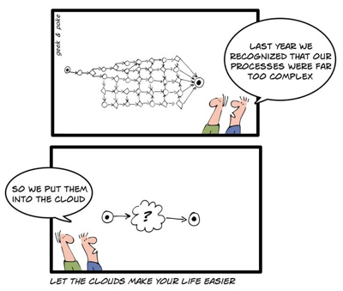
Agenda
Cloud Computing Overview
Distributed Data Storage
Distributed Data Analysis
Data Integration and Large-Scale Analysis (DIA)
(bachelor/master)

Slide 4
Cloud Computing Overview

Slide 5
Motivation Cloud Computing
Cloud Computing Overview
Definition Cloud Computing
  On-demand, remote storage and compute resources, or services
  User: computing as a utility (similar to energy, water, internet services)
  Cloud provider: computation in data centers / multi-tenancy
Service Models
  IaaS: Infrastructure as a service (e.g., storage/compute nodes)
  PaaS: Platform as a service (e.g., distributed systems/frameworks)
  SaaS: Software as a Service (e.g., email, databases, office, github)
➔ Transforming IT Industry/Landscape
  Since ~2010 increasing move from on-prem to cloud resources
  System software licenses become increasingly irrelevant
  Few cloud providers dominate IaaS/PaaS/SaaS markets (w/ 2018 revenue):
  Microsoft Azure Cloud ($ 32.2B), Amazon AWS ($ 25.7B), Google Cloud (N/A), IBM Cloud ($ 19.2B), Oracle Cloud ($ 5.3B), Alibaba Cloud ($ 2.1B)

Slide 6
Motivation Cloud Computing, cont.
Cloud Computing Overview
100%
Argument #1: Pay as you go
  No upfront cost for infrastructure
  Variable utilization ➔ over-provisioning
  Pay per use or acquired resources
Argument #2: Economies of Scale
  Purchasing and managing IT infrastructure at scale ➔ lower cost
  (applies to both HW resources and IT infrastructure/system experts)
  Focus on scale-out on commodity HW over scale-up ➔ lower cost
Argument #3: Elasticity
  Assuming perfect scalability, work done
  in constant time * resources
  Given virtually unlimited resources
  allows to reduce time as necessary
Utili-zation
Time
100 days @ 1 node
≈
1 day @ 100 nodes
(but beware Amdahl’s law: max speedup sp = 1/s)

Slide 7
Characteristics and Deployment Models
Cloud Computing Overview
Extended Definition
  ANSI recommended definitions for service
  types, characteristics, deployment models
Characteristics
  On-demand self service: unilateral resource provision
  Broad network access: network accessibility
  Resource pooling: resource virtualization / multi-tenancy
  Rapid elasticity: scale out/in on demand
  Measured service: utilization monitoring/reporting
Deployment Models
  Public cloud: general public, on premise of cloud provider
  Hybrid cloud: combination of two or more of the above
  Community cloud: single community (one or more orgs)
  Private cloud: single org, on/off premises
[Peter Mell and Timothy Grance: The NIST Definition of Cloud Computing, NIST 2011]
MS Azure
Private Cloud
IBM Cloud Private

Slide 8
Excursus: 1 Query/Minute for 1 Week
Cloud Computing Overview
Experimental Setup
  1GB TPC-H database, 4 queries on
  2 cloud DBs / 1 on-prem DB
[Tim Kiefer, Hendrik Schön, Dirk Habich, Wolfgang Lehner: A Query, a Minute: Evaluating Performance Isolation in Cloud Databases. TPCTC 2014]
➔ 10,080 Qs
CloudA
Relative execution time
CloudB
On-prem

Slide 9
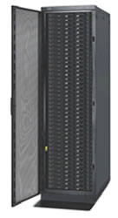

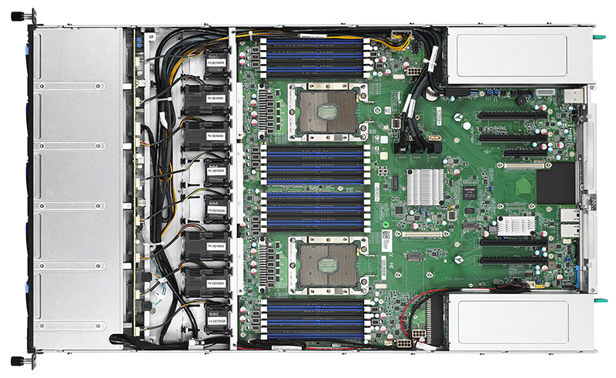

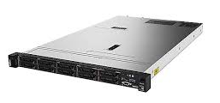


Anatomy of a Data Center
Cloud Computing Overview
Commodity CPU:
Xeon E5-2440: 6/12 cores
Xeon Gold 6148: 20/40 cores
Server:
Multiple sockets, RAM, disks
Rack:
16-64 servers +
top-of-rack switch
Data Center:
>100,000 servers
Cluster:
Multiple racks + cluster switch
[Google
Data Center, Eemshaven, Netherlands]

Slide 10
Fault Tolerance
Cloud Computing Overview
[Christos Kozyrakis and Matei Zaharia: CS349D: Cloud Computing Technology, lecture, Stanford 2018]
Yearly Data Center Failures
  ~0.5 overheating (power down most machines in <5 mins, ~1-2 days)
  ~1 PDU failure (~500-1000 machines suddenly disappear, ~6 hrs)
  ~1 rack-move (plenty of warning, ~500-1000 machines powered down, ~6 hrs)
  ~1 network rewiring (rolling ~5% of machines down over 2-day span)
  ~20 rack failures (40-80 machines instantly disappear, 1-6 hrs)
  ~5 racks go wonky (40-80 machines see 50% packet loss)
  ~8 network maintenances (~30-minute random connectivity losses)
  ~12 router reloads (takes out DNS and external vIPs for a couple minutes)
  ~3 router failures (immediately pull traffic for an hour)
  ~dozens of minor 30-second blips for dns
  ~1000 individual machine failures (2-4% failure rate, at least twice)
  ~thousands of hard drive failures (1-5% of all disks will die)

Slide 11
Fault Tolerance, cont.
Cloud Computing Overview
Other Common Issues
  Configuration issues, partial SW updates, SW bugs
  Transient errors: no space left on device, memory corruption, stragglers
Recap: Error Rates at Scale
  Cost-effective commodity hardware
  Error rate increases with increasing scale
  Fault Tolerance for distributed/cloud
  storage and data analysis
➔ Cost-effective Fault Tolerance
  BASE (basically available, soft state, eventual consistency)
  Effective techniques
    ECC (error correction codes), CRC (cyclic redundancy check) for detection
    Resilient storage: replication/erasure coding, checkpointing, and lineage
    Resilient compute: task re-execution / speculative execution

Slide 12





Containerization
Cloud Computing Overview
Docker Containers
  Shipping container analogy
    Arbitrary, self-contained goods,
    standardized units
    Containers reduced loading times ➔ efficient international trade
  #1 Self-contained package of necessary SW and data (read-only image)
  #2 Lightweight virtualization w/ shared OS and resource isolation via cgroups
Cluster Schedulers
  Container orchestration: scheduling,
  deployment, and management
  Resource negotiation with clients
  Typical resource bundles (CPU, memory, device)
  Examples: Kubernetes, Mesos, (YARN),
  Amazon ECS, Microsoft ACS, Docker Swarm
[Brendan Burns, Brian Grant, David Oppen-heimer, Eric Brewer, John Wilkes: Borg, Omega, and Kubernetes. CACM 2016]
➔ from machine- to application-oriented scheduling

Slide 13
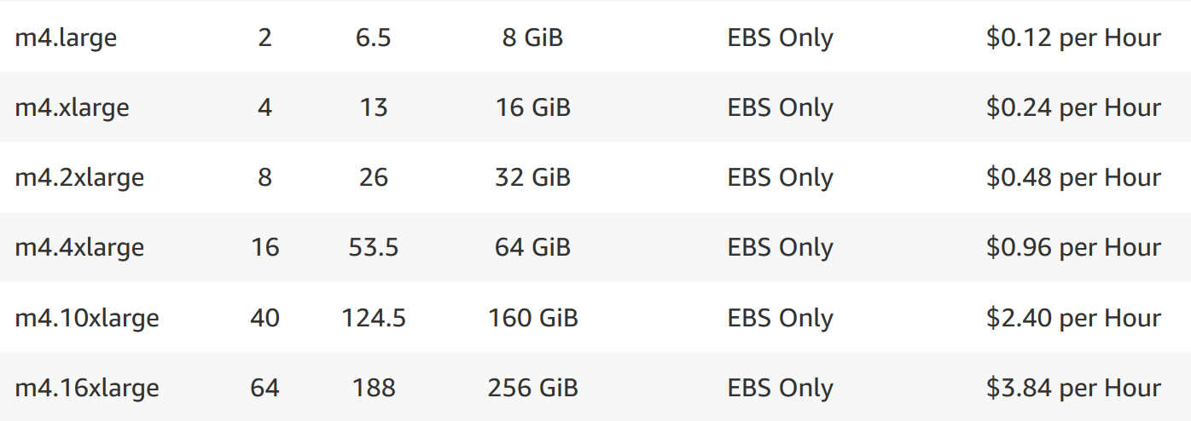
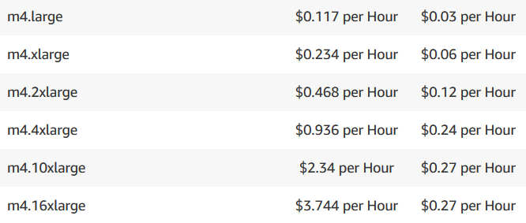
Example Amazon Services – Pricing (current gen)
Cloud Computing Overview
vCores
Mem
Amazon EC2 (Elastic
Compute Cloud)
  IaaS offering of different
  node types and generations
  On-demand, reserved, and
  spot instances
Amazon ECS (Elastic Container Service)
  PaaS offering for Docker containers
  Automatic setup of Docker environment
Amazon EMR (Elastic Map Reduce)
  PaaS offering for Hadoop workloads
  Automatic setup of YARN, HDFS, and
  specialized frameworks like Spark
  Prices in addition to EC2 prices
Pricing according to EC2 (in EC2 launch mode)

Slide 14
Distributed Data Storage
Cloud Object Storage
Distributed File Systems

Slide 15

Data Lakes
Distributed Data Storage
Concept “Data Lake”
  Store massive amounts of un/semi-structured, and structured data
  (append only, no update in place)
  No need for architected schema or upfront costs (unknown analysis)
  Typically: file storage in open, raw formats (inputs and intermediates)
  ➔ Distributed storage and analytics for scalability and agility
Criticism: Data Swamp
  Low data quality (lack of schema,
  integrity constraints, validation)
  Missing meta data (context) and
  data catalog for search
  ➔ Requires proper data curation / tools
  According to priorities (data governance)
Excursus: Research Data Management
  FAIR data principles: findable, accessible, interoperable, re-usable
[Credit: www.collibra.com]

Slide 16
Object Storage
Distributed Data Storage
Recap: Key-Value Stores
  Key-value mapping, where values can be of a variety of data types
  APIs for CRUD operations; scalability via sharding (objects or object segments)
Object Store
  Similar to key-value stores, but: optimized for large objects in GBs and TBs
  Object identifier (key), meta data, and object as binary large object (BLOB)
  APIs: often REST APIs, SDKs, sometimes implementation of DFS APIs
Key Techniques
  Partitioning
  Replication &
  Distribution
  Erasure Coding
  (partitioning + parity)
Partitioning
D₁
Replication
D₁₁
D₁₂
D
D₂
D₂₁
D₂₂
D₃
D₃₁
D₃₂
Distribution
D₁₁
D₁₂
D₂₁
D₃₂
D₂₂
D₃₁
Notes:
Note: erasure coding in Hadoop 3.0: https://blog.cloudera.com/introduction-to-hdfs-erasure-coding-in-apache-hadoop/

Slide 17
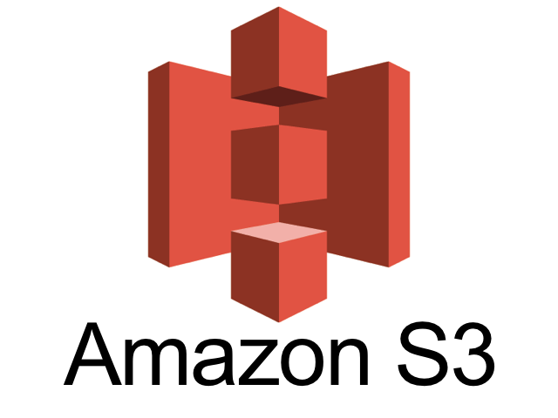
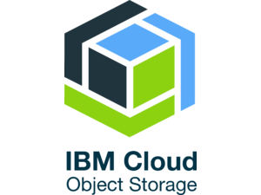
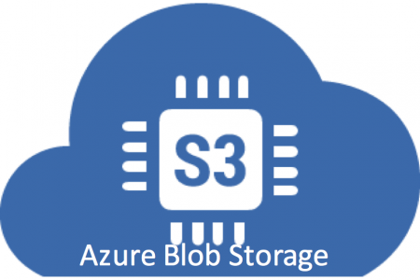
Object Storage, cont.
Distributed Data Storage
Example Object Stores / Protocols
  Amazon Simple Storage Service (S3)
  OpenStack Object Storage (Swift)
  IBM Object Storage
  Microsoft Azure Blob Storage
Amazon S3
  Reliable object store for photos, videos, documents or any binary data
  Bucket: Uniquely named, static data container
  http://s3.aws-eu-central-1.amazonaws.com/mboehm-b1
  Object: key, version ID, value, metadata, access control
  Single (5GB)/multi-part (5TB) upload and direct/BitTorrent download
  Storage classes: STANDARD, STANDARD_IA, GLACIER, DEEP_ARCHIVE
  Operations: GET/PUT/LIST/DEL, and SQL over CSV/JSON objects

Slide 18

Hadoop Distributed File System (HDFS)
Distributed Data Storage
Brief Hadoop History
  Google’s GFS + MapReduce [ODSI’04]
  → Apache Hadoop (2006)
  Apache Hive (SQL), Pig (ETL), Mahout/SystemML (ML), Giraph (Graph)
HDFS Overview
  Hadoop’s distributed file system, for large clusters and datasets
  Implemented in Java, w/ native libraries for compression, I/O, CRC32
  Files split into 128MB blocks, replicated (3x), and distributed
[Sanjay Ghemawat, Howard Gobioff, Shun-Tak Leung: The Google file system. SOSP 2003]
Client
Hadoop Distributed File System (HDFS)
Name Node
Data Node
Data Node
Data Node
Data Node
Data Node
Data Node
M
1
2
3
4
5
6
Head Node
Worker Nodes (shared-nothing cluster)

Slide 19
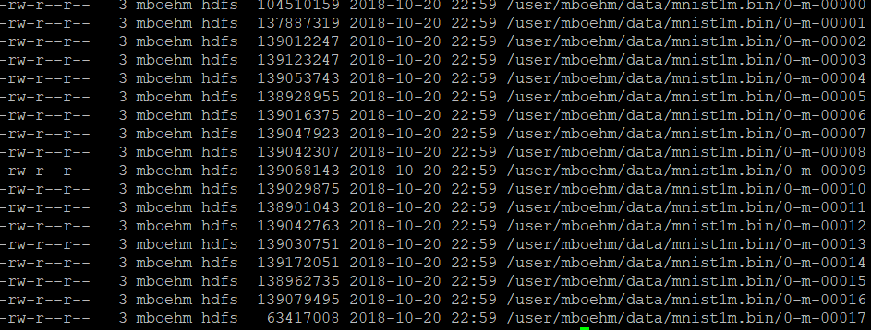
Hadoop Distributed File System, cont.
Distributed Data Storage
HDFS NameNode
  Master daemon that manages file system
  namespace and access by clients
  Metadata for all files (e.g., replication,
  permissions, sizes, block ids, etc)
  FSImage: checkpoint of FS namespace
  EditLog: write-ahead-log (WAL) of file write operations (merged on startup)
HDFS DataNode
  Worker daemon per cluster node that manages block storage (list of disks)
  Block creation, deletion, replication as individual files in local FS
  On startup: scan local blocks and send block report to name node
  Serving block read and write requests
  Send heartbeats to NameNode (capacity, current transfers) and
  receives replies (replication, removal of block replicas)
hadoop fs -ls ./data/mnist1m.bin

Slide 20
Hadoop Distributed File System, cont.
Distributed Data Storage
Client
D
HDFS Write
  #1 Client RPC to NameNode
  to create file → lease/replica DNs
  #2 Write blocks to DNs, pipelined
  replication to other DNs
  #3 DNs report to NN via heartbeat
HDFS Read
  #1 Client RPC to NameNode
  to open file → DNs for blocks
  #2 Read blocks sequentially from
  closest DN w/ block
  InputFormats and RecordReaders
  as abstraction for multi-part files
  (incl. compression/encryption)
1. Create foo.txt
HDFS Client
D₁
2
D₂
foo.txt: D1-1,2
D2-1,2
3
Name Node
Data Node
Data Node
M
1
2
D₁
D₂
D₁
D₂
1. Open foo.txt
HDFS Client
D₁
2
D₂
foo.txt: D1-1,2
D2-1,2
Name Node
Data Node
Data Node
M
1
2
D₁
D₂
D₁
D₂

Slide 21
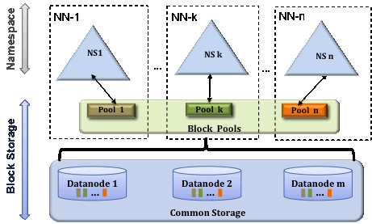
Hadoop Distributed File System, cont.
Distributed Data Storage
Data Locality
  HDFS is generally rack-aware (node-local, rack-local, other)
  Schedule reads from closest data node
  Replica placement (rep 3): local DN, other-rack DN, same-rack DN
  MapReduce/Spark: locality-aware execution (function vs data shipping)
HDFS Federation
  Eliminate NameNode as
  namespace scalability bottleneck
  Independent NameNodes,
  responsible for name spaces
  DataNodes store blocks of
  all NameNodes
  Client-side mount tables
[Credit: https://hadoop.apache.org/docs/current/hadoop-project-dist/hadoop-hdfs/Federation.html]

Slide 22


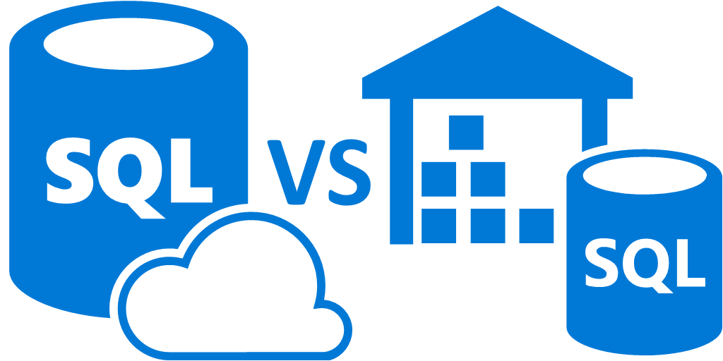

Excursus: Amazon Redshift
Distributed Data Storage
[Anurag Gupta et al.: Amazon Redshift and the Case for Simpler Data Warehouses. SIGMOD 2015]
Motivation (release 02/2013)
  Simplicity and cost-effectiveness
  (fully-managed DWH at petabyte scale)
System Architecture
  Data plane: data storage and SQL execution
  Control plane: workflows for monitoring,
  and managing databases, AWS services
Data Plane
  Leader node + sliced compute nodes
  in EC2 with local storage
  Replication across nodes + S3 backup
  Query compilation in C++ code
  Support for flat and nested files
Similar
Systems
[Mengchu Cai et al.: Integrated Querying of SQL database data and S3 data in Amazon Redshift.
IEEE Data Eng. Bull. 41(2) 2018]
Microsoft

Slide 23
Distributed Data Analysis
Data-Parallel Computation
(MapReduce, Spark)

Slide 24
Hadoop History and Architecture
Distributed Data Analysis
[Jeffrey Dean, Sanjay Ghemawat: MapReduce: Simplified Data Processing on Large Clusters. OSDI 2004]
Recap: Brief History
  Google’s GFS [SOSP’03] + MapReduce
  → Apache Hadoop (2006)
  Apache Hive (SQL), Pig (ETL), Mahout (ML), Giraph (Graph)
Hadoop Architecture / Eco System
  Management (Ambari)
  Coordination / workflows
  (Zookeeper, Oozie)
  Storage (HDFS)
  Resources (YARN)
  [SoCC’13]
  Processing
  (MapReduce)
Worker Node 1
Worker Node n
MR AM
MR task
MR task
MR task
Head Node
MR task
MR task
MR task
MR task
Resource Manager
Node Manager
Node Manager
NameNode
MR Client
DataNode
DataNode
1
3
2
3
2
9

Slide 25
Central Data Abstractions
Distributed Data Analysis
#1 Files and Objects
  File: Arbitrarily large sequential data in specific file format (CSV, binary, etc)
  Object: binary large object, with certain meta data
#2 Distributed Collections
  Logical multi-set (bag) of key-value pairs
  (unsorted collection)
  Different physical representations
  Facilitates distribution of pairs
  via horizontal partitioning
  (aka shards, partitions)
  Can be created from single file,
  or directory of files (unsorted)
Key | Value
4 | Delta
2 | Bravo
1 | Alfa
3 | Charlie
5 | Echo
6 | Foxtrot
7 | Golf
1 | Alfa

Slide 26
MapReduce – Programming Model
Distributed Data Analysis
Overview Programming Model
  Inspired by functional programming languages
  Implicit parallelism (abstracts distributed storage and processing)
  Map function: key/value pair → set of intermediate key/value pairs
  Reduce function: merge all intermediate values by key
Example
SELECT Dep, count(*) FROM csv_files GROUP BY Dep
Name | Dep
X | CS
Y | CS
A | EE
Z | CS
map(Long pos, String line) {
parts ← line.split(“,”)
emit(parts[1], 1)
}
CS | 1
CS | 1
EE | 1
CS | 1
reduce(String dep,
Iterator<Long> iter) {
total ← iter.sum();
emit(dep, total)
}
Collection of key/value pairs
CS | 3
EE | 1

Slide 27
MapReduce – Execution Model
Distributed Data Analysis
#1 Data Locality (delay sched., write affinity)
#2 Reduced shuffle (combine)
#3 Fault tolerance (replication, attempts)
Input CSV files (stored in HDFS)
Map-Phase
map
task
[Reduce-Phase]
Output Files (HDFS)
CSV File 1
Split 11
map
task
Split 12
reduce
task
Out 1
Split 21
map
task
CSV File 2
reduce
task
Out 2
Split 22
map
task
reduce
task
Out 3
CSV File 3
Split 31
map
task
Split 32
map
task
Shuffle, Merge, [Combine]
Sort, [Combine], [Compress]
w/ #reducers = 3

Slide 28

Spark History and Architecture
Distributed Data Analysis
Summary MapReduce
  Large-scale & fault-tolerant processing w/ UDFs and files ➔ Flexibility
  Restricted functional APIs ➔ Implicit parallelism and fault tolerance
  Criticism: #1 Performance, #2 Low-level APIs, #3 Many different systems
Evolution to Spark (and Flink)
  Spark [HotCloud’10] + RDDs [NSDI’12] → Apache Spark (2014)
  Design: standing executors with in-memory storage,
  lazy evaluation, and fault-tolerance via RDD lineage
  Performance: In-memory storage and fast job scheduling (100ms vs 10s)
  APIs: Richer functional APIs and general computation DAGs,
  high-level APIs (e.g., DataFrame/Dataset), unified platform
➔ But many shared concepts/infrastructure
  Implicit parallelism through dist. collections (data access, fault tolerance)
  Resource negotiators (YARN, Mesos, Kubernetes)
  HDFS and object store connectors (e.g., Swift, S3)

Slide 29
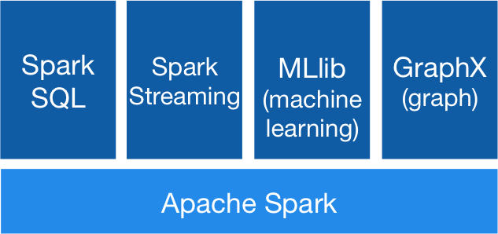
Spark History and Architecture, cont.
Distributed Data Analysis
High-Level Architecture
  Different language bindings:
  Scala, Java, Python, R
  Different libraries:
  SQL, ML, Stream, Graph
  Spark core (incl RDDs)
  Different cluster managers:
  Standalone, Mesos,
  Yarn, Kubernetes
  Different file systems/
  formats, and data sources:
  HDFS, S3, SWIFT, DBs, NoSQL
Focus on a unified platform
for data-parallel computation
[https://spark.apache.org/]
Standalone
MESOS
YARN
Kubernetes

Slide 30
Resilient Distributed Datasets (RDDs)
Distributed Data Analysis
RDD Abstraction
  Immutable, partitioned
  collections of key-value pairs
  Coarse-grained deterministic operations (transformations/actions)
  Fault tolerance via lineage-based re-computation
Operations
  Transformations:
  define new RDDs
  Actions: return
  result to driver
Distributed Caching
  Use fraction of worker memory for caching
  Eviction at granularity of individual partitions
  Different storage levels (e.g., mem/disk x serialization x compression)
JavaPairRDD
<MatrixIndexes,MatrixBlock>
Type | Examples
Transformation (lazy) | map, hadoopFile, textFile, flatMap, filter, sample, join, groupByKey, cogroup, reduceByKey, cross, sortByKey, mapValues
Action | reduce, save, collect, count, lookupKey
Node1
Node2

Slide 31
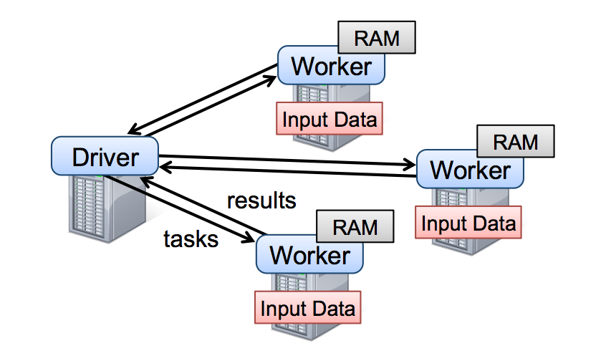
Resilient Distributed Datasets (RDDs), cont.
Distributed Data Analysis
RDD Abstraction & Lifecycle
  Immutable, partitioned collections of KV pairs
  Coarse-grained transformations and actions
X.filter(foo())
X.mapValues(foo())
X.reduceByKey(foo())
X.cache()/X.persist(…)
sc.parallelize(lst)
Local Data
(value, collection)
Distributed Collection
lst = X.collect()
v = X.reduce(foo())
sc.hadoopFile(f)
sc.textFile(f)
X.saveAsObjectFile(f)
X.saveAsTextFile(f)
File on DFS

Slide 32
Partitions and Implicit/Explicit Partitioning
Distributed Data Analysis
Spark Partitions
  Logical key-value collections are split into physical partitions
  Partitions are granularity of tasks, I/O, shuffling, evictions
Partitioning via Partitioners
  Implicitly on every data shuffling
  Explicitly via R.repartition(n)
Partitioning-Preserving
  All operations that are guaranteed to keep keys unchanged
  (e.g. mapValues(), mapPartitions() w/ preservesPart flag)
Partitioning-Exploiting
  Join: R3 = R1.join(R2)
  Lookups:
  v = C.lookup(k)
~128MB
Example Hash Partitioning:
For all (k,v) of R:
pid = hash(k) % n
Hash partitioned
⋈
⋈
0: 8, 1, 6
0: 1, 2
% 3
0: 3, 6
0: 6, 3
2: 2, 3, 4
2: 3, 4
2: 2, 5, 8
2: 5, 2
1: 7, 5
1: 5, 6
1: 4, 7, 1
1: 4, 1

Slide 33
Spark Lazy Evaluation, Caching, and Lineage
Distributed Data Analysis
A
B
partitioning- aware
G
Stage 1
groupBy
C
D
F
reduce
map
union
E
join
Stage 2
Stage 3
cached
[Matei Zaharia, Mosharaf Chowdhury, Tathagata Das, Ankur Dave, Justin Ma, Murphy McCauly, Michael J. Franklin, Scott Shenker, Ion Stoica: Resilient Distributed Datasets: A Fault-Tolerant Abstraction for In-Memory Cluster Computing. NSDI 2012]
Notes:
Notes:
Dryad-­‐like DAGs
Pipelines functions within a stage
Locality & data reuse aware
Partitioning-­‐aware to avoid shuffles

Slide 34
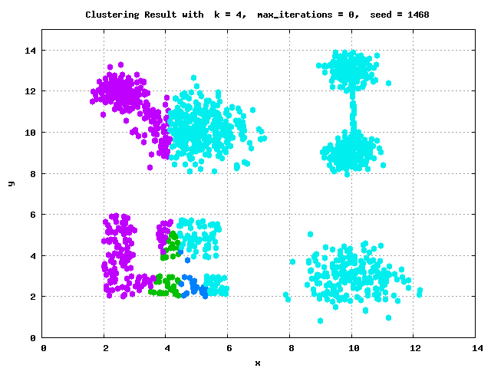
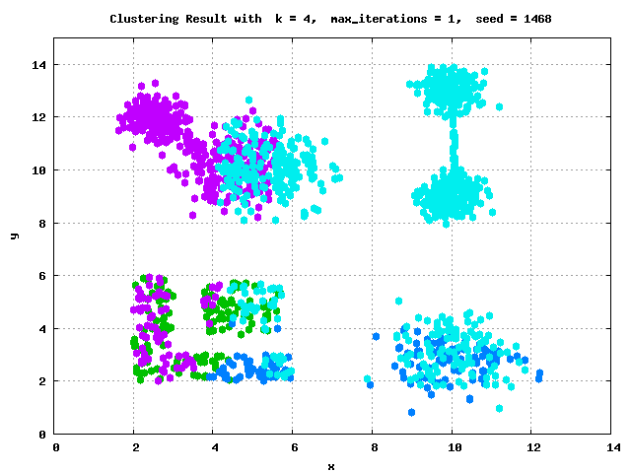
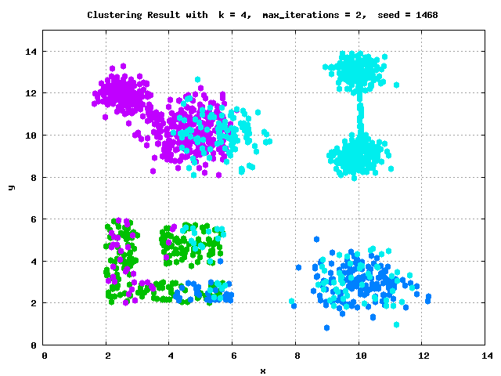
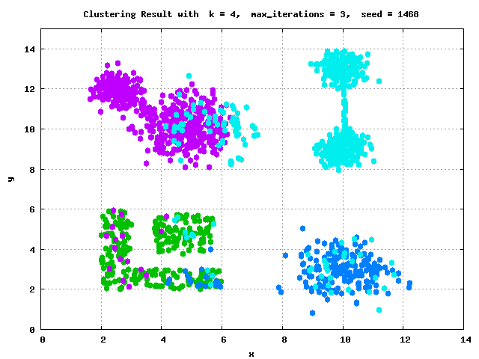
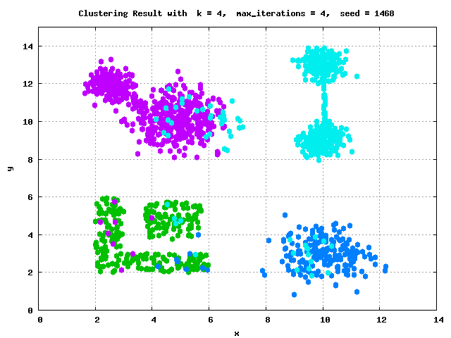

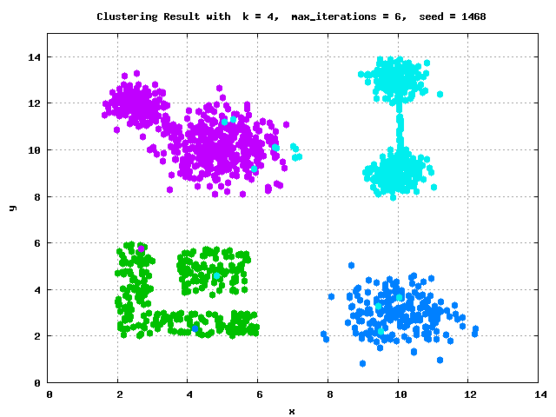




Example: k-Means Clustering
Distributed Data Analysis
k-Means Algorithm
  Given dataset D and number of clusters k, find cluster centroids
  (“mean” of assigned points) that minimize within-cluster variance
  Euclidean distance: sqrt(sum((a-b)^2))
Pseudo Code
function Kmeans(D, k, maxiter) {
  C‘ = randCentroids(D, k);
  C = {};
  i = 0; //until convergence
  while( C‘ != C & i<=maxiter ) {
  C = C‘;
  i = i + 1;
  A = getAssignments(D, C);
  C‘ = getCentroids(D, A, k);
  }
  return C‘
  }

Slide 35
Example: K-Means Clustering in Spark
Distributed Data Analysis
// create spark context (allocate configured executors)
JavaSparkContext sc = new JavaSparkContext();
// read and cache data, initialize centroids
JavaRDD<Row> D = sc.textFile(“hdfs:/user/mboehm/data/D.csv“)
.map(new ParseRow()).cache(); // cache data in spark executors
Map<Integer,Mean> C = asCentroidMap(D.takeSample(false, k));
// until convergence
while( !equals(C, C2) & i<=maxiter ) {
C2 = C; i++;
// assign points to closest centroid, recompute centroid
Broadcast<Map<Integer,Row>> bC = sc.broadcast(C)
C = D.mapToPair(new NearestAssignment(bC))
.foldByKey(new Mean(0), new IncComputeCentroids())
.collectAsMap();
}
return C;
Note: Existing library algorithm
[https://github.com/apache/spark/blob/master/mllib/src/
main/scala/org/apache/spark/mllib/clustering/KMeans.scala]
Notes:
Spark Local Mode
Download and unzip Spark https://spark.apache.org/downloads.html,
or pull dependency into IDE project via maven or similar tools
Setup prerequisites and path variables
Test spark-shell, spark-submit, or in your IDE
NOTE: in local mode, operations run in driver JVM and I/O to local FS
Amazon AWS EMR (Elastic Map Reduce)

Slide 36

Spark DataFrames and DataSets
Distributed Data Analysis
Overview Spark DataFrame
  DataFrame is distributed collection of rows
  with named/typed columns
  Relational operations (e.g., projection,
  selection, joins, grouping, aggregation)
  DataSources (e.g., json, jdbc, parquet, hdfs, s3, avro, hbase, csv, cassandra)
DataFrame and Dataset APIs
  DataFrame was introduced as basis for Spark SQL
  DataSets allow more customization and compile-time analysis errors (Spark 2)
Example
DataFrame
DataFrame = Dataset[Row]
logs = spark.read.format("json").open("s3://logs")
logs.groupBy(logs.user_id).agg(sum(logs.time))
.write.format("jdbc").save("jdbc:mysql//...")
[Michael Armbrust: Structuring Apache Spark – SQL, DataFrames, Datasets, and Streaming, Spark Summit 2016]

Slide 37



Serverless Computing
Distributed Data Analysis
[Joseph M. Hellerstein et al: Serverless Computing: One Step Forward, Two Steps Back. CIDR 2019]
Definition Serverless
  FaaS: functions-as-a-service (event-driven, stateless input-output mapping)
  Infrastructure for deployment and auto-scaling of APIs/functions
  Examples: Amazon Lambda, Microsoft Azure Functions, etc
Example
Lambda Functions
Event Source (e.g., cloud services)
Other APIs and Services
Auto scaling
Pay-per-request
(1M x 100ms = 0.2$)
import com.amazonaws.services.lambda.runtime.Context;
import com.amazonaws.services.lambda.runtime.RequestHandler;
public class MyHandler implements RequestHandler<Tuple, MyResponse> {
@Override
public MyResponse handleRequest(Tuple input, Context context) {
return expensiveStatelessComputation(input);
}
}

Slide 38
Conclusions and Q&A
Cloud Computing Overview
Distributed Data Storage
Distributed Data Analysis
Next Lectures (Part B: Modern Data Management)
  12 Data Stream Processing Systems and Q&A [Jan 17]
  News group and office hour on demand
  End of January new COVID status → update on exam Feb 04

