Slide 1

Data Management
12 Stream Processing
Last update: Jan 14, 2022

Slide 2



Announcements/Org
#1 Video Recording
  Link in TUbe & TeachCenter (lectures will be public)
  Optional attendance (independent of COVID)
  Virtual lectures (recorded) until end of semester
  https://tugraz.webex.com/meet/m.boehm
#2 Exercise Submissions
  Exercise 3: in progress of being graded (target Jan 16)
  Exercise 4: extra credit, due Jan 18 + 7 late days
#3 Course Evaluation and Exam
  Evaluation period: Jan 01 – Feb 15
  (thanks for the nomination for price of excellent teaching)
  Exam dates: Feb 04, 12.30pm and Feb 04, 5.30pm
  (90+min written exam, start 10 late)
Status: RED
Q&A

Slide 3
Data Management Courses
Data Management Group
Architecture of
Database Systems
(ADBS, WS)
DB system internals
+ prog. project
Architecture of
ML Systems
(AMLS, SS)
ML system internals
Prog. projects in SystemDS
[github.com/apache/systemds]
Master
Data Integration and Large-Scale Analysis
(DIA, WS)
Distributed
Data Management
Bachelor
Intro to Scientific Writing (WS)
Data Management / Databases
(DM, SS+WS)
Data management from user/application perspective

Slide 4
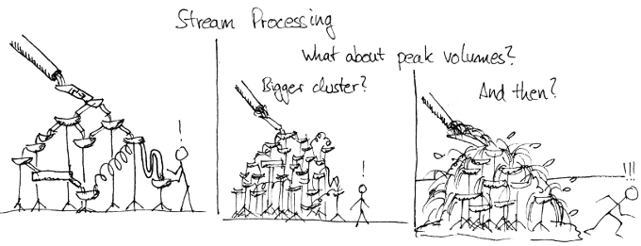
Agenda
Data Stream Processing
Distributed Stream Processing
Q&A and Exam Preparation
Data Integration and Large-Scale Analysis (DIA)
(bachelor/master)

Slide 5
Data Stream Processing

Slide 6

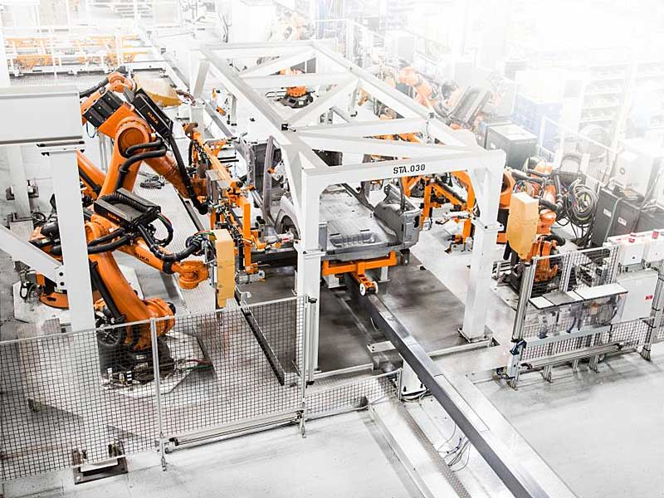
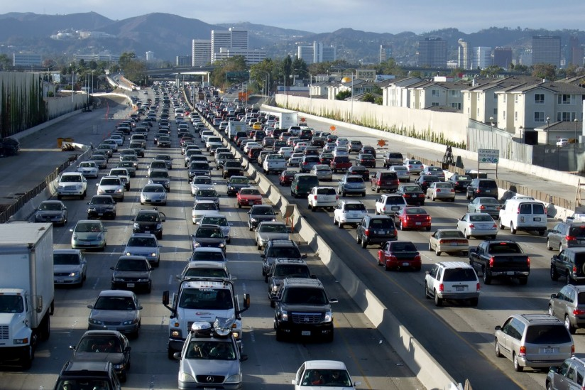
Stream Processing Terminology
Data Stream Processing
Ubiquitous Data Streams
  Event and message streams (e.g., click stream, twitter, etc)
  Sensor networks, IoT, and monitoring (traffic, env, networks)
Stream Processing Architecture
  Infinite input streams, often with window semantics
  Continuous (aka standing) queries
Stream Processing Engines
Queries
Input Stream
Output Stream
“data at rest”
DBMS
“data in motion”
Stored (Continuous) Queries
Stored Data

Slide 7
Stream Processing Terminology, cont.
Data Stream Processing
Use Cases
  Monitoring and alerting (notifications on events / patterns)
  Real-time reporting (aggregate statistics for dashboards)
  Real-time ETL and event-driven data updates
  Real-time decision making (fraud detection)
  Data stream mining (summary statistics w/ limited memory)
Data Stream
  Unbounded stream of data tuples S = (s₁, s₂, …) with s_{i} = (t_{i}, d_{i})
  See 10 NoSQL Systems (time series)
Real-time Latency Requirements
  Real-time: guaranteed task completion by a given deadline (30 fps)
  Near Real-time: few milliseconds to seconds
  In practice, used with much weaker meaning
Continuously active

Slide 8




History of Stream Processing Systems
Data Stream Processing
2000s
  Data stream management systems (DSMS, mostly academic prototypes):
  STREAM (Stanford’01), Aurora (Brown/MIT/Brandeis’02) → Borealis (‘05), NiagaraCQ (Wisconsin), TelegraphCQ (Berkeley’03), and many others
  ➔ but mostly unsuccessful in industry/practice
  Message-oriented middleware and Enterprise Application Integration (EAI):
  IBM Message Broker, SAP eXchange Infra., MS Biztalk Server, TransConnect
2010s
  Distributed stream processing engines, and “unified” batch/stream processing
  Proprietary systems: Google Cloud Dataflow, MS StreamInsight / Azure Stream Analytics, IBM InfoSphere Streams / Streaming Analytics, AWS Kinesis
  Open-source systems: Apache Spark Streaming (Databricks), Apache Flink (Data Artisans/Alibaba), Apache Beam, Apache Kafka, Apache Storm

Slide 9
System Architecture – Native Streaming
Data Stream Processing
Basic System Architecture
  Data flow graphs (potentially
  w/ multiple consumers)
  Nodes: asynchronous ops (w/ state)
  (e.g., separate threads)
  Edges: data dependencies
  (tuple/message streams)
  Push model: data production
  controlled by source
Operator Model
  Read from input queue
  Write to potentially
  many output queues
  Example Selection
  σ_{A=7}
Archive
State
while( !stopped ) {
r = in.dequeue(); // blocking
if( pred(r.A) ) // A==7
for( Queue o : out )
o.enqueue(r); // blocking
}

Slide 10
System Architecture – Sharing
Data Stream Processing
Multi-Query Optimization
  Given set of continuous queries (deployed), compile DAG w/o redundancy
  (see 08 Physical Design MV) ➔ common subexpression elimination
Operator and Queue Sharing
  Operator sharing: complex ops w/ multiple predicates for adaptive reordering
  Queue sharing: avoid duplicates in output queues via masks
T₁
T₂
T₁
T₂
∪
⋈_{A=B}
∪
⋈_{A=B}
σ_{a}
σ_{b}
σ_{c}
∪
σ_{d}
σ_{a}
∪
σ_{d}
S_{AS}
S_{US}
S_{EU}
σ_{b}
σ_{c}
Ad
S_{AS}
σ_{b}
σ_{c}
Ad
S_{US}
S_{EU}
S_{US}
S_{EU}

Slide 11
System Architecture – Handling Overload
Data Stream Processing
#1 Back Pressure
  Graceful handling of
  overload w/o data loss
  Slow down sources
  E.g., blocking queues
#2 Load Shedding
  #1 Random-sampling-based load shedding
  #2 Relevance-based load shedding
  #3 Summary-based load shedding (synopses)
  Given SLA, select queries and shedding placement
  that minimize error and satisfy constraints
#3 Distributed Stream Processing (see course DIA)
  Data flow partitioning (distribute the query)
  Key range partitioning (distribute the data stream)
A
B
C
3ms
9ms
2ms
Self-adjusting operator scheduling
Pipeline runs at rate of slowest op
[Nesime Tatbul et al: Load Shedding in a Data Stream Manager. VLDB 2003]
Notes:
Notes:
* relevance -> dropping tuples early good for performance, but due to common subexpressions might hurt many applications
* Summary -> focus on aggregation functions and drop tuples with small contribution

Slide 12
Time (Event, System, Processing)
Data Stream Processing
Event Time
  Real time when the event/
  data item was created
Ingestion Time
  System time when the
  data item was received
Processing Time
  System time when the
  data item is processed
In Practice
  Delayed and unordered data items
  Use of heuristics (e.g., water marks = delay threshold)
  Use of more complex triggers (speculative and late results)
skew
ideal
Processing Time
Event Time

Slide 13


Durability and Consistency Guarantees
Data Stream Processing
#1 At Most Once
  “Send and forget”, ensure data is never counted twice
  Might cause data loss on failures
#2 At Least Once
  “Store and forward” or acknowledgements from receiver,
  replay stream from a checkpoint on failures
  Might create incorrect state (processed multiple times)
#3 Exactly Once
  “Store and forward” w/ guarantees regarding state updates and sent msgs
  Often via dedicated transaction mechanisms
Notes:
Note: IBM MQ Series, AWS Simple Queueing Service (SQS)

Slide 14
Window Semantics
Data Stream Processing
Windowing Approach
  Many operations like joins/aggregation undefined over unbounded streams
  Compute operations over windows of time or elements
#1 Tumbling Window
  Every data item is only
  part of a single window
  Aka Jumping window
#2 Sliding Window
  Time- or tuple-based
  sliding windows
  Insert new and
  expire old data items
size = 2min
12:05
12:07
12:09
size = 2min, step = 1min
12:05
12:07
12:09

Slide 15
Spark Streaming Example
Data Stream Processing
[https://spark.apache.org/docs/latest/
streaming-programming-guide.html]
// create spark context w/ batch interval 1s
sc = new JavaStreamingContext(conf, Durations.seconds(1));
// create DStream listening on socket (ip, port)
lines = sc.socketTextStream("localhost", 9999);
// traditional word count example on Dstream batches
JavaPairDStream<String, Integer> wordCounts = lines
.flatMap(x -> Arrays.asList(x.split(" ")).iterator())
.mapToPair(s -> new Tuple2<>(s, 1))
.reduceByKey((i1, i2) -> i1 + i2);
wordCounts.print();
Tumbling 1s Window
// extended word count example on Dstream windows
JavaPairDStream<String, Integer> wordCounts2 = lines
.flatMap(x -> Arrays.asList(x.split(" ")).iterator())
.mapToPair(s -> new Tuple2<>(s, 1))
.reduceByKeyAndWindow((i1, i2) -> i1 + i2,
Durations.seconds(30), Durations.seconds(10));
Sliding
30s Window
Window Length
Sliding Interval
Notes:
Note: window length and sliding interval must be multiples of the batch interval of the source DStream

Slide 16

Stream Joins
Data Stream Processing
Basic Stream Join
  Tumbling window:
  use classic join methods
  Sliding window (symmetric
  for both R and S)
    Applies to arbitrary join pred
    See 08 Query Processing (NLJ)
Excursus: How Soccer Players
Would do Stream Joins
  Handshake-join w/ 2-phase forwarding
For each new r in R:
1. Scan window of stream S
to find match tuples
2. Insert new r into window
of stream R
3. Invalidate expired tuples
in window of stream R
[Jens Teubner, René Müller: How soccer players would do stream joins. SIGMOD 2011]

Slide 17
Stream Joins, cont.
Data Stream Processing
[Zachary G. Ives, Daniela Florescu, Marc Friedman, Alon Y. Levy, Daniel S. Weld: An Adaptive Query Execution System for Data Integration. SIGMOD 1999]
Double-Pipelined Hash Join
  Join of bounded streams (or unbounded w/ invalidation)
  Equi join predicate, symmetric and non-blocking
  For every incoming tuple (e.g. left): probe (right)+emit, and build (left)
H_{R,RID}
1, 2, 7
⋈_{RID=SID}
H_{R,RID}
1, 2
H_{R,RID}
1, 1, 2, 7
H_{S,SID}
1, 7, 7
H_{R,RID}
H_{S,SID}
1, 7
H_{R,RID}
1, 1, 2
H_{S,SID}
7
H_{S,SID}
1 | ab
7 | zy
2 | cd
1 | xw
emit 1(abxw)
emit 1(efxw)
1 | ef
7 | vu
emit 7(ghvu)
Stream
R
Stream
S
emit 7(ghzy)
7 | gh

Slide 18
Excursus: Example Twitter Heron
Data Stream Processing
[Credit: Karthik Ramasamy]
Motivation
  Heavy use of Apache Storm
  at Twitter
  Issues: debugging,
  performance, shared
  cluster resources,
  back pressure mechanism
Twitter Heron
  API-compatible distributed streaming engine
  De-facto streaming engine at Twitter since 2014
Dhalion (Heron Extension)
  Automatically reconfigure Heron topologies
  to meet throughput SLO
Now back pressure implemented in Apache Storm 2.0 (May 2019)
Data per day
Cluster Size
# of Topologies
# of Msgs
per day
[Sanjeev Kulkarni et al: Twitter Heron: Stream Processing at Scale. SIGMOD 2015]
[Avrilia Floratou et al: Dhalion: Self-Regulating Stream Processing in Heron. PVLDB 2017]

Slide 19
Q&A and Exam Preparation
Basic focus: fundamental concepts and
ability to apply learned techniques to given problems

Slide 20
Exam Logistics
Exam Preparation
Timing/Logistics
  [COVID-19]: Procedure and behavioral guide for on-campus exams (students) https://www.youtube.com/watch?v=dE4xoCjONRM&feature=youtu.be
  Exam starts 10min after official start
  90min working time (plenty of time to think about answers)
  Write into the worksheet if possible, additional paper allowed
  Leave early if ready (usually starting after 45min)
  Grading for Feb 04 will happen early February
Covered Content
  Must-have: Data modeling/normalization, SQL query processing
  Relational algebra, physical design, query and transaction processing
  DM only: NoSQL, distributed storage and computation, streaming
Notes:
Staff: https://www.youtube.com/watch?v=jS7iedkr9zo&feature=youtu.be

Slide 21
Exam Logistics, cont.
Exam Preparation
Past Exams
  https://mboehm7.github.io/teaching/ss21_dbs/index.htm (3+3)
  https://mboehm7.github.io/teaching/ws2021_dbs/index.htm3 (2+2)
  https://mboehm7.github.io/teaching/ss20_dbs/index.htm (3+3)
  https://mboehm7.github.io/teaching/ws1920_dbs/index.htm (3+3)
  https://mboehm7.github.io/teaching/ss19_dbs/index.htm (3+3)

Slide 22
#1 Data Modeling
Exam Preparation
Task 1a: Specify the cardinalities in Modified Chen notation (8 Points)
  A hospital employs at least 4 nurses and has at least 8 patient rooms.
  A nurse works in exactly one hospital and treats up to 16 patients.
  A patient is treated by at least one but potentially many nurses.
  Every patient has a room, a rooms belongs to exactly one hospital, and rooms are never shared by multiple patients.
1
M
1
M
M
MC
1
C

Slide 23

#1 Data Modeling, cont.
Exam Preparation
Task 1b: Specify the cardinalities in (min, max) notation (4 Points)
  A hospital employs at least 4 nurses and has at least 8 patient rooms.
  A nurse works in exactly one hospital and treats up to 16 patients.
  A patient is treated by at least one but potentially many nurses.
  Every patient has a room, a rooms belongs to exactly one hospital, and rooms are never shared by multiple patients.
(4,*)
(1,1)
(8,*)
(0,16)
(1,1)
(1,*)
(0,1)
(1,1)
Only provide answers you’re asked for!

Slide 24
#1 Data Modeling, cont.
Exam Preparation
1
M
Task 1c: Map the given ER diagram
into a relational schema (10 points)
  Including data types, primary keys,
  and foreign keys
Solution
  Hospitals(
  HID:int, phone:char(16), Country:varchar(64), City:varchar(64))
  Nurses(
  NID:int, Name:varchar(64), Degree:varchar(32), HID^{FK}:int)
  Patient(
  PID:int, Name:varchar(64), Phone:char(16), RID^{FK}:int)
  Room(
  RID:int, TV:boolean, Size:int, HID^{FK}:int)
  Treated(
  NID^{FK}:int, PID^{FK}:int)
1
M
M
MC
1
C

Slide 25
#1 Data Modeling, cont.
Exam Preparation
Task 1d: Bring your schema in 3rd normal form and explain why it is in 3NF (12 points)
  Let Hospital.Phone and Patient.Phone be multi-valued attributes
  Assume the functional dependency City → Country
Solution
  Phones(Number:char(16), HID^{FK}:int, PID^{FK}:int)
  Cities(City:varchar(64), Country:varchar(64))
  Hospitals(HID:int, City^{FK}:varchar(64))
  1st Normal Form: no multi-valued attributes
  2nd Normal Form: 1NF + all non-key attributes fully functional dependent on PK
  3rd Normal Form: 2NF + no dependencies among non-key attributes

Slide 26
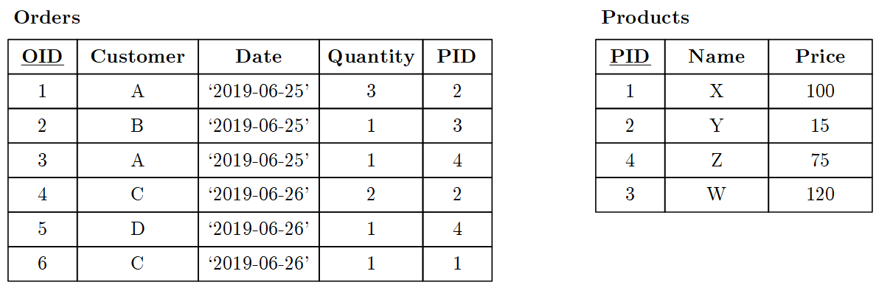
#2 Structured Query Language
Exam Preparation
Task 2a: Compute
the results for the
following queries
(15 points)
Q1: SELECT DISTINCT Customer, Date
FROM Orders O, Products P
WHERE O.PID = P.PID AND Name IN('Y','Z')
Customer | Date
A | ‘2019-06-25’
C | ‘2019-06-26’
D | ‘2019-06-26’
Customer | Count
A | 2
C | 2
B | 1
D | 1
Q2: SELECT Customer, count(*) FROM Orders
GROUP BY Customer
ORDER BY count(*) DESC, Customer ASC
Q3: SELECT Customer, sum(O.Quantity * P.Price)
FROM Orders O, Products P
WHERE O.PID = P.PID
GROUP BY Customer
Customer | Sum
A | 120
B | 120
C | 130
D | 75

Slide 27
#2 Structured Query Language, cont.
Exam Preparation
Task 2b: Write SQL
queries to answer
the following Qs
(15 points)
Q4: Which products where bought on 2019-06-25 (return the distinct product names)?
SELECT DISTINCT P.Name
FROM Orders O, Products P
WHERE O.PID = P.PID
AND Date = ‘2019-06-25’
Q5: Which customers placed only one order?
SELECT Customer FROM Orders
GROUP BY Customer HAVING count(*) = 1
Q6: How much revenue (sum( O.Quantity * P.Price)) did products with a price less then 90 generate (return (product name, revenue))?
SELECT P.Name, sum(O.Quantity * P.Price)
FROM Orders O, Products P
WHERE O.PID = P.PID AND Price < 90
GROUP BY P.Name

Slide 28
#3 Query Processing
Exam Preparation
Task 3a: Assume tables R(a,b), and S(c,d,e), draw a logical query tree in relational algebra for the following query: (5 points)
Task 3b: Draw an optimized logical query
tree for the above query in relational
algebra by eliminating the union operation
(3 points)
∪
Q7: SELECT R.a, S.d FROM R, S
WHERE R.b = S.c AND S.e < 3
UNION ALL
SELECT R.a, S.d FROM R, S
WHERE R.b = S.c AND S.e = 7
π_{a,d}
π_{a,d}
⋈_{b=c}
⋈_{b=c}
R
σ_{e<3}
R
σ_{e=7}
S
S
π_{a,d}
⋈_{b=c}
R
σ_{e<3 v e=7}
S

Slide 29

#3 Query Processing, cont.
Exam Preparation
Task 3c: Given the schema and query above, which attribute or attributes are good candidates for secondary indexes and how could they be exploited during query processing? (4 points)
Solution
  S.e → index scan
  (lookup e=7,
  lookup e=3 and scan DESC)
  R.b (or S.c) → index nested loop join
  (for every S tuple s, loopup s.c in IX)
π_{a,d}
⋈_{b=c}
ix
R
σ_{e<3 v e=7}
table data
S
$$\text{⋈}$$
S
ix
R

Slide 30
#3 Query Processing, cont.
Exam Preparation
Task 3d: Describe the volcano (open-next-close) iterator model by example of a selection operator and discuss the space complexity of this selection operator. (6 points)
Solution
  Open, next, close calls
  propagate from root to leafs
  Open: operator initialization
  Next: compute next tuple
  (selection: call next of input
  until next qualifying tuple found)
  Close: cleanup resources
  Space complexity: O(1)
void open() { R.open(); }
void close() { R.close(); }
Record next() {
while( (r = R.next()) != EOF )
if( p(r) ) //A==7
return r;
return EOF;
}

Slide 31
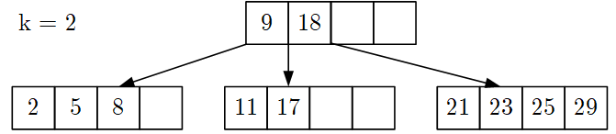
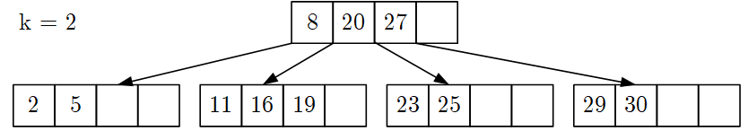
#4 Physical Design – B-Trees
Exam Preparation
Task 4a: Given B-tree, insert key 19 and draw resulting B-tree (7 points)
Task 4b: Given B-tree, delete key 27, and draw resulting B-tree (8 points)
9
18
23
2
5
8
4
11
17
19
21
25
29
8
20
2
5
6
4
11
16
19
23
25
29
30

Slide 32
#5 Transaction Processing
Exam Preparation
Task 5a: Describe the concept of a database transaction log, and explain how it relates to the ACID properties Atomicity and Durability (7 points)
Solution
  Log: append-only TX changes,
  often on separate devices
  Write-ahead logging (log written
  before DB, forced-log on commit)
  Recovery: forward (REDO) and
  backward (UNDO) processing
  #1 Atomicity: A TX is executed atomically
  (completely or not at all); on failure/aborts no changes in DB (UNDO)
  #2 Durability: Guaranteed persistence of changes of successful TXs; in case of system failures, the database is recoverable (REDO)
DBMS
DB Buffer
Log Buffer
P7
P3’
P1
P7
P3
Data
Log

Slide 33
#6 NoSQL
Exam Preparation
Task 6a: Describe the concept and system architecture of a key-value store, including techniques for achieving high write throughput, and scale-out in distributed environments. Please focus specifically on aspects of physical design such as index structures, and distributed data storage. (10 points)
Solution
  KV store: simple map of key-value pairs,
  w/ get/put interface, often distributed
  Index structure for high write throughput:
  Log-structured merge trees (LSM)
  Distributed data storage for scale-out:
  horizontal partitioning (sharding) via hash or range partitioning,
  partitioning via selection, reconstruction via union
  eventual consistency for high availability and partition tolerance
B
A
C
L1
L2
L3

Slide 34
Conclusions and Q&A
12 Stream Processing Systems
Q&A and Exam Preparation
Misc
  Last Office Hours: on demand
  Exercise 4 Reminder: Jan 18, 11.59pm + [7 late days]
Exams
  Exams: Feb 04 12.30pm (i12, i13), Feb 04 5.30pm (i13)
  Oral exams for international students (so far 3, to be scheduled)

