Slide 1

Data Integration and Analysis
01 Introduction and Overview
Last update: Oct 07, 2021

Slide 2

Announcements/Org
#1 Video Recording
  Link in TUbe & TeachCenter (lectures will be public)
  Optional attendance (independent of COVID)
  Hybrid, in-person but video-recorded lectures
    HS i5 + Webex: https://tugraz.webex.com/meet/m.boehm
#2 COVID-19 Precautions (HS i5)
  Room capacity: 24/48 (green/yellow), 12/48 (orange/red)
  TC lecture registrations (limited capacity, contact tracing)
#3 Course Registration (as of Oct 07)
  Data Integration and Large-Scale Analysis (DIA)
WS20/21: 96 (2)
WS21/22: 122 (4)

Slide 3


Announcements/Org, cont.
#4 Study Abroad Fair
  International Days 2021
  Oct 19 – 21, 2021
  Virtual presentations, drop-in café
  https://tu4u.tugraz.at/studierende/
  mein-auslandsaufenthalt/
  informationsveranstaltungen/international-days-2021/
#5 Open Data-Science Positions
  REDWAVE (ML engineer for recycling)
  Know-Center (data/ML engineer for automotive)

Slide 4
Agenda
Data Management Group
Course Organization
Course Motivation and Goals
Course Outline and Projects
Excursus: Apache SystemDS

Slide 5
Data Management Group
https://damslab.github.io/

Slide 6



About Me
Data Management Group
09/2018 TU Graz, Austria
  BMK endowed chair for data management
  Data management for data science
  (ML systems internals, end-to-end data science lifecycle)
2012-2018 IBM Research – Almaden, USA
  Declarative large-scale machine learning
  Optimizer and runtime of Apache SystemML
2011 PhD TU Dresden, Germany
  Cost-based optimization of integration flows
  Systems support for time series forecasting
  In-memory indexing and query processing
https://github.com/
apache/systemds
DB group

Slide 7
Data Management Courses
Data Management Group
Architecture of
Database Systems
(ADBS, WS)
DB system internals
+ prog. project
Architecture of
ML Systems
(AMLS, SS)
ML system internals
Prog. projects in SystemDS
[github.com/apache/systemds]
Master
Data Integration and Large-Scale Analysis
(DIA, WS)
Distributed
Data Management
Bachelor
Intro to Scientific Writing (WS)
Data Management / Databases
(DM, SS+WS)
Data management from user/application perspective

Slide 8
Course Organization

Slide 9



Basic Course Organization
Course Organization
Staff
  Lecturer: Univ.-Prof. Dr.-Ing. Matthias Boehm, ISDS
  Assistants: M.Sc. Shafaq Siddiqi, M.Sc. Sebastian Baunsgaard
Language
  Lectures and slides: English
  Communication and examination: English/German
Course Format
  VU 2/1, 5 ECTS (2x 1.5 ECTS + 1x 2 ECTS), bachelor/master
  Weekly lectures (Fri 3pm, including Q&A), attendance optional
  Mandatory exercises or programming project (2 ECTS)
  Recommended papers for additional reading on your own
Prerequisites
  Preferred: course Data Management / Databases is very good start
  Sufficient: basic understanding of SQL / RA (or willingness to fill gaps)
  Basic programming skills (Python, R, Java, C++)

Slide 10
Course Logistics
Course Organization
Website
  https://mboehm7.github.io/teaching/ws2122_dia/index.htm
  All course material (lecture slides) and dates
Video Recording Lectures (TUbe)?
Communication
  Informal language (first name is fine)
  Please, immediate feedback (unclear content, missing background)
  Newsgroup: N/A – email is fine, summarized in following lectures
  Office hours: by appointment or after lecture
Exam
  Completed exercises or project (checked by me/staff)
  Final written exam (oral exam if <25 students take the exam)
  Grading (30% project/exercises completion, 70% exam)

Slide 11
Course Logistics, cont.
Course Organization
Course Applicability
  Bachelor programs computer science (CS), as well as
  software engineering and management (SEM)
  Master programs computer science (CS), as well as
  software engineering and management (SEM)
    Catalog Data Science: compulsory course in major/minor
  Free subject course in any other study program or university

Slide 12
Course Motivation and Goals

Slide 13
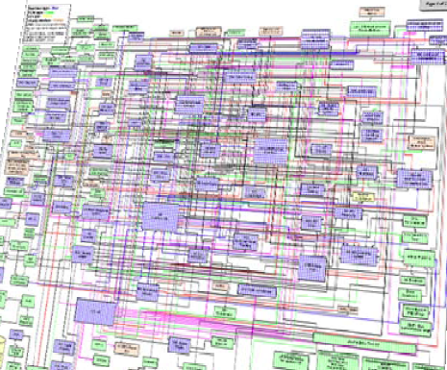
Data Sources and Heterogeneity
Course Motivation and Goals
Terminology
  Integration (Latin integer = whole): consolidation of data objects / sources
  Homogeneity (Greek homo/homoios = same): similarity
  Heterogeneity: dissimilarity, different representation / meaning
Heterogeneous IT Infrastructure
  Common enterprise IT infrastructure contains >100s of
  heterogeneous and distributed systems and applications
  E.g., health care data management: 20 - 120 systems
Multi-Modal Data (example health care)
  Structured patient data, patient records incl. prescribed drugs
  Knowledge base drug APIs (active pharmaceutical ingredients) + interactions
  Doctor notes (text), diagnostic codes, outcomes
  Radiology images (e.g., MRI scans), patient videos
  Time series (e.g., EEG, ECoG, heart rate, blood pressure)

Slide 14




The Data Science Lifecycle aka KDD Process aka CRISP-DM
Course Motivation and Goals
Data-centric View:
Application perspective
Workload perspective
System perspective
Data Scientist
Data Integration
Data Cleaning
Data Preparation
Model Selection
Training
Hyper-parameters
Validate & Debug
Deployment
Scoring & Feedback
Exploratory Process
(experimentation, refinements, ML pipelines)
Data/SW Engineer
DevOps Engineer
Notes:
KDD: Knowledge Discovery in Databases
CRISP-DM: CRoss-Industry Standard Process for Data Mining

Slide 15
The 80% Argument
Data Science Lifecycle
Data Sourcing Effort
  Data scientists spend 80-90% time on
  finding, integrating, cleaning datasets
Technical Debts in ML Systems
  Glue code, pipeline jungles, dead code paths
  Plain-old-data types (arrays), multiple languages, prototypes
  Abstraction and configuration debts
  Data testing, reproducibility, process management, and cultural debts
[Michael Stonebraker, Ihab F. Ilyas: Data Integration: The Current Status and the Way Forward.
IEEE Data Eng. Bull. 41(2) (2018)]
ML
[D. Sculley et al.: Hidden Technical Debt in Machine Learning Systems. NIPS 2015]

Slide 16

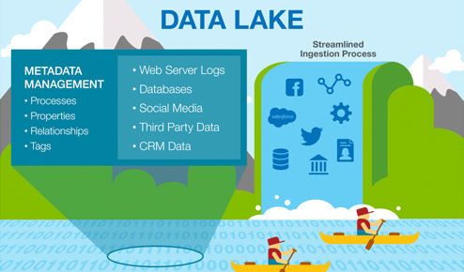



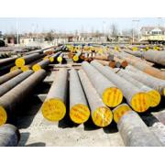


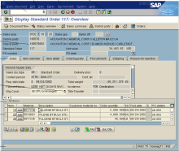
Complementary
Architectures
Course Motivation and Goals
Distributed Computation
Frameworks
#1 Information System Pyramid
#2 Data
Lake
Audio, Image, Video, Text, Streams, Logs
Operational Systems
Strategic
Systems
Analytical Systems
DSS
Vertical Integration
(e.g., ETL)
Catalogs
Distributed Data Stores
DWH
Material
ERP
CRM
SCM
eCommerce
Horizontal Integration (e.g., EAI)

Slide 17
Course Goals
Course Motivation and Goals
Common Data and System Characteristics
  Heterogeneous data sources and formats, often distributed
  Large data collections → distributed data storage and analysis
#1 Major data integration architectures
#2 Key techniques for data integration and cleaning
#3 Methods for large-scale data storage and analysis

Slide 18
Course Outline and Projects

Slide 19
Part A: Data Integration and Preparation
Course Outline and Projects
Data Integration Architectures
01 Introduction and Overview [Oct 08]
02 Data Warehousing, ETL, and SQL/OLAP [Oct 15]
03 Message-oriented Middleware, EAI, and Replication [Oct 22]
Key Integration Techniques
04 Schema Matching and Mapping [Oct 29]
05 Entity Linking and Deduplication [Nov 05]
06 Data Cleaning and Data Fusion [Nov 12, Shafaq]
07 Data Provenance and Blockchain [Nov 19]

Slide 20
Part B: Large-Scale Data Management & Analysis
Course Outline and Projects
Cloud Computing
08 Cloud Computing Foundations [Nov 26]
09 Cloud Resource Management and Scheduling [Dec 03]
10 Distributed Data Storage [Dec 10]
Large-Scale Data Analysis
11 Distributed, Data-Parallel Computation [Jan 07]
12 Distributed Stream Processing [Jan 14]
13 Distributed Machine Learning Systems [Jan 21]
14 Q&A and exam preparation [Jan 21]
  https://mboehm7.github.io/teaching/ws2021_dia/ExamDIA_v1.pdf
  https://mboehm7.github.io/teaching/ws2021_dia/ExamDIA_v2.pdf

Slide 21
Overview Projects or Exercises
Course Outline and Projects
Team
  1-3 person teams (w/ clearly separated responsibilities)
  In exceptions also larger teams (e.g., Data Cleaning Benchmark)
Objectives
  Non-trivial programming project in DIA context (2 ECTS → 50 hours)
  Preferred: Open source contribution to Apache SystemDS
  https://github.com/apache/systemds (from HW to high-level scripting)
  Alternative Exercise: Data engineering and ML pipeline
    Data integration and preparation of multi-modal data sources
    Data cleaning and ML model training and evaluation
Timeline
  Oct 22: List of projects proposals / exercise description
  Oct 29: Binding project/exercise selection
  Jan 21: Final project/exercise deadline

Slide 22


Apache SystemDS:
A Declarative ML System for the
End-to-End Data Science Lifecycle
Background and System Architecture
https://github.com/apache/systemds

Slide 23
What is an ML System?
Data Science Lifecycle
Classification
Regression
Recommenders
Clustering
Dim Reduction
Neural Networks
Statistics
Data Mining
Machine Learning (ML)
ML Applications
(entire KDD/DS lifecycle)
Rapidly Evolving
Runtime Techniques (Execution, Data Access)
ML System
Compilation Techniques
Distributed Systems
HPC
Data Management
Accelerators
Operating Systems
Prog. Language Compilers
HW Architecture

Slide 24

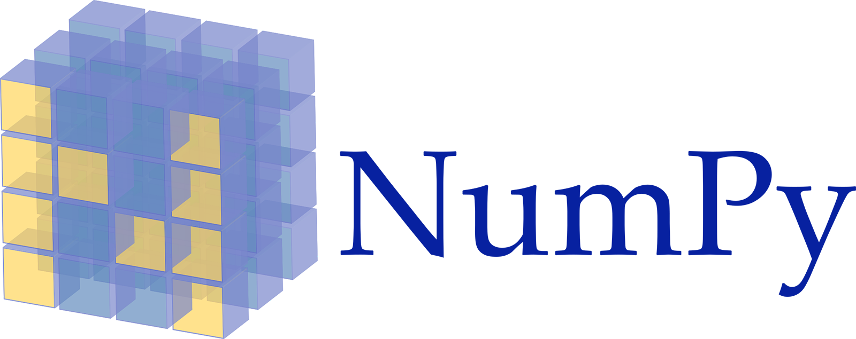












Landscape of ML Systems
Data Science Lifecycle
Existing ML Systems
  #1 Numerical computing frameworks
  #2 ML Algorithm libraries (local, large-scale)
  #3 Linear algebra ML systems (large-scale)
  #4 Deep neural network (DNN) frameworks
  #5 Model management, and deployment
Exploratory Data-Science Lifecycle
  Open-ended problems w/ underspecified objectives
  Hypotheses, data integration, run analytics
  Unknown value → lack of system infrastructure
  → Redundancy of manual efforts and computation
Data Preparation Problem
  80% Argument: 80-90% time for finding, integrating, cleaning data
  Diversity of tools ➔ boundary crossing, lack of optimization
“Take these datasets and show value or competitive advantage”
[NIPS 2015]
[DEBull 2018]

Slide 25
The Data Science Lifecycle
Data Science Lifecycle
Data-centric View:
Application perspective
Workload perspective
System perspective
Data extraction, schema alignment, entity resolution, data validation, data cleaning, outlier detection, missing value imputation, semantic type detection, data augmentation, feature selection, feature engineering, feature transformations
Data Scientist
Data Integration
Data Cleaning
Data Preparation
Model Selection
Training
Hyper-parameters
Validate & Debug
Deployment
Scoring & Feedback
Data Integration
Data Cleaning
Data Preparation
Exploratory Process
(experimentation, refinements, ML pipelines)
Data/SW Engineer
DevOps Engineer
Key observation: SotA
data integration/cleaning based on ML

Slide 26
Example: Linear Regression Conjugate Gradient
Apache SystemDS – Overview
1: X = read($1); # n x m matrix
2: y = read($2); # n x 1 vector
3: maxi = 50; lambda = 0.001;
4: intercept = $3;
5: ...
6: r = -(t(X) %*% y);
7: norm_r2 = sum(r * r); p = -r;
8: w = matrix(0, ncol(X), 1); i = 0;
9: while(i<maxi & norm_r2>norm_r2_trgt)
10: {
11: q = (t(X) %*% (X %*% p))+lambda*p;
12: alpha = norm_r2 / sum(p * q);
13: w = w + alpha * p;
14: old_norm_r2 = norm_r2;
15: r = r + alpha * q;
16: norm_r2 = sum(r * r);
17: beta = norm_r2 / old_norm_r2;
18: p = -r + beta * p; i = i + 1;
19: }
20: write(w, $4, format="text");
Note:
#1 Data Independence
#2 Implementation-Agnostic Operations
Read matrices from HDFS/S3
Compute initial gradient
Compute conjugate gradient
Compute
step size
Update model and residuals
➔ “Separation
of Concerns”

Slide 27
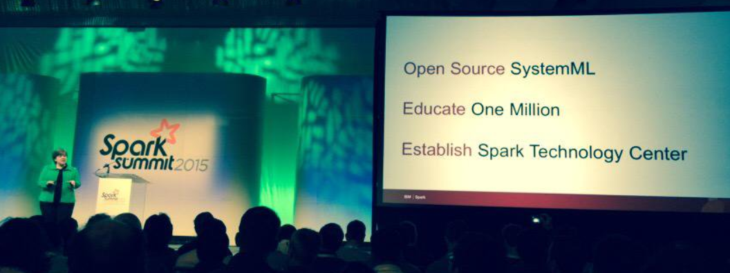



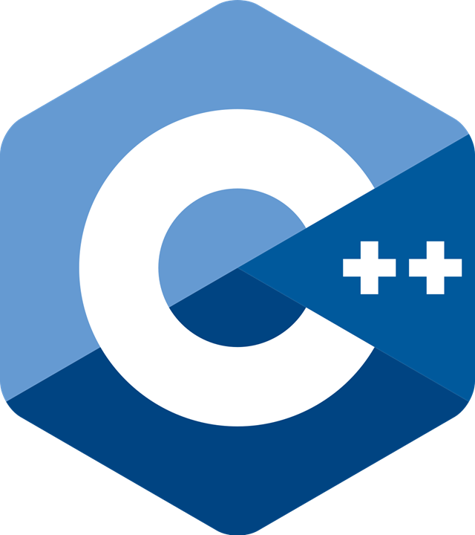
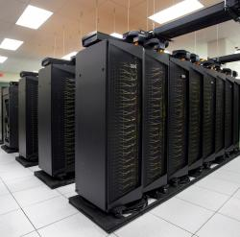
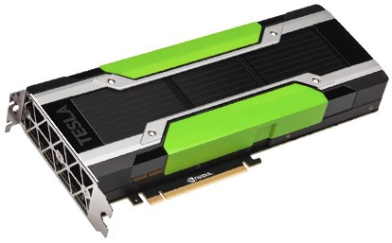
Apache SystemML/SystemDS
Apache SystemDS – Overview
DML Scripts
APIs: Command line, JMLC,
Spark MLContext, Spark ML,
(20+ Scalable Algorithms)
Language
Compiler
[SIGMOD’15,’17,’19,’21a,’21b,’21c]
[PVLDB’14,’16a,’16b,’18]
[ICDE’11,’12,’15]
[CIDR’17,’20]
[VLDBJ’18]
[DEBull’14]
[PPoPP’15]
07/2020 Renamed to SystemDS
05/2017 Apache Top-Level Project
11/2015 Apache Incubator Project
08/2015 Open Source Release
Runtime
Write Once, Run Anywhere
In-Memory Single Node
(scale-up)
Hadoop or Spark Cluster
(scale-out)
In-Progress:
GPU
since 2014/16
since 2012
since 2010/11
since 2015

Slide 28
Basic HOP and LOP DAG Compilation
Apache SystemDS – Overview
LinregDS (Direct Solve)
X = read($1);
y = read($2);
intercept = $3;
lambda = 0.001;
...
if( intercept == 1 ) {
ones = matrix(1, nrow(X), 1);
X = append(X, ones);
}
I = matrix(1, ncol(X), 1);
A = t(X) %*% X + diag(I)*lambda;
b = t(X) %*% y;
beta = solve(A, b);
...
write(beta, $4);
Cluster Config:
driver mem: 20 GB
exec mem: 60 GB
Scenario:
X: 10⁸ x 10³, 10¹¹
y: 10⁸ x 1, 10⁸
HOP DAG
(after rewrites)
8KB
CP
write
8MB
16MB
CP
b(solve)
CP
172KB
b(+)
1.6TB
CP
SP
800GB
r(diag)
ba(+*)
ba(+*)
SP
1.6TB
r(t)
8KB
SP
CP
800GB
800MB
dg(rand)
(10³x1,10³)
X
(10⁸x10³,10¹¹)
y
(10⁸x1,10⁸)
LOP DAG
(after rewrites)
16KB
r’(CP)
Hybrid Runtime Plans:
  Size propagation / memory estimates
  Integrated CP / Spark runtime
  Dynamic recompilation during runtime
Distributed Matrices
  Fixed-size (squared) matrix blocks
  Data-parallel operations
mapmm(SP)
tsmm(SP)
800MB
1.6GB
r’(CP)
X
X_{1,1}
(persisted in MEM_DISK)
y
X_{2,1}
X_{m,1}

Slide 29
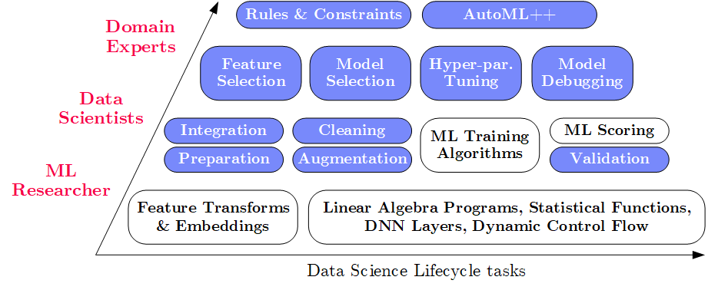
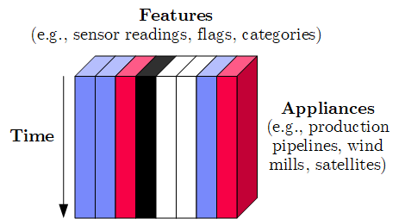
Apache SystemDS Design
Apache SystemDS – Overview
Apache SystemML (since 2010)
→ SystemDS (09/2018)
→ Apache SystemDS (07/2020)
Objectives
  Effective and efficient data preparation, ML, and model debugging at scale
  High-level abstractions for different lifecycle tasks and users
#1 Based on DSL for ML Training/Scoring
  Hierarchy of abstractions for DS tasks
  ML-based SotA, interleaved, performance
#2 Hybrid Runtime Plans and Optimizing Compiler
  System infrastructure for diversity of algorithm classes
  Different parallelization strategies and new architectures (Federated ML)
  Abstractions → redundancy → automatic optimization
#3 Data Model: Heterogeneous Tensors
  Data integration/prep requires generic data model

Slide 30
Language Abstractions and APIs, cont.
Apache SystemDS – Overview
Example: Stepwise Linear Regression
User Script
Built-in Functions
X = read(‘features.csv’)
Y = read(‘labels.csv’)
[B,S] = steplm(X, Y,
icpt=0, reg=0.001)
write(B, ‘model.txt’)
m_steplm = function(...) {
while( continue ) {
parfor( i in 1:n ) {
if( !fixed[1,i] ) {
Xi = cbind(Xg, X[,i])
B[,i] = lm(Xi, y, ...)
} }
# add best to Xg
# (AIC)
} }
m_lmCG = function(...) {
while( i<maxi&nr2>tgt ) {
q = (t(X) %*% (X %*% p))
+ lambda * p
beta = ... }
}
m_lm = function(...) {
if( ncol(X) > 1024 )
B = lmCG(X, y, ...)
else
B = lmDS(X, y, ...)
}
Linear Algebra Programs
Feature Selection
Facilitates optimization across data science lifecycle tasks
ML Algorithms
m_lmDS = function(...) {
l = matrix(reg,ncol(X),1)
A = t(X) %*% X + diag(l)
b = t(X) %*% y
beta = solve(A, b) ...}
Many interesting DIA projects here

Slide 31
Apache SystemDS Architecture
Apache SystemDS – Overview
> 17,500 tests
[M. Boehm, I. Antonov, S. Baunsgaard, M. Dokter, R. Ginthör, K. Innerebner, F. Klezin, S. N. Lindstaedt,
A. Phani, B. Rath, B. Reinwald, S. Siddiqui, S. Benjamin Wrede: SystemDS: A Declarative Machine Learning System for the End-to-End Data Science Lifecycle. CIDR 2020]

Slide 32
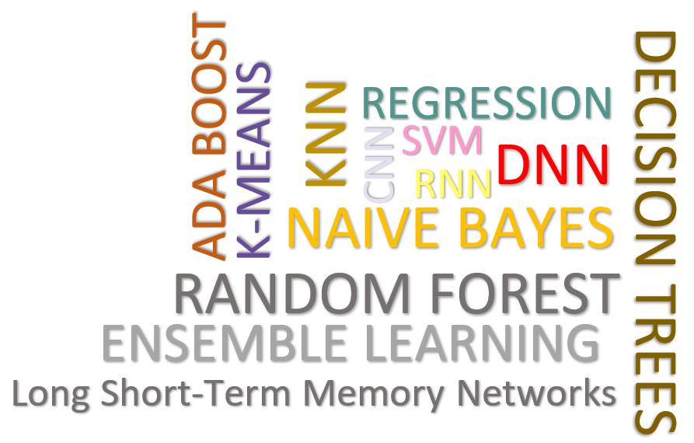
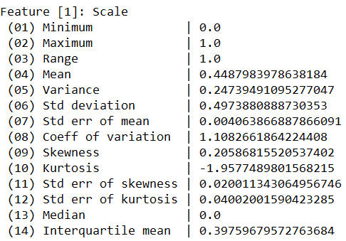
Data Cleaning Pipelines
Apache SystemDS – Selected Features
Automatic Generation of Cleaning Pipelines
  Library of robust, parameterized data cleaning primitives (physical/logical)
  Enumeration of DAGs of primitives & hyper-parameter optimization (HB, BO)
Data Samples
Logical
Data- and Task-parallel Computation
O
Physical
LP₁
LP₂
…
LP_{n}
Top-k Pipelines
Target
App
…
…
…
PP₁
PP_{n}
PP₁
PP_{n}
PP₁
PP_{n}
Rules/Objectives
Outlier Detection → MVI → Deduplication → Resolve Mislabels
P_{1:} gmm → imputeFD → mergeDup → delML
P_{n:} outlierBySd→ mice → delDup → voting
Debugging
University | Country
TU Graz | Austria
TU Graz | Austria
TU Graz | Germany
IIT | India
IIT | IIT
IIT | Pakistan
IIT | India
SIBA | Pakistan
SIBA | null
SIBA | null
University | Country
TU Graz | Austria
TU Graz | Austria
TU Graz | Austria
IIT | India
IIT | India
IIT | India
IIT | India
SIBA | Pakistan
SIBA | Pakistan
SIBA | Pakistan
A | B | C | D
0.77 | 0.80 | 1 | 1
0.96 | 0.12 | 1 | 1
0.66 | 0.09 | null | 1
0.23 | 0.04 | 17 | 1
0.91 | 0.02 | 17 | null
0.21 | 0.38 | 17 | 1
0.31 | null | 17 | 1
0.75 | 0.21 | 20 | 1
null | null | 20 | 1
0.19 | 0.61 | 20 | 1
0.64 | 0.31 | 20 | 1
A | B | C | D
0.77 | 0.80 | 1 | 1
0.96 | 0.12 | 1 | 1
0.66 | 0.09 | 17 | 1
0.23 | 0.04 | 17 | 1
0.91 | 0.02 | 17 | 1
0.21 | 0.38 | 17 | 1
0.31 | 0.29 | 17 | 1
0.75 | 0.21 | 20 | 1
0.41 | 0.24 | 20 | 1
0.19 | 0.61 | 20 | 1
0.64 | 0.31 | 20 | 1
Dirty Data
After imputeFD(0.5)
Dirty Data
After MICE

Slide 33


Multi-Level Lineage Tracing & Reuse
Apache SystemDS – Selected Features
[SIGMOD’21]
Lineage as Key Enabling Technique
  Trace lineage of operations (incl. non-determinism), dedup for loops/functions
  Model versioning, data reuse, incremental maintenance, autodiff, debugging
Full Reuse of Intermediates
  Before executing instruction,
  probe output lineage in cache
  Map<Lineage, MatrixBlock>
  Cost-based/heuristic caching
  and eviction decisions (compiler-assisted)
Partial Reuse of Intermediates
  Problem: Often partial result overlap
  Reuse partial results via dedicated
  rewrites (compensation plans)
  Example: steplm
for( i in 1:numModels )
R[,i] = lm(X, y, lambda[i,], ...)
m_lmDS = function(...) {
l = matrix(reg,ncol(X),1)
A = t(X) %*% X + diag(l)
b = t(X) %*% y
beta = solve(A, b) ...}
m_steplm = function(...) {
while( continue ) {
parfor( i in 1:n ) {
if( !fixed[1,i] ) {
Xi = cbind(Xg, X[,i])
B[,i] = lm(Xi, y, ...)
} }
# add best to Xg
# (AIC)
} }
X
m>>n
t(X)

Slide 34



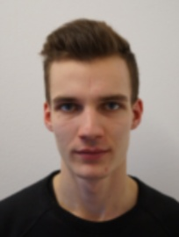



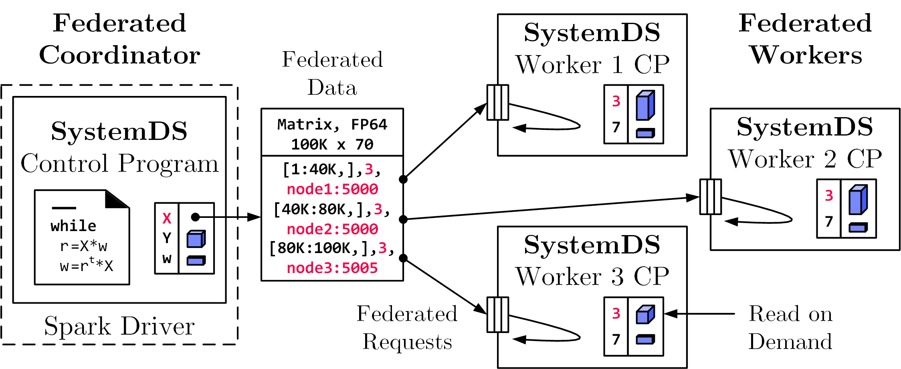
Federated Learning
ExDRa Project Overview
[SIGMOD 2021]
Federated Backend
  Federated data (matrices/frames) as meta data objects
  Federated linear algebra, (and federated parameter server)
Federated Requests: READ, PUT, GET, EXEC_INST, EXEC_UDF, CLEAR
X = federated(addresses=list(node1, node2, node3),
ranges=list(list(0,0), list(40K,70), ..., list(80K,0), list(100K,70)));
Notes:
Design Simplicity: (1) reuse instructions, (2) federation hierarchies
Note: Generalizes nicely to multi-device settings

Slide 35


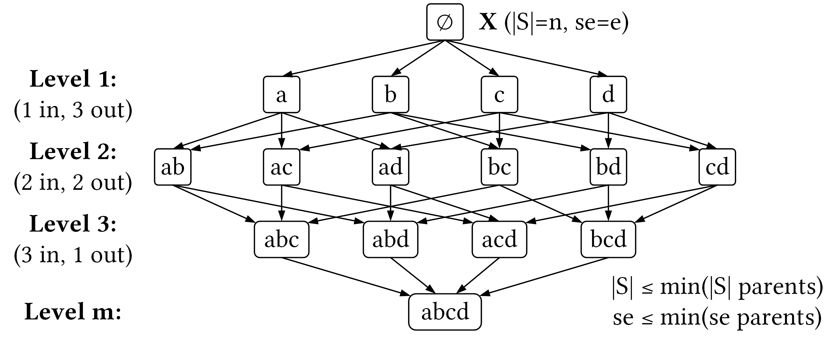
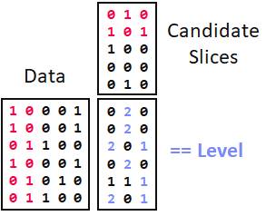
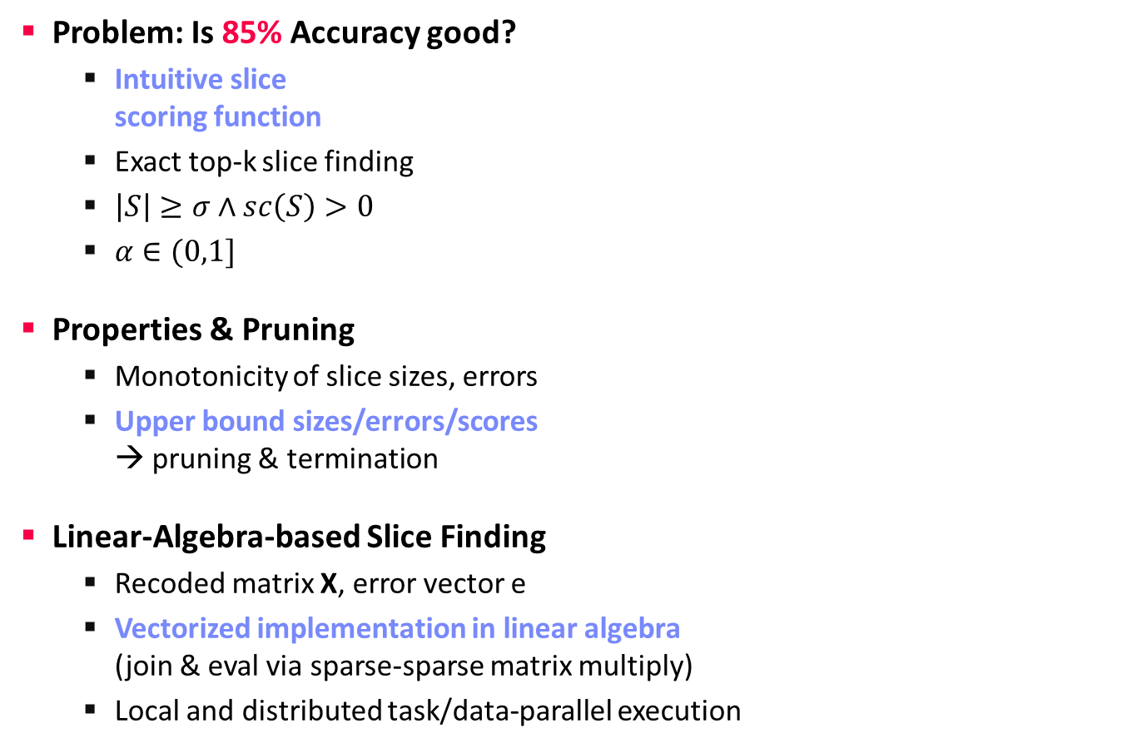
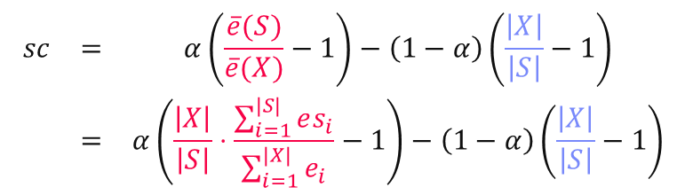
Model Debugging
Apache SystemDS – Selected Features
[SIGMOD’21]
[Credit: sliceline,
Silicon Valley, HBO]
Problem: Is 85% Accuracy good?
  Intuitive slice
  scoring function
  Exact top-k slice finding
  $\left|S\right|≥σ∧sc\left(S\right)>0$
  $α∈(0,1]$
Properties & Pruning
  Monotonicity of slice sizes, errors
  Upper bound sizes/errors/scores
  → pruning & termination
Linear-Algebra-based Slice Finding
  Recoded matrix X, error vector e
  Vectorized implementation in linear algebra
  (join & eval via sparse-sparse matrix multiply)
  Local and distributed task/data-parallel execution
$$\begin{matrix}sc & = & α\left(\frac{\overline{e}(S)}{\overline{e}(X)}−1\right)−\left(1−α\right)\left(\frac{\left|X\right|}{\left|S\right|}−1\right) \\ & = & α\left(\frac{\left|X\right|}{\left|S\right|}⋅\frac{\sum_{i=1}^{|S|}{es_{i}}}{\sum_{i=1}^{|X|}{e_{i}}}−1\right)−\left(1−α\right)\left(\frac{\left|X\right|}{\left|S\right|}−1\right)\end{matrix}$$
slice error
slice size
Notes:
Compelling properties:
The components are balanced under α = 0.5.
The score of the original X is always sc = 0.
For α = 0 (all weight on size), the maximum feasible score is 0, and no slice smaller than X can reach it.
All components of Equation (1) are either constants, or slice errors and sizes, which makes this function amenable to pruning.

Slide 36
Summary and Q&A
Course Goals
  #1 Major data integration architectures
  #2 Key techniques for data integration and cleaning
  #3 Methods for large-scale data storage and analysis
Programming Projects
  Unique project in Apache SystemDS (teams or individuals), or
  Exercise on data engineering and ML pipeline
Next Lectures
  02 Data Warehousing, ETL, and SQL/OLAP [Oct 15]
  03 Message-oriented Middleware, EAI, and Replication [Oct 22]

