Slide 1

Data Integration and Analysis
07 Data Provenane and Blockchain
Last update: Nov 19, 2021

Slide 2


Announcements/Org
#1 Video Recording
  Link in TUbe & TeachCenter (lectures will be public)
  Optional attendance (independent of COVID)
  Virtual lectures (recorded) until end of year
  https://tugraz.webex.com/meet/m.boehm

Slide 3
Agenda
Motivation and Terminology
Data Provenance
Blockchain Fundamentals

Slide 4
Data Provenance
Motivation and Terminology

Slide 5

Excursus: FAIR Data Principles
Motivation and Terminology
[https://www.go-fair.org/fair-principles/]
#1 Findable
  Metadata and data have globally unique persistent identifiers
  Data describes w/ rich meta data; registered/indexes and searchable
#2 Accessible
  Metadata and data retrievable via open, free and universal comm protocols
  Metadata accessible even when data no longer available
#3 Interoperable
  Metadata and data use a formal, accessible, and broadly applicable format
  Metadata and data use FAIR vocabularies and qualified references
#4 Reusable
  Metadata and data described with plurality of accurate and relevant attributes
  Clear license, associated with provenance, meets community standards

Slide 6
Terminology
Motivation and Terminology
Data Provenance
  Track and understand data origins and transformations of data
  (where?, when?, who?, why?, how?)
  Contains meta data, context, and modifications (transform, enrichment)
  Synonyms: data lineage, data pedigree
Data Catalogs (curation/governance)
  Directory of datasets including data provenance (meta data, artifacts)
  Raw/original, curated datasets, derived data products
Blockchain
  Data structure logging transactions in verifiable and permanent way
Measure / Acquire
Data Cleaning
Data Prep
Model Training
M
Model Serving
Notes:
Synonyms: art vs kings vs dogs

Slide 7

Applications and Goals
Motivation and Terminology
a) High-Level Goals
#1 Versioning and Reproducibility (analogy experiments)
#2 Explainability, Interpretability, Verification
b) Low-Level Goals
#3 Full and Partial Reuse of Intermediates
#4 Incremental Maintenance of MatViews, Models, etc
#5 Tape/log of Executed Operations → Auto Differentiation
#6 Recomputation for Caching / Fault Tolerance
#7 Debugging via Lineage Query Processing

Slide 8
Data Provenance
Notes:
TODO boris glavic

Slide 9
Overview Data Provenance
Data Provenance
Def Data Provenance
  Information about the origin and creation process of data
Example
  Debugging suspicious query results
Customer | Sum
A | 7620
B | 120
C | 130
D | 75
SELECT Customer, sum(O.Quantity*P.Price)
FROM Orders O, Products P
WHERE O.PID = P.PID
GROUP BY Customer
OID | Customer | Date | Quantity | PID
1 | A | 2019-06-22 | 3 | 2
2 | B | 2019-06-22 | 1 | 3
3 | A | 2019-06-22 | 101 | 4
4 | C | 2019-06-23 | 2 | 2
5 | D | 2019-06-23 | 1 | 4
6 | C | 2019-06-23 | 1 | 1
PID | Product | Price
1 | X | 100
2 | Y | 15
4 | Z | 75
3 | W | 120
OID | Customer | Date | Quantity | PID
1 | A | 2019-06-22 | 3 | 2
2 | B | 2019-06-22 | 1 | 3
3 | A | 2019-06-22 | 101 | 4
4 | C | 2019-06-23 | 2 | 2
5 | D | 2019-06-23 | 1 | 4
6 | C | 2019-06-23 | 1 | 1
PID | Product | Price
1 | X | 100
2 | Y | 15
4 | Z | 75
3 | W | 120

Slide 10
Overview Data Provenance, cont.
Data Provenance
[Boris Glavic: CS595 Data Provenance – Introduction to Data Provenance, Illinois Institute of Technology, 2012]
An Abstract View
  Data: schema, structure → data items
  Data composition (granularity): attribute, tuple, relation
  Transformation: consumes inputs, produces outputs
  Hierarchical transformations: query w/ views, query block, operators
  Additional: env context (OS, libraries, env variables, state), users
Goal: Tracing of Derived Results
  Inputs and parameters
  Steps involved in creating the result
  ➔ Store and query data & provenance
  General Data Protection
  Regulation (GDPR)?
[Zachary G. Ives: Data Provenance: Challenges, Benefits, Research, NIH Webinar 2016]
Read file1
Sort rows
Compute median
Write to file2
Prov.
Notes:
TODO ref boris

Slide 11
Classification of Data Provenance
Data Provenance
Overview
  Base query Q(D) = O with database D = {R₁, …, R_{n}}
  Forward lineage query: L_{f}(R_{i}”, O’) from subset of input relation to output
  Backward lineage query: L_{b}(O’, R_{i}) from subset of outputs to base tables
#1 Lazy Lineage Query Evaluation
  Rewrite (invert) lineage queries as relational queries over input relations
  No runtime overhead but slow lineage query processing
#2 Eager Lineage Query Evaluation
  Materialize annotations (data/transforms) during base query evaluation
  Runtime overhead but fast
  lineage query processing
  Lineage capture: Logical (relational)
  vs physical (instrumented physical ops)
[Fotis Psallidas, Eugene Wu: Smoke: Fine-grained Lineage at Interactive Speed. PVLDB 2018]

Slide 12
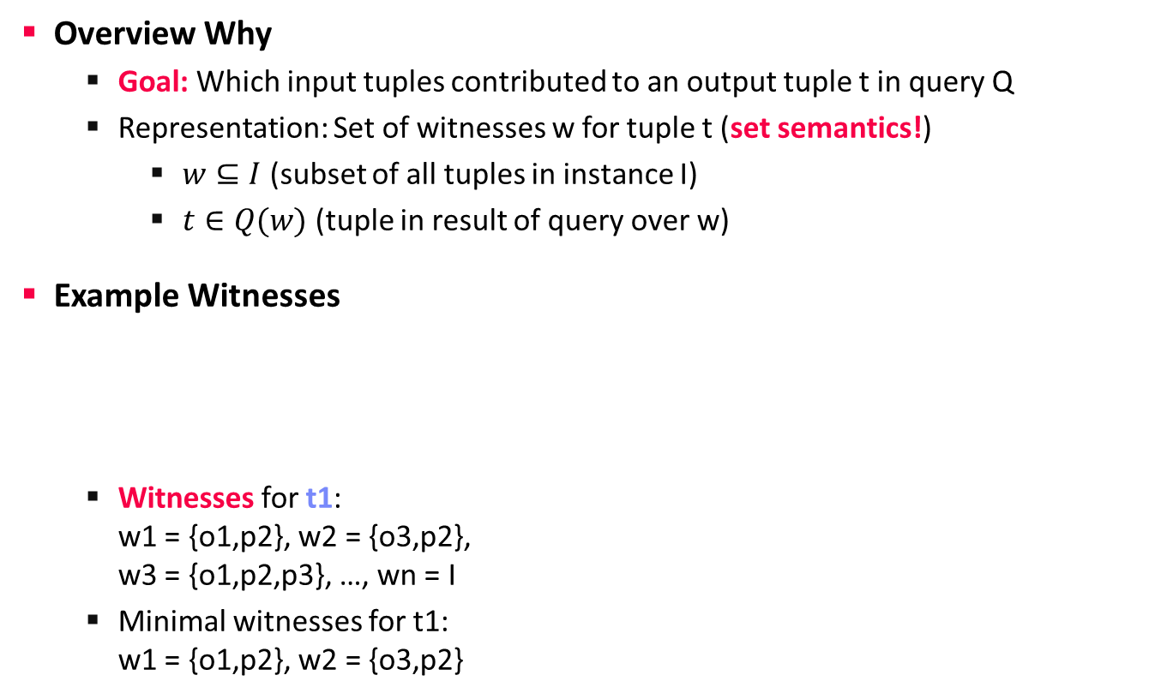
Why-Provenance
Data Provenance
[Boris Glavic: CS595 Data Provenance – Provenance Models and Systems, Illinois Institute of Technology, 2012]
Overview Why
  Goal: Which input tuples contributed to an output tuple t in query Q
  Representation: Set of witnesses w for tuple t (set semantics!)
    $w⊆I$ (subset of all tuples in instance I)
    $t∈Q(w)$ (tuple in result of query over w)
Example Witnesses
  Witnesses for t1:
  w1 = {o1,p2}, w2 = {o3,p2},
  w3 = {o1,p2,p3}, …, wn = I
  Minimal witnesses for t1:
  w1 = {o1,p2}, w2 = {o3,p2}
Customer | Date | PID
A | 2019-06-22 | 2
B | 2019-06-22 | 3
A | 2019-06-22 | 2
PID | Product
1 | X
2 | Y
4 | Z
3 | W
SELECT Customer, Product
FROM Orders O, Products P
WHERE O.PID=P.PID
o1
p1
o2
p2
o3
p3
p4
Customer | Product
A | Y
B | W
t1
t2
Others: Where/How Provenance

Slide 13
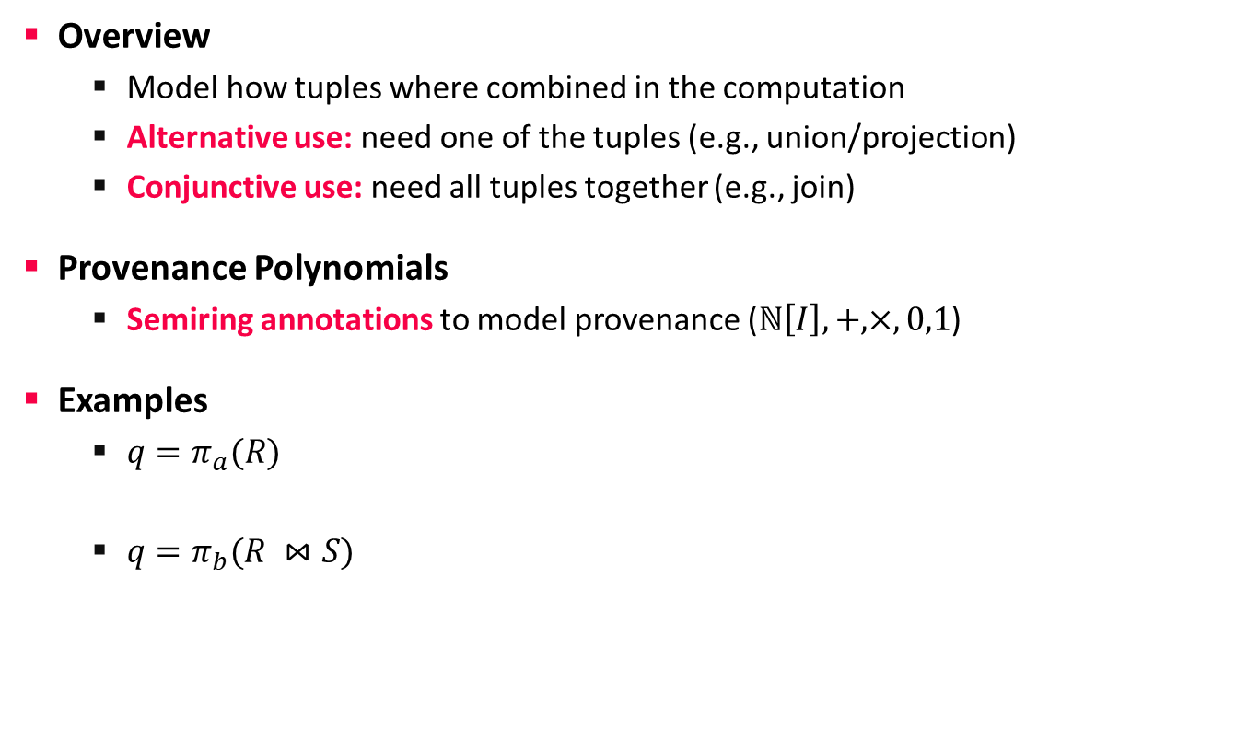
How-Provenance
Data Provenance
[Boris Glavic: CS595 Data Provenance – Provenance Models and Systems, Illinois Institute of Technology, 2012]
Overview
  Model how tuples where combined in the computation
  Alternative use: need one of the tuples (e.g., union/projection)
  Conjunctive use: need all tuples together (e.g., join)
Provenance Polynomials
  Semiring annotations to model provenance ($ℕ\left[I\right], +,×, 0,1$)
Examples
  $q=π_{a}(R)$
  $q=π_{b}(R ⋈S)$
a | b
1 | 2
1 | 3
a
1
r1
r1 + r2
r2
Provenance Polynomials
a | b
1 | P
2 | G
3 | M
c | a
S | 1
S | 2
W | 2
r1
s1
b
P
G
r1 x s1
r2
s2
(r2 x s2) + (r2 x s3)
s3
Notes:
A semiring is a set R equipped with two binary operations + and ⋅, called addition and multiplication, such that:
(R, +) is a commutative monoid with identity element 0:
(R, ⋅) is a monoid with identity element 1:
Multiplication left and right distributes over addition:
Multiplication by 0 annihilates R: 0⋅a = a⋅0 = 0

Slide 14
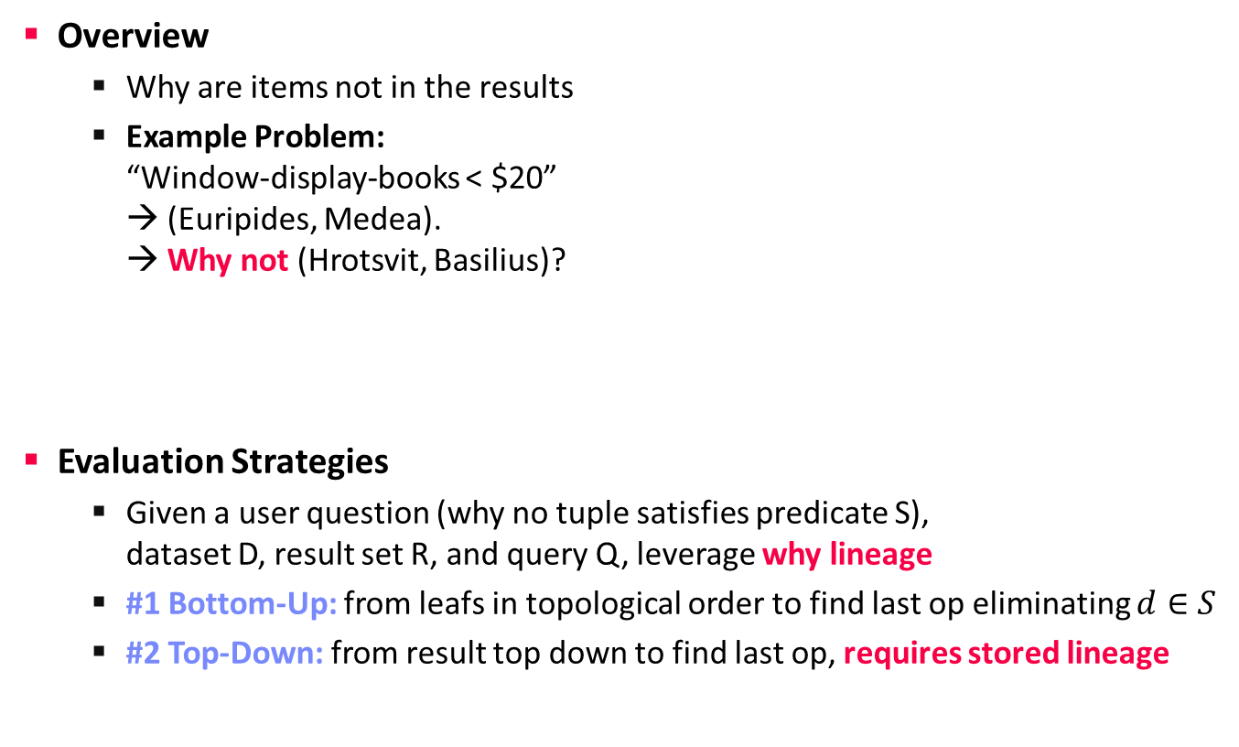
Why Not?-Provenance
Data Provenance
[Adriane Chapman, H. V. Jagadish: Why not? SIGMOD 2009]
Overview
  Why are items not in the results
  Example Problem:
  “Window-display-books < $20”
  → (Euripides, Medea).
  → Why not (Hrotsvit, Basilius)?
Evaluation Strategies
  Given a user question (why no tuple satisfies predicate S),
  dataset D, result set R, and query Q, leverage why lineage
  #1 Bottom-Up: from leafs in topological order to find last op eliminating $d∈S$
  #2 Top-Down: from result top down to find last op, requires stored lineage
>= 20$?
Bug in the
query / system?
Not in
book store?

Slide 15

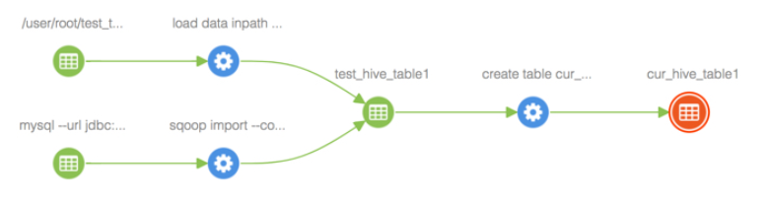
Apache Atlas
Data Provenance
Apache Atlas Overview
  Metadata management and governance capabilities
  Build catalog (data classification, cross-component lineage)
Example
  Configure Atlas hooks w/ Hadoop components
  Automatic tracking of lineage and side effects
[https://www.cloudera.com/tutorials/cross-component-lineage-with-apache-atlas-across-apache-sqoop-hive-kafka-storm/.html]

Slide 16

Provenance for ML Pipelines (fine-grained)
Data Provenance
DEX: Dataset Versioning
  Versioning of datasets, stored with delta encoding
  Checkout, intersection, union queries over deltas
  Query optimization for finding efficient plans
MISTIQUE: Intermediates of ML Pipelines
  Capturing, storage, querying of intermediates
  Lossy deduplication and compression
  Adaptive querying/materialization for finding efficient plans
Linear Algebra Provenance
  Provenance propagation by decomposition
  Annotate parts w/ provenance polynomials
  (identifiers of contributing inputs + impact)
[Amit Chavan, Amol Deshpande: DEX: Query Execution in a Delta-based Storage System. SIGMOD 2017]
[Manasi Vartak et al: MISTIQUE: A System to Store and Query Model Intermediates for Model Diagnosis. SIGMOD 2018]
A
B
C
D
E
S_{x}
S_{y}
$$A=S_{x}BT_{u}+S_{x}CT_{v}+S_{y}DT_{u}+S_{y}ET_{v}$$
T_{u}
[Zhepeng Yan, Val Tannen, Zachary G. Ives: Fine-grained Provenance for Linear Algebra Operators. TaPP 2016]
T_{v}

Slide 17
Provenance for ML Pipelines (coarse-grained)
Data Provenance
[Credit: https://databricks.com/
blog/2018/06/05 ]
MLflow
  Programmatic API for
  tracking parameters,
  experiments, and results
  autolog() for specific params
Flor (on Ground)
  DSL embedded in python for managing the
  workflow development phase of the ML lifecycle
  DAGs of Actions, Artifacts, and Literals
  Data context generated by activities in Ground
Dataset Relationship Management
  Reuse, reveal, revise, retarget, reward
  Code-to-data relationships (data provenance)
  Data-to-code relationships (potential transforms)
import mlflow
mlflow.log_param("num_dimensions", 8)
mlflow.log_param("regularization", 0.1)
mlflow.log_metric("accuracy", 0.1)
mlflow.log_artifact("roc.png")
[Credit: https://rise.cs.berkeley.edu/
projects/jarvis/ ]
[Joseph M. Hellerstein et al: Ground: A Data Context Service. CIDR 2017]
[Zachary G. Ives, Yi Zhang, Soonbo Han, Nan Zheng,: Dataset Relationship Management. CIDR 2019]

Slide 18
Provenance for ML Pipelines (coarse-grained), cont.
Data Provenance
HELIX
  Goal: focus on iterative development
  w/ small modifications (trial & error)
  Caching, reuse, and recomputation
  Reuse as Max-Flow problem → NP-hard → heuristics
  Materialization to disk
  for future reuse
Collaborative
Optimizer
[Doris Xin, Stephen Macke, Litian Ma, Jialin Liu, Shuchen Song, Aditya G. Parameswaran: Helix: Holistic Optimization for Accelerating Iterative Machine Learning. PVLDB 2018]
load
recompute
[Behrouz Derakhshan, Alireza Rezaei Mahdiraji, Ziawasch Abedjan, Tilmann Rabl, Volker Markl: Optimizing Machine Learning Workloads in Collaborative Environments. SIGMOD 2020]
Notes:
Note: reuse poly, but materialization opt NP-hard

Slide 19


Lineage Tracing & Reuse in SystemDS
Data Provenance
Problem
  Exploratory data science (data preprocessing, model configurations)
  Reproducibility and explainability of trained models (data, parameters, prep)
  Lineage/Provenance as Key Enabling Technique:
  Model versioning, reuse of intermediates, incremental maintenance,
  auto differentiation, and debugging (query processing over lineage)
Efficient Lineage Tracing
  Tracing of inputs, literals,
  and non-determinism
  Trace lineage of
  logical operations
  Deduplication for loops/functions
  Program/output reconstruction
[Arnab Phani, Benjamin Rath, Matthias Boehm: LIMA: Fine-grained Lineage Tracing and Reuse in Machine Learning Systems, SIGMOD 2021]

Slide 20

Lineage Tracing & Reuse in SystemDS
Data Provenance
Multi-level, Lineage-based Reuse
  Lineage trace uniquely identifies intermediates
  Reuse intermediates at function / block / operation level
Full Reuse of Intermediates
  Before executing instruction,
  probe output lineage in cache
  Map<Lineage, MatrixBlock>
  Cost-based/heuristic caching
  and eviction decisions (compiler-assisted)
Partial Reuse of Intermediates
  Problem: Often partial result overlap
  Reuse partial results via dedicated
  rewrites (compensation plans)
  Example: steplm
for( i in 1:numModels )
R[,i] = lm(X, y, lambda[i,], ...)
m_lmDS = function(...) {
l = matrix(reg,ncol(X),1)
A = t(X) %*% X + diag(l)
b = t(X) %*% y
beta = solve(A, b) ...}
m_steplm = function(...) {
while( continue ) {
parfor( i in 1:n ) {
if( !fixed[1,i] ) {
Xi = cbind(Xg, X[,i])
B[,i] = lm(Xi, y, ...)
} }
# add best to Xg
# (AIC)
} }
X
m>>n
t(X)
Notes:
Note: inspired by earlier work on COLUMBUS, KeystoneML, Helix, PRETZEL, MISTIQUE, Alpine Meadow

Slide 21
BREAK (and Test Yourself)
Data Provenance
Given below tables R and S (with tuples r_{i} and s_{i}), query Q and results O, specify the provenance polynomials for every tuple in O. (3 points)
A: r1 x s1 + r3 x s1 + r2 x s3
(equivalent: (r1 + r3) x s1 + r2 x s3)
B: r2 x s2
C: r2 x s4

Slide 22
Blockchain Fundamentals

Slide 23
Recap: Database (Transaction) Log
Blockchain Fundamentals
User 2
User 1
User 3
Database Architecture
  Page-oriented storage on disk and
  in memory (DB buffer)
  Dedicated eviction algorithms
  Modified in-memory pages marked as
  dirty, flushed by cleaner thread
  Log: append-only TX changes
  Data/log often placed on different devices
  and periodically archived (backup + truncate)
Write-Ahead Logging (WAL)
  The log records representing changes to some (dirty)
  data page must be on stable storage before the data page (UNDO - atomicity)
  Force-log on commit or full buffer (REDO - durability)
  Recovery: forward (REDO) and
  backward (UNDO) processing
  Log sequence number (LSN)
DBMS
DB Buffer
Log Buffer
P7
P3’
P1
P7
P3
Data
Log
[C. Mohan, Donald J. Haderle, Bruce G. Lindsay, Hamid Pirahesh, Peter M. Schwarz: ARIES: A Transaction Recovery Method Supporting Fine-Granularity Locking and Partial Rollbacks Using Write-Ahead Logging. TODS 1992]

Slide 24
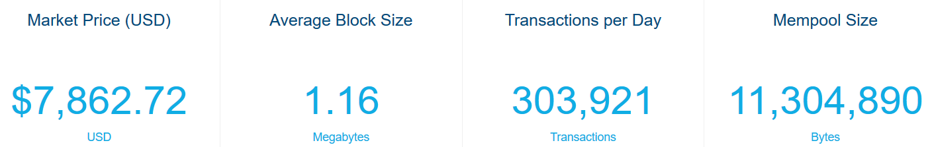
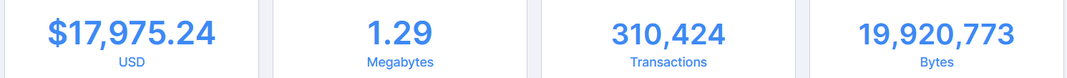
Bitcoin and Blockchain
Blockchain Fundamentals
[Satoshi Nakamoto: Bitcoin: A Peer-to-Peer Electronic Cash System, White paper 2008]
Motivation
  Peer-to-peer (decentralized, anonymous) electronic cash/payments
  Non-reversible transactions w/o need for trusted third party
  Statistics
  Nov 21 2019:
  Nov 19 2020:
Transaction Overview
  Electronic coin defined as
  chain of digital signatures
  Transfer by signing hash of previous
  TX and public key of next owner
  Double-spending problem
  (without global verification)
[https://www.blockchain.
com/charts]
(Paypal Oct 2020)

Slide 25
Blockchain Data Structure
Blockchain Fundamentals
[Satoshi Nakamoto: Bitcoin: A Peer-to-Peer Electronic Cash System, White paper 2008]
Timestamp Server
  Decentralized timestamp server: chain of hashes ➔ public ledger
Proof-of-Work
  Scanning for value (nonce) which SHA-256 hash
  begins with a number of zero bits
  → exponential in number of zeros
  # zero bits determined by MA of avg blocks/hour
  Hard to recompute for chain, easy to check
  Majority decision: CPU time, longest chain
Hash
Hash
Enforces order dependency
➔ No double-spending
Block
Block
TX
TX
TX
TX
TX
Hash
00110111
Prev hash
nonce
TX
TX
TX
Merkel tree (hash tree)
Notes:
Note: Nov 19 difficulty 17 zero bits, adjusted every 216 blocks so ~1 block every 10 minutes

Slide 26
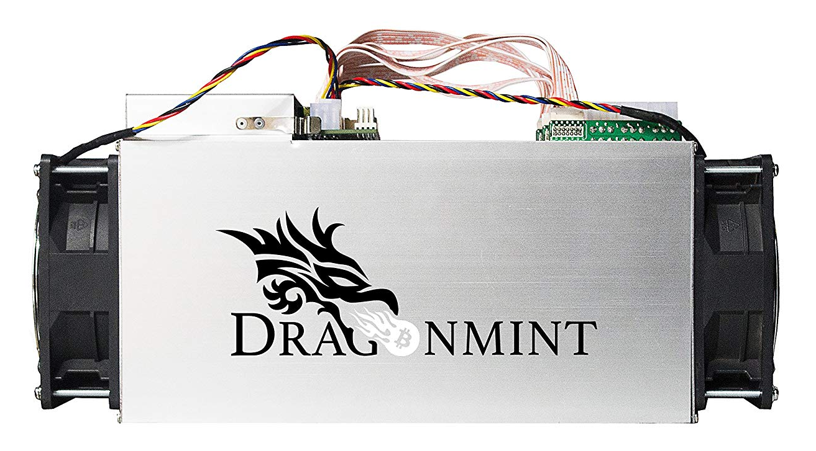
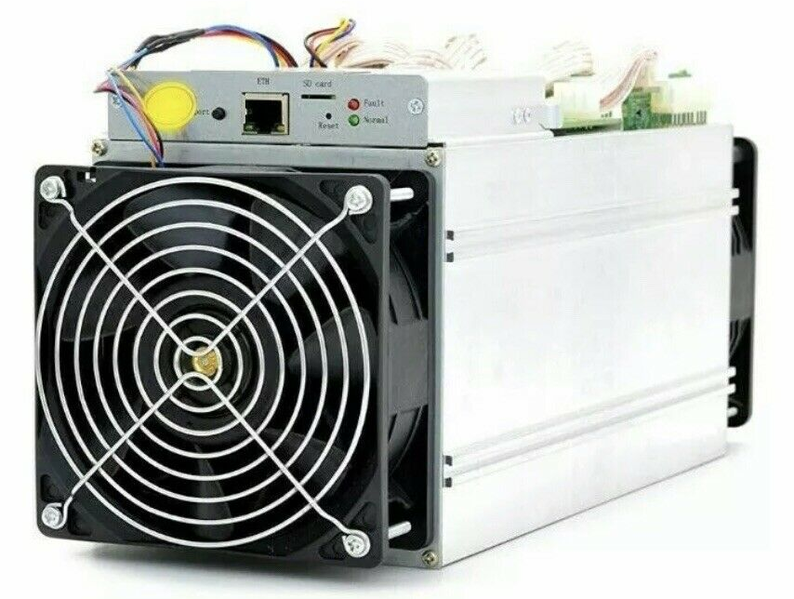
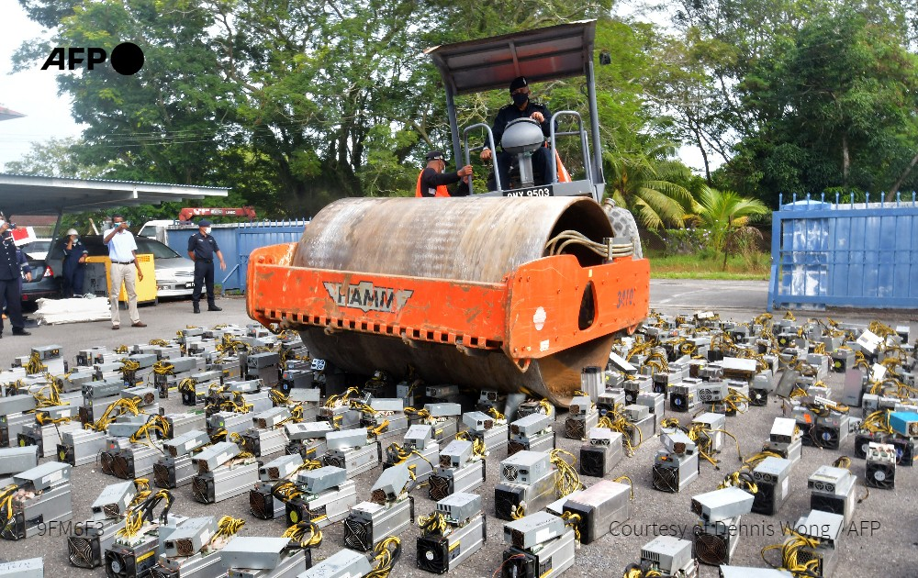
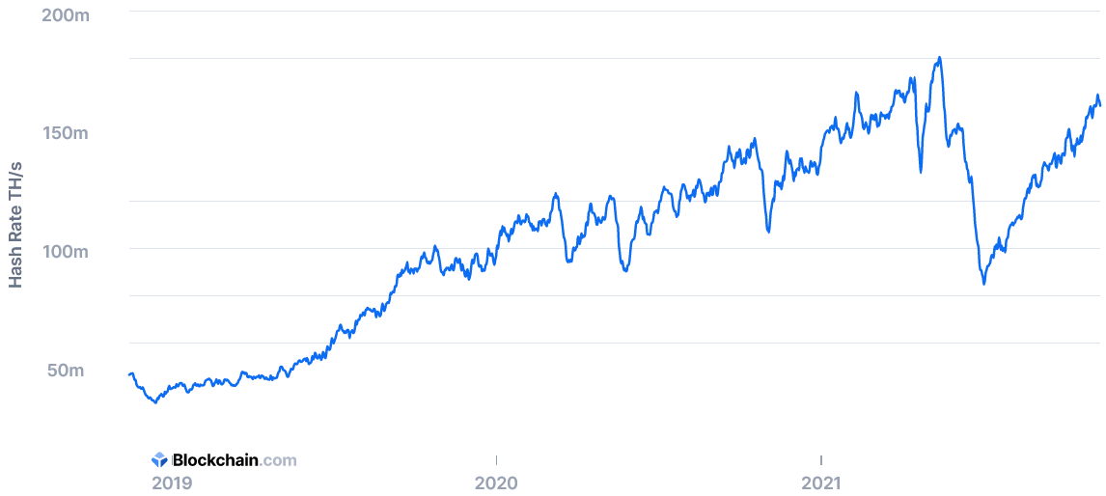
Blockchain Data Structure, cont.
Blockchain Fundamentals
Bitcoin Mining
  HW: from CPU to GPUs/FPGAs/ASICs (10-70 TH/s @ 2-3KW)
  Usually mining pools → “mining cartels”
Hash Rate of Bitcoin Network
  ~10 min per block (144 blocks per day)
180 EH
@Malaysia
Nov 12, 2021: ~160EH
[https://www.blockchain.com/en/charts/hash-rate?
daysAverageString=7&timespan=180days, Nov 12 2021]
Notes:
Notes: 18.5M/21M BTC mined in 2020

Slide 27
Blockchain Communication
Blockchain Fundamentals
[Satoshi Nakamoto: Bitcoin: A Peer-to-Peer Electronic Cash System, White paper 2008]
Networking Protocol
  New TXs are broadcast to all nodes
  Each node collects new TXs into a block
  Each node works on finding proof-of-work for its block
  → Incentive: 1st TX in block new coin
  (halves every 210k blocks) for the block creator + TX fees
  When a node finds a proof-of-work, broadcast the block to all nodes
  Nodes accept the block if all TXs are valid (double spending)
  Nodes express acceptance by working on next block in the chain,
  using the hash of the accepted block as the previous hash
Fault Tolerance
  TX broadcasts: no need to reach all but many → next block contains it
  Block broadcast: no need to reach all → next block references it
2008: 50BTC
2012: 25BTC
2016: 12.5BTC
2020: 6.25BTC
Notes:
Note: bitcoin limited to 21M but TX fees might go up.

Slide 28

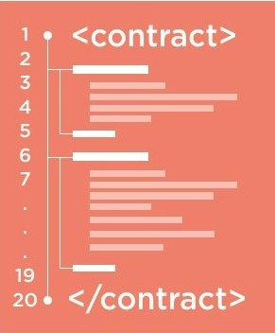
Smart Contracts (Ethereum)
Blockchain Fundamentals
Motivation
  Problem: Bitcoin TXs for transferring X $BTC from A to B
  (exchange as assets)
  Goals: voting, auctions, games, bets, legal agreements (notary)
Ethereum
  Decentralized platform that allows creation, management,
  and execution of smart contracts
  Ether cryptocurrency, block mining rate: seconds (5 ETH/block)
Smart Contract
  Store smart contract (turing-complete programs) on the blockchain
  On transfer/trigger: run smart contract (in ) in Ethereum Virtual Machine
  Language: Serpent/Solidity (deterministic, w/ control flow and function calls)
  ➔ Problem: while(true) → EVM gas and fees (start gas, gas price)
  Immutability guarantees persistence
[Credit: Shana Hutchison]

Slide 29
Consensus Mechanisms
Blockchain Fundamentals
“means of showing that one invested a non-trivial amount of effort related to some statement”
Proof of Work (PoW)
  Validation by performing work, existence of HW resources
  High HW cost of attacks
  Wasted work, resources, energy (only first block, no real outcome, e-waste)
Proof of Stake (PoS)
  Validation by stake-weighted random node selection
  Intrinsic coin cost, less HW resources/energy
  Untested attack mitigation?
Proof of Space/Capacity
  Upfront creation of “plot files”, store nonces+hashes,
  find solutions, occasional validation
  HW costs of attacks, use of unused space
  Moderate adoption
Ethereum 2.0
→ PoS/sharding
over time
[https://www.chia.net/]
[Stefan Dziembowski, Sebastian Faust, Vladimir Kolmogorov,
Krzysztof Pietrzak: Proofs of Space. IACR Cryptol. 2013]

Slide 30
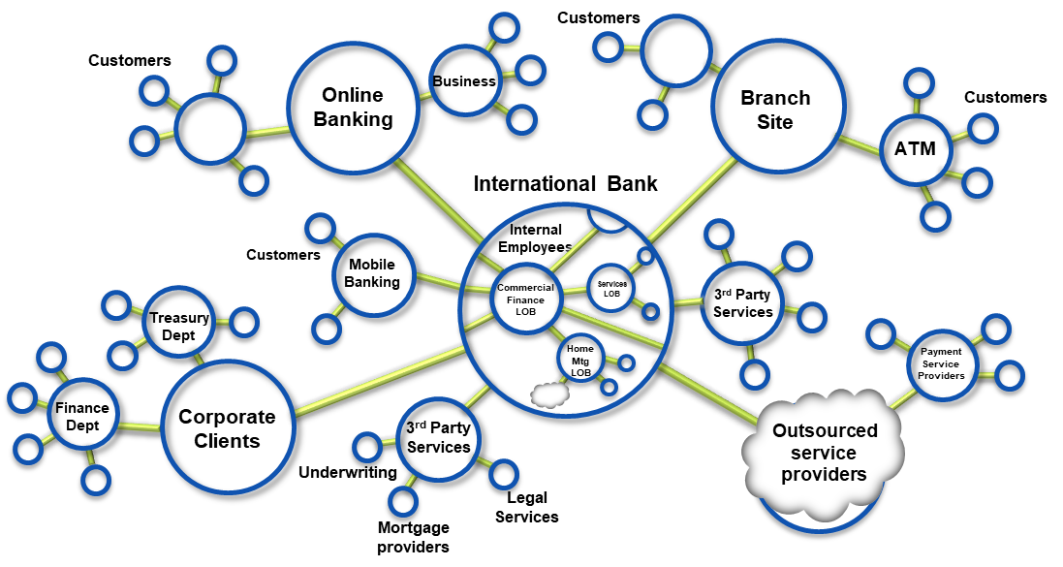

Permissioned/Private Blockchains
Blockchain Fundamentals
Private Setup
  Business Networks connect businesses
  Participants with Identity
  Assets flow over business networks
  Transactions describe exchange or
  change of states of assets
  Smart contracts underpin
  transactions
  Blockchain as shared, replicated,
  permissioned ledger (TX log):
  consensus, provenance, immutability
Hyperledger Fabric (https://github.com/hyperledger/)
  IBM, Oracle, Baidu, Amazon, Alibaba, Microsoft, JD, SAP, Huawei, Tencent
  Blockchain-as-a-Service (BaaS) offerings: distributed ledger, libs, tools
[C. Mohan: State of Permissionless and Permissioned Blockchains: Myths and Reality, 2019]

Slide 31
Discussion Blockchain
Blockchain Fundamentals
➔ Recommendation: Investigate business requirements/context,
decide on technical properties and acceptable trade-offs
[Sujaya Maiyya, Victor Zakhary, Mohammad Javad Amiri, Divyakant Agrawal, Amr El Abbadi: Database and Distributed Computing Foundations of Blockchains. SIGMOD 2019]
DM
03 MoM & Replication
10/11 Distributed Storage/Compute
Many established techniques
SotA toward scalable/efficient blockchains
(especially for permissioned blockchains)

Slide 32
Summary and Q&A
Summary
  Motivation and Terminology
  Data Provenance
  Blockchain Fundamentals
Next Lectures (Part B)
  08 Cloud Computing Foundations [Nov 27]
  09 Cloud Resource Management and Scheduling [Dec 04]
  10 Distributed Data Storage [Dec 11]

