Slide 1

Data Integration and Analysis
09 Cloud Resource Management
Last update: Dec 03, 2021

Slide 2


Announcements/Org
#1 Video Recording
  Link in TUbe & TeachCenter (lectures will be public)
  Optional attendance (independent of COVID)
  Virtual lectures (recorded) until end of the year
  https://tugraz.webex.com/meet/m.boehm
#2 Programming Projects/Exercises
  Progress?, Questions & Answers
  Selected Project Discussions (on demand)
73/116

Slide 3
Course Outline Part B:
Large-Scale Data Management and Analysis
12 Distributed Stream
Processing
13 Distributed Machine Learning Systems
11 Distributed Data-Parallel Computation
Compute/
Storage
10 Distributed Data Storage
09 Cloud Resource Management and Scheduling
Infra
08 Cloud Computing Fundamentals

Slide 4
Agenda
Motivation, Terminology, and Fundamentals
Resource Allocation, Isolation, and Monitoring
Task Scheduling and Elasticity

Slide 5
Motivation, Terminology, and Fundamentals

Slide 6
Recap: Motivation Cloud Computing
Motivation, Terminology, and Fundamentals
Definition Cloud Computing
  On-demand, remote storage and compute resources, or services
  User: computing as a utility (similar to energy, water, internet services)
  Cloud provider: computation in data centers / multi-tenancy
Service Models
  IaaS: Infrastructure as a service (e.g., storage/compute nodes)
  PaaS: Platform as a service (e.g., distributed systems/frameworks)
  SaaS: Software as a Service (e.g., email, databases, office, github)
➔ Transforming IT Industry/Landscape
  Since ~2010 increasing move from on-prem to cloud resources
  System software licenses become increasingly irrelevant
  Few cloud providers dominate IaaS/PaaS/SaaS markets (w/ 2018 revenue):
  Microsoft Azure Cloud ($ 32.2B), Amazon AWS ($ 25.7B), Google Cloud (N/A), IBM Cloud ($ 19.2B), Oracle Cloud ($ 5.3B), Alibaba Cloud ($ 2.1B)

Slide 7
Recap: Motivation Cloud Computing, cont.
Motivation, Terminology, and Fundamentals
100%
Argument #1: Pay as you go
  No upfront cost for infrastructure
  Variable utilization ➔ over-provisioning
  Pay per use or acquired resources
Argument #2: Economies of Scale
  Purchasing and managing IT infrastructure at scale ➔ lower cost
  (applies to both HW resources and IT infrastructure/system experts)
  Focus on scale-out on commodity HW over scale-up ➔ lower cost
Argument #3: Elasticity
  Assuming perfect scalability, work done
  in constant time * resources
  Given virtually unlimited resources
  allows to reduce time as necessary
Utili-zation
Time
100 days @ 1 node
≈
1 day @ 100 nodes
(but beware Amdahl’s law: max speedup sp = 1/s)

Slide 8
Overview Resource Management & Scheduling
Motivation, Terminology, and Fundamentals
Resource Bundles
  Logical containers (aka nodes/instances) of different resources (vcores, mem)
  Disk capacity, disk and network bandwidth
  Accelerator devices (GPUs, FPGAs), etc
Resource Management
Scheduling is a fundamental computer science technique
(at many different levels)
Resource Selection
Resource Allocation
Resource Isolation & Monitoring
Task Scheduling
4x m5.large
(2vCPU, 8GB Mem)
12/48GB
10/12 vc
8
2

Slide 9
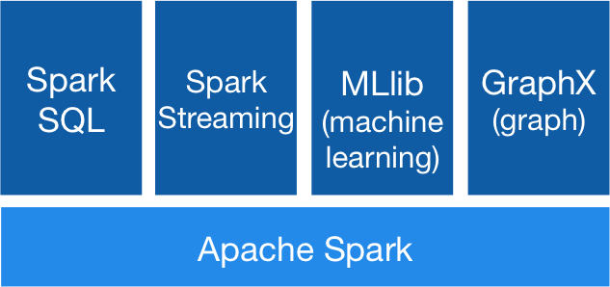




Recap: Apache Spark History and Architecture
Motivation, Terminology, and Fundamentals
High-Level Architecture
  Different language bindings:
  Scala, Java, Python, R
  Different libraries:
  SQL, ML, Stream, Graph
  Spark core (incl RDDs)
  Different file systems/
  formats, and data sources:
  HDFS, S3, DBs, NoSQL
  Different cluster managers:
  Standalone, Mesos,
  Yarn, Kubernetes
➔ Separation of concerns:
resource allocation vs task scheduling
[https://spark.apache.org/]
Standalone
MESOS
YARN
Kubernetes

Slide 10
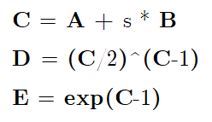
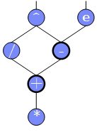
Scheduling Problems
Motivation, Terminology, and Fundamentals
[Eleni D. Karatza: Cloud Performance Resource Allocation and Scheduling Issue, Aristotle University of Thessaloniki 2018]
Bag-of-Tasks Scheduling
  Job of independent (embarrassingly parallel) tasks
  Examples: EC2 instances, map tasks
Gang Scheduling
  Job of frequently communicating parallel tasks
  Examples: MPI programs, parameter servers
DAG Scheduling
  Job of tasks with precedence constraints
  (e.g., data dependencies)
  Examples: Op scheduling Spark, TensorFlow, SystemDS
Real-Time Scheduling
  Job or task with associated deadline (soft/hard)
  Examples: rendering, car control
A
s
B
Notes:
Note: real-time scheduling w/ regular or irregular deadlines

Slide 11
Basic Scheduling Metrics and Algorithms
Motivation, Terminology, and Fundamentals
Common Metrics
  Mean time to completion (total runtime for job), and
  max-stretch (completion/work – relative slowdown)
  Mean response time (job waiting time for resources)
  Throughput (jobs per time unit)
#1 FIFO (first-in, first-out)
  Simple queueing and processing in order
  Problem: Single long-running job can stall many short jobs
#2 SJF (shortest job first)
  Sort jobs by expected runtime and execute in order ascending
  Problem: Starvation of long-running jobs
#3 Round-Robin (FAIR)
  Allocate similar time (tasks, time slices) to all jobs

Slide 12
Resource Allocation, Isolation, and Monitoring

Slide 13
Resource Selection
Resource Allocation, Isolation, and Monitoring
#1 Manual Selection
  Rule of thumb (I/O, mem, CPU characteristics of app)
  Data characteristics, and framework configurations, experience
Example Spark Submit
export HADOOP_CONF_DIR=/etc/hadoop/conf
SPARK_HOME=../spark-2.4.0-bin-hadoop2.7
$SPARK_HOME/bin/spark-submit \
--master yarn --deploy-mode client \
--driver-java-options "-server –Xms40g –Xmn4g" \
--driver-memory 40g \
--num-executors 10 \
--executor-memory 100g \
--executor-cores 32 \
SystemDS.jar -f test.dml -stats -explain -args …

Slide 14
Resource Selection, cont.
Resource Allocation, Isolation, and Monitoring
#2 Application-Agnostic, Reactive
  Dynamic allocation based on workload characteristics
  Examples: Spark dynamic allocation, Databricks AutoScaling
#3 Application-Aware, Proactive
  Estimate time/costs of job under
  different configurations (what-if)
  Min $costs under time constraint
  Min runtime under $cost constraint
[Herodotos Herodotou, Fei Dong, Shivnath Babu: No one (cluster) size fits all: automatic cluster sizing for data-intensive analytics. SoCC 2011]
(fixed MR job w/ 6 nodes)

Slide 15

Resource Negotiation and Allocation
Resource Allocation, Isolation, and Monitoring
“Tetris Analogy”
(w/ expiration and queues)
Problem Formulation
  N nodes with memory and CPU constraints
  Stream of jobs with memory and CPU requirements
  Assign jobs to nodes (or to minimal number of nodes)
  ➔ Knapsack problem (bin packing problem)
In Practice: Heuristics
  Major concern: scheduling efficiency (online, cluster bottleneck)
  Approach: Sample queues, best/next-fit selection
  Multiple metrics: dominant resource calculator
12/48GB
8GB
2
32GB
[https://blog.cloudera.com/managing-cpu-resources-in-your-hadoop-yarn-clusters/]
6/8GB
1/32GB
2/8GB
1
6
8GB
Notes:
TODO algorithm for schedule requests -> minimize relative waste
Note: story Spark driver and executor on same node → long scheduling delay → slows down ALL executors

Slide 16
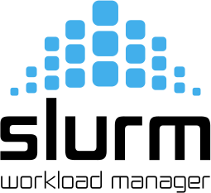
Slurm Workload Manager
Resource Allocation, Isolation, and Monitoring
Slurm Overview
  Simple Linux Utility for Resource Management (SLURM)
  Heavily used in HPC clusters (e.g., MPI gang scheduling)
Scheduler Design
  Allocation/placement of requested resources
  Considers nodes, sockets, cores, HW threads,
  memory, GPUs, file systems, SW licenses
  Job submit options: sbatch (async job script), salloc (interactive),
  srun (sync job submission and scheduling)
  Configuration: cluster, node count (ranges), task count, mem, etc
  Constraints via filters: sockets-per-node, cores-per-socket, threads-per-core
  mem, mem-per-cpu, mincpus, tmp min-disk-space
  Elasticity via re-queueing
[Don Lipari: The SLURM Scheduler Design, User Group Meeting, 2012]

Slide 17
Background: Hadoop JobTracker (anno 2012)
Resource Allocation, Isolation, and Monitoring
Overview
  Hadoop cluster w/ fixed configuration of n map slots, m reduce slots
  (fixed number and fixed memory config map/reduce tasks)
  JobTracker schedules map and reduce tasks to slots
  FIFO and FAIR schedulers, account for data locality
Data Locality
  Levels: data local, rack local, different rack
  Delay scheduling (with FAIR scheduler)
  wait 1-3s for data local slot
Problem
  Intermixes resource allocation and task scheduling
  → Scalability problems in large clusters
  Forces every application into MapReduce programming model
[Matei Zaharia et al: Delay scheduling: a simple technique for achieving locality and fairness in cluster scheduling. EuroSys 2010]

Slide 18

Mesos Resource Management
Resource Allocation, Isolation, and Monitoring
[Benjamin Hindman et al: Mesos: A Platform for Fine-Grained Resource Sharing in the Data Center. NSDI 2011]
Overview Mesos
  Fine-grained, multi-framework cluster sharing
  Scalable and efficient scheduling → delegated to frameworks
  Resource offers

Slide 19
Mesos Resource Management, cont.
Resource Allocation, Isolation, and Monitoring
Resource Offers
  Mesos master decides how many resources to offer
  Framework scheduler decides which offered resources to accept/reject
  Challenge: long waiting times, lots of offers → filter specification
Offered resources
Reported available resources
Mesosphere Marathon: container orchestration
(e.g., Docker)

Slide 20
YARN Resource Management
Resource Allocation, Isolation, and Monitoring
[Vinod Kumar Vavilapalli et al: Apache Hadoop YARN: yet another resource negotiator. SoCC 2013]
Overview YARN
  Hadoop 2 decoupled resource scheduler (negotiator)
  Independent of programming model, multi-framework cluster sharing
  Resource Requests
Resource Scheduling via
Resource Manager
Task Scheduling via Application Masters (AMs)
Resource Isolation via
Node Managers

Slide 21
YARN Resource Management, cont.
Resource Allocation, Isolation, and Monitoring
Example Apache SystemML AM Submission (anno 2014)
// Set up the container launch context for the application master
ContainerLaunchContext amContainer =
Records.newRecord(ContainerLaunchContext.class);
amContainer.setCommands(Collections.singletonList(command));
amContainer.setLocalResources(constructLocalResourceMap(yconf));
amContainer.setEnvironment(constructEnvionmentMap(yconf));
// Set up resource type requirements for ApplicationMaster
Resource capability = Records.newRecord(Resource.class);
capability.setMemory((int)computeMemoryAllocation(memHeap));
capability.setVirtualCores(numCores);
// Finally, set-up ApplicationSubmissionContext for the application
String qname = _dmlConfig.getTextValue(DMLConfig.YARN_APPQUEUE);
appContext.setApplicationName(APPMASTER_NAME); // application name
appContext.setAMContainerSpec(amContainer);
appContext.setResource(capability);
appContext.setQueue(qname); // queue (w/ min/max capacity constraints)
// Submit application (non-blocking)
yarnClient.submitApplication(appContext);

Slide 22
YARN Resource Management, cont.
Resource Allocation, Isolation, and Monitoring
Capacity Scheduler
  Hierarchy of queues w/ shared resource among sub queues
  Soft (and optional hard) [min, max] constraints of max resources
  Default queue-user mapping
  No preemption during runtime
  (only redistribution over queues)
Fair Scheduler
  All applications get same resources over time
  Fairness decisions on memory requirements,
  but dominant resource fairness possible too
data science
root
indexing

Slide 23
Hydra: Federated RM @ Microsoft
Resource Allocation, Isolation, and Monitoring
[Carlo Curino et al.: Hydra: a federated resource manager for data-center scale analytics. NSDI 2019]
Overview Hydra
  Federated RM for internal MS big-data cluster
  Leverage sub-clusters w/ YARN RM + router
  AM-RM proxy (comm. across sub clusters)
  Global policy generator + state store for runtime adaptation
Deployment Statistics
[https://www.youtube.com/watch?v=k_X13YamZXY&feature=emb_logo]
>250K servers
>500K daily jobs
>1 ZB data processed
>1T tasks scheduled
(~2G tasks daily)
>70K QPS (scheduling)
~60% avg CPU util

Slide 24

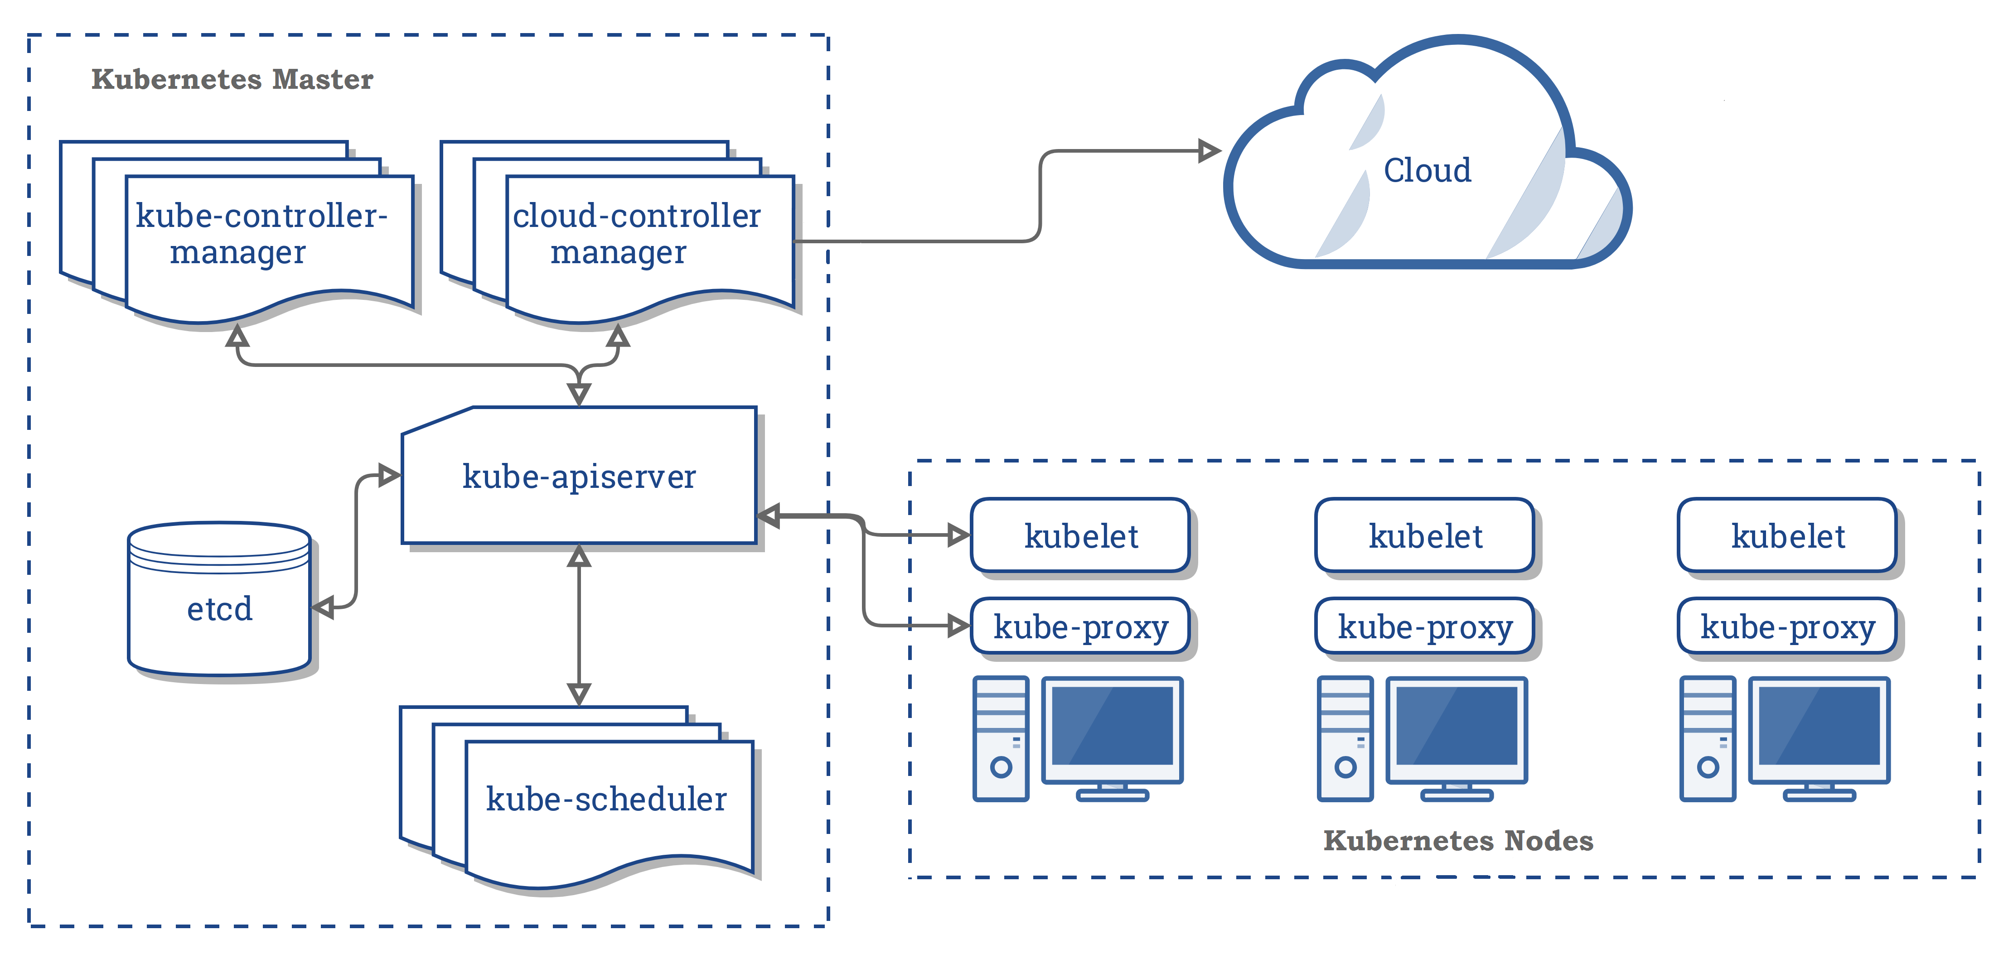
Kubernetes Container Orchestration
Task Scheduling and Elasticity
Overview Kubernetes
  Open-source system for automating, deployment, and
  management of containerized applications
  Container: resource isolation and application image
System Architecture
  Pod: 1 or more containers
  w/ individual IP
  Kubelet: node manager
  Controller: app master
  API Server + Scheduler
  Namespaces, quotas,
  access control, auth.,
  logging & monitoring
  Wide variety of applications
➔ from machine- to application-oriented scheduling
KV Store
[https://kubernetes.io/docs/concepts/
overview/components/]
Notes:
Note: Kubernetes name – seven of nine (friendlier borg) → seven spokes

Slide 25
Kubernetes Container Orchestration, cont.
Task Scheduling and Elasticity
Pod Scheduling (Placement)
  Default scheduler: kube-scheduler, custom schedulers possible
  #1 Filtering: finding feasible nodes for pod
  (resources, free ports, node selector, requested volumes, mem/disk pressure)
  #2 Scoring: score feasible nodes → select highest score
  (spread priority, inter-pod affinity, requested priority, image locality)
  Tuning: # scored nodes: max(50, percentageOfNodesToScore [1,100])
  (sample taken round robin across zones)
  ➔ Binding: scheduler notifies API server

Slide 26
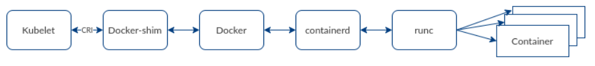

Container Runtime
Task Scheduling and Elasticity
Container Stack
  Docker as stack of development and runtime services
  containerd: high-level daemon for image management
  runc: low-level container runtime
Kubernetes deprecated Docker (as of 12/2020)
  Container Runtime Interface (CRI)
  Integrate other runtimes: cri-containerd, cri-o (Open Container Initiative)
[https://www.inovex.de/blog/containers-docker-containerd-nabla-kata-firecracker/]
[Credit:
www.inovex.de]
[https://kubernetes.io/blog/
2016/12/container-runtime-interface-cri-in-kubernetes/]
Notes:
Note: docker images created via docker build still runnable

Slide 27
Resource Isolation
Resource Allocation, Isolation, and Monitoring
Overview Key Primitives
  Platform-dependent resource isolation primitives → container runtime
  Linux namespaces: restricting visibility
  Linux cgroups: restricting usage
Cgroups (Control Groups)
  Developed by Google engineers → Kernel 2.6.24 (2008)
  Resource metering and limiting
  (memory, CPU, block I/O, network)
  Each subsystem has a hierarchy (tree)
  with each node = group of processes
  Soft and hard limits on groups
  Mem hard limit → triggers OOM killer (physical, kernel, total)
  CPU → set weights (time slices)/no limits, cpuset to pin groups to CPUs
Linux Containers
(e.g., basis of Docker)
[Jérôme Petazzoni: Cgroups, name-spaces and beyond: What are containers made from? DockerConEU 2015.]
[https://www.youtube.com/watch?v=sK5i-N34im8&feature=youtu.be]
Notes:
NOTE: Linux Containers, Solaris Projects [Mesos paper]

Slide 28
Resource Isolation, cont.
Resource Allocation, Isolation, and Monitoring
[https://developer.ibm.com/hadoop/
2017/06/30/deep-dive-yarn-cgroups/]
<property>
<name>yarn.nodemanager.resource.
percentage-physical-cpu-limit<name>
<value>60</value>
</property>
Example YARN
  Set max CPU time per node manager
  Container weights: cores/total cores
  OOM killer if mem w/ overhead exceeded
Lesson Learned
  “The resource isolation provided by
  containers has enabled Google to
  drive utilization significantly higher
  than industry norms. [..] Borg uses
  containers to co-locate batch jobs
  with latency-sensitive, user-facing
  jobs on the same physical machines. ”
  “The isolation is not perfect, though: containers
  cannot prevent interference in resources that the operating-system kernel doesn’t manage, such as level 3 processor caches and memory bandwidth […]”
(hard → strict/soft)
[Abhishek Verma et al. Large-scale cluster management at Google with Borg. EuroSys 2015]
[Malte Schwarzkopf et al.: Omega: flexible, scalable schedulers for large compute clusters. EuroSys 2013]
[Brendan Burns et al.: Borg, Omega, and Kubernetes. ACM Queue 14(1): 10 (2016)]
Notes:
Note: Borg → Borglet

Slide 29
Task Scheduling and Elasticity

Slide 30
Task Scheduling Overview
Task Scheduling and Elasticity
Problem Formulation
  Given computation job and set of resources (servers, threads)
  Distribute job in pieces across resources
#1 Job-Task Partitioning
  Split job into sequence of N tasks
#2 Task Placement / Execution
  Assign tasks to K resources for execution
Goal: Min Job Completion Time
  Beware: Max runtime per resource
  determines job completion time
Computation Job
t₁
t₂
t₃
t₄
t₅
t₆
Node 1
Node 2
Node 1:
t₁
t₂
t₃
t₅
Node 2:
t₄
t₆
Job done

Slide 31
Task Scheduling – Partitioning
Task Scheduling and Elasticity
Example Hyper-param Tuning
parfor(i in 1:800)
R[i,] = lm(X,y,reg[i])
Static Partitioning
  M = K tasks, task size ceil(N/K)
  Low overhead, poor load balance
Fixed Partitioning
  M = N/d tasks, task size d
  E.g., # iterations, # tuples to process
Self-Scheduling
  Exponentially decreasing task sizes d
  → M = log N tasks (w/ min task size)
  Low overhead and good load balance at end
  Guided self scheduling
  Factoring: waves of task w/ equal size
400
400
100
100
100
100
100
100
100
100
200
100
50
50
200
100
50
50
[Susan Flynn Hummel, Edith Schonberg, Lawrence E. Flynn: Factoring: a practical and robust method for scheduling parallel loops. SC 1991]

Slide 32
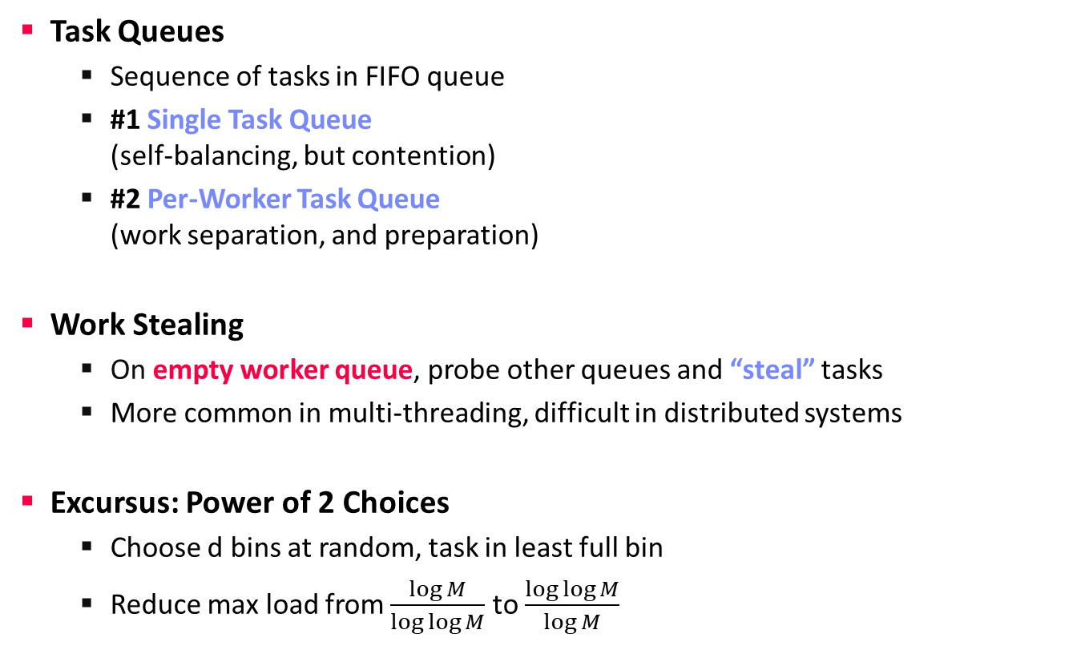
Task Scheduling – Placement
Task Scheduling and Elasticity
Task Queues
  Sequence of tasks in FIFO queue
  #1 Single Task Queue
  (self-balancing, but contention)
  #2 Per-Worker Task Queue
  (work separation, and preparation)
Work Stealing
  On empty worker queue, probe other queues and “steal” tasks
  More common in multi-threading, difficult in distributed systems
Excursus: Power of 2 Choices
  Choose d bins at random, task in least full bin
  Reduce max load from $\frac{\log{M}}{\log{\log{M}}}$ to $\frac{\log{\log{M}}}{\log{M}}$
Node 1
Node 2
Node 1
Node 2
“Airport”
“Super Market”
[Michael D. Mitzenmacher:
The Power of Two Choices in Randomized Load Balancing, PhD Thesis UC Berkeley 1996]

Slide 33
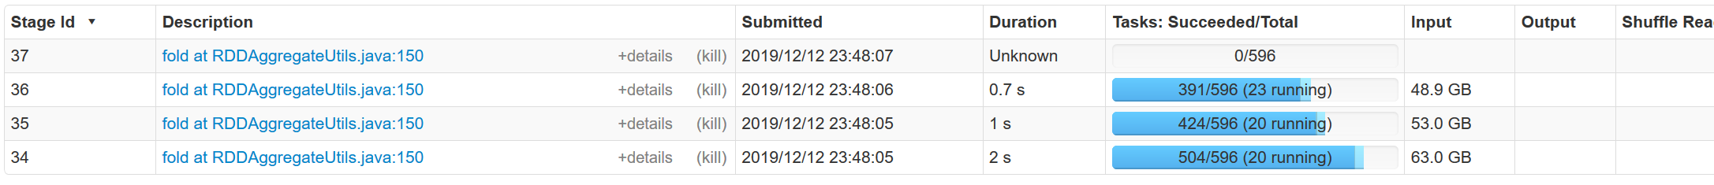
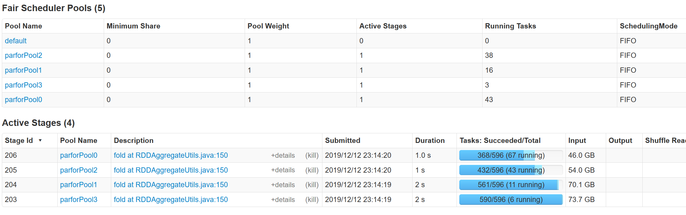
Spark Task Scheduling
Task Scheduling and Elasticity
SystemDS Example (80GB):
X = rand(rows=1e7,cols=1e3)
parfor(i in 1:4)
for(j in 1:10000)
print(sum(X)) #spark job
Overview
  Schedule job DAGs in stages (shuffle barriers)
  Default task scheduler: FIFO; alternative: FAIR
FIFO
FAIR

Slide 34
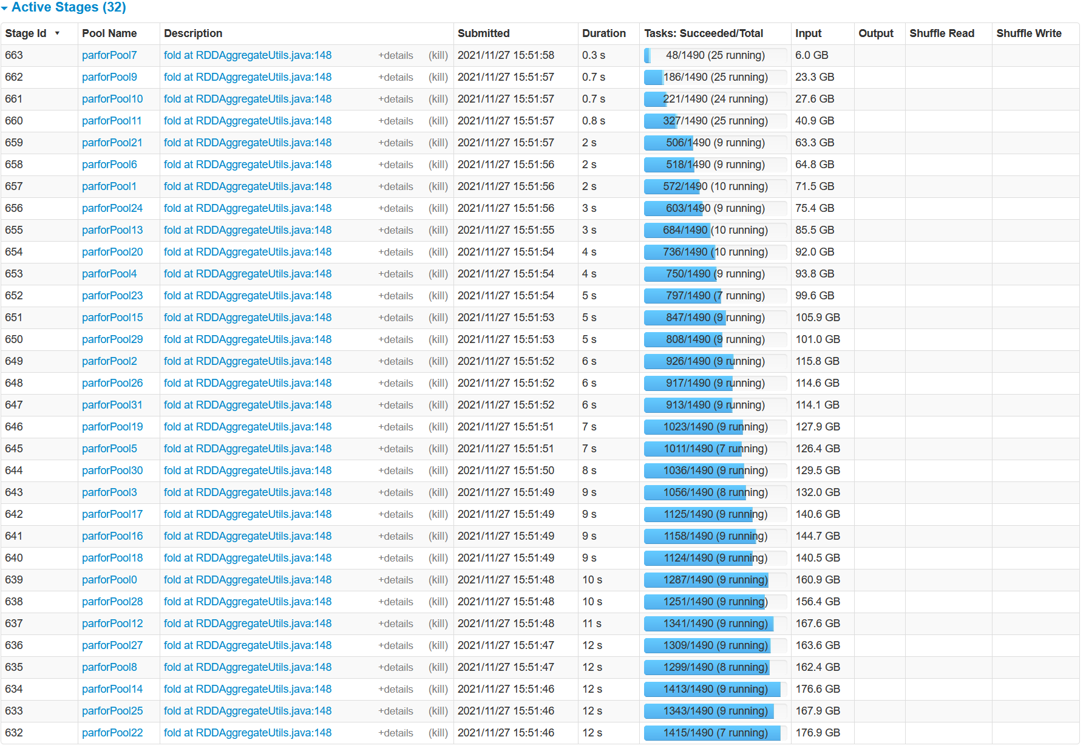
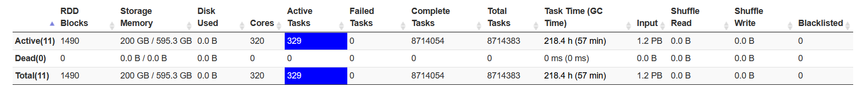
Spark Task Scheduling, cont.
Task Scheduling and Elasticity
FAIR scheduling
w/ k=32
concurrent jobs
and 200GB
FAIR:
Share 320 cores among 32 concurrent jobs
→ ~10 tasks/job
Elapsed:
~40min

Slide 35
Spark Task Scheduling, cont.
Task Scheduling and Elasticity
<allocations>
<pool name=“data_science">
<schedulingMode>FAIR</schedulingMode>
<weight>1</weight>
<minShare>6</minShare>
</pool>
<pool name=“indexing">
<schedulingMode>FIFO</schedulingMode>
<weight>2</weight>
<minShare>8</minShare>
</pool>
</allocations>
Fair Scheduler
Configuration
  Pools with shares of cluster
  Scheduling modes: FAIR, FIFO
  weight: relative to equal share
  minShare: min numCores
Spark on Kubernetes
  Run Spark in shared cluster
  with Docker container apps,
  Distributed TensorFlow, etc
  Custom controller, and
  shuffle service (dynAlloc)
$SPARK_HOME/bin/spark-submit \
--master k8s://https://<k8s-api>:<k8s-api-port> \
--deploy-mode cluster
--driver-java-options "-server -Xms40g -Xmn4g" \
--driver-memory 40g \
--num-executors 10 \
--executor-memory 100g \
--executor-cores 32 \
--conf spark.kubernetes.container.image=<sparkimg> \
SystemDS.jar -f test.dml -stats -explain -args …

Slide 36
Spark Dynamic Allocation
Task Scheduling and Elasticity
[https://spark.apache.org/docs/
latest/job-scheduling.html]
Configuration for YARN/Mesos
  Set spark.dynamicAllocation.enabled = true
  Set spark.shuffle.service.enabled = true (robustness w/ stragglers)
Executor Addition/Removal
  Approach: look at task pressure (pending tasks / idle executors)
  Increase exponentially (add 1, 2, 4, 8) if
  pending tasks for spark.dynamicAllocation.schedulerBacklogTimeout
  Decrease executors they are idle for spark.dynamicAllocation.executorIdleTimeout

Slide 37
Sparrow Task Scheduling
Task Scheduling and Elasticity
[Kay Ousterhout, Patrick Wendell, Matei Zaharia, Ion Stoica: Sparrow: distributed, low latency scheduling. SOSP 2013]
Sparrow Overview
  Decentralized, randomized task
  scheduling with constraints, fair sharing
  Problems: Low latency, quality placement,
  fault tolerance, high throughput
Approach
  Baselines: Random, Per-task (power of two choices)
  New Techniques: Batch Scheduling, Late Binding
Baseline: Per-task sampling
Batch sampling w/ late binding
Notes:
Batch scheduling -> better tail latency
Late binding: Queue length alone bad indicator of time, race conditions with multiple schedulers

Slide 38
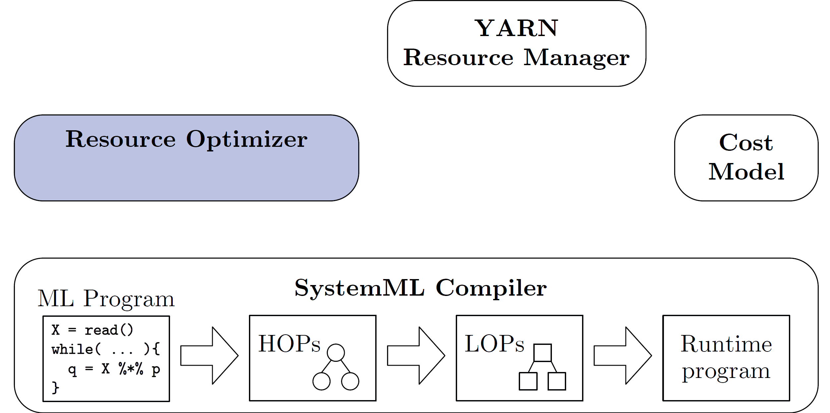
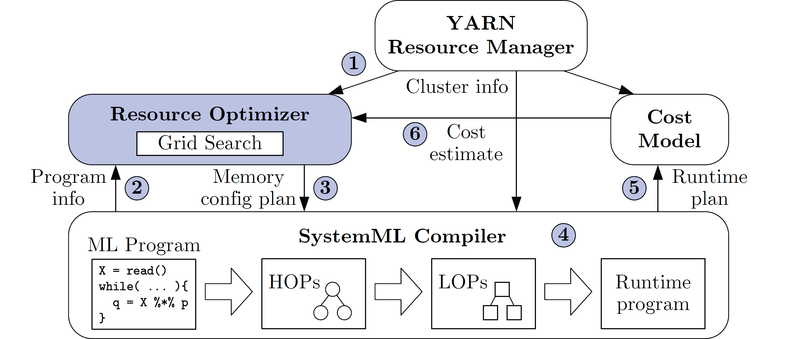
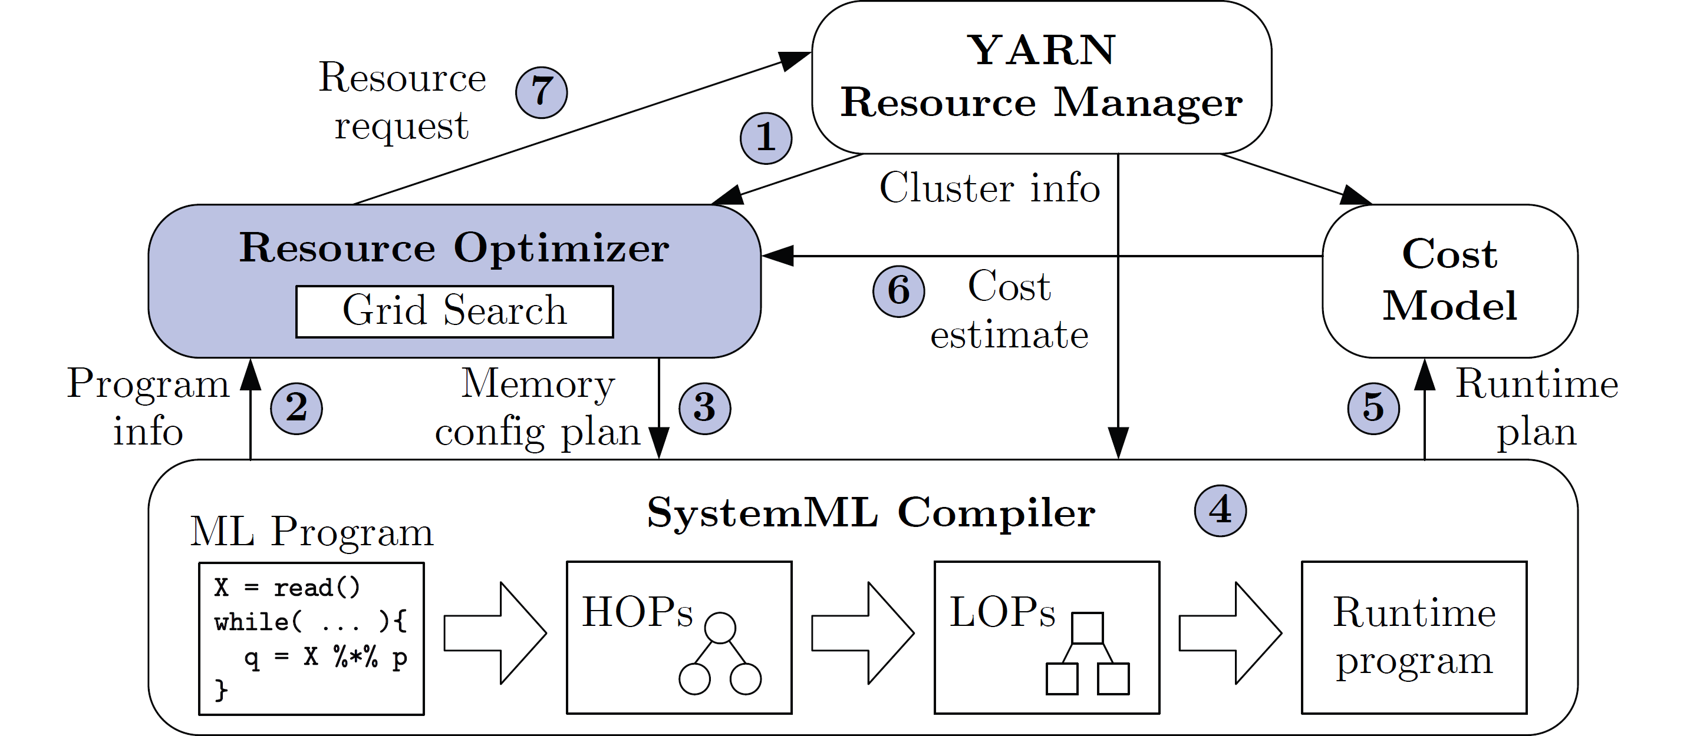
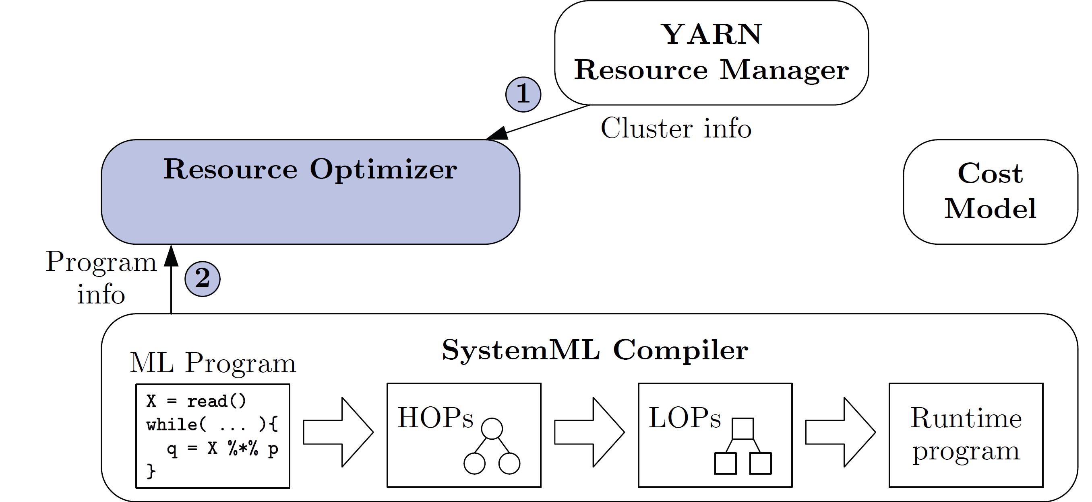
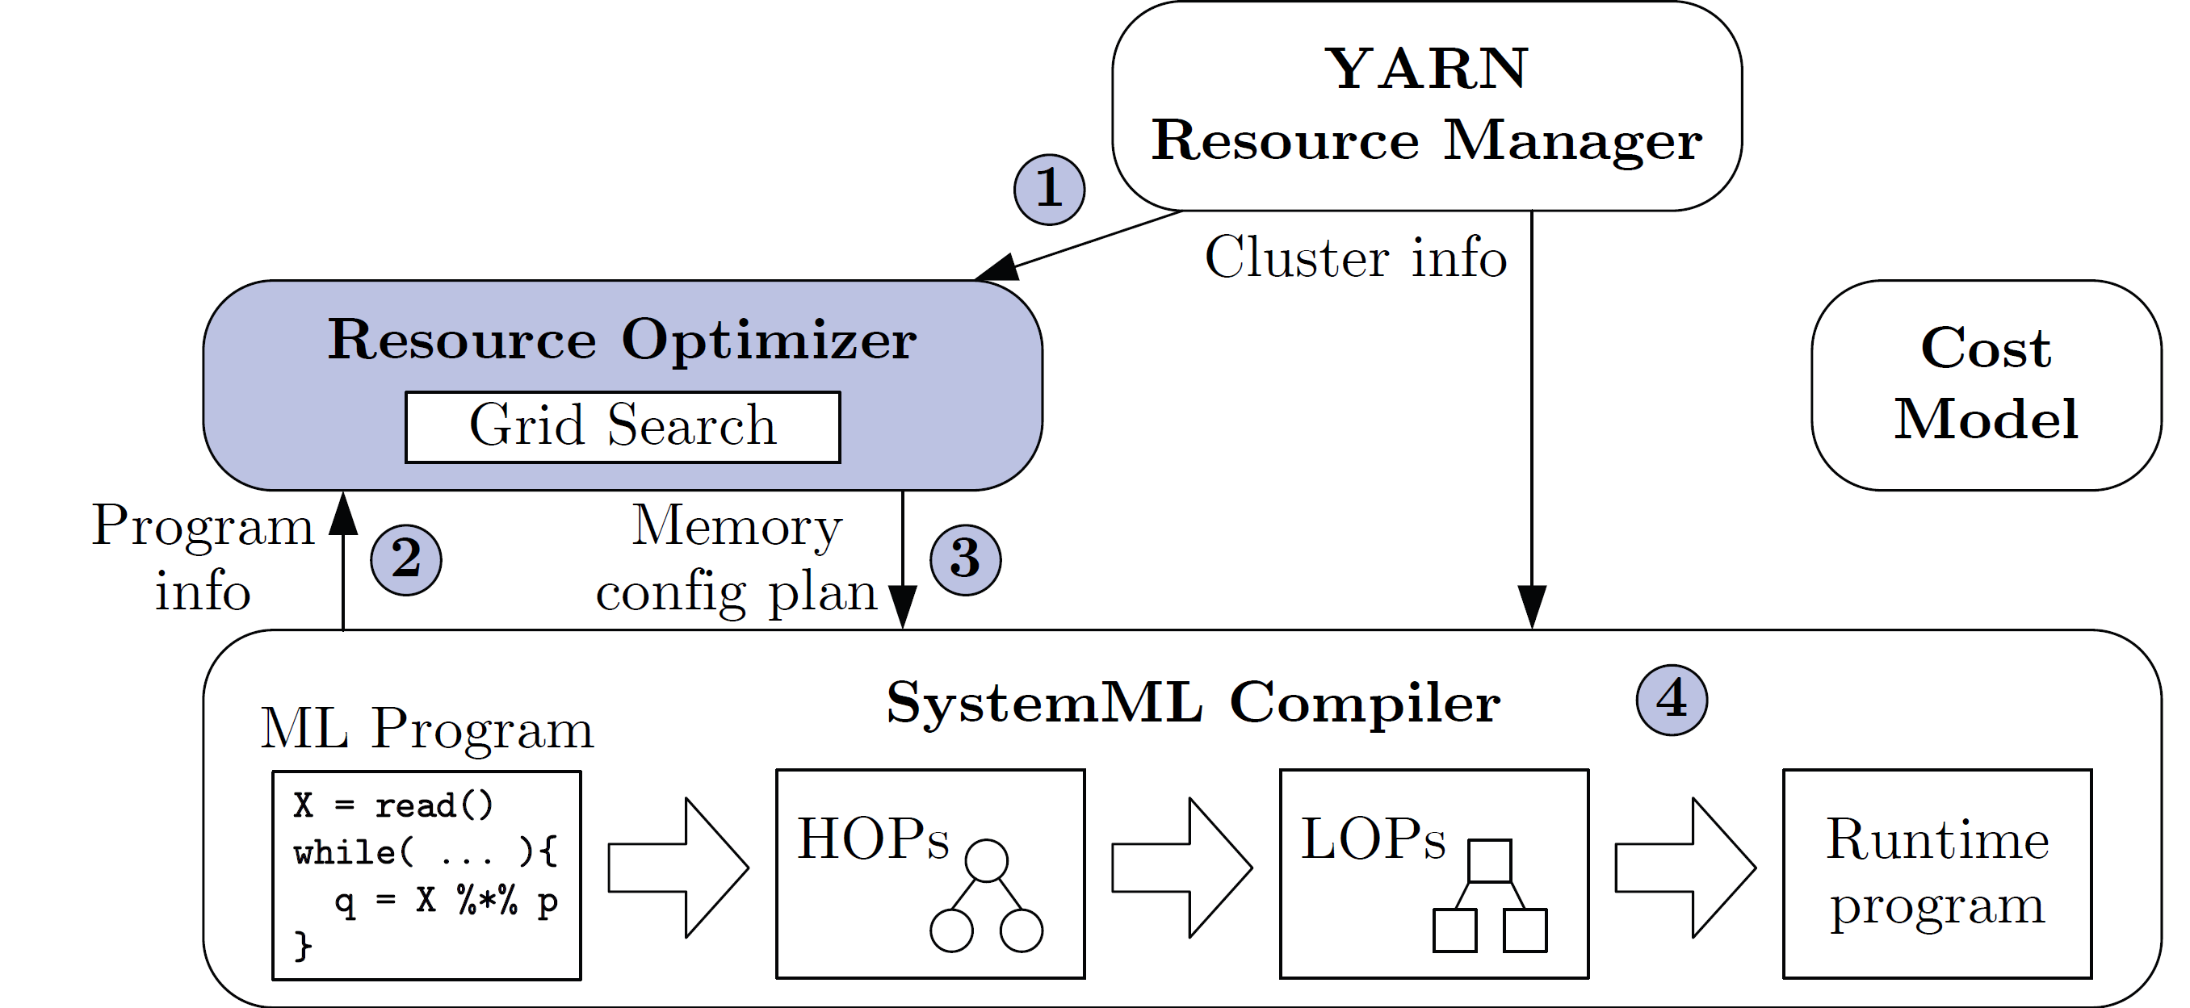
Resource Elasticity in SystemML
Task Scheduling and Elasticity
[Botong Huang et al.: Resource Elasticity for Large-Scale Machine Learning. SIGMOD 2015]
Basic Ideas
  Optimize ML program resource configurations via online what-if analysis
  Generating and costing runtime plans for local/MR
  Program-aware grid enumeration, pruning, and re-optimization techniques
Min runtime w/o unnecessary
over-allocation

Slide 39



Serverless Computing (FaaS)
Task Scheduling and Elasticity
[Joseph M. Hellerstein et al: Serverless Computing: One Step Forward, Two Steps Back. CIDR 2019]
Definition Serverless
  FaaS: functions-as-a-service (event-driven, stateless input-output mapping)
  Infrastructure for deployment and auto-scaling of APIs/functions
  Examples: Amazon Lambda, Microsoft Azure Functions, etc
Example
Lambda Functions
Event Source (e.g., cloud services)
Other APIs and Services
Auto scaling
Pay-per-request
(1M x 100ms = 0.2$)
import com.amazonaws.services.lambda.runtime.Context;
import com.amazonaws.services.lambda.runtime.RequestHandler;
public class MyHandler implements RequestHandler<Tuple, MyResponse> {
@Override
public MyResponse handleRequest(Tuple input, Context context) {
return expensiveStatelessComputation(input);
}
}
Notes:
Note: lambda calculus

Slide 40
Summary and Q&A
Motivation, Terminology, and Fundamentals
Resource Allocation, Isolation, and Monitoring
Task Scheduling and Elasticity
Next Lectures
  Holidays (and programming projects/exercises)
  10 Distributed Data Storage [Jan 07]
  11 Distributed, Data-Parallel Computation [Jan 14]
  12 Distributed Stream Processing [Jan 21]
  13 Distributed Machine Learning Systems [Jan 28]

