Slide 1

Data Integration and Analysis
12 Stream Processing
Last update: Jan 18, 2022

Slide 2



Announcements/Org
#1 Video Recording
  Link in TUbe & TeachCenter (lectures will be public)
  Optional attendance (independent of COVID)
  Virtual lectures (recorded) until end of the semester
  https://tugraz.webex.com/meet/m.boehm
#2 Programming Projects/Exercises
  Deadline Reminder: Jan 21 11.59pm
  (max 7 late days, with (2*late_days) point deduction)
  Exercise submission in TeachCenter, projects via pull requests
#3 Course Evaluation and Exam
  Evaluation period: Jan 01 – Feb 15
  Exam date: Feb 04, 3pm (90+min written exam)
73/116

Slide 3
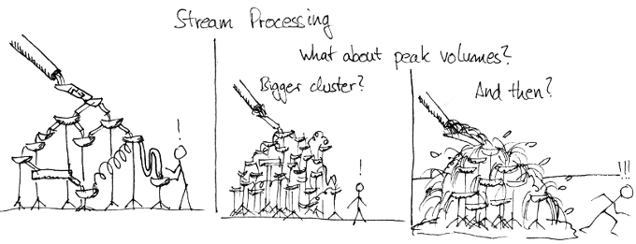
Agenda
Data Stream Processing
Distributed Stream Processing
Data Stream Mining

Slide 4
Data Stream Processing

Slide 5

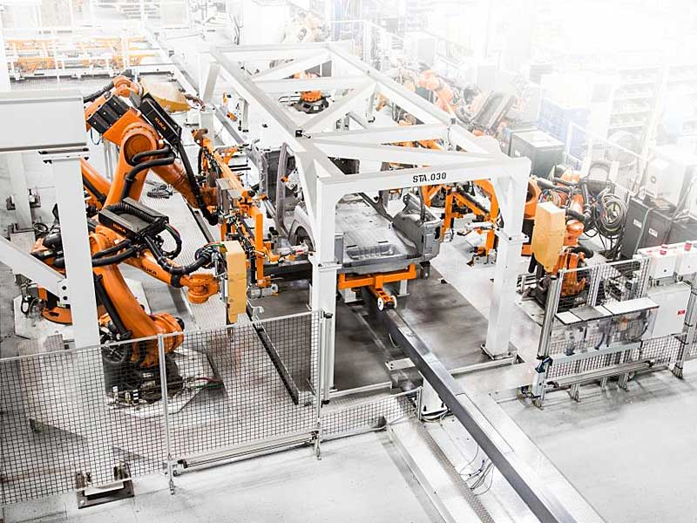
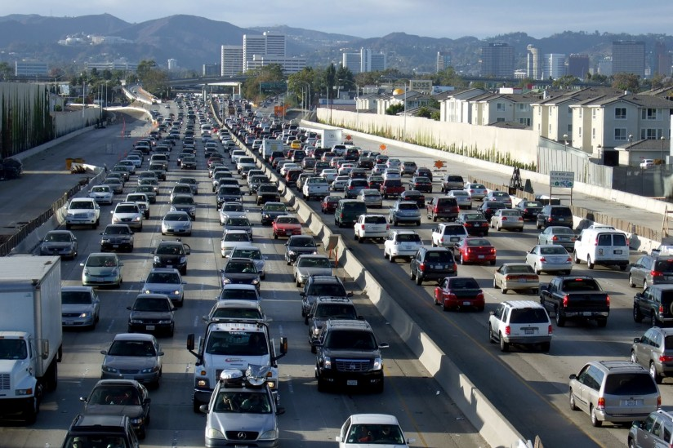
Stream Processing Terminology
Data Stream Processing
Ubiquitous Data Streams
  Event and message streams (e.g., click stream, twitter, etc)
  Sensor networks, IoT, and monitoring (traffic, env, networks)
Stream Processing Architecture
  Infinite input streams, often with window semantics
  Continuous (aka standing) queries
Stream Processing Engines
Queries
Input Stream
Output Stream
“data at rest”
DBMS
“data in motion”
Stored (Continuous) Queries
Stored Data

Slide 6
Stream Processing Terminology, cont.
Data Stream Processing
Use Cases
  Monitoring and alerting (notifications on events / patterns)
  Real-time reporting (aggregate statistics for dashboards)
  Real-time ETL and event-driven data updates
  Real-time decision making (fraud detection)
  Data stream mining (summary statistics w/ limited memory)
Data Stream
  Unbounded stream of data tuples S = (s₁, s₂, …) with s_{i} = (t_{i}, d_{i})
  See DM 10 NoSQL Systems (time series)
Real-time Latency Requirements
  Real-time: guaranteed task completion by a given deadline (30 fps)
  Near Real-time: few milliseconds to seconds
  In practice, used with much weaker meaning
Continuously active

Slide 7




History of Stream Processing Systems
Data Stream Processing
2000s
  Data stream management systems (DSMS, mostly academic prototypes):
  STREAM (Stanford’01), Aurora (Brown/MIT/Brandeis’02) → Borealis (‘05), NiagaraCQ (Wisconsin), TelegraphCQ (Berkeley’03), and many others
  ➔ but mostly unsuccessful in industry/practice
  Message-oriented middleware and Enterprise Application Integration (EAI):
  IBM Message Broker, SAP eXchange Infra., MS Biztalk Server, TransConnect
2010s
  Distributed stream processing engines, and “unified” batch/stream processing
  Proprietary systems: Google Cloud Dataflow, MS StreamInsight / Azure Stream Analytics, IBM InfoSphere Streams / Streaming Analytics, AWS Kinesis
  Open-source systems: Apache Spark Streaming (Databricks), Apache Flink (Data Artisans), Apache Kafka (Confluent), Apache Storm

Slide 8
System Architecture – Native Streaming
Data Stream Processing
Basic System Architecture
  Data flow graphs (potentially
  w/ multiple consumers)
  Nodes: asynchronous ops (w/ state)
  (e.g., separate threads)
  Edges: data dependencies
  (tuple/message streams)
  Push model: data production
  controlled by source
Operator Model
  Read from input queue
  Write to potentially
  many output queues
  Example Selection
  σ_{A=7}
Archive
State
while( !stopped ) {
r = in.dequeue(); // blocking
if( pred(r.A) ) // A==7
for( Queue o : out )
o.enqueue(r); // blocking
}

Slide 9
System Architecture – Sharing
Data Stream Processing
Multi-Query Optimization
  Given set of continuous queries (deployed), compile minimal DAG w/o redundancy (see DM 08 Physical Design MV) ➔ subexpression elimination
Operator and Queue Sharing
  Operator sharing: complex ops w/ multiple predicates for adaptive reordering
  Queue sharing: avoid duplicates in output queues via masks
T₁
T₂
T₁
T₂
∪
⋈_{A=B}
∪
⋈_{A=B}
σ_{a}
σ_{b}
σ_{c}
∪
σ_{d}
σ_{a}
∪
σ_{d}
S_{AS}
S_{US}
S_{EU}
σ_{b}
σ_{c}
Ad
S_{AS}
σ_{b}
σ_{c}
Ad
S_{US}
S_{EU}
S_{US}
S_{EU}

Slide 10
System Architecture – Handling Overload
Data Stream Processing
#1 Back Pressure
  Graceful handling of
  overload w/o data loss
  Slow down sources
  E.g., blocking queues
#2 Load Shedding
  #1 Random-sampling-based load shedding
  #2 Relevance-based load shedding
  #3 Summary-based load shedding (synopses)
  Given SLA, select queries and shedding placement
  that minimize error and satisfy constraints
#3 Distributed Stream Processing (see last part)
  Data flow partitioning (distribute the query)
  Key range partitioning (distribute the data stream)
A
B
C
3ms
9ms
2ms
Self-adjusting operator scheduling
Pipeline runs at rate of slowest op
[Nesime Tatbul et al: Load Shedding in a Data Stream Manager. VLDB 2003]

Slide 11
Time (Event, System, Processing)
Data Stream Processing
Event Time
  Real time when the event/
  data item was created
Ingestion Time
  System time when the
  data item was received
Processing Time
  System time when the
  data item is processed
In Practice
  Delayed and unordered data items
  Use of heuristics (e.g., water marks = delay threshold)
  Use of more complex triggers (speculative and late results)
skew
ideal
Processing Time
Event Time

Slide 12


Durability and Consistency Guarantees
Data Stream Processing
#1 At Most Once
  “Send and forget”, ensure data is never counted twice
  Might cause data loss on failures
#2 At Least Once
  “Store and forward” or acknowledgements from receiver,
  replay stream from a checkpoint on failures
  Might create incorrect state (processed multiple times)
#3 Exactly Once
  “Store and forward” w/ guarantees regarding state updates and sent msgs
  Often via dedicated transaction mechanisms
03 Message-oriented Middleware, EAI, and Replication
Notes:
Note: IBM MQ Series, AWS Simple Queueing Service (SQS)

Slide 13
Window Semantics
Data Stream Processing
Windowing Approach
  Many operations like joins/aggregation undefined over unbounded streams
  Compute operations over windows of (a) time or (b) elements counts
#1 Tumbling Window
  Every data item is only
  part of a single window
  Aka Jumping window
#2 Sliding Window
  Time- or tuple-based
  sliding windows
  Insert new and
  expire old data items
size = 2min
12:05
12:07
12:09
size = 2min, step = 1min
12:05
12:07
12:09

Slide 14

Stream Joins
Data Stream Processing
Basic Stream Join
  Tumbling window:
  use classic join methods
  Sliding window (symmetric
  for both R and S)
    Applies to arbitrary join pred
    See DM 08 Query Processing (NLJ)
Excursus: How Soccer Players
Would do Stream Joins
  Handshake-join w/ 2-phase forwarding
For each new r in R:
1. Scan window of stream S
to find match tuples
2. Insert new r into window
of stream R
3. Invalidate expired tuples
in window of stream R
[Jens Teubner, René Müller: How soccer players would do stream joins. SIGMOD 2011]

Slide 15
Stream Joins, cont.
Data Stream Processing
[Zachary G. Ives, Daniela Florescu, Marc Friedman, Alon Y. Levy, Daniel S. Weld: An Adaptive Query Execution System for Data Integration. SIGMOD 1999]
Double-Pipelined Hash Join
  Join of bounded streams (or unbounded w/ invalidation)
  Equi join predicate, symmetric and non-blocking
  For every incoming tuple (e.g. left): probe (right)+emit, and build (left)
H_{R,RID}
1, 2, 7
⋈_{RID=SID}
H_{R,RID}
1, 2
H_{R,RID}
1, 1, 2, 7
H_{S,SID}
1, 7, 7
H_{R,RID}
H_{S,SID}
1, 7
H_{R,RID}
1, 1, 2
H_{S,SID}
7
H_{S,SID}
1 | ab
7 | zy
2 | cd
1 | xw
emit 1(abxw)
emit 1(efxw)
1 | ef
7 | vu
emit 7(ghvu)
Stream
R
Stream
S
emit 7(ghzy)
7 | gh

Slide 16
Distributed Stream Processing

Slide 17
Query-Aware Stream Partitioning
Distributed Stream Processing
[Theodore Johnson, S. Muthu Muthukrishnan, Vladislav Shkapenyuk, Oliver Spatscheck: Query-aware partitioning for monitoring massive network data streams. SIGMOD 2008]
Example Use Case
  AT&T network monitoring with
  Gigascope (e.g., OC768 network)
  2x40 Gbit/s traffic → 112M packets/s → 26 cycles/tuple on 3Ghz CPU
  Complex query sets (apps w/ ~50 queries) and massive data rates
Baseline Query
Execution Plan
Query flow_pairs:
SELECT S1.tb, S1.srcIP, S1.max, S2.max
FROM heavy_flows S1, heavy_flows S2
WHERE S1.srcIP = S2.srcIP
and S1.tb = S2.tb+1
Self join
⋈_{tb=tb+1}
High-level aggregation
γ₂
Query heavy_flows:
SELECT tb,srcIP,max(cnt) as max_cnt
FROM flows
GROUP BY tb, srcIP
Low-level aggregation
γ₁
Low-level filtering
σ
Query flows:
SELECT tb, srcIP, destIP, COUNT(*) AS cnt
FROM TCP WHERE ...
GROUP BY time/60 AS tb,srcIP,destIP
TCP

Slide 18
Query-Aware Stream Partitioning, cont.
Distributed Stream Processing
Optimized Query
Execution Plan
  Distributed plan
  operators
  Pipeline and task
  parallelism
Host 4
⋈_{tb=tb+1}
γ₂
∪
γ₁
Partitioning on srcIP
σ
⋈_{tb=tb+1}
TCP
γ₂
Host 1
γ₁
Host 2
Host 3
γ₁
γ₁
γ₁
σ
σ
σ
σ
TCP
TCP
TCP
TCP

Slide 19
Stream Group Partitioning
Distributed Stream Processing
11 Distributed, Data-Parallel Computation
Large-Scale Stream Processing
  Limited pipeline parallelism and task parallelism (independent subqueries)
  Combine with data-parallelism over stream groups
#1 Shuffle Grouping
  Tuples are randomly distributed across consumer tasks
  Good load balance
#2 Fields Grouping
  Tuples partitioned by grouping attributes
  Guarantees order within keys, but load imbalance if skew
#3 Partial Key Grouping
  Apply “power of two choices” to streaming
  Key splitting: select among 2 candidates per key
  (works for all associative aggregation functions)
#4 Others: Global, None, Direct, Local
[Md Anis Uddin Nasir et al: The power of both choices: Practical load balancing for distributed stream processing engines. ICDE 2015]

Slide 20
Example Apache Storm
Distributed Stream Processing
Bolt 1
Example Topology DAG
  Spouts: sources
  of streams
  Bolts: UDF
  compute ops
  Tasks mapped to
  worker processes
  and executors
  (threads)
Bolt 3
Bolt 2
Spout 1
Config conf = new Config();
conf.setNumWorkers(3);
topBuilder.setSpout("Spout1", new FooS1(), 2);
topBuilder.setBolt("Bolt1", new FooB1(), 3).shuffleGrouping("Spout1");
topBuilder.setBolt("Bolt2", new FooB2(), 2).shuffleGrouping("Spout1");
topBuilder.setBolt("Bolt3", new FooB3(), 2)
.shuffleGrouping("Bolt1").shuffleGrouping("Bolt2");
StormSubmitter.submitTopology(..., topBuilder.createTopology());

Slide 21
Example Twitter Heron
Distributed Stream Processing
[Credit: Karthik Ramasamy]
Motivation
  Heavy use of Apache Storm
  at Twitter
  Issues: debugging,
  performance, shared
  cluster resources,
  back pressure mechanism
Twitter Heron
  API-compatible distributed streaming engine
  De-facto streaming engine at Twitter since 2014
Dhalion (Heron Extension)
  Automatically reconfigure Heron topologies
  to meet throughput SLO
Now back pressure implemented in Apache Storm 2.0 (May 2019)
Data per day
Cluster Size
# of Topologies
# of Msgs
per day
[Sanjeev Kulkarni et al: Twitter Heron: Stream Processing at Scale. SIGMOD 2015]
[Avrilia Floratou et al: Dhalion: Self-Regulating Stream Processing in Heron. PVLDB 2017]

Slide 22
Discretized Stream (Batch) Computation
Distributed Stream Processing
Motivation
  Fault tolerance (low overhead, fast recovery)
  Combination w/ distributed batch analytics
Discretized Streams (DStream)
  Batching of input tuples (100ms – 1s) based on ingest time
  Periodically run distributed jobs of stateless, deterministic tasks → DStreams
  State of all tasks materialized as RDDs, recovery via lineage
Criticism: High latency, required for batching
[Matei Zaharia et al: Discretized streams: fault-tolerant streaming computation at scale. SOSP 2013]
Batch Computation
Sequence of immutable, partitioned datasets (RDDs)

Slide 23


Unified Batch/Streaming Engines
Distributed Stream Processing
Apache Spark Streaming (Databricks)
  Micro-batch computation with exactly-once guarantee
  Back-pressure and water mark mechanisms
  Structured streaming via SQL (2.0), continuous streaming (2.3)
Apache Flink (Data Artisans, now Alibaba)
  Tuple-at-a-time with exactly-once guarantee
  Back-pressure and water mark mechanisms
  Batch processing viewed as special case of streaming
Google Cloud Dataflow
  Tuple-at-a-time with exactly-once guarantee
  MR → FlumeJava → MillWheel → Dataflow
  Google’s fully managed batch and stream service
➔ Apache Beam (API+SDK from Dataflow)
  Abstraction for Spark, Flink, Dataflow w/ common API, etc
  Individual runners for the different runtime frameworks
[https://flink.apache.org/news/
2019/02/13/unified-batch-streaming-blink.html]
[T. Akidau et al.: The Dataflow Model: A Practical Approach to Balancing Correctness, Latency, and Cost in Massive-Scale, Unbounded, Out-of-Order Data Processing. PVLDB 2015]

Slide 24
Resource Elasticity
Distributed Stream Processing
[Li Wang, Tom Z. J. Fu, Richard T. B. Ma, Marianne Winslett, Zhenjie Zhang: Elasticutor: Rapid Elasticity for Realtime Stateful Stream Processing. SIGMOD 2019]
#1 Static
  Static, operator-level key partitioning
#2 Resource-Centric
  Dynamic, operator-level key partitioning
  Global synchronization for
  key repartitioning and state migration
#3 Executor-Centric
  Static, operator-level key partitioning
  CPU core reassignments via
  local and remote tasks

Slide 25
Data Stream Mining
Selected Example Algorithms

Slide 26
Overview Stream Mining
Data Stream Mining
Streaming Analysis Model
  Independent of actual storage model and processing system
  Unbounded stream of data item S = (s₁, s₂, …)
  Evaluate function f(S) as aggregate over stream or window of stream
  Standing vs ad-hoc queries
Recap: Classification of Aggregates
  Additive aggregation functions (SUM, COUNT)
  Semi-additive aggregation functions (MIN, MAX)
  Additively computable aggregation functions (AVG, STDDEV, VAR)
  Aggregation functions (MEDIAN, QUANTILES) → approximations
➔ Selected Algorithms
  Higher-Order Statistics (e.g., STDDEV)
  Approximate # Distinct Items (e.g., KMV, HyperLogLog)
  Approximate Heavy Hitters (e.g. CountMin-Sketch)
02 Data Warehousing, ETL, and SQL/OLAP

Slide 27


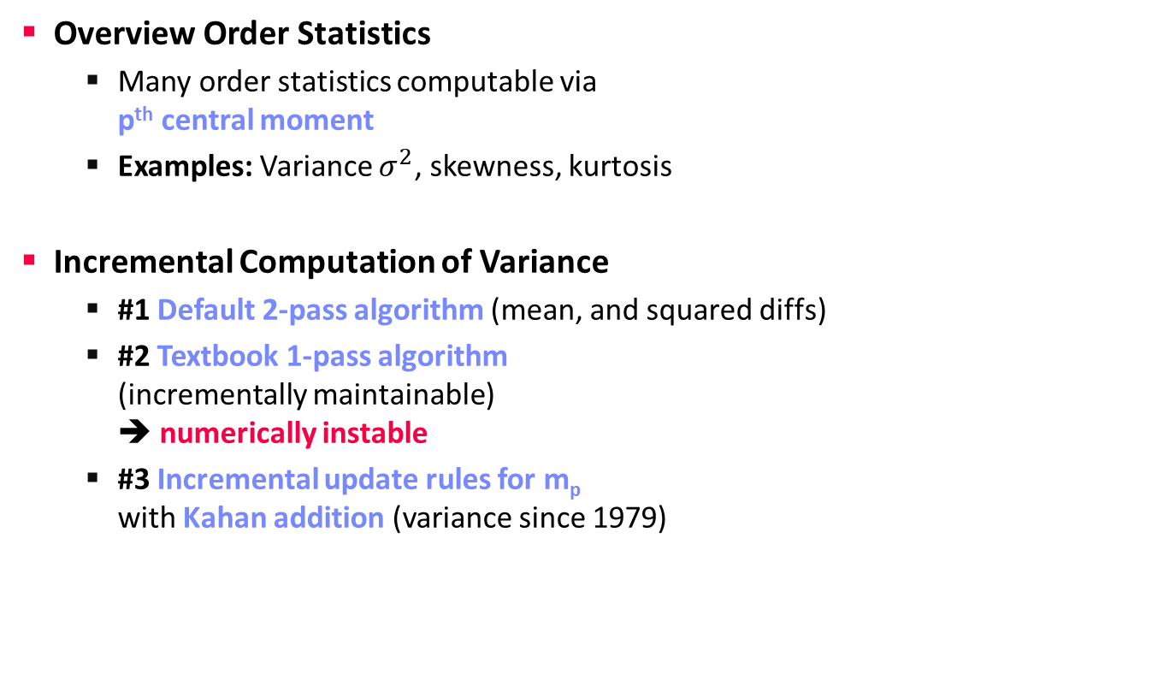
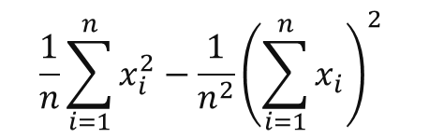
Higher-Order Statistics
Data Stream Mining
Overview Order Statistics
  Many order statistics computable via
  p^{th} central moment
  Examples: Variance $σ^{2}$, skewness, kurtosis
Incremental Computation of Variance
  #1 Default 2-pass algorithm (mean, and squared diffs)
  #2 Textbook 1-pass algorithm
  (incrementally maintainable)
  ➔ numerically instable
  #3 Incremental update rules for m_{p}
  with Kahan addition (variance since 1979)
$$m_{p}= \frac{1}{n}\sum_{i=1}^{n}{{\left(x_{i}−\overline{x}\right)}^{p}}$$
$${σ^{2}=\frac{n}{n−1}m}_{2}$$
$$\frac{1}{n}\sum_{i=1}^{n}{x_{i}^{2}}−\frac{1}{n^{2}}{\left(\sum_{i=1}^{n}{x_{i}}\right)}^{2}$$
[Yuanyuan Tian, Shirish Tatikonda, Berthold Reinwald: Scalable and Numerically Stable Descriptive Statistics in SystemML. ICDE 2012]
11 Distributed, Data-Parallel Computation
Notes:
Note: rewrite to textbook 1-pass via 2nd binomial formula

Slide 28

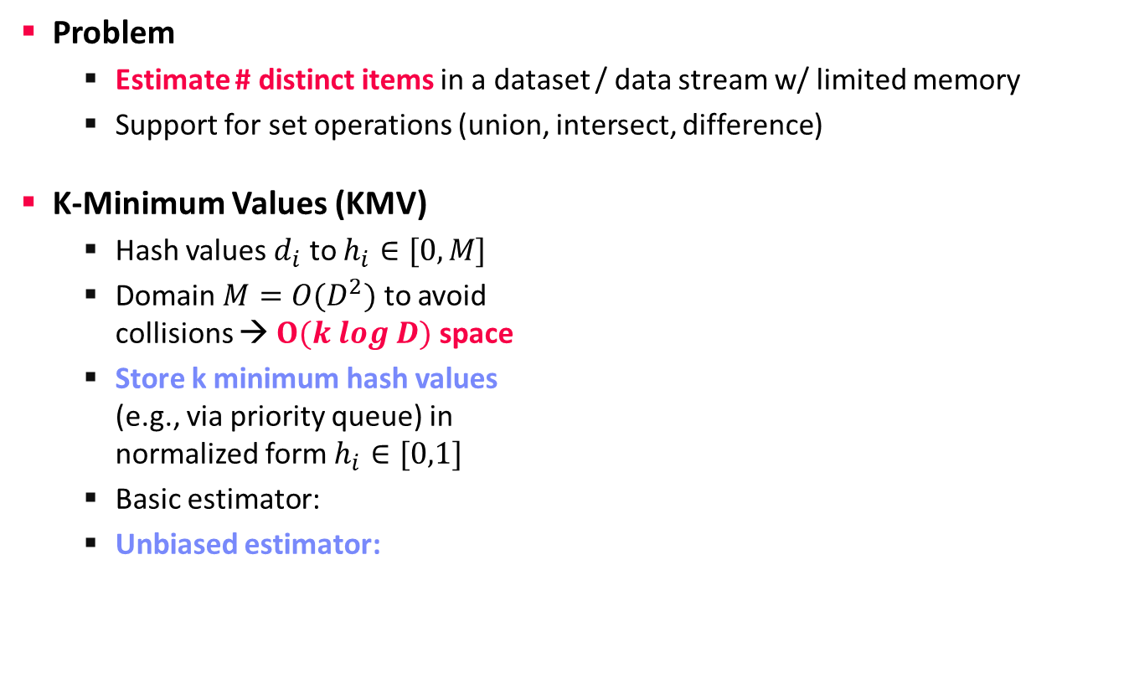

Number of Distinct Items
Data Stream Mining
Problem
  Estimate # distinct items in a dataset / data stream w/ limited memory
  Support for set operations (union, intersect, difference)
K-Minimum Values (KMV)
  Hash values $d_{i}$ to $h_{i}∈[0,M]$
  Domain $M=O(D^{2})$ to avoid
  collisions → $O(k log D)$ space
  Store k minimum hash values
  (e.g., via priority queue) in
  normalized form $h_{i}∈[0,1]$
  Basic estimator:
  Unbiased estimator:
Duplicates yield same hash!
0
1
U_{(k=4)}=0.24
$${\hat{D}}_{k}^{BE}=k/U_{(k)}$$
Example:
16.67 vs 12.5
$${\hat{D}}_{k}^{UB}=(k−1)/U_{(k)}$$
[Kevin S. Beyer, Peter J. Haas, Berthold Reinwald, Yannis Sismanis, Rainer Gemulla: On synopses for distinct-value estimation under multiset operations. SIGMOD 2007]

Slide 29
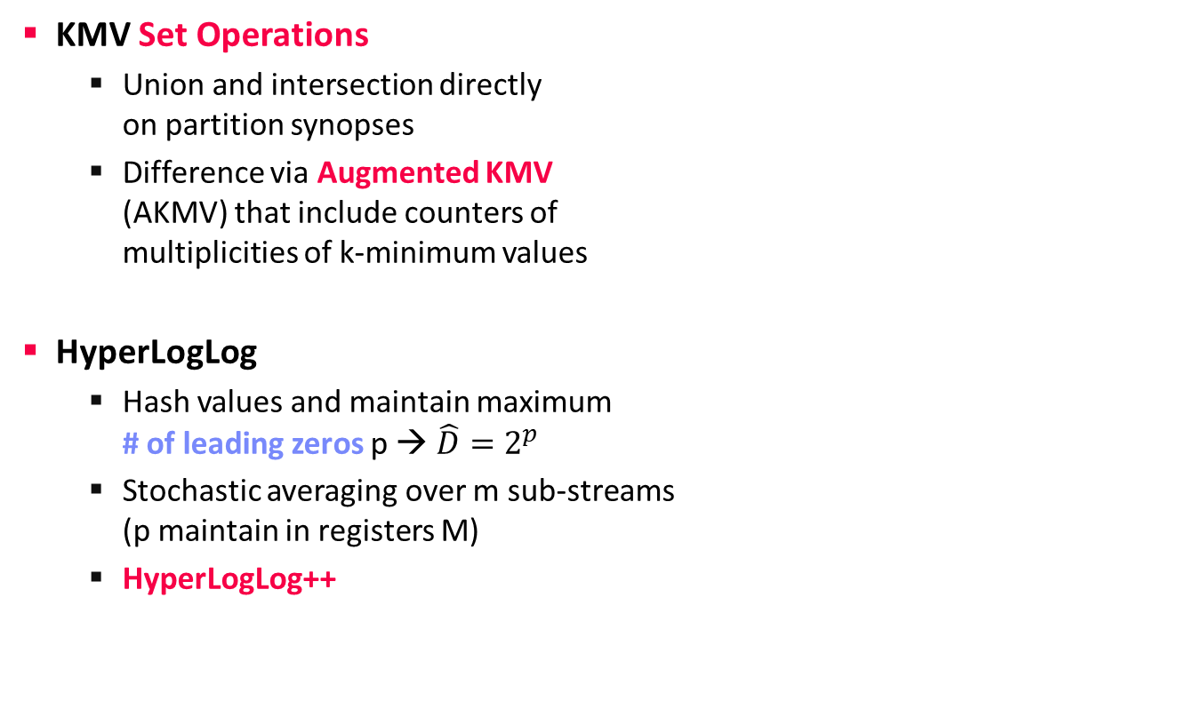
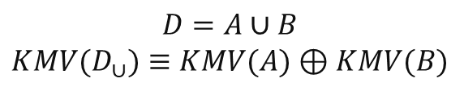
Number of Distinct Items, cont
Data Stream Mining
11 Distributed, Data-Parallel Computation
KMV Set Operations
  Union and intersection directly
  on partition synopses
  Difference via Augmented KMV
  (AKMV) that include counters of
  multiplicities of k-minimum values
HyperLogLog
  Hash values and maintain maximum
  # of leading zeros p → $\hat{D}=2^{p}$
  Stochastic averaging over m sub-streams
  (p maintain in registers M)
  HyperLogLog++
0
1
$$D=A∪B$$
$$KMV(D_{∪})≡KMV(A)⊕KMV(B)$$
[P. Flajolet, Éric Fusy, O. Gandouet, and F. Meunier: Hyperloglog: The analysis of a near-optimal cardinality estimation algorithm. AOFA 2007]
[Stefan Heule, Marc Nunkesser, Alexander Hall: HyperLogLog in practice: algorithmic engineering of a state of the art cardinality estimation algorithm. EDBT 2013]
Notes:
Note: HyperLogLog extension of LogLog algorithm (2003) and Flajolet–Martin algorithm (1985)

Slide 30
Stream Summarization
Data Stream Mining
[Graham Cormode, S. Muthukrishnan: An Improved Data Stream Summary: The Count-Min Sketch and Its Applications. LATIN 2004]
Problem
  Summarize stream in sketch/synopsis w/ limited memory
  Finding quantiles, frequent items (heavy hitters), etc
Count-Min (CM) Sketch
  Two-dimensional count array
  of width w and depth d
  d hash functions map
  {1 … n} → {1 … w}
  Update (s_{i},c_{i}): compute
  d hashes for s_{i} and increase
  counts of all locations
  Point query (s_{i}): compute
  d hashes for s_{i} and estimate
  frequency as min(count[j,h_{j}(s_{i})])
Unlikely similar hash collisions
h₁
 | 6 |  |  | 2 | 1
1 |  | 3 | 5
3 |  | 4 |  | 1 | 1
 | 1 | 2 | 1 | 5
 | 7 | 1 | 1
h₂
h₃
h₄
h_{d}

Slide 31
Summary and Q&A
Data Stream Processing
Distributed Stream Processing
Data Stream Mining
Next Lectures
  13 Distributed Machine Learning Systems [Jan 28]
  14 Q&A and Exam Preparation [Jan 28]
  Written Exam [Feb 04, 3pm] (so far, 50/76)

