Slide 1

Data Integration and Analysis
13 Distributed ML Systems
Last update: Jan 24, 2022

Slide 2



Announcements/Org
#1 Video Recording
  Link in TUbe & TeachCenter (lectures will be public)
  Optional attendance (independent of COVID)
  Virtual lectures (recorded) until end of the semester
  https://tugraz.webex.com/meet/m.boehm
#2 Programming Projects/Exercises
  Deadline Reminder: Jan 21 11.59pm → Jan 28 11.59pm
  (max 7 late days, with (2*late_days) point deduction)
  Exercise submission in TeachCenter, projects via pull requests
#3 Course Evaluation and Exam
  Evaluation period: Jan 01 – Feb 15
  Exam date: Feb 04, 3pm (90+min written exam)
  Doodle for registered oral exam participants
16 Ex.
15 Proj.
(xxx+27
students)

Slide 3
Data Management Courses
Data Management Group
Architecture of
Database Systems
(ADBS, WS)
DB system internals
+ prog. project
Architecture of
ML Systems
(AMLS, SS)
ML system internals
Prog. projects in SystemDS
[github.com/apache/systemds]
Master
Data Integration and Large-Scale Analysis
(DIA, WS)
Distributed
Data Management
Bachelor
Intro to Scientific Writing (WS)
Data Management / Databases
(DM, SS+WS)
Data management from user/application perspective

Slide 4
Agenda
Landscape of ML Systems
Distributed Linear Algebra
Distributed Parameter Servers
Q&A and Exam Preparation (New)

Slide 5
Landscape of ML Systems

Slide 6
What is an ML System?
Landscape of ML Systems
Classification
Regression
Recommenders
Clustering
Dim Reduction
Neural Networks
Statistics
Data Mining
Machine Learning (ML)
ML Applications
(entire KDD/DS lifecycle)
Rapidly Evolving
Runtime Techniques (Execution, Data Access)
ML System
Compilation Techniques
Distributed Systems
HPC
Data Management
Accelerators
Operating Systems
Prog. Language Compilers
HW Architecture

Slide 7




The Data Science Lifecycle aka KDD Process aka CRISP-DM
Landscape of ML Systems
Data-centric View:
Application perspective
Workload perspective
System perspective
Data extraction, schema alignment, entity resolution, data validation, data cleaning, outlier detection, missing value imputation, semantic type detection, data augmentation, feature selection, feature engineering, feature transformations
Data Scientist
Data Integration
Data Cleaning
Data Preparation
Model Selection
Training
Hyper-parameters
Validate & Debug
Deployment
Scoring & Feedback
Exploratory Process
(experimentation, refinements, ML pipelines)
Data/SW Engineer
ML/DevOps Engineer
Key observation: SotA
data integration/cleaning based on ML

Slide 8
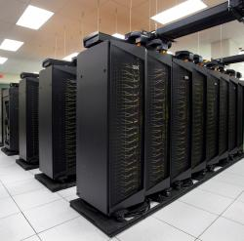
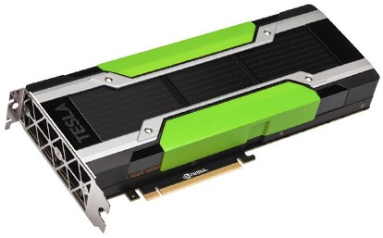
Driving Factors for ML
Landscape of ML Systems
[Credit: Andrew Ng’14]
Improved Algorithms and Models
  Success across data and application domains
  (e.g., health care, finance, transport, production)
  More complex models which leverage large data
Availability of Large Data Collections
  Increasing automation and monitoring ➔ data
  (simplified by cloud computing & services)
  Feedback loops, data programming/augmentation
HW & SW Advancements
  Higher performance of hardware and infrastructure (cloud)
  Open-source large-scale computation frameworks,
  ML systems, and vendor-provides libraries
Feedback Loop
Data
Usage
Model

Slide 9
Stack of ML Systems
Landscape of ML Systems
Deployment & Scoring
Validation & Debugging
Training
Hyper-parameter Tuning
ML Apps & Algorithms
Supervised, unsupervised, RL
linear algebra, libs, AutoML
Model and Feature Selection
Language Abstractions
Eager interpretation, lazy evaluation, prog. compilation
Data Programming & Augmentation
Fault Tolerance
Approximation, lineage, checkpointing, checksums, ECC
Execution Strategies
Local, distributed, cloud
(data, task, parameter server)
Data Preparation
(e.g., one-hot, binning)
Data Representations
Dense & sparse tensor/matrix;
compress, partition, cache
Data Integration & Data Cleaning
CPUs, NUMA, GPUs, FPGAs, ASICs, RDMA, SSD/NVM
HW & Infrastructure
Improve accuracy vs. performance vs. resource requirements
➔ Specialization & Heterogeneity

Slide 10
Accelerators (GPUs, FPGAs, ASICs)
Landscape of ML Systems
Apps
Lang
Faults
Memory- vs Compute-intensive
  CPU: dense/sparse, large mem, high
  mem-bandwidth, moderate compute
  GPU: dense, small mem, slow PCI,
  very high mem-bandwidth / compute
Graphics Processing Units (GPUs)
  Extensively used for deep learning training and scoring
  NVIDIA Volta: “tensor cores” for 4x4 mm → 64 2B FMA instruction
Field-Programmable Gate Arrays (FPGAs)
  Customizable HW accelerators for prefiltering, compression, DL
  Examples: Microsoft Catapult/Brainwave Neural Processing Units (NPUs)
Application-Specific Integrated Circuits (ASIC)
  Spectrum of chips: DL accelerators to computer vision
  Examples: Google TPUs (64K 1B FMA), NVIDIA DLA, Intel NNP
DL
Exec
Data
Ops
Roofline Analysis
HW
ML
Operational Intensity

Slide 11
Data Representation
Landscape of ML Systems
Apps
Lang
Faults
ML- vs DL-centric Systems
  ML: dense and sparse matrices or tensors, different sparse
  formats (CSR, CSC, COO), frames (heterogeneous)
  DL: mostly dense tensors,
  embeddings for NLP, graphs
Data-Parallel Operations for ML
  Distributed matrices: RDD<MatrixIndexes,MatrixBlock>
  Data properties: distributed caching,
  partitioning, compression
Lossy Compression ➔ Acc/Perf-Tradeoff
  Sparsification (reduce non-zero values)
  Quantization (reduce value domain), learned
  New data types: Intel Flexpoint (mantissa, exp)
Exec
Data
HW
vec(Berlin) – vec(Germany)
+ vec(France) ≈ vec(Paris)
Node1
Node2
[Credit: Song Han’16]

Slide 12



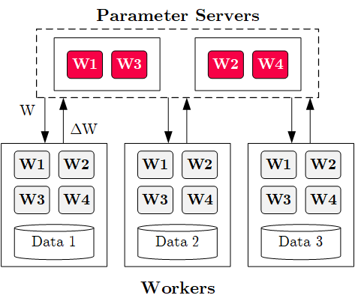




Execution Strategies
Landscape of ML Systems
Apps
Lang
Faults
Batch Algorithms: Data and Task Parallel
  Data-parallel operations
  Different physical operators
Mini-Batch Algorithms: Parameter Server
  Data-parallel and model-parallel PS
  Update strategies (e.g.,
  async, sync, backup)
  Data partitioning strategies
  Federated ML (trend 2018)
Lots of PS Decisions ➔ Acc/Perf-Tradeoff
  Configurations (#workers, batch size/param schedules, update type/freq)
  Transfer optimizations: lossy compression, sparsification, residual accumulation, layer-wise all-reduce, gradient clipping, momentum corrections
Exec
Data
HW

Slide 13
Fault Tolerance & Resilience
Landscape of ML Systems
Apps
Lang
Faults
Resilience Problem
  Increasing error rates at scale
  (soft/hard mem/disk/net errors)
  Robustness for preemption
  Need cost-effective resilience
Fault Tolerance in Large-Scale Computation
  Block replication (min=1, max=3) in distributed file systems
  ECC; checksums for blocks, broadcast, shuffle
  Checkpointing (MapReduce: all task outputs; Spark/DL: on request)
  Lineage-based recomputation for recovery in Spark
ML-specific Schemes (exploit app characteristics)
  Estimate contribution from lost partition to avoid strugglers
  Example: user-defined “compensation” functions
Exec
Data
HW

Slide 14
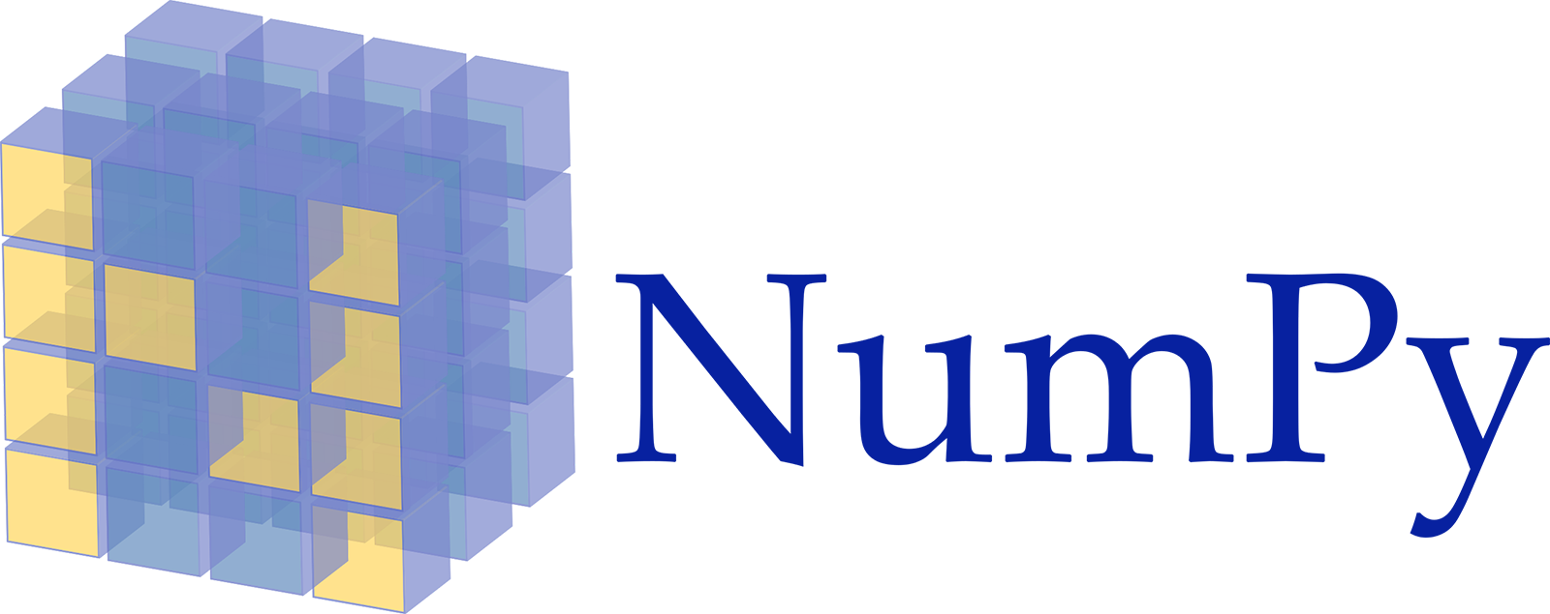

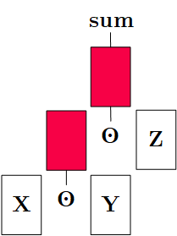
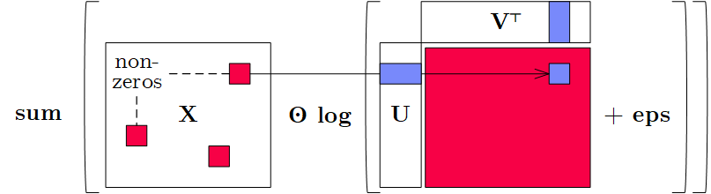
Language Abstractions
Landscape of ML Systems
Apps
Lang
Faults
Optimization Scope
  #1 Eager Interpretation (debugging, no opt)
  #2 Lazy expression evaluation
  (some opt, avoid materialization)
  #3 Program compilation (full opt, difficult)
Optimization Objective
  Most common: min time s.t. memory constraints
  Multi-objective: min cost s.t. time, min time s.t. acc, max acc s.t. time
Trend: Fusion and Code Generation
  Custom fused operations
  Examples: SystemDS,
  Weld, Taco, Julia,
  TF XLA, TVM, TensorRT
Exec
Data
HW
Apache SystemDS
Sparsity-Exploiting Operator

Slide 15
ML Applications
Landscape of ML Systems
Apps
Lang
Faults
ML Algorithms (cost/benefit – time vs acc)
  Unsupervised/supervised; batch/mini-batch; first/second-order ML
  Mini-batch DL: variety of NN architectures and SGD optimizers
Specialized Apps: Video Analytics
in NoScope (time vs acc)
  Difference detectors / specialized
  models for “short-circuit evaluation”
AutoML (time vs acc)
  Not algorithms but tasks (e.g., doClassify(X, y) + search space)
  Examples: MLBase, Auto-WEKA, TuPAQ, Auto-sklearn, Auto-WEKA 2.0
  AutoML services at Microsoft Azure, Amazon AWS, Google Cloud
Data Programming and Augmentation (acc?)
  Generate noisy labels for pre-training
  Exploit expert rules, simulation models,
  rotations/shifting, and labeling IDEs (Software 2.0)
Exec
Data
HW
[Credit: Daniel Kang‘17]
[Credit: Jonathan Tremblay‘18]

Slide 16

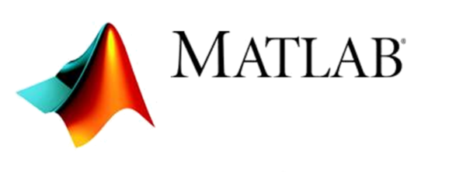



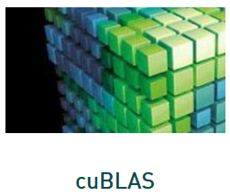



Landscape of ML Systems
Landscape of ML Systems
#1 Language Abstraction
#2 Execution Strategies
Linear Algebra Programs
Parameter Server
(Modell-Parallel)
Computation Graphs
Task-Parallel Constructs
Algorithm Libraries
Data-Parallel Operations
Operator Libraries
Collections
Local (single node)
Graphs
Matrices
HW accelerators (GPUs, FPGAs, ASICs)
Tensors
Frames
Distributed
#4 Data Types
#3 Distribution

Slide 17
Distributed Linear Algebra

Slide 18
Linear Algebra Systems
Distributed Linear Algebra
Comparison Query Optimization
  Rule- and cost-based rewrites and operator ordering
  Physical operator selection and query compilation
  Linear algebra / other ML operators, DAGs,
  control flow, sparse/dense formats
#1 Interpretation (operation at-a-time)
  Examples: R, PyTorch, Morpheus [PVLDB’17]
#2 Lazy Expression Compilation (DAG at-a-time)
  Examples: RIOT [CIDR’09],
  Mahout Samsara [MLSystems’16]
  Examples w/ control structures: Weld [CIDR’17],
  OptiML [ICML’11], Emma [SIGMOD’15]
#3 Program Compilation (entire program)
  Examples: SystemML [PVLDB’16], Julia
  Cumulon [SIGMOD’13], Tupleware [PVLDB’15]
DB
PL
HPC
Compilers for Large-scale ML
Optimization Scope
1: X = read($1); # n x m matrix
2: y = read($2); # n x 1 vector
3: maxi = 50; lambda = 0.001;
4: intercept = $3;
5: ...
6: r = -(t(X) %*% y);
7: norm_r2 = sum(r * r); p = -r;
8: w = matrix(0, ncol(X), 1); i = 0;
9: while(i<maxi & norm_r2>norm_r2_trgt) 10: {
11: q = (t(X) %*% X %*% p)+lambda*p;
12: alpha = norm_r2 / sum(p * q);
13: w = w + alpha * p;
14: old_norm_r2 = norm_r2;
15: r = r + alpha * q;
16: norm_r2 = sum(r * r);
17: beta = norm_r2 / old_norm_r2;
18: p = -r + beta * p; i = i + 1;
19: }
20: write(w, $4, format="text");

Slide 19
Linear Algebra Systems, cont.
Distributed Linear Algebra
Note: TF 2.0
[Dan Moldovan et al.: AutoGraph: Imperative-style Coding with Graph-based Performance. SysML 2019.]
Some Examples …
(1.x)
X = read("./X");
y = read("./y");
p = t(X) %*% y;
w = matrix(0,ncol(X),1);
while(...) {
q = t(X) %*% X %*% p;
...
}
var X = drmFromHDFS("./X")
val y = drmFromHDFS("./y")
var p = (X.t %*% y).collect
var w = dense(...)
X = X.par(256).checkpoint()
while(...) {
q = (X.t %*% X %*% p)
.collect
...
}
# read via queues
sess = tf.Session()
# ...
w = tf.Variable(tf.zeros(...,
dtype=tf.float64))
while ...:
v1 = tf.matrix_transpose(X)
v2 = tf.matmult(X, p)
v3 = tf.matmult(v1, v2)
q = sess.run(v3)
...
(Custom DSL
w/ R-like syntax;
program compilation)
(Embedded DSL in Scala;
lazy evaluation)
(Embedded DSL in Python;
lazy [and eager] evaluation)

Slide 20
ML Libraries
Distributed Linear Algebra
Fixed algorithm implementations
  Often on top of existing linear algebra or UDF abstractions
SparkML/ MLlib
Single-node Example (Python)
from numpy import genfromtxt
from sklearn.linear_model \
import LinearRegression
X = genfromtxt('X.csv')
y = genfromtxt('y.csv')
reg = LinearRegression()
.fit(X, y)
out = reg.score(X, y)
Distributed Example (Spark Scala)
import org.apache.spark.ml .regression.LinearRegression
val X = sc.read.csv('X.csv')
val y = sc.read.csv('y.csv')
val Xy = prepare(X, y).cache()
val reg = new LinearRegression()
.fit(Xy)
val out reg.transform(Xy)

Slide 21


DL Frameworks
Distributed Linear Algebra
High-level DNN Frameworks
  Language abstraction for DNN construction and model fitting
  Examples: Caffe, Keras
Low-level DNN Frameworks
  Examples: TensorFlow, MXNet, PyTorch, CNTK
model = Sequential()
model.add(Conv2D(32, (3, 3), padding='same',
input_shape=x_train.shape[1:]))
model.add(Activation('relu'))
model.add(Conv2D(32, (3, 3)))
model.add(Activation('relu'))
model.add(
MaxPooling2D(pool_size=(2, 2)))
model.add(Dropout(0.25))
...
opt = keras.optimizers.rmsprop(
lr=0.0001, decay=1e-6)
# Let's train the model using RMSprop
model.compile(loss='cat…_crossentropy',
optimizer=opt,
metrics=['accuracy'])
model.fit(x_train, y_train,
batch_size=batch_size,
epochs=epochs,
validation_data=(x_test, y_test),
shuffle=True)

Slide 22
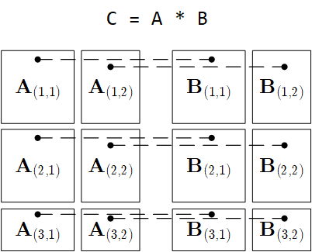
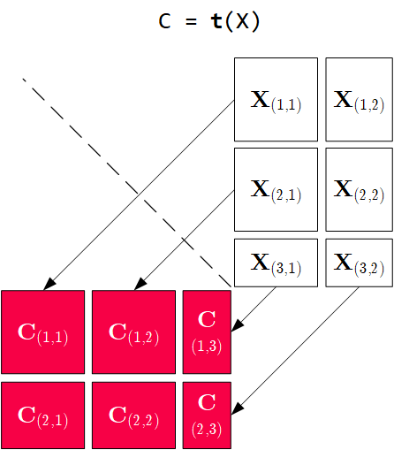
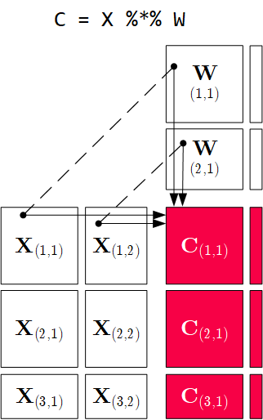
Distributed Matrix Operations
Distributed Linear Algebra
Elementwise Multiplication
(Hadamard Product)
Matrix
Multiplication
Transposition
Note: also with row/column vector rhs
Note: 1:N join

Slide 23
Physical Operator Selection
Distributed Linear Algebra
Common Selection Criteria
  Data and cluster characteristics (e.g., data size/shape, memory, parallelism)
  Matrix/operation properties (e.g., diagonal/symmetric, sparse-safe ops)
  Data flow properties (e.g., co-partitioning, co-location, data locality)
#0 Local Operators
  SystemML mm, tsmm, mmchain; Samsara/Mllib local
#1 Special Operators (special patterns/sparsity)
  SystemML tsmm, mapmmchain; Samsara AtA
#2 Broadcast-Based Operators (aka broadcast join)
  SystemML mapmm, mapmmchain
#3 Co-Partitioning-Based Operators (aka improved repartition join)
  SystemML zipmm; Emma, Samsara OpAtB
#4 Shuffle-Based Operators (aka repartition join)
  SystemML cpmm, rmm; Samsara OpAB
t(X) %*% (X%*%v)
1st
pass
v
2nd
pass
X
q┬
X

Slide 24
Physical Operator Selection, cont.
Distributed Linear Algebra
Examples Distributed MM Operators
Y
_{1,1}
Y_{1,1}
Y_{1,2}
Broadcast-based MM (mapmm)
Shuffle-based MM (cpmm)
Y
_{2,1}
Y_{2,1}
Y_{2,2}
X_{1,1}
X_{1,2}
Y_{3,1}
Y_{3,2}
X_{2,1}
X_{2,2}
Y_{4,1}
Y_{4,2}
X_{3,1}
X_{3,2}
X_{1,1}
X_{1,2}
X_{1,3}
X_{1,4}
X_{4,1}
X_{4,2}
X_{2,1}
X_{2,2}
X_{2,3}
X_{2,4}

Slide 25
Sparsity-Exploiting Operators
Distributed Linear Algebra
Goal: Avoid dense intermediates and unnecessary computation
#1 Fused Physical Operators
  E.g., SystemML [PVLDB’16]
  wsloss, wcemm, wdivmm
  Selective computation
  over non-zeros of
  “sparse driver”
#2 Masked Physical Operators
  E.g., Cumulon MaskMult [SIGMOD’13]
  Create mask of “sparse driver”
  Pass mask to single masked
  matrix multiply operator
sum(W * (X – U %*% t(V))^2)
^2
W
X
U V┬
sum
*
–
O / (C %*% E %*% t(B))
/
mm
C
mm
O
M
E
t(B)

Slide 26
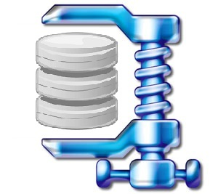
Overview Data Access Methods
Distributed Linear Algebra
Node1
Node2
#1 (Distributed) Caching
  Keep read only feature matrix in (distributed) memory
#2 Buffer Pool Management
  Graceful eviction of intermediates, out-of-core ops
#3 Scan Sharing (and operator fusion)
  Reduce the number of scans as well as read/writes
#4 NUMA-Aware Partitioning and Replication
  Matrix partitioning / replication → data locality
#5 Index Structures
  Out-of-core data, I/O-aware ops, updates
#6 Compression
  Fit larger datasets into available memory
Socket1
Socket2

Slide 27
Distributed Parameter Servers

Slide 28
Background: Mini-batch ML Algorithms
Distributed Parameter Servers
W’
Mini-batch ML Algorithms
  Iterative ML algorithms, where each iteration
  only uses a batch of rows to make the
  next model update (in epochs or w/ sampling)
  For large and highly redundant training sets
  Applies to almost all iterative, model-based
  ML algorithms (LDA, reg., class., factor., DNN)
  Stochastic Gradient Descent (SGD)
Statistical vs Hardware Efficiency (batch size)
  Statistical efficiency: # accessed data points to achieve certain accuracy
  Hardware efficiency: number of independent computations to
  achieve high hardware utilization (parallelization at different levels)
  Beware higher variance / class skew for too small batches!
➔ Training Mini-batch ML algorithms sequentially is hard to scale
Data
Batch 1
Batch 2
W’’
Epoch

Slide 29
Background: Mini-batch DNN Training (LeNet)
Distributed Parameter Servers
[Yann LeCun, Leon Bottou, Yoshua Bengio, and Patrick Haffner: Gradient-Based Learning Applied to Document Recognition, Proc of the IEEE 1998]
# Initialize W1-W4, b1-b4
# Initialize SGD w/ Nesterov momentum optimizer
iters = ceil(N / batch_size)
for( e in 1:epochs ) {
for( i in 1:iters ) {
X_batch = X[((i-1) * batch_size) %% N + 1:min(N, beg + batch_size - 1),]
y_batch = Y[((i-1) * batch_size) %% N + 1:min(N, beg + batch_size - 1),]
## layer 1: conv1 -> relu1 -> pool1
## layer 2: conv2 -> relu2 -> pool2
## layer 3: affine3 -> relu3 -> dropout
## layer 4: affine4 -> softmax
outa4 = affine::forward(outd3, W4, b4)
probs = softmax::forward(outa4)
## layer 4: affine4 <- softmax
douta4 = softmax::backward(dprobs, outa4)
[doutd3, dW4, db4] = affine::backward(douta4, outr3, W4, b4)
## layer 3: affine3 <- relu3 <- dropout
## layer 2: conv2 <- relu2 <- pool2
## layer 1: conv1 <- relu1 <- pool1
# Optimize with SGD w/ Nesterov momentum W1-W4, b1-b4
[W4, vW4] = sgd_nesterov::update(W4, dW4, lr, mu, vW4)
[b4, vb4] = sgd_nesterov::update(b4, db4, lr, mu, vb4)
}
}
NN Forward
Pass
NN Backward
Pass
→ Gradients
Model
Updates

Slide 30
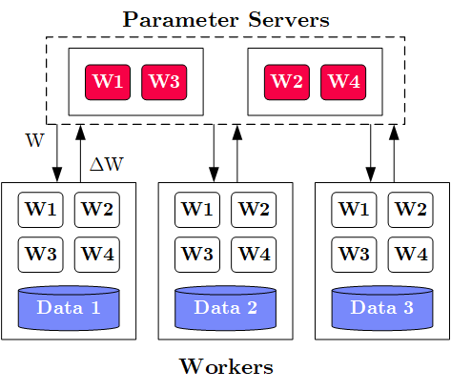
Overview Data-Parallel Parameter Servers
Distributed Parameter Servers
M
System
Architecture
  M Parameter
  Servers
  N Workers
  Optional
  Coordinator
Key Techniques
  Data partitioning D → workers Di (e.g., disjoint, reshuffling)
  Updated strategies (e.g., synchronous, asynchronous)
  Batch size strategies (small/large batches, hybrid methods)
W .. Model
ΔW .. Gradient
N

Slide 31
History of Parameter Servers
Distributed Parameter Servers
1st Gen: Key/Value
  Distributed key-value store for
  parameter exchange and synchronization
  Relatively high overhead
2nd Gen: Classic Parameter Servers
  Parameters as dense/sparse matrices
  Different update/consistency strategies
  Flexible configuration and fault tolerance
3rd Gen: Parameter Servers w/
improved data communication
  Prefetching and range-based pull/push
  Lossy or lossless compression w/ compensations
Examples
  TensorFlow, MXNet, PyTorch, CNTK, Petuum
[Alexander J. Smola, Shravan M. Narayanamurthy: An Architecture for Parallel Topic Models. PVLDB 2010]
[Jeffrey Dean et al.: Large Scale Distributed Deep Networks. NIPS 2012]
[Mu Li et al: Scaling Distributed Machine Learning with the Parameter Server. OSDI 2014]
[Jiawei Jiang, Bin Cui, Ce Zhang, Lele Yu: Heterogeneity-aware Distributed Parameter Servers. SIGMOD 2017]
[Jiawei Jiang et al: SketchML: Accelerating Distributed Machine Learning with Data Sketches. SIGMOD 2018]

Slide 32
Basic Worker Algorithm (batch)
Distributed Parameter Servers
for( i in 1:epochs ) {
for( j in 1:iterations ) {
params = pullModel(); # W1-W4, b1-b4 lr, mu
batch = getNextMiniBatch(data, j);
gradient = computeGradient(batch, params);
pushGradients(gradient);
}
}
[Jeffrey Dean et al.: Large Scale Distributed Deep Networks. NIPS 2012]

Slide 33
Extended Worker Algorithm (nfetch batches)
Distributed Parameter Servers
gradientAcc = matrix(0,...);
for( i in 1:epochs ) {
for( j in 1:iterations ) {
if( step mod nfetch = 0 )
params = pullModel();
batch = getNextMiniBatch(data, j);
gradient = computeGradient(batch, params);
gradientAcc += gradient;
params = updateModel(params, gradients);
if( step mod nfetch = 0 ) {
pushGradients(gradientAcc); step = 0;
gradientAcc = matrix(0, ...);
}
step++;
} }
nfetch batches require
local gradient accrual and local model update
[Jeffrey Dean et al.: Large Scale Distributed Deep Networks. NIPS 2012]

Slide 34
Update Strategies
Distributed Parameter Servers
Bulk Synchronous
Parallel (BSP)
  Update model w/
  accrued gradients
  Barrier for N workers
Asynchronous
Parallel (ASP)
  Update model
  for each gradient
  No barrier
Synchronous w/
Backup Workers
  Update model w/
  accrued gradients
  Barrier for N of
  N+b workers
Batch 1
Batch 2
Batch 3
Batch 1
Batch 2
Batch 3
Batch 1
Batch 2
Batch 3
Batch 1
Batch 2
Batch 3
Batch 1
Batch 2
Batch 3
but, stale model updates
Batch 1
Batch 2
Batch 3
Batch 1
Batch 2
Batch 3
Batch 1
Batch 2
Batch 3
Batch 1
Batch 2
Batch 3
Batch 1
Batch 2
Batch 3
Batch 1
Batch 2
Batch 3
Batch 1
Batch 2
Batch 3
[Martín Abadi et al: TensorFlow: A System for Large-Scale Machine Learning. OSDI 2016]

Slide 35








Federated ML
Distributed Parameter Servers
[Keith Bonawitz et al.: Towards Federated Learning at Scale: System Design. MLSys 2019]
Motivation Federated ML
  Learn model w/o central data consolidation
  Privacy + data/power caps vs personalization and sharing
Data Ownership ➔ Federated ML in the enterprise
(machine vendor – middle-person – customer equipment)
Federated ML Architecture
  Multiple control programs w/ single master
  Federated tensors (metadata handles)
  Federated instructions and parameter server
ExDRa Project (Exploratory Data Science over Raw Data)
  Basic approach: Federated ML + ML over raw data
  System infra, integration, data org & reuse, Exp DB, geo-dist.
W
ΔW
CP 1*
CP 2
FT
X1
X
CP 3
X2
Gefördert im Programm "IKT der Zukunft" vom Bundesministerium für Verkehr, Innovation, und Technologie (BMVIT→BMK)
Notes:
Note: besides privacy, sometimes not economically feasible to consolidate data

Slide 36
Q&A and Exam Preparation
Example Exam DIA WS20/21 v2
(90min for 100/100 points)
https://mboehm7.github.io/teaching/ws2021_dia/ExamDIA_v1.pdf
https://mboehm7.github.io/teaching/ws2021_dia/ExamDIA_v2.pdf

Slide 37
Task 1: Entity Resolution
Q&A and Exam Preparation
a) Explain the phases of a typical entity resolution pipeline and discuss example techniques for the individual phases. [16/100 points]
Prepare Data
Blocking/Sorting
Matching
Clustering
A2
A2
A
r1, r4
A1
C1
D1
A1
A1
A2
B1
B2
C2
C1
C2
C
r2, r7
C1
C2
B3
D1
D1
D
r3
B1
B2
B1
B2
r5, r6, r8
B3
B3
B
Notes:
Step 1: data cleaning, normalization, schema mapping
Step 2: blocking via blocking keys, sorting + window, blocking via ML / LSH
Step 3: similarity+threshold, ML via classification
Step 4: connected components, correlation/Markov clustering

Slide 38
Task 1: Entity Resolution, cont.
Q&A and Exam Preparation
b) Assume two publication datasets A and B that need deduplication. Explain the following two categories of schema matching techniques. [4/100 points]
Schema-based Matching:
  Find similarities among (groups of) attributes of S1 and S2
  Examples: match paper title and author attributes
  based on attribute similarity
Instance-based Matching:
  Find similarities among (groups of) attributes of S1 and S2,
  with the help of instance data in S1 and S2
  Examples: match paper titles and author attributes
  based on term frequencies, string similarity of example papers
  (e.g., after capitalization of words, splitting of author lists)

Slide 39
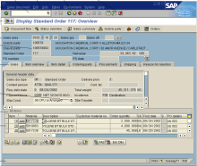
Task 2: Data Warehousing
Q&A and Exam Preparation
a) Describe the overall system architecture of a data warehouse,
name its components, and briefly describe their purpose. [5/100 points]
subject-oriented, integrated,
time-varying,
non-volatile collection of data
Data Mart 1
Data Mart 2
Data Mart 3
Analysis-centric independent subsets
(e.g., geo, org, functional)
Data Warehouse
(consolidated raw data, aggregates, metadata)
Materialized, non-volatile integration
Async replication,
and ETL vs ELT
Staging Area
Operational source
systems
S₁
S₃
S₄
S₂

Slide 40
Task 2: Data Warehousing, cont.
Q&A and Exam Preparation
b) Given below entity relationship (ER) diagram, create the corresponding star and snowflake schemas. Data types can be ignored, but indicate primary and foreign key constraints. [5+5/100 points]
Star
Schema
Users
UID
Name
City
Country
Movies
MID
Name
Length
Genre
Ratings
MID
UID
DID
Score
Dates
DID
Day
Month
Year

Slide 41
Task 2: Data Warehousing, cont.
Q&A and Exam Preparation
Snowflake
Schema
Cities
City
Country
Users
UID
Name
City
Movies
MID
Name
Length
GID
Ratings
MID
UID
DID
Score
Months
Month
Year
Genre
GID
GName
Dates
DID
Day
Month
Years
Year

Slide 42
Task 3: Data Cleaning
Q&A and Exam Preparation
ID | Position | Salary ($)
1 | Manager | null
2 | Secretary | 2200
3 | Manager | 3600
4 | Technician | null
5 | Technician | 2500
6 | Secretary | null
a) In the context of missing value
imputation, describe the following types
of missing data. [9/100 points]
Missing Completely at Random (MCAR):
  Missing values are randomly distributed
  across all records
Missing at Random (MAR):
  Missing values are randomly distributed
  within one or more sub-groups of records
  Missing values depend on the recorded but not
  on the missing values, and can be recovered
Not Missing at Random (NMAR):
  Missing data depends on the missing
  values themselves
  E.g., missing low salary, age, weight, etc.
(3500)
(2400)
(2000)
ID | Position | Salary ($)
1 | Manager | 3500
2 | Secretary | 2200
3 | Manager | 3600
4 | Technician | null
5 | Technician | null
6 | Secretary | 2000
ID | Position | Salary ($)
1 | Manager | 3500
2 | Secretary | null
3 | Manager | 3600
4 | Technician | null
5 | Technician | 2500
6 | Secretary | null
<= 2400
missing

Slide 43
Task 3: Data Cleaning
Q&A and Exam Preparation
b) Given the data below, name two techniques for missing value imputation (1x MCAR, 1x MAR), and impute the values. [5/100 points]
  MCAR: mean imputation
  (4500+2000+4000+2500)/4 = 3250
  MAR: linear regression, functional dependencies
  (Age * 100) = 5000 and 3500
c) Explain the difference between Outlier Detection and Anomaly Detection, with at least one example strategy for each. [6/100 points]
Outlier Detection:
  Remove likely incorrect values from data analysis
  Classification, clustering, pattern recognition (e.g., outlierByIQR)
Anomaly Detection:
  Find rare / anomalous data points / subsequences
  Classification / max k-nearest neighbor (e.g., matrix profile)

Slide 44
Task 4: Data Provenance
Q&A and Exam Preparation
a) Explain the general goal and concept of data provenance, and distinguish why-provenance and how-provenance. [5/100 points]
Data Provenance:
  Track and understand data origins and transformations of data
  (where?, when?, who?, why?, how?)
  Information about the origin and creation process of data
Why-Provenance:
  Which input tuples contributed to an output tuple t in query Q
  Representation: Set of witnesses w for tuple t
How-Provenance:
  How tuples where combined in the computation of an output
  Representation: provenance polynomials

Slide 45
Task 4: Data Provenance, cont.
Q&A and Exam Preparation
b) Given below tables R and S (w/ tuples r_{i} and s_{i}), query Q and the results O, specify the provenance polynomials for tuples in O. [3/100 points]
A: r1 x s1 + r3 x s1 + r2 x s3
(equivalent: (r1 + r3) x s1 + r2 x s3)
B: r2 x s2
C: r2 x s4

Slide 46
Task 5: Cloud Computing
Q&A and Exam Preparation
a) Explain the motivation of cloud computing in terms of overall goal,
key drivers, and advantages. [4/100 points]
Argument #1: Pay as you go
  No upfront cost for infrastructure
  Variable utilization ➔ over-provisioning
  Pay per use or acquired resources
Argument #2: Economies of Scale
  Purchasing and managing IT infrastructure at scale ➔ lower cost
  (applies to both HW resources and IT infrastructure/system experts)
  Focus on scale-out on commodity HW over scale-up ➔ lower cost
Argument #3: Elasticity
  Assuming perfect scalability, work done in constant time * resources
  Given virtually unlimited resources allows to reduce time as necessary
“Computing as utility”
100%
Utili-zation
Time

Slide 47
Task 5: Cloud Computing, cont.
Q&A and Exam Preparation
b) Explain the concept of resource allocation for multiple resources such as CPU and memory (dominant resource calculation in YARN). [3/100 points]
Multi-Metric Scheduling
  Multiple metrics: dominant resource calculator
  All constraints of relevant metrics must be respected
  Focus on bottleneck resource during scheduling
12/48GB
8GB
2
32GB
6/8GB
1/32GB
2/8GB
1
6
8GB

Slide 48
Task 6: Distributed, Data-parallel Computation
Q&A and Exam Preparation
Given a distributed dataset (left), describe a data-parallel approach of imputing the missing values (NULL) of Attr1 with its mode, and Attr2 with its mean. Describe strategies for improving the performance. Finally, fill in the concrete imputed values (right). [12+5+3/100 points]
1: data-parallel group-by [Attr1,count]
→ (X:5),(Y,3),(Z,1)
2: data-parallel sum(Attr2)
→ 37
3: data-parallel count(Attr2)
→ 10
4: Apply mode and mean to input data
with shuffling
X
3.7
Performance Improvements:
Pre-aggregation/combine (groupByKey → reduceByKey)
Caching for multi-pass computation
Fusion of passes 1-3 with multiple outputs
X
3.7
X

Slide 49
Task 7: Stream Processing
Q&A and Exam Preparation
Assume an input stream S with schema S(A,T) (where T is event time, and A is an integer column) and a continuous query Q with stream window aggregation. Compute the maximum output stream rate (tuples/second) for the following windows. [4/100 points]
Tumbling Window (size 200ms):
Sliding Window (size 500ms, step 100ms):
Max 200 tuples/s
Max 3 tuples/window
→ 15 Tuples/s
→ 30 Tuples/s

Slide 50
Task 7: Stream Processing
Q&A and Exam Preparation
b) Explain the following three techniques for handling overload situations in stream processing engines? [6/100 points]
#1 Back Pressure
  Graceful handling of
  overload w/o data loss
  Slow down sources
  E.g., blocking queues
#2 Load Shedding
  #1 Random-sampling-based load shedding
  #2 Relevance-based load shedding
  #3 Summary-based load shedding (synopses)
#3 Distributed Stream Processing
  Data flow partitioning (distribute the query)
  Key range partitioning (distribute the data stream
A
B
C
3ms
9ms
2ms
Self-adjusting operator scheduling
Pipeline runs at rate of slowest op

Slide 51
Summary and Q&A
Thanks
(please, participate in the
course evaluation)
Landscape of ML Systems
Distributed Linear Algebra
Distributed Parameter Servers
Q&A and Exam Preparation
#1 Projects and Exercises
  Feb 28, 11.59pm last chance exercise submission (7 late days)
#2 Course Evaluation and Exam
  Evaluation period: Dec 15 – Jan 31 (1/120)
  Exam date: Feb 04, 3pm in HS i13 (47/120)

