Slide 1

Introduction to Scientific Writing
01 Structure of Scientific Papers
Last update: Oct 23, 2021

Slide 2

Announcements/Org
#1 Virtual Lectures
  https://tugraz.webex.com/meet/m.boehm
  Optional attendance (independent of COVID)
#2 Course Registrations (as of Oct 28)
  Changes in WS20/21, now max constraints
  Introduction to Scientific Writing
ISDS Group Boehm
40/40

Slide 3
Agenda
Data Management Group
Course Organization, Outline, and Projects
Structure of Scientific Papers
Paper Project Proposals

Slide 4
Data Management Group
https://damslab.github.io/

Slide 5




About Me
Data Management Group
09/2018 TU Graz, Austria
  BMK endowed chair for data management
  Data management for data science
  (ML systems internals, end-to-end data science lifecycle)
2012-2018 IBM Research – Almaden, USA
  Declarative large-scale machine learning
  Optimizer and runtime of Apache SystemML
2011 PhD TU Dresden, Germany
  Cost-based optimization of integration flows
  Systems support for time series forecasting
  In-memory indexing and query processing
https://github.com/
apache/systemds
DB group

Slide 6
Data Management Courses
Data Management Group
Architecture of
Database Systems
(ADBS, WS)
DB system internals
+ prog. project
Architecture of
ML Systems
(AMLS, SS)
ML system internals
Prog. projects in SystemDS
[github.com/apache/systemds]
Master
Data Integration and Large-Scale Analysis
(DIA, WS)
Distributed
Data Management
Bachelor
Intro to Scientific Writing (WS)
Data Management / Databases
(DM, SS+WS)
Data management from user/application perspective

Slide 7
Course Organization,
Outline, Goals, and Projects

Slide 8


Course Logistics
Course Organization
Staff
  Lecturer: Univ.-Prof. Dr.-Ing. Matthias Boehm, ISDS
  Assistant: M.Sc. Shafaq Siddiqi, ISDS
Language
  Lectures and slides: English
  Communication and examination: English/German
  Submitted paper and talk: English
  Informal language (first name is fine), immediate feedback
Course Format
  SE 1, 2 ECTS (0.5 ECTS lectures + 1.5 ECTS paper/talk), bachelor
  3 lectures, optional attendance
  Mandatory paper and presentation

Slide 9
Course Logistics, cont.
Course Organization
Website
  https://mboehm7.github.io/teaching/ws2122_isw/index.htm
  All course material (lecture slides) and dates
Video Recording Lectures (TUbe)? No
  Lectures and discussions via Webex
  No recording in order to foster discussion, private presentations
Goals
  Understanding of / communication through scientific writing
  Best practices for effective scientific reading, writing, and reproducibility
Grading
  Overall: pass/fail (no detailed 1-5 grades)
  Includes submitted paper and final presentation
  (pass := adhere to given constraints + acceptable quality)

Slide 10
Outline Lectures
Course Organization
01 Structure of Scientific Papers [Oct 28, 6.15pm, optional]
02 Scientific Reading and Writing [Nov 04, 6pm, optional]
03 Experiments, Reproducibility, and Projects [Nov 11, 6pm, optional]
...
04 Project Presentations [Jan 13, 6pm, mandatory]

Slide 11
Paper Projects
Course Organization
Alternative: LV combined with bachelor thesis
Team
  1-4 person teams (w/ clearly separated responsibilities)
Project
  Pick from a given list of papers / groups of papers
  #1 Write short summary paper (#pages = 2 * team-size,
  written in LaTeX, ACM acmart template, document-class sigconf, PDF)
  #2 Prepare and present talk on paper summary (7min + 3min Q&A)
Timeline
  Today: List of projects proposals, feel free to bring your own
  Nov 11: project selection via email to m.boehm@tugraz.at (11.59pm)
  subject: [Scientific Writing] Project Selection
  Dec 23: paper submission via email to m.boehm@tugraz.at (11.59pm)
  Jan 13: Final project presentation (all students)

Slide 12
Structure of Scientific Papers
In Computer Science (Data Management)

Slide 13
Overview Types of Scientific Writing
Structure of Scientific Papers
Classification of Scientific/Technical Documents
  Formal vs informal writing, cumulative?, single vs multi-author
  Archival vs non-archival publications
➔ Scientific Writing Skills are crucial
  Different types of docs share many similarities
/
Monographs
Scientific Papers
Others
BS Thesis
Preprint
Grant Proposal
MS Thesis
Conference
Design doc
PhD Thesis
Journal
White Paper
Habilitation
Tech Report
Blog
Website
Notes:
Besides: programming, reading, writing, communication main skills

Slide 14
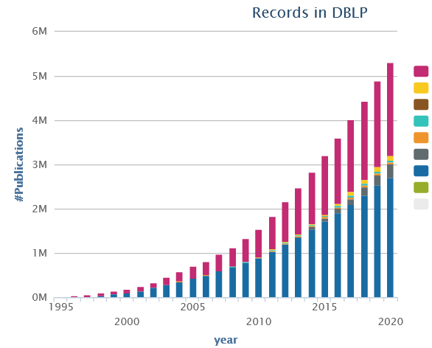
Preparation
Structure of Scientific Papers
#1 Know your Audience
#2 Get your Workflow in Order
  Writing: LaTeX (e.g., Overleaf, TeXnicCenter), versioning (e.g., git), templates
  Plotting: R (plot, ggplot), Python (matplotlib), Gnuplot
  Figures: MS Visio, Inkscape → pdf, eps, svg (vector graphics)
#3 Mindset: Quality over Quantity
  Aim for top-tier conferences/journals (act as filter)
  Make the paper useful for others (ideas, evidence, code)
  Example (my own theses/books)
    Seminar (~bachelor), 5 months, 446 pages
    Diploma (~master), 9 months, 274 pages
    PhD thesis, 4 years, 237 pages
    1st book, 5+2 years, 157 pages
Your reader’s time is a scarce resource

Slide 15
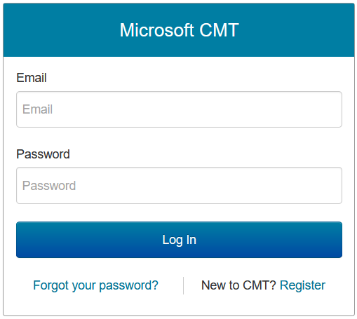
Paper Writing and Publication Process
Structure of Scientific Papers
[Recommended Reading]
Research – Writing Cycle
  Read lots of papers
  Idea → Research → Writing → Document
  Idea → Writing/Research → Document
  Incremental refinement of drafts
Paper Submission Cycle
  Blind vs double-blind submission
  Revisions and Camera-ready
  Similar: bachelor/master thesis
  → drafts to advisor / final version
Demo CMT
  Example DEEM 2021, PVLDB 2022
[Simon Peyton Jones: How to write a great research paper, MSR Cambridge]
[Eamonn Keogh: How to do good research, get it published in SIGKDD and get it cited!, KDD 2009]
Example SIGMOD 2020
October 15, 2019: Abstract submission
October 22, 2019: Paper submission
December 10 - 11, 2019: Author responses
January 17, 2020: Initial notification
February 19, 2020: Revised submission
March 13, 2020: Final notification
April 12, 2020: Camera ready due

Slide 16
Paper/Thesis Structure by Example
Structure of Scientific Papers
Example Paper
[Ahmed Elgohary, Matthias Boehm, Peter J. Haas, Frederick R. Reiss, Berthold Reinwald:
Compressed Linear Algebra for Large-Scale Machine Learning. PVLDB 2016]
[Ahmed Elgohary, Matthias Boehm, Peter J. Haas, Frederick R. Reiss, Berthold Reinwald: Scaling Machine Learning via Compressed Linear Algebra. SIGMOD Record 2017 46(1)]
[Ahmed Elgohary, Matthias Boehm, Peter J. Haas, Frederick R. Reiss, Berthold Reinwald: Compressed Linear Algebra for Large-Scale Machine Learning. VLDB Journal 2018 27(5)]
[Ahmed Elgohary, Matthias Boehm, Peter J. Haas, Frederick R. Reiss, Berthold Reinwald: Compressed Linear Algebra for Large-Scale Machine Learning. Commun. ACM 2019 62(5)]

Slide 17
Ideas and Topic Selection
Structure of Scientific Papers
Problem-Oriented Research
  Focus on problem/observation first, not your solution
  Discuss early ideas with collaborators and friends
  Develop your taste for good research topics
  Topic selection needs time → pipeline model
Ex. Compressed Linear Algebra
  Problem: Iterative ML algorithms + memory-bandwidth-bound operations
  ➔ crucial to fit data in memory ➔ automatic lossless compression
  Sub-problems: #rows>>#cols, column correlation, column characteristics
  ➔ column-wise compression w/ heterogeneous encoding formats
Prog-ress
Time

Slide 18
Prototypes and Experiments
Structure of Scientific Papers
Worst Mistake: Schrödinger's Results
  Postpone implementation and experiments till last before the deadline
  No feedback, no reaction time (experiments require many iterations)
  Karl Popper: falsifiability of scientific results
Continuous Experiments
  Run experiments during survey / prototype building
  Systematic experiments ➔ observations and ideas for improvements
  Don’t be afraid of throw away prototypes that don’t work
Ex. Compressed Linear Algebra
  Data characteristics inspired overall design of encoding schemes
  Initially slow compression → dedicated sampling schemes and estimators
  Initially slow compressed operations → cache-conscious operations,
  selected operations with better asymptotic behavior

Slide 19

Title and Authors
Structure of Scientific Papers
List of Authors
  #1 by contribution
  (main, …, advisor)
  #2 by last name
Title
  Descriptive yet concise
  Short name if possible
  → easier to cite and discuss
[Credit: sliceline,
Silicon Valley, HBO]

Slide 20
Abstract
Structure of Scientific Papers
[Simon Peyton Jones: How to write a great research paper, MSR Cambridge]
% 1. State the problem
Large-scale machine learning (ML) algorithms are often
iterative, using repeated read-only data access and I/O-bound
matrix-vector multiplications to converge to an optimal model.
It is crucial for performance to fit the data into single-node
or distributed main memory.
% 2. Say why it's an interesting problem
General-purpose, heavy- and lightweight compression techniques struggle to achieve both good compression ratios and fast decompression speed to enable block-wise uncompressed operations.
% 3. Say what your solution achieves
Hence, we initiate work on compressed linear algebra (CLA), in which lightweight database compression techniques are applied to matrices and then linear algebra operations such as matrix-vector multiplication are executed directly on the compressed representations. We contribute effective column compression schemes, cache-conscious operations, and an efficient sampling-based compression algorithm. Our experiments show that CLA achieves in-memory operations performance close to the uncompressed case and good compression ratios that allow us to fit larger datasets into available memory.
% 4. Say what follows from your solution
We thereby obtain significant end-to-end performance improvements up to 26x or reduced memory requirements.

Slide 21
Introduction
Structure of Scientific Papers
Context (1 paragraph)
Problems (1-3 paragraphs)
[Existing Work (1 paragraph)]
[Idea (1 paragraph)]
Contributions (1 paragraph)
Introduction Matters
Anchoring: most reviewers reach their
opinion after reading introduction and
motivation and then look for evidence
[Eamonn Keogh: How to do good research, get it published in SIGKDD and get it cited!, KDD 2009]

Slide 22
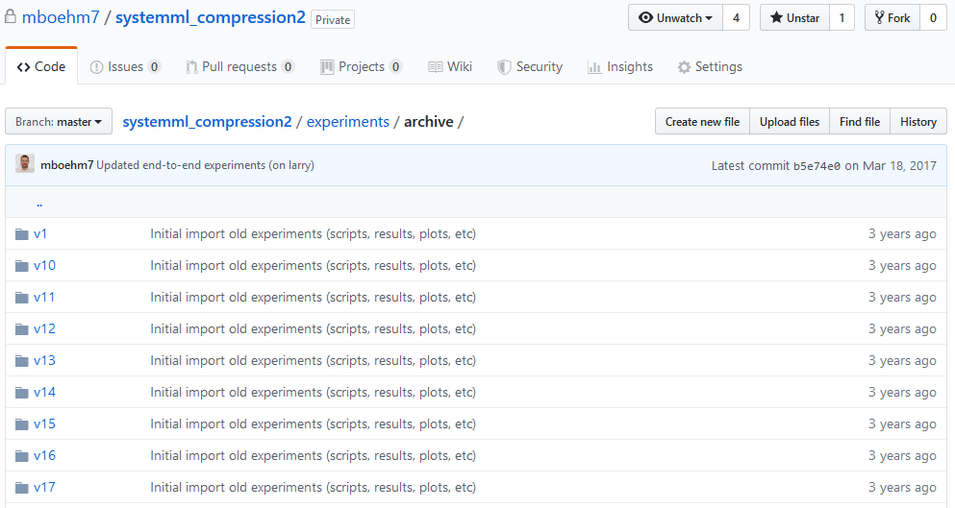
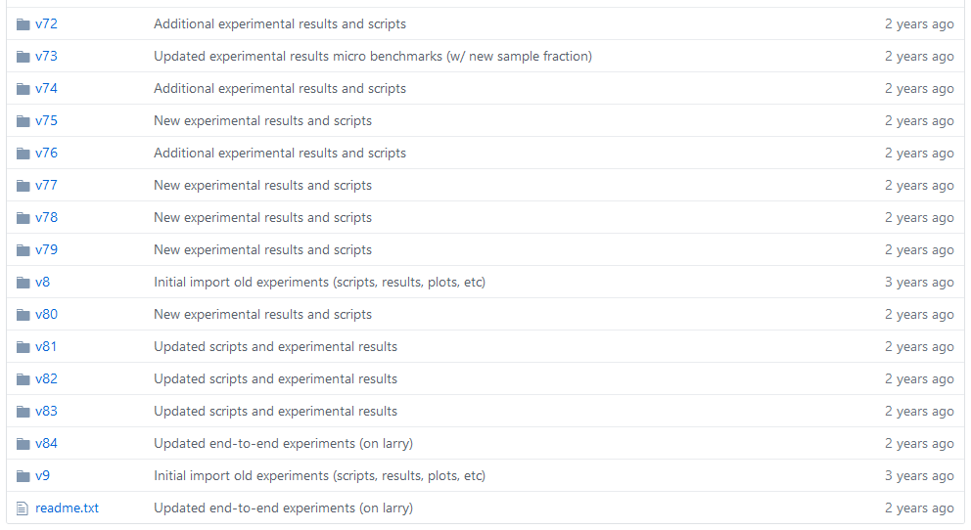
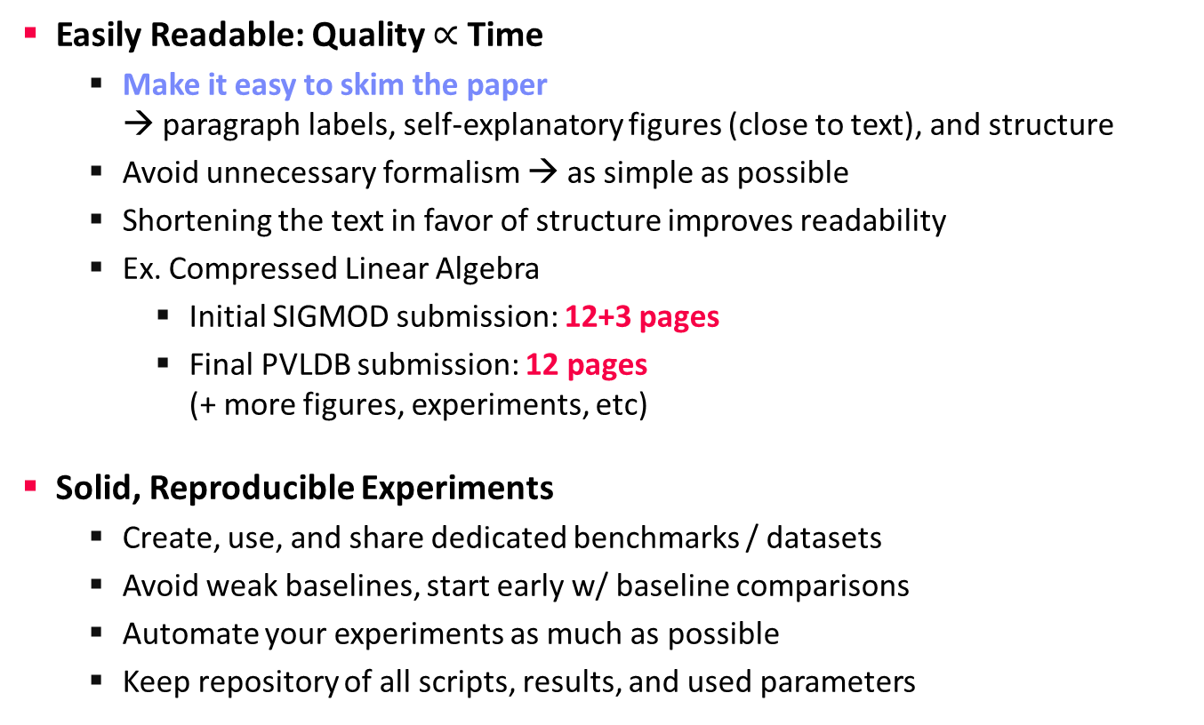
Writing the Paper (and more Experiments)
Structure of Scientific Papers
02 Scientific Reading and Writing
03 Experiments and Reproducibility
Easily Readable: Quality $∝$ Time
  Make it easy to skim the paper
  → paragraph labels, self-explanatory figures (close to text), and structure
  Avoid unnecessary formalism → as simple as possible
  Shortening the text in favor of structure improves readability
  Ex. Compressed Linear Algebra
    Initial SIGMOD submission: 12+3 pages
    Final PVLDB submission: 12 pages
    (+ more figures, experiments, etc)
Solid, Reproducible Experiments
  Create, use, and share dedicated benchmarks / datasets
  Avoid weak baselines, start early w/ baseline comparisons
  Automate your experiments as much as possible
  Keep repository of all scripts, results, and used parameters

Slide 23
Related Work
Structure of Scientific Papers
Purpose of a “Related Work”-Section
  Not a mandatory task or to show you know the field
  Put you work in context of related areas (~ 1 paragraph each)
  Discuss closely related work
  Crisp separation from existing work (what are the differences)
Placement
  Section 2 or Section n-1
  Throughout the paper
Give Credit
  Cite broadly, give credit to inspiring ideas, create connections
  Honestly acknowledge limitations of your approach
[Simon Peyton Jones: How to write a great research paper, MSR Cambridge]

Slide 24
References
Structure of Scientific Papers
inproceedings{StonebrakerBPR11,
author = {Michael {Stonebraker et al.}},
title = {{The Architecture of SciDB}},
booktitle = {{SSDBM}},
year = {2011}
}
Setup
  Use LaTeX \cite{} and BibTeX
  Use a consistent source
  of bibtex entries (e.g., DBLP)
Different References Styles
  But, not in footnotes (unless required)
VLDB2016.bib
\bibliographystyle{abbrv}
\bibliography{VLDB2016}

Slide 25
Dealing with Feedback / Criticism
Structure of Scientific Papers
Different Kinds of Feedback
  Casual discussion of early ideas
  Comments on paper drafts
  Reviewer comments (good and bad)
Example Compressed Linear Algebra
  SIGMOD Reviewer 2 (REJECT)
    “The rewriting for q=Xv seems wrong: To
    compute q, one takes each row of the
    matrix X and multiplies it with the vector v.”
  PVLDB Reviewer 3 (WEAK ACCEPT)
    “I kinda disagree with the broad definition
    of declarative ML from the introduction.”
Paper Rebuttal and/or Revision
  Rebuttal: seriously consider all feedback (in doubt agree), and
  answer with facts / ideas how to address the comments
  Revision (conditional accept): address all revision requests
# Always welcome feedback/criticism
# Address all feedback w/ sincere effort
[Matthias Boehm et al.: Declarative Machine Learning - A Classification of Basic Properties and Types. CoRR 2016.]

Slide 26
Paper Projects
In Computer Science (Data Management)

Slide 27
Paper Projects
Paper Project Proposals
Visual Analytics
  #1.1 Tarique Siddiqui, Paul Luh, Zesheng Wang, Karrie Karahalios, Aditya G. Parameswaran: ShapeSearch: A Flexible and Efficient System for Shape-based Exploration of Trendlines. SIGMOD 2020
  #1.2 Uwe Jugel, Zbigniew Jerzak, Gregor Hackenbroich, Volker Markl: M4: A Visualization-Oriented Time Series Data Aggregation. PVLDB 7(10) 2014
Video Analytics
  #2.1 Favyen Bastani, Songtao He, Arjun Balasingam, Karthik Gopalakrishnan, Mohammad Alizadeh, Hari Balakrishnan, Michael J. Cafarella, Tim Kraska, Sam Madden: MIRIS: Fast Object Track Queries in Video. SIGMOD 2020
  #2.2 Daniel Kang, Peter Bailis, Matei Zaharia: BlazeIt: Optimizing Declarative Aggregation and Limit Queries for Neural Network-Based Video Analytics. PVLDB 13(4) 2019
  #2.3 Daniel Kang, John Emmons, Firas Abuzaid, Peter Bailis, Matei Zaharia: NoScope: Optimizing Deep CNN-Based Queries over Video Streams at Scale. PVLDB 10(11) 2017

Slide 28
Paper Projects, cont.
Paper Project Proposals
Fairness / Causality / Diversity
  #3.1 Julia Stoyanovich, Bill Howe, H. V. Jagadish: Responsible Data Management. PVLDB 13(12) 2020
  #3.2 Babak Salimi, Luke Rodriguez, Bill Howe, Dan Suciu: Interventional Fairness: Causal Database Repair for Algorithmic Fairness. SIGMOD 2019
  #3.3 Marina Drosou, Evaggelia Pitoura: DisC diversity: result diversification based on dissimilarity and coverage. PVLDB 6(1) 2012
Graphs
  #4.1 Renchi Yang, Jieming Shi, Xiaokui Xiao, Yin Yang, Juncheng Liu, Sourav S. Bhowmick: Scaling Attributed Network Embedding to Massive Graphs. PVLDB 14(1) 2020
  #4.2 Siddhartha Sahu, Amine Mhedhbi, Semih Salihoglu, Jimmy Lin, M. Tamer Özsu: The Ubiquity of Large Graphs and Surprising Challenges of Graph Processing. PVLDB 11(4) 2017
  #4.3 Yuanyuan Tian, Andrey Balmin, Severin Andreas Corsten, Shirish Tatikonda, John McPherson: From "Think Like a Vertex" to "Think Like a Graph". PVLDB 7(3) 2013
  #4.4 Grzegorz Malewicz, Matthew H. Austern, Aart J. C. Bik, James C. Dehnert, Ilan Horn, Naty Leiser, Grzegorz Czajkowski: Pregel: a system for large-scale graph processing. SIGMOD 2010

Slide 29
Paper Projects, cont.
Paper Project Proposals
NLP
  #5.1 Orest Gkini, Theofilos Belmpas, Georgia Koutrika, Yannis E. Ioannidis: An In-Depth Benchmarking of Text-to-SQL Systems. SIGMOD 2021
  #5.2 Diptikalyan Saha, Avrilia Floratou, Karthik Sankaranarayanan, Umar Farooq Minhas, Ashish R. Mittal, Fatma Özcan: ATHENA: An Ontology-Driven System for Natural Language Querying over Relational Data Stores. PVLDB 9(12) 2016
  #5.3 Fei Li, H. V. Jagadish: Constructing an Interactive Natural Language Interface for Relational Databases. PVLDB 8(1) 2014
Provenance
  #6.1 Pingcheng Ruan, Gang Chen, Anh Dinh, Qian Lin, Beng Chin Ooi, Meihui Zhang: Fine-Grained, Secure and Efficient Data Provenance for Blockchain. PVLDB 12(9) 2019
  #6.2 Daniel Deutch, Nave Frost, Amir Gilad: Provenance for Natural Language Queries. PVLDB 10(5) 2017
  #6.3 Adriane Chapman, H. V. Jagadish: Why not? SIGMOD 2009

Slide 30
Paper Projects, cont.
Paper Project Proposals
Reusing Intermediates
  #7.1 Behrouz Derakhshan, Alireza Rezaei Mahdiraji, Ziawasch Abedjan, Tilmann Rabl, Volker Markl: Optimizing Machine Learning Workloads in Collaborative Environments. SIGMOD 2020
  #7.2 Doris Xin, Litian Ma, Jialin Liu, Stephen Macke, Shuchen Song, Aditya Parameswaran: Helix: Accelerating Human-in-the-loop Machine Learning. PVDLB 11(12) 2018
  #7.3 Ce Zhang, Arun Kumar, Christopher Ré: Materialization optimizations for feature selection workloads. SIGMOD 2014
  #7.4 Milena Ivanova, Martin L. Kersten, Niels J. Nes, Romulo Goncalves: An architecture for recycling intermediates in a column-store. SIGMOD 2009
Raw Query Processing
  #8.1 Dominik Durner, Viktor Leis, Thomas Neumann: JSON Tiles: Fast Analytics on Semi-Structured Data. SIGMOD 2021
  #8.2 Manos Karpathiotakis, Ioannis Alagiannis, Anastasia Ailamaki: Fast Queries Over Heterogeneous Data Through Engine Customization. PVLDB 9(12) 2016
  #8.3 Ioannis Alagiannis, Renata Borovica, Miguel Branco, Stratos Idreos, Anastasia Ailamaki: NoDB: efficient query execution on raw data files. SIGMOD 2012

Slide 31
Paper Projects, cont.
Paper Project Proposals
Transactions / High Availability
  #9.1 Jingyu Zhou et al: FoundationDB: A Distributed Unbundled Transactional Key Value Store. SIGMOD 2021
  #9.2 Audrey Cheng, Xiao Shi, Lu Pan, Anthony Simpson, Neil Wheaton, Shilpa Lawande, Nathan Bronson, Peter Bailis, Natacha Crooks, Ion Stoica: RAMP-TAO: Layering Atomic Transactions on Facebook's Online TAO Data Store. PVLDB 14(12) 2021
  #9.3 Yihe Huang, William Qian, Eddie Kohler, Barbara Liskov, Liuba Shrira: Opportunities for Optimism in Contended Main-Memory Multicore Transactions. PVLDB 13(5) 2020
  #9.4 Umar Farooq Minhas, Shriram Rajagopalan, Brendan Cully, Ashraf Aboulnaga, Kenneth Salem, Andrew Warfield: RemusDB: Transparent High Availability for Database Systems. PVLDB 4(11) 2011
  #9.5 Michael J. Cahill, Uwe Röhm, Alan D. Fekete: Serializable isolation for snapshot databases. SIGMOD 2008
Data Flow Systems
  #10.1 Matei Zaharia et al.: Resilient Distributed Datasets: A Fault-Tolerant Abstraction for In-Memory Cluster Computing. NSDI 2012
  #10.2 Christopher Olston, Shubham Chopra, Utkarsh Srivastava: Generating example data for dataflow programs. SIGMOD 2009

Slide 32
Paper Projects, cont.
Paper Project Proposals
Database Cracking
  #11.1 Pedro Holanda, Stefan Manegold, Hannes Mühleisen, Mark Raasveldt: Progressive Indexes: Indexing for Interactive Data Analysis. PVLDB 12(13) 2019
  #11.2 Felix Martin Schuhknecht, Alekh Jindal, Jens Dittrich: The Uncracked Pieces in Database Cracking. PVLDB 7(2) 2013
  #11.3 Stratos Idreos, Martin L. Kersten, Stefan Manegold: Database Cracking. CIDR 2007
Index Structures
  #12.1 Tim Kraska, Alex Beutel, Ed H. Chi, Jeffrey Dean, Neoklis Polyzotis: The Case for Learned Index Structures. SIGMOD 2018
  #12.2 Huanchen Zhang, Hyeontaek Lim, Viktor Leis, David G. Andersen, Michael Kaminsky, Kimberly Keeton, Andrew Pavlo: SuRF: Practical Range Query Filtering with Fast Succinct Tries. SIGMOD 2018
  #12.3 Viktor Leis, Alfons Kemper, Thomas Neumann: The adaptive radix tree: ARTful indexing for main-memory databases. ICDE 2013
  #12.4 Nicolas Bruno, Surajit Chaudhuri: Constrained physical design tuning. Proc. VLDB Endow. 1(1) 2008

Slide 33
Paper Projects, cont.
Paper Project Proposals
Data Cleaning
  #13.1 Peng Li, Xi Rao, Jennifer Blase, Yue Zhang, Xu Chu, Ce Zhang: CleanML: A Study for Evaluating the Impact of Data Cleaning on ML Classification Tasks. ICDE 2021
  #13.2 Mohammad Mahdavi, Ziawasch Abedjan: Baran: Effective Error Correction via a Unified Context Representation and Transfer Learning. PVLDB 13(11) 2020
  #13.3 Md Mahdavi et al: Raha: A Configuration-Free Error Detection System. SIGMOD 2019
  #13.4 Alireza Heidari, Joshua McGrath, Ihab F. Ilyas, Theodoros Rekatsinas: HoloDetect: Few-Shot Learning for Error Detection. SIGMOD 2019
  #13.5 Theodoros Rekatsinas, Xu Chu, Ihab F. Ilyas, Christopher Ré: HoloClean: Holistic Data Repairs with Probabilistic Inference. PVLDB 10(11) 2017
  #13.6 Ziawasch Abedjan et al: Detecting Data Errors: Where are we and what needs to be done? PVLDB 9(12) 2016
Query Optimization
  #14.1 Ryan Marcus, Parimarjan Negi, Hongzi Mao, Nesime Tatbul, Mohammad Alizadeh, Tim Kraska: Bao: Making Learned Query Optimization Practical. SIGMOD 2021
  #14.2 Guido Moerkotte, Thomas Neumann: Analysis of Two Existing and One New
  Dynamic Programming Algorithm for the Generation of Optimal Bushy Join Trees without Cross Products. VLDB 2006

Slide 34
Paper Projects, cont.
Paper Project Proposals
Query Compilation
  #15.1 Timo Kersten, Viktor Leis, Alfons Kemper, Thomas Neumann, Andrew Pavlo, Peter A. Boncz: Everything You Always Wanted to Know About Compiled and Vectorized Queries But Were Afraid to Ask. PVLDB 11(13) 2018
  #15.2 Prashanth Menon, Andrew Pavlo, Todd C. Mowry: Relaxed Operator Fusion for In-Memory Databases: Making Compilation, Vectorization, and Prefetching Work Together At Last. PVLDB 11(1) 2017
  #15.3 Andrew Crotty, Alex Galakatos, Kayhan Dursun, Tim Kraska, Carsten Binnig, Ugur Çetintemel, Stan Zdonik: An Architecture for Compiling UDF-centric Workflows. PVLDB 8(12) 2015
  #15.4 Milos Nikolic, Mohammed Elseidy, Christoph Koch: LINVIEW: incremental view maintenance for complex analytical queries. SIGMOD 2014
  #15.5 Yannis Klonatos, Christoph Koch, Tiark Rompf, Hassan Chafi: Building Efficient Query Engines in a High-Level Language. PVLDB 7(10) 2014
  #15.6 Thomas Neumann: Efficiently Compiling Efficient Query Plans for Modern Hardware. Proc. VLDB Endow. 4(9) 2011

Slide 35
Paper Projects, cont.
Paper Project Proposals
Compression
  #16.1 Peter A. Boncz, Thomas Neumann, Viktor Leis: FSST: Fast Random Access String Compression. Proc. VLDB Endow. 13(11) 2020
  #16.2 Daniel J. Abadi, Samuel Madden, Miguel Ferreira: Integrating compression and execution in column-oriented database systems. SIGMOD 2006
  #16.3 Marcin Zukowski, Sándor Héman, Niels Nes, Peter A. Boncz: Super-Scalar RAM-CPU Cache Compression. ICDE 2006
Modern Hardware
  #17.1 Lasse Thostrup, Jan Skrzypczak, Matthias Jasny, Tobias Ziegler, Carsten Binnig: DFI: The Data Flow Interface for High-Speed Networks. SIGMOD 2021
  #17.2 Clemens Lutz, Sebastian Breß, Steffen Zeuch, Tilmann Rabl, Volker Markl: Pump Up the Volume: Processing Large Data on GPUs with Fast Interconnects. SIGMOD 2020
  #17.3 Ismail Oukid et al.: FPTree: A Hybrid SCM-DRAM Persistent and Concurrent B-Tree for Storage Class Memory. SIGMOD 2016
  #17.4 Changkyu Kim et al.: FAST: fast architecture sensitive tree search on modern CPUs and GPUs. SIGMOD 2010
  #17.5 René Müller, Jens Teubner, Gustavo Alonso: Data Processing on FPGAs. Proc. VLDB Endow. 2(1) 2009

Slide 36
Summary and Q&A
Data Management Group
Course Organization, Outline, and Projects
Structure of Scientific Papers
Paper Project Proposals
Remaining Questions?
Next Lectures
  02 Scientific Reading and Writing [Nov 04]
  03 Experiments, Reproducibility, and Projects [Nov 11]

