Slide 1

Introduction to Scientific Writing
02 Scientific Reading and Writing
Last update: Nov 04, 2021

Slide 2

Announcements/Org
#1 Virtual Lectures
  https://tugraz.webex.com/meet/m.boehm
  Optional attendance (independent of COVID)
#2 Course Registrations (as of Oct 29)
  Changes in WS20/21, now max constraints
  Introduction to Scientific Writing
ISDS Group Boehm
39/40

Slide 3
Agenda
Scientific Reading
Scientific Writing
Scientific Writing skills can only be learned hands on, and incrementally improved w/ experience

Slide 4
Scientific Reading
In Computer Science (Data Management)

Slide 5
Types of Reading
Scientific Reading
Skimming
  Goal: understand what the paper/thesis is about
  Read abstract, and optionally introduction
  scan paper (sections/subsections, structure, figures)
Understanding
  Goal: understand how the presented approach
  accomplishes the paper’s goals
  #1 Skimming (see above)
  #2 Read the whole paper sequentially, add notes/annotations
Reviewing
  Goal: evaluate potential impact, and limitations
  #1 Skimming (see above)
  #2 Understanding (see above) + strengths and weaknesses
  #3 Write summary, strong/weak points, detailed comments (incl reading)
What?
How?
What’s Wrong?

Slide 6
Finding Relevant Work
Scientific Reading
Motivation
  Some research areas might be very large (e.g., index structures, compression)
  How do you find relevant scientific papers/thesis via multiple channels
By Venue/Year
  Start of top-tier conferences/journals and find latest work
  These papers’ related work should provide a good
  categorization and discussion of related work → recursive lookup
By Author
  Sometimes there are well-known experts in a certain sub-area
  Find author publications via DBLP and other libraries
By Keywords
  Broad survey of other related work, to augment the bias year/venue/author approach

Slide 7
Finding Relevant Work, cont.
Scientific Reading
Prefer Trustworthy Sources
  Archival publications, awareness of peer-review
  From right communities (e.g., ML systems vs ML algorithms)
  Reputation of website, authors, etc
Recap: Give Credit
  Cite broadly, give credit to inspiring ideas, create connections
  Honestly acknowledge limitations of your approach

Slide 8
Process of Reading – Skimming/Understanding
Scientific Reading
Abstract and Structure
#1 Partial Reading (mostly skimming)
  Read into each paragraph until you get what it’s about
  1st sentence/label: topic sentence
#2 Fast Reading
  Normal reading vs reading w/o vocalization
  Avoid need for rereading text
    Back/forward references,
    Misplacement after distractions
    Rereading due to lack of understanding
➔ Read according to your goals of reading

Slide 9
Process of Reading – Understanding/Evaluation
Scientific Reading
Skepticism
  Critical reading is important for understanding and evaluation
  #1 Start open-minded, listen to arguments and trust provided evidence
  #2 Don’t accept superficial, contradictory, or unproven claims
  #3 If there are problems, which constructive feedback could you give or how could the problems be addressed?
Questions to Ask Yourself?
  What is the problem? Is it a real or artificial problem?
  How would you solve the problem yourself?
  How is the paper solving the problem?
  Is this the simplest approach that yields these results (justified complexity)
  Are there limitations that are not covered by the paper?
  Is there existing work that already addresses the same problem?

Slide 10
Proofreading Your Own Paper
Scientific Reading
#1 Read Slowly & Carefully
  Problem: Brain interpolates between words
  Awareness of common syntactic issues
  (the the, missing/wrong articles, adapt/adopt)
  Awareness of common semantic issues
  (missing reference, inconsistent / no logical consequence)
#2 Read Fully
  Read and annotate issue, don’t fix immediately (destroys the flow)
  Take annotated document and fix issues
#3 Ask Big Questions
  Pitfall: Being overly focused on syntactic/local issues
  Is the overall idea clearly communicated and does it make sense?
  Are there missing pieces, missing experiments, missing related work?
→ Read out loud
→ Use PDF-to-Speech

Slide 11
Reviewing (how NOT to review a paper)
Scientific Reading
Paper Reviews
  Goals: paper selection, ensure high quality, constructive feedback and recommendations, widen own horizon
  Lots of similarities to code reviews in OSS
Learning by What NOT to Do
  Accept if no time to review
  The Goldilocks Method
  (examples, proofs, theoretical analysis, experiments)
  If you can’t say something nasty … (ignore good parts, focus on weaknesses)
  Silent but deadly (low scores, no comments)
  The Natives are Restless (recommend full rewrite by native English speaker)
  The Referee Moves the Goalpost (changed problem)
  Blind reviewing
[Graham Cormode: How NOT to review a paper: the tools and techniques of the adversarial reviewer. SIGMOD Rec. 37(4) 2008]
This paper leaves many questions unanswered.
Some claims are questionable.
The paper is of limited interest.

Slide 12
Reviewing, cont. (how NOT to review a paper)
Scientific Reading
Introduction
  Disagree w/ “Interestingly...”,
  “Importantly...” or “In practice”,
Related Work
  “Many important references
  are omitted”
Proposed Method
  To simple, impractical, or
  well-known; correctness?
Experiments
  Datasets synthetic/real, not all aspects evaluated, too small datasets
Conclusions
  Disagree w/ every claim; future work can be dismissed
Adversarial Paper Summary
This paper attempts to address the well-studied problem of Graticule Optimization. It proposes the obvious approach of simply storing a set of reference points and calculating offsets. Such approaches are well known in this area. It goes on to propose some simple variations based on precalculating distances. This is an approach that I would expect any straightforward implementation to adopt. Some proof-of-concept experiments show that on a few data sets, the results are slightly better than the most naïve prior methods.

Slide 13
Excursus: An Automatic CS Paper Generator
Scientific Reading
SCIgen: https://pdos.csail.mit.edu/archive/scigen
  Generates random CS research papers, incl graphs and figures
  Uses hand-written context-free grammar
  Test for low-submission standards of conferences
Two Examples
  [Jeremy Stribling, Daniel Aguayo and Maxwell Krohn: Rooter: A
  Methodology for the Typical Unification of Access Points and Redundancy]
  → accepted as “non-reviewed” WMSCI 2005
  [Thomer M. Gil: The Influence of Probabilistic Methodologies on Networking]
  → rejected
➔ Meaningless mix of sentences and technical terms
(today: GPT-3, what’s the take-away for your own papers?)

Slide 14
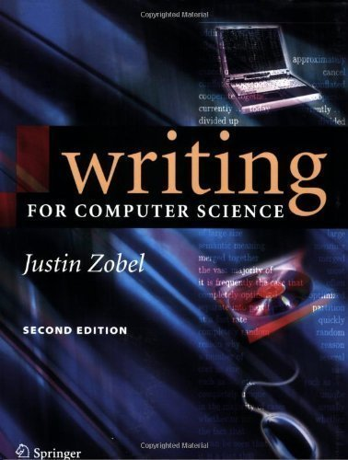
Scientific Writing
In Computer Science (Data Management)
[Justin Zobel: Writing for Computer Science,
2nd ed. Springer 2004, ISBN 978-1-85233-802-2]

Slide 15
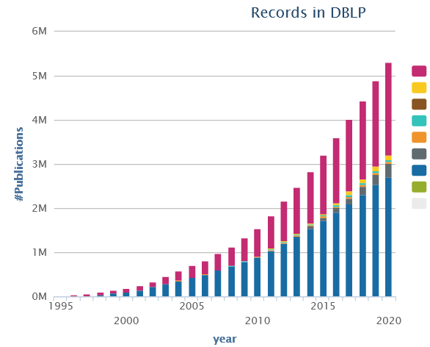
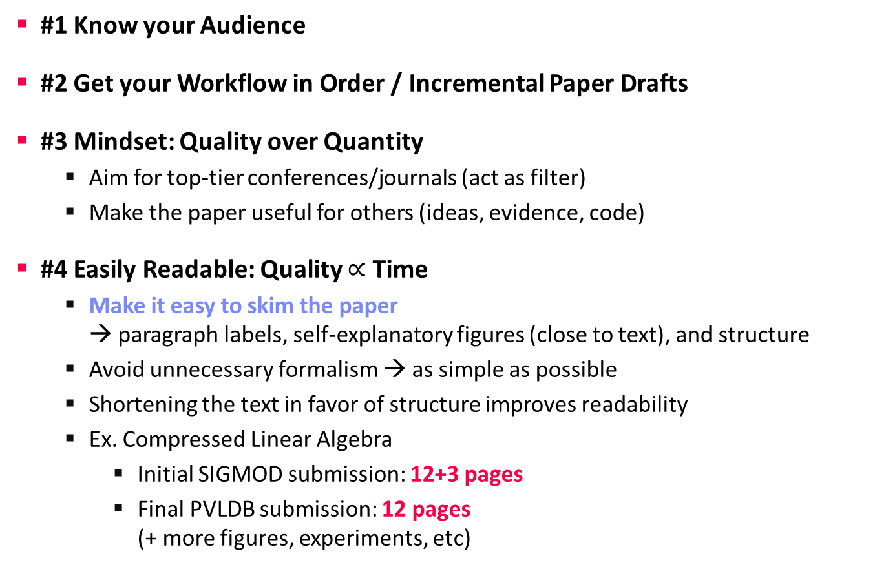
Recap: Writing the Paper
Scientific Writing
#1 Know your Audience
#2 Get your Workflow in Order / Incremental Paper Drafts
#3 Mindset: Quality over Quantity
  Aim for top-tier conferences/journals (act as filter)
  Make the paper useful for others (ideas, evidence, code)
#4 Easily Readable: Quality $∝$ Time
  Make it easy to skim the paper
  → paragraph labels, self-explanatory figures (close to text), and structure
  Avoid unnecessary formalism → as simple as possible
  Shortening the text in favor of structure improves readability
  Ex. Compressed Linear Algebra
    Initial SIGMOD submission: 12+3 pages
    Final PVLDB submission: 12 pages
    (+ more figures, experiments, etc)

Slide 16
Scope and Structure
Scientific Writing
Sections and Subsections
  Abstract (see 01 Structure of Scientific Papers)
  Introduction → context, problem, contributions
  Background / Preliminaries → necessary background for understanding
  Main Part → your technical core contributions
  Main Part 2
  Experiments → setting, micro benchmarks end-to-end
  Related Work → areas of related work, differences
  Conclusions → summary, conclusions, and future work
  References
Recommendations
  Avoid sections with only one subsection (e.g., 2 and 2.1)
  Avoid more than two or at most three nesting levels
  Clearly separate motivation/background from your own work

Slide 17
Scope and Structure, cont.
Scientific Writing
Bullet Lists
  begin{itemize} … \item \end{itemize}
  begin{enumerate} … \end{enumerate}
Figures and Tables
  Captions below figures, above tables
Code
  \begin{verbatim} … \end{verbatim}
Theorem, Definition, Examples
  Refine theorem environments as needed
Algorithms
  Can be clearer than text, but not always
  Carefully select the right level of abstraction

Slide 18
Formatting
Scientific Writing
Motivation
  A carelessly formatted paper (layout, figures, fonts,
  underlining) creates a bad first impression
  Recap: skimming and anchoring
Figures
  Use same font and font size as the main text / code in main paper
  Avoid text overlap, too aggressive colors
Orphans and Widows
  Imprecise definition
  Avoid few words per line,
  single line at next page
Highlighting
  Use \emph{} (emphasize) over underlining or bold
“The paper’s approach is probably equally sloppy”
Looks ugly and wastes
lots of space

Slide 19
Punctuation
Scientific Writing
Commas
  Whenever a pause is appropriate,
  or required to avoid ambiguity
  Lists: red, blue, black, and white (oxford/serial comma)
  Special sentence start: However, Hence, Therefore, In this paper,
Semicolons
  Divide a long sentence into sub-sentences, or separation for emphasis
  Lists with sublists
Exclamations
  Avoid exclamation marks! Never use more than one!!
When using disk[,] tree algorithms
were found to be particularly poor.
A woman without her man is nothing.
A woman: without her, man is nothing.
We use index structures like b-trees, tries, and hash tables; as well as compression techniques like run-length encoding, dictionary encoding, and null suppression.
Notes:
Note: US vs french spacing between sentences

Slide 20


Writing Style
Scientific Writing
Goal: Clear, easy-to-read writing
Variation
  Diversity (structure, length of sentences/paragraphs, choice of words, sentence beginning) helps keeping the reader’s attention
The system of rational numbers is incomplete. This was discovered 2000 years ago by the Greeks. The problem arises in squares with sides of unit length. The length of the diagonals of these squares is irrational. This discovery was a serious blow to the Greek mathematicians.
The Greeks discovered 2000 years ago that the system of rational numbers is incomplete. The problem is that some quantities, such as the length of the diagonal of a square with unit sides, are irrational. This discovery was a serious blow to the Greek mathematicians.

Slide 21
Writing Style, cont.
Scientific Writing
Prefer Active Voice
  Easier to understand, shorter, more interesting to read
  Use we over I
Prefer Present Tense
  Most content of a research paper can be described in present
  Exceptions: user studies, (specific experimental setup), related work
Use of References
  Use \cite{key1,key2}
  Don’t use refs as nouns
  Prefer primary sources
In this section, the background and motivation for compressed linear algebra is introduced.
In this section, we provide the background and motivation for compressed linear algebra.
Later, [40] investigated query processing on heavyweight Huffman coding schemes,
Later, Raman and Swart investigated query processing on heavyweight Huffman coding schemes [40],

Slide 22
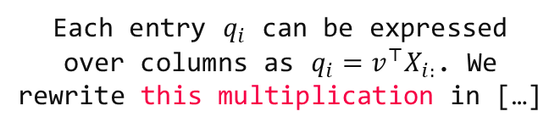
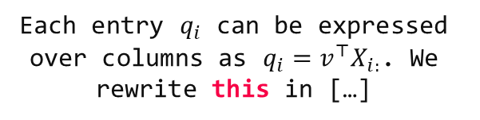
Writing Style, cont.
Scientific Writing
Articles and Spaces
  Plural allows to drop articles
  Use guarded spaces for references
  that should not appear on a new line
Clear References
  Make sure there are no unclear
  “it” or “this” references
  Add descriptive nouns
Titles and Names
  Titles: capitalize meaning-carrying words
  Names: capitalize, e.g., Bayesian, Euclidean
  References like Figure 1, Table 2, Section 3,
  Chapter 4, Equation 5 are names as well
employ general-purpose compression techniques
employ a general-purpose compression technique
Each entry $q_{i}$ can be expressed over columns as $q_{i}=v^{⊤}X_{i:}$. We rewrite this in […]
Each entry $q_{i}$ can be expressed
over columns as $q_{i}=v^{⊤}X_{i:}$. We rewrite this multiplication in […]
Figure~\ref{fig:exp1}
Equation~\eqref{eq:e1}

Slide 23

Plagiarism
Scientific Writing
#1 Self-Plagiarism (Bad Idea)
  Avoid reusing motivation, introduction, figures, and examples
  Start writing every thesis / paper from scratch
  (unless thesis summaries/extends previous papers)
#2 Figure Plagiarism (Bad Idea)
  Never copy figures from other papers, web, etc
  Create all figures yourself, even for surveys
  (can be based on ideas of existing papers)
  Exceptions do exist w/ explicit references
#3 Plagiarisms (Really Bad Idea)
  Never copy figures or text from other peoples work and claim its yours
  (slight rewording does not change that)
  For archival scientific publications, there is a high chance it will be detected

Slide 24
Plagiarism – Duplicate Submission
Scientific Writing
Example SIGMOD’21
A research paper submitted to SIGMOD 2021 cannot be under review for any other publishing forum or presentation venue, including conferences, workshops, and journals, during the time it is being considered for SIGMOD. Furthermore, after you submit a research paper to SIGMOD, you must await the response from SIGMOD and only re-submit elsewhere if your paper is rejected - or withdrawn at your request - from SIGMOD. This restriction applies not only to identical papers but also to papers with a substantial overlap in scientific content and results.
Every research paper submitted to SIGMOD 2021 must present substantial novel research not described in any prior publication. In this context, a prior publication is (a) a paper of five pages or more presented, or accepted for presentation, at a refereed conference or workshop with proceedings; or (b) an article published, or accepted for publication, in a refereed journal. If a SIGMOD 2021 submission has overlap with a prior publication, the submission must cite the prior publication, along with all other relevant published work, following the guidelines in the Anonymity Requirements for Double-Blind Reviewing section below.

Slide 25
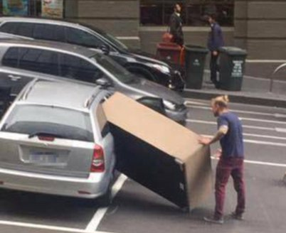
Page Limits
Scientific Writing
Most Conferences/Journals
  Given predefined template, changes not permitted
  SIGMOD/PVDLB: 12 pages + unlimited references
  ICDE: 12 pages incl. references
#1 Avoid Cheating
  Don’t change the template, fonts, or margins (at least not too excessively)
  Condensing more text into the paper will make it harder to read
#2 Carefully Trim Down Draft
  Write unlimited paper, then select, and revise
  Write and revise section by section as you write
#3 Never Excuse Missing Content
by “lack of space”
[Credit: https://twitter.com/
fadeladib/status/1322646406088347649]
[Eamonn Keogh: How to do good research, get it published in SIGKDD and get it cited!, KDD 2009]
Due to the lack of space, we omit
[essential details] /
[essential experiments]

Slide 26
Summary and Q&A
Scientific Reading
Scientific Writing
Remaining Questions?
Paper Project Selection by Nov 11
Next Lectures
  03 Experiments, Reproducibility, and Projects [Nov 11]

