Slide 1

Introduction to Scientific Writing
03 Experiments & Reproducibility
Last update: Nov 11, 2021

Slide 2

Announcements/Org
#1 Virtual Lectures
  https://tugraz.webex.com/meet/m.boehm
  Optional attendance (independent of COVID)
#2 Course Registrations (as of Nov 05)
  Changes in WS20/21, now max constraints
  Introduction to Scientific Writing
#3 Timeline
  Nov 11: project selection via email to m.boehm@tugraz.at (11.59pm)
  subject: [Scientific Writing] Project Selection
  Dec 23: paper submission via email to m.boehm@tugraz.at (11.59pm)
  Jan 13: Final project presentation (all students)
ISDS Group Boehm
39/40

Slide 3
Agenda
Experiments and Result Presentation
Reproducibility and RDM
Reminder: Paper Project Selection

Slide 4
Experiments and
Result Presentation
In Computer Science (Data Management)
[Ioana Manolescu, Stefan Manegold: Performance Evaluation in Database Research: Principles and Experiences, ICDE 2008]

Slide 5
Motivation
Experiments and Result Presentation
Worst Mistake: Schrödinger's Results
  Postpone implementation and experiments till last before the deadline
  No feedback, no reaction time (experiments require many iterations)
  Karl Popper: falsifiability of scientific results → refutable by evidence
Continuous Experiments
  Run experiments during survey / prototype building
  Systematic experiments ➔ observations and ideas for improvements
  Don’t be afraid of throw away prototypes that don’t work
Good Research Fires Itself
  Initial experiments give directions for further improvements
  Problem-oriented methodology

Slide 6
Types of Experiments
Experiments and Result Presentation
#1 Exploratory Experiments
  Tests for functional correctness
  Unstructured experiments for initial feedback → eval feasibility
#2 Micro Benchmarks
  Measure specific aspects in controlled and understandable scope
  Bottom-up approach
#3 Benchmarks
  Evaluate on community/own benchmarks
  Examples: TPC-C, TPC-H, TPC-DS, JOB, MLPerf
#4 End-to-end Applications
  Evaluate in larger scope of real datasets and query workloads
  Examples: Customer workload, ML pipelines (dataprep, training, eval)

Slide 7
From Idea to Experiments
Experiments and Result Presentation
[I. Manolescu, S/ Manegold: Performance Evaluation in Database Research: Principles and Experiences, ICDE 2008]
Overview
  Proper planning helps to keep you from “getting lost”
  Repeatable experiments simplify your own work
  There is no single way how to do it right
  There are many ways how to do it wrong
Basic Planning
  Which data / data sets should be used?
  Which workload / queries should be run?
  Which hardware & software should be used?
  Metrics: What to measure? How to measure?
  Comparison: How to compare? CSI: How to find out what is going on?

Slide 8
Dataset Selection
Experiments and Result Presentation
Synthetic Data
  Generate data with specific data characteristics
  Systematic evaluation w/ datasize, sparsity, etc
  Inappropriate for certain topics: compression, ML accuracy
“Real” Data Repositories
  Wide selection of available datasets w/ different characteristics
  UCI ML Repository: https://archive.ics.uci.edu/ml/index.php
  Florida Sparse Matrix Collection: https://sparse.tamu.edu/
  Google dataset search: https://datasetsearch.research.google.com/
  Common Datasets in ML: ImageNet, Mnist, CIFAR, KDD, Criteo
  Common Datasets in DM: Census, Taxi, Airlines, DBLP, benchmarks etc
Representative
of real data distributions?
Representative for variety of workloads / common case?

Slide 9
Benchmarks
Experiments and Result Presentation
Overview
  Community- and organization-driven creation of agreed benchmarks
  Benchmarks can define a field and foster innovation
#1 Data Management
  Query processing: 007,
  TPC-C, TPC-E, TPC-H, TPC-DS (w/ audit)
  Join ordering: JOB
#2 “Big Data”
  MR/Spark: BigBench, HiBench, SparkBench
  Array Databases: GenBase
#3 Machine Learning Systems
  SLAB, DAWNBench, MLPerf, MLBench, AutoML Bench, Meta Worlds, TPCx-AI
[Michael J. Carey, David J. DeWitt, Jeffrey F. Naughton: The oo7 Benchmark. SIGMOD 1993]
[http://www.tpc.org/tpch/]
(See AMLS course
for details)

Slide 10
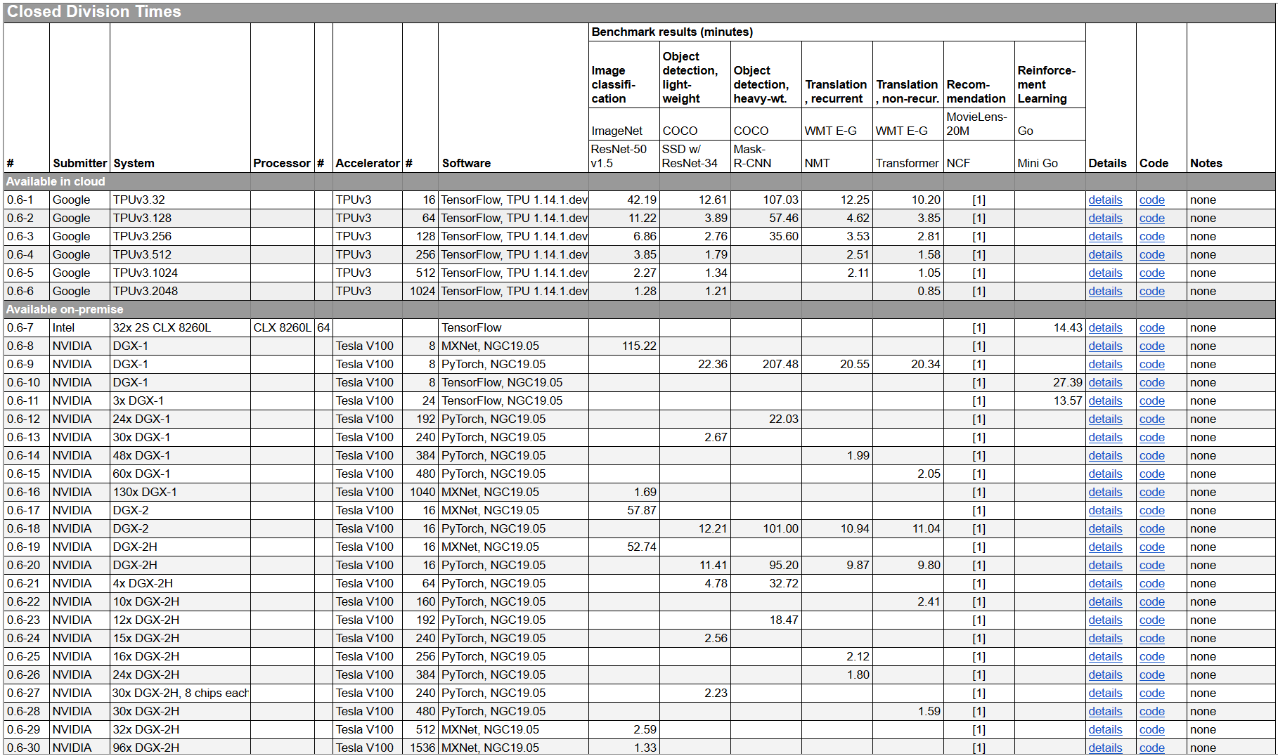
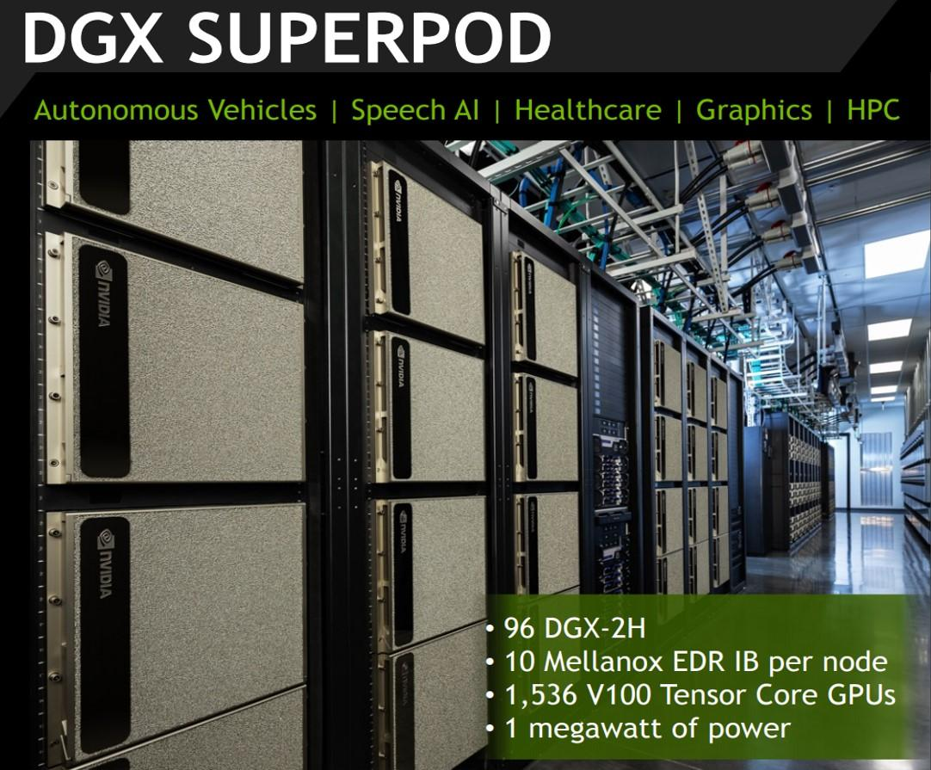
Benchmarks, cont.
Experiments and Result Presentation
[MLPerf v0.6:
https://mlperf.org/training-results-0-6/]
96 x DGX-2H = 96 * 16 = 1536 V100 GPUs
➔ ~ 96 * $400K = $35M – $40M
[https://www.forbes.com/sites/tiriasresearch/2019/06/19/nvidia-offers-a-turnkey-supercomputer-the-dgx-superpod/#693400f43ee5]
Notes:
Note: MLPerf 0.7 e.g., w/ 512 A100

Slide 11
Baselines
Experiments and Result Presentation
#1 Primary Baseline
  Existing algorithm or system infrastructure
  Main comparison point, usually with same runtime operations
  Beware: Avoid speedup-only results (need absolute numbers for grounding)
#2 Additional Baselines
  Alternative systems w/ different runtime and compiler
  Usually, not directly comparable but important for grounding
  E.g.,: for SystemDS → R, Julia, Spark, TensorFlow, PyTorch
Problem of Weak Baselines
  Authors want to show improvements
  Successive improvements over
  state-of-the-art don’t add up
[Timothy G. Armstrong, Alistair Moffat, William Webber, Justin Zobel: Improvements That Don't Add Up: Ad-Hoc Retrieval Results Since 1998. CIKM 2009]
[Maurizio Ferrari Dacrema, Paolo Cremonesi, Dietmar Jannach: Are We Really Making Much Progress? A Worrying Analysis of Recent Neural Recommendation Approaches. RecSys 2019]

Slide 12
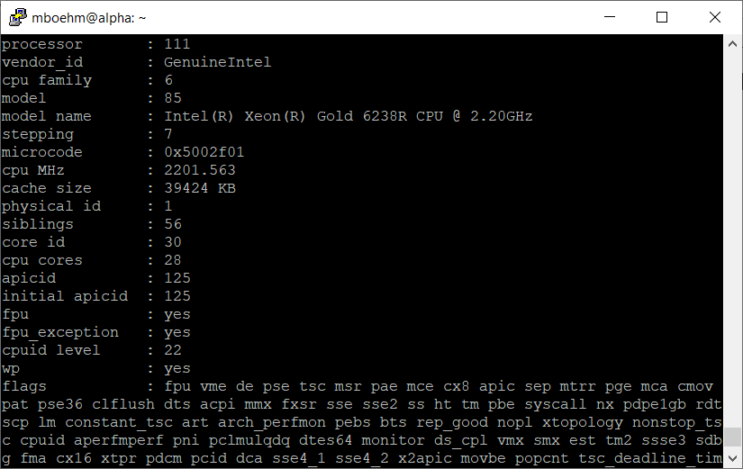
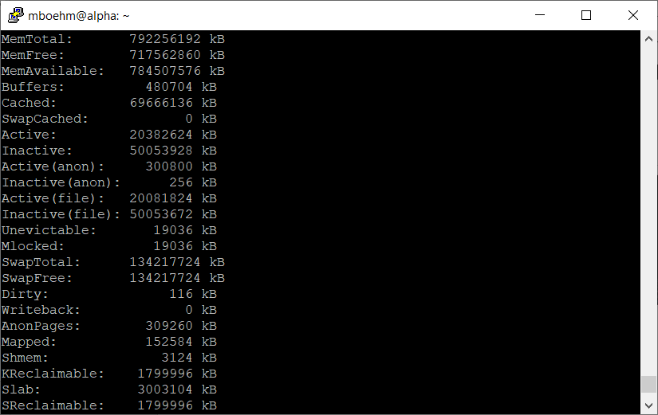
Presentation – Experimental Setting
Experiments and Result Presentation
Hardware Selection
  Multiple nodes for distributed computation
  Avoid too outdated HW (irrelevance)
Find Balanced Level of Detail
  Underspecified: “We ran all
  experiments on an Intel CPU”
  Over-specified:
  cat /proc/cpuinfo
  cat /proc/meminfo
Recommendation
  HW components: #nodes, CPUs, memory, network, I/O
  SW components: OS, programming language, versions, other software
  Baselines and configuration → Use recent versions of baseline systems
  Data and workloads w/ data sizes, parameters, configurations

Slide 13


Presentation – Figures
Experiments and Result Presentation
Axes
  Use Informative axes labels with units (e.g., Total Execution Time [ms])
  Don’t cheat or mislead readers and reviewers
  Start y-axis at 0 for linear scale
100
Yours
100
Yours
Runtime
90
Mine
Runtime [s]
Runtime [s]
50
80
Mine
Aha, so 12%
0
1
2
3
What are the units? Where are the tics?
This is a misleading y axis

Slide 14
Presentation – Figures, cont.
Experiments and Result Presentation
Fair Ranges of Parameters
  Evaluate common ranges of values
  Don’t hide important information
If there are multiple relevant parameters, show them all
For log-scale you can’t start at 0
Don’t limit range to make you look good
[J. Sommer, M. Boehm, A. V. Evfimievski,
B. Reinwald, P. J. Haas: MNC: Structure-Exploiting Sparsity Estimation for
Matrix Expressions. SIGMOD 2019]

Slide 15
Presentation – Figures, cont.
Experiments and Result Presentation
[I. Manolescu, S/ Manegold: Performance Evaluation in Database Research: Principles and Experiences, ICDE 2008]
Plots Types
  Barplot for categories
  Plot + Line/linepoints for
  continuous parameters
  Visible font sizes (similar to text)
Legends
  Order them by appearance
  Attach directly to graph
Human brain is a
poor join processor
Humans get frustrated

Slide 16
Presentation – Figures, cont.
Experiments and Result Presentation
Diversity & Consistency
  Diversity: if applicable use mix of different plot types and tables
  Consistency: use consistent colors and names for same baselines
Labeling
  Make the plots self-contained
  Simplifies skimming and avoids join with text
[Matthias Boehm et al: SystemDS: A Declarative Machine Learning System for the End-to-End Data Science Lifecycle. CIDR 2020]

Slide 17
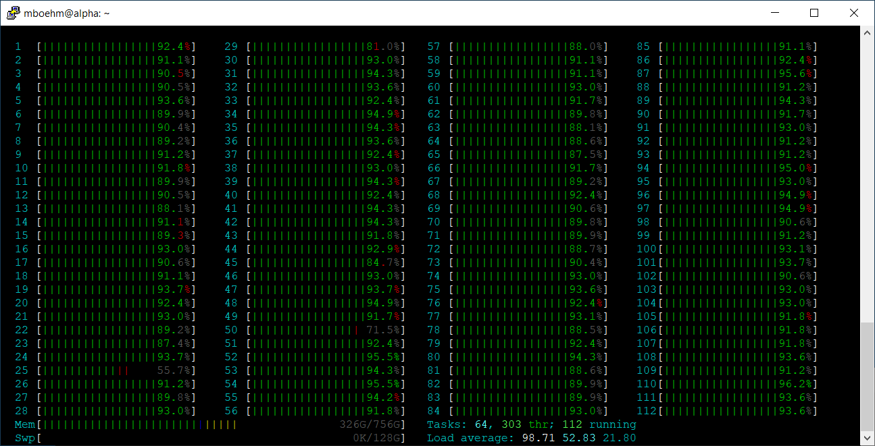
Presentation – Result Interpretation
Experiments and Result Presentation
Use the Right OS Tools
  System-specific tracing/statistics
  top / htop / iotop
  (looks CPU bound)
  perf -stat -d ./run.sh
  (no, it’s memory-bandwidth bound)
Performance counter stats for './run.sh':
12721364.53 msec task-clock # 83.640 CPUs utilized
463352 context-switches # 0.036 K/sec
5455536095415 instructions # 0.14 insn per cycle (62.50%)
335314473273 branches # 26.358 M/sec (62.50%)
1463380955 branch-misses # 0.44% of all branches (62.50%)
2185062643097 L1-dcache-loads # 171.763 M/sec (62.50%)
142845949268 L1-dcache-load-misses # 6.54% of all L1-dcache hits (62.50%)
3375555316 LLC-loads # 0.265 M/sec (50.00%)
1016330404 LLC-load-misses # 30.11% of all LL-cache hits (50.00%)
152.096000108 seconds time elapsed
12052.466691000 seconds user
674.704421000 seconds sys
Don’t just report the results but try
to understand and explain them

Slide 18
Presentation – Result Interpretation, cont.
Presentation – Result Interpretation
Use the Right PL Tools / Flags
  E.g., Understanding
  Java JIT compilation
  -XX:+PrintCompilation
  E.g., Understanding
  HW Cache Hierarchy (L1i 32KB)
  -XX:-DontCompileHugeMethods
[Matthias Boehm et al: On Optimizing Operator Fusion Plans for Large-Scale Machine Learning in SystemML. PVLDB 11(12) 2018]

Slide 19
Reproducibility and
RDM (Research Data Management)
In Computer Science (Data Management)

Slide 20
Research Data Management (RDM)
Reproducibility and RDM
Overview
  Ensure reproducibility of research results and conclusions
  Common problem: “All code and data was on the student’s laptop
  and the student left / the laptop crashed.”
  Create value for others (compare, reuse, understand, extend)
  EU Projects: Mandatory proposal section & deliverable on RDM plan
RDM @ TU Graz: https://www.tugraz.at/sites/rdm/home/
  Toni Ross-Hellauer → Ilire Hasani-Mavriqi / Sarah Stryeck (ISDS):
  Open and Reproducible Research Group (ORRG)
  TU Graz RDM Policy since 12/2019, towards faculty-specific RDM policies
“Ensure that research data, code and any other materials needed to reproduce research findings are appropriately documented, stored and shared in a research data repository in accordance with the FAIR principles (Findable, Accessible, Interoperable and Reusable) for at least 10 years from the end of the research project, unless there are valid reasons not to do so. [...]
Develop a written data management strategy for managing research outputs within the first 12 months of the PhD study as part of their supervision agreements.”

Slide 21

Excursus: FAIR Data Principles
Reproducibility and RDM
[https://www.go-fair.org/fair-principles/]
#1 Findable
  Metadata and data have globally unique persistent identifiers
  Data describes w/ rich meta data; registered/indexes and searchable
#2 Accessible
  Metadata and data retrievable via open, free and universal comm protocols
  Metadata accessible even when data no longer available
#3 Interoperable
  Metadata and data use a formal, accessible, and broadly applicable format
  Metadata and data use FAIR vocabularies and qualified references
#4 Reusable
  Metadata and data described with plurality of accurate and relevant attributes
  Clear license, associated with provenance,
  meets community standards

Slide 22
RDM in Practice – Example So2Sat LCZ42
Reproducibility and RDM
[Xiao Xiang Zhu et al: So2Sat LCZ42: A Benchmark Dataset for the Classification of Global Local Climate Zones. GRSM 2020]
Data and ML Pipelines
  ESA Sentinel-1/2 datasets → 4PB/year
  Training of local climate zone classifiers on
  So2Sat LCZ42 (15 experts, 400K instances,
  10 labels each, 85% confidence, ~55GB H5)
  ML pipeline: preprocessing, ResNet18,
  climate models
Label Creation/ Validation
  Team learning
  Labeling w/ checks
  Label validation
  Quantitative
  validation w/ 10
  expert votes on correctness
Notes:
Notes: Confusion matrices (values in %) of the original labels the final labels (refined by majority voting) vs. the votes cast bythe label validation crew for the polygons of the evaluation cities selected in Tables II and III: (a) original labels polygon-wise assessment, (b) original labels pixel-wise, (c) final labels polygon-wise, and (d) final labels pixel-wise
Unfortunately, not many European cities contain LCZ class 7 (light-weight low-rise), which mostly describes informal settlements (e.g., slums). Therefore, we included the polygons of class 7 for an additional 9 cities that are representative of the 9 major non-European geographical regions of the world

Slide 23
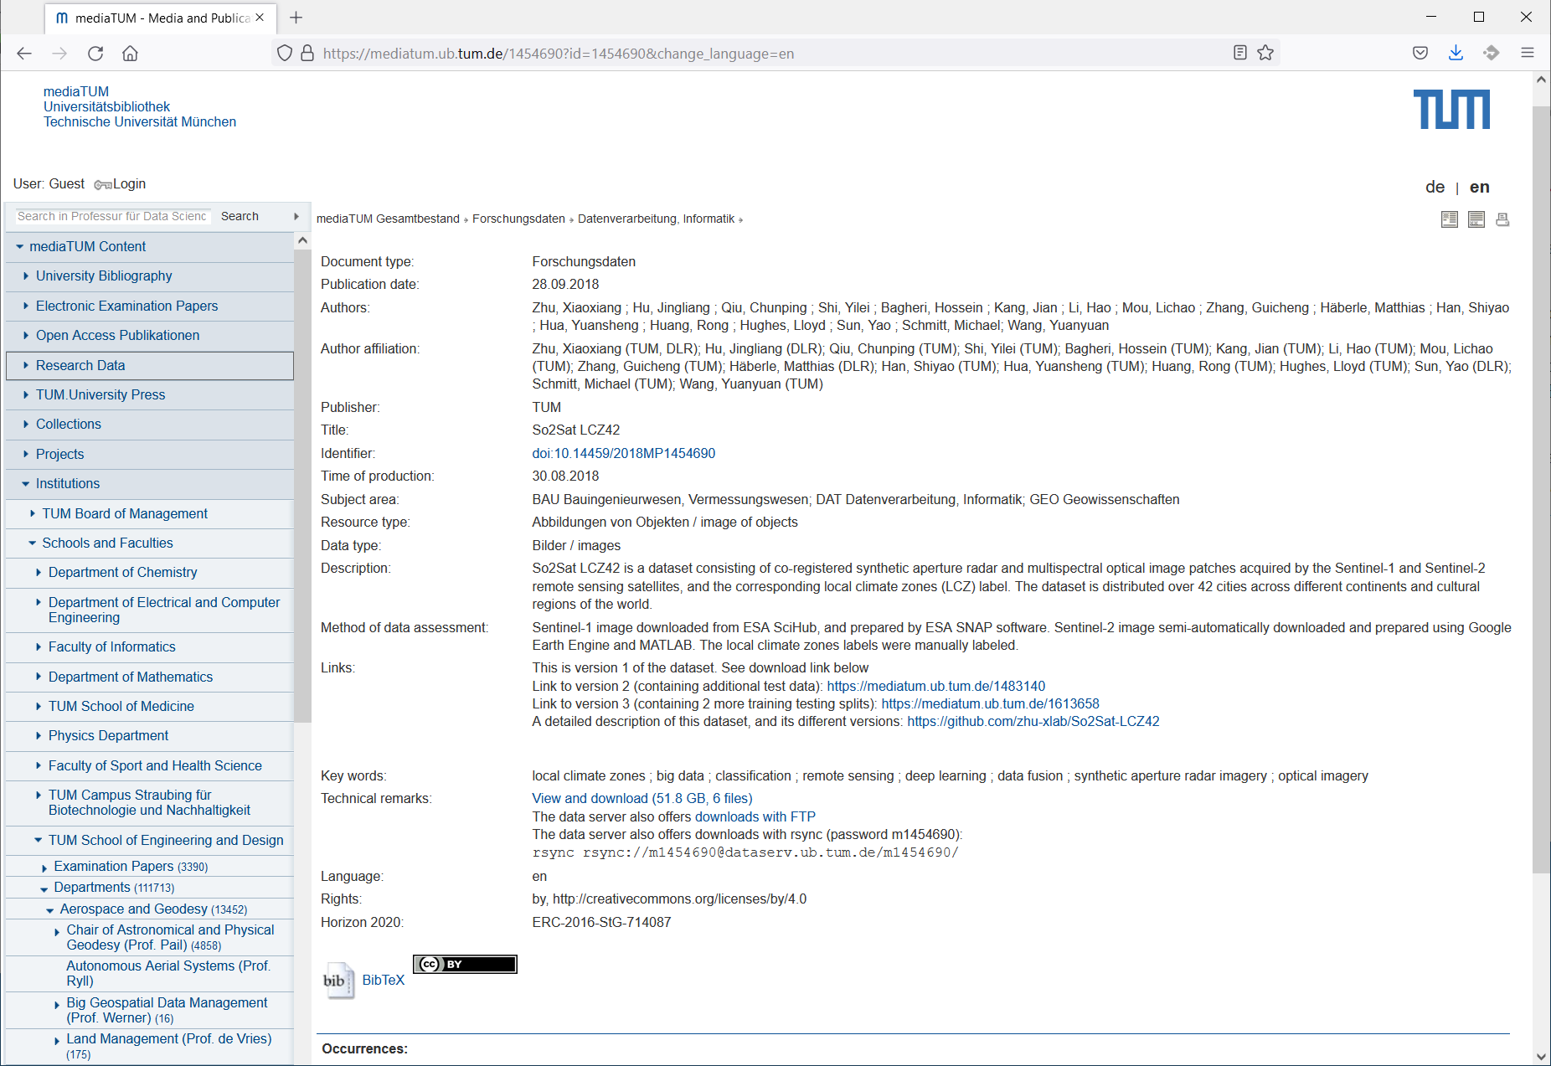
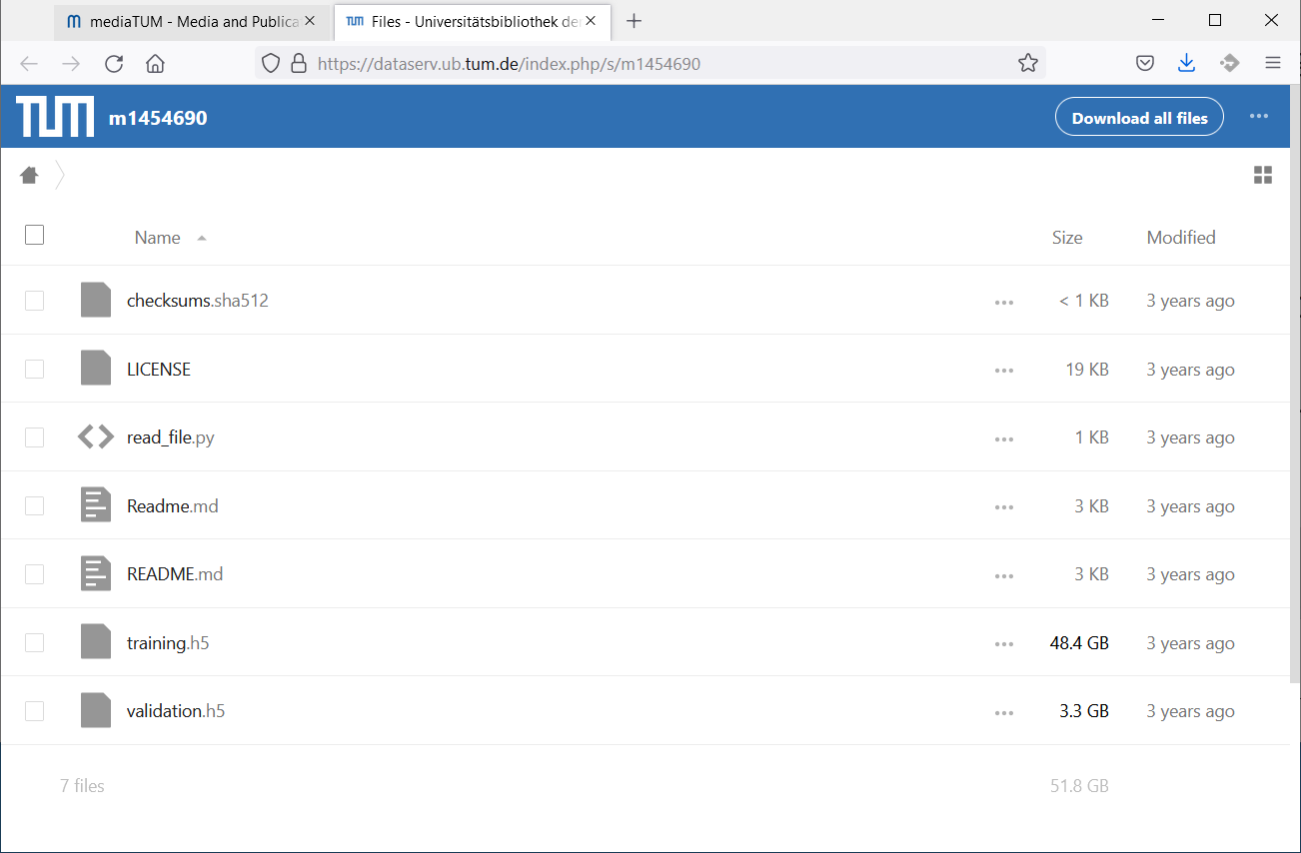
RDM in Practice – Example So2Sat LCZ42, cont.
Reproducibility and RDM
[So2Sat LC42 Dataset
https://mediatum.ub.tum.de/1454690]

Slide 24
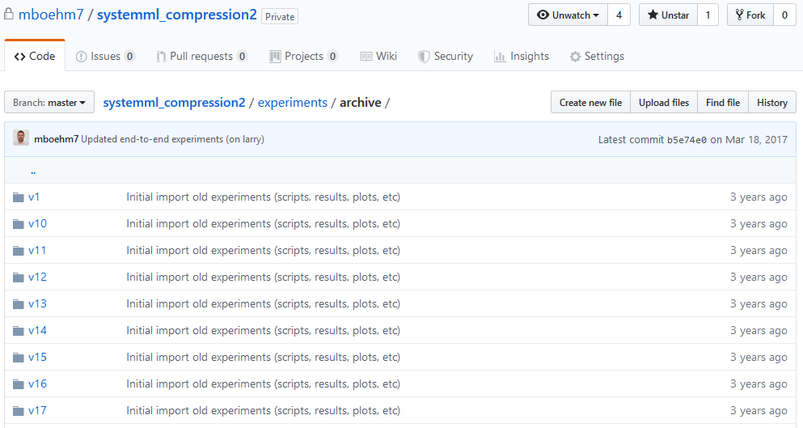
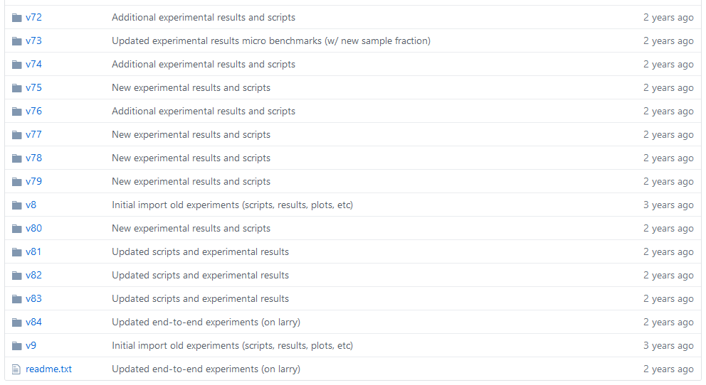
RDM in Practice @DAMSLab
Reproducibility and RDM
Code and Artifacts
  Apache SystemDS: https://github.com/apache/systemds (OSS)
    Complete code history, src/bin releases (SystemDS 2.2.0 in Oct 2021)
    DIA / AMLS programming projects in SystemDS
  Additional private github repos for student projects / prototypes
Central Paper Repository
  All paper submissions w/ latex sources, figures, reviews, rebuttals, etc
  All paper-related experiments
    Archive: append-only experimental results
    Plots: scripts and figures of plots
    Results: latest results used for the current plots
    Scripts: data preparation, baselines, benchmarks
    ➔ Automate your experiments as much as possible

Slide 25


SIGMOD Reproducibility Process
Reproducibility and RDM
Overview
  Accepted papers can submit package, verified by committee
  ACM Results Replicated / ACM Artifacts Available labels
  Most Reproducible Paper Award ($750, visibility)
#1 Replicability (aka Repeatability)
  Recreate result data and graphs shown in the final paper
  Expected: same trend of baseline comparisons, parameter influence
#2 Reproducibility
  Verify robustness of results wrt parameters and environments
  Examples: different data and workload characteristics, hardware

Slide 26
SIGMOD Reproducibility Process, cont.
Reproducibility and RDM
Ideal Reproducibility Submission
  “At a minimum the authors should provide a complete set of scripts to install the system, produce the data, run experiments and produce the resulting graphs along with a detailed Readme file that describes the process step by step so it can be easily reproduced by a reviewer.
  The ideal reproducibility submission consists of a master script that:
    installs all systems needed,
    generates or fetches all needed input data,
    reruns all experiments and generates all results,
    generates all graphs and plots, and finally,
    recompiles the sources of the paper
  ... to produce a new PDF for the paper that contains the new graphs. “
Note: It takes time, plan from start
  We prepared for SIGMOD 2019 Repro,
  but finally, not submitted (ran out of time)
[Credit:
db-reproducibility.
seas.harvard.edu/
#Guidelines]
[J. Sommer, M. Boehm, A. V. Evfimievski,
B. Reinwald, P. J. Haas: MNC: Structure-Exploiting Sparsity Estimation for
Matrix Expressions. SIGMOD 2019]

Slide 27
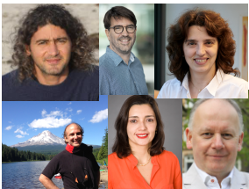
Excursus: SIGMOD Contributions Award 2020
Reproducibility and RDM
The SIGMOD 2020 Contributions Award recognizes the innovative work in the data management community to encourage scientific reproducibility of our publications. Reproducibility was introduced at the 2008 SIGMOD Conference and since then has influenced how the community approaches experimental evaluation.
Philippe Bonnet (ITU Copenhagen)
Stratos Idreos
(Harvard)
Ioana Manolescu
(Ecole Polytechnique)
Dennis Shasha
(NYU)
Stefan Manegold
(CWI Amsterdam)
Juliana Freire
(NYU)

Slide 28
Tools for Automation
Reproducibility and RDM
Motivation
  Tooling for running artifacts in a self-contained manner
  Metadata storage in semi-structured formats like JSON/XML
Examples
Name | Target | Link
CK | ML Systems | http://ctuning.org
CWL | Analysis Workflows | http://commonwl.org
Popper | Container Workflows | https://github.com/ systemslab/popper
ReproZip | General-purpose Bundles | http://reprozip.org
Sciunit | Self-contained Experiments Bundles | http://sciunit.run
Sumatra | Numerical Simulations | https://github.com/ open-research/sumatra

Slide 29
Reminder: Paper Projects
In Computer Science (Data Management)

Slide 30
Overview Paper Projects
Paper Project Selection
Alternative: LV combined with bachelor thesis
Team
  1-4 person teams (w/ clearly separated responsibilities)
Project
  Pick from a given list of papers / groups of papers
  #1 Write short summary paper (#pages = 2 * team-size,
  written in LaTeX, ACM acmart template, document-class sigconf, PDF)
  #2 Prepare and present talk on paper summary (7min + 3min Q&A)
Timeline
  Oct 28: List of projects proposals, feel free to bring your own,
  or ask for extended proposals (e.g., ML systems, distributed systems)
  Nov 11: project selection via email to m.boehm@tugraz.at (11.59pm)
  subject: [Scientific Writing] Project Selection
  Dec 23: paper submission via email to m.boehm@tugraz.at (11.59pm)
  Jan 13: Final project presentation (all students)
See 01 Structure of Scientific Papers for project list

Slide 31
Summary and Q&A
Experiments and Result Presentation
Reproducibility and RDM
Reminder: Paper Project Selection
Remaining Questions?

