Slide 1

Architecture of DB Systems
01 Introduction and Overview
Last update: Oct 18, 2023

Slide 2

Announcements/Org
#1 Lecture Format
  Introduction virtual, remaining lectures blocked Dec 04 - Dec 07
  Optional attendance
  Hybrid, in-person but live-streaming / video-recorded lectures
    HS i10 + Zoom: https://tu-berlin.zoom.us/j/9529634787?
    pwd=R1ZsN1M3SC9BOU1OcFdmem9zT202UT09
#2 Course Registration (as of Oct 12)
  Architecture of Database Systems (ADBS)
WS20/21: 73 (0)
WS21/22: 94 (0)
WS23/24: 101 (0)

Slide 3
Agenda
Data Management Group
Course Organization
Course Motivation and Goals
Course Outline and Projects
Excursus: DAPHNE Project

Slide 4
Data Management Group
https://damslab.github.io/

Slide 5





About Me
Data Management Group
Since 09/2022 TU Berlin, Germany
  University professor for Big Data Engineering (DAMS)
2018-2022 TU Graz, Austria
  BMK endowed chair for data management & RAM
  Data management for data science (DAMS),
  SystemDS & DAPHNE
2012-2018 IBM Research – Almaden, CA, USA
  Declarative large-scale machine learning
  Optimizer and runtime of Apache SystemML
2007-2011 PhD TU Dresden, Germany
  Cost-based optimization of integration flows
  Time series forecasting / indexing & query processing
DB group

Slide 6
Data Management Courses (at TU Graz)
Data Management Group
Architecture of
Database Systems
(ADBS, WS)
DB system internals
+ prog. project
Architecture of
ML Systems
(AMLS, SS)
ML system internals
Master
Data Integration and Large-Scale Analysis
(DIA, WS)
Distributed
Data Management
Bachelor
Intro to Scientific Writing (WS)
Data Management / Databases
(DM, SS+WS)
Data management from user/application perspective

Slide 7
Course Organization

Slide 8
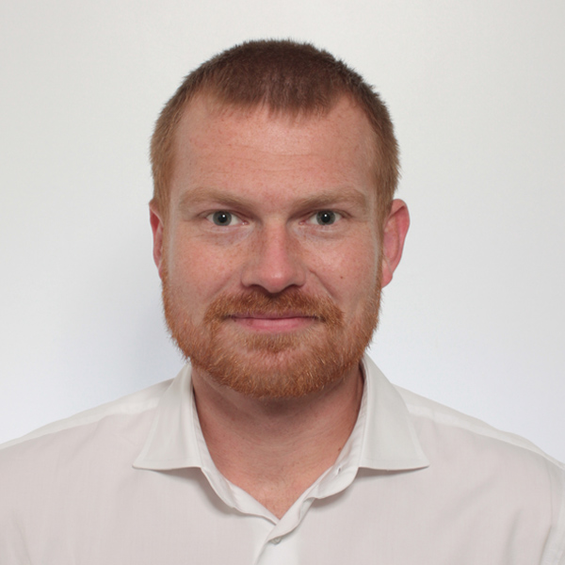
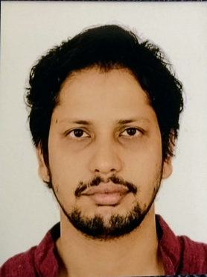
Basic Course Organization
Course Organization
Staff
  Lecturer: Prof. Dr. Matthias Boehm (TU Berlin)
  Assistants: M.Tech. Arnab Phani (TU Berlin)
Language
  Lectures and slides: English
  Communication and examination: English/German
Course Format
  VU 2/1, 5 ECTS (2x 1.5 ECTS + 1x 2 ECTS), bachelor/master
  Lectures (Wed 6pm kickoff + blocked, including Q&A), attendance optional
  Mandatory programming project (~2 ECTS)
  Recommended papers for additional reading on your own
Prerequisites
  Preferred: course Data Management / Databases is very good start
  Sufficient: basic understanding of SQL / RA (or willingness to fill gaps)
  Basic programming skills in low-level language (C, C++)

Slide 9
Course Logistics
Course Organization
Website
  https://mboehm7.github.io/teaching/ws2324_adbs/index.htm
  All course material (lecture slides) and dates
Live-Streaming / Video Recording (on website)
Communication
  Informal language (first name is fine)
  Please, immediate feedback (unclear content, missing background)
  Newsgroup: N/A – email is fine, summarized in following lectures
  Office hours: by appointment or after lecture
Exam
  Completed programming project (checked by me/staff)
  Final written exam (oral exam if <=35 students take the exam)
  Grading (30% project/exercises completion, 70% exam)

Slide 10
Course Logistics, cont.
Course Organization
Course Applicability
  Master programs computer science (CS), as well as
  software engineering and management (SEM)
    Catalog Data Science (elective course in major/minor)
    Catalog Software Technology (elective course in major/minor)
  Free subject course in any other study program or university

Slide 11
Course Motivation and Goals

Slide 12

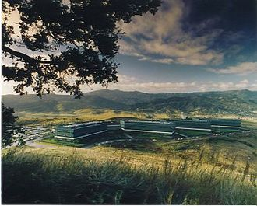
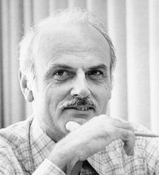
History 1970/80s
(relational)
Course Motivation and Goals
SQL Standard
(SQL-86)
Oracle, IBM DB2, Informix, Sybase → MS SQL
SEQUEL
QUEL
System R @ IBM Research – Almaden
(Jim Gray et al.,
Turing Award ‘98)
Ingres @ UC Berkeley (Stonebraker et al.,
Turing Award ‘14)
Tuple Calculus
Relational Algebra
Relational Model
Edgar F. “Ted” Codd @ IBM
Research (Turing Award ‘81)
Goal: Data Independence
(physical data independence)
  Ordering Dependence
  Indexing Dependence
  Access Path Dependence
[E. F. Codd: A Relational Model of Data for Large Shared Data Banks.
Comm. ACM 13(6), 1970]

Slide 13
Success of SQL / Relational Model
Course Motivation and Goals
Query:
SELECT O_OID, sum(L_Price)
FROM Orders, Lineitem, Customer
WHERE O_OID = L_OID AND O_CID = C_CID
AND O_Odate >= ‘2018-11-14’
AND C_Msegment = ‘AUTOMOBILE’
GROUP BY O_OID
#1 Declarative: what not how
#2 Flexibility:
closure property → composability
Logical Query Plans
C(P)=2.2G
Physical Query Plan
C(P)=1.32M
C(P)=0.34M
#4 Physical Data
Independence
Γ
Hash
GrpJoin
sum(Price)
Γ
Γ
0.001
σ
>=2018-11-14
Hash
Join
⋈
⋈
0.2
σ
TScan L
AUTOMOBILE
⋈
L
⋈
σ
⋈
IXScan
O
σ
σ
σ
σ
L
C
10K
⋈
C
Date
TScan C
O
C
O
O
1G
L
#3 Automatic Optimization
100M
Notes:
Cost model: cout (sum of cardinalities of all intermediates)

Slide 14

DBMS Architecture
Course Motivation and Goals
[Theo Härder, Erhard Rahm: Datenbanksysteme: Konzepte und Techniken der Implementierung, 2001]
Coarse-grained System Architecture
Metadata Management
Data System
Transaction Management
Access System
Storage System

Slide 15
DBMS Architecture, cont.
Course Motivation and Goals
[Theo Härder, Erhard Rahm: Datenbanksysteme: Konzepte und Techniken der Implementierung, 2001]
Q_{i}
Set-Oriented Interface
SELECT * FROM R
Data
System
Data System (Nonprocedural access)
Record-Oriented Interface
FIND NEXT record
(Data) Access System
(Navigational access)
Internal Record Interface
B-Tree
getNext
Access
System
(Record) Storage System
(Access path mgmt)
ACCESS
page j
System buffer Interface
Storage
System
Buffer Management
(Propagation control)
File Interface
READ
block k
Operating System
(File Mgmt)
Device Interface

Slide 16
Course Goals
Course Motivation and Goals
New Workloads
Constantly Changing Environment
  New application and data analysis workloads
  Heterogeneous and changing hardware characteristics
#1 Architecture and internals of traditional/modern DB systems
#2 Understanding of DB characteristics → better evaluation / usage
#3 Understanding of effective techniques → build/extend DB systems (these fundamental techniques are broadly applicable in other systems)
DBMS
New HW/Env

Slide 17
Course Outline and Projects

Slide 18
Course Outline
Course Outline and Projects
A: System Architecture and Data Access
01 Introduction and Overview [Oct 18, 6pm]
02 DB System Architectures [Dec 04, 9.30am]
03 Data Layouts and Bufferpool Management [Dec 04, 12.30pm]
04 Index Structures and Partitioning [Dec 04, 3pm]
05 Compression Techniques [Dec 04, 5.30pm]
B: Query Processing and Optimization
06 Query Processing (operators, execution models) [Dec 05, 9am]
07 Query Compilation and Parallelization [Dec 05, 11.30pm]
08 Query Optimization (rewrites, costs, join ordering) [Dec 05, 2.30pm]
09 Adaptive Query Processing [Dec 07, 9am]

Slide 19
Course Outline, cont.
Course Outline and Projects
C: Emerging Topics
10 Cloud Database Systems [Dec 07, 12.30pm]
11 Modern Concurrency Control [Dec 07, 3pm]
12 Modern Storage and HW Accelerators [Dec 07, 5.30pm]

Slide 20
Overview Programming Project
Course Outline and Projects
Team
  1-3 person teams (w/ clearly separated responsibilities)
Task: Efficient Group-by Aggregation
  Column-oriented frame storage w/ materialized intermediates
  Multi-threaded group-by aggregation w/ multiple group-by columns,
  additive aggregation functions, different data types / characteristics
  C test / performance suites → correct and minimum perf
  Programming language: no restrictions, but C or C++ recommended
Timeline
  Test drivers, reference implementation available on website
  Jan 21, 11.59pm: Final programming project deadline (submission via email)
Price Top-1 Submission (and min perf target)
  1x Attendance SIGMOD’25 in Berlin (travel, hotel, conf registration)
Notes:
Note previous semester: transactional in-memory index, get/set/scan/insert/delete, order-preserving
Note DM: physical operators for correctness not performance

Slide 21
Overview Programming Project, cont.
Course Outline and Projects
Recap: Classification of Aggregates (DM, DIA)
  Additive, semi-additive, additively-computable, others
#1 Sort Group-By
  Similar to sort-merge join
  (Sort, GroupAggregate)
  Sorted group output
#2 Hash Group-By
  Similar to hash join (HashAggregate)
  Higher temporary memory consumption
  Unsorted group output
  #1 w/ tuple grouping
  #2 w/ direct aggregation (e.g., count)
  Beware: cache-unfriendly if many groups (size(H) > L2/L3 cache)
  γ_{A,count(*)}(R)
sort
O(N log N)
X X X X X X Y Y Y Y Y Y Y Z Z Z Z Z
aggregate O(N)
X,6
Y,7
Z,5
build & agg
O(N)
 | H_{A,Agg}
Y
X
Z
γ_{A,count(*)}
R
Notes:
Note: quantile/median requires sort per partition -> sort group-by
Postgres: GroupAggregate, HashAggregate

Slide 22
Overview Programming Project, cont.
Course Outline and Projects
API Sketch
  Materialized inputs, outputs
  Multiple group by attributes
  Multiple aggregated attributes
  Aggregation functions: sum/min/max
Data Characteristics
  Frames w/ column-oriented storage
  Data Types: INT16, INT32, INT64
  Varying # distinct values,
  skew, missing values
Performance Target
  Relative to [naïve] reference implementation
  Perf target: score >= # physical-cores / 2
  γ_{sum(C)}(R)
  γ_{A,sum(C)}(R)
  γ_{A,B,sum(C)}(R)
  γ_{A,B,sum(C),sum(D)}(R)
i32
i16
i64
i64
A
B
C
D
getNumRows()
getNumCols()
getRow(size_t r)
getCol(size_t c)

Slide 23
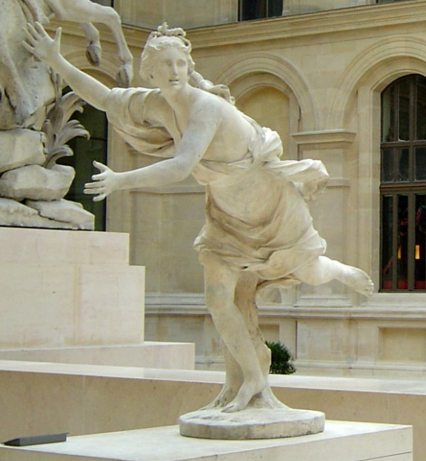

DAPHNE:
Integrated Data Analysis Pipelines for
Large-Scale DM, HPC, and ML
Motivation, Vision, and System Architecture
https://daphne-eu.github.io/
[Louvre, Paris]
Notes:
#1 Acronym
#2 DAPHNE: Greek mythology - daughter of the river god Peneus, associated with fountains, wells, springs, streams; Apollo -> large industry interest

Slide 24
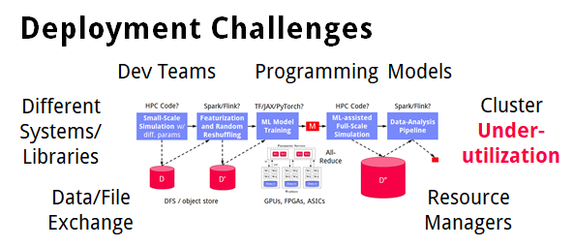
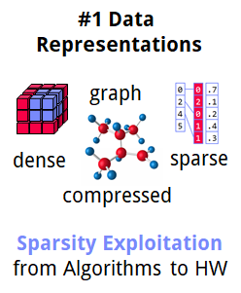
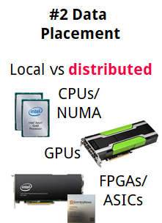
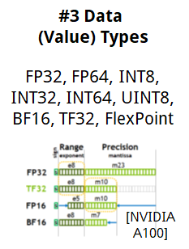
Motivation
➔ DAPHNE Overall Objective:
Open and extensible system infrastructure
DAPHNE Project
Integrated Data Analysis Pipelines
  Open data formats, query processing
  Data preprocessing and cleaning
  ML model training and scoring
  HPC, custom codes, and simulations
Hardware Challenges
  DM+ML+HPC share compilation
  and runtime techniques /
  converging cluster hardware
  End of Dennard scaling:
  P = α CFV² (power density 1)
  End of Moore’s law
  Amdahl’s law: sp = 1/s
  ➔ Increasing Specialization

Slide 25



DAPHNE Use Cases
DAPHNE Project
[Xiao Xiang Zhu et al: So2Sat LCZ42: A Benchmark Dataset for the Classification of Global Local Climate Zones. GRSM 2020]
DLR Earth Observation
  ESA Sentinel-1/2 datasets → 4PB/year
  Training of local climate zone classifiers on
  So2Sat LCZ42 (15 experts, 400K instances,
  10 labels each, 85% confidence, ~55GB H5)
  ML pipeline: preprocessing, ResNet18,
  climate models
IFAT Semiconductor Ion Beam Tuning
KAI Semiconductor Material Degradation
AVL Vehicle Dev Process (ejector geometries, KPIs)
ML-assisted simulations, data cleaning, augmentation
[So2Sat LC42 Dataset
https://mediatum.ub.tum.de/1454690]

Slide 26
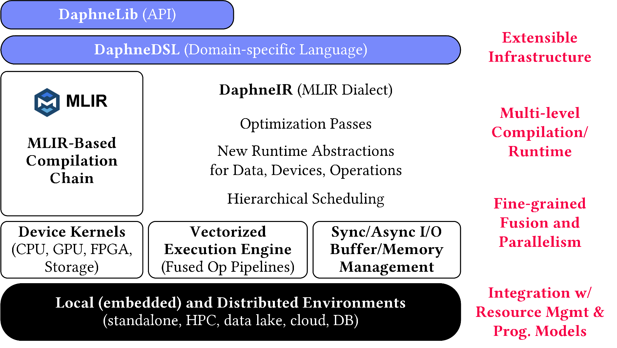
DAPHNE System Architecture
DAPHNE Project
[Patrick Damme et al.: DAPHNE: An Open and Extensible System Infrastructure for Integrated Data Analysis Pipelines, CIDR 2022]
[CIDR 2022]
MLIR Dialects, Extension Catalog
(new dtypes, kernels,
scheduling algs)
LLVM
Notes:
#1
#2 Sideways Access

Slide 27
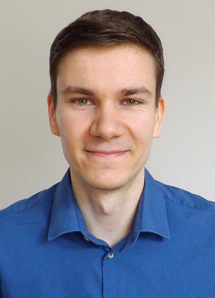


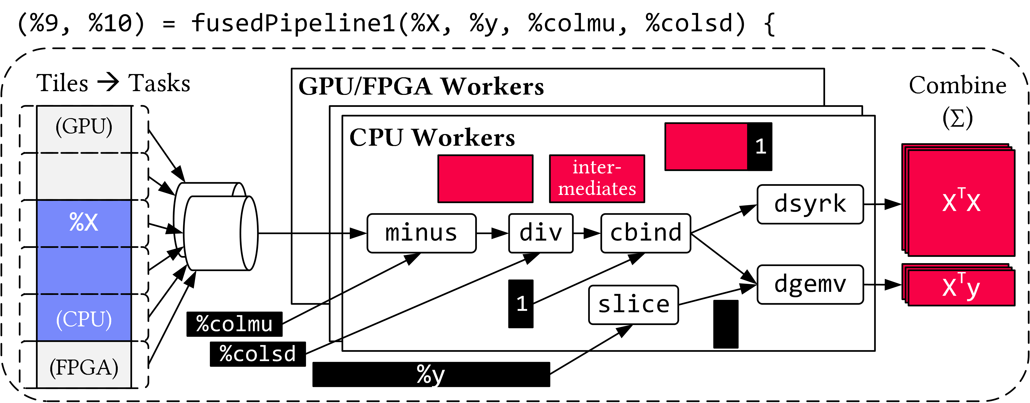
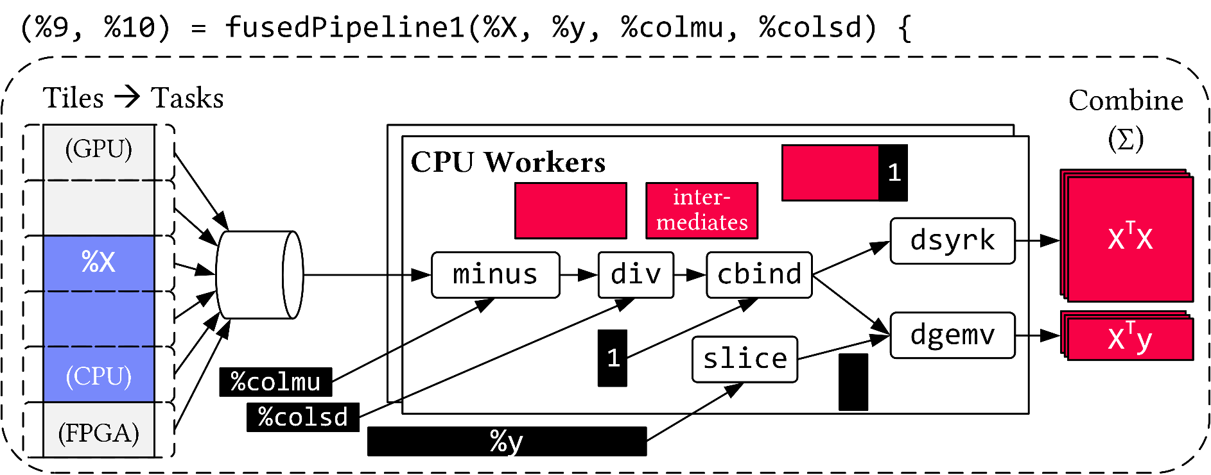
Vectorized (Tiled) Execution
DAPHNE Project
AH
AK
Default Parallelization
Frame & Matrix Ops
Locality-aware,
Multi-device Scheduling
Fused Operator Pipelines
on Tiles/Scalars + Codegen
[PVLDB 2018]

Slide 28

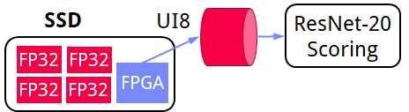
Vectorized (Tiled) Execution, cont.
DAPHNE Project
#1 Zero-copy Input Slicing
  Create view on sliced input (no-op)
  All kernels work on views
#2 Sparse Intermediates
  Reuse dense/sparse kernels
  Sparse pipeline intermediates for free
#3 Fine-grained Control
  Task sizes (dequeue, data access) vs data binding (cache-conscious ops)
  Scheduling for load balance (e.g., sparse operations)
#4 Computational Storage
  Task queues connect eBPF programs,
  async I/O into buffers, and op pipelines
Notes:
eBPF … Extended Berkeley Packet Filter

Slide 29

Distributed Vectorized Execution
DAPHNE Project
Federated matrices/frames + distribution primitives
Hierarchical vectorized pipelines and scheduling
Coordinator
(spawns fused pipeline)
Node 1
#1 Prepare Inputs
(X)
X
[1:
100M]
y
#2 Coarse-grained
Tasks Scheduling
y
X^{T}X
colmu
#3 Combine
Outputs
y
colsd
Node 2
X^{T}y
X
[100M:
200M]

Slide 30
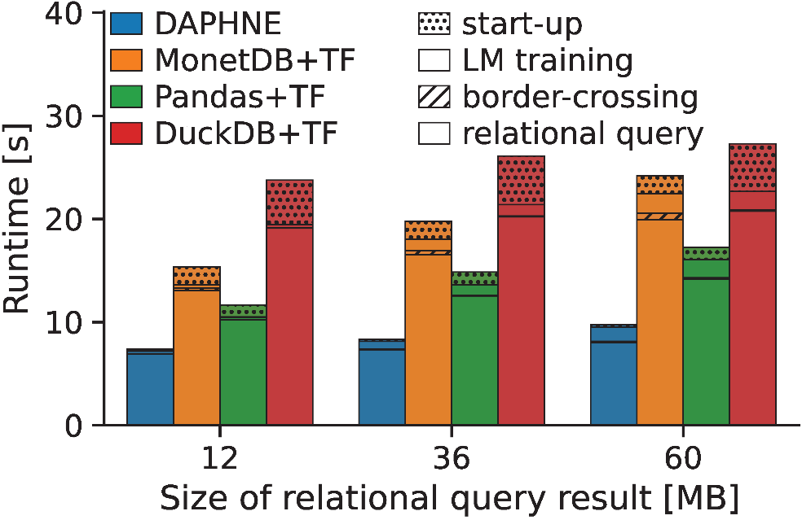
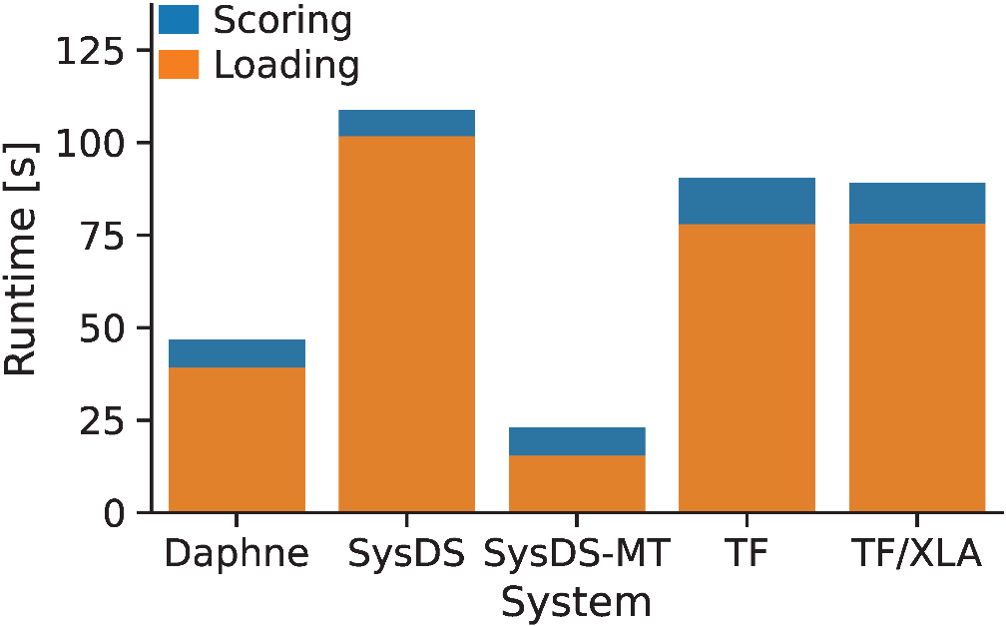
DAPHNE – Experiments (simple IDA pipelines)
DAPHNE Project
Setup: Single node w/ 2x Intel Xeon Gold 6238 (112 vcores, 7.7 TFLOP/s),
768 GB DDR4 RAM, 12x 2TB SSDs (data), NVIDIA T4 GPU (8.1 TFLOP/s, 16 GB), and Intel FPGA PAC D5005 (w/ Stratix 10SX FPGA, 32 GB) since Dec 29
P1: TPC-H SF10 csv, query processing
+ linear regression training on CPUs
P2: So2Sat LCZ42 csv (testset),
ResNet-20 scoring on GPU

Slide 31
Summary and Q&A
Course Goals
  #1 Architecture and internals of traditional/modern DB systems
  #2 Understanding of DB characteristics → better evaluation / usage
  #3 Understanding of effective techniques → build/extend DB systems
  (these fundamental techniques are broadly applicable in other systems)
Programming Project
  Column-oriented frame storage w/ materialized intermediates
  Multi-threaded group-by aggregation w/ multiple group-by columns,
  additive aggregation functions, different data types / characteristics
Next Lectures
  02 DB System Architectures [Dec 04]
  03 Data Layouts and Bufferpool Management [Dec 04]
  04 Index Structures and Partitioning [Dec 04]
  05 Compression Techniques [Dec 04]

