Slide 1

Data Integration and Large-scale Analysis (DIA)
06 Data Cleaning and Data Fusion
Prof. Dr. Matthias Boehm
Technische Universität Berlin
Berlin Institute for the Foundations of Learning and Data
Big Data Engineering (DAMS Lab)
Last update: Nov 17, 2023

Slide 2

Announcements / Administrative Items
#1 Video Recording
  Hybrid lectures: in-person H 0107, zoom live streaming, video recording
  https://tu-berlin.zoom.us/j/9529634787?pwd=R1ZsN1M3SC9BOU1OcFdmem9zT202UT09
#2 Lectures
  Dec 07: no lecture because blocked ADBS course Dec 04 - Dec 07 at TU Graz
  Moved lecture 08 Cloud Fundamentals to Dec 14 and 09 Cloud Scheduling to Dec 21
Example Exams
  https://mboehm7.github.io/teaching/ws2122_dia/ExamDIA_v1.pdf
  https://mboehm7.github.io/teaching/ws2122_dia/ExamDIA_v2.pdf
  https://mboehm7.github.io/teaching/ws2021_dia/ExamDIA_v1.pdf
  https://mboehm7.github.io/teaching/ws2021_dia/ExamDIA_v2.pdf

Slide 3
Agenda
Motivation and Terminology
Data Cleaning and Fusion
Missing Value Imputation

Slide 4
Motivation and Terminology

Slide 5
Recap: Corrupted/Inconsistent Data
Heterogeneity of Data Sources
  Update anomalies on denormalized data / eventual consistency
  Changes of app/preprocessing over time (US vs us) → inconsistencies
Human Error
  Errors in semi-manual data collection, laziness (see default values), bias
  Errors in data labeling (especially if large-scale: crowd workers / users)
Measurement/Processing Errors
  Unreliable HW/SW and measurement equipment (e.g., batteries)
  Harsh environments (temperature, movement) → aging
No Global Keys
Uniqueness & duplicates
Contradictions & wrong values
Missing Values
[Credit: Felix Naumann]
Ref. Integrity
ID | Name | BDay | Age | Sex | Phone | Zip
3 | Smith, Jane | 05/06/1975 | 44 | F | 999-9999 | 98120
3 | John Smith | 38/12/1963 | 55 | M | 867-4511 | 11111
7 | Jane Smith | 05/06/1975 | 24 | F | 567-3211 | 98120
Zip | City
98120 | San Jose
90001 | Lost Angeles
Typos

Slide 6
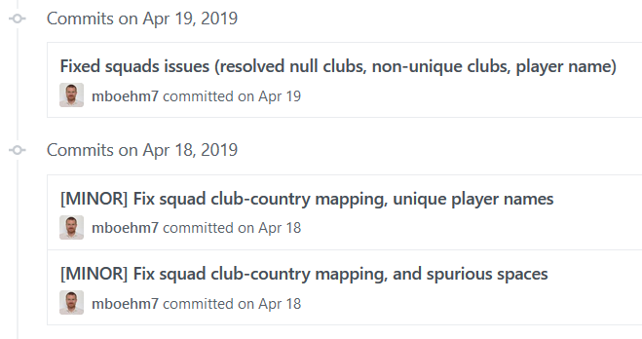
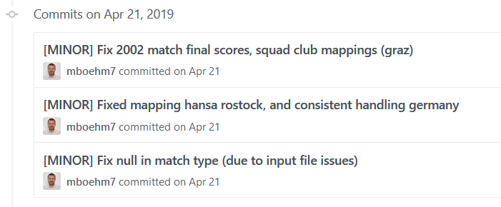
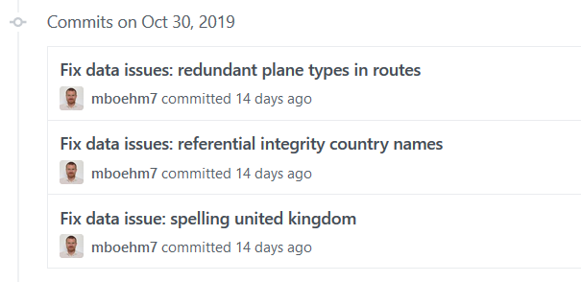





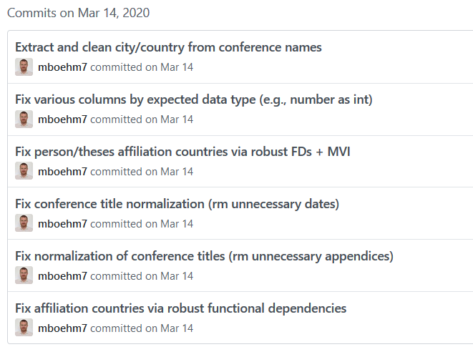
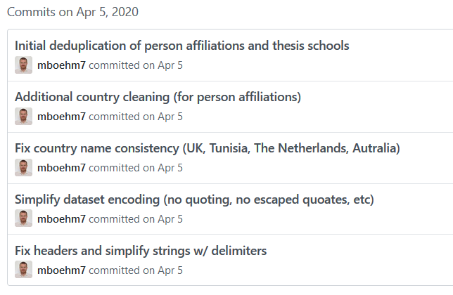
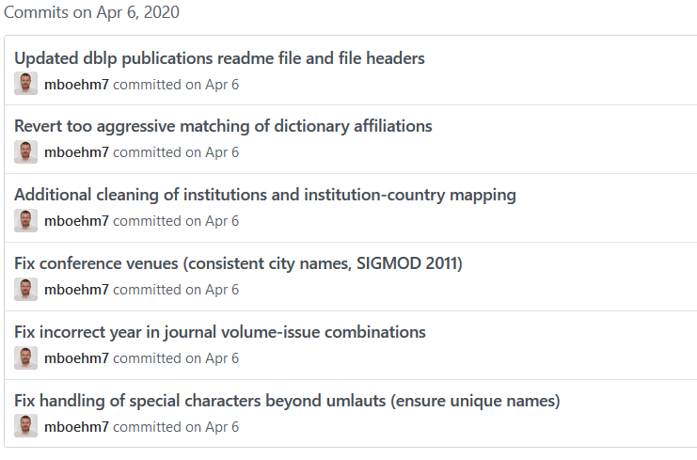
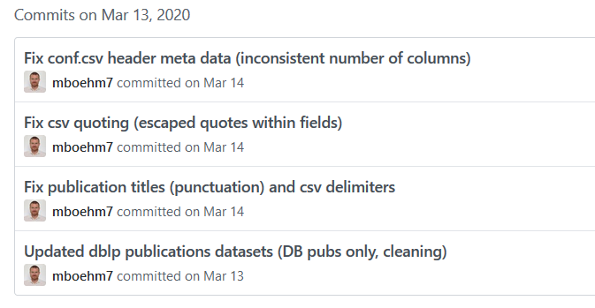
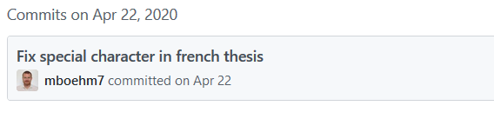
Examples (aka errors are everywhere)
DM SS’19
(Soccer World Cups)
DM WS’19/20
(Airports and Airlines)
DM SS’20
(DBLP Publications)
☺

Slide 7
Terminology
#1 Data Cleaning (aka Data Cleansing)
  Detection and repair of data errors
  Outliers/anomalies: values or objects that do not match normal behavior
  (different goals: data cleaning vs finding interesting patterns)
  Data Fusion: resolution of inconsistencies and errors (e.g., entity resolution see Lecture 05)
#2 Missing Value Imputation
  Fill missing info with “best guess”
  Difference between NAs and 0 (or special values like NaN) for ML models
#3 Data Wrangling
  Automatic cleaning unrealistic? → Interactive data transformations
  Recommended transforms + user selection

Slide 8
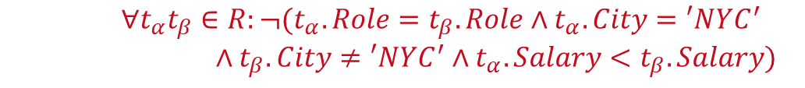
Express Expectations as Validity Constraints
Route
(Airline, From, To)
Planes
(Semi-)Automatic Approach: Expectations!
  PK → Values must be unique and defined (not null)
  Exact PK-FK → Inclusion dependencies
  Noisy PK-FK → Robust inclusion dependencies |R[X]∈S[Y]| / |R[X]| > δ
  Semantics of attributes → value ranges / # distinct values
  Invariant to capitalization → duplicates that differ in capitalization
  Patterns → regular expressions
Formal Constraints
  Functional dependencies (FD), conditional FDs (CFD), metric dependencies
  Inclusion dependencies, matching dependencies
  Denial constraints
Outlier Terminology
  Outlier Detection: detect and remove unwanted data points
  Anomaly Detection: detect and extract rare/unusual/interesting events
Age=9999?
2019-11-15 vs Nov 15, 2019
$$∀t_{α}t_{β}∈R:¬(t_{α}.Role=t_{β}.Role∧t_{α}.City=′NYC^{′}$$
$∧t_{β}.City≠′NYC^{′}∧t_{α}.Salary<t_{β}.Salary)$

Slide 9
Data Cleaning and Fusion

Slide 10
Data Validation
[Neoklis Polyzotis, Sudip Roy, Steven Euijong Whang, Martin Zinkevich: Data Management Challenges in Production Machine Learning. Tutorial, SIGMOD 2017]
Validity checks on expected shape
before training first model
Check a feature’s min, max, and most common value
  Ex: Latitude values must be within the range [-90, 90] or [-π/2, π/2]
The histograms of continuous or categorical values are as expected
  Ex: There are similar numbers of positive and negative labels
Whether a feature is present in enough examples
  Ex: Country code must be in at least 70% of the examples
Whether a feature has the right number of values (i.e., cardinality)
  Ex: There cannot be more than one age of a person
(Google Research)

Slide 11
Data Validation, cont.
[Sebastian Schelter, Dustin Lange, Philipp Schmidt, Meltem Celikel, Felix Bießmann, Andreas Grafberger: Automating Large-Scale Data Quality Verification. PVLDB 2018]
Constraints
and Metrics
for quality
check UDFs
Approach
  #1 Quality checks on basic metrics, computed in Apache Spark
  #2 Incremental maintenance of metrics and quality checks
(Amazon Research)
Organizational Lesson: benefit of shared vocabulary/procedures
Technical Lesson: fast/scalable; reduce manual and ad-hoc analysis

Slide 12
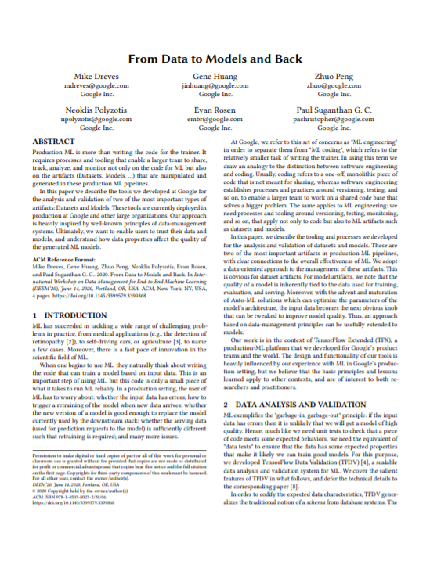
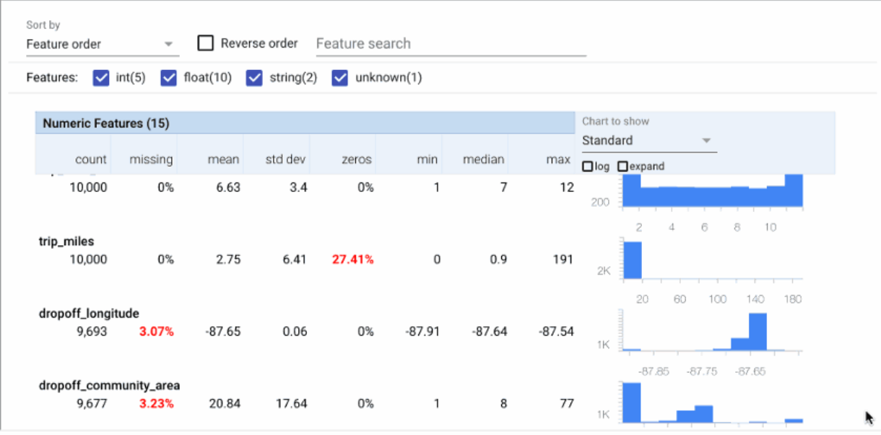

Data Validation, cont.
TensorFlow Data Validation (TFDV)
  Library or TFX components
  Stats, schema extraction, validation checks, anomaly detection
[Mike Dreves; Gene Huang; Zhuo Peng; Neoklis Polyzotis; Evan Rosen; Paul Suganthan: From Data to Models and Back. DEEM 2020]
[Eric Breck, Neoklis Polyzotis, Sudip Roy, Steven Whang, Martin Zinkevich: Data Validation for Machine Learning. MLSys 2019]
[Emily Caveness et al: TensorFlow Data Validation: Data Analysis and Validation in Continuous ML Pipelines. SIGMOD 2020]
(Google)

Slide 13

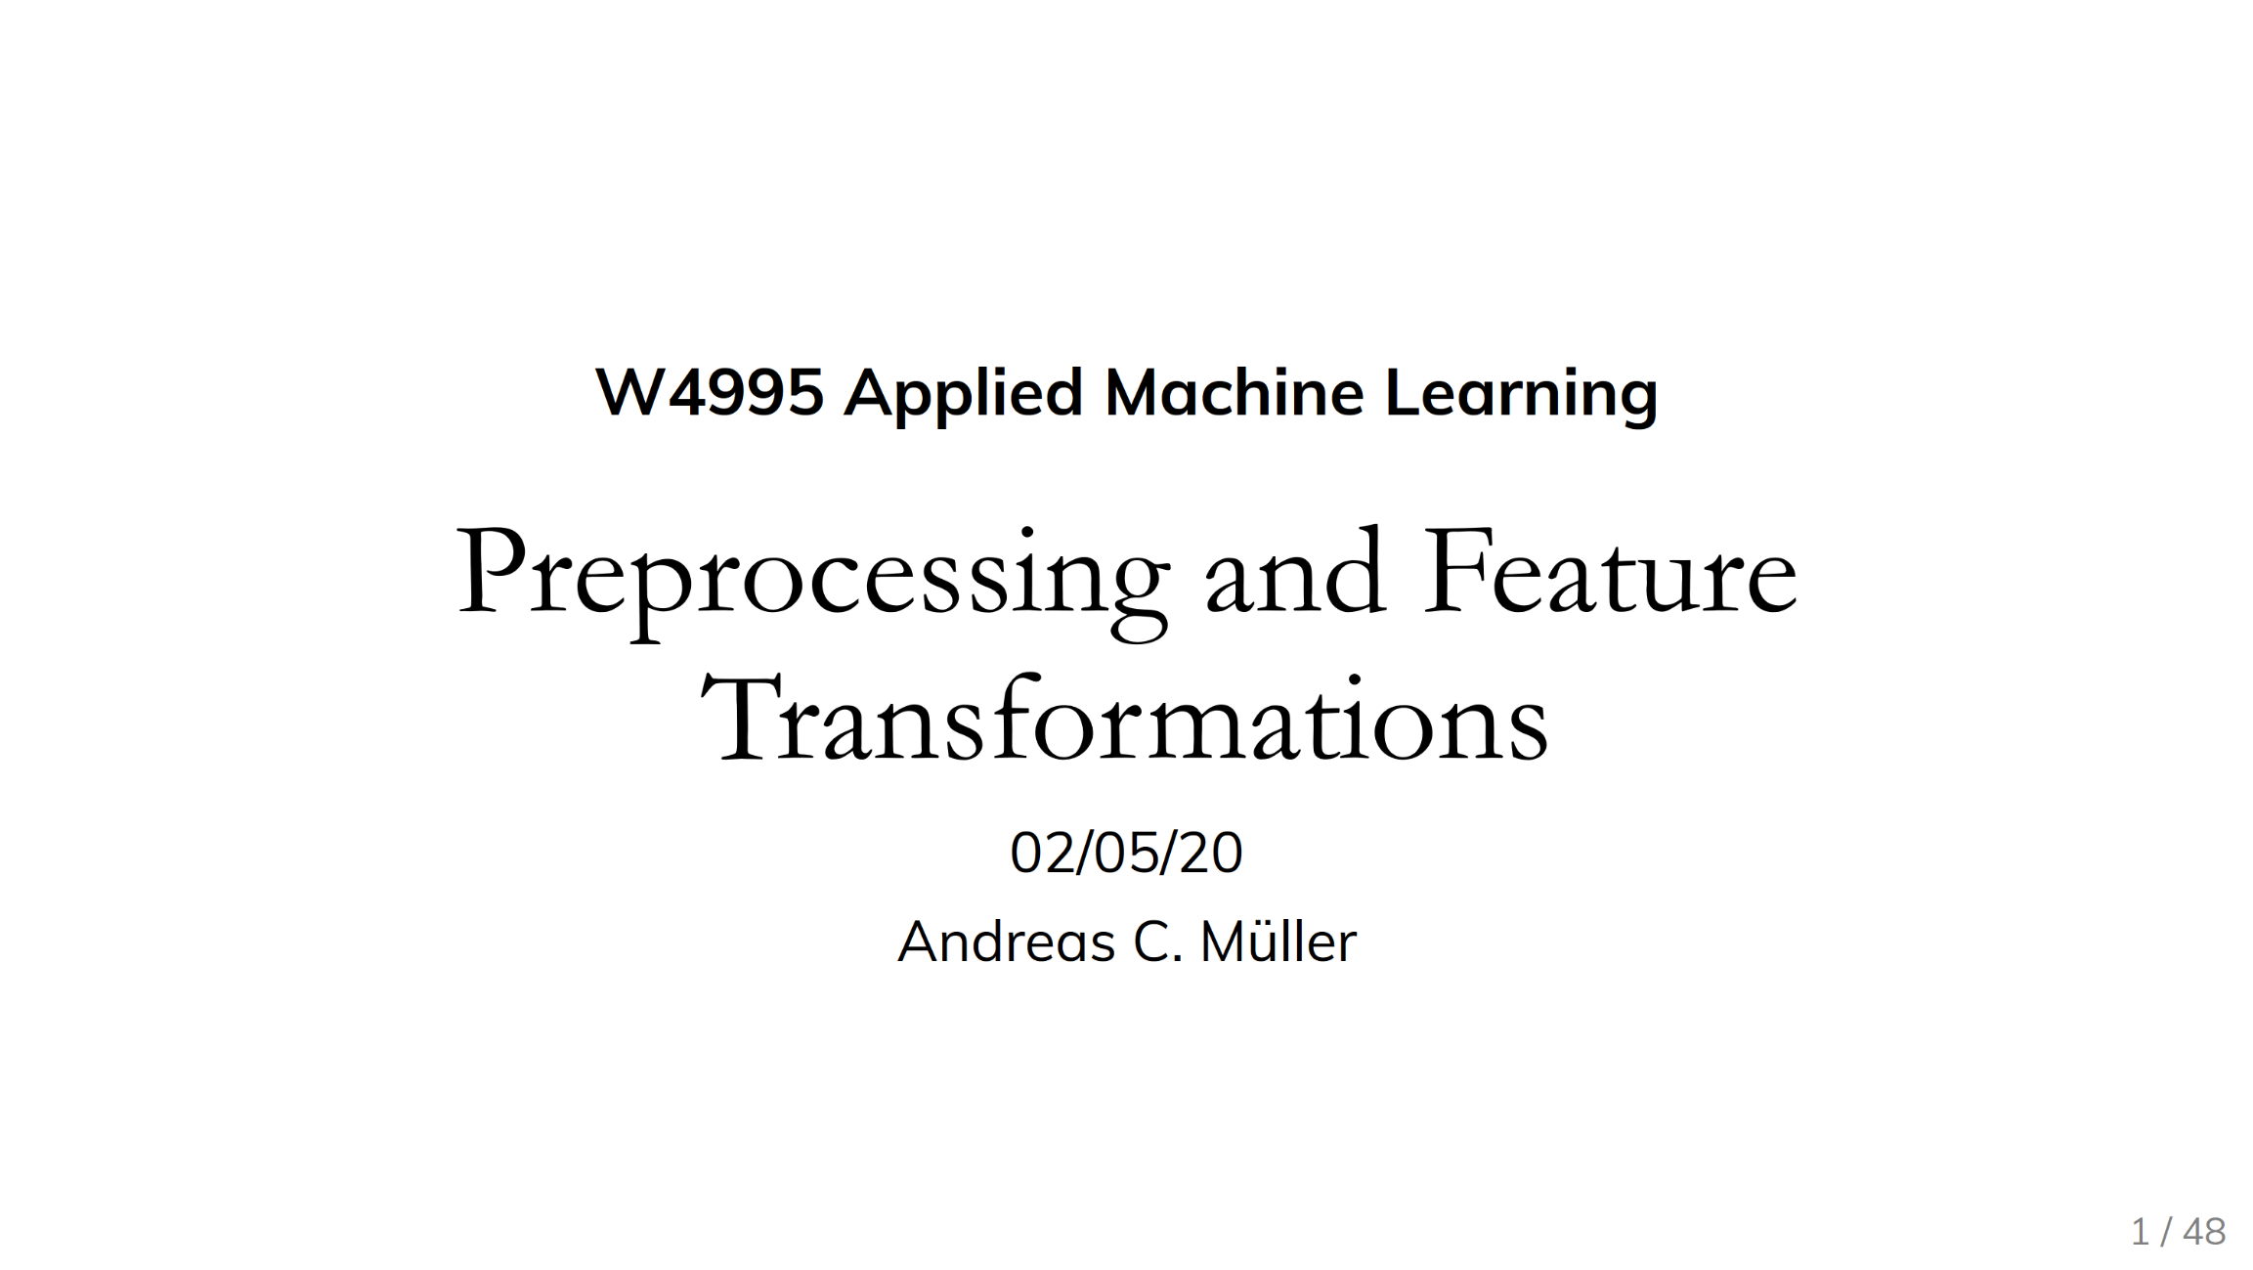
Standardization/Normalization
X = X – colMeans(X);
X = X / sqrt(colVars(X));
#1 Standardization
  Centering and scaling to mean 0 and variance 1
  Ensures well-behaved training
  (and distance computation)
  Densifying operation / NaNs
  Batch normalization in DNN: standardization of activations
#2 (Min-Max) Normalization
  Rescale values into common range [0,1]
  Avoid bias to large-scale features
  Does not handle outliers
X = replace(X, pattern=NaN,
replacement=0); #robustness
X = (X – colMins(X))
/ (colMaxs(X) – colMins(X));
Recommended Reading
[Andreas C. Mueller: Preprocessing and Feature Transformations, Applied ML Lecture 2020, https://www.youtube.com/watch?v=XpOBSaktb6s]

Slide 14
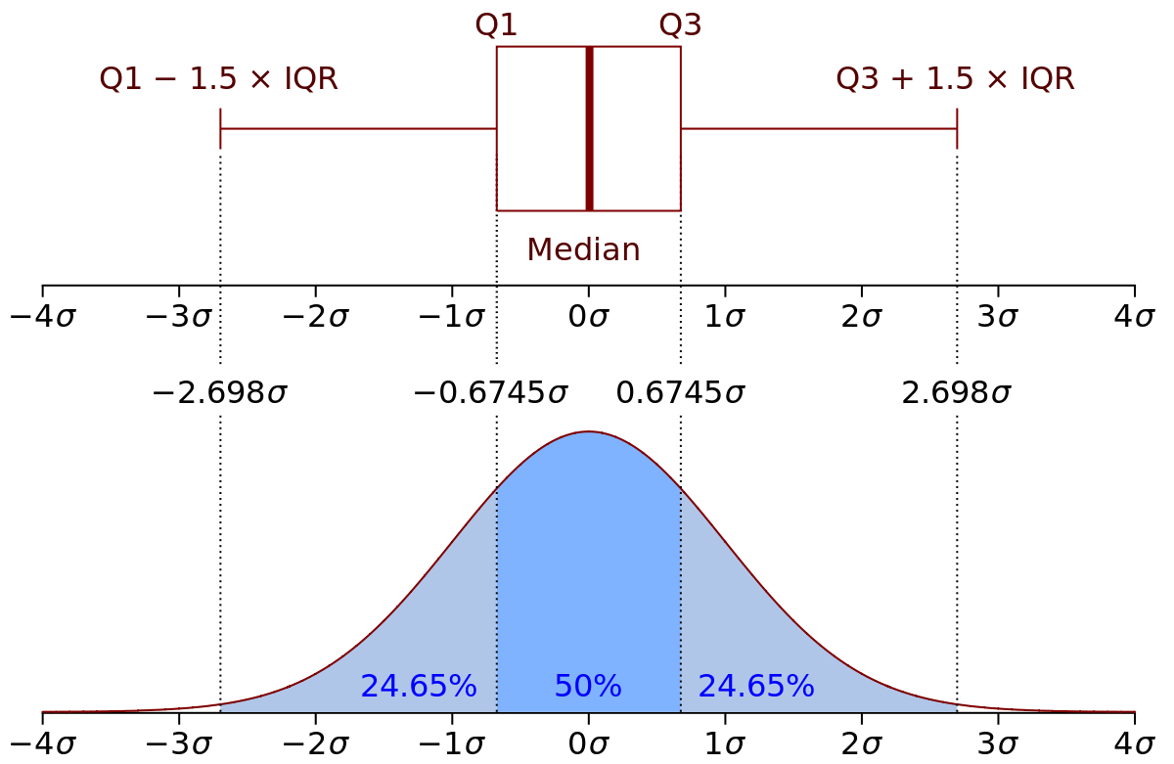

Winsorizing and Trimming
Recap: Quantiles
  Quantile Q_{p} w/ $p∈(0,1)$ defined as $P\left[X≤x\right]=p$
Winsorizing
  Replace tails of data distribution at
  user-specified threshold
  Quantiles / std-dev ➔ Reduce skew
Truncation/Trimming
  Remove tails of data distribution
  at user-specified threshold
Largest Difference from Mean
[Credit:
https://en.wikipedia.org]
# compute quantiles for lower and upper
ql = quantile(X, 0.05);
qu = quantile(X, 0.95);
# replace values outside [ql,qu] w/ ql and qu
Y = min(qu, max(ql, X));
# remove values outside [ql,qu]
I = X < qu | X > ql;
Y = removeEmpty(X, “rows”, select = I);
SystemDS: winsorize() outlier()
outlierByIQR()
outlierBySd()
# determine largest diff from mean
I = (colMaxs(X)-colMeans(X))
> (colMeans(X)-colMins(X));
Y = ifelse(xor(I,op), colMaxs(X), colMins(X));
Notes:
Box and whisker plots
SystemDS: quantiles via sort+pick, quickselect possible
Iterative winsoring/trimming to X std-devs of mean also possible

Slide 15
Winsorizing and Trimming, cont.
Q1
median
Q3
SystemDS outlierByIQR
  less than Q1 – ( k×IQR ) or greater than
  Q3 + ( k×IQR ) → outlier
SystemDS outlierBySd
  less than mean – ( k×stdev ) or greater than
  mean + ( k×stdev ) → outlier
Methods for Handling Outliers
  Replace outliers with default values (constants or mean/median/mode)
  Update outliers as missing values
  Data clipping
Q1 – 1.5 * IQR
IQR
Q3 + 1.5 * IQR
Outlier
-3σ
-2σ
-1σ
µ
1σ
2σ
3σ

Slide 16
Outliers and Outlier Detection
Types of Outliers
  Point outliers: single data points far from the data distribution
  Contextual outliers: noise or other systematic anomalies in data
  Sequence (contextual) outliers: sequence of values w/ abnormal shape/agg
  Univariate vs multivariate analysis
  Beware of underlying assumptions (distributions)
Types of Outlier Detection
  Type 1 Unsupervised: No prior knowledge
  of data, similar to unsupervised clustering
  → expectations: distance, # errors
  Type 2 Supervised: Labeled normal and abnormal
  data, similar to supervised classification
  Type 3 Normal Model: Represent normal behavior,
  similar to pattern recognition → expectations: rules/constraints
[Varun Chandola, Arindam Banerjee, Vipin Kumar: Anomaly detection: A survey. ACM Comput. Surv. 2009]
[Victoria J. Hodge, Jim Austin: A Survey of Outlier Detection Methodologies. Artif. Intell. Rev. 2004]

Slide 17
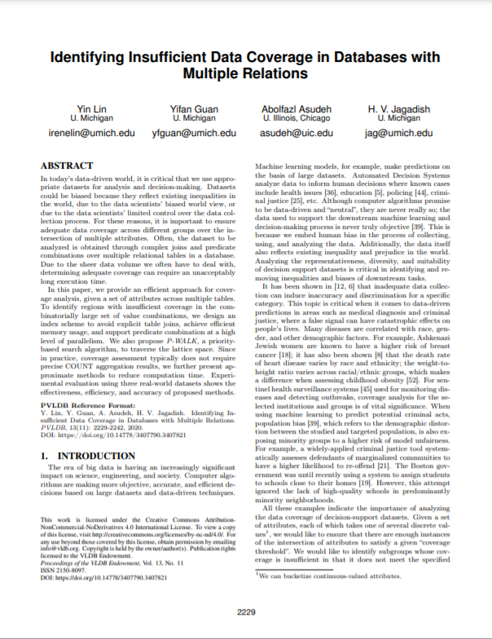
Outlier Detection Techniques
Classification
  Learn a classifier using labeled data
  Binary: normal / abnormal
  Multi-class: k normal / abnormal (one against the rest) → none=abnormal
  Examples: AutoEncoders, Bayesian Networks, SVM, decision trees
K-Nearest Neighbors
  Anomaly score: distance to kth nearest neighbor
  Compare distance to threshold + (optional) max number of outliers
Clustering
  Clustering of data points, anomalies are points not assigned / too far away
  Examples: DBSCAN (density), K-means (partitioning)
Frequent Itemset Mining
  Rare itemset mining / sequence mining
  Examples: Apriori/Eclat/FP-Growth
[Varun Chandola, Arindam Banerjee, Vipin Kumar: Anomaly detection: A survey. ACM Comput. Surv. 2009]
[Yin Lin et al: Identifying Insufficient Data Coverage in Databases with multiple Relations. PVLDB 2020]

Slide 18
Time Series Anomaly Detection
Basic Problem Formulation
  Given regular (equi-distant) time series of measurements
  Detect anomalous subsequences s of length l (fixed/variable)
Anomaly Detection
  #1 Supervised: Classification problem
  #2 Unsupervised: k-Nearest Neighbors
  (discords) → All-pairs
  similarity join
[Matrix Profile XIV, SoCC’19]
[Chin-Chia Michael Yeh et al: Matrix Profile I: All Pairs Similarity Joins for Time Series: A Unifying View That Includes Motifs, Discords and Shapelets. ICDM 2016]

Slide 19
Automatic Data Repairs
Overview Repairs
  Question: Repair data, rules/constraints, or both? Piece-meal vs holistic data repairs?
  General principle: “minimality of repairs”
Example Data Repair
  Functional dependency A→ B
  Violation for A=1
[Xu Chu, Ihab F. Ilyas: Qualitative Data Cleaning. Tutorial, PVLDB 2016]
OK, dist=1
A | B
1 | 2
1 | 3
1 | 3
4 | 5
A | B
1 | 3
1 | 3
1 | 3
4 | 5
A | B
1 | 2
1 | 2
1 | 2
4 | 5
A | B
1 | 5
1 | 5
1 | 5
4 | 5
vs
vs

Slide 20
[George Beskales, Ihab F. Ilyas, Lukasz Golab, Artur Galiullin: On the relative trust between inconsistent data and inaccurate constraints. ICDE 2013]
Automatic Data/Rule Repairs, cont.
Example
  Expectation:
  City → Country;
  new data conflicts
Relative Trust: {FName, LName} → Salary
  Trusted FD:
  ➔ change salary according to {FName, LName} → Salary
  Trusted Data:
  ➔ change FD to {FName, LName, DoB, Phone} → Salary
  Equally-trusted:
  ➔ change FD to {FName, LName, DoB} → Salary AND data accordingly
IATA | ICAO | Name | City | Country
MEL | YMML | Melbourne International Airport | Melbourne | Australia
MLB | KMLB | Melbourne International Airport | Melbourne | USA
x
x
x
x
x
x
Max d changes
dist_{D}
x
x
x
x
dist_{C}

Slide 21
Excursus: Simpson’s Paradox
Overview: Statistical paradox stating that an analysis of groups may yield
different results at different aggregation levels
Example
UC Berkeley ‘73
 | Men |  | Women
 | Appl. | Adm. | Appl. | Adm.
A | 825 | 62% | 108 | 82%
B | 560 | 63% | 25 | 68%
C | 325 | 37% | 593 | 34%
D | 417 | 33% | 375 | 35%
E | 191 | 28% | 393 | 24%
F | 373 | 6% | 341 | 7%
 | Applicants | Admitted
Men | 8442 | 44%
Women | 4321 | 35%
➔ more women had applied to departments that admitted a small percentage of applicants
“The real Berkeley story
A Wall Street Journal interview with Peter Bickel, one of the statisticians involved in the original study, makes clear that Berkeley was never sued—it was merely afraid of being sued”
[https://www.refsmmat.com/posts/
2016-05-08-simpsons-paradox-berkeley.html]

Slide 22
[Jiannan Wang et al: A sample-and-clean framework for fast and accurate query processing on dirty data. SIGMOD 2014]
Selected Research
[Sanjay Krishnan et al: ActiveClean: Interactive Data Cleaning For Statistical Modeling. PVLDB 2016]
ActiveClean (SampleClean)
  Suggest sample of data for manual cleaning (rule/ML-based
  detectors, Simpson's paradox)
  Example Linear Regression
  Approach: Cleaning and training as form of SGD
    Initialization: model on dirty data
    Suggest sample of data for cleaning; compute gradients over newly cleaned data
    Incrementally update model w/ weighted gradients of previous steps

Slide 23
Selected Research, cont.
[Theodoros Rekatsinas, Xu Chu, Ihab F. Ilyas, Christopher Ré: HoloClean: Holistic Data Repairs with Probabilistic Inference. PVLDB 2017]
HoloClean
  Clean and enrich based on quality rules,
  value correlations, and reference data
  Probabilistic models for capturing data generation
  HoloDetect
    Learn data representations of errors
    Data augmentation w/ erroneous data from sample
    of clean data (add/remove/exchange characters)
Other Systems
  AlphaClean (generate data cleaning pipelines) [preprint 2019]
  BoostClean (generate repairs for domain value violations) [preprint 2017]
  CPClean (prioritize repairs for incomplete data) [preprint 2020]
[Alireza Heidari, Joshua McGrath, Ihab F. Ilyas, Theodoros Rekatsinas: HoloDetect: Few-Shot Learning for Error Detection, SIGMOD 2019]

Slide 24
Query Planning w/ Data Cleaning
Problem
  Given query tree or data flow graph
  Find placement of data cleaning operators to reduce costs
Approach
  Budget B of user actions
  Active learning user feedback on query results
  Map query results back to sources via lineage
  Cleaning in decreasing order of impact
Extensions?
  Query-aware placement/refinement (e.g., UK) of cleaning primitives
  Ordering of cleaning primitives (norm, dedup, missing value?)
[Dong Deng et al: The Data Civilizer System. CIDR 2017]
⨝
σ_{UK}
S
dedup
R

Slide 25


Data Wrangling
Data Wrangler Overview
  Interactive data cleaning via spreadsheet-like interfaces
  Iterative structure inference, recommendations,
  and data transformations
  Predictive interaction
  (infer next steps from interaction)
Commercial/Free Tools
  Trifacta (from Data Wrangler)
  Google Fusion Tables: semi-automatic
  resolution and deduplication (sunset Dec 2019)
[Vijayshankar Raman, Joseph M. Hellerstein: Potter's Wheel: An Interactive Data Cleaning System. VLDB 2001]
[Sean Kandel, Andreas Paepcke, Joseph M. Hellerstein, Jeffrey Heer: Wrangler: interactive visual specification of data transformation scripts. CHI 2011]
[Jeffrey Heer, Joseph M. Hellerstein, Sean Kandel: Predictive Interaction for Data Transformation. CIDR 2015]

Slide 26
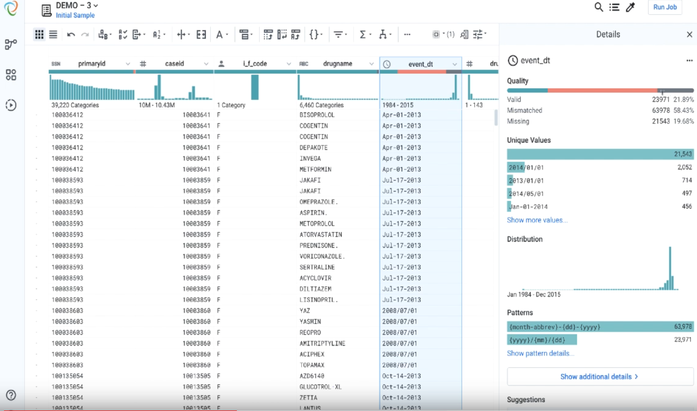
[Credit: Alex Chan (Apr 2, 2019) https://www.trifacta.com/blog/trifacta-for-data-quality-introducing-smart-cleaning/]
Data Wrangling, cont.
Example:
Trifacta
Smart Cleaning

Slide 27
Missing Value Imputation

Slide 28
Types of Missing Values
Missing Value
  Application context defines if 0 is missing value or not
  If differences between 0 and missing values, use NA or NaN?
  Could be a number outside the domain or symbol as ‘?’
Relationship to Data Cleaning
  Missing value is error, need to generate data repair
  Data imputation techniques can be used as outlier/anomaly detectors
Recap: Reasons
  #1 Heterogeneity of Data Sources
  #2 Human Error
  #3 Measurement/Processing Errors
MCAR: Missing Completely at Random
MAR: Missing at Random
MNAR: Missing Not at Random

Slide 29
Types of Missing Values, cont.
ID | Position | Salary ($)
1 | Manager | null
2 | Secretary | 2200
3 | Manager | 3600
4 | Technician | null
5 | Technician | 2500
6 | Secretary | null
(3500)
Missing Completely at Random
  Missing values are randomly distributed across all records
  (independent from recorded or missing values)
Missing at Random
  Missing values are randomly distributed
  within one or more sub-groups of records
  Missing values depend on the recorded but not
  on the missing values, and can be recovered
Not Missing at Random
  Missing data depends on the missing values themselves
  E.g., missing low salary, age, weight, etc
(2400)
(2000)
ID | Position | Salary ($)
1 | Manager | 3500
2 | Secretary | 2200
3 | Manager | 3600
4 | Technician | null
5 | Technician | null
6 | Secretary | 2000
ID | Position | Salary ($)
1 | Manager | 3500
2 | Secretary | null
3 | Manager | 3600
4 | Technician | null
5 | Technician | 2500
6 | Secretary | null
<= 2400
missing
[Abdulhakim Ali Qahtan, Ahmed K. Elmagarmid, Raul Castro Fernandez, Mourad Ouzzani, Nan Tang: FAHES: A Robust Disguised Missing Values Detector. KDD 2018]

Slide 30
Basic Missing Value Imputation
Basic Value Imputation (for MCAR)
  General-purpose: replace by user-specified constant,
  or drop records, or one-hot encode as separate column
  Continuous variables: replace by mean, median, Functional Dependencies (FDs)
  Categorical variables: replace by mode (most frequent category), FDs
Examples Categorical (Col C)
  Mode ➔ {X, X}
  Functional Dependency
  (e.g., B/1000→C) ➔ {Y, Z}
Examples Numerical (Col E)
  Mean ➔ {35, 35}
  Functional Dependency
  (e.g., D→E) ➔ {35, 45}

Slide 31
Iterative Missing Value Imputation
Iterative Algorithms (chained-equation imputation for MAR)
  Train ML model on available data to predict missing information
    Initialize with basic imputation (e.g., mean)
    One dirty variable at a time
    Feature k → label, split data into training: observed / scoring: missing
    Types: categorical → classification, continuous → regression
  Noise reduction: train models over feature subsets + averaging
SystemDS: mice()
Train X, y
Score
[Stef van Buuren, Karin Groothuis-Oudshoorn: mice: Multivariate Imputation by Chained Equations in R, J. of Stat. Software 2011]

Slide 32
Iterative Missing Value Imputation, cont.
MICE Example
  Initialization: fill in the missing values with column mean (with or without NAs)
  Iterations:
  each column
  per iteration
V1 | V2 | V3 | V4 | V5
1 | 56 | 2 | 2 | 2
2 | 23 | 0 | 0 | 0
1 | NA | 0 | 0 | 2
2 | 24 | -1 | 2 | NA
NA | 22 | 1 | 2 | 0
V1 | V2 | V3 | V4 | V5
1 | 56 | 2 | 2 | 2
2 | 23 | 0 | 0 | 0
1 | 25 | 0 | 0 | 2
2 | 24 | -1 | 2 | 0.8
1.2 | 22 | 1 | 2 | 0
train(y)
train(x)
V1 | V2 | V3 | V4 | V5
1 | 56 | 2 | 2 | 2
2 | 23 | 0 | 0 | 0
1 | 25 | 0 | 0 | 2
2 | 24 | -1 | 2 | 0.8
1.2 | 22 | 1 | 2 | 0
V1 | V2 | V3 | V4 | V5
1 | 56 | 2 | 2 | 2
2 | 23 | 0 | 0 | 0
1 | 25 | 0 | 0 | 2
2 | 24 | -1 | 2 | 0.8
? | 22 | 1 | 2 | 0
test(x)

Slide 33
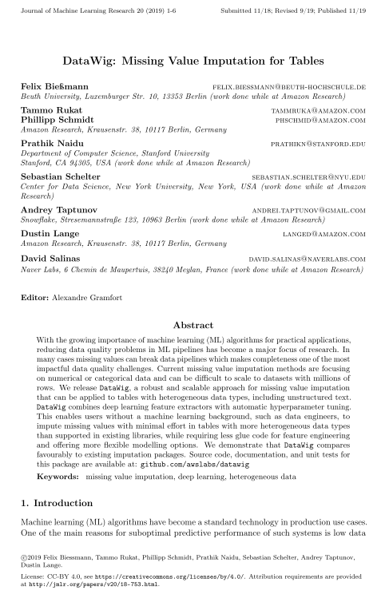
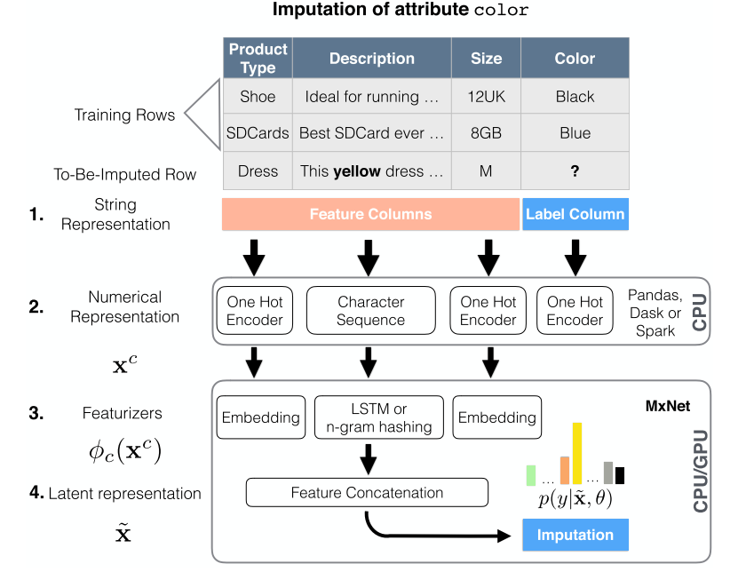
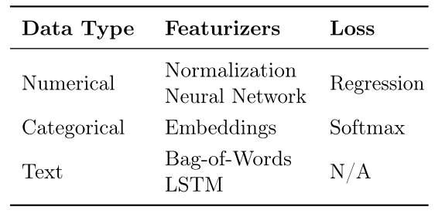
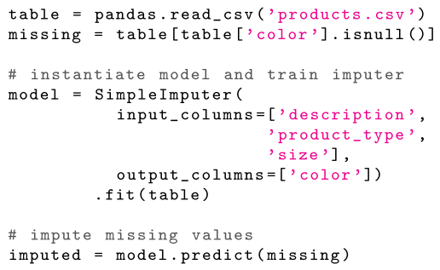
[Felix Bießmann et al: DataWig: Missing Value Imputation for Tables, J. of ML Research 2019]
DNN Based MV Imputation
DataWig
  Missing values imputation for heterogeneous
  data including unstructured text

Slide 34
[Jose Cambronero, John K. Feser, Micah Smith, Samuel Madden: Query Optimization for Dynamic Imputation. PVLDB 2017]
Query Planning w/ MV Imputation
Dynamic Imputation
  Data exploration w/ on-the-fly imputation
  Optimal placement of drop δ and impute μ (chained-equation imputation via decision trees)
  Multi-objective optimization
Perf Optimized
Plan
Quality Optimized
Plan

Slide 35
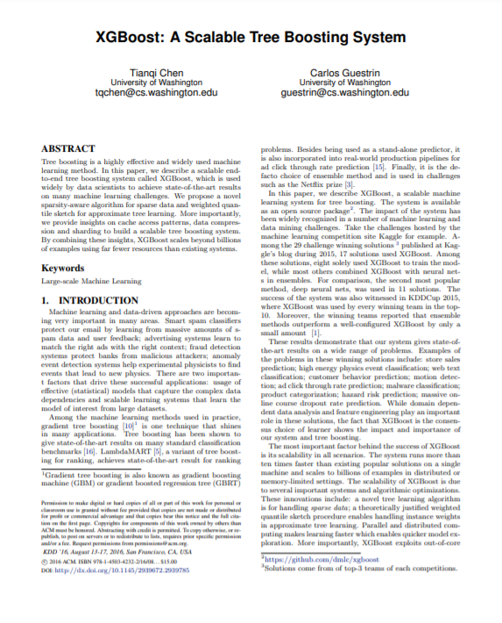
[Tianqi Chen and Charlos Guestrin: XGBoost: A Scalable Tree Boosting System, KDD 2016]
XGBoost’s Sparsity-aware Split Finding
Motivation
  Missing values
  Sparsity in general (zero values, one-hot encoding)
XGBoost
  Implementation of gradient boosted decision trees
  Multi-threaded, cache-conscious
Sparsity-aware Split Finding
  Handles the missing values by
  default paths (learned from data)
  An example will be classified into the default direction
  when the feature needed for the split is missing
Example | Age | Gender
X1 | ? | male
X2 | 15 | ?
X3 | 25 | female
age < 20
Y
N
default
Is male?
X3
Y
N
X1
default
X2

Slide 36
[Steffen Moritz and Thomas Bartz-Beielstein: imputeTS: Time Series Missing Value Imputation in R, The R Journal 2017]
Time Series Imputation
Example R Package
imputeTS

Slide 37
Excursus: Time Series Recovery
Motivating Use Case
  Given overlapping weekly aggregates y (daily moving average)
  Reconstruct the original time series X
Problem Formulation
  Aggregates y
  Original time series X (unknown)
  Mapping O of subsets of X to y
  ➔ Least squares regression problem
Advanced Method
  Discrete Cosine Transform (DCT)
  (sparsest spectral representation)
  Non-negativity and smoothness constraints
[Faisal M. Almutairi et al: HomeRun: Scalable Sparse-Spectrum Reconstruction of Aggregated Historical Data. PVLDB 2018]

Slide 38

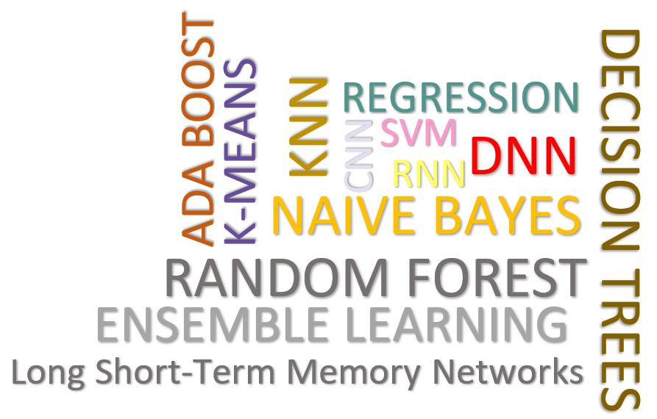
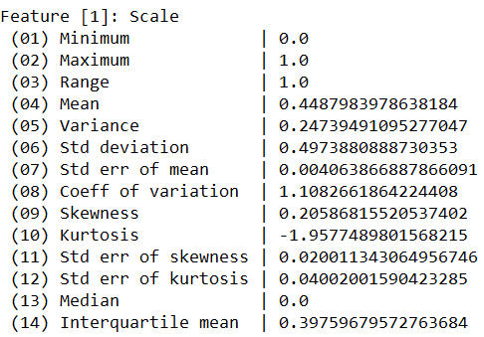
[Shafaq Siddiqi, Roman Kern, Matthias Boehm: SAGA: A Scalable Framework for Optimizing Data Cleaning Pipelines for Machine Learning Applications, SIGMOD 2024]
Data Cleaning Pipelines
Automatic Generation of Cleaning Pipelines
  Library of robust, parameterized data cleaning primitives,
  Enumeration of DAGs of primitives & hyper-parameter optimization (evolutionary, HB)
Data- and Task-parallel Computation
Data Samples
Logical
O
Physical
LP₁
LP₂
…
LP_{n}
Top-k Pipelines
Target
App
…
…
…
PP₁
PP_{n}
PP₁
PP_{n}
PP₁
PP_{n}
Rules/Objectives
Outlier Detection → MVI → Deduplication → Resolve Mislabels
P_{1:} gmm → imputeFD → mergeDup → delML
P_{n:} outlierBySd→ mice → delDup → voting
Debugging
University | Country
TU Graz | Austria
TU Graz | Austria
TU Graz | Germany
IIT | India
IIT | IIT
IIT | Pakistan
IIT | India
SIBA | Pakistan
SIBA | null
SIBA | null
University | Country
TU Graz | Austria
TU Graz | Austria
TU Graz | Austria
IIT | India
IIT | India
IIT | India
IIT | India
SIBA | Pakistan
SIBA | Pakistan
SIBA | Pakistan
A | B | C | D
0.77 | 0.80 | 1 | 1
0.96 | 0.12 | 1 | 1
0.66 | 0.09 | null | 1
0.23 | 0.04 | 17 | 1
0.91 | 0.02 | 17 | null
0.21 | 0.38 | 17 | 1
0.31 | null | 17 | 1
0.75 | 0.21 | 20 | 1
null | null | 20 | 1
0.19 | 0.61 | 20 | 1
0.64 | 0.31 | 20 | 1
A | B | C | D
0.77 | 0.80 | 1 | 1
0.96 | 0.12 | 1 | 1
0.66 | 0.09 | 17 | 1
0.23 | 0.04 | 17 | 1
0.91 | 0.02 | 17 | 1
0.21 | 0.38 | 17 | 1
0.31 | 0.29 | 17 | 1
0.75 | 0.21 | 20 | 1
0.41 | 0.24 | 20 | 1
0.19 | 0.61 | 20 | 1
0.64 | 0.31 | 20 | 1
Dirty Data
After imputeFD(0.5)
Dirty Data
After MICE

Slide 39
Summary and Q&A
Motivation and Terminology
Data Cleaning and Fusion
Missing Value Imputation
Next Lectures (Data Integration Architectures)
  07 Data Provenance and Catalogs [Nov 30]
  no lecture → project work [Dec 07]
Next Lectures (Large-scale Data Management and Analysis)
  08 Cloud Computing Fundamentals [Dec 14]
  09 Cloud Resource Management and Scheduling [Dec 21]
  10 Distributed Data Storage [Jan 11]
  11 Distributed, Data-Parallel Computation [Jan 18]
  12 Distributed Stream Processing [Jan 25]
  13 Distributed Machine Learning Systems [Feb 01]

