Slide 1

Programmierpraktikum: Datensysteme
03 Background Transaction Processing
Prof. Dr. Matthias Boehm
Technische Universität Berlin
Berlin Institute for the Foundations of Learning and Data
Big Data Engineering (DAMS Lab)
Last update: Nov 10, 2023

Slide 2

Announcements / Administrative Items
#1 Video Recording
  Hybrid lectures: in-person H 0111, zoom live streaming, video recording
  https://tu-berlin.zoom.us/j/9529634787?pwd=R1ZsN1M3SC9BOU1OcFdmem9zT202UT09
#2 Project Progress
  How many teams already started the project work?
  Any problems or blocking technical issues?
  Reminder: team work – avoid discriminating assignments of tasks

Slide 3
Agenda
Overview Transaction Processing
Locking and Concurrency Control
Logging and Recovery
Additional Literature:
[Jim Gray, Andreas Reuter: Transaction Processing: Concepts and Techniques. Morgan Kaufmann 1993]
[Gerhard Weikum, Gottfried Vossen: Transactional Information Systems: Theory, Algorithms, and the Practice of Concurrency Control and Recovery. Morgan Kaufmann 2002]

Slide 4
Overview Transaction Processing

Slide 5
Transaction (TX) Processing
User 2
User 1
User 3
Goal: Basic Understanding of Transaction Processing
  Transaction processing from user perspective
  Locking and concurrency control to ensure #1 correctness
  Logging and recovery to ensure #2 reliability
read/write TXs
#1 Multiple users
➔ Correctness?
DBS
DBMS
#2 Various failures
(TX, system, media)
➔ Reliability?
Deadlocks
Constraint violations
DBs
Network failure
Crash/power failure
Disk failure

Slide 6
Terminology of Transactions
Database Transaction
  A transaction (TX) is a series of steps that brings a database from
  a consistent state into another (not necessarily different) consistent state
  ACID properties (atomicity, consistency, isolation, durability)
Terminology
by Example
#1 Isolation level (defined by addressed anomalies)
#2 Start/begin of TX (BOT/BT)
START TRANSACTION ISOLATION LEVEL SERIALIZABLE;
UPDATE Account SET Balance=Balance-100
WHERE AID = 107;
UPDATE Account SET Balance=Balance+100
WHERE AID = 999;
SELECT Balance INTO lbalance
FROM Account WHERE AID=107;
IF lbalance < 0 THEN
ROLLBACK TRANSACTION;
END IF
COMMIT TRANSACTION;
#3 Reads and writes of data objects
#6 Savepoints (checkpoint for partial rollback)
#4 Abort/rollback TX (unsuccessful end of transaction, EOT/ET)
#5 Commit TX (successful end of transaction, EOT/ET)

Slide 7
Example OLTP Benchmarks
Online Transaction Processing (OLTP)
  Write-heavy database workloads, primarily with point lookups/accesses
  Applications: financial, commercial, travel, medical, and governmental ops
  Benchmarks: e.g., TPC-C, TPC-E, AuctionMark, SEATS (Airline), Voter
Example TPC-C
  45% New-Order
  43% Payment
  4% Order Status
  4% Delivery
  4% Stock Level
New Order Transaction:
1) Get records describing a
warehouse (tax), customer, district
2) Update the district to increment
next available order number
3) Insert record into Order and NewOrder
4) For All Items
a) Get item record (and price)
b) Get/update stock record
c) Insert OrderLine record
5) Update total amount of order
[http://www.tpc.org/tpc_documents_current_versions/pdf/tpc-c_v5.11.0.pdf]

Slide 8
[Theo Härder, Andreas Reuter: Principles of Transaction-Oriented Database Recovery. ACM Comput. Surv. 15(4) 1983]
ACID Properties
Atomicity
  A transaction is executed atomically (completely or not at all)
  If the transaction fails/aborts no changes are made to the database (UNDO)
Consistency
  A successful transaction ensures that all consistency constraints are met
  (referential integrity, semantic/domain constraints)
Isolation
  Concurrent transactions are executed in isolation of each other
  Appearance of serial transaction execution
Durability
  Guaranteed persistence of all changes made by a successful transaction
  In case of system failures, the database is recoverable (REDO)

Slide 9

Anomalies – Lost Update
TA1 updates points for Exercise 1
TA2 updates points for Exercise 2
Problem: Write-write dependency
Solution: Exclusive lock on write
SELECT Pts INTO :points
FROM Students WHERE Sid=789;
points += 23.5;
UPDATE Students SET Pts=:points
WHERE Sid=789;
COMMIT TRANSACTION;
SELECT Pts INTO :points
FROM Students WHERE Sid=789;
points += 24.0;
UPDATE Students SET Pts=:points
WHERE Sid=789;
COMMIT TRANSACTION;
Student received 24 instead of 47.5 points
(lost update 23.5)
Time

Slide 10
Anomalies – Dirty Read
TA1 updates points for Exercise 1
TA2 updates points for Exercise 2
Problem: Write-read dependency
Solution: Read only committed changes; otherwise, cascading abort
UPDATE Students SET Pts=100
WHERE Sid=789;
ROLLBACK TRANSACTION;
SELECT Pts INTO :points
FROM Students WHERE Sid=789;
points += 24.0;
UPDATE Students SET Pts=:points
WHERE Sid=789;
COMMIT TRANSACTION;
Student received 124 instead of 24 points
Time

Slide 11
Anomalies – Unrepeatable Read
TA1 updates points for Exercise 1
TA2 runs statistics for Exercise 1
Problem: Read-write dependency
Solution: TA works on consistent snapshot of touched records
SELECT Pts INTO :p1
FROM Students WHERE Sid=789;
...
SELECT Pts INTO :p2
FROM Students WHERE Sid=789;
...
COMMIT TRANSACTION;
START TRANSACTION;
UPDATE Students SET Pts=Pts+23.5
WHERE Sid=789;
COMMIT TRANSACTION;
modified
value
TA2 sees only committed data but analysis corrupted as p1!=p2
Time

Slide 12
Anomalies – Phantom
TA1 inserts missing student
TA2 runs statistics for Exercise 1
Similar to non-repeatable read but at set level
(snapshot of accessed data objects not sufficient)
SELECT Avg(Pts) INTO :p1
FROM Students WHERE Sid<1000;
...
SELECT Avg(Pts) INTO :p2
FROM Students WHERE Sid<1000;
...
COMMIT TRANSACTION;
START TRANSACTION;
INSERT INTO Students
VALUES (999, ..., 0);
COMMIT TRANSACTION;
added row
(harder to track because new database object)
TA2 sees only committed data but analysis corrupted as p1!=p2
Time

Slide 13
Isolation Levels
Different Isolation Levels
  Tradeoff Isolation vs performance per session/TX
  SQL standard requires guarantee against lost updates for all
SQL Standard Isolation Levels
  Serializable with
  highest guarantees
  (pseudo-serial execution)
How can we enforce these isolation levels?
  User: set default/transaction isolation level (mixed TX workloads possible)
  System: dedicated concurrency control strategies + scheduler
SET TRANSACTION
ISOLATION LEVEL
READ COMMITTED
Isolation Level | Lost Update | Dirty Read (P1) | Unrepeatable Read (P2) | Phantom Read (P3)
READ UNCOMMITTED | No* | Yes | Yes | Yes
READ COMMITTED | No* | No | Yes | Yes
REPEATABLE READ | No* | No | No | Yes
[SERIALIZABLE] | No* | No | No | No
* Lost update potentially w/ different semantics in standard
Notes:
SQL Standard (02 Foundations WD2011, page 134): The four transaction isolation levels guarantee that each SQL-transaction will be executed completely or not at all, and that no updates will be lost. The transaction isolation levels are different with respect to phenomena P1, P2, and P3. Table 8, “SQL-transaction isolation levels and the three phenomena” specifies the phenomena that are possible and not possible for a given transaction isolation level.

Slide 14
Excursus: A Critique of SQL Isolation Levels
Summary
  Criticism: SQL standard isolation levels are
  ambiguous (strict/broad interpretations)
  Additional anomalies: dirty write, cursor lost update,
  fuzzy read, read skew, write skew
  Additional isolation levels: cursor stability and snapshot isolation
Snapshot Isolation (< Serializable)
  Type of optimistic concurrency control via multi-version concurrency control
  TXs reads data from a snapshot of committed data when TX started
  TXs never blocked on reads, other TXs data invisible
  TX T1 only commits if no other TX wrote the same data items in the time interval of T1
Current Status?
  “SQL standard that fails to accurately define database isolation levels and
  database vendors that attach liberal and non-standard semantics
[Hal Berenson, Philip A. Bernstein, Jim Gray, Jim Melton, Elizabeth J. O'Neil, Patrick E. O'Neil: A Critique of ANSI SQL Isolation Levels. SIGMOD 1995]
[http://dbmsmusings.blogspot.com/
2019/05/introduction-to-
transaction-isolation.html]
Notes:
Problems SQL: only three anomalies considered, no precise definition of state to expect, no handling of snapshot isolation, different definitions of serializable (serial order, none of the three anomalies)
Examples:
Dirty writes: T1 and T2 write to objects that together → might violate constraints
Write skew: T1 reads x and y, T2 reads x and y and writes x, T1 writes y → again constraint violations

Slide 15
Excursus: Isolation Levels in Practice
Default and Maximum Isolation Levels
for “ACID” and “NewSQL” DBs
[as of 2013]
  3/18 SERIALIZABLE
  by default
  8/18 did not provide
  SERIALIZABLE at all
[Peter Bailis, Alan Fekete, Ali Ghodsi, Joseph M. Hellerstein, Ion Stoica: HAT, Not CAP: Towards Highly Available Transactions. HotOS 2013]
Beware of defaults, even though the SQL standard says SERIALIZABLE is the default

Slide 16
Locking and Concurrency Control
(Consistency and Isolation)

Slide 17
Overview Concurrency Control
Terminology
  Lock: logical synchronization of TXs access to database objects (row, table, etc)
  Latch: physical synchronization of access to shared data structures
#1 Pessimistic Concurrency Control
  Locking schemes (lock-based database scheduler)
  Full serialization of transactions
#2 Optimistic Concurrency Control (OCC)
  Optimistic execution of operations, check of conflicts (validation)
  Optimistic and timestamp-based database schedulers
#3 Mixed Concurrency Control (e.g., PostgreSQL)
  Combines locking and OCC
  Might return synchronization errors
ERROR: could not serialize access
due to concurrent update
ERROR: deadlock detected

Slide 18



Serializability Theory
Operations of Transaction T_{j}
  Read and write operations of A by T_{j}: r_{j}(A) w_{j}(A)
  Abort of transaction T_{j}: a_{j} (unsuccessful termination of T_{j})
  Commit of transaction T_{j}: c_{j} (successful termination of T_{j})
Schedule S
  Operations of a transaction T_{j} are executed in order
  Multiple transactions may be executed concurrently
  ➔ Schedule describes the total ordering of operations
Equivalence of Schedules S1 and S2
  Read-write, write-read, and write-write
  dependencies on data object A
  executed in same order:
T_{i}
T_{j}
S
$$r_{i}\left(A\right)<_{S1}w_{j}(A)⇔r_{i}\left(A\right)<_{S2}w_{j}(A)$$
$$w_{i}\left(A\right)<_{S1}r_{j}(A)⇔w_{i}\left(A\right)<_{S2}r_{j}(A)$$
$$w_{i}\left(A\right)<_{S1}w_{j}(A)⇔w_{i}\left(A\right)<_{S2}w_{j}(A)$$

Slide 19
Serializability Theory, cont.
T1: BOT r₁(A) w₁(A) r₁(B) w₁(B) c₁
Example Serializable Schedules
  Input TXs
  Serial execution
  Equivalent schedules
  Wrong schedule
Serializability Graph (conflict graph)
  Operation dependencies (read-write, write-read, write-write) aggregated
  Nodes: transactions; edges: transaction dependencies
  Transactions are serializable (via topological sort) if the graph is acyclic
  Beware: Serializability Theory considers only successful transactions, which disregards
  anomalies like dirty read that might happen in practice
T2: BOT r₂(C) w₂(C) r₂(A) w₂(A) c₂
r₁(A) w₁(A) r₁(B) w₁(B) c₁ r₂(C) w₂(C) r₂(A) w₂(A) c₂
r₁(A) r₂(C) w₁(A) w₂(C) r₁(B) r₂(A) w₁(B) w₂(A) c₁ c₂
r₁(A) w₁(A) r₂(C) w₂(C) r₁(B) w₁(B) r₂(A) w₂(A) c₁ c₂
r₁(A) r₂(C) w₂(C) r₂(A) w₁(A) r₁(B) w₁(B) w₂(A) c₁ c₂

Slide 20
TEST YOURSELF: Serializable Schedules
Given two transactions T₁ and T₂, which pairs of the following three schedules are equivalent?
Explain for each pair (S₁-S₂, S₁-S₃, S₂-S₃) why they are equivalent or non-equivalent. [5/100 points]
  T₁ = {r₁(a), r₁(c), w₁(a), w₁(c)}
  T₂ = {r₂(b), w₂(b), r₂(c), w₂(c)}
Schedules
  S₁ = {r₁(a), r₁(c), w₁(a), w₁(c), r₂(b), w₂(b), r₂(c), w₂(c)} = {T₁, T₂}
  S₂ = {r₁(a), r₂(b), r₁(c), w₁(a), w₂(b), w₁(c), r₂(c), w₂(c)}
  S₃ = {r₁(a), r₂(b), r₁(c), w₁(a), w₂(b), r₂(c), w₁(c), w₂(c)}
➔ S₁ ≡ S₂ (equivalent, because r₂(b), w₂(b) independent of T₁)
➔ S₂ ≢ S₃ (non-equivalent, because w₁(c), r₂(c) of c in different order)
➔ S₁ ≢ S₃ (transitive)

Slide 21
Locking Schemes
Existing Lock
Compatibility of Locks
  X-Lock (exclusive/write lock)
  S-Lock (shared/read lock)
Multi-Granularity Locking
  Hierarchy of DB objects
  Additional intentional IX and IS locks
 | None | S | X
S | Yes | Yes | No
X | Yes | No | No
Requested Lock
IS
DB
IS
Table
IS
 | None | S | X | IS | IX
S | Yes | Yes | No | Yes | No
X | Yes | No | No | No | No
IS | Yes | Yes | No | Yes | Yes
IX | Yes | No | No | Yes | Yes
Page
S
Row

Slide 22
Two-Phase Locking (2PL)
Overview
  2PL is a concurrency protocol that guarantees SERIALIZABLE
  Expanding phase: acquire locks needed by the TX
  Shrinking phase: release locks acquired by the TX (can only start if all needed locks acquired)
Phase 1
Expanding
Phase 2
Shrinking
# of locks
Time
BOT
EOT

Slide 23
Two-Phase Locking, cont.
Strict 2PL (S2PL) and Strong Strict 2PL (SS2PL)
  Problem: Transaction rollback can cause (Dirty Read)
  Release all X-locks (S2PL) or X/S-locks (SSPL) at end of transaction (EOT)
Strict 2PL w/ pre-claiming (aka conservative 2PL)
  Problem: incremental expanding can cause deadlocks for interleaved TXs
  Pre-claim all necessary locks (only possible if entire TX known + latches)
Strict 2PL prevents dirty reads and thus cascading abort
# of locks
Time
BOT
EOT
# of locks
Strict 2PL w/ preclaiming prevents deadlocks
Time
BOT
EOT

Slide 24
Deadlocks
TX1
TX2
Deadlock Scenario
  Deadlocks of concurrent transactions
  Deadlocks happen due to cyclic dependencies
  without pre-claiming (wait for exclusive locks)
#1 Deadlock Prevention
  Pre-claiming (guarantee if TX known upfront)
#2 Deadlock Avoidance
  Preemptive vs non-preemptive strategies
  NO_WAIT (if deadlock suspected wrt timestamp TS, abort lock-requesting TX)
  WOUND-WAIT (T1 locks something held by T2 → if T1<T2, restart T2)
  WAIT-DIE (T1 locks something held by T2 → if T1>T2, abort T1 but keep TS)
#3 Deadlock Detection (DL_DETECT)
  Maintain a wait-for graph (WFG) of blocked TX (similar to serializability graph)
  Detection of cycles in graph (on timeout) → abort one or many TXs
lock R
lock S
lock S
lock R
blocks until TX2 releases S
blocks until TX1 releases R
Time
DEADLOCK, as this will never happen
Notes:
Wound-wait: If older txn locks R held by younger txn -> restart younger
if younger txn locks R held by older txn -> younger waits until older finishes
Wound-die: If older txn locks R held by younger txn -> older waits
if younger txn locks R held by older txn -> abort & restart younger with same TS

Slide 25
[Philip A. Bernstein, Nathan Goodman: Concurrency Control in Distributed Database Systems. ACM Comput. Surv. 1981]
(Basic) Timestamp Ordering
Synchronization Scheme
  Transactions get timestamp (or version number) TS(T_{j}) at BOT
  Each data object A has readTS(A) and writeTS(A)
  Use timestamp comparison to validate access, otherwise abort
  No locks but latches (physical synchronization)
Read Protocol T_{j}(A)
  If TS(T_{j}) >= writeTS(A): allow read, set readTS(A) = max(TS(T_{j}), readTS(A))
  If TS(T_{j}) < writeTS(A): abort T_{j} (older than last modifying TX)
Write Protocol T_{j}(A)
  If TS(T_{j}) >= readTS(A) AND TS(T_{j}) >= writeTS(A): allow write, set writeTS(A)=TS(T_{j})
  If TS(T_{j}) < readTS(A): abort T_{j} (older than last reading TX)
  If TS(T_{j}) < writeTS(A): abort T_{j} (older than last modifying TX)
BEWARE: Timestamp Ordering requires handling of dirty reads,
and concurrent transactions (e.g., via abort or versions)
Great, low overhead scheme if conflicts are rare (no hot spots)
[Stephan Wolf et al: An Evaluation of Strict Timestamp Ordering Concurrency Control for Main-Memory Database Systems. IMDM@ VLDB 2013 ]
Notes:
“It generates serializable schedules, but does not guarantee recoverability. In fact, aborted transactions can cause inconsistency, as another transaction which accessed dirty data could have already committed.”

Slide 26
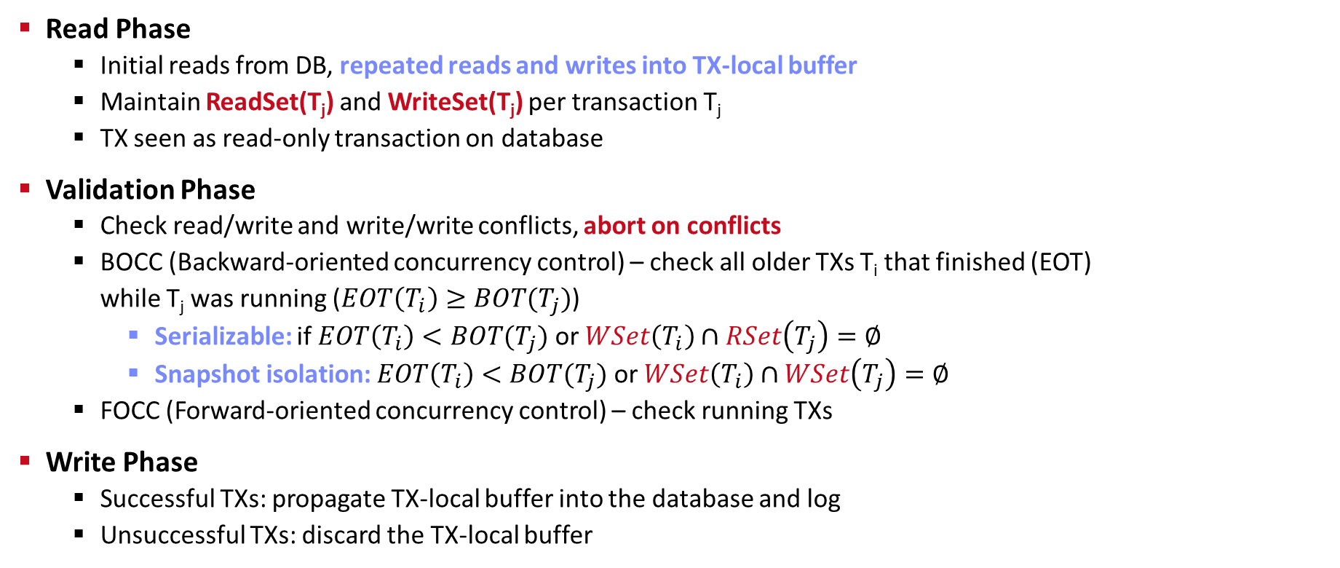
Optimistic Concurrency Control (OCC)
Read Phase
  Initial reads from DB, repeated reads and writes into TX-local buffer
  Maintain ReadSet(T_{j}) and WriteSet(T_{j}) per transaction T_{j}
  TX seen as read-only transaction on database
Validation Phase
  Check read/write and write/write conflicts, abort on conflicts
  BOCC (Backward-oriented concurrency control) – check all older TXs T_{i} that finished (EOT)
  while T_{j} was running ($EOT\left(T_{i}\right)≥BOT(T_{j})$)
    Serializable: if $EOT\left(T_{i}\right)<BOT(T_{j})$ or $WSet\left(T_{i}\right)∩RSet\left(T_{j}\right)=∅$
    Snapshot isolation: $EOT\left(T_{i}\right)<BOT(T_{j})$ or $WSet\left(T_{i}\right)∩WSet\left(T_{j}\right)=∅$
  FOCC (Forward-oriented concurrency control) – check running TXs
Write Phase
  Successful TXs: propagate TX-local buffer into the database and log
  Unsuccessful TXs: discard the TX-local buffer

Slide 27
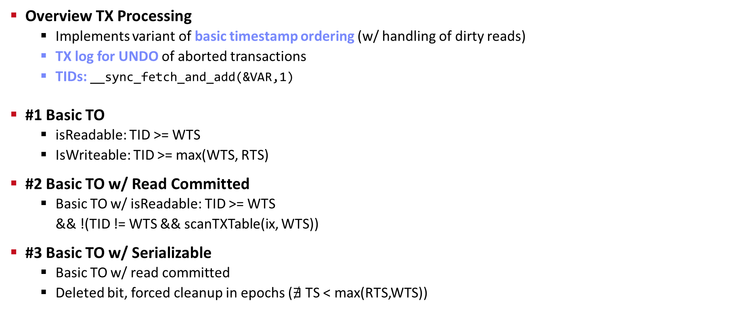
Excursus: Basic Timestamp Ordering in Project Reference Implementation
Overview TX Processing
  Implements variant of basic timestamp ordering (w/ handling of dirty reads)
  TX log for UNDO of aborted transactions
  TIDs: __sync_fetch_and_add(&VAR,1)
#1 Basic TO
  isReadable: TID >= WTS
  IsWriteable: TID >= max(WTS, RTS)
#2 Basic TO w/ Read Committed
  Basic TO w/ isReadable: TID >= WTS
  && !(TID != WTS && scanTXTable(ix, WTS))
#3 Basic TO w/ Serializable
  Basic TO w/ read committed
  Deleted bit, forced cleanup in epochs ($∄$ TS < max(RTS,WTS))
./speed_test 1468 0 0 0 0 \
4000 160000 100
NUM_TXN_FAIL: 0
NUM_TXN_COMP: 16,000,000
Time to run: 15.223s.
NUM_TXN_FAIL: 0
NUM_TXN_COMP: 16,000,000
Time to run: 15.394s.
NotImplementedException

Slide 28
Logging and Recovery
(Atomicity and Durability)

Slide 29
Failure Types and Recovery
Transaction Failures
  E.g., Violated integrity constraints, abort
  ➔ R1-Recovery: partial UNDO of this uncommitted TX
System Failures (soft crash)
  E.g., HW or operating system crash, power outage
  Kills all in-flight transactions, but does not lose persistent data
  ➔ R2-Reovery: partial REDO of all committed TXs
  ➔ R3-Recovery: global UNDO of all uncommitted TXs
Media Failures (hard crash)
  E.g., disk hard errors (non-restorable)
  Loses persistent data → need backup data (checkpoint)
  ➔ R4-Recovery: global REDO of all committed TXs

Slide 30
User 2
Database (Transaction) Log
User 3
User 1
DBMS
Database Architecture
  Page-oriented storage on disk and in memory (DB buffer)
  Dedicated eviction algorithms
  Modified in-memory pages marked as
  dirty, flushed by cleaner thread
  Log: append-only TX changes
  Data/log often placed on different devices
  and periodically archived (backup + truncate)
Write-Ahead Logging (WAL)
  The log records of changes to some (dirty) data page must be
  on stable storage before the data page (UNDO - atomicity)
  Force-log on commit or full buffer (REDO - durability)
  Recovery: forward (REDO) and backward (UNDO) processing
  Log sequence number (LSN)
DB Buffer
Log Buffer
P7
P3’
P1
P7
P3
Data
Log
[C. Mohan, Donald J. Haderle, Bruce G. Lindsay, Hamid Pirahesh, Peter M. Schwarz: ARIES: A Transaction Recovery Method Supporting Fine-Granularity Locking and Partial Rollbacks Using Write-Ahead Logging. TODS 1992]

Slide 31
Logging Types and Recovery
#1 Logical (Operation) Logging
  REDO: log operation (not data) to construct after state
  UNDO: inverse operations (e.g., increment/decrement), not stored
  Non-determinism cannot be handled, more flexibility on locking
#2 Physical (Value) Logging
  REDO: log REDO (after) image of record or page
  UNDO: log UNDO (before) image of record or page
  Larger space overhead (despite page diff) for set-oriented updates
Restart Recovery (ARIES)
  Conceptually: take database checkpoint and replay log since checkpoint
  Operation and value locking; stores log seq. number (LSN, PageID, PrevLSN)
  Phase 1 Analysis: determine winner and loser transactions
  Phase 2 Redo: replay all TXs in order [repeating history] → state at crash
  Phase 3 Undo: replay uncommitted TXs (losers) in reverse order
UPDATE Emp
SET Salary=Salary+100
WHERE Dep=‘R&D’;
Notes:
Database vendors employ various optimizations to minimize logging overhead, such as deferred delete, preserving only RowIDs of inserted rows.

Slide 32
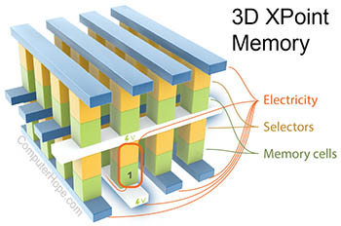
Excursus: Recovery on Storage Class Memory
Background: Storage Class Memory (SCM)
  Byte-addressable, persistent memory with higher capacity,
  but latency close to DRAM
  Examples: Resistive RAM, Magnetic RAM,
  Phase-Change Memory (e.g., Intel 3D XPoint)
SOFORT: DB Recovery on SCM
  Simulated DBMS prototype on SCM
  Instant recovery by trading TX throughput vs
  recovery time (% of data structures on SCM)
Write-Behind Logging (for hybrid SCM)
  Update persistent data (SCM) on commit,
  log change metadata + timestamps ➔ 1.3x
[Credit: https://
computerhope.com]
[Ismail Oukid, Wolfgang Lehner, Thomas Kissinger, Thomas Willhalm, Peter Bumbulis: Instant Recovery for Main Memory Databases. CIDR 2015]
[Joy Arulraj, Matthew Perron, Andrew Pavlo: Write-Behind Logging. PVLDB 2016]
Notes:
3D Xpoint selectors: Chalcogenide class, no need for FETs → higher density

Slide 33
Summary & QA
Thanks
Overview Transaction Processing
Locking and Concurrency Control
Logging and Recovery
Next Lectures
  Nov 27: Experiments and Reproducibility
  Additional lectures / Q&A sessions on demand
  Feb 01: Project Submissions (virtual)
  Feb 12: Project Presentations (in-person)

