Slide 1
SPOOF: Sum-Product Optimization and Operator Fusion for Large-Scale Machine Learning
Tarek Elgamal², Shangyu Luo³, Matthias Boehm¹, Alexandre V. Evfimievski¹, Shirish Tatikonda⁴,
Berthold Reinwald¹, Prithviraj Sen¹
¹ IBM Research – Almaden ² University of Illinois
³ Rice University ⁴ Target Corporation

Slide 2

Motivation
Declarative Large-Scale Machine Learning (ML)
  Simplify development / usage of ML tasks or algorithms
  SystemML: High-level language → data independence / plan generation
  State-of-the-art compilers: rewrites, operator selection, fused operators
Ubiquitous Optimization Opportunities
  Example Rewrites: X┬ y → (y┬ X)┬, sum(λ X) → λ sum(X),
  trace(X Y) → sum(X ʘ Y┬)
  Example Fused operators: sum(X ʘ Y ʘ Z), X┬(X v), sum(X ʘ log(U V┬))
sum
1st
pass
sparsity exploitation
v
2nd
pass
*
Z
X
q┬
X
X
U V┬
sum
* log
X
*
Y

Slide 3
Motivation
Declarative Large-Scale Machine Learning (ML)
  Simplify development / usage of ML tasks or algorithms
  SystemML: High-level language → data independence / plan generation
  State-of-the-art compilers: rewrites, operator selection, fused operators
Ubiquitous Optimization Opportunities
  Example Rewrites: X┬ y → (y┬ X)┬, sum(λ X) → λ sum(X),
  trace(X Y) → sum(X ʘ Y┬)
  Example Fused operators: sum(X ʘ Y ʘ Z), X┬(X v), sum(X ʘ log(U V┬))
  ➔ Fewer intermediates, fewer scans, sparsity exploitation, less compute
Problems and Challenges
  Large Development Effort: number of patterns, multiple runtime back-ends, multiple formats and combinations (sparse/dense)
  High Performance Impact: slightly changed patterns can render rewrites
  and fused operators inapplicable

Slide 4
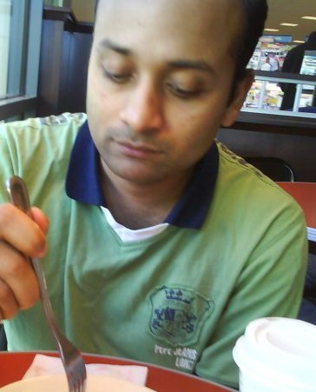

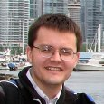
Example PNMF – A 1000x War Story
Poisson Nonnegative Matrix Factorization (PNMF)
  X ≈ W H of low rank k; X: 200K x 200K, sp=0.001 (480MB)
1: X = read("./input/X")
2: k = 100; eps = 1e-15; max_iter = 10; iter = 1;
3: W = rand(rows=nrow(X), cols=k, min=0, max=0.025)
4: H = rand(rows=k, cols=ncol(X), min=0, max=0.025)
5: while( iter < max_iter ) {
6: H = (H*(t(W)%*%(X/(W%*%H)))) / t(colSums(W));
7: W = (W*((X/(W%*%H))%*%t(H))) / t(rowSums(H));
8: obj = sum(W%*%H) - sum(X*log(W%*%H));
9: print("iter=" + iter + " obj=" + obj);
10: iter = iter + 1;
11: }
12: write(W, "./output/W");
13: write(H, "./output/H");
1: X = read("./input/X")
2: k = 100; eps = 1e-15; max_iter = 10; iter = 1;
3: W = rand(rows=nrow(X), cols=k, min=0, max=0.025)
4: H = rand(rows=k, cols=ncol(X), min=0, max=0.025)
5: while( iter < max_iter ) {
6: H = (H*(t(W)%*%(X/(W%*%H+eps)))) / t(colSums(W));
7: W = (W*((X/(W%*%H+eps))%*%t(H))) / t(rowSums(H));
8: obj = sum(W%*%H) - sum(X*log(W%*%H+eps));
9: print("iter=" + iter + " obj=" + obj);
10: iter = iter + 1;
11: }
12: write(W, "./output/W");
13: write(H, "./output/H");
This PNMF script takes >24h
It still takes forever – btw, I changed it slightly
Here is an interesting
rewrite: sum(W H) →
colSums(W) rowSums(H)
X
W H
sum
* log
The problem is W H (320GB), but
we could add sparsity-exploiting fused operators and rewrites
➔ rewrites and fused operators: 1000x

Slide 5
Our Vision: Holistic Optimization Framework
SPOOF Compiler Framework
  Automatic rewrite identification and operator fusion
  Increased opportunities and side effects (CSE, rewrites ←→ fusion)
  Key ideas: (1) break up LA operations into basic operators (in RA),
  (2) elementary sum-product and RA rewrites, and (3) fused operator generation
sum(W H)
(X/(W H +ε))H┬
Non-invasive integration into SystemML
colSums(W)
* rowSums(H)
Op TMP5

Slide 6
Sum-Product Optimization
SP-Plan Representation: restricted relational algebra
  Data: input matrices are relations of (i, j, v)-tuples (intermediates are tensors)
  Basic operations: selection σ, extended projection Π, aggregation Γ, join ⨝
  Composite operations: e.g., multiply A_{ij} *_{i=k ∧ j=l} B_{kl} := Π_{i,j;a*b}(A_{ija} ⨝_{i=k ∧ j=l} B_{klb})
  addition A_{ij} +_{i=k ∧ j=l} B_{kl} := Π_{i,j;a+b}(A_{ija} ⟗_{i=k ∧ j=l} B_{klb})
  Two restrictions: a single value attribute per relation, and unique composite indexes per relation ➔ single value per tensor cell
Example
SP Plan
  sum(W H)
SP-Plan
HOP DAG

Slide 7
Sum-Product Optimization, cont.
But, SP opt alone can be counter-productive
(e.g., CSE ‘W H’)
Example SP Plan Rewrites
  W:= 200K x 100, H:= 100 x 200K
Aggregation Elimination
Sum-Product
(distributive law)
Sum-Product
(distributive law)
8.04 TFLOPs
8 TFLOPs
60 MFLOPs
40 MFLOPs

Slide 8
Operator Fusion
C-Plan Representation
  Hybrid approach: hand-coded operator skeletons with custom body code
  ➔ Efficiency (data access, multi-threading) and flexibility
  Template C-Nodes: generic fused operator skeletons (w/ data binding)
  e.g., SpoofOuterProduct, SpoofCellwise, SpoofRowAggregate
  Primitive C-Nodes: vector/scalar operations
Example C-Plan
  (X / (W H + ε)) H┬
  (PNMF update rule)
C-Plan
HOP DAG

Slide 9
Operator Fusion, cont.
Example C-Plan Codegen
  Recursive codegen on C-Plan
  Generated operator inherits
  data access, multi-threading, etc
  from template skeleton
1: public final class TMP5 extends SpoofOuterProduct {
2: public TMP5() {
3: _type = OuterProductType.RIGHT;
4: }
5: protected void exec(double a, double[] b, int bi,
6: double[] c, int ci,..., double[] d, int di, int k)
7: {
8:
9:
10:
11:
12: }
13: }
1: public final class TMP5 extends SpoofOuterProduct {
2: public TMP5() {
3: _type = OuterProductType.RIGHT;
4: }
5: protected void exec(double a, double[] b, int bi,
6: double[] c, int ci,..., double[] d, int di, int k)
7: {
8: double TMP1 = dotProduct(b, c, bi, ci, k); // WH
9:
10:
11:
12: }
13: }
1: public final class TMP5 extends SpoofOuterProduct {
2: public TMP5() {
3: _type = OuterProductType.RIGHT;
4: }
5: protected void exec(double a, double[] b, int bi,
6: double[] c, int ci,..., double[] d, int di, int k)
7: {
8: double TMP1 = dotProduct(b, c, bi, ci, k); // WH
9: double TMP2 = TMP1 + 1.0E-15; // +eps
10:
11:
12: }
13: }
1: public final class TMP5 extends SpoofOuterProduct {
2: public TMP5() {
3: _type = OuterProductType.RIGHT;
4: }
5: protected void exec(double a, double[] b, int bi,
6: double[] c, int ci,..., double[] d, int di, int k)
7: {
8: double TMP1 = dotProduct(b, c, bi, ci, k); // WH
9: double TMP2 = TMP1 + 1.0E-15; // +eps
10: double TMP3 = a / TMP2; // X/
11:
12: }
13: }
1: public final class TMP5 extends SpoofOuterProduct {
2: public TMP5() {
3: _type = OuterProductType.RIGHT;
4: }
5: protected void exec(double a, double[] b, int bi,
6: double[] c, int ci,..., double[] d, int di, int k)
7: {
8: double TMP1 = dotProduct(b, c, bi, ci, k); // WH
9: double TMP2 = TMP1 + 1.0E-15; // +eps
10: double TMP3 = a / TMP2; // X/
11: vectMultiplyAdd(TMP3, c, d, ci, di, k); // t(H)
12: }
13: }
Custom body code

Slide 10
Experimental Setting
Cluster Setup
  1 head node (2x4 Intel E5530, 64GB RAM), and
  6 worker nodes (2x6 Intel E5-2440, 96GB RAM, 12x2TB disks)
  Spark 1.5.2 with 6 executors (24 cores, 60GB), 30GB driver memory
ML Programs and Data
  3 full-fledged ML algorithms (PNMF, L2SVM, Mlogreg)
  Synthetically generated data
Selected Baselines
  Apache SystemML 0.10 (May 2016): Base, Fused, SPOOF
  Julia 0.5 (Sep 2016) w/ LLVM-based just-in-time compiler

Slide 11
Micro Benchmarks: Operations Performance
(@ single worker node)
(X / (W H + ε)) H┬, (PNMF)
10K x 10K, k=100, Multi-threaded
sum(X ʘ Y ʘ Z), (L2SVM)
dense, Multi-threaded
➔ Sparsity-exploiting operators at 1/12 peak compute bandwidth
➔ Fused operator w/o intermediates at peak 1xlocal / remote memory bandwidth (25GB/s)

Slide 12
End-to-End Experiments: PNMF and LSVM
PNMF Execution Time (incl. compilation and I/O)
  20 iterations, rank k = 100
L2SVM Execution Time (incl. compilation and I/O)
  20 outer iterations, ε = 10⁻¹⁴
Dataset | Base | Fused | SPOOF
10K x 10K, 0.001 | 251 s | 6 s | 9 s
25K x 25 K, 0.001 | 4,748 s | 9 s | 11 s
200K x 200K, 0.001 | >24h | 121 s | 125 s
Dataset | Base | Fused | SPOOF
100K x 10, 1.0 (8MB) | 3 s | 3 s | 5 s
1M x 10, 1.0 (80MB) | 9 s | 7 s | 8 s
10M x 10, 1.0 (800MB) | 50 s | 34 s | 17 s
100M x 10, 1.0 (8GB) | 525 s | 320 s | 114 s

Slide 13
Conclusions
Summary
  SPOOF: Automatic rewrite identification and operator fusion
  Non-invasive compiler/runtime integration into SystemML
  Plan representation/compilation for sum-product and codegen
Conclusions and Future Work
  Many rewrite/fusion opportunities with huge performance impact
  Performance close to hand-coded ops w/ moderate compilation overhead
  Future work: distributed operations, optimization algorithms
Available Open Source (soon)
  SYSTEMML-448: Code Generation, experimental in 1.0 release
  Sum-product optimization and fusion optimizations later

Slide 14

SystemML is Open Source:
Apache Incubator Project since 11/2015
Website: http://systemml.apache.org/
Sources: https://github.com/apache/incubator-systemml

Slide 15
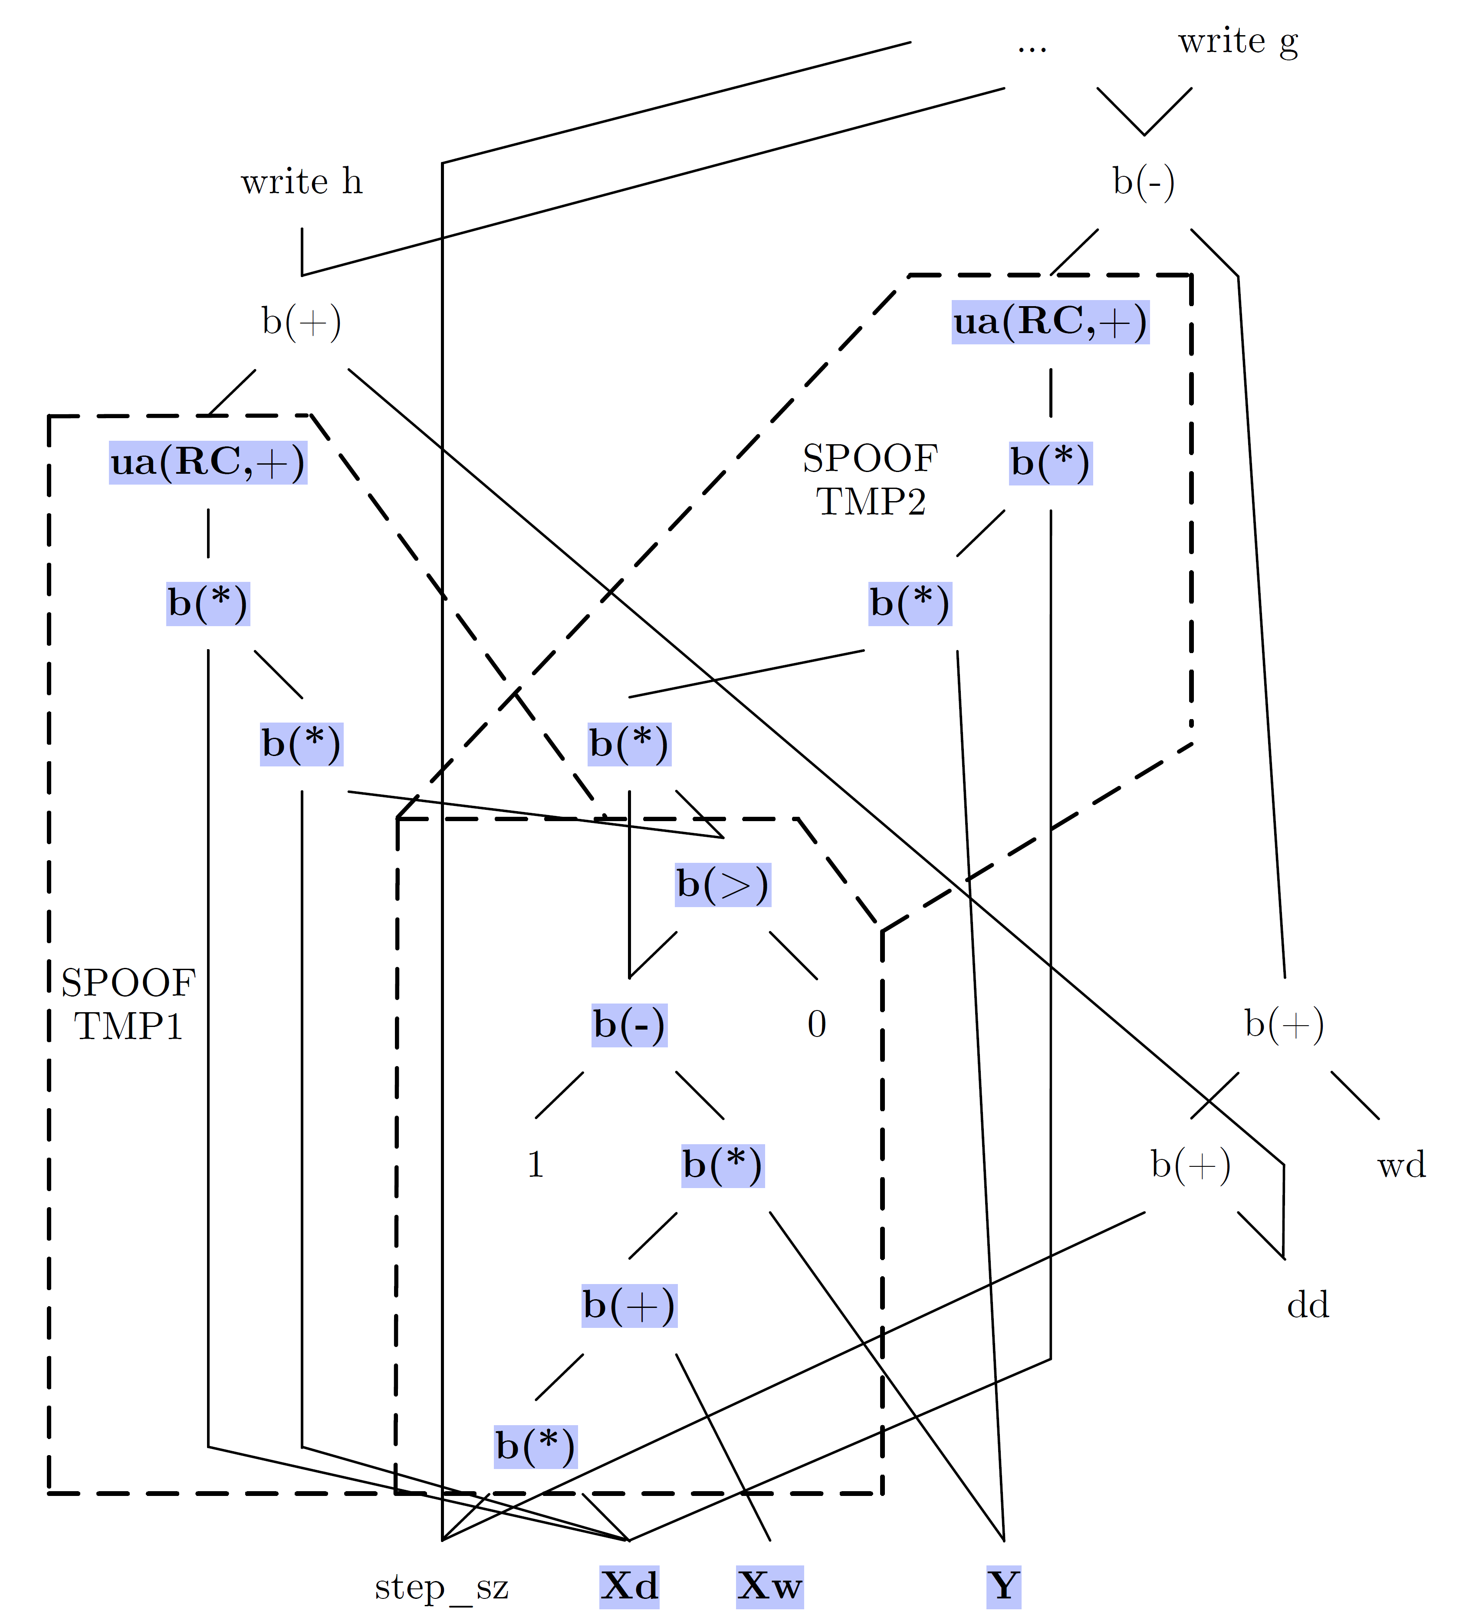
Backup: Operator Fusion, cont.
1: out = 1 - Y * (Xw + step_sz*Xd);
2: sv = (out > 0);
3: out = out * sv;
4: g = wd+step_sz*dd - sum(out*Y*Xd);
5: h = dd + sum(Xd*sv*Xd);
6: step_sz = step_sz - g/h;
Example C-Plan Codegen
  L2SVM inner loop
1: public final class TMP2 extends SpoofCellwise {
2: public TMP2() {
3: _type = CellType.FULL_AGG;
4: }
5: protected double exec(double a, double[][]
6: vectors, double[] scalars,.., int rowIndex)
7: {
8: double TMP3 = vectors[1][rowIndex];
9: double TMP4 = vectors[0][rowIndex];
10: double TMP5 = a * scalars[0];
11: double TMP6 = TMP4 + TMP5;
12: double TMP7 = TMP3 * TMP6;
13: double TMP8 = 1 - TMP7;
14: double TMP9 = (TMP8 > 0) ? 1 : 0;
15: double TMP10 = TMP8 * TMP9;
16: double TMP11 = TMP10 * TMP3;
17: double TMP12 = TMP11 * a;
18: return TMP12;
19: }
20: }
# Intermediates: Base: 10, Fused: 5, Spoof: 0

Slide 16
Backup: Plan Caching Effects for Mlogreg
Dynamic Recompilation
  Problem of unknown or changing sizes (e.g., UDFs, data-dep. ops, size expr.)
  Integration of Spoof into dynamic recompiler ➔ huge compilation overhead
  ➔ Plan cache: reuse compiled ops across DAGs / recompilations
Mlogreg Cache Statistics
  500K x 200 (800MB), 20/5 outer/inner iterations, ε = 10⁻¹⁴
  CSLH: Context-sensitive literal heuristic
Statistic | Spoof no PC
Execution time | 49.29 s
PC hit rates | 0 / 462
Javac compile time (sync) | 34.45 s
JIT compile time (async) | 25.36 s
Statistic | Spoof no PC | Spoof constant PC | Spoof CSLH
Execution time | 49.29 s | 19.87 s | 14.48 s
PC hit rates | 0 / 462 | 388 / 462 | 449 / 462
Javac compile time (sync) | 34.45 s | 6.88 s | 1.97 s
JIT compile time (async) | 25.36 s | 18.84 s | 10.50 s

