Slide 1




MNC: Structure-Exploiting Sparsity Estimation for Matrix Expressions
Johanna Sommer
IBM Germany
Matthias Boehm
Graz University of Technology
Alexandre V. Evfimievski
IBM Research – Almaden
Berthold Reinwald
IBM Research – Almaden
Peter J. Haas
UMass Amherst
SIGMOD 2019
Amsterdam, Netherlands
Research 16: Machine Learning

Slide 2
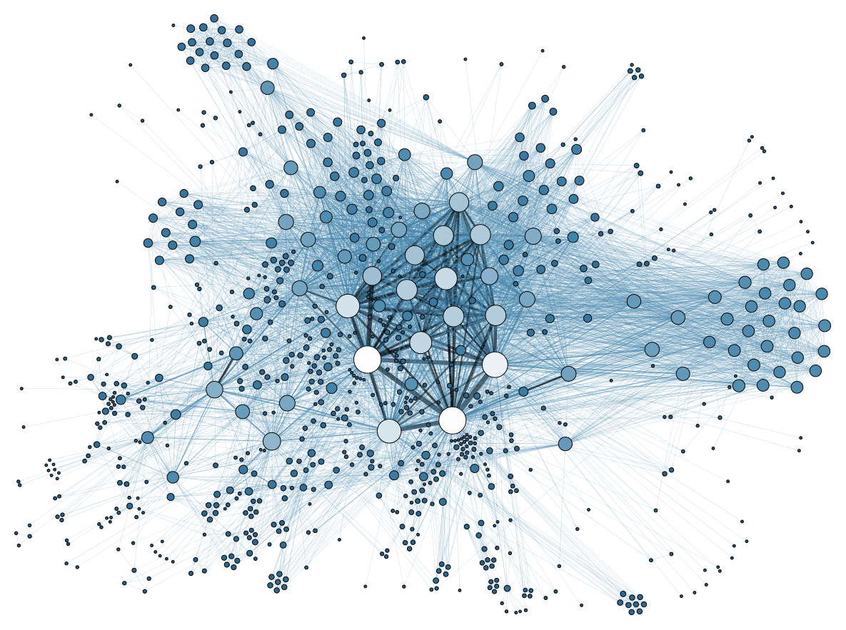

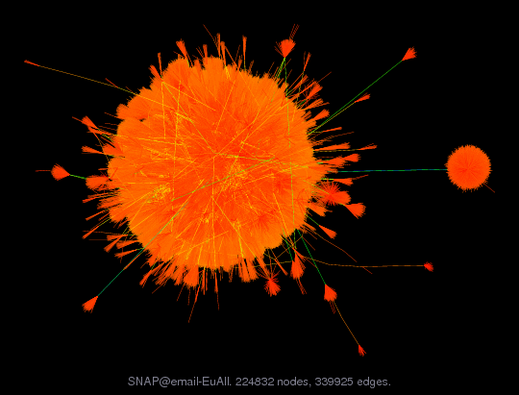




Motivation Sparsity Estimation
Ubiquitous Sparse Matrices
  Sparse inputs: NLP, graph analytics,
  recommenders, scientific computing
  Data preprocessing: binning/recoding + one-hot encoding/feature hashing
  Sparse intermediates: selection predicates, dropout
  Transformation matrices: random reshuffling, sampling
  ➔ Automatic application of sparse operations
Problem of Sparsity Estimation
  Compilation: memory and
  cost estimation (local vs
  distributed, rewrites, resource
  allocation, operator fusion)
  Runtime: format decisions
  and memory pre-allocation
MM chain w/
n=20 matrices
(1.8B plans)
sparsity-unaware
99x

Slide 3
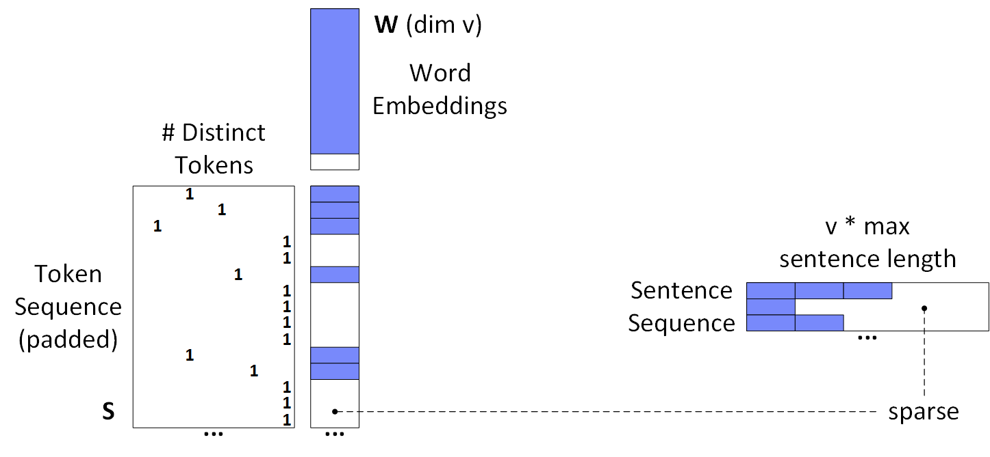
A Case for Exploiting Structural Properties
Use case NLP Sentence Encoding
  Encoding a sequence of words (padded to max sentence length)
  into sequence of word embeddings → SentenceCNN in IBM Watson C&C
ML Systems: Mostly heuristics to
avoid OOMs and slow operations
1) Matrix multiplication
Structural property:
1 non-zero
per row
➔ exact sparsity estimate possible
2) Matrix reshape
Research Question:
Principled but practical sparsity estimation?

Slide 4
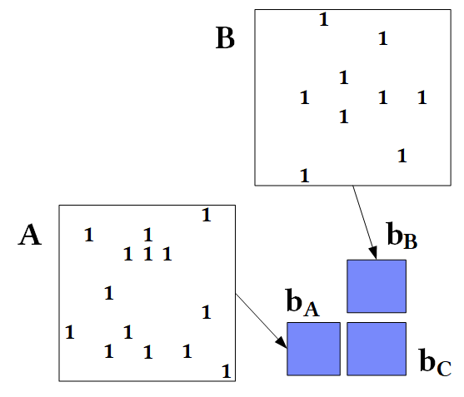
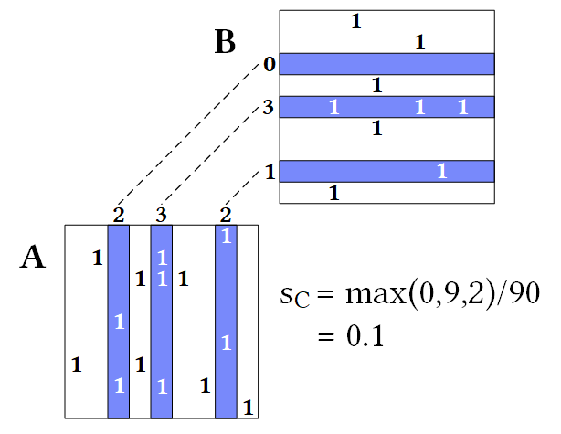
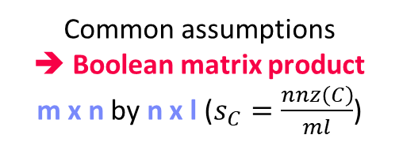


Existing MM Sparsity Estimators
Common assumptions
➔ Boolean matrix product
m x n by n x l ($s_{C}=\frac{nnz\left(C\right)}{ml}$)
Assumptions
  A1: No Cancellation Errors
  A2: No Not-A-Number (NaN*0=NaN)
#1 Naïve Metadata Estimators
  Derive the output sparsity solely
  from the sparsity of inputs (e.g., SystemML)
#2 Naïve Bitset Estimator
  Convert inputs to bitsets and perform Boolean mm
  Examples: SciDB [SSDBM’11], NVIDIA cuSparse, Intel MKL
#3 Sampling
  Take a sample of aligned columns of A and rows of B
  Sparsity estimated via max of count-products
  Examples: MatFast [ICDE’17], improvements in paper
$${\hat{s}}_{c}=1−{(1−s_{A}s_{B})}^{n}$$
$${\hat{s}}_{c}=\min\left(1,s_{A}n\right)⋅\min{(1, s_{B}n)}$$

Slide 5
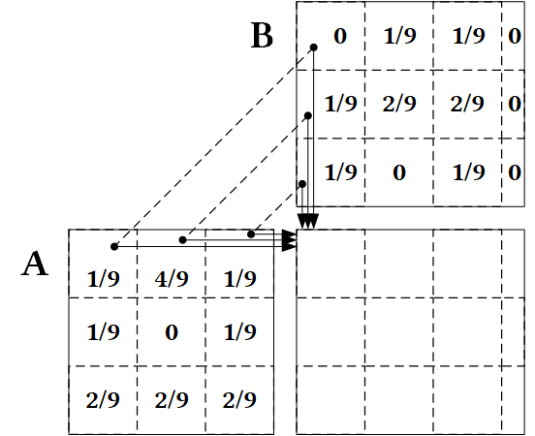
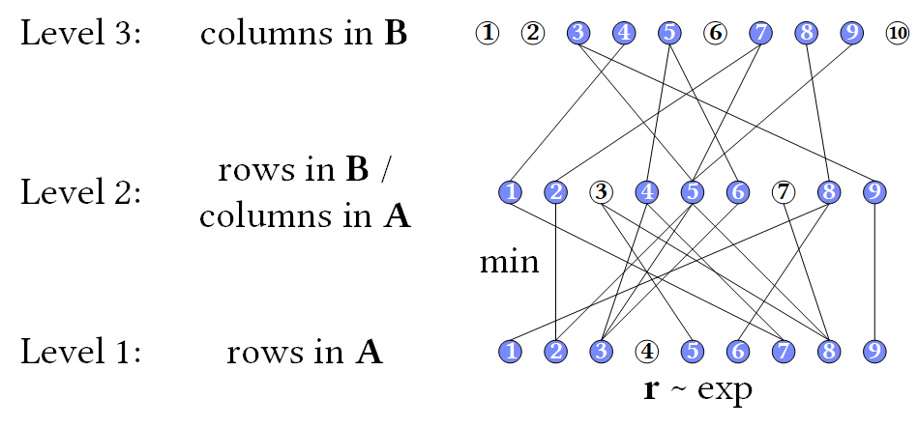
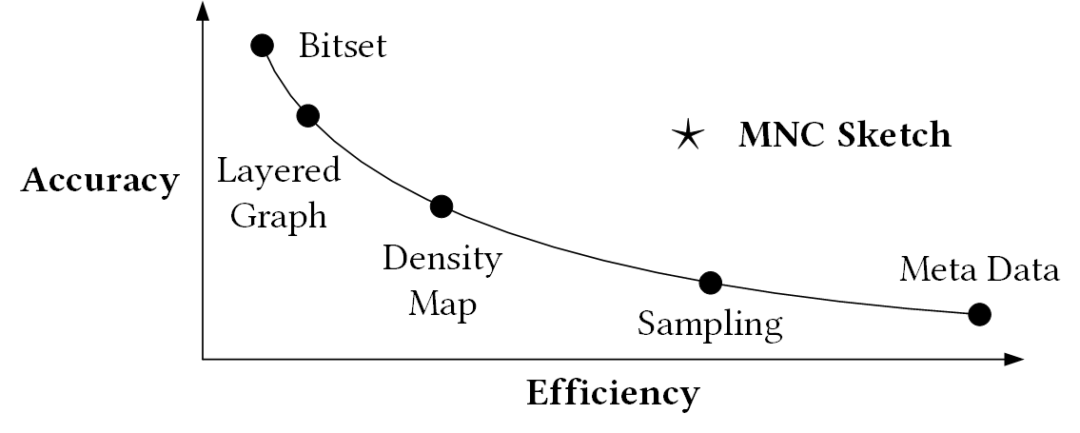
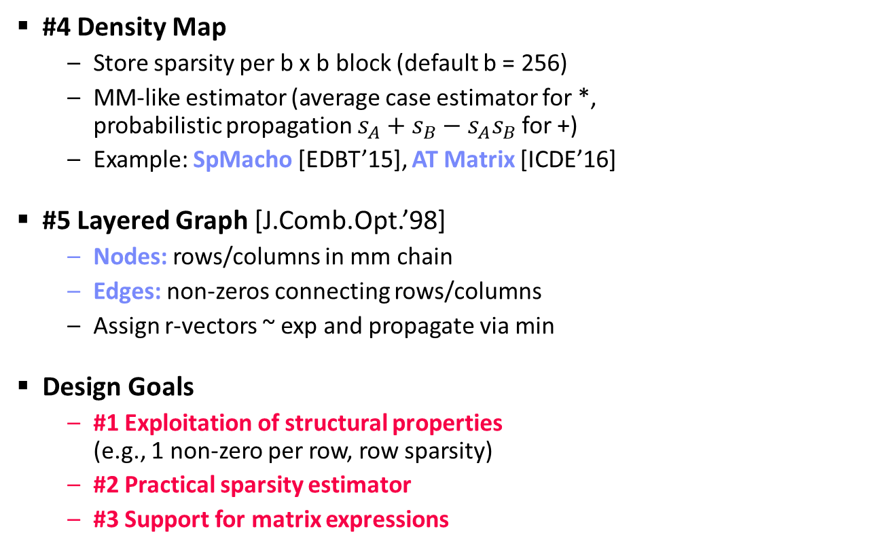
Existing MM Sparsity Estimators, cont.
#4 Density Map
  Store sparsity per b x b block (default b = 256)
  MM-like estimator (average case estimator for *,
  probabilistic propagation $s_{A}+s_{B}−s_{A}s_{B}$ for +)
  Example: SpMacho [EDBT’15], AT Matrix [ICDE’16]
#5 Layered Graph [J.Comb.Opt.’98]
  Nodes: rows/columns in mm chain
  Edges: non-zeros connecting rows/columns
  Assign r-vectors ~ exp and propagate via min
Design Goals
  #1 Exploitation of structural properties
  (e.g., 1 non-zero per row, row sparsity)
  #2 Practical sparsity estimator
  #3 Support for matrix expressions

Slide 6
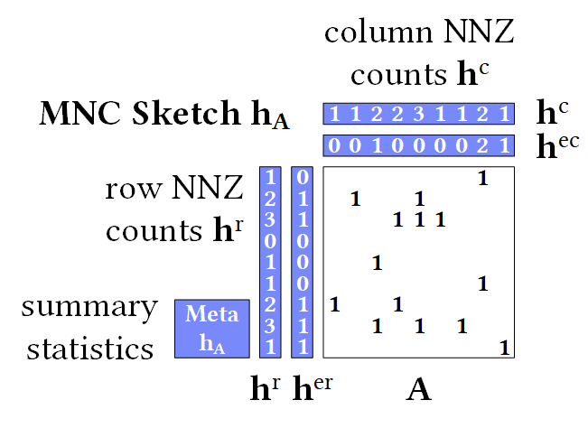
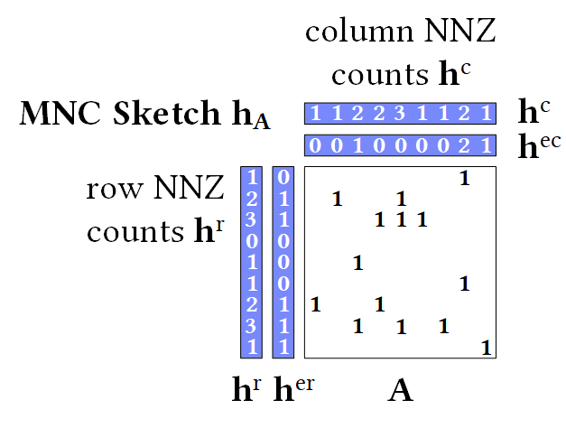
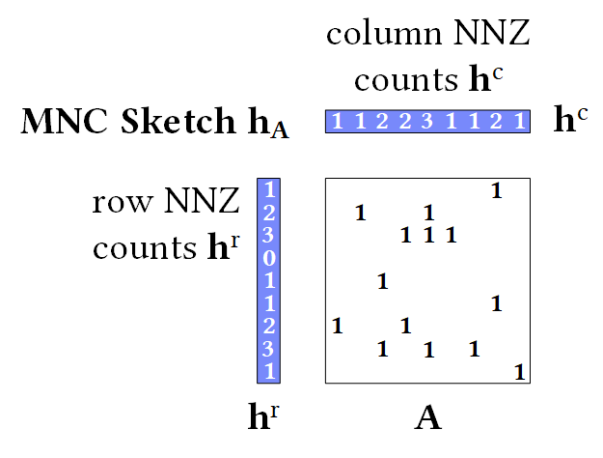
MNC (Matrix Non-zero Count) Sketch
#1 Row/Column NNZs
  Count vectors for nnz per row/col
  h^{r} = rowSums(A != 0)
  h^{c} = colSums(A != 0)
#2 Extended Row/Column NNZs
  h^{er} = rowSums((A!=0)*(h^{c}=1))
  h^{ec} = colSums((A!=0)*(h^{r}=1))
#3 Summary Statistics
  Max nnz per row/column
  # of non-empty rows/columns, # of half-full rows/columns
Construction: O(nnz(A))
  1st pass: compute basic row/column count vectors
  2nd pass: compute extended row/column count vectors, summary stats

Slide 7
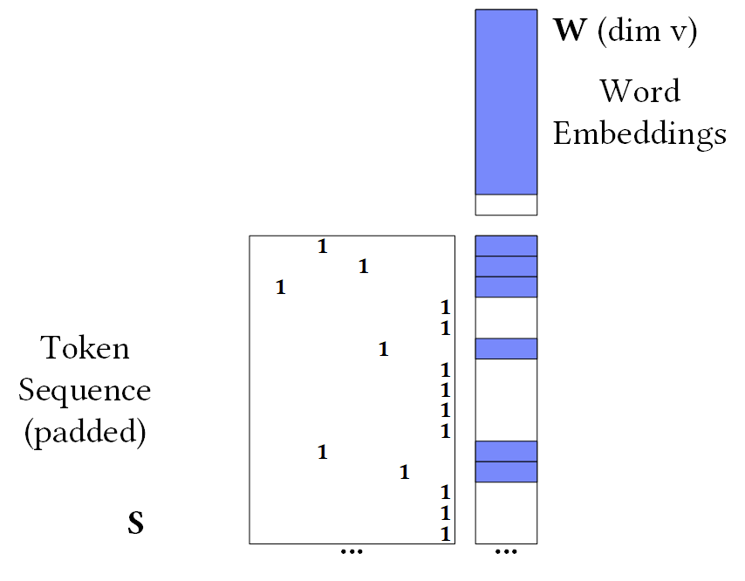
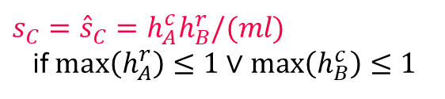

MNC Sparsity Estimation
3 0 2
B
Basic Estimator
  DensityMap-like estimator over column/rows slices
#1 Exact Sparsity Estimation
  Under assumptions A1 and A2
  exact sparsity estimation possible
  Intuition: dot product of counts because no aggregation / collisions
1 7 3
  A
$s_{C}={\hat{s}}_{C}=h_{A}^{c}h_{B}^{r}/(ml)$
if $max\left(h_{A}^{r}\right)≤1∨\max\left(h_{B}^{c}\right)≤1$
9
9
9
3
$$max\left(h_{A}^{r}\right)=1$$
3
…
3
0
1
0
2
0
1
1
1
0
9
0
1
s_{C} = (0*3 + 1*3 + 0*3
+ 2*3 + 0*3 + 1*3 + 1*3
+ 1*3 + 0*3 + 9*0) / 45
= 18 / 45 = 0.4
1
…
1
1
…

Slide 8
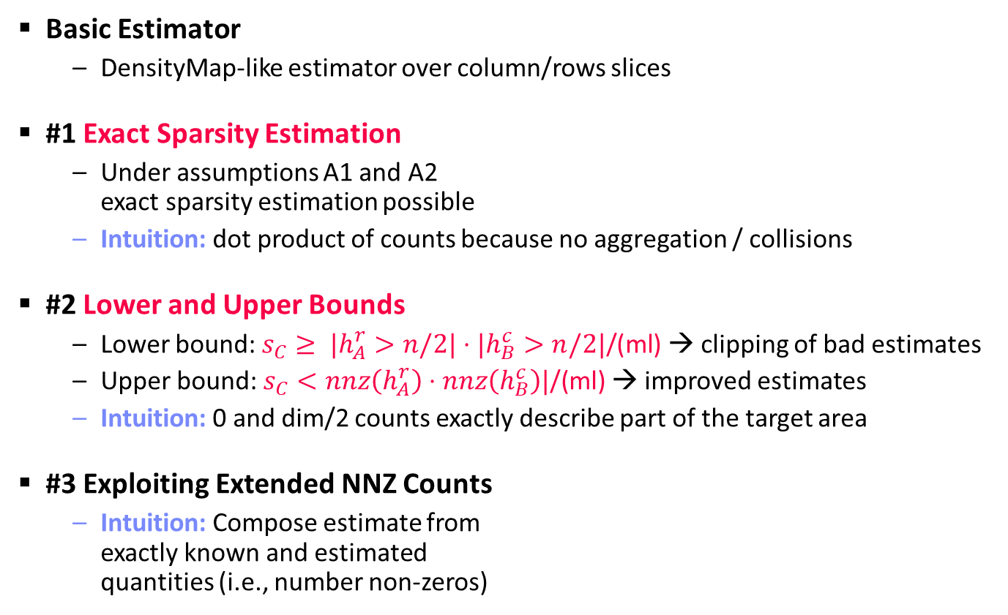
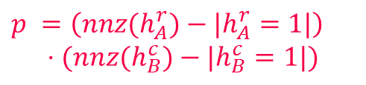
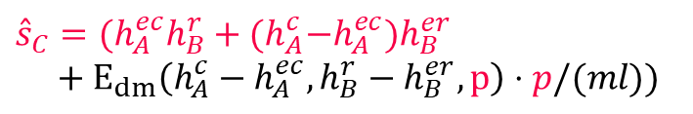
MNC Sparsity Estimation
3 0 2
B
Basic Estimator
  DensityMap-like estimator over column/rows slices
#1 Exact Sparsity Estimation
  Under assumptions A1 and A2
  exact sparsity estimation possible
  Intuition: dot product of counts because no aggregation / collisions
#2 Lower and Upper Bounds
  Lower bound: $s_{C}≥ |h_{A}^{r}>n/2|⋅|h_{B}^{c}>n/2|\text{/(}\text{ml}\text{)}$ → clipping of bad estimates
  Upper bound: $s_{C}<nnz\left(h_{A}^{r}\right)⋅nnz\left(h_{B}^{c}\right)|\text{/(}\text{ml}\text{)}$ → improved estimates
  Intuition: 0 and dim/2 counts exactly describe part of the target area
#3 Exploiting Extended NNZ Counts
  Intuition: Compose estimate from
  exactly known and estimated
  quantities (i.e., number non-zeros)
1 7 3
  A
$s_{C}={\hat{s}}_{C}=h_{A}^{c}h_{B}^{r}/(ml)$
if $max\left(h_{A}^{r}\right)≤1∨\max\left(h_{B}^{c}\right)≤1$
${\hat{s}}_{C}=(h_{A}^{ec}h_{B}^{r}+{(h}_{A}^{c}−h_{A}^{ec})h_{B}^{er}$
$+ E_{dm}\left(h_{A}^{c}−h_{A}^{ec},h_{B}^{r}−h_{B}^{er}, p\right)⋅p/(ml))$
$p =\left(nnz(h_{A}^{r})−|h_{A}^{r}=1|\right)$
$$⋅(nnz(h_{B}^{c})−|h_{B}^{c}=1|)$$

Slide 9
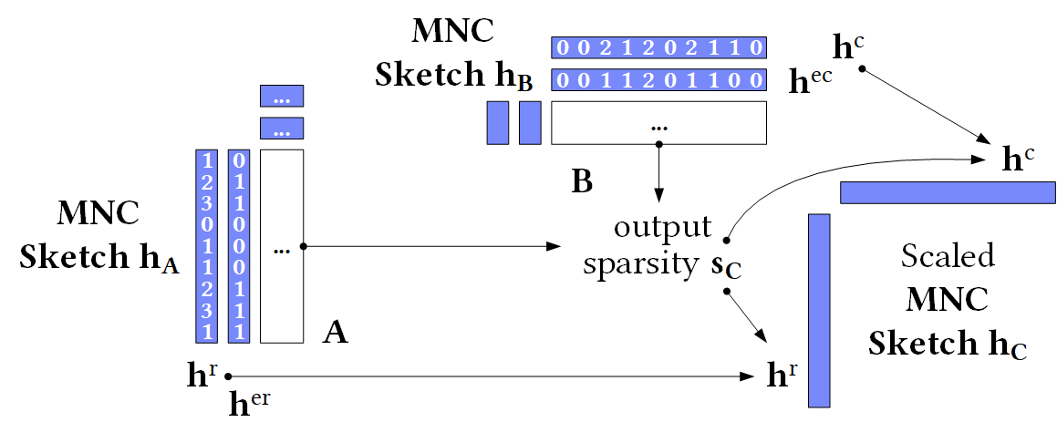
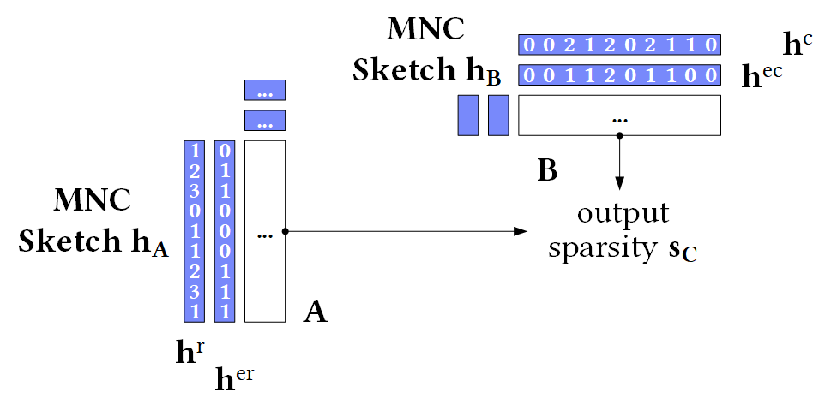

MNC Sketch Propagation
Basic Sketch Propagation
  Estimate sparsity ${\hat{s}}_{C}$
  Propagate $h_{A}^{r}$ and $h_{B}^{c}$
  scaled to sparsity ${\hat{s}}_{C}$
  → E.g., $\sum{h_{C}^{r}}≈{\hat{s}}_{C}ml$
  Assumption:
  Structure preserving
Probabilistic Rounding
  Ultra-sparse matrices → basic rounding would introduce bias
  $h_{C}^{r}=round(h_{A}^{r}⋅{\hat{s}}_{C}ml/\sum{h_{A}^{r}})$ w/ probability $h_{C}^{r}−\left\lfloor h_{C}^{r}\right\rfloor$ of rounding $h_{C}^{r}$ up
Exact Sketch Propagation
  If A or B are fully diagonal → propagate $h_{B}$ or $h_{A}$, respectively

Slide 10
MNC Additional Operations
Criticism: Long chains of pure matrix products rare in ML workloads
#1 Reorganization Operations
  Operations that change position
  of non-zero values
  Examples: transpose, reshape,
  diag, cbind and rbind
#2 Element-wise Operations
  Cell-wise operations with
  and without broadcasting
  Examples: A=0, A!=0, A+B, A*B
Sparsity Estimation and Sketch Propagation
in the paper

Slide 11
SparsEst: Sparsity Estimation Benchmark
B1 Structured Matrix Products (Struct)
B2 Real Matrix Operations (Real)
Name | Expression | Data
B1.1 NLP | X W | Syn1
B1.2 Scale | diag(λ) X | Syn2
B1.3 Perm | table(s1,s2) X | Syn2
B1.4 Outer | C R | Syn3/Syn4
B1.5 Inner | R C | Syn4/Syn3
Name | Expression | Data
B2.1 NLP | X W | AMin A
B2.2 Project | X P | Cov
B2.3 CoRefG | G t(G) | AMin R
B2.4 EmailG | G G | Email
B2.5 Mask | M * X | Mnist1m
B3 Real Matrix Expressions (Chain)
Name | Expression | Data
B3.1 NLP | reshape(X W) | AMin A
B3.2 Scale&Shift | t(S) t(X) diag(w) X S B | Mnist1m
B3.3 Graph | P G G G G | AMin R
B3.4 Recomm. | (P X != 0) * (P L t(R)) | Amazon
B3.5 Predicate | X * (R * S + T) != 0 | Mnist1m
25.1M x 2.5M, 3.9e-7
1M x 784, 0.25
3.1M x 3.1M, 2.6e-6
8M x 2.3M, 1.2e-6
Notes:
Amazon, 8Mx2.3M, 1.2e-6
AMin A, 25.1M x 2.5M, 3.9e-7
AMin R, 3.1M x 3.1M, 2.6e-6
Cov 581K x 54, 0.22
Email, 265M x 265K, 6e-6
Mnist1, 1M x 784, 0.25
Amin A: 17,646,972 sentences with 374,677,894 tokens, max length of 2,508 tokens, and encoded with dictionary of size 2,518,950.

Slide 12
Experimental Setup
HW and SW Setting
  2+10 node cluster w/ 2-socket Xeon E5-2620 (24 vcores, 128GB memory)
  CentOS 7.2, OpenJDK 1.8.0_151, Apache Hadoop 2.7.3 with 80GB heap
Baselines (available at https://github.com/apache/systemml)
  FP64 dense / sparse matrix multiplication (ground truth)
  Meta data estimators: MetaWC, MetaAC
  Bitset estimator: Bitset
  Sampling-based estimator: Sample (f = 5%)
  Density map estimator: DMap (b = 256, FP64)
  Layered graph estimator: LGraph (r = 32)
  MNC sparsity estimator: MNC basic, MNC
Baselines for Word Embeddings
  Primitives in TensorFlow and PyTorch only return dense tensors
Single-threaded estimators
(multi-threaded experiments
in the paper)

Slide 13
Construction and Estimation
MNC close
to Sampling
Bitset/Dmap densifying
[20K,20K] x [20K,20K] → [20K,20K]
[10K,x] x [x,10K] → [10K,10K]
Construction
Estimation
O(nnz(A))
Construct once, estimate many times
Notes:
1) MNC close to sampling and significantly faster than bitset or the layered graph
2) With increasing dimensions/sparsity density map and bitset become less competitive
3) Sampling dominated by on-the fly sampling, MNC by construction → good for estimating many times
REMARK: 8 TFLops workload dense

Slide 14
Accuracy SparsEst Benchmark
B1.1 NLP
B1.3 Perm
B1.4 Outer
B1.5 Inner
Exact
Exact
Exact
Exact
Upper bound
B1 Struct
B2.1 NLP
B2.2 Project
B2.3 CoRefG
B2.4 EmailG
Exact
Exact
B2 Real
Exact
Exact
But: Also
negative results
e.g., for B3.3 with
vanishing structure
(in the paper)
B3.1 NLP
B3.4 Rec
B3 Chain
B3.5 Pred

Slide 15
Conclusions
Summary
  Analysis of existing sparsity estimators
  MNC Sketch: simple, count-based sketch for matrix expressions
  SparsEst: new sparsity estimation benchmark (struct, real, chains)
Conclusions
  Exploitation of structural properties ➔ good accuracy at low overhead
  Versatile MNC sketch ➔ broadly applicable in ML systems
  Lots of future work: bounds, operations, optimizer integration, distributed
Available open source in SystemML/SystemDS
https://github.com/apache/systemml
https://github.com/tugraz-isds/systemds
Notes:
Additional Contributions (in the paper)
Extended sampling-based estimators
DP mmchain optimizer based on MNC sketches

Slide 16
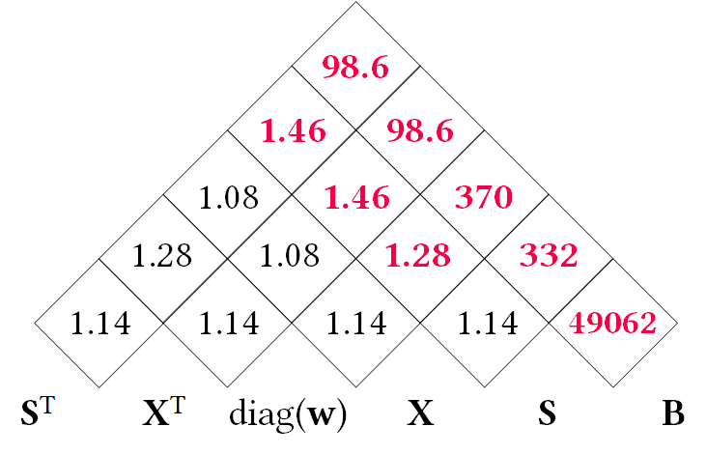
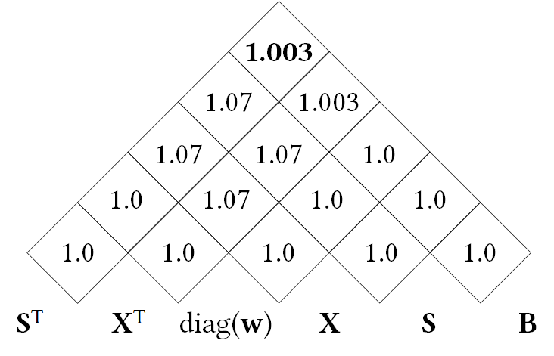
Backup: Accuracy B3.2 All Intermediates
Scale
X
S
Neg. column means
Background: Deferred Standardization
  Mean subtraction is densifying
  Substitute standardized X with
  X %*% S and optimize mm chain
Accuracy B3.2
  Mnist1m
Shift
Dense output if colMeans non-zero
t(X) %*% diag(w) %*% X %*% B →
t(S) %*% t(X) %*% diag(w) %*% X %*% S %*% B
Density Map
MNC Sketch
MMChain Opt Memo Table
Notes:
Candidate for backup

