Slide 1

Architecture of ML Systems
01 Introduction and Overview
Last update: Mar 02, 2022

Slide 2



Announcements/Org
#1 Video Recording
  Link in TeachCenter & TUbe (lectures will be public)
  Optional attendance (independent of COVID)
  Hybrid, in-person, TUbe video-recording, and
  webex live: https://tugraz.webex.com/meet/m.boehm
  Update: status ORANGE, max 50% capacity, 2.5G rule
#2 Course Registrations (as of Mar 02)
  Architecture of Machine Learning Systems (AMLS):
  Bachelor/master/PhD ratio? CS/other ratio?
#3 Gründungsgarage Volume XVIII
  Academic Startup Accelerator
  https://www.gruendungsgarage.at/
  Next application deadline: Mar 13, 2022
111 (7)

Slide 3
Agenda
Data Management Group
Motivation and Goals
Course Organization
Course Outline, and Projects
Apache SystemDS and DAPHNE

Slide 4
Data Management Group
https://damslab.github.io/

Slide 5




About Me
Data Management Group
2018-2022 TU Graz, Austria
  BMK endowed chair for data management
  Data management for data science
  (ML systems internals, end-to-end data science lifecycle)
2012-2018 IBM Research – Almaden, USA
  Declarative large-scale machine learning
  Optimizer and runtime of Apache SystemML
2011 PhD TU Dresden, Germany
  Cost-based optimization of integration flows
  Systems support for time series forecasting
  In-memory indexing and query processing
https://github.com/
apache/systemds
DB group

Slide 6
Data Management Courses
Data Management Group
Architecture of
Database Systems
(ADBS, WS)
DB system internals
+ prog. project
Architecture of
ML Systems
(AMLS, SS)
ML system internals
Prog. projects in SystemDS
[github.com/apache/systemds]
Master
Data Integration and Large-Scale Analysis
(DIA, WS)
Distributed
Data Management
Bachelor
Intro to Scientific Writing (WS)
Data Management / Databases
(DM, SS+WS)
Data management from user/application perspective

Slide 7
Motivation and Goals

Slide 8
Example ML Applications (Past/Present)
Motivation and Goals
Transportation / Space
  Lemon car detection and reacquisition (classification, seq. mining)
  Airport passenger flows from WiFi data (time series forecasting)
  Data analysis for assisted driving (various use cases)
  Automotive vehicle development (ML-assisted simulations)
  Satellite senor analytics (regression and correlation)
  Earth observation and local climate zone classification and monitoring
Finance
  Water cost index based on various influencing factors (regression)
  Insurance claim cost per customer (model selection, regression)
  Financial analysts survey correlation (bivariate stats w/ new tests)
Health Care
  Breast cancer cell grow from histopathology images (classification)
  Glucose trends and warnings (clustering, classification)
  Emergency room diagnosis / patient similarity (classification, clustering)
  Patient survival analysis and prediction (Cox regression, Kaplan-Meier)

Slide 9
A Car Reacquisition Scenario
Motivation and Goals
Features
Labels
Machine
Learning
Algorithm
Class skew
Low precision
Warranty Claims
Algorithm
Predictive Models
Repair History
Algorithm
Diagnostic Readouts
Algorithm
➔ 25x
improved precision
+ custom loss functions
+ hyper-parameter tuning

Slide 10
Example ML Applications (Past/Present), cont.
Motivation and Goals
Production/Manufacturing
  Paper and fertilizer production (regression/classification, anomalies)
  Semiconductor manufacturing, and material degradation modeling
  Mixed waste sorting and recycling (composition, alignment, quality)
Other Domains
  Machine data: errors and correlation (bivariate stats, seq. mining)
  Smart grid: energy demand/RES supply, weather models (forecasting)
  Elastic flattening via sparse linear algebra (spring-mass system)
Information Extraction
  NLP contracts → rights/obligations (classification, error analysis)
  PDF table recognition and extraction, OCR (NMF clustering, custom)
  Learning explainable linguistic expressions (learned FOL rules, classification)
Algorithm Research (+ various state-of-the art algorithms)
  User/product recommendations via various forms of NMF
  Localized, supervised metric learning (dim reduction and classification)
  Learning word embeddings via orthogonalized skip-gram

Slide 11
What is an ML System?
Motivation and Goals
Classification
Regression
Recommenders
Clustering
Dim Reduction
Neural Networks
Statistics
Data Mining
Machine Learning (ML)
ML Applications
(entire KDD/DS lifecycle)
Rapidly Evolving
Runtime Techniques (Execution, Data Access)
ML System
Compilation Techniques
Distributed Systems
HPC
Data Management
Accelerators
Operating Systems
Prog. Language Compilers
HW Architecture

Slide 12
What is an ML System?, cont.
Motivation and Goals
ML System
  Narrow focus: SW system that executes ML applications
  Broad focus: Entire system (HW, compiler/runtime, ML application)
  Trade-off runtime/resources vs accuracy
  Early days: no standardizations (except some exchange formats), lots of different languages and system architectures, but many shared concepts
Course Objectives
  Architecture and internals of modern (large-scale) ML systems
    Microscopic view of ML system internals
    Macroscopic view of ML pipelines and data science lifecycle
  #1 Understanding of characteristics → better evaluation / usage
  #2 Understanding of effective techniques → build/extend ML systems

Slide 13
Course Organization

Slide 14
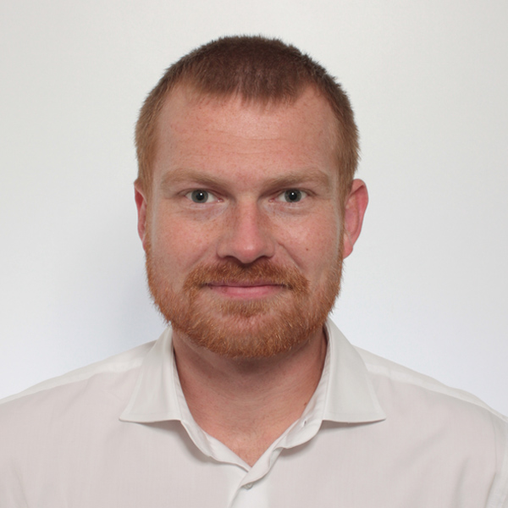


Basic Course Organization
Course Organization
Staff
  Lecturer: Univ.-Prof. Dr.-Ing. Matthias Boehm, ISDS
  Assistants: M.Sc. Shafaq Siddiqi, M.Sc. Sebastian Baunsgaard
Language
  Lectures and slides: English
  Communication and examination: English/German
Course Format
  VU 2/1, 5 ECTS (2x 1.5 ECTS + 1x 2 ECTS), bachelor/master
  Weekly lectures (start 12.15pm, including Q&A), attendance optional
  Mandatory programming project or exercises (2 ECTS)
  Recommended papers for additional reading on your own
Prerequisites (preferred)
  Basic courses Data Management/Databases, and
  Basic courses on applied ML / Knowledge Discovery and Data Mining

Slide 15
Course Logistics
Course Organization
Website
  https://mboehm7.github.io/teaching/ss22_amls/index.htm
  All course material (lecture slides) and dates
Video Recording / Live Streaming Lectures (TUbe, webex)
Communication
  Informal language (first name is fine)
  Please, immediate feedback (unclear content, missing background)
  Newsgroup: N/A – email is fine, summarized in following lectures
  Office hours: by appointment or after lecture
Exam
  Completed programming project (checked by me/staff)
  Final written exam (oral exam if <=25 students take the exam)
  Grading (30% project/exercises completion, 70% exam)

Slide 16
Course Logistics, cont.
Course Organization
Course Applicability
  Master programs computer science (CS), as well as
  software engineering and management (SEM)
    Catalog Data Science (compulsory course in major, and elective)
    Catalog Machine Learning (elective course)
    Catalog Interactive and Visual Information Systems (elective course)
    Catalog Software Technology (elective course)
  PhD CS doctoral school list of courses
  Free subject course in any other study program or university

Slide 17
Course Outline and Projects
Partially based on
[Matthias Boehm, Arun Kumar, Jun Yang: Data Management in Machine Learning Systems. Synthesis Lectures on Data Management, Morgan & Claypool Publishers 2019]
Major updates in SS2020, SS2021, and SS2022

Slide 18
Part A: Overview and ML System Internals
Course Outline and Projects
01 Introduction and Overview [Mar 04]
02 Languages, Architectures, and System Landscape [Mar 11]
03 Size Inference, Rewrites, and Operator Selection [Mar 18]
04 Operator Fusion and Runtime Adaptation [Mar 25]
05 Data- and Task-Parallel Execution [Apr 01]
06 Parameter Servers [Apr 08]
07 Hybrid Execution and HW Accelerators [Apr 29]
08 Caching, Partitioning, Indexing, and Compression [May 06]

Slide 19
Part B: ML Lifecycle Systems
Course Outline and Projects
09 Data Acquisition, Cleaning, and Preparation [May 13]
10 Model Selection and Management [May 20]
11 Model Debugging, Fairness, and Explainability [Jun 03]
12 Model Serving Systems and Techniques [Jun 10]
13 Q&A and Exam Preparation

Slide 20


Programming Projects
Course Outline and Projects
Open Source Projects
  Programming project in context of open source projects
    Apache SystemDS: https://github.com/apache/systemds
    DAPHNE: https://daphne-eu.eu/
    (private repo but OSS release end 03/2022)
    Other OSS projects possible, but harder to merge PRs
  Commitment to open source and open communication (PRs, mailing list)
  Remark: Don’t be afraid to ask questions / develop code in public
Objectives
  Non-trivial feature in an ML system (2 ECTS → 50 hours)
  OSS processes: Break down into subtasks, code/tests/docs, PR per project,
  code review, incorporate review comments, etc
Team
  Individuals or up to three-person teams (w/ separated responsibilities)

Slide 21
Alternative Exercise
Course Outline and Projects
Task: ML Pipeline [to be published Mar 11]
  Given the TBD dataset(s) (e.g., UCI/Kaggle Wine or others)
  Data Prep: Setup train/test/validation splits; perform
  data validation, data augmentation, feature engineering
  Modeling: Compare multiple baseline models using an OSS ML system
  Tuning: hyper-parameter tuning and cross validation
  Parallelization: parallelize your ML pipeline (at least the tuning part)
  Debugging: Perform model debugging and investigate explainability
Objectives
  End-to-end development of an ML pipeline on real data
  Handle data issues, under-specified objectives, model training and debugging
Team
  Individuals or up to three-person teams (w/ separated responsibilities)

Slide 22


Apache SystemDS:
A Declarative ML System for the
End-to-End Data Science Lifecycle
Background and System Architecture
https://github.com/apache/systemds

Slide 23

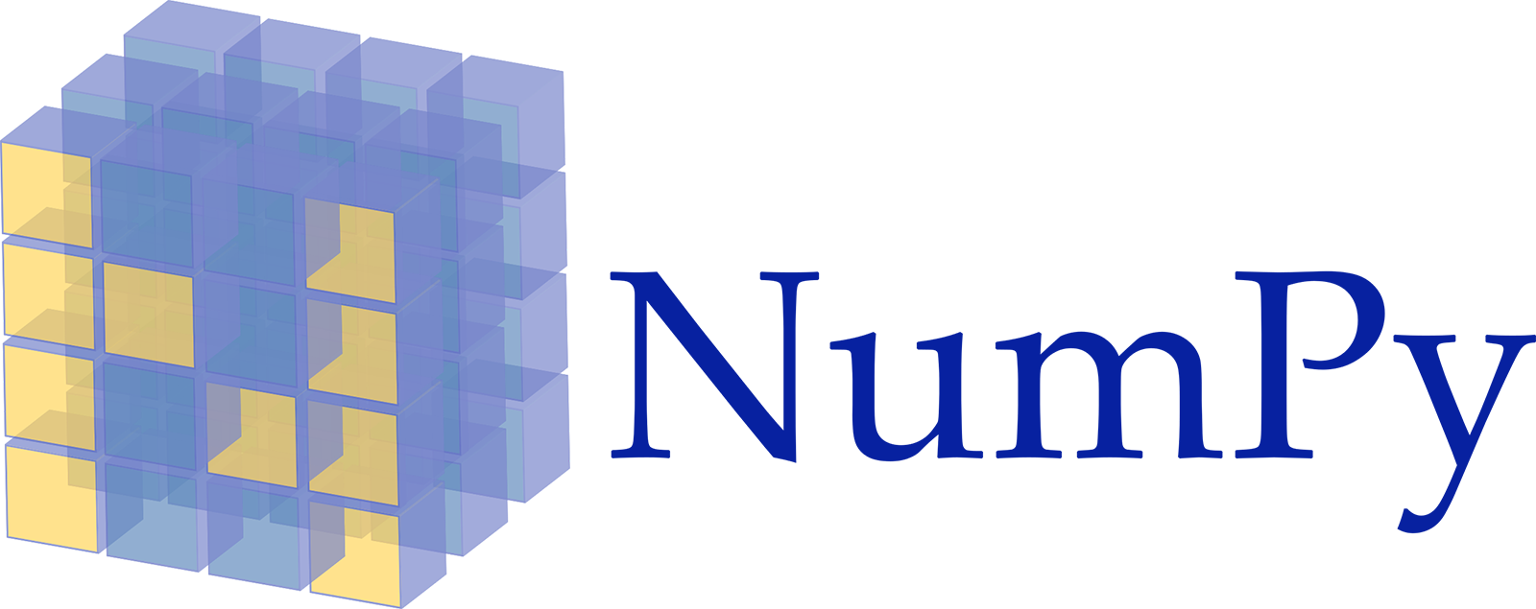











Landscape of ML Systems
Overview Apache SystemDS
Existing ML Systems
  #1 Numerical computing frameworks
  #2 ML Algorithm libraries (local, large-scale)
  #3 Linear algebra ML systems (large-scale)
  #4 Deep neural network (DNN) frameworks
  #5 Model management, and deployment
Exploratory Data-Science Lifecycle
  Open-ended problems w/ underspecified objectives
  Hypotheses, data integration, run analytics
  Unknown value → lack of system infrastructure
  → Redundancy of manual efforts and computation
Data Preparation Problem
  80% Argument: 80-90% time for finding, integrating, cleaning data
  Diversity of tools ➔ boundary crossing, lack of optimization
“Take these datasets and show value or competitive advantage”
[NIPS 2015]
[DEBull 2018]

Slide 24




The Data Science Lifecycle aka KDD Process aka CRISP-DM
Overview Apache SystemDS
Data-centric View:
Application perspective
Workload perspective
System perspective
Data extraction, schema alignment, entity resolution, data validation, data cleaning, outlier detection, missing value imputation, semantic type detection, data augmentation, feature selection, feature engineering, feature transformations
Data Scientist
Data Integration
Data Cleaning
Data Preparation
Data Integration
Data Cleaning
Data Preparation
Model Selection
Training
Hyper-parameters
Validate & Debug
Deployment
Scoring & Feedback
Exploratory Process
(experimentation, refinements, ML pipelines)
Data/SW Engineer
DevOps Engineer
Key observation: SotA
data integration/cleaning based on ML

Slide 25
Example: Linear Regression Conjugate Gradient
Overview Apache SystemDS
1: X = read($1); # n x m matrix
2: y = read($2); # n x 1 vector
3: maxi = 50; lambda = 0.001;
4: intercept = $3;
5: ...
6: r = -(t(X) %*% y);
7: norm_r2 = sum(r * r); p = -r;
8: w = matrix(0, ncol(X), 1); i = 0;
9: while(i<maxi & norm_r2>norm_r2_trgt)
10: {
11: q = (t(X) %*% (X %*% p))+lambda*p;
12: alpha = norm_r2 / sum(p * q);
13: w = w + alpha * p;
14: old_norm_r2 = norm_r2;
15: r = r + alpha * q;
16: norm_r2 = sum(r * r);
17: beta = norm_r2 / old_norm_r2;
18: p = -r + beta * p; i = i + 1;
19: }
20: write(w, $4, format="text");
Note:
#1 Data Independence
#2 Implementation-Agnostic Operations
Read matrices from HDFS/S3
Compute initial gradient
Compute conjugate gradient
Compute
step size
Update model and residuals
➔ “Separation
of Concerns”

Slide 26
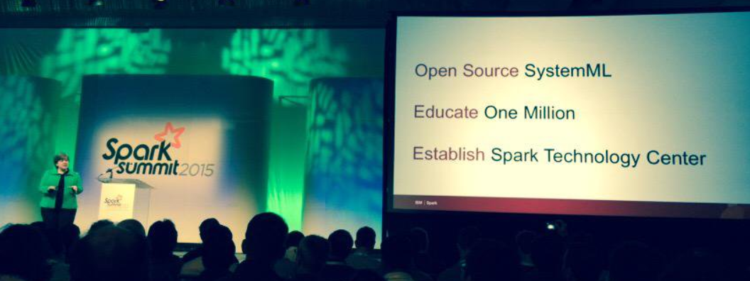



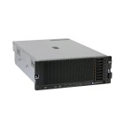

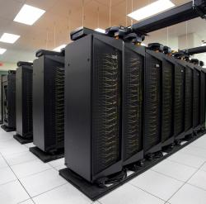
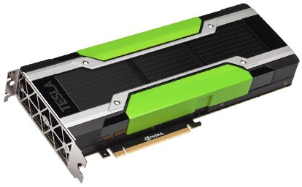
Apache SystemML/SystemDS
Overview Apache SystemDS
DML Scripts
APIs: Command line, JMLC,
Spark MLContext, Spark ML,
(20+ Scalable Algorithms)
Language
Compiler
[SIGMOD’15,’17,’19,’21abc]
[PVLDB’14,’16ab,’18]
[ICDE’11,’12,’15]
[CIDR’17,’20]
[VLDBJ’18]
[DEBull’14]
[PPoPP’15]
07/2020 Renamed to SystemDS
05/2017 Apache Top-Level Project
11/2015 Apache Incubator Project
08/2015 Open Source Release
Runtime
Write Once, Run Anywhere
In-Memory Single Node
(scale-up)
Hadoop or Spark Cluster
(scale-out)
In-Progress:
GPU
since 2014/16
since 2012
since 2010/11
since 2015

Slide 27
Basic HOP and LOP DAG Compilation
Overview Apache SystemDS
LinregDS (Direct Solve)
X = read($1);
y = read($2);
intercept = $3;
lambda = 0.001;
...
if( intercept == 1 ) {
ones = matrix(1, nrow(X), 1);
X = append(X, ones);
}
I = matrix(1, ncol(X), 1);
A = t(X) %*% X + diag(I)*lambda;
b = t(X) %*% y;
beta = solve(A, b);
...
write(beta, $4);
Cluster Config:
driver mem: 20 GB
exec mem: 60 GB
Scenario:
X: 10⁸ x 10³, 10¹¹
y: 10⁸ x 1, 10⁸
HOP DAG
(after rewrites)
8KB
CP
write
8MB
16MB
CP
b(solve)
CP
172KB
b(+)
1.6TB
CP
SP
800GB
r(diag)
ba(+*)
ba(+*)
SP
1.6TB
r(t)
8KB
SP
CP
800GB
800MB
dg(rand)
(10³x1,10³)
X
(10⁸x10³,10¹¹)
y
(10⁸x1,10⁸)
LOP DAG
(after rewrites)
16KB
r’(CP)
Hybrid Runtime Plans:
  Size propagation / memory estimates
  Integrated CP / Spark runtime
  Dynamic recompilation during runtime
Distributed Matrices
  Fixed-size (squared) matrix blocks
  Data-parallel operations
mapmm(SP)
tsmm(SP)
800MB
1.6GB
r’(CP)
X
X_{1,1}
(persisted in MEM_DISK)
y
X_{2,1}
X_{m,1}

Slide 28
Static and Dynamic Rewrites
Overview Apache SystemDS
Example Static Rewrites (size-indep.)
  Common Subexpression Elimination
  Constant Folding / Branch Removal /
  Block Sequence Merge
  Static Simplification Rewrites
  Right/Left Indexing Vectorization
  For Loop Vectorization
  Spark checkpoint/repartition injection
Example Dynamic Rewrites (size-dep.)
  Dynamic Simplification Rewrites
  Matrix Mult Chain Optimization
trace(X%*%Y) → sum(X*t(Y))
Y
O(n³)
O(n²)
X
X
Y ┬
→
*
sum(λ*X) → λ*sum(X)
sum(X+Y) → sum(X)+sum(Y)
rowSums(X) → X, iff ncol(X)=1
sum(X^2) → X%*%t(X), iff ncol(X)=1
t(X)
1kx1k
X
1kx1k
Z
1
t(X)
1kx1k
X
1kx1k
p
1
Size propagation and sparsity estimation
→
2,002 MFLOPs
4 MFLOPs

Slide 29
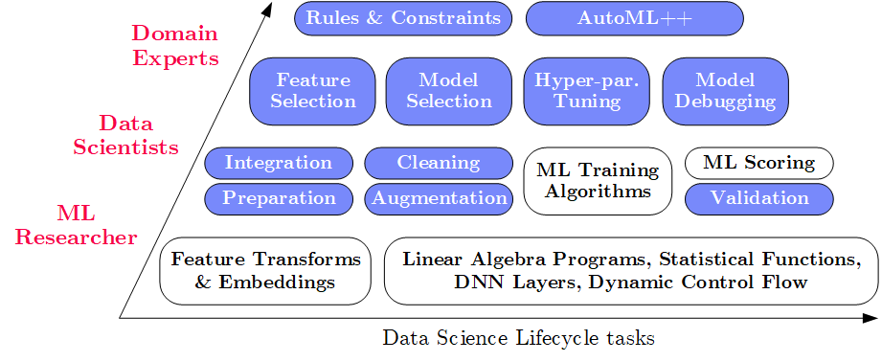
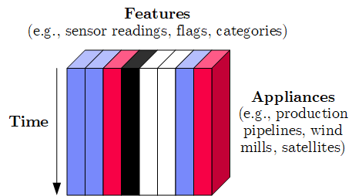
Apache SystemDS Design
Overview Apache SystemDS
Apache SystemML (since 2010)
→ SystemDS (09/2018)
→ Apache SystemDS (07/2020)
Objectives
  Effective and efficient data preparation, ML, and model debugging at scale
  High-level abstractions for different lifecycle tasks and users
#1 Based on DSL for ML Training/Scoring
  Hierarchy of abstractions for DS tasks
  ML-based SotA, interleaved, performance
#2 Hybrid Runtime Plans and Optimizing Compiler
  System infrastructure for diversity of algorithm classes
  Different parallelization strategies and new architectures (Federated ML)
  Abstractions → redundancy → automatic optimization
#3 Data Model: Heterogeneous Tensors
  Data integration/prep requires generic data model

Slide 30
Language Abstractions and APIs, cont.
Overview Apache SystemDS
Example: Stepwise Linear Regression
User Script
Built-in Functions
X = read(‘features.csv’)
Y = read(‘labels.csv’)
[B,S] = steplm(X, Y,
icpt=0, reg=0.001)
write(B, ‘model.txt’)
m_steplm = function(...) {
while( continue ) {
parfor( i in 1:n ) {
if( !fixed[1,i] ) {
Xi = cbind(Xg, X[,i])
B[,i] = lm(Xi, y, ...)
} }
# add best to Xg
# (AIC)
} }
m_lmCG = function(...) {
while( i<maxi&nr2>tgt ) {
q = (t(X) %*% (X %*% p))
+ lambda * p
beta = ... }
}
m_lm = function(...) {
if( ncol(X) > 1024 )
B = lmCG(X, y, ...)
else
B = lmDS(X, y, ...)
}
Linear Algebra Programs
Feature Selection
Facilitates optimization across data science lifecycle tasks
ML Algorithms
m_lmDS = function(...) {
l = matrix(reg,ncol(X),1)
A = t(X) %*% X + diag(l)
b = t(X) %*% y
beta = solve(A, b) ...}

Slide 31
Apache SystemDS Architecture
Overview Apache SystemDS
> 83,400 tests
> 8,500 DSL tests
[M. Boehm, I. Antonov, S. Baunsgaard, M. Dokter, R. Ginthör, K. Innerebner, F. Klezin, S. N. Lindstaedt,
A. Phani, B. Rath, B. Reinwald, S. Siddiqui, S. Benjamin Wrede: SystemDS: A Declarative Machine Learning System for the End-to-End Data Science Lifecycle. CIDR 2020]

Slide 32
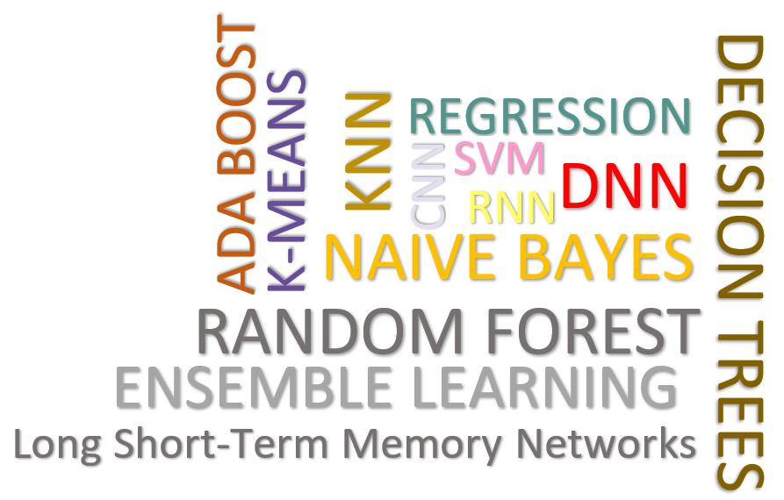
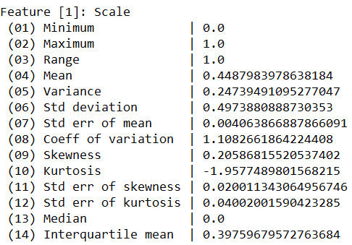
Data Cleaning Pipelines
Apache SystemDS: Selected Features and Research
[WIP] WashHouse:
Data Cleaning Benchmark
Automatic Generation of Cleaning Pipelines
  Library of robust, parameterized data cleaning primitives
  Enumeration of DAGs of primitives & hyper-parameter optimization (HB, BO)
Data Samples
Logical
Data- and Task-parallel Computation
O
Physical
LP₁
LP₂
…
LP_{n}
Top-k Pipelines
Target
App
…
…
…
PP₁
PP_{n}
PP₁
PP_{n}
PP₁
PP_{n}
Rules/Objectives
Outlier Detection → MVI → Deduplication → Resolve Mislabels
P_{1:} gmm → imputeFD → mergeDup → delML
P_{n:} outlierBySd→ mice → delDup → voting
Debugging
University | Country
TU Graz | Austria
TU Graz | Austria
TU Graz | Germany
IIT | India
IIT | IIT
IIT | Pakistan
IIT | India
SIBA | Pakistan
SIBA | null
SIBA | null
University | Country
TU Graz | Austria
TU Graz | Austria
TU Graz | Austria
IIT | India
IIT | India
IIT | India
IIT | India
SIBA | Pakistan
SIBA | Pakistan
SIBA | Pakistan
A | B | C | D
0.77 | 0.80 | 1 | 1
0.96 | 0.12 | 1 | 1
0.66 | 0.09 | null | 1
0.23 | 0.04 | 17 | 1
0.91 | 0.02 | 17 | null
0.21 | 0.38 | 17 | 1
0.31 | null | 17 | 1
0.75 | 0.21 | 20 | 1
null | null | 20 | 1
0.19 | 0.61 | 20 | 1
0.64 | 0.31 | 20 | 1
A | B | C | D
0.77 | 0.80 | 1 | 1
0.96 | 0.12 | 1 | 1
0.66 | 0.09 | 17 | 1
0.23 | 0.04 | 17 | 1
0.91 | 0.02 | 17 | 1
0.21 | 0.38 | 17 | 1
0.31 | 0.29 | 17 | 1
0.75 | 0.21 | 20 | 1
0.41 | 0.24 | 20 | 1
0.19 | 0.61 | 20 | 1
0.64 | 0.31 | 20 | 1
Dirty Data
After imputeFD(0.5)
Dirty Data
After MICE

Slide 33


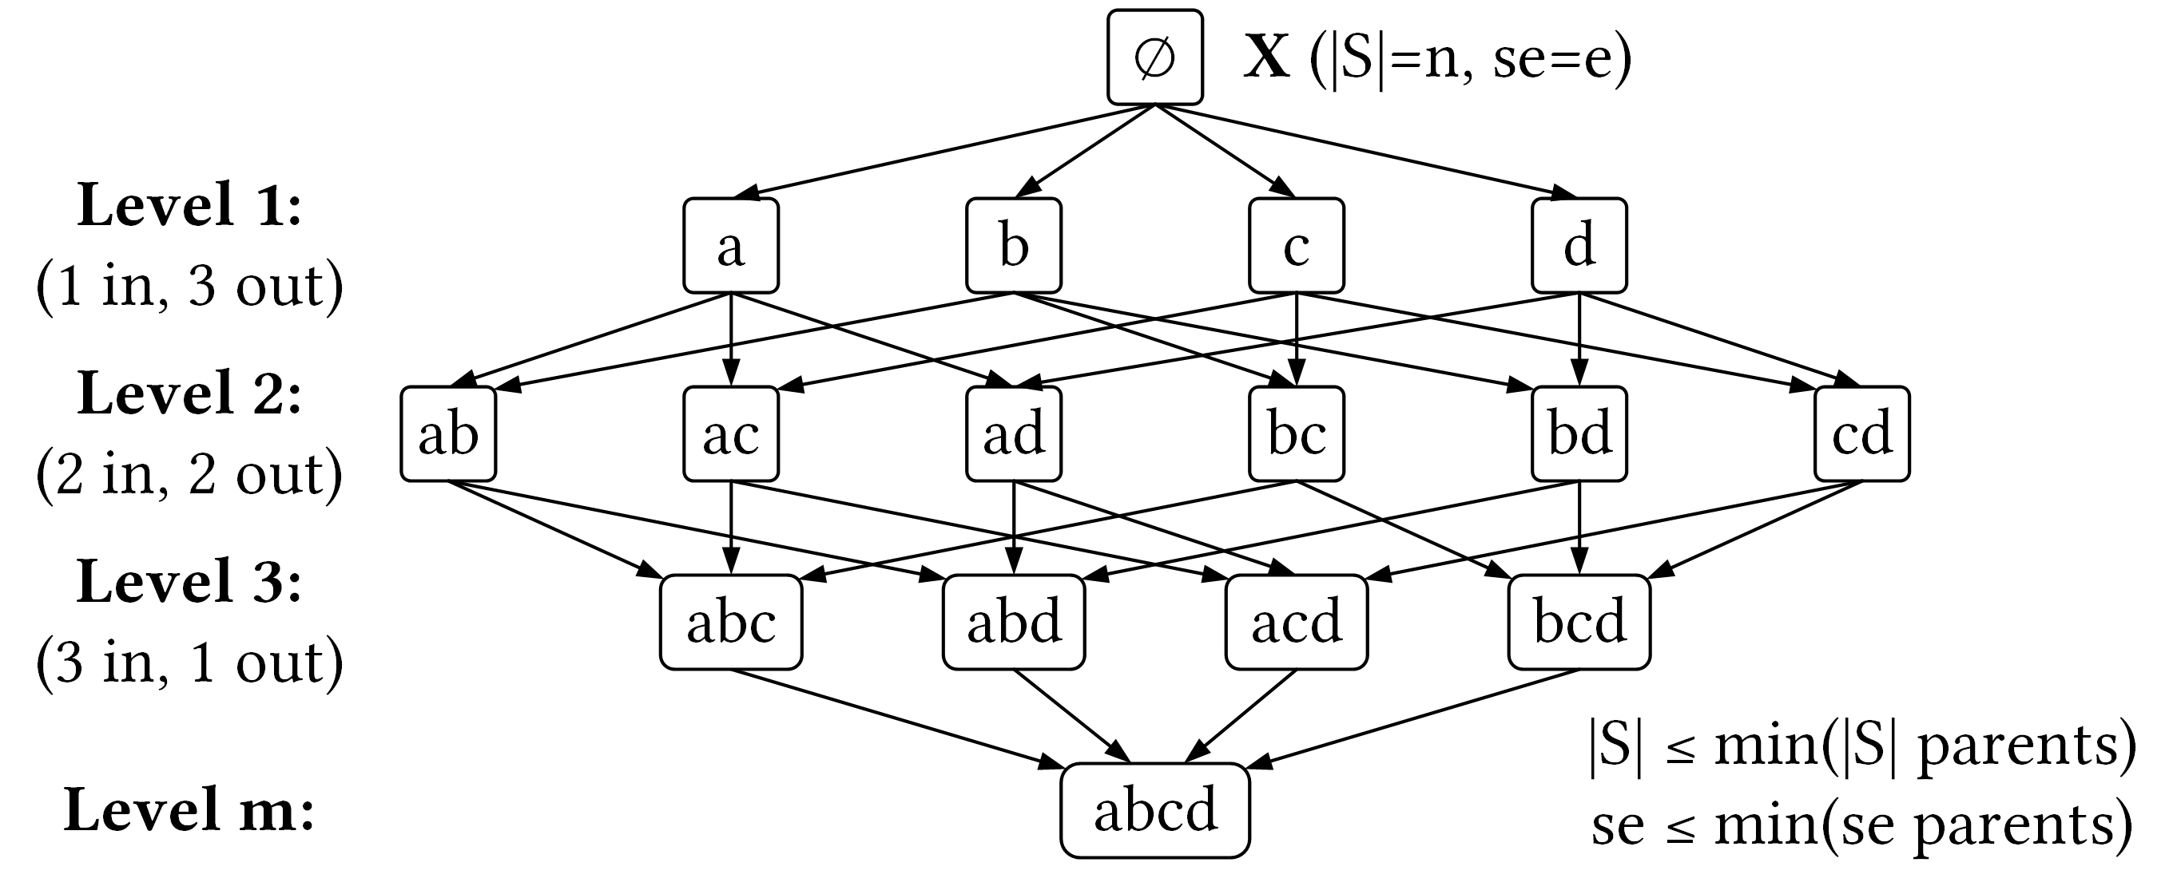
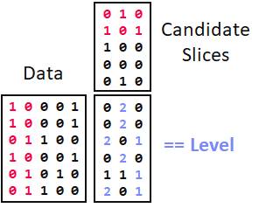
SliceLine for Model Debugging
Apache SystemDS: Selected Features and Research
[SIGMOD’21c]
[Credit: sliceline,
Silicon Valley, HBO]
Problem Formulation
  Intuitive slice
  scoring function
  Exact top-k slice finding
  $\left|S\right|≥σ∧sc\left(S\right)>0$
  $α∈(0,1]$
Properties & Pruning
  Monotonicity of slice sizes, errors
  Upper bound sizes/errors/scores
  → pruning & termination
Linear-Algebra-based Slice Finding
  Recoded matrix X, error vector e
  Vectorized implementation in linear algebra
  (join & eval via sparse-sparse matrix multiply)
  Local and distributed task/data-parallel execution
$$\begin{matrix}sc & = & α\left(\frac{\overline{e}(S)}{\overline{e}(X)}−1\right)−\left(1−α\right)\left(\frac{\left|X\right|}{\left|S\right|}−1\right) \\ & = & α\left(\frac{\left|X\right|}{\left|S\right|}⋅\frac{\sum_{i=1}^{|S|}{es_{i}}}{\sum_{i=1}^{|X|}{e_{i}}}−1\right)−\left(1−α\right)\left(\frac{\left|X\right|}{\left|S\right|}−1\right)\end{matrix}$$
slice error
slice size

Slide 34
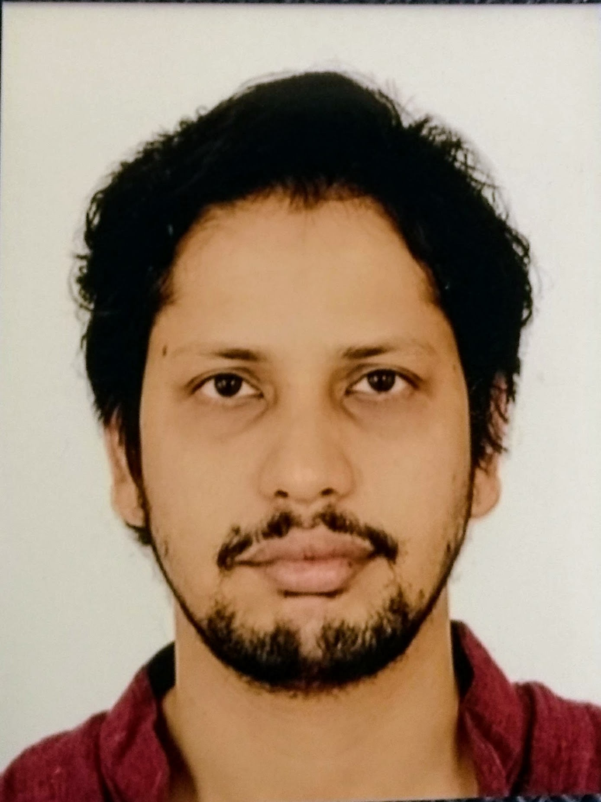

Multi-Level Lineage Tracing & Reuse
Apache SystemDS: Selected Features and Research
[SIGMOD’21a]
Lineage as Key Enabling Technique
  Trace lineage of operations (incl. non-determinism), dedup for loops/functions
  Model versioning, data reuse, incremental maintenance, autodiff, debugging
Full Reuse of Intermediates
  Before executing instruction,
  probe output lineage in cache
  Map<Lineage, MatrixBlock>
  Cost-based/heuristic caching
  and eviction decisions (compiler-assisted)
Partial Reuse of Intermediates
  Problem: Often partial result overlap
  Reuse partial results via dedicated
  rewrites (compensation plans)
  Example: steplm
for( i in 1:numModels )
R[,i] = lm(X, y, lambda[i,], ...)
m_lmDS = function(...) {
l = matrix(reg,ncol(X),1)
A = t(X) %*% X + diag(l)
b = t(X) %*% y
beta = solve(A, b) ...}
m_steplm = function(...) {
while( continue ) {
parfor( i in 1:n ) {
if( !fixed[1,i] ) {
Xi = cbind(Xg, X[,i])
B[,i] = lm(Xi, y, ...)
} }
# add best to Xg
# (AIC)
} }
X
m>>n
t(X)

Slide 35
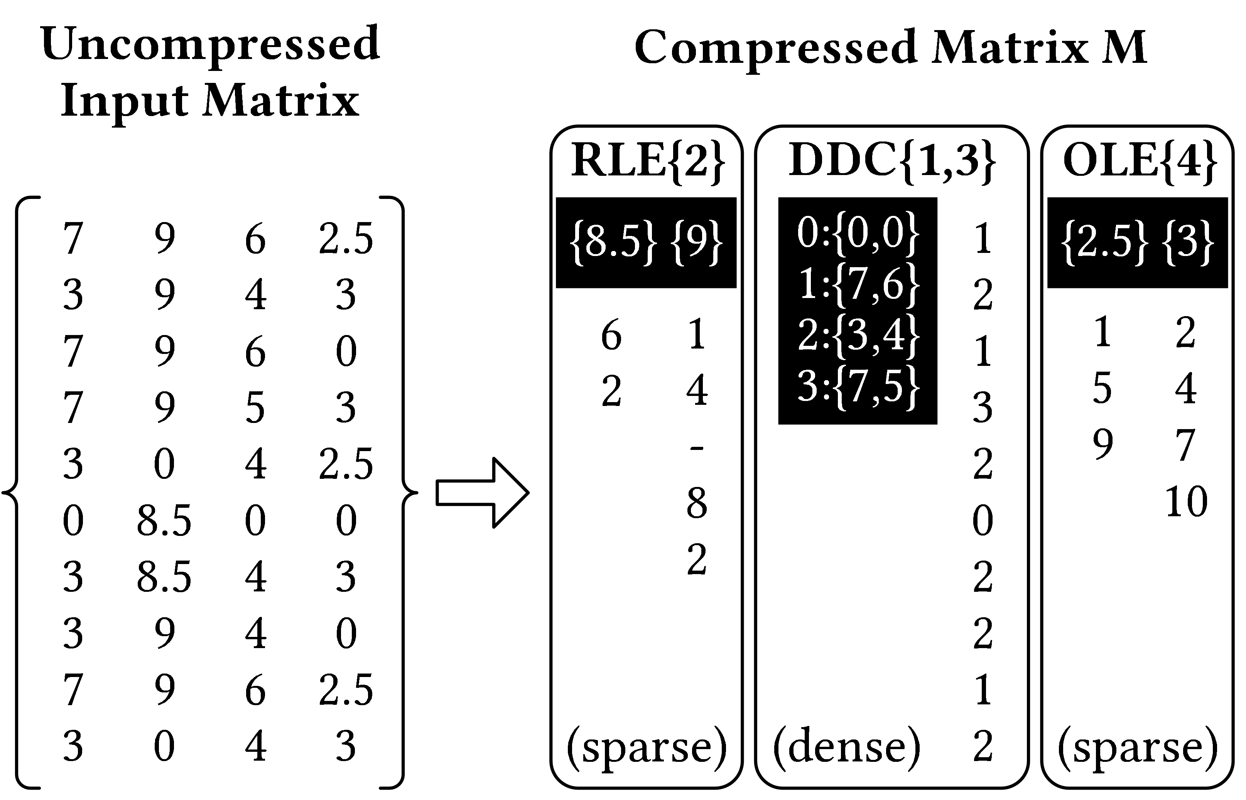
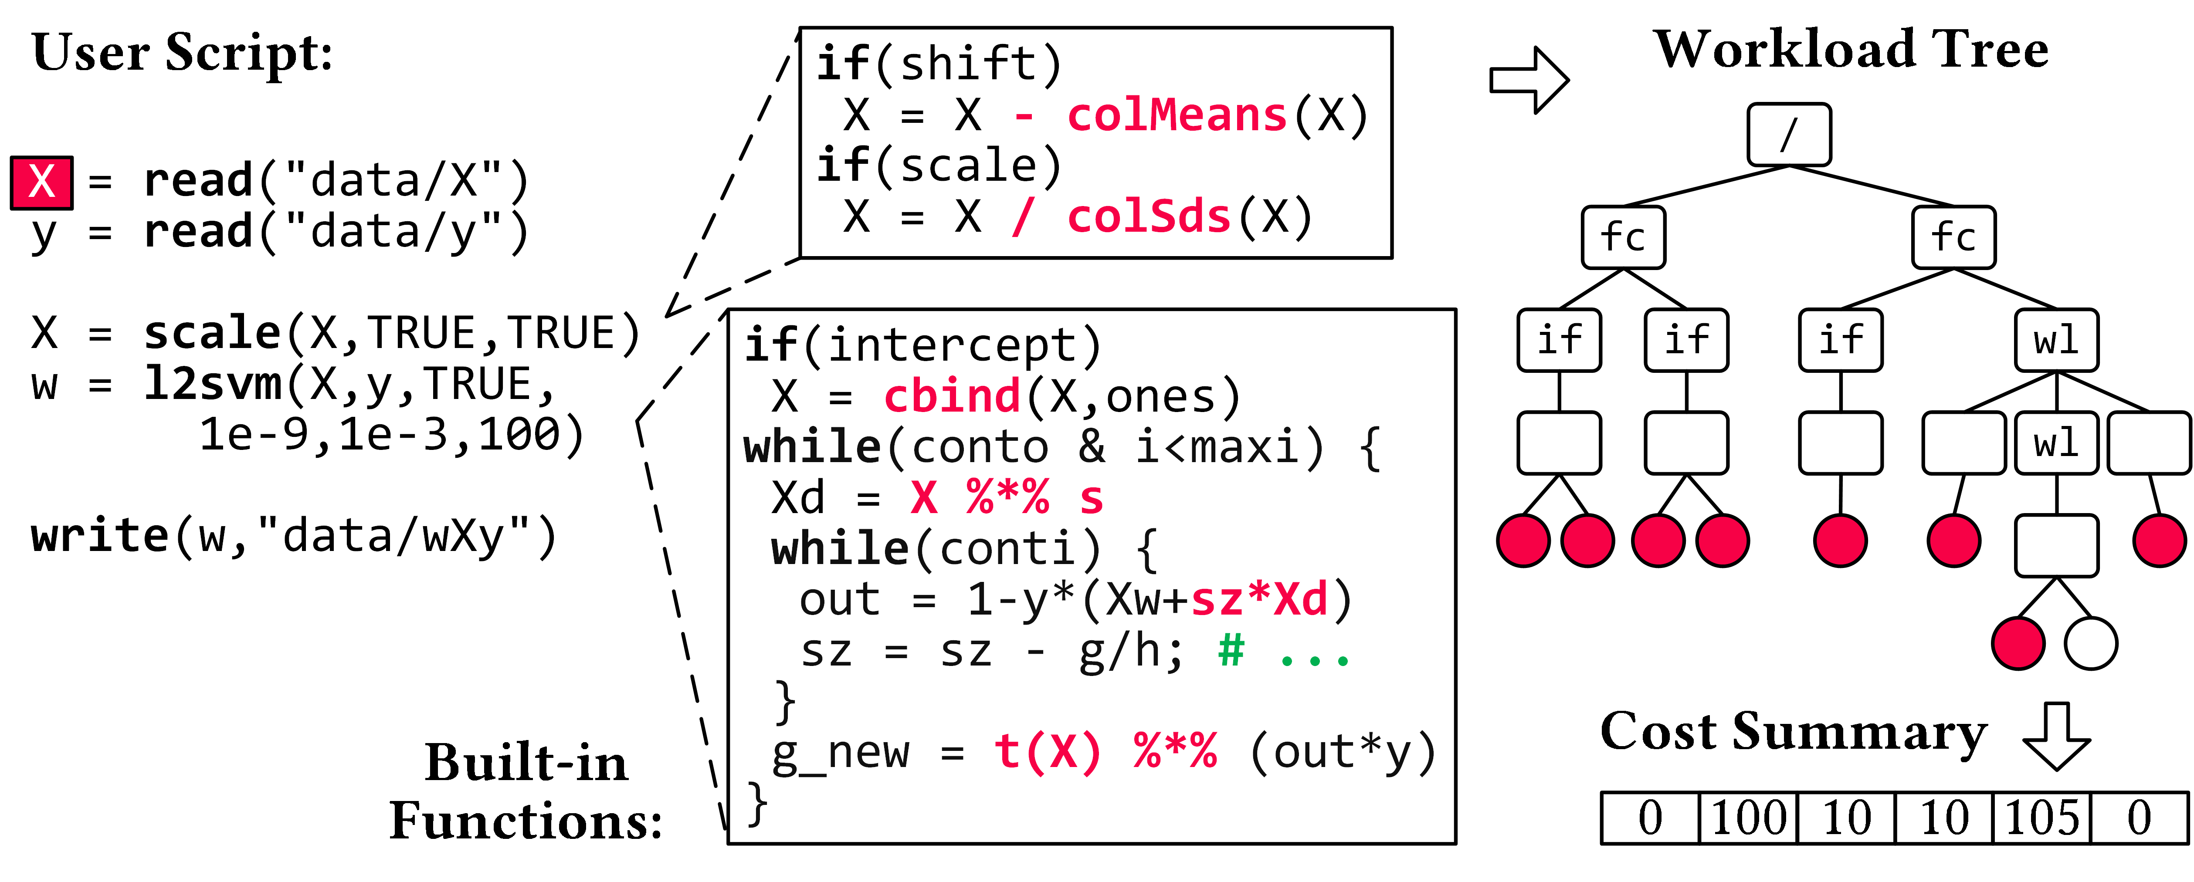
Compressed Linear Algebra Extended
Apache SystemDS: Selected Features and Research
[under submission]
Lossless Matrix Compression
  Improved general applicability (compression time, new compression schemes, new kernels, intermediates, workload-aware)
  Sparsity → Redundancy exploitation
  (data redundancy, structural redundancy)
Workload-aware Compression
  Workload summary → compression
  Compression → execution planning

Slide 36





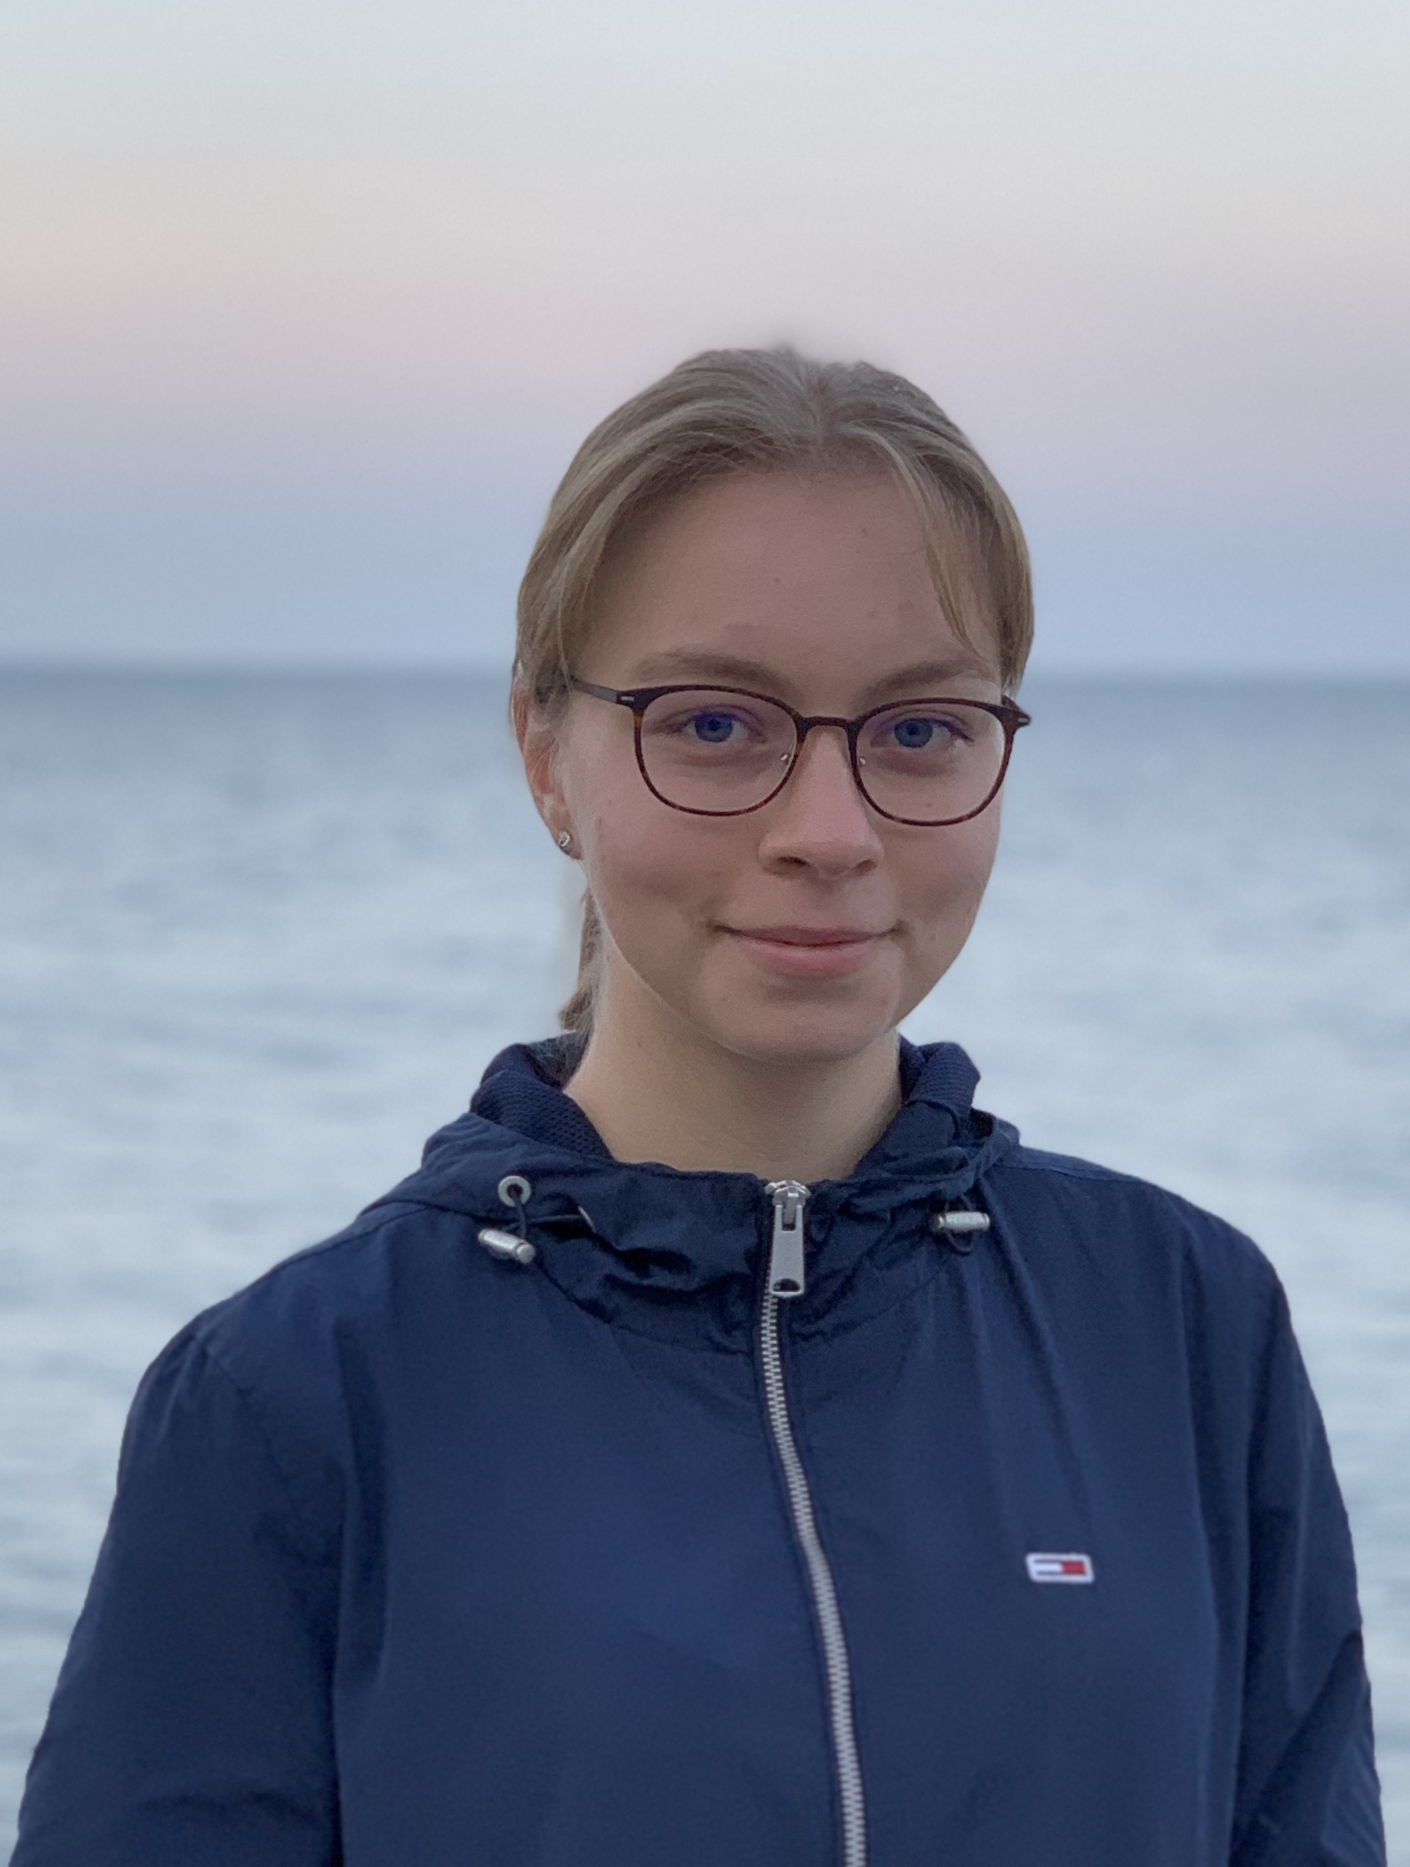
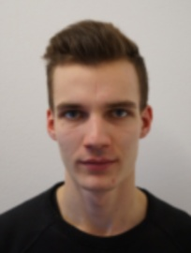

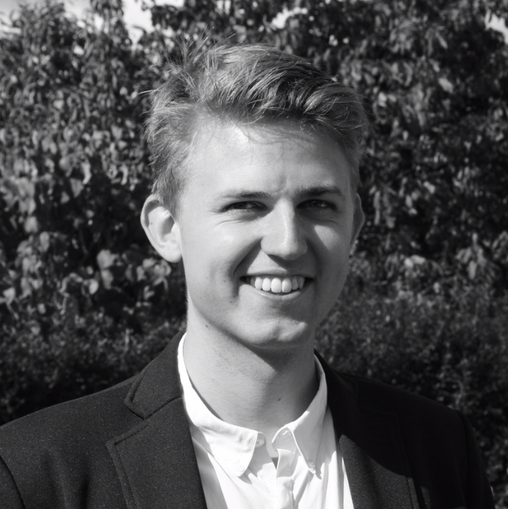

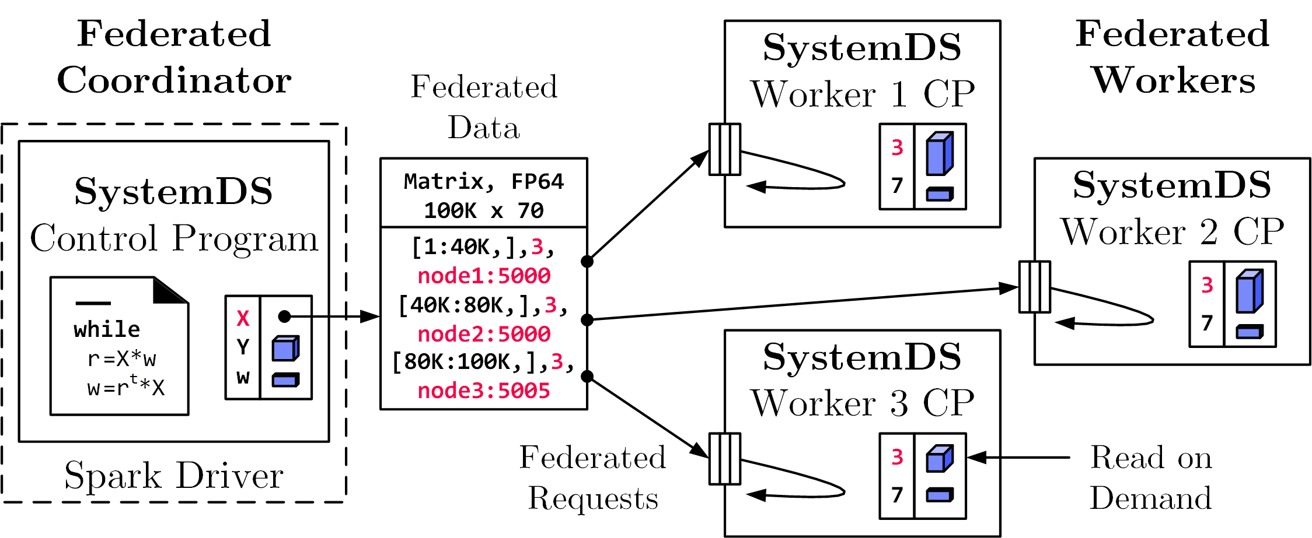
Federated Learning
Apache SystemDS
[SIGMOD 2021b]
Federated Backend
  Federated data (matrices/frames) as meta data objects
  Federated linear algebra, (and federated parameter server)
Federated Requests: READ, PUT, GET, EXEC_INST, EXEC_UDF, CLEAR
X = federated(addresses=list(node1, node2, node3),
ranges=list(list(0,0), list(40K,70), ..., list(80K,0), list(100K,70)));

Slide 37
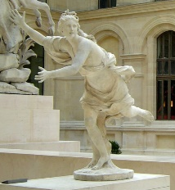















An Open and Extensible System Infrastructure for Integrated Data Analysis Pipelines https://daphne-eu.eu/
Integrated Data Analysis Pipelines
for Large-scale Data Management,
HPC, and Machine Learning;
DAPHNE daughter of river god Peneus (fountains, streams), chased by Apollo
The DAPHNE project is funded by the European Union's Horizon 2020 research and innovation program under grant agreement number 957407 for the time period from Dec/2020 through Nov/2024.
[Louvre, Paris]

Slide 38
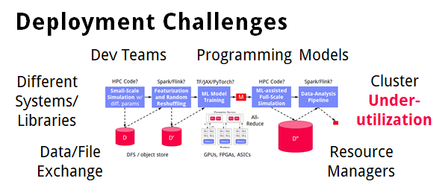
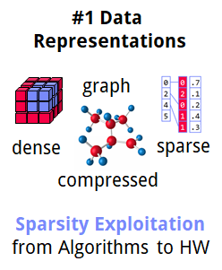
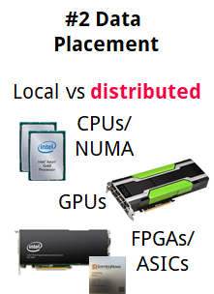
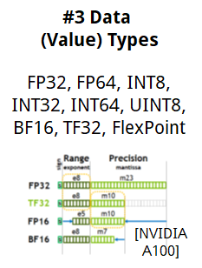
Motivation
➔ DAPHNE Overall Objective:
Open and extensible system infrastructure
DAPHNE Project
Integrated Data Analysis Pipelines
  Open data formats, query processing
  Data preprocessing and cleaning
  ML model training and scoring
  HPC, custom codes, and simulations
Hardware Challenges
  DM+ML+HPC share compilation
  and runtime techniques /
  converging cluster hardware
  End of Dennard scaling:
  P = α CFV² (power density 1)
  End of Moore’s law
  Amdahl’s law: sp = 1/s
  ➔ Increasing Specialization

Slide 39
DAPHNE Use Cases
DAPHNE Project
[Xiao Xiang Zhu et al: So2Sat LCZ42: A Benchmark Dataset for the Classification of Global Local Climate Zones. GRSM 2020]
DLR Earth Observation
  ESA Sentinel-1/2 datasets → 4PB/year
  Training of local climate zone classifiers on
  So2Sat LCZ42 (15 experts, 400K instances,
  10 labels each, 85% confidence, ~55GB H5)
  ML pipeline: preprocessing, ResNet18,
  climate models
IFAT Semiconductor Ion Beam Tuning
KAI Semiconductor Material Degradation
AVL Vehicle Dev Process (ejector geometries, KPIs)
ML-assisted simulations, data cleaning, augmentation
[So2Sat LC42 Dataset
https://mediatum.ub.tum.de/1454690]

Slide 40
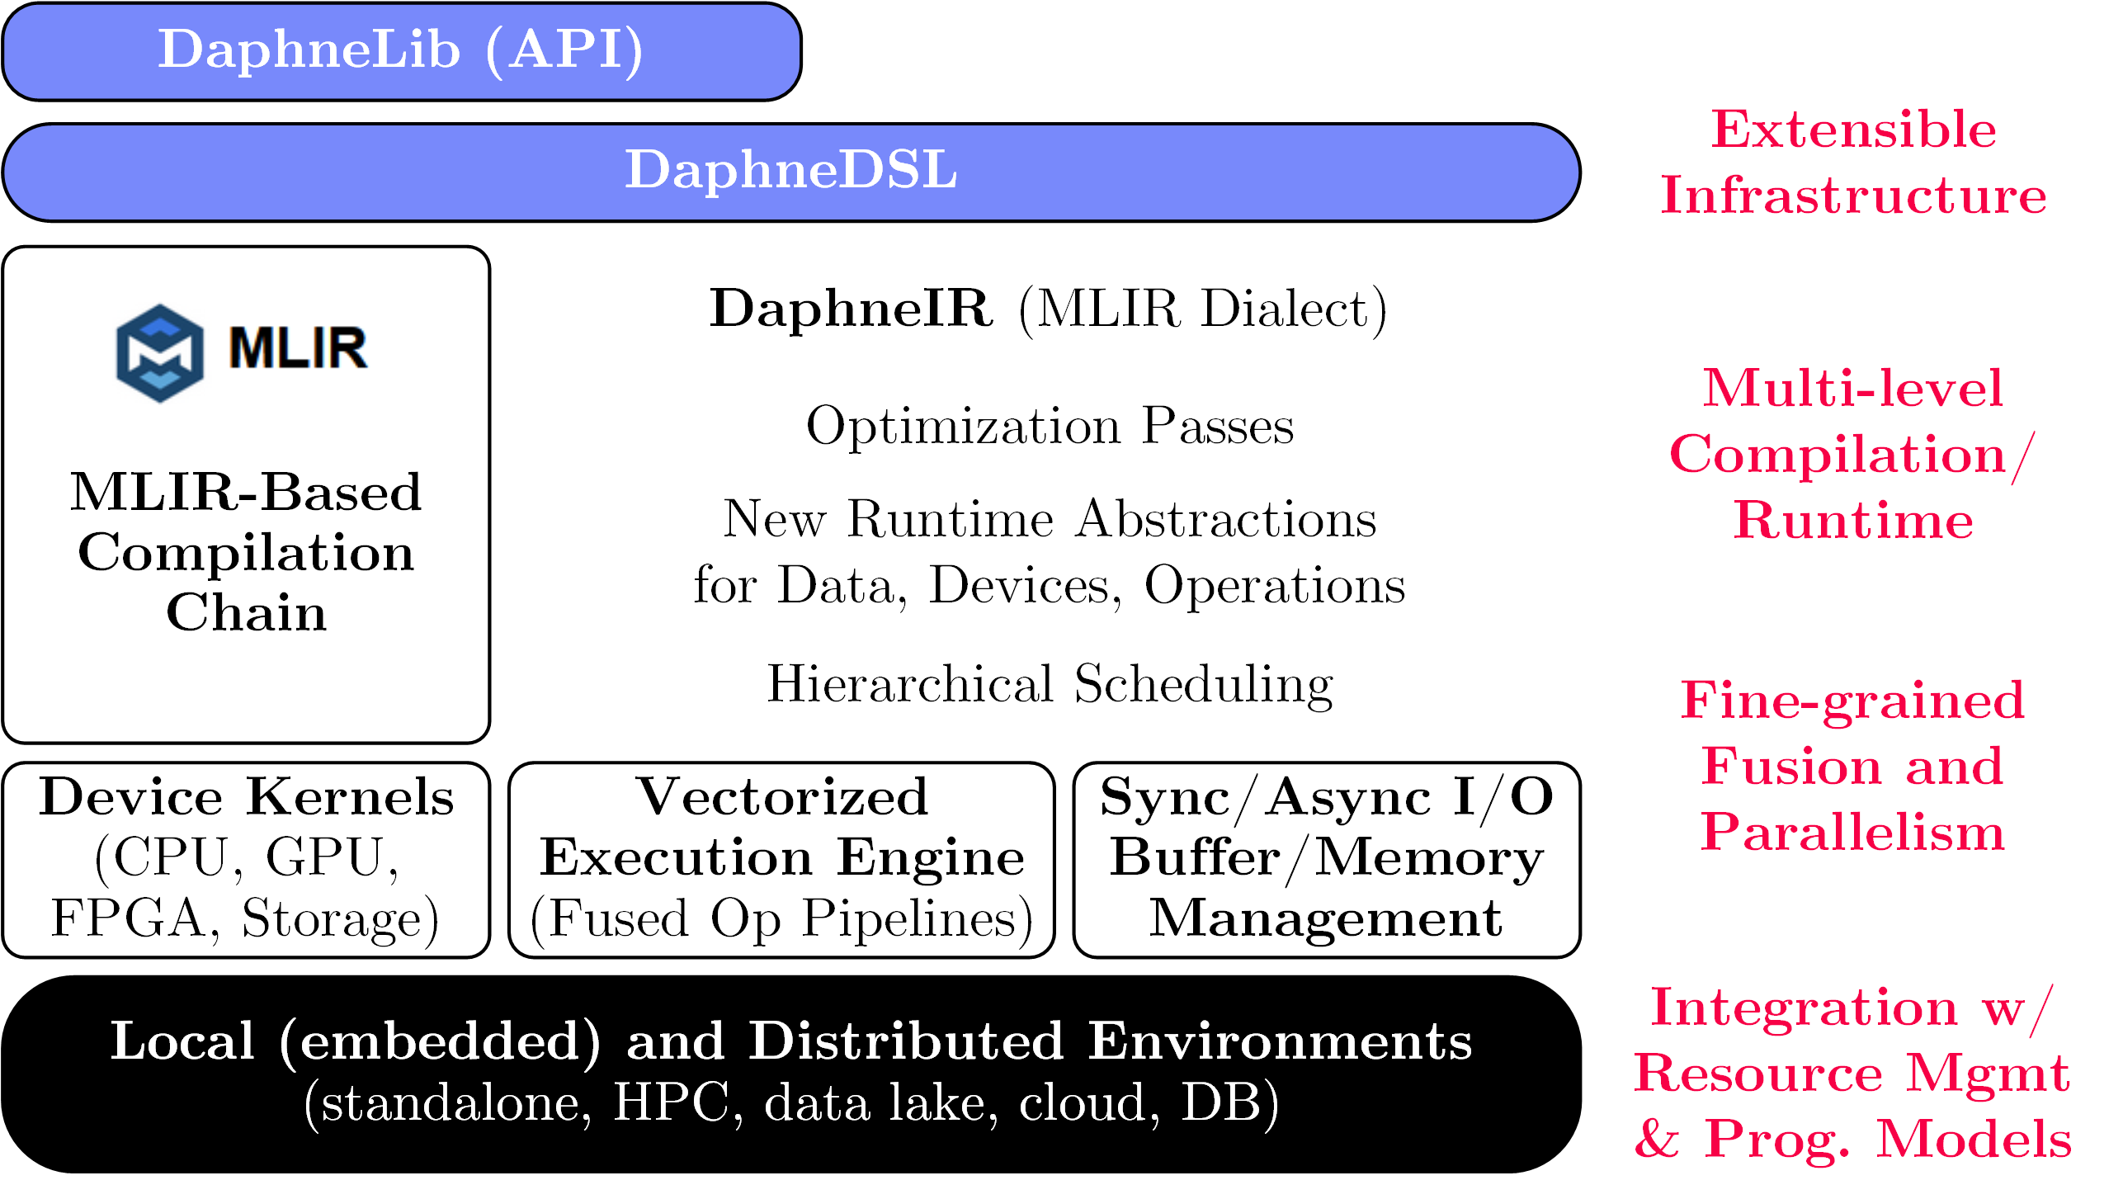
DAPHNE System Architecture
DAPHNE Project
[Patrick Damme et al.: DAPHNE: An Open and Extensible System Infrastructure for Integrated Data Analysis Pipelines, CIDR 2022]

Slide 41
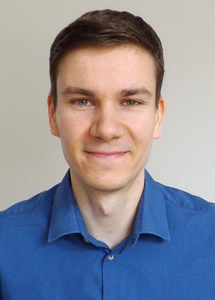

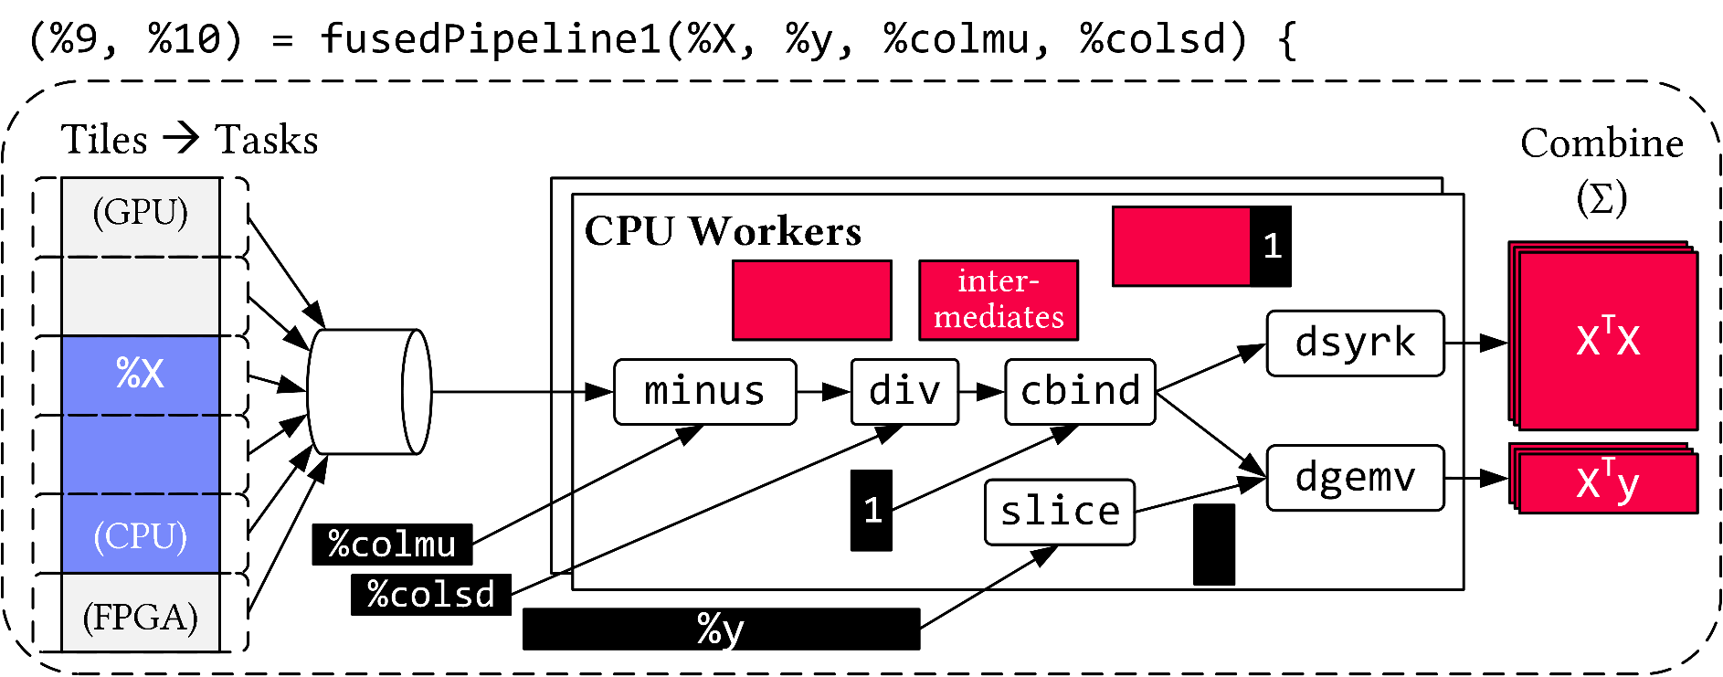
Vectorized (Tiled) Execution
DAPHNE Project
Default Parallelization
Frame & Matrix Ops
Locality-aware,
Multi-device Scheduling
Fused Operator Pipelines
on Tiles/Scalars + Codegen

Slide 42
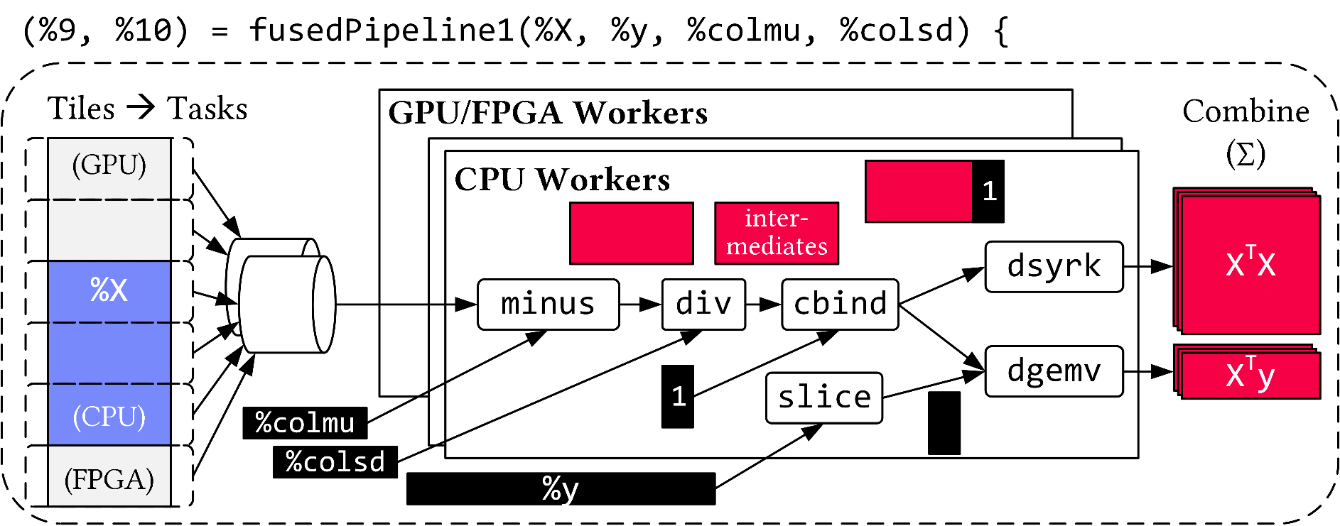
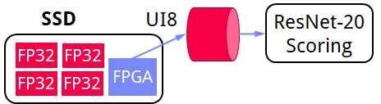
Vectorized (Tiled) Execution, cont.
DAPHNE Project
#1 Zero-copy Input Slicing
  Create view on sliced input (no-op)
  All kernels work on views
#2 Sparse Intermediates
  Reuse dense/sparse kernels
  Sparse pipeline intermediates for free
#3 Fine-grained Control
  Task sizes (dequeue, data access) vs data binding (cache-conscious ops)
  Scheduling for load balance (e.g., sparse operations)
#4 Computational Storage
  Task queues connect eBPF programs,
  async I/O into buffers, and op pipelines
Notes:
eBPF … Extended Berkeley Packet Filter

Slide 43
Summary & Q&A
Thanks
Data Management Group
Motivation and Goals
Course Organization
Course Outline, and Projects
Apache SystemDS and DAPHNE
Next Lectures (Part A)
  02 Languages, Architectures, and System Landscape [Mar 11] + projects
  03 Size Inference, Rewrites, and Operator Selection [Mar 18]
  04 Operator Fusion and Runtime Adaptation [Mar 25]
  05 Data- and Task-Parallel Execution [Apr 01]
  06 Parameter Servers [Apr 08]
  07 Hybrid Execution and HW Accelerators [Apr 29]
  08 Caching, Partitioning, Indexing and Compression [May 06]
Programming Projects in
Apache SystemDS, DAPHNE,
or Exercise on ML Pipeline

