Slide 1

Architecture of ML Systems (AMLS)
06 Parameter Servers
Prof. Dr. Matthias Boehm
Technische Universität Berlin
Berlin Institute for the Foundations of Learning and Data
Big Data Engineering (DAMS Lab)
Last update: May 30, 2024

Slide 2

Announcements / Org
#1 Hybrid & Video Recording
  Hybrid lectures (in-person, zoom) with optional attendance
  https://tu-berlin.zoom.us/j/9529634787?pwd=R1ZsN1M3SC9BOU1OcFdmem9zT202UT09
  Zoom video recordings, links from website
  https://mboehm7.github.io/teaching/ss24_amls/index.htm
#2 Exam Registration
  Moses exam registration for written exams, open now until two days before exam
  Exam slots (on-time exercise/project registrations w/ priority)
    Thu Jul 18, 4.15pm in H0107 (24/144 seats)
    Sa Aug 10, 2.15pm in A053 and EB 301 (106/639 seats)
    Sa Oct 12, 1.15pm in PTZ S001 (57/346 seats)
  Exam preparation in last lecture Jul 11.

Slide 3
Categories of Execution Strategies
Batch/Mini-batch, Independent Tasks MIMD
Batch
SIMD/SPMD
Mini-batch
05_{a} Data-Parallel Execution
05_{b} Task-Parallel Execution
06 Parameter Servers (data, model)
07 Hybrid Execution and HW Accelerators
08 Caching, Partitioning, Indexing, and Compression

Slide 4
Agenda
Data-Parallel Parameter Servers
Model-Parallel Parameter Servers
Distributed Reinforcement Learning
Federated Machine Learning

Slide 5
Data-Parallel Parameter Servers

Slide 6
Recap: Mini-batch ML Algorithms
Mini-batch ML Algorithms
  Iterative ML algorithms, where each iteration
  only uses a batch of rows to make the next
  model update (in epochs or w/ sampling)
  For large and highly redundant training sets
  Applies to almost all iterative, model-based
  ML algorithms (LDA, reg., class., factor., DNN)
  Stochastic Gradient Descent (SGD)
Statistical vs Hardware Efficiency (batch size)
  Statistical efficiency: # accessed data points to achieve certain accuracy
  Hardware efficiency: number of independent computations to
  achieve high hardware utilization (parallelization at different levels)
  Beware higher variance / class skew for too small batches!
➔ Training Mini-batch ML algorithms sequentially is hard to scale
Data
Batch 1
W’
Batch 2
W’’
Epoch

Slide 7
Background: Mini-batch DNN Training (LeNet)
[Yann LeCun, Leon Bottou, Yoshua Bengio, and Patrick Haffner: Gradient-Based Learning Applied to Document Recognition, Proc of the IEEE 1998]
# Initialize W1-W4, b1-b4
# Initialize SGD w/ Nesterov momentum optimizer
iters = ceil(N / batch_size)
for( e in 1:epochs ) {
for( i in 1:iters ) {
X_batch = X[((i-1) * batch_size) %% N + 1:min(N, beg + batch_size - 1),]
y_batch = Y[((i-1) * batch_size) %% N + 1:min(N, beg + batch_size - 1),]
## layer 1: conv1 -> relu1 -> pool1
## layer 2: conv2 -> relu2 -> pool2
## layer 3: affine3 -> relu3 -> dropout
## layer 4: affine4 -> softmax
outa4 = affine::forward(outd3, W4, b4)
probs = softmax::forward(outa4)
## layer 4: affine4 <- softmax
douta4 = softmax::backward(dprobs, outa4)
[doutd3, dW4, db4] = affine::backward(douta4, outr3, W4, b4)
## layer 3: affine3 <- relu3 <- dropout
## layer 2: conv2 <- relu2 <- pool2
## layer 1: conv1 <- relu1 <- pool1
# Optimize with SGD w/ Nesterov momentum W1-W4, b1-b4
[W4, vW4] = sgd_nesterov::update(W4, dW4, lr, mu, vW4)
[b4, vb4] = sgd_nesterov::update(b4, db4, lr, mu, vb4)
}
}
NN Forward
Pass
NN Backward
Pass
→ Gradients
Model
Updates
Notes:
Note: number of layers = layer ops w/ weights

Slide 8
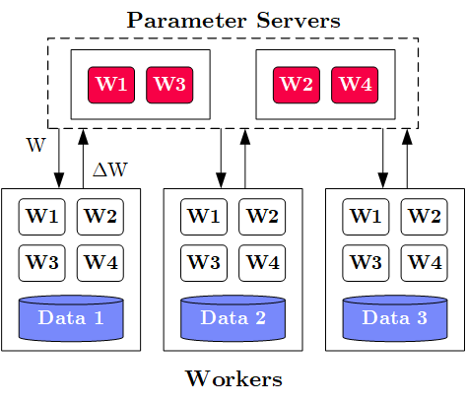
Overview Parameter Servers
M
System Architecture
  M Parameter Servers
  N Workers
  Optional Coordinator
Key Techniques
  Data partitioning D → workers Di
  (e.g., disjoint, reshuffling)
  Updated strategies
  (e.g., synchronous, asynchronous)
  Batch size strategies
  (small/large batches, hybrid methods)
W .. Model
ΔW .. Gradient
N
Notes:
Note: Nabla vs Delta operators

Slide 9
History of Parameter Servers
1st Gen: Key/Value
  Distributed key-value store for
  parameter exchange and synchronization
  Relatively high overhead
2nd Gen: Classic Parameter Servers
  Parameters as dense/sparse matrices
  Different update/consistency strategies
  Flexible configuration and fault tolerance
3rd Gen: Parameter Servers w/
improved data communication
  Prefetching and range-based pull/push
  Lossy or lossless compression w/ compensations
Examples
  TensorFlow, MXNet, PyTorch, CNTK, Petuum
[Alexander J. Smola, Shravan M. Narayanamurthy: An Architecture for Parallel Topic Models. PVLDB 2010]
[Jeffrey Dean et al.: Large Scale Distributed Deep Networks. NeurIPS 2012]
[Mu Li et al: Scaling Distributed Machine Learning with the Parameter Server. OSDI 2014]
[Jiawei Jiang, Bin Cui, Ce Zhang, Lele Yu: Heterogeneity-aware Distributed Parameter Servers. SIGMOD 2017]
[Jiawei Jiang et al: SketchML: Accelerating Distributed Machine Learning with Data Sketches. SIGMOD 2018]
Notes:
Note: PVLDB’2010 paper used Memcached for parameter exchange

Slide 10
Basic Worker Algorithm (batch)
for( i in 1:epochs ) {
for( j in 1:iterations ) {
params = pullModel(); # W1-W4, b1-b4 lr, mu
batch = getNextMiniBatch(data, j);
gradient = computeGradient(batch, params);
pushGradients(gradient);
}
}
[Jeffrey Dean et al.: Large Scale Distributed Deep Networks. NeurIPS 2012]

Slide 11
Extended Worker Algorithm (nfetch batches)
nfetch batches require
local gradient accrual and local model update
gradientAcc = matrix(0,...);
for( i in 1:epochs ) {
for( j in 1:iterations ) {
if( step mod nfetch = 0 )
params = pullModel();
batch = getNextMiniBatch(data, j);
gradient = computeGradient(batch, params);
gradientAcc += gradient; # parallel to updateModel
params = updateModel(params, gradients);
step++;
if( step mod nfetch = 0 ) {
pushGradients(gradientAcc); step = 0;
gradientAcc = matrix(0, ...);
}
} }
[Jeffrey Dean et al.: Large Scale Distributed Deep Networks. NeurIPS 2012]

Slide 12
Update Strategies
Bulk Synchronous Parallel (BSP)
  Update model w/
  accrued gradients
  Barrier for N workers
Asynchronous Parallel (ASP)
  Update model for each gradient
  No barrier
Synchronous w/ Backup Workers
  Update model w/
  accrued gradients
  Barrier for N of N+b workers
Batch 1
Batch 2
Batch 3
Batch 1
Batch 2
Batch 3
Batch 1
Batch 2
Batch 3
Batch 1
Batch 2
Batch 3
Batch 1
Batch 2
Batch 3
but, stale model updates
Batch 1
Batch 2
Batch 3
Batch 1
Batch 2
Batch 3
Batch 1
Batch 2
Batch 3
Batch 1
Batch 2
Batch 3
Batch 1
Batch 2
Batch 3
[Martín Abadi et al: TensorFlow: A System for Large-Scale Machine Learning. OSDI 2016]
Batch 1
Batch 2
Batch 3
Batch 1
Batch 2
Batch 3

Slide 13
Update Strategies, cont.
Stale-Synchronous Parallel (SSP)
  Similar to backup workers,
  weak synchronization barrier
  Maximum staleness of s clocks between fastest
  and slowest worker → if violated, block fastest
Hogwild!
  Even the model update
  completely unsynchronized
  Shown to converge for sparse model updates
Decentralized
  #1: Exchange partial gradient updates
  with local peers
  #2: Peer-to-peer re-assignment of work
  Other Examples: Ako, FlexRR
[Qirong Ho et al: More Effective Distributed ML via a Stale Synchronous Parallel Parameter Server. NeurIPS 2013]
[Benjamin Recht, Christopher Ré, Stephen J. Wright, Feng Niu: Hogwild: A Lock-Free Approach to Parallelizing Stochastic Gradient Descent. NeurIPS 2011]
[Xiangru Lian et al: Can Decentralized Algorithms Outperform Centralized Algorithms? A Case Study for Decentralized Parallel Stochastic Gradient Descent. NeurIPS 2017]

Slide 14
Data Partitioning Schemes
Goals Data Partitioning
  Even distribute data across workers
  Avoid skew regarding model updates → shuffling/randomization
#1 Disjoint Contiguous
  Contiguous row partition of features/labels
#2 Disjoint Round Robin
  Rows of features distributed round robin
#3 Disjoint Random
  Random non-overlapping selection of rows
#4 Overlap Reshuffle
  Each worker receives a reshuffled
  copy of the whole dataset
Xp = X[id*bsize+1:(id+1)*bsize,];
Xp = X[seq(1,nrow(X))%%N==id),];
P = table(seq(1,nrow(X)),
sample(nrow(X),nrow(X),FALSE));
Xp = P[id*bsize+1: (id+1)*bsize,] %*% X
Xp = Pi %*% X

Slide 15
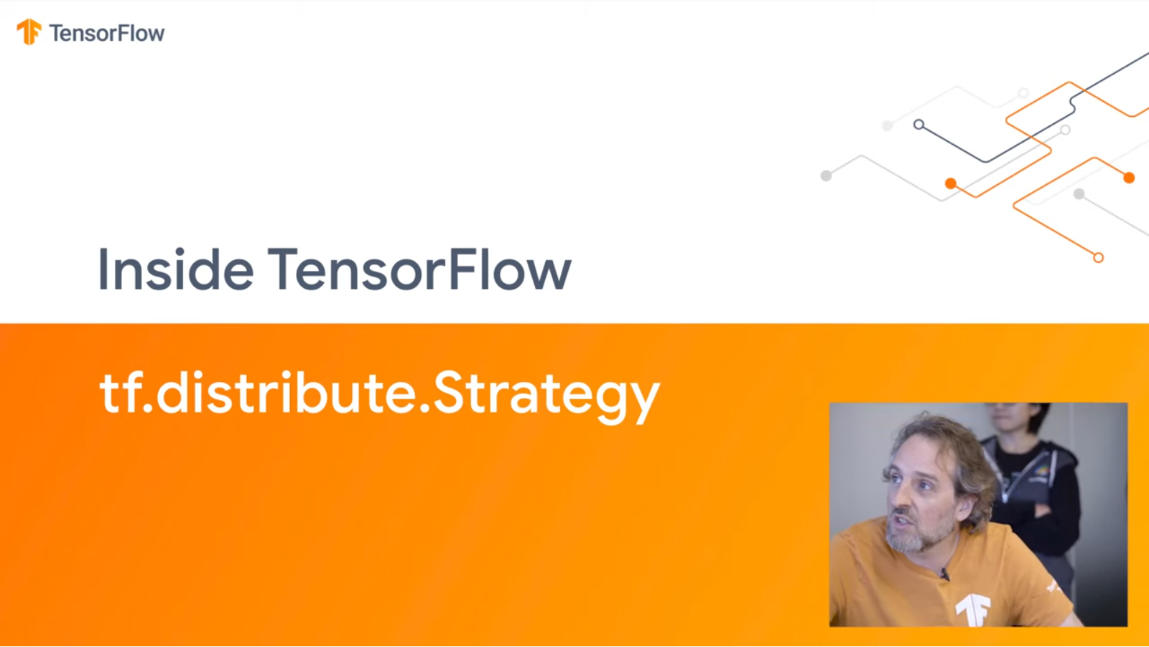
Example Distributed TensorFlow DP
# Create a cluster from the parameter server and worker hosts
cluster = tf.train.ClusterSpec({"ps": ps_hosts, "worker": worker_hosts})
# Create and start a server for the local task.
server = tf.train.Server(cluster, job_name=..., task_index=...)
# On worker: initialize loss
train_op = tf.train.AdagradOptimizer(0.01).minimize(
loss, global_step=tf.contrib.framework.get_or_create_global_step())
# Create training session and run steps asynchronously
hooks=[tf.train.StopAtStepHook(last_step=1000000)]
with tf.train.MonitoredTrainingSession(master=server.target,
is_chief=(task_index == 0), checkpoint_dir=..., hooks=hooks) as sess:
while not mon_sess.should_stop():
sess.run(train_op)
# Program needs to be started on ps and worker
But new experimental APIs and Keras Frontend
[Inside TensorFlow: tf.distribute.Strategy, 2019, https://www.youtube.com/watch?v=jKV53r9-H14]

Slide 16
Example SystemDS Parameter Server
# Initialize SGD w/ Adam optimizer
[W1, mW1, vW1] = adam::init(W1);
[b1, mb1, vb1] = adam::init(b1); ...
# Create the model object
modelList = list(W1, W2, W3, W4, b1, b2, b3, b4, vW1, vW2, vW3, vW4,
vb1, vb2, vb3, vb4, mW1, mW2, mW3, mW4, mb1, mb2, mb3, mb4);
# Create the hyper parameter list
params = list(lr=0.001, beta1=0.9, beta2=0.999, epsilon=1e-8, t=0,
C=C, Hin=Hin, Win=Win, Hf=Hf, Wf=Wf, stride=1, pad=2, lambda=5e-04,
F1=F1, F2=F2, N3=N3)
# Use paramserv function
modelList2 = paramserv(model=modelList, features=X, labels=Y,
upd=fGradients, aggregation=fUpdate, mode=REMOTE_SPARK, utype=ASP,
freq=BATCH, epochs=200, batchsize=64, k=144, scheme=DISJOINT_RANDOM,
hyperparams=params)

Slide 17
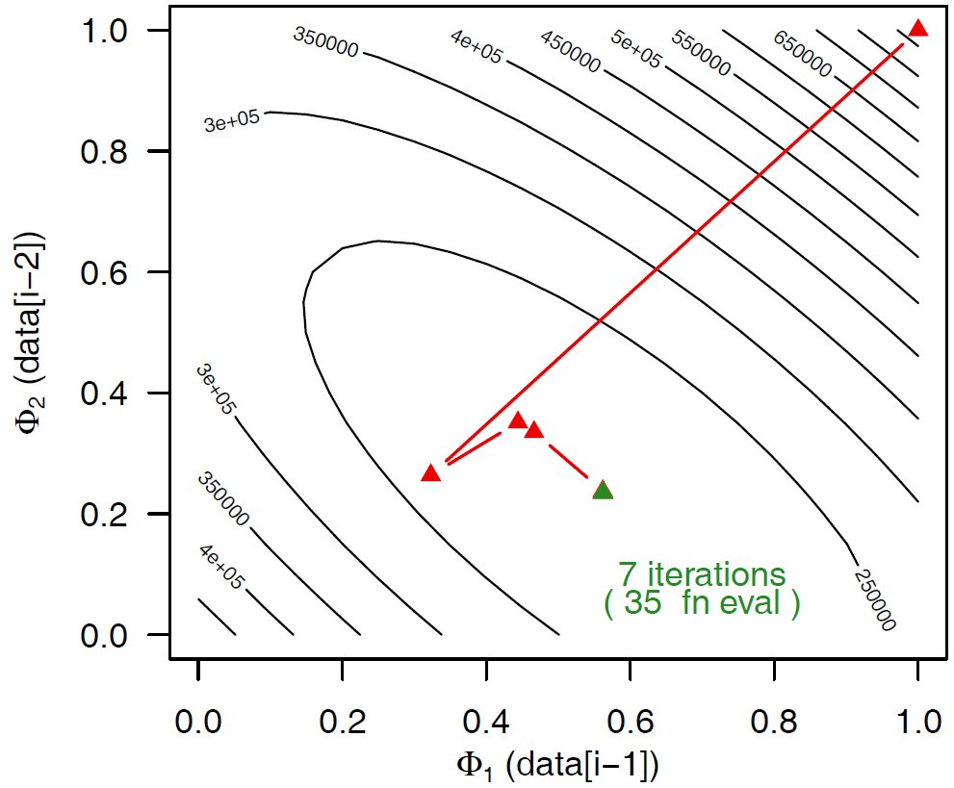

Selected Optimizers (updateModel)
Stochastic Gradient Descent (SGD)
  Vanilla SGD, basis for many other optimizers
  See 05 Data/Task-Parallel: $−γ∇f(D,θ)$
SGD w/ Momentum
  Incorporates parameter velocity w/ momentum
SGD w/ Nesterov Momentum
  Incorporates parameter velocity w/ momentum,
  but update from position after momentum
AdaGrad
  Adaptive learning rate w/ regret guarantees
RMSprop
  Adaptive learning rate, extended AdaGrad
X = X – lr*dX
v = mu*v – lr*dX
X = X + v
v0 = v
v = mu*v – lr*dX
X = X – mu*v0 + (1+mu)*v
[John C. Duchi et al: Adaptive Subgradient Methods for Online Learning and Stochastic Optimization. JMLR 2011]
c = dr*c+(1-dr)*dX^2
X = X-(lr*dX/(sqrt(c)+eps))
Notes:
Regret: loss incurred during learning, loss difference to loss w/ optimal weights (applicability to exercise?)

Slide 18
Selected Optimizers (updateModel), cont.
Adam
  Individual adaptive learning rates for different parameters + momentum
Shampoo
  Preconditioned gradient method
  (Newton’s method, Quasi-Newton)
  Retains gradients tensor structure by
  maintaining a preconditioner per dim
  Space: O(m²n²) → O(m² + n²), time: O(m³ + n³)
[Diederik P. Kingma, Jimmy Ba: Adam: A Method for Stochastic Optimization. ICLR 2015]
t = t + 1
m = beta1*m + (1-beta1)*dX # update biased 1st moment est
v = beta2*v + (1-beta2)*dX^2 # update biased 2nd raw moment est
mhat = m / (1-beta1^t) # bias-corrected 1st moment est
vhat = v / (1-beta2^t) # bias-corrected 2nd raw moment est
X = X - (lr * mhat/(sqrt(vhat)+epsilon)) # param update
L = L + dX %*% t(dX)
R = R + t(dX) %*% dX
X = X – lr * pow(L,1/4)
%*% dX %*% pow(R,1/4))
[Vineet Gupta, Tomer Koren, Yoram Singer: Shampoo: Preconditioned Stochastic Tensor Optimization. ICML 2018]
Notes:
Note: Newton’s method employs the local Hessian as a preconditioner
“Shampoo maintains an m×m matrix L1/4t to precondition the rows of Gt and R1/4t for its columns. The ¼ exponent arises from our analysis; intuitively, it is a sensible choice as it induces an overall step-size decay rate of O(1/√t), which is common in stochastic optimization methods.”

Slide 19
Batch Size Configuration
ResNet-50 on ImageNet
Simple CNN on
MNIST
What is the right batch size for my data?
  Maximum useful batch size is dependent on
  data redundancy and model complexity
Additional Heuristics/Hybrid Methods
  #1 Increase the batch size instead
  of decaying the learning rate
  #2 Combine batch and mini-batch
  algorithms (full batch + n online updates)
[Christopher J. Shallue et al.: Measuring the Effects of Data Parallelism on Neural Network Training. JMLR 2019]
8192
128
vs
[Samuel L. Smith, Pieter-Jan Kindermans, Chris Ying, Quoc V. Le: Don't Decay the Learning Rate, Increase the Batch Size. ICLR 2018]
[Ashok Cutkosky, Róbert Busa-Fekete: Distributed Stochastic Optimization via Adaptive SGD. NeurIPS 2018]

Slide 20
Reducing Communication Overhead
[Priya Goyal et al: Accurate, Large Minibatch SGD: Training ImageNet in 1 Hour. CoRR 2017 (kn=8K, 256 GPUs)]
Large Batch Sizes
  Larger batch sizes reduce the relative communication overhead
Overlapping Computation/Communication
  For deep NN w/ many weight/bias matrices,
  compute and comm. can be overlapped
  Collective operations: all-Reduce / ring all-reduce / hierarchical all-reduce
Compressed Communication
  Lossy (mantissa truncation, quantization), and
  lossless (delta, bitpacking) for W and dW
  Residual accumulation (accrue clipping errors)
In-Network Aggregation (SwitchML)
  Aggregate worker updates in programmable switches
  32b fix-point, coordinated updates
tf.distribute:
MirroredStrategy
MultiWorkerMirroredStrategy
[Frank Seide et al: 1-bit stochastic gradient descent and its application to data-parallel distributed training of speech DNNs. INTERSPEECH 2014]
[Amedeo Sapio et al: Scaling Distributed Machine Learning with In-Network Aggregation, NSDI 2021]
Notes:
Large-batches: synchronous SGD with k=256 workers * n=32 per-worker batch size = 8K

Slide 21
Reducing Communication Overhead, cont.
Sparse Communication
  Mini-batches of sparse data → sparse dW
  Gradient sparsification/clipping (send gradients larger than a threshold)
Non-Uniform Parameter Access
  Exploit sparsity skew to select
  replication (sync/async) vs relocation
Word Embeddings
(1 Epoch word2vec on
Billion Word Benchmark)
Knowledge Graph Embeddings
(1 Epoch ComplEx on Wikidata5m)
[Alexander Renz-Wieland, Rainer Gemulla, Steffen Zeuch, Volker Markl: Dynamic Parameter Allocation in Parameter Servers. PVLDB 13(11) 2020]
[Alexander Renz-Wieland, Rainer Gemulla, Zoi Kaoudi, Volker Markl: NuPS: A Parameter Server for Machine Learning with Non-Uniform Parameter Access. SIGMOD 2022]

Slide 22
Model-Parallel Parameter Servers

Slide 23
Problem Setting
Limitations Data-Parallel Parameter Servers
  Need to fit entire model and activations into each worker node/device
  (or overhead for repeated eviction & restore)
  Very deep and wide networks (e.g., ResNet-1001)
Model-Parallel Parameter Servers
  Workers responsible for disjoint partitions of the network/model
  Exploit pipeline parallelism and independent subnetworks
  Examples: recurrent neural networks, pre-processing tasks
Hybrid Parameter Servers
  “To be successful, however, we believe that model parallelism
  must be combined with clever distributed optimization techniques
  that leverage data parallelism.”
  “[…] it is possible to use tens of thousands of CPU cores for training a single model”
[Kaiming He, Xiangyu Zhang, Shaoqing Ren, Jian Sun: Identity Mappings in Deep Residual Networks. ECCV 2016]
[Jeffrey Dean et al.: Large Scale Distributed Deep Networks. NeurIPS 2012]

Slide 24
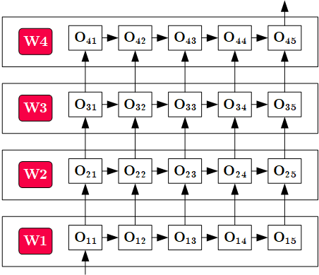
Overview Model-Parallel Execution
System Architecture
  Nodes act as workers
  and parameter servers
  Data Transfer for
  boundary-crossing
  data dependencies
Pipeline Parallelism
Workers
w/ disjoint
network/model partitions

Slide 25
Example Distributed TensorFlow MP
# Place variables and ops on devices
with tf.device("/gpu:0"):
a = tf.Variable(tf.random.uniform(...))
a = tf.square(a)
with tf.device("/gpu:1"):
b = tf.Variable(tf.random.uniform(...))
b = tf.square(b)
with tf.device("/cpu:0"):
loss = a+b
# Declare optimizer and parameters
opt = tf.train.GradientDescentOptimizer(learning_rate=0.1)
train_op = opt.minimize(loss)
# Force distributed graph evaluation
ret = sess.run([loss, train_op]))
Explicit Placement of Operations
(shown via toy example)

Slide 26
[Paul Barham et al: Pathways: Asynchronous Distributed Dataflow for ML, MLSys 2022]
Pathways: Asynchronous, Distributed Data Flow
System Overview
  TF and JAX programs (e.g., JAX pmap())
  Virtual device requests → device islands
  MLIR dialect, lowering to physical devices
  PLAQUE shared data-flow system w/ sharded buffer,
  sparse comm., gang scheduling
Resource Management and Scheduling
Notes:
https://blog.google/technology/ai/introducing-pathways-next-generation-ai-architecture/
(model distributed across devices in sharded buffer)

Slide 27
Distributed Reinforcement Learning
Hybrid Data- and Task- Parallel Execution
Data-Parallel Parameter Servers
Nested Parallelism

Slide 28
Reinforcement Learning
RL Characteristics
  Closed-loop: goal-directed learning from interaction
  Time-delayed reward: map situations → actions, max reward
  No instructions:
  exploitation (known actions)
  vs exploration (find actions)
RL Elements
  Policy: stimulus-response rules (perceived environment state → actions)
  Reward Signal: scalar reward at each time step (direct vs indirect)
  Value Function: long-term desirability of states (expected reward)
  Model of the environment: expected behavior of environment → planning
[Richard S. Sutton, Andrew G. Barto: Reinforcement Learning: An Introduction, MIT Press, 2015]
Action
Agent
Environment
(real/sim)
Reward/State
Notes:
Q-Learning: off-policy temporal difference (TD) control algorithm, w/ action-value functions (Q-functions)

Slide 29
[Eric Liang, Richard Liaw et al: RLlib: Abstractions for Distributed Reinforcement Learning. ICML 2018]
Distributed RL in RLlib
[Philipp Moritz, Robert Nishihara et al.: Ray: A Distributed Framework for Emerging AI Applications. OSDI 2018]
Framework Overview
  RLlib on tasks/actors in Ray
  Interleaved policy
  training,
  simulations, etc
Parallelization Strategies
  Hierarchical Parallel Task Model
  (locally, centralized control)
  Policy optimizer step methods
  (All-reduce, local multi-GPU,
  async, parameter server)
  Policy graph (algorithm-specific)
  on multiple remote evaluator replicas
Example Parameter Server
(task stream, wait for #updates)

Slide 30
[Matteo Hessel, Manuel Kroiss, et al: Podracer architectures for scalable Reinforcement Learning, CoRR 2021]
Podracer RL Architectures
Use of TPU Pods via JAX/TF XLA
#1 Anakin
  Agent-environment interaction can be compiled into a single XLA program
  Scalability: replicate basic setup to larger TPU slices
TPU Core
CPU
Notes:
Note: “One CPU host [56 cores] is connected to 8 TPU cores (grouped into 4 chips). All TPU cores are connected to each other via high speed network.”

Slide 31
[Matteo Hessel, Manuel Kroiss, et al: Podracer architectures for scalable Reinforcement Learning, CoRR 2021]
Podracer RL Architectures, cont.
#2 Sebulba
  Decomposed actors
  and learners
  Support for arbitrary
  environments
Notes:
Note: parameter updates at learners, action selection at actors, batch of parallel environments

Slide 32
Federated Machine Learning

Slide 33


Problem Setting and Overview
Motivation Federated ML
  Learn model w/o central data consolidation
  Privacy + data/power caps vs personalization and sharing
  Applications Characteristics
    #1 On-device data more relevant than server-side data
    #2 On-device data is privacy-sensitive or large
    #3 Labels can be inferred naturally from user interaction
  Example: Language modeling for mobile keyboards and voice recognition
Challenges
  Massively distributed (data stored across many devices)
  Limited and unreliable communication
  Unbalanced data (skew in data size, non-IID )
  Unreliable compute nodes / data availability
W
ΔW
[Jakub Konečný: Federated Learning - Privacy-Preserving Collaborative Machine Learning without Centralized Training Data, UW Seminar 2018]

Slide 34
A Federated ML Training Algorithm
while( !converged ) {
1. Select random subset (e.g. 1000)
of the (online) clients
2. In parallel, send current parameters θ_{t}
to those clients
2a. Receive parameters θ_{t} from server [pull]
2b. Run some number of minibatch SGD steps,
producing θ’
2c. Return θ’-θ_{t} (model averaging) [push]
3. θ_{t+1} = θ_{t} + data-weighted average of client updates
}
[Brendan McMahan, Eider Moore, Daniel Ramage, Seth Hampson, Blaise Agüera y Arcas: Communication-Efficient Learning of Deep Networks from Decentralized Data. AISTATS 2017]
At each client

Slide 35
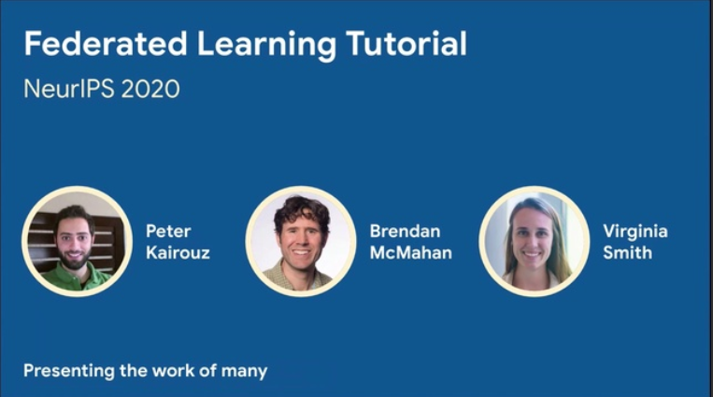
Algorithmic Parameter-Server Extensions
#1 Client Sampling (FedAvg w/ model averaging)
#2 Decentralized, Fault-tolerant Aggregation
#3 Peer-to-peer Gradient and Model Exchange
#4 Meta-learning for Private Models
#5 Handling Statistical Heterogeneity (non-IID data)
  Reducing variance
  Selecting relevant subsets of data
  Tolerating partial client work
  Partitioning clients into congruent groups
  Adaptive Optimization (FedOpt, FedAvgM)
[Peter Kairouz, Brendan McMahan, Virginia Smith: Federated Learning Tutorial. NeurIPS 2020, https://slideslive.com/38935813/
federated-learningtutorial]
[Sashank J. Reddi et al: Adaptive Federated Optimization. CoRR 2020]

Slide 36
Federated Learning Protocol
Recommended Reading
  [Keith Bonawitz, Hubert Eichner, Wolfgang Grieskamp, Dzmitry Huba, Alex Ingerman, Vladimir Ivanov, Chloé Kiddon, Jakub Konecný, Stefano Mazzocchi, H. Brendan McMahan, Timon Van Overveldt, David Petrou, Daniel Ramage, Jason Roselander: Towards Federated Learning at Scale: System Design. MLSys 2019]

Slide 37
Federated Learning at the Device
Data Collection
  Maintain repository of
  locally collected data
  Apps make data available
  via dedicated API
Configuration
  Avoid negative impact on
  data usage or battery life
  Training and evaluation tasks
Multi-Tenancy
  Coordination between multiple
  learning tasks (apps and services)

Slide 38
Federated Learning at the Server
Actor Programming Model
  Comm. via message passing
  Actors sequentially process
  stream of events/messages
  ➔ Scaling w/ # actors
Coordinators
  Driver of overall learning algorithm
  Orchestration of aggregators
  and selectors (conn handlers)
Robustness
  Pipelined selection
  and aggregation rounds
  Fault Tolerance at aggregator/
  master aggregator levels

Slide 39


Excursus: Data Ownership
Limited Access to Data Sources
  #1 Infeasible data consolidation (privacy, economically/technically)
  #2 Data ownership (restricted data enrichment and consolidation)
Example Data Ownership
  Thought experiment:
  middle person B uses machine from machine
  vendor A to test customer C’s equipment.
  Who owns the data?
  Unclear. Usually negotiated in bilateral contracts!
Note: Recent Work on Incentives
  Payments according to value of data (e.g., improved model accuracy)
XXXXXXXX
XXXXXXXXXXXXXXXXXXXXXXX
XXXXXXXX
XXXXX
Machine Vendor A
Middle Person B
Customer C

Slide 40
Excursus: Spectrum of Data Sharing
Fine-grained Spectrum
  Spectrum of technologies with performance/privacy/utility tradeoffs
  Different applications with different requirements → Potential for new markets
Increasing Utility/Perf
Increasing Privacy
Private Data (no sharing)
Privacy-
enhancing Technologies
(FHE, MPC, Differential Privacy)
Aggregates (Federated ML, Federated w/
secure comm.)
Anonymized
Data
(k-anonymity, pseudonyms)
Surrogate
Data
(char-preserving
synthetic data, dataset distillation)
Public Data (full sharing, sharing w/ partners)
  Key Property: no reconstruction of private raw data

Slide 41








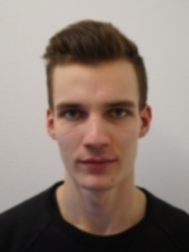



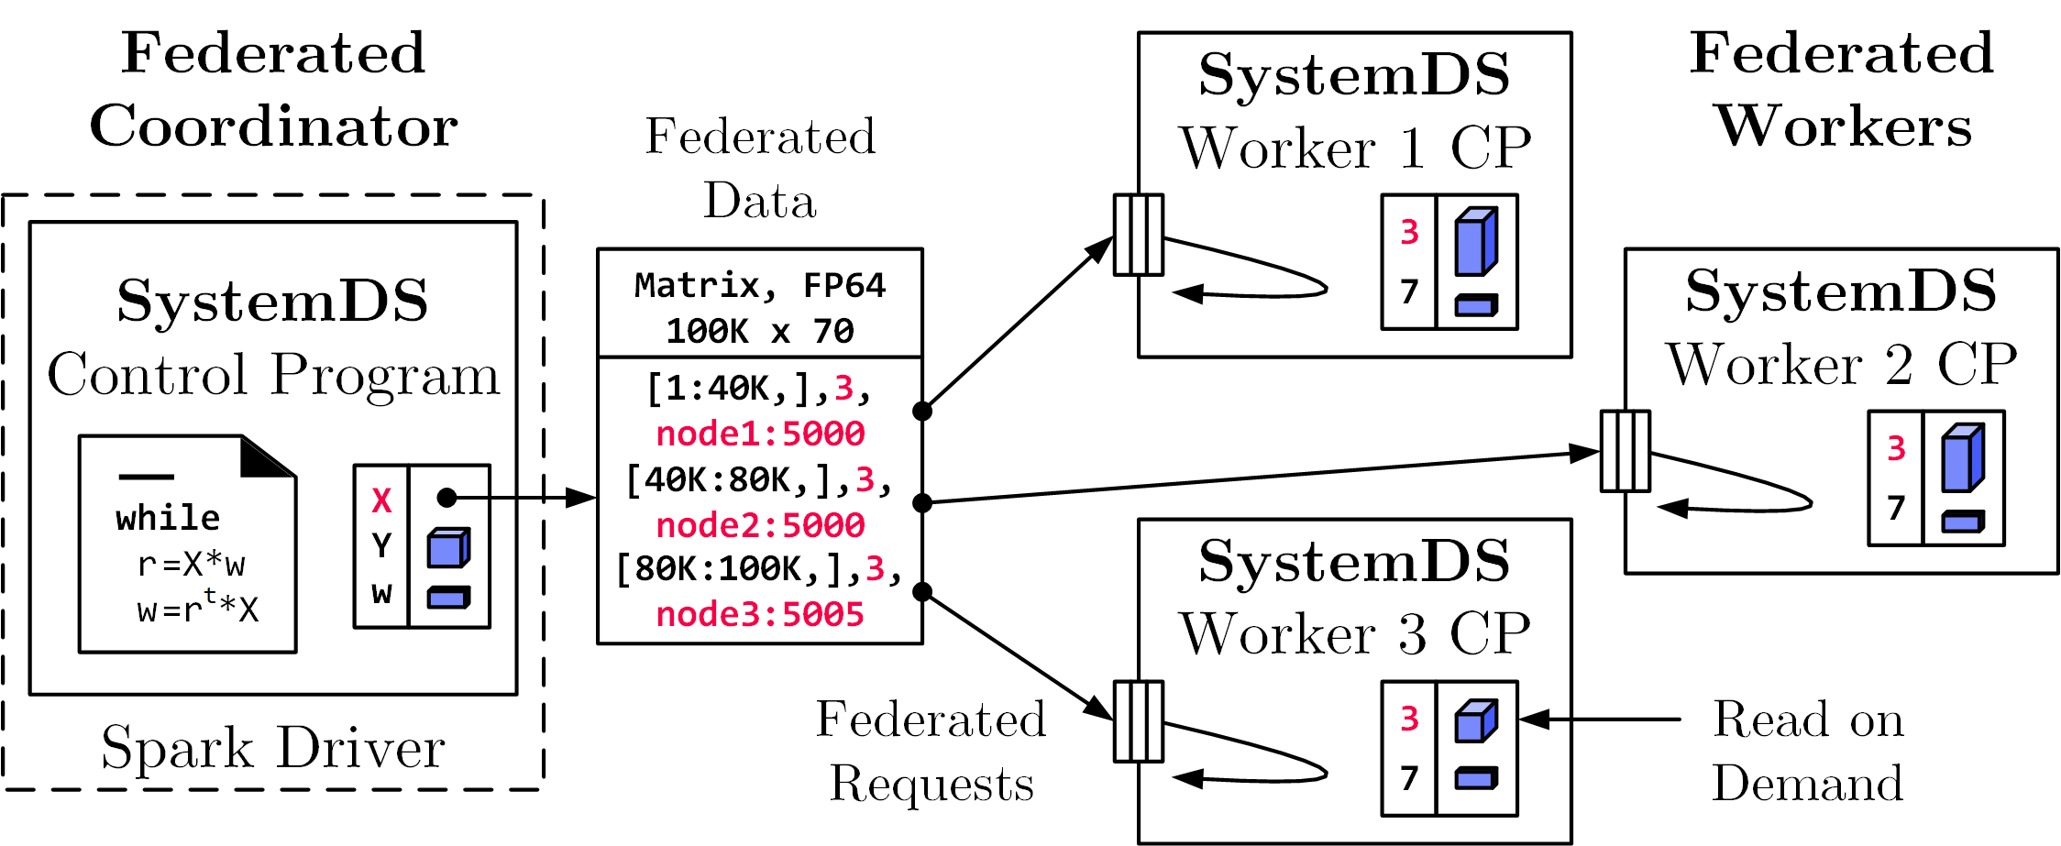
Federated Learning in SystemDS
Federated Backend
  Federated data (matrices/frames) as meta data objects
  Federated linear algebra, (and federated parameter server)
X = federated(addresses=list(node1, node2, node3),
ranges=list(list(0,0), list(40K,70), ..., list(80K,0), list(100K,70)));
Federated Requests:
READ, PUT, GET, EXEC_INST,
EXEC_UDF, CLEAR
➔ Design Simplicity:
(1) reuse instructions
(2) federation hierarchies

Slide 42
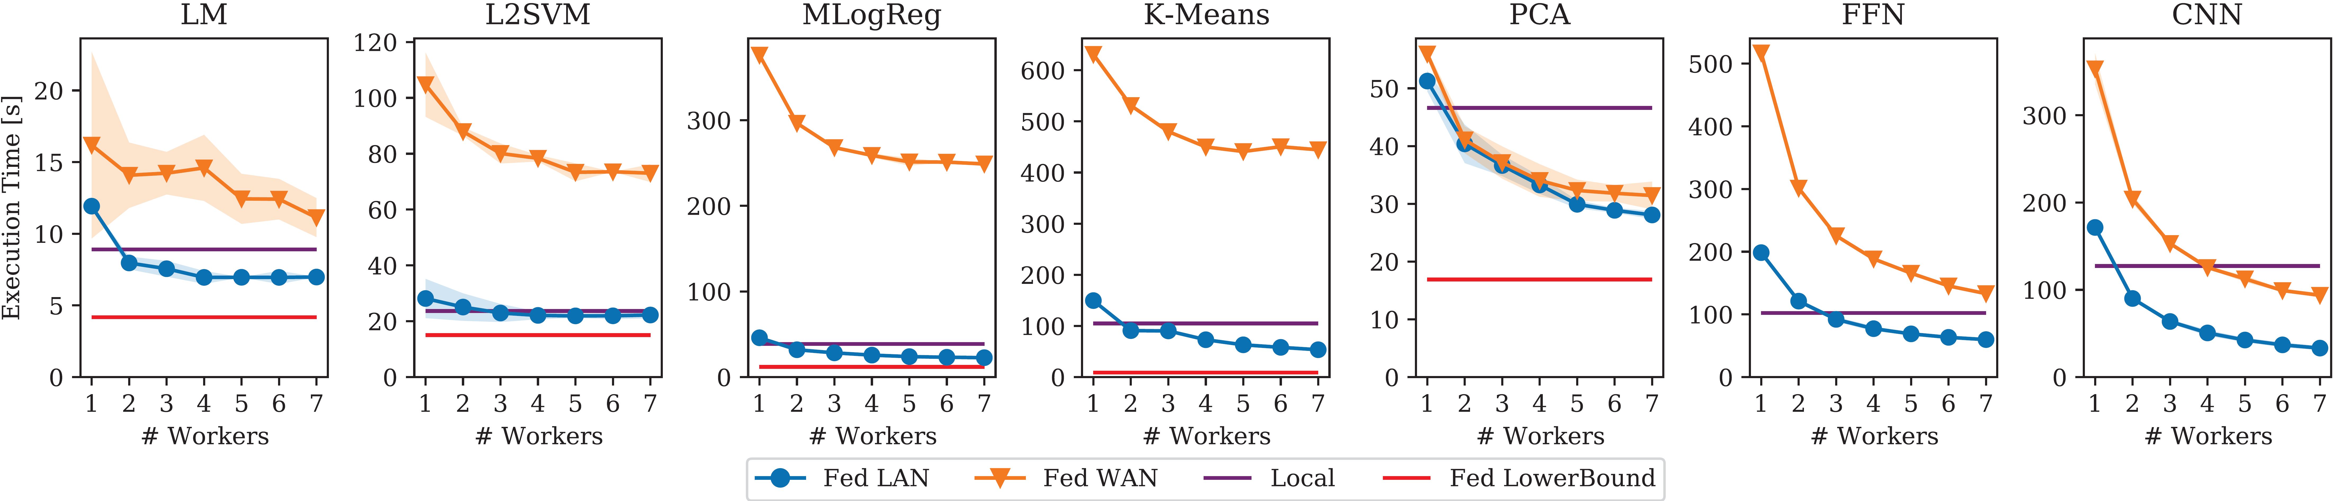
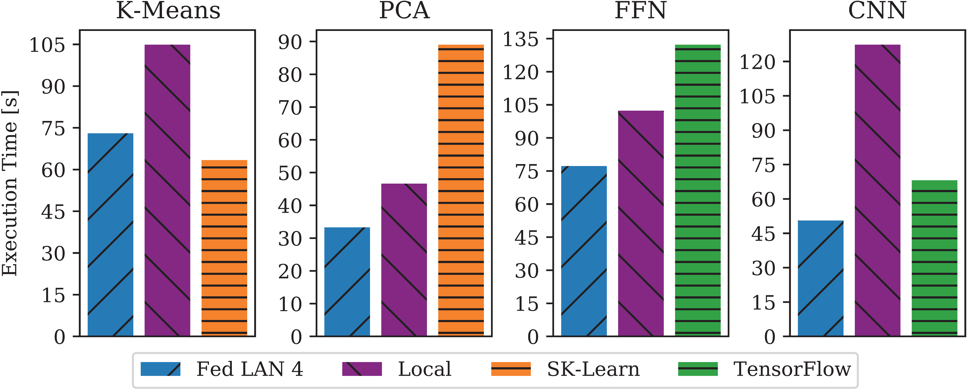
Federated Learning in SystemDS – Experiments
Reproducible Results (old, current)
Workloads and Baselines
  LM: linear regression, lmCG
  L2SVM: l2-regularized SVM
  MLogReg: multinomial logreg
  K-Means: Lloyd’s alg. w/ K-Means++ init
  PCA: principal component analysis
  FFN: fully-connected feed-forward NN
  CNN: convolutional NN
Comparisons w/
Scikit-learn and TensorFlow

Slide 43
Federated Learning in SystemDS – Example Operations
b) Local MV (EXEC_INST, 3)
a) broadcast v
(PUT(v, 2))
X₁
Matrix-Vector Multiplication
  o = X %*% v, local v
  Row-partitioned, federated X
  Row-partitioned, federated o
Vector-Matrix Multiplication
  o = v %*% X, local v
  Row-partitioned,
  federated X, local o
  New broadcast handling
Data Preparation
  [X,M] = transformencode(F,spec)
  Recoding, feature hashing, binning,
  one-hot encoding
c) Clean 2
(EXEC_INST)
X₂
a) broadcast sliced v
(PUT(v, 4))
b) Local MV
(EXEC_INST, 5)
X₁
c) Aggregate (GET, 5) +
X₂
d) Clean 4,5 (EXEC_INST)
1) Build local record maps
(EXEC_UDF)
X₁: D B C D C
2) Aggregate, broadcast, recode
X₂: A B B C C

Slide 44
Federated Learning in SystemDS – Example Operations, cont.
Federated Quantiles
  Key operation for equi-height binning, outlier removal, etc
  Problem: requires sorting → infeasible in a federated environment
  Recursive equi-width histograms (w/ 256 bins)
q=0.95 ?
(380/400)
init
H[0,10000]
H[7500,10000]
H[9750,9875]
X₁
20
160
15
5
0
1
3
1
min=0
max=1e3
110
175
60
55
110
285
345
400
10
11
28
6
10
21
49
55
…
X₁
90
15
45
50
10
10
25
5
min=10
max=1e4

Slide 45


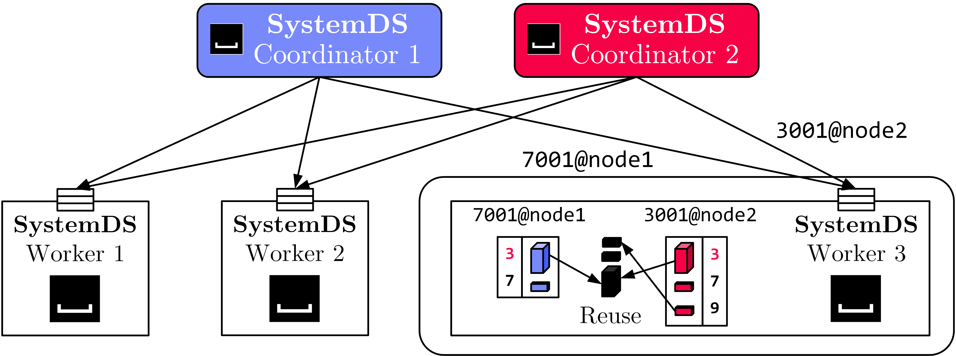
Federated Data Preparation, Learning, and Debugging
Federated Feature Transformations
Federated Linear-algebra-based Data Cleaning,
Data Preparation, and Model Debugging (e.g., federated quantiles)
Multi-tenant
Federated Learning
  Tenant Isolation
Lineage-based Reuse
Asynchronous Compression

Slide 46

TensorFlow Federated
Overview TFF
  Federated PS algorithms and federated second order functions
  Primarily for simulating federated training, no OSS federated runtime
#1 Federated PS
  See algorithmic PS
  improvements
#2 Federated Analytics
  r = t(y) %*% X
  User-level composition
  of federated algorithms
  PET primitives
  (privacy-enhancing technologies)
[https://www.tensorflow.org/federated/]
iterative_process = tff.learning.build_federated_averaging_process(
model_fn, # function for created federated models
client_optimizer_fn=lambda: tf.keras.optimizers.SGD(learning_rate=0.02),
server_optimizer_fn=lambda: tf.keras.optimizers.SGD(learning_rate=1.0))
X = ... # tff.type_at_clients(tf.float32)
by = tff.federated_broadcast(y)
R = tff.federated_sum(
tff.federated_map(X, by, foo_mm), foo_s)
# note: tff.federated_secure_sum

Slide 47
Summary & QA
Data-Parallel Parameter Servers
Model-Parallel Parameter Servers
Distributed Reinforcement Learning
Federated Machine Learning
Next Lectures (Part A)
  07 Hybrid Execution and HW Accelerators [Jun 06]
  08 Caching, Partitioning, Indexing and Compression [Jun 13, virtual only]

