Slide 1

No Lecture Materials or Mobile Devices
90min, 100 points
Architecture of ML Systems (AMLS)
12b Q&A and Exam Preparation [continues 5.45pm]
Prof. Dr. Matthias Boehm
Technische Universität Berlin
Berlin Institute for the Foundations of Learning and Data
Big Data Engineering (DAMS Lab)
Last update: Jul 12, 2024

Slide 2
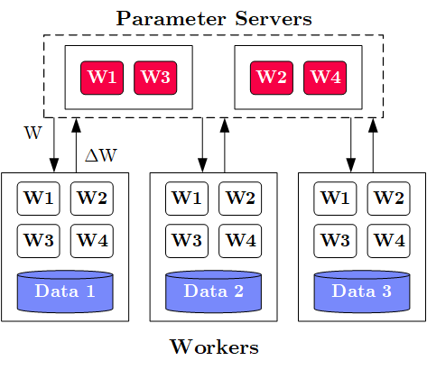
Task 1 Parameter Servers [question appeared in every exam]
10/100
Task 1a: Describe the overall system architecture of data-parallel parameter servers,
explain its components and interaction among these components [10/100 points]
System Architecture
  M Parameter Servers w/ model
  N Workers w/ data partitions
  Optional Coordinator
Interactions
  Workers pull model from parameter servers,
  slice a mini-batch of data, run a forward and
  backward pass to compute gradients,
  which are pushed back to parameter serves
  Parameter servers wait for gradients,
  aggregate the gradients/models, and
  perform a global model update
M
W .. Model
ΔW .. Gradient
N

Slide 3
Task 1 Parameter Servers, cont. [question appeared in every exam]
16/100
Task 1b: Describe synchronous (BSP) and asynchronous (ASP) update strategies in
data-parallel parameter servers and name their advantages and disadvantages. [6/100 points]
 | Synchronous | Asynchronous
Description
Advantages
Disadvantages
 | Synchronous | Asynchronous
Description | Per-batch or -n-batches synchronization barrier (wait for all workers before update) | Every pushed gradient updates the model, workers obtain model immediately
Advantages | Consistent learning process and model updates | No waiting for stragglers
Disadvantages | Workers wait for slowest worker (repeatedly) | Workers use stale models, potential divergence

Slide 4
Task 2 Data Preparation
26/100
Task 2a: Given the raw input data below, apply recoding and one-hot encoding to all categorical columns, and binning with 3 equi-width bins to all numerical columns. [10/100 points]
A | B | C
Low | 0 | S
High | 3 | M
Med | 7 | L
Low | 9 | XL
Low | 15 | M
Low | 7 | M
Med | 4 | L
High | 12 | XL
High | 13 | L
ALow | AMed | AHigh | B | CS | CM | CL | CXL
1 | 0 | 0 | 1 | 1 | 0 | 0 | 0
0 | 0 | 1 | 1 | 0 | 1 | 0 | 0
0 | 1 | 0 | 2 | 0 | 0 | 1 | 0
1 | 0 | 0 | 2 | 0 | 0 | 0 | 1
1 | 0 | 0 | 3 | 0 | 1 | 0 | 0
1 | 0 | 0 | 2 | 0 | 1 | 0 | 0
0 | 1 | 0 | 1 | 0 | 0 | 1 | 0
0 | 0 | 1 | 3 | 0 | 0 | 0 | 1
0 | 0 | 1 | 3 | 0 | 0 | 1 | 0
Notes:
Q: how many rows and columns

Slide 5
Task 2 Data Preparation, cont.
38/100
Task 2b: What is feature hashing and what is its advantage over recoding? [3/100 points]
  Hash values and compute modulo with user-provided k
  Reduces the number of distinct items, and thus columns in one-hot-encoded representation
Task 2c: Describe the text encodings bag-of-word and word-embeddings. [6/100 points]
  Bag-of-word: encode sentence as a vector of token counts
  (how often every distinct token appeared in the sentence)
  Word Embedding: continuous bag-of-words,
  learned numerical vectors for predicting the context words from a word or a word from its context
Task 2d: What is data augmentation and name 2 concrete techniques. [3/100 points]
  Synthetically generate labeled examples from small real labeled dataset through transformations
  Examples: rotations, reflections, shearing, noise modulation
A | B | C | D | E
2 | 2 | 1 | 0 | 1

Slide 6
Task 3 Model Selection
46/100
Task 3a: Describe the task of hyper-parameter tuning by example of GridSearch. Assume three hyper-parameters with 10 discretized values each, how many models do we need to train? [8/100 points]
Hyper Parameter Tuning
  Given a model and dataset, find best hyper parameter values
  (e.g., learning rate, regularization, kernel parameters, tree params)
  by training the model and evaluating it on the validation set.
Grid Search
  Discretize continuous parameters (linearly or exponentially)
  Every hyper-parameter is a dimension of a hyper-cube
  For all combinations, train and evaluate the model
Example: 10^3 = 1000 trained models
1
β
0
α
1

Slide 7
Task 3 Model Selection, cont.
56/100
Task 3b: Explain Bayesian Optimization as a more directed search strategy,
and how it balances exploitation and exploration? [5/100 points]
  Use lightweight ML models like Gaussian Processes
  to find next points
  Acquisition function to balance exploitation (expected mean)
  and exploration (uncertainty, expected variance)
Task 3c: Describe the problem of neural architecture search, and how to deal with
multiple optimization objectives (e.g., accuracy and runtime). [5/100 points]
  Automatically compose neural network architectures from building blocks
  Search strategies: evolutionary algorithms and bayesian optimization
  Multi-objective optimization:
  (1) linearization, (2) pareto front to user, (3) primary objective w/ constraints on other dims

Slide 8
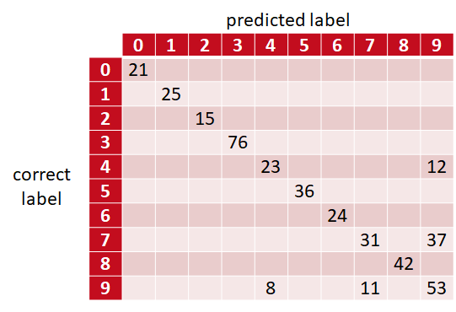
Task 4 Model Debugging
64/100
Task 4a: Describe sources of bias in machine learning and name examples how to
ensure fairness when building ML models with examples. [4/100 points]
  Sources: selection bias, sample bias, data bias (e.g., NMAR), confirmation bias
  Fairness constraints: monotonicity, group fairness constraints
Task 4b: Explain the concept of a confusion matrix
and describe it in detail. [4/100 points]
  Matrix of correct versus predicted labels
  Cells contain counts or relative frequencies
  of correct/predicted pair occurrences
  Enables understanding which classes are
  “confused” with each other

Slide 9
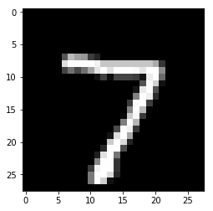
Task 4 Model Debugging, cont.
68/100
Task 4c: Explain the concept of occlusion-based explanations by example of classifying
below hand-written digit as a seven [4/100].
Slide black/gray square over input image
Measure how feature maps (layer activation)
and classifier output change
Show a heat map
of these changes

Slide 10
Task 5 Compilation Techniques
76/100
Task 5a: Describe the purpose of the rewrite common subexpression elimination (CSE) and
sketch an algorithm to perform CSE on a directed acyclic graph (DAG) of operators. [5/100 points]
  Convert tree/graph of operators with redundant
  common subexpressions into redundancy-free operator graph
  Step 1: Collect and replace leaf nodes
  (variable reads and literals)
  Step 2: recursively remove CSEs bottom-up
  starting at the leaves by merging nodes with
  same inputs (beware non-determinism)
Task 5b: Explain the concept of operator fusion and
how it can improve runtime performance [3/100 points]
  Merge sequence or sub-DAG of data-dependent operators into a single operator
  Performance Improvements: avoid unnecessary allocation, reduced write/read memory bandwidth requirements / cache locality, additional specialization (e.g., data types, dimensions)
R1
R2
R1
R2
-
+
-
+
7
abs
abs
rand
7
abs
rand
*
*
*
A
B
A
B
A
B

Slide 11
Task 5 Compilation Techniques
83/100
Task 5c: Assume an example chain of matrix multiplications (A B C D E), describe the
problem of matrix multiplication chain optimization, and a dynamic programming algorithm
for solving it efficiently [7/100 points]
Matrix Multiplication is associative, mmchain
opt aims to find optimal parenthesization
Dynamic programming applies because
(1) optimal substructure, and
(2) overlapping subproblems
Bottom-up sub-chain optimization
via composition from solved subproblems
Top-down read-out of optimal split matrix
5
1
Cost matrix m
4
222
2
j
i
3
135
125
3
2
105
56
72
4
1
350
35
15
27
5
0
0
0
0
0
M1
M2
M3
M4
M5

Slide 12
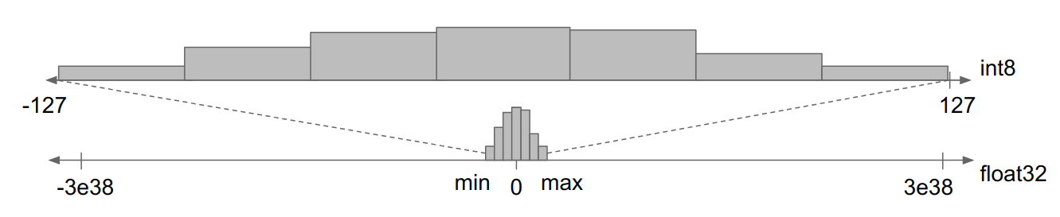
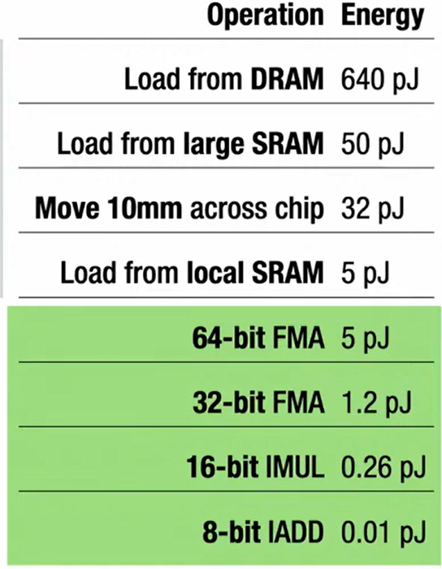
Task 6 Data Access Optimizations
91/100
Task 6a: Describe min-max quantization of an FP64 (floating point) representation into UINT8 (integer).
Why does such an encoding increasing training and/or inference performance? [8/100 points]
Determine min/max range of matrix
Split range into 2^8 = 256 buckets/bins
Encode FP64 values in a bin via binID (lossy, but order-preserving)
➔ Performance Improvements
  (1) Reduced memory bandwidth requirements
  (2) Increased instruction parallelism (e.g., AVX512: 8 FP64 → 64 UINT8 ops)
  (3) Reduced energy consumption
FP64
Min/Max Quantization
[Jonathan Ragan-Kelly: The Future of Fast Code: Giving Hardware What It Wants, PLDI 2024 Keynote (inspired by Bill Dally on 14nm)]

Slide 13

Task 7 Model Deployment
100/100
Task 7a: Consider a deployed model M in a cloud serving
environment and assume 1000s of clients. Explain three
strategies for improving model scoring throughput
at the serving site. [9/100 points]
Reuse of input-prediction pairs (fewer model invocations)
Batching of client requests / vectorization
(fewer kernel launches, utilize compute better, less sync barriers)
Quantization of input data (data transfer to serving systems, instruction parallelism)
Inference Program Compilation
Specialized, Smaller Models
client requests
M
Serving System
predictions

Slide 14
Final Questions & Answering
THANKS
and
GOOD LUCK!

